Slide 1
Effect of Top-Down Emission Adjustment using OMI NO₂ and HCHO Column Densities on South Korean Air Quality Simulation
2017 CMAS Conference, October 23 ~ October 25, 2017
October 24, 2017
Changhan Bae¹, Hyun Cheol Kim^{2,3}, Byeong-Uk Kim⁴, Cheol Yu⁵, Yongjae Lim⁶,
Jae-bum Lee⁶ and Soontae Kim¹
¹ Department of Environmental Engineering, Ajou University, Suwon, South Korea
² Air Resources Laboratory, National Oceanic and Atmospheric Administration, College Park, MD, USA ³ Cooperative Institute for Climate and Satellites, University of Maryland, College Park, MD, USA ⁴ Georgia Environmental Protection Division, Atlanta, Georgia, USA
⁵ Air Quality Policy Division, Ministry of Environment, Sejong, South Korea
⁶ National Institute of Environmental Research, Incheon, South Korea
Ajou University, AQRL
Notes:
Good morning everyone it is nice to meet you here. My name is Changhan Bae.
Today I will talk about “Effect of Top Down Emission Adjustment using OMI NO2 and HCHO Column densities on south Korean air quality simulation”.

Slide 2
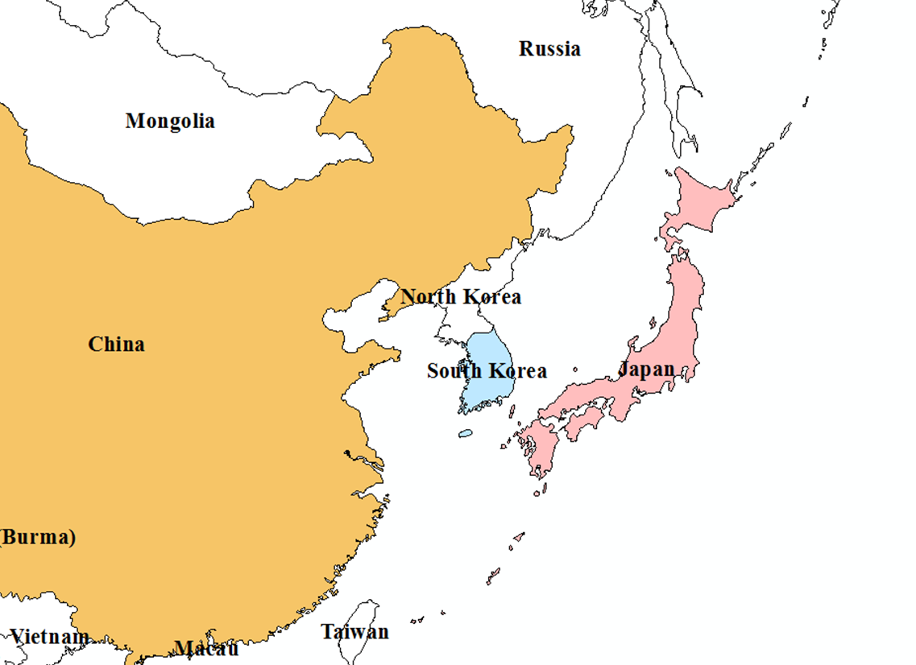
Recent NO₂ and O₃ Trend over Seoul Metropolitan Area
Northeast Asia
Seoul Metropolitan Area (SMA)
http://film.ktv.go.kr
The population of SMA is around 25 millions, 50% of the total population of South Korea.
The area of the SMA is 11,704 km² (US-NC: 139,509 km²).
Since 2000, the implementation of air quality management policies resulted in a downward trend of NO₂ while O₃ trend was upward.
Notes:
The Seoul Metropolitan Area, SMA is located north-west side of South Korea.
Right side figure shows observed NO2 and O3 concentration tendency over SMA last ten years.
Since 2000, the implementation of air quality management policies resulted in a downward trend of NO2 while O3 trend was upward. The SMA also has PM issue, so this city needs to efficient air quality management.

Slide 3
Air Quality Management and Modeling
Air quality management
Air quality modeling
Input1 :
Emissions
Input2 :
Meteorology
Input3 :
Atmospheric
chemistry
For air quality management, air quality modeling is used to analyze the cause of air pollution and estimate the effect of the emission reduction plan.
However, air quality simulation basically requires a high level of accuracy in its inputs.
Emission input data is one of the most important inputs to ensure the reliability of air quality simulation results.
Notes:
For air quality management, air quality modeling is used to analyze the cause of air pollution and estimate the effect of the emission reduction plan.
However, air quality simulation requires a high level of accuracy in its inputs.
Emission input data is one of the most important inputs to ensure the reliability of air quality simulations results.

Slide 4
South Korean National Emission Inventory
South Korean emissions inventory: Clean Air Policy Support System (CAPSS)
 | CAPSS
Spatial coverage | South Korea
Inventory year cycle | One year (Latest version: CAPSS 2014)
Emission source categories | 12 upper levels, 54 intermediate levels and 312 lower levels source categories; 527 detail source classification codes
Species | SO₂, NO_{x}, NH₃, PM₁₀, PM_{2.5}, VOC, and CO
Spatial resolution | Administrative districts in South Korea (266 regions)
Reference | Lee et al. (2011)
CAPSS emission inventory is developed based on a bottom-up approach
Bottom-up emissions inventories are often reported to be inaccurate due to uncertainties in input parameters (Jaegle et al., 2005; Li et al., 2016; Saikawa et al., 2016; Li et al., 2017).
It also takes much time to collect all required information.
→An approach to constructing emission inventories based on modeling result and satellite
observations can be useful (Müller and Stavrakou, 2005; Sofiev et al., 2009; Streets et
al., 2013; Stavrakou et al., 2016).
Notes:
For the South Korea, national emissions inventory name is Clean Air policy Support System so-called CAPSS
This table shows details of the CAPSS inventory.
The CAPSS emission inventory is developed based on a bottom up approach.
Bottom-up emissions inventories are often reported to be inaccurate due to uncertainties in input parameters (Jaegle et al., 2005; Li et al., 2016; Saikawa et al., 2016; Li et al., 2017).
It also takes much time to collect all required information.
→ An approach to constructing emission inventories based on modeling result and satellite observations can be useful

Slide 5
Purpose of This Study
The accuracy of input data affects the performance of air quality simulation. Emissions data is one of the main input data for air quality simulation.
The bottom-up emission estimation provides more complete information, but it is limited due to inherent uncertainties in basic information or lack of timely update.
→ We try to supplement the existing bottom-up emissions inventory with emission adjustment factors estimated from satellite-based measurements.
Notes:
The bottom-up emission estimation provides more complete information, but it is limited due to inherent(인헤런) uncertainties in basic information or lack of timely update.
→ We try to supplement the existing bottom-up emissions inventory with emission adjustment factors estimated from satellite-based measurements.

Slide 6
Meteorology, Emission, and Chemical Transport Models
Meteorology data
Meteorology modeling
(WRF/MCIP)
Meteorology initial field
NOAA/FNL
Emissions
modeling
(SMOKE/MEGAN)
Emission inventories
CREATE 2015 for Northeast Asia
CAPSS 2013 for South Korea
Emission data
Air quality data
Chemical transport modeling
(CMAQ)
Revised emission
Vertical column density comparison
OMI VCD
Notes:
Air quality Simulations are operated using WRF-SMOKE-CMAQ
Base air quality simulation was conducted using CAPSS 2013 and CREATE 2015 emissions inventories
for South Korea and other Asian countries.
Alternative simulations Used the top-down emission adjustment

Slide 7
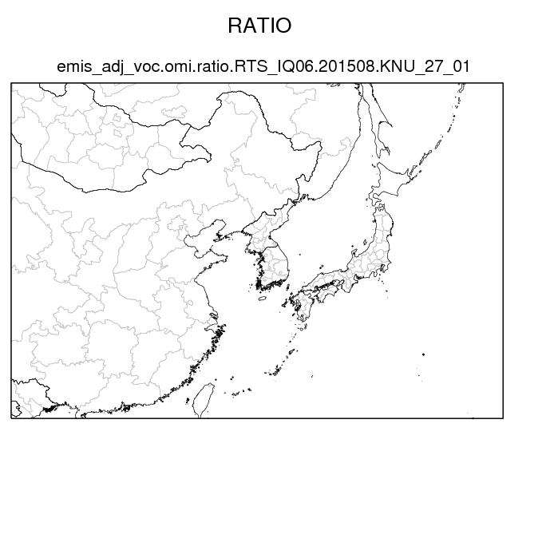
Modeling Domain and Configuration of CMAQ Simulation
CMAQ v4.7.1
Chemical Mechanism
: SAPRC99
Aerosol Module
: Aero5
Advection Scheme
: YAMO
Horizontal Diffusion
: Multiscale
Vertical Diffusion
: Eddy
Period
: 2015. 05.01 ~ 08.31
Pre-run
: 20 days
Beijing
SMA
Japan
South Korea
China
Shanghai
Horizontal resolution
: 27-km
Notes:
This is CMAQ configurations and modeling domain. Modeling domain is north east asia region include China, South Korea, and Japan. Horizontal resolution is 27-km. CMAQ version is 4.7.1 and SAPRC99 Chemical Mechanism, and AERO5 Aerosol Module are used. Target period is 2015 May to August

Slide 8
Constraints on NOx and Isoprene Emissions with Satellite Observation
Satellite (Aura)
Model
Local pass time
(Temporal match)
AK
sVCD
mVCD
Conservative downscaling
(Horizontal match following a method by
Kim et al. (2016))
Averaging kernel
(Vertical match)
Emission
adjustment
sVCD/DS
mVCD/AK
Comparison
Notes:
This slide shows a flowchart of Constraints on NOx and VOC Emissions with Satellite Observation.
Processing of satellite data is an important issue in the comparison with regional model. So Averaging kernel and conservative downscaling technique are applied to adjust vertical sensitivity and spatial resolution issue.

Slide 9
Constraints on NOx and Isoprene Emissions with Satellite Observation
Details about satellite data
The Ozone monitoring instrument (OMI), onboard the Aura satellite.
An equator crossing time is 13:38 local time (LT).
Retrieved by the Royal Netherlands Meteorological Institute (KNMI) using the differential optical absorption spectroscopy technique.
For basic data quality control, each pixel is screened using cloud coverage and data quality flag. Pixels with over 40% cloud cover or contaminated by row anomaly problems were filtered out.
Averaging kernel and conservative downscaling technique are also applied to adjust vertical sensitivity and spatial resolution issues.
Equation for emission adjustment
$E_{(adj)}= E_{(base)}× \frac{OMI VCD}{CMAQ VCD}$
Notes:
Here are details about satellite data
An equator crossing time is 13:38 local time (LT).
Retrieval method, and basic data quality control logic
→
For emission adjustment, the ratio between the base simulation and satellite observations were used to adjust current bottom-up emissions inventory

Slide 10
Constraints on Isoprene Emissions by Satellite Observation Data
HCHO VCD related VOC species
Major Source of NMVOC
Satellite
observation
Vegetation
Oxidation
Process
(OH·, O₃, NO₃)
HCHO
Anthropogenic
Model
simulation
Biomass burning
Formaldehyde (HCHO) is formed by oxidation process of NMVOC (Palmer et al., 2003).
Isoprene is one of the dominant VOC species of the oxidation process (Barkley et al. 2013; Palmer et al. 2006, 2003; Shim et al. 2005).
Notes:
HCHO is formed various pathway in the air and HCHO precursor species emitted various sources. In previous studies, formaldehyde (HCHO) is formed by oxidation process of NMVOC
Isoprene is one of the dominant VOC species of the oxidation process.
So we tested isoprene emissions adjust.

Slide 11
Simulation List
1. Base simulation
2. NOx emission revised run (based on NO₂ VCD)
- 2.1 All areas in the domain except South Korea
- 2.2 South Korea only
- 2.3 All areas in the domain
3. Isoprene emission revised run (based on HCHO VCD)
- All areas in the domain
4. NOx and isoprene emission revised run (combine 2.3 & 3.1)
Notes:
Here is Simulation list in this study
Case 2 NOx emission revise, case 3 isoprene emission revise, and case 4 nox and isoprene r
Case 2.1 and 2.2 is to distinguish the effect of local emission adjustment and upwind area emission adjustment

Slide 12
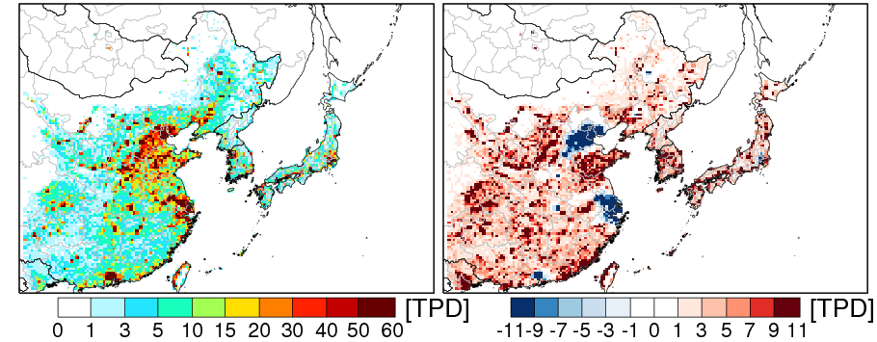
Inventory Based and OMI-Constrained NOx Emission
Inventory based emission
OMI Constrained – Inventory based
NOx
Total NOx emission during this study (Unit: Ton) | NE China | Beijing (china) | Shanghai (China) | SMA
Inventory based | 73,882 | 1,125 | 3,760 | 767
OMI-constrained | 94,220 (28% increase) | 522 (54% decrease) | 1,137 (70% decrease) | 1,086 (42% increase)
The total NOx emission for the Northeast China region is increased 28%. However, In some megacities (i.e., Beijing, Shanghai) NOx emissions decreased up to 70% compare by CREATE 2015 inventory.
Notes:
This slide shows NOx emission change based on satellite data
Left-hand figure is inventory based NOx emission and right-hand figure is a change in NOx emissions from satellite data application.
The total NOx emission for the Northeast China region is increased 28%. However, In some megacities (i.e., Beijing, Shanghai) NOx emissions decreased up to 70% compare by CREATE 2015 inventory.

Slide 13
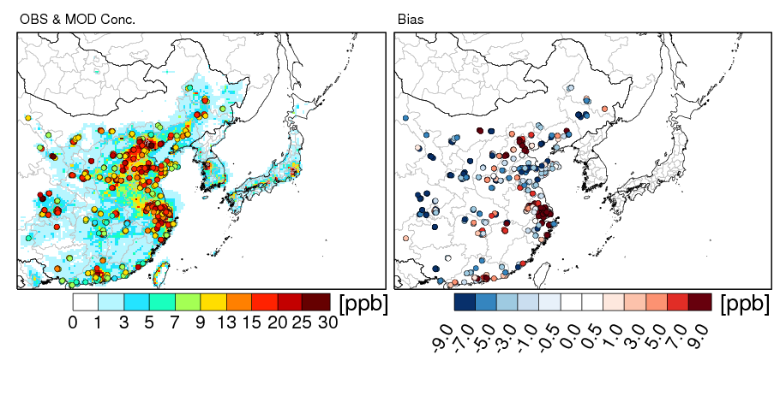
Effect of NOx Emission Adjustment except South Korea
NO₂ period mean concentration (2015. 05. 01 ~ 08. 31)
(a) OBS & Base simulation
(b) Bias of base simulation
(c) Bias of NOx adjust simulation
Beijing and Shanghai are overestimated, while other china regions are underestimated.
After the emission adjustment, the NO₂ concentration was decreased in Beijing and Shanghai area while increased in the other areas.
An overall bias of NO₂ is reduced.
Notes:
This figure show period means NO2 concentrations and bias of simulations
Base simulation results, Beijing and Shanghai are overestimated, while other china regions are underestimated.
After the emission adjustment, the NO₂ concentration was decreased in Beijing and Shanghai, while increased in the other areas.
As a result an overall bias of NO2 is reduced.

Slide 14
Effect of NOx Emission Adjustment except South Korea:
Shanghai and Beijing, NO₂, Daily Mean
NO₂ daily mean concentration (2015. 05. 01 ~ 08. 31)
Bias: 36 ppb
Bias: 9 ppb
Bias: 26 ppb
Bias: 4 ppb
Notes:
These are time series of daily mean NO2 concentration over Shanghai, and Beijing.
Gray circle is observation, Blackline is base simulation and red line is NOx emission adjustment simulation.
Comparisons of simulated NO₂ concentrations to the observed concentrations show consistent over-predictions.
In Shanghai, the simulated concentration is overestimated about three times.
But, After NOx emission adjustment NO₂ bias is reduced from 36 ppb to 9 ppb (Shanghai).
And the slope is getting close to 1:1 line.

Slide 15
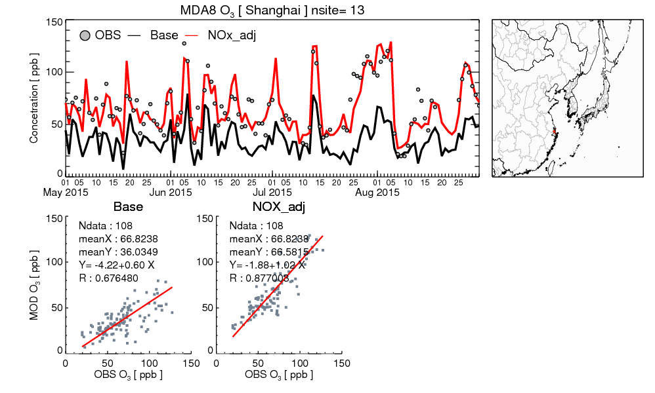
Effect of NOx Emission Adjustment except South Korea:
Shanghai, MDA8 O₃
Comparisons of simulated O₃ concentrations to the observed concentrations show consistent under-predictions
In case of Ozone, the correlation coefficient is also improved
Bias: -30.8 ppb
Bias: 0.3 ppb
Notes:
This is Maximum daily 8-hour average ozone concentration over Shanghai.
Base simulation of O₃ concentrations show consistent under-predictions
After NOx emission adjustment O₃ concentration is increased.
It seems that the NO titration effect was weakened lead to ozone concentration increases.
As a result some high peak ozone period we can see very good model performance.
In case of Ozone, the correlation coefficient is also improved.

Slide 16
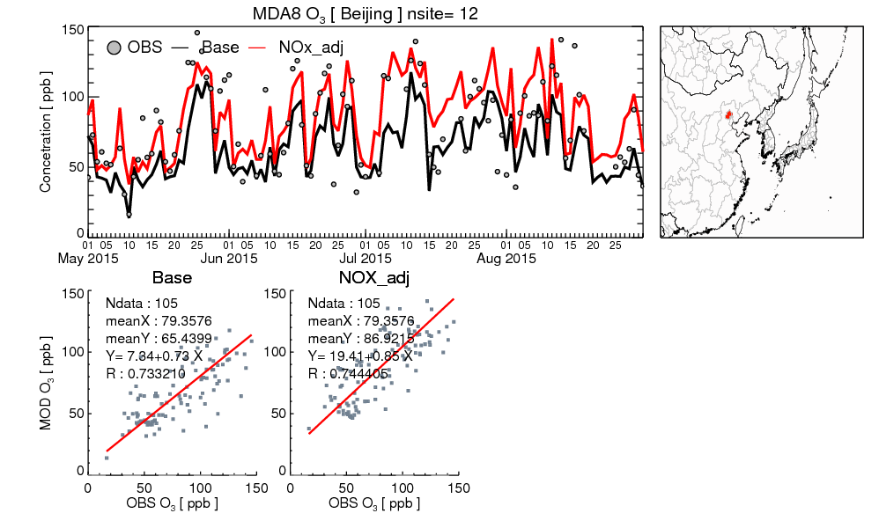
Effect of NOx Emission Adjustment except South Korea:
Beijing, MDA8 O₃
Significant inaccuracy?
no precipitation days
Bias: -6 ppb
Bias: +7 ppb
Bias: -20 ppb
Bias: +1 ppb
Notes:
Same time series For Beijing, NOx emission adjustment improve O3 simulation accuracy in high ozone days, but sometimes we can see Significant inaccuracy.
In that days, it seems that Precipitation is the dominant reason of the inaccuracy.
Except Precipitation days, Emission adjustment is beneficial to reduce model bias.

Slide 17
Effect of “South Korea only” NOx Emission Adjustment:
SMA, NO₂, 13-14 LT
NO₂ concentration (2015. 05. 01 ~ 08. 31)
After South Korea NOx emission adjustment NO₂ bias is improved from -5.8 ppb to -0.4 ppb during 13-14 local time.
However NO₂ daily mean
concentration change is
somewhat different. →
Notes:
This is 13 o’clock NO2 concentrations over SMA.
After South Korea NOx emission adjustment NO₂ bias is reduced from -5.8 ppb to -0.4 ppb
However NO₂ daily mean concentration change is somewhat different.

Slide 18
Effect of “South Korea only” NOx Emission Adjustment:
SMA, NO₂, Daily Mean
NO₂ daily mean concentration (2015. 05. 01 ~ 08. 31)
— OBS
— Base
— NOx_adj
Crossing time
(13-14 LT)
Notes:
In case of SMA, After NOx emission adjustment Model performance is improved during daytime.
The reason is related diurnal variation.
When using Orbit satellites, the comparison between satellites and models is very limited.
In this study, only the concentrations at 13 o’clock were comparable.
If the 13 o'clock model bias can represent the whole time, the satellite-based emission correction would be useful. For example, in Beijing and Shanghai, all times are overestimated, so adjust with satellites has been effective in improving the accuracy of the simulation.
However, in the SMA, simualted no2 diurnal variation has some problem,
It means, it is necessary to pay attention to adjusting all time emissions using OMI data.

Slide 19
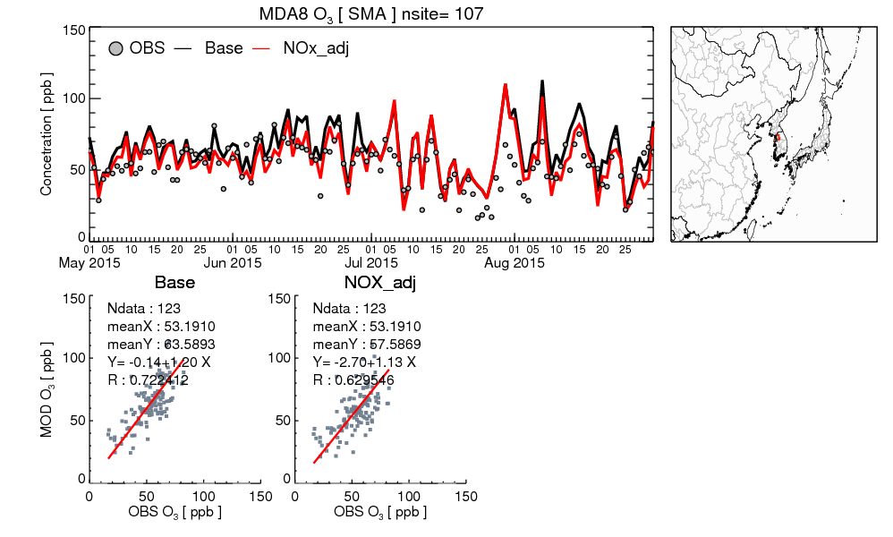
Effect of “South Korea only” NOx Emission Adjustment:
SMA, MDA8 O₃
Despite NO₂ adjustment is limited, ozone bias is reduced.
SMA O₃ bias is reduced from 10.4 ppb to 4.4 ppb.
Notes:
Despite NO2 adjustment is limited, ozone bias is reduced.
Because ozone is usually generated during the day, and the adjustment of NOx emissions from OMI can improve the accuracy of daytime NO2 simulation.

Slide 20
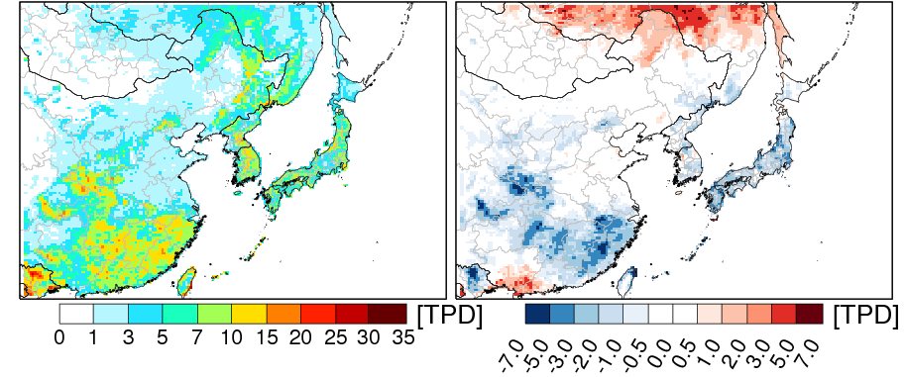
MEGAN and OMI-Constrained Isoprene Emission
MEGAN
OMI Constrained – MEGAN
Isoprene
Total isoprene emission during study period (Unit: Ton) | NE China | Beijing (china) | Shanghai (China) | SMA
MEGAN | 31,180 | 184 | 40 | 119
OMI-constrained | 26,570 (15% decrease) | 141 (23% decrease) | 32 (20% decrease) | 112 (6% decrease)
Notes:
This slide shows Isoprene emission change based on satellite data
Left-hand figure is isoprene emission from MEGAN and This figure is OMI Constrained isoprene emission minus MEGAN .
The total isoprene emission for the Northeast China region is 15% decrease

Slide 21
Simulation Results Summary Table
 | Region : SMA |  | NO₂ (13-14 LT) |  |  | MDA8 O₃
Case | Target species | Target Region | Conc. | Bias | R | Conc. | Bias | R
1 | Base simulation |  | 11.5 | -6.8 | 0.473 | 63.6 | 10.4 | 0.722
2.1 | NOx | Domain wide except South Korea | 12.8 | -5.5 | 0.514 | 64.1 | 10.9 | 0.717
2.2 | NOx | South Korea only | 16.4 | -1.9 | 0.406 | 57.6 | 4.4 | 0.630
2.3 | NOx | Domain wide | 17.7 | -0.6 | 0.428 | 57.8 | 4.6 | 0.617
3 | Isoprene | Domain wide | 11.5 | -6.8 | 0.470 | 63.2 | 10.0 | 0.736
4 | NOx & Isoprene | Domain wide | 17.7 | -0.6 | 0.426 | 57.4 | 4.2 | 0.624
Adjustment of isoprene emissions change SMA ozone concentration little in this study.
After the domain-wide NOx emission adjustment, SMA NO₂ bias is reduced from -6.8 ppb to -0.6 ppb and O₃ bias is also reduced (10.4 ppb → 4.2 ppb).
Notes:
This is Simulation Results Summary Table
Adjustment of isoprene emissions change SMA ozone concentration little in this study.
After the domain-wide NOx emission adjustment, SMA NO₂ bias is reduced from -6.8 ppb to -0.6 ppb and O₃ bias is also reduced (10.4 ppb → 4.2 ppb).

Slide 22
Conclusion and Future Study
In this study, we have examined the effects of NOx and isoprene emission adjustments using satellite observation data on modeled air quality.
Using the top-down emission adjustment for the China region (i.e., Beijing and Shanghai), the performance of simulated daily mean NO₂ and MDA8 O₃ concentrations are a significantly improvement.
The uncertainty of chemistry or meteorology data exists in VCD comparisons between observation and model. Caution should be taken to interpret VCD differences solely as emissions issues because of other modeling uncertainties such as diurnal variation and precipitation (see slide 16, 18).
As a next step, we will continue to develop effective emission adjustment methods considering the limitations in this study.

Slide 23
Thank you
again121@ajou.ac.kr/ Changhan Bae

