Slide 1
Enhancements to an Agricultural Land Modeling System – FEST-C and Its Application
Ellen Cooter¹, Limei Ran¹, Verel Benson², Dongmei Yang³,
Jesse Bash¹, Ruoyu Wang¹, and Yongping Yuan¹
¹ORD NERL/USEPA, Research Triangle Park, NC
²Verel W. Benson, Benson Consulting
200 Haywood Ct, Columbia, MO 65203, USA
³Institute for the Environment
University of North Carolina at Chapel Hill, NC USA

Slide 2
Presentation Outline
FEST-C Description
Software download, installation and execution
FEST-C V1.2 Enhancements and Updates
Recent Applications
Future Enhancements

Slide 3
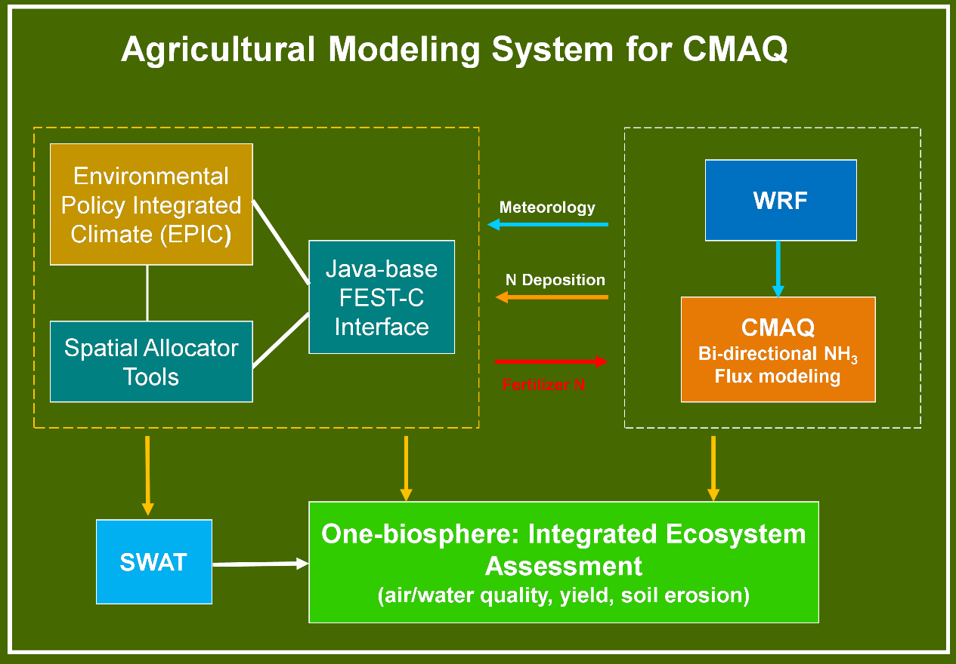
Fertilizer Emission Scenario Tool for CMAQ (FEST-C)
Produces initial soil nitrogen pool and fertilizer activity inputs required to run bi-directional CMAQ
FEST-C v1.0: first release in 10/2013
FEST-C v1.2: current release 05/2016
Soil & Water Assessment Tool
Any CMAQ or GEOS-CHEM CONUS domain (e.g., 12km US1, DISCOVER-AQ 4km)
Other regions (e.g. China) with adapted land use, crop, soil and other data

Slide 4
Where do I get FEST-C?
  CMAS (includes installation instructions, users manual and tutorial
What do I need to install FEST-C (US1 12km domain)?
  Linux (5G to install, 4G memory, output needs 14 GB/yr )
  SA (required) and VERDI (optional)
  Installed and tested on UNC (KittyHawk), NCC (SOL), HPCC and Dell T7600 (CAUTION: many small files)
How do I run FEST-C?
  Interface-driven (FEST-C)
  Background execution (time varies with host configuration)
  Software creates and executes scripts

Slide 5
What input data do I need?
  Simulation cell size, domain extent and projection
  MCIP formatted weather data on same domain as you will run CMAQ (currently need full year)
  MODIS and NLCD data layers
What data are provided/generated
  BELD coverage (location of agricultural land)
  Soils
  Agricultural management
  All other input files needed to simulate biogeochemistry
What do I get out?
  BELD file required for bidirectional CMAQ (tool provided with SA)
  Daily agricultural depth of fertilizer application and fertilizer amount
  Initial soil chemistry status
  Other N pool information that can be used to support further CMAQ model development, e.g., new NO model.

Slide 6
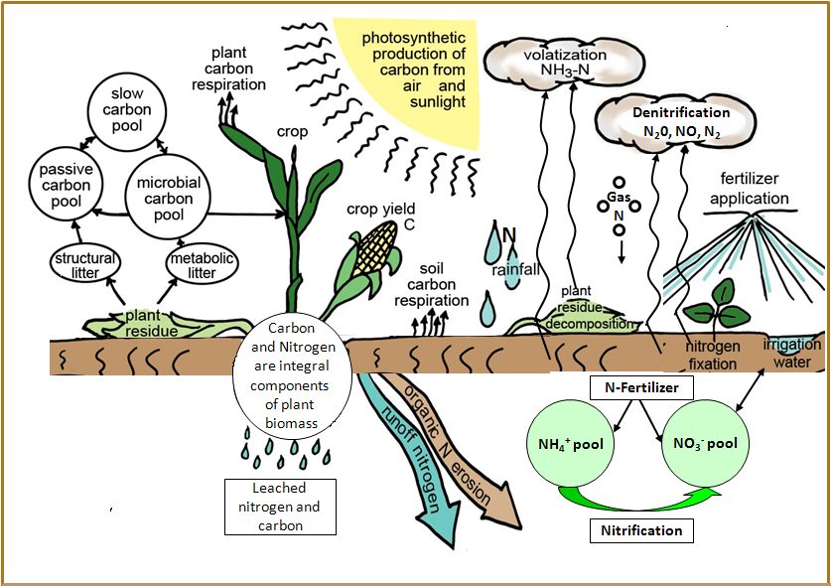
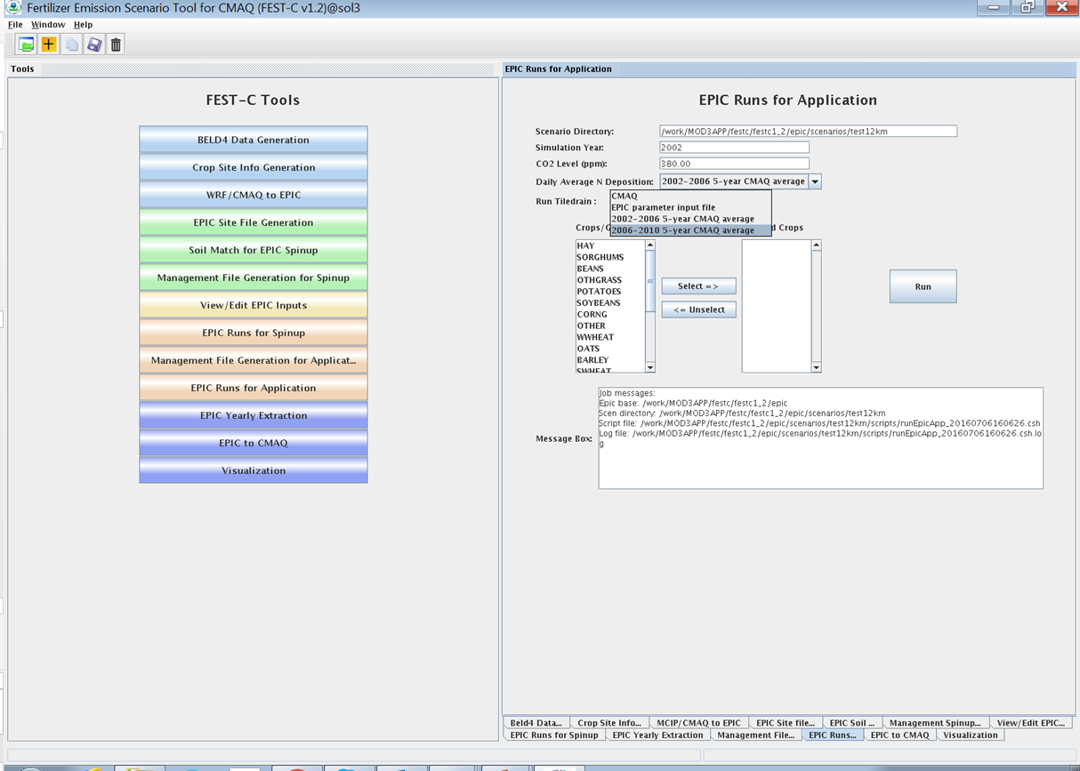
FESTC V1.2 System : Enhancement and Updates
Environmental Policy Integrated Climate model
FEST-C interface
  Addition of tile drain management option for crops
  Improved evapotranspiration parameterization
  Improved pasture and wheat management
  User-defined ambient CO₂ concentration
  Elevation input update
  Average N deposition input options (2002-2006, 2006 – 2010)
  R post-processing tool kit

Slide 7
FESTC V1.2: Applications
  Support to the 2014 NEI
  China air quality simulations
  Exploring land use and emissions changes
  One-Biosphere integration

Slide 8
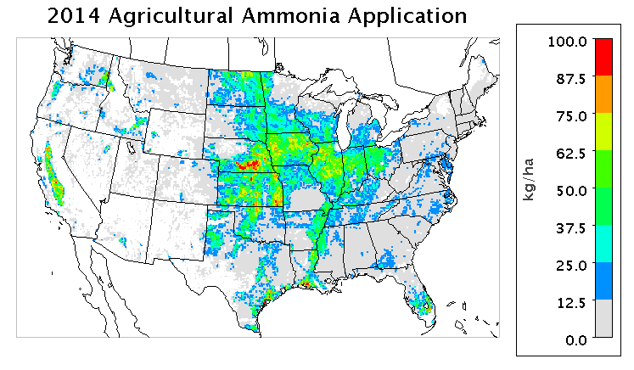
Contributions to 2014 NEI
FEST-C results provide “fertilizer activity” data and drive bidirectional CMAQ estimates of agricultural soil NH₃ emissions for the 2014 NEI. They offer an alternative to previous Carnegie-Mellon University model estimates.

Slide 9
Bidirectional CMAQ/FEST-C for China
Bidirectional CMAQ/FEST-C ambient NH₃ estimates show better general agreement with observations, particularly during high-concentration periods in November.
 | bidi | nobidi
NMB | 5.0% | 21.4%
NME | 34.9% | 57.3%
(Fu et al., 2015) http://www.atmos-chem-phys.net/15/6637/2015

Slide 10
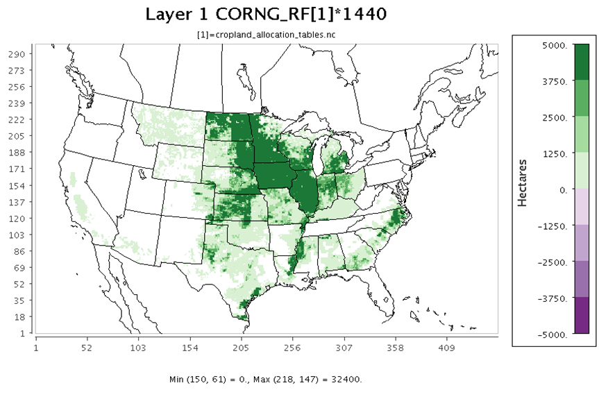
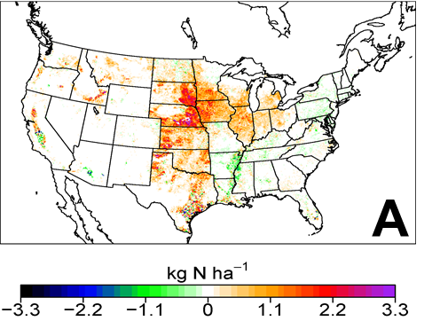
Exploring Multimedia Consequences
of Land Use Change
Projected Grain Corn Increases
Soil NH₃ Emission Response
Bidirectional CMAQ can simulate N_{r} emission (and deposition) response to FEST-C estimates of N fertilizer application and land use or land management changes.

Slide 11
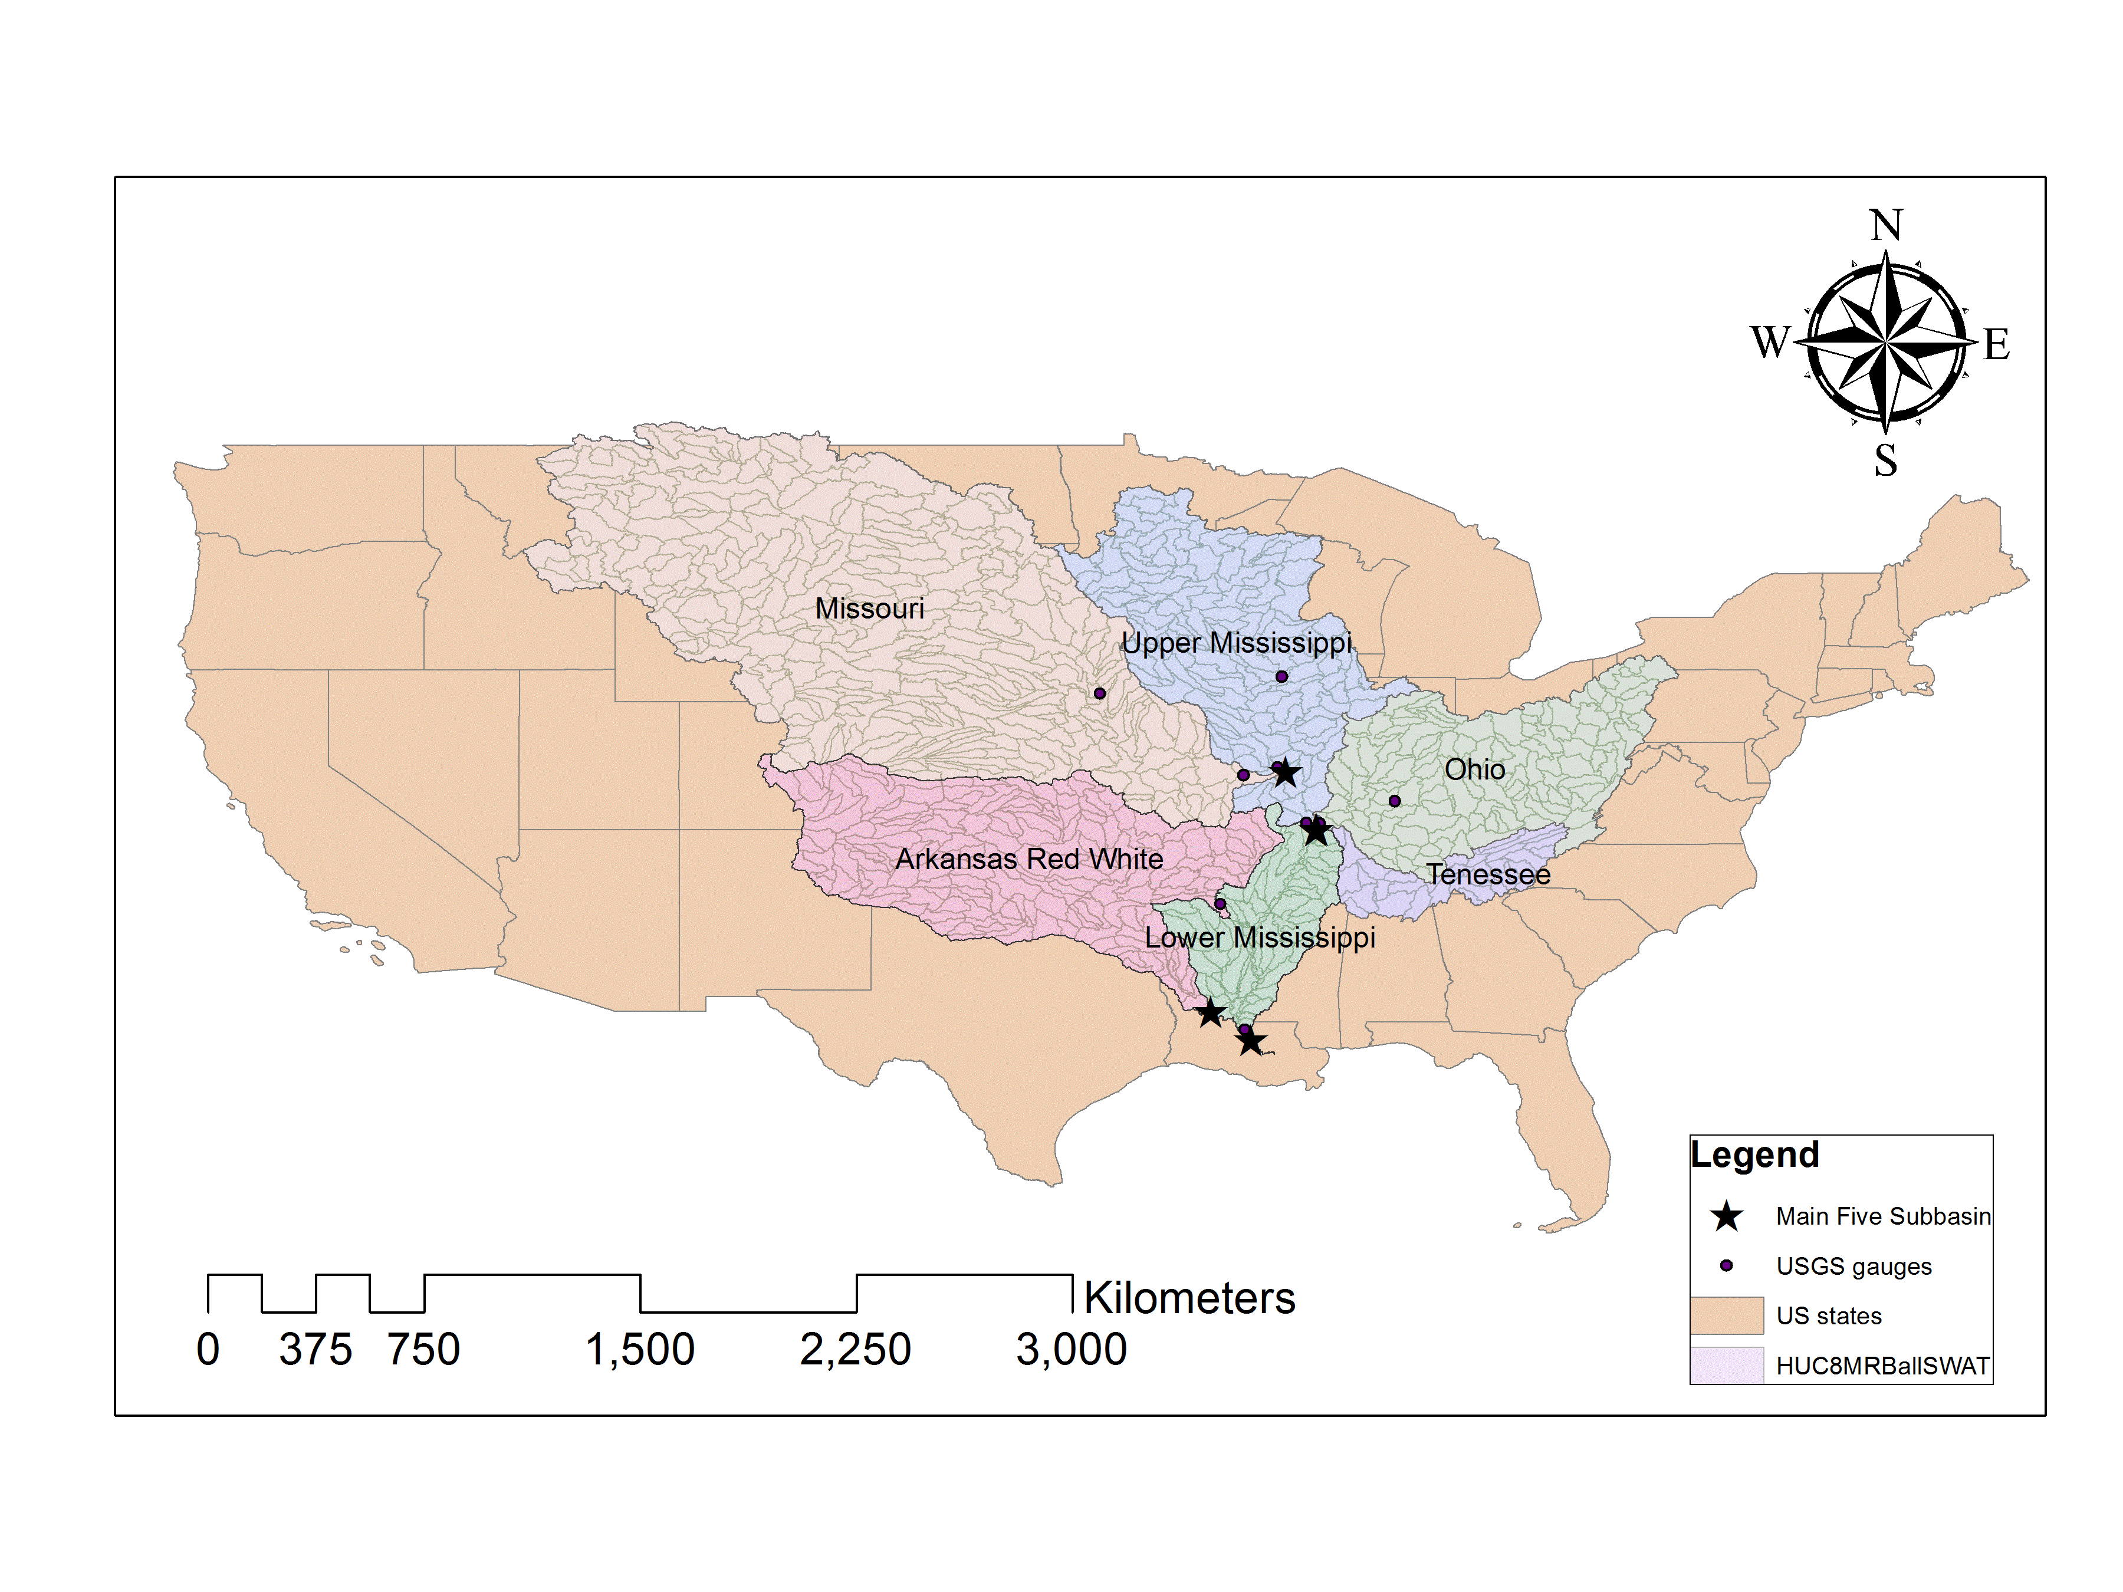
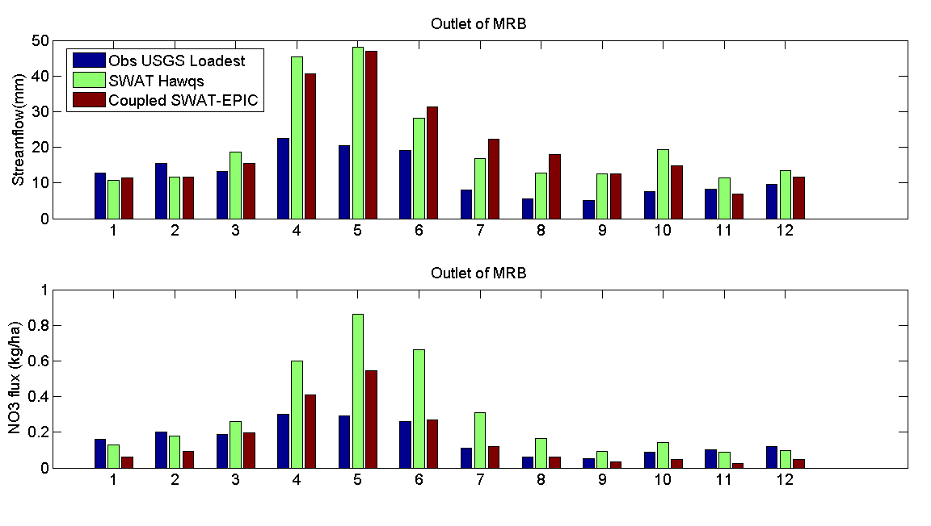
Linking Air, Land and Water
CMAQ and FEST-C are part of a One-Biosphere modeling system that explores hypoxia in the northern Gulf of Mexico associated with N loads from the Mississippi River and atmospheric deposition. Here we compare nitrate loads without (HAWQS) and with CMAQ and FEST-C (EPIC) inputs.
  SWAT is a USDA water quality model. EPA Office of Water uses its HAWQS interface to run SWAT. This figure compares monthly streamflow and NO₃ from HAWQS and SWAT-EPIC to USGS 07373420 obs near St. Francisville, LA.

Slide 12
Future Enhancements
New release with improved N (N₂O emissions), Carbon and soil water algorithms and modular code design (FY17)
Eliminate need for full year of MCIP input (FY17)
Wind erosion (FY17)
Additional output variables to support One Biosphere modeling e.g., Harmful Algal Blooms (HAB’s) and Northern Gulf of Mexico hypoxia prediction (FY17)
LAI estimates for natural mix forest stands (bidi implementation in FY18)
Full implementation of vegetation and hydrologic cycle (ET) response to increasing CO₂ (run with dynamically downscaled WRF-Climate inputs) (FY18)

