Slide 1
STILT-ASP: A Trajectory-Based Modeling Tool for Assessing the Impacts of Biomass Burning on Air Quality
C. M. Brodowski¹, M. J. Alvarado¹,
C. R. Lonsdale¹, J.M. Henderson¹, J. C. Lin²,
A. K. Kochanski ²
¹AER ²University of Utah
CMAS Conference
October 25, 2016
Copyright 2016
Notes:
Welcome. My name is Christopher Brodowski, and I’d like to talk to you today about a modeling tool AER has developed that assesses the impact of biomass burning on air quality.

Slide 2
Motivation
Create a screening tool to estimate the qualitative and quantitative effects of wildfires on a particular location without requiring a full run of an Eulerian emissions model such as CMAQ or SMOKE
The tool should use publically available global inputs by default
Non-expert users should be able to run the tool via a Graphical User Interface (GUI)
Notes:
<TODO: Insert sentence telling why wildfires are important?> The goal of this project was to develop a screening tool capable of estimating the qualitative (yes/no) and quantitative (how much?) effects of wildfires on a particular location. The tool should not require a large-scale modeling study or a detailed Eulerian emissions model, such as CMAQ or SMOKE. STILT-ASP should also be easy to run from a Graphical User Interface (GUI) by non-expert users.

Slide 3
Lagrangian Model Analysis of Biomass Burning Events
Derive upstream influence on receptor by propagating air parcels backward in time
Determine resulting species concentrations by calculating emissions, deposition, and chemistry along each parcel’s path
D. Wen et al. (2012, 2013, 2014)
Notes:
The modeling tool is composed of two main algorithms. The first determines the upstream influence on a particular location by propagating air parcels backward in time according to meteorological fields and turbulence. The second half is responsible for calculating the emissions, deposition and chemistry along each parcel’s path forward in time.

Slide 4
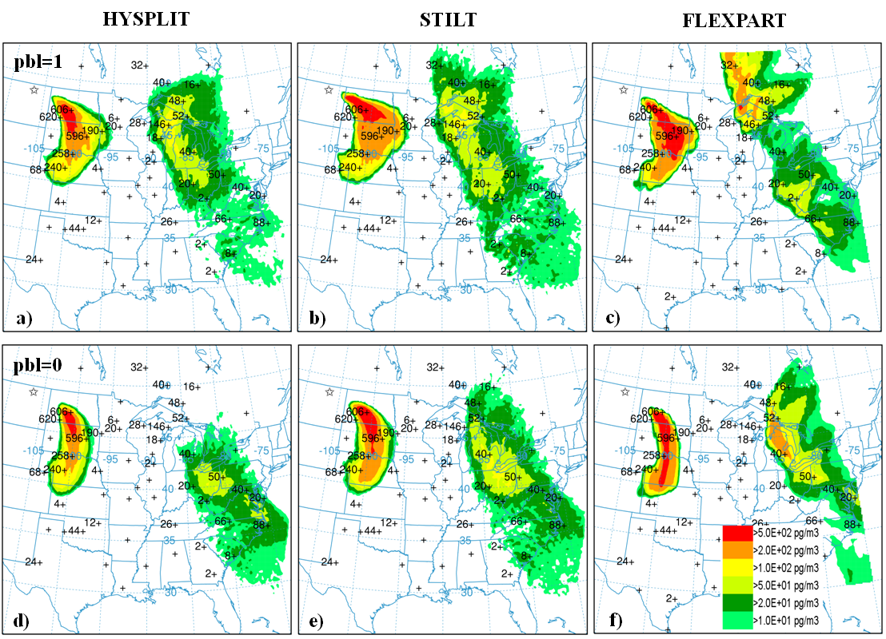
Stochastic Time-Inverted Lagrangian Transport (STILT) Model
STILT (Lin et. al, 2003; stilt-model.org) is a Lagrangian particle dispersion model derived from HYSPLIT but contains modifications that improve mass conservation and allow the use of customized meteorological fields
STILT allows for multiple air parcels to be released from a single location and time and for those parcels to be dispersed according to turbulence
STILT has been used in inverse modeling to improve emission estimates for greenhouse gases
(Hegarty et. al., J. Appl. Meteor. Climatol., 2013)
Notes:
The “backward” half of our processing is done by the Stochastic Time-Inverted Lagrangian Transport model, or STILT. STILT is similar to HYSPLIT but our STILT formulation is configured to allow multiple air parcels to be released from a single receptor and for those air parcels to be dispersed according to customized meteorological fields and turbulence. For those of you familiar with HYSPLIT, I believe the online formulation offered by ARL does not include a stochastic component by default.
<TODO: insert blurb about Jen’s figure>

Slide 5
Aerosol Simulation Program (ASP v2.1)
ASP (Alvarado and Prinn, 2009) models the formation of O₃ and SOA in smoke plumes.
Gas-phase chemistry
≤C₄ gases follow Leeds Master Chemical Mechanism v3.2 (Saunders et al., 2003)
Other organic gases follow RACM2 (Goliff et al., 2013)
Inorganic aerosol thermodynamics
OA thermodynamics using the Volatility Basis Set (VBS) (Robinson et al., 2007)
Evolution of the aerosol size distribution and optical properties
ASP can be run as a box model, or as a subroutine within 3D models (Alvarado et al., 2009) or within Lagrangian models (STILT-ASP).
Receptor is Austin, TX at 2011-09-07 10:00:00 CST
Notes:
The chemistry component of the tool is handled by the Aerosol Simulation Program, or ASP. For organic gases with four or fewer carbons, the chemistry is unlumped and follows the Leeds Master Chemical Mechanism, while for larger organic gases we follow RACM2. The model simulates inorganic aerosol thermodynamics and uses the Volatility Basis Set to simulate the organic aerosol thermodynamics. The model also calculates the evolution of the aerosol size distribution and the aerosol optical properties. ASP may be run as a standalone box model or as a subroutine within Eulerian or Lagrangian models, the last of which was our implementation for this project.

Slide 6
Current Process Flow
Compute the parcel trajectories using STILT
Retrieve chemical boundary conditions from MOZART model output
Apply emissions to the boundary profile using publically available components:
Biogenic Emissions (MEGAN monthly-averaged emissions)
Anthropogenic Emissions (globally available HTAP data)
Fire Emissions (Fire Inventory from NCAR/FINN)
Compute changes in species concentration in each parcel due to emissions, deposition, and chemistry
Notes:
For our biogenic emissions, we chose monthly emissions estimated using the MEGAN model. For anthropogenic, we used global monthly emissions from the HTAP version 2 inventory. An assumed diurnal cycle is applied to the emissions, and they are mapped to the ASP speciation and regridded to match the output meteorology grid (currently NAM12 or NARR).

Slide 7
Test Case #1: Houston Metro
August 26th, 2011
Wildfires in the Pacific Northwest and Lower Mississippi River areas
MDA8 Ozone = 98 ppbv at CAMS 1 site
7-day back trajectories were used
Notes:
Our first test case is August 26th, 2011 in the Houston metro area. At this time, wildfires were observed in the Lower Mississippi and Pacific Northwest. We are comparing model output to the 8-hour Maximum Daily Average (MDA) ozone record at the CAMS1 site, which was 98 ppb. A 7-day back trajectory was used in an attempt to capture the remote influence. Here we have the total ozone concentration in ppbv along each air parcel during the simulation, starting at 2:00 p.m. Central Standard Time on August 26th of 2011. The relatively high ozone in the Lower Mississippi river region is apparent, though the effects of any fires in the Pacific Northwest are less clear.

Slide 8
Results – Test Case #1
μ = 2.7 ppb
Measured
Modeled
With Fire
Emissions
μ = 0.222
Modeled
Without
Fire Emissions
Notes:
The two plot panels show the results of 8 run, done at 1-hour intervals over the period corresponding to the MDA8 ozone period recorded at the CAMS1 site. The first figure shows the difference in ozone concentration between a run with nonfire emissions only and the same run with fire emissions included in the simulation. The mean contribution to ozone by fires over the 8-hour period was 2.7 ppb. The second figure shows the ratio between the difference in ozone concentration indicated by fire emissions and the difference in CO concentration indicated by fire emissions. The mean value for extratropical plumes more than 2 days old is approximately 20%, and our result here is consistent with the literature value. These results indicate that wildfires did impact the Houston CAMS1 site. <click forward> The MDA8 ozone predicted by STILT-ASP is slightly more than 20 ppbv too high, and the culprit appears to be the non-fire emissions colored in green. FINN emissions are not responsible for the overall overestimate of MDA8 ozone in the Houston case.

Slide 9
Test Case #2: Austin-Round Rock Metro, September 7th, 2011
Fires originated from Bastrop, TX area (just SE of Austin)
5 day back-trajectories were used
MDA8 Ozone = 86.5 ppbv at CAMS 614 site
Notes:
Our second test case was at the CAMS 614 receptor in the Austin area on September 7th, 2011, which measured an MDA8 ozone of 86.5 ppb. The parcel dispersion data (image again taken from 2:00 p.m. Central Standard Time) indicate that the bulk of the flow came from the Northern Plains and Canada during this period and not from the South and East, so we anticipated minimal influence of the Bastrop, TX wildfires on the MDA8 ozone at the ground site.

Slide 10
Results – Test Case #2
μ = 0.8 ppb
Measured
μ = 0.157
Modeled
With Fire
Emissions
Modeled
Without
Fire Emissions
Notes:
Here we see that the mean difference in ozone concentration between runs with fire emissions and runs without fire emissions is less than 1 ppb. This is only about 30% of the value calculated in the Houston case, which had a similar level of measured MDA8 ozone. The ratio between the ozone difference and the CO difference is less than 16%, which deviates further from the desired value of 20% described in the literature than the Houston case. <click forward> Unlike in Houston, the total ozone concentration is underestimated in Austin on September 7th, and it does not appear that changes in the fire emissions can account for the discrepancy.

Slide 11
Test Case #3 – Austin/Round Rock Metro, September 8th, 2011
Fires originated from Bastrop, TX area
5 day back-trajectories were used
MDA8 Ozone = 75.4 ppbv at CAMS 601 site
Notes:
Our final test case was for the CAMS601 receptor in the Austin/Round Rock metro area on September 8th of 2011. The parcel trajectories again indicate flow primarily from the north, so we would again expect smaller fire influence than for Houston.

Slide 12
Results – Test Case #3
μ = 0.505
Measured
Modeled
With Fire
Emissions
μ = 0.26
Modeled
Without
Fire Emissions

Slide 13
Summary of Results
Houston
The estimated impact of wildfires on the MDA8 ozone at this site (2.7 ppbv) appears reasonable
The modeled ΔO₃/ΔCO ratio (22%) is extremely close to the mean value for extratropical fire plumes more than 2 days old (20%; Jaffe and Wigder, 2012)
STILT-ASP currently overestimates the MDA8 ozone for the Houston event by ~25 ppbv, and the culprit appears to be the non-fire emissions
Austin
The impact of the fires in Bastrop, TX on MDA8 ozone levels in the Austin area is likely small (≤ 0.8 ppbv)
Most back trajectories predicted by STILT came from the north, rather than from Bastrop to the southeast
STILT-ASP currently underestimates the MDA8 ozone for both Austin events
Overall
STILT-ASP seems to effectively estimate relative/qualitative wildfire impacts on ozone, but the computation of full ozone concentration is a work in progress

Slide 14
Ongoing Improvements
Simulating cases where more data on the gas/aerosol composition of the atmosphere is available (2013 Houston DISCOVER-AQ)
Improve estimates of non-fire emissions by running biogenic emissions models BEIS and MEGAN on-line in the tool
Updating anthropogenic emissions to follow TCEQ 2012 guidelines
Improve the speed of STILT-ASP through code parallelization and other techniques

Slide 15
Acknowledgements
This work was funded by TCEQ Contract #582-15-50414, Work Order #582-16-62311-03 and NSF Grant AGS-1144165
Contact aqac@aer.com to download STILT-ASP
Questions?

