Slide 1
Recent SMOKE v4.0 Enhancements and More
B.H. Baek, Catherine Seppanen, Zachariah Adelman, Carlie Coats
UNC at Chapel Hill
Alison Eyth, Madeleine Strum, Jeffrey Vukovich
U.S. EPA
Vernon Hughes and Leonardo Ramirez
California Air Resource Board (CARB)
Notes:
What is SMOKE simple way
Not a model like air quality models but a processor to convert monthly/annual county-level inventory pollutants to air quality modeling needs
Histroy of SMOKE system and inventory data evolution … does not fit into a single pathway like area, mobile, point and biogenic
New way of thinking to process them and meets the need of air quality model with the countious support from inventory group in OAQPS at EPA
Over the last 11 years, I have mada a few siginifcant updates…like SMOKE-MOVES integration tool in 2010. Now we are making another move forward movement to the future to meet the needs of global air quality modeling community.
2013 CARB also wants us to update the system to meet their CARB modeling system and developing the one integrated system without many sysytem

Slide 2
Outlines
Recent SMOKE version 4.0 Release Updates
Future Upcoming SMOKE updates
Q&A

Slide 3
SMOKE v4.0 Updates
Released on September 2016
Support California Air Resource Board (CARB) Emissions Modeling System
Expanded 20 characters SCC and SIC
Expanded 12-digit FIPS, called GEOCODE
CARB’s Gridded Daily/hourly Mobile Modeling Emissions Data System (MEDS) Inventory based on EMFAC and DTIM
CARB’s Quality Assurance Data Extraction Format (QADEF)
Parallelization of SMOKE Programs using OpenMP
Support Global Gridded Inventories (i.e., EDGAR, HTAP,,,) Processing
Required the latest I/OAPI v3.2 Library to read native NetCDF

Slide 4
CARB Support
New 20-Characters SCC and SIC Codes
New GEOCODE [1-4]: Geographical Code (12-Characters)
New Geographical Code that can replace a current 6-digit FIPS (Country/State/County)
GEOCODE1: 3-Character Country Code (Ex: USA, KOR, CHN,,,,)
GEOCODE2: 6-Character State Code (Ex: USA037,,,,,)
GEOCODE3: 9-Character County Code (Ex: USA037001,,,,,)
GEOCODE4: 12-Character Trial/District Code (Ex: USA037001001,,,,)
Example of GEOCODE4 Input file:
===========================================================================================
# GEOCODE4, Description, Timezone
NCC006044MBU, "NCC-Santa Cruz-Monterey Bay Unified Apcd", PST
0SV006045SHA, "SV-Shasta-Shasta County Aqmd", PST
0MC006046NSI, "MC-Sierra-Northern Sierra Aqmd", PST
NEP006047SIS, "NEP-Siskiyou-Siskiyou County Apcd", PST

Slide 5
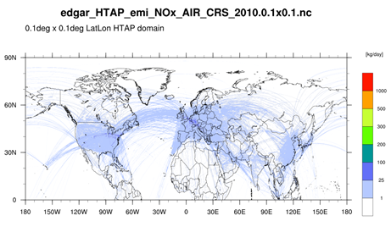
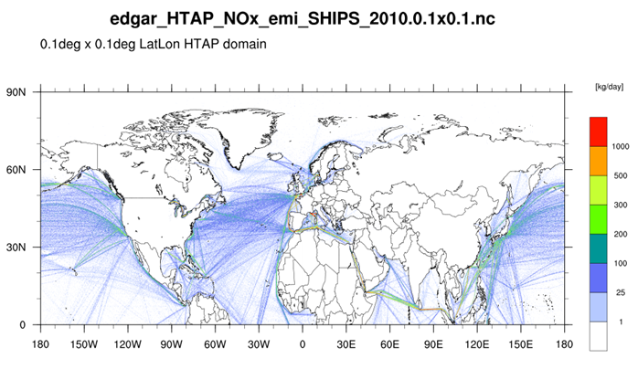
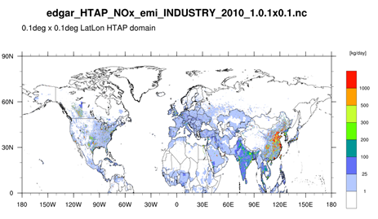
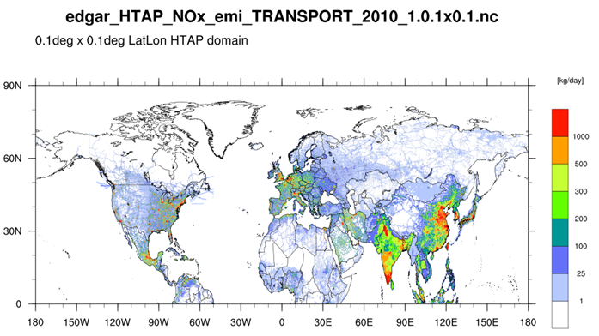
Global Gridded HTAP Emissions
Sectors: aircraft, shipping, industry, energy, transportation, residential, and agriculture
Pollutants: CO, NMVOC, NO_{x}, SO₂, NH₃, PM₁₀, PM_{2.5},BC and OC
EPA OAQPS, Emission Inventory and Analysis Group

Slide 6
EPA’s Hemispheric Modeling Challenges
Consistent Emissions Processing across various sectors from various sources/countries.
Temporal Allocation
Horizontal and Vertical Spatial Allocation
Accurate country-specific Time Zone handling
Local time to GMT as well as holidays
Accurate spatial allocations with and without Surrogates
Mixing US and Global gridded emissions without double counting

Slide 7
EPA Northern Hemispheric Modeling
GRIDMASK file that includes both the country and time zone by grid cell : used Arcmap zonal statistics to calculate the majority coverage in the cell

Slide 8
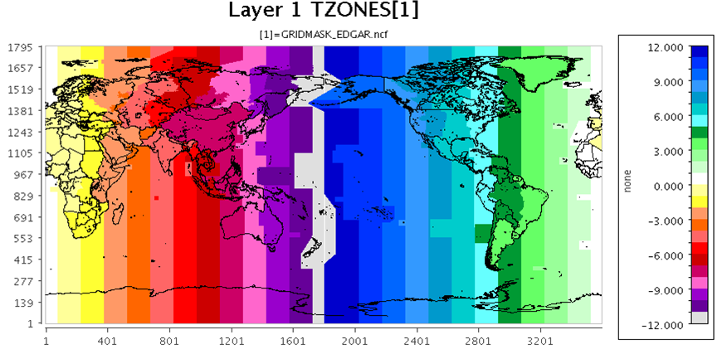
EPA Northern Hemispheric Modeling
GRIDMASK file maps grid cells to time zones
: Finer time zones/country assignment? Required to update the GRIDMASK

Slide 9
SMOKE v4.0 for Hemispheric Modeling
Grid Cell = Inventory Source (6.48 millions sources : 1600*3600)
Smkinven Updates to read and process the native NetCDF-formatted pregridded emissions inventory files (i.e., HTAP, EDGAR,,,,)
IMPORT_GRDNETCDF_YN : Process the native NetCDF pregridded Inventory files
NETCDF_INV_YEAR : Required to provide the year of emissions
NETCDF_POL_UNIT : Required to specify the modeling the unit of each pollutant
ARINV: Area Inventory List File
===============================================================
#LIST GRID
#SCC, Pollutant, Variable_Name, Month, File_location_name
SOLVENT,VOC,emis_nmvoc,0,/nas/EDGAR/solvent/nmvoc/v42_2010.nc
SOLVENT,CH4,emis_ch4,0,/nas/EDGAR/solvent/ch4/v42_2010.nc
ENERGY,NOX ,emis_nox,0,/nas/EDGAR/energy/nox/v42_2010.nc
ENERGY,PM25,emis_pm25,0,/nas/EDGAR/energy/pm2.5/v42_2010.nc
ENERGY,NOX,emis_nmvoc,0,/nas/EDGAR/energy/nmvoc/v42_2010.nc
===============================================================
Notes:
Treat individual grid cell as a single source
There are
Processing more than one sectors at a time as long as they are listed in this ARINV Smkinven list input file

Slide 10
SMOKE v4.0 for Hemispheric Modeling
Grdmat Updates to regrid the pregridded emissions into the output modeling domain without any spatial surrogate.
Built a new function to disaggregate the grid cell into multiple point and the regrid them into the new modeling domain.
Spcmat used to assign a single chemical speciation profile by grid cell
Cntlmat used to zero-out US emissions by Country-level
Notes:
Explain about the limitatin of gridded inventory processing. Emission by grid cell can be assigned to a single chemical speciation,

Slide 11
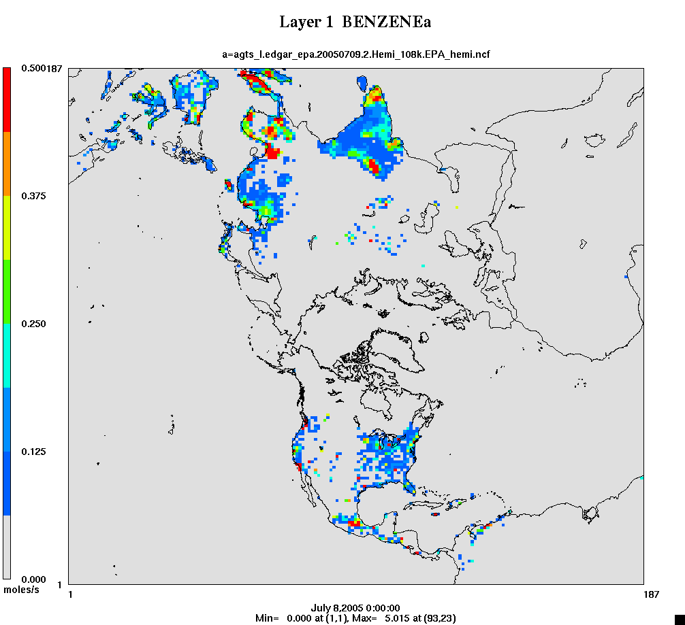
Example of Gridded HTAP Emissions

Slide 12
Vertical Distribution
EPA’s Hemispheric Emissions created for 44 layers (from J. Xing: 2015)
Layer 1 median at 10m, and layer 44 at 18,200m
HTAP emissions
Use SMOKE program Layalloc to put emissions at specific height ranges
Aircraft emissions split into landing and takeoff (layers 1-15), climbing and descent (16-33), and cruising (34-38)
Layering needs to be run every day because layer heights change by cell and by hour
LayAlloc Program: Vertically redistributing the 2D gridded emissions into 3D
LAYER_FRACTION: Layer Allocation Input File
=======================================================================
No., Bottom Ht(m), Top Ht(m), Fraction 1, 0, 100, 0.60 2, 100, 200, 0.20 3, 200, 400, 0.10 4, 400, 600, 0.07 5, 600, 1000, 0.03
=======================================================================

Slide 13
Vertical Distributions by Sector
L | Km | L | Km
1 | .01 | 25 | 4.2
5 | 0.1 | 30 | 6.8
10 | 0.4 | 35 | 10
15 | 0.9 | 40 | 14
20 | 2.1 | 44 | 18

Slide 14
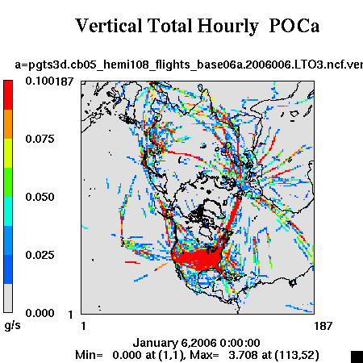
Example of Gridded HTAP Emissions

Slide 15
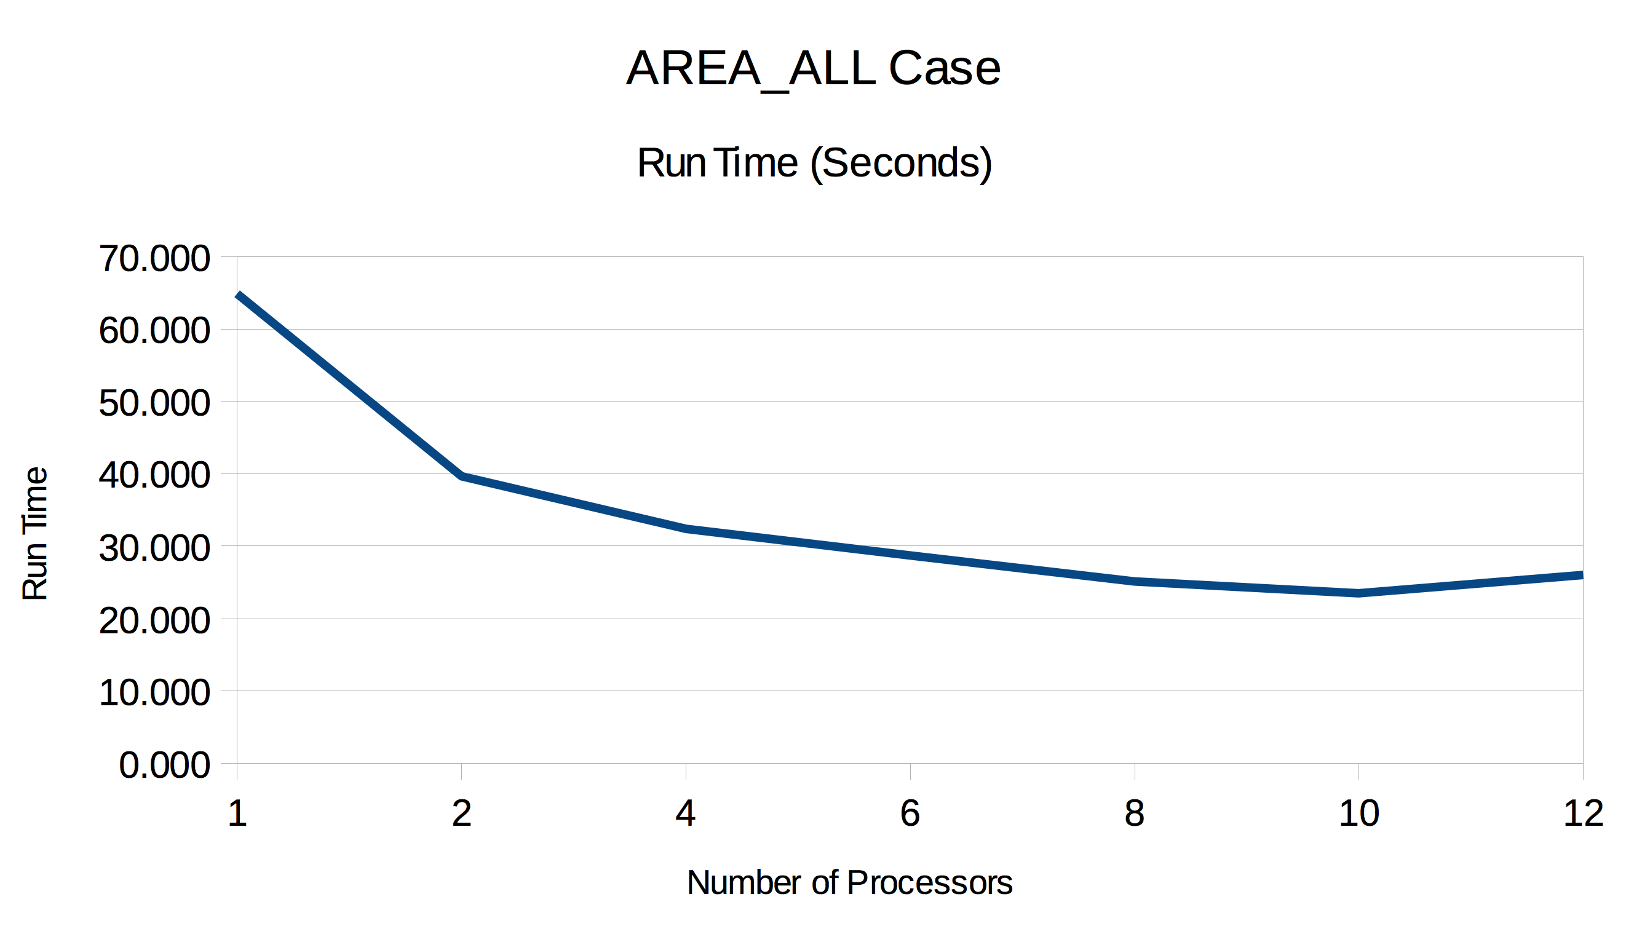
Other Enhancements
OpenMP Parallelization in SMOKE
Smkreport and Smkmerge
Upto 2-2.5x Speed up
Requires a complete restructuring
New Spatial Allocator PostgeSQL
Easier, Faster and Simpler
SMOKE Wiki Page:
http://www.airqualitymodeling.org/cmaqwiki/index.php?title=SMOKE-NEI-Platform6.3
Based on the EPA’s NEI Platform README
Added a few tips for SMOKE modeling users

Slide 16
Upcoming SMOKE Updates
SMOKE4AERMOD System Development
Designed for NATA 2014 Studies
Point Sources [Almost Completed]:
Point-EGU
Point-NonEGU
Airports with Runway (w/o Runway)
Nonpoint Sources [Ongoing]:
CMV, RWC,,,
Nonroad Sources [Ongoing]
Onroad Mobiles Sources:
RPD, RPV, RPP, RPH

Slide 17
Upcoming SMOKE Updates
FAA’s AEDT/EDMS Aircraft Emissions Processing:
Supports from OTAQ and OAQPS offices
New NEI platform sector for aircraft with a fully trajectory emissions
Based on the previous FAA’s AEDTproc and EDMS2inv tools
The Integration of the SMOKE setup structures between NEI Modeling Platform and CMAS SMOKE release versions
Restructuring the current CMAS version of SMOKE system
NEI platform updates are needed.

Slide 18
Acknowledgement
U.S. EPA
Office of Air Quality Planning and Standards (OAQPS)
Office of Transportation and Air Quality (OTAQ)
Office of Research and Development (ORD)
California Air Resource Board (CARB)
M3users community

