Slide 1
Simulating the phase partitioning of HNO₃, NH₃, and HCl with size-resolved particles over northern Colorado in winter
Image provided by the NOAA/OAR/ESRL PSD, Boulder, CO, USA, from their website at http://www.esrl.noaa.gov/psd/
James T. Kelly¹, Kirk R. Baker¹, Christopher G. Nolte², Sergey L. Napelenok², William C. Keene³, and Alexander A. P. Pszenny⁴
¹Office of Air Quality Planning & Standards, U.S. EPA, Research Triangle Park, NC
²Office of Research and Development, U.S. EPA, Research Triangle Park, NC
³Department of Environmental Sciences, University of Virginia, Charlottesville, Virginia
⁴Institute for the Study of Earth, Oceans and Space, University of New Hampshire, Durham, NH
Acknowledgments: Daniel Wolfe, Bruce Bartram, William Dubé, Nicholas Wagner, U.S. EPA Modeling Platform Development Team, Allan Beidler, James Beidler, Chris Allen, Lara Reynolds, and Dr. Daniel Bon
1

Slide 2
Motivation
Dynamic gas/particle mass transfer
Temperature
H₂SO₄
SO₄²⁻,
Mg²⁺, K⁺, Ca²⁺, Na⁺,
NH₄⁺, NO₃⁻, Cl⁻,
H₂O
Gas/particle equilibrium
Coarse
Aitken
Accumulation
NH₃, HNO₃, HCl
RH
Particle Diameter
CMAQ’s inorganic PM predictions involve the partitioning of species between the gas phase and size-distributed particles
Comprehensive evaluations of these predictions are usually not possible due to incomplete observational datasets

Slide 3
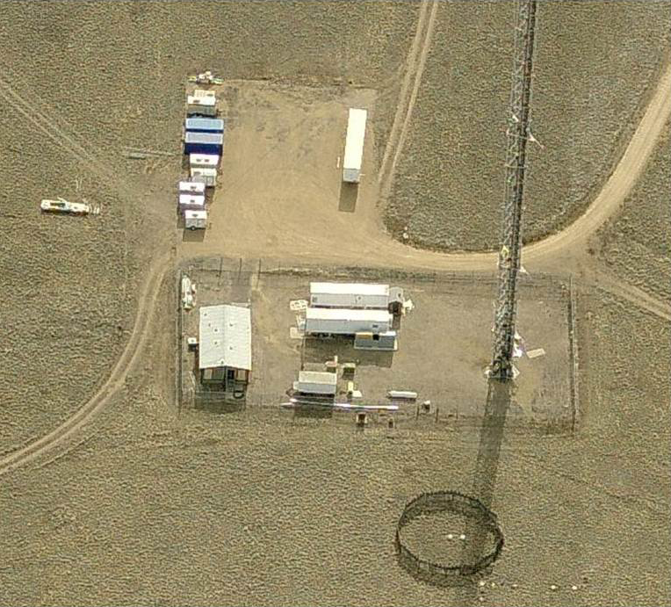
NACHTT Campaign
In Feb-Mar 2011, comprehensive observations of inorganic PM and trace gases were made in CO
Observations include
Gas: NH₃, HNO₃, and HCl
Size-segregated PM: SO₄²⁻, NH₄⁺, NO₃⁻, Cl⁻, Mg²⁺, Ca²⁺, and K⁺
Meteorology: T, RH, wind speed and wind direction
Full suite of measurements to comprehensively evaluate inorganic aerosol predictions
BAO Tower
NOAA Boulder Atmospheric Observatory tower in Weld County, CO (40.0500°N, 105.0039°W)*
3
NACHTT: Nitrogen, Aerosol Composition, and Halogens on a Tall Tower
*Image provided by the NOAA/OAR/ESRL PSD, Boulder, CO, USA, from their website at http://www.esrl.noaa.gov/psd/

Slide 4
Objectives
Primary objective
Comprehensively evaluate CMAQ’s inorganic aerosol predictions for a site influenced by complex meteorology and emissions
Secondary objective
Characterize contributions of emission sectors to predictions to the site using the CMAQ-ISAM* source apportionment model
4
*ISAM: Integrated Source Apportionment Model

Slide 5
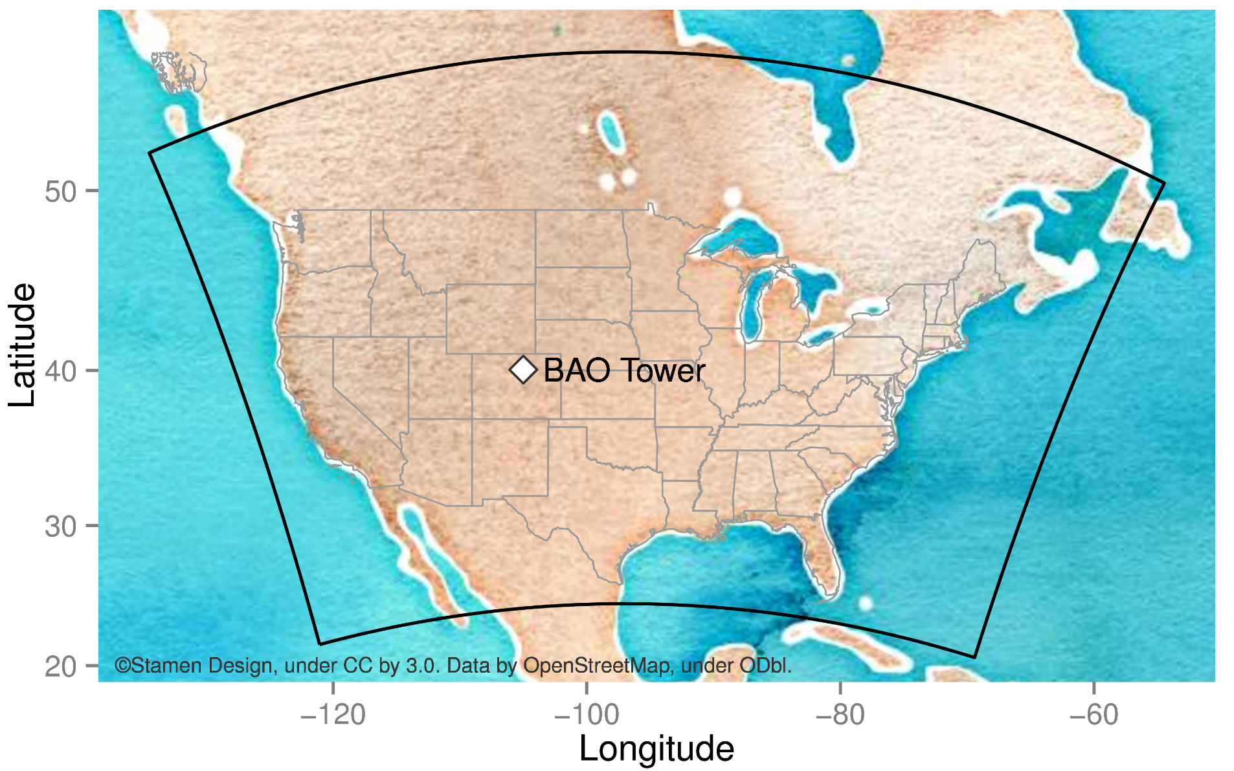
Modeling
Air quality modeling
CMAQv5.0.2
12 km horizontal resolution
25 vertical layers
CB05tucl gas-phase chemistry
AERO6 aerosol processes
Emissions
NEI11 version 2
BEISv3.6.1 biogenic emissions
NH₃ bidirectional surface exchange
Meteorology
WRF version 3.4, MCIP 4.1.3
Boundary conditions
GEOS-Chem version 8-03-02
2° x 2.5° horizontal resolution
Air Quality Modeling Domain w/ BAO Tower
Simulations discussed below
Base: configuration shown on left
x4nh3: NH₃ emissions scaled by four
ISAM: CMAQ with Integrated Source Apportionment
B-F: brute-force runs using “Base”
5

Slide 6
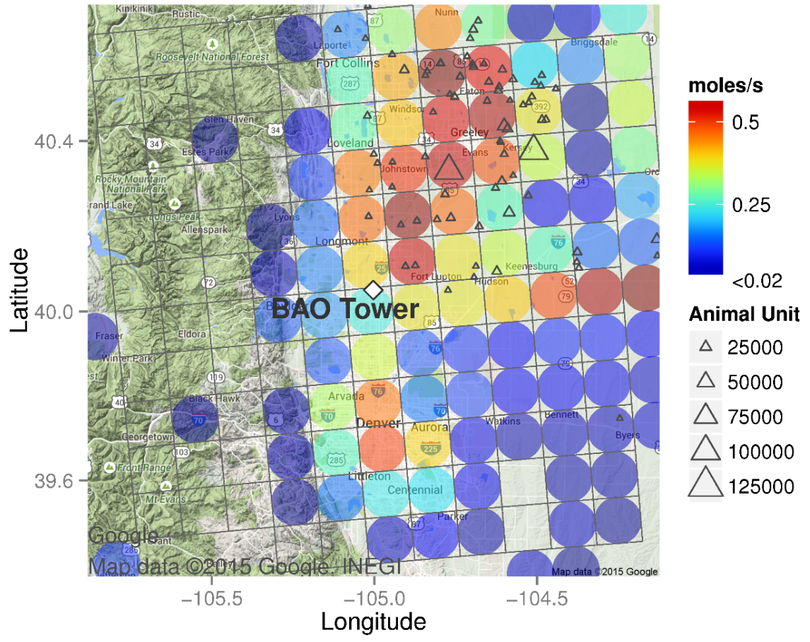
Site Location
BAO Tower
~33 km north of Denver
Southwest of numerous animal feedlots
East of Front Range
Sampling from 22-m agl
NH₃ emissions
Elevated in region with animal feedlots and Denver (see figure)
Challenging conditions
Diverse emission sources and complex terrain
Greeley
RMNP
~33 km
Denver
Colors indicate average NH₃ emissions in model cells
BAO: Boulder Atmospheric Observatory
RMNP: Rocky Mountain National Park
6

Slide 7
Inorganic Trace Gases
NH₃ observations are underpredicted in Base simulation but predicted reasonably well in x4nh3 simulation
HNO₃ observations are underpredicted in both simulations, more severely in x4nh3
HCl observations are substantially underpredicted in both simulations

Slide 8
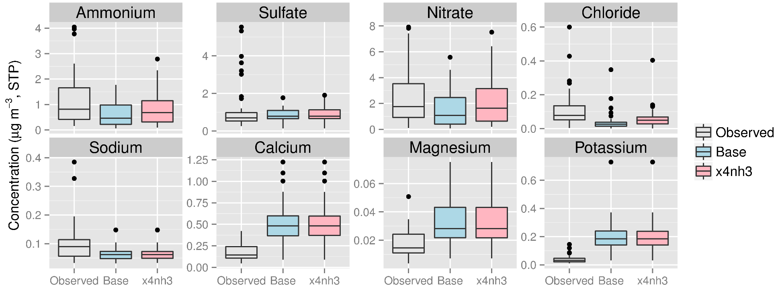
Inorganic PM Components
NH₄⁺ is underpredicted in both cases; NH₄⁺ predictions for x4nh3 are improved compared with Base but are closer to Base than to measurements
Little difference in SO₄²⁻ predictions for the Base and x4nh3 cases (as expected); both simulations underpredict infrequent high SO₄²⁻ measurements
NO₃⁻ is underpredicted in Base case; NO₃⁻ predications are improved in x4nh3 case
Cl⁻ and Na⁺ are underpredicted; Ca²⁺, Mg²⁺, and K⁺ are overpredicted

Slide 9
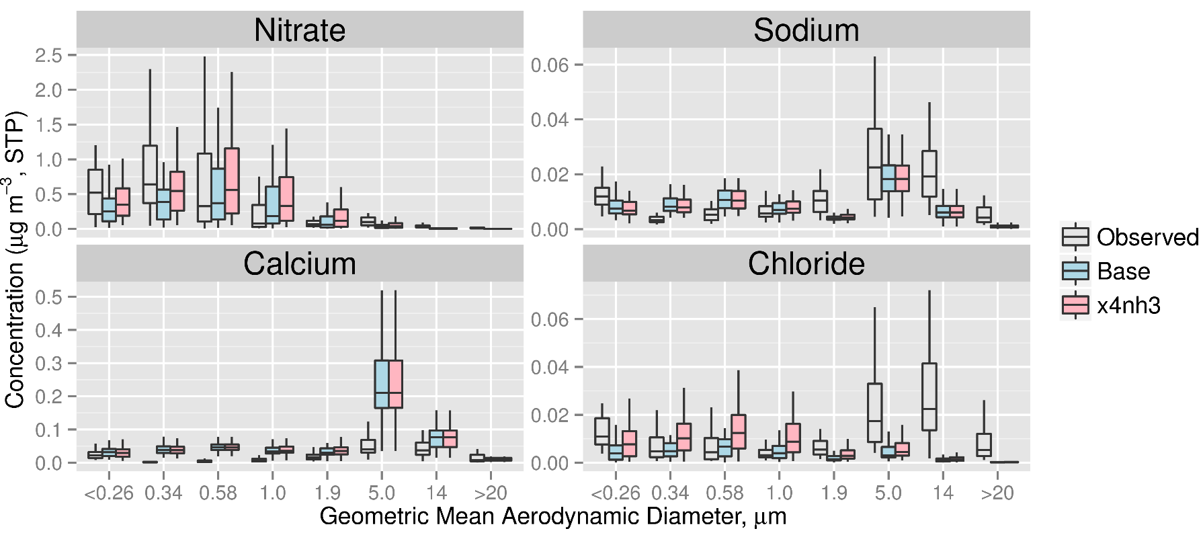
PM Size Distributions
Distributions of NO₃⁻ (and NH₄⁺ and SO₄²⁻) agree reasonably with observations but are shifted to slightly larger diameters
Na⁺ distributions are predicted well but coarse Na⁺ is underpredicted; coarse Cl⁻ is underpredicted
Ca²⁺ (and Mg²⁺ and K⁺) is overpredicted in all size fractions
Note: outlier points not shown in figure for clarity

Slide 10
Total Levels (Gas + Particle)
Large underestimate of observed total ammonium (NH₃+NH₄⁺) in Base; better agreement in x4nh3
Observed total nitrate (HNO₃+NO₃⁻) is moderately underestimated in Base; slightly better agreement for x4nh3
Large underestimate of observed total chloride (HCl+Cl⁻) in Base; slightly better agreement for x4nh3

Slide 11
Gas Fraction (Gas / Total)
Total ammonium partitions mostly to the gas phase in all cases; close agreement between observations and x4nh3 estimates
Total nitrate partitions too much to the gas phase in Base and too much to the particle phase in x4nh3
Total chloride partitions too much to the gas phase in Base; close agreement between observations and x4nh3 estimates

Slide 12
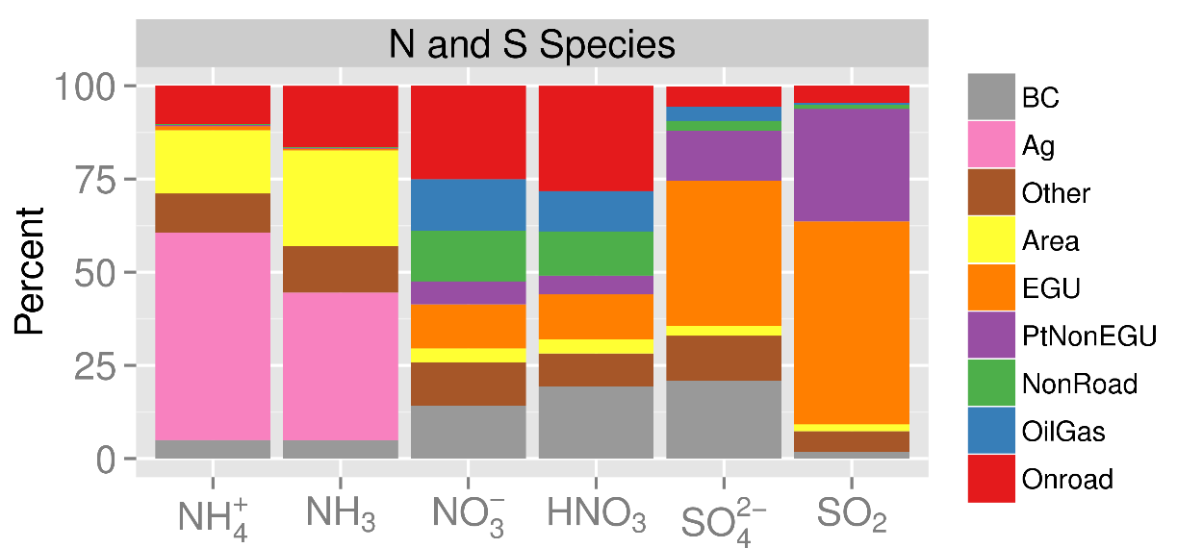
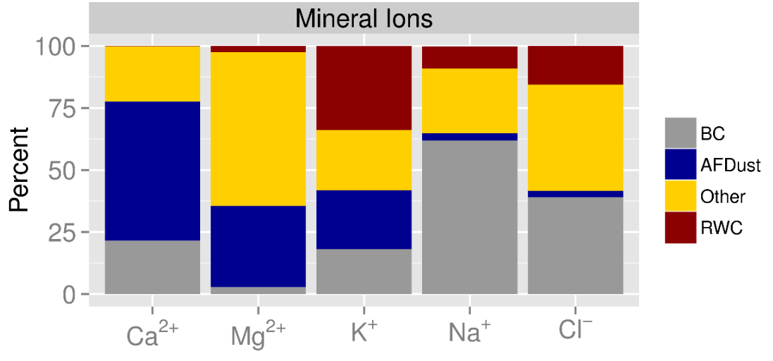
Source Apportionment
Agricultural sector is largest contributor to NHx
Mobile sources are largest contributors to HNO₃ & NO₃⁻
EGUs are largest contributors to SOx
Area fugitive dust is largest contributor to fine particle Ca²⁺
RWC is largest contributor to fine particle K⁺
Boundaries are largest contributors to fine Na⁺ and Cl⁻

Slide 13
Contributions of RWC to K⁺
Good agreement in spatial patterns and magnitude of residential wood combustion contributions to fine-mode K⁺
Percent contribution of RWC to fine mode K⁺ at the BAO site is 34% for CMAQ-ISAM and 33% for brute-force

Slide 14
Boundary Contribution to NO₃⁻
General agreement in spatial patterns of the contribution of boundary NOy to fine-mode NO₃⁻ concentrations
Percent contribution of boundary NOy to total NO₃⁻ at the BAO site is 14% for CMAQ-ISAM and 7% for brute-force

Slide 15
Summary
CMAQ predictions capture the general features of observed distributions of gas mixing ratios, size-distributed particle concentrations, and gas-particle partitioning fractions
CMAQ-ISAM source apportionment estimates are consistent with expectations based on major emission sectors and provide useful insights in some cases
Areas for improvement have been identified
NH₃ emissions, presumably from nearby animal feedlots, to help address NHx underpredictions, which appear to be related to emissions and transport
Flux and speciation of fugitive and windblown dust emissions to help address mineral cation overpredictions and chloride underpredictions
NOy boundary conditions in Alberta, Canada region
Additional testing of CMAQ-ISAM and comparison with other source apportionment methods is warranted for secondary PM
Better representation of terrain-influenced winds with finer-scale modeling to improve temporal characteristics of predictions

Slide 16
Additional Slides

Slide 17
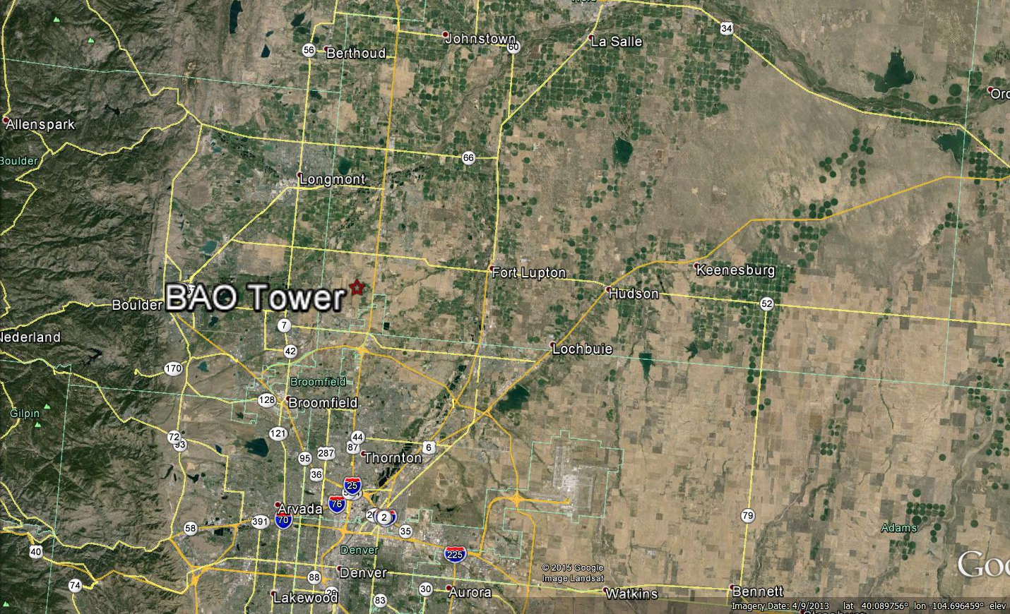
Conceptual Meteorology
S. Platte River
Downslope Events
Evening
Day
Denver
Meteorology is influenced by terrain
Daytime upslope flows in Rocky foothills
Nocturnal drainage flows along South Platte River valley
Downslope wind events associated with synoptic forcing

Slide 18
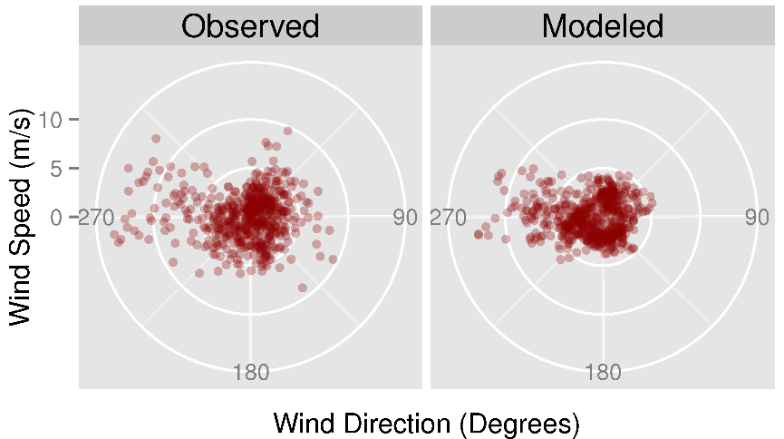
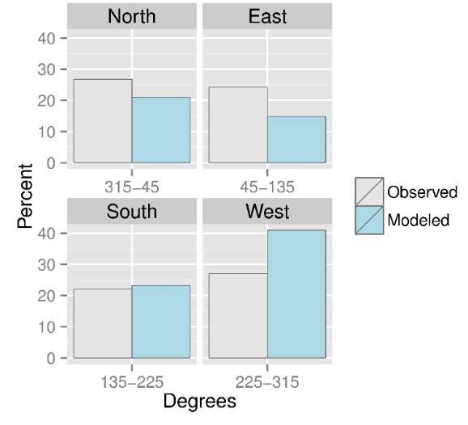
Meteorology
(a)
(b)
Generally light and variable winds captured by model (Fig. a)
High speed westerlies captured by the model; model does not replicate high speed northeasterlies (Fig. a)
Modeled winds too frequent from west; too infrequent from northeast (Fig. b)
18

