Slide 1
Development and Evaluation of a Hybrid Eulerian-Lagrangian Modeling Approach
Beata Czader, Peter Percell, Daewon Byun, Yunsoo Choi
University of Houston

Slide 2
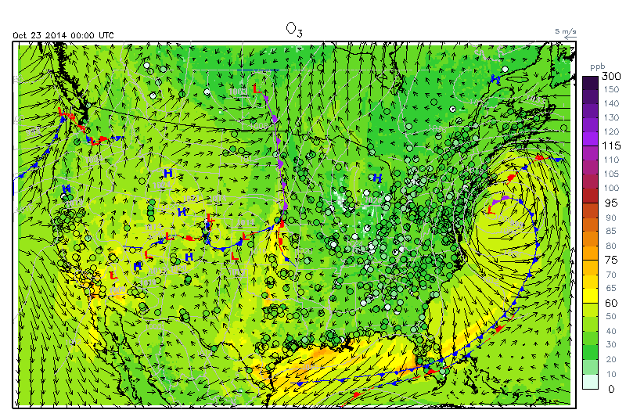
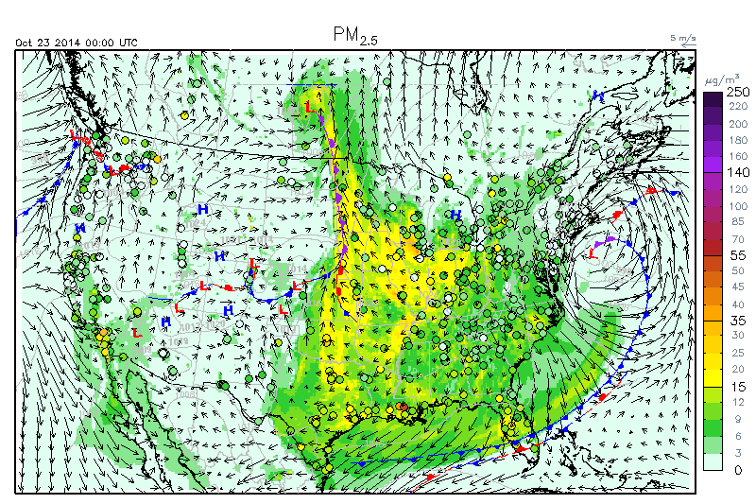
Motivation and Goal
UH Air Quality Forecasting system provides 48-hour ozone and PM2.5 everyday over the US (12km) and Southeast Texas (4km) based on CMAQ 5.0.1 (http://spock.geosc.uh.edu).
Sometimes we have high biased ozone and PM2.5.
What can we do after finding extremely high biased ozone and PM2.5?
Is there a timely cheap trajectory model with reasonable chemical boundary condition and detailed chemistry?

Slide 3
Motivation and Goal
Air pollution can be numerically simulated using Eulerian or Lagrangian approach.
Eulerian models have fixed frame of reference with a modeling domain divided into many grid cells. They account for transport processes and detailed chemistry but simulations are time consuming.
Lagrangian models operate in moving coordinates. They have simplified chemistry and static boundary conditions. They are fast.
An ideal air pollution model would combine the computational efficiency of a Lagrangian model with the chemistry details of a chemical-transport model (Eulerian).
The goal of this work was to develop a hybrid Euleran – Lagrangian modeling approach able to quickly simulate source-receptor relationships.

Slide 4
Conceptual model
In the simplest application, CMAQ domain is reduced to only one cell in the horizontal direction, which corresponds to a 2D column.
This sub-domain (nest) travels with the averaged wind inside CMAQ domain but do not necessarily align with the CMAQ grid cells.
The vertical layer structure and the physical and chemical processes in STOPS are the same as in the full domain CMAQ model.
Exception is calculation of advection fluxes that are obtained utilizing difference between a cell horizontal wind velocity and averaged velocity of STOPS.

Slide 5
Conceptual model
Initially developed for ozone pollution applications was named the
Screening Trajectory Ozone Prediction System (STOPS)
But it is not limited to ozone prediction but similarly to CMAQ it can simulate concentrations of many species, including particulate matter and some toxic compounds, such as formaldehyde and 1,3-butadiene.
STOPS is a moving nest (Lagrangian approach) inside CMAQ structure (Eulerian model).
STOPS is a stand-alone tool, but it needs CMAQ simulated concentrations for boundary and initial conditions as well as emission and meteorological files that are prepared for CMAQ.

Slide 6
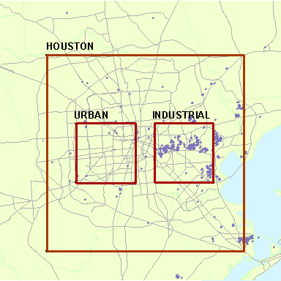
Domain set up
The initial location of the STOPS domain can be defined by choosing position of the domain middle cell in terms of latitude and longitude coordinates or in terms of the column and row number corresponding to the CMAQ full domain.
The modeling domain can be extended with a few horizontal layers of cells padding the middle cell.
Name | Column and row in host grid | Number of padding cells in each direction | Number of rows | Number of columns
Houston | 25, 30 | 10 | 21 | 21
Urban | 21, 30 | 2 | 5 | 5
Industrial | 29, 30 | 2 | 5 | 5
Purple dots correspond to a location of point sources.

Slide 7
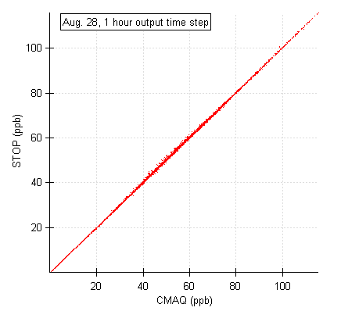
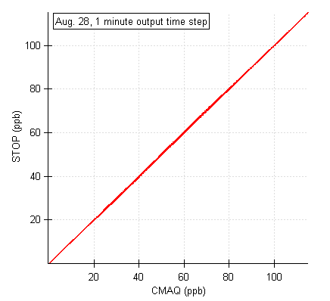
Comparison to CMAQ results
Given that STOPS is based on the CMAQ source code and uses the same input files its results shall closely approximate those obtained with the 3-D CMAQ model.
To assure the correctness of the algorithm’s implementation, the results were compared with the CMAQ simulation results.
Comparison of STOPS
in a static mode
OUTPUT TIME STEP | CMAX | SMAX | MAXD | MIND | MB | MAE
1h | 128.43 | 129.69 | 2.84 | -6.17 | -0.79 | 0.92
5 m | 130.38 | 130.79 | 1.79 | -3.36 | -0.27 | 0.38
1 m | 129.42 | 129.57 | 0.79 | -1.19 | -0.06 | 0.12
The differences comes from boundary conditions.

Slide 8

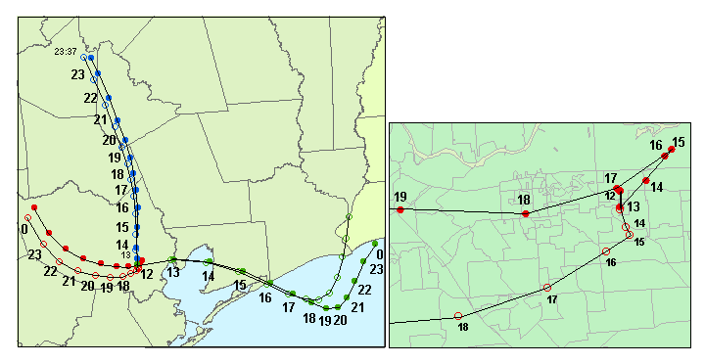
Trajectory
The trajectory for STOPS movement is calculated based on the mean wind that is mass averaged up to the Planetary Boundary Layer (PBL) height.
a)
Aug. 28
b)
Details of trajectory on Aug. 25, 2000
Aug. 30
Aug. 25
filled circles - trajectories determined based on the winds in the middle column,
open circles - trajectories determined based on the average winds in the whole STOPS domain.

Slide 9
Comparison to CMAQ results
Aug. 25
Aug. 28
Aug. 30
starting position at urban domain
starting position at industrial domain
triangles - trajectories determined based on the winds in the middle column (mwind),
crosses - those determined based on the average winds in the whole sub-domain (awind).

Slide 10
Comparison to CMAQ results
Aug. 25
Aug. 28
Aug. 30
starting position at urban domain
Better agreement between CMAQ-STOPS concentration pairs was found when the STOPS trajectory was calculated based on the winds in the middle column.
Under uniform winds STOPS results are close to CMAQ while for complicated meteorological conditions, such as wind recirculation, the results deviate from CMAQ.
starting position at industrial domain
triangles - trajectories determined based on the winds in the middle column (mwind),
corsses - those determined based on the average winds in the whole sub-domain (awind).

Slide 11
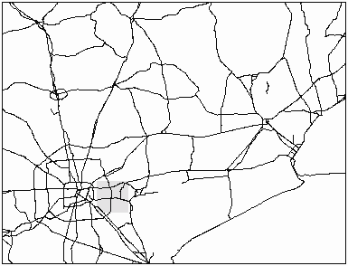
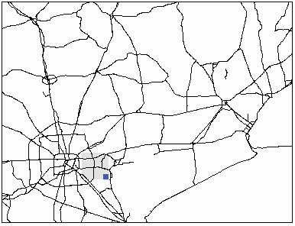
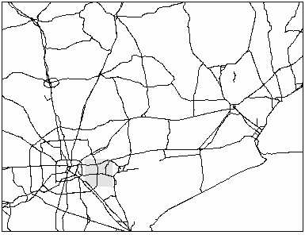
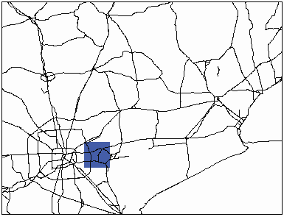
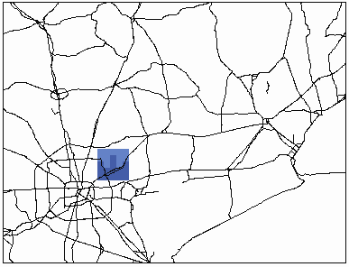
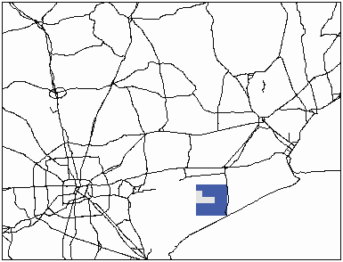

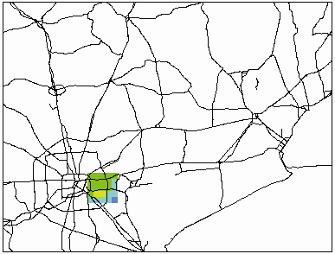
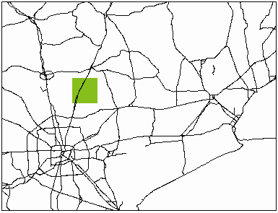
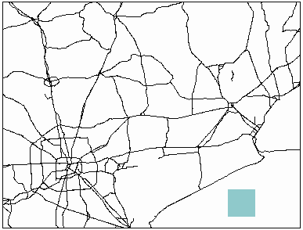
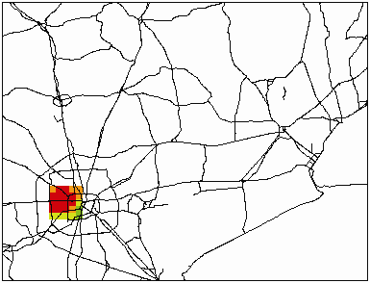
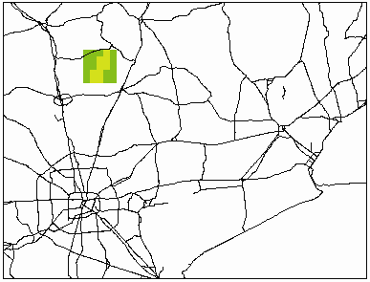
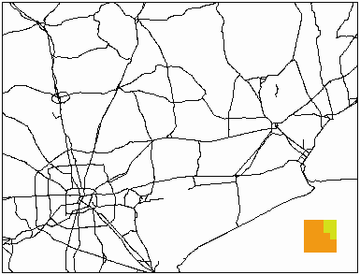
Applications
August 25, 2000
August 28, 2000
August 30, 2000
6 CST
6 CST
6 CST
Ozone mixing ratios
for August 25, 28, 30 of 2000 from the base case simulations.
9 CST
9 CST
9 CST
12 CST
12 CST
12 CST
15 CST
15 CST
15 CST

Slide 12
Applications
Changes in pollutant mixing ratios along STOPS trajectories for different starting positions and days.
VOC
NO_{x}
Changes in pollutant mixing ratios along STOPS trajectories.
Changes in O₃, NO, and NO₂ along STOPS trajectory
for August 25.

Slide 13
Applications
Re-simulations for different emissions events such as ‘upset’ emissions from industrial facilities or wild fire emissions. Additional emissions are directly ‘injected’ into STOPS without the need of SMOKE processing. Amount, species name(s), and time of release are set up in the run script.
Here, STOPS re-simulations were performed with an extended SAPRC99 chemical mechanism that explicitly treat emissions and chemistry of many VOCs. Additional emission spike of several individual VOCs was added one at the time, imitating ‘upset emission’ release.
Changes in ozone occurring along trajectory downwind from emission source on August 25 upon addition of individual VOC (one at a time)
Different compounds affect ozone concentration to a different extent. The low reactive i-butane (I_BUTA) has a small effect on ozone, which is in contrast to other more reactive VOCs that have potential of increasing ozone locally, close to the emission source, and with higher magnitude.

Slide 14
Additional applications
When implemented into the real-time air quality forecasting STOPS can be used as time efficient re-simulations tool that can utilize the same inputs as already prepared for the forecasting and forecasted concentrations.

Slide 15
Implementation
A Fortran-90 module was created to hold the additional data structure related to STOPS and subroutines associated with a coordinate conversion, position and velocity along the trajectory.
The SUBHFILE subroutine was modified. This subroutine determines the spatial relationship between the CMAQ grid and grids of input data, e.g., inputs with emission or meteorological data may have different horizontal domains that the CMAQ domain. SUBHFILE subroutine was enhanced to support a moving horizontal sub-domain, whose grid points do not necessarily coincide with grid points of the input data, and may have different locations at every synchronization time step.
The boundary subroutine, RDBCON, was modified to support a boundary thickness of 3 cells and to get boundary values for changing locations directly from the CMAQ full-grid concentrations.
The netCDF output file, CONC, saves only STOPS grid concentrations. In addition, an ASCII output file is generated that holds trajectory information, this is latitude and longitude of the middle point of the STOPS domain for each output time step, along with the corresponding column and row numbers of a full CMAQ domain.
For source-receptor applications the STOPS code was modified in a way that additional emissions can be directly injected into STOPS without a need of reprocessing an emission inventory. A name of the emitted compound(s) (in terms of model species), a location of emission release, starting and ending times, and the emission rate need to be specified by the user in the STOPS run script.
For the purpose of comparing STOPS results against CMAQ results the post processing program was developed and incorporated into the STOPS build and run scripts. With this, additional file, HCONC, is generated from the STOPS simulations. It holds CMAQ concentrations from grid cells that correspond to the current location of STOPS.

Slide 16
Conclusions
STOPS performance depends on the trajectory calculations and the atmospheric conditions occurring during the simulation period.
The limitation of STOPS is due to the Lagrangian movement when applied for non-uniform winds for which the plume might be dispersed outside of STOPS domain. This is a limitation of every Lagrangian approach.
The advantages of STOPS:
  usage of realistic boundary conditions at every simulations time step, which is not a case in Lagrangian models
  detailed treatment of chemistry; therefore, it can be used to simulate secondary species such as ozone and fast reacting VOCs, such as ethylene or 1,3-butadiene,
  fast.

