Slide 1

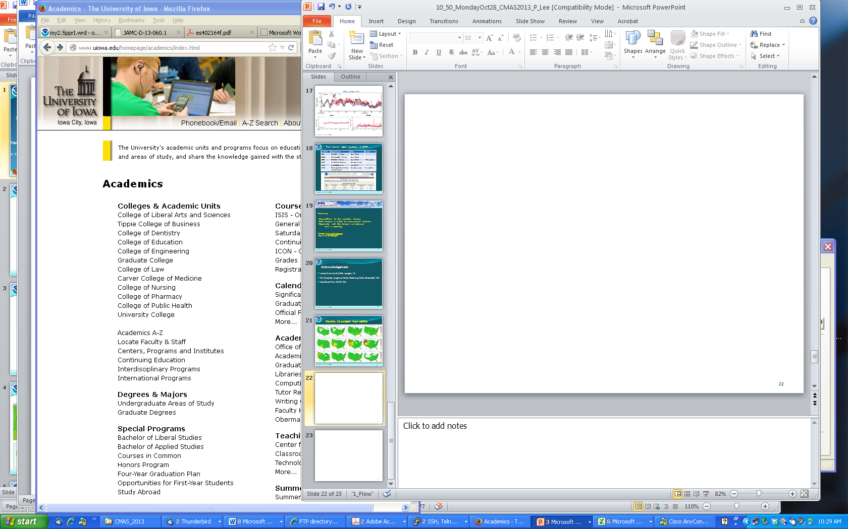



Air Quality Reanalysis
(Translating research to service)
Pius Lee¹, Greg Carmichael², Yongtao Hu³, Edward Hyer⁴, Yang Liu⁵, Dick McNider⁶, Brad Pierce⁷ , Arastoo Pour Biazar⁶, Ted Russell³, Scott Spak², Youhua Tang^{1,8}, Hyuncheol Kim^{1,8},
Li Pan^{1,8}, Weiwei Chen^{1,9} and Daniel Tong^{1,8}
¹Air Resources Lab., NOAA Center for Weather and Climate Prediction, College Park, MD
²College of Engineering, University of Iowa, Iowa City, IA
³School of Civil and Environmental Engr., Georgia Institute of Technology, Atlanta, GA
⁴Naval Research Laboratory, Monterey, CA
⁵Department of Environmental Health, Emory University, Atlanta, GA
⁶Department of Atmospheric Science, University Alabama, Huntsville AL
⁷National Environmental Satellite and Information Service (NESDIS), Madison, WI
⁸Cooperative Institute for Climate and Satellite, University of Maryland College Park, MD
⁹Northeast Institute of Geography and Agroecology, Chinese Academy of Sciences
13th CMAS Oct27-29, 2014, Chapel Hill
Notes:
Emphasis on teamwork: Overall team leadership provided by Professor Greg Carmichael.

Slide 2

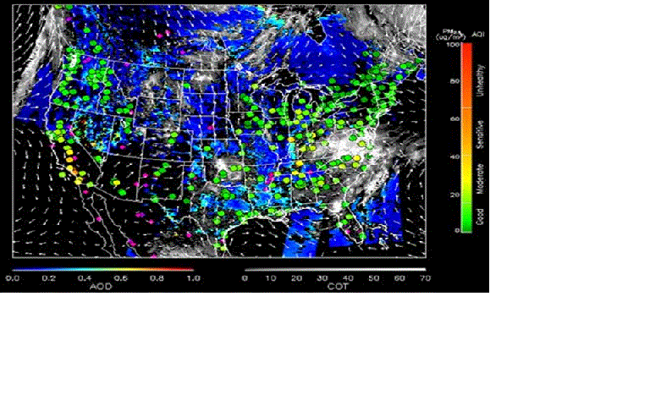
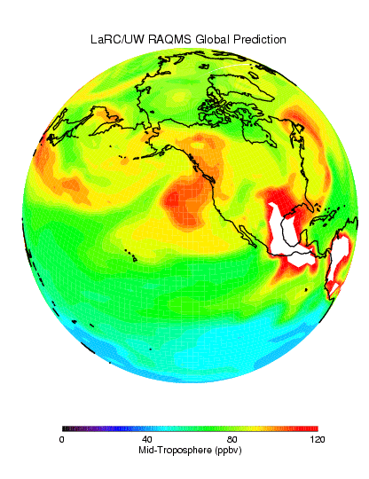
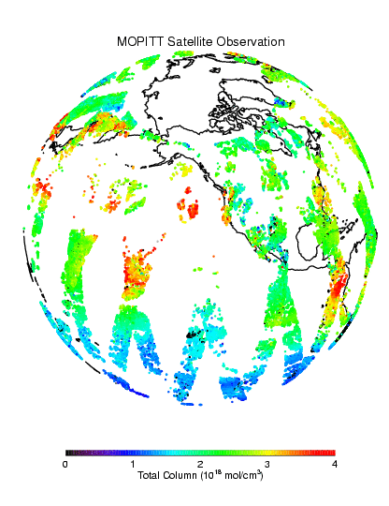
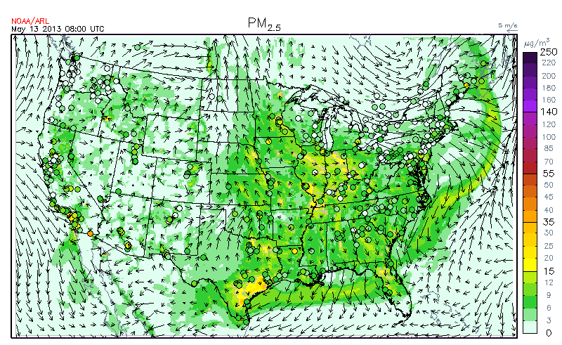
AQAST Project: Air Quality Reanalysis
(Translating Research to Services)
+ AQ Assessments
+ State Implementation Plan Modeling
+ Rapid deployment of on-demand rapid-response forecasting; e.g., new fuel type,…, etc.
+ Health Impacts assessments
+ Demonstration of the impact of observations on AQ distributions
+ Ingestion of new AQAST products into operations
Kim (Poster Tue16)
Global
Assimilation
Satellite
Products
Constrained
http://acmg.seas.harvard.edu/aqast/projects.html
13th CMAS Oct27-29, 2014, Chapel Hill
Notes:
Objective: Best estimated state of the chemical composition of the atmosphere (lower troposphere)
A sizeable user group: AQ application as well as health epidemiology scenarios
A ‘reanalysis’ is a climate or weather model simulation of the past that includes data assimilation of historical observations. The observations can be very comprehensive (satellite, in situ, multiple variables) or relatively sparse (say, sea level pressure only), and the models themselves are quite varied. Generally these models are drawn from the weather forecasting community (at least for the atmospheric components) which explains the odd terminology. An ‘analysis’ from a weather forecasting model is the 6 hour (say) forecast from the time of observations. Weather forecasting groups realised a decade or so ago that the time series of their weather forecasts (the analyses) could not be used to track long term changes because their models had been updated many times over the decades. Thus the idea arose to ‘re-analyse’ the historical observations with a single consistent model. These sets of 6 hour forecasts using the data available at each point are then more consistent in time (and presumably more accurate) that the original analyses were. - See more at: http://www.realclimate.org/index.php/archives/2011/07/reanalyses-r-us/#sthash.WKOIKeHl.dpuf

Slide 3
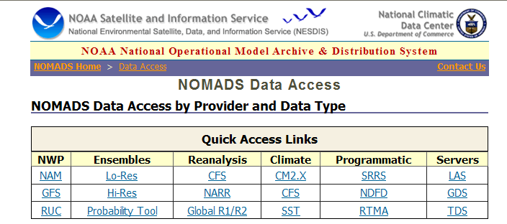
Goal: A user friendly downloadable archive
This study aims to build a prototype
User friendliness and reliability are keys to success: e.g..
13th CMAS Oct27-29, 2014, Chapel Hill
Notes:
Long term – user, and on-demand subseting and downloading gui e.g.

Slide 4
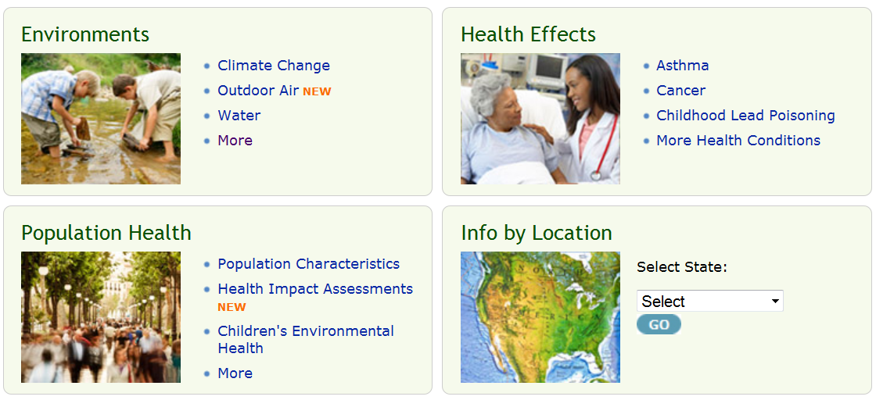
Applications of Reanalysis
Ozone – modeled (~ 3 yr data lag) & monitor (~ 1 yr data lag), both from EPA
PM2.5 mass - modeled (~ 3 yr data lag) & monitor (~ 1 yr data lag), both from EPA
Air Toxics - benzene, formaldehyde, modeled from EPA, 2005 only (NATA)
Reanalysis would be able to provide PM2.5 speciation data with national coverage at county level, which are highly valuable for health effects studies
13th CMAS Oct27-29, 2014, Chapel Hill
Notes:
Tracking currently group their data into 4 categories. The first order application of our reanalysis data would be in the subcategory “Outdoor Air” under “Environments”.
The call out box shows what Tracking currently has and the data limitations
Second order application would be to provide more up to date air toxics data – needs further discussion to make it useful to Tracking.

Slide 5
WRF_ARW-MCIP-CMAQ forward model
WRF-ARW (LCC)
(42 σ-P model Layers)
LBC from GFS
EPA Emissions Inventory + simple obs-based adjustment
C-grid
McQueen
(Talk Tue)
MCIP
Li (Poster Mon31)
Huang
(Poster Mon41)
C-grid
42 σ-P met. Layers
Tong,Chen (Talks Wed)
Projection of
endo-domain intermitten sources: Obs’d wild fire
and prescribed burns
MODIS-
AOD-based adjusted IC,
BC: RAQMS
C-grid
Column integrated AOD
C-grid
CMAQ 4.7.1
C-grid
Hourly 3-D Gridded Chemical Concentration
13th CMAS Oct27-29, 2014, Chapel Hill

Slide 6

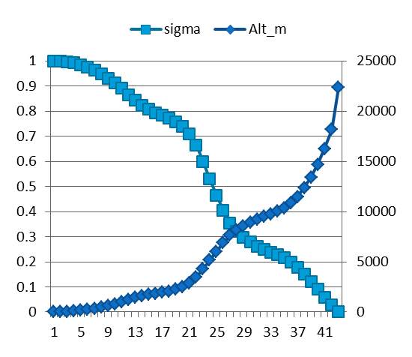
WRF_ARW-MCIP-CMAQ model physics and chemistry options
WRF-ARW | Both North America (12 km) & CONUS (4 km)
Map projection & grid | Lambert Conformal & Arakawa C staggering
Vert. co-ordinate | 42 σ-p unevenly spaced levels
advection | RK3 (Skamarock and Weisman (2008))
SW & LW radiation | RRTMG (Iacono et al. 2008))
PBL Physics | Mellor-Yamada-Janjic (MYJ) level 2.5 closure
Surface layer scheme | Monin-Obukhov Similarity with viscous sub-layer
Land Surface Model | NCEP NOAH
Cloud Microphysics | Thompson et al. (2008)
Cloud convective mixing | Betts-Miller-Janjic Mass adjustment
AQ forecast: ^12 km nested to 4 km
CMAQ4.7.1 | Both CONUS(12 km) & SENEX (4 km)
Map projection & grid | Lambert Conformal & Arakawa C staggering
Vert. co-ordinate | 42 σ-p unevenly spaced levels
Gas chemistry | Cb05 with 156 reactions
Aerosol chemistry | Aero5 with updated evaporation enthalpy
Anthropogenic emission | 2005NEI as base year, mobile projected using AQS*, area and off-road used CSPR^, point source uses 2012 CEM data
 | WRAP oil and gas emissions data
Biogenic emission | BEIS-3.14
Lateral BC | RAQM (B. Pierce)
42 vertical layers
13th CMAS Oct27-29, 2014, Chapel Hill
Notes:
^12 km domain is set a bit large to match National AQ Forecasting Capability for side-by-side verification.

Slide 7

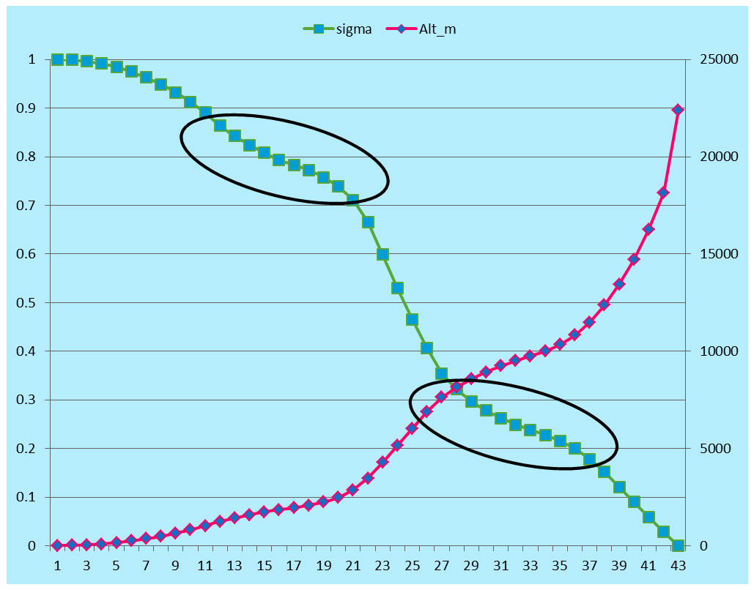
Re-configuration of vertical structure: Decision to match GFS (NCEP)
sigma | Pres (hPa) | Z (m)
1 | 1013 | 0
0.999 | 1012 | 4
0.996 | 1010 | 20
0.992 | 1007 | 48
0.985 | 993 | 92
0.864 | 872 | 1245
0.843 | 852 | 1430
0.824 | 836 | 1590
0.808 | 821 | 1735
0.322 | 348 | 8150
0.297 | 326 | 8580
0.278 | 310 | 8940
0.262 | 296 | 8580
Near surface
Top of fully dev PBL
tropopause
13th CMAS Oct27-29, 2014, Chapel Hill

Slide 8
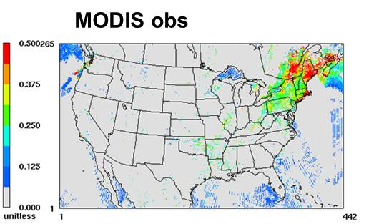
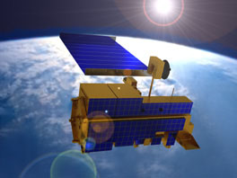
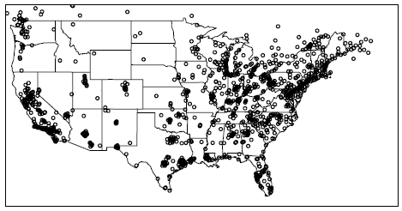
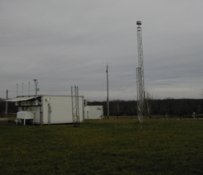
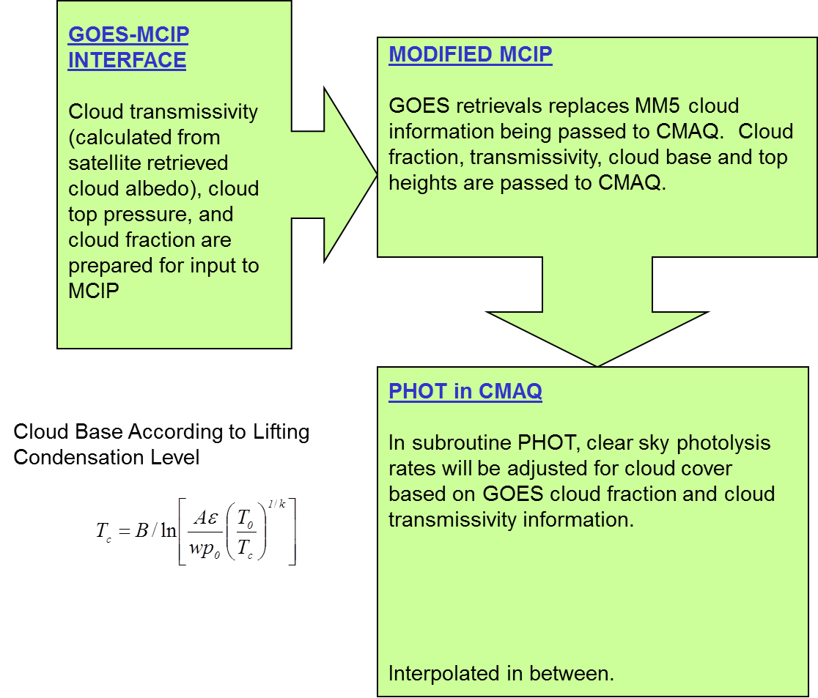
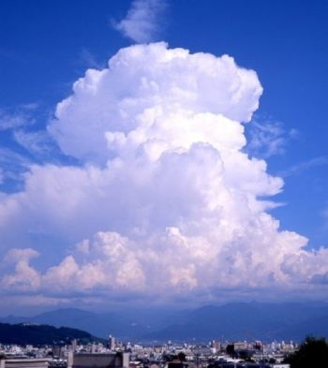
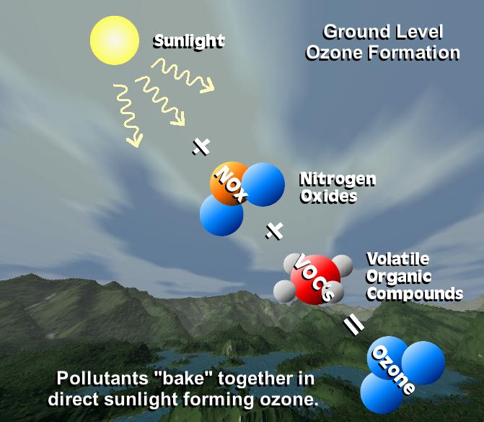
done
done
AIRNow
done
Cloud-obs Photolysis rates
Yet to do
Isoprene
& PAR
Transmittance
13th CMAS Oct27-29, 2014, Chapel Hill
Notes:
Raqms
The RAQMS analyses include assimilation of real-time Aura MLS stratospheric ozone profiles (above 50mb) and cloud cleared OMI total column ozone as well as Terra and Aqua MODIS aerosol optical depth that uses modeled upper tropospheric RH to filter potential cirrus cloud contamination. Wild fire emissions are based on Terra and Aqua MODIS fire detections.
HMS

Slide 9
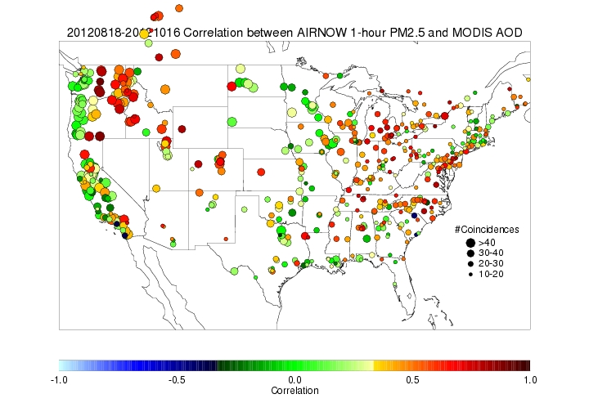
MODIS (Moderate Resolution Imaging Spectroradiometer) AOD
National correlation map between AIRNow measurement and MODIS AOD
Typically good correlation between
surface PM_{2.5} and AOD retrieved
by MODIS
Courtesy :NESDIS
Orbit: | 705 km, 10:30 a.m. descending node (Terra) or 1:30 p.m. ascending node (Aqua)
Swath Dimensions: | 2330 km (cross track) by 10 km (along track at nadir)
Spatial Resolution: | 250 m (bands 1-2) 500 m (bands 3-7) 1000 m (bands 8-36)
http://terra.nasa.gov/About/
13th CMAS Oct27-29, 2014, Chapel Hill

Slide 10
Optimal Interpolation (OI)
OI simplifies the extended Kalman filter formulation (Dee et al. Q. J. R. Meteor. Soc. 1998) by limiting the analysis problem to a subset of obs.
Obs far away (beyond background error correlation length scale) have no effect in the analysis.
Injection of Obs through OI takes place at 1800 UTC daily.
13th CMAS Oct27-29, 2014, Chapel Hill

Slide 11
MODIS AOD & AIRNow PM_{2.5} assimilated
For initial condition adjustment
MODIS AOD (Terra and Aqua)
Tang (Poster Mon35)
18Z
00Z
06Z
12Z
14Z
17Z
19Z
AIRNOW PM2.5, PM10, Ozone
13th CMAS Oct27-29, 2014, Chapel Hill
Notes:
6 hour forecasts and retain the optimal analysis states

Slide 12
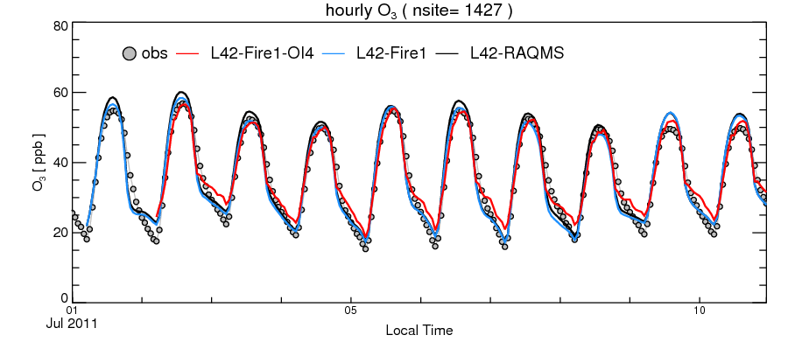
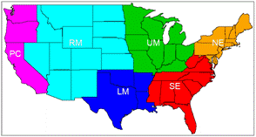
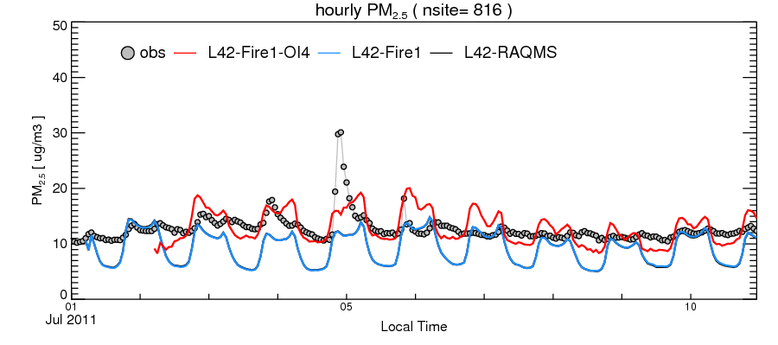
Analysis field Verification: AIRNOW O₃ & PM _{2.5} over CONUS
13th CMAS Oct27-29, 2014, Chapel Hill
Notes:
Raqms
The RAQMS analyses include assimilation of real-time Aura MLS stratospheric ozone profiles (above 50mb) and cloud cleared OMI total column ozone as well as Terra and Aqua MODIS aerosol optical depth that uses modeled upper tropospheric RH to filter potential cirrus cloud contamination. Wild fire emissions are based on Terra and Aqua MODIS fire detections.

Slide 13
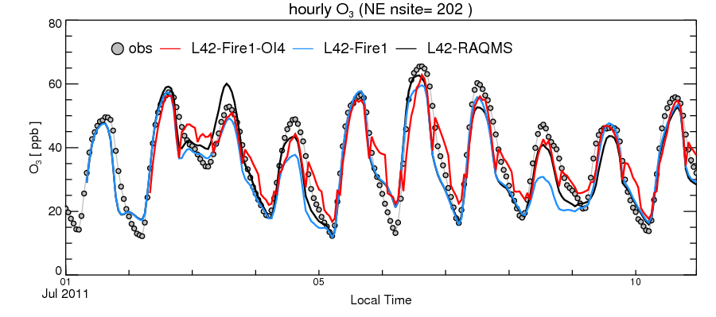
Analysis field Verification: AIRNOW O₃ & PM _{2.5} over NE

Slide 14
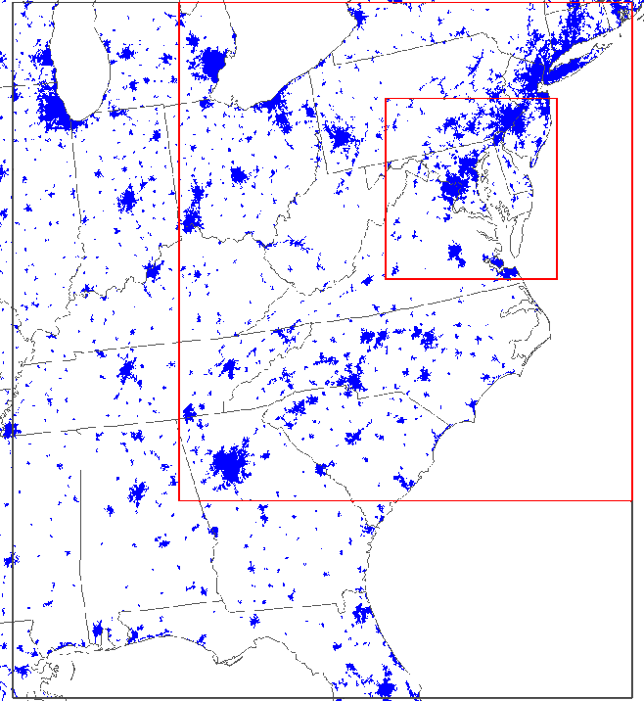
Analysis fields as IC and forecast with Total AOD Assimilation basis for LBCs
WRF 3.2.1 for meteorological fields
  NCEP North American Regional Reanalysis (NARR) 32-km resolution inputs
  NCEP ADP surface and soundings observational data
  MODIS landuse data for most recent land cover status
  3-D and surface nudging, Noah land-surface model
SMOKE 2.6 for CMAQ ready gridded emissions
  NEI inventory projected to 2011 using EGAS growth and existing control strategies
  BEIS3 biogenic emissions based on BELD3 database
  GOES biomass burning emissions: ftp://satepsanone.nesdis.noaa.gov/EPA/GBBEP/
CMAQ 4.6 revised to simulate gaseous & PM species
  SAPRC99 mechanism, AERO4, ISORROPIA thermodynamic, Mass conservation,
  Updated SOA module (Baek et. al. JGR 2011) for multi-generational oxidation of semi-volatile organic carbons
4 km
12 km
36 km
DISCOVER-AQ
GA_Tech
4 km
IC/BC of Base and AOD_DA cases
13th CMAS Oct27-29, 2014, Chapel Hill
Notes:
Calculate differences between forecasts (B) and observations (O) at each AIRNOW station as a time series
Pair up AIRNOW stations, and calculate the correlation coefficients between the two time series at the paired stations
Plot the correlation as a function of the distance between the two stations,
Intercept Rz can be used to calculate the ratio between model error (EB) and and observational error (including representative error)
Horizontal length scale can be inferred as well

Slide 15
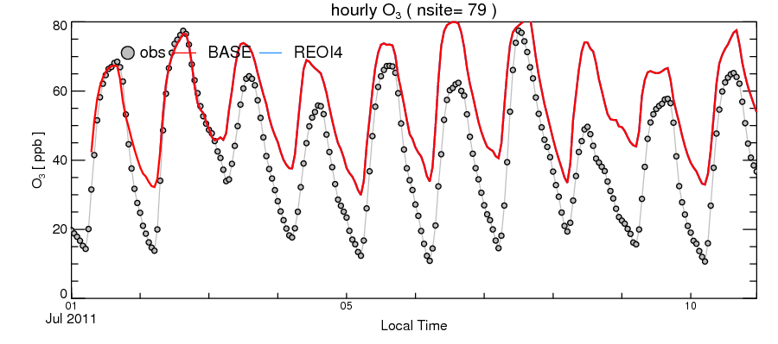
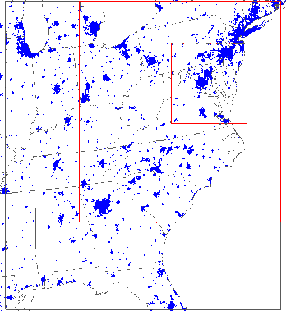
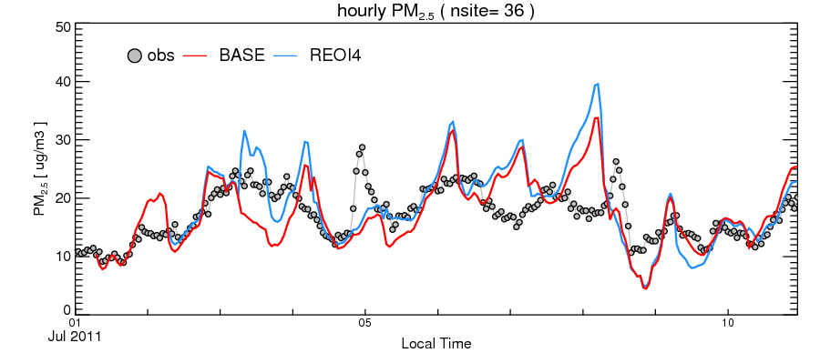
Analysis field Verification: AIRNOW O₃ & PM _{2.5} over BW SIP
13th CMAS Oct27-29, 2014, Chapel Hill
Notes:
Raqms
The RAQMS analyses include assimilation of real-time Aura MLS stratospheric ozone profiles (above 50mb) and cloud cleared OMI total column ozone as well as Terra and Aqua MODIS aerosol optical depth that uses modeled upper tropospheric RH to filter potential cirrus cloud contamination. Wild fire emissions are based on Terra and Aqua MODIS fire detections.

Slide 16
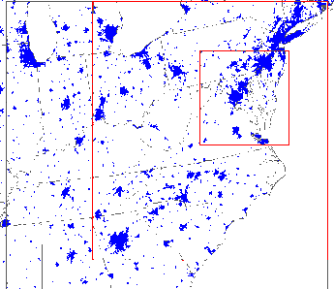
PM2.5 24h avg | Obs mean | Mean bias | RMSE | Corr. Coef.
L42 | 12.3 | -7.7 | 10.4 | 0.4
L42RAQMS | 12.3 | -5.4 | 8.5 | 0.5
L42-Fire1 | 12.3 | -7.6 | 10.6 | 0.3
L42-Fire1-OI4 | 12.3 | -1.11 | 6.65 | 0.61
CONUS
Application of analysis field for State Implementation Planning
DISCOVER-AQ
GA_Tech
4 km
PM2.5 24h avg | Obs mean | Mean bias | RMSE | Corr. Coef.
Base | 19.8 | -0.67 | 24.18 | 0.49
With L42-Fire1-OI4 field to derive LBC | 19.8 | 1.15 | 5.79 | 0.53
13th CMAS Oct27-29, 2014, Chapel Hill

Slide 17
Summary
Configured forward-model vertical structure matching that of GFS
The reanalysis forward model is tested and used to generate July 2011
analysis fields for MDE for SIP modeling
Data Set assimilated: RAQMS (MLS, OMI O3, MODIS AOD); HMS Fire; GOES cloud fraction for photolytic rate correction; MODIS AOD; AIRNow O₃, PM_{2.5}
July 2011 analysis fields was compared to NAQFC simulation results
Next sets: lightning NOx; OMI SO2; PAR adjustment by retrievals
Verification to include data from O₃ lidar network
Begin transition of assimilation algorithm to GSI
Production mode generation of analysis field for 2010
13th CMAS Oct27-29, 2014, Chapel Hill
Notes:
An important source of pm -- strong sensitivity to seasonality and geographical characteristics

Slide 18
EXTRA SLIDES
Contact: Pius.Lee@noaa.gov
http://www.arl.noaa.gov/
18
13th CMAS Oct27-29, 2014, Chapel Hill

Slide 19
Push towards higher resolution at NCEP
product | Targeted next | date | Remark
GFS | T878L64 ~ 22km | April 2014
GDAS | T574 Enkr/GSI ~ 27 km | April 2014
GEFS | T382L64 ~ 35 km | April 2014 | ~30 members
NAM | 12 km North America | Already in place
NAM | 3 km CONUS nest | July 2014
NAM | On demand basis 1.3 km limited domain | Already in place | Fire weather
13th CMAS Oct27-29, 2014, Chapel Hill
Notes:
Epidemiologists want at least hourly chemical composition of the lower atmosphere in 12 km resolution or finer.
NCEP’s push for finer horizontal grid spacing is a desirable trend.
This may mean a similar push for chemical reanalysis fields.

Slide 20
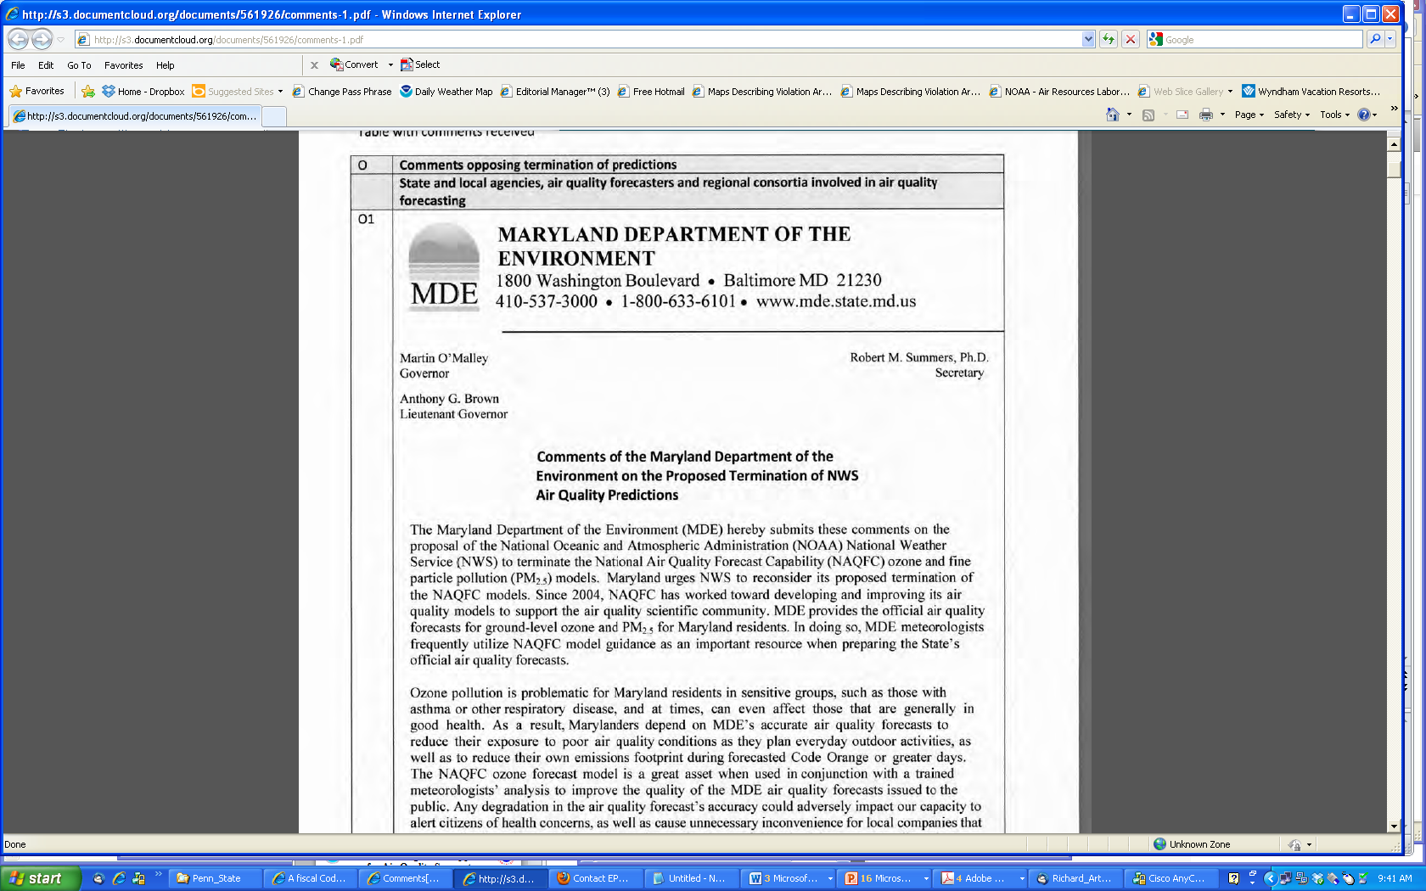
Thank you for voicing support to NAQFC
“I am writing to comment on the
Proposed Termination of NWS Ozone Air Quality Predictions …
The NAQFC is the only numerical forecast model that is available every day,
is fully documented, accessible for evaluation, and shows good forecast skill.
It should be retained”. (November 1 2012, Bill Ryan, PSU)
On “The proposal to shelve the $5.4 million National Air Quality Forecasting
Capability in March has drawn protests from public health officials…”
(January 26 2013, Dan Vergano, USA Today)
November 2012,
MDE as Oppose_1
13th CMAS Oct27-29, 2014, Chapel Hill

