Slide 1
Impact of MOVES2014 on Emission Inventories from On-road Mobile Sources
Alexis Zubrow, Darrell Sonntag, Harvey Michaels, David Brzezinski, Alison Eyth

Slide 2
MOVES2014
EPA’s mobile emission model
Used for State Implementation Plan and Transportation Conformity Analysis
Replaces the MOVES2010 series
Estimates emissions and energy use from all on-road sources at the national, county, and project scales
Contains the impacts of recent regulations:
Light-duty and Heavy-duty Greenhouse Gas and Fuel Economy Standards
Tier 3 Vehicle Emissions and Fuel Standards Program
(emission standards and sulfur content in gasoline)
Contains new emissions and activity data for on-road vehicles
Adds nonroad emission capabilities through the incorporation of NONROAD2008

Slide 3
New Emission Test Programs & Data
Fuel Effects
EPAct study on Gasoline fuel effects (funded by DOE, CRC and EPA)
Effects of E85 on emissions
EPA In-Use Sulfur Test Program
Updated renewable fuel usage and future fuel supply
Evaporative Emissions
Ethanol, RVP, leak magnitude study
High Evap Field Study – leak frequency
Running loss vapor leak study
Multiday Diurnal Testing
PM Emissions
Speciation of Kansas City light-duty gasoline study
New PM Speciation profiles for diesel and CNG from literature
Temperature Effects
EPA Cold Temperature Study
Heavy Duty
In-Use Compliance Program emissions data
Literature review of CNG Transit bus emissions
Population and Activity
R.L. Polk Vehicle Population for 2011
Updated Vehicle Sales Projections
Updated FHWA VMT estimates
Updated Flex-fuel vehicle penetrations
National average speed distribution using GPS data
Updated truck weights based on Weigh-in-Motion data
Notes:
Note for Alexis: These are just some of the major updates. We had many more updates, which make it difficult to attribute changes to which update.

Slide 4
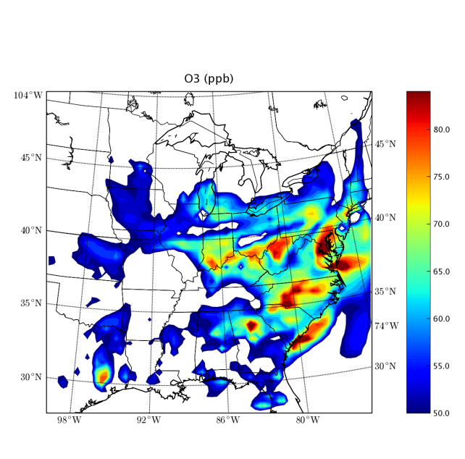
Air Quality Modeling using MOVES2014
MOVES
VOC and PM_{2.5} emission rates by model year, fuel type, regulatory class, emission process
Speciation incorporated into MOVES2014
Formerly conducted within SMOKE through COMBO files
MOVES2014 estimates
CB05 mechanism species
18 PM_{2.5} species needed for CMAQv5 Aerosol Module Version 6 and CAMx5.4
Allows differentiation in VOC and PM speciation profiles by:
Technology/Regulatory class
(e.g. light-duty/heavy-duty)
Model year
(e.g. pre-2007/2007+ diesel)
Fuel Type
(gasoline, E85, diesel, CNG)
Emission process
(e.g. running, start, extended idle, evaporative)
Plan to update supported mechanisms to include CB6 and other mechanisms
SPECIATE
PM_{2.5} and VOC Speciation Profiles
SMOKE
Prepares emissions in gridded, hourly form needed for Chemical Transport Model
Chemical Transport Model
Notes:
MOVES produces 55 toxics, EC, sulfate makes 57 unique species
i.e. account for mix of pre- and post-2007 diesel
No model year distinction, fuel distinction, emission process distinction in SCC
Custom weighted speciation profiles need to be applied for each calendar year

Slide 5
3-city comparisons
State-supplied National Emission Inventory (NEI) inputs for 3 urban counties
Unique fleet mix, fuels, temperatures, age distributions, inspection & maintenance programs, average speed distributions, road types, etc.
Projections to 2030 using national default growth assumptions
Consistent inputs were developed for both MOVES2010b and MOVES2014
Note: certain fleet characteristics are different between the models, e.g. fuel splits

Slide 6
Highway-Source NOx
Relative change with MOVES2014
2011
Reduced truck weights
Updated gasoline fuel effects
2030
Large changes due to emission and fuel regulations (Tier 3 and HD GHG reductions)
 | NOx
2011 | -21% to -5%
2030 | -57% to -53%

Slide 7
Highway-Source VOC
Relative change with MOVES2014
2011
Updates to evaporative and fuel effects for gasoline vehicles
2030
Reductions in 2017+ vehicles (Tier 3 Low Sulfur rule)
Increase in temperature sensitivity for newer gasoline vehicles (MY 2010+)
 | VOC
2011 | -21% to -5%
2030 | -33% to -13%

Slide 8
Highway-Source PM2.5
Relative change with MOVES2014
 | PM
2011 | -19% to -6%
2030 | -58% to -42%
2010
PM running emissions less sensitive to temperature (lowers emissions esp. in cold weather
2030
Tier 3 reductions

Slide 9
3 State Comparison
Comparison of 2011 NEIv1 vs 2011 NEIv2 (draft) for 3 states
GA, IA, MD
Cumulative impact from change in model from MOVES2010b to MOVES2014 AND changes in inputs
Using MOVES in emissions rate mode (SMOKE-MOVES)

Slide 10
Updated Inputs
Inputs revised for 2011 NEIv2 (draft):
Age distribution
New default county specific age distribution for light duty vehicles (LDV), from CRC A-88
Regional long-haul splits
Changes split between short vs long-haul for the single unit (52, 53) and combination (61, 62) trucks, from CRC A-88
Impacts hotelling
Regional fuels
Representative counties
Previously 163 representative counties, now 284 within CONUS domain
Revised age bins and added ramp fraction
Includes state comments

Slide 11
Updated Inputs (2)
Input changes (cont) :
Hotelling
Includes extended idle and auxiliary power units (APU)
Distributed based on urban + rural restricted combination long-haul VMT (62)
New type of run: rate-per-hour (RPH) that takes hotelling hours directly
Limited number of states supplied hotelling hours
Revised CDBs
Some states supplied updated CDBs for 2011 NEIv2.
Temporalization
Incorporated monitoring data VTRIS with state submitted MOVES CDB data
Spatial surrogates
Meteorology

Slide 12
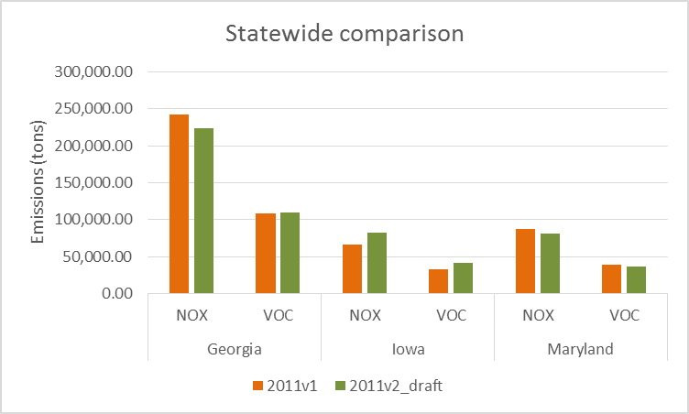
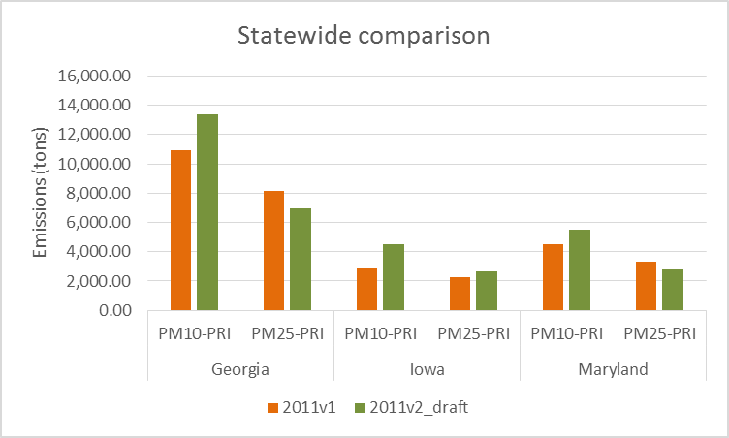
3 State
PM₁₀ increasing across all states: change in brake and tire wear EF

Slide 13
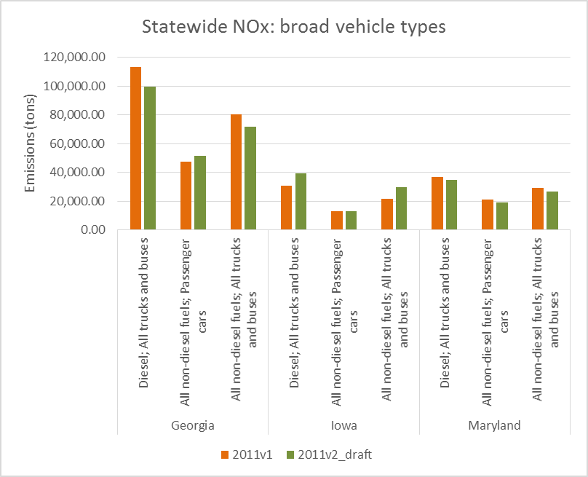
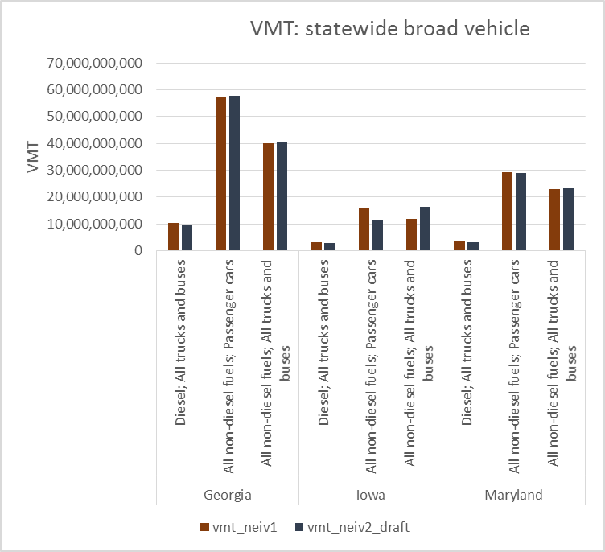
3 State: Broad Vehicle
NOx
VMT
Shift in Iowa VMT from passenger -> trucks (primarily LDT) based on improved population inputs
Increase in Iowa diesel “All trucks and buses” emissions primarily from changes in hotelling (EXT and APU)

Slide 14
Observations
With equivalent inputs, MOVES2014 estimates lower emissions in urban areas
Larger reductions typically observed for future years
Due to projected impact of EPA regulations
Revised inputs can create greater changes in the emissions than changes to MOVES alone
Shifts in vehicle distribution can have subtle impacts
Setting up “equivalent” inputs is difficult for SMOKE-MOVES
New source classification codes

Slide 15
Next Steps
Compare results across more scenarios
Run AQ sensitivities
Compare SMOKE-MOVES for a change in MOVES alone with “consistent” inputs
Evaluate future year impacts

Slide 16
Acknowledgments
EPA: Laurel Driver, Rich Cook, Chris Dresser, David Choi, Ted Maciag (SEE)
ERG: Allison DenBlyker, John Koupal, Scott Fincher
CSC: Chris Allen, James Beidler
UNC: BH Baek, Catherine Seppanen
MOVES MJO Workgroup

Slide 17
Extra 3-City Slides

Slide 18
3-city comparisons
Consistent Input Data between MOVES2010b and MOVES2014
State-supplied data for the National Emission Inventory
Base year (2011) Vehicle Miles Traveled and vehicle population
Vehicle Age distribution (2011)
Average speed distribution
Road type distribution (e.g. urban vs. rural)
Temporal VMT distribution (vehicle travel by hour of day, day of week, month of year)
Inspection/Maintenance Program
Common Projections to 2030
National VMT growth rates
National vehicle population growth rates
Modeled future changes to age distributions (based on 2011 state supplied age distributions)
MOVES default Data
Meteorology data (same between runs)
Fuel Formulation and Fuel Supply data from MOVES2014 (did not specify E85 fuel usage in 2010b)
Differences between runs
Emission rates, fuel effects, temperature effects,
“Internal default vehicle classifications in MOVES”
Fuel Split (e.g. diesel, gasoline, CNG E85) by vehicle model year and vehicle type
Mileage accumulation rates by vehicle classes
Vehicle weights
Default extended idle activity

Slide 19
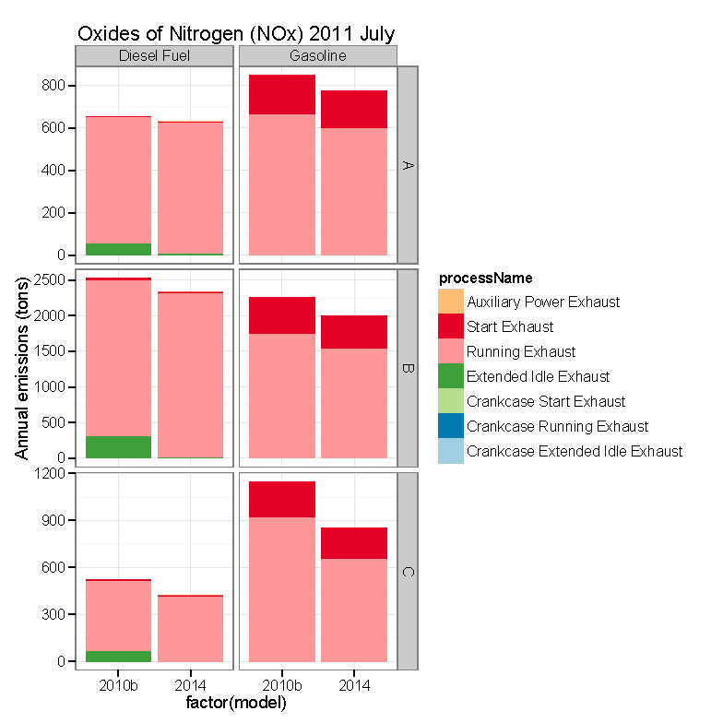

Slide 20
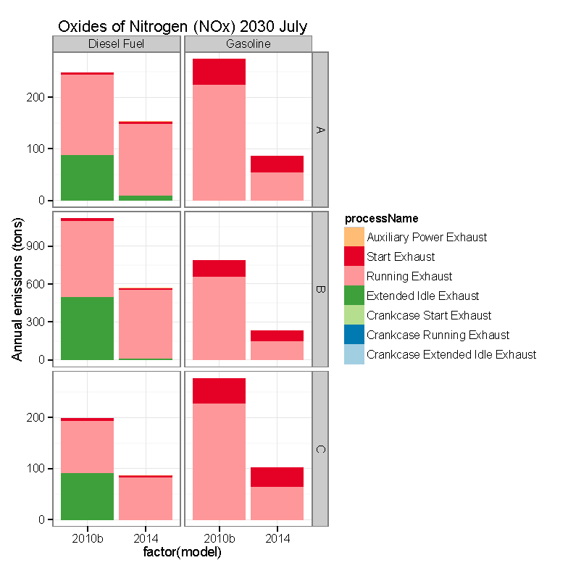

Slide 23
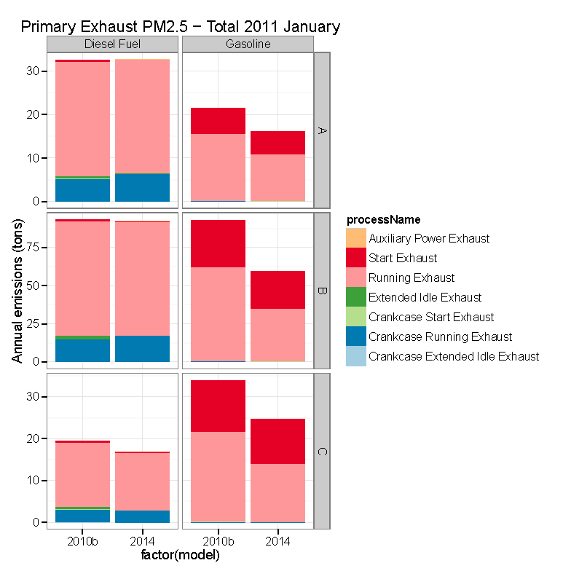

Slide 24
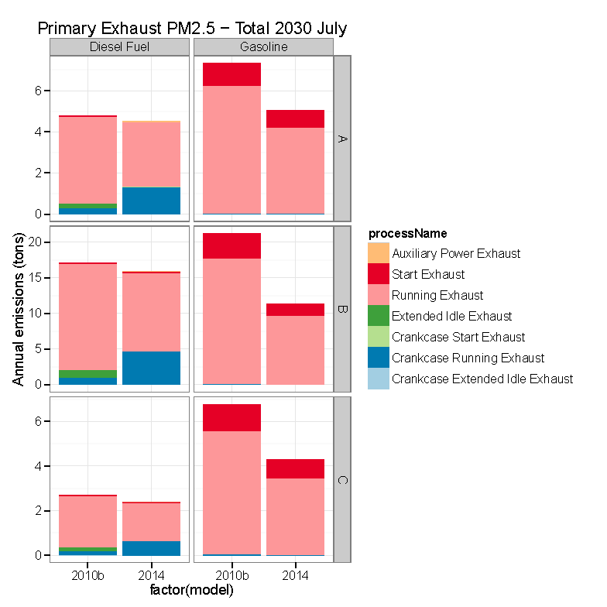

Slide 25
Differences in 3 State Inputs
Extended idle
MOVES2010b used vehicle population (VPOP) of heavy-duty diesel vehicles (SCC7 2230074) to calculate extended idle emissions
MOVES2014 uses hotelling hours directly to calculate extended idle emissions
SCCs
MOVES2010b uses MOBILE6 based SCCs
MOVES2014 uses codes more inline with MOVES IDs. No 1-1 mapping between 2 types of SCCs. To compare:
Map fuels to all non-diesel or diesel
Map source types to: motorcycles, passenger cars, all trucks and buses.
Within “all trucks and buses”, MOVES2014 has a different composition of the fleet

Slide 26
Differences in 3 State Inputs (cont.)
Activity data
No clean mapping between SCCs -> difficult to match VMT and VPOP exactly between two runs
Equivalent at the aggregate level (e.g. All trucks and buses)
Distribution within fuels and within source type may be different in the two runs

