Slide 1
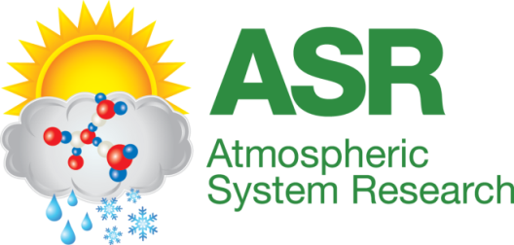
Assessment of long-term simulations with various observations for better understanding of aerosol effects on radiation “brightening” in the US.
Chuen-Meei Gan, Jonathan Pleim, Rohit Mathur, Christian Hogrefe, Charles N. Long, Jia Xing, David Wong, Robert Gilliam, Shawn Roselle and Chao Wei

Slide 2
Objective
The main goal of this project is to investigate the changes in anthropogenic emissions of SO₂ and NO_{x} over the past 21 years (1990-2010) across the United States (US), their impacts on anthropogenic aerosol loading over North America, and subsequent impacts on regional radiation budgets.

Slide 3
Overview of coupled WRF-CMAQ model with feedback (fb) and without feedback (nfb)
WRFv3.4 & CMAQv5.02
Simulation period: 1990 - 2010
Resolution: 36 km, 1-hour
Nudging coefficients (lower than typical nudging coefficients of standard run):
guv: 0.00005
gt: 0.00005
gq: 0.00001
PBL | ACM2 (Pleim 2007)
Microphysics | Morrison 2-moment
Chemistry | Carbon Bond 05
Surface layer | Pleim-Xiu
Cumulus | Kain-Fritsch (new Eta)
Radiation | RRTMG
Land Use | NLCD 50
Poster Session 2
Emissions Inventories, Models, and Processes
26. Jia Xing - Development and validation of long-term emission inventories in the United States from 1990 to 2010
Emissions:
Jia Xing, Jonathan Pleim, Rohit Mathur, George Pouliot, Christian Hogrefe, Chuen-Meei Gan, and Chao We., “Historical gaseous and primary aerosol emissions in the United States from 1990–2010”, Atmos. Chem. Phys., 13, 7531-7549, doi:10.5194/acp-13-7531-2013, 2013.

Slide 4
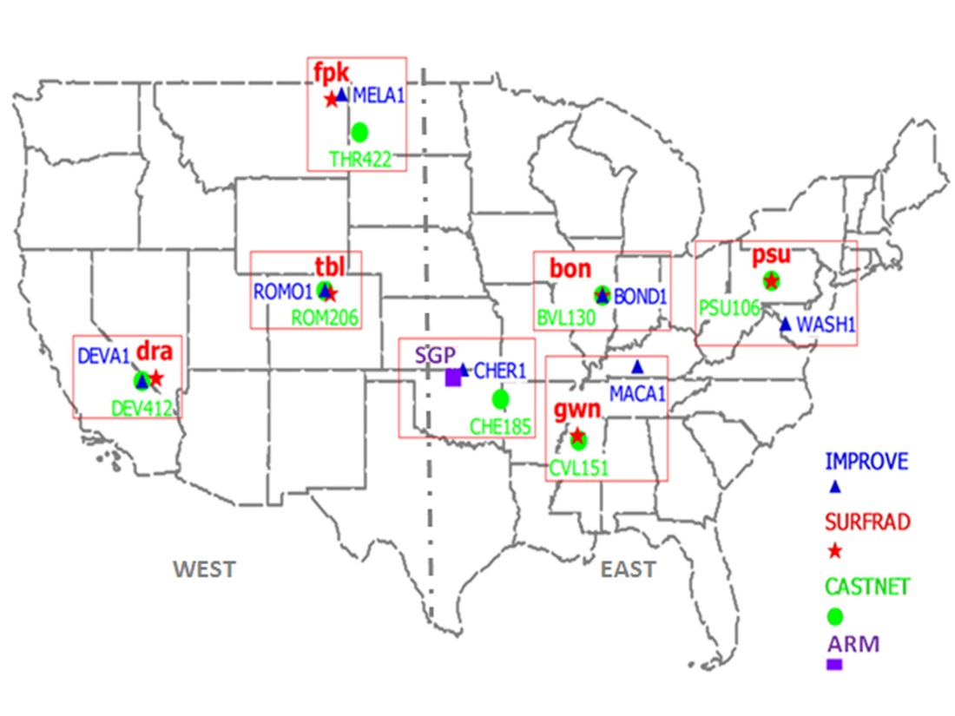
Observations Overview
Surface networks used in this study:
SURFRAD, ARM, CASTNET & IMPROVE.
Variables of interest: SO₄, NO_{x}, PM_{2.5}, AOD and SW radiation.
Analysis region is seperated by 100º into East (i.e. bon, psu, gwn & sgp) and West (i.e. fpk, tbl & dra) of USA.
A complete analysis of observed trends was presented in Gan et al. 2014.
Reference: Chuen-Meei Gan, Jonathan Pleim, Rohit Mathur, Christian Hogrefe, Charles Long, Jia Xing, Shawn Roselle and Chao Wei: “Assessment of the effect of air pollution controls on trends in shortwave radiation over the United States from 1995 through 2010 from multiple observation networks”, Atmos. Chem. Phys., 14, 1701-1715, doi:10.5194/acp-14-1701-2014, 2014.
Notes:
Mainly focus on 6 sites from SURFRAD & 1 site from ARM.
Locate sites from CASTNET & IMPROVE which is the closest with each SURFRAD sites & consist the longest available measurements.
Annual mean for each sites, then average them for network mean.
They are shown as anomalies except AOD.

Slide 5
CASTNET Comparison (time series)
WEST
EAST
Notes:
*Similar averaging technique is used for model and emission. Data is subset from each grid cell.
*no much change in the western but significant decreasing trends in the eastern US especially sulfate.
*also, emission trends do agree well with the obs.
*One of the possible reasons for better agreement for the last 10 years may be the improvement of instrumentation / technology and sufficient information to construct better emission datasets.

Slide 6
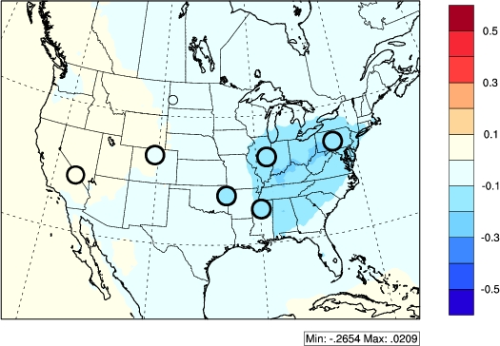
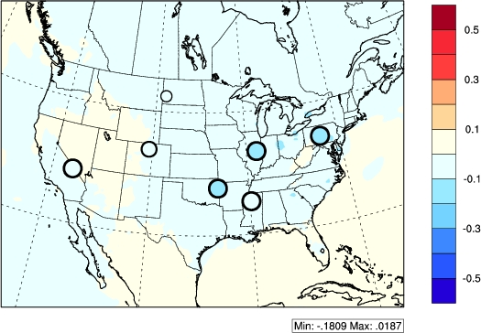
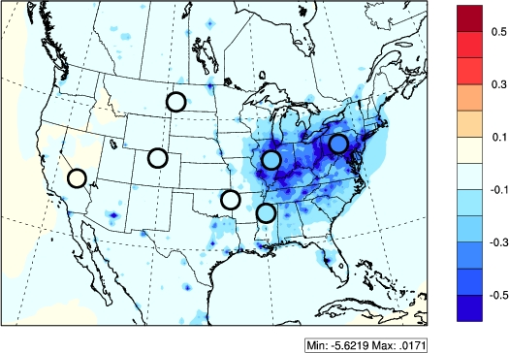
CASTNET Comparison
CASTNET SO4 16 years
CASTNET NO3 16 years
Model agreed well with observations especially the last 10 years comparisons.
Model is able to characterize the observed SO2 and SO4 trends.
Similar trends are shown in the emission trends (i.e. decreasing).
CASTNET SO2 16 years

Slide 7
IMPROVE Comparison (time series)
WEST
EAST

Slide 8
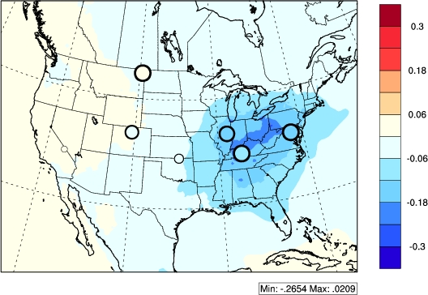
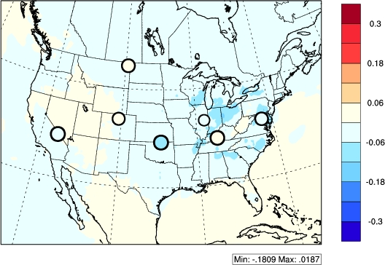
IMPROVE Comparison
IMPROVE SO4 16 years
IMPROVE NO3 16 years
In general, the surface measured concentrations agreed well with the model predictions (16-10 years comparison) for both networks especially SO4.
This finding shows that model is able to replicate the long-term trends which give confident in examining the aerosol direct effect.

Slide 9
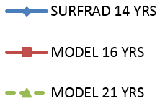
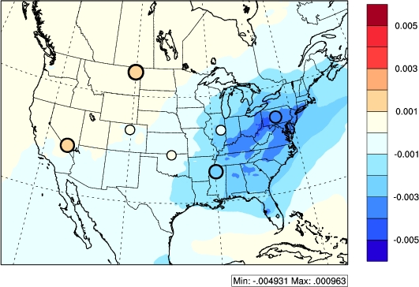
SURFRAD Aerosol Optical Depth (AOD)
WEST |  |  |  | EAST
14 yrs obs | 16 yrs sim | 10 yrs obs | 10 yrs sim | 14 yrs obs | 16 yrs sim | 10 yrs obs | 10 yrs sim
0.0009 | 0.0002 | 0.0005 | 0.00003 | -0.001 | -0.002 | -0.003 | -0.002
Both simulations and observations show a decreasing trend in eastern US and an slightly increasing trend in western US.
This is because many control programs under the CAA were aimed at reducing the pollution concentrations mainly in the developed area but the pollution concentrations were low at the rural western monitors from the beginning.
This finding shows that the implementation of CAA does affect the US in particular eastern US.
As a result of the reduction of particulate matter, the AOD is reduced over the past 16 years.
SURFRAD AOD 16 years
Notes:
*even thought the AOD from model is underestimate but it still capable to capture the trend from observed.

Slide 10
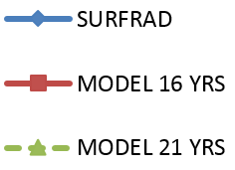
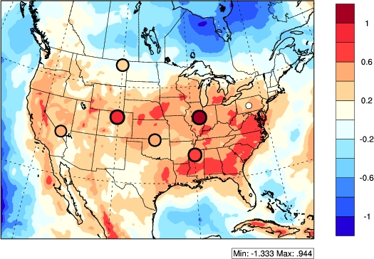
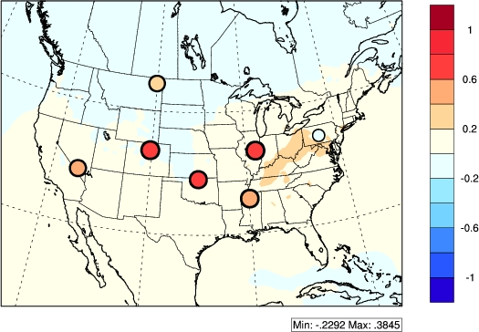
SURFRAD Shortwave (SW) Radiation (Rad) with Feedback (FB)
WEST
EAST
Brightening effect
SURFRAD all-sky SW rad 16 years
SURFRAD clear-sky SW rad 16 years
Notes:
*both of them (all sky and clear-sky) illustrate increasing trend in the rad.
*Larger trend in the all-sky simulation, but it can due to cloud effect and aerosol indirect effect.
*in order to exam only aerosol direct effect, we need to focus on clear-sky scenario.
*even thought the model clear-sky SW rad show smaller trend but it still able to represent the observed trend.

Slide 11
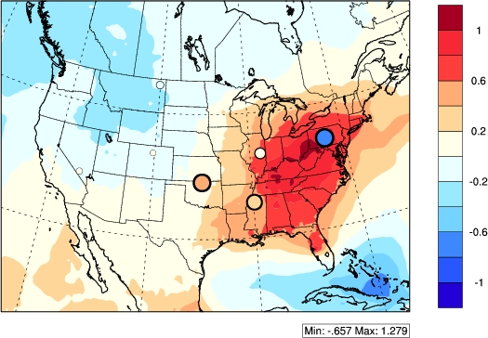
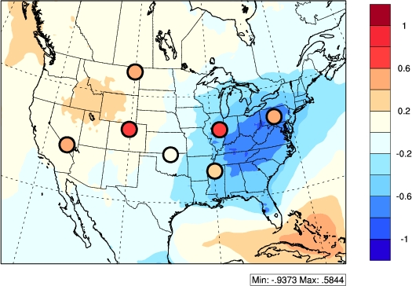
SURFRAD Clear-sky Direct & Diffuse SW Rad (FB)
WEST
EAST
The observed clear-sky diffuse SW rad is increasing which is opposite of what would be expected if changes in clear-sky rad were just attributable to changes in the aerosol direct effect.
SURFRAD clear-sky direct SW rad 16 years
SURFRAD clear-sky diffuse SW rad 16 years
Notes:
If it is due to the aerosol direct effect, SWC direct should increase while SWC diffuse decrease. However, in the obs, the SWC direct shown no much trend (slightly increase) while the SWC diffuse increase significantly.

Slide 12
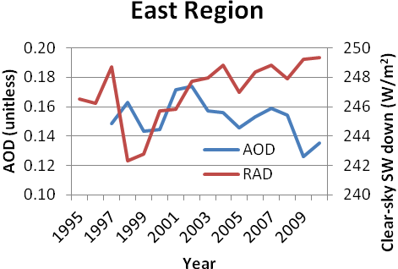
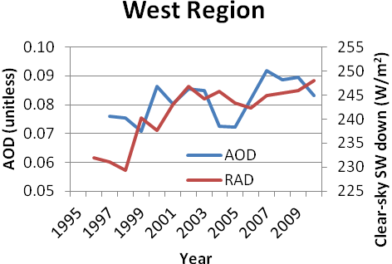
SURFRAD Comparison
 | WEST |  |  |  | EAST
 | 16 yrs obs | 16 yrs sim | 10 yrs obs | 10 yrs sim | 16 yrs obs | 16 yrs sim | 10 yrs obs | 10 yrs sim
SW | 0.5131 | 0.2454 | 0.5824 | 0.2609 | 0.6296 | 0.4222 | 0.5567 | 0.5072
SWC | 0.4799 | 0.0015 | 0.5278 | 0.0715 | 0.3691 | 0.1077 | 0.3055 | 0.2253
SW DIR | 0.1739 | 0.4575 | -0.0723 | 0.4385 | 0.4149 | 0.7614 | 0.4213 | 1.0551
SW DIF | 0.4009 | -0.2072 | 0.6481 | -0.1742 | 0.2555 | -0.3318 | 0.2104 | -0.5313
SWC DIR | 0.0005 | -0.1239 | -0.0052 | 0.0194 | -0.0085 | 0.5264 | -0.022 | 0.8532
SWC DIF | 0.4781 | 0.1255 | 0.532 | 0.0521 | 0.3764 | -0.4187 | 0.3267 | -0.628
AOD | 0.0009 | 0.0002 | 0.0005 | 0.00003 | -0.0012 | -0.0015 | -0.0026 | -0.0024
Annual mean of AOD versus clear-sky SW radiation between 1995 - 2010
For all-sky SW radiation, the "brightening" occurs at the same time that cloudiness exhibits a decreasing trend suggesting the possibility that indirect effects of decreasing aerosols may be a contributing factor. However, trends in cloud cover can have many other reasons.
The clear-sky SW radiation may be associated at least in part with a decrease in aerosols, particularly in the eastern US where substantial reductions in anthropogenic emissions of SO₂ and NO_{x}, resulted from the implementation of CAA.
However, analysis of the clear-sky diffuse SW radiation shows that the radiative impacts of decreasing aerosol concentrations are confounded by other factors.

Slide 13
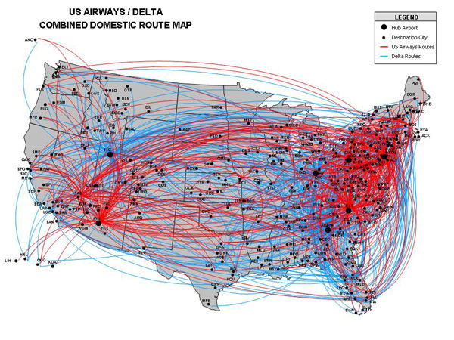
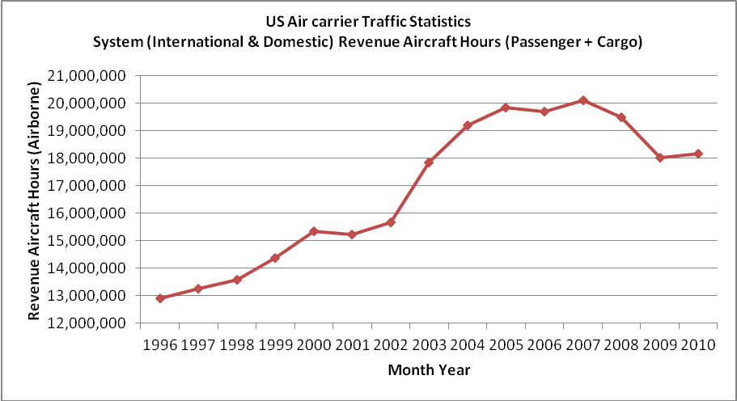
Contrail effect on SW radiation
WEST
EAST
Figure 12: US Airways and Delta combined domestic routes.
(source: http://www.proaerobusiness.com/route_maps.htm)
Monthly US system (international and domestic) aircraft airborne flight hours for the period January 1996 through December 2010 for the sum of passenger and cargo flights. (source: US Bureau of transportation Statistics)
As a result of the increasing air traffic, the contrails persistence can potentially increase the diffuse radiation.
Characterization of contrails or ice cloud properties (crystal shapes, contrail altitude and etc.) are important.
Other factors: “clear-sky” definition, aerosol semi-direct and indirect effect and other cloud effects.

Slide 14
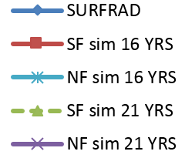
SURFRAD clear-sky SW Rad (FB vs. NFB)
WEST
EAST
Notes:
*For the clear-sky SW radiation, the NF case shows a very flat trend (SWC, direct and diffuse).
*This finding proves that the aerosol direct effect does play a role in the “brightening” phenomena.
*More works need to be done to address the causes of the increase of measured clear-sky SW diffuse radiation.

Slide 15
Conclusion
In general, the coupled WRF-CMAQ model is capable to replicate the observed trends in surface concentration and AOD especially the last 10 years. This finding illustrates the importance of the accuracy of the emission.
In conclusion, this analysis suggest that there was a SW radiation “brightening” over the past 16 years in the US especially in the east but less apparent in the west.
The western US could be influenced by local terrain influences as well as episodic long-range pollution transport which may contribute to the lack of a clear association between trends in aerosol burden and surface radiation at these locations.
However, analysis of the clear-sky diffuse SW radiation shows that the radiative impacts of decreasing aerosol concentrations are confounded by other factors.
There are several possible interpretations to resolve this seeming contradiction such as increasing contrails from air traffic, classification of “clear-sky” conditions in the radiation retrieval methodology and indirect aerosol and other cloud effects.
On going tests: Ice clouds simulation tests to identify inconsistencies in observed diffuse radiation.

Slide 16
Thank you! Questions?
*Special thanks to all the co-authors for their contributions and support.
Acknowledgment:
This research was performed while Chuen-Meei Gan held a National Research Council Research Associateship Award at US EPA.
The research presented in this study was supported through an interagency agreement between the US Department of Energy (funding IA DE-SC0003782) and the US Environmental Protection Agency (funding IA RW-89-9233260).
The author also would like thank John Augustine from NOAA-SURFRAD for his support and assistance in obtaining the SURFRAD data.
Dr. Long acknowledges the support of the Climate Change Research Division of the US Department of Energy as part of the Atmospheric System Research (ASR) Program.

Slide 17
Extra Slides

Slide 18
Case study: SW Rad Aerosol Forcing
${SW RF}_{aerosol}$= ${−S}_{o}\left(1−α\right)\left(1−e^{−∆τ}\right)\left(1−g\right)ω_{o}$
So (extraterrestrial downward SW flux at the TOA at 40ºN) = 343 W/m²
α is computed SURFRAD network mean surface albedo of continental aerosols = 0.2522
Δτ is the measured change in 500-nm AOD
g is the typical asymmetry parameter for continental aerosols = 0.87
ω_{o} is a representative single scattering albedo of continental aerosol = 0.97
Mean aerosol SW Radiative Forcing |  |  | W/m²/year
 | dT | RFaer (Eqt1) | Obs SW trend | Obs SWC trend
Aug et al. | -0.0016 | 0.0518 | 0.6875
obs_east | -0.0012 | 0.0388 | 0.6866 | 0.4732
obs_west | 0.0009 | -0.0291 | 0.5024 | 0.4697
model_east_16yrs | -0.0015 | 0.0486 | 0.4222 | 0.1027
model_west_16yrs | 0.0002 | -0.0065 | 0.2454 | 0.0015
BON_aeronet | -0.003 | 0.0972 | 1.0328 | 0.7598
bon_surfrad | -0.0008 | 0.0253 | 1.0328 | 0.7598

