Slide 1
The 2013 Severe Haze over the Southern Hebei, China: Source Apportionment and Policy Implications
Litao Wang, Zhe Wei, Jing Yang, Pu Zhang, Xiujuan Zhao, Yang Zhang, Fenfen Zhang, Jie Su, Chenchen Meng, and Qiang Zhang
Hebei University of Engineering, Handan, Hebei, China
State Environmental Protection Key Laboratory of Sources and Control of Air Pollution Complex, Beijing, China
North Carolina State University, Raleigh, NC, USA
Tsinghua University, Beijing , China

Slide 2
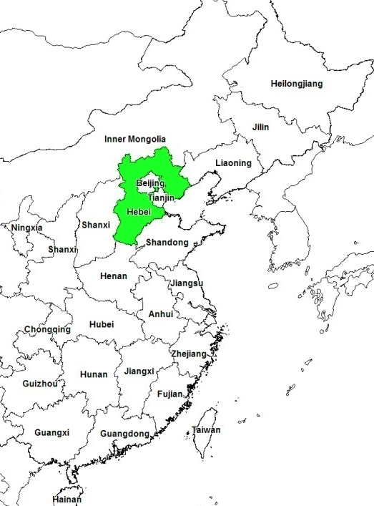
Where is Hebei

Slide 3
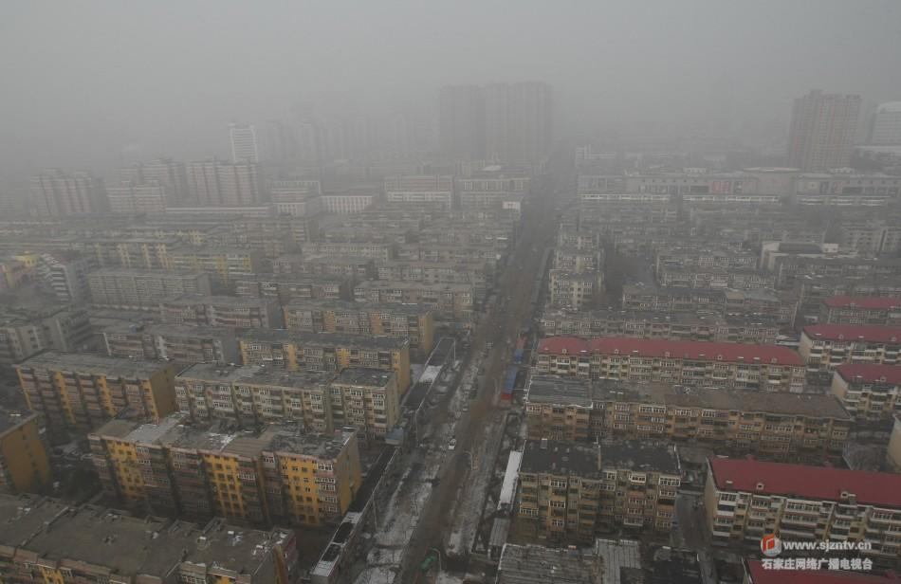
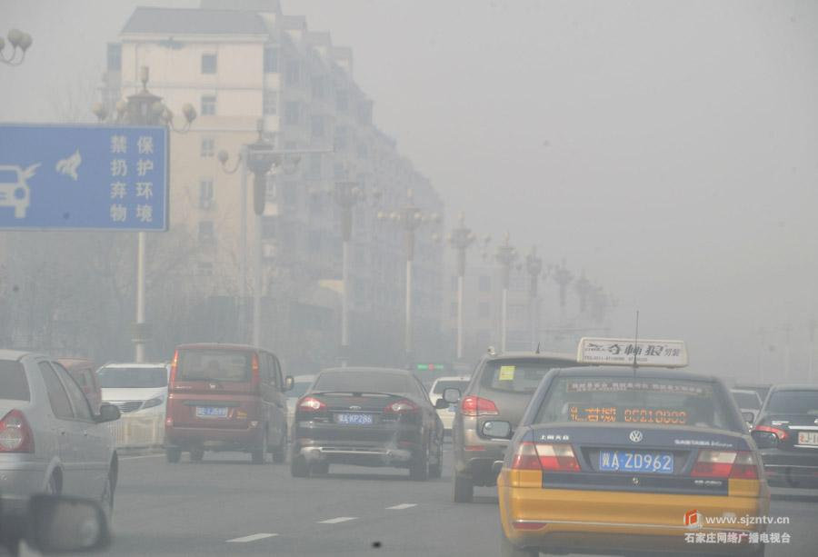
Why the southern Hebei cities
January 27, 2013, Shijiazhuang
Source: http://news.xinhuanet.com/city/2013-01/10/c_124213096.htm

Slide 4
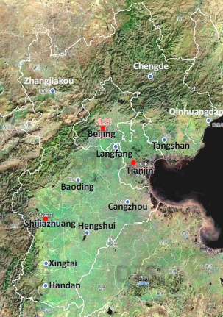
Why the southern Hebei cities
Top 10 polluted cities in China (MEP) in Jan. 2013:
Xingtai (Southern Hebei)
Shijiazhuang (Southern Hebei)
Baoding (Hebei)
Handan (Southern Hebei)
Langfang (Hebei)
Hengshui (Hebei)
Jinan
Tangshan (Hebei)
Beijing
Zhengzhou

Slide 5
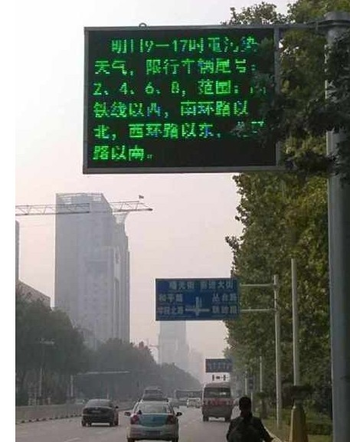
Top 5 polluted cities in China
Jan.-Jun., 2013
  Xingtai
  Shijiazhuang
  Handan
  Baoding
  Tangshan
Jul.-Sep, 2013
  Xingtai
  Shijiazhuang
  Tangshan
  Handan
  Jinan

Slide 6
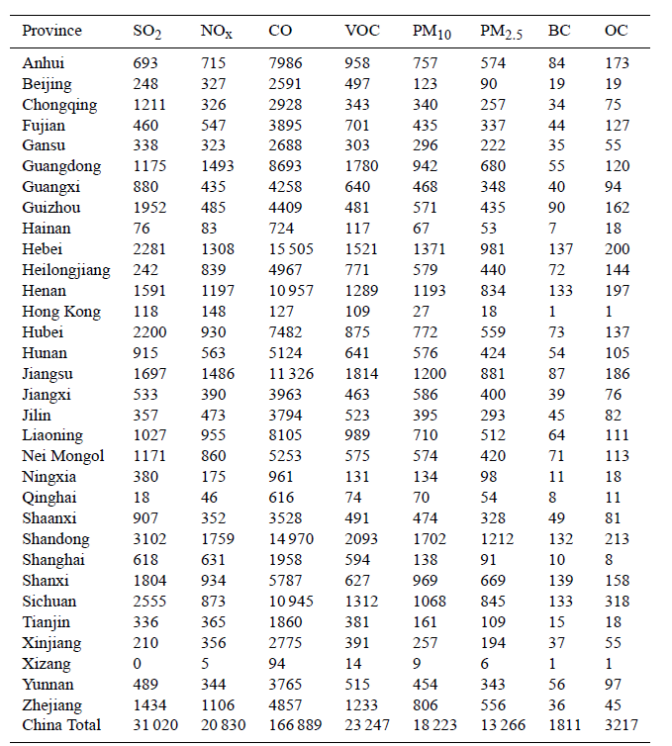
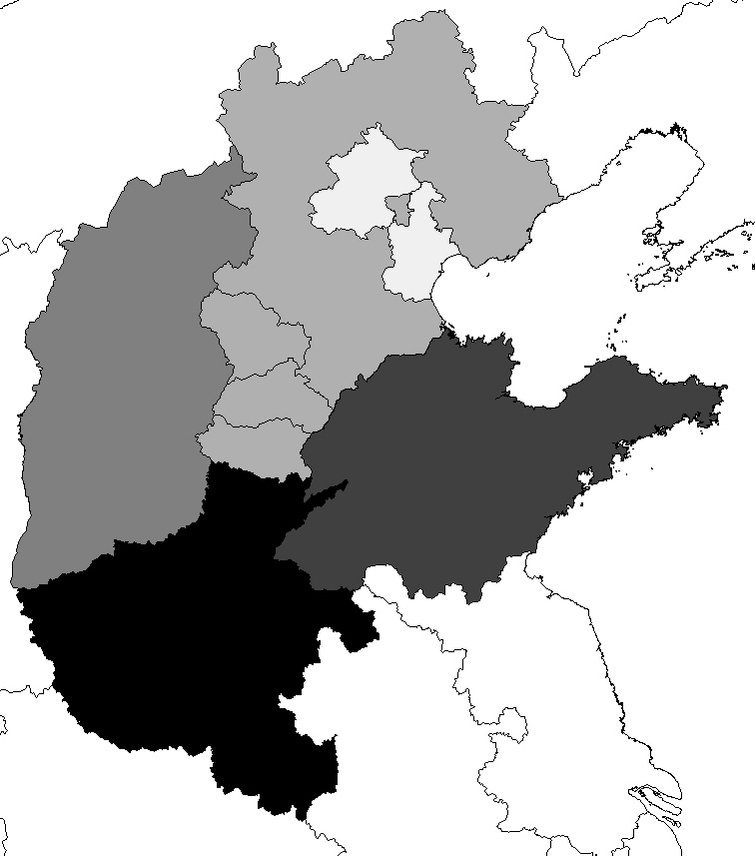
Emissions
INTEX-B，2006. (Zhang et al., 2009., ACP)
3
4
1
4
2
2
2
3
8
5
10
6
5
5
4
4
1
1
2
1
1
1
5
2
6
8
4
15
7
7
1
8
4 Province total：28% 25% 28% 24% 29% 28% 30% 24%

Slide 7
Haze frequencies
Wang et al., 2012. Atmos. Environ.
Monthly total number of hazy days occurred in the seven cities: Shijiazhuang, Xingtai, Beijing, Tianjin, Taiyuan, Zhengzhou and Jinan, from 2001 to February 2013.

Slide 8
Comparison of Dec 2007, Jan and Feb, 2013

Slide 9
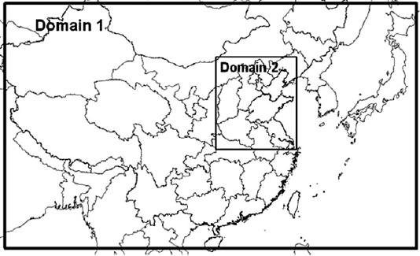
Model Configuration
CMAQ 4.7.1
MM5 3.7
Period: Jan. and Feb., 2013
Horizontal:
  Domain 1: 36*36 km
  Domain 2: 12*12 km
Vertical: 14 layers
Gas phase: SAPRC-99
Aerosol: AERO4
Emission: MEIC (http://www.meicmodel.org/)

Slide 10

Emission Scenarios
Brute Force Method
Sectors Regions | All sectors (AL) | Powerplants (PO) | Industrial (IN) | Domestic (DO) | Transportation (TR) | Agriculture (AG)
Southern Hebei (SHB) | √ | √ | √ | √ | √ | √
Northern Hebei (NHB) | √ | √ | √ | √ | √ | √
Beijing & Tianjin (BJTJ) | √ | √ | √ | √ | √ | √
Shanxi (SX) | √ | √ | √ | √ | √ | √
Shandong (SD) | √ | √ | √ | √ | √ | √
Henan (HN) | √ | √ | √ | √ | √ | √

Slide 11
Evaluation database
Dataset | Data type | Variable | Data frequency | Site number | Time period
NCDC | Meteorology | T2, RH2, WD10, WS10, | Every 1 or 3-hour | 371 | Jan. 1 – Feb. 28, 2013
 |  | Precipitation | Daily
CNEMC | Air quality | PM_{2.5}, PM₁₀ | Hourly | 496 | Jan. 13 – Feb. 28, 2013
HEBEU | Air quality | PM_{2.5}, PM₁₀ | Hourly | 1 | Jan. 1 – Feb. 28, 2013
CNEMC- China National Environmental Monitoring Center

Slide 12
Model Performance Evaluation- 36km
January
February

Slide 13
Model Performance Evaluation- 12km
January
February
Concentrations
NMBs

Slide 14
Model Performance Evaluation
Time series of PM_{2.5} concentrations. (a-d) are for Shijiazhuang, (e-f) are for Xingtai, (g-i) are for Handan.
Urban
Urban
Rural
Rural
Urban
Rural
Urban
Rural
Urban

Slide 15
Comparison of PBL height
Dec, 2007
Jan 1-13, 2013
Jan 14-31, 2013
Feb, 2013
Even with the same emission, the southern Hebei cities may experience heavier air pollution than the other cities.
The convergence and confrontation of the stable air blowing from the Taihang Mountain and the air blowing from the south or east over southern Hebei, result in a very stable atmosphere.

Slide 16
Contributions by Region
Southern Hebei
Northern Hebei
Beijing &Tianjin
Shanxi
Shandong
Henan
Shijiazhuang
Xingtai
Handan

Slide 17
Contributions by Region and Sector
Southern Hebei
Northern Hebei
Beijing &Tianjin
Shanxi
Shandong
Henan
Shijiazhuang
Xingtai
Handan

Slide 18
Conclusions
Even in the top two most polluted months, i.e., Jan 2013 and Dec 2007, a large faction of PM_{2.5} may originate from quite different regional sources.
Domestic and industrial sources in northern Hebei, Beijing & Tianjin, and Shanxi are the two most important contributors. But the top two largest contributors in Shandong and Henan to Xingtai and Handan are domestic and agricultural emissions.
The special locations, huge amounts of emissions, and highly complex emission environment, pose a significant challenge to mitigate air pollution in southern Hebei to meet the national standards for PM concentrations.

Slide 19
Acknowledgement
This study was co-sponsored by the National Natural Science Foundation of China, the Natural Science Foundation of Hebei Province, the State Environmental Protection Key Laboratory of Sources and Control of Air Pollution Complex, the Excellent Young Scientist Foundation of Hebei Education, and the China Scholarship Council at HEBEU, China and the U.S. DOE climate modeling programs at NCSU, U.S.A.
This study used resources of the National Energy Research Scientific Computing Center (NERSC), which is supported by the Office of Science of the U.S. Department of Energy.

Slide 20
Thank you for your attention!

