Slide 1
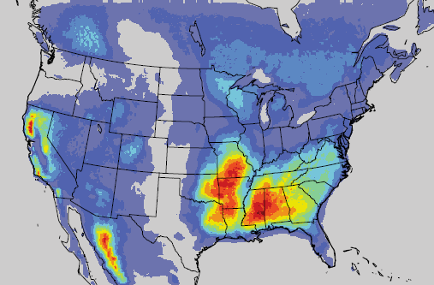
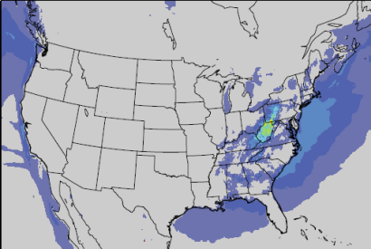
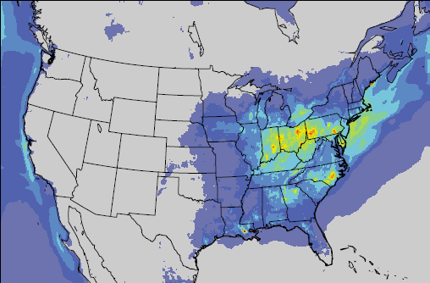
A significant source of isoprene aerosol controlled by acidity
H. O. T. Pye, R. Pinder, I. Piletic, A. Karambelas, Y. Xie, S. Capps, Y.-H. Lin, S. H. Budisulistiorini, J. Surratt, Z. Zhang, A. Gold, D. Luecken, B. Hutzell, M. Jaoui, J. Offenberg, T. Kleindienst, M. Lewandowski, E. Edney
US EPA NERL, UNC-Chapel Hill, Alion Science & Technology
Notes:
mechanism by which isoprene forms organic aerosol
which shows that a significant portion of isoprene SOA is controlled by acidity
collaboration across the EPA Natl Exp Res Lab, UNC-Chapel Hill, Alion, and a summer student from the University of Wisconsin.

Slide 2
Isoprene is a Major
Contributor to Organic Aerosol
Total OM in Yorkville, Georgia 2010
Data: Lin et al. 2013 ACP
Low-NO_{x} products
Speciated
isoprene aerosol:
19% of
total OM
High-NO_{x} products
Notes:
Organic aerosol is an important component of PM2.5 and isoprene is a major contributor to that organic aerosol, particularly in the Southeast United States.

Slide 3
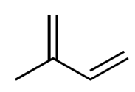
Initial Isoprene Aerosol Modeling
Gas phase
+ OH
Surrogate 1
Surrogate 2
Surrogate 1
Surrogate 2
isoprene
Y_{mass}=26%
Y_{mass}≈3%
Aerosol affected by:
OH
Aerosol mass
Emission
GEOS-Chem
[Henze and Seinfeld 2006 GRL]
Particle phase
Notes:
Isoprene aerosol modeling has typically followed what is called an Odum 2-product approach in which chamber experiments are parameterized using two surrogate species that partition between the gas and aerosol phase based on vapor pressure.
There are a number of limitations to this model including the fact that there
are few influences on aerosol mass,
mass is potentially double counted between the gas and aerosol phase, and
current model performance indicates we are underestimating isoprene SOA.

Slide 4
Explicit Prediction of Known Isoprene-derived SOA Species
Allows for direct comparison of model predictions and observations
One species (2-methyltetrols) often accounts for a significant portion of total organic aerosol:
  6.6% of OC in Centreville, AL [Ding et al. 2008 ES&T]
  5.2 to 8.9% of total OM in Yorkville, GA [Lin et al. 2013 ACP]
Individual species may serve as surrogates for TOTAL isoprene aerosol
Individual species indicate interaction with NO_{x}, acidity, and aerosol constituents in a mechanistic manner
→should lead to improved model response to changes in emissions
Notes:
Want to understand if any of the species have formation pathways that are representative of overall isoprene aerosol production

Slide 5
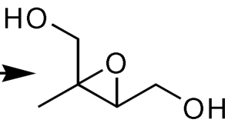
Low-NO_{x} Isoprene Chemistry
Gas phase
IEPOX
Low-NO_{x} Path
+HO₂
+OH,O₂
isoprene
RO₂
Implemented in CMAQ with SAPRC07 chemistry [Xie et al. 2013 ACP]
Emission
Notes:
In order to predict the 12 new species, we base their formation on later generation isoprene oxidation products.
Under low-NOx conditions, isoprene epoxydiols, or IEPOX, have been identified as a precursor to organic aerosol.
IEPOX forms under low-NOx conditions in which the peroxy radical from initial reaction with OH further reacts to form IEPOX.
Previous work by Xie et al. has implemented this chemistry in CMAQ with SAPRC07 gas-phase chemistry.

Slide 6
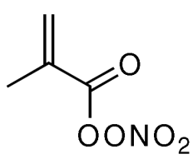
High-NO_{x} Isoprene Chemistry
Gas phase
IEPOX
Low-NO_{x} Path
+HO₂
+OH,O₂
isoprene
RO₂
+NO
High-NO_{x} Path
+OH, NO₂
Emission
MPAN
Notes:
When NOx concentrations are higher, the fate of the RO2 radical from isoprene reacts changes and it reacts to a greater degree with NO to form methacrolein. When NO2/NO ratios are high, it continues to react and form MPAN.
MPAN has been demonstrated to lead to aerosol when isoprene is oxidized under high-NOx conditions, but until recently, the identity of the intermediate between MPAN and the aerosol phase had not been identified.

Slide 7
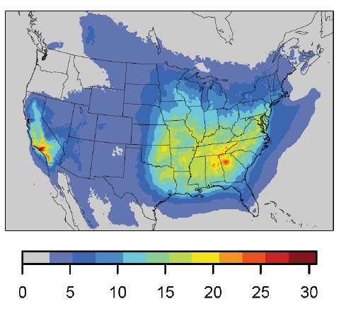
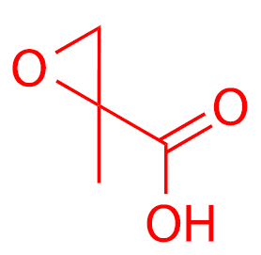
High-NO_{x} Isoprene Chemistry
Gas phase
MAE [ppt]
IEPOX
Low-NO_{x} Path
+HO₂
+OH,O₂
isoprene
RO₂
+NO
High-NO_{x} Path
+OH, NO₂
Emission
MAE formation implemented in CMAQ with SAPRC07 chemistry [Lin et al. 2013 PNAS]
+OH
MPAN
MAE
Notes:
Work by Lin et al. provided evidence in the form of computational chemistry, laboratory experiments, ambient observations and CMAQ modeling to support the identification of methacrylic acid epoxide, or MAE, as a precursor to isoprene SOA under high-NOx conditions. CMAQ was updated to predict MAE from MPAN+OH reaction.
CMAQ simulations indicate the MAE pathways are important over a large area of the Eastern United states and california. and highlight the fact that NOx sources are necessary to convert isoprene to this new species since concentrations tend to be high over urban areas like Atlanta and So Cal.

Slide 8
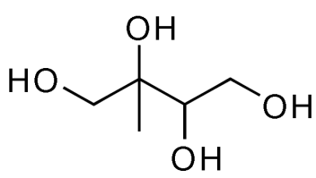
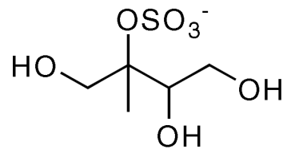
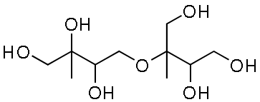
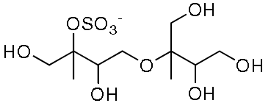
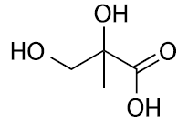
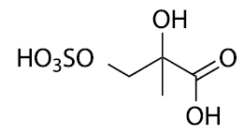
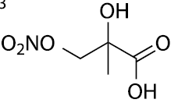
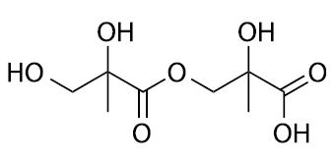
Formation of Isoprene Aerosol
Gas phase
2-methyltetrol
+H₂O
IEPOX
+SO₄⁻²
Low-NO_{x} Path
acid
+NO₃⁻
+HO₂
+OH,O₂
isoprene
RO₂
+NO
2-methylglyceric acid (2-MG)
High-NO_{x} Path
Particle phase
+OH, NO₂
+H₂O
Emission
+SO₄⁻²
+OH
acid
+NO₃⁻
MPAN
MAE
[Pye et al. 2013 ES&T]
Notes:
Because epoxides are soluble and participate in unique particle phase reactions, we are able to expand CMAQ to predict 12 individual isoprene aerosol species.
For each epoxide, we model their uptake using a Henry’s law coefficient and allow them to react in the particle with various nucleophiles such as water, sulfate, and nitrate to form methyltetrols, OS, ON, etc from IEPOX. The particle phase reactions are modeled as acid-catalyzed so all particle phase reactions are a function of the particle phase acidity.
For IEPOX, acid catalyzed reactions with water lead to the known isoprene aerosol constituent 2-methyltetrols while for MAE, it leads to 2-methylglyceric acid.

Slide 9
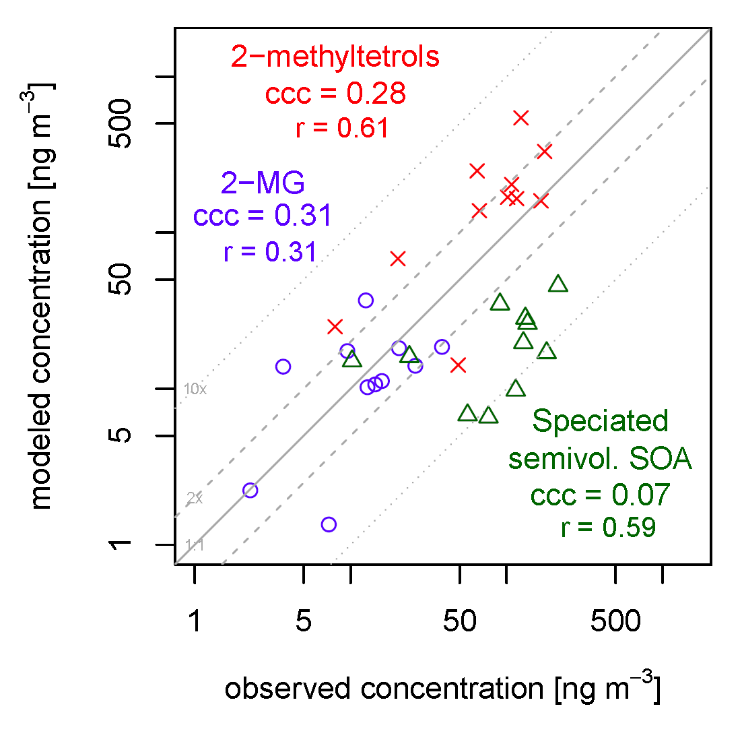
Comparison to Observations in Research Triangle Park, NC
Notes:
To evaluate CMAQ’s predictions, we compared to filter based measurements taken in RTP during 2006.
Each point on this figure represents a 1 day sample.
vertical axis
2-methyltetrols are overestimated by about a factor of 2,
2-MG has very little mean bias.
The concordance correlation coefficient is around 0.3 for both.
You will also note that the model is capturing the relative abundance of 2-methyltetrols compared to 2-MG.
Also included on the plot in green triangles is an estimate of the sum of 2-tet and 2-MG based on the semivolatile odum 2-product SOA in standard CMAQ with laboratory based speciation. This approach tends to underestimate the species by up to a factor of 10 on several days.

Slide 10
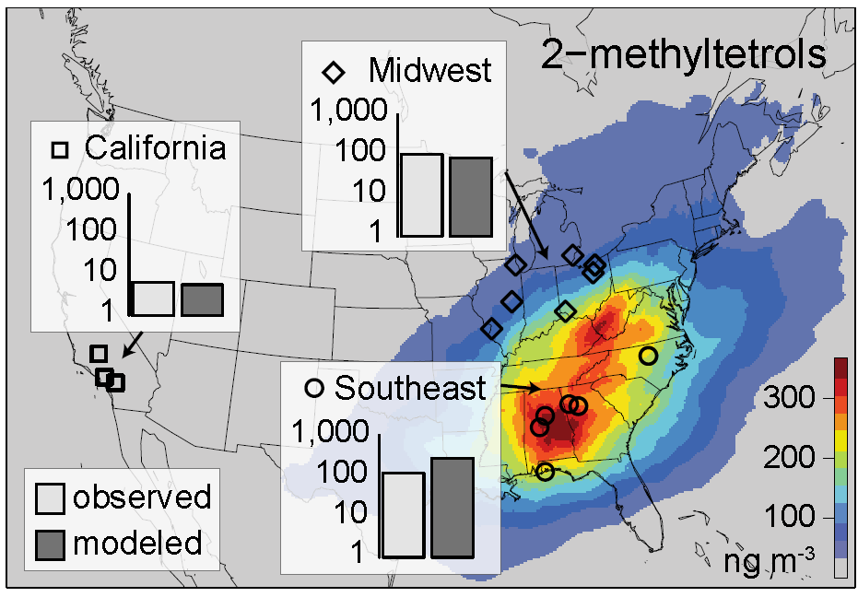
Comparison to Observations: 2-methyltetrols
Notes:
If we look over a larger geographic region, we see that 2-methyltetrols are well predicted over much of the united states.

Slide 11
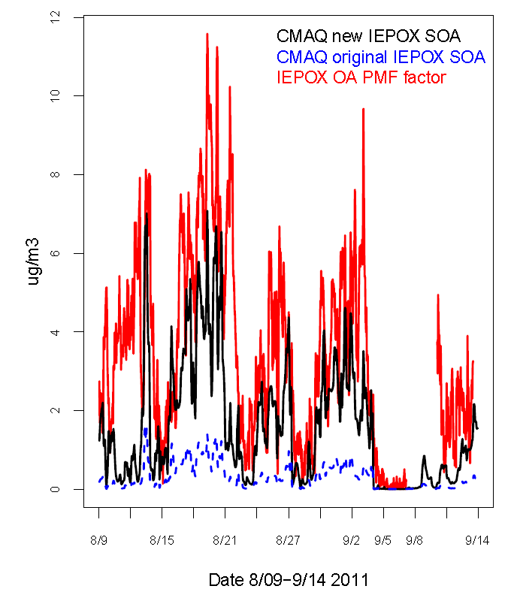
Current Treatment a Subset of Isoprene SOA
Some known isoprene SOA species not represented in CMAQ (e.g. C₅ alkene triols, 3-MeTHF-3,4-diols)
PMF analysis of ACSM/AMS data attributes a significant portion of ambient OA to IEPOX:
  33% of organic aerosol in Atlanta, GA [Budisulistiorini et al. 2013 ES&T]
  Up to 53% of total organic aerosol in Borneo [Robinson et al. 2011 ACP]
μg m⁻³
Karambelas, Pye, Budisulistiorini, Surratt, and Pinder, in preparation
Notes:
In work by Karambelas et al. in prep, we have been examining model predictions compared to the Budisulistiorini PMF data.
The goals of which are two fold:
Determine if ACSM data is plausible given the amount of IEPOX in the model and uptake pathways
Determine if one of the CMAQ species could serve as a surrogate for IEPOX-OA (does it have the right governing pathway?)
In this plot, the PMF factor from ambient data is shown in red. In blue, is our baseline model which is a subset of total isoprene SOA. If we assume that the aerosol we do have in CMAQ is representative of the pathways leading to IEPOX-OA and we scale the uptake coefficient by a factor of 10 to account for missing particle-phase reactions, we get the black trace.

Slide 12
New Mechanism Consistent with ACSM Data
CMAQ results support a significant contribution of IEPOX to organic aerosol consistent with ACSM data
Increasing the existing model IEPOX uptake pathways in CMAQ (r² =0.53) brings model predictions close to the IEPOX-OA PMF factor observations and significantly increases modeled aerosol mass
μg m⁻³
Karambelas, Pye, Budisulistiorini, Surratt, and Pinder, in preparation
Notes:
Based on this analysis
CMAQ results support a significant contribution of IEPOX to ambient organic aerosol: sufficient precursor, good correlation in other words, the IEPOX-OA PMF factor is plausible
New CMAQ uptake pathways have higher correlation with IEPOX-OA PMF factor than semivolatile Odum 2-product SOA→may serve as surrogate for IEPOX-derive OA
CMAQ Model Pathway Correlation with IEPOX-OA PMF factor (r²)
Semivolatile Odum 2-product 0.49
Reactive uptake [Pye et al. 2013] 0.53

Slide 13
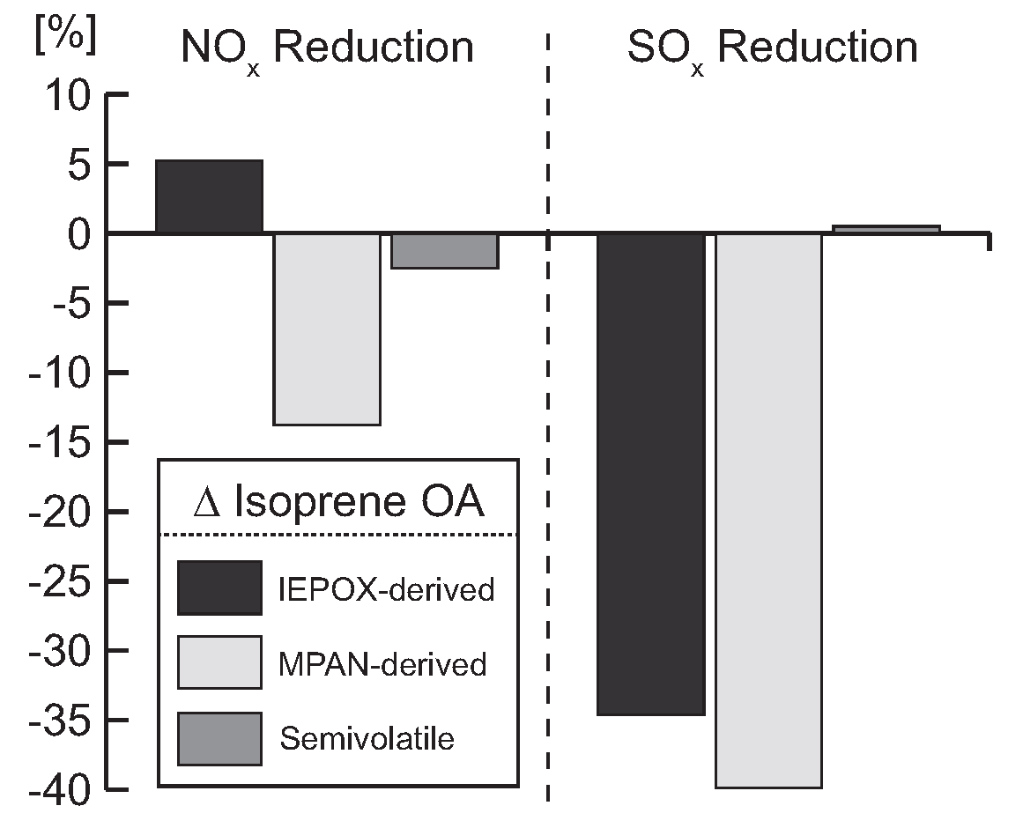
Effect of 25% Emission Reduction on Isoprene SOA
SO_{x} reduction has larger impact than NO_{x} reduction
Change in epoxide OA in opposite direction of change in semivolatile OA
[Pye et al. 2013 ES&T]
Notes:
One of our goals is to develop a model that properly response to changes in emissions as well as other factors. Here we examine the effect of a 25% reduction in NOx and SOx emissions on isoprene SOA.
On the vertical axis is the percent change in isoprene SOA from IEPOX, MPAN or MAE, and semivolatile Odum 2-product pathways.
The NOx reduction is shown on the left while SOx is on the right.
One thing to note is that the SOx reduction has a large impact on both epoxide-derived aerosol types. This occurs because all the aerosol from those pathways is modeled as acid catalyzed. As SOx is reduced, sulfate concentrations are lower, acidity is reduced, and the rate of particle phase reaction is slowed such that uptake is less efficient.
Note that althougth both IEPOX and MPAN-derived aerosol show significant changes, the IEPOX-derived signal will dominate since IEPOX produces more aerosol than MPAN.
As a result, the net effect of a reduction in NOX is to increase epoxide SOA while Odum 2-product SOA is predicted to decrease.
For both emission changes, the semivolatile aerosol is generally less responsive to changes in emissions and reponds in the opposite direction.

Slide 14
Conclusions
CMAQ can now explicitly simulate known isoprene derived aerosol-phase constituents resulting in organic carbon concentrations that are more consistent with observations
New pathways respond differently than semivolatile isoprene aerosol to emission reductions
SO_{x} likely represents an anthropogenic control on biogenic aerosol

Slide 15
References for CMAQ Updates
Updates Scheduled for 2015 CMAQ Release
Gas-phase isoprene chemistry updates:
Xie, Y., F. Paulot, W. P. L. Carter, C. G. Nolte, D. J. Luecken, W. T. Hutzell, P. O. Wennberg, R. C. Cohen, and R. W. Pinder, Understanding the impact of recent advances in isoprene photooxidation on simulations of regional air quality, Atmos. Chem. Phys.,13, 8439-8455, (2013). doi:10.5194/acp-13-8439-2013
Lin, Y.-H., H. Zhang. H. O. T. Pye, Z. Zhang, W. J. Marth, S. Park, M. Arashiro, T. Cui, S. H. Budisulistiorini, K. G. Sexton, W. Vizuete, Y. Xie, D. J. Luecken, I. R. Piletic, E. O. Edney, L. J. Bartolotti, A. Gold, J. D. Surratt, Epoxide as a precursor to secondary organic aerosol formation from isoprene photooxidation in the presence of nitrogen oxides. Proc. Nat. Acad. Sci. U.S.A. 110, 6718 (2013). doi:10.1073/pnas.1221150110
Isoprene aerosol updates:
Pye, H. O. T., R. W. Pinder, I. Piletic, Y. Xie, S. L. Capps, Y.-H. Lin, J. D. Surratt, Z. Zhang, A. Gold, D. J. Luecken, W. T. Hutzell, M. Jaoui, J. H. Offenberg, T. E. Kleindienst, M. Lewandowski, E. O. Edney, Epoxide pathways improve model predictions of isoprene markers and reveal key role of acidity in aerosol formation. Environ. Sci. Technol. 47, 11056-11064 (2013). doi:10.1021/es402106h

Slide 17
Explicit Isoprene SOA Species
Organonitrates
(two forms)
2-methyltetrols
IEPOX-derived organosulfate
IEPOX-derived organonitrate
MPAN-derived organonitrate
2-methylglyceric acid
MPAN-derived organosulfate
Oligomers
(dimers, six forms)
Proposed Mechanism
[Surratt et al. 2010 PNAS, Lin et al. 2013 PNAS]
Detected in Ambient Aerosol
Contributes Significant Mass
Indicative of Low-NO_{x} Conditions
Indicative of High-NO_{x} Conditions
Quantified in Many Datasets
Notes:
Here are the six isoprene SOA species we update CMAQ to predict.
BOXES
These six chosen for a number of reasons: LIST
Focus of the presentation will be heavily on 2-methyltetrols and 2-MG since they have been quantified in many datasets.

Slide 18
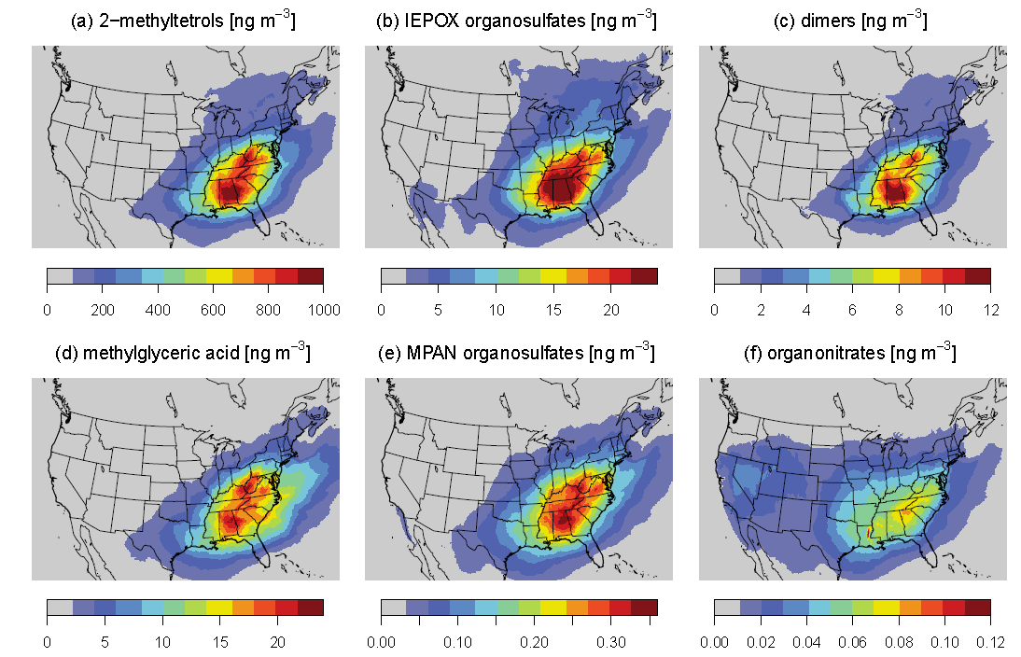
6 new species: ~1 μg m⁻³

Slide 19
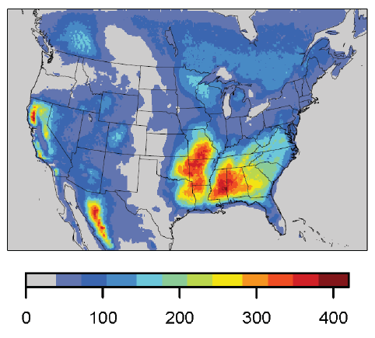
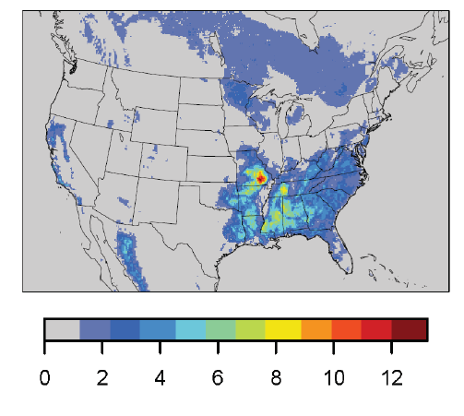
Gas-Phase Precursors
IEPOX [ppt]
Isoprene [ppb]
RO₂+HO₂ …
MAE [ppt]
RO₂+NO…

Slide 20
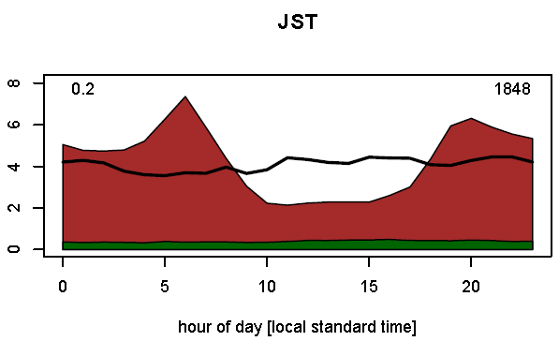
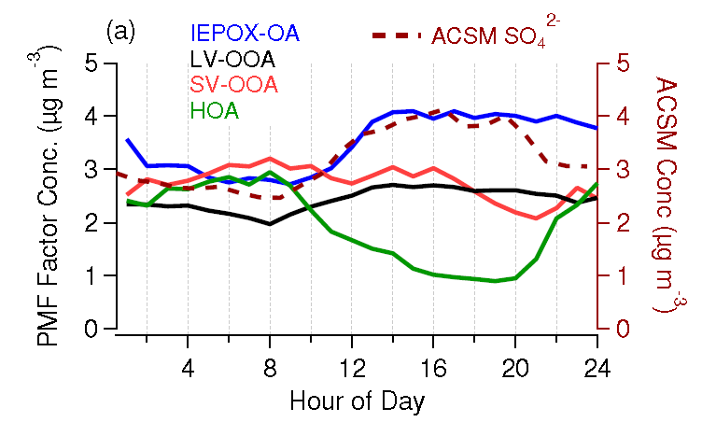
Current Treatment a Subset of Isoprene SOA
Some known isoprene SOA species not represented in CMAQ (e.g. C₅ alkene triols, 3-MeTHF-3,4-diols)
PMF analysis of ACSM/AMS data attributes a significant portion of ambient OA to IEPOX:
  33% of organic aerosol in Atlanta, GA [Budisulistiorini et al. 2013 ES&T]
  Up to 53% of total organic aerosol in Borneo [Robinson et al. 2011 ACP]
IEPOX-OA
~33% of aerosol
CMAQ model total OC
Downtown Atlanta
μgC m⁻³
SEARCH observed OC
Model MPAN- and IEPOX-derived OC
JST [Budisulistiorini et al. 2013 ES&T]
Notes:
If we add up our 12 explicit model species (shown in green) in our most aggressive uptake scenario and compare to the total organic aerosol (brown for model, line for observations), we see that we don’t predict enough mass to match the IEPOX-OA factor from JST.

Slide 21
Additional References
Budisulistiorini, S. H., et al. (2013), Real-time continuous characterization of secondary organic aerosol derived from isoprene epoxydiols (IEPOX) in downtown Atlanta, Georgia, using the Aerodyne Aerosol Chemical Speciation Monitor (ACSM), Environ. Sci. Technol., 47, 5686-5694. http://dx.doi.org/10.1021/es400023n
Carlton, A. G., P. V. Bhave, S. L. Napelenok, E. D. Edney, G. Sarwar, R. W. Pinder, G. A. Pouliot, and M. Houyoux (2010), Model representation of secondary organic aerosol in CMAQv4.7, Environ. Sci. Technol., 44(22), 8553-8560. http://dx.doi.org/10.1021/es100636q
Ding, X., M. Zheng, L. Yu, X. Zhang, R. J. Weber, B. Yan, A. G. Russell, E. S. Edgerton, and X. Wang (2008), Spatial and seasonal trends in biogenic secondary organic aerosol tracers and water-soluble organic carbon in the southeastern United States, Environ. Sci. Technol., 42(14), 5171-5176. http://dx.doi.org/10.1021/es7032636
Lin, Y. H., E. M. Knipping, E. S. Edgerton, S. L. Shaw, and J. D. Surratt (2013), Investigating the influences of SO₂ and NH₃ levels on isoprene-derived secondary organic aerosol formation using conditional sampling approaches, Atmos. Chem. Phys., 13(16), 8457-8470. http://dx.doi.org/10.5194/acp-13-8457-2013
Paulot, F., J. D. Crounse, H. G. Kjaergaard, A. Kurten, J. M. St Clair, J. H. Seinfeld, and P. O. Wennberg (2009), Unexpected epoxide formation in the gas-phase photooxidation of isoprene, Science, 325(5941), 730-733. http://dx.doi.org/10.1126/science.1172910
Robinson, N. H., et al. (2011), Evidence for a significant proportion of secondary organic aerosol from isoprene above a maritime tropical forest, Atmos. Chem. Phys., 11(3), 1039-1050. http://dx.doi.org/10.5194/acp-11-1039-2011
Surratt, J. D., A. W. H. Chan, N. C. Eddingsaas, M. Chan, C. L. Loza, A. J. Kwan, S. P. Hersey, R. C. Flagan, P. O. Wennberg, and J. H. Seinfeld (2010), Reactive intermediates revealed in secondary organic aerosol formation from isoprene, Proc. Nat. Acad. Sci. U.S.A., 107(15), 6640-6645. http://dx.doi.org/10.1073/pnas.0911114107

