Slide 1

The 2013 DISCOVER-AQ Field Campaigns in the
San Joaquin Valley of California and in Houston, Texas
Kenneth Pickering, NASA GSFC
Christopher Loughner, ESSIC, GSFC
James Crawford, NASA LaRC
and the DISCOVER-AQ Observation Team
Jim Crawford
Principal Investigator
NASA LaRC
James.H.Crawford@nasa.gov
Ken Pickering
Project Scientist
NASA GSFC
Kenneth.E.Pickering@nasa.gov
Webpage: http://discover-aq.larc.nasa.gov/

Slide 2
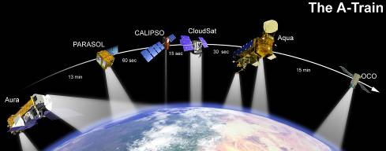
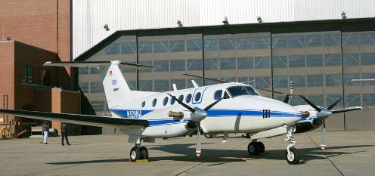
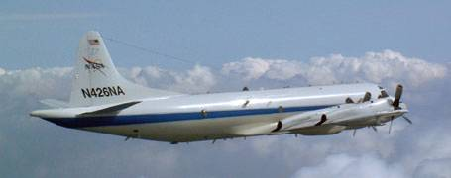
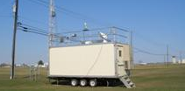
Investigation Overview
Deriving Information on Surface Conditions from Column
and VERtically Resolved Observations Relevant to Air Quality
A NASA Earth Venture campaign intended to improve the interpretation of satellite observations to diagnose near-surface conditions relating to air quality
Objectives:
1. Relate column observations to surface conditions for aerosols and key trace gases O₃, NO₂, and CH₂O
2. Characterize differences in diurnal variation of surface and column observations for key trace gases and aerosols
3. Examine horizontal scales of variability affecting satellites and model calculations
NASA King Air
NASA P-3B
Deployments and key collaborators
Maryland, July 2011 (EPA, MDE, UMd, and Howard U.)
SJV, California, Jan/Feb 2013 (EPA, CARB, and SJVAPCD)
Houston,Texas, Sept. 2013 (EPA, TCEQ, and U. of Houston)
Front Range, Colorado, Summer 2014 (EPA, NCAR, CDPHE)
NATIVE, EPA AQS, and associated Ground sites
Notes:
DISCOVER-AQ is a 5-year, $30M airborne field study funded under NASA’s Earth Venture 1 program. The goals of the program are intended to shed light on challenges in observing air quality from space. Results are expected to be of direct benefit to GEO-CAPE planning and development.

Slide 3
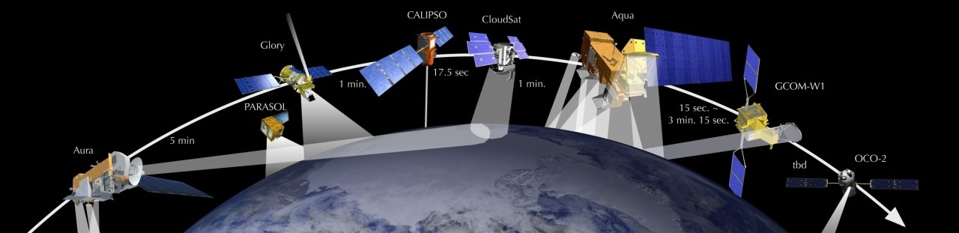
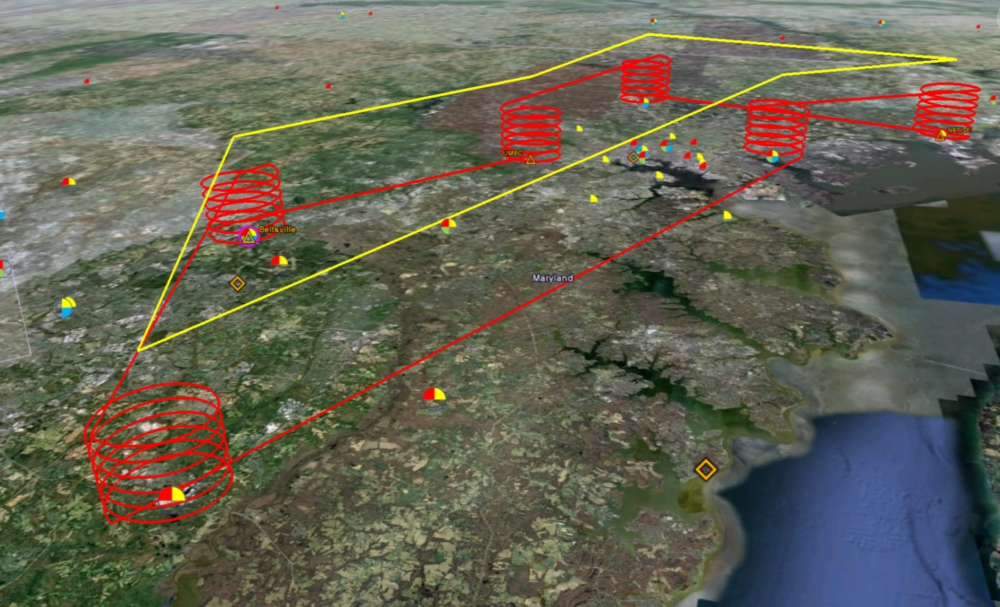
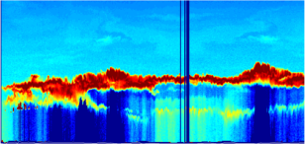

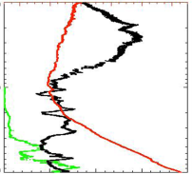
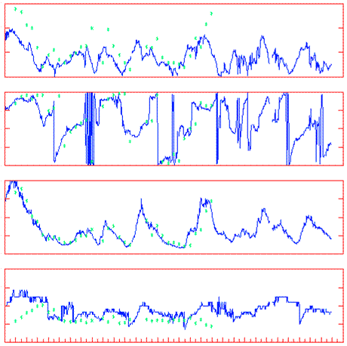
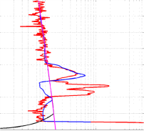
Deployment Strategy
Systematic and concurrent observation of column-integrated, surface, and vertically-resolved distributions of aerosols and trace gases relevant to air quality as they evolve throughout the day.
Three major observational components:
NASA King Air (Remote sensing)
Continuous mapping of aerosols with HSRL and trace gas columns with ACAM
NASA P-3B (in situ meas.)
In situ profiling of aerosols and trace gases over surface measurement sites
Ground sites
In situ trace gases and aerosols
Remote sensing of trace gas and aerosol columns
Ozonesondes
Tethered balloon
Aerosol lidar observations
Notes:
The density and simultaneity of observations from different perspectives is a key aspect of DISCOVER-AQ in creating a dataset useful for linking remote sensing and in situ observations of air quality.

Slide 4
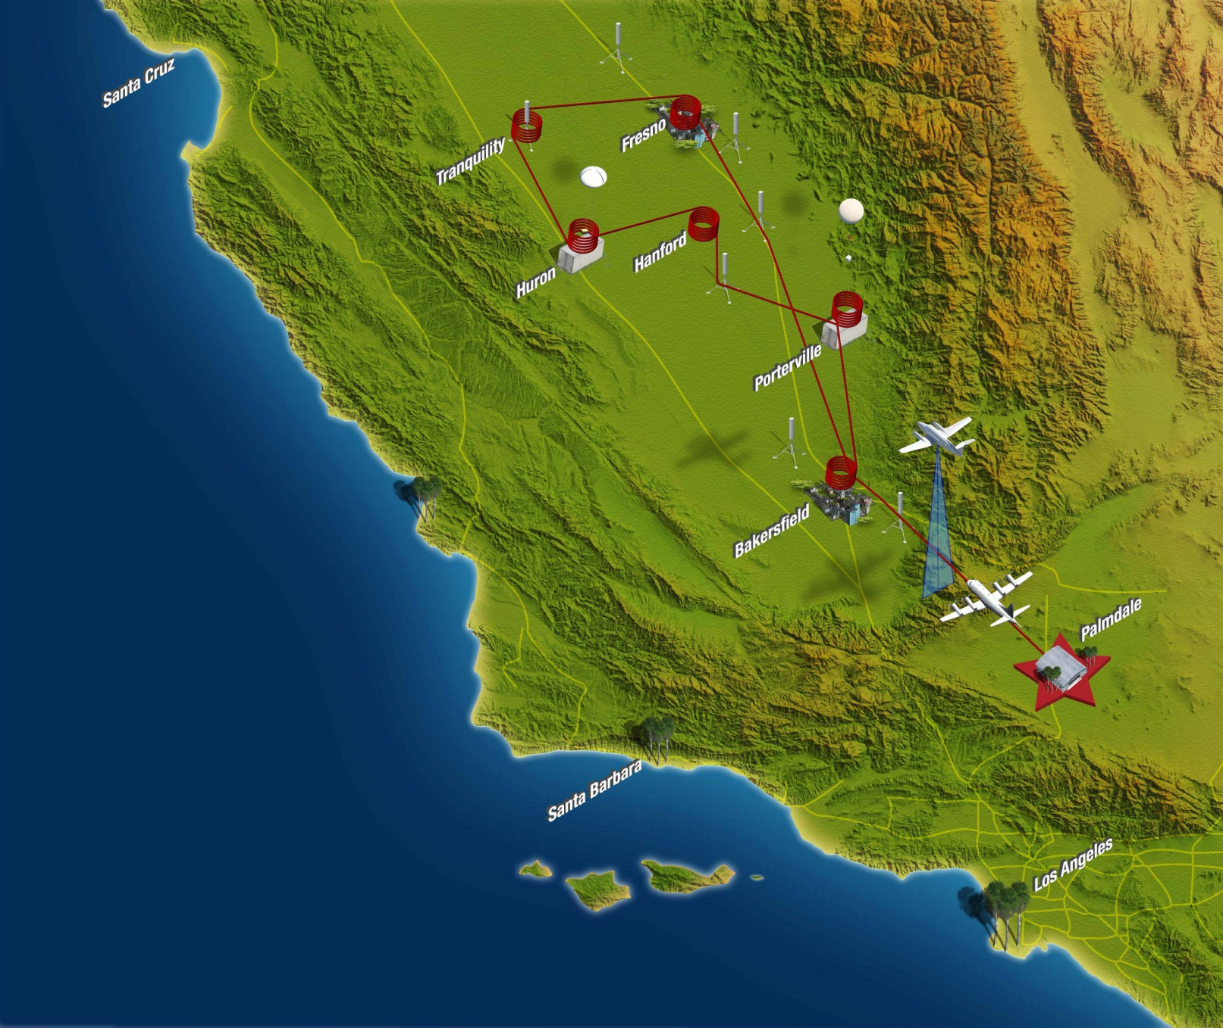
San Joaquin Valley Campaign
16 January – 6 February 2013
Notes:
DISCOVER-AQ is a 5-year, $30M airborne field study funded under NASA’s Earth Venture 1 program. The goals of the program are intended to shed light on challenges in observing air quality from space. Results are expected to be of direct benefit to GEO-CAPE planning and development.

Slide 5
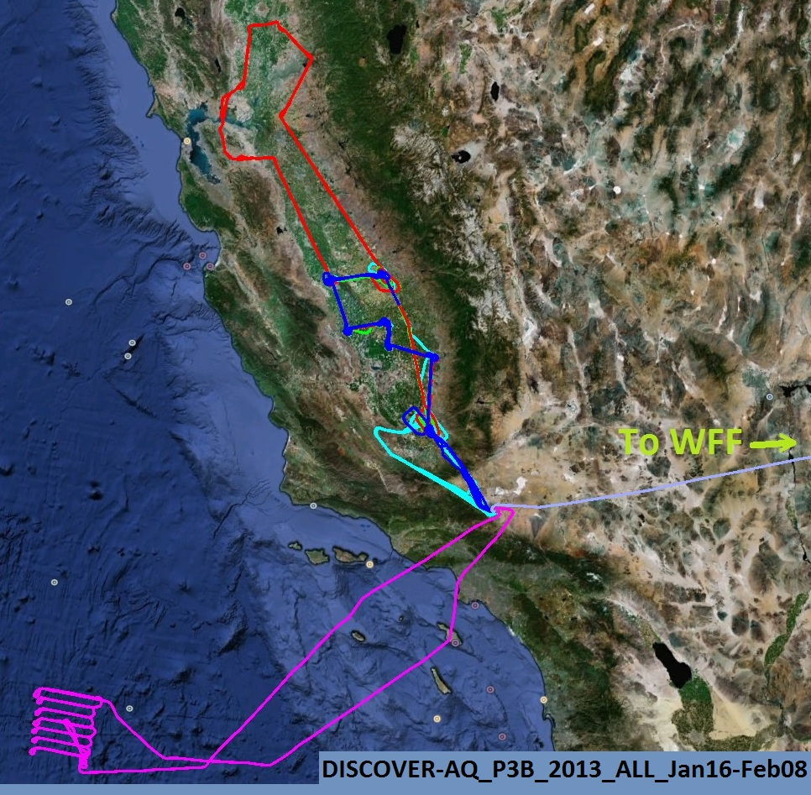
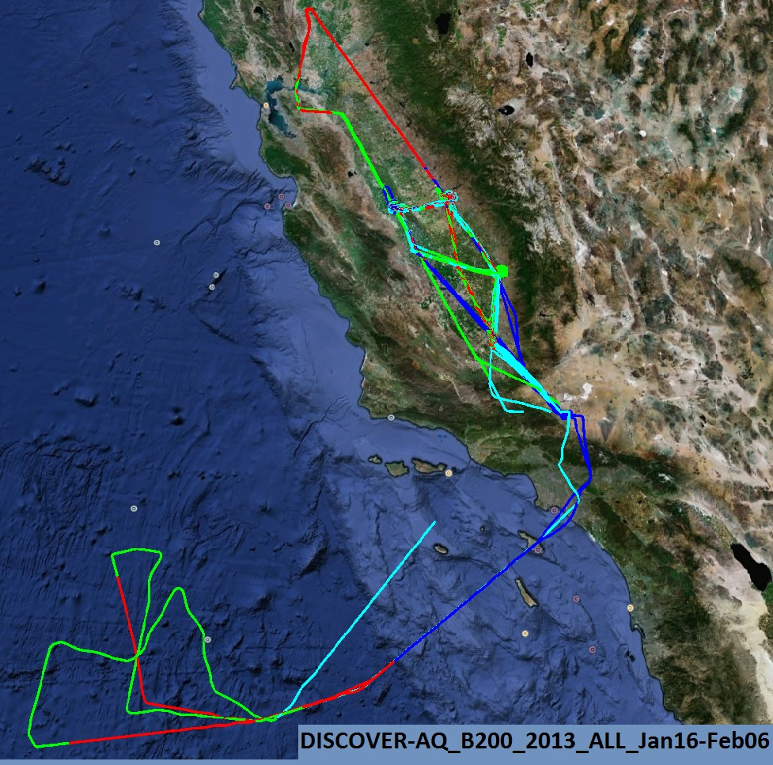
San Joaquin Valley Campaign
16 January – 6 February 2013
10 flight days
~170 spiral profiles
~150 missed approaches
Collaboration with PODEX ER-2 flights over Pacific and SJV
Notes:
DISCOVER-AQ is a 5-year, $30M airborne field study funded under NASA’s Earth Venture 1 program. The goals of the program are intended to shed light on challenges in observing air quality from space. Results are expected to be of direct benefit to GEO-CAPE planning and development.

Slide 6

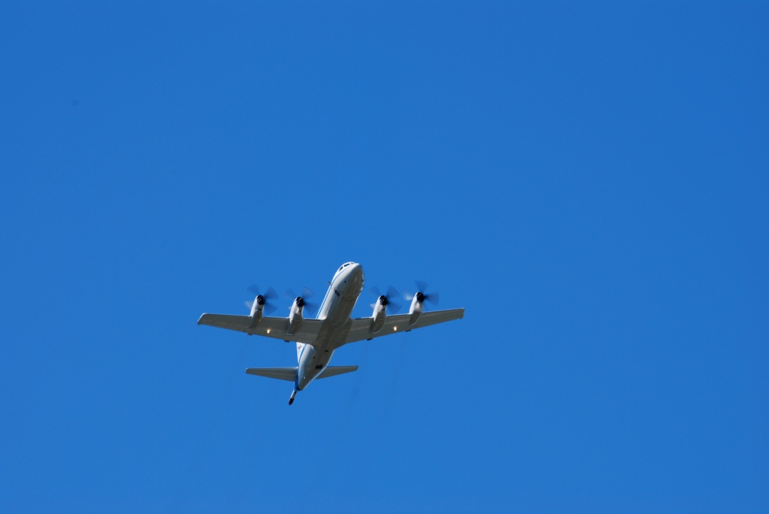
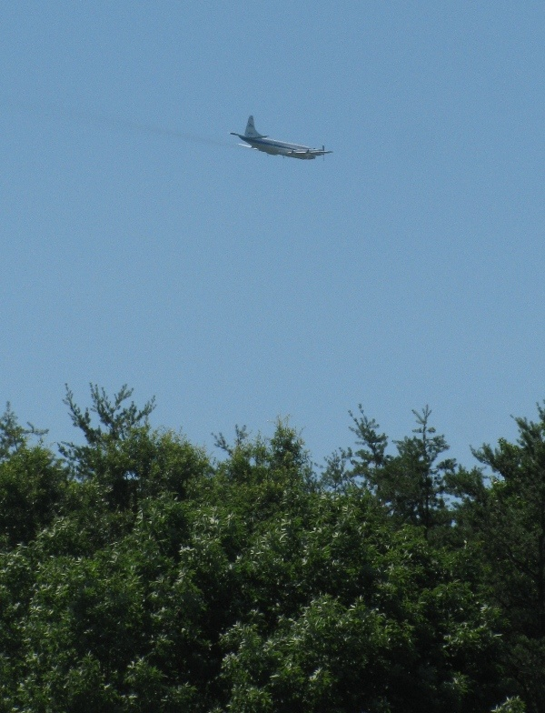
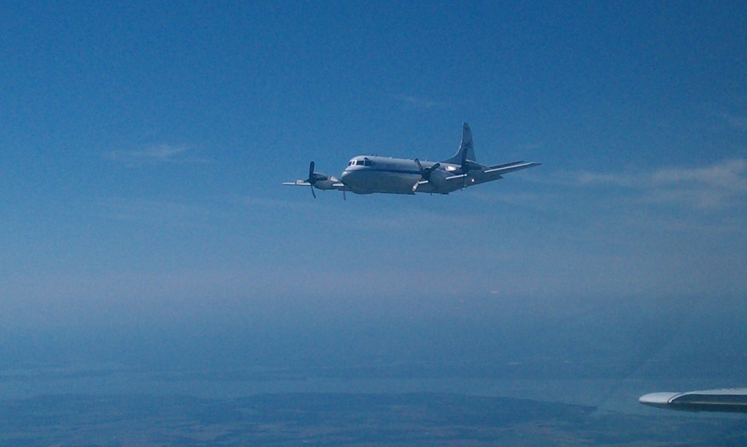
P-3B flights spiral over six ground sites
(typically 3 times per day, ~2 hours apart)
P-3B In Situ Airborne Measurements
Bruce Anderson, NASA LaRC | aerosol optical, microphysical, and chemical properties
Andrew Weinheimer, NCAR | O₃, NO₂, NO, NO_{y}
John Holloway, NOAA/ESRL | SO₂ (Houston only)
John Nowak, NOAA/ESRL | NH₃ (SJV only)
Ronald Cohen, UC Berkeley | NO₂, ANs, PNs, HNO₃
Alan Fried, NCAR | HCHO
Glenn Diskin, NASA LaRC | H₂O, CO, CH₄
Melissa Yang, NASA LaRC | CO₂
Armin Wisthaler, NILU | Non-methane hydrocarbons

Slide 7
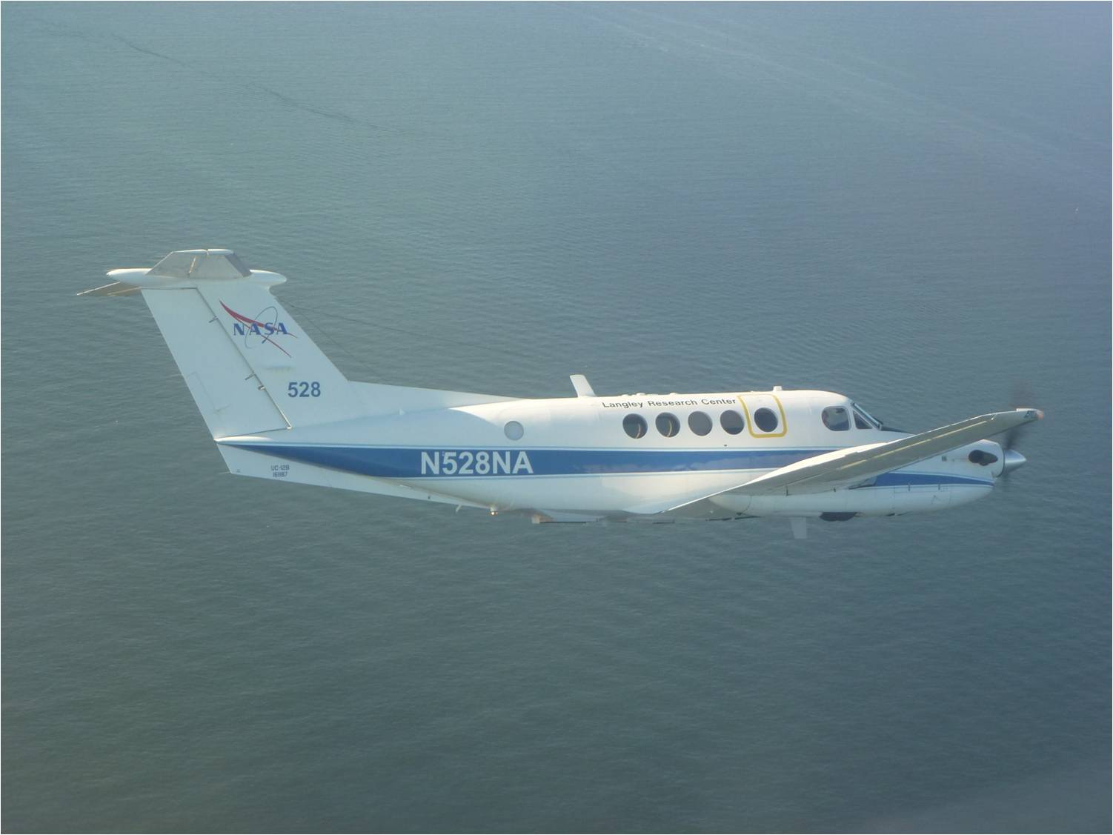
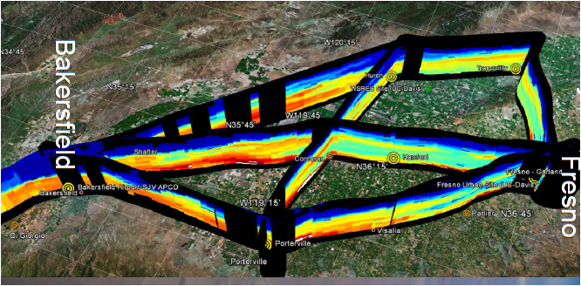
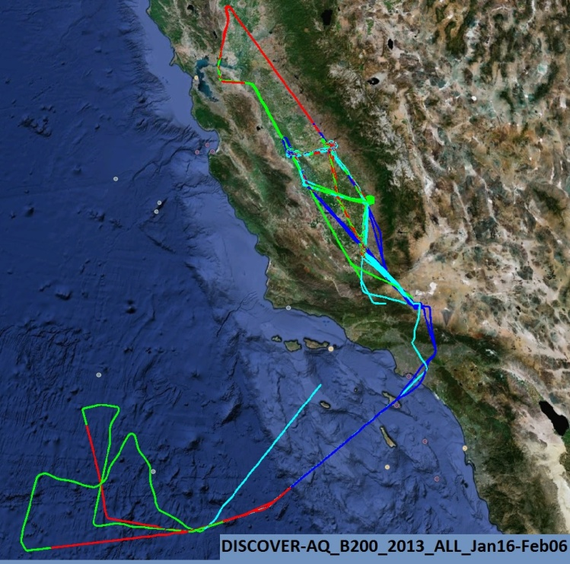
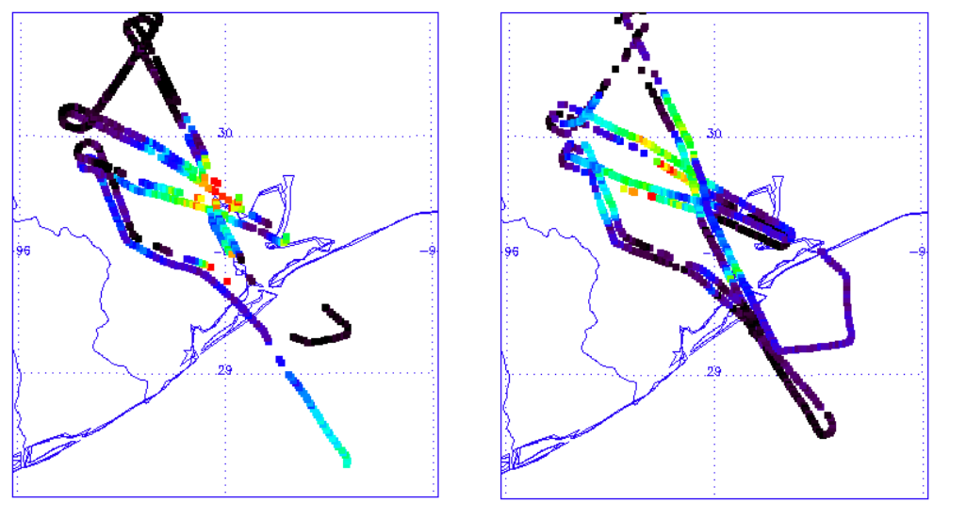
King Air flies over ground sites 4-6 times per day
High Spectral Resolution Lidar (HSRL-2)
Chris Hostetler and Rich Ferrare, NASA LaRC
Airborne Compact Atmospheric Mapper (ACAM)
Scott Janz, NASA GSFC
Sept 4, 2013
NO₂ Morning
Sept. 4, 2013
NO₂ Afternoon
Red = 5.2E16 molec/cm²

Slide 8
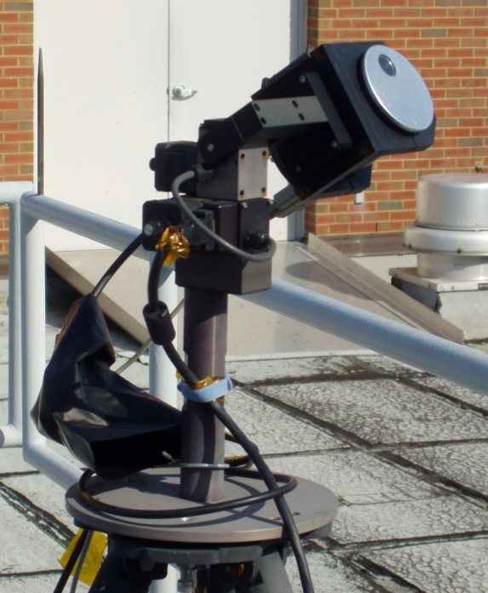
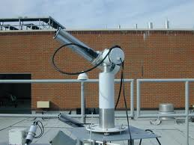
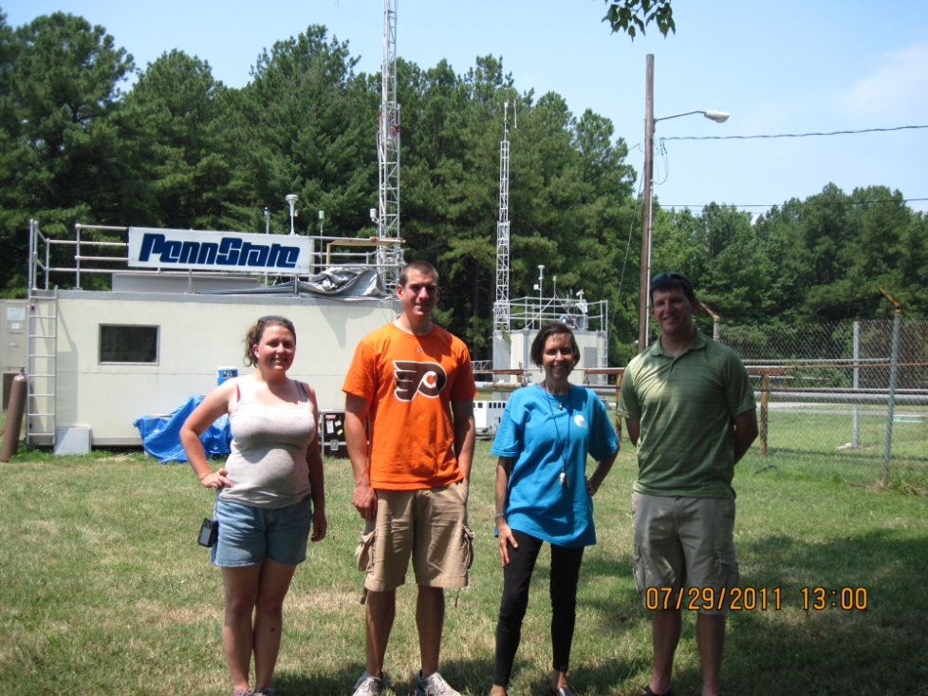
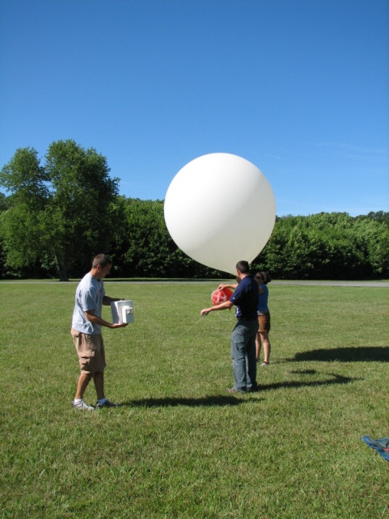
Augmentation of Surface Sites
Pandora UV/VIS Spectrometer
DRAGON network – AERONET Sun Photometers
Instrumented Trailer
Ozonesondes

Slide 9
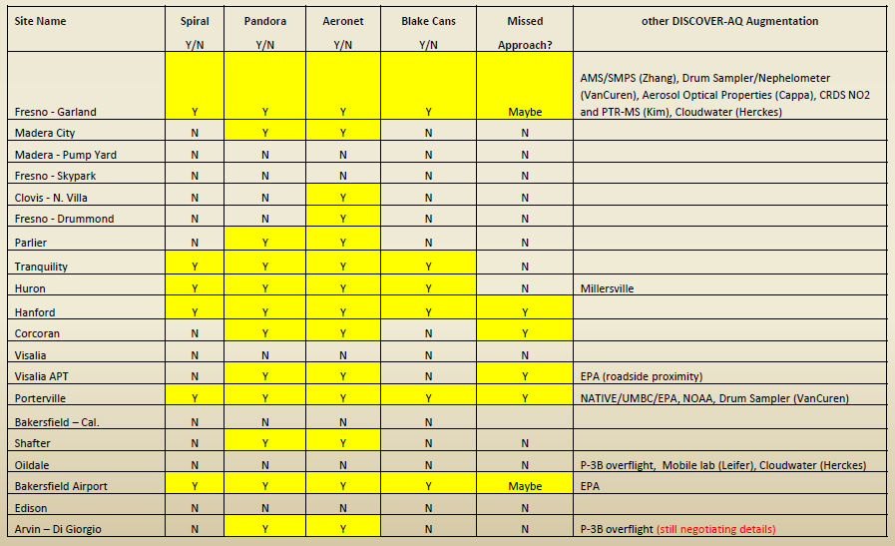
San Joaquin Valley Ground Sites
(Y)
Tethered balloon
NO2
O3 sondes
(Y)
NO2
Total Sites 6 12 14 6 6

Slide 10
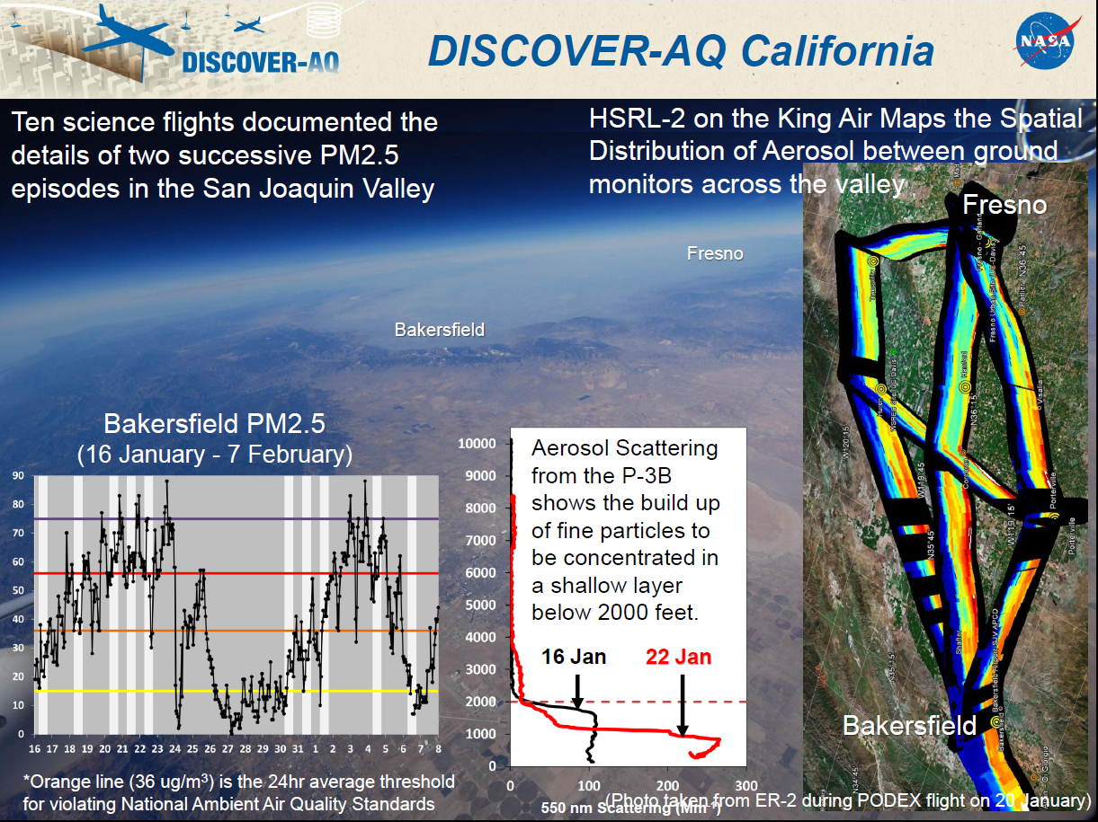

Slide 11
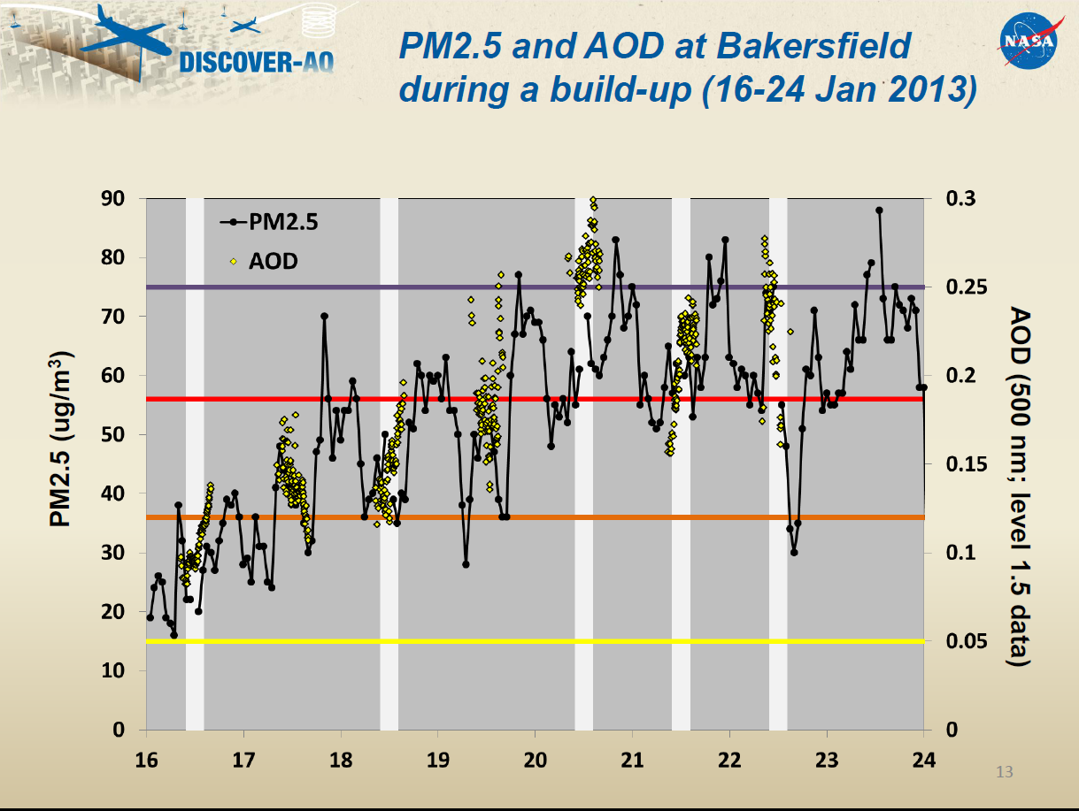

Slide 12
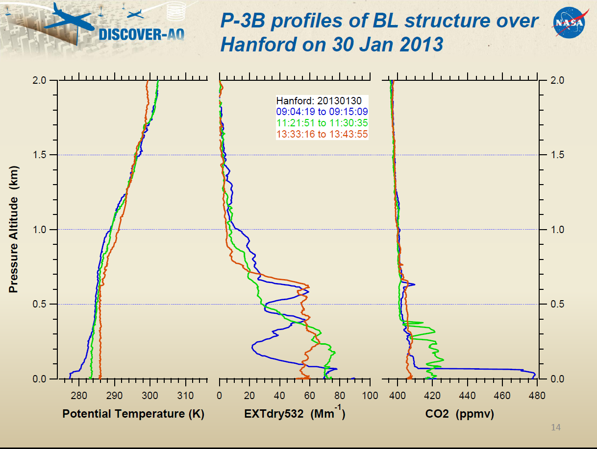

Slide 13
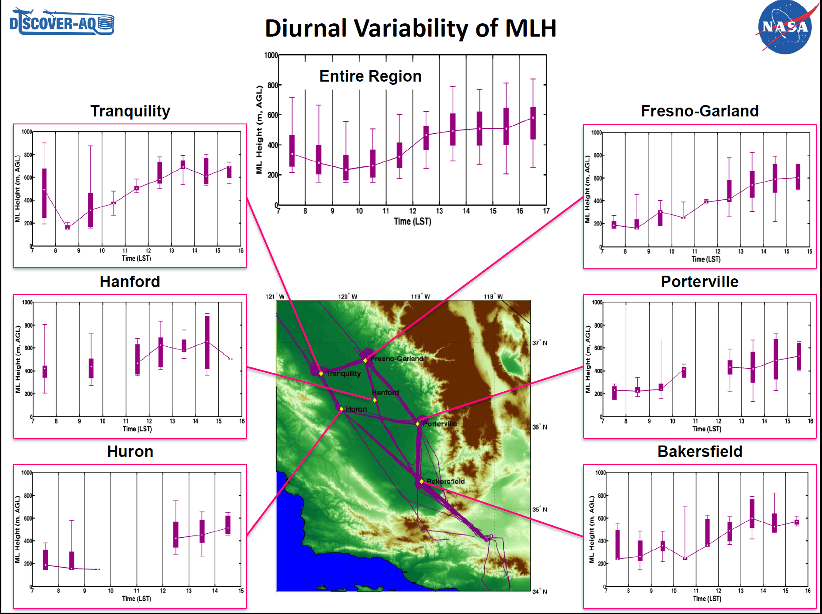

Slide 14
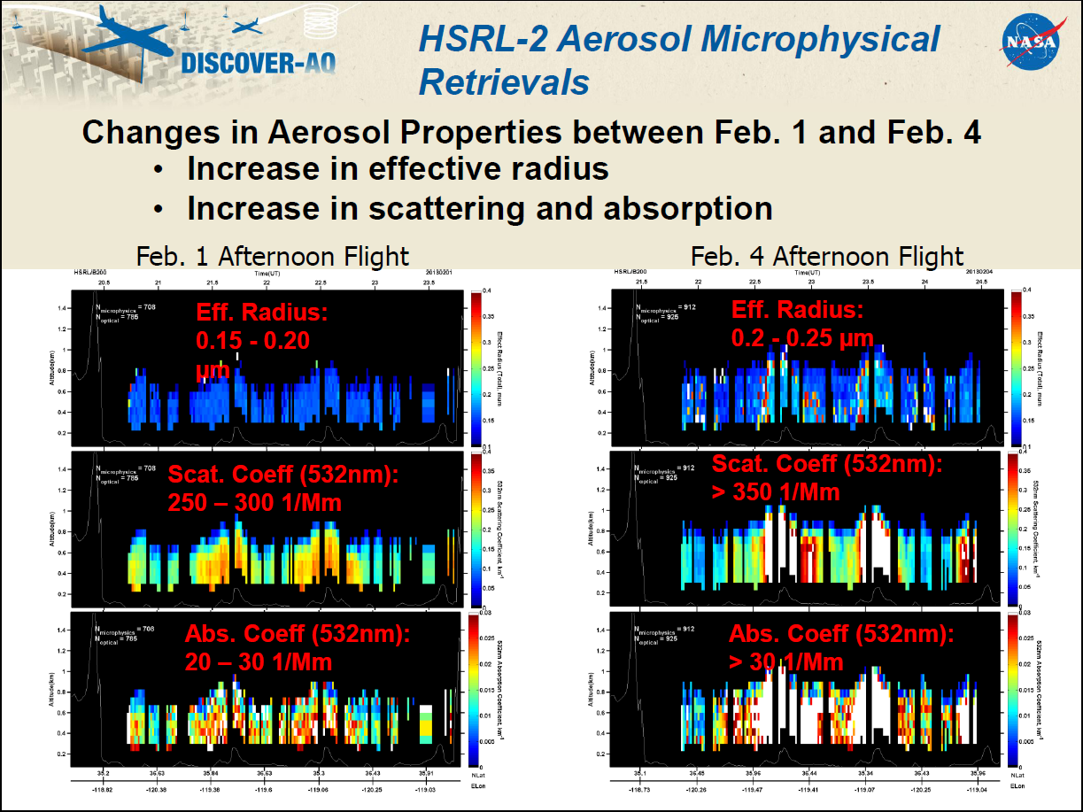

Slide 15
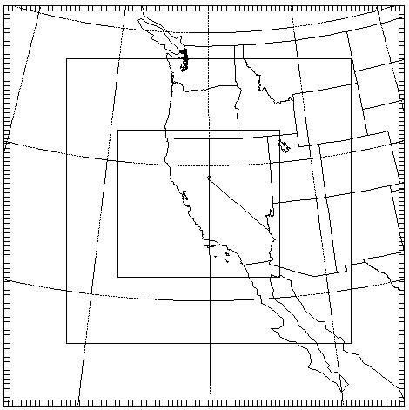
DAQ-SJV WRF simulation
WRF simulation run by Z. Zhao and
A. Kaduwela of CARB
Weather Research and Forecasting (WRF) Version 3.4.1 Model Set-up
Re-initialize frequency | ~0.5 month
Radiation | LW: RRTM SW: Dudhia
Surface layer | MM5 similarity
Land surface model | Pleim-Xiu
Boundary layer | YSU
Cumulus | Kain-Fritsch
Microphysics | WSM-6
Nudging | analysis nudging
Initial and boundary conditions | North American Regional Reanalysis
36 km horizontal resolution
12 km
4 km

Slide 16
DAQ-SJV and DAQ-Houston CMAQ simulations
CMAQ Version 5.0 Model Set-up
Chemical mechanism | CB05
Aerosols | AER05
Dry deposition | M3DRY
Vertical diffusion | ACM2
Anthropogenic emissions | NEI 2005 projected to year 2012
Biogenic emissions | BEIS on-line
Lightning NOx | On-line; Allen et al. (2012, ACP)
Chemical initial and boundary conditions | MOZART CTM

Slide 17
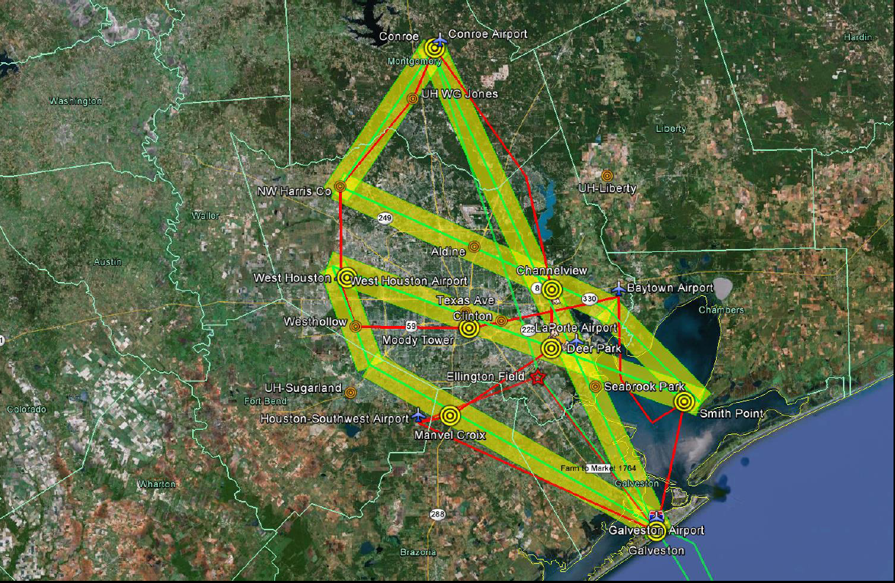
Houston Campaign
September 4 – 26, 2013
RED - P-3B flight track
GREEN - King Air flight track
Yellow - ACAM swath
P-3B: 9 flight days
194 profiles
King Air: 11 flight days

Slide 18
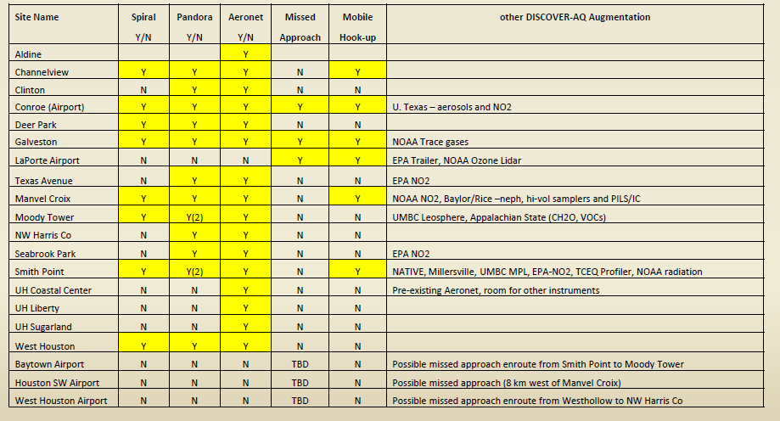
Houston Ground Sites
O3 sondes, MOPS
O3, NO2 sondes,MOPS
Total Sites 8 11 15 3 Three mobile vans:
Aerodyne: Channelview to Deer Park
University of Houston: Conroe to NW Harris Co.
NASA/Langley: Manvel Croix to Galveston

Slide 19
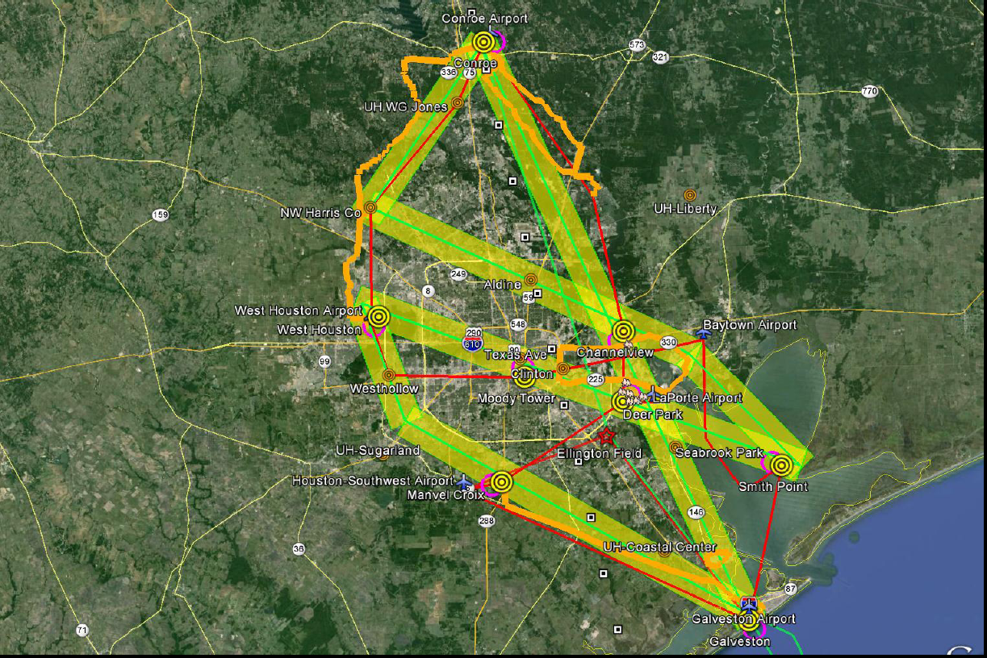
Observing Strategy for Houston
Orange - Mobile van routes

Slide 20
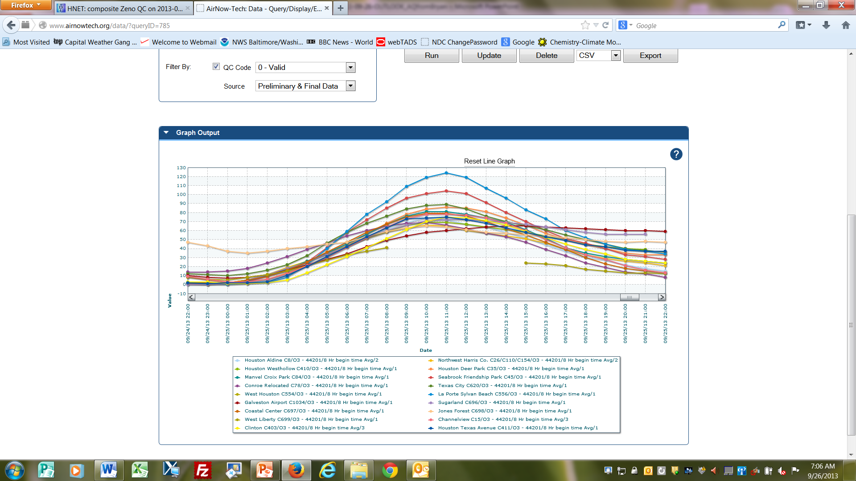
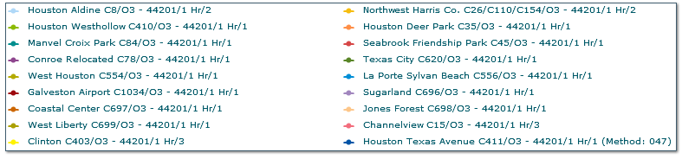
Hourly (8 Hr) Ozone (airnowtech.org)
September 25th
130
La Porte
1st time over 8-hour standard during mission.
100
Seabrook
Texas City
60
Hourly Ozone (ppb)
20
La Porte - Jones Forest ~ 90 ppbv
Notes:
Flight days 4,6,11,12,13,14

Slide 21
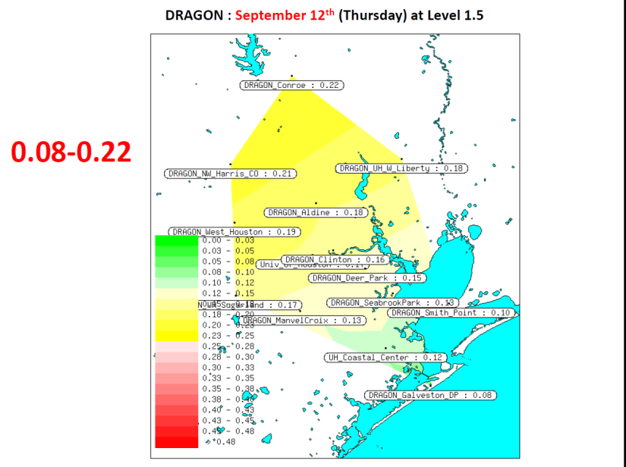
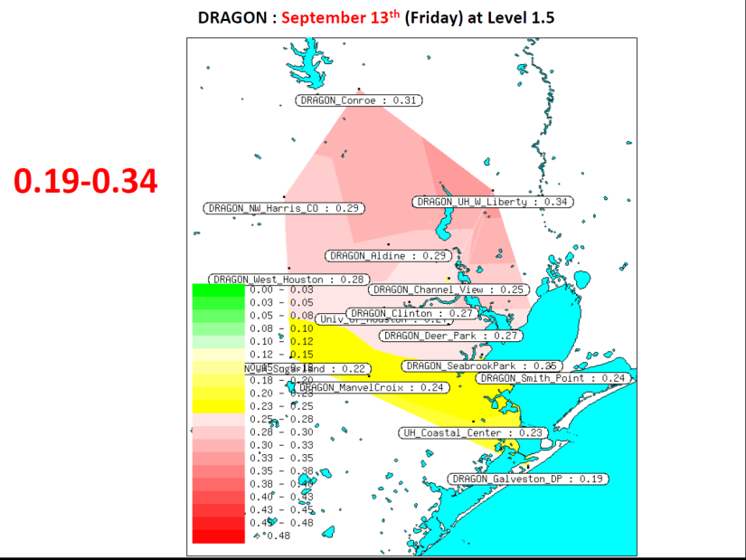
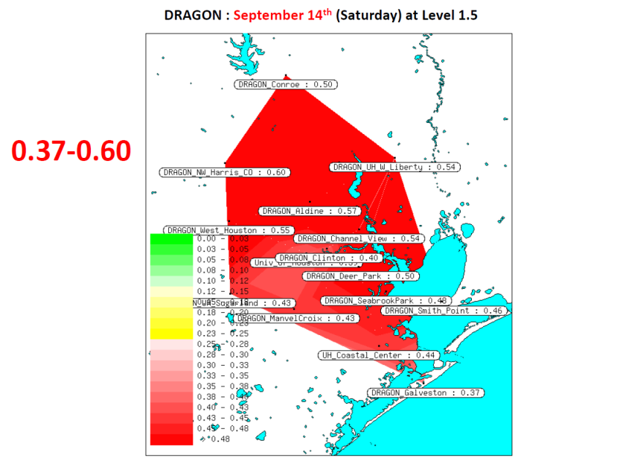
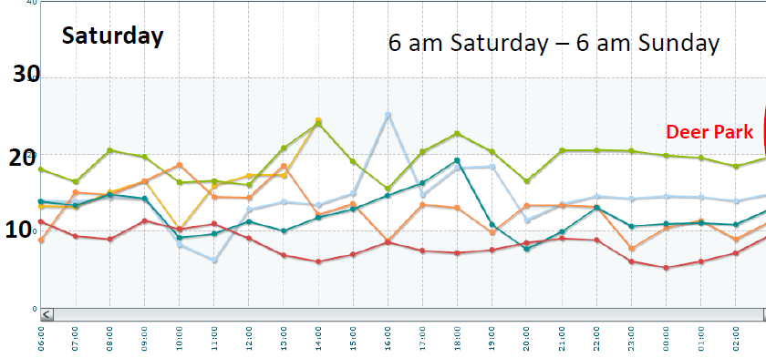
Houston Aerosol Episode of Sept. 14, 2013
High AOD associated with
agricultural fire plumes
from Mississippi Valley.
Back door cold front
pushed smoke over
Houston.
No real impact seen in
surface PM2.5.
Hourly
PM2.5
(µg/m³)

Slide 22
Air Quality Forecasts for Houston Deployment
Univ. of Houston (Yunsoo Choi)
WRF/CMAQ - 4-km resolution; NEI-2008 with MOVES
WRF-Chem – 4-km resolution; NEI-2005
NOAA/ARL (Pius Lee)
WRF/CMAQ at 12-km resolution; point and area emissions
projected to current year; MOBILE6 vehicle emissions
TCEQ (Mark Estes and ENVIRON)
WRF/CAMx at 12-km resolution
NASA/GSFC (Arlindo da Silva)
GEOS-5 at 0.25 deg. resolution; GOCART aerosols, CO, SO₂
Model evaluation using DISCOVER-AQ observations is now beginning

Slide 23
Summary
The DISCOVER-AQ field program in the San Joaquin Valley (SJV) provided
~170 profiles and ~150 missed approaches in the layer from near surface
to ~3.2 km over 10 flight days in Jan.-Feb. 2013. Ground-based and air-
borne remote sensing data also available.
The SJV campaign documented two major wintertime aerosol buildup
periods with large surface PM2.5 concentrations but only modest AOD.
The September 2013 Houston campaign produced nearly 200 profiles and
nearly 100 missed approaches from near surface to 3.2 – 4.7 km over 9
flight days. Considerable ground site instrument augmentation.
Major Houston ozone episode in the final week of September. AOD enhanced
in mid-September due to Mississippi Valley agricultural fires, but little surface
PM2.5 impact.
DISCOVER-AQ offers a wealth of data for regional model evaluation!

