Slide 1


Assessment of the two-way Coupled WRF-CMAQ Model with Observations from the CARES
Chuen-Meei Gan, Francis Binkowski, Jia Xing, Robert Gilliam, David Wong, Jonathan Pleim, Rohit Mathur, Kirk Baker and James Kelly

Slide 2
Content
Objective
WRF-CMAQ overview
CALNEX-CARES overview
Measurements overview
Single Column Model (SCM)
Evaluation, Result & Discussion
Conclusions

Slide 3
Objective
The main goal of this project is to evaluate the improved aerosol component of the two-way coupled WRF-CMAQ model particularly in representing aerosol physical and optical properties by utilizing observations from the Carbonaceous Aerosol and Radiative Effects Study (CARES) in June 2010 which was held in central California.
The model output is evaluated with observations by using:-
  a Single Column Model
  surface and satellite measurements

Slide 4
Overview of coupled WRF-CMAQ model with feedback (fb) and without feedback (nfb)
ID | Feedback (direct effect only) | Without Feedback
PBL | ACM2 (Pleim 2007) | ACM2 (Pleim 2007)
Microphysics | Morrison 2-mom | Morrison 2-mom
Chemistry | CB05 | CB05
Surface layer | Pleim-Xiu | Pleim-Xiu
Cumulus | Kain-Fritsch | Kain-Fritsch
Radiation | RRTMG | RRTMG
Mobile Profile | EPA | EPA
Land Use | NLCD | NLCD
Resolution: 4km (2 months simulation May-June 2010)
Nudging coefficients: guv: 0.00005; gt: 0.00 005; gq: 0.00001

Slide 5
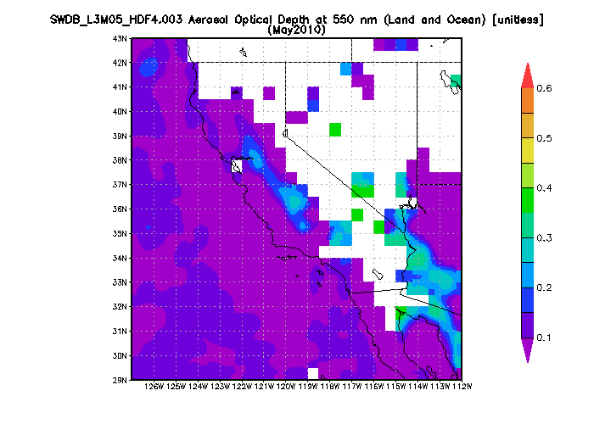
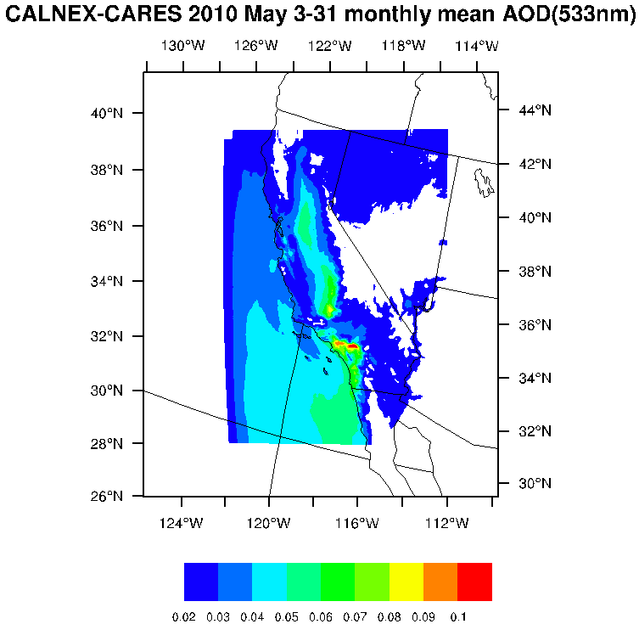
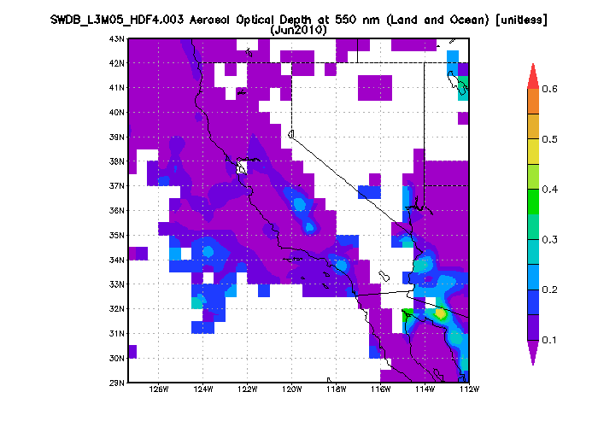
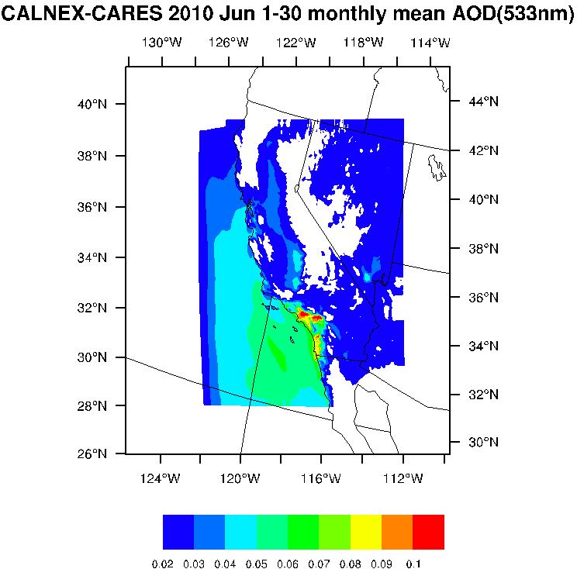
Comparison of WRF-CMAQ and SeaWiFS Satellite AOD
SeaWiFS Deep Blue Level 3 Long-term Aerosol Daily Data products at 0.5x0.5 and 1.0x1.0 degree resolutions (since 1997).
AOD observation:
http://gdata1.sci.gsfc.nasa.gov/daac-bin/G3/gui.cgi?instance_id=SWDB_monthly
Model AOD range about 0.07-0.1 while observation range 0.2-0.5

Slide 6
AERONET vs. Feedback model output (AOD [unitless] hourly)
AERONET
In general, the AOD from the WRF-CMAQ with feedback model is lower compared to AERONET (10 sites) and satellite.

Slide 7
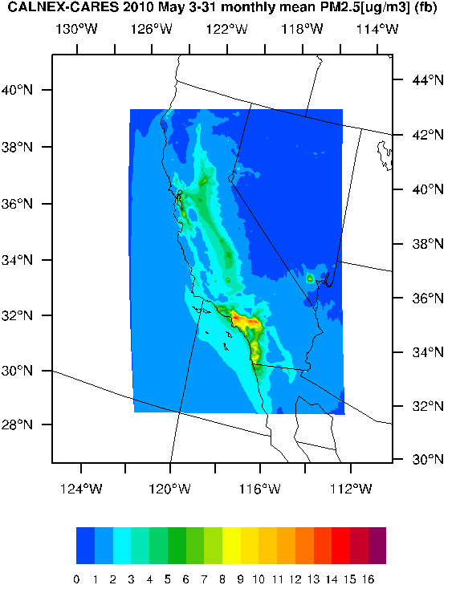
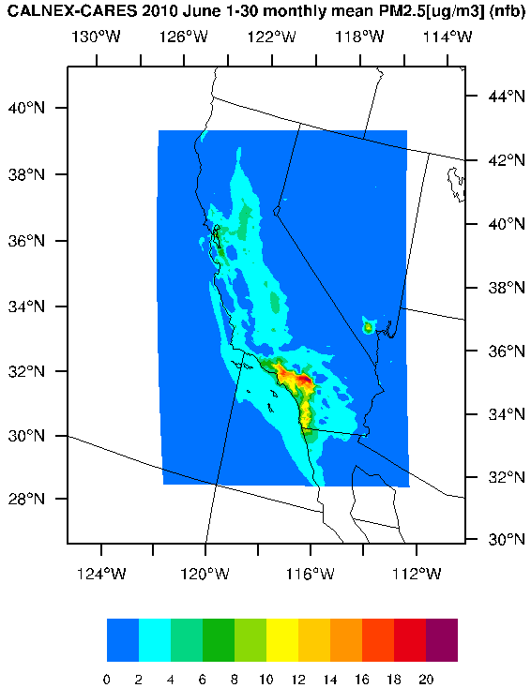
IMPROVE vs. Feedback model output (PM2.5 [µg/m³] daily)
WRF-CMAQ simulations of surface PM2.5 are slightly lower than IMPROVE observations( 19 sites), consistent with the AOD comparison results.
These underestimations of surface PM2.5 concentrations likely contribute to the AOD underestimations, though potential underestimations in the upper atmosphere would have a bigger impact.

Slide 8
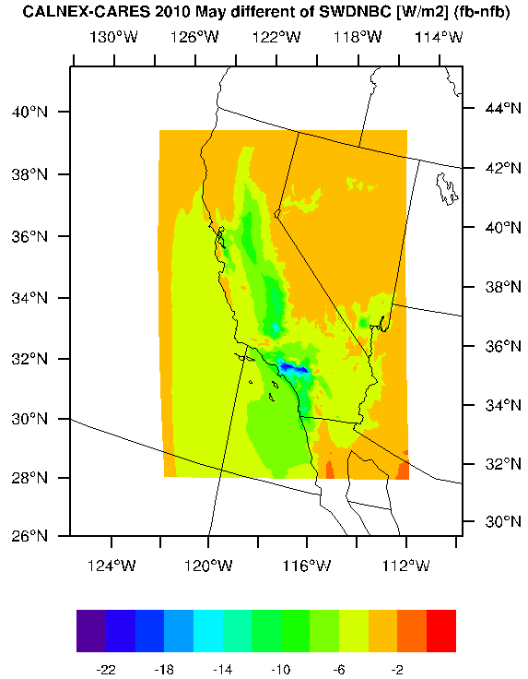
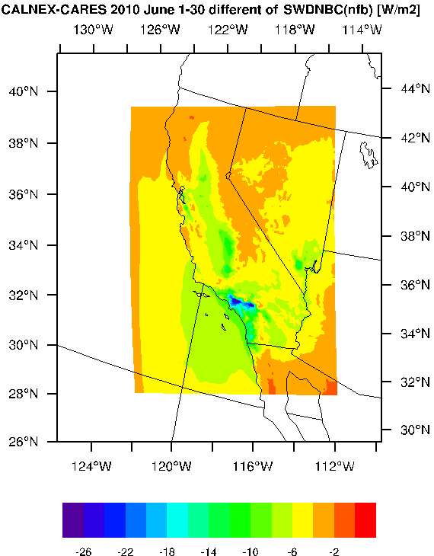
Comparison of Shortwave Radiation Down Clear-sky (W/m²) with feedback and without feedback
This shows the aerosol direct effect.
Global/Regional Modeling Applications (oral presentation Wednesday)
Assessment of aerosol effects on surface radiation in the north hemisphere using two-way WRF-CMAQ model
Jia Xing et al.
Poster Session 2
Investigation of multi-decadal trends in aerosol direct radiative effect from anthropogenic emission changes over North America by using a multiscale two-way coupled WRF-CMAQ model
Chao Wei et al.

Slide 9
CALNEX – CARES 2010
Carbonaceous Aerosols and Radiative Effects Study (CARES)
Where: Central California region, to the northeast of Sacramento
When: June 2-28, 2010.
What: This field campaign is designed to increase scientific knowledge about the evolution of black carbon and secondary organic aerosols from both urban/manmade and biogenic sources. New knowledge gained from subsequent detailed process-level analyses can then be integrated into regional and global aerosol models used for simulating the direct and indirect radiative effects on climate.
http://campaign.arm.gov/cares/
California Nexus (CALNEX)
Where: California and the eastern Pacific coastal region
When: May 2010
What: The focus of NOAA's field study includes ESRL CSD airborne measurements using the NOAA WP-3D aircraft and the Twin Otter Remote Sensing aircraft, and surface measurements using the R/V Atlantis mobile platform as well as stationary ground sites.
http://www.esrl.noaa.gov/csd/projects/calnex/
Poster Session 1
Inter-comparison of Photochemical Modeling by EPA and CARB for the CALNEX 2010 Study
James Kelly and Kirk Baker
Oral Presentation (Tuesday)
Evaluating fine-scale photochemical modeling for California during May-June 2010
James Kelly, Kirk Baker, and Chris Misenis

Slide 10
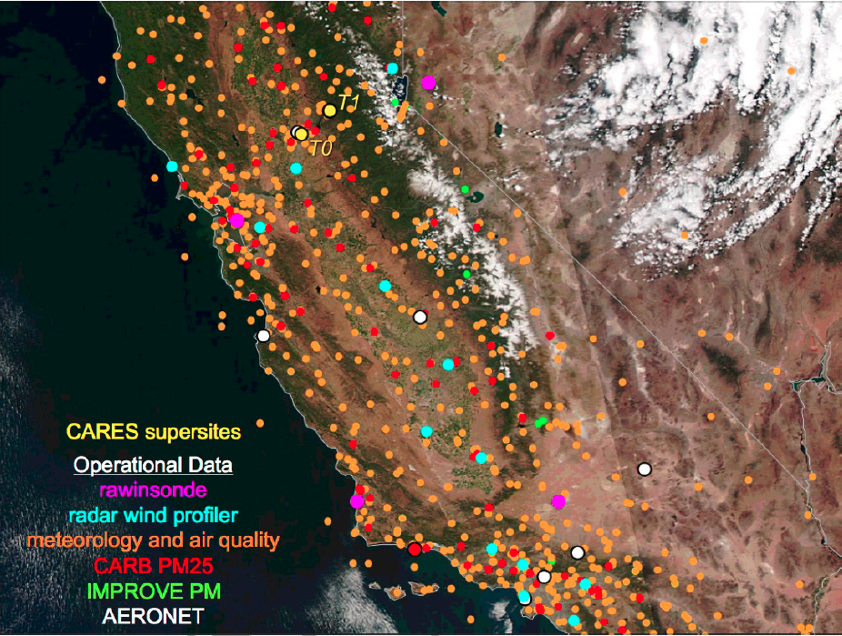
Locations of the supersites, CARB, IMPROVE and AERONET stations as well as the operational profile sites on a regional map.
Figure 5.1 from “Aerosol Modeling Testbed: CARES Field Campaign Data in the Analysis Toolkit Format
(June 2012 Version 1.0)”
  Sacramento, CA (urban area):-
  T0 [lat = 38.55 lon = -121.47]
  Cool, CA (~40km downwind in the forested Sierra Nevada foothills area):-
  T1 [lat = 38.88 lon = -121.02]
Notes:
A wide range of ground-based and airborne instruments were deployed to monitor comprehensive aerosol properties, meteorological variables and gaseous species.

Slide 11
Measured Inputs (aircraft DOE G1) for SCM & Evaluation
Measurement of number of particles for each layer
a) FIRMS (Fast Integrated Mobility Spectrometer )
    diameter range [0.03 - 0.07µm]
b) UHSAS (Ultra High Sensitivity Aerosol Spectrometer)
    diameter range [0.06 -1.0µm]
    c) CAPS (Cloud, Aerosol, and Precipitation Spectrometer system)
    diameter range [0.6 - 56.3µm]
    Measurement of aerosol composition
    a) AMS (Aerosol mass Spectrometer)
    CL, NH4, NO3, SO4, and OC
    b) SP2 (Single Particle Soot Photometer)
    BC
Aerosol Optical Properties
  a) TSI 3563 Nephelometer (neph)
  total scatter and backscatter (450, 550, and 700 nm).
  b) PSAP (Particle Soot Absorption Photometer)
  absorption (461.6, 522.7 and 648.3 nm)
Size resolve composition profiles
INPUT
SCM
OUTPUT
AOD
SSA

Slide 12
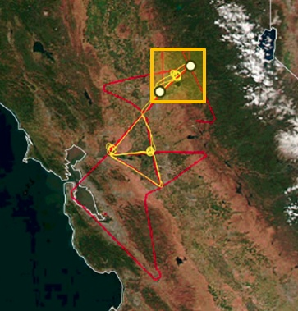
Flight Information Case1 (June 14, 2010)
Flight paths on June 14 of the G-1 (yellow) between 1656 and 2111 UTC and the B-200 (red) between 1723 and 2041 UTC, White dots denote the T0 and T1 supersites.
Figure 4.10 from “Aerosol Modeling Testbed: CARES Field Campaign Data in the Analysis Toolkit Format (June 2012 Version 1.0)”

Slide 13
Comparison of Observation-Derived and WRF-CMAQ input profiles (RH, T, Water and concentration) for CASE 1
obs: observation (red line)
model FB T0/T1: data from wrf-cmaq (feedback) extracted at location T0/T1 (blue / black line)
WS_{model} = so4 + nh4 + no3 + mg + k + ca
WS_{obs} = na + so4 + nh4 + no3 + cl + ca + k + mg + oc
Relative humidity and temperature are similar.
The concentrations in the WRF-CMAQ water soluble (WS) input profiles are much smaller than those in the observation-derived profile while the concentrations in the elemental carbon profile are higher than observations.

Slide 14
AOD comparison for CASE 1
The AOD using the observation-derived inputs match observed extinctions better than those calculated with WRF-CMAQ derived inputs.
This indicate that the SCM optics calculations are able to represent the “aerosol properties” if inputs are correct.
However, the Single Scattering Albedo (SSA) computed from observation-derived inputs is not matching as well as the AOD.
The contributions from absorption and scattering maybe not be accurate.
Note that this SCM is calculate extinction based on BH (Bohren and Huffman)Mie and BH Core.
EC is not well represented?

Slide 15
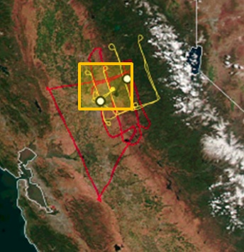
Flight Information Case2 June 24, 2010
Flight paths on June 24 and 25 of the G-1 (yellow) between 2230 and 0112 UTC and the B-200 (red) between 2221 and 0043 UTC, White dots denote the T0 and T1 supersites.
Figure 4.21 from “Aerosol Modeling Testbed: CARES Field Campaign Data in the Analysis Toolkit Format (June 2012 Version 1.0)”

Slide 16
Comparison of Observation-Derived and WRF-CMAQ input profiles (RH, T, Water and concentration) for CASE 2
obs: observation (red line)
model FB T0/T1: data from wrf-cmaq (feedback) extracted at location T0/T1 (blue / black line)
Relative humidity and temperature of observations and WRF-CMAQ simulations are similar in the lower atmosphere.
Water soluble input profile is slightly smaller than observation while the elemental carbon is higher than observation.
Note that the water soluble profile do not show a significant change above 1 km.

Slide 17
AOD comparison for CASE 2
Both observation-based and WRF-CMAQ-based input profiles yield similar vertical extinctions compared with the measurement (AOD and SSA).
Note that, the model-derived WS profile is closer to the observation.
Again, this shows that the input profile affect the calculation more than the calculation itself.
Poster Session 1
Optimizing a coated-sphere module for use in coupled WRF-CMAQ
David Wong and Francis Binkowski

Slide 18
Conclusion
The comparison of AOD and PM2.5 between the coupled WRF-CMAQ with the observations (in situ and satellite) are reasonably well.
The coupled WRF-CMAQ with feedback is capable of representing the aerosol optical properties and its direct effect on shortwave radiation.
The comparisons of modeled to observed AOD during the CARES field study revealed a low bias.
The SCM assessment (temporal and spatial) utilizing specialized field measurements helped to identifying possible causes for this low bias.
After the evaluation of the size resolve composition profiles, AOD and SSA, this study suggests several possible causes:
  Low particulate matter near surface.
  Missing / insufficient of some species (e.g. water soluble).
  Vertical aerosol distribution profile. (e.g. plume aloft)
On going tests
  Different scale (10 km simulation)
  Finer temporal resolution (hourly to 10 or 20 minutes).
  Different campaign, different location (SGP AIOP field study May 2003)

Slide 19
Thank you! Questions?
  References
  Zaveri, R. A. et al.: Overview of the 2010 Carbonaceous Aerosols and Radiative Effects Study (CARES), Atmos. Chem. Phys., 12, 7647-7687, doi:10.5194/acp-12-7647-2012, 2012.
  Fast, J. D. et al.: Transport and mixing patterns over Central California during thr carbonaceous aerosol and radiative effect study (CARES), Atmos. Chem. Phys., 12, 1759–1783, 2012 doi:10.5194/acp-12-1759-2012
  Schmid, B., et al. (2006), How well do state-of-the-art techniques measuring the vertical profile of tropospheric aerosol extinction compare? J. Geophys. Res., 111, D05S07, doi:10.1029/2005JD005837.
  Hallar, A. G., et al. (2006), Atmospheric Radiation Measurements Aerosol Intensive Operating Period: Comparison of aerosol scattering during coordinated flights, J. Geophys. Res., 111, D05S09, doi:10.1029/2005JD006250.
  Michalsky, J. J., G. P. Anderson, J. Barnard, J. Delamere, C. Gueymard, S. Kato, P. Kiedron, A. McComiskey, and P. Ricchiazzi (2006), Shortwave radiative closure studies for clear skies during the Atmospheric Radiation Measurement 2003 Aerosol Intensive Observation Period, J. Geophys. Res., 111, D14S90, doi:10.1029/2005JD006341.
  Strawa, A. W., et al. (2006), Comparison of in situ aerosol extinction and scattering coefficient measurements made during the Aerosol Intensive Operating Period, J. Geophys. Res., 111, D05S03, doi:10.1029/2005JD006056.
  Ricchiazzi, P., C. Gautier, J. A. Ogren, and B. Schmid (2006), A comparison of aerosol optical properties obtained from in situ measurements and retrieved from Sun and sky radiance observations during the May 2003 ARM Aerosol Intensive Observation Period, J. Geophys. Res., 111, D05S06, doi:10.1029/2005JD005863.
  http://campaign.arm.gov/cares/
  http://www.arb.ca.gov/research/calnex2010/calnex2010.htm
  http://disc.sci.gsfc.nasa.gov/giovanni/overview/index.html
  Acknowledgment:
  This research was performed while Chuen-Meei Gan held a National Research Council Research Associateship Award at U.S. EPA

Slide 20
Additional Observations
(time series)
AERONET
IMPROVE
CASTNET

Slide 21
AERONET vs Feedback model output (AOD hourly)
10 sites

Slide 22
Continue AERONET vs Feedback model output (AOD hourly)

Slide 23
IMPROVE vs Feedback model output (PM2.5 daily)
19 sites

Slide 24
Continue IMPROVE vs Feedback model output (PM2.5 daily)
19 sites

Slide 25
Continue IMPROVE vs Feedback model output (PM2.5 daily)
19 sites

Slide 26
CASTNET vs Feedback model output (Ozone 8-hour max daily)
6 sites

Slide 27
Data Processing
Method of data fusion
  Combine the measurements of FIRM, UHSAS and CAPS by matching diameter bins.
  Mean concentration (number of particles dN/dlogDp) is used for diameter overlap region.
  Combined the measurements of AMS and SP2 to obtained aerosol compositions vertically.
  This datasets are interpolated to obtain the size distribution and composition uniformly. Spatial resolution is 100 m for both datasets.
  By utilizing the lognormal distribution, the geometry diameter and standard deviation can be estimated.
  The dataset is seperated into 3 modes:
  Aitken (0.01 – 0.1µm), Accumulation (0.1 – 2.5µm) and Coarse (2.5 – 40µm)
  Water content is computed by ISOROPPIA using mass and relative humidity measurements.

Slide 28
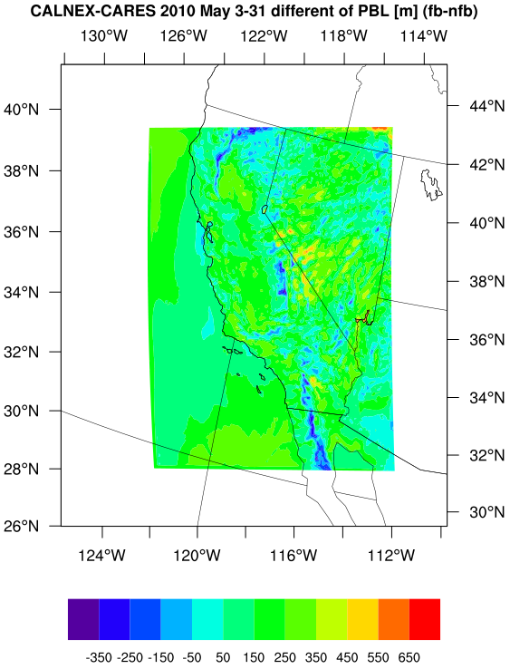
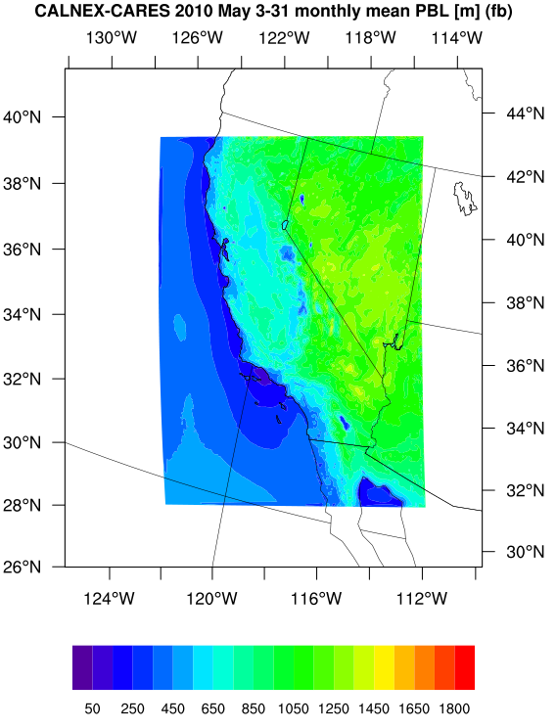
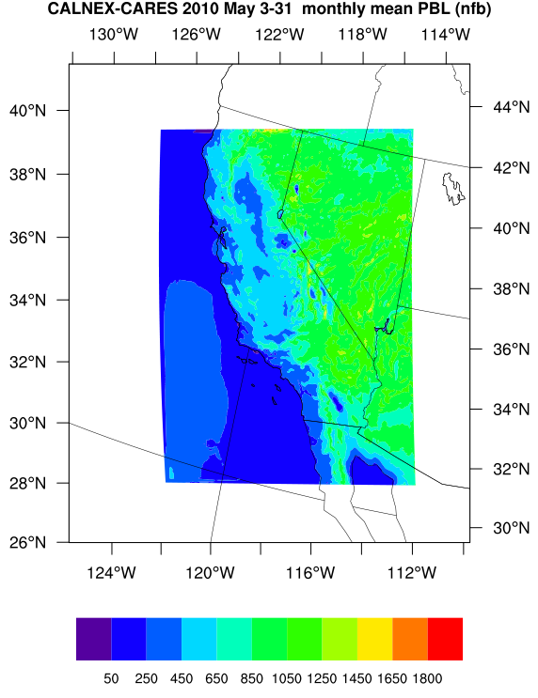
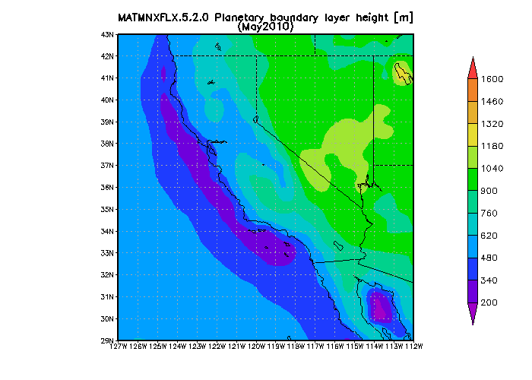
Planetary Boundary Layer Height (meter)
PBLH observation
http://gdata1.sci.gsfc.nasa.gov/daac-bin/G3/gui.cgi?instance_id=MERRA_MONTH_2D
The MERRA is a NASA reanalysis for the satellite era using a major new version (V5) of the Goddard Earth Observing System (GEOS) Data Assimilation System (DAS). The MERRA focuses on historical analyses of the hydrological cycle on a broad range of weather and climate time scales.
This MERRA Instance of Giovanni focuses on visualizing and analyzing the MERRA 2D monthly data from the MERRA HISTORY COLLECTIONS. All data used here are at GEOS-5 native resolution of 2/3 longitude by 1/2 latitude degrees

Slide 29
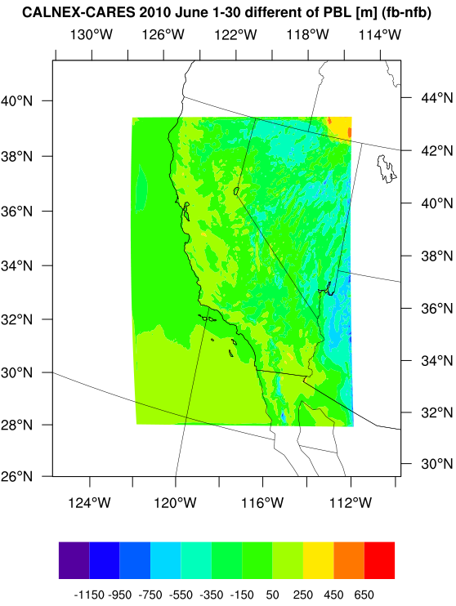
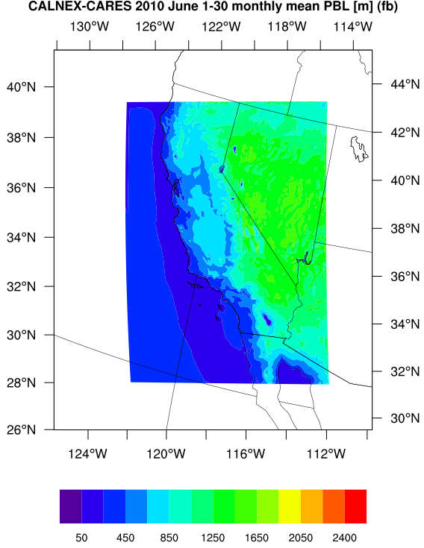
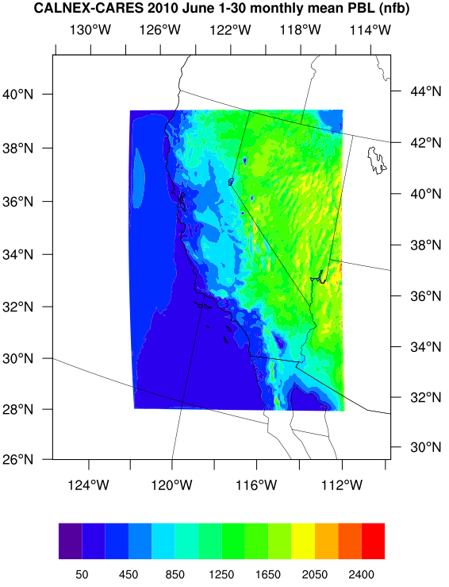
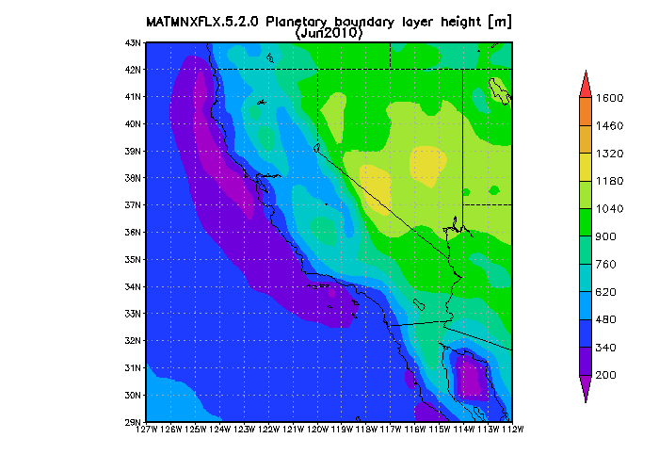
Planetary Boundary Layer Height (meter)

Slide 30
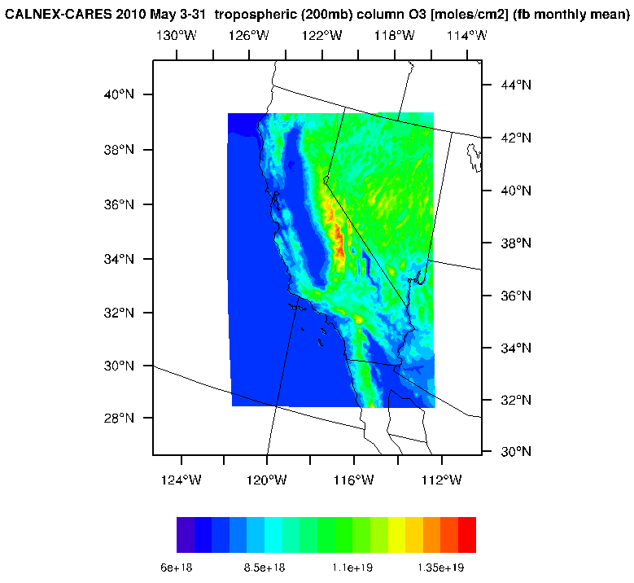
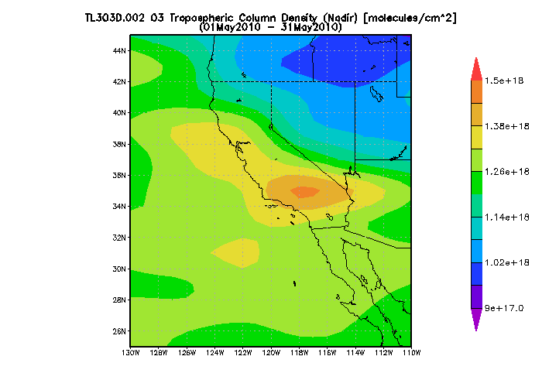

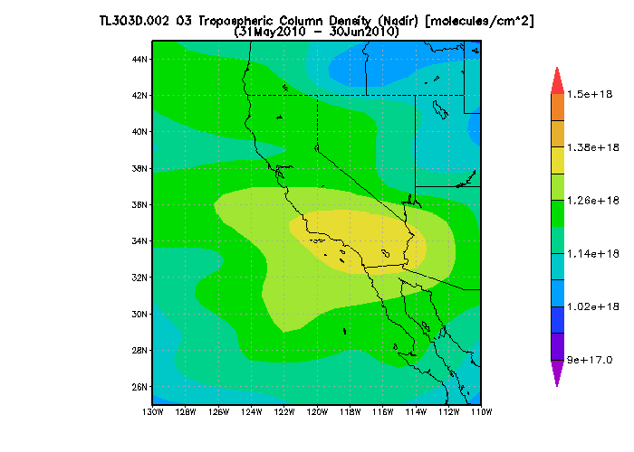
O3 Tropospheric Column Density (mole/cm²)
This interface is for the visualization and analysis of EOS Aura TES daily level 3 gridded data. Level 3 daily data (per TES global survey of about 26 hours) are provided at 2° latitude by 4° longitude. The level 3 data are derived from level 2 retrieved parameters at each pressure level using spatial Delauney triangulation and interpolation (over poles extrapolation is used). Currently, methane (CH4), carbon monoxide (CO), water vapor (H2O), deuterated water vapor (HDO), nitric acid (HNO3), ozone (O3), and atmospheric temperature data are available. Only nadir observation data are offered, except HNO3 which are limb mode data

Slide 31
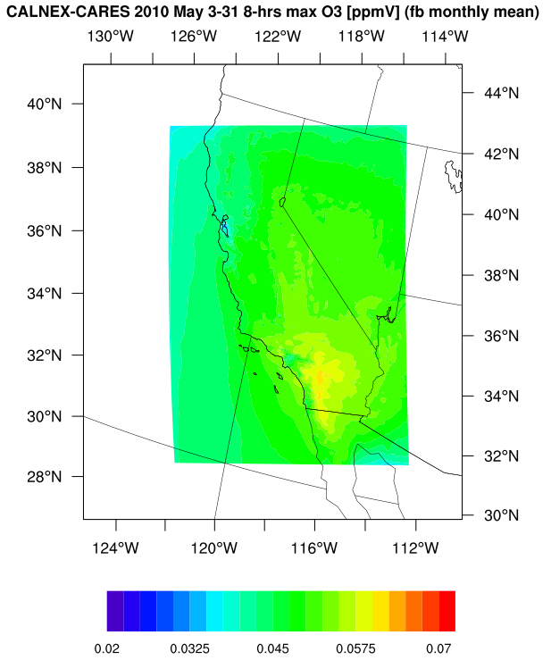
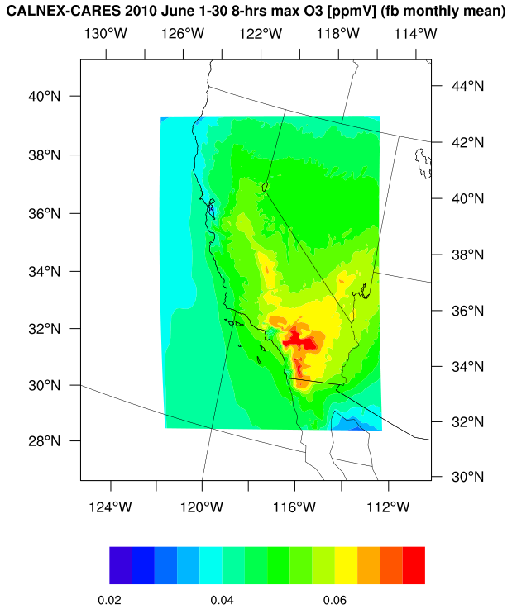
O3 8-hour max daily (ppmV)
The O3 from model is higher than satellite and surface observations.
However, it has a good correlation with the surface measurements.
CASTNET

