Slide 1
Evaluation of the CMAQ5.0 in the framework of the CALIOPE air quality forecasting system over Europe
M.T. Pay¹. J. M. Baldasano^{1,2}, S. Gassó^{1,2}
¹Earth Science Department, Barcelona Supercomputing Center, Spain
²Environmental Modelling Laboratory, Technical University of Catalonia, Spain
11th Annual CMAS Conference, Chapel Hill, NC, October 15-17, 2012

Slide 2
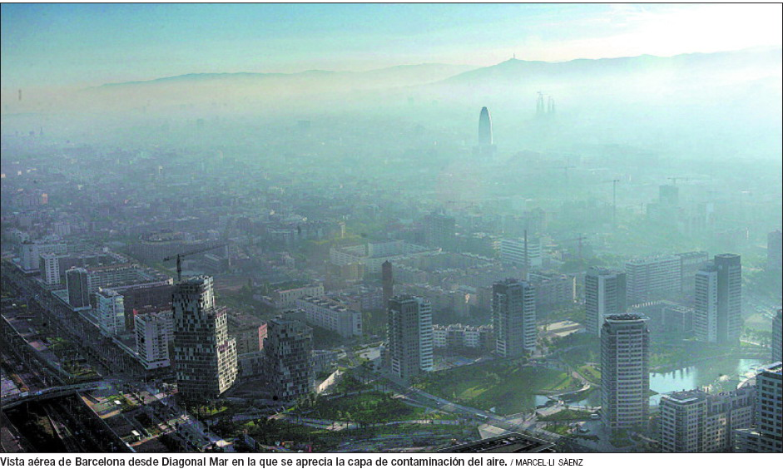
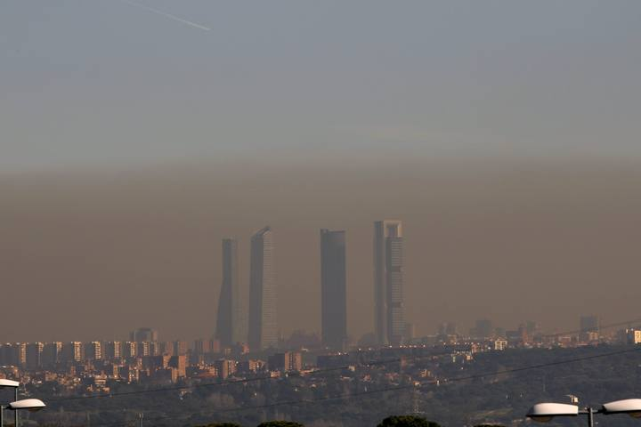
Introduction
European cities undergo frequent photochemical pollution episodes which exceed the European air quality targets (EEA, 2010). (especially NO₂, PM10 and PM2.5)
Air quality modelling is both a challenge and a scientific problem, being one of the requirements of the 2008/50/EC Directive.
Reliable air quality forecasts: exposure is more efficiently reduced and better protection can be ensure by means of information and short-term action plans.
Air pollution in the Barcelona city (Spain). Source: El País.
Air pollution in the Madrid city (Spain), 8 February 2011. Source: El País.

Slide 3
Objective
In the European context, CALIOPE is an air quality forecasting system (CALIOPE AQF) -based on WRF-ARW/HERMES/CMAQ/BSC-DREAM8b models and implemented in the MareNostrum supercomputer- (Baldasano et al., 2008, ASR) which provide daily forecast for Europe and Spain.
This work compares the two version of the CMAQ Chemical Transport Model versions 4.5 and 5.0 (both integrated in the CALIOPE AQF).
The CMAQ version 5.0 includes scientific improvements for gas-phase chemistry (CB05) and aerosol, especially devoted to SIA and SOA and aerosol dynamic (fine-coarse).
The mail goal is to examine the differences between both CMAQ versions in terms of the main pollutants O₃, NO₂ and PM10 (and their chemical composition) when they are applied to the European region with high resolution for the forecasted April 9th - 7th June 2012.

Slide 4
The CALIOPE system (http://www.bsc.es/caliope/)
Domains:
EU = 12 km x 12 km (480 x 400 grid cells)
IP = 4 km x 4 km (399 x 399 grid cells)
Modules
Meteorology: WRF-ARW v3.0.1.1,
  EU = IC & BC: GFS/FNL (NCEP)
  IP = one-way nesting
  38 sigma levels (50 hPa)
Emissions: HERMES-EMEP
  EU = Disaggregation from EMEP inventory.
  IP = HERMES model bottom-up.
Chemical Transport Model: CMAQv4.5
  EU = BC: LMDz-INCA2
  IP = one-ways nesting
  15 sigma levels (50 hPa)
  CBIV, Cloud chem., AERO4
Mineral dust from Africa: BSC-DREAM8b
Model evaluation:
  Near-real time
  Kalman filter post-processing

Slide 5
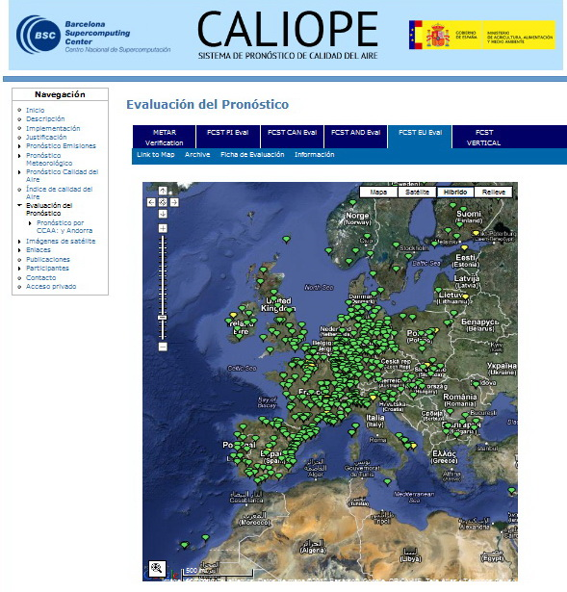
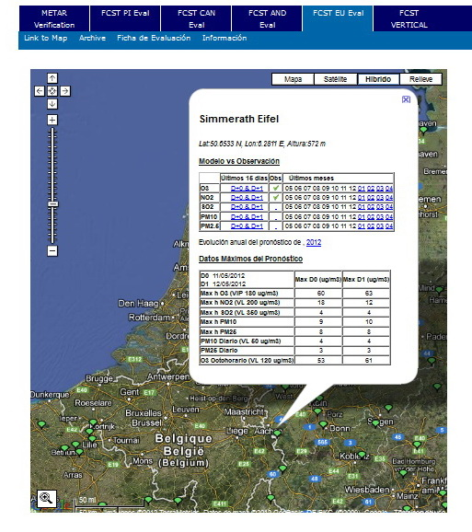
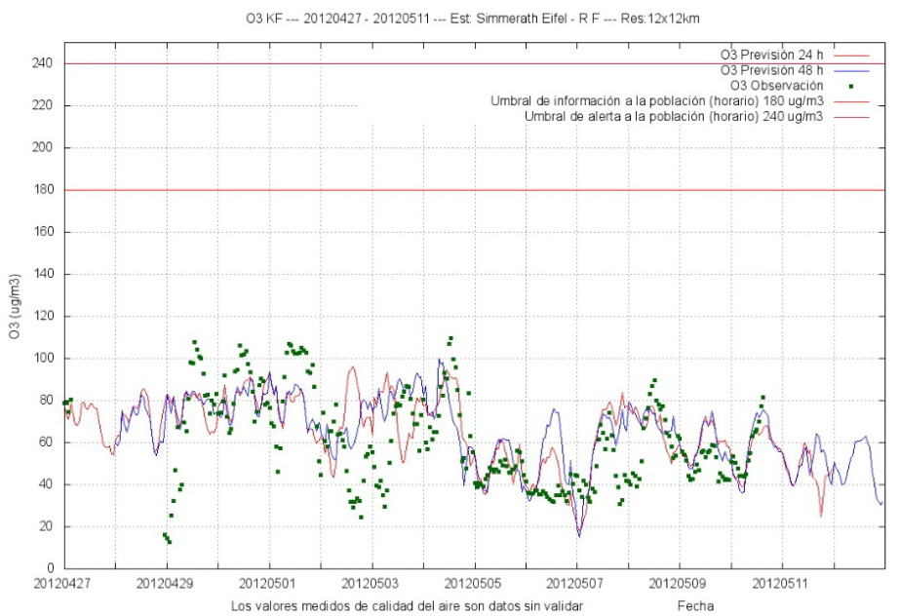

Confidence on the CALIOPE system (based on CMAQ4.5)
1. Peer Review Publications:
Domain | Reference
Europe | Pay et al. (2010, 2012a)
 | Basart et al. (2011)
Spain | Baldasano et al. (2011)
 | Pay et al. (2011, 2012b)
 | Sicardi et al. (2011)
Barcelona & Madrid | Gonçalves et al. (2009)
 | Soret et al. (2011)
Cataluña (NE Spain) | Jiménez-Guerrero et al. (2008)
2. Near-Real Time (NRT) evaluation:

Slide 6
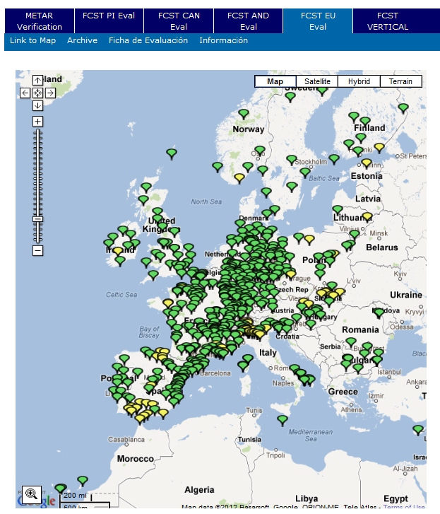
Evaluation methods
  Evaluation in forecast mode comparing CMAQv4.5 vs CMAQv5.0 against air quality measurement from the online AirBase monitoring network (the European Air Quality dataBase) for the period: from April 9th till 7th June 2012.
AirBase ground-level concentrations
  Background rural/suburban stations
  Gaseous and particulate matter: O₃, NO₂, and PM10.
  Online (NOT VALIDATED DATA)
 | AIRBASE 2012 | Selection from AIRBASE 2012
O₃ | 569 | 167
NO₂ | 362 | 128
PM10 | 238 | 74

Slide 7
CMAQ configuration in this study
Version |  | CMAQv4.5 | CMAQv5.0
Compile options | ModDiver | Yammartino | Yammartino
 | ModHadv | Yammartino | Yammartino
 | ModVadv | Yammartino | Yammartino
 | ModHdiff | multiscale | multiscale
 | ModVdiff | eddy | acm2
 | ModDepv | aero_depv2 | m3dry
 | ModCgrds | N/A | namelist
 | ModPhot | photolysis | internal
 | ModChem | ebi_cb4 | ebi_cb05cl
 | ModAero | aero4 | aero5
 | ModCloud | acm | aero5
 | Mechanism | cb4_aero4_aq | cb05cl_ae5_aq
Execution options | KZMIN | NO | Yes
 | In-line deposition velocity calculation | - | Yes

Slide 8
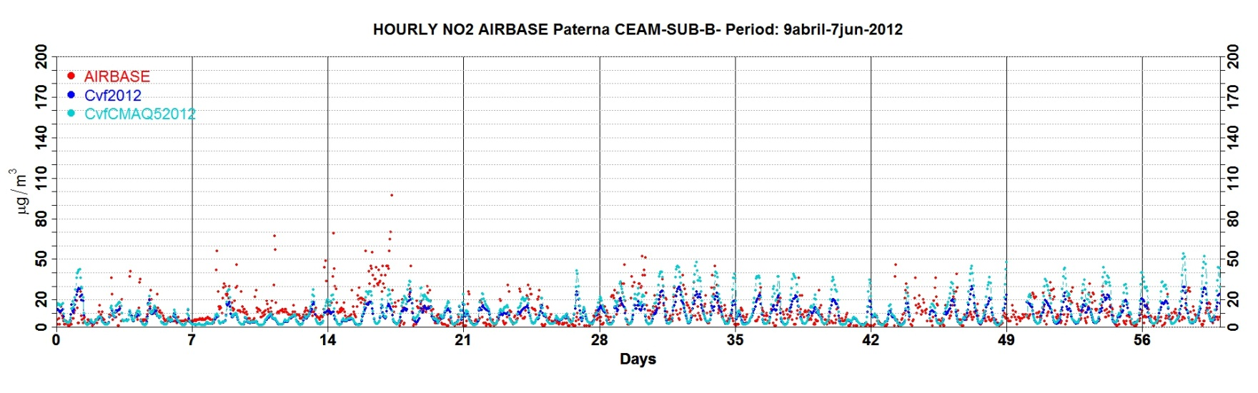

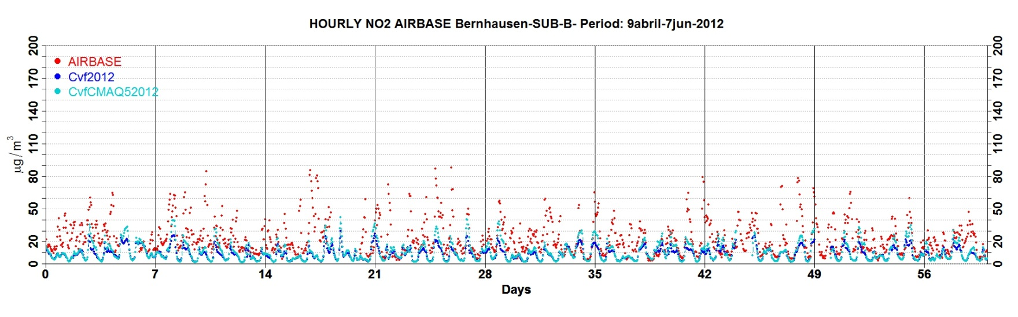
NO₂ hourly evaluation at AirBase stations: examples
At SUBURBAN stations under the influence traffic emission peaks are reduced around 10-20 µg m⁻³.
Background levels remain without changes.
At RURAL stations different between version are less than 10 µg m⁻³.
Notes:
Pink boxes indicate differentes between CMAQ versions greater than 10 ugm-3

Slide 9
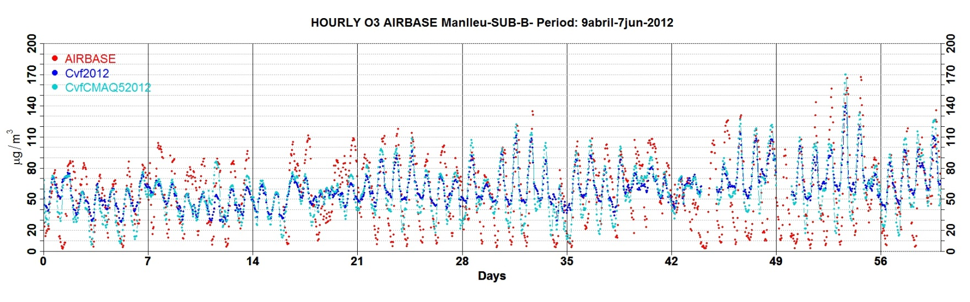
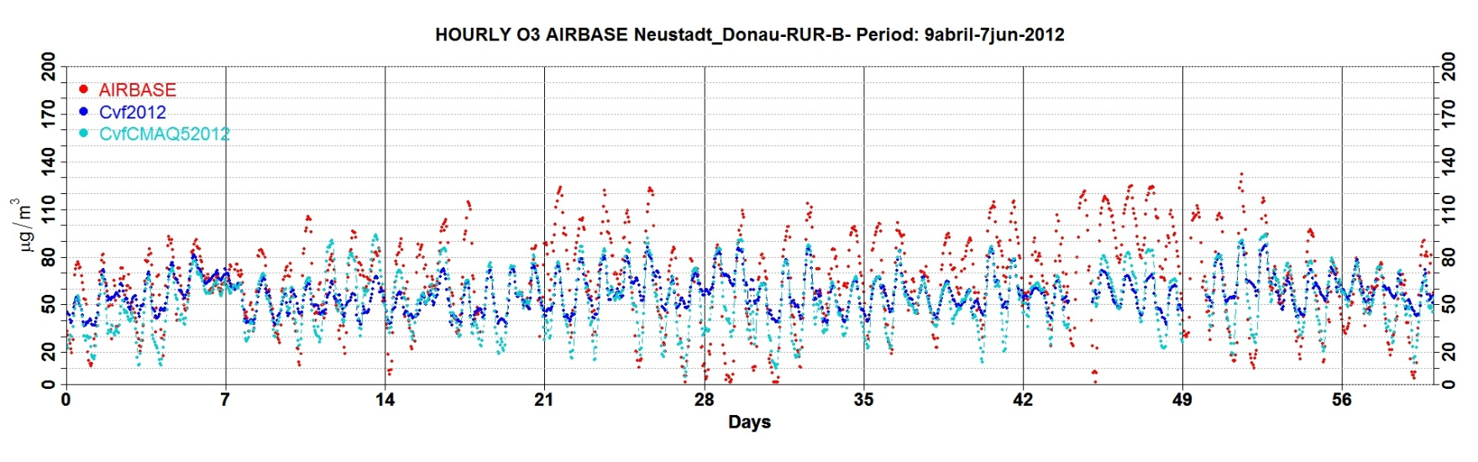
O₃ hourly evaluation at AirBase stations: examples
With CMAQ5.0 O₃ bias reduction on daily cycle:
  daily peaks ~10-20 µg m⁻³
  night minimum ~10-30 µg m⁻³
This is favoured in part by the high peaks of NO₂.

Slide 10
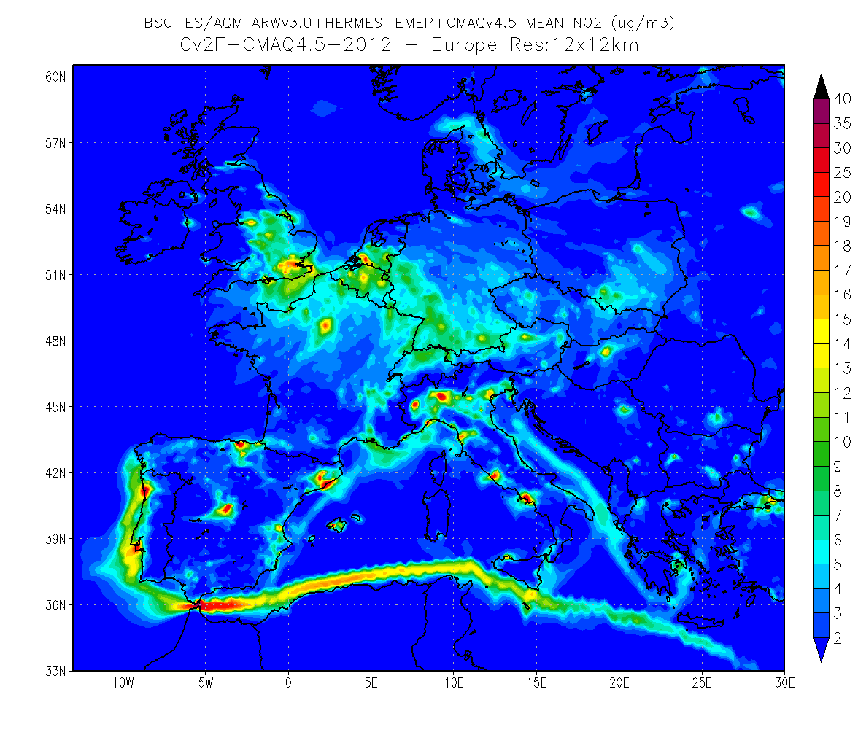
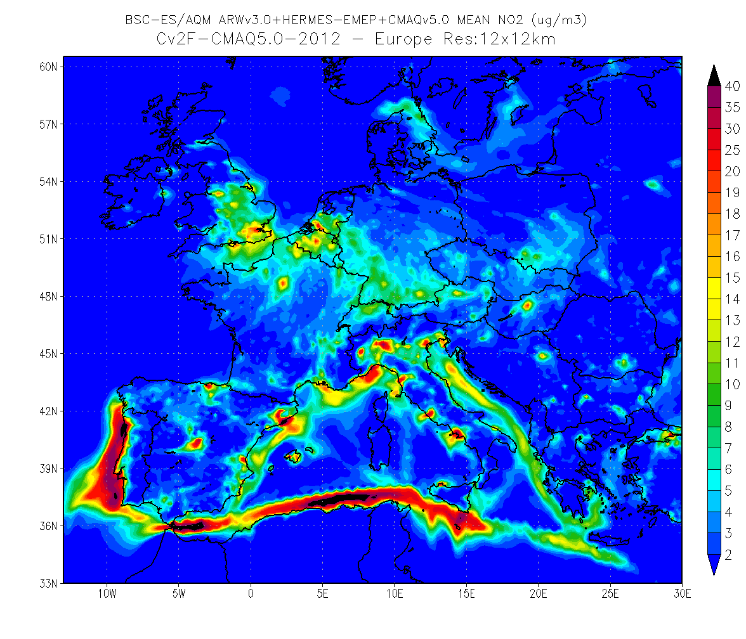
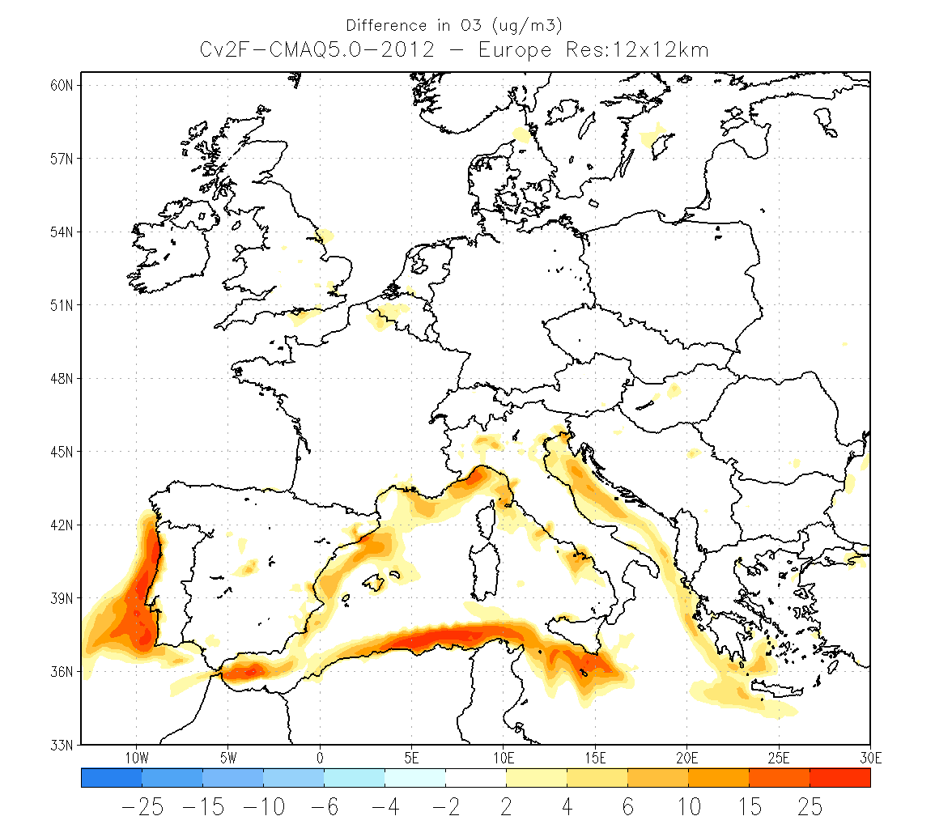
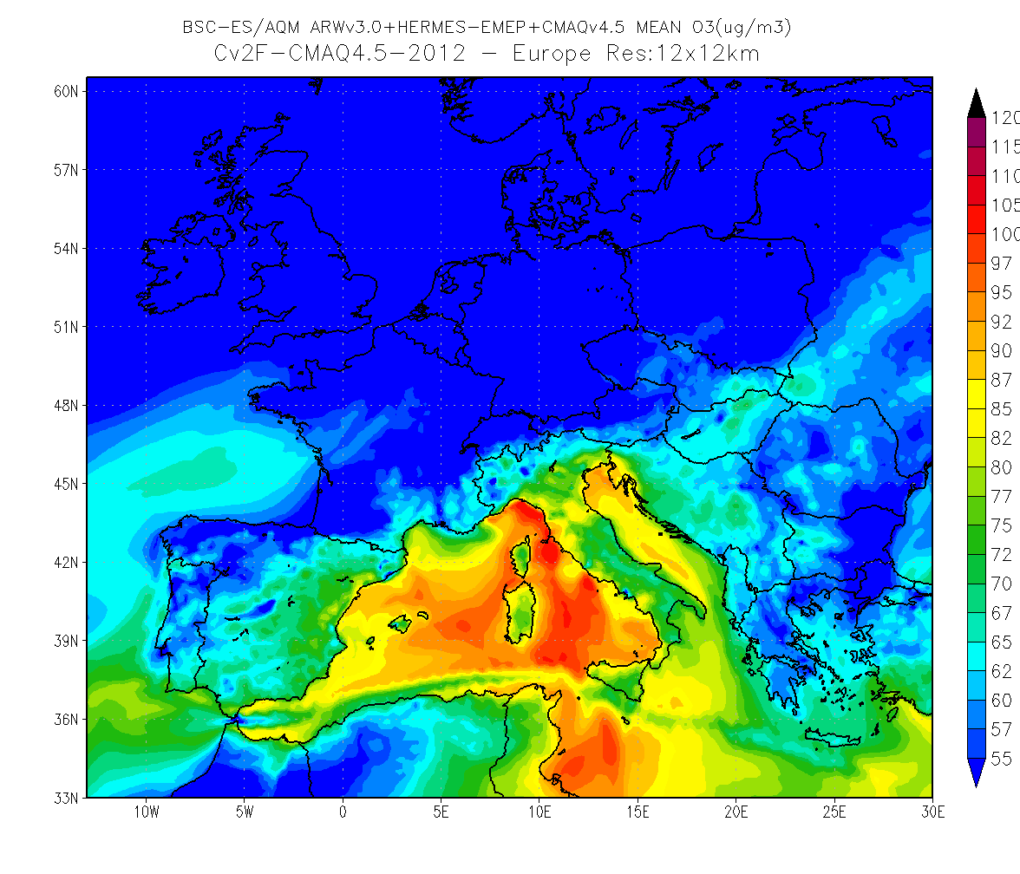
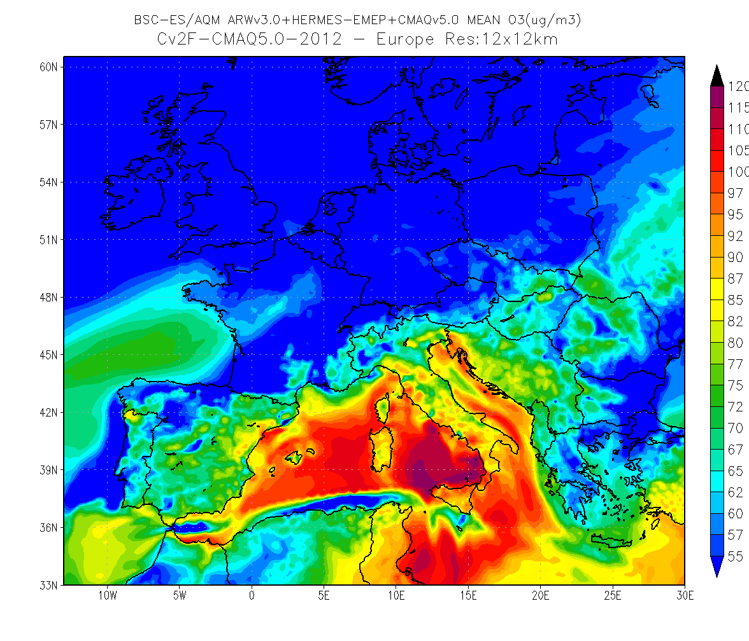
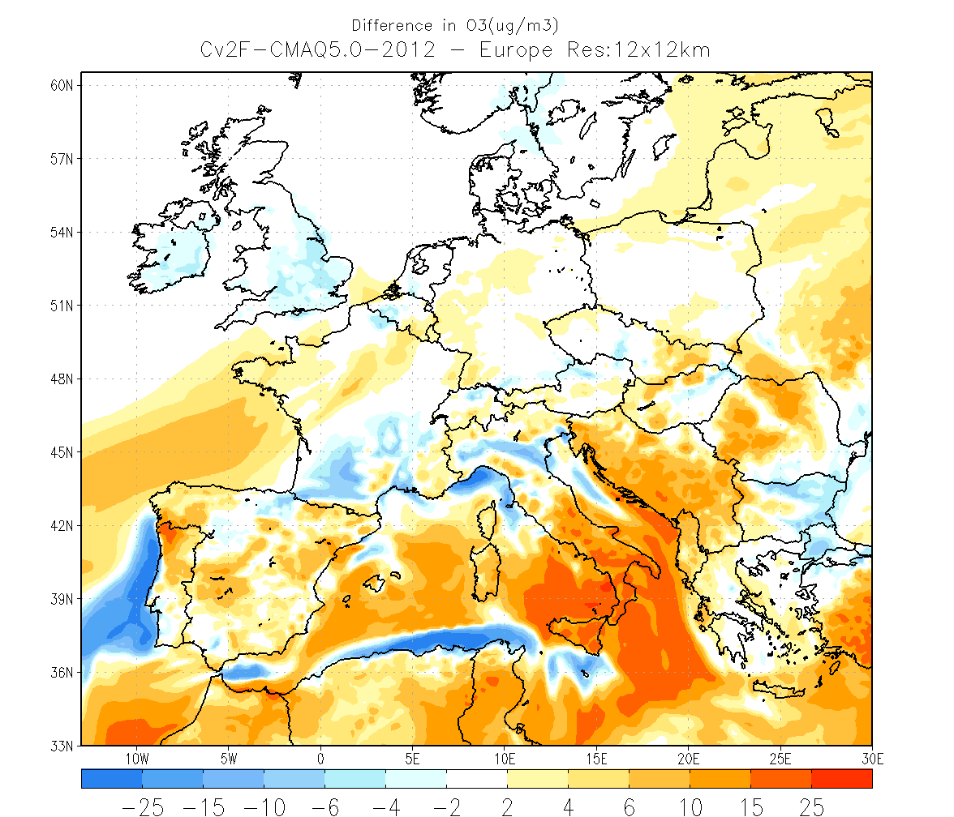
Differences in O₃ and NO₂: 12/05/2012
Bias (µgm⁻³)
CMAQv5.0 – CMAQv4.5
CMAQv4.5
CMAQv5.0
NO₂
O₃

Slide 11
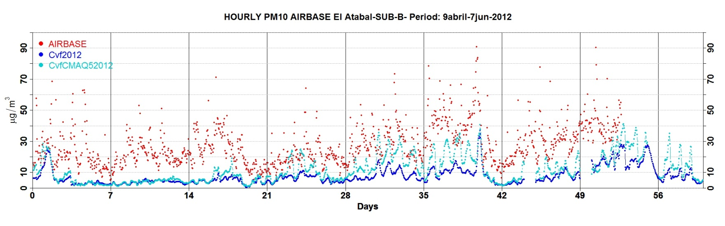
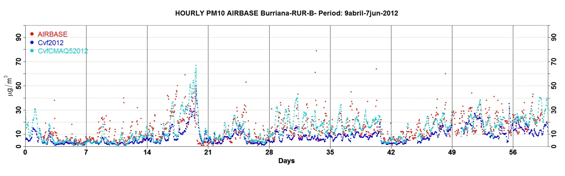
PM10 hourly evaluation at AirBase stations: examples
With CMAQ5.0, PM10 bias reductions against AirBase:
  Background levels ~5 µg m⁻³.
  Daily peaks ~10-20 µg m⁻³.
This is favoured in part by the improvement in AERO5 (aerosol dynamic, thermodynamic, etc.)

Slide 12
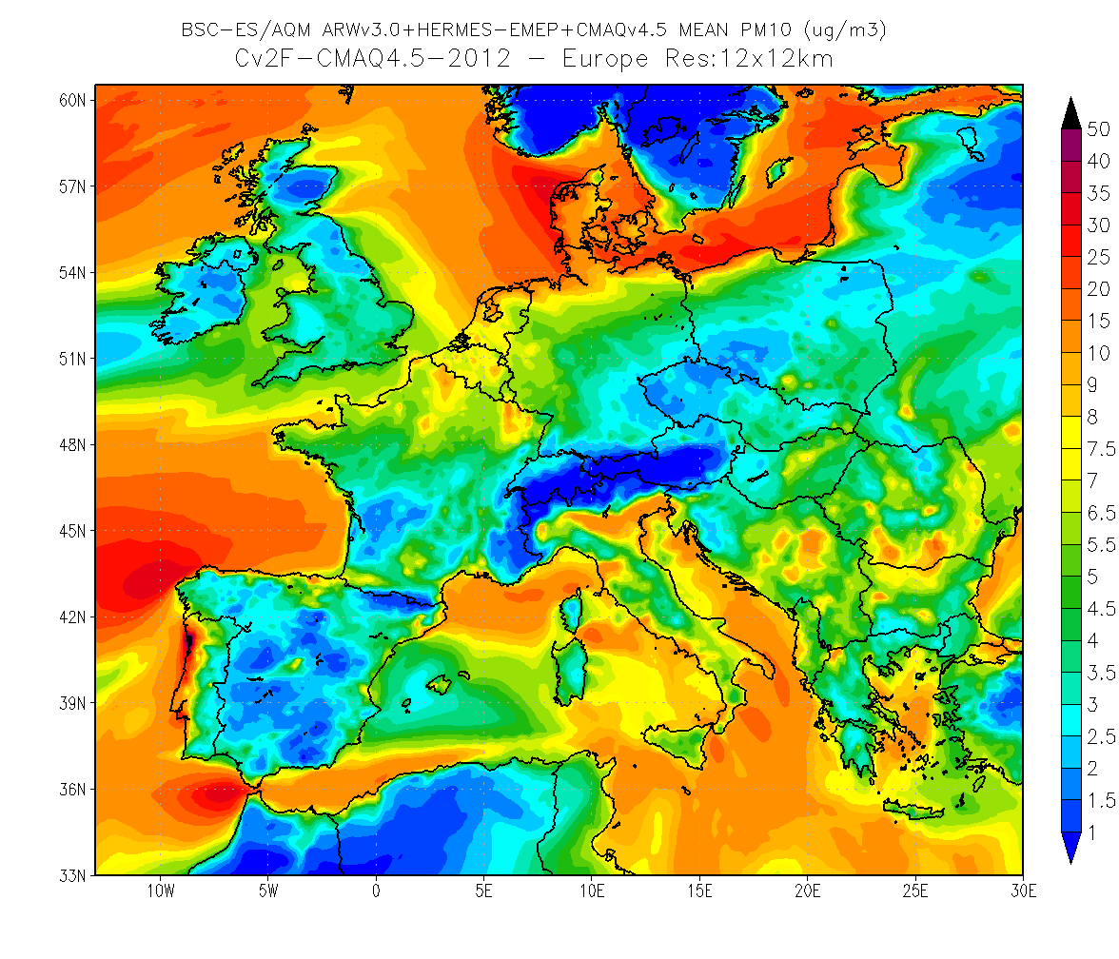
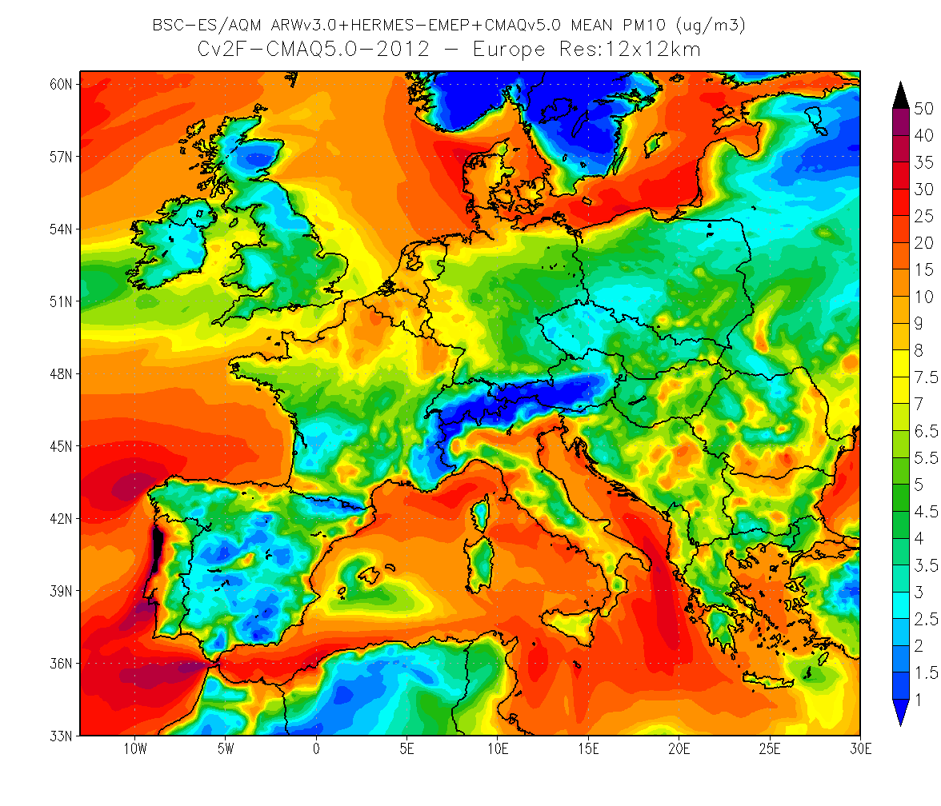
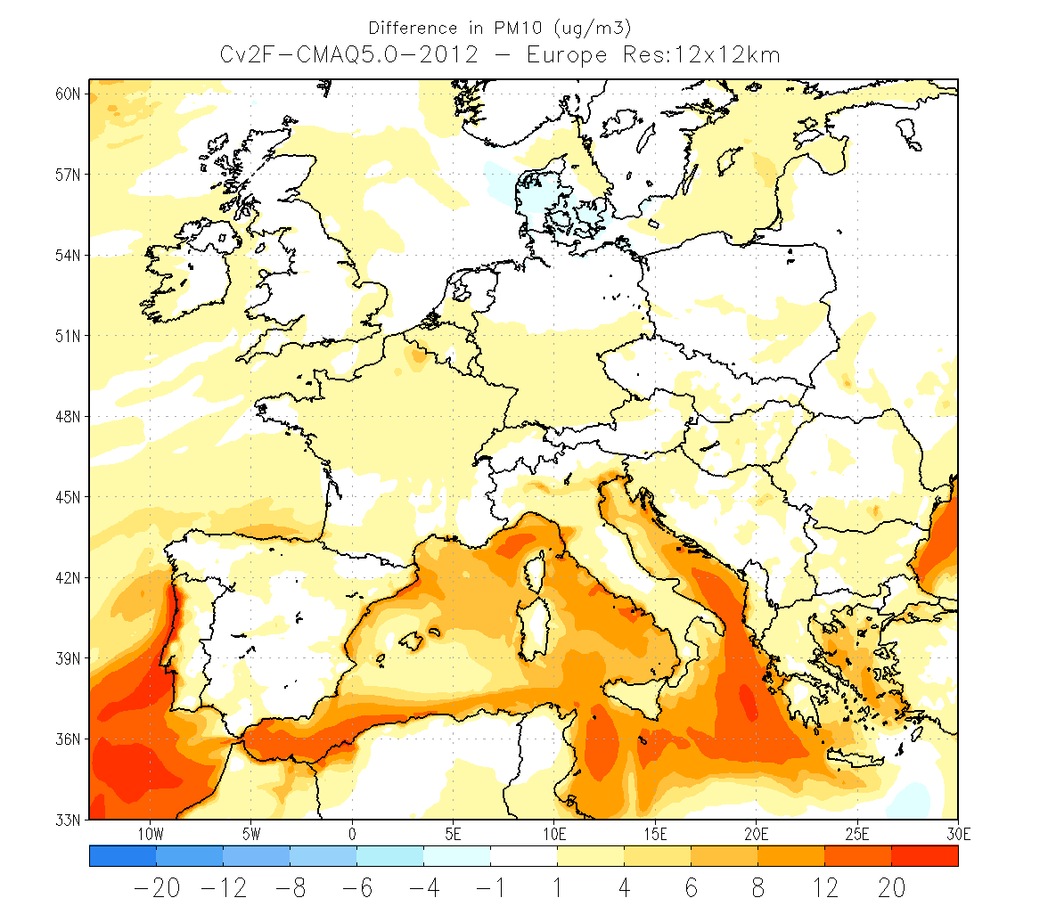
Differences in PM10: 12/05/2012
Bias (µgm⁻³)
CMAQv5.0 – CMAQv4.5
CMAQv4.5
CMAQv5.0

Slide 13
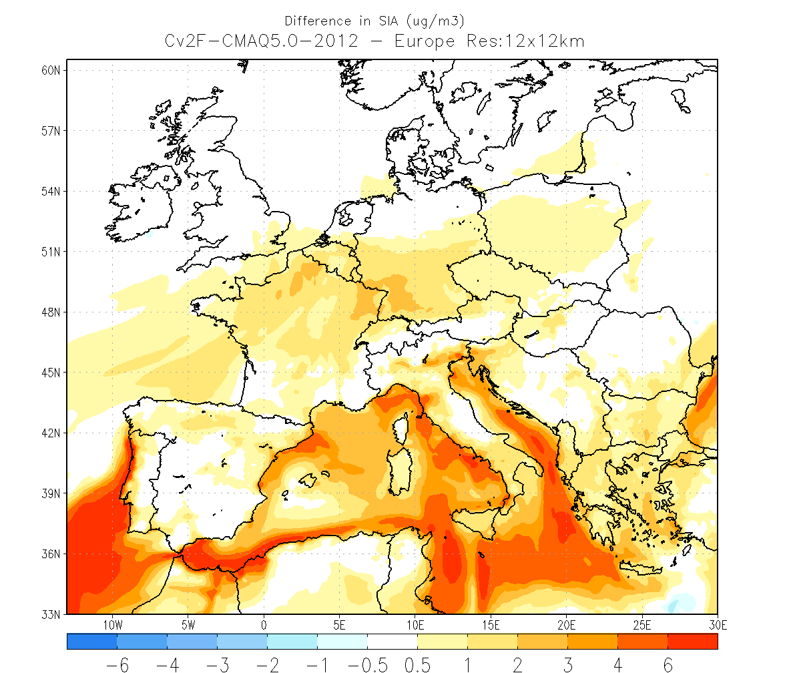
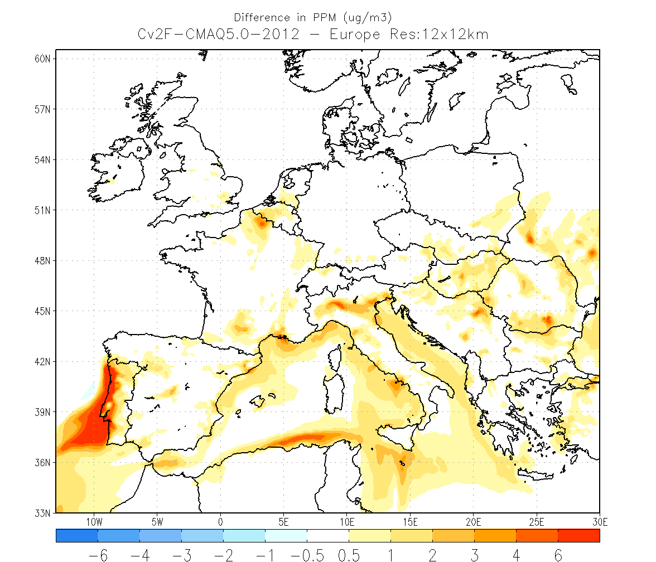
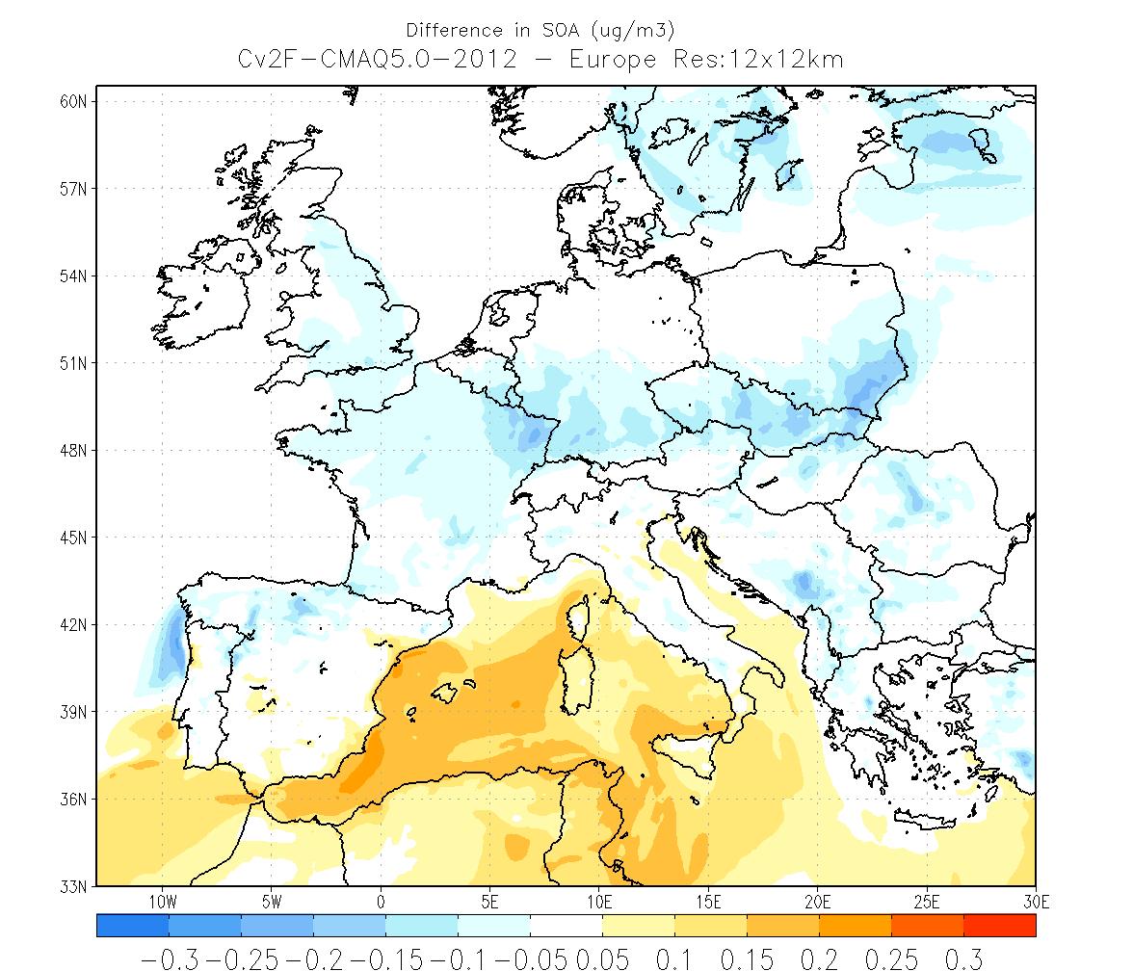
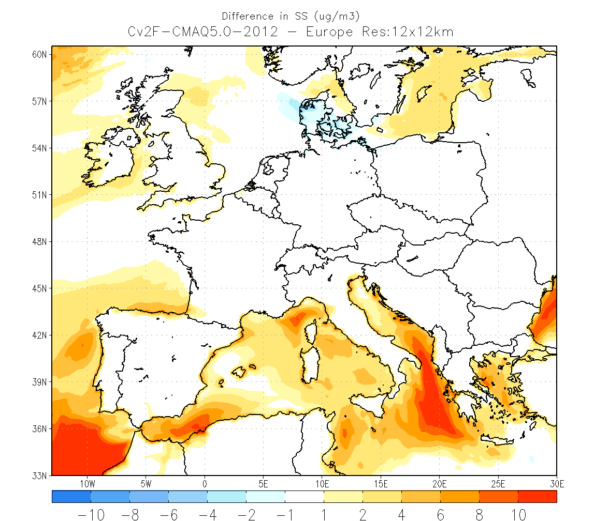
Differences in PM10 components: 12/05/2012
Bias (µgm⁻³): CMAQv5.0 – CMAQv4.5
SIA
PPM
CMAQv5.0
SOA
SS

Slide 14
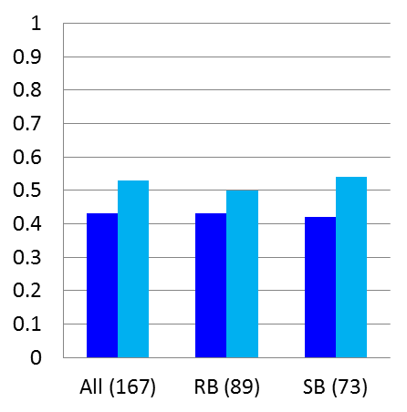
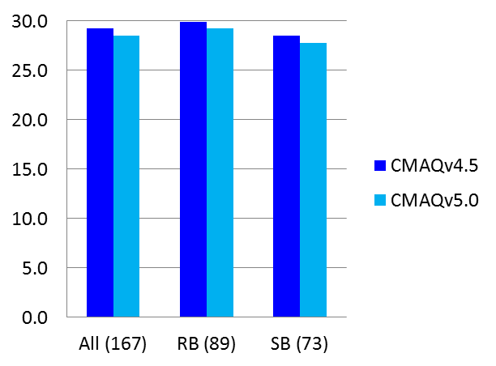
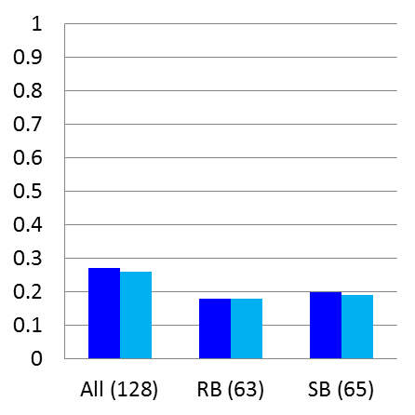
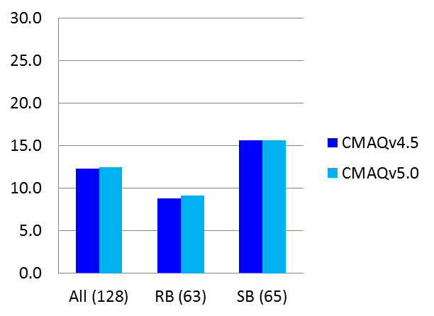
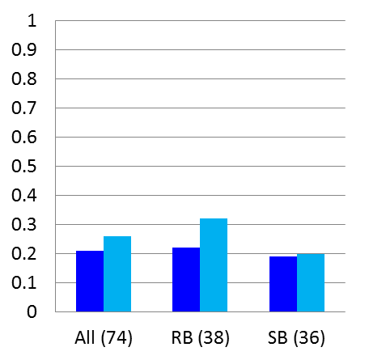
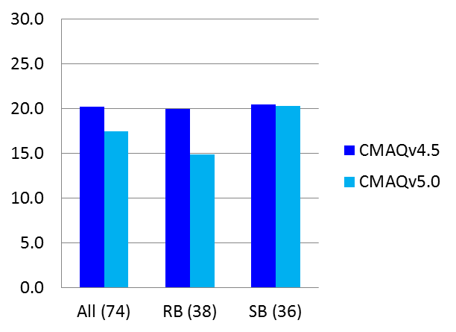
Global statistical evaluation from April 9th till 7th June 2012
Spatial correlation (r)
RMSE (µg m⁻³)
For O₃, the highest improvements with CMAQv5.0 are found at SB stations where r increases from 0.42 to 0.54 and RMSE decreases by ~1 µgm⁻³.
Concerning NO₂ model performance, r and RMSE do not show significant improvements between both CMAQ versions, but mean bias improves by 18% in CMAQ5.0 respect CMAQ4.5
For PM10, relatively improvements of r by 24% for all the stations, and reduction of RMSE by ~3 µgm⁻³ using CMAQv5.0, which represents a reduction of 13% in the error. Significant improvements at RB stations, where r increases by 45% and RMSE is reduced by ~5 µgm⁻³ (26% reduction).
O₃
NO₂
PM10

Slide 15
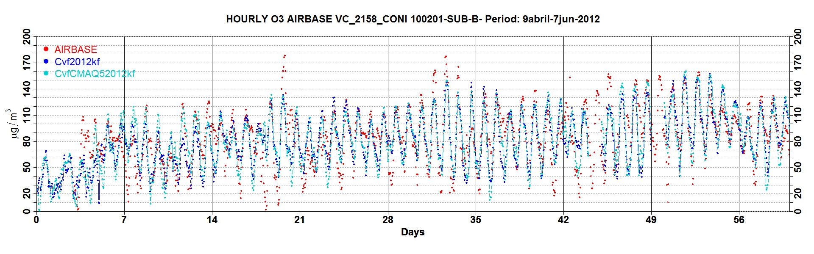
Bias correction techniques (Kalman filter)
Overall the bias-adjustment technique is more effective over CMAQv5.0 than over version 4.5
The pollutant with the highest improvement is O₃. r for all stations increases till 0.53 with CMAQv5.0 after applying KF, meanwhile r reach 0.43 with CMAQ4.5 with the same bias-correction.
The NO₂ performance after applying KF demonstrate significant relative improvements compared to O₃, mostly because the original modeling system skills are lower for this pollutant.
For PM10, KF presents a higher relative improvement applied over CMAQ5.0 than over version 4.5, with an increasing of 19% in r (from 0.36 to 0.43) and a decrease of 15% in RMSE (from 18.1 µgm⁻³ to 15.4 µgm⁻³).
Type (#n) | Version | MOD (µgm⁻³) | OBS (µgm⁻³) | r | RMSE (µgm⁻³)
O₃ All (167) | CMAQv4.5 | 59.1 | 74.3 | 0.43 | 29.2
 | CMAQv5.0 | 58.3 | 74.3 | 0.53 | 28.5
NO₂ All (128) | CMAQv4.5 | 8.8 | 9.8 | 0.59 | 9.4
 | CMAQv5.0 | 8.7 | 9.8 | 0.56 | 9.8
PM10 All (74) | CMAQv4.5 | 13.3 | 14.2 | 0.36 | 18.1
 | CMAQv5.0 | 13.2 | 14.2 | 0.43 | 15.4

Slide 16
Summary
The first evaluation results (April 9th till 7th June 2012) of the two CMAQ versions 4.5 and 5.0, both integrated in the AQF CALIOPE system, indicate:
For NO₂, CMAQv5.0 reduces mean bias (r and RMSE do show significant improvements):
  Bias reduction of forecasted NO₂ peaks (~10-20 µgm⁻³) at SUBURBAN stations with CMAQ5.0.
  Positive biases (CMAQ5.0-CMAQ4.5): > 10 µgm⁻³ along shipping routes and 10-15 µgm⁻³. over important emission sources.
For O₃, CMAQv5.0 improves forecast daily cycle:
  Especially at night-time over SUBURBAN stations, where O₃ biases are reduced between 20 and 30 µgO₃ m⁻³ = positive impact of NO₂ performance.
  Positive biases (CMAQ5.0-CMAQ4.5): 15-25 µgm⁻³ in the Mediterranean Sea and 6-15 µgm⁻³ downwind important NO_{x} emission sources.
For PM10, CMAQv5.0 improves statistics (r, RMSE, and especially bias).
  Episodes of secondary aerosol formation are now reproduced (i.e. 7-14th May 2012) where daily peaks are reduced in ~10-20 µgm⁻³.
  Positive biases (CMAQ5.0-CMAQ4.5): > 12 µgm⁻³ over Mediterranean Sea (mainly SS) and 4-6 µgm⁻³ inland background conc. (mainly SIA ~3 µgm⁻³ and PPM > 4 µgm⁻³).
Bias-adjustment technique based on Kalman filter is more effective over CMAQv5.0.
The scientific improvements included in CMAQv5.0 contribute to INCREASE: (1) the knowledge about air quality over Europe, and (2) the confidence on CALIOPE AQF

Slide 17
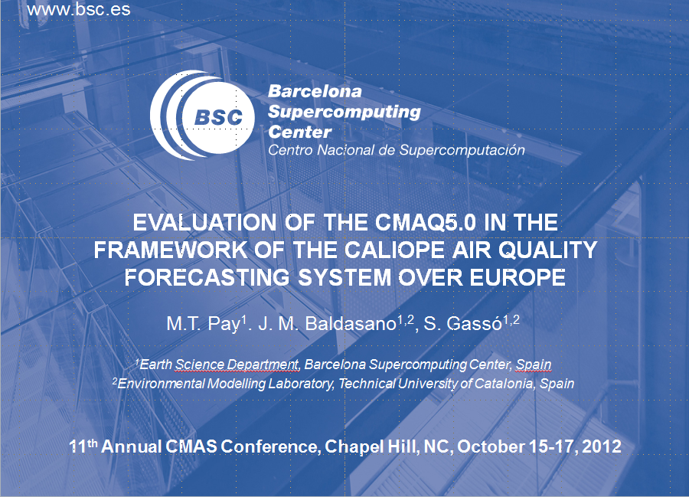
Thank you for your attention
Webs:
Daily Operational Air Quality Forecasts Europe/Iberian Peninsula: http://www.bsc.es/caliope
Daily BSC-DREAM8b mineral dust model forecasts North Africa/Europe/East-Asia: http://www.bsc.es/projects/earthscience/DREAM/
Some references:
Baldasano, J.M., et al., 2011. An annual assessment of air quality with the CALIOPE modeling system over Spain. Sci. Total Environ., 409, 2163-2178.
Pay, M.T., et al., 2012. Spatio-temporal variability of levels and speciation of particulate matter across Spain in the CALIOPE modeling system. Atmospheric Environment 46, 376-396 (2012).
Sicardi et al., 2012. Assessment of Kalman filer bias-adjustment technique to improve the simulation of ground-level ozone over Spain. Sci. Total Environ. 416, 329-342.

