Slide 1
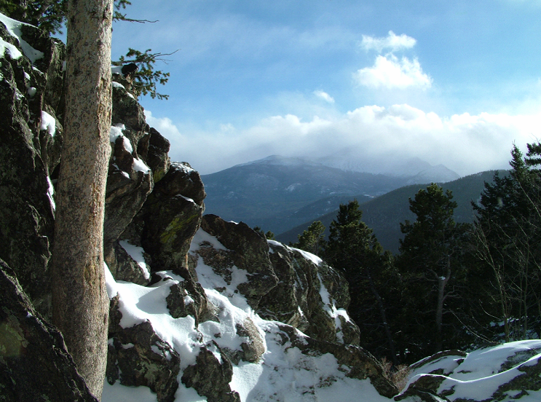
Modeled Ammonia Nitrogen Deposition Source Apportionment at Rocky Mountain National Park for RoMANS2
Mike Barna¹
Marco Rodriguez²
Kristi Gebhart¹
Bret Schichtel¹
Bill Malm³
¹ NPS, Fort Collins, CO
² AECOM, Fort Collins, CO
³ CIRA, Fort Collins, CO
CMAS Annual Meeting
UNC-Chapel Hill
October 15-17, 2012

Slide 2
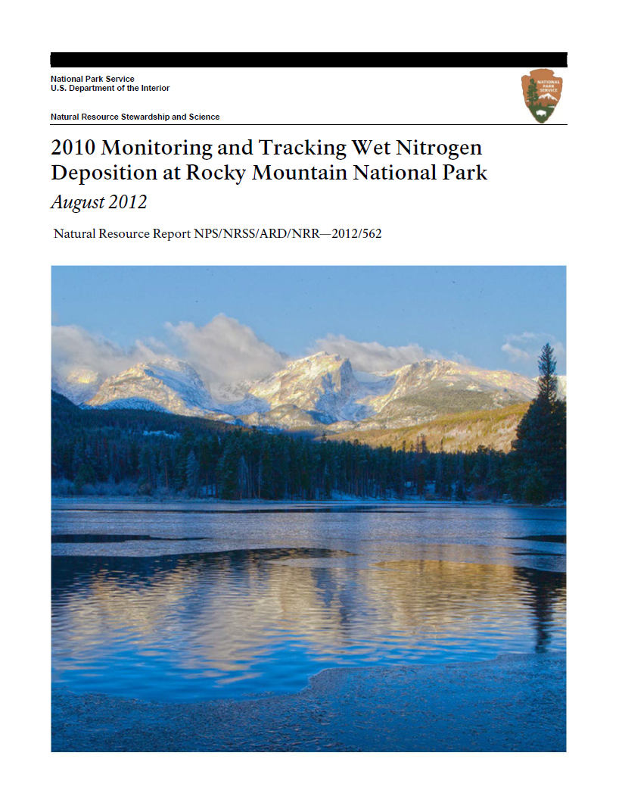
Nitrogen deposition at Rocky Mt NP
Nitrogen deposition and ecosystem change has been extensively studied at RMNP
  NADP and CASTNet
  RoMANS (2006)
  RoMANS2 (2009)
‘resource management goal’ of 1.5 kg/ha/yr
http://www.nature.nps.gov/air/Pubs/pdf/rmnp-trends/rmnp-trends_2010.pdf
Notes:
2

Slide 3
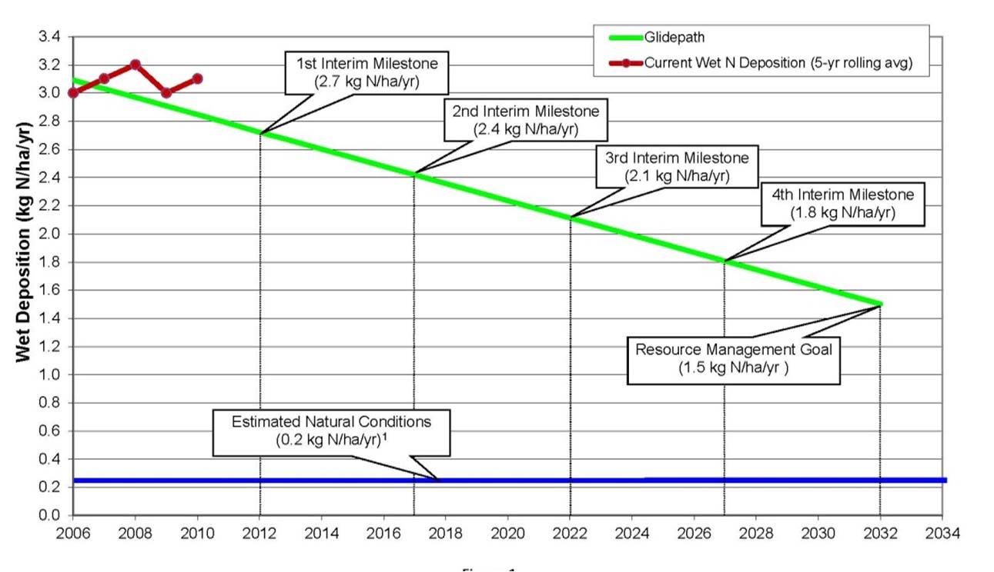
N dep ‘glide path’ at Rocky Mountain NP
Specified as NADP wet deposited nitrogen
Notes:
3

Slide 4
What is the total N deposition at RMNP?
NADP and CASTNet are invaluable resources for investigating trends and patterns in nitrogen deposition, but can’t answer everything
Limitations inherent in monitoring:
  Not all species of interest are accounted
  Dry deposition not a true flux measurement
  Spatial and temporal resolution
Use chemical transport models to fill in gaps
  Estimate deposition in unmonitored areas
  Round-out the ‘total N deposition’ budget
Notes:
4

Slide 5
‘Missing’ (read: unmonitored) nitrogen
Reduced organic nitrogen gases
  Ammonia, amines
‘Nighttime’ nitrogen
  N2O5, nitrate radical
Gas-phase organic nitrates
  PAN, isoprene nitrate
Particle-phase organic nitrates
  High uncertainty, maybe important (Lin et al., 2010)
Notes:
5

Slide 6
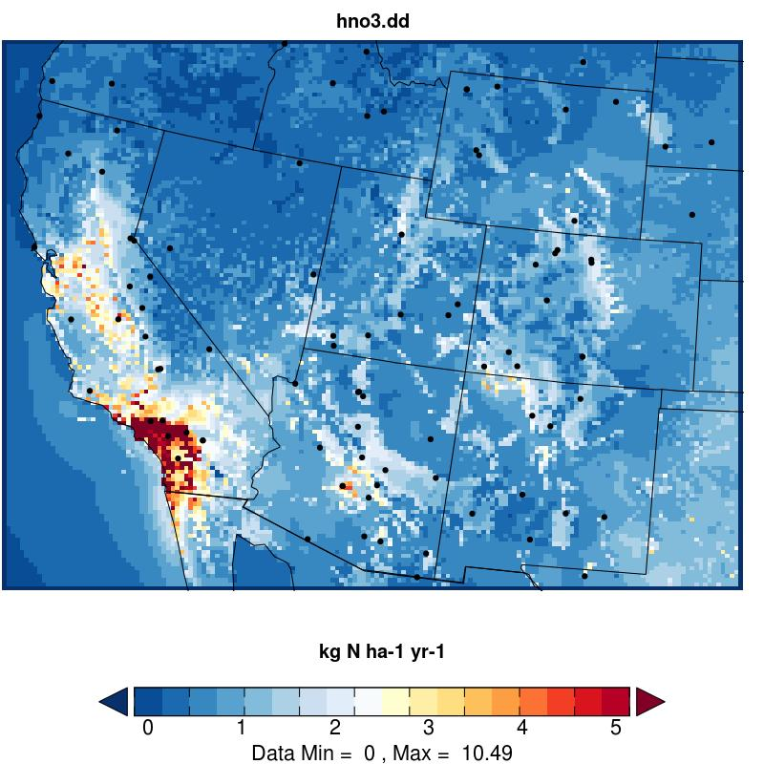
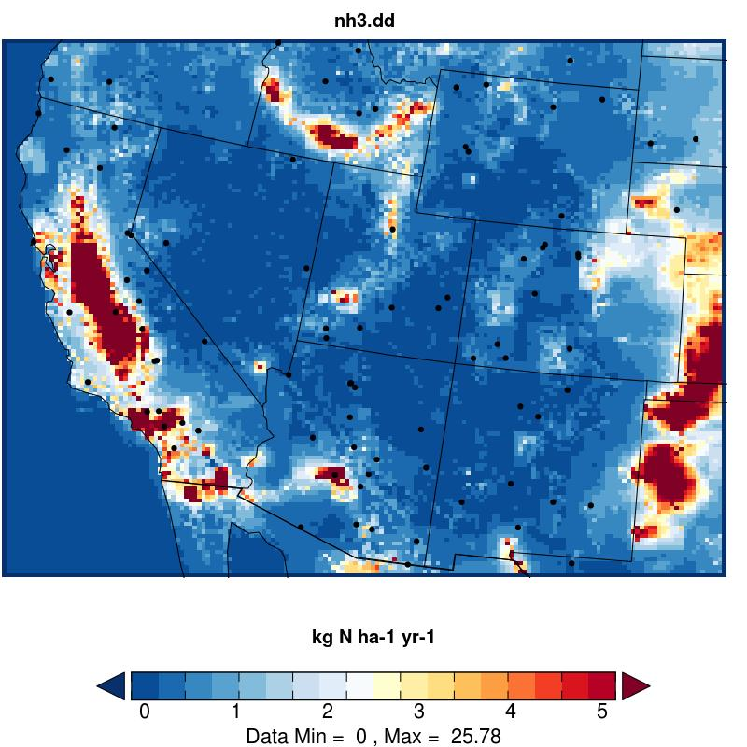
Simulated HNO3 and NH3 dry dep
Nitric acid is monitored by CASTNet, but ammonia obs are rare
HNO3
NH3
Notes:
6

Slide 7
Simulated ‘total’ N dry dep at ROMO
Notes:
7

Slide 8
Observed & predicted N at RMNP
Reduced N:
NH3
NH4+
Ammonia predictions are too low
Oxidized N:
HNO3
NO3-
Notes:
8

Slide 9
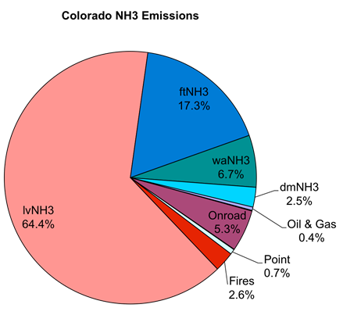
Colorado Romans2 NH3 emissions
Colorado Totals | NH3 (tons/yr)
Area | 76
Onroad | 4,484
Nonroad | 49
Point | 526
Fires | 2,152
Livestock | 54,078
Fertilizer | 14,527
Wild Animals | 5,626
Domestic | 2,099
Oil & Gas | 350
Biogenic | 0
Windblown Dust | 0
Total Colorado | 83,967

Slide 10
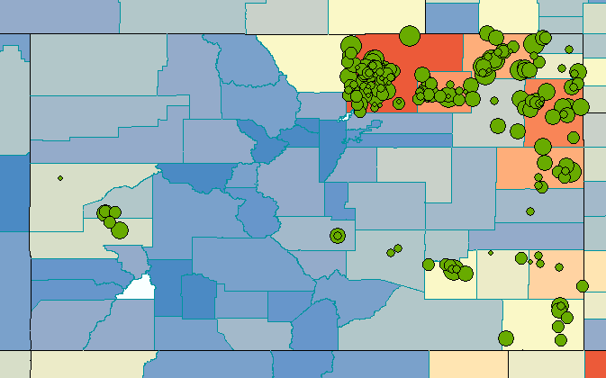
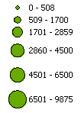
Romans2 Colorado NH3 emissions
Spatially redistribute county-wide NH3 CAFO emissions relative to CAFO size using Jay Ham’s (CSU) inventory
RMNP
Livestock Numbers
(Adelman and Omary, 2011)

Slide 11
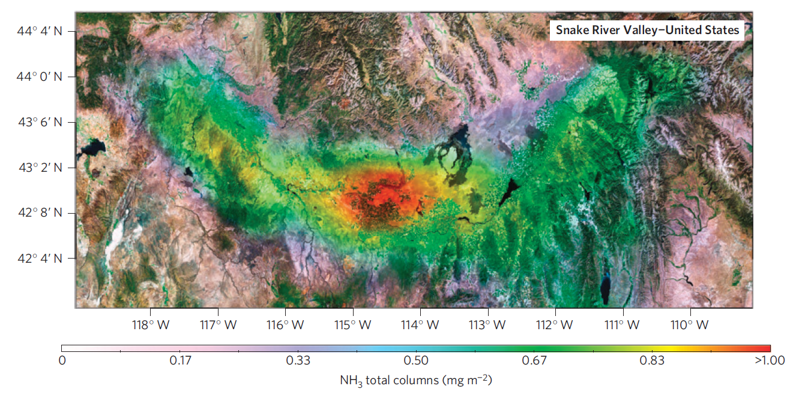
Use a ‘top down’ approach for NH3 EI?
Clarisse et al., 2009, Nature Geoscience
IASI – Infrared Atmospheric Sounding Interferometer
“good qualitative agreement”
“emissions significantly underestimated in northern hemisphere”
Notes:
11

Slide 12
NH3 regions: which impact RMNP?
Use CAMx PSAT with ~20 source regions:
866
865
867
002
778
820/003
864
819
862
861
001
851
857
853
852
845
834
844
842
855
858
859
856
860
821
Notes:
12

Slide 13
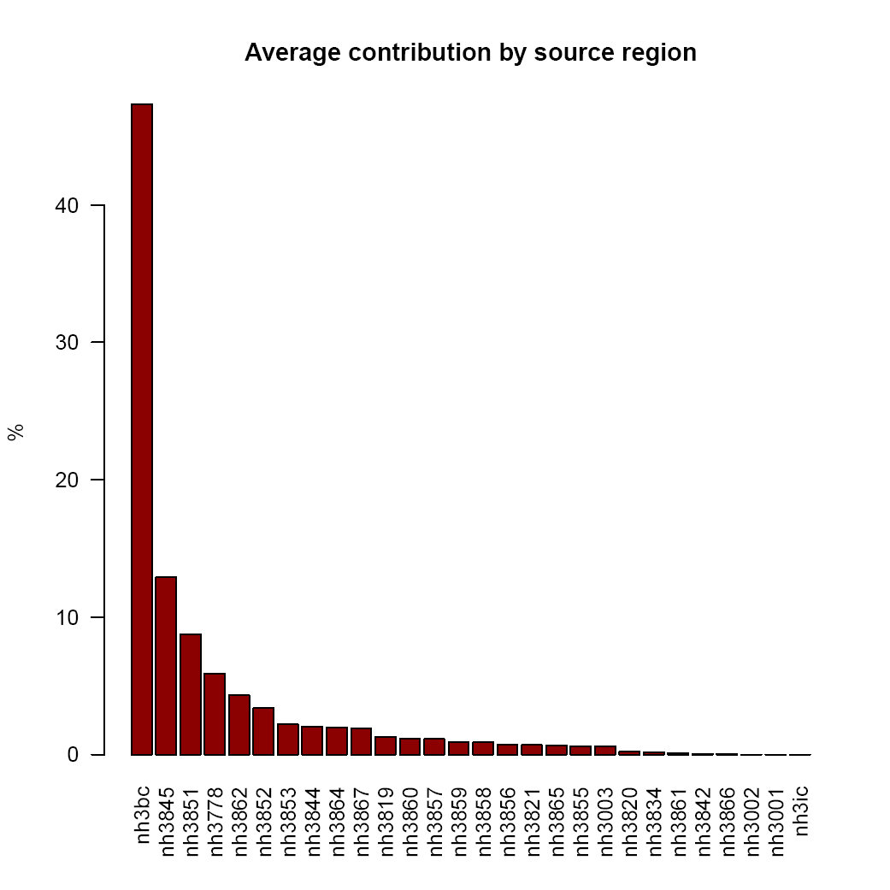
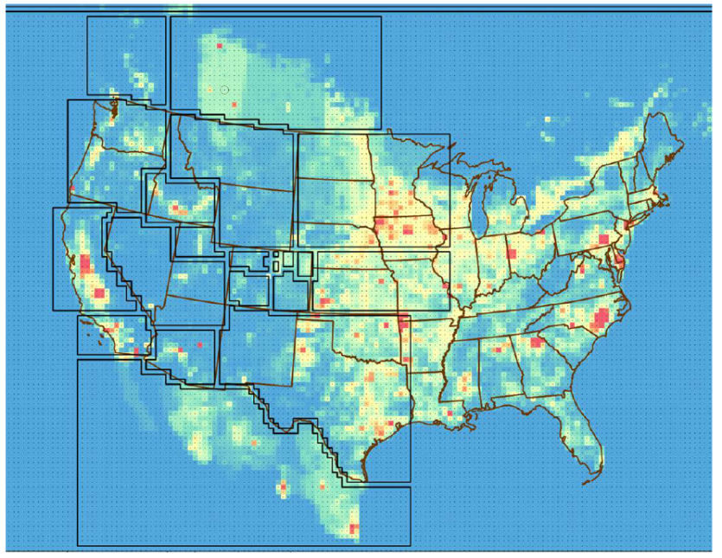
NH3 impacts by region: January
January
Model Mean = 0.018 ug/m³
Model Max = 0.057 ug/m³
Notes:
13

Slide 14
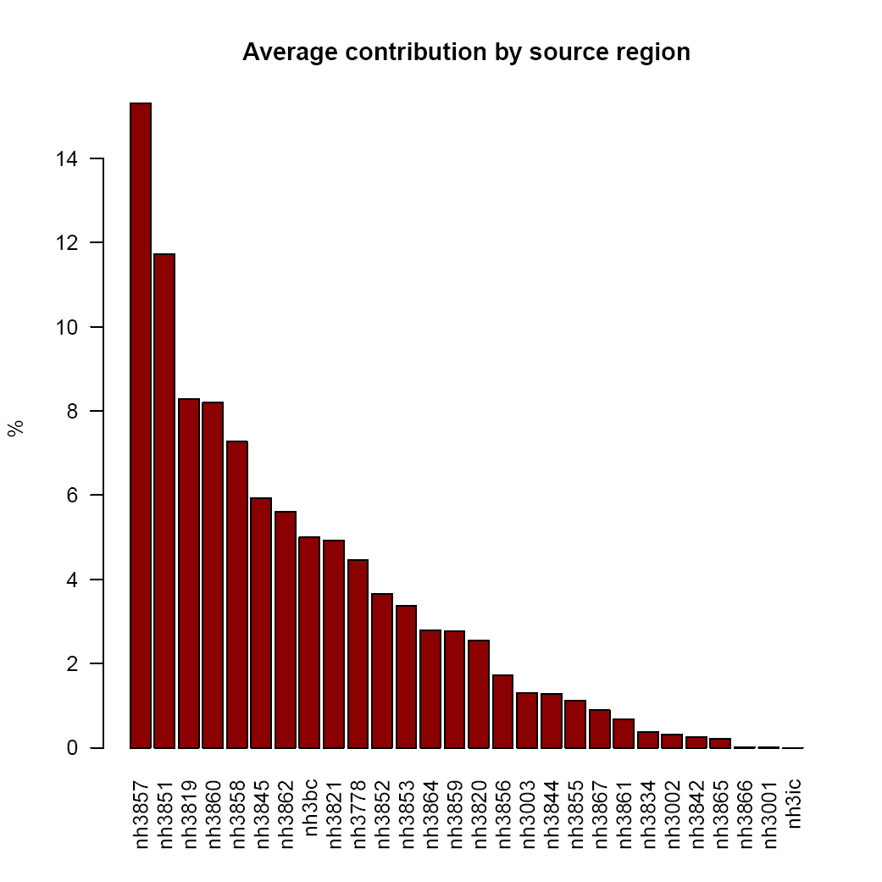

NH3 impacts by region: July
July
Model Mean = 0.200 ug/m³
Model Max = 1.865 ug/m³
Notes:
14

Slide 15
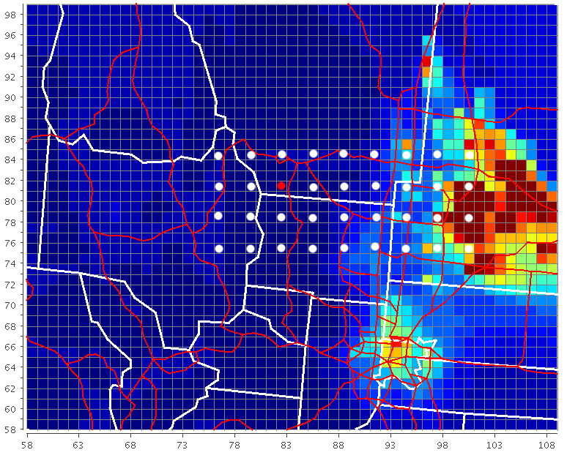
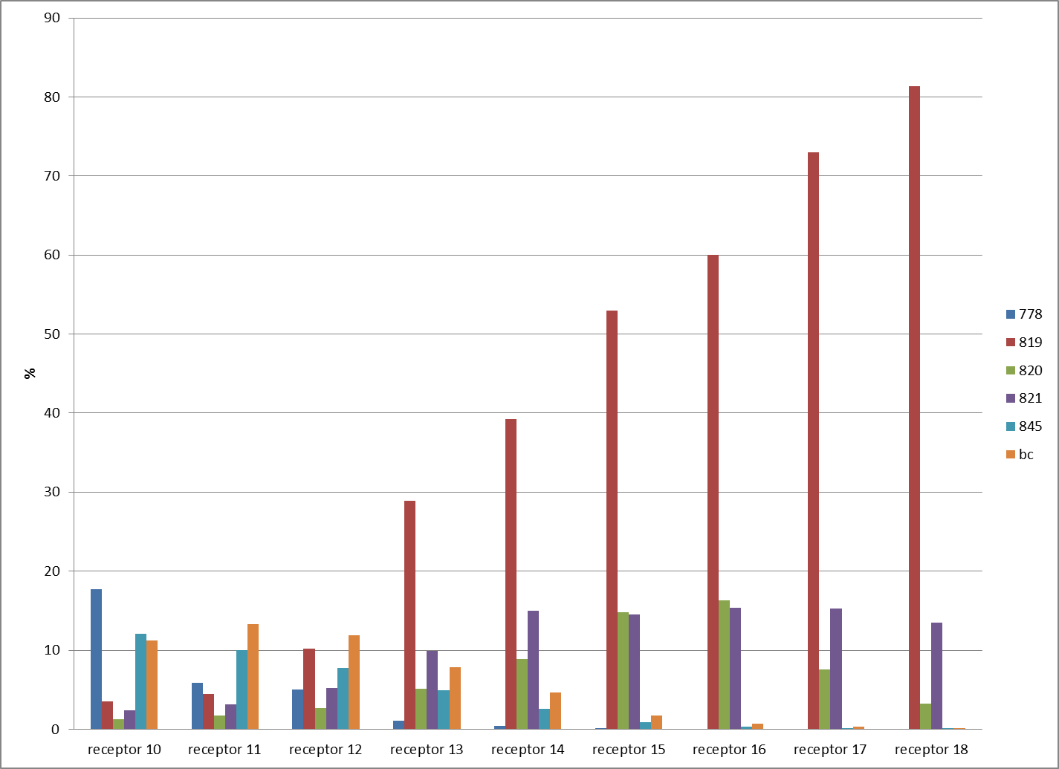
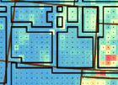
Apportionment depends on location
Annual NH3 Source Apportionment
receptor transect
820
821
819
Notes:
15

Slide 16
Summary
A variety of local and non-local sources are contributing to ammonia at RMNP
  Boundary conditions in winter (lower NH3)
  California, Snake River Valley, Front Range, others, in summer (higher NH3)
  Results are easily influenced by transport, i.e., not getting easterly flow to RMNP
Model inter-comparison would be nice
  Influence of bi-directional flux
  Estimation of dry deposition velocities
Notes:
16

Slide 17
Summary (continued)
What is the role of unmonitored N?
  Ammonia
  Gas-phase reduced organic N
  Gas-phase organic nitrates
  Particle organic nitrates
  N2O5 and NO3 radical
Accounting for ‘missing’ nitrogen can almost double the estimated dry deposition at RMNP (1.2 vs 2.2 kg/ha/yr).
Notes:
17

Slide 18
Acknowledgements
Zac Adelman and Mohammad Omary (UNC-Chapel Hill)
Jay Ham (Colorado State U.)
Jeff Collett, Jr (Colorado State U.)
Notes:
18

