Slide 1
Development of a Crop Residue Burning
Emissions Inventory: Preliminary CMAQ Results
George Pouliot, Jessica McCarty,
Carie Ernst, Tyler Kerr, Amber Soja,
Tom Pace, and Tom Pierce
10th Annual CMAS Conference
25 October 2011

Slide 2
Motivation and Purpose
Historically, state-reported data for agricultural burning emissions have been spotty.
The current SMARTFIRE system does not include emissions from agricultural emissions.
Can the PhD work of McCarty be adapted to build a relatively inexpensive satellite-based approach that would produce spatially and temporally resolved emissions from agricultural burning?
Notes:
Be sure to check the accuracy of these statements … I think they are true but am not certain what SMARTFIRE is doing currently.

Slide 3
Definitions
MODIS: Moderate Resolution Imaging Spectroradiometer on aboard the Aqua and Terra satellites
MOD/MYD14: MODIS active fire product
McCarty (2011): Regionally-tuned 8-day cropland differenced Normalized Burn Ratio product for the contiguous U.S.
SMARTFIRE (v1): Satellite Mapping Automated Reanalysis Tool for Fire Incident Reconciliation (SMARTFIRE) version 1 (Raffuse et al., 2009)

Slide 4
MODIS burn product: MCDA45A1
● Monthly level-3 gridded 500-meter product, which contains burning and quality information on a per-pixel basis.
● Produced from both the Terra and Aqua MODIS-derived daily surface reflectance inputs, the algorithm analyzes the daily surface reflectance dynamics to locate rapid changes, uses that information to detect the approximate date of burning, and maps the spatial extent of recent fires only.

Slide 5
Data for estimating agricultural burning emissions
McCarty (2011): Regionally-tuned 8-day cropland differenced Normalized Burn Ratio product for the contiguous U.S. combined with MODIS Active Fire Product
MODIS Official Burned Area Product (MCD45A1) (Roy et al., 2005; 2008) combined with the MODIS Active Fire Product (MOD/MYD14) (Giglio et al., 2003; 2006) to create a daily area burned product
SMARTFIRE v1 combined with FCCS fuel map and FCCS=0 selected
Notes:
This seems redundant of previous slides; perhaps they could be combined/simplified.

Slide 6
Method to compute crop residue burning emissions
Start with MODIS daily burn area product
Use McCarty (2011) (but not fire locations) to estimate emissions for PM2.5, PM10, CO, NOX, SO2
Use emission factor ratios to compute VOC and NH3 emissions
Notes:
Reference for VOC and NH3 would be useful although is given later … a simple flow chart rather than words would have been more effective to describe methodology

Slide 7
Agricultural burn areas as mapped by two methods
Notes:
What’s the take home message? It would be effective to put this message at bottom of slide.

Slide 8
Estimating VOC and NH3 Emissions
Used AP-42 emission factor ratios to estimate VOC for specific crop types
Used 2002 NEI emission ratios to estimate NH3/NOX
Crop Type | VOC/CO | NH3/NOX
Kentucky bluegrass | 0.05 | 0.29
Corn | 0.18 | 0.42
Cotton | 0.07 | 0.71
Rice | 0.10 | 0.42
Soybean | 0.15 | 0.71
Sugarcane | 0.11 | 0.71
Wheat | 0.10 | 0.71
Other/fallow/lentils | 0.05 | 0.29

Slide 9
Crop residue burning emissions inventory
Converted lbs/day to tons/day for CO, PM10, PM25, SO2
For NOx, computed NOx = 10 * NO2
Notes:
What is the basis for the NOx calculation? Why is the lbs to tons conversion an important issue for the audience?

Slide 10
Basis for emission factors
Started with the emission factors from McCarty (2011), but increased by one standard deviation to be consistent with other literature-reported values
This resulted in an inconsistency between PM10 and PM2.5 factors
Used the ratio of PM10/PM2.5 from the mean and applied this to the high value to get PM2.5 factors
Notes:
Specific examples starting w/ the McCarty values, the standard deviations, the literature values, and the resulting recommendation would have been very useful here.

Slide 11
PM10 and PM2.5 Emission Factors
Crop Type | PM10 (lbs/ton) | PM2.5 (lbs/ton)
Kentucky bluegrass | 52.46 | 38.62
Corn | 42 | 11.81
Cotton | 17.73 | 12.66
Rice | 21.17 | 7.06
Soybean | 17.73 | 12.66
Sugarcane | 11.31 | 9.84
Wheat | 19.19 | 10.98
Other/fallow/lentils | 26.87 | 18.59

Slide 12
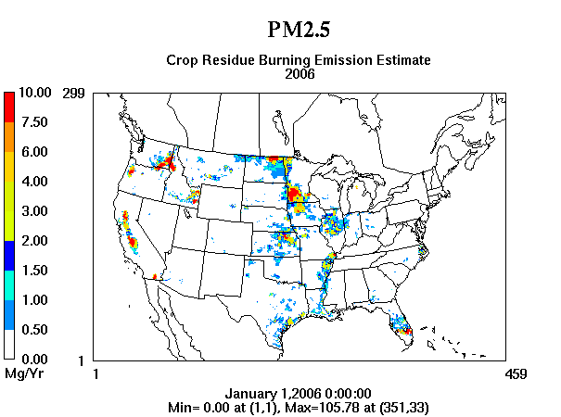
2006 emissions estimate
Notes:
It would be nice to see this is a meaningful unit like tons/acre or metric-tons/ha instead of Mg per grid cell.

Slide 13
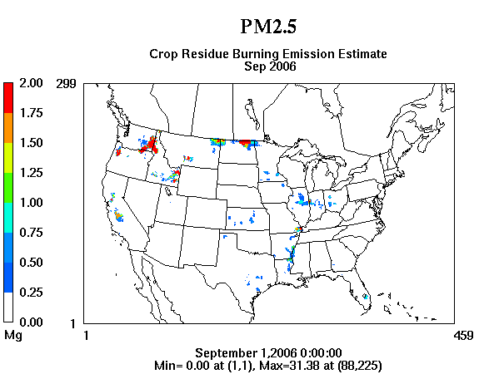
September 2006 emissions

Slide 14
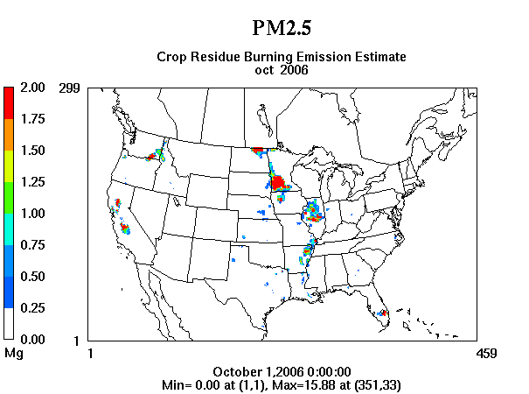
October 2006 emissions

Slide 15
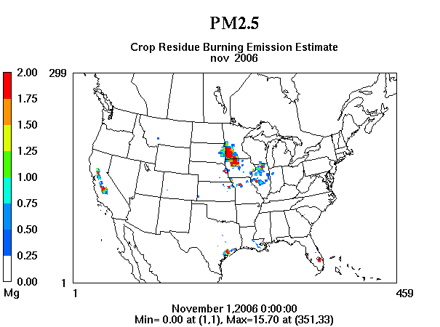
November 2006 emissions

Slide 16
Updated diurnal profile

Slide 17
Processing Emissions
Computed daily county-level estimates by crop type
Applied diurnal profile
Used current EPA Speciation for VOC and PM2.5
Allocated county averages to model grid using spatial surrogates (agriculture mask)
Assumed emissions in layer 1 (no plume rise)

Slide 18
Model Configuration
CMAQ 5 (Beta)
12-km CONUS Domain
WRF Meteorology used in CMAQ5 beta testing
34 vertical layers
GEOS CHEM boundary conditions
Three model runs were compared:
Base (using old 2002 ag burning emissions)
Zero crop residue emissions
Emissions using new emission factors and new temporal profile

Slide 19
Purpose of CMAQ runs
Identify monitors where CMAQ run with ag burning responds to emissions by comparing to run without ag burning emissions
Note: Ag burning is only a small portion of total PM2.5 emissions and does not have a large spatial extent. Most monitor/model pairs show zero or negligible differences. However, three episodes appear to have a crop residue burning signal.
September, October and November runs complete
Focus on PM2.5

Slide 20
Three episodes of interest in 2006:
22-30 September: Bluegrass in WA,ID, and MT
14-15 October: Wheat in Arkansas
8-15 November: Sugarcane in Florida

Slide 21
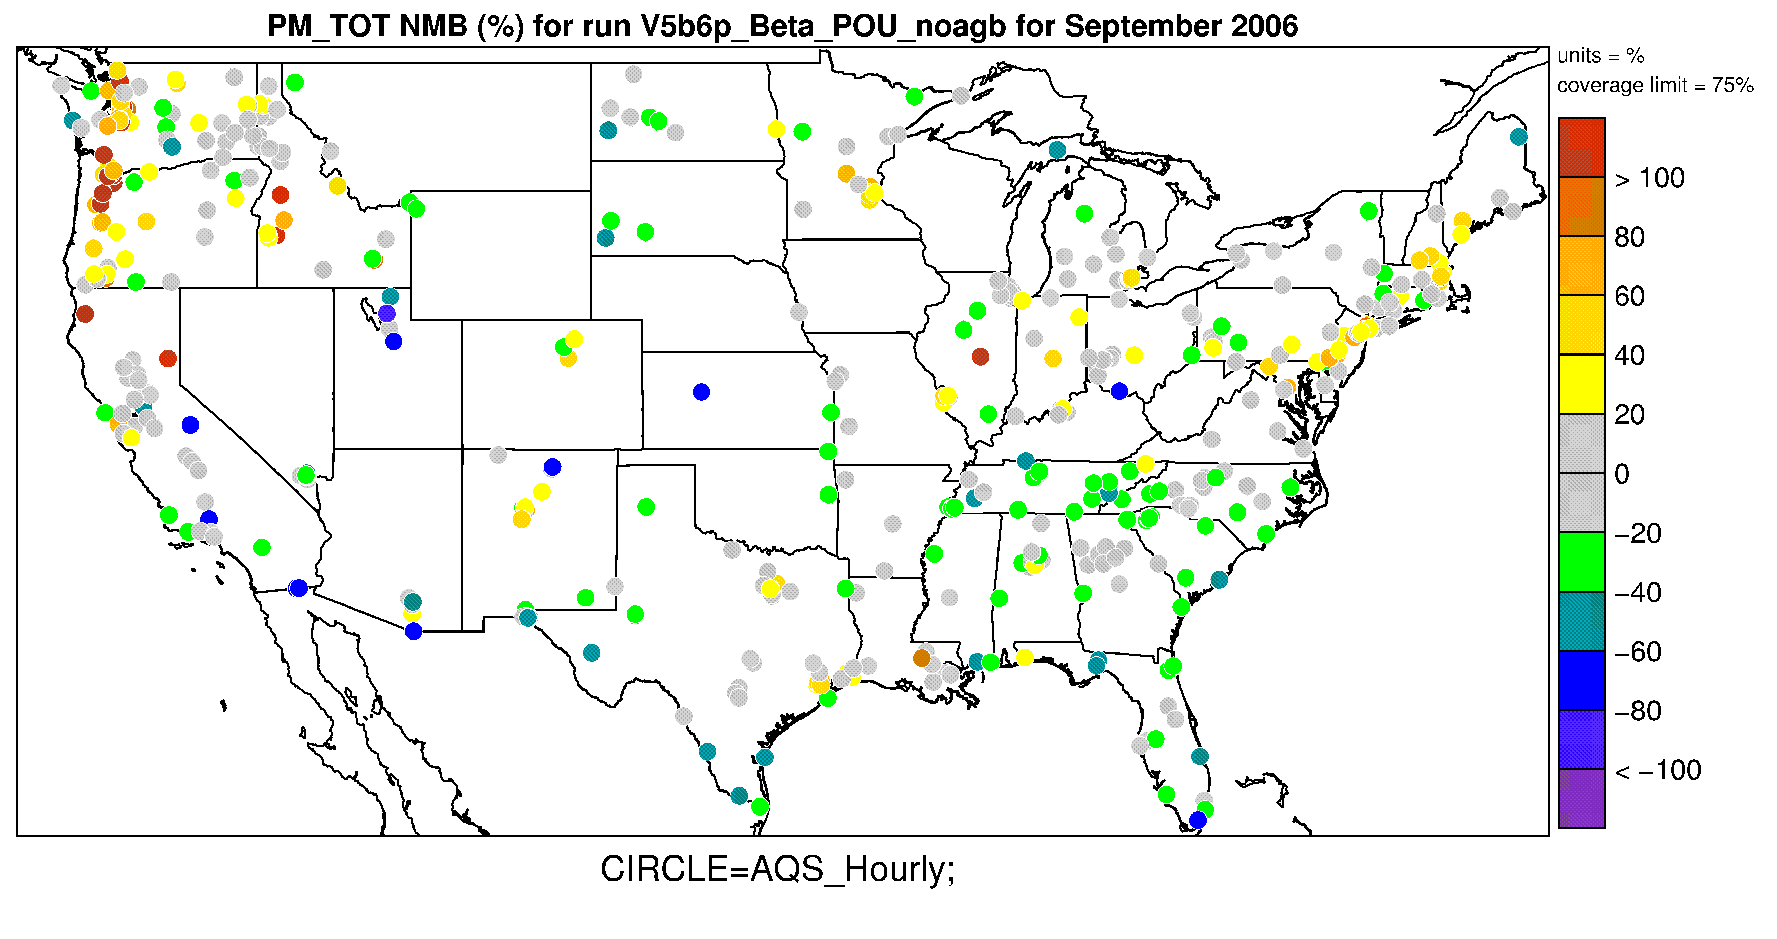
Even without crop residue burning emissions, CMAQ has high bias for PM2.5 in the Pacific Northwest and the northeastern U.S.

Slide 22
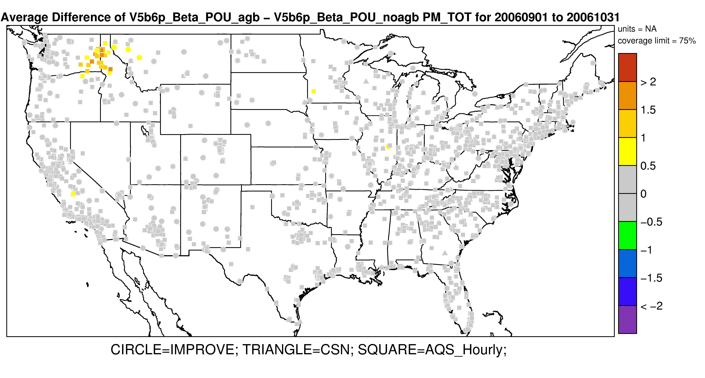
Average difference in PM2.5 between model runs at monitoring sites for Sep-Oct 2006
Model runs: With and without crop residue burning emissions

Slide 23
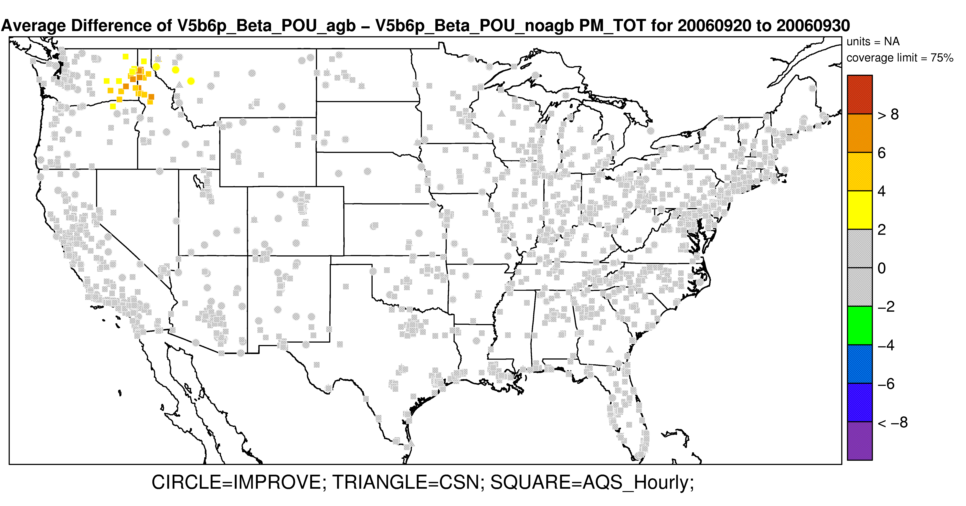
Difference in model results for the Sep 20-30, 2006, episode
Notes:
Blue Grass : These are hot fires

Slide 24
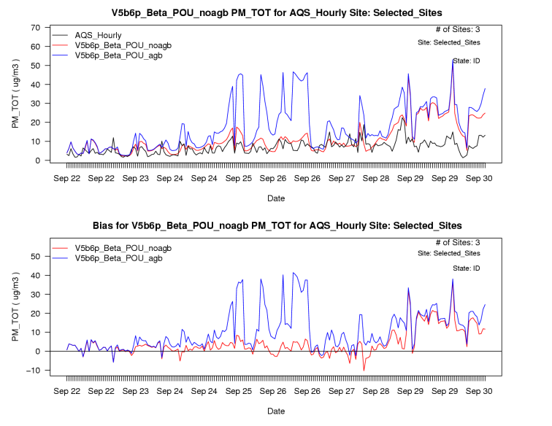
Ag burning emissions increase modeled concentrations during Sep 22-30, 2006
3 Sites from Idaho

Slide 25
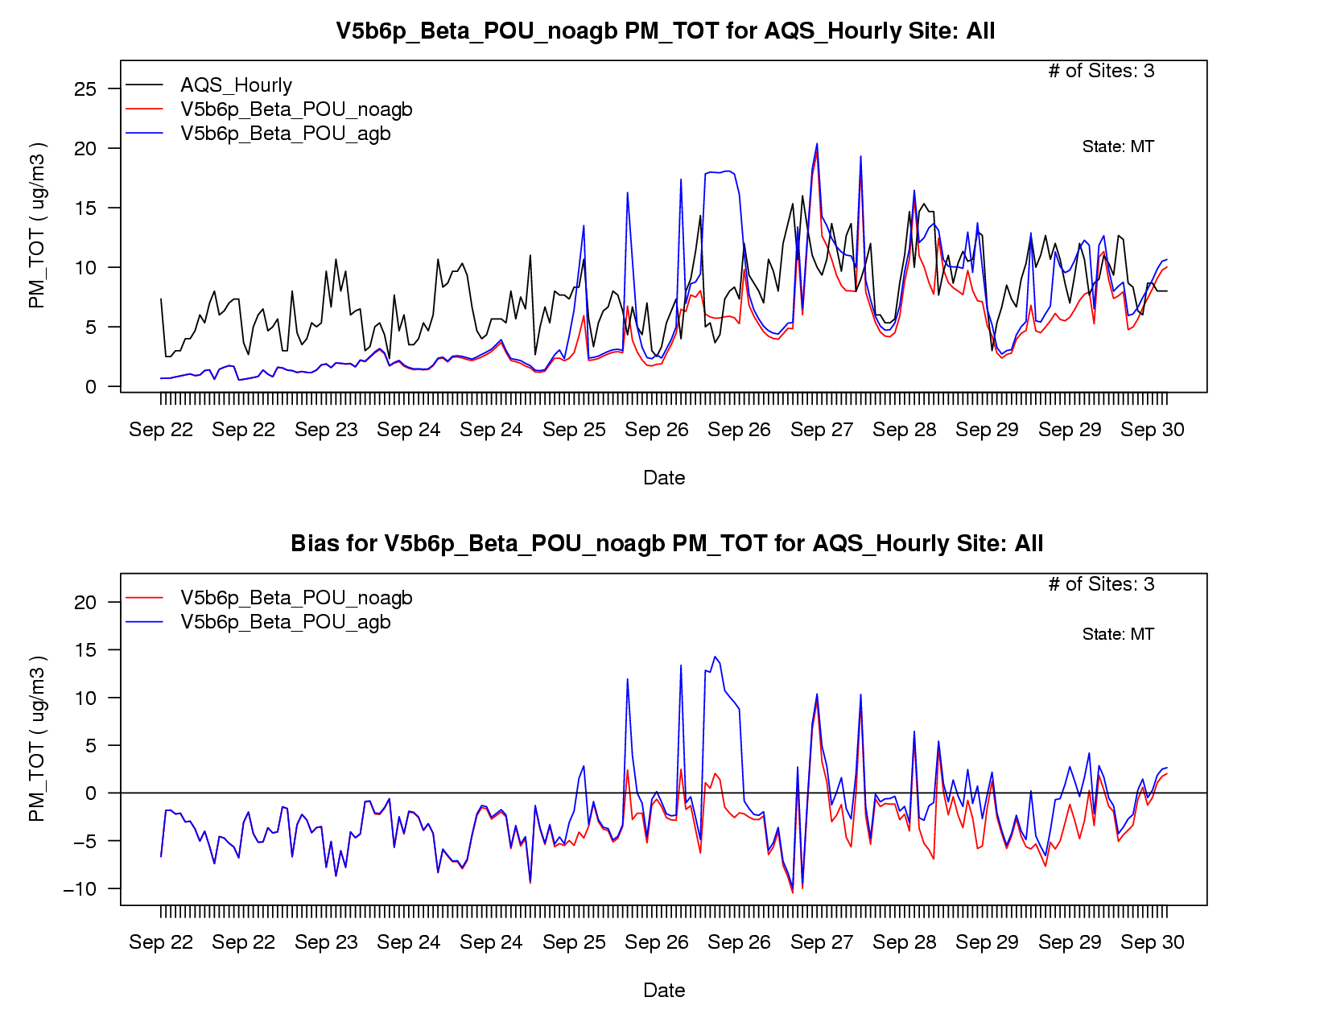
Ag burning emissions increase modeled concentrations during Sep 22-30, 2006
3 Sites from Montana

Slide 26
Second episode: Oct 14-15 (Arkansas)

Slide 27
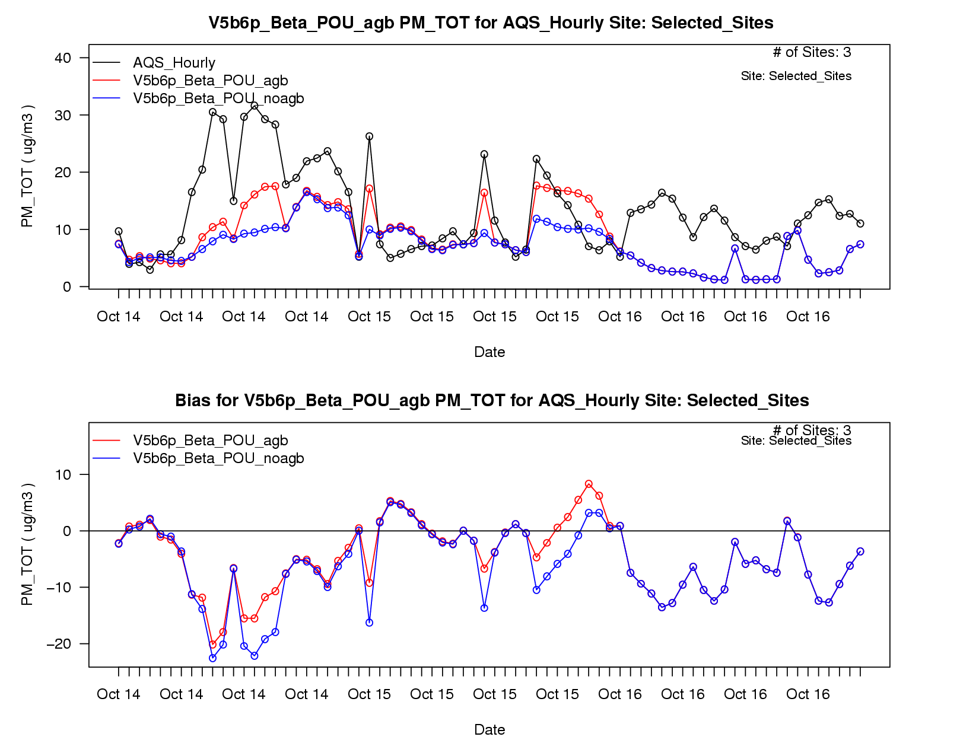
Results at 3 sites in Arkansas
Note: Emissions have good correlation on an hourly time scale
Notes:
Wheat Burning

Slide 28
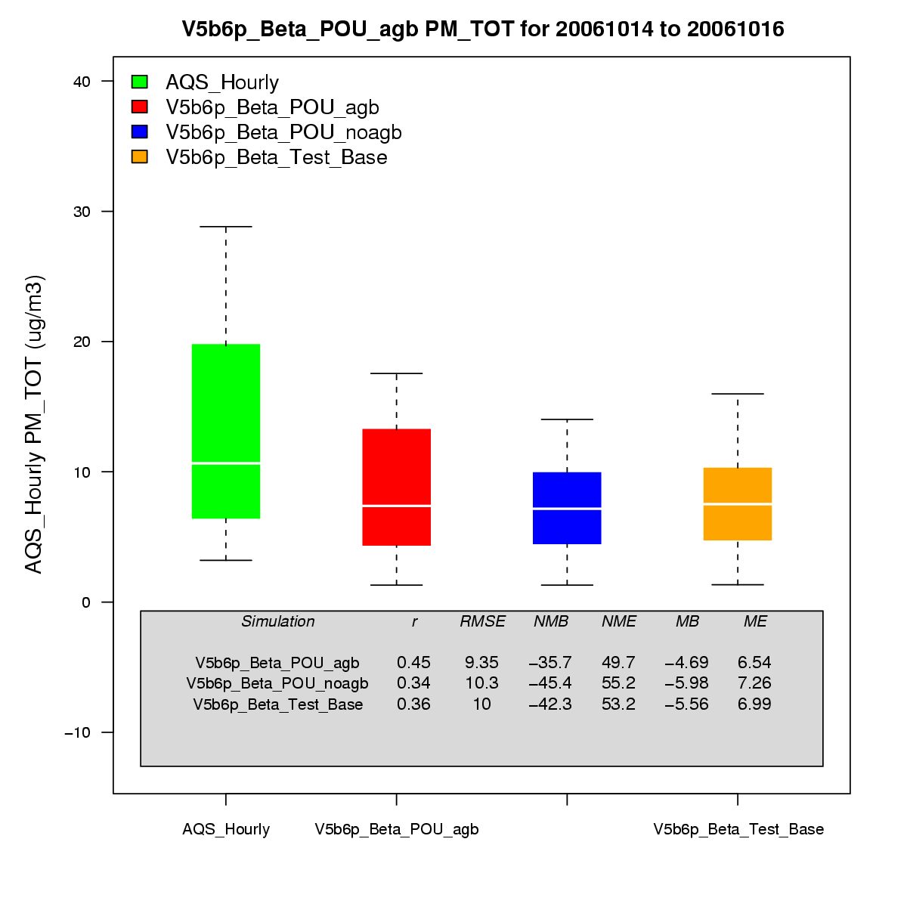
Evaluation statistics from the Oct 14-16 episode
3 AQS Sites from Arkansas

Slide 29
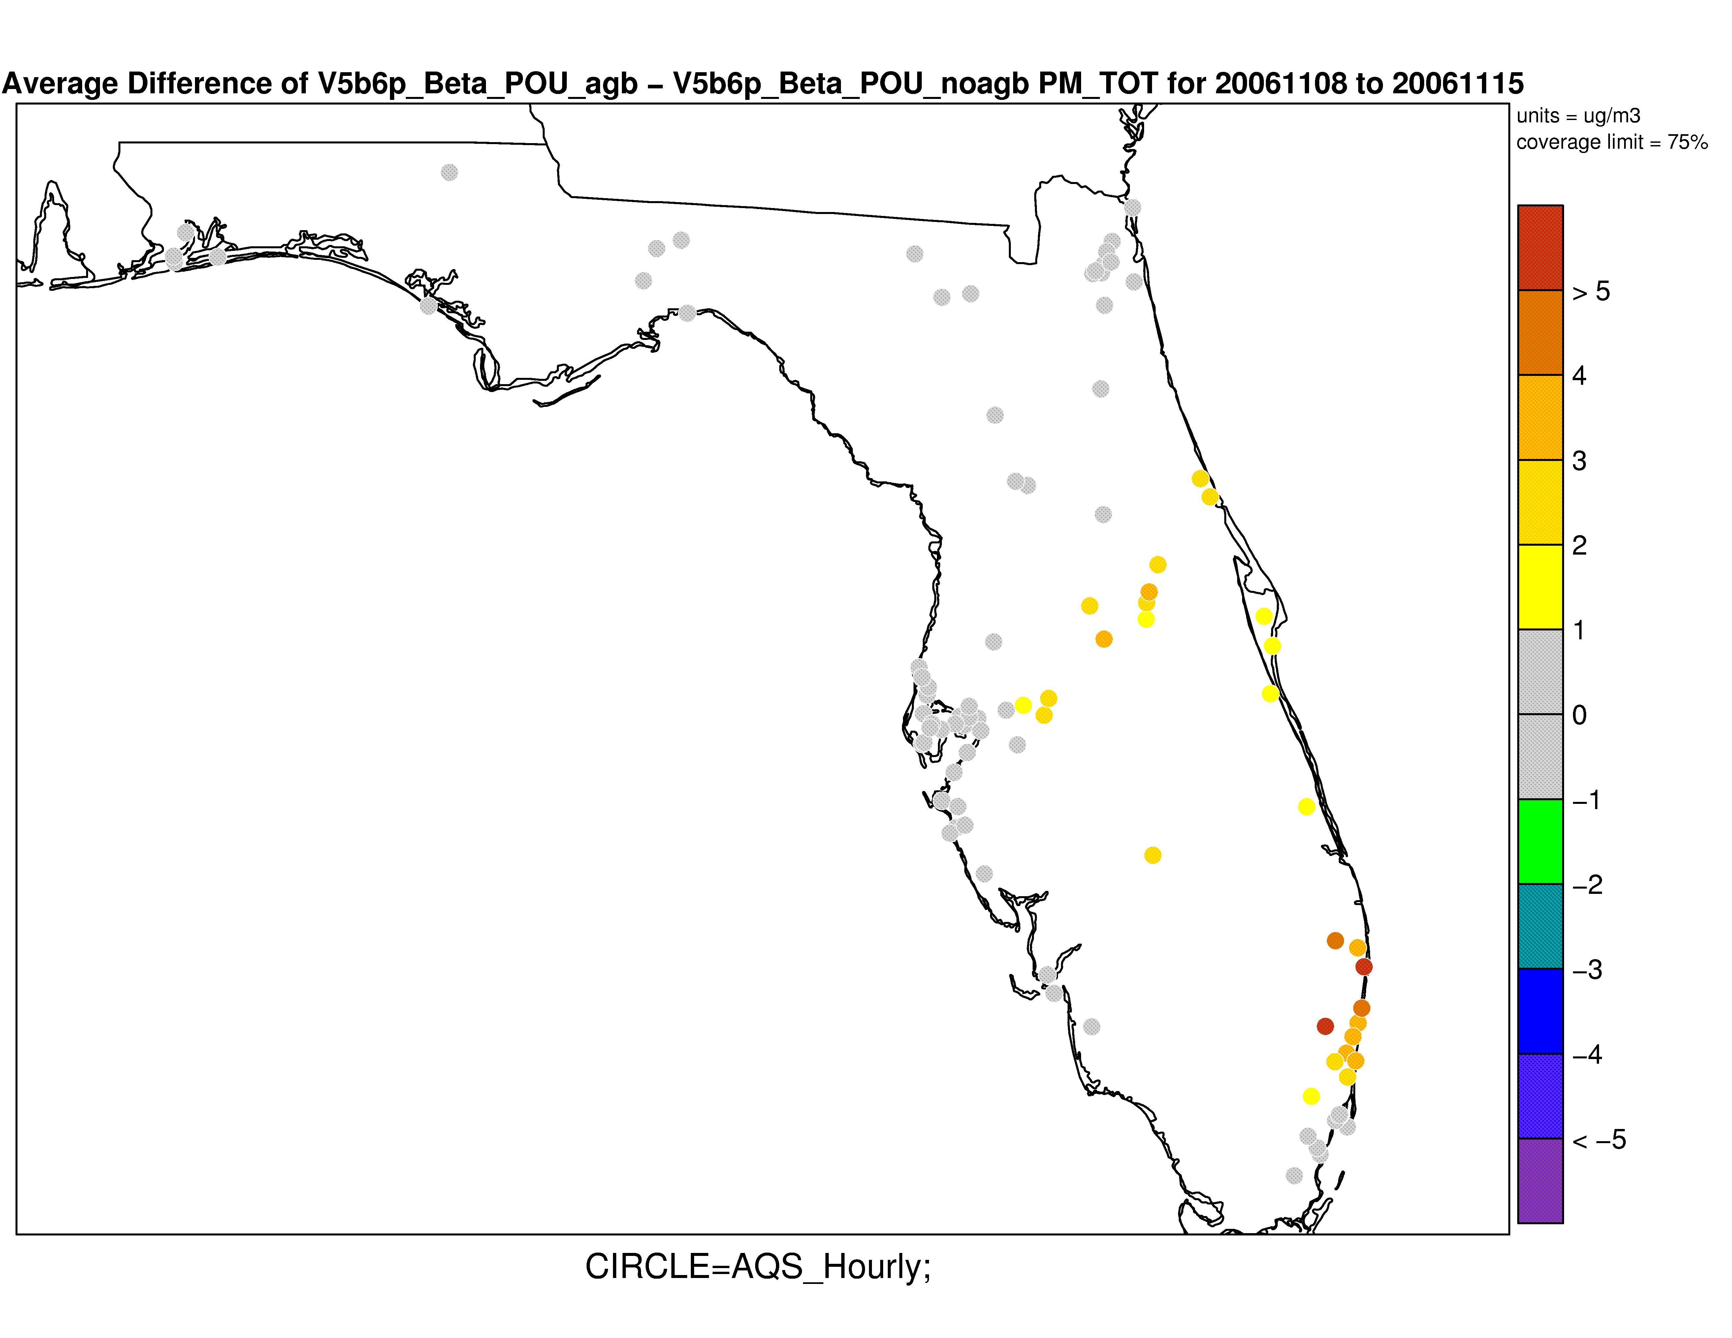
Sugarcane in Florida during Nov 8-15, 2006
Model to Model Average Difference PM2.5

Slide 30
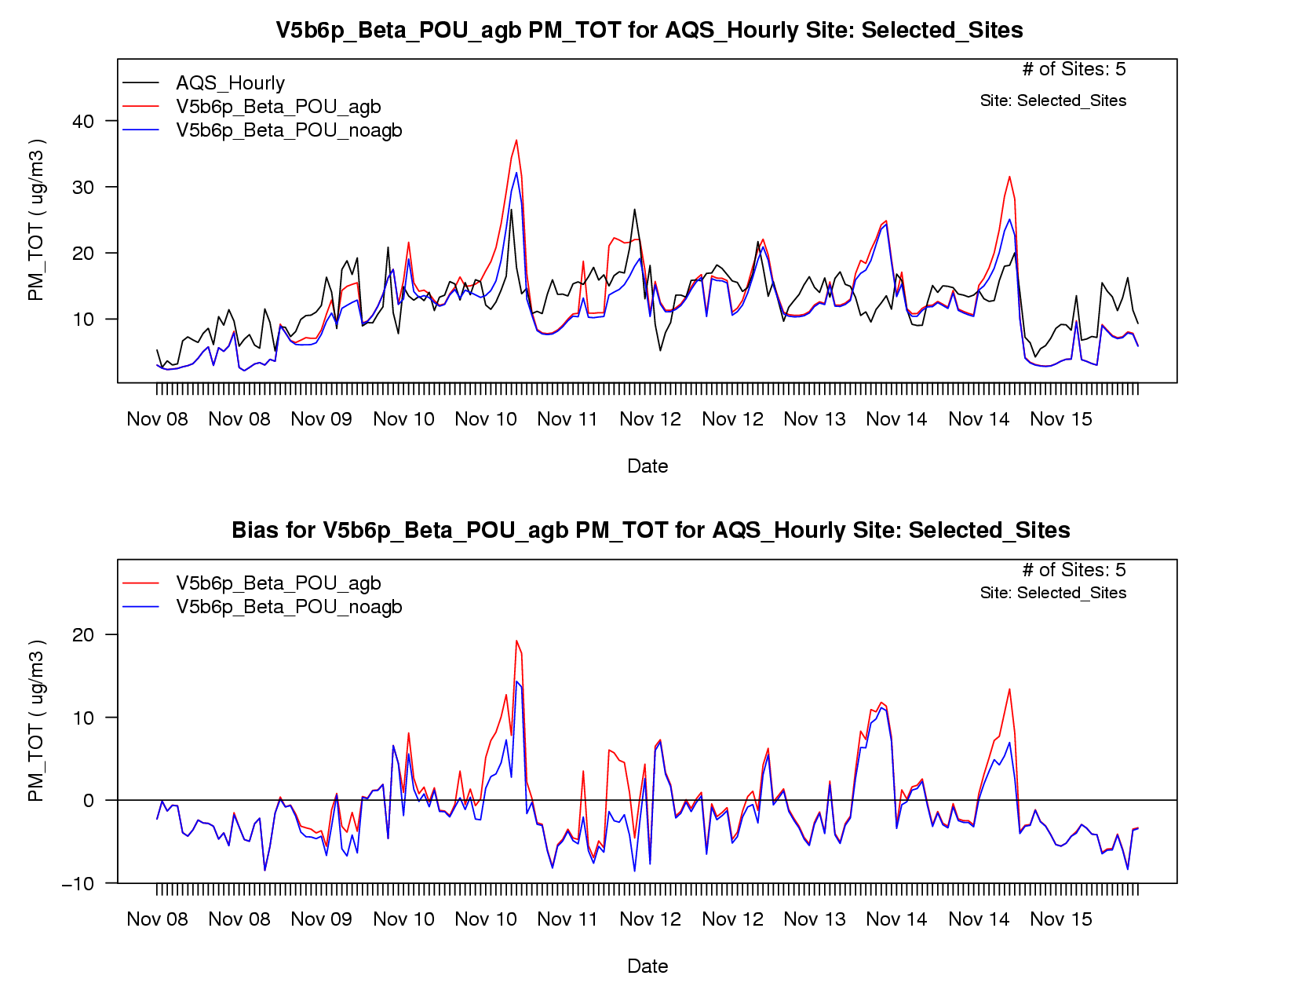
Time Series: 5 AQS Sites in FL

Slide 31
Evaluation statistics from the Nov 8-15 episode
Data for five monitoring sites in Florida
Notes:
As w/ the other slides of this sort, it would be good to summarize the overall findings/key points for the audience to focus on.

Slide 32
Some thoughts….
Pacific NW episode -- Sep 22-30, 2006
Overprediction could be due to emissions too high for crop residue burning (or plume rise too low) and/or problems with meteorology
Arkansas episode -- Oct 14-15, 2006
Emissions seem to be well represented for crop residue burning
Florida episode -- Nov 8-15, 2006
Some events captured

Slide 33
Summary of results (based on analysis of Sept-Oct 2006)
Crop residue burning is small part of PM2.5 inventory
Emissions appear to produce only a small signal in PM2.5 concentrations for most places/times
Few notable episodes that can assist in analyzing impact of crop residue emissions in AQ modeling
In Pacific NW, emission factors may be too high
Emissions look okay in Arkansas in October
Difficult to tell if crop residue emissions are missing, because model tends to be biased high for PM2.5 in most places during Sept/Oct 2006
Notes:
Note: I would look at underprediction in the Pacific NW as a possible culprit … contact the Washington State group who has looked at that area in detail … POCs: Joe Vaughan or Brian Lamb. … Check your last statement out w/ Wyat, Kristen, and Shawn to be sure it’s correct.

Slide 34
Further Work
Continue to review emission factors and estimates
Review VOC speciation
Look at 8 day product from McCarty and run CMAQ
Produce and examine inventories for other years (2003,2004,2005,2007,2008, 2009)
Include estimates into the 2008 NEI

Slide 35
Acknowledgements
AMAD: D. Mobley, S. Roselle, W. Appel, A. Torian
CSC: R. Cleary, C. Chang

