Slide 1

CMAS conference, 22 Oct. 2019
Inter-comparison of Mobile Source Emissions from the CARS and CAPSS in Seoul Metropolitan Area, South Korea
(Comprehensive Automobile Research modeling System)
Park, M.W., Woo, J.H. and Kim, Y.H.
Konkuk University, South Korea
Baek, B.H. and Pedruzzi, Rizzieri
CMAS / University of North Carolina at Chapel Hill, USA
Notes:
Hi, I’m Minwoo Park from Konkuk University, South Korea.
This time, I’ll present about our research, “Inter-comparison of Mobile Source Emissions from the CARS and CAPSS in Seoul Metropolitan Area, South Korea”

Slide 2
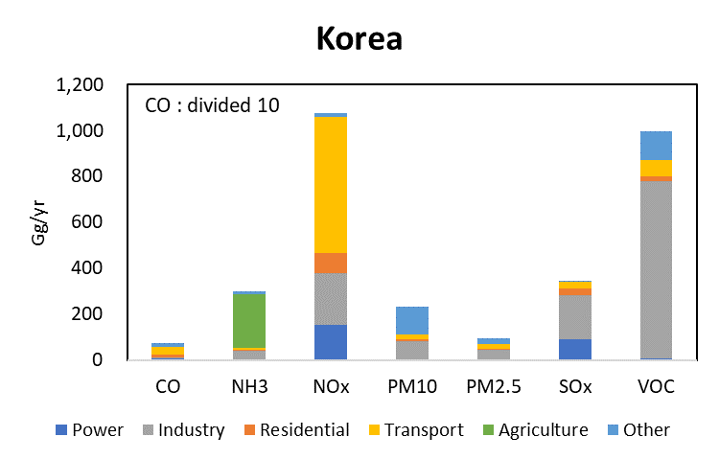
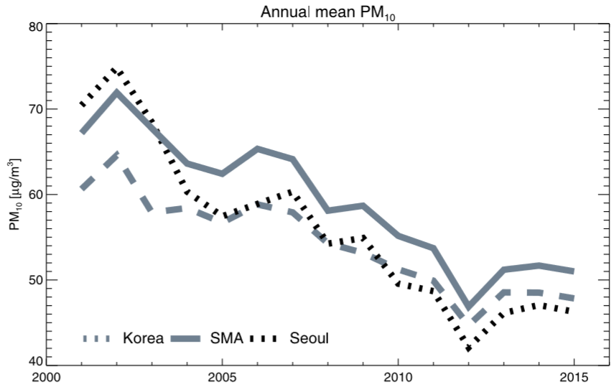
CMAS conference, 22 Oct. 2019
1. Background
*CAPSS Emissions Inventory
Fine particle emissions in Korea, *CAPSS 2016 (PM10 233.1Gg, PM2.5 100.2Gg).
Industrial combustion and mobile sources make up a large part of PM2.5 Emissions.
Especially in SMA(Seoul Metropolitan Area), mobile source is one of the most important fine particle source. Half of populations and 43% of vehicles are in SMA.
PM10 concentration of SMA is higher than the national average.
After 2012, the concentration of PM10 is increasing again.
Accurate understanding of the mobile source of SMA is required.
H.C. Kim et al., 2017
*CAPSS(Clean Air Policy Support System) : National air pollutant emissions inventory of S.Korea.
Notes:
This is my background of research. First, What is the CAPSS?
CAPSS is the National air pollutant emissions inventory of S.Korea.
We use this Emissions Inventory for basic data of research or making policies.
Industrial combustion and mobile sources are most effective fine particle sources in korea.
Especially in SMA(Seoul Metropolitan Area), mobile source is one of the most important fine particle source. Because half of populations and 43% of vehicles are in SMA.
But!, look at below pie charts, left one is nmvoc emissions rate of casps, middle one is of nei, and right one is from eea.
In korea over than 50% of vehicles are use gasoline, but our VOC emissions portion by mobile is almost 10%.
This portion is lower than Europe where diesel vehicles are superior to gasoline.
It shows 61% of VOCs are emitted from Solvent sector.
In south korea, people are getting more and more interest in fine particle. So we need to estimate mobile emissions effectively, to support air quality forecasting model.
Gasoline vehicles have a higher proportion than EU, but the VOC/NOx ratio is lower than Europe.
Diesel vehicles in Europe, gasoline vehicles in USA are known to make up a largest portion of the total.

Slide 3
CMAS conference, 22 Oct. 2019
1. Background
Structure of CARS Model Development
Estimating the emissions of mobile sources by high resolution of temporal and spatial distribution is easy to support not only air quality policies but also forecast models.
*KAQMS(Korea Air Quality Modeling System)
Notes:
This slide show the structure of CARS model development.
KAQM is Korean air quality modeling system.
CAPSS was an Emissions inventory, whereas CARS works as a model.
So, we have been developed CARS model to make more high resolution and dramatic mobile emissions.

Slide 4
CMAS conference, 22 Oct. 2019
2. Objective
  High resolution District-level and Link-level Bottom-up Onroad Mobile Emissions Inventory based on the Measured Local Activities in Korea.
  Developing more effective mobile activity DB and Model to support Air Quality Forecasting Models than existing National Air Pollutant Emissions Inventory(CAPSS).
  Capabilities:
    User’s friendly CSV formats for inputs and Emission Factors (EFs).
    Spatially, Chemically, and Temporally Enhanced, Gridded-Speciated Hourly Onroad Mobile Emissions for Air Quality Modeling System
    Apply region code based on real time activity of use, not based on the registered vehicles(CAPSS). To reflect traffic flow across states.
  National Control Strategies Supports
    Develop projected and/or controlled mobile bottom-up Inventory based on the changes of national emissions standard control strategies (Ex: Euro 5, Euro 6,,,)
  Stand-alone easy-to-use Mobile Emissions Simulator
Notes:
This is the objectives.

Slide 5
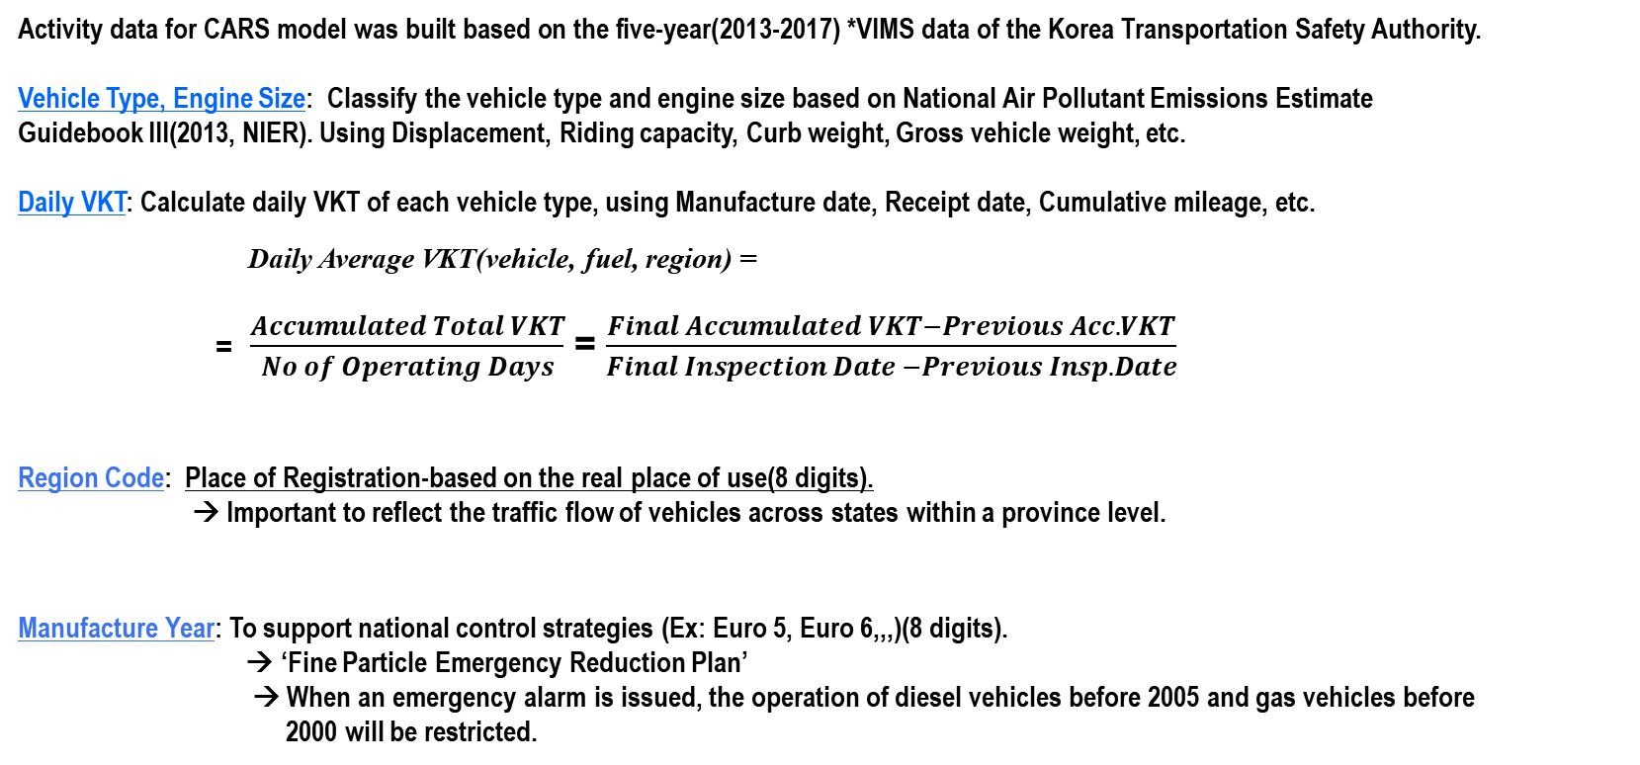
CMAS conference, 22 Oct. 2019
3. Methodology
Activity data for CARS
Activity data for CARS model was built based on the five-year(2013-2017) *VIMS data of the Korea Transportation Safety Authority.
Vehicle Type, Engine Size: Classify the vehicle type and engine size based on National Air Pollutant Emissions Estimate Guidebook III(2013, NIER). Using Displacement, Riding capacity, Curb weight, Gross vehicle weight, etc.
Daily VKT: Calculate daily VKT of each vehicle type, using Manufacture date, Receipt date, Cumulative mileage, etc.
Daily Average VKT(vehicle, fuel, region) =
= $\frac{Accumulated Total VKT}{No of Operating Days}$ = $\frac{Final Accumulated VKT−Previous Acc. VKT}{Final Inspection Date −Previous Insp. Date}$
Region Code: Place of Registration-based on the real place of use(8 digits).
→ Important to reflect the traffic flow of vehicles across states within a province level.
Manufacture Year: To support national control strategies (Ex: Euro 5, Euro 6,,,)(8 digits).
→ ‘Fine Particle Emergency Reduction Plan’
→ When an emergency alarm is issued, the operation of diesel vehicles before 2005 and gas vehicles before
2000 will be restricted.
*VIMS : Vehicle Inspection Management System
*NIER : National Institute of Environmental Research
*TS : korea Transportation Safety authority
Notes:
When an emergency alert is issued, the operation of diesel cars in the previous model year in 2005 and gas cars in the previous model year in 2000 will be restricted.

Slide 6
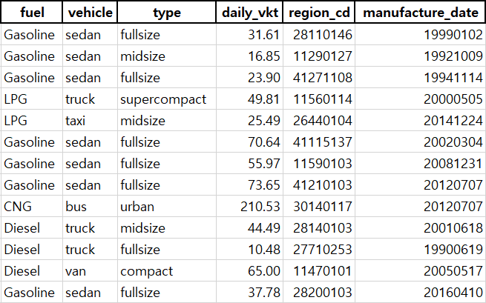
CMAS conference, 22 Oct. 2019
3. Methodology
Format of CAPSS and CARS Emissions
Units : Tons/yr
Region Code (County level) | Tier 1 | Tier 2 | Fuel | NOx | PM2.5 | VOC
11110 | Truck | Fullsize | Diesel | 90,318 | 2,822 | 4,066
11110 | Truck | Compact | Diesel | 47,322 | 1,625 | 1,160
11110 | SUV | Compact | Diesel | 43,392 | 856 | 897
11110 | BUS | Urban | CNG | 9,559 | 0 | 11,779
11110 | Sedan | Midsize | Gasoline | 8,015 | 9 | 6,396
11110 | Taxi | Midsize | LPG | 359 | 0 | 60
11110 | Motocycle | Compact | Gasoline | 978 | 0 | 953
CAPSS
Format
Based on full package of vehicles population database in Korea (I/M data)
CARS
Activity DB
- Emission estimating methodology of Mobile Sources in CAPSS and CARS are following COPERT of EEA.
- More than 20 million vehicle inventory database was developed.
●
●
●
6
Notes:
District level까지 고해상도로 지역을 세분화함으로써 사람들이 자기 동네의 대기질 예보에 대해 알 수 있도록하였다.
People are always interested in the air quality of their neighborhood.
In CAPSS inventory, region is divided by county level(5digits).
But our model use district level of region. And additionally, divide by manufactured year for make more responsibility of control strategies.
Inventory 형식의 emissions인 capss에 chemical, temporal profile을 적용할 수 있도록하였다.

Slide 7
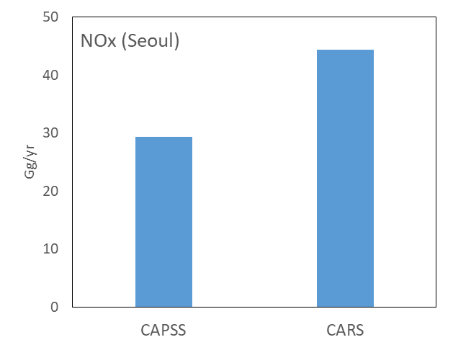
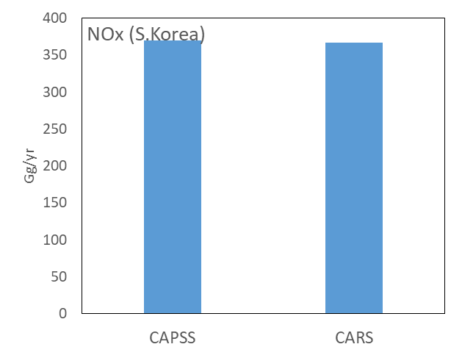
CMAS conference, 22 Oct. 2019
4. Results
Emissions by pollutants
NOx Emissions by Province
44.4
Tons/yr
 |  | CAPSS 2015 | CARS
S.Korea | NOx | 369,585.0 | 367,180.1
 | SOx | 208.6 | 300.1
 | PM10 | 9,583.3 | 13,511.7
 | PM2.5 | 8,816.6 | 13,415.2
 | VOC | 46,145.1 | 44,430.9
SMA | NOx | 143,642.3 | 154,508.7
 | SOx | 82.7 | 131.8
 | PM10 | 3,147.5 | 5,376.2
 | PM2.5 | 2,895.7 | 5,315.5
 | VOC | 21,155.9 | 24,821.9
Seoul | NOx | 29,375.4 | 44,393.1
 | SOx | 19.7 | 40.4
 | PM10 | 531.1 | 1,513.3
 | PM2.5 | 488.6 | 1,556.8
 | VOC | 7,775.3 | 6,484.7
51%
-1%
29.4
+8%
369.6
367.2
-1%
+51%
7
Notes:
Left table show Emissions by pollutant at CAPSS and CARS. S.Korea, SMA, Seould.
Right graph shows the result of using activity data made by the real time usage.
Compared to CAPSS emissions, which allocated by registered vehicles, emissions of NOX are shows good matching at country level.
When look only sma, we can see that the emissions of vehicles are calculated higher in the seoul where the most flowing traffics.
So, this slide explain we were able to calculate the emissions reflecting the traffic flow.
NOx is a common denominator, because it is evenly emitted throughout the sectors and relatively well understood pollutant.

Slide 8
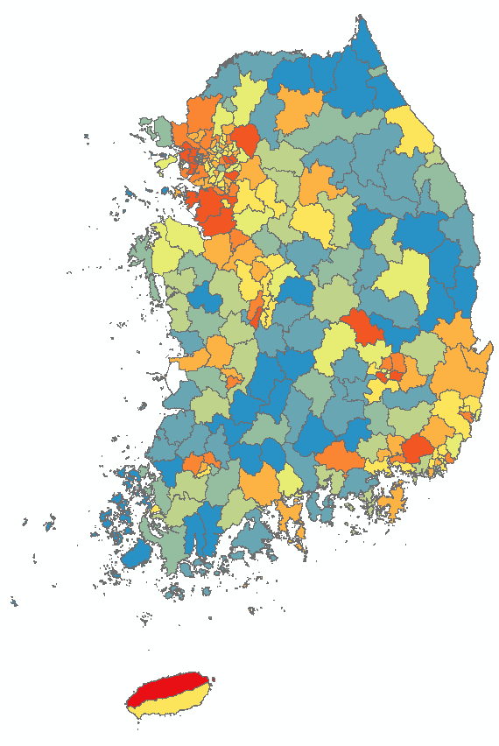
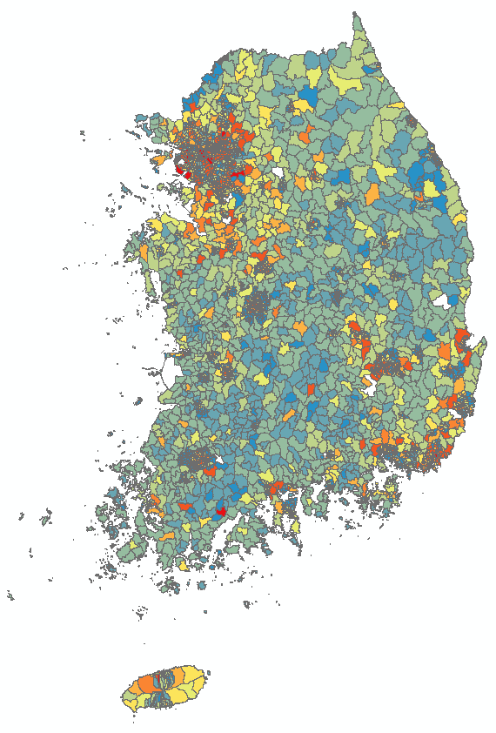

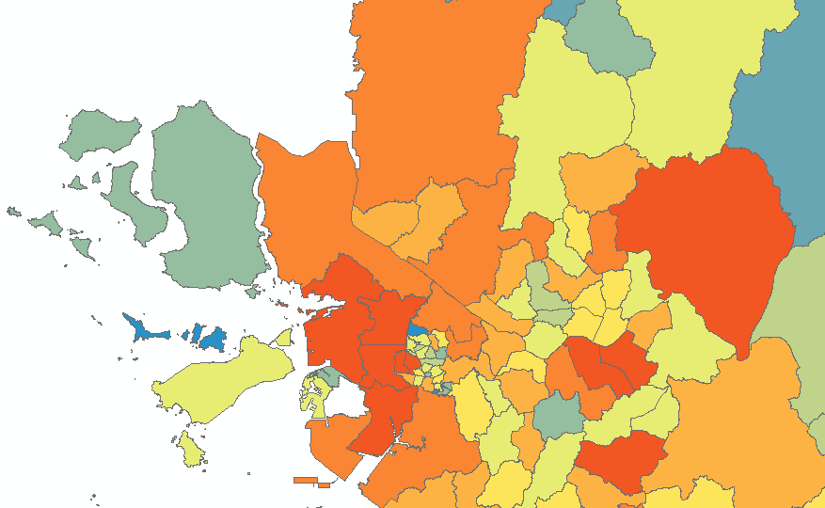
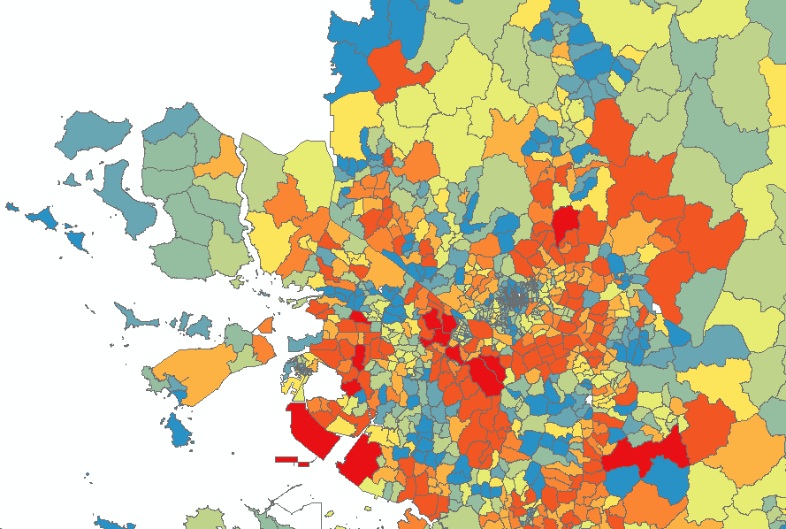
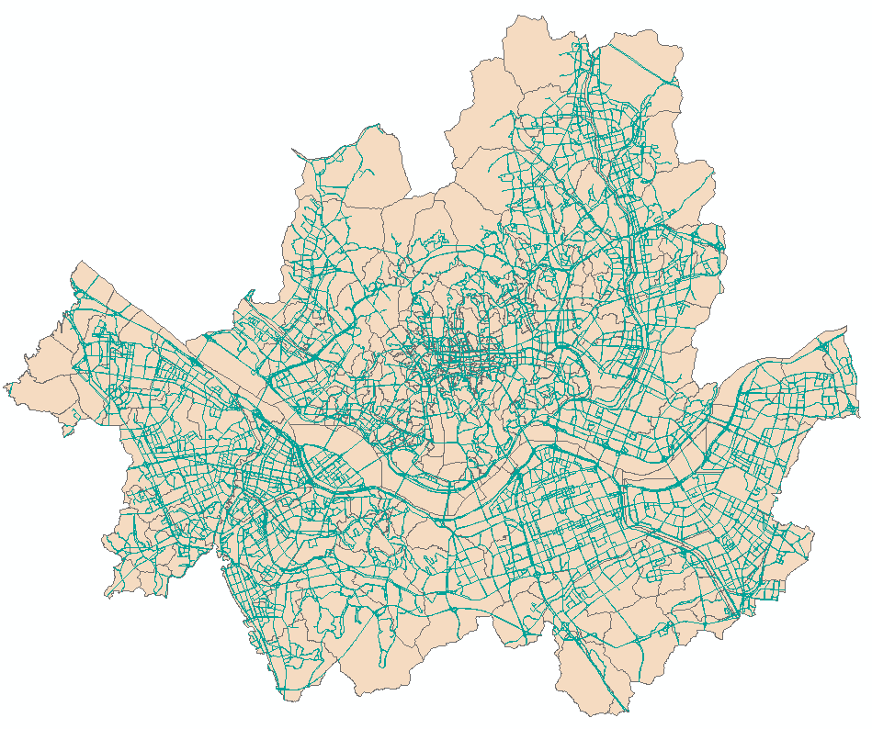
CMAS conference, 22 Oct. 2019
4. Results
High resolution Spatial Allocation by sum of daily VKT(sedan)
CAPSS
CARS
CARS
High
*SMA
SMA
Seoul
low
Divided in
17 States
250 Counties
Divided in
17 States
250 Counties
5047 Districts
Emission produced by Link Level
Include Link Length, Lanes, Max Speed and AADT
*SMA : Seoul Metropolitan Area
8
Notes:
This figures show the enhanced resolution of CARS model.
Previously, the CAPSS were classified into 250 counties.
However, the CARS model can be separated into 5047 districts.

Slide 9
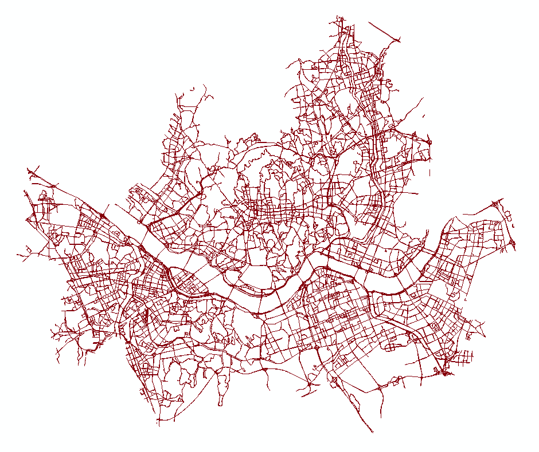
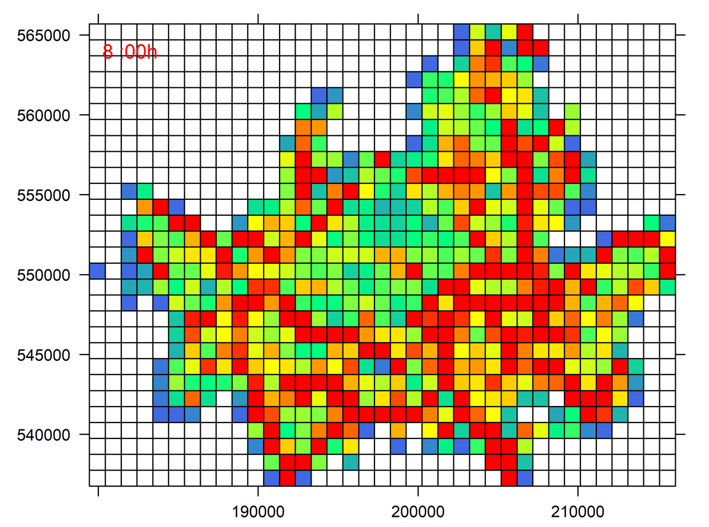
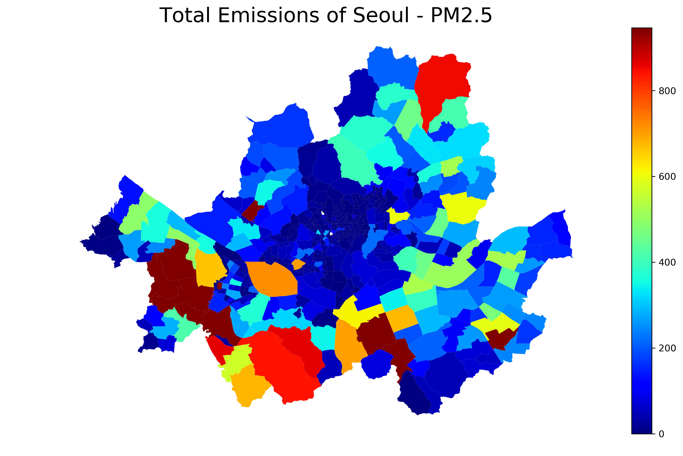
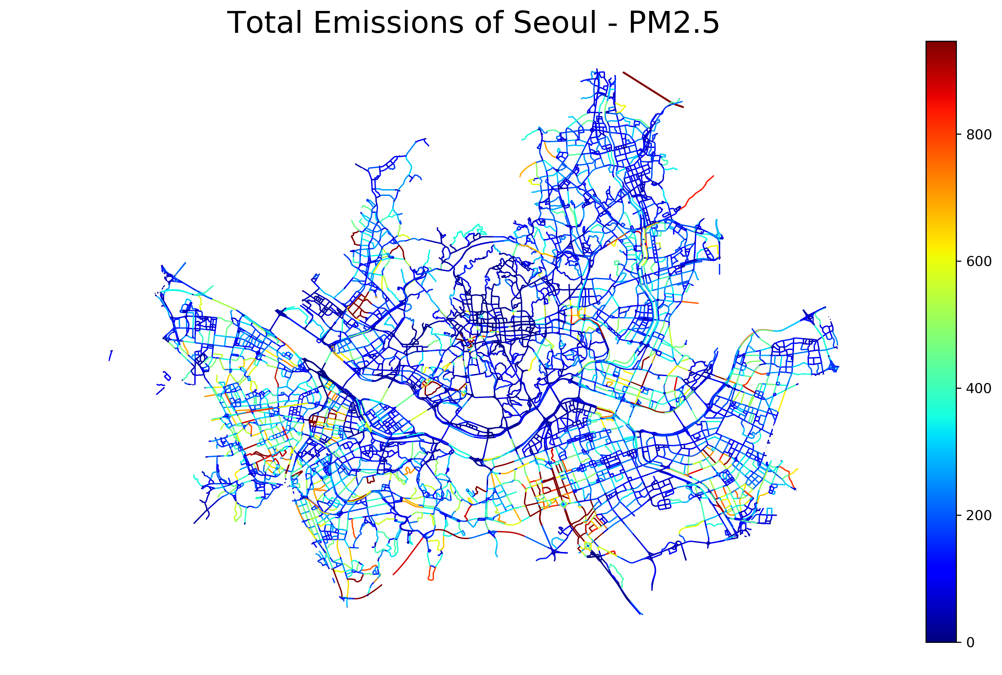
CMAS conference, 22 Oct. 2019
4. Results
(1-1) Link-level Traffic Activity (High-Resolution)
(3)
Gridded Mobile Emissions for AQ Model
(1-2)
District-level Mobile Emissions
(2)
Link-level Mobile Emissions
9

Slide 10
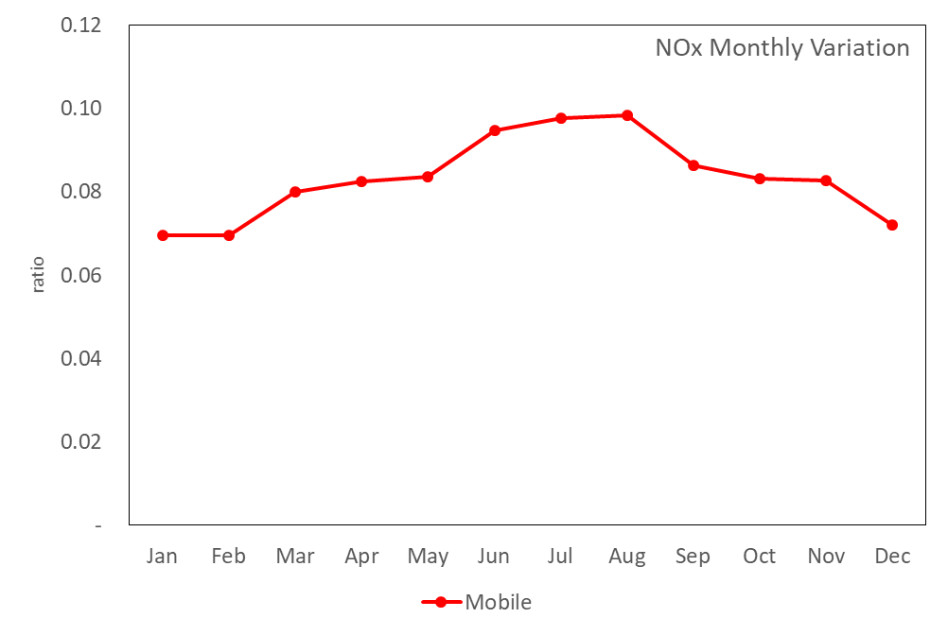
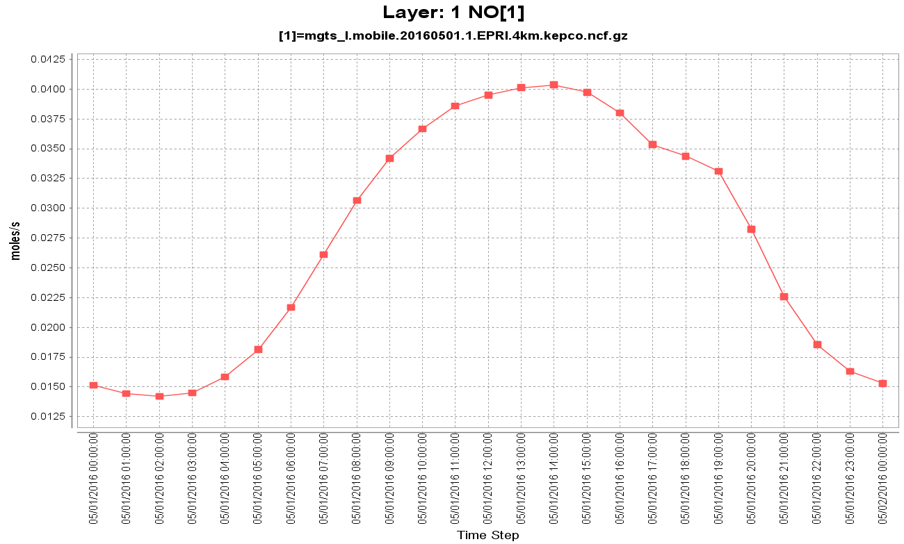
CMAS conference, 22 Oct. 2019
4. Results
Temporal Profile
CARS
NOx Monthly Variation
NOx Hourly
Variation
CARS Model can apply temporal Variation of each vehicle types.
This function would be helpful at supporting Air Quality Forecast Modeling.
10

Slide 11
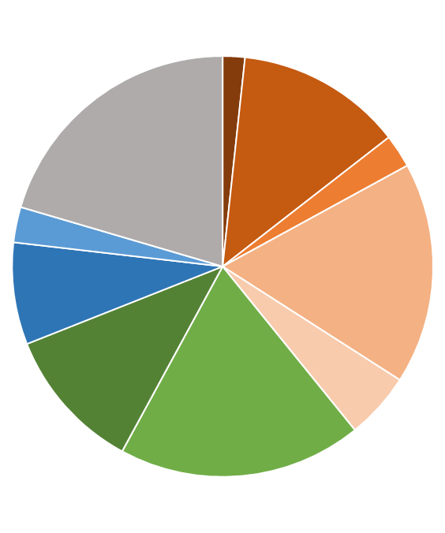
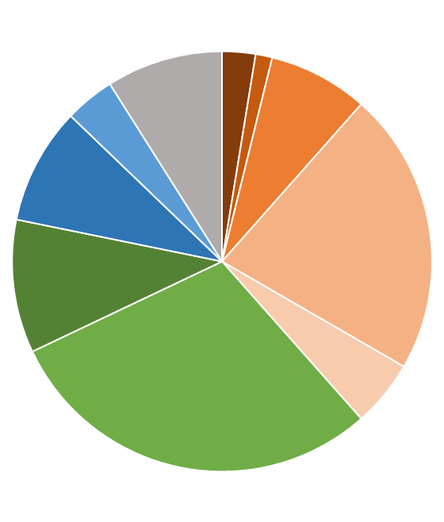
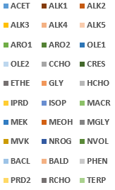
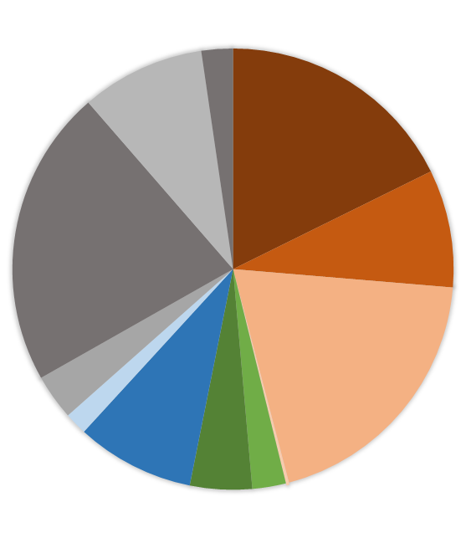

CMAS conference, 22 Oct. 2019
4. Results
Chemical Speciation
CARS
(A-1) Diesel Vehicles
(A-2) Gasoline Vehicles
(B-1) Diesel Vehicles
(B-2) Gasoline Vehicles
We use B profiles for VOC species(using SAPRC chemical speciation mechanism). Which was validated by KORUS-AQ field campaign measurements.
KORUS-AQ : An international Cooperative Air Quality Field Study in Korea.
(A) Lyu et al, 2008
(B) M, Li et al, 2015; Wang et al, 2013; Wei Wei et al, 2014
11

Slide 12
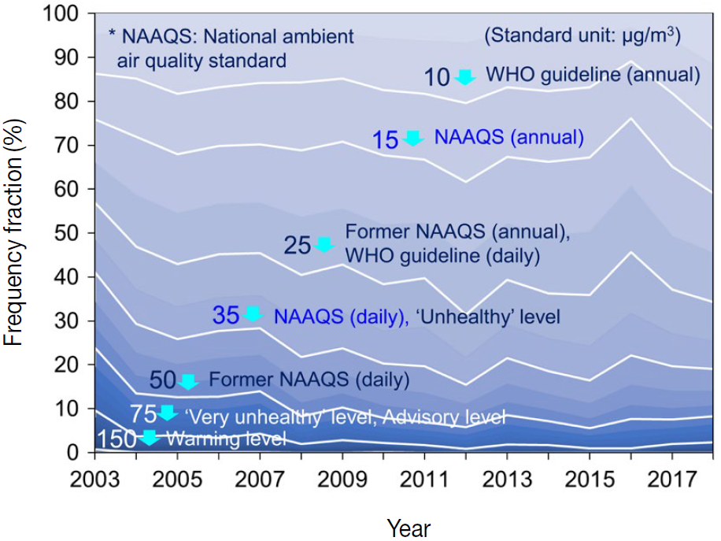
CMAS conference, 22 Oct. 2019
4. Results
Applying Control Strategy
Fine Particle Emergency Reduction Plan :
When averaged concentration of PM2.5 is over than 50ug/m3 on 0am to 4pm. + When averaged concentration of PM2.5 will over than 50ug/m3 at tomorrow 24hour avg.
→ The operation of diesel vehicles in the previous model year in 2005 and gas vehicles in the previous model year in 2000 will be restricted.
12
Notes:
Because, When an emergency alert is issued, the operation of diesel cars in the previous model year in 2005 and gas cars in the previous model year in 2000 will be restricted.

Slide 13
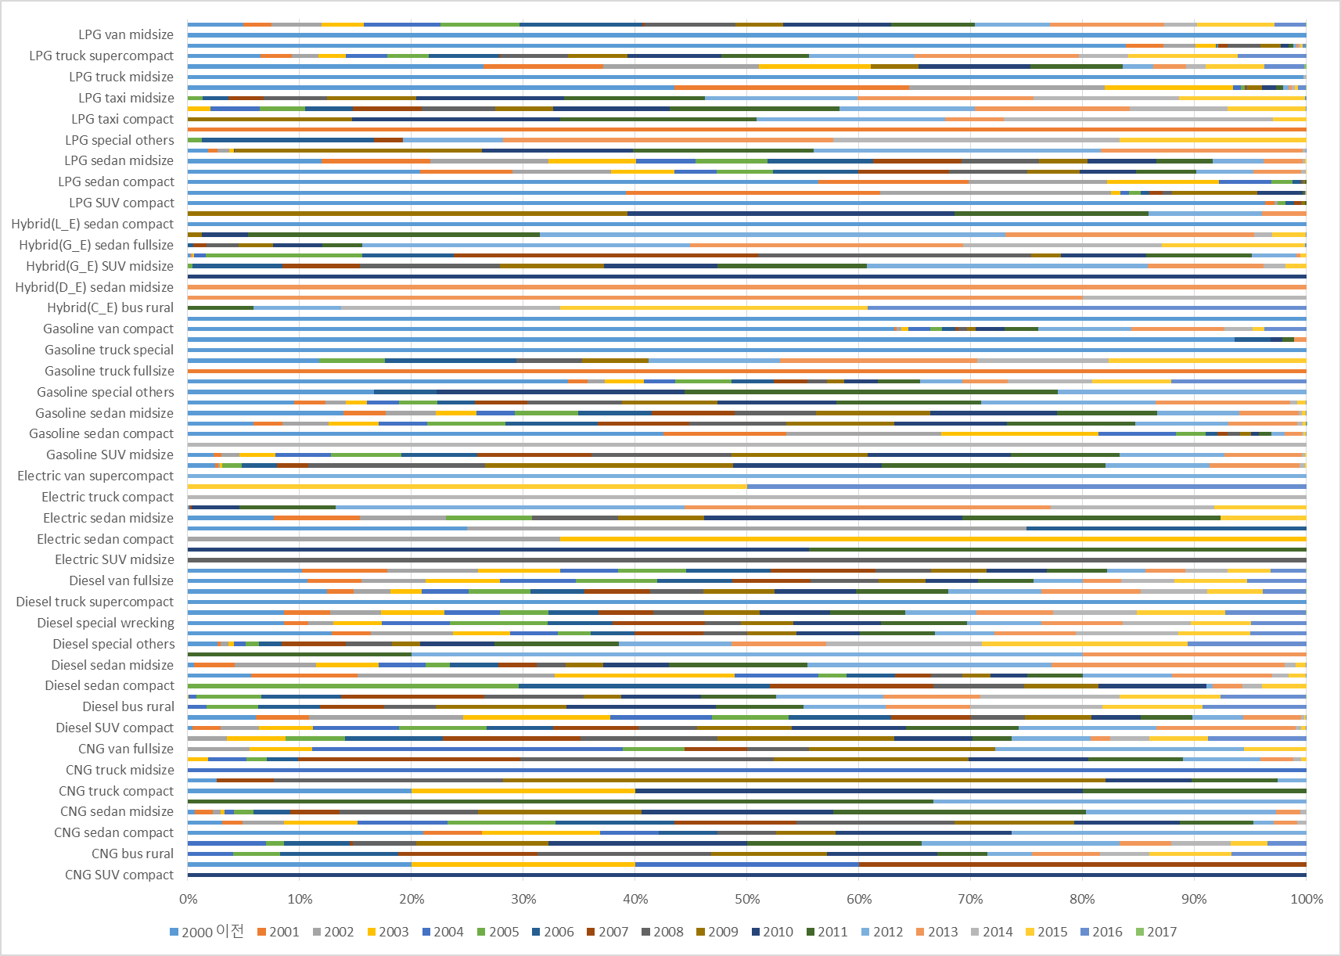
CMAS conference, 22 Oct. 2019
4. Results
Age distribution by each vehicle type(Seoul)
95 vehicle type (fuel type / vehicle type / engine size)
13
Notes:
This is a graph of the age distribution by vehicle type and fuel type.
We can use this table to identify emissions changes resulting from the application of the reduction strategies.

Slide 14
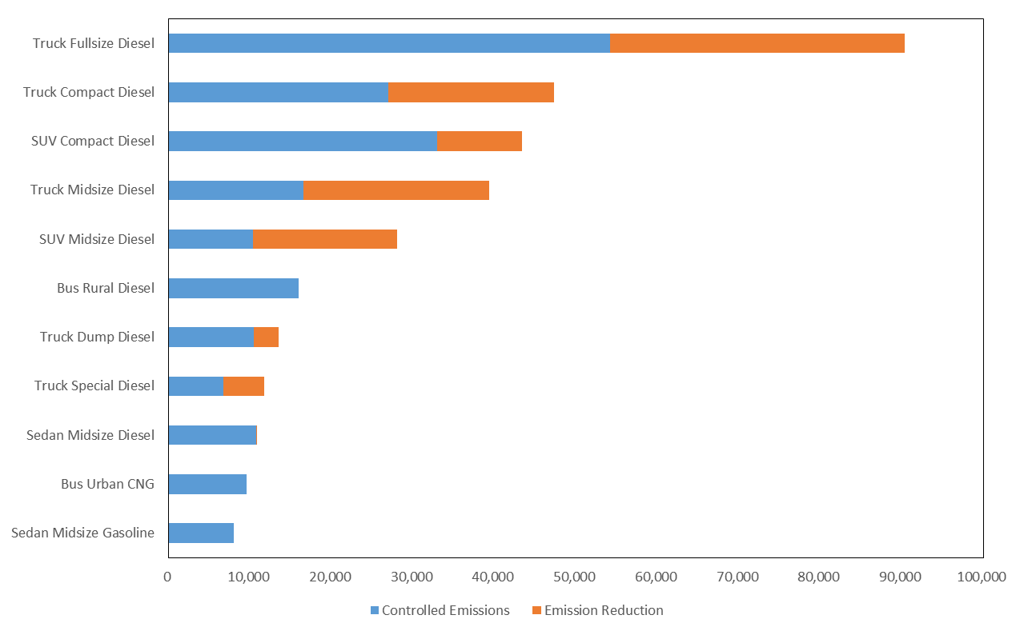
CMAS conference, 22 Oct. 2019
4. Results
Applying Control Strategy
Activity data for CARS model was built based on the five-year(2013-2017) *VIMS data.
Using previous age distribution table, we can apply control strategies by age of vehicles.
Tons/yr
*VIMS : Vehicle Inspection Management System
14
Notes:
The Orange bars represent reduced emissions according to reduction strategies, and the blue bars shows the amount of emissions that have been emitted since.

Slide 15
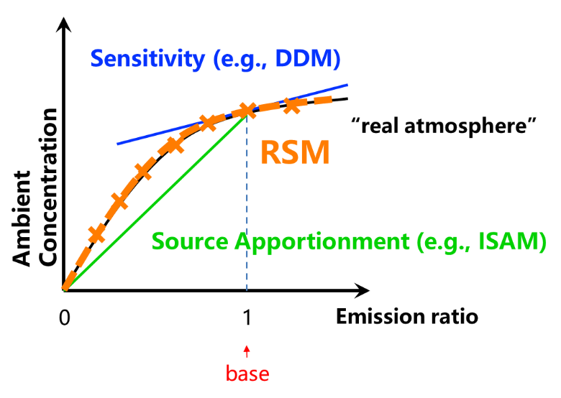
CMAS conference, 22 Oct. 2019
4. Results
Policy Supporting Air Quality Model
Response Surface Model(RSM) is a real-time atmospheric chemical transport information integrated into ABaCAS decision making system
(see presentation by Song Liu, Oct 21, Grumman Auditorium)
Simulation of the SMOKE-CMAQ system over South Korea 120 times according to the 120 emission scenarios by region/sector to generate the Response Surface Model (RSM) and visualization of the system using the Visualization Analysis Tool (VAT).
(see presentation by Jinseok Kim, Oct 23, Dogwood Room)
(Jiming Hao et al., 2017)
15

Slide 16
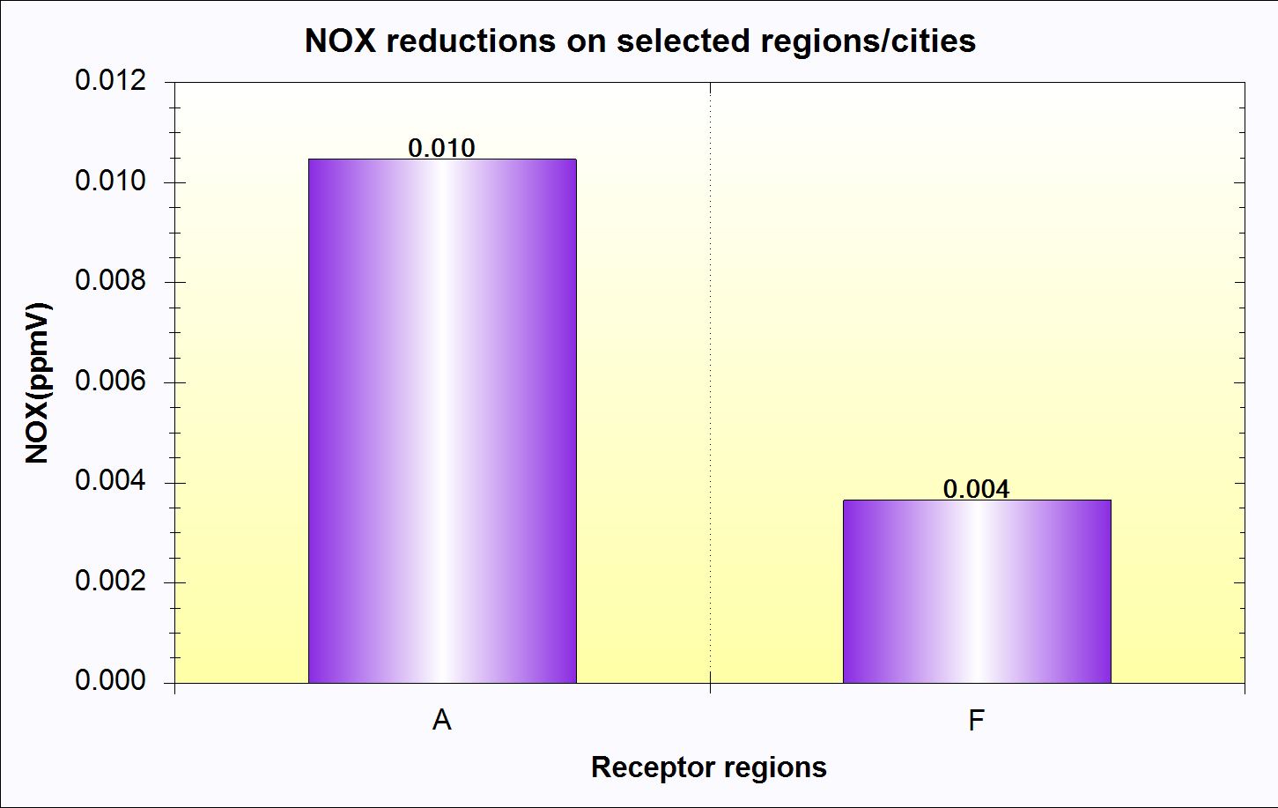
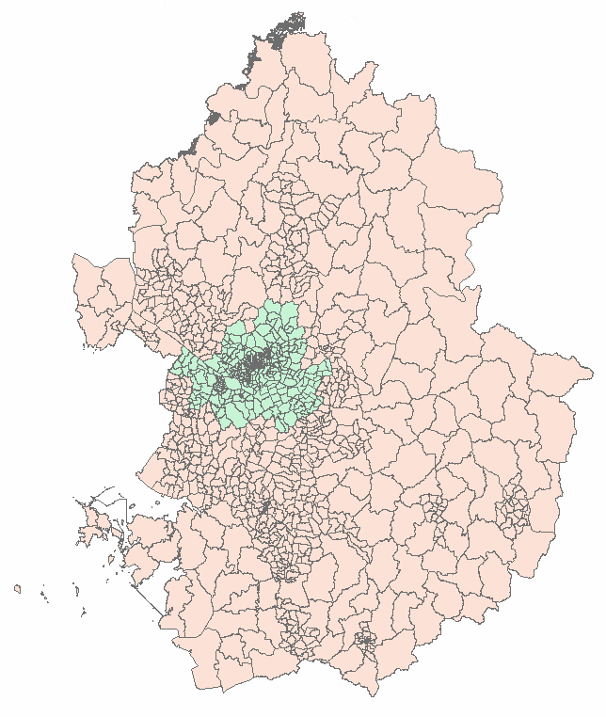
CMAS conference, 22 Oct. 2019
4. Results
Policy Supporting Air Quality Model
When ‘Fine Particle Emergency Reduction Plan’ was applied, NOx emission was reduced 39Gg/yr of 260Gg/yr(15%).
By concentration, NOx concentration was reduced 10ppb in Seoul and 4ppb in GyeongGi.
A : Seoul
F : GyeongGi (State included in SMA)
Result of RSM
16
Notes:
서울 2017 NOx 평균 농도 30ppb

Slide 17
CMAS conference, 22 Oct. 2019
5. Conclusion and Future work
  CARS is onroad mobile emissions model to support Air Quality Forecasting Models better than existing National Air Pollutant Emissions Inventory(CAPSS).
  Generates high resolution District-level and Link-level bottom-up onroad mobile emissions inventory based on the local mobile-related activities in Korea
  Generates spatially, chemically, and temporally enhanced Gridded-Speciated Hourly emissions for air quality forecasting models
  Easy to support national control strategies by manufactured year data.
  NOx emissions and concentrations were reduced 39Gg/yr(15% of total SMA Emissions) and 10ppb, when apply Fine Particle Emergency Reduction Plan.
  Differences other than NOx seem from cold start and/or evaporative emissions. Further investigations are needed.
  Using CTM, such as CMAQ, to check the change in concentration when applying the emissions reduction strategies through gridded-speciated hourly emissions.
17
Notes:
NOX와 VOC are more effective pollutants to analysis mobile emissions…
These dots are summaries about presentations.

Slide 18
Thank You!
(Jiming Hao et al., 2017)

