Slide 1


Estimation of Surface NO₂ Using Airborne Remote Sensing Data and CMAQ Model Output from DISCOVER-AQ Campaigns
Kenneth Pickering¹, Lok Lamsal², Melanie Follette-Cook², Dale Allen¹, William Swartz³, Scott Janz⁴, Wyat Appel⁵, Gabriele Pfister⁶
¹ Dept. of Atmospheric and Oceanic Science, University of Maryland
² GESTAR, NASA Goddard Space Flight Center
³ Johns Hopkins University Applied Physics Laboratory
⁴ NASA Goddard Space Flight Center
⁵ EPA Center for Environmental Measurement and Modeling
⁶ ACOM, National Center for Atmospheric Research

Slide 2
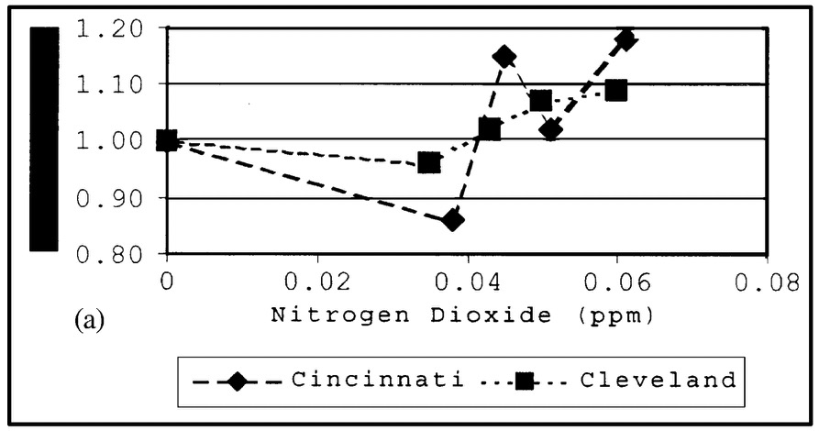
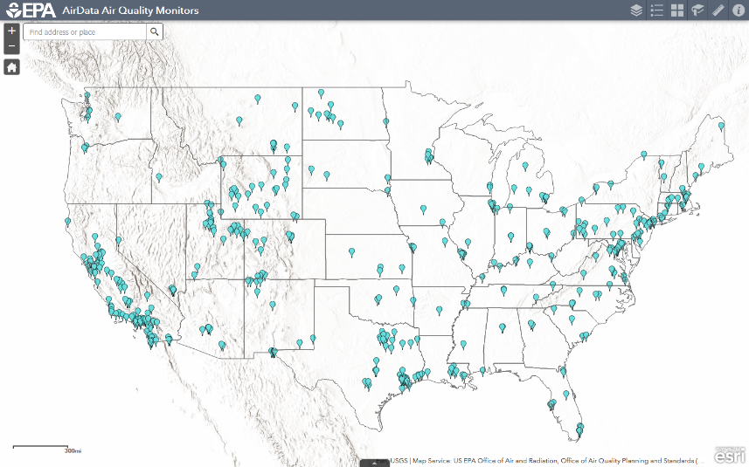
Motivation: Surface (“nose-level”) NO₂ from airborne and satellite observations
There is strong interest in satellite-derived ground-level air pollutant products (NO₂, PM_{2.5}) for air pollution and health studies.
NO₂ associated with mortality
(toxic gas at high concentrations; increases bronchitis and reduces lung function; a marker for combustion-related pollutants; major
precursor for tropospheric ozone)
Relative
Risk
Insufficient NO₂ monitoring by in situ sensors (heterogeneous coverage; some US states and many countries lack monitoring)
Jaffe et al. [2003]
Active NO₂ Monitors – Oct. 2019
NO₂ measurements from FRM in situ monitors are biased relative to true NO₂ (biases (10-50%) vary diurnally/seasonally and are difficult to quantify)
TEMPO geostationary satellite observations coming in 2022
(hourly fine horizontal resolution column NO₂; need to prepare for
using these data to estimate surface NO₂)
420 stations
Notes:
NO2 is harmful to health.
It is important to know what the surface concentration is.
Surface measurement is challenging, due to insufficient surface network coverage, even in the US.
There are also known biases in in situ surface monitors.
This has led us to satellite and airborne remote sensing for better surface measurements.

Slide 3
Satellites and ground-based monitors show similar* NO₂ trends
OMI Trop NO₂
EPA/AQS NO₂
*see Silvern et al. [2019] for recent trend (dis)agreement
Lamsal et al. [2015]
Notes:
We have been developing NO2 retrievals from OMI for a number of years.
Top row shows how trop VCDs have diminished over the US over Aura time period, with reductions in emissions.
A similar trend is seen in ground-based AQ monitors.
Although trend in the last few years has been more difficult to discern.

Slide 4
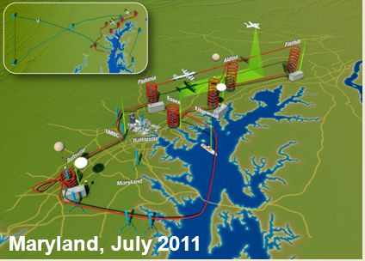
Taking advantage of DISCOVER-AQ correlative observing strategy to enhance approach to inferring surface concentrations
Four deployments
  MD – Jul 2011
  CA – Jan/Feb 2013
  TX – Sep 2013
  CO – Jul/Aug 2014
Coordinated satellite, airborne column and in situ profile measurements, surface monitors, surface remote sensing, etc.
Multiple modeling simulations
Our goals:
  Develop science-quality NO₂ data products from airborne and satellite sensors
  Assess and interpret various NO₂ observations and simulations
  Improve approach to infer surface concentrations from remote sensing data
NASA Earth Venture mission intended to improve the interpretation of satellite observations to diagnose near-surface conditions related to air quality
Notes:
Work today will utilize data and modeling simulations from the DISCOVER-AQ campaign.
D-AQ is an Earth Venture mission that took place over four intensive field campaigns, in MD, CA, TX, and CO.
D-AQ valuable because of its rich correlative data set, including satellite, airborne in situ and remote sensing, and surface monitors, etc.
Also multiple modeling simulations.
Our goals are to:
develop science-quality NO2 products from aircraft and satellites
assess and interpret various retrievals and simulations
improve approach to remote sensing of surface concentrations

Slide 5
Aircraft remote sensing observations provide for retrieval of NO₂ column densities
 | Airborne Compact Atmospheric Mapper (ACAM) | GEO-CAPE Airborne Simulator (GCAS)
Campaign | MD, CA | TX, CO
Aircraft | UC-12 (MD), B200 (CA) | B200
Flight altitude | ~8 km | ~9 km
Ground spatial resolution | 1.5 x 1.1 km² | ~250 x 250 m²
ACAM NO₂ VCD (below aircraft) from July 29, 2011 (MD)
EDT
Slant column abundance retrievals based on the differential optical absorption spectroscopy (DOAS) method
NO₂ vertical distributions from high-resolution Community Multiscale Air Quality (CMAQ) model simulations to account for the spatial/temporal variation in atmospheric NO₂
Air mass factor (AMF) computations for conversion to vertical column density (VCD) using on-line VLIDORT, surface reflectivity from MODIS BRDFs, and CMAQ model profiles
VCDs validated with in situ airborne profiles and ground-based remote sensing observations
Lamsal et al. [2017]
Notes:
We are using airborne remote sensing from two instruments that flew during D-AQ (although today only focusing on ACAM during the MD campaign).
ACAM flew at ~8 km, observing scattered/reflected radiance from below.
Retrieval akin to OMI methodology, as stated in slide.
Example VCD retrieval in right plots, which have been validated with airborne in situ and ground-based remote sensing observations.

Slide 6
WRF and CMAQ Model Simulations
 | Maryland | Texas | Colorado
Modeler | Wyat Appel - EPA | Dale Allen - UMD | Gabi Pfister - NCAR
Meteorological driver | WRF 3.8.1 | WRF 3.8.1 | WRF 3.8.1
WRF PBL scheme | ACM2 | ACM2 | YSU
Coupled WRF/CMAQ | yes | no | no
Nudging | FDDA, surface, obs. | FDDA, surface, obs. | FDDA, obs.
CMAQ version | 5.2 | 5.2 | 5.2 Beta
Chemical mechanism | CB6 | CB6r3 | CB6r3
Aerosol mechanism | AERO6 | AERO6 | AERO6
Horizontal resolution | 1 km (nested in 4 km) | 4 km (nested in 12 km) | 4 km (nested in 12 km)
Lightning NO emissions | no | yes | no
Anthropogenic emissions | NEI 2011 | CEMS; TCEQ | Colorado specific*
Meteorological IC/BC | NAM | NAM | ECMWF
Chemical IC/BC | GEOS-Chem | MOZART | RAQMS
* https://www.colorado.gov/airquality/tech_doc_repository.aspx?action=open&file=
FRAPPE-NCAR_Final_Report_July2017.pdf

Slide 7

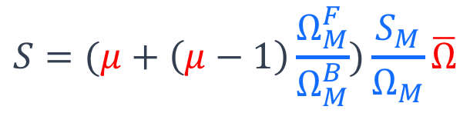


Surface concentration inferred from aircraft column retrievals and model vertical profile information
Simple, intuitive case:
Accounting for spatial variability in the PBL:
$$S=\frac{S_{M}}{Ω_{M}}Ω$$
$$S=(μ+\left(μ−1\right)\frac{Ω_{M}^{F}}{Ω_{M}^{B}})\frac{S_{M}}{Ω_{M}}\overline{Ω}$$
Model (blue)
Measurement (red)
$$S≡surface concentration$$
$$\overline{Ω}≡Ω \text{averaged} \text{over} \text{a} \text{model} \text{grid}\text{−}\text{size} \text{region}$$
$Ω≡\text{vertical} \text{column} \text{density}\text{ (}\text{below} \text{aircraft}\text{)}$
$$μ≡Ω/\overline{Ω} \text{(}\text{sub}\text{−}\text{grid} \text{inhomogeneity}\text{)}$$
Results using mean
values of columns
for each site
Subscripts:
M, model
F, free troposphere
B, boundary layer
-
Notes:
The simplest approach to inferring surface concentration from ACAM VCDs is to scale them with the modeled ratio of surface concentration to VCD below aircraft.
The more complicated approach accounts for spatial variability in the PBL.
Thus, we use the more complicated formulation, which includes spatial inhomogeneity and model information on FT/PBL partitioning.

Slide 8
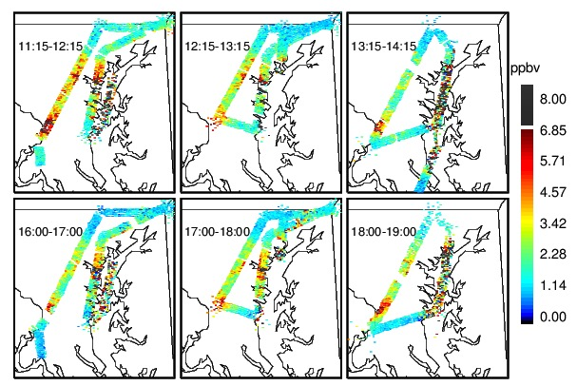
Inferred surface concentrations correspond to aircraft VCDs
ACAM NO₂ VCD from July 29, 2011 (MD)
ACAM-derived NO₂ surface concentration
EDT
EDT
Lamsal et al. [2017]
July 29 was a very hot and high O₃ day
Notes:
Example of ACAM VCDs (from previous slide) and new surface concentration.
Correspondence over polluted regions shown.

Slide 9
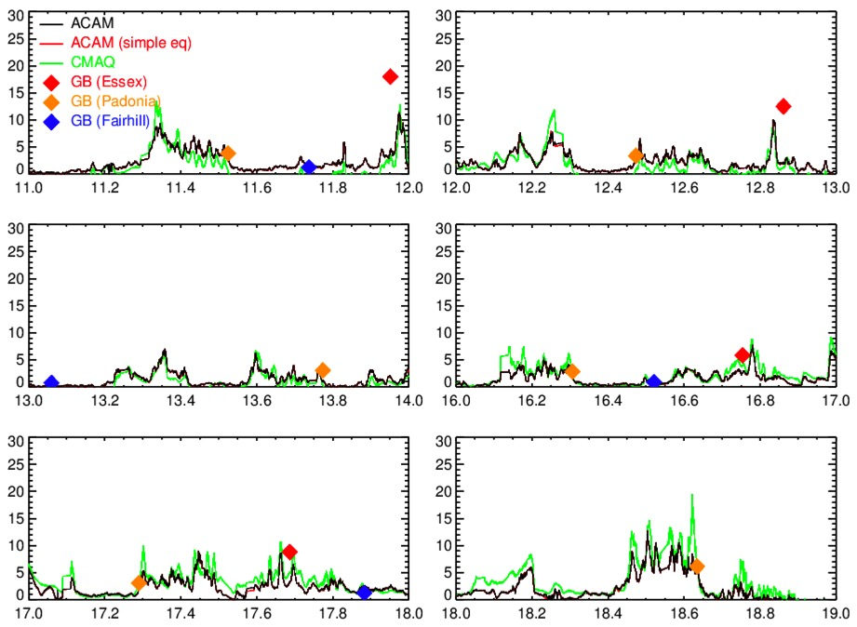
Aircraft VCDs, surface concentrations, and ground-based comparisons
July 29, 2011
Fairhill
Padonia
Edgewood
Essex
Surface Concentration (ppbv)
CMAQ monthly mean
Essex – urban Padonia - suburban
Fairhill – rural Edgewood – on the bay
Time (h EDT)
Ground-based coincidence criteria: 5 km, 10 min
Notes:
These are line plots of the data from the same flight (as previous slide).
Top is ACAM VCD (below aircraft) compared with CMAQ. Generally good but with biases and differences in some peaks.
Bottom is surface concentration (will be more clear on next slide).
Added ground-based measurements coincident with aircraft overflights (based on coincidence criteria).
Essex, Padonia, and Fairhill represent urban/suburban/rural measurements. Edgewood is a hard case because it’s complicated dynamically and right on Bay.

Slide 10
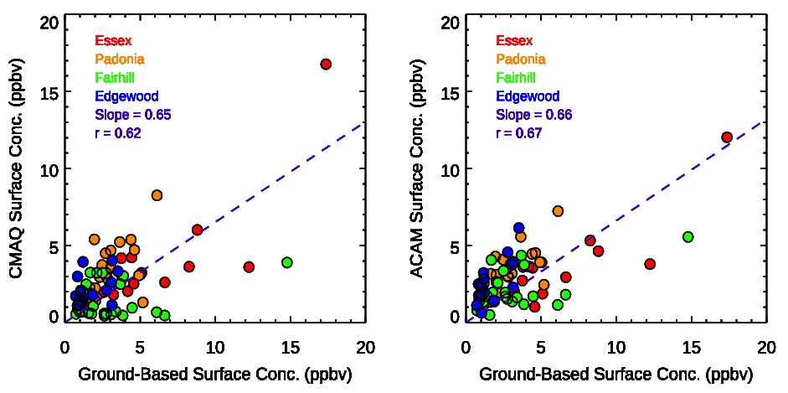
Scatterplots – Maryland
CMAQ Surface NO₂ vs. Surface Obs.
ACAM-Derived Surface NO₂ vs. Surface Obs.
Data points are
for each ACAM over-
pass during MD
campaign
Less scatter in
ACAM estimates of
surface NO₂
Used average of CMAQ grid points within 1 km of
surface station
Used average of ACAM pixels within 2 km of
surface station

Slide 11
Statistics for Maryland
Data from all 14 Maryland flight days
Station | Essex Molybdenum converter | Padonia Photolytic | Fairhill Photolytic | Edgewood Photolytic
Median Ratio of ACAM Sfc estimate to Sfc Obs. | 0.63 | 1.04 | 1.01 | 1.53
^{Station} | Essex Molybdenum converter | Padonia Photolytic | Fairhill Photolytic | Edgewood Photolytic
Correlation of ACAM Sfc Estimate vs. Sfc Obs. | 0.67 | 0.43 | 0.65 | 0.67

Slide 12
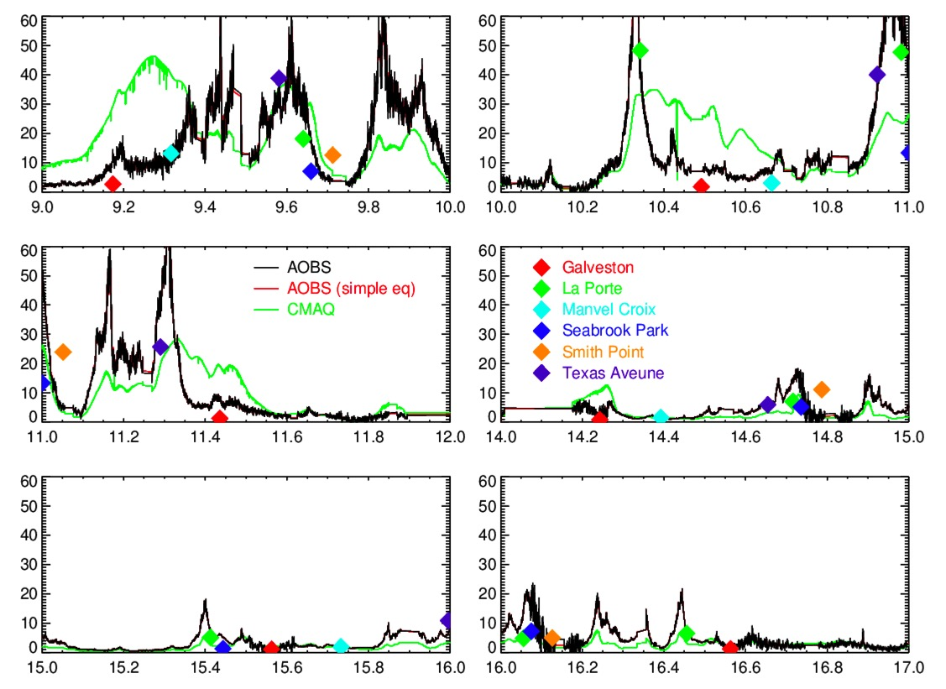
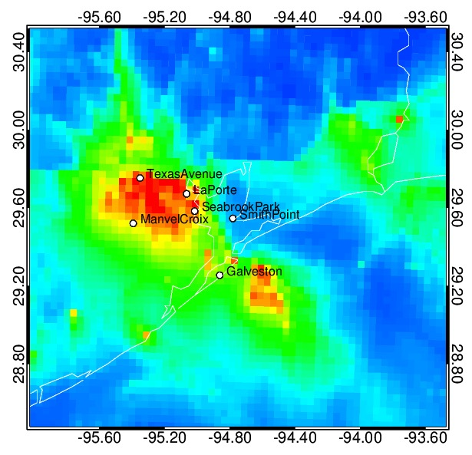
Texas – Time series for September 25, 2013
Highest ozone day of Houston
campaign
Daily mean CMAQ NO₂ and station locations
GCAS
Surface Concentration (ppbv)
Time (h CDT)

Slide 13
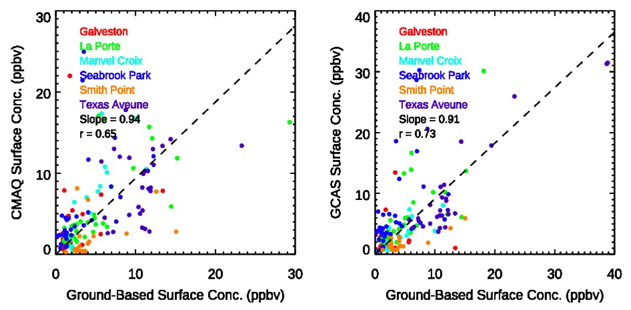
Texas – Scatter plots
Using all GCAS overpasses

Slide 14
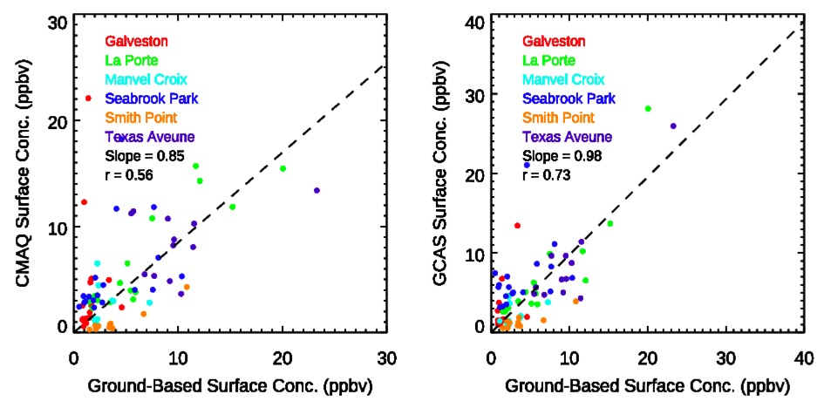
Texas 15-20 UT (10 – 15 CDT) Scatterplots
Only considering the
midday hours
improves the slope
for GCAS-derived sfc
concentrations
And, now the GCAS-
derived surface data
compare better with
observations than
those from CMAQ itself

Slide 15
Texas Statistics
Data from all 9 flight days.
Six ground sites with true NO₂ obs.
Highest correlations of
GCAS-based surface NO2
with surface observations at
most polluted sites: LaPorte,
Manvel Croix, Texas Ave.
Lower correlations at sites
on Galveston Bay: Seabrook
Park and Smith Point
Lowest correlation at site
dominated by marine air:
Galveston
Station | Median GCAS/GB | GCAS–GB Correlation
Galveston | 1.34 | 0.02
La Porte | 1.30 | 0.80
Manvel Croix | 0.76 | 0.75
Seabrook Park | 1.70 | 0.43
Smith Point | 0.49 | 0.49
Texas Avenue | 0.75 | 0.78
See talk by Dale Allen at 3 PM in Dogwood Room: more detail on CMAQ simulation
and NO₂ results

Slide 16
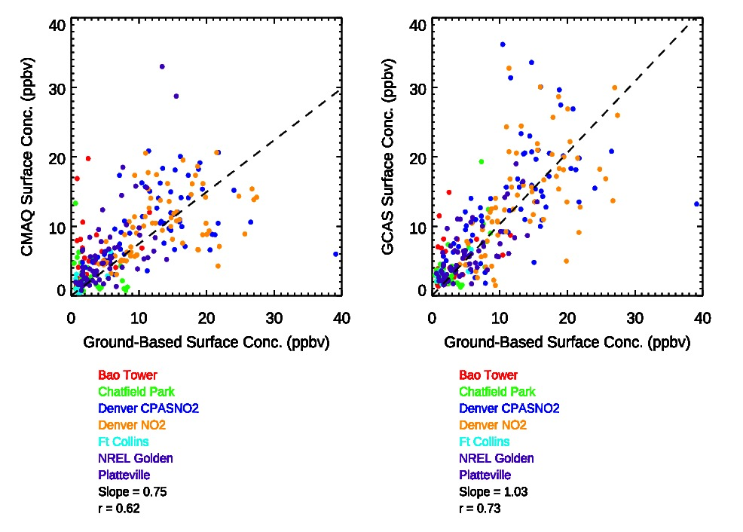
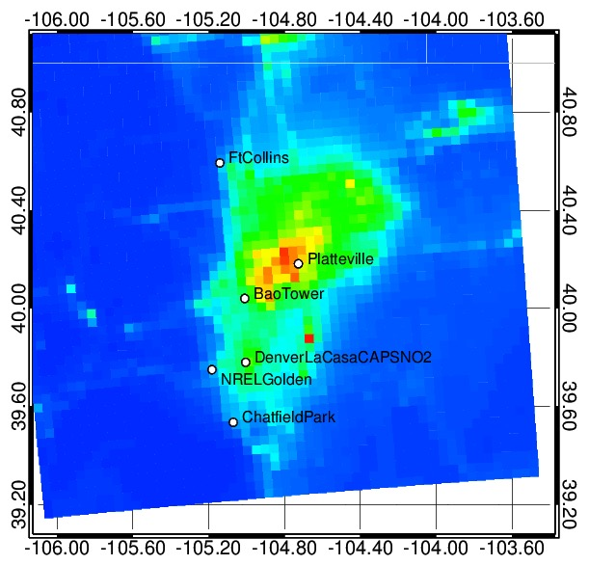
Colorado – Scatter plots
GCAS-based estimates provide
less scatter than model
estimates.
Daily mean CMAQ NO2 and station locations
8/2/14

Slide 17
Colorado Statistics
Data from all 17 flight days
All true NO2 except Denver La Casa
Station | Median GCAS/GB | GCAS–GB Correlation
BAO Tower | 1.67 | 0.27
Chatfield Park | 1.14 | 0.42
Denver La Casa CAPS | 1.30 | 0.39
Denver La Casa Moly | 1.00 | 0.38
Ft Collins | 1.54 | 0.46
NREL Golden | 1.39 | 0.37
Platteville | 1.10 | 0.66
GCAS-derived surface
NO₂ has a high bias at
all sites
Further investigation
needed to determine
cause.
Correlations only fair
to moderate; lower than
other campaigns

Slide 18
Summary
Estimates of surface NO₂ have been computed from a combination of airborne remotely
sensed data and CMAQ model output.
Maryland campaign - moderate correlations were found between ACAM-derived surface NO₂
and ground-based in situ observations.
Median ACAM-derived and ground-based NO₂ were similar at the suburban and rural sites with
true NO₂ observations.
Texas campaign – correlations between GCAS-derived and observed mixing ratios were greater
for the more polluted sites and lower at coastal sites where strong NO₂ gradients exist.
Better comparison with surface observations obtained for mid-day hours when the boundary
layer was better mixed in the vertical.
Colorado campaign – Agreement of GCAS-derived surface estimates with observations poorer
than in other campaigns. Further investigation necessary.
Future work – Investigate use of CMAQ PBL vertical gradient to filter times/locations to analyze

