Slide 1
Status and Plans for the Next Generation Air Quality Modeling System Development
Jonathan E. Pleim, David Wong, Robert C. Gilliam, Jerold A. Herwehe, O. Russell Bullock Jr., George Pouliot, Christian Hogrefe, Daiwen Kang, Bill Hutzell, Rohit Mathur, Shawn Roselle, and Limei Ran
CED/NERL/ORD/USEPA
17th Annual CMAS Conference, Chapel Hill, NC: October 22-24, 2018

Slide 2
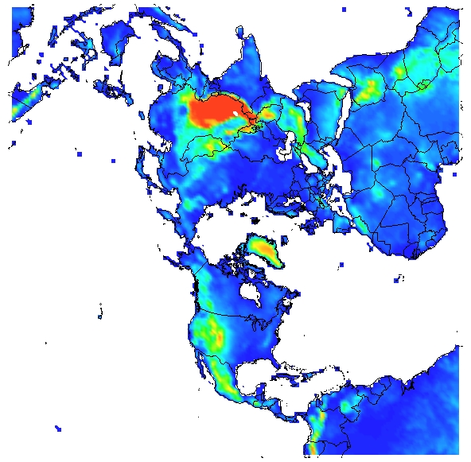
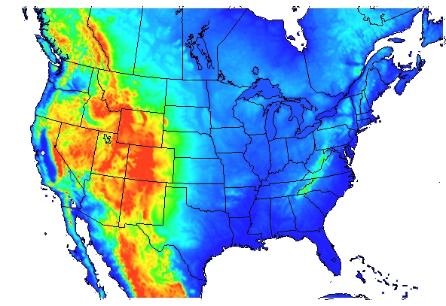
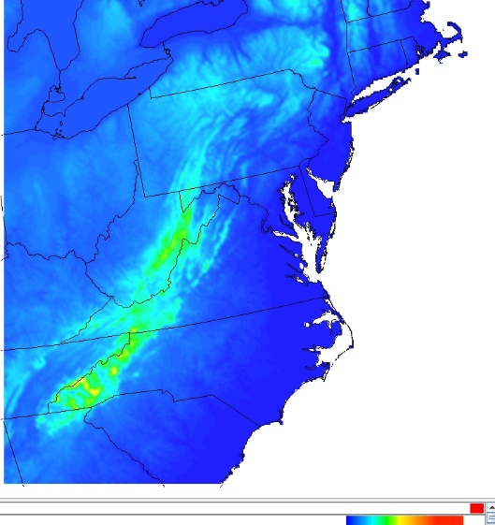
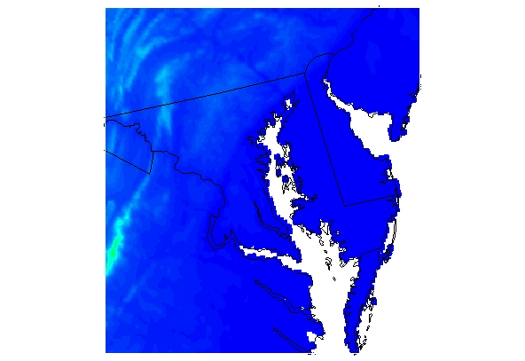
Drivers for Next Generation AQ modeling
As AQ is cleaner in US, more comes from beyond our borders
  Current systems either rely on different global models for LBCs for regional AQ modeling or Multiple nesting from Hemispheric to regional and urban:
  Multi-step process, Many opportunities for user mistakes, Interpolation errors on boundaries, Resolution discontinuities, Map projection differences, No upscale feedback
ΔX = 108 km
ΔX = 12 km
ΔX = 4 km
ΔX = 1 km

Slide 3
Vision for Next Generation Model
Extend to global scales
  Single global mesh with seamless refinement to local scales
  Integrated chemistry, dynamics, physics
Three configurations of flexible systems:
  Online global variable grid (e.g. MPAS-AQ)
  Online regional (WRF-AQ or limited area MPAS-AQ)
  Offline regional (WRF followed by AQ)
Interoperability of as much model code as possible
  1-D AQ component coupled to various met models
Transport in met models for online systems (adv, diffusion)
  Ensure mass conservation
  Consistency with met parameters
  Minimize numerical diffusion and dispersion
MPAS

Slide 4

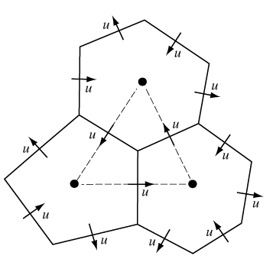
MPAS
Fully-compressible, non-hydrostatic dynamics
Finite volume discretization on centroidal Voronoi (nominally hexagonal) grids
Single global mesh with seamless refinement to local scales
Latest version: MPAS 6.1
MPAS uniform mesh (240 km)
MPAS non-uniform mesh (92km – 25km)
Refinement over CONUS

Slide 5
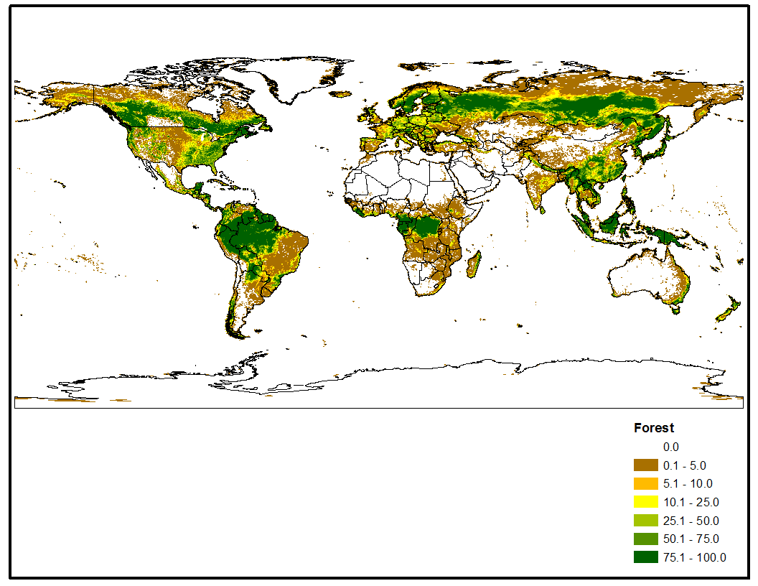
MPAS development and testing for AQ
Added physics
  ACM2 Boundary layer model
  Pleim-Xiu Land Surface Model (PX LSM)
  Updated Kain-Fritsch convective cloud scheme
    including radiation feedback and dynamic lifetime
Data Assimilation
  Implemented FDDA similar to WRF
  Implemented indirect soil moisture data assimilation in PX LSM
Landuse for met and biogenics
  NLCD 2011 US Blended with MODIS 2013 including subgrid fractional coverage

Slide 6
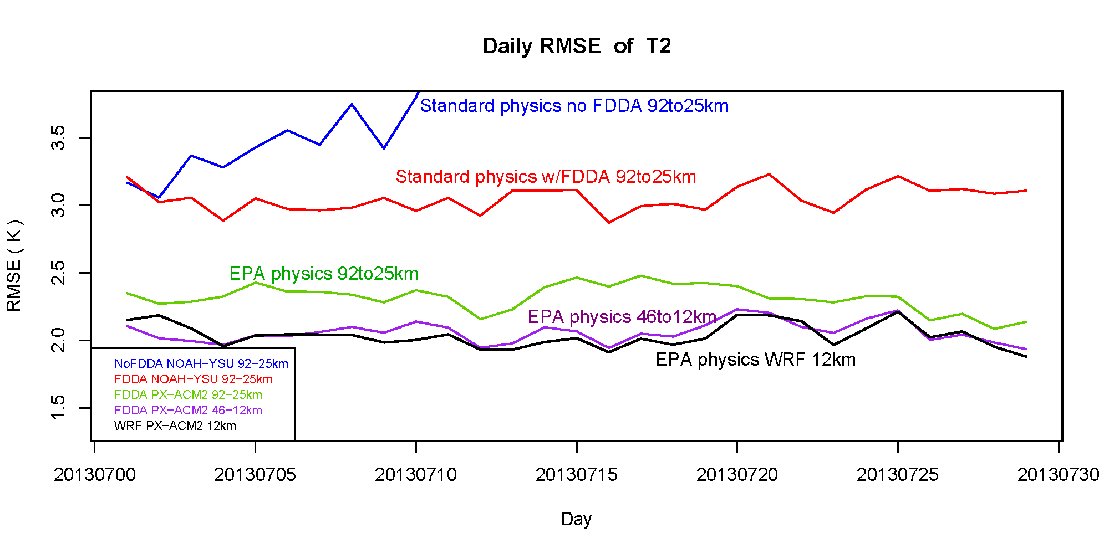
2-m Temperature Daily RMSE for CONUS
July 2013
Courtesy of Rob Gilliam

Slide 7
MPAS w/ EPA physics & FDDA
July 2016 with 46km/12 km mesh resolution
FDDA using 6-hrly GFS analyses at 0.25 deg resolution
Surface analyses for PX LSM soil nudging : 0.25-deg GFS with 12 km NAM blending over US
RMSE T-2m
RMSE WS-10m

Slide 8
MPAS-CMAQ
MPAS-CMAQ is a prototype of Next Gen AQ model
  CMAQ is called as module in MPAS
  2-way data transfer through MPAS-CMAQ Coupler analogous to MPAS coupler for WRF Physics
  Advection of chemical species in MPAS identical to meteorological scalars
    no need for mass adjustment for continuity
  MPAS uses z-coordinates in a hybrid terrain following layer structure
  For CMAQ generalized coordinates the vertical Jacobian = 1, ρJ = ρ
  Subgrid cloud fractions from KF used to affect photolysis
  Stratospheric Ozone from GFS analysis for layers above the Tropopause (from GFS)
Initial testing for July 1-31, 2013 and October 1-31, 2015
  Global emissions from 0.1 x 0.1 degree HTAP_v2.2 [Janssens-Maenhout et al., ACP 2015]

Slide 9
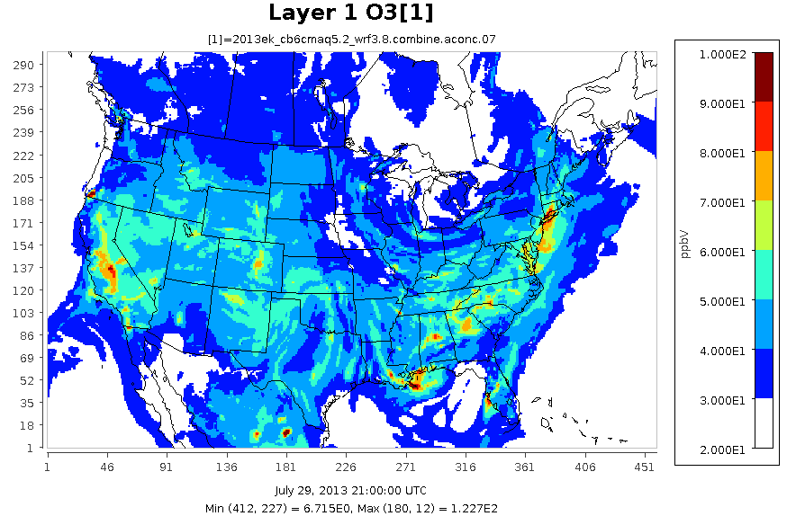
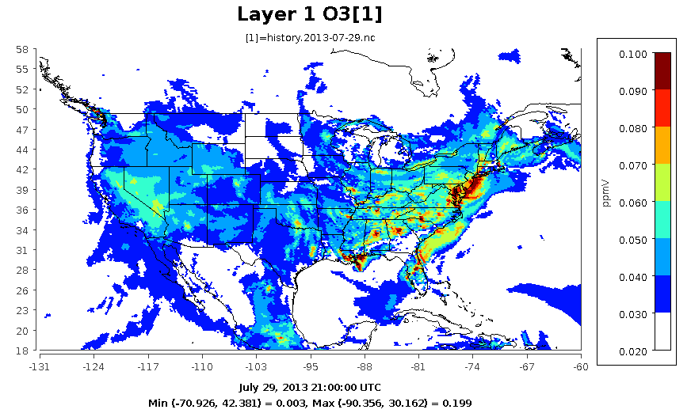
Ozone July 29, 2013, 21Z
WRF-CMAQ
MPAS-CMAQ
MPAS-CMAQ ozone concentrations have similar distribution as WRF-CMAQ but higher in urban areas
Ozone in Mountain west is mostly 30 – 60 ppb indicating that GFS ozone in stratosphere is affecting background troposphere

Slide 10
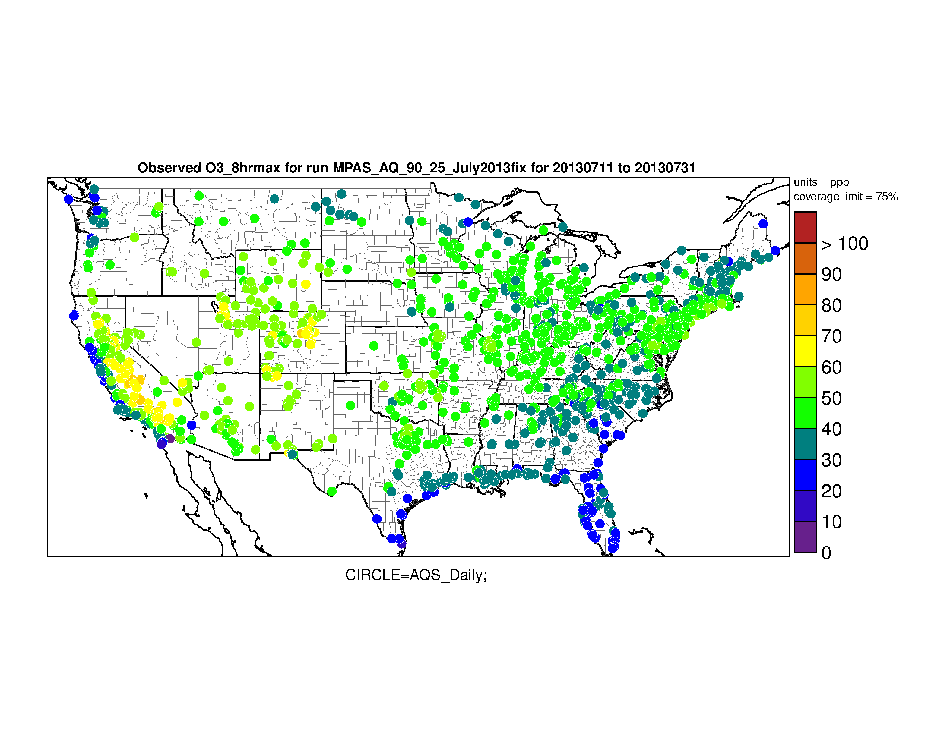
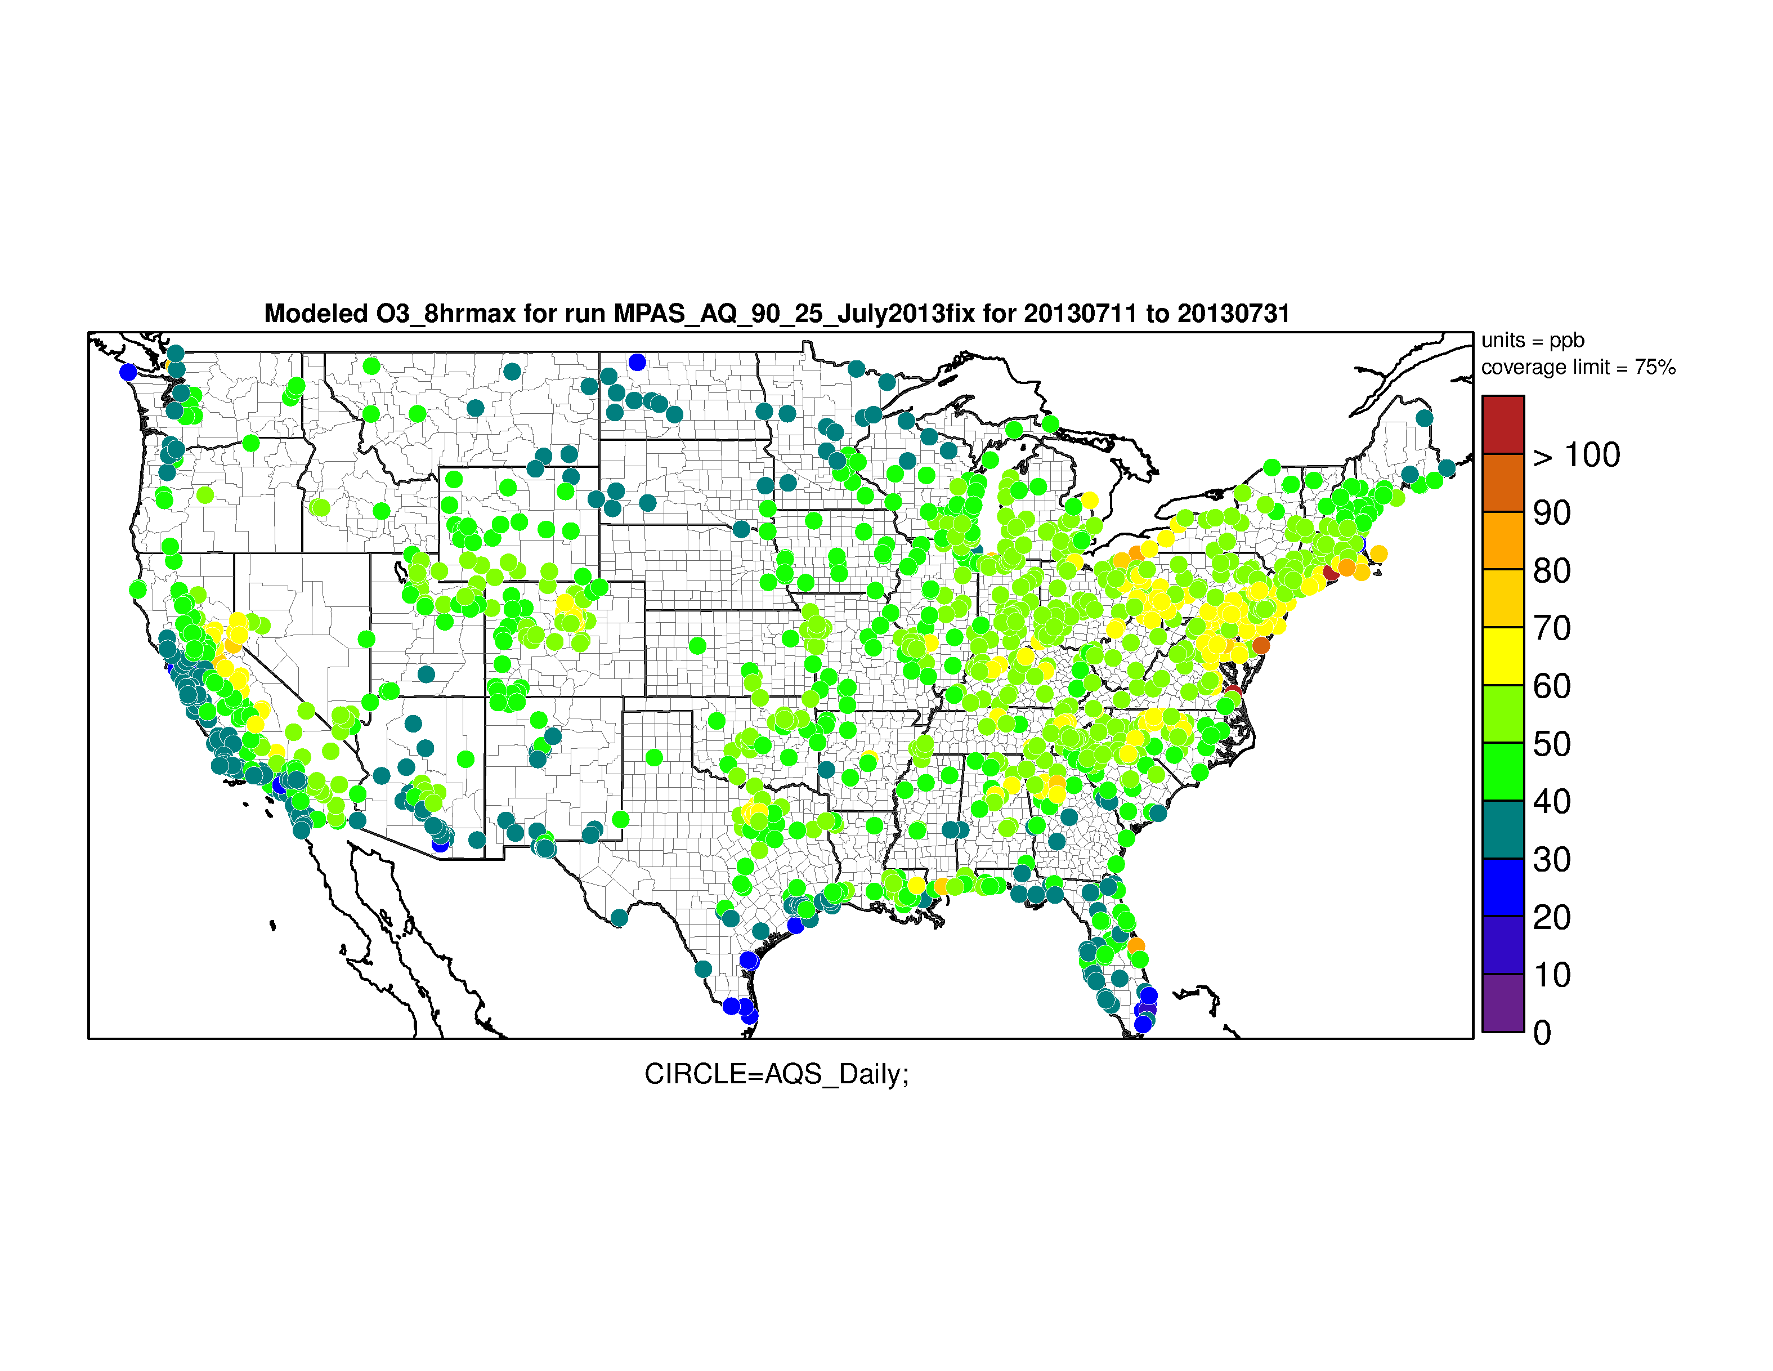
Max 8hr Ozone – July 11 - 31
AQS Observations
MPAS-CMAQ
Modeled max 8hr ozone greater than observations in East, low in CA, and slightly low in mountain west

Slide 11
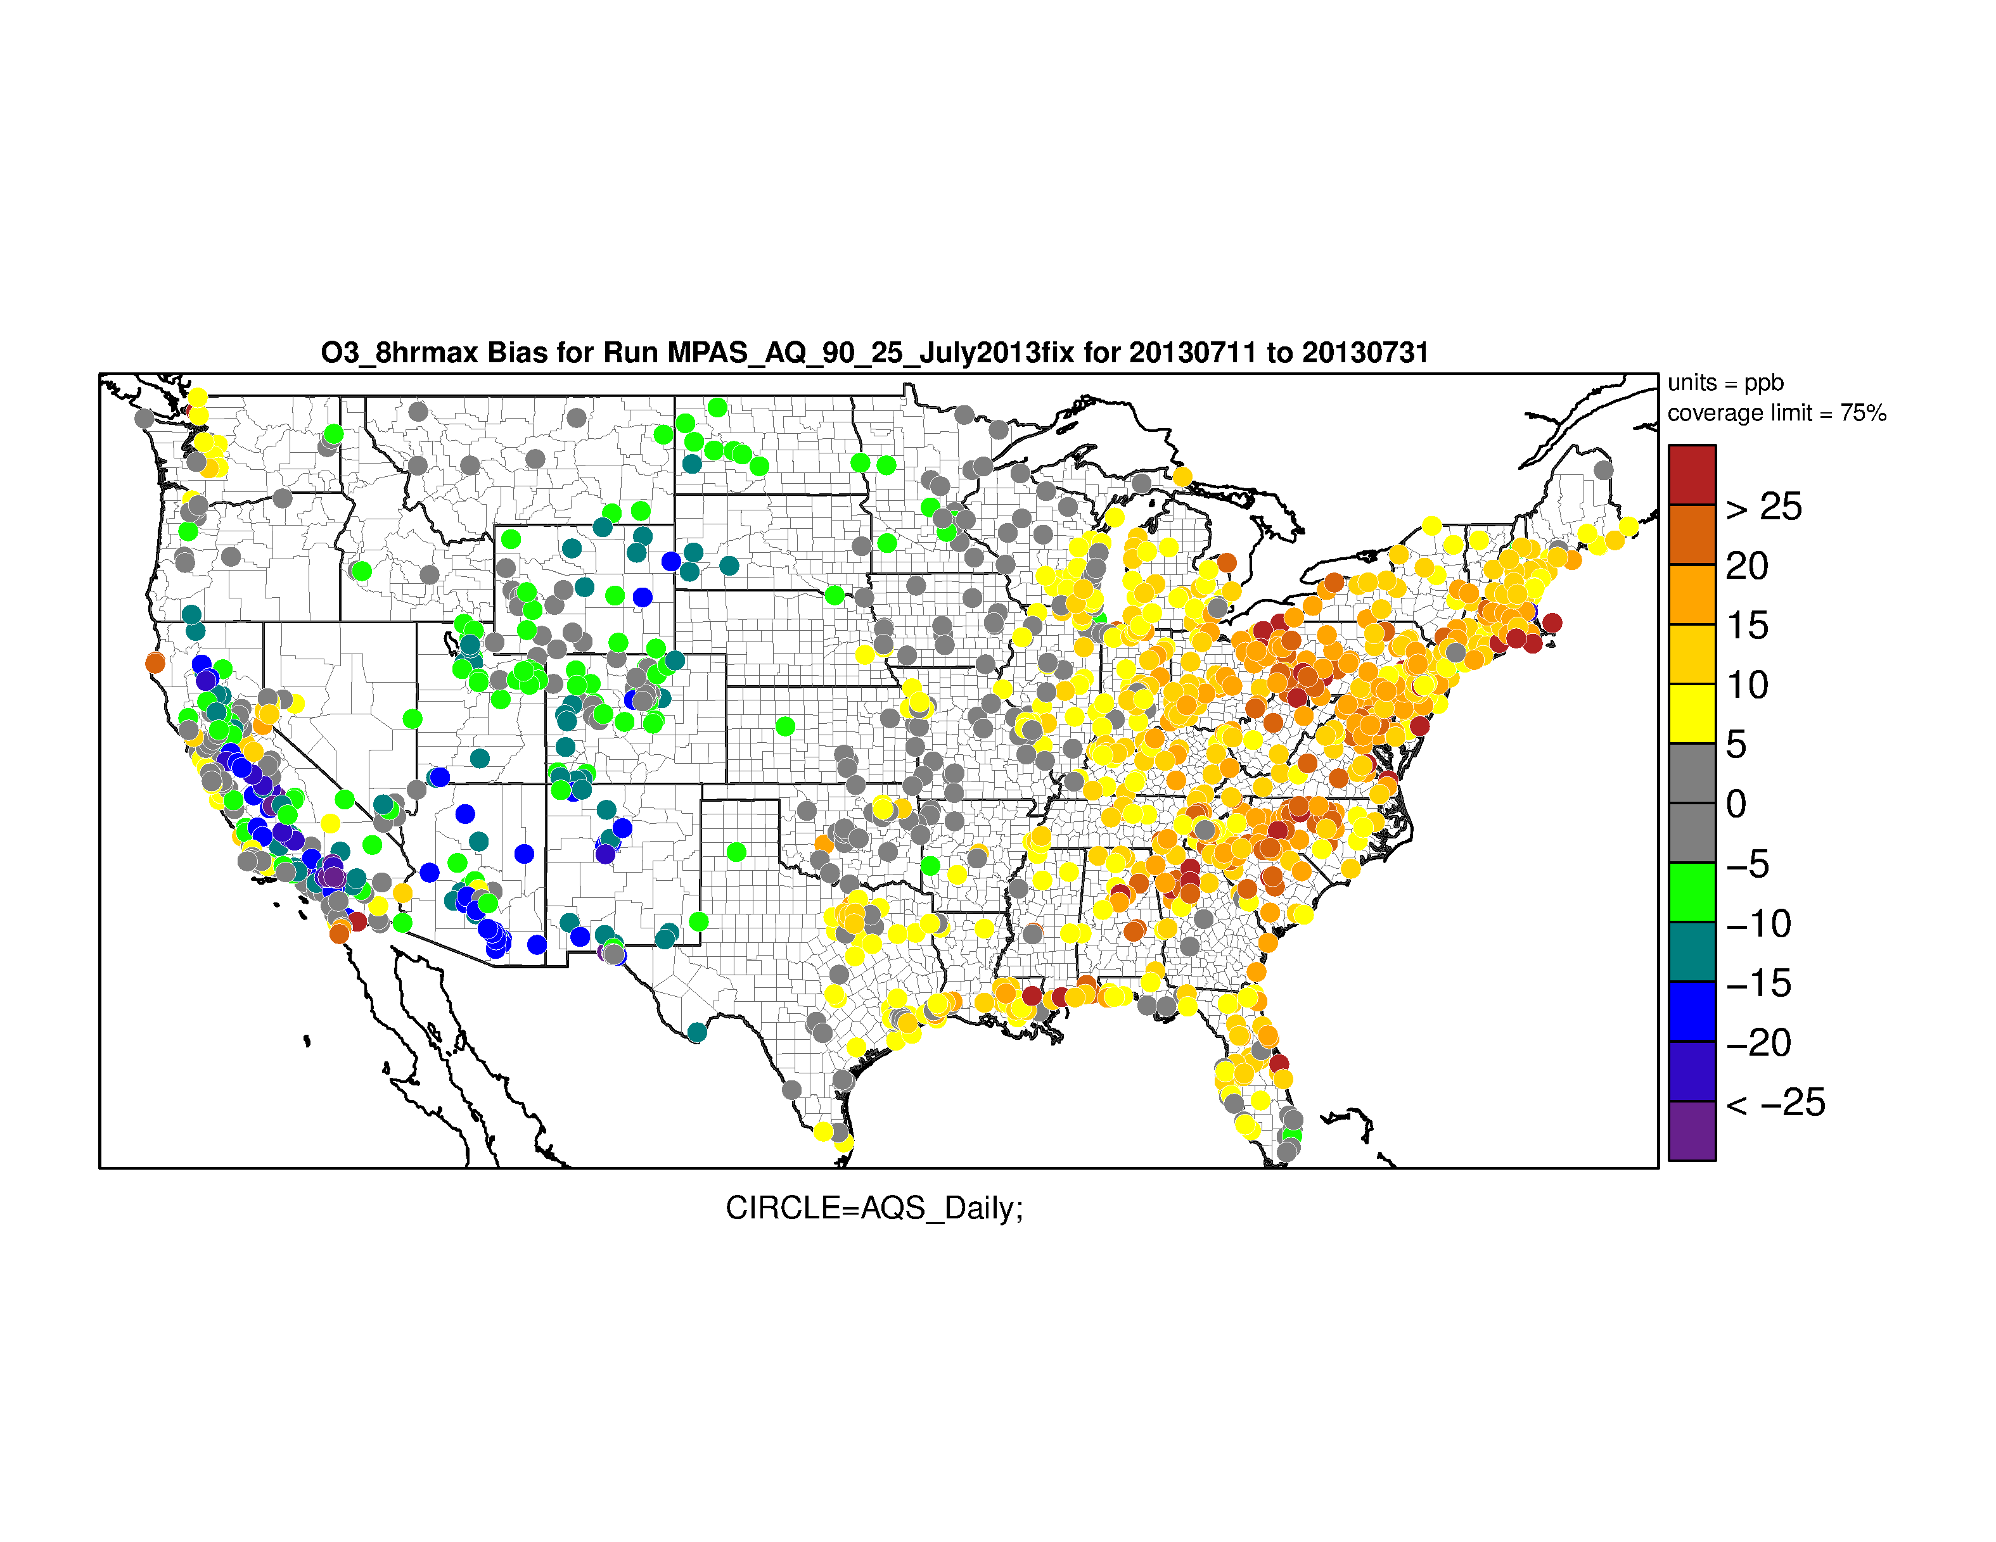
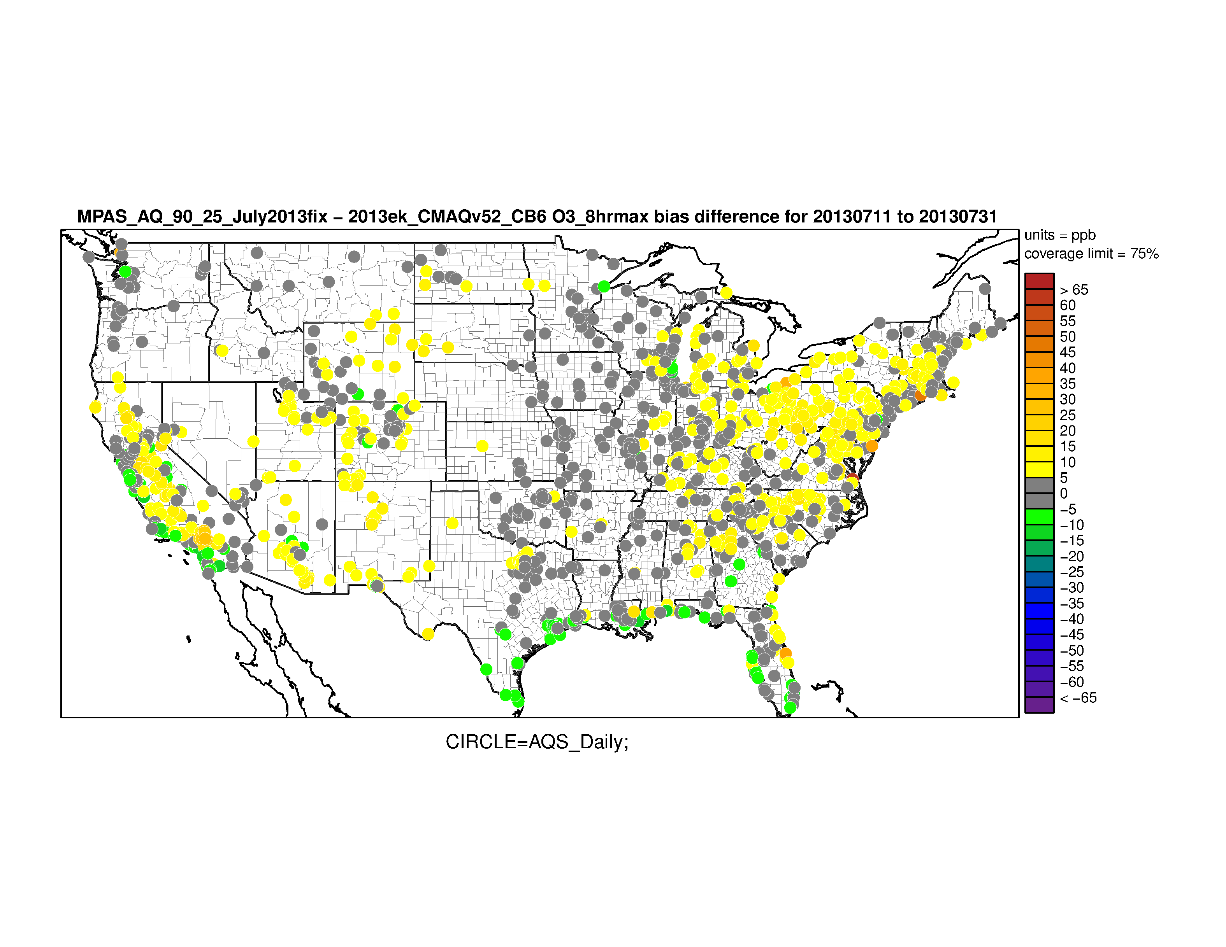
Max 8hr Ozone – July 11 - 31
MPAS-CMAQ Bias
Bias difference (MPAS-CMAQ – WRF-CMAQ)
AQS Observations
MPAS-CMAQ Ozone bias is better than WRF-CMAQ along the Gulf and CA coast but worse everywhere else

Slide 12

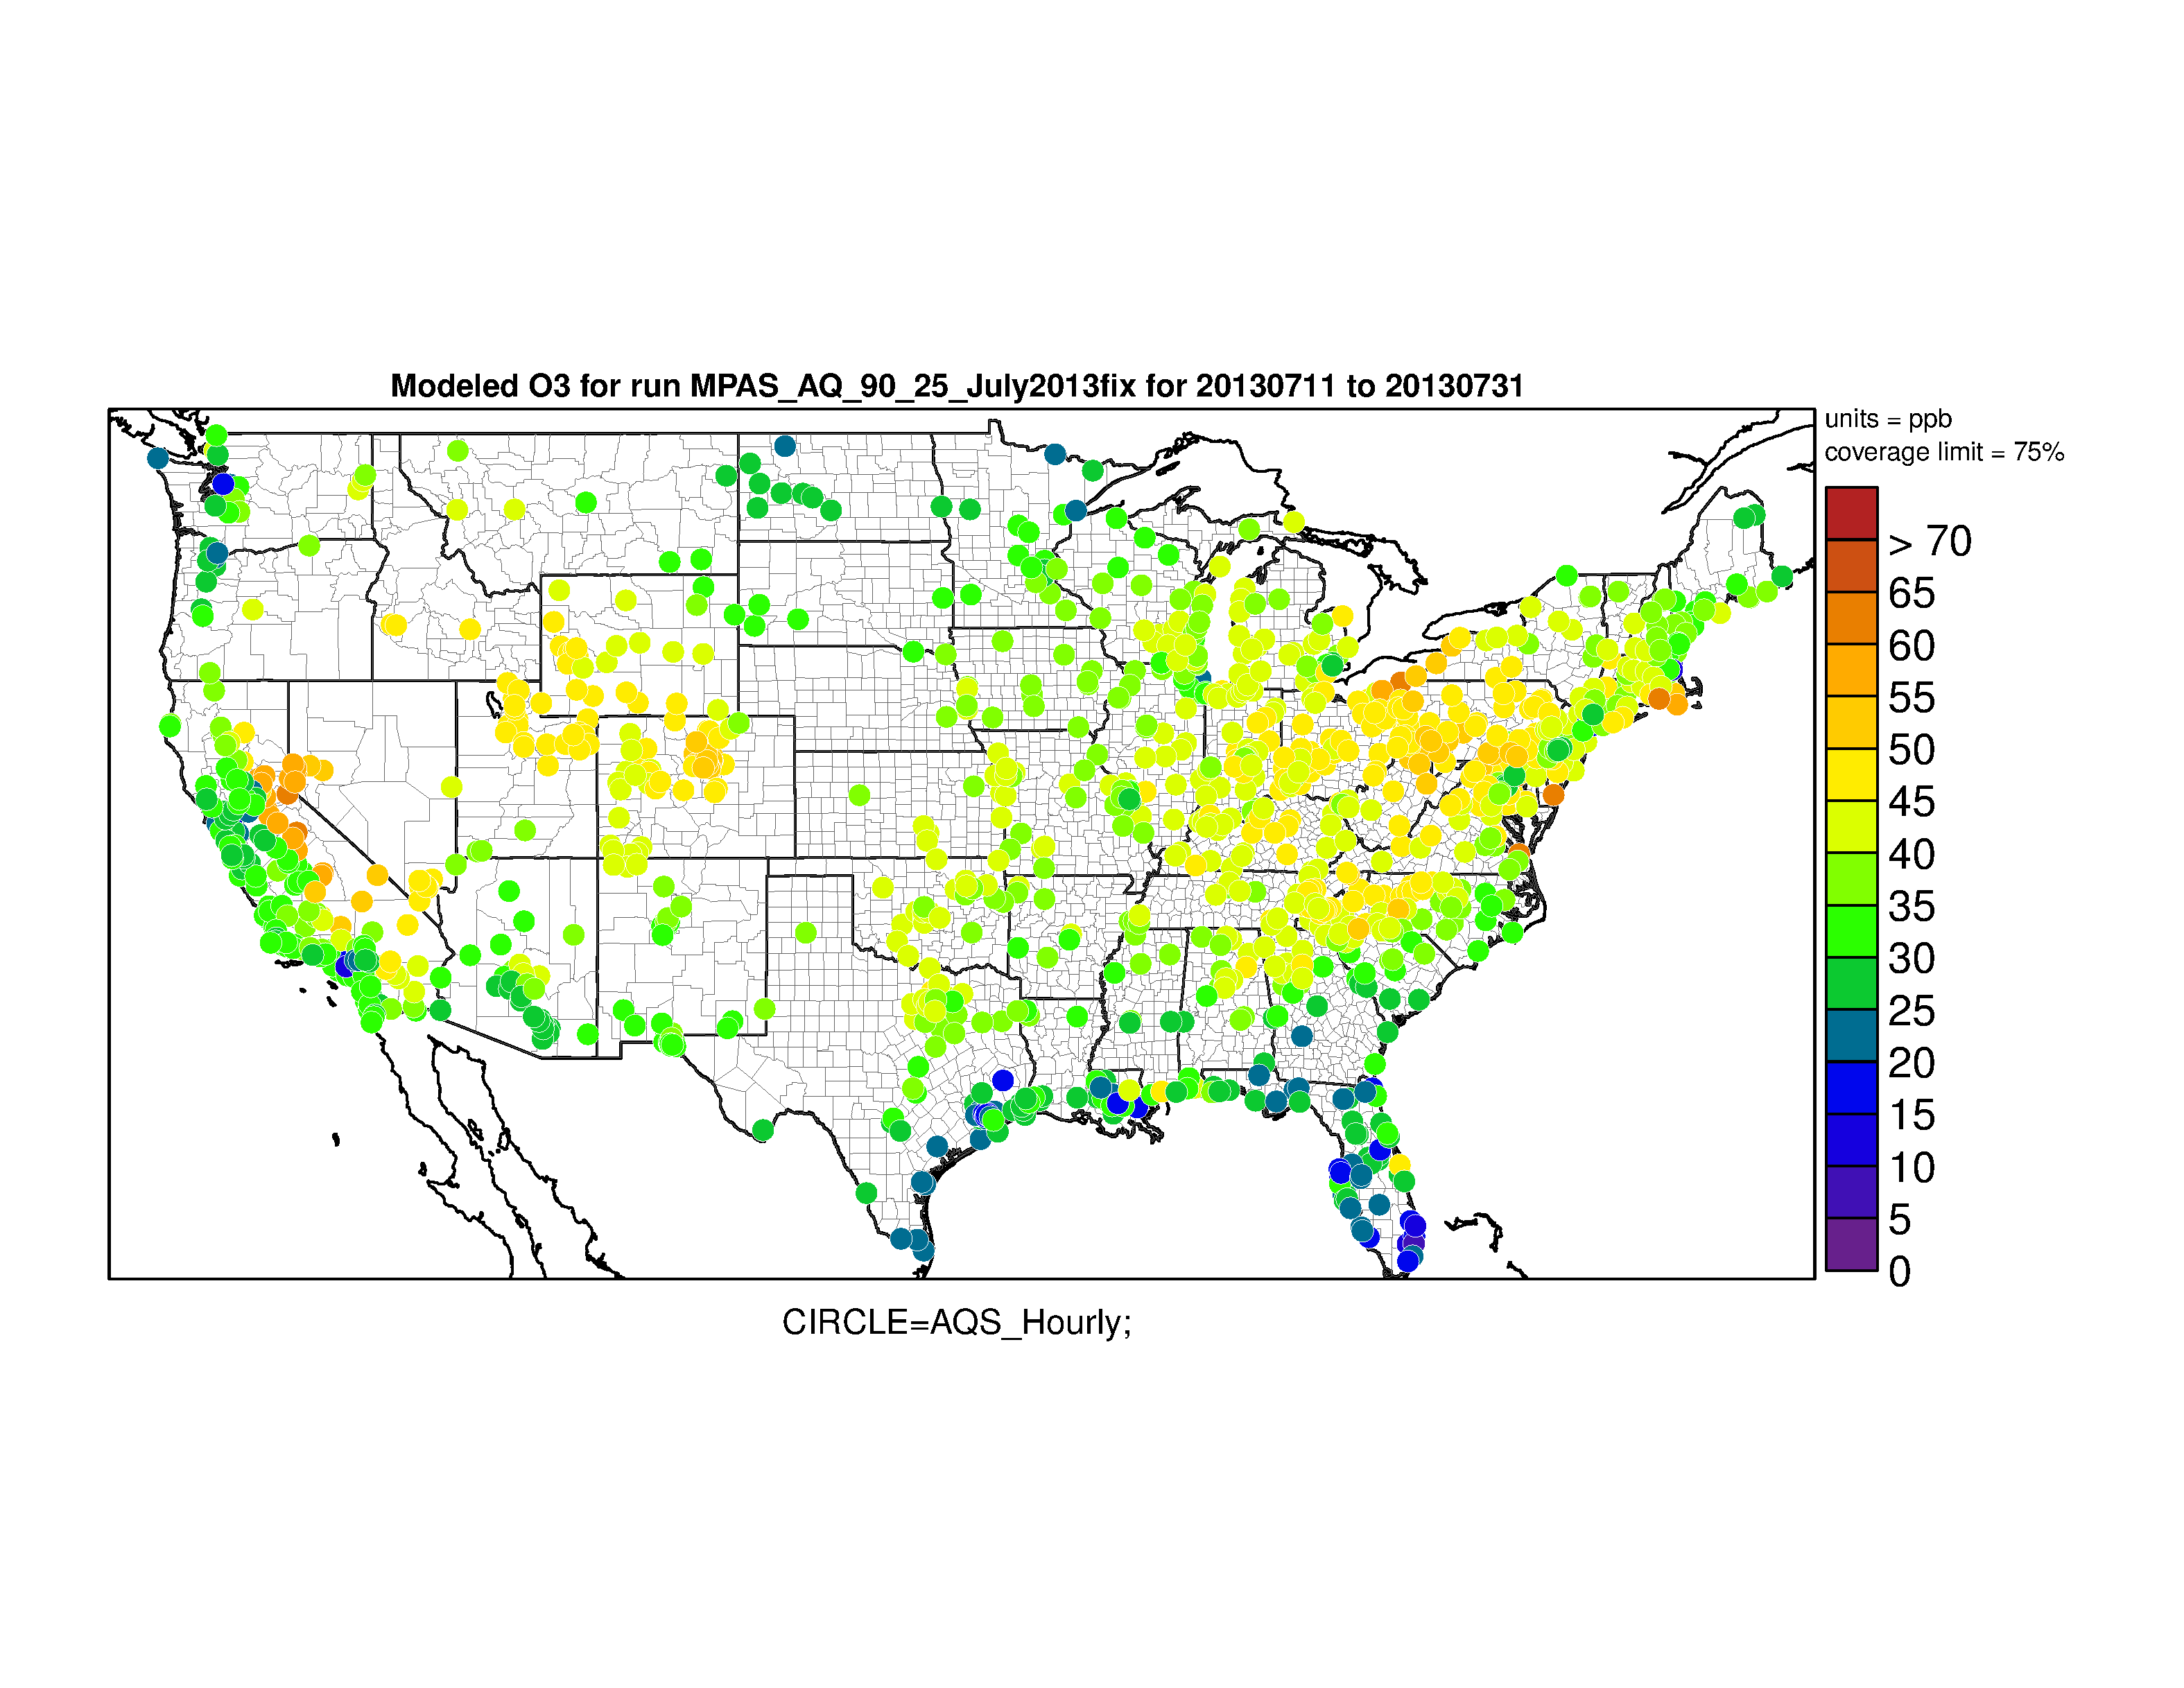
Hourly average ozone July 11- 31, 2013
AQS Observed
MPAS-CMAQ
MPAS-AQ is too high most of East
Low concentrations along Gulf coast and high concentration in MT west look good

Slide 13
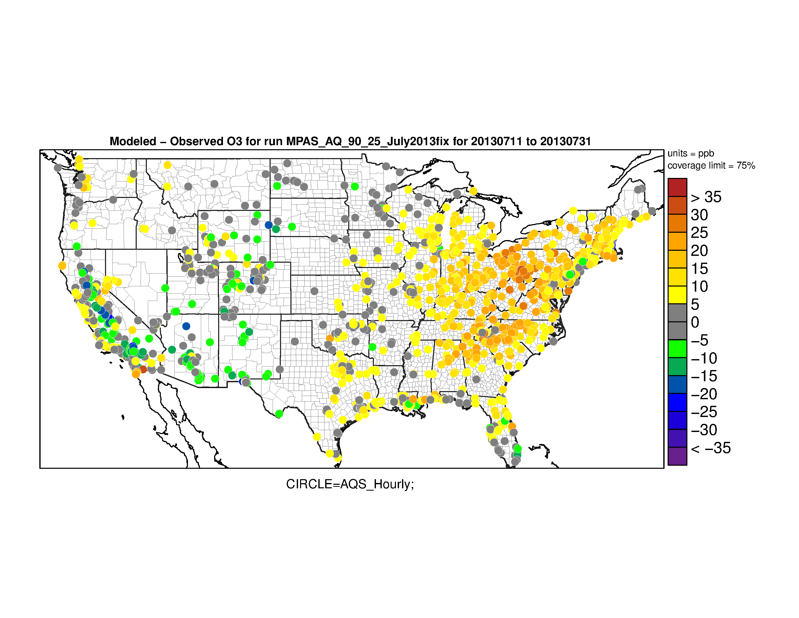
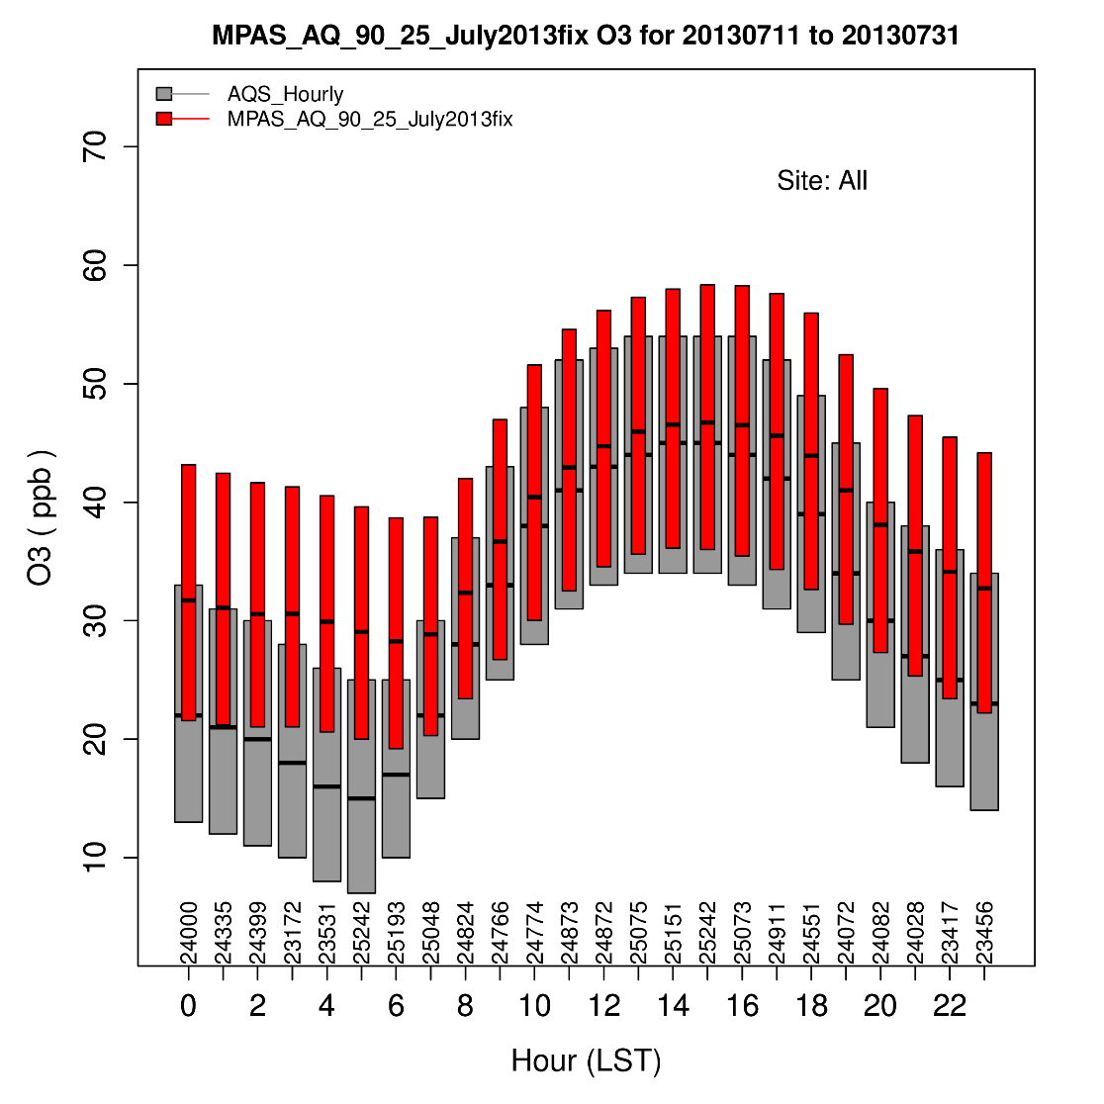
Ozone compared to AQS
Hourly average high bias in East greater than
high bias in max 8hr ozone
High bias is mostly at night

Slide 14
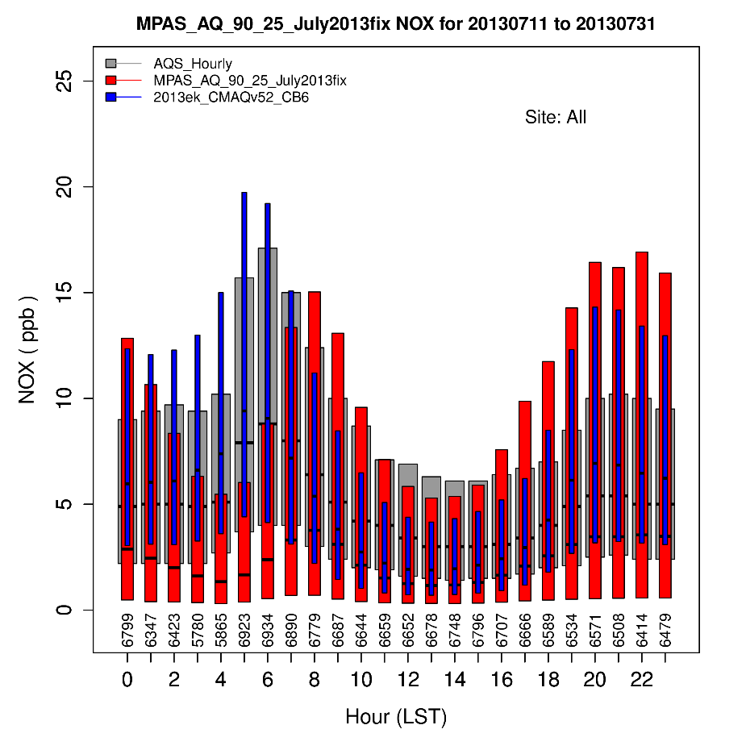
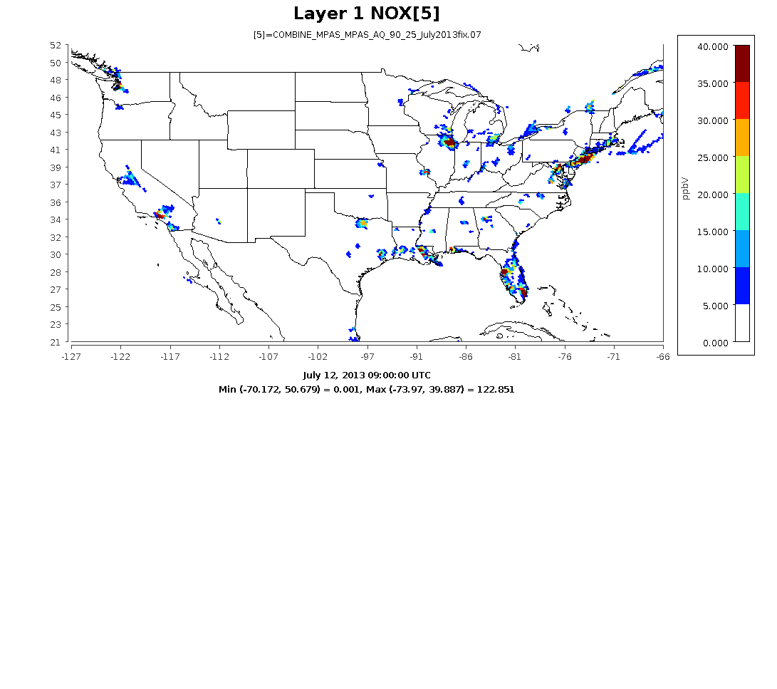
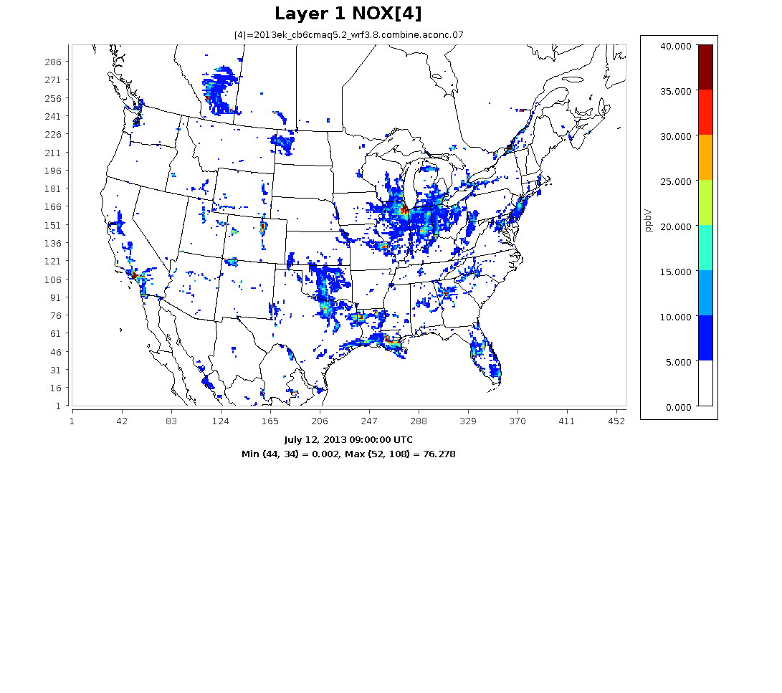
NOx concentration at night
July 12, 2013 - 9Z
MPAS NOx is high in cities but much lower in surrounding areas
Less titration could be reason for ozone overprediction at night.
Next runs for 2016 will use 2016 NEI for US
MPAS NOx drops in early morning
(2 – 6 AM)

Slide 15
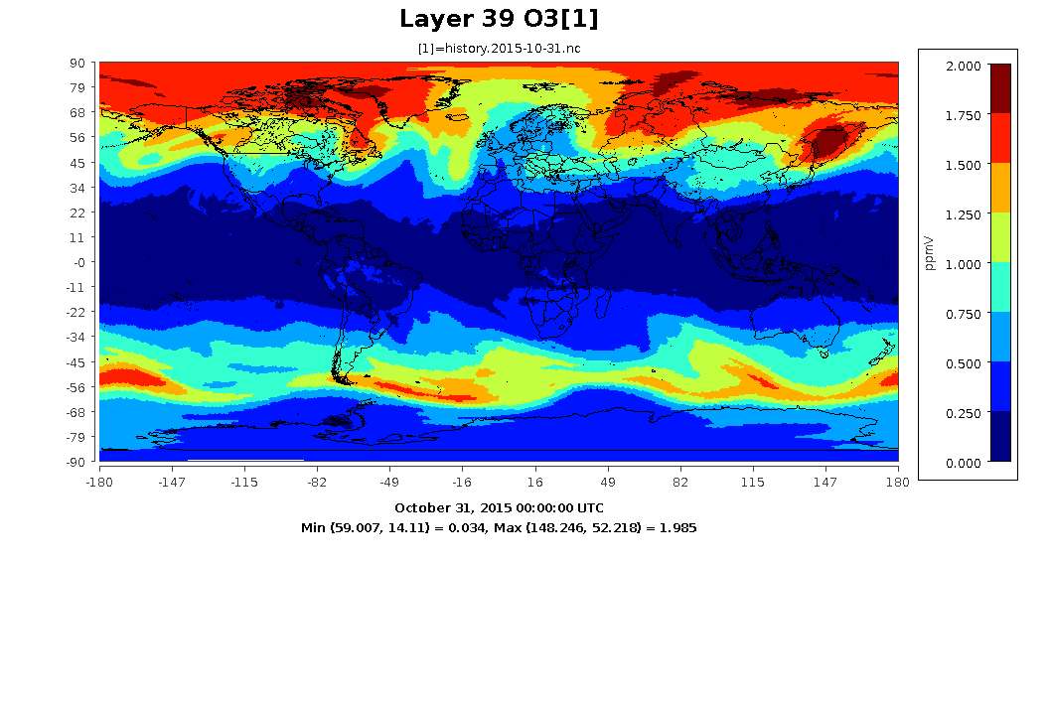
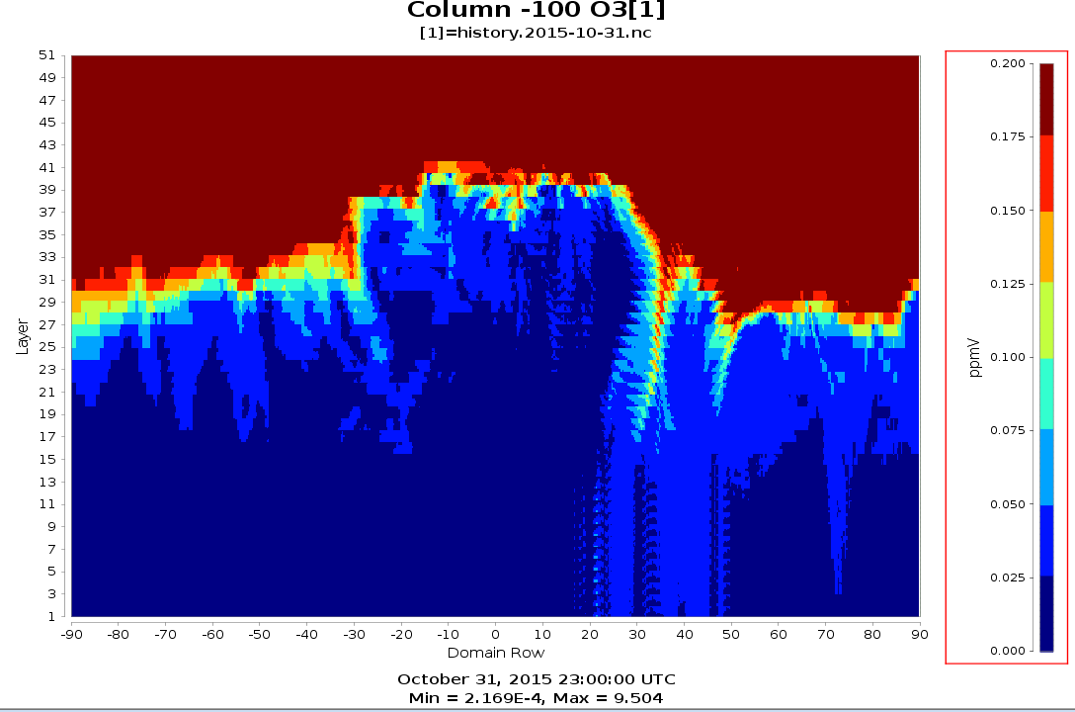
Assimilation of Stratospheric ozone
Replace O₃ concentrations for all model layers above Tropopause with ozone from GFS 0.25 deg analysis every 6-hours
Pole-to-pole vertical cross section along -100° meridian
MPAS-CMAQ O₃ at around 85-95 mb

Slide 16
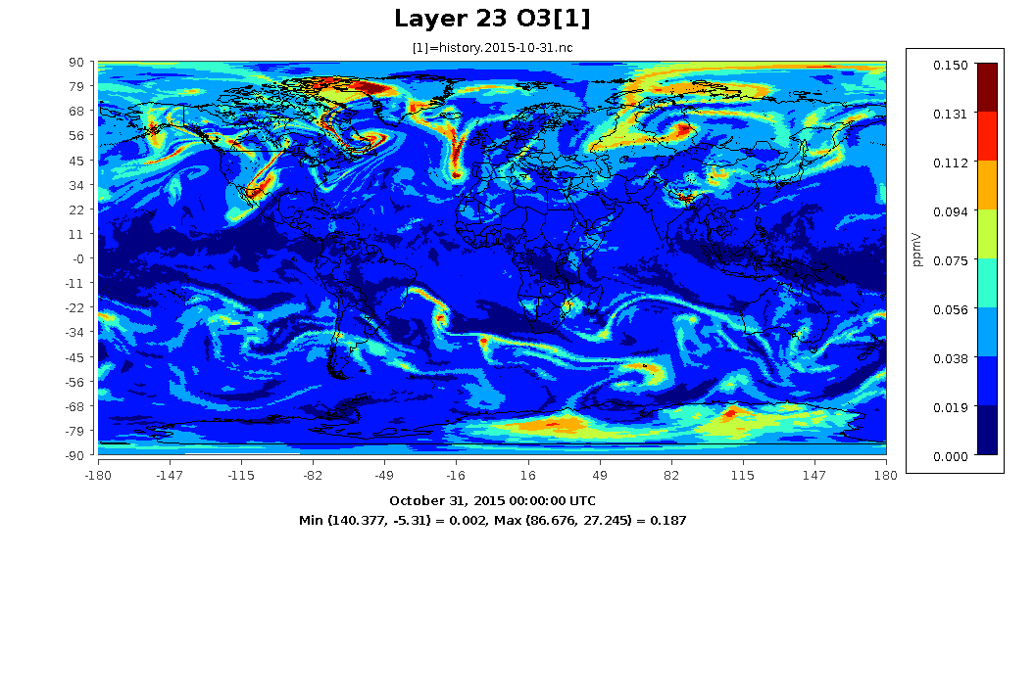
O₃ at around 400 mb on October 31, 2015

Slide 17
Work in progress
Updates to MPASv6.1
  Includes EPA physics and FDDA
  Implement latest developments in PX LSM
    More realistic vegetation table and capability to directly use MODIS LAI and FPAR
    Use subgrid fractional soil type data and advanced soil moisture calculation
  FDDA from GFS analyses at 0.25 deg resolution with 3 hrly forcast data
Update CMAQ components to CMAQv5.3
  Implement Plume rise for US
  Implement Dust emission model with linkages to MODIS FPAR and coarse sand from soil data
  Implement Sea Salt emission model
Run updated model with New emissions for 2016
  Combines global HTAPv2 2010 emissions with NEI 2016 for US
  Biogenics from GEOS-Chem run using MEGAN
Evaluate with global data, Satellite, Ozonesondes

Slide 18
Next steps
Further developments for MPAS-CMAQ
  Global In-line biogenic emissions using MEGAN3
  Global bi-directional flux of NH₃ from Fertilizer
Regional MPAS-CMAQ and coupling to WRF-CMAQ
  Test and evaluate driving regional MPAS-CMAQ with global MPAS-CMAQ LBCs
  Develop, test, evaluate driving WRF-CMAQ with global MPAS-CMAQ LBCs
Redesigned AQ model
  Redesign CMAQ from ground up to refresh model structure and coding
  Improve efficiency and flexibility.

Slide 19
Disclaimer
The views expressed in this presentation are those of the authors and do not necessarily reflect the views or policies of the U.S. EPA

