Slide 1

Model Inter-comparison and
Evaluation of Particular Matter
- Study for MICS-Asia III
17th Annual CMAS conference
Chapel Hill
October 23, 2018
Jiani Tan, Joshua S. Fu
Department of Civil and Environmental Engineering
The University of Tennessee, Knoxville, US
Notes:
Thank you for showing your interest in this presentation. My name is Jiani Tan. I am a ph.d student from the university of Tennessee, under professor Dr. Fu. The topic of this speech contains 2 parts, the first part is to evaluate the multiple models performances on simulating particles to find the reasons for model bias with observation. The second target is to do a inter-model comparison between these models to investigate the factors that cause the model differences.

Slide 2

Participating Modeling Groups
Jiani Tan, Joshua Fu, Kan Huang - University of Tennessee, USA
Syuichi Itahashi - Central Research Institute of Electric Power Industry, Japan
Kazuyo Yamaji - Kobe University, Japan
Tatsuya Nagashima, Yu Morino - National Institute for Environmental Studies, Japan
Xuemei Wang, Yiming Liu - Sun Yat-Sen University, China
Hyo-Jung Lee, Jeong-Eon Kang - Pusan National University, South Korea
Chuan-Yao Lin - Research Center for Environmental Changes Academia Sinica, Taiwan
Baozhu Ge, Jia Zhu, Meigen Zhang, Zifa Wang - Institute of Atmospheric Physics, Chinese Academy of Science, China
Mizuo Kajino - Japan Meteorological Agency, Japan
Zhining Tao - NASA Goddard Space Flight Center, USA
Liao Hong – Nanjing Univ of Information Science & Technology, China
Notes:
First, I would like to acknowledge all the modelers that contribute to the multiple models results. This work incorporates 12 models from 11 modelling groups from
US and Asia. And the following are the participating institutions.

Slide 3
Content
Background / Purpose
  Brief introduction of MICS-Asia
  Purpose of this study
Methodology
  Participating models and major mechanisms/processes
  Model processes related to particle formation
Results
  Model with observation data
  Model inter-comparison
Summary
Notes:
The content of this study.
In the background and purpose part, I will give a brief introduction of Mics-Asia, which is an international corporation for model application in Asia. And the purpose and main goal of this study.
The second part is about the research approach used in this study. Since it is inter-model comparison, I will pay more time to introduce the different models and their chemical mechanisms. After that, I will emphasize on the process that related to the formation of particles.
In the results part, I will first show the model evaulation results with ground observation and satellite. Then I will show the comparison between models.

Slide 4
Background/Purpose
The Model InterComparison Study for Asia (MICS-Asia)
Purpose: understand model performance and uncertainties in Asia.
Phase 1 (1990-2000), long-range transport and deposition of sulfur.
Phase 2 (2001-2009), include more species: sulfur, nitrogen, ozone and aerosols.
Phase 3 (2010-present), 3 topics
  Evaluate strengths and weakness of air quality models in Asia and reduce model uncertainty.
  Develop reliable emission inventories in Asia with bottom-up method.
  Estimate the radiative forcing and sensitivity analysis of short-lived climate pollutants.
Notes:
MICS-Asia is the abbreviation of the Model intercomparison study for Asia. It is an intercomparison study with different regional models from international modelling groups to simulate the air quality in EA. The purpose is to understand the model bias and identify the uncertaintys of model application in Asia.
The first phase of MICS-Asia (MICS-Asia I) involved 8 regional chemistry-transport models (CTM) to study the air quality issue related to sulfur (S) (including SO₂, SO₄²⁻ and wet SO₄²⁻ deposition) in 1990s.
The 2nd phase of MICS-ASIA (MICS-ASIA II) incorporated 9 regional models to study the chemistry and transport of air pollutants and acid deposition in early 2000s.
The 3rd phase starts in 2010, and we have just finished collecting model results from different groups. In this phase, we designed 3 topics, 1st, evaluate the …. 2nd … 3rd …

Slide 5
Background/Purpose
The Model InterComparison Study for Asia (MICS-Asia)
Purpose: understand model performance and uncertainties in Asia.
Phase 1 (1990-2000), long-range transport and deposition of sulfur.
Phase 2 (2001-2009), include more species, sulfur, nitrogen, ozone and aerosols.
Phase 3 (2010-present), 3 topics
  Evaluate strengths and weakness of air quality models in Asia and reduce model uncertainty.
12 regional model with different model types/versions.
Model performance on PM₁₀, PM_{2.5} and components.
So-called “diagnostic evaluation” approach to check model bias/differences caused by individual process.
Notes:
Prepare: diagnostic evaluation. Check model bias oriented by individual process.
This presetation show the preliminary results for the 1st topic.
There are altogether 14 modeling groups participated in this project, but M4 and M9 models are not included in this study due to unreasonable model submission.

Slide 6
Methodology
Models | Model Version |  | Gas Mechanism | Aerosol Partitioning | Dust Emission | Sea-salt Emission
M1 | WRF-CMAQ | 5.0.2 | SAPRC99 | ISORv2 |  | ×
M2 |  | 4.7.1 |  | ISORv1 |  | ×
M3 |  | 4.7.1 |  |  |  | ×
M5 |  | 4.7.1 |  |  |  | ×
M6 |  | 5.0.2 |  | ISORv2 |  | ×
M14 | RAMS-CMAQ | 4.6 |  | ISORv1 | × | ×
M7 | WRF-Chem | 3.7.1 | RACM | MADE/VBS
M8 |  | 3.6.1
M13 | GEOS-Chem |  | Bey et al. |  |  | ×
M11 | NHM-Chem |  | SAPRC99 | ISOR2/MADE | × | ×
M10 | NAQPMS |  | CBMZ | ISOR2 | × | ×
M12 | NU-WRF |  | RADM2 | GOCART | × | ×
Notes:
This table summarized the configuration of 12 models.
6 models used WRF-CMAQ with different version of CMAQ, 2 models used WRF-Chem. And other 4 models GEOS-Chem NAQPMS…
Gas-chemistry mechanism: 4 types…
SARPC-99: photochemical reactions of Nox with VOCs to form O3.
RACM and RADM2 are originally designed for Regional atmospheric Deposition model
CBMZ is updated mechanism from carbon bond mechanism.
Aerosol-chemistry mechanism:
Cmaq4.7.1 use isorropia v1; updated to issorropia v2 in CMAQ5.0.2. Some updated related this study is the partitioning of crustal species such as K+, Ca2+ and MG2, dust reigons; update in the formation of sufate. Cmaq5.0.2 has adopt the windblown dust mechanism, but not turned on in this study.
GOCART mechanism only has BC, OC and sulfate as component of PM10 with no nitrate and ammonium.
Important to mentioned the inclution of dust and sea-salt…
Other factors not listed here:
- spatial resolution: 45km; region cover whole East Asia while M14 only cover China (not used in multi-model ensemble)
- vertical resolution: WRF-CMAQ, and WRF-Chem models all 40 layer, first layer is around 60 meter high.
- boundary condition: no spin-up time required. Some models use downscale from geos-chem; some models use model default.

Slide 7
Model Process Related to Particle Formation
Inputs
Source of particles
BC / IC
Fine particles
Formation of particles
Coarse particles
Wet depo
Removal of particles
Dry depo
Notes:
Diagram, main process related to …

Slide 8
Model Process Related to Particle Formation
Inputs
Source of particles
BC / IC
Partition gas-aerosol phase
Fine particles
Formation of particles
Coarse particles
Dust emission
Wet depo
Washout ratio
Removal of particles
Dry depo
Dry depo velocity
Notes:
For fine particles. The fine particles are generally formed from gas-phase to aerosol-phase, instance: from so2 to sulfate. So we check model portioning between gas and aerosol.
For coarse particles, the sources could be more natural, like wind-blown dust and sea-salt emission. This study focus on dust emission.
For wet and dry deposition, we introduced two indicators, washout ratio and dry depo velocity to exclude the impact brought by different model inputs

Slide 9
Observation Networks
1) Spatial coverage of
observation data
2) Data quality and
completeness
> 80%
EANET: E1-E54
API: A1-A86
Ref: R1-R35
Notes:
For evaluation.
EANET: Acid Deposition Monitoring Network in East Asia
Ground observation networks of Air Pollution Indices (APIs) (A1-A86), EANET sites (E1-E54, only show sites with available observation during research time) and Reference sites (R1-R35) located in Heibei-Beijing-Taijin (HBT), Pearl River Delta (PRD) and Taiwan. Regions shaded by grey color have been reported to receive impact from dust storms.

Slide 10
Simulating the Spatial Distribution
Compare MMM with obs, unit: µg m⁻³
1 standard deviation
unit: µg m⁻³
1sd% =1sd/MMM unit: %
Notes:
Contours are mutli-model ensemble results, mean value. Marker are values for observation sites.
We use 1 standard deviation to show inter-model variation. The problem some regions have high inter-model difference, but low concentration so they are not the hot spot in the figure. To solve this, we use the 1sd%, which is 1sd devided by MMM.
PM10:
1) Largely underestimated in northwest China by 300% and high inter-model variation >210%, due to dust emission.
2) NCP: High model bias of 50% but low inter-model variation 10-30%. Also the model bias of PM2.5 is much lower. Due to underestimation of coarse model PM.

Slide 11
HBT (7 sites)
-58 µg m⁻³
-42%

Slide 12
HBT (7 sites)
-9.2 µg m⁻³
-12%
Lower model bias in PM_{2.5} than PM₁₀
indicates model bias in coarse particles

Slide 13
High variation of sulfate in Japan and nitrate over open ocean
Notes:
Generally well simulated
But the number of observation are limited in East China, where the concentration of SNA are the highest.
High inter-model variations of sulfate in Japan
High inter-model variations of nitrate over ocean

Slide 14
Inter-model Comparison
Partition of gas-aerosol phase

Slide 15
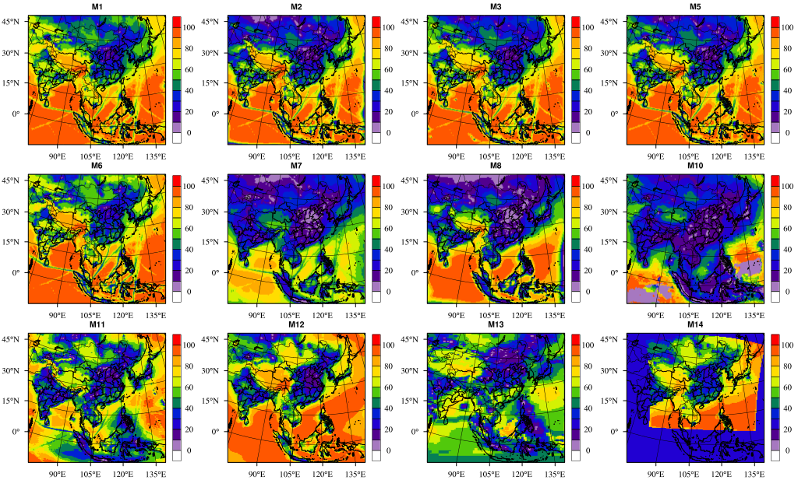
Sulfate Oxidization Ratio
Yellow – CMAQ
Blue – Chem
White – Others
M1
M2
M3
M5
M6
M7
M8
M10
M11
M12
M13
M14
SOR = SO₄²⁻/(SO₂+SO₄²⁻)×100%.
Both SO₂ and SO₄²⁻ are transferred from ppb and µg m⁻³ to same unit mole(S) m⁻³
Notes:
1) SOR how to calculate, what does it mean
2) Color tags
3) results:
In order for inter-model comparison, we use same color of tags for same models
Partitioning of S and N to gas-aerosol phase for observation and individual models for (a-e) SO₂-SO₄²⁻ and (f-h) NO₂-NO₃⁻. The results for individual sites are in fig. S6 in the supplementary material. The unit is µmole (S or N) m⁻³. The SO₂ and SO₄² concentration are transferred from ppb and µg m⁻³ to mole(S or N) m⁻³ before calculating. The values with blue color above the bars are observed/modelled SOR and NOR.
M1, M6 – wrf-cmaq 5.0.2 ; M2, M3, M5 – wrf-cmaq 4.7.1 ; M14 rams-cmaq
M7 – M8 – wrf-chem ; M10 – NAQPMS ; M13-geoschem; M11 – NHM-Chem; M12-NU-WRF

Slide 16
Partitioning of S to gas-aerosol phase
Both SO₂ and SO₄²⁻ are transferred from ppb and µg m⁻³ to same unit mole(S) m⁻³
Notes:
Partitioning of S and N to gas-aerosol phase for observation and individual models for (a-e) SO₂-SO₄²⁻ and (f-h) NO₂-NO₃⁻. The results for individual sites are in fig. S6 in the supplementary material. The unit is µmole (S or N) m⁻³. The SO₂ and SO₄² concentration are transferred from ppb and µg m⁻³ to mole(S or N) m⁻³ before calculating. The values with blue color above the bars are observed/modelled SOR and NOR.
M1, M6 – wrf-cmaq 5.0.2 ; M2, M3, M5 – wrf-cmaq 4.7.1 ; M14 rams-cmaq
M7 – M8 – wrf-chem ; M10 – NAQPMS ; M13-geoschem; M11 – NHM-Chem; M12-NU-WRF

Slide 17
Partitioning of S to gas-aerosol phase
WRF-CMAQ
WRF-Chem
Notes:
Blue colors are the SOR value
Both SO₂ and SO₄²⁻ are transferred from ppb and µg m⁻³ to same unit mole(S) m⁻³
CMAQ models simulated higher SOR values than Chem models in all regions.
Partitioning of S and N to gas-aerosol phase for observation and individual models for (a-e) SO₂-SO₄²⁻ and (f-h) NO₂-NO₃⁻. The results for individual sites are in fig. S6 in the supplementary material. The unit is µmole (S or N) m⁻³. The SO₂ and SO₄² concentration are transferred from ppb and µg m⁻³ to mole(S or N) m⁻³ before calculating. The values with blue color above the bars are observed/modelled SOR and NOR.
M1, M6 – wrf-cmaq 5.0.2 ; M2, M3, M5 – wrf-cmaq 4.7.1 ; M14 rams-cmaq
M7 – M8 – wrf-chem ; M10 – NAQPMS ; M13-geoschem; M11 – NHM-Chem; M12-NU-WRF

Slide 18
Partitioning of S to gas-aerosol phase
V5.0.2
V4.7.1
Link: Partitioning of N
Notes:
For CMAQ models, M1 and M6 are the newer version, with
Partitioning of S and N to gas-aerosol phase for observation and individual models for (a-e) SO₂-SO₄²⁻ and (f-h) NO₂-NO₃⁻. The results for individual sites are in fig. S6 in the supplementary material. The unit is µmole (S or N) m⁻³. The SO₂ and SO₄² concentration are transferred from ppb and µg m⁻³ to mole(S or N) m⁻³ before calculating. The values with blue color above the bars are observed/modelled SOR and NOR.
M1, M6 – wrf-cmaq 5.0.2 ; M2, M3, M5 – wrf-cmaq 4.7.1 ; M14 rams-cmaq
M7 – M8 – wrf-chem ; M10 – NAQPMS ; M13-geoschem; M11 – NHM-Chem; M12-NU-WRF

Slide 19
Inter-model Comparison
Dust Emission

Slide 20
Model results at Dust/Non-dust regions
M10, M11 and M12 and M14 include dust emissions as input
Notes:
Figure 10 Multi-model performances on (a-b) annual average PM₁₀ at dust sites and non-dust sites and (c-d) monthly average PM₁₀ at dust sites and non-dust sites. The yellow bar is the observation, the blue line is the mmm of models and different markers represent individual models. (e) R values of models with observation at dust and non-dust sites (calculated by monthly average data).

Slide 21
Dust Mechanism in Model
M10, M11 and M12 and M14 include dust emissions as input
Notes:
R values , dust model very low R values
List the mechanism for the initiation of dust in models. And they includes very different parameters.
Large uncertainty in the formation of dust.

Slide 22
Inter-model Comparison
Removal Processes

Slide 23

Wet deposition – washout ratio
(j) M11_N washout %
M2 and M5 (CMAQv4.7.1) – similarly
M6 (CMAQv5.0.2) – 30% lower in India, Japan and Korea
M10 and M11 – 60% lower in India, 120% lower in Indonesia and Philippines and 9% in south China.
Washout ratio: $λ_{wet}=\frac{C_{ depo}}{C_{surface_air}} ×100\%$, scavenge efficiency (%)
Notes:
We have evaluation of wet and dry deposition (not shown here)
What is washout ratio, why use here
Why only 5 models.

Slide 24
Dry deposition Velocity
M2 and M5 (CMAQv4.7.1) – similar
M6 (CMAQv5.0.2) - 0.2 cm s⁻¹ lower over the inland regions, (east China and India).
M10 and M11 - 0.5 cm s⁻¹ lower over the inland regions.
Dry deposition velocity: $V_{d}=−F / C_{air}$ , removal rate (cm s⁻¹)
Notes:
Same problem found for S wet deposition

Slide 25
Summary
Model Evaluation
PM₁₀: -29 µg m⁻³ (-34%), PM_{2.5}: -8 µg m⁻³ (-17%)
Northwest China (-300%) , dust
HBT (-47%), PM-coarse
SO₄²⁻: -0.7 µg m⁻³ (-19%)
Underestimation in SOR
high inter-model variation (50%)
East Asia (variation 72%)
NO₃⁻: -0.1 µg m⁻³ (-6%)
NH₄⁺: 0.1 µg m⁻³ (12%)
Inter-model variation (1sd% = 1sd/MMM)
Inputs
BC 1sd% – 27%
BC / IC
Domain center-10~20%
Fine PM
Sulfate– 50% ; SOR - 50%
Nitrate -52% ; NOR - 70%
Coarse PM
PMC – 53% (with dust)
Wet depo
Total wet S - 50%; wet N - 30%
Washout ratio S - 27%; N - 24%
Dry depo
Total dry S – 31%; dry N – 18%
Velocity S - 88%; N - 40%

Slide 26

Thank You for Your Attention!
Contact: jsfu@utk.edu

Slide 27
Backup slices

Slide 28
Model Performance Evaluation

Slide 29

Simulating the Monthly Trends
Central East Asia
Monthly, average of all sites in the same regions
Central EA: China; East EA: Japan + Korea; North EA: Mongolia + Russia; South EA: Southeast Asia + India
Notes:
Monthly average of PM and components from MMM (red line) and observation (blue line). The grey-shaded areas are ±1 standard deviation of models. Unit: µg m⁻³. The upper left/right values with blue colors indicate the number of sites (n) and R value between model and observation.

Slide 30
Simulating the Monthly Trends
Central East Asia
Monthly, average of all sites in the same regions
Central EA: China; East EA: Japan + Korea; North EA: Mongolia + Russia; South EA: Southeast Asia + India
Fail to catch the magnitude, large underestimation in March
Notes:
Monthly average of PM and components from MMM (red line) and observation (blue line). The grey-shaded areas are ±1 standard deviation of models. Unit: µg m⁻³. The upper left/right values with blue colors indicate the number of sites (n) and R value between model and observation.

Slide 31
Northern East Asia
Southern East Asia
Eastern East Asia
Opposite trend
Fail to catch 2 sites with extraordinary high observation
Fail to catch the magnitude

Slide 32
Compare with satellite: AOD

Slide 33
Compare with MODIS
Spring: underestimation in Taklamakan Desert and Vietnam
Winter: overestimation in eastern China
Notes:
The 2 seasons with largest mod-obs differences

Slide 35
Gas-particle partitioning

Slide 36
Gas-Aerosol Partitioning
Mechanism | Specie | Reaction
SAPRC-99 | 77 | 226
RADM2/RACM | 42/56 | 220 / 237
CBMZ | 67 | 164
Mechanism | Partitioning | Note
AERO 5/6 | ISORROPIA I / II | Update in crustal species New speciation scheme: PM_{other}->
MADE / SOA_VBS | Vapor-liquid equilibrium theory for SOA partitioning
GOCCART | 4 size bins (0.1-0.5, 0.5-1.5, 1.5-5, 5-10 µm) | No output of NO₃⁻ and NH₄⁺

Slide 37
Partitioning of N to Gas-aerosol Phase
Link: go back
Notes:
Partitioning of S and N to gas-aerosol phase for observation and individual models for (a-e) SO₂-SO₄²⁻ and (f-h) NO₂-NO₃⁻. The results for individual sites are in fig. S6 in the supplementary material. The unit is µmole (S or N) m⁻³. The SO₂ and SO₄² concentration are transferred from ppb and µg m⁻³ to mole(S or N) m⁻³ before calculating. The values with blue color above the bars are observed/modelled SOR and NOR.

Slide 38
Coarse-particle

Slide 39
Model Results of PM-coarse (PM₁₀-PM_{2.5})
M1
M2
M3
M5
M6
M7
M8
M10
Yellow – CMAQ
Blue – Chem
White - other
M10, M12 and M14 has dust emission
M11
M12
M14

Slide 40
Monthly Variation of Dust
Monthly variation is poorly simulated at dust sites
Notes:
Figure 10 Multi-model performances on (a-b) annual average PM₁₀ at dust sites and non-dust sites and (c-d) monthly average PM₁₀ at dust sites and non-dust sites. The yellow bar is the observation, the blue line is the mmm of models and different markers represent individual models. (e) R values of models with observation at dust and non-dust sites (calculated by monthly average data).

Slide 41
Removal Process

Slide 42
Model Performance on Wet Deposition
M10 and M11 overestimate Japan and Korea
M10
M11
No model catch the high depo in Malaysia and Philippine

Slide 43
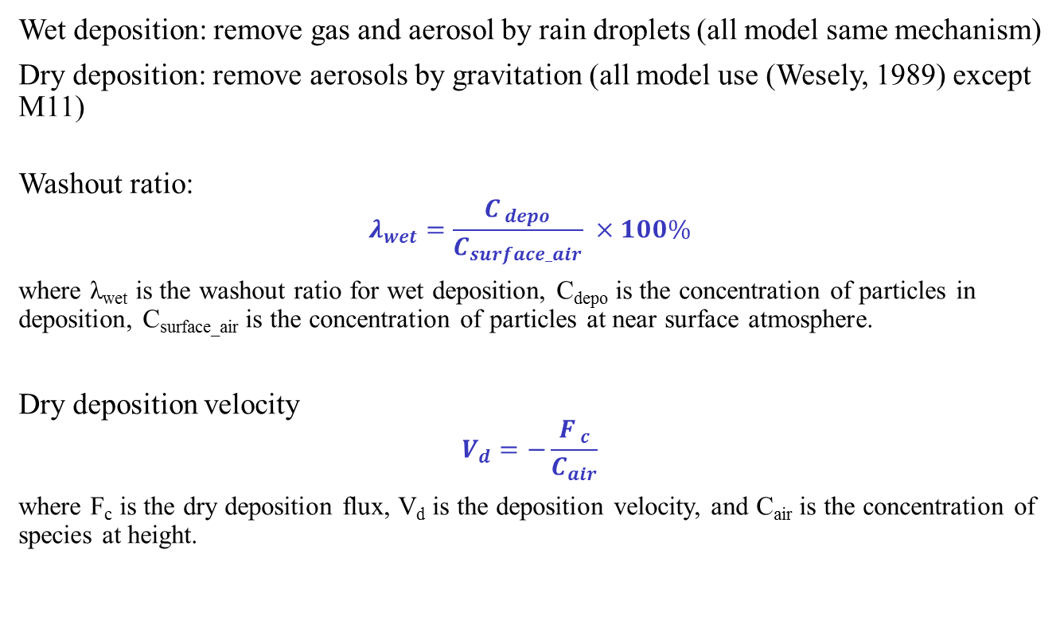
Removal Mechanism
Wet deposition: remove gas and aerosol by rain droplets (all model same mechanism)
Dry deposition: remove aerosols by gravitation (all model use (Wesely, 1989) except M11)
Washout ratio:
$$λ_{wet}=\frac{C_{ depo}}{C_{surface_air}} ×100\%$$
where λ_{wet} is the washout ratio for wet deposition, C_{depo} is the concentration of particles in deposition, C_{surface_air} is the concentration of particles at near surface atmosphere.
Dry deposition velocity
$$V_{d}=−\frac{F_{ c}}{C_{air}}$$
where F_{c} is the dry deposition flux, V_{d} is the deposition velocity, and C_{air} is the concentration of species at height.

Slide 44

Discussion
Underestimation of PM in coastal region, related to sea-salt emission.
Coastal regions is still underestimated, but much better with sea-salt emission.
M10 and M12: CMAQ – fixed proportion: Na⁺(38.6%), Cl⁻(53.9%), SO₄²⁻(7.5%)
$$\frac{dF}{dr}=1.373u_{10m}^{3.41}r^{−A}(1+0.057r^{3.45})×{10}^{1.607e^{−B^{2}}}$$
where dF/dr-density function with unit of particles m⁻²s⁻²µm⁻¹, indicating the rate of seawater droplet generation per unit area of sea surface with per increment of particle radius. r-particle radius at RH=80%, u_{10m}-10 meter wind speed, A-adjustment parameter control the shape of sub-micron size distribution, B-a parameter related to particle radius, calculated as (0.433-logr)/0.433.
M11: new coastal zone method:
$$S_{100}=\frac{C_{s} k V_{wind}h}{A_{avg}L+0.5w_{0}}$$
where S₁₀₀-Sea-salt flux at 100% bubble coverage, C_{s}-mean braking wave CNhot (condensation nuclei after vaporize volatile component at 360°C) at 5 meters, k-multiplier for tower C_{s} compared to mean profile, V_{wind}-mean surf-zone wind speed, h-height of plume layer for beach profile, A_{avg}-mean bubble fractional coverage area between wave, L-distance wave travels to shore, w₀-initial width of breaking wave bubble front.

Slide 45
Observation Networks
1) Spatial coverage of observation data
2) Data quality and completeness
> 80%
3) Aerosol Optical Depth (AOD) from AERONET and MODIS (not shown)
AERONET
EANET: E1-E54
API: A1-A86
Ref: R1-R35
Notes:
Observation data availability
Observation networks of Air Pollution Indices (APIs) (A1-A86), EANET sites (E1-E54, only show sites with available observation during research time) and Reference sites (R1-R35) located in Heibei-Beijing-Taijin (HBT), Pearl River Delta (PRD) and Taiwan. Regions shaded by grey color have been reported to receive impact from dust storms.

Slide 46
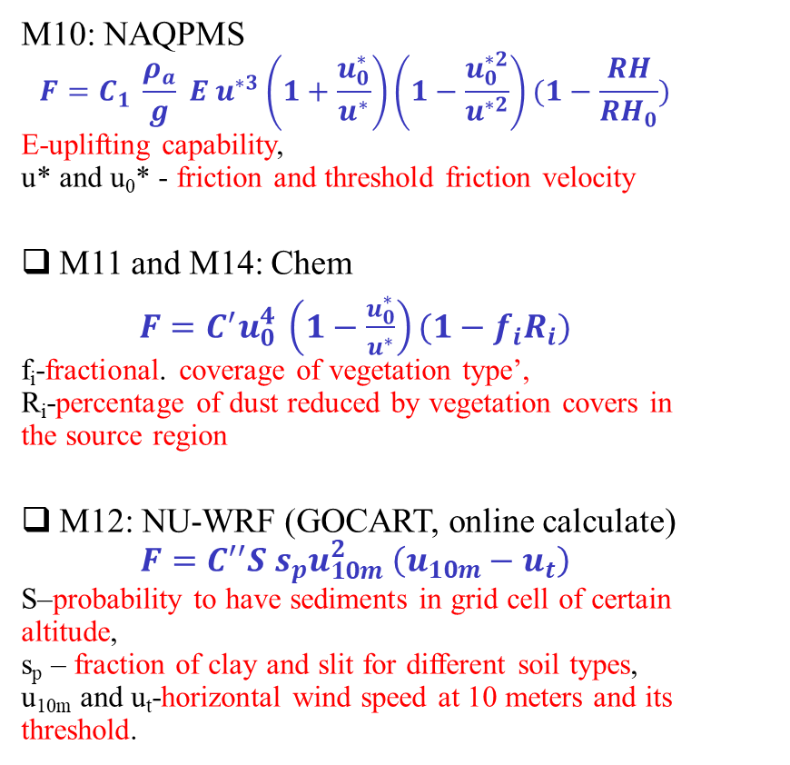
Dust Mechanism in Model
M10, M11 and M12 and M14 include dust emissions as input
M10: NAQPMS
$$F=C_{1} \frac{ρ_{a}}{g} E u^{∗3}\left(1+\frac{u_{0}^{∗}}{u^{∗}}\right)\left(1−\frac{u_{0}^{∗2}}{u^{∗2}}\right)(1−\frac{RH}{{RH}_{0}})$$
E-uplifting capability,
u* and u₀* - friction and threshold friction velocity
M11 and M14: Chem
$F=C^{′}u_{0}^{4} \left(1−\frac{u_{0}^{∗}}{u^{∗}}\right)(1−f_{i}R_{i})$
f_{i}-fractional. coverage of vegetation type’,
R_{i}-percentage of dust reduced by vegetation covers in the source region
M12: NU-WRF (GOCART, online calculate)
$$F=C^{′′}S s_{p}u_{10m}^{2} \left(u_{10m}−u_{t}\right)$$
S–probability to have sediments in grid cell of certain altitude,
s_{p} – fraction of clay and slit for different soil types,
u_{10m} and u_{t}-horizontal wind speed at 10 meters and its threshold.
Notes:
R values , dust model very low R values
List the mechanism for the initiation of dust in models. And they includes very different parameters.
Large uncertainty in the formation of dust.

