Slide 1
Quantification of Lightning NO_{X} and its Impact on
Air Quality over the Contiguous United States
Daiwen Kang, Rohit Mathur, Limei Ran, Gorge Pouliot, David Wong, Kristen Foley, Wyat Appel, and Shawn Roselle
Computational Exposure Division, National Exposure Research Laboratory, U.S. Environmental Protection Agency,
Research Triangle Park, NC 27711, USA
Office of Research and Development
Computational Exposure Division, National Exposure Research Laboratory
17th Annual CMAS Conference, Chapel Hill, NC
October 24, 2018

Slide 2
Facts on Lightning-induced NO Emissions
Lightning is a major atmospheric source of NO_{X} (NO + NO2; NO is produced initially, but quickly oxidized into NO₂ in the atmosphere)
Global lightning NO_{X} (LNO_{X}) production is ~2-8 Tg N yr⁻¹ (~10-15% of the total NO_{X} budget)
Lightning activity varies spatially and seasonally, which affects NO emissions.
Most lightning-induced NO enters upper troposphere; can affect surface AQ through mixing.

Slide 3
Lightning NO Production in CMAQ
Starting with CMAQv5.2, lightning NO production is driven by hourly National Lightning Detection Network (NLDN) lightning flash data.
The NO yield is 350 moles/flash.
Vertical distribution of lightning NO is the same as in previous CMAQ versions.

Slide 4
Model configuration and simulations
Modeling System (WRF3.8 and CMAQ5.2) with WRF lightning assimilation (Heath et al., 2016, J. Adv. Model. Earth Syst.) as the met input.
Domain: 12km horizontal resolution with 35 vertical layers over the contiguous United States.
Boundary conditions: hemispheric CMAQ simulations
Simulation period: April-September, 2011
Emissions: 2011 NEI, NH3 bidi, inline biogenic emissions
Without lightning NO (Base) and with lightning NO (NLDN)

Slide 5
Analysis Regions and O₃ Sonde Locations
Edgewood, MD
Beltsville, MD
Wallops Island, VA
Boulder, CO
Huntsville, AL

Slide 6
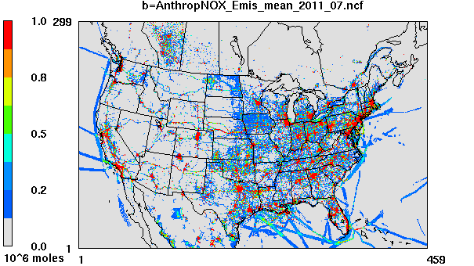
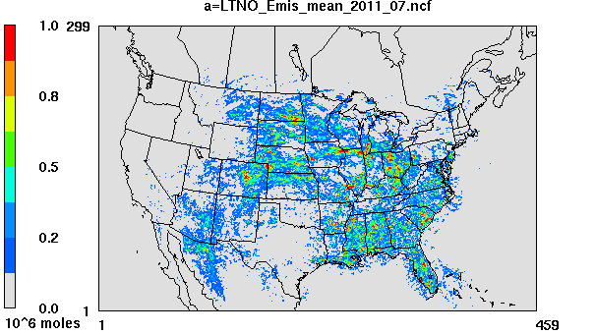
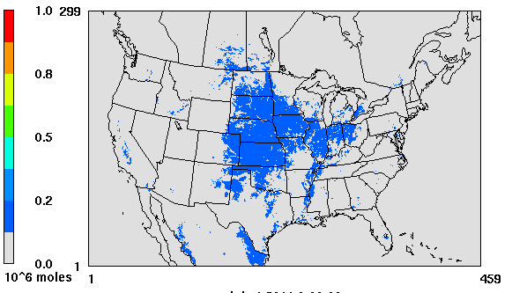
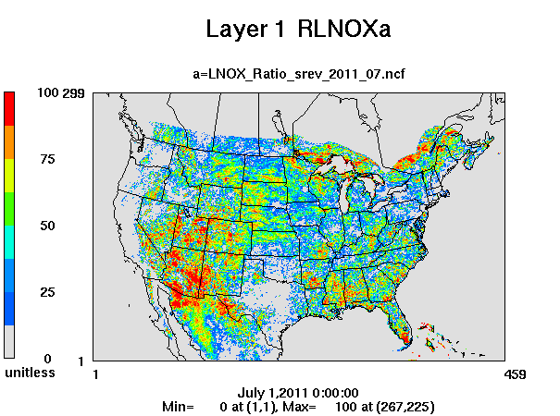
NO_{X} Emissions and LNOx Ratios in July, 2011
a. Anthropogenic NO_{X}
b. LNO_{X}
c. Soil NO
d. Ratio of LNO_{X} to total NO_{X} emissions
%

Slide 7
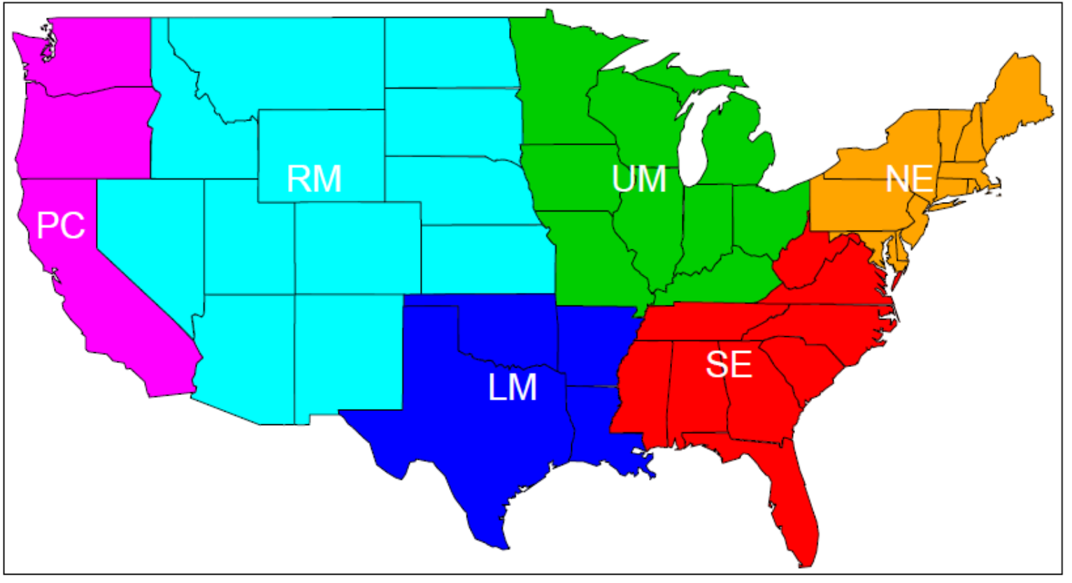
LNO_{X} Contribution to the Total NO_{X} Emissions by Month and Region
Regions

Slide 8
Daily LNO_{X} contribution to the total NO_{X} emissions
Ratio of LNO_{X} to Total NO_{X} (%)

Slide 9
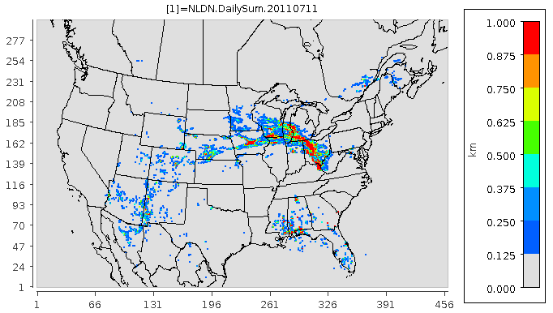
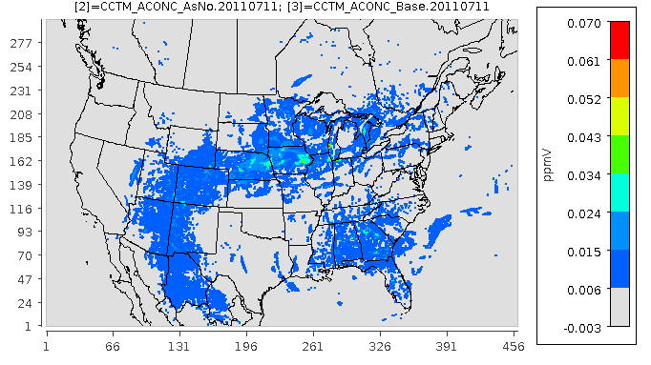
Lightning Flashes and Surface O₃ Change
(NLDN-Base) on July 11, 2011
The maximum change of hourly O₃ mixing ratios ranges mostly from 6 ppbv to 30 ppbv in the regions of lightning strikes. Even though the most lightning flashes occurred in the Upper Midwest region, the corresponding changes in O₃ are not as significant, because the change of O₃ at a location depends not only on the intensity of lightning strikes, but also on the timing of the strikes and the relative contribution of LNO_{X} to the total NO_{X} emissions.
Lightning Flash Rate (daily sum)
Km⁻²
surface maximum hourly O₃ change (NLDN-Base)

Slide 10
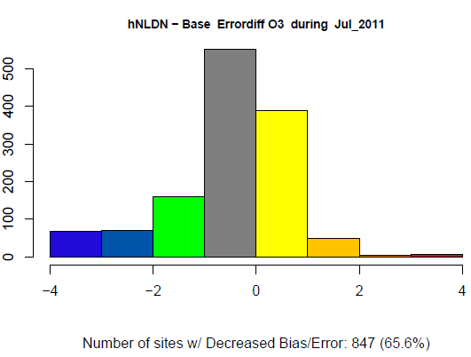
Monthly Mean Error Difference (NLDN-Base) of DM8HR O₃ for July 2011
Significant error reduction over the mountain states and northeast coastal regions
Slight error increase over the southeast region and California
Over the domain, more error reductions than increases
9

Slide 11
Time series of DM8HR O₃ and MB Difference
RM
SE
In SE, LNO_{X} makes the overprediction slightly worse in July and August.
In RM, the underprediction is consistently reduced on all the days in July and August.
SE
RM

Slide 12
Diurnal Profiles of Hourly O₃
Lightning NO has minimal impact on the domain-wide mean diurnal profile, while differing impacts on different regions: slight increase in SE and significant increase in RM. Other regions (not shown here): decrease in NE, UM, and PC (especially during daytime hours), and increase in LM with model overprediction in all these regions.
Domain
RM
SE

Slide 13
Vertical profiles of hourly O₃: Modeled vs. Observed (Average of Multiple Launches)
Altitude (km)
0 2 4 6 8 10
Altitude (km)
0 2 4 6 8 10
Altitude (km)
0 2 4 6 8 10
Sonde
Base
NLDN
Beltsville, MD
Edgewood, MD
Wallops, VA
40 60 80 100 120 140
O₃ Mixing Ratio (ppb)
40 60 80 100 120 140
O₃ Mixing Ratio (ppb)
40 60 80 100 120
O₃ Mixing Ratio (ppb)
O₃ mixing ratios aloft are consistently increased and brought closer to the observations by LNO_{X}.

Slide 14
Vertical profiles of hourly O₃: Modeled vs. Observed (Average of Multiple Launches)
Altitude (km)
0 2 4 6 8 10 12
Altitude (km)
0 2 4 6 8 10
Sonde
Base
NLDN
Boulder, CO
Huntsville, AL
40 60 80 100 120 140
O₃ Mixing Ratio (ppb)
40 60 80 100 120
O₃ Mixing Ratio (ppb)

Slide 15
Overlay of the measured O₃ by aircraft (P3B) during the DISCOVER-AQ campaign on July 28, 2011
Altitude (km)
0 1 2 3 4 5
Base
Altitude (km)
0 1 2 3 4 5
NLDN
40 45 50 55 60 65 70 75 80 85 90
O₃ Mixing Ratio (ppb)
40 45 50 55 60 65 70 75 80 85 90
O₃ Mixing Ratio (ppb)
Increase aloft to reduce the underprediction
Decrease near the surface to alleviate the overprediction

Slide 16
Difference of vertical cross-section along the P3B path
Altitude (km)
0 5 10 15
Altitude (km)
0 5 10 15
NOx
NO
< 0 0.02 0.04 0.06 0.08 0.1 1.2 1.4 1.6 1.8 2 <
< 0 0.02 0.04 0.06 0.08 0.1 1.2 1.4 1.6 1.8 2 <
NO (ppb)
NOx (ppb)
Majority of LNOx is injected in the middle to upper troposphere (above 6 km) with small amounts being put near the surface.
O₃ is significantly enhanced aloft, but reduced near the surface.
Altitude (km)
0 5 10 15
O₃
<-5 -2 0 2 4 6 8 10 15 20 30 <
O₃ (ppb)

Slide 17
Summary
The contribution of LNO_{X} emissions to the total NO_{X} emissions ranges from 10% (September) to 22% (July) over the contiguous US.
Averaged over the six-month period (April - September), SE has the largest LNO_{X} ratios (19.5%) followed by RM (16%).
During July and August, the largest LNO_{X} ratios are observed for the RM region (30% and 28%, respectively).

Slide 18
Summary
CMAQv5.2 contains a LNOx algorithm that uses observed lightning flashes along with an assumed NOx production per flash and a scheme to distribute the NOx vertically.
CMAQ simulation for summer 2011 shows that the addition of LNOx emissions reduces the daily CMAQ low bias for DM8HR O₃ by as much as 5 ppbv in the RM region.
Comparisons with surface observations show no improvement with LNOx where surface O₃ is already overpredicted. However, vertical structure is improved with LNOx at all sites, especially aloft.
*The main content of this presentation will appear in the A&WMA’s EM magazine next month (November, 2018)

Slide 19
Disclaimer
The views expressed in this presentation are those of the authors and do not necessarily reflect the views or policies of the U.S. EPA

Slide 20
Additional Plots

Slide 21
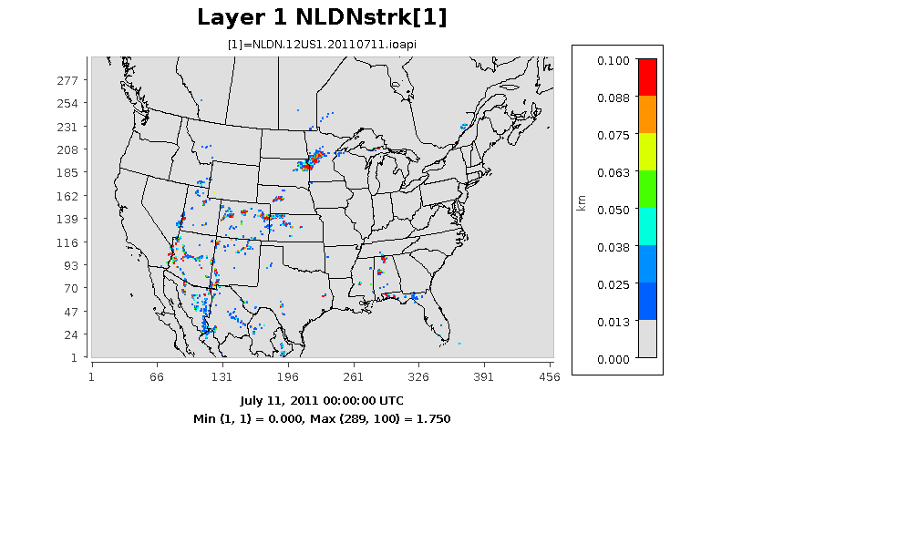
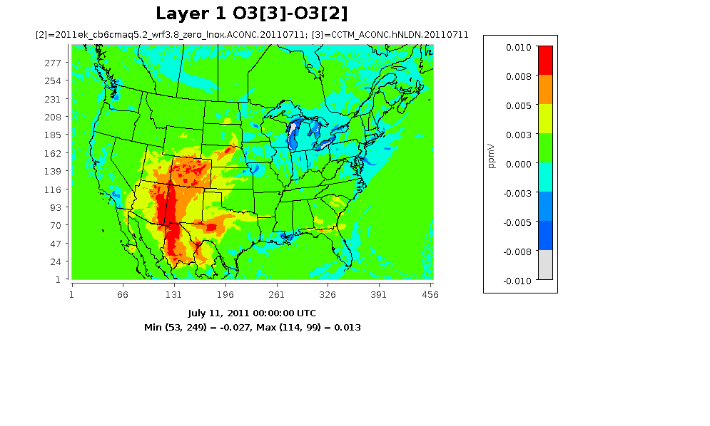
Lightning Flash Rate (km⁻²)
Layer 1 O₃[NLDN] – O₃[Base]
Lightning Strikes and Surface O₃ Change (NLDN-Base) on July 11

Slide 22
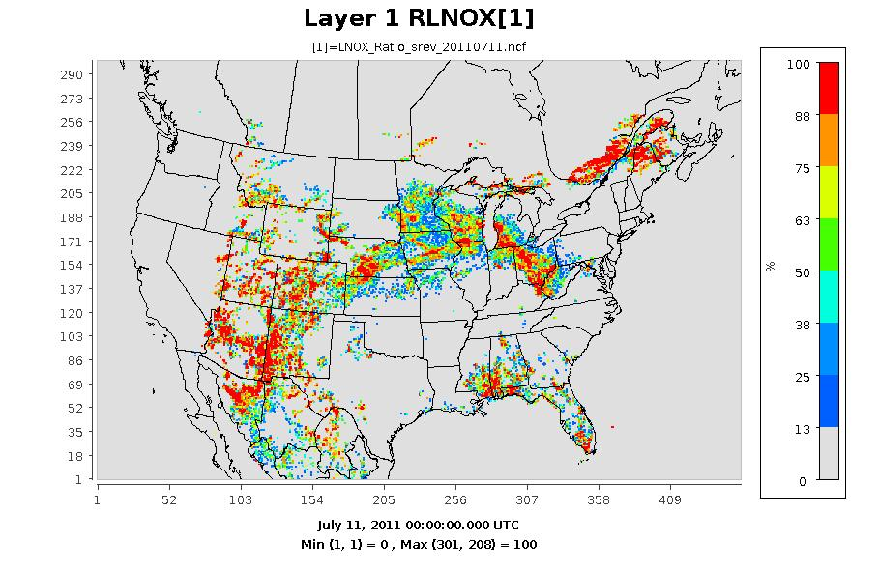
LNO_{X} ratios on July 11, 2011

Slide 23
Diurnal Profiles for other regions

Slide 24
Daily Mean NO_{X} Time Series in July, 2011

