Slide 1
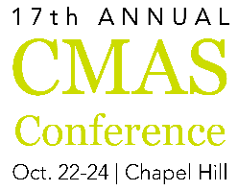




Wildfires Impacts on Regional Air Quality
A Case Study on Colorado
Cheng-En Yang, Joshua S. Fu, Xinyi Dong, Jian Sun,
Qingzhao Zhu, Yang Liu, Yongqiang Liu
10/23/2018

Slide 2
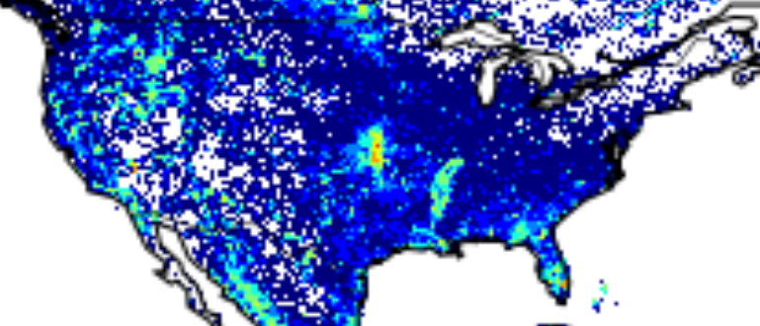
Percentage of Annual Burned Area
1880
1997-2014
(Source: Sargent,1884; Pyne, 2010)
(Source: Global Fire Emissions Database, Version 4.1)
Farmers clearing land
Hunters leaving fires to burn in abandoned camps
Hotter and drier meteorological conditions in the western US

Slide 3
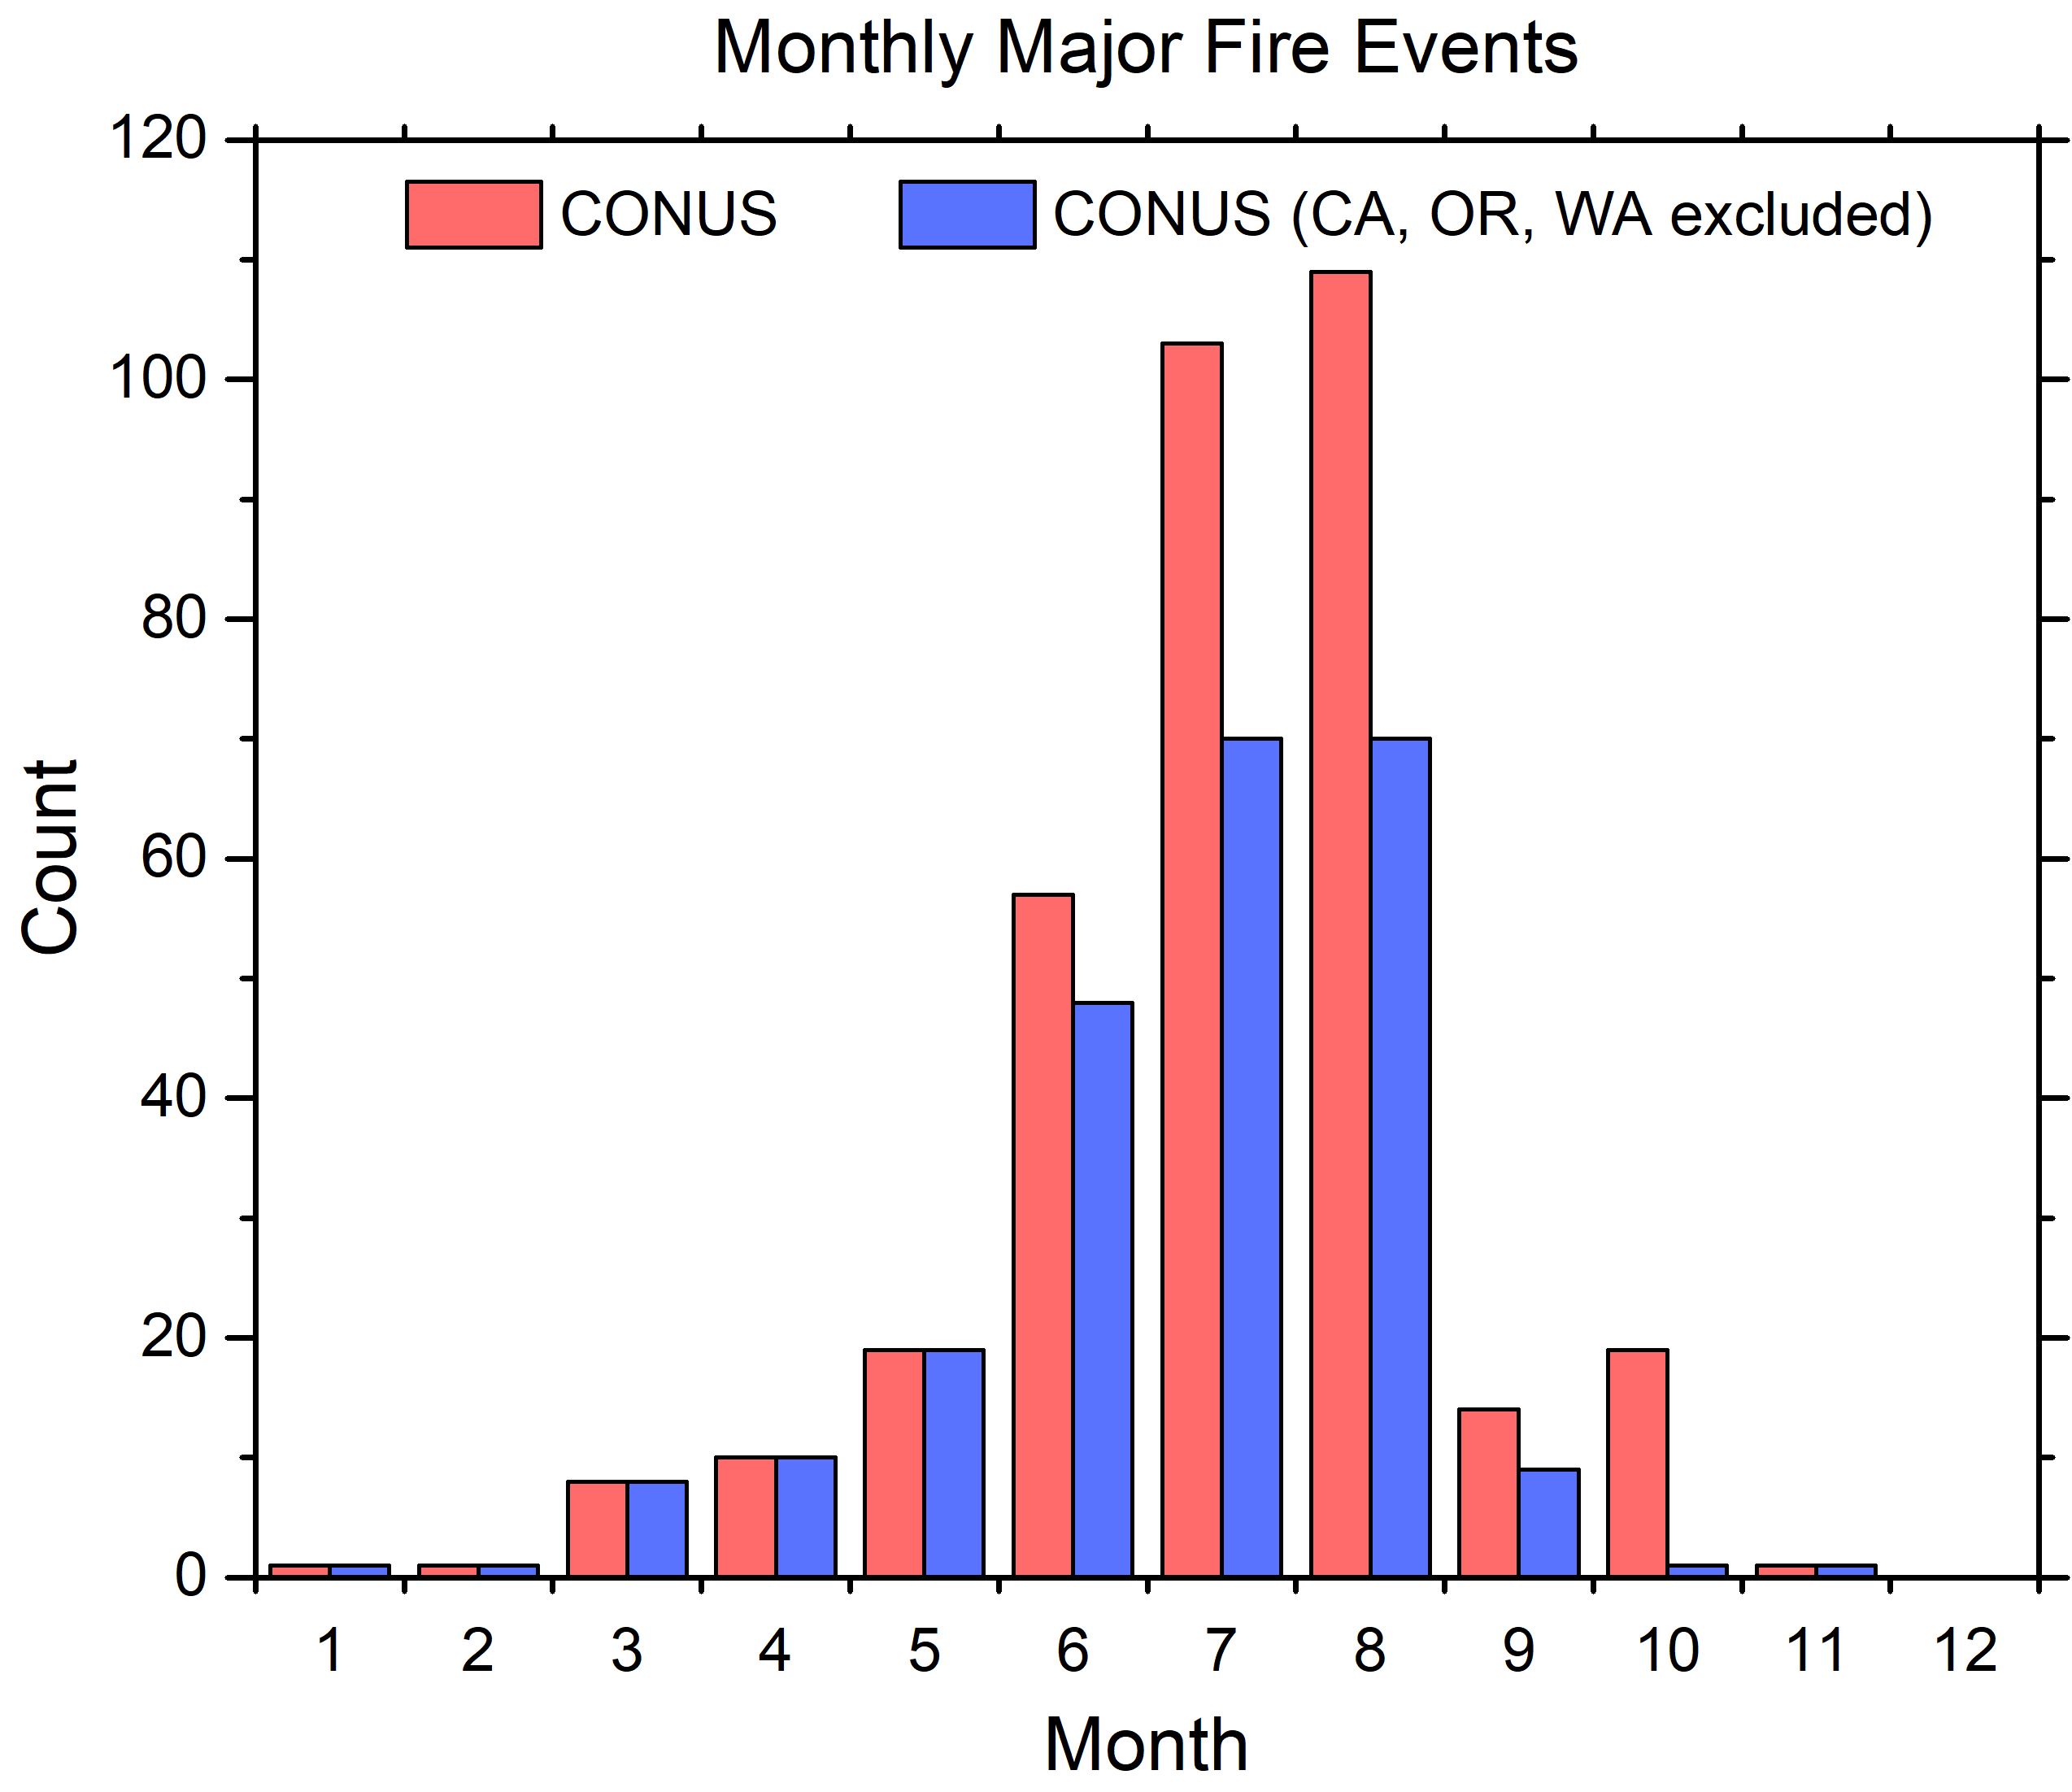
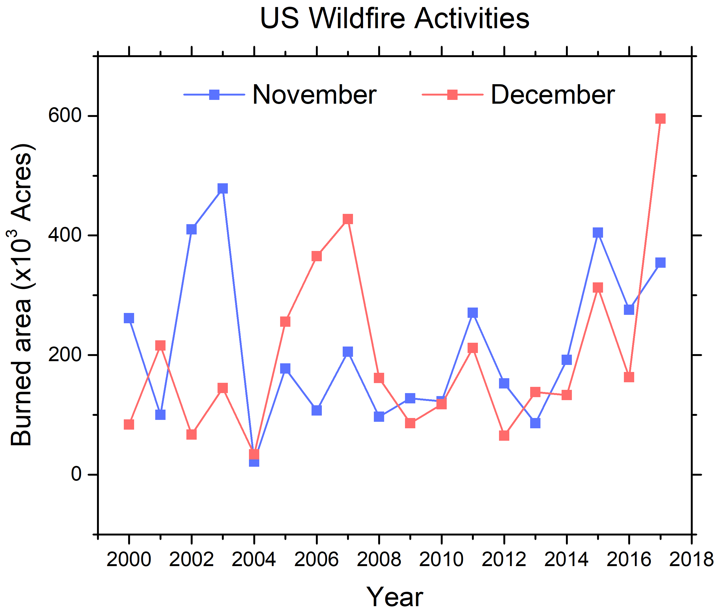
Historical Major Fire Distributions
1980–2013 major fires (>50K acres burned) only
Major fire months:
April–October
November–December:
more large fire events
in recent years
(Data from Yongqiang Liu, USFS)

Slide 4
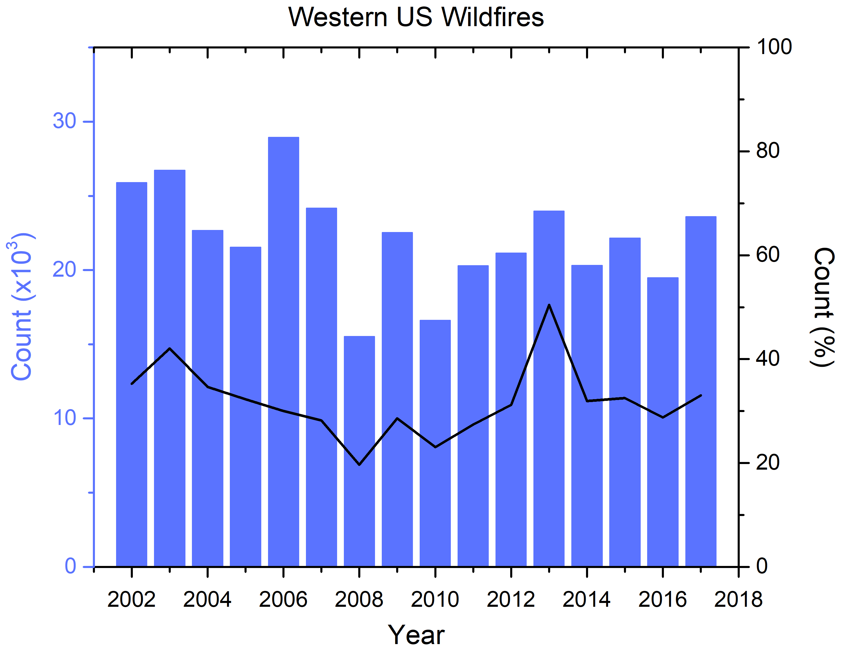
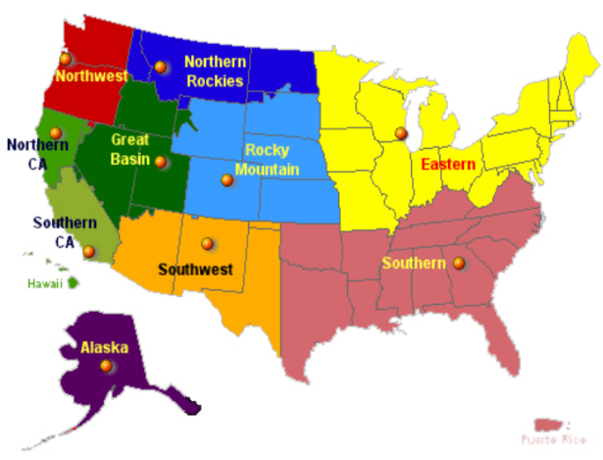
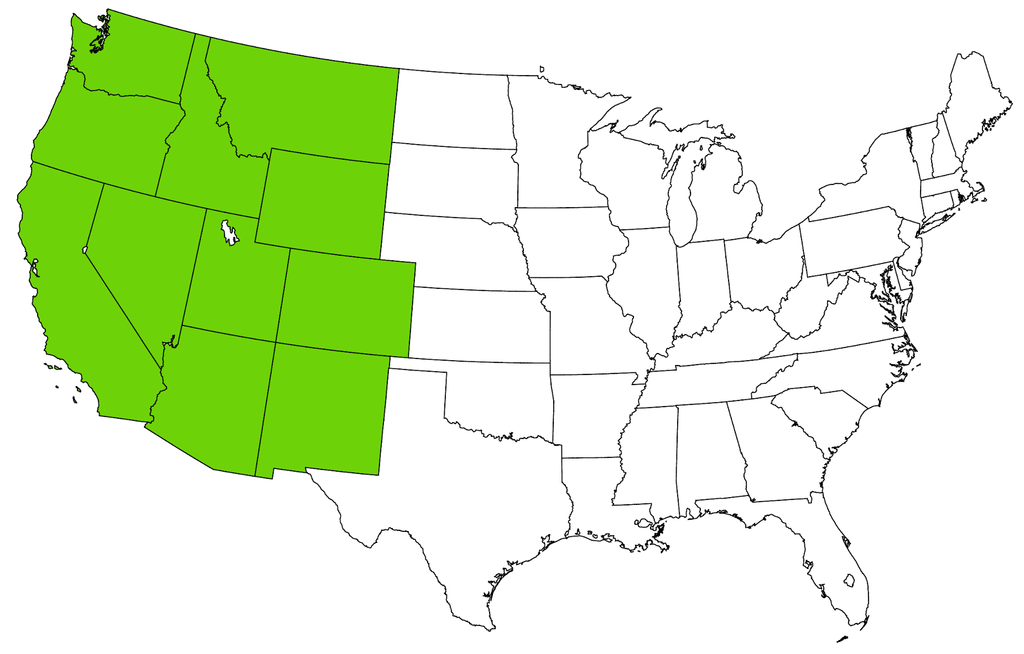
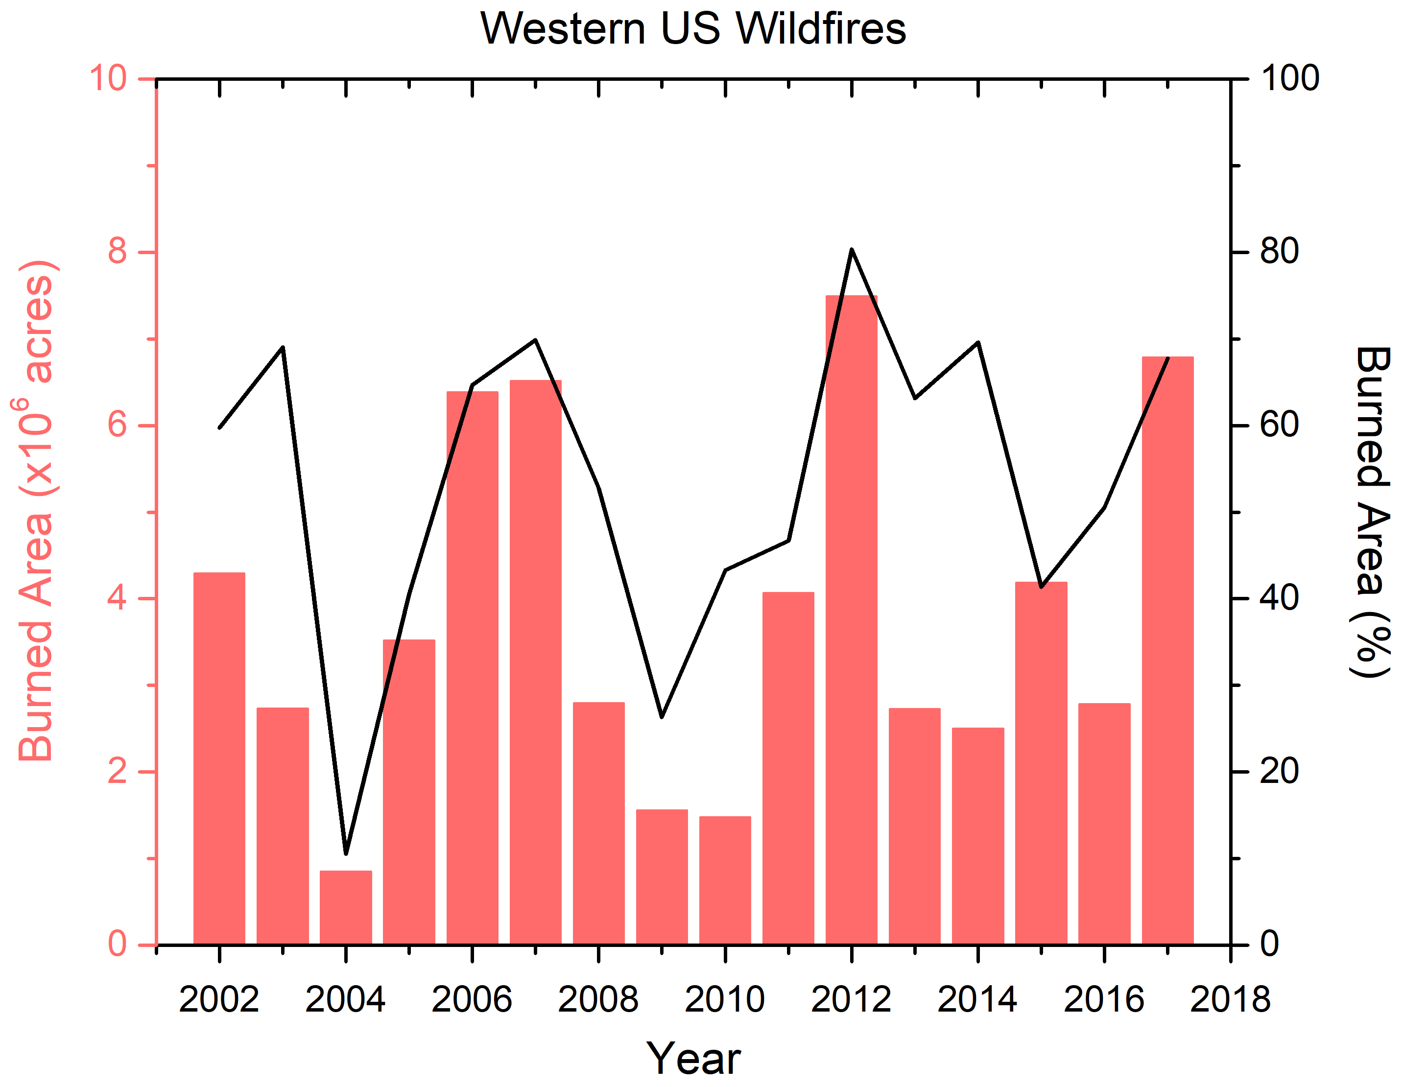
Annual Wildfires in The US
(National Interagency Fire Center;
National Interagency Coordination Center )
10/16 years > 50%
Western US (WUS)

Slide 5
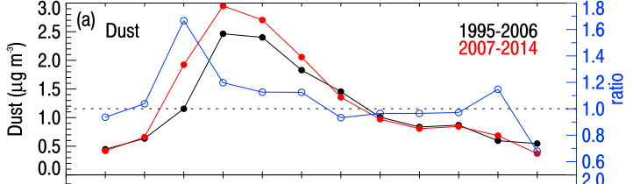
Seasonal Dust Concentration
Peaks in spring and early summer
Dust vs. wildfire contributions on PM_{2.5}
Southwest US
(Source: Hand et al., 2016)

Slide 6
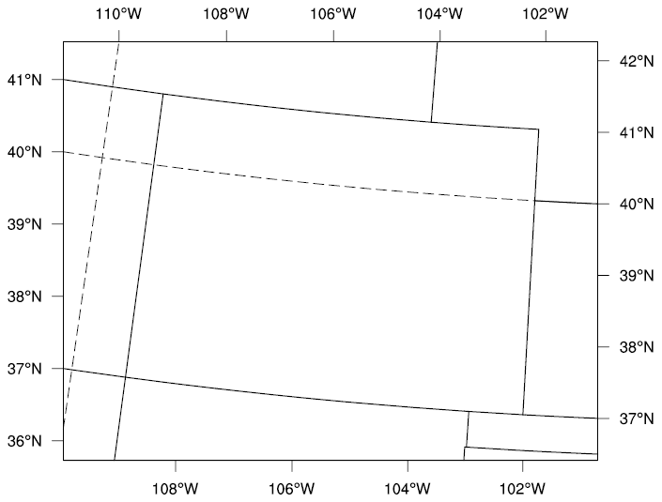
Experimental Design
Domain: Colorado
Duration: 2011−2014
Resolution: 12km x 12km, 25 layers
Meteorology: WRF v3.8.1
Initial / boundary conditions: GEOS-Chem v11-01
Emission: 2011, 2014 National Emission Inventory (NEI),
scaled 2012−2013, fire emissions from Dr. Kirk Baker
Scenarios: Base, noFire, and noDust by CMAQ v5.2

Slide 7
Results – Monthly PM_{2.5} in Base Case
  Goals (best)
  MFB ≤ ±30%
  MFE ≤ 50%
  Criteria
  (acceptable)
  MFB ≤ ±60%
  MFE ≤ 75%
  Generally underestimated PM_{2.5} with some best and some acceptable performance
  Modeled PM_{2.5} (μg/m³)
  AQS/IMPROVE PM_{2.5} (μg/m³)
Notes:
Goals (the level of accuracy that is considered to be close to the best a model can be expected to achieve) and Criteria (the level of accuracy that is considered to be acceptable for modeling applications)
(Boylan JW, Russell AG. PM and light extinction model performance metrics, goals, and criteria for three-dimensional air quality models. Atmospheric Environment. 2006;40:4946–4959.)
201304, 201206, 201306, 201406, 201110 acceptable

Slide 8
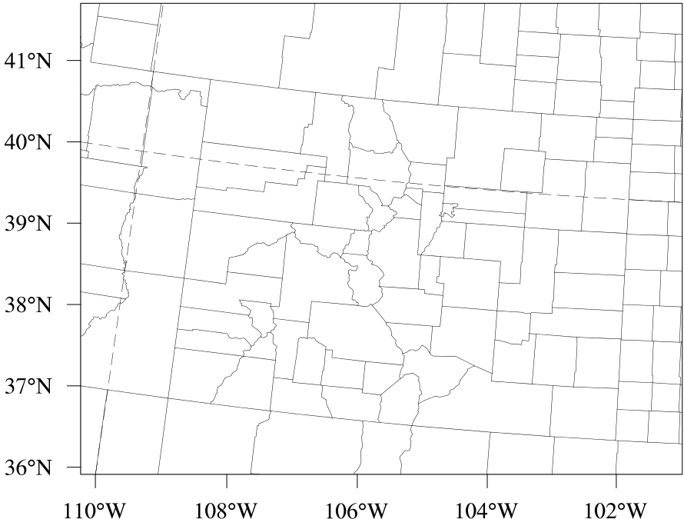
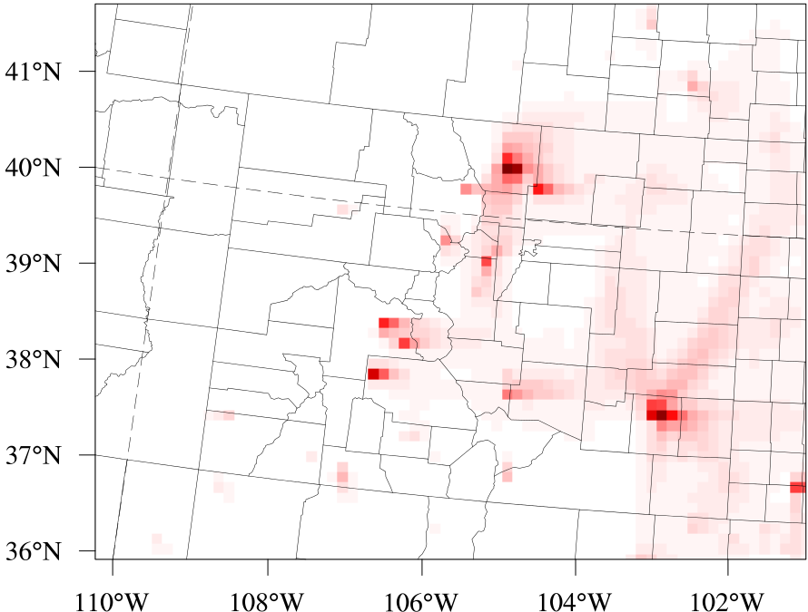
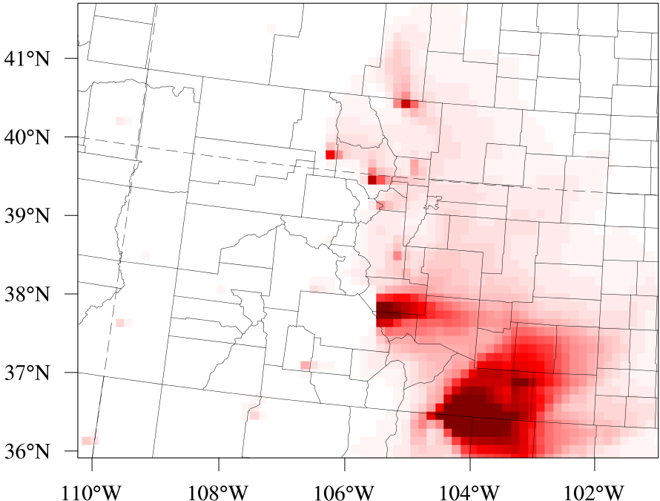
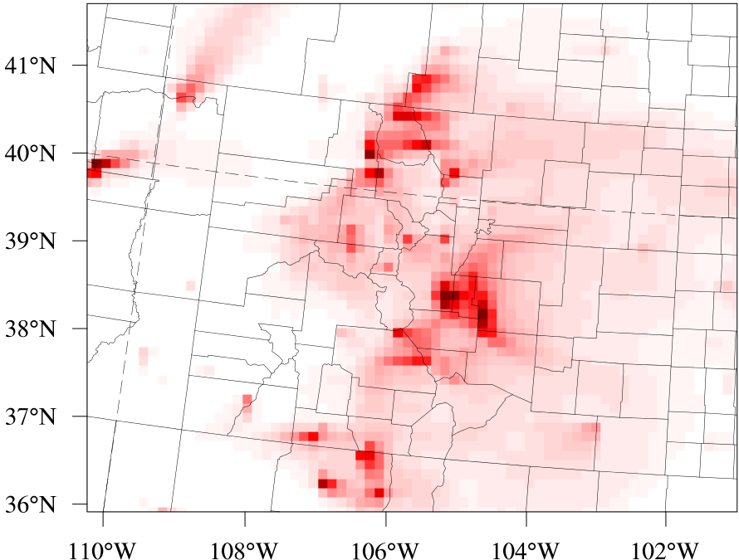
2011 Monthly Mean PM_{2.5} – Dust vs. Fires
  Base - noDust
  Base - noFire
Observed major wildfires
(http://www.denverpost.com)
Max ~ 0.003
Max = 1.5
  APR
  2011
Max ~ 0.001
Max = 12.9
  JUN
  No significant dust contribution
  Monthly mean max PM_{2.5} by fires at surface: up to 12.9 µg/m³
Max ~ 0.001
Max = 1.9
  OCT
Notes:
Source: https://www.denverpost.com/2014/06/07/colorado-wildfires-major-fires-from-1971-2013-interactive-graphic/

Slide 9
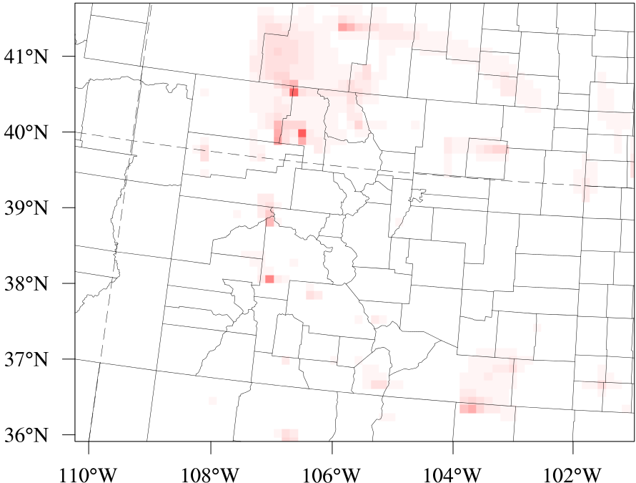
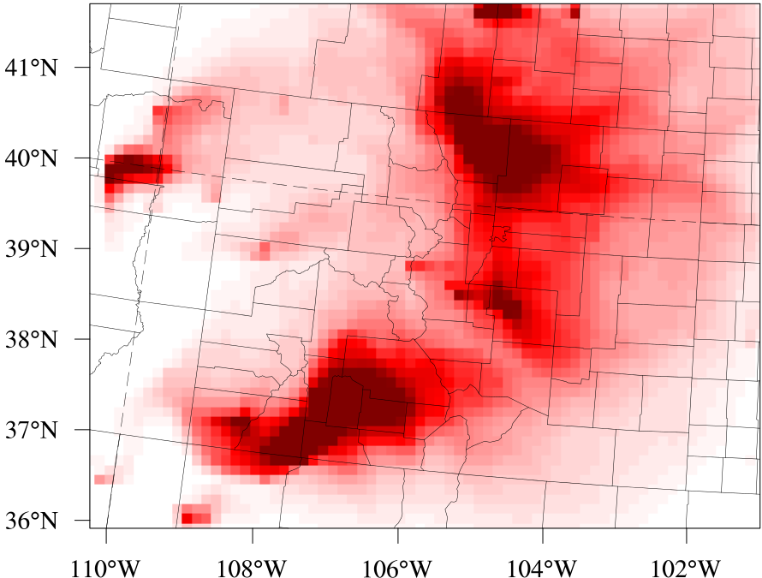
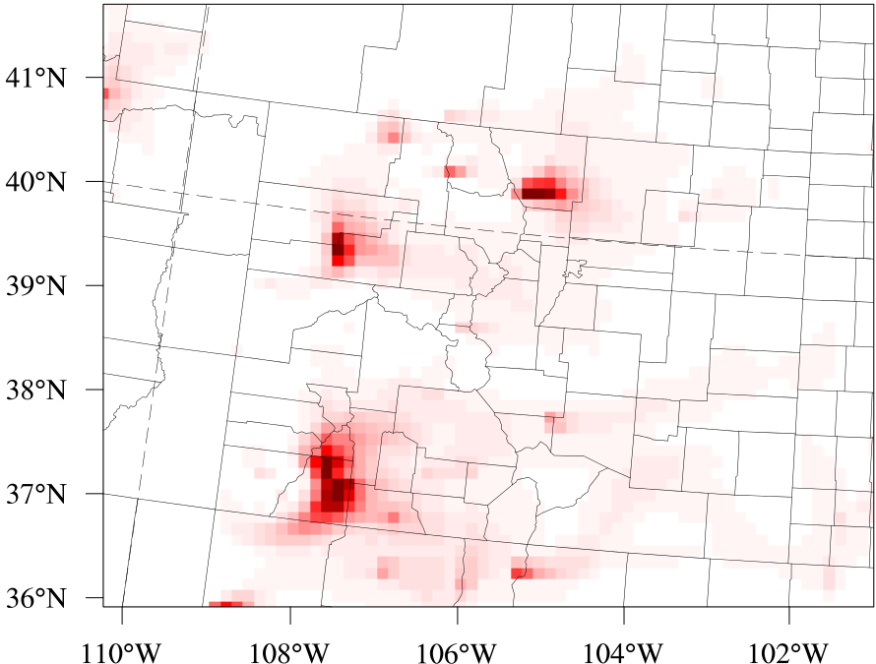
2012−2013 Monthly Mean PM_{2.5} by Fires
  2012
  Base - noFire
  2013
  Base - noFire
Observed major wildfires
(http://www.denverpost.com)
Max = 0.3
Max = 0.3
  APR
Max = 18.5
Max = 67.6
  2012
  JUN
  2013
Max = 2.3
Max = 0.5
  OCT
Notes:
Source: https://www.denverpost.com/2014/06/07/colorado-wildfires-major-fires-from-1971-2013-interactive-graphic/
No big fires in Colorado during 2014

Slide 10
Maximum of Hourly Mean PM_{2.5} Changes
  (Unit: µg/m³)
Case | Year | APR | MAY | JUN | JUL | AUG | SEP | OCT
Base − noDust | 2011 | 0.09 | 0.01 | 0.05 | 0.03 | 0.05 | 0.01 | 0.01
Base − noFire | 2011 | 18.9 | 27.2 | 116.2 | 4.8 | 13.1 | 8.7 | 32.4
 | 2012 | 7.1 | 10.2 | 54.9 | 58.9 | 8.1 | 10.5 | 17.4
 | 2013 | 4.3 | 3.8 | 307.2 | 112.3 | 9.2 | 5.1 | 5.2
 | 2014 | 8.6 | 16.4 | 11.0 | 11.0 | 7.1 | 11.9 | 8.1
  2011 hourly mean PM_{2.5} attributed by dust: < 0.1 µg/m³
  Significant fire contributions on PM_{2.5} during early summertime

Slide 11
Summary
Generally underestimated monthly-mean PM_{2.5} compared to AQS/IMPROVE sites in Colorado during 2011–2014
No significant dust contributions on 2011 PM_{2.5} in Colorado, even during spring and early summertime
Contribution of fires on PM_{2.5}
  Monthly: up to 68 µg/m³ (Jun 2013)
  Hourly maximum: up to 307 µg/m³ (Jun 2013)

Slide 12
Ongoing Work
The western US domain
Future wildfire emissions by Dr. Yongqiang Liu using USFS statistical fire model
Meteorology
downscale
CESM
WRF
MCIP
Initial /Boundary
Conditions
0.5°×0.5°
CAM-Chem
CMAQ
IC/BC
CMAQ v5.2
Emission
Base
12km CONUS
12km
WUS
0.5°×0.5°
IIASA Global
12km
WUS
Future

Slide 13
Acknowledgements
This study was supported by the U.S. EPA Science to Achieve Results (STAR) Grant R835869. This research used resources of the Oak Ridge Leadership Computing Facility at the Oak Ridge National Laboratory, which is supported by the Office of Science of the U.S. Department of Energy under Contract No. DE-AC05-00OR22725.
Notes:
It has not been formally reviewed by EPA. The views expressed in this document are solely those of the authors and do not necessarily reflect those of the Agency. EPA does not endorse any products or commercial services mentioned in this presentation.

Slide 14
Thank You
Questions?

Slide 15
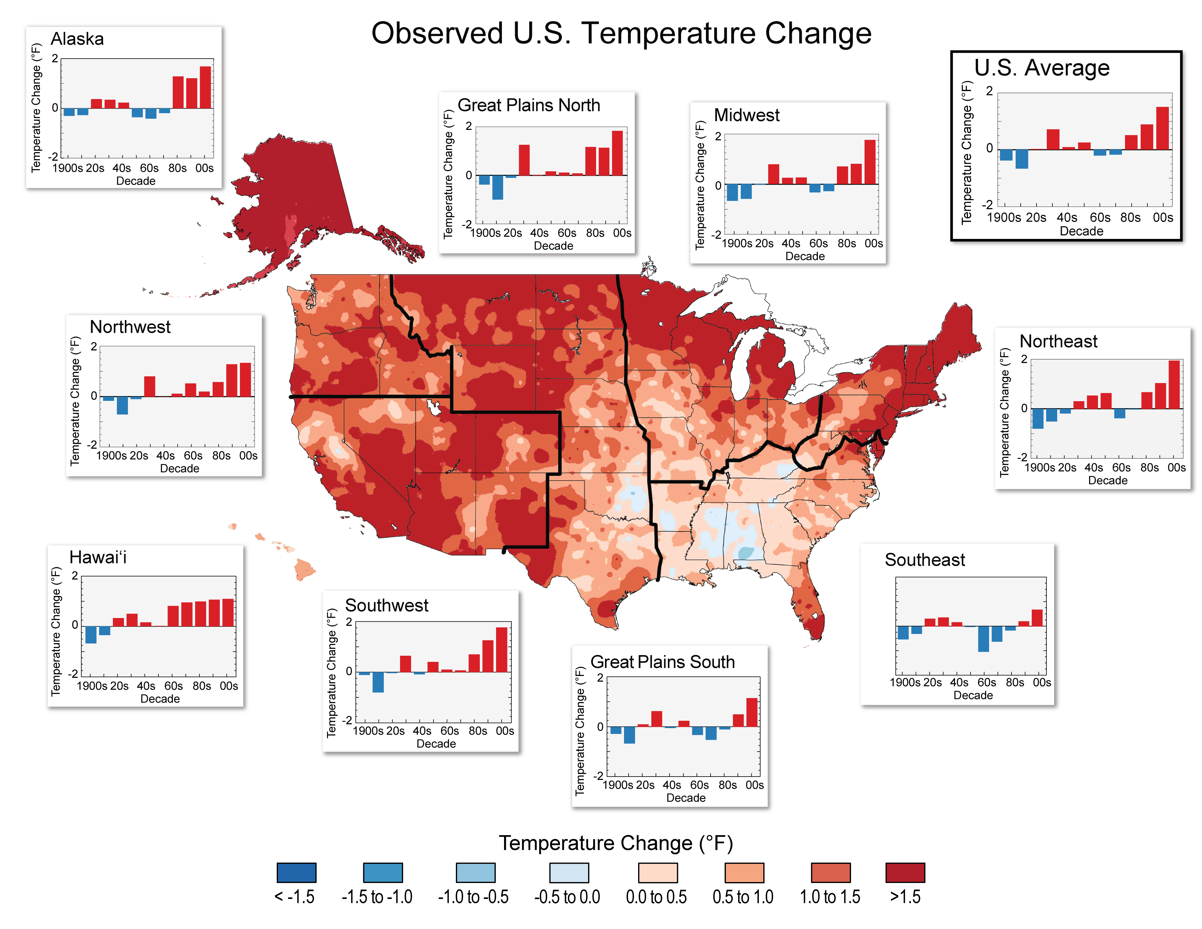
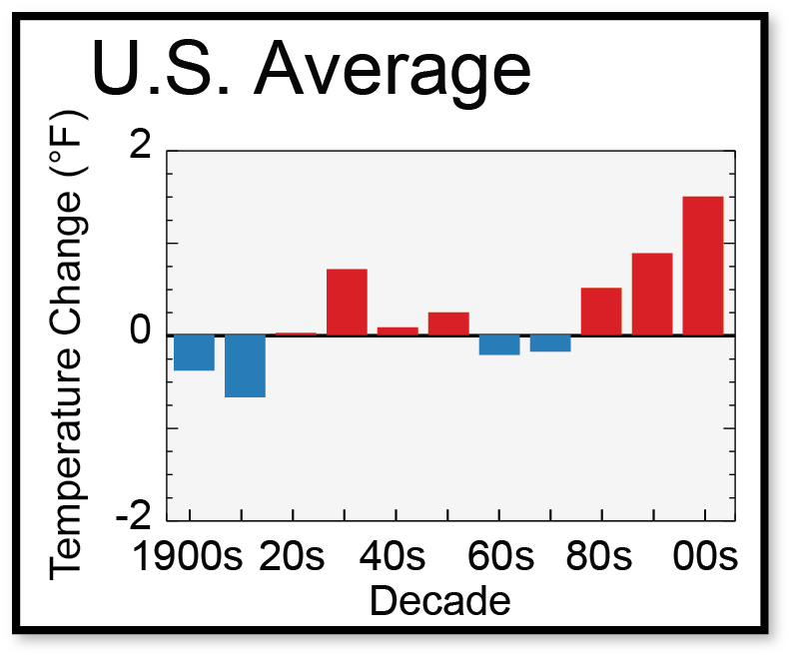
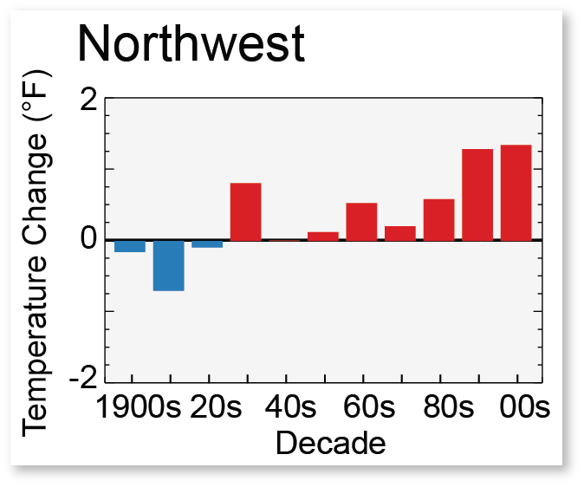
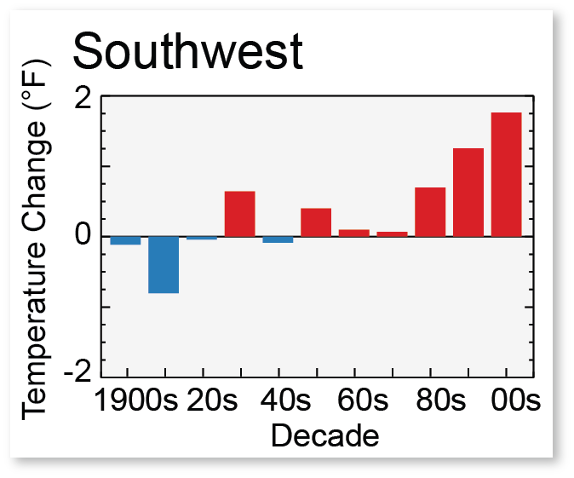
It Becomes Hotter…
Decadal mean temperature changes relative to 1901–1960 average
(Source: NOAA NCDC / CICS-NC)

Slide 16
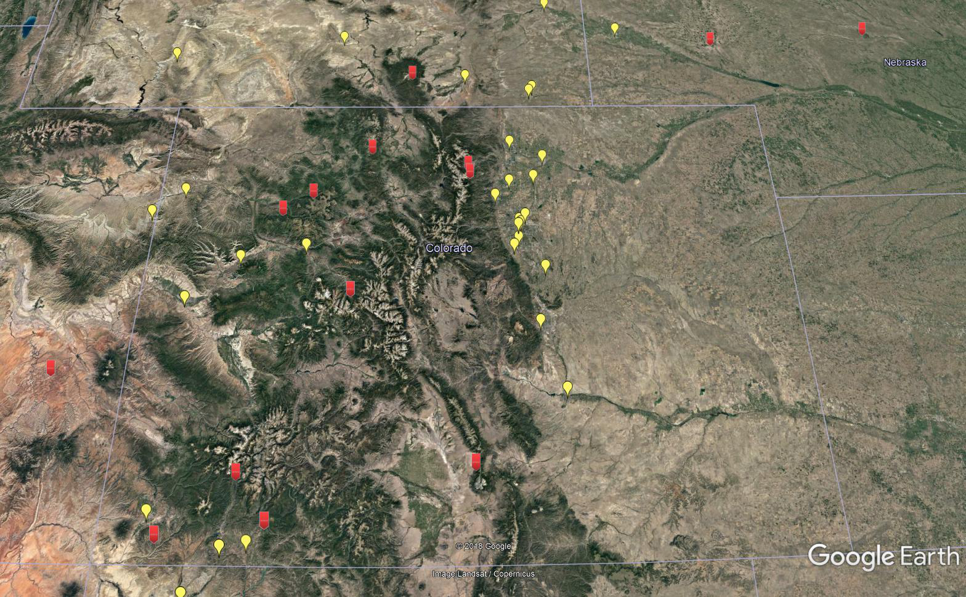
EPA AQS and IMPROVE Sites Locations

Slide 17
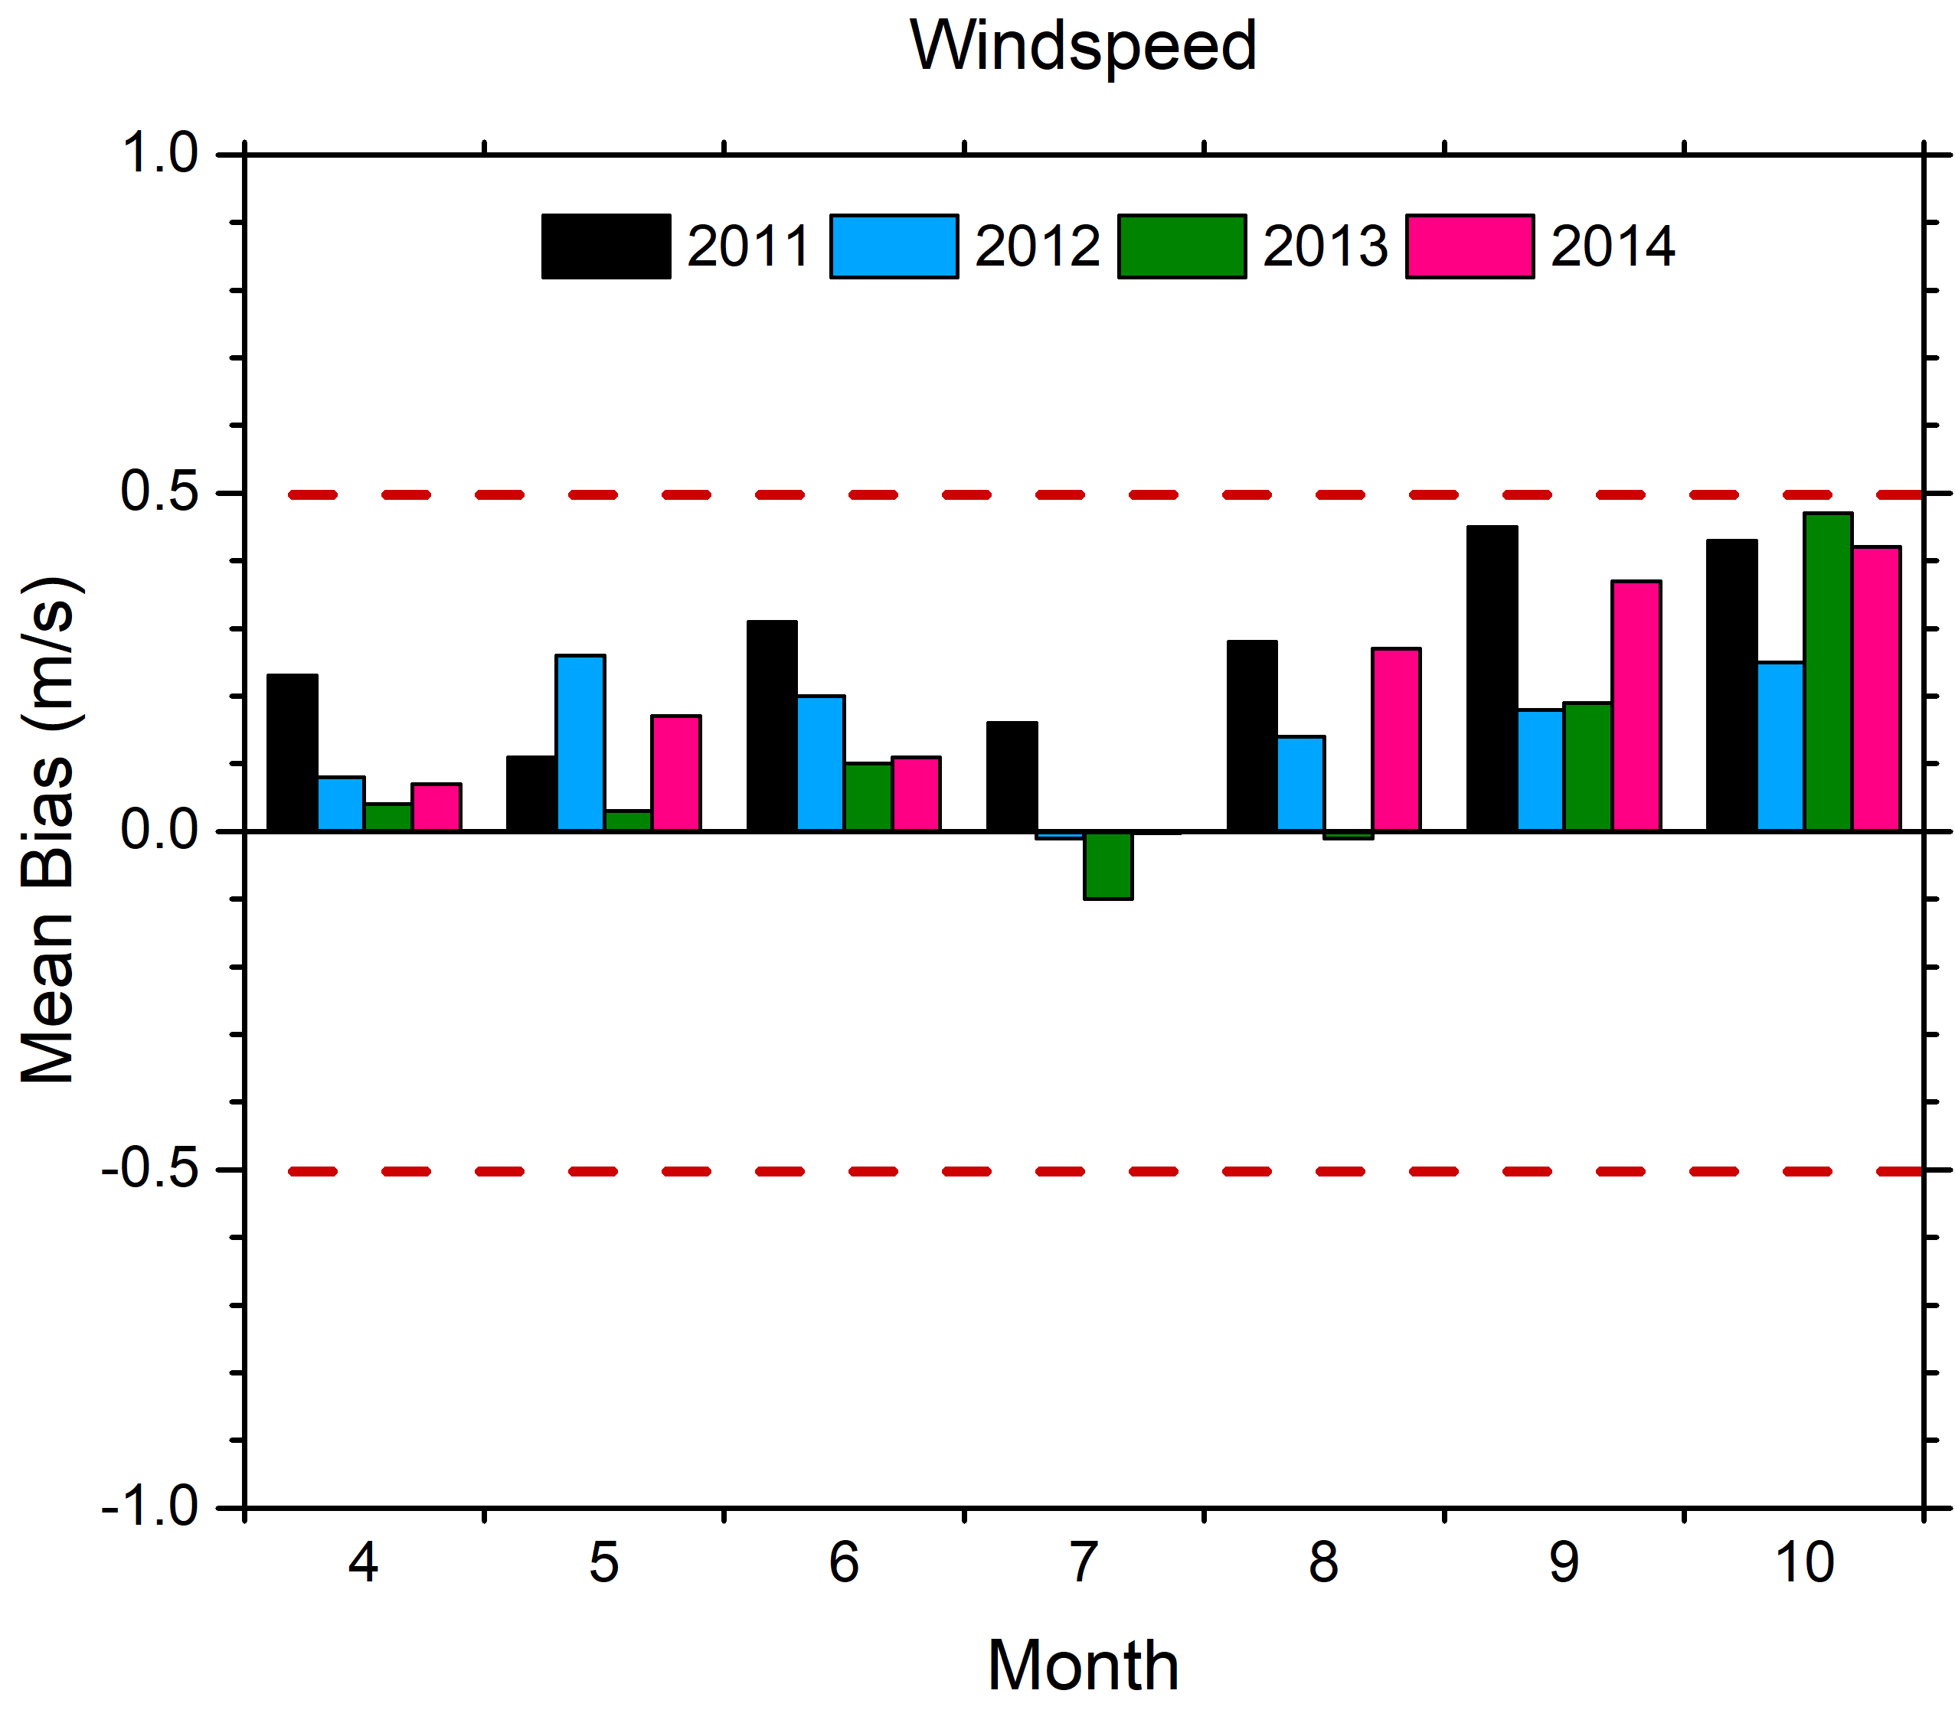
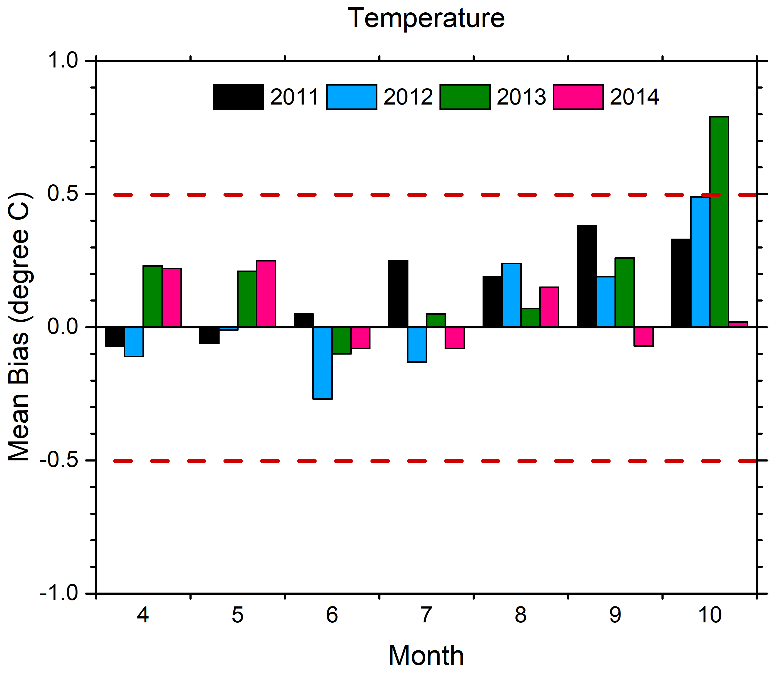
WRF Validations
2011 MCIP data from US EPA
2012 − 2014 WRF v3.8.1 (same schemes as 2011)
Notes:
1. Only 2014/10 temperature may be out of the criteria
2. Zhang et al., (2014). Evaluation of a seven-year air quality simulation using the Weather Research and Forecasting (WRF)/Community Multiscale Air Quality (CMAQ) models in the eastern United States. Sci. Total Environ., 473, 275–285, 2014.

Slide 18
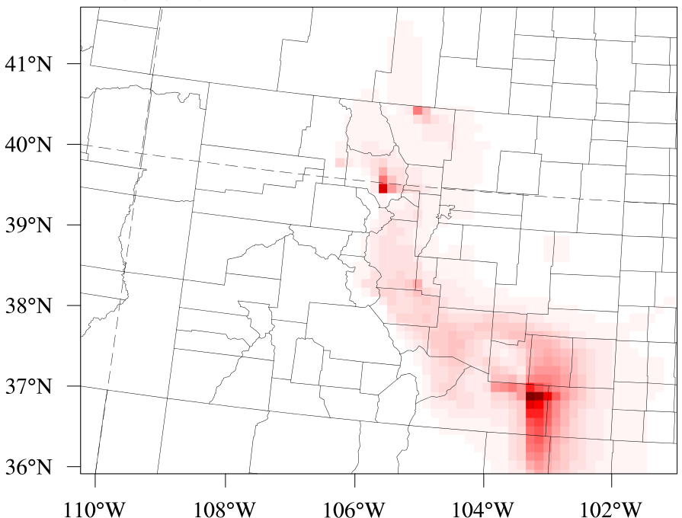
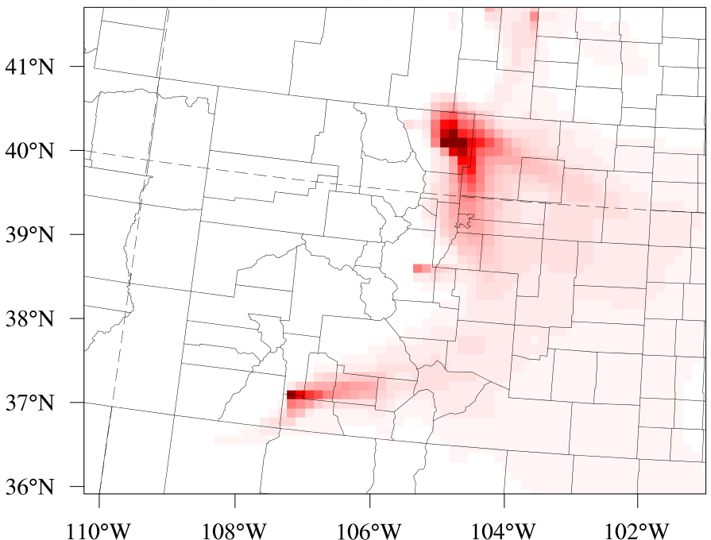
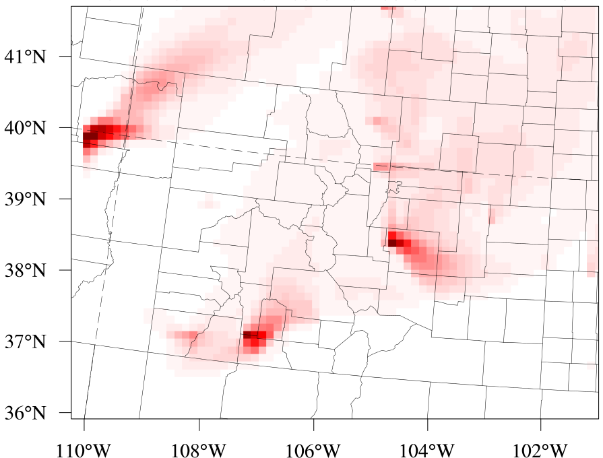
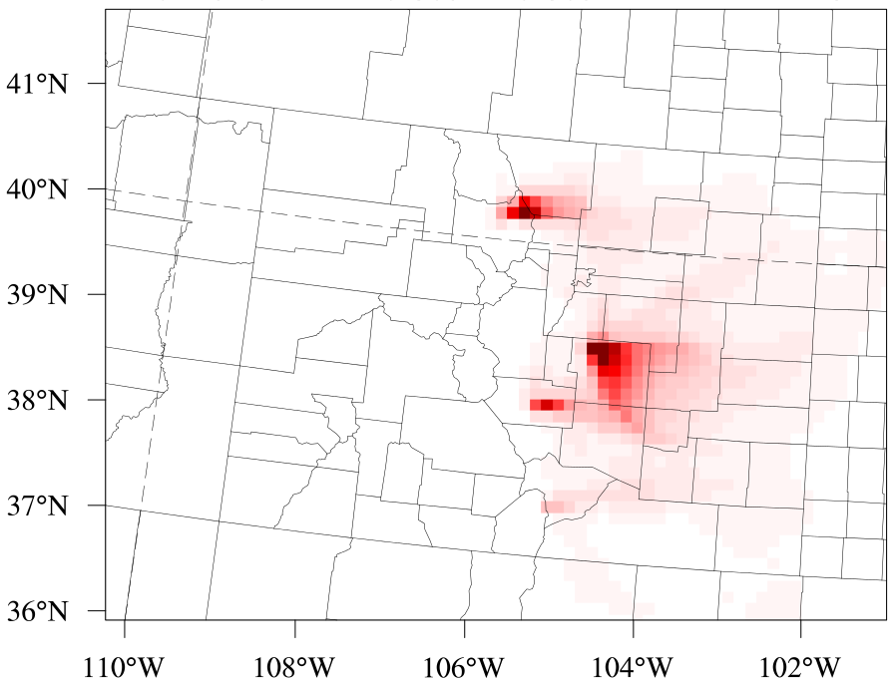
2011−2013 Daily Mean Fire Contributions on PM_{2.5}
  2011
  06/08 – 06/09
  2012
  06/10 – 06/11
  2012
  06/26 – 06/27
  2013
  06/11 – 06/12
  2011
  2013
  2012
Notes:
Source: https://www.denverpost.com/2014/06/07/colorado-wildfires-major-fires-from-1971-2013-interactive-graphic/
No big fires in Colorado during 2014

Slide 19
Meteorology
CESM
downscaling
WRF
MCIP
WUS grid info
Initial conditions
Boundary conditions
(CB05e51_ae6nvPOA_aq)
CAM-Chem
CMAQ
IC/BC
CMAQ
Emission
(CB05e51_
ae6nvPOA
_aq)
Base years
12km CONUS
12km
WUS
Future years
0.5°×0.5°
Global
12km
WUS
Notes:
CESM-WRF downscaling reference: Gao et al., 2012, ERL
IC/BC & emission for future year emissions: Gao et al., 2013, JGR
Aerosol module uses ae6nvPOA to fit the inputs from CAM-Chem

