Slide 1
Assessing the Meteorological Aspects of High Ozone Over Lake Michigan
Richard T. McNider¹, Arastoo Pour-Biazar², Kevin Doty², Andrew White¹, Yuling Wu², Momei Qin³, Yongtao Hu³, Talat Odman³, Patricia Cleary⁴, Eladio Knipping⁵, Bright Dornblaser⁶, Pius Lee⁷, Christopher Hain⁸, Stuart McKeen⁹
¹Department of Atmospheric Science, University of Alabama in Huntsville, Huntsville, Alabama, USA.
²Earth System Science Center, University of Alabama in Huntsville, Huntsville, Alabama, USA.
³School of Civil and Environmental Engineering, Georgia Institute of Technology, Atlanta, Georgia, USA.
⁴Department of Chemistry, University of Wisconsin-Eau Claire, Eau Claire, Wisconsin, USA
⁵Electric Power Research Institute, Washington, DC, USA
⁶Texas Commission on Environmental Quality, Austin, Texas, USA
⁷NOAA Air Resources Laboratory, Silver Springs, Maryland, USA
⁸NASA SPoRT Center, Huntsville, Alabama, USA
⁹NOAA Aeronomy Laboratory, Boulder, Colorado, USA
mcnider@nsstc.uah.edu

Slide 2
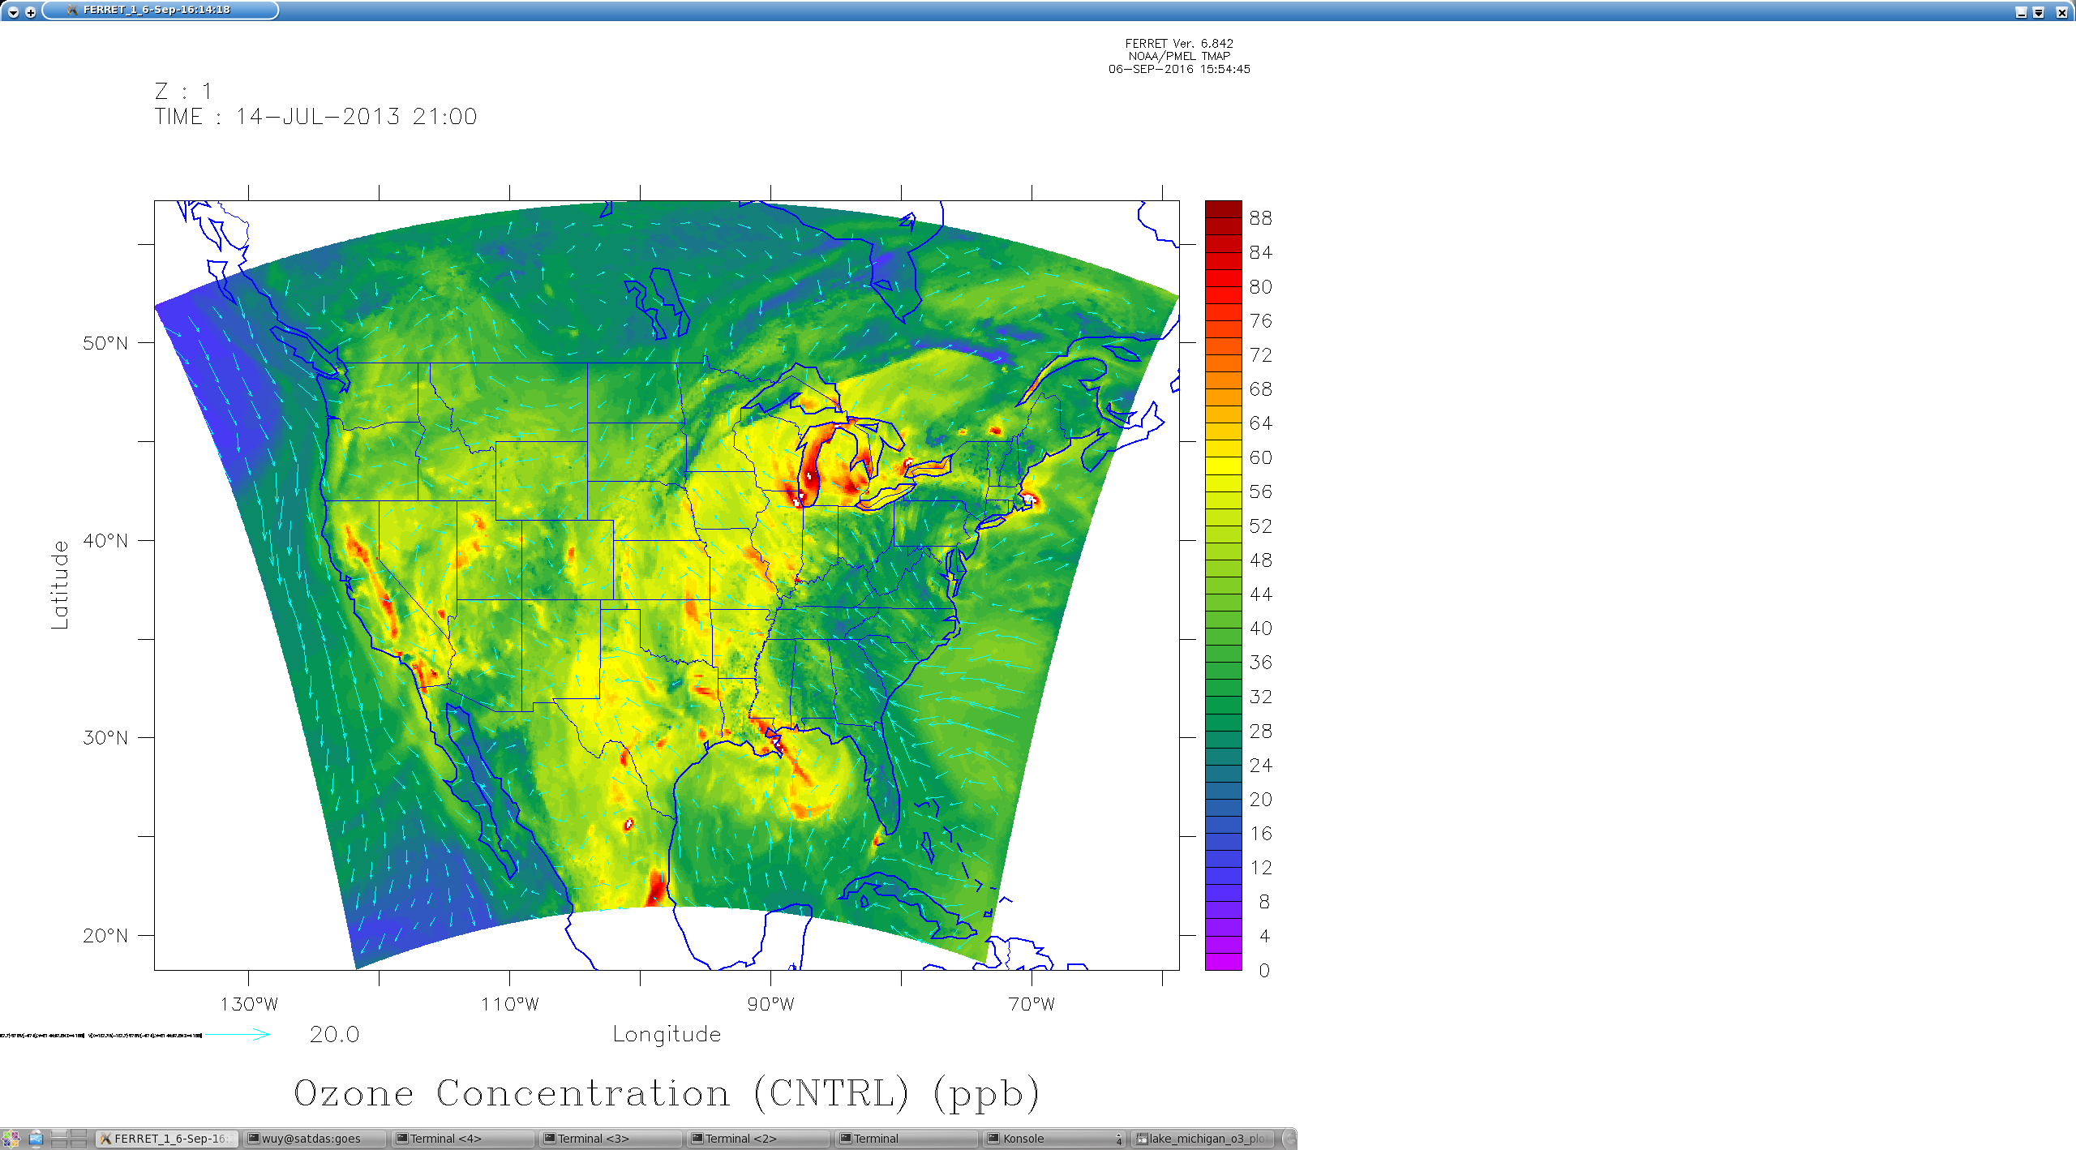
Model images of ozone have long shown high values over the Great Lakes
From Cleary et al. 2015

Slide 3
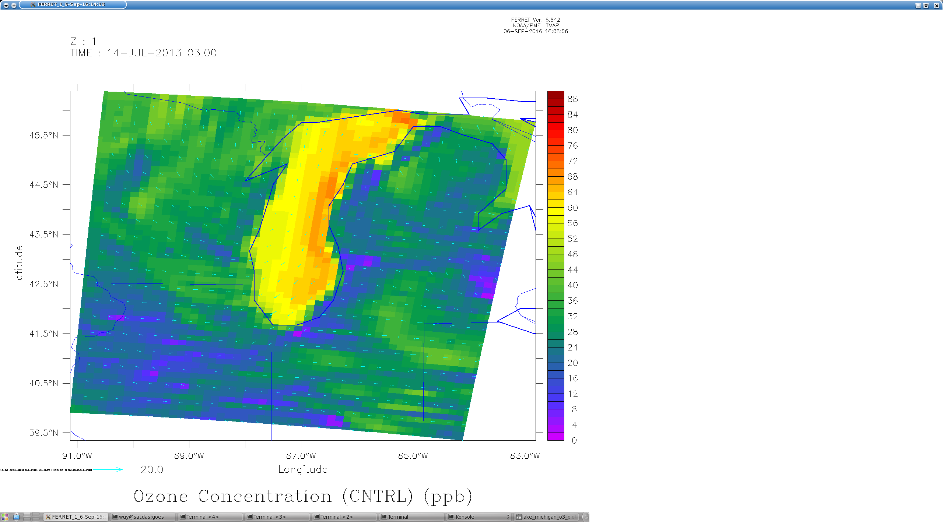
High ozone appears connected to over water grid boxes.
How much of this amplification is real or is it partly a model artifact?

Slide 4
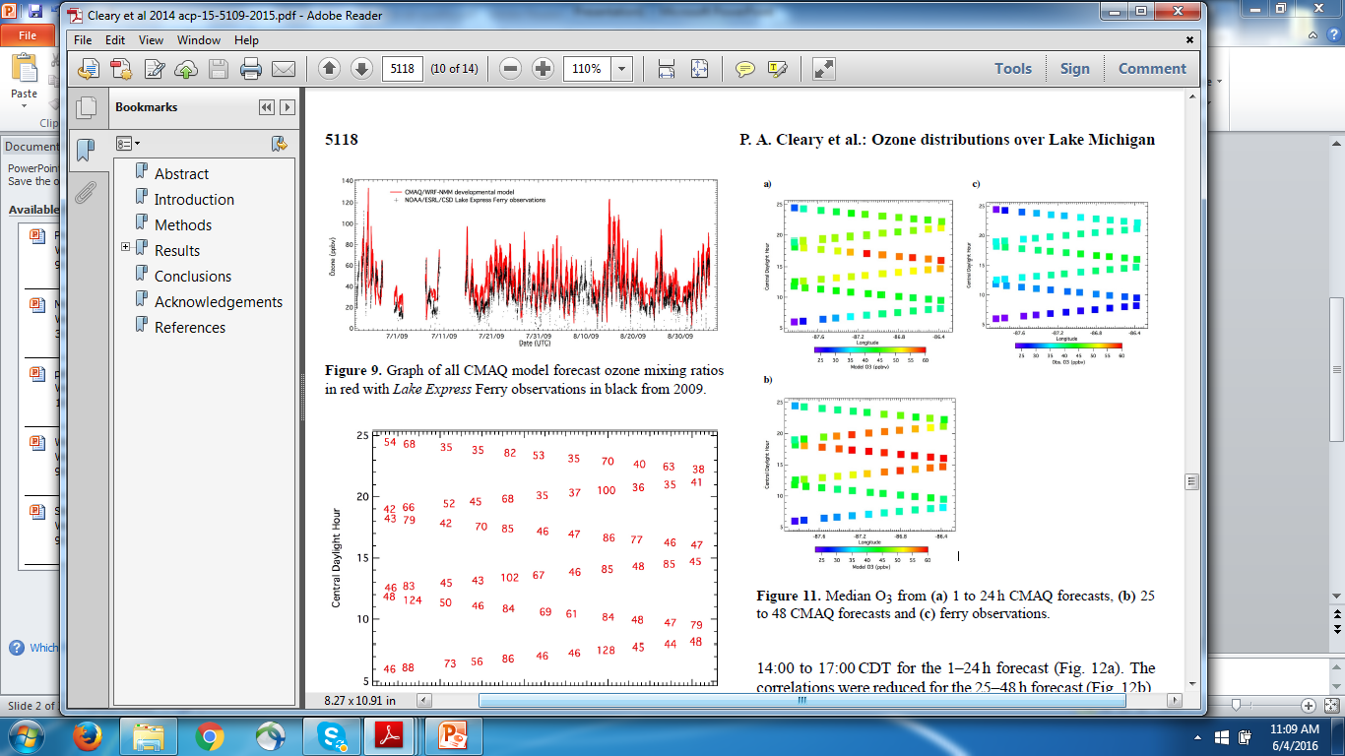
For 2009 ozone season NOAA Operational CMAQ consistently over predicted surface ozone compared to ferry data.
CMAQ Red
Ferry Observations Black
From Cleary et al. 2015
Notes:
This shows the consistent over-prediction in the NOAA real-time operation CMAQ modeling system compared to ferry observations of ozone. Red line is CMAQ and black the ferry obs. UAH modeled on the over-prediction period July 1, 2009 through September 1, 2009

Slide 5
CMAQ NOAA Operational
Ferry Observations
From Cleary et al. 2015
Notes:
This shows the median ozone on the left two panels predicted from CMAQ. The right panel shows the ferry obs of ozone. The y=axis gives the time. As can be seen the model seems to over-predict ozone for all times especailly the peak ozone during the day.

Slide 6
Note that the CMAQ performance discussed above from Cleary et al. 2015 is from the operational CMAQ. The operational CMAQ is forced not by WRF but by NCEP’s 12 km North American Model (NAM).

Slide 7
Excessive Vertical Mixing in Operational Forecast Models
Operational forecast models (e.g UK Met office and ECMWF -Louis, 1979; Beljaars, 1995; Bechtold et al., 2008)) and climate models have generally had to add mixing to enhance performance evaluations in most settings.
However, over oceans (Brown et al., 2005) and smooth areas such as the Antarctic interior (King and Connolley, 1997) this added mixing produces problems (Brown et al., 2005). Here reduced mixing formulations such as “short-tailed” forms appear to work better.
The stable boundary over the Great Lakes may be a place where models have added too much mixing.
For an excellent review – see Savijärvi, H., 2009. Stable boundary layer: Parametrizations for local and larger scales. Quarterly Journal of the Royal Meteorological Society, 135(641), pp.914-921.

Slide 8
CMAQ Over-prediction of Surface Ozone
Hypothesis: There may be due to too much mixing in the stable boundary layer in the operational NAM. This mixing is bringing down ozone from aloft causing surface values to be too high.

Slide 9
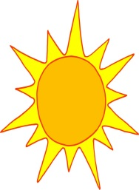
Schematic of Ozone Formation in Lake Michigan in the 1990’s
Residual Layer Stable
Precursors
Subsidence/Divergence
Increases stability
Ozone Production
Stable Layer
Too much mixing can bring high ozone aloft to surface.
Cold Water
High ozone can be produced in residual layer aloft as a near perfect smog chamber (Dye et al. 1995).
However, if the model has too much mixing then too much ozone from the residual layer may be mixing to surface causing over prediction of surface ozone
Notes:
It is hypothesized that if the model has too much mixing in the stable layer over water then too much ozone will brought to the surface – perhaps producing the discrepancy between model and ferry observations.

Slide 10
Actual operational CMAQ cross-sections
Over southern Lake Michigan highest ozone was aloft over western shore but not over most of lake
At ferry transact over eastern lake highest ozone was not aloft.
Ozone
Ozone
However, in examining VOC/NOx ratios it was found that higher ozone production potential might be aloft over most of lake.

Slide 11
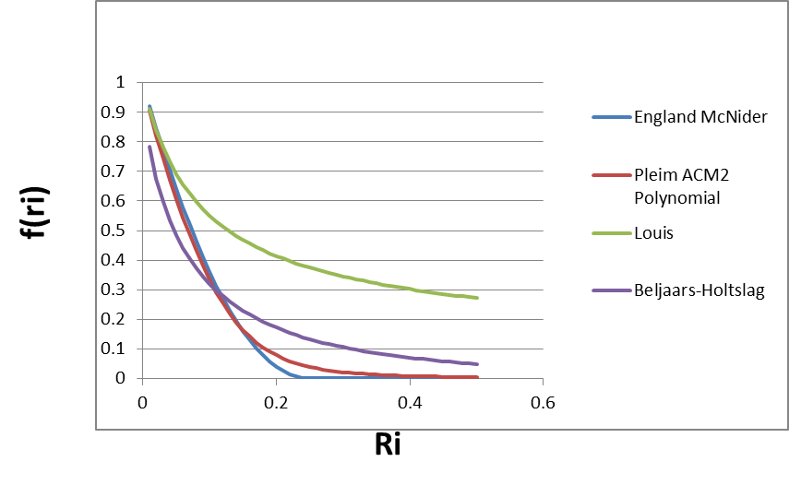

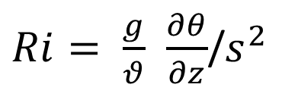
Typical Boundary Layer Stable Parameterization
K_{z} = l_{m}²s
$f(Ri)$
where l_{m} is mixing length and s is shear .
$Ri= \frac{g}{θ}$ $\frac{∂θ}{∂z}$/$s^{2}$
Short-tailed form
(England and McNider 1995 Bound. Layer Meteor) fit to Businger Profiles
Current Pleim ACM2 scheme has a short-tail form but with slightly more mixing than in McNider et al. 2012 JGR
Long-tailed – Maintains mixing well beyond what fundamental theory prescribes

Slide 12
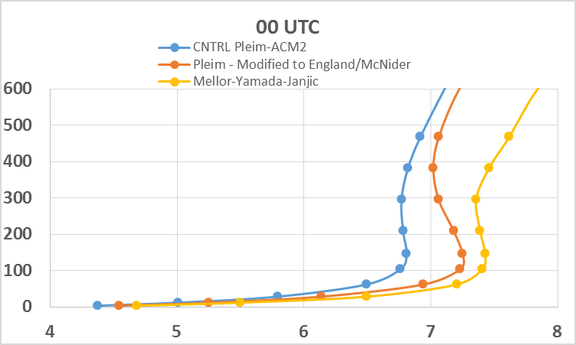
Wind Speed Profiles
CNTRL – Pleim ACM2
Height (m)
Mellor
Yamada
Janjic
used in
NAM
England-McNider and Mellor Yamada Janjic have less mixing

Slide 13
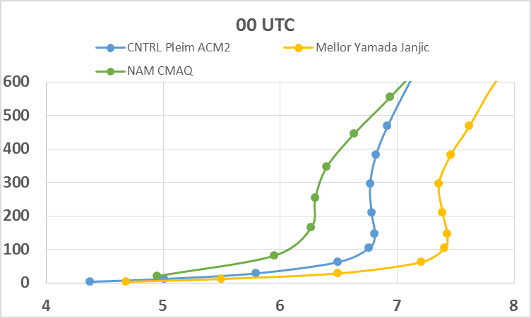
Wind Speed Profiles
NAM/CMAQ
Height (m)
Note much reduced shear indicating greater mixing

Slide 14
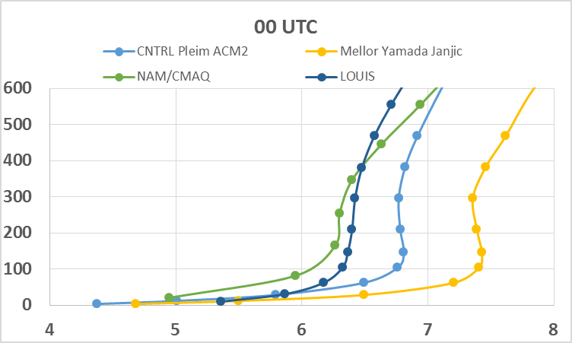
Wind Speed Profiles
NAM/CMAQ
Height (m)
Louis – Long-tail form

Slide 15
CMAQ Chemistry Runs to Examine Impact of Mixing
The mixing sensitivity runs discussed above shows that the operational NAM/CMAQ likely had much larger mixing than the Pleim-ACM2 scheme.
In order to test whether too much mixing may have been responsible for the ozone over-prediction over water two WRF/CMAQ chemistry runs were carried out.
The CMAQ runs were made for August 2011 by Georgia Tech.
WRF was run with the standard Pleim ACM2. This WRF run was then used to drive CMAQ.
WRF was run with the long-tailed Louis scheme (greater mixing). This WRF was used to drive CMAQ.

Slide 16
The CMAQ runs showed that indeed the model run driven by the Louis (larger mixing) WRF increased ozone over Lake Michigan

Slide 17
The pattern of increased ozone was consistent with the over-prediction seen in the operational CMAQ runs reported by Cleary et al. 2015.
At this point we might have concluded that our original hypothesis – that too much mixing in the meteorological was responsible for the operational CMAQ over-prediction was valid.

Slide 18
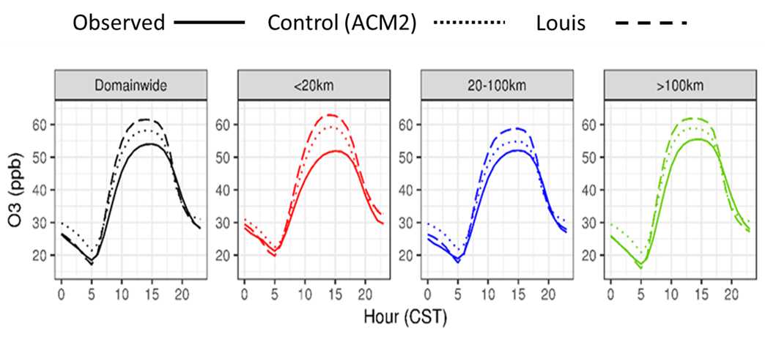
However, an examination of time series plots from the two CMAQ runs gave us pause.
Pleim –ACM2
The Louis formulation which should have mixed more ozone to the surface at night actually showed lower ozone. This was then a hint that the Louis form was actually producing less mixing in CMAQ than the Pleim-ACM2 formulation.
Louis
Night

Slide 19
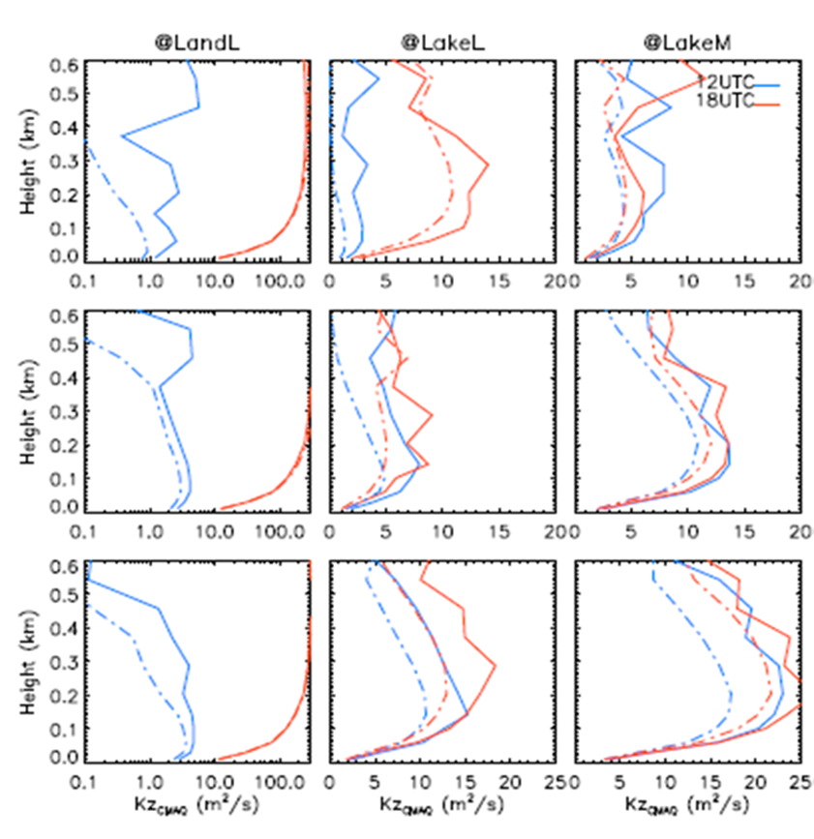
Vertical Mixing Coefficients
The solid lines are for the Pleim ACM2 case (small mixing) and dashed dotted lines for the Louis case (large mixing).
Blue is for 12 UTC and red for 18 UTC
Plots show that the K_{z} diagnosed in CMAQ are smaller for the Louis form than from the Pleim ACM2.
Ferry
Transact
Pleim
ACM2
Louis
Southern
Lake Michigan

Slide 20
So why are K’s in CMAQ smaller for Louis than Pleim ACM2?
K_{z} = l_{m}²s
$f(Ri)$
where l_{m} is mixing length and s is shear .
Louis
$Ri= \frac{g}{θ}$ $\frac{∂θ}{∂z}$/$s^{2}$
Pleim ACM2
The answer is that CMAQ does not use the Ks from WRF or NAM. It rediagnoses Ks from wind and temperature profiles. In WRF the Louis Ks are so large they mix out the shear. When this shear is used in the CMAQ diagnosed Ks it produces a smaller K than in WRF.

Slide 21
The shear that is passed to CMAQ has already been mixed out by the large Ks in WRF (or NAM). Thus, rediagnosed Ks are smaller.
NAM/CMAQ
Height (m)
Louis – Long-tail form

Slide 22
Summary and Conclusions
Based on this analysis it is concluded that excessive mixing in the stable boundary layer in the operational NCEP NAM actually produces less mixing in CMAQ.
The analysis also brings up questions about using CMAQ in an offline form. The wind and temperature profiles passed to WRF represent the result of mixing . Using these to diganose Ks in CMAQ may lead to error.
Using the same mixing formulation in WRF and in CMAQ may minimize this error.
For example the Pleim –ACM2 should be used in WRF since it is currently the form used in CMAQ . However, the shear in WRF reflects the mixing that has already occurred. Thus, the Ks in CMAQ using Pleim ACM2 may be smaller than Pleim ACM2 Ks in WRF.
The Pleim ACM2 may have more mixing than Mellor-Yamada- Janjic or England-McNider.

Slide 23
Acknowledgements
This research was sponsored in part by the Electric Power Research Institute (EPRI) and the NASA Applied Science Air Quality Team (AQAST).
The findings in this research do not necessarily reflect the views of EPRI or NASA.
We thank Program Managers - John Haynes and Eladio Knipping for their support.

