Slide 1
Spatiotemporal estimates of surface PM_{2.5} concentrations in the western U.S. using NASA MODIS retrievals and data assimilation techniques
S. Marcela Loría-Salazar¹, Cesunica E. Ivey¹, Heather A. Holmes¹, and Howard H. Chang²
¹Atmospheric Sciences Program, Department of Physics, University of Nevada, Reno
²Department of Biostatistics and Bioinformatics, Emory University
October 24th, 2017
16th Annual CMAS Conference
Chapel Hill, North Carolina, USA

Slide 2
Motivation
EPA PM_{2.5}
MODIS AOD
http://www.epa.gov/airdata/ad_maps.html
Loria-Salazar et al., 2016
(Atmos. Environ)
Point-level
measurement
Grid AQ data
Data fusion model
$${{PM}_{2.5}}_{obs}\left(s,t\right)=α_{0}\left(s,t\right)+α_{1}\left(s,t\right) {AOD}_{MODIS}+ ε\left(s,t\right)$$
Additive bias:
$α_{0}\left(s,t\right)$ =${ β}_{0}\left(s\right)$ +${ β}_{0}\left(t\right)$ +${ γ}_{0}Z_{0}$
Multiplicative bias:
$α_{1}\left(s,t\right)$ =${ β}_{1}\left(s\right)$ +${ β}_{1}\left(t\right)$ +${ γ}_{1}Z_{1}$
Chang et al. 2013
Notes:
However, the semi-arid western U.S. continues to be an unproven and infrequently explored area for remotely sensed atmospheric aerosol pollution retrievals. The study of aerosol transport and optical properties in this area is a challenge due to the complex terrain, bright surfaces, presence of anthropogenic and biogenic emissions, secondary organic aerosol formation, smoke from wildfires, and low aerosol concentrations during non-fire conditions.
Previous studies have shown that MODIS retrievals failed to estimate column-integrated aerosol pollution levels and particle size over Nevada and California in the summer months of 2012 and 2013 due to high surface albedo, heterogeneous vertical profile of aerosol concentrations, and incorrect parameterizations for surface reflectance. MODIS algorithms overestimated AOD by more than a factor of 3 in Reno, NV and more than a factor of 2 over Fresno, CA.

Slide 3
Motivation
EPA PM_{2.5}
MODIS AOD
http://www.epa.gov/airdata/ad_maps.html
Loria-Salazar et al., 2016
(Atmos. Environ)
Point-level
measurement
Grid AQ data
Data fusion model
$${{PM}_{2.5}}_{obs}\left(s,t\right)=α_{0}\left(s,t\right)+α_{1}\left(s,t\right) {AOD}_{MODIS}+ ε\left(s,t\right)$$
Additive bias:
$α_{0}\left(s,t\right)$ =${ β}_{0}\left(s\right)$ +${ β}_{0}\left(t\right)$ +${ γ}_{0}Z_{0}$
Land use and meteorological variables
Multiplicative bias:
$α_{1}\left(s,t\right)$ =${ β}_{1}\left(s\right)$ +${ β}_{1}\left(t\right)$ +${ γ}_{1}Z_{1}$
Chang et al. 2013
Notes:
However, the semi-arid western U.S. continues to be an unproven and infrequently explored area for remotely sensed atmospheric aerosol pollution retrievals. The study of aerosol transport and optical properties in this area is a challenge due to the complex terrain, bright surfaces, presence of anthropogenic and biogenic emissions, secondary organic aerosol formation, smoke from wildfires, and low aerosol concentrations during non-fire conditions.
Previous studies have shown that MODIS retrievals failed to estimate column-integrated aerosol pollution levels and particle size over Nevada and California in the summer months of 2012 and 2013 due to high surface albedo, heterogeneous vertical profile of aerosol concentrations, and incorrect parameterizations for surface reflectance. MODIS algorithms overestimated AOD by more than a factor of 3 in Reno, NV and more than a factor of 2 over Fresno, CA.

Slide 4
Challenges in the western U.S.
Diverse aerosol chemical and physical compositions
Transboundary aerosol pollution from Eurasia
Irregular topography induces complicated transport
Heterogeneous surface reflectance impacting aerosol retrievals
$$AOH\left(λ\right)=\frac{AOD(λ)}{β_{ext}(λ)}$$
Loria-Salazar et al., (JGR, 2014)
Notes:
However, the semi-arid western U.S. continues to be an unproven and infrequently explored area for remotely sensed atmospheric aerosol pollution retrievals. The study of aerosol transport and optical properties in this area is a challenge due to the complex terrain, bright surfaces, presence of anthropogenic and biogenic emissions, secondary organic aerosol formation, smoke from wildfires, and low aerosol concentrations during non-fire conditions.
Previous studies have shown that MODIS retrievals failed to estimate column-integrated aerosol pollution levels and particle size over Nevada and California in the summer months of 2012 and 2013 due to high surface albedo, heterogeneous vertical profile of aerosol concentrations, and incorrect parameterizations for surface reflectance. MODIS algorithms overestimated AOD by more than a factor of 3 in Reno, NV and more than a factor of 2 over Fresno, CA.

Slide 5
Challenges in the western U.S.
Diverse aerosol chemical and physical compositions
Transboundary aerosol pollution from Eurasia
Irregular topography induces complicated transport
Heterogeneous surface reflectance impacting aerosol retrievals
Session: Remote Sensing and Measurements Studies Oct 25, 2017 at 9:30 AM
$$AOH\left(λ\right)=\frac{AOD(λ)}{β_{ext}(λ)}$$
Loria-Salazar et al., (JGR, 2014)
Notes:
However, the semi-arid western U.S. continues to be an unproven and infrequently explored area for remotely sensed atmospheric aerosol pollution retrievals. The study of aerosol transport and optical properties in this area is a challenge due to the complex terrain, bright surfaces, presence of anthropogenic and biogenic emissions, secondary organic aerosol formation, smoke from wildfires, and low aerosol concentrations during non-fire conditions.
Previous studies have shown that MODIS retrievals failed to estimate column-integrated aerosol pollution levels and particle size over Nevada and California in the summer months of 2012 and 2013 due to high surface albedo, heterogeneous vertical profile of aerosol concentrations, and incorrect parameterizations for surface reflectance. MODIS algorithms overestimated AOD by more than a factor of 3 in Reno, NV and more than a factor of 2 over Fresno, CA.

Slide 6
Challenges in the western U.S.
Diverse aerosol chemical and physical compositions
Transboundary aerosol pollution from Eurasia
Irregular topography induces complicated transport
Heterogeneous surface reflectance impacting aerosol retrievals
$$AOH\left(λ\right)=\frac{AOD(λ)}{β_{ext}(λ)}$$
Loria-Salazar et al., (JGR, 2014)
Notes:
However, the semi-arid western U.S. continues to be an unproven and infrequently explored area for remotely sensed atmospheric aerosol pollution retrievals. The study of aerosol transport and optical properties in this area is a challenge due to the complex terrain, bright surfaces, presence of anthropogenic and biogenic emissions, secondary organic aerosol formation, smoke from wildfires, and low aerosol concentrations during non-fire conditions.
Previous studies have shown that MODIS retrievals failed to estimate column-integrated aerosol pollution levels and particle size over Nevada and California in the summer months of 2012 and 2013 due to high surface albedo, heterogeneous vertical profile of aerosol concentrations, and incorrect parameterizations for surface reflectance. MODIS algorithms overestimated AOD by more than a factor of 3 in Reno, NV and more than a factor of 2 over Fresno, CA.

Slide 7
Objectives and Hypotheses
Objective
Apply the surface PM_{2.5} concentration model to generate spatially resolved PM_{2.5} exposure metrics using satellite aerosol optical depth (AOD) data over the western U.S. from 2013 to 2014
Quantify the dose response relationship for wildfire smoke exposure by categorizing the spatial-temporal field in fire and non-fire periods
Hypotheses
Data assimilation techniques, used in conjunction with NASA satellite and ground-based data, can improve estimates of near surface PM_{2.5} concentrations.
MODIS collection 6 alone will not be able to capture fire periods

Slide 8
High surface reflectance California and Nevada, summer, 2012
High surface reflectance
Terra-DB AOD (550)
July, 2012
Terra true color
July 28, 2012
Albedo (650 nm)
July, 2012
Loria-Salazar et al., 2016 (Atmos. Environ, 2016)
Notes:
Health effects of ambient air quality
Georgia Birth Cohort
Geo-coded patient information
Atlanta - epidemiologic results using central monitor data suggest associations of acute health effects and mobile source emissions
Spatially resolved health study needs spatial air quality metrics

Slide 9
High surface reflectance in Col. 6 California and Nevada, summer, 2012
High surface reflectance
Terra-DB AOD (550)
July, 2012
Terra true color
July 28, 2012
Albedo (650 nm)
July, 2012
Complex terrain in the western U.S. led to artificial hotspots in retrieved AOD
Surface data base was not being able to resolve the heterogeneity of the terrain
Shadowing
Loria-Salazar et al., 2016 (Atmos. Environ, 2016)
Notes:
Health effects of ambient air quality
Georgia Birth Cohort
Geo-coded patient information
Atlanta - epidemiologic results using central monitor data suggest associations of acute health effects and mobile source emissions
Spatially resolved health study needs spatial air quality metrics

Slide 10
High surface reflectance in Col. 6 California and Nevada, summer, 2012
High surface reflectance
Terra-DB AOD (550)
July, 2012
Terra true color
July 28, 2012
Albedo (650 nm)
July, 2012
Loria-Salazar et al., 2016 (Atmos. Environ, 2016)
Notes:
Health effects of ambient air quality
Georgia Birth Cohort
Geo-coded patient information
Atlanta - epidemiologic results using central monitor data suggest associations of acute health effects and mobile source emissions
Spatially resolved health study needs spatial air quality metrics

Slide 11
High surface reflectance in Col. 6 California and Nevada, summer, 2012
High surface reflectance
Terra-DB Best AOD (550)
July, 2012
Terra true color
July 28, 2012
Albedo (650 nm)
July, 2012
Loria-Salazar et al., 2016 (Atmos. Environ, 2016)
Notes:
Health effects of ambient air quality
Georgia Birth Cohort
Geo-coded patient information
Atlanta - epidemiologic results using central monitor data suggest associations of acute health effects and mobile source emissions
Spatially resolved health study needs spatial air quality metrics

Slide 12
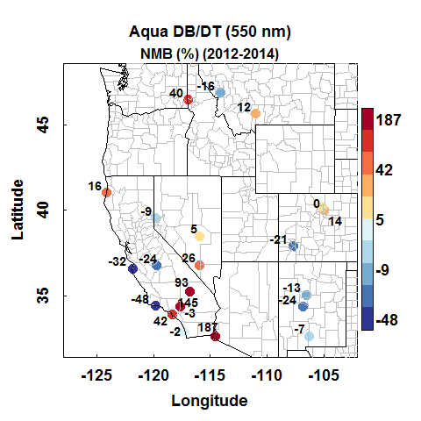
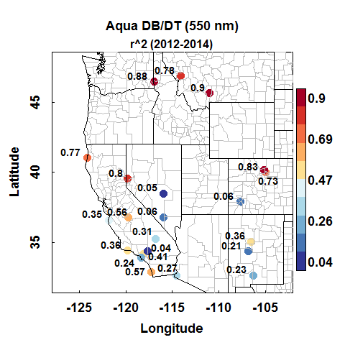
Evaluation of Aqua MODIS Col. 6 AOD Western U.S., 2012-2014
$$NMB=\frac{\sum_{i=0}^{n}{{AOD}_{MODIS}−{AOD}_{AERONET}}}{\sum_{i=0}^{n}{{AOD}_{AERONET}}}$$
Notes:
The presence of wildfire smoke impacts the correlation between surface and satellite measurements of AOD in this region. AOD from AERONET and MODIS showed low correlation for days with typical ambient pollutant concentrations (e.g. R²~0.46 for Terra-MODIS over Las Vegas, NV in August 2013). During fire periods the correlation between instruments showed an improvement (e.g. R²~0.87 for Terra-MODIS over Reno, NV in August 2012 and R²~0.82 for Aqua-MODIS over Fresno, CA in August 2013) because of the increase in columnar aerosol concentration.

Slide 13
Evaluation of Aqua MODIS Col. 6 AOD Western U.S., 2012-2014
$$NMB=\frac{\sum_{i=0}^{n}{{AOD}_{MODIS}−{AOD}_{AERONET}}}{\sum_{i=0}^{n}{{AOD}_{AERONET}}}$$
Notes:
The presence of wildfire smoke impacts the correlation between surface and satellite measurements of AOD in this region. AOD from AERONET and MODIS showed low correlation for days with typical ambient pollutant concentrations (e.g. R²~0.46 for Terra-MODIS over Las Vegas, NV in August 2013). During fire periods the correlation between instruments showed an improvement (e.g. R²~0.87 for Terra-MODIS over Reno, NV in August 2012 and R²~0.82 for Aqua-MODIS over Fresno, CA in August 2013) because of the increase in columnar aerosol concentration.

Slide 14
Spatial evaluation of MODIS C6 AOD California and Nevada, Summer 2012
MODIS retrievals can predict AOD using the DT (25%) (-), DB (60%) (+), and DB best (63%) (+)
Loria-Salazar et al., 2016 (Atmos. Environ, 2016)
Notes:
The presence of wildfire smoke impacts the correlation between surface and satellite measurements of AOD in this region. AOD from AERONET and MODIS showed low correlation for days with typical ambient pollutant concentrations (e.g. R²~0.46 for Terra-MODIS over Las Vegas, NV in August 2013). During fire periods the correlation between instruments showed an improvement (e.g. R²~0.87 for Terra-MODIS over Reno, NV in August 2012 and R²~0.82 for Aqua-MODIS over Fresno, CA in August 2013) because of the increase in columnar aerosol concentration.

Slide 15
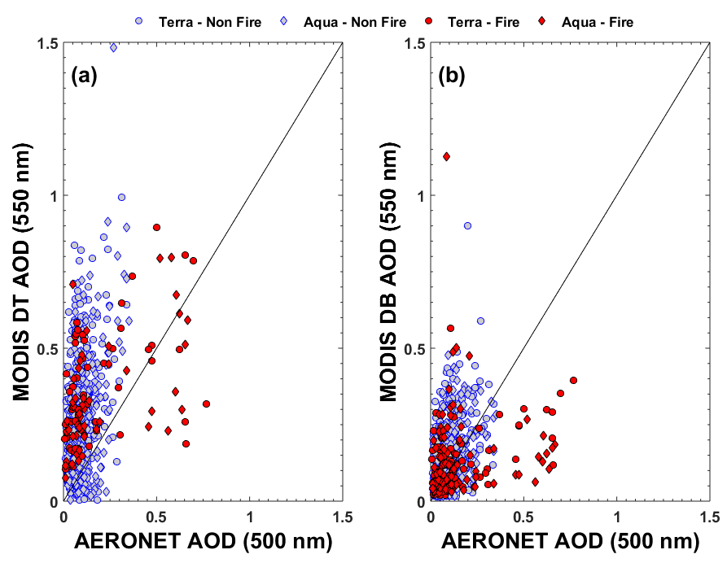
Spatial evaluation of MODIS C6 AOD California and Nevada, Summer 2012
MODIS retrievals can predict AOD using the DT (25%) (-), DB (60%) (+), and DB best (63%) (+)
During fires periods:
Improvement in the correlation between MODIS and AERONET AOD (+)
Increase in the normalized mean bias (-)
Loria-Salazar et al., 2016 (Atmos. Environ, 2016)
Notes:
The presence of wildfire smoke impacts the correlation between surface and satellite measurements of AOD in this region. AOD from AERONET and MODIS showed low correlation for days with typical ambient pollutant concentrations (e.g. R²~0.46 for Terra-MODIS over Las Vegas, NV in August 2013). During fire periods the correlation between instruments showed an improvement (e.g. R²~0.87 for Terra-MODIS over Reno, NV in August 2012 and R²~0.82 for Aqua-MODIS over Fresno, CA in August 2013) because of the increase in columnar aerosol concentration.

Slide 16
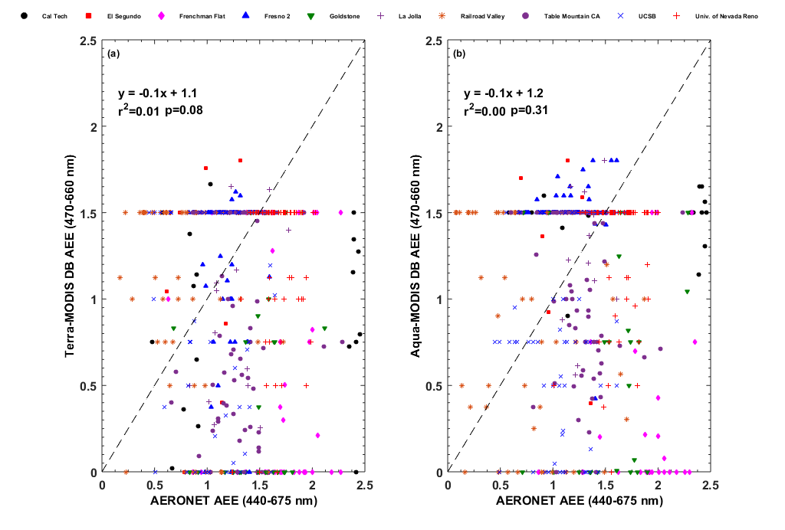
Spatial evaluation of MODIS C6 AOD California and Nevada, Summer 2012
MODIS retrievals can predict AOD using the DT (25%) (-), DB (60%) (+), and DB best (63%) (+)
During fires periods:
Improvement in the correlation between MODIS and AERONET AOD (+)
Increase in the normalized mean bias (-)
AEE from DB did not present any relationship with AERONET observations (r²~0) (-)
Loria-Salazar et al., 2016 (Atmos. Environ, 2016)
Notes:
The presence of wildfire smoke impacts the correlation between surface and satellite measurements of AOD in this region. AOD from AERONET and MODIS showed low correlation for days with typical ambient pollutant concentrations (e.g. R²~0.46 for Terra-MODIS over Las Vegas, NV in August 2013). During fire periods the correlation between instruments showed an improvement (e.g. R²~0.87 for Terra-MODIS over Reno, NV in August 2012 and R²~0.82 for Aqua-MODIS over Fresno, CA in August 2013) because of the increase in columnar aerosol concentration.

Slide 17
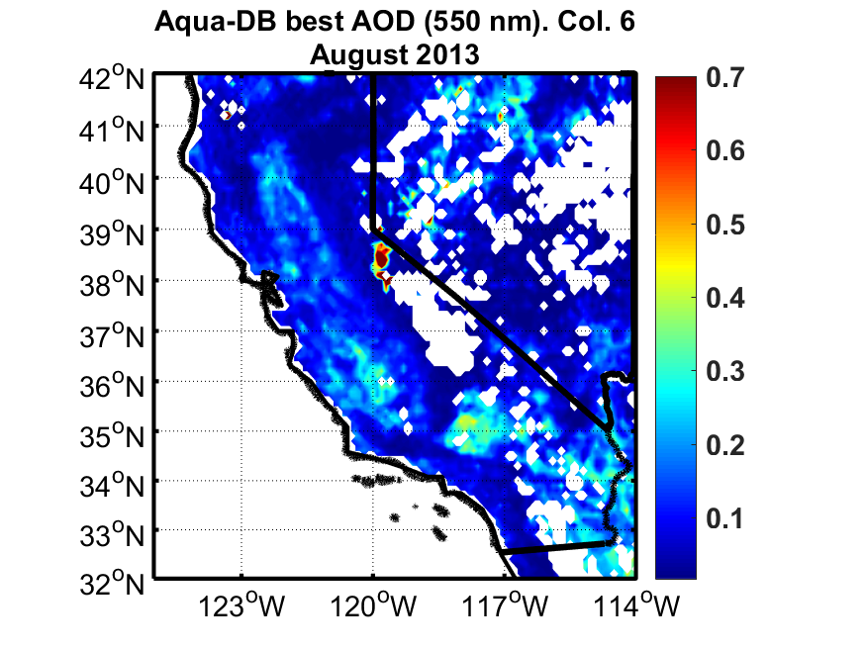
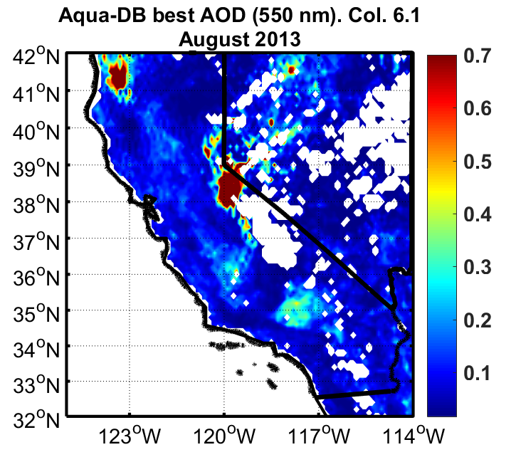
Aqua MODIS DB Best AOD California and Nevada, August, 2013
Collection 6
Collection 6.1
Notes:
The presence of wildfire smoke impacts the correlation between surface and satellite measurements of AOD in this region. AOD from AERONET and MODIS showed low correlation for days with typical ambient pollutant concentrations (e.g. R²~0.46 for Terra-MODIS over Las Vegas, NV in August 2013). During fire periods the correlation between instruments showed an improvement (e.g. R²~0.87 for Terra-MODIS over Reno, NV in August 2012 and R²~0.82 for Aqua-MODIS over Fresno, CA in August 2013) because of the increase in columnar aerosol concentration.

Slide 18
Aqua MODIS DB Best AOD California and Nevada, August, 2013
Collection 6
Collection 6.1
Notes:
The presence of wildfire smoke impacts the correlation between surface and satellite measurements of AOD in this region. AOD from AERONET and MODIS showed low correlation for days with typical ambient pollutant concentrations (e.g. R²~0.46 for Terra-MODIS over Las Vegas, NV in August 2013). During fire periods the correlation between instruments showed an improvement (e.g. R²~0.87 for Terra-MODIS over Reno, NV in August 2012 and R²~0.82 for Aqua-MODIS over Fresno, CA in August 2013) because of the increase in columnar aerosol concentration.

Slide 19
Aqua MODIS DB Best AOD California and Nevada, August, 2013
Collection 6
Collection 6.1
Notes:
The presence of wildfire smoke impacts the correlation between surface and satellite measurements of AOD in this region. AOD from AERONET and MODIS showed low correlation for days with typical ambient pollutant concentrations (e.g. R²~0.46 for Terra-MODIS over Las Vegas, NV in August 2013). During fire periods the correlation between instruments showed an improvement (e.g. R²~0.87 for Terra-MODIS over Reno, NV in August 2012 and R²~0.82 for Aqua-MODIS over Fresno, CA in August 2013) because of the increase in columnar aerosol concentration.

Slide 20
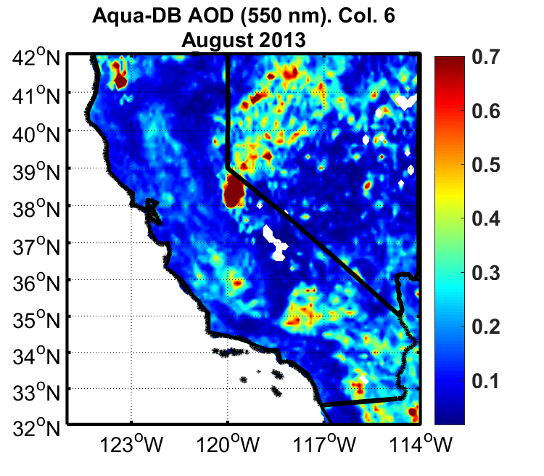
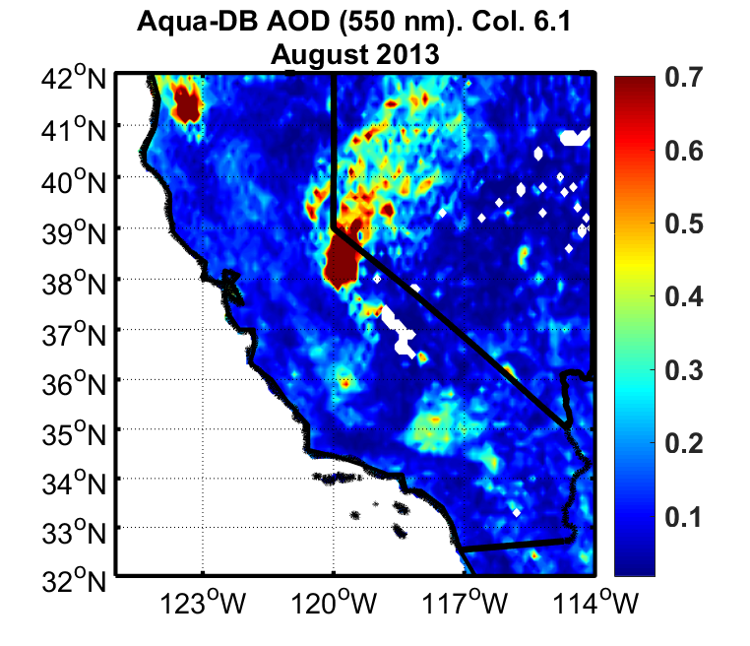
Aqua MODIS DB AOD California and Nevada, August, 2013
Collection 6
Collection 6.1
Notes:
The presence of wildfire smoke impacts the correlation between surface and satellite measurements of AOD in this region. AOD from AERONET and MODIS showed low correlation for days with typical ambient pollutant concentrations (e.g. R²~0.46 for Terra-MODIS over Las Vegas, NV in August 2013). During fire periods the correlation between instruments showed an improvement (e.g. R²~0.87 for Terra-MODIS over Reno, NV in August 2012 and R²~0.82 for Aqua-MODIS over Fresno, CA in August 2013) because of the increase in columnar aerosol concentration.

Slide 21
Aqua MODIS DB AOD California and Nevada, August, 2013
Collection 6
Collection 6.1
Notes:
The presence of wildfire smoke impacts the correlation between surface and satellite measurements of AOD in this region. AOD from AERONET and MODIS showed low correlation for days with typical ambient pollutant concentrations (e.g. R²~0.46 for Terra-MODIS over Las Vegas, NV in August 2013). During fire periods the correlation between instruments showed an improvement (e.g. R²~0.87 for Terra-MODIS over Reno, NV in August 2012 and R²~0.82 for Aqua-MODIS over Fresno, CA in August 2013) because of the increase in columnar aerosol concentration.

Slide 22
Aqua MODIS DB AOD C6.1 California and Nevada, August, 2013
Notes:
The presence of wildfire smoke impacts the correlation between surface and satellite measurements of AOD in this region. AOD from AERONET and MODIS showed low correlation for days with typical ambient pollutant concentrations (e.g. R²~0.46 for Terra-MODIS over Las Vegas, NV in August 2013). During fire periods the correlation between instruments showed an improvement (e.g. R²~0.87 for Terra-MODIS over Reno, NV in August 2012 and R²~0.82 for Aqua-MODIS over Fresno, CA in August 2013) because of the increase in columnar aerosol concentration.

Slide 23
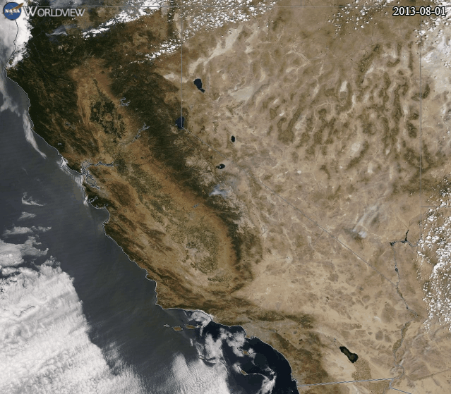
Aqua MODIS DB AOD C6.1 California and Nevada, August, 2013
Visible
Collection 6.1
Notes:
The presence of wildfire smoke impacts the correlation between surface and satellite measurements of AOD in this region. AOD from AERONET and MODIS showed low correlation for days with typical ambient pollutant concentrations (e.g. R²~0.46 for Terra-MODIS over Las Vegas, NV in August 2013). During fire periods the correlation between instruments showed an improvement (e.g. R²~0.87 for Terra-MODIS over Reno, NV in August 2012 and R²~0.82 for Aqua-MODIS over Fresno, CA in August 2013) because of the increase in columnar aerosol concentration.

Slide 24
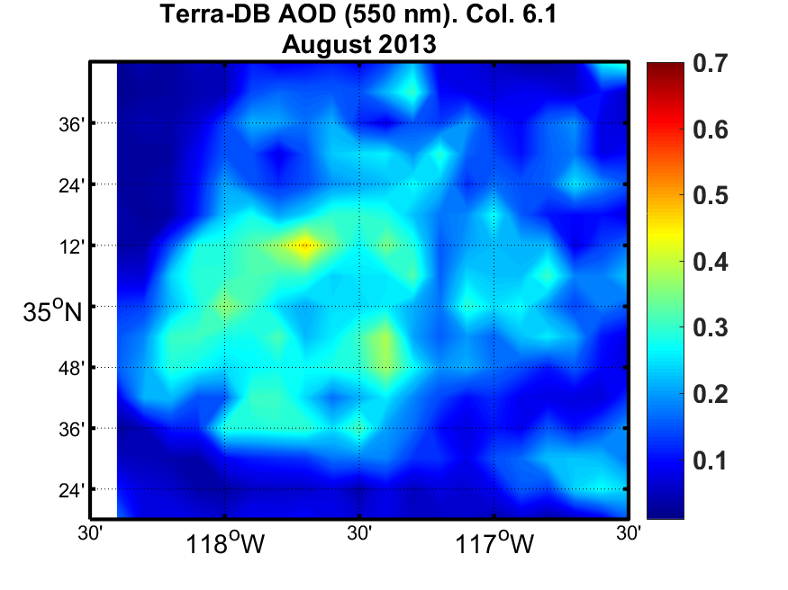
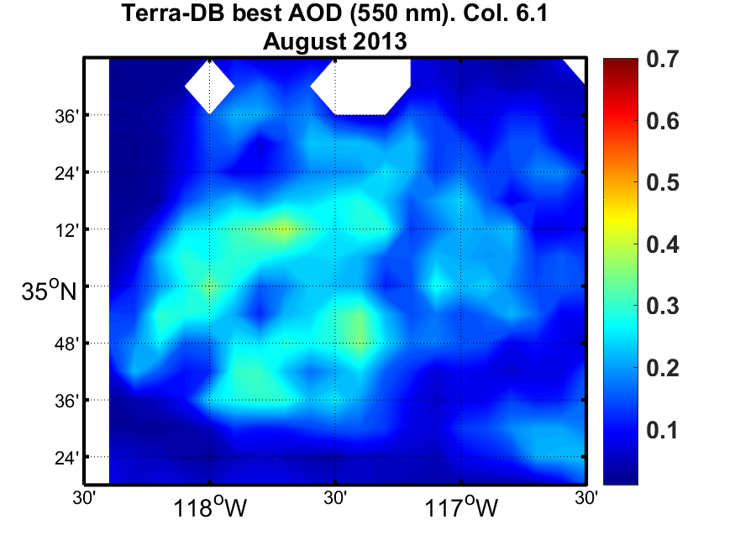
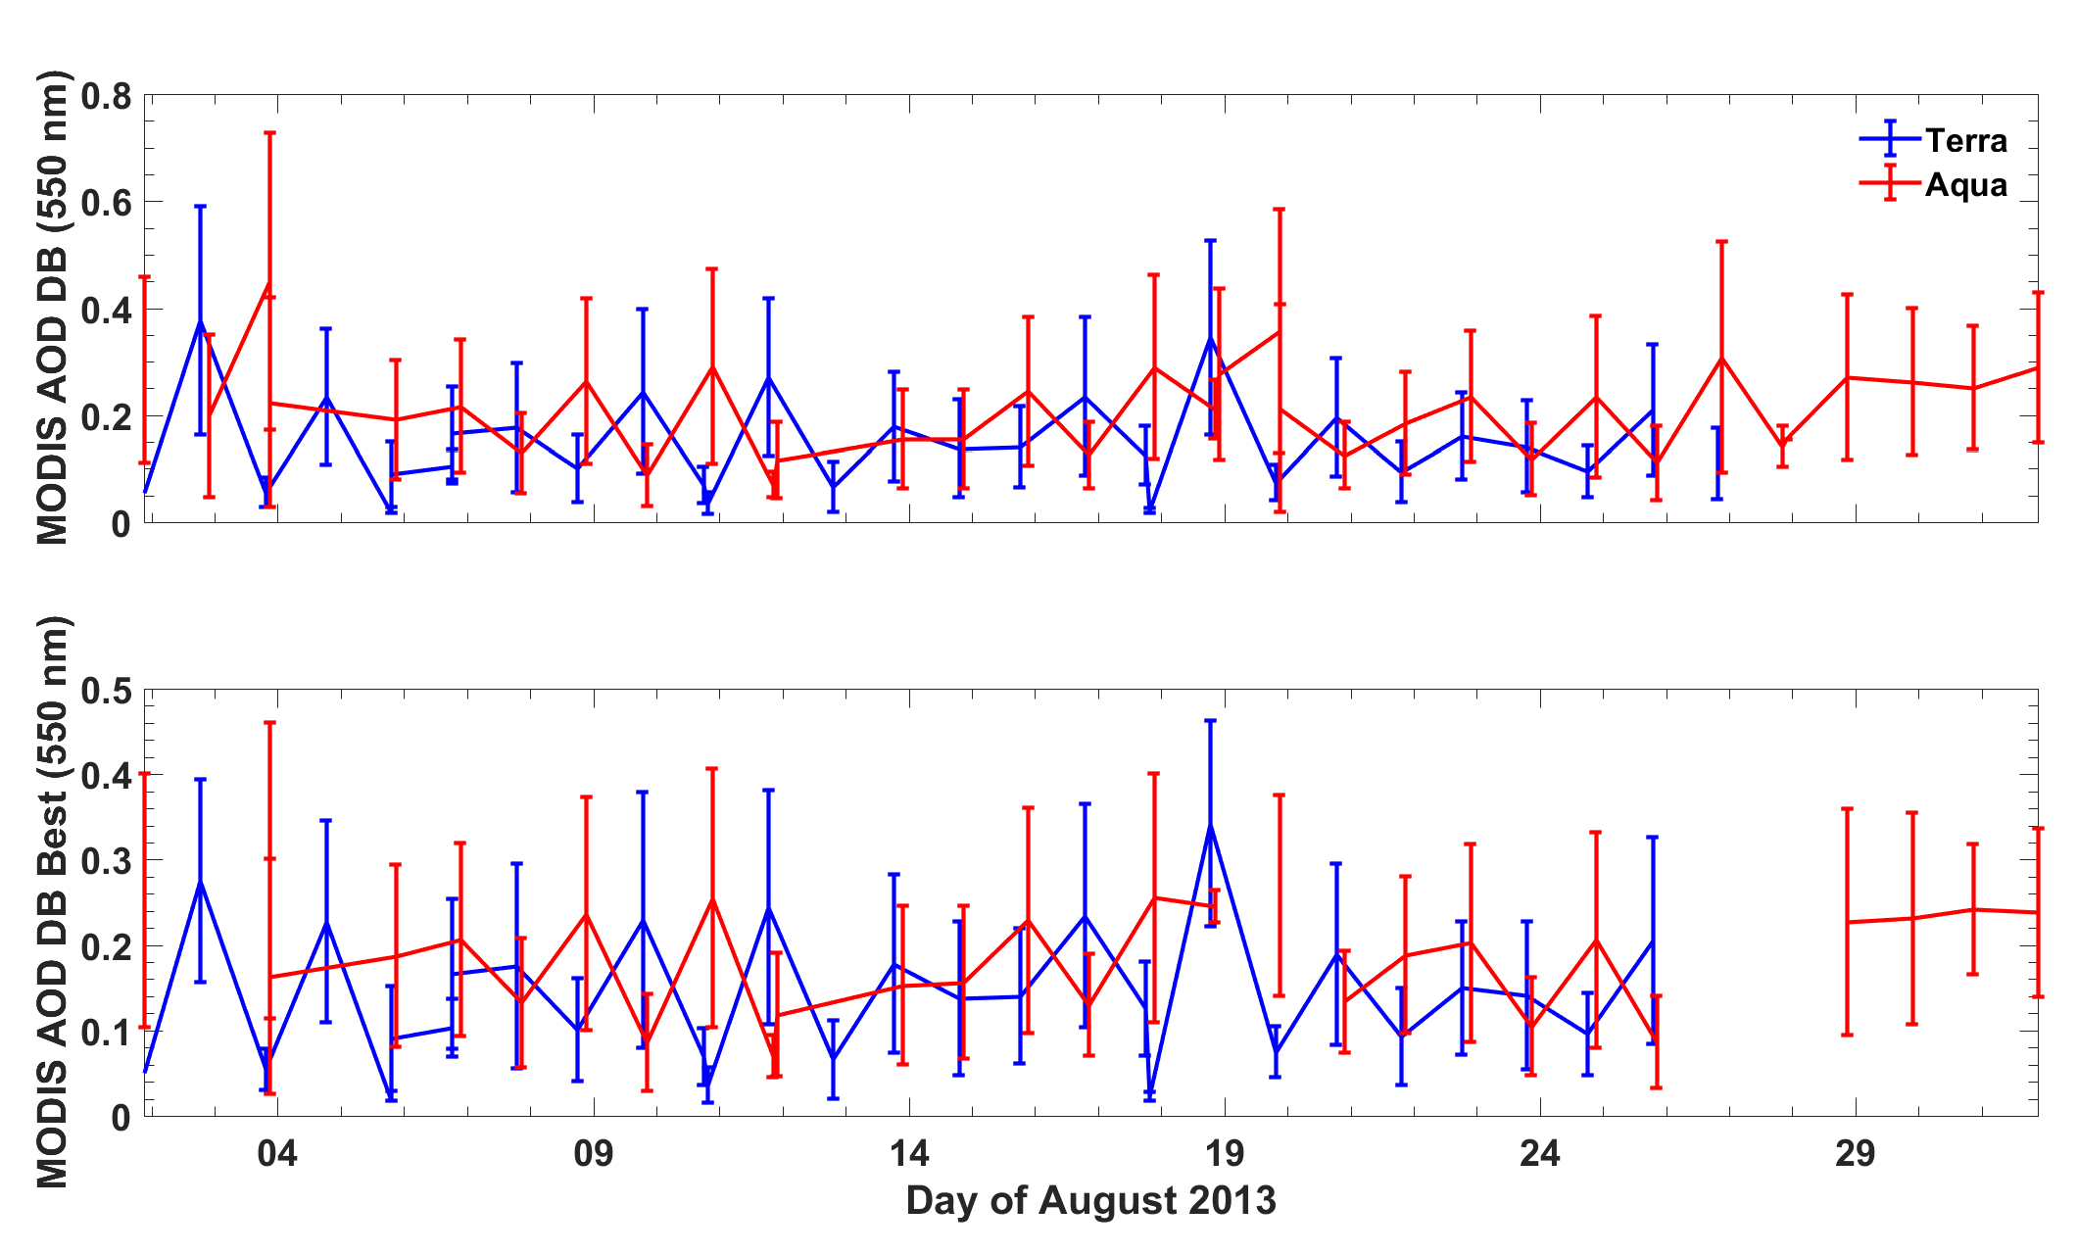
Aqua MODIS DB AOD C6.1 California and Nevada, August, 2013
Notes:
The presence of wildfire smoke impacts the correlation between surface and satellite measurements of AOD in this region. AOD from AERONET and MODIS showed low correlation for days with typical ambient pollutant concentrations (e.g. R²~0.46 for Terra-MODIS over Las Vegas, NV in August 2013). During fire periods the correlation between instruments showed an improvement (e.g. R²~0.87 for Terra-MODIS over Reno, NV in August 2012 and R²~0.82 for Aqua-MODIS over Fresno, CA in August 2013) because of the increase in columnar aerosol concentration.

Slide 25
Aqua MODIS DB AOD C6.1 California and Nevada, August, 2013
Notes:
The presence of wildfire smoke impacts the correlation between surface and satellite measurements of AOD in this region. AOD from AERONET and MODIS showed low correlation for days with typical ambient pollutant concentrations (e.g. R²~0.46 for Terra-MODIS over Las Vegas, NV in August 2013). During fire periods the correlation between instruments showed an improvement (e.g. R²~0.87 for Terra-MODIS over Reno, NV in August 2012 and R²~0.82 for Aqua-MODIS over Fresno, CA in August 2013) because of the increase in columnar aerosol concentration.

Slide 26
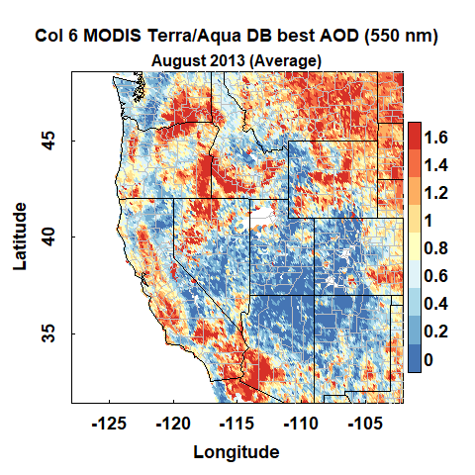
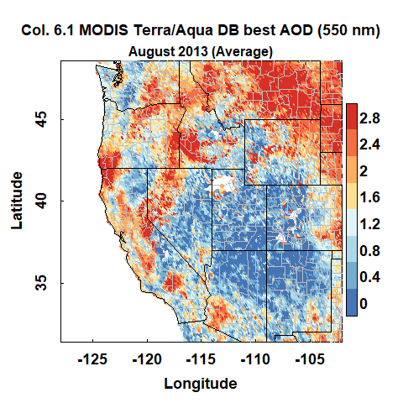
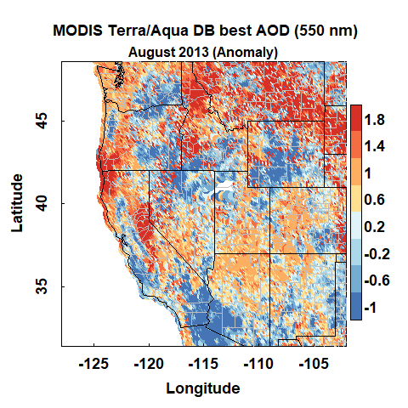
Terra-Aqua MODIS DB - Best Western U.S., August, 2013
Collection 6
Collection 6.1
Col. 6.1- Col. 6
Notes:
The presence of wildfire smoke impacts the correlation between surface and satellite measurements of AOD in this region. AOD from AERONET and MODIS showed low correlation for days with typical ambient pollutant concentrations (e.g. R²~0.46 for Terra-MODIS over Las Vegas, NV in August 2013). During fire periods the correlation between instruments showed an improvement (e.g. R²~0.87 for Terra-MODIS over Reno, NV in August 2012 and R²~0.82 for Aqua-MODIS over Fresno, CA in August 2013) because of the increase in columnar aerosol concentration.

Slide 27
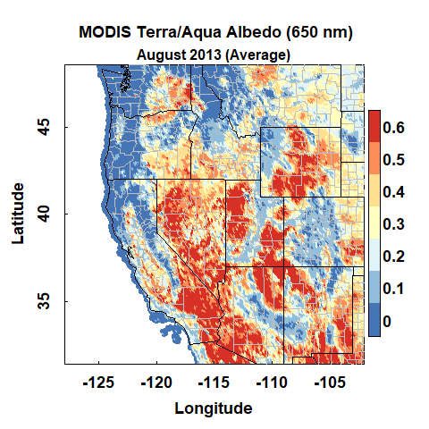
Terra-Aqua MODIS DB - Best Western U.S., August, 2013
Albedo
Collection 6.1
Col. 6.1- Col. 6
Notes:
The presence of wildfire smoke impacts the correlation between surface and satellite measurements of AOD in this region. AOD from AERONET and MODIS showed low correlation for days with typical ambient pollutant concentrations (e.g. R²~0.46 for Terra-MODIS over Las Vegas, NV in August 2013). During fire periods the correlation between instruments showed an improvement (e.g. R²~0.87 for Terra-MODIS over Reno, NV in August 2012 and R²~0.82 for Aqua-MODIS over Fresno, CA in August 2013) because of the increase in columnar aerosol concentration.

Slide 28
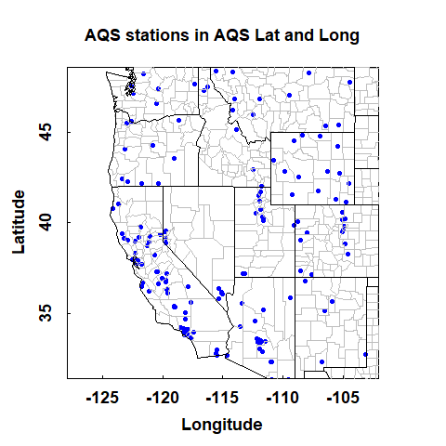
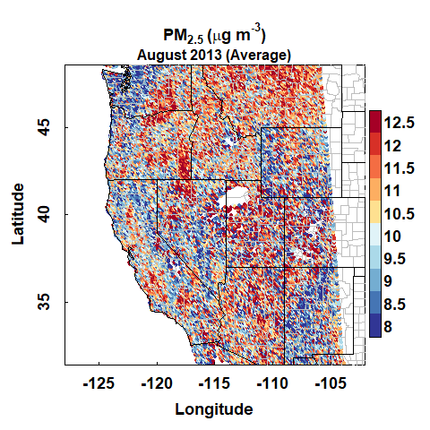
PM_{2.5} derived from Terra-Aqua MODIS AOD DB - Best Western U.S., August, 2013
Monitors
Collection 6
Model / no LUR
Notes:
The presence of wildfire smoke impacts the correlation between surface and satellite measurements of AOD in this region. AOD from AERONET and MODIS showed low correlation for days with typical ambient pollutant concentrations (e.g. R²~0.46 for Terra-MODIS over Las Vegas, NV in August 2013). During fire periods the correlation between instruments showed an improvement (e.g. R²~0.87 for Terra-MODIS over Reno, NV in August 2012 and R²~0.82 for Aqua-MODIS over Fresno, CA in August 2013) because of the increase in columnar aerosol concentration.

Slide 29
Conclusions
Summary
MODIS AOD C6 have uncertainty in the western U.S. due to complex terrain, bright surface, heterogeneous aerosol profiles
The combined DB-DT MODIS product from C6 performs the best for the western U.S. in comparison with AERONET AOD
MODIS C6 is not able to capture fire plumes because they are filtered as clouds
MODIS C6.1 shows improvements in surface reflectance parametrizations and fire plume detection
Future Directions
Data fusion models in the western U.S. should use physical parameters as covariates (e.g. emissions information, surface reflectance, wildfire emissions, PBLH) to account for the complexity of the features of the region
Implement LUR in the model

Slide 30
Acknowledgments
Yellowstone/UCAR
We would like to acknowledge high-performance computing support from Yellowstone (ark:/85065/d7wd3xhc) provided by NCAR's Computational and Information Systems Laboratory, sponsored by the National Science Foundation.
Financial Support
NASA Earth and Science Student Fellowship (NNX16AN94H)
Nevada Space Grant Consortium – Research Infrastructure
NASA HAQAST (NNX16AQ28G, PI: Liu)
NASA DB Mission
N. Christina Hsu, PhD
Andrew M. Sayer, PhD

Slide 31
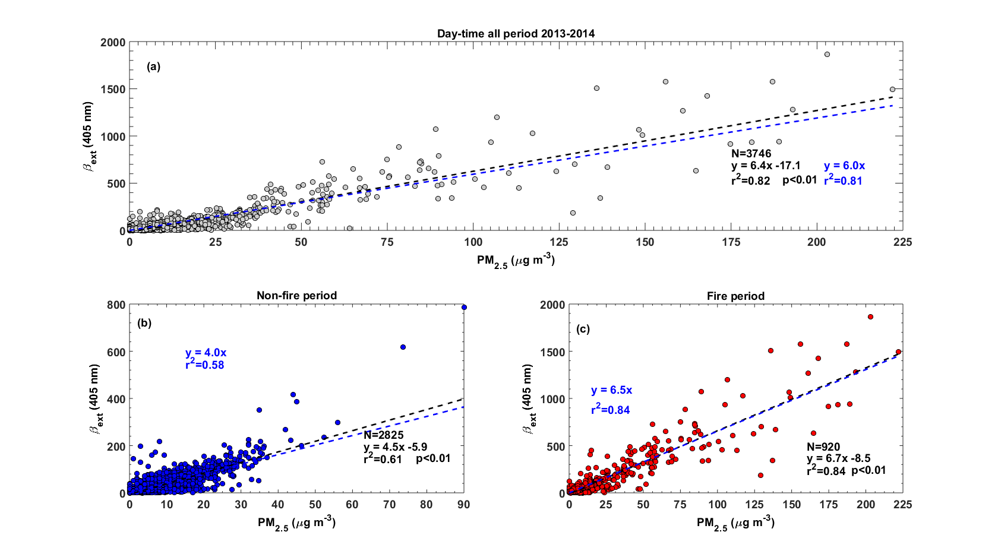
β_{ext} model from surface PM_{2.5}
Notes:
Health effects of ambient air quality
Georgia Birth Cohort
Geo-coded patient information
Atlanta - epidemiologic results using central monitor data suggest associations of acute health effects and mobile source emissions
Spatially resolved health study needs spatial air quality metrics

Slide 32
β_{ext} model from surface PM_{2.5}
Non-fire periods:
$$β_{ext}={\left(−{0.000408{ PM}_{2.5}}^{2}+0.07919 {PM}_{2.5}+1.6358\right)}^{1/{0.264033}}$$
Fire periods:
$$β_{ext}={\left(−{0.000205{ PM}_{2.5}}^{2}+0.06543 {PM}_{2.5}+2.1819\right)}^{1/{0.283988}}$$
Notes:
Health effects of ambient air quality
Georgia Birth Cohort
Geo-coded patient information
Atlanta - epidemiologic results using central monitor data suggest associations of acute health effects and mobile source emissions
Spatially resolved health study needs spatial air quality metrics

Slide 33
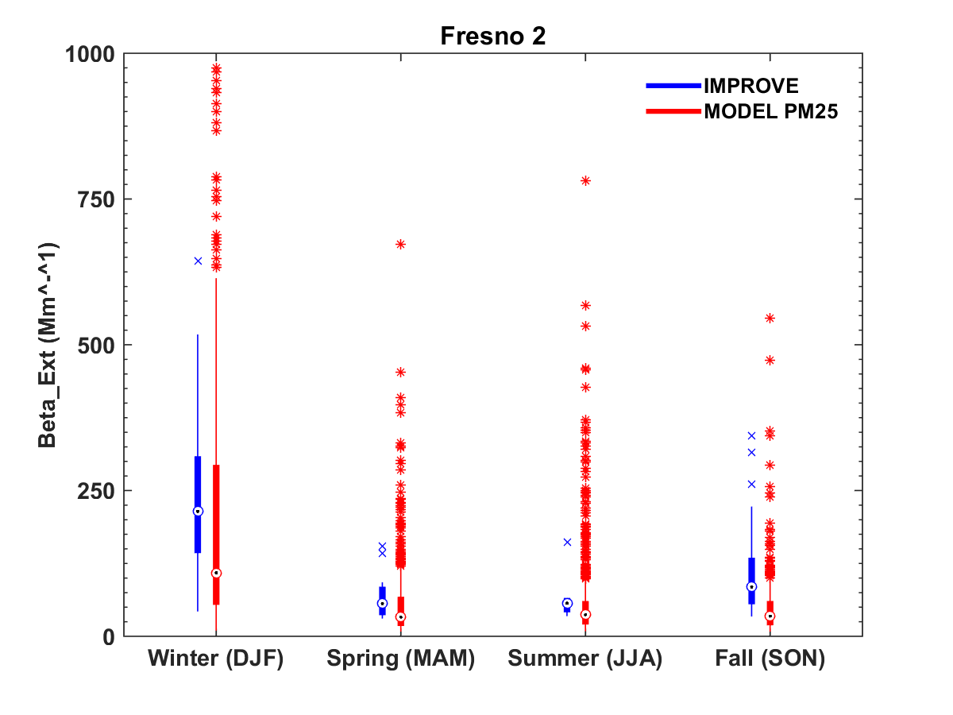
β_{ext} model from surface PM_{2.5}
Notes:
Health effects of ambient air quality
Georgia Birth Cohort
Geo-coded patient information
Atlanta - epidemiologic results using central monitor data suggest associations of acute health effects and mobile source emissions
Spatially resolved health study needs spatial air quality metrics

Slide 34
Potential hygroscopic growth
${f\left(RH\right)}_{PBLH}=\frac{\sum_{i=1}^{N_{PBLH}}{{f\left(RH\right)}_{i}}}{N_{PBLH}}$
Pitchford et al., 2012 (Research in progress)

Slide 35
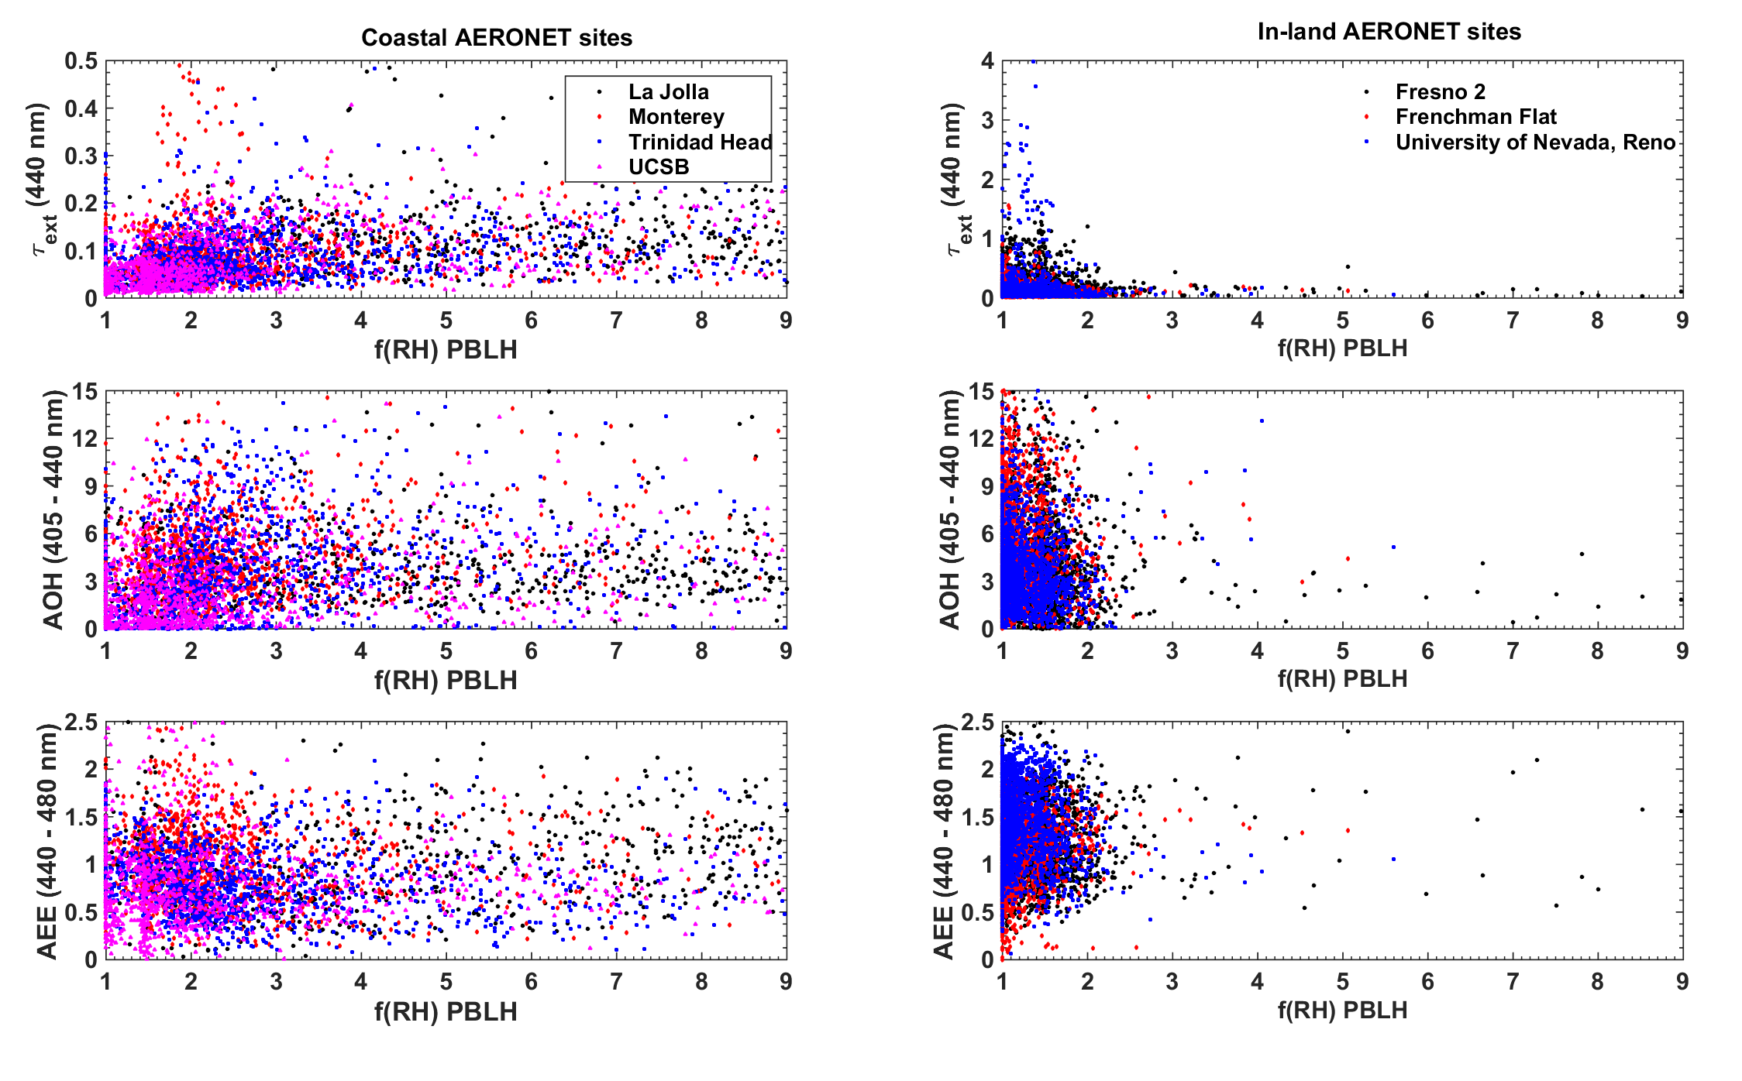
Potential hygroscopic growth
r²~0.17
r²<0.01

