Slide 1
Tracking Continental Scale Background Ozone with CMAQ
Peng Liu¹, Christian Hogrefe², Rohit Mathur², Uarporn Nopmongcol³, Shawn Roselle², Tanya Spero²
¹ NRC Associate at US EPA, RTP, NC 27711, USA
² National Exposure Research Laboratory, U.S. Environmental Protection Agency, Research Triangle Park, NC, 27711, USA
³ Ramboll Environ, 773 San Marin Drive, Suite 2115, Novato, CA 94945, USA
CMAS Conference
Chapel Hill, NC, October 23-25, 3017
The views expressed in this presentation are those of the authors and do not necessarily represent the views or policies of the U.S. Environmental Protection Agency.
Notes:
Focus: compare H-CMAQ with other 3 global CTMs

Slide 2
Motivation & Goals
As the National Ambient Air Quality Standards (NAAQS) for ozone has become more stringent, there has been growing attention on characterizing the contributions and the uncertainties in ozone from outside the US to the ozone concentrations within the US.
The Air Quality Model Evaluation International Initiative Phase III (AQMEII3) provides an opportunity to investigate this issue through the combined efforts of multiple research groups from the US and Europe.
Challenges in understanding the contribution and uncertainties estimated by multi-model ensemble:
(1) only limited efforts have been made to shed light on the reasons behind the model differences in O₃ prediction, especially at the process level, though significant discrepancy has been noticed (Campbell et al. 2015; Solazzo et al. 2017).
(2) in CTMs, a variety of chemical and physical processes are entangled and interact with each other.
The goal of this study is to investigate how the estimate of the impact of lateral boundary ozone on surface ozone may be affected by physical vs chemical processes in CTMs.

Slide 3
Methods
ZeroEmis Case --CMAQ
(zero anthropogenic emissions in North America ; 2010 meteorology)
Impact by Chemical Processes
(using reactive tracers)
How does the influence of boundary ozone depend on the chemical environment?
BASE case --CMAQ
(2010 emissions; 2010 meteorology)
How does the influence of boundary ozone depend on the representations of physical processes?
Impact by Physical Processes
(using inert tracers)
BASE case --CAMx *
(2010 emissions; 2010 meteorology)
*The AQMEII3 CAMx simulations included both inert and reactive tracers (Nopmongcol et al., 2017) but only the inert tracers were included in the present study to focus on the impact of physical processes.
Notes:
May want to repeat during the presentation that Nopmongcol et al. also used chemically reactive tracers in their AQMEII3 manuscript but that those CAMx reactive tracer results are not included in this analysis

Slide 4
Methods---- Chemically Inert and Reactive Tracers
All AQMEII3 participants employed chemically inert tracers to track the inflow of ozone from the lateral boundaries at different altitude ranges:
O₃ boundary conditions below 750 mb
O₃ boundary conditions between 750 mb and 250 mb
O₃ boundary conditions above 250 mb
The inert tracers undergo advection, diffusion, cloud mixing/transport, scavenging, and deposition, with no emissions or chemical formation/destruction occurring within the modeling domain.
Chemically reactive tracer of ozone were also implemented in CMAQ (run by US. EPA, thanks to Bill Hutzell), with no separation in the altitude ranges.
Reactions included for the reactive tracer: ozone photolysis, recycling via NO₂, via HO₂ radical, ozone loss by reactions with other trace gases.

Slide 5
Methods---- Model Description
 | CMAQ502 | CAMx6.2
Institute | U.S. EPA | RAMBOLL Environ (U.S.)
Meteorology | NCEP/WRF
Horizontal Resolution | 12km
Chemical Boundary Conditions | ECMWF’s C-IFS
Anthropogenic Emissions | same
Dry Deposition for Ozone and Tracers | Pleim and Ran (2011) | Zhang et al. (2003)
Wet Deposition for Inert Tracers | YES | NO
Sub-Grid Cloud Mixing in CTMs | YES | NO

Slide 6
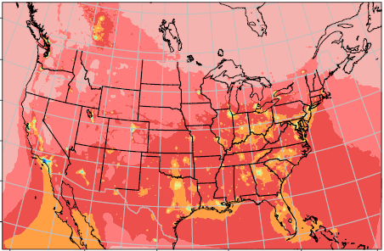
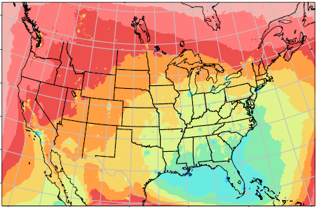
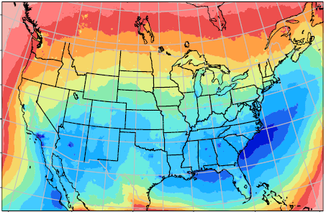
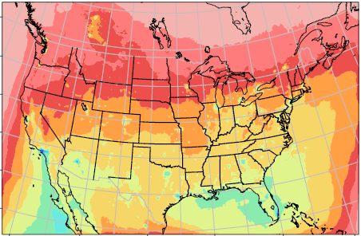
Results—Influence of anthropogenic emissions on boundary ozone
BASE case:
(CMAQ reactive tracer minus inert tracer) at surface when DM8A O₃ occurs*
WINTER SPRING SUMMER FALL
O₃ chemistry is necessary for the purpose of source attribution for lateral boundary ozone.
The largest difference occurs in summer when photochemistry is most active.
In winter, the difference is uniform across most of the U.S., except for the local areas with high anthropogenic emissions.
These results are consistent with previous CAMx studies for base case emission conditions (Baker et al. 2015; Nopmongcol et al. 2017)
* average across all the DM8As in a season

Slide 7
Results—Influence of anthropogenic emissions on boundary ozone
BASE case:
vertical profiles averaged over the northeastern U.S. at different local times
WINTER SUMMER
550 mbar
750 mbar
900 mbar
The relative contributions of boundary ozone from different altitude ranges do not change significantly for reactive and inert tracers.

Slide 8
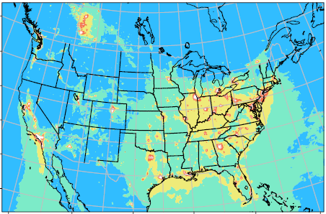
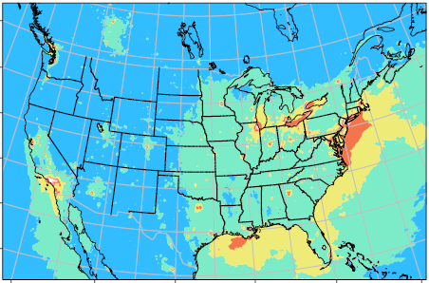
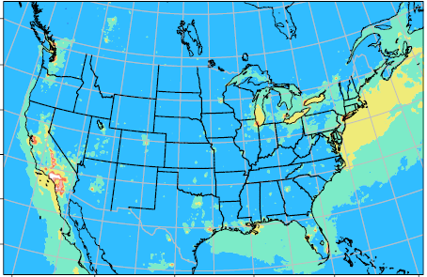
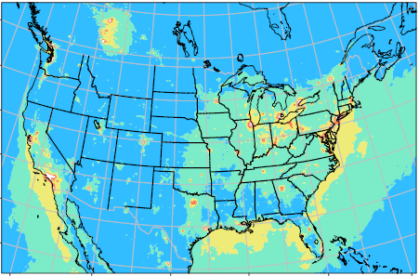
Results—Influence of anthropogenic emissions on boundary ozone
ZeroEmis minus BASE:
reactive tracer at surface when DM8A ozone occurs
WINTER SPRING SUMMER FALL
Though O₃ chemistry is necessary to estimate lateral boundary ozone contribution, the anthropogenic emissions only play limited role in this chemistry, especially summer.
Notes:
Model’s ability to simulate the spatial gradient of O3 concentrations

Slide 9
Results—Influence of anthropogenic emissions on boundary ozone
ZeroEmis minus BASE:
vertical profiles averaged over the northeastern U.S. at different local standard time
WINTER SUMMER
550 mbar
750 mbar
900 mbar
Notes:
Model’s ability to simulate the spatial gradient of O3 concentrations

Slide 10
Results—Influence of physical processes on boundary ozone
CAMx minus CMAQ:
inert tracer at surface when DM8A ozone occurs
WINTER SPRING SUMMER FALL
Consistently higher inert tracer at surface is seen in CAMx.
The influence of physical processes on boundary ozone is comparable with that of anthropogenic emissions, or even larger, such as during summer time.

Slide 11
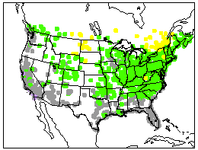
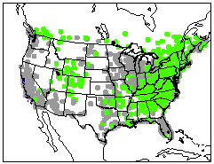
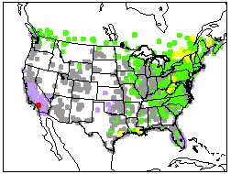
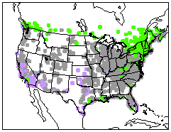
Results—Influence of physical processes on boundary ozone
CAMx minus CMAQ:
WINTER SPRING SUMMER FALL
Inert Tracer
DM8A O₃
For winter and spring, the spatial distributions of difference in O₃ and difference in inert tracer are highly correlated, suggesting the important role that physical processes play in estimating boundary ozone impact.
For summer, though the largest difference in inert tracers shows up, the largest difference in reactive tracers may not necessarily occur in summer, because the active photochemistry of ozone may decrease the magnitude of the difference. This also explains relatively smaller difference in DM8A O₃ .

Slide 12
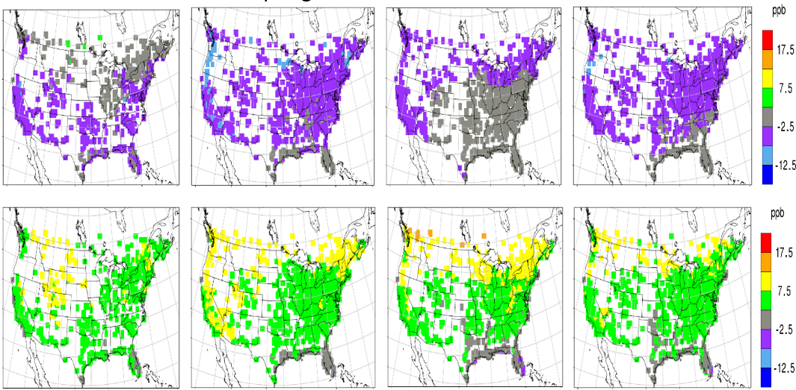
Results—Influence of physical processes on boundary ozone
CAMx minus CMAQ:
WINTER SPRING SUMMER FALL
Inert Tracer at Surface
coming from
surface ~750 mbar
Inert Tracer at Surface
coming from
250mbar ~750 mbar
Consistent higher inert tracer in CAMx is due to stronger mixing down from the free troposphere to PBL.
Similar results are expected for reactive tracers due to the model discrepancy in vertical mixing.

Slide 13
Conclusions & Future Work
By comparing the chemically reactive and inert tracers for lateral boundary ozone, it is found that though O₃ chemistry is necessary to estimate lateral boundary ozone contributions, the anthropogenic emissions only play limited role in this chemistry. For example, in summer, the difference between inert and reactive tracers can be as large as 14~16 ppb, with the impact from anthropogenic emissions on reactive tracers only about 2ppb.Thus, the primary loss mechanism affecting the reactive tracer boundary contribution estimates likely is photolysis.
By comparing CAMx and CMAQ, we demonstrate the impact of representing physical processes on estimating boundary ozone contribution. The relative importance of physical and chemical processes in estimating boundary ozone contribution varies with season.
The current work highlights the importance and necessity to continue exploring the multi-model differences at process level, in order to improve the quantitative estimate of the impact of large scale background ozone using a multi-model ensemble.

Slide 14
References
Baker, K. R., Emery, C., Dolwick, P., and Yarwood, G.: Photochemical grid model estimates of lateral boundary contributions to ozone and particulate matter across the continental United States, Atmos. Environ., 123, 49–62, 2015.
Nopmongcol, U., Liu, Z., Stoeckenius, T., and Yarwood, G.: Modeling intercontinental transport of ozone in North America with CAMx for the Air Quality Model Evaluation International Initiative (AQMEII) Phase 3, Atmos. Chem. Phys., 17, 9931-9943, https://doi.org/10.5194/acp-17-9931-2017, 2017.
Campbell, P., Zhang, Y., Yahya, K., Wang, K., Hogrefe, C., Pouliot, G., Knote, C., Hodzic, A., San Jose, R., Pérez, J. L., Jiménez-Guerrero, P., Baró, R., and Makar, P.: A multi-model assessment for the 2006 and 2010 simulations under the Air Quality Model Evaluation International Initiative (AQMEII) phase 2 over North America: Part I. Indicators of the sensitivity of O₃ and PM_{2.5} formation regimes. Atmos. Environ., 115, 569-586, 2015.
Solazzo, E., Bianconi, R., Hogrefe, C., Curci, G., Tuccella, P., Alyuz, U., Balzarini, A., Baró, R., Bellasio, R., Bieserk J., Brandt, J., Christensen, J. H., Colette, A., Francis, X. V., Garcia-Vivanco, M., Jiménez-Guerrero, P., Im, U., Manders, A., Nopmongcol, U., Kitwiroon, N., Pirovano, G., Pozzoli, L., Prank, M., Sokhi, R. S., Unal, A., Yarwood, G., and Galmarini, S.: Evaluation and error apportionment of an ensemble of atmospheric chemistry transport modeling systems: multivariable temporal and spatial breakdown, Atmos. Chem. Phys., 17, 3001–3054, doi: 10.5194/acp-17-3001-2017, 2017.
Brandt, J., J. D. Silver, L. M. Frohn, C. Geels, A. Gross, A. B. Hansen, K. M. Hansen, G. B. Hedegaard, C. A. Skjøth, H. Villadsen, A. Zare, and J. H. Christensen: An integrated model study for Europe and North America using the Danish Eulerian Hemispheric Model with focus on intercontinental transport. Atmospheric Environment 53, 156-176, 2012.
Pleim, J., Ran, L.: Surface Flux Modeling for Air Quality Applications. Atmosphere 2, 271-302, 2011.
Zhang, L., J. R. Brook, and R. Vet. :A revised parameterization for gaseous dry deposition in air-quality models. Atmos. Chem. Phys., 3, 2067–2082, 2003.
Simpson, D., Fagerli, H., Jonson, J.E., Tsyro, S., Wind, P., Tuovinen, J.-P. : Transboundary Acidification, Eutrophication and Ground Level Ozone in Europe, PART I, Unified EMEP Model Description, p. 104, 2003.
Notes:
Do we expect the results be different if make O3 tracers involved in chemistry? What kind of modification needed to make O3 tracer active?

Slide 15
Reactions for reactive tracer
! assume that all O3P recycles back to ozone
!<BOZ_R8> O3_EDGES = # 1.0/<O3_O3P_IUPAC04>;
<BOZ_R9> O3_EDGES = O1D_EDGES # 1.0/<O3_O1D_IUPAC04>;
! O1D recycles back or forms OH
<BOZ_R10> O1D_EDGES + M = O3_EDGES + M # 2.1E-11 @ -102.;
<BOZ_R11> O1D_EDGES + H2O = H2O # 2.2E-10;
<BOZ_R3> O3_EDGES + NO = NO2_EDGES + NO # 1.0*K<R3>;
! recycling via NO2
<BOZ_R7> NO2 + O3_EDGES = NO2 # 1.0*K<R7>;
<BOZ_R49> NO3 + O3_EDGES = NO2_EDGES + NO3 # 1.0*K<R49>;
<BOZ_R1> NO2_EDGES = O3_EDGES # 1.0/<NO2_SAPRC99>;
<BOZ_R28> NO2_EDGES + OH = OH + HNO3_EDGES # 1.0*K<R28>;
<BOZ_N31> NO2_EDGES + HO2 = HO2 + PNA_EDGES # 1.0*K<R31>;
! second order recycling of NO2
<BOZ_R52> HNO3_EDGES = NO2_EDGES # 1.0/<HNO3_IUPAC04>;
<BOZ_R29> OH + HNO3_EDGES = OH # 1.0*K<R29>;
<BOZ_R32> PNA_EDGES = NO2_EDGES # 1.0*K<R32>;
<BOZ_R33> OH + PNA_EDGES = NO2_EDGES + OH # 1.0*K<R33>;
<BOZ_R51> PNA_EDGES = 0.610*NO2_EDGES # 1.0/<HO2NO2_IUPAC04>;
! reaction accounting for recycling via HO2 radical
<BOZ_R12> O3_EDGES + OH = OH + HO2_EDGES # 1.0*K<R12>;
! bc ozone losses; terminations neglect photolysis of acids and
! peroxides
<BOZ_R34> HO2_EDGES + HO2_EDGES = # 1.0*K<R34>;
<BOZ_R35> HO2_EDGES + HO2_EDGES + H2O = %3 # 3.22E-34 @ -2800 &
2.38E-54 @ -3200;
<BOZ_R30a> NO + HO2_EDGES = NO # 1.0*K<R30>;
<BOZ_R31> HO2_EDGES + NO2 = NO2 # 1.0*K<R31>;
<BOZ_R43> OH + HO2_EDGES = OH # 1.0*K<R43>;
<BOZ_R56> XO2 + HO2_EDGES = XO2 # 1.0*K<R56>;
<BOZ_R57> XO2N + HO2_EDGES = XO2N # 1.0*K<R57>;
<BOZ_R68> MEO2 + HO2_EDGES = MEO2 # 1.0*K<R68>;
! bc O3 production
<BOZ_R91> C2O3 + HO2_EDGES = C2O3 + 0.150*O3 # 1.0*K<R91>;
<BOZ_R107> CXO3 + HO2_EDGES = CXO3 + 0.150*O3 # 1.0*K<R107>;
! the remaining simple loss reactions for bc tracer
<BOZ_R13> O3_EDGES + HO2 = HO2 # 1.0*K<R13>;
<BOZ_R118> O3_EDGES + OLE = OLE # 1.0*K<R118>;
<BOZ_R122> O3_EDGES + ETH = ETH # 1.0*K<R122>;
<BOZ_R126> IOLE + O3_EDGES = IOLE # 1.0*K<R126>;
<BOZ_R138> CRNO + O3_EDGES = CRNO # 1.0*K<R138>;
<BOZ_R145> OPEN + O3_EDGES = OPEN # 1.0*K<R145>;
<BOZ_R159> O3_EDGES + ISOP = ISOP # 1.0*K<R159>;
<BOZ_R162> O3_EDGES + ISPD = ISPD # 1.0*K<R162>;
<BOZ_R167> TERP + O3_EDGES = TERP # 1.0*K<R167>;
<BOZ_CL3> CL + O3_EDGES = CL # 1.0*K<CL3>;

Slide 16
WRF/CMAQ and WRF/CAMx
DM8A Ozone of 2010: Rural vs. Urban site ---- Cont’d
DM8A O3 (total tracer) | Observation |  | WRF/CMAQ |  | WRF/CAMx
 | Rural | Urban | Rural | Urban | Rural | Urban
winter | 37.5 | 31.8 | 33.5 (29.8) | 30.2 (30.1) | 37.4 (33.7) | 33.9 (33.6)
spring | 48.6 | 45.1 | 49.1 (40.4) | 47.0 (41.0) | 51.8 (42.7) | 49.4 (42.7)
summer | 46.7 | 44.9 | 50.2 (35.3) | 49.2 (35.7) | 52.3 (40.1) | 51.4 (39.6)
fall | 40.9 | 37.2 | 42.1 (32.5) | 39.4 (32.9) | 42.1 (33.8) | 39.5 (33.9)

