Slide 1
Regional Air Quality Modeling of Wildfires for Health Assessments over the Continental United States
Cesunica E. Ivey, Cong Liu, Yang Liu, Howard Chang, Matt Strickland, and Heather A. Holmes
AAAR Meeting, Raleigh, NC
Thursday, 19 October 2017
10:00 AM, Room 306B
Source: http://www.latimes.com/local/la-me-rim-fire-20140808-story.html

Slide 2
Background
NASA’s Health and Air Quality Applied Sciences Team
Investigate links between wildfire smoke exposure and asthma in Colorado.
State and city partners (highlighted
in green) of the CDC Tracking network.
Associations between same day PM2.5 levels during the 2012 Colorado wildfires and all-ages ED visits for asthma.
Notes:
What the HAQAST project is about

Slide 3
Objective
Estimate daily wildfire smoke exposure metrics for a multi-year health study using a chemical transport model (CMAQ).
State and city partners (highlighted
in green) of the CDC Tracking network.
Associations between same day PM2.5 levels during the 2012 Colorado wildfires and all-ages ED visits for asthma.
Notes:
What the HAQAST project is about

Slide 4
Goal
Understand the model response to wildfire emissions inventories.
State and city partners (highlighted
in green) of the CDC Tracking network.
Associations between same day PM2.5 levels during the 2012 Colorado wildfires and all-ages ED visits for asthma.
Notes:
What the HAQAST project is about

Slide 5
Wildfire Modeling
Study period: 2013 and 2014
Modeling domain: 12 km horizontal resolution and 34 vertical terrain-following layers
Chemistry and transport: CMAQ Model, v5.2 beta
Emissions:
Fire Inventory of NCAR, v1.5
National Emissions Inventory 2011 (wildfires omitted)
Obtain annual FINN emissions and integrate with the WRAP plume profile
Replace NFEI fire emissions with FINN emissions
Simulate episode with both emissions using CMAQ
Notes:
Wildfire smoke and human health

Slide 6
Fire Inventory of NCAR
Available in three versions:
GEOS-CHEM* (Harvard)
MOZART-4 (NCAR)
SAPRC99*
Current study:
Carbon Bond V (CB05) mechanism
Combination of GEOS and SAPRC emissions
Emission Factors by Vegetation Type
Wiedinmyer et al., Geoscientific Model Development, 2011
Notes:
General info
Mapping: https://github.com/barronh/geos2cmaq/blob/master/mapping/cb05cl_ae6_aq.csv

Slide 7
NEI vs. FINN
National Emissions Inventory
FINN
Estimated using BlueSky (2011) modeling framework and local activity data
Available every three years (2002,2005,2008,2011,etc.)
Update available for wildfires in between years through EPA
Developed by state managers and compiled by EPA
Emission factors are derived from MODIS land cover product
Available at daily frequency
Active fires are detected using MODIS thermal and fire products
Developed at National Center for Atmospheric Research (NCAR)
Notes:
MODIS thermal anomalies product
MODIS rapid response, MODIS data processing system

Slide 8
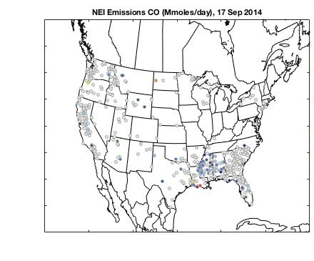
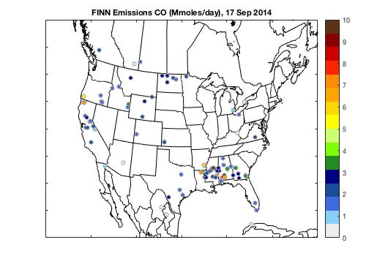
NEI vs. FINN
Carbon Monoxide Emissions (Mmoles/day)
17 Sep 2014
NEI
FINN
Notes:
Wildfire smoke and human health

Slide 9
NEI vs. FINN
Total Wildfire Emissions for Continental U.S.
PM2.5
CO
NOx
(Blue Sky)
Notes:
Bar charts of total emissions comparisons---write the code tomorrow

Slide 10
Colorado Evaluation
AQS Site 080310002
NAMS Hourly O₃
SLAMS Hourly PM_{2.5}
2105 Broadway, Denver, CO
Notes:
King fire overview----change the pictures

Slide 11
Colorado Evaluation
AQS Site 080310002, Denver, CO
Hourly Ozone: June 26 – July 9, 2014
Notes:
King fire overview----change the pictures

Slide 12
Colorado Evaluation
AQS Site 080310002, Denver, CO
Hourly PM_{2.5}: June 26 – July 9, 2014
Notes:
King fire overview----change the pictures

Slide 13
Yosemite Rim Fire
Started on 17 Aug 2013
Considered out on 4 Nov 2014
Over 250,000 acres burned
Largest fire in Sierra Nevada history
Hunter’s illegal campfire fire got out of control
2013 Rim Fire in Yosemite National Park
Source: http://www.latimes.com/local/la-me-rim-fire-20140808-story.html
Notes:
Rim fire overview

Slide 14
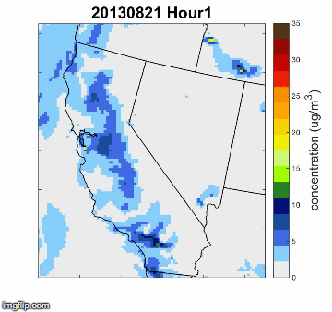
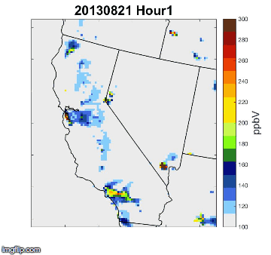
Yosemite Rim Fire
August 21, 2017: Hourly (UTC) PM2.5 and CO
PM2.5
CO
Notes:
Rim fire overview

Slide 15
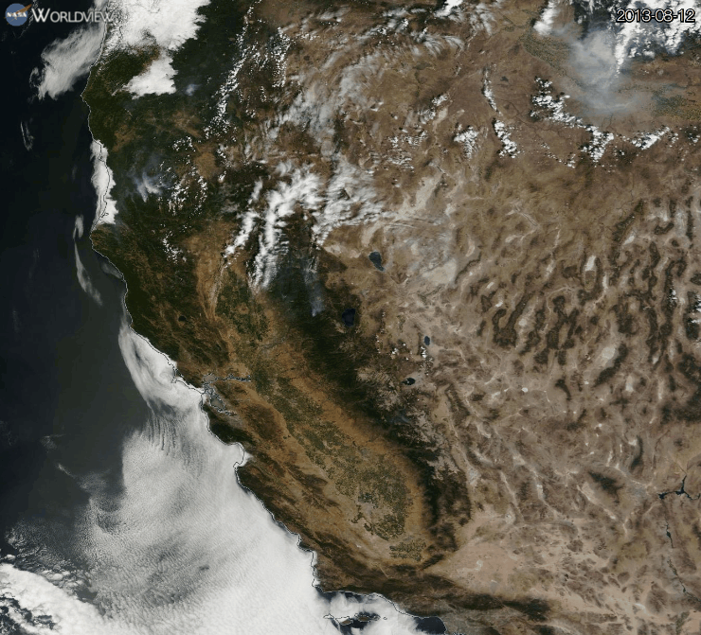
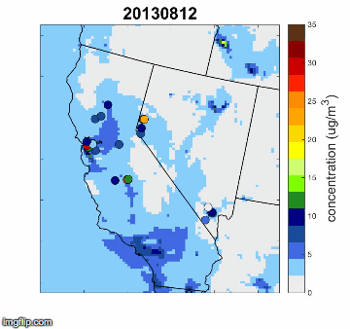
Yosemite Rim Fire
August 12-22, 2013: PM_{2.5}
CMAQ
MODIS True color
corr = 0.30, slope = 0.59, intercept = 19.5
Notes:
Rim fire overview

Slide 16
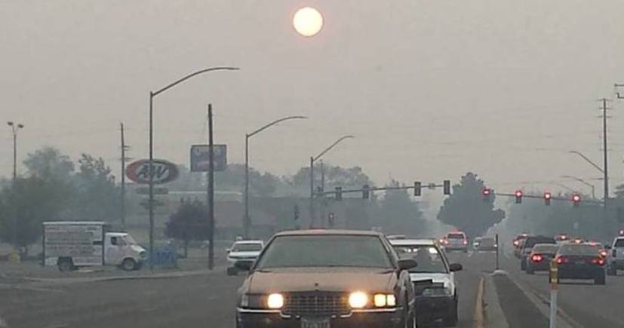
King Fire
Started on 13 Sep 2014
Ended 14 October 2014
97,000 acres burned
Started allegedly by an arsonist
2014 King Fire as seen from Lake Tahoe
Source: http://wildfiretoday.com/2014/09/14/california-king-fire-near-pollock-pines/
Left: King Fire haze impacting visibility and sunlight in Reno, midday.
Notes:
King fire overview

Slide 17
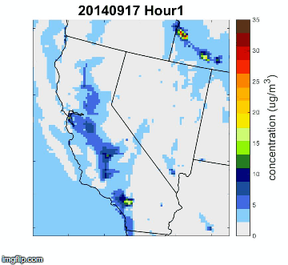
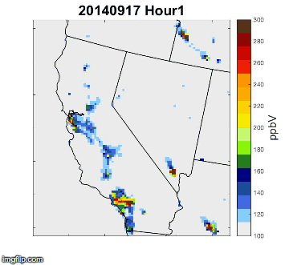
King Fire
September 17, 2014: Hourly (UTC) PM2.5 and CO
PM2.5
CO
Notes:
King fire overview----change the pictures

Slide 18
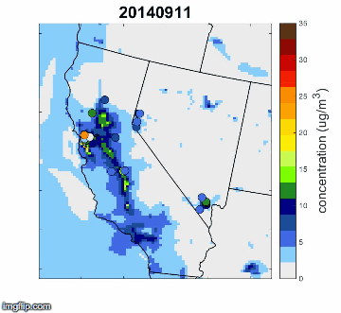
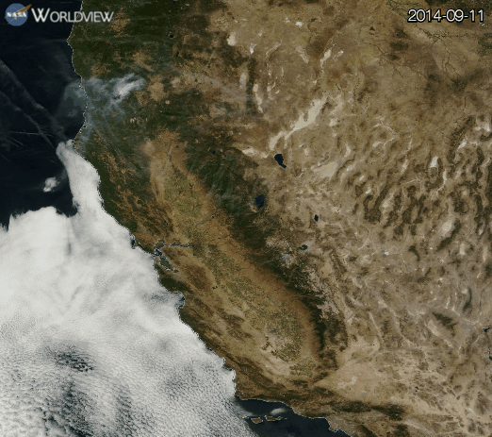
King Fire
September 11-21, 2014: PM_{2.5}
CMAQ
MODIS True color
Notes:
King fire overview----change the pictures

Slide 19
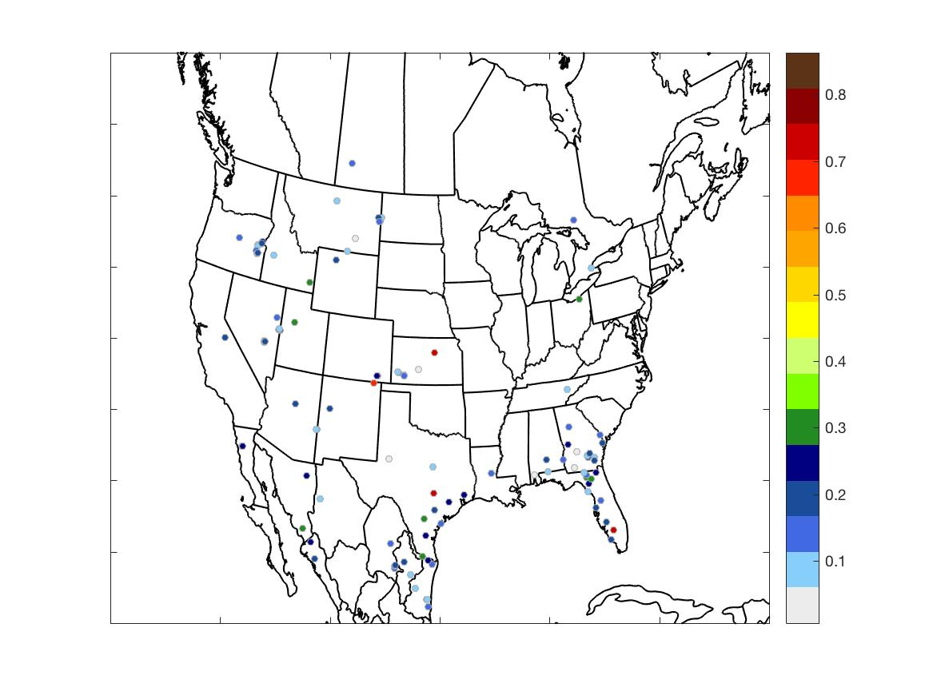
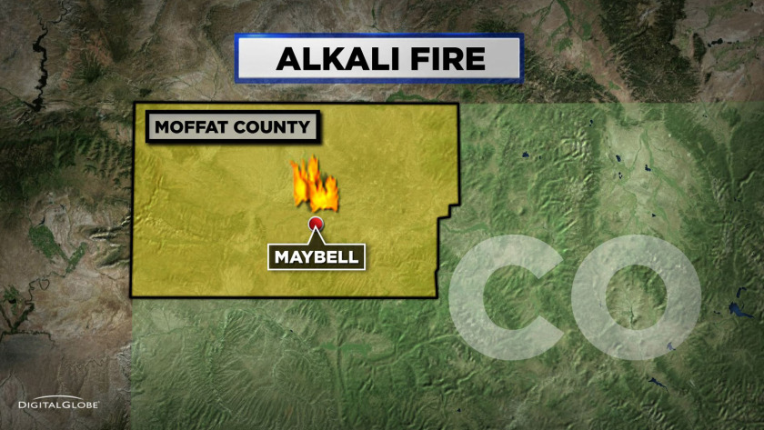
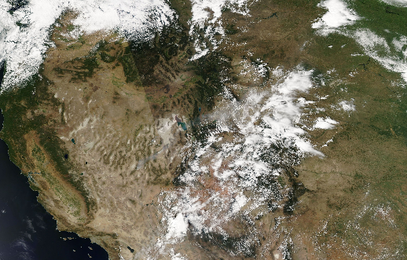
Challenges and Uncertainties
Known:
Plume direction subject to meteorological uncertainty
Fire detection is impacted by cloud cover
Alkali Fire (20,000 acres, July 24, 2014)
FINN Emissions: 24 July 2014 15:00 UTC
Notes:
What the HAQAST project is about

Slide 20
Challenges and Uncertainties
Current Study:
Capturing magnitude of emissions
Capturing aerosol formation in wildfire smoke
Alkali Fire (20,000 acres, July 24, 2014)
FINN Emissions: 24 July 2014 15:00 UTC
Notes:
What the HAQAST project is about

Slide 21
Summary
FINN emissions improve spatial and temporal distribution of fire emissions
Low bias in estimated emissions, however there are fewer false alarms
CMAQ-modeled PM, CO, ozone will be used as exposure surrogates in H-AQAST health studies (2011-2014)
Future: simulations will include FINN-v2 wildfire emissions; plume direction improvement
Notes:
summary

Slide 22
Backup Slides
Notes:
summary

Slide 23
Wildfire Modeling
CMAQv5.2 beta
Compiled with mvapich2, pnetcdf,
Seasonal runs with 10-day spinup
16-cores per season (1 season run with 12 cores)
Timing: ## computational hrs per simulation day
Place holder
Notes:
Slide for CMAS

Slide 24
Monitor Locations
Fresno
CSN: 060190008 (may be decommissioned)
SLAMS: 060190011
Reno
CSN: 320310016
Notes:
summary

Slide 25
FINN Species Equivalents
GEOS-CB05 Equivalents
Source: https://github.com/barronh/geos2cmaq/blob/master/mapping/cb05cl_ae6_aq.csv
Notes:
summary

Slide 26
Fire Inventory of NCAR
WRAP Diurnal Profile
Daily to hourly emissions using diurnal consumption

