Slide 1
Burned Area Comparisons between Prescribed Burning Permits in Southeastern USA and two Satellite-derived Products
three
Ran Huang and Talat Odman
2017 CMAS Conference
Remote Sensing and Measurements
October 25, 2017
Notes:
Good morning！ I’m so glad today to give you the talk about pb burned area comparison between permit records and satellite-derived products in the southeast.

Slide 2
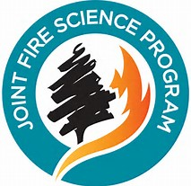
Acknowledgements
Frank Sorrels, Daniel Chan
John K. Fish
Mark Ruminski, Shobha Kondragunta, Xiaoyang Zhang
Yongtao Hu, Armistead Russell
James Randerson, Yang Chen
Notes:
First, I would like to thank those who provide us with the data and help us.

Slide 3
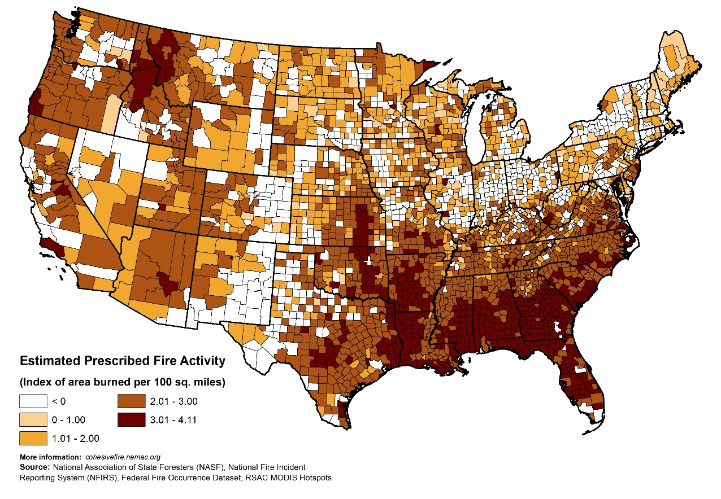
Prescribed Burning
Prescribed burning (PB) is a land management tool used to improve native vegetation and wildlife habitat, control insects and disease, and reduce wildfire risk in the USA.
According to US EPA 2014 NEI:
12.5% of PM_{2.5} emissions in the US are attributable to prescribed burning;
35% of PM_{2.5} emissions from prescribed burning originate from the southeastern US;
Prescribed burning is the largest source of PM_{2.5} (24%) in the southeastern US
Fire Emissions
(Tons)
Notes:
PB, is a land management tool..
According to 2014 NEI, under the fire section, 45% of fire emissions comes from PB. 12.5% …
From this figure we can see, Southeast US is the most active PB area in the US.

Slide 4
Questions we meet …
There is no unified record of prescribed burning information for the Southeast U.S.
There is no post-burn information
A permit is not an actual fire
Satellite-derived products are popular tools to estimate the burned area.
PB is usually small fires to keep them under control. Satellite-derived products may have large uncertainty when used in estimating burn area of those small fires. (Hoelzemann 2004; Randerson et al. 2012; Kukavskaya et al. 2013; Mouillot et al. 2014)
Notes:
The fire emission usually estimated based on burned area, permit records and satellite-derived products are the major data sources. However, there is no unified record of prescribed burning information for the Southeastern U.S. . Also, there is no post-burn information which means that a permit is not an actual fire. What about satellite-derived products? It’s really popular tools. But, there’s only a few products continues to be available publicly at this time to provide burned area information. PB is usually small fires to keep them under control. Some previous researchers show that satellite-derived products have large uncertainty when used in estimating burn area of those small fires

Slide 5
Our Analysis
GA and FL
Jan. – Apr. of 2015 and 2016
Permit records compared to satellite-derived burned areas
3 satellite products
BBEP
GFED4s
BAECV
Notes:
Our analysis focuses on GA and FL, because they have the most complete PB permit records.
.

Slide 6
Burned area
Permit Records
Satellite-derived Products
State | Period | Location Info
GA | 2015, 2016: Jan. – Apr. | Address
FL | 2015, 2016: Jan. – Apr. | Lat/Lon
BBEP | GFED4s | BAECV (2015)
Daily | Monthly | Annual
Daily | Monthly | Annual
Blended Polar Geo Biomass Burning Emissions Product (BBEP):
GOES-East, GOES-West, MODIS and the AVHRR, hourly. (Burned area, fuel loading, combustion factor, and emission factor.)
Global Fire Emissions Database (GFED4s):
Small fires included, combining 1-km thermal anomalies (active fires) from Terra and Aqua and 500 m burned area observations from MODIS.
Burned Area Essential Climate Variable (BAECV)
Landsat 4, 5 and 7 sense; Using a gradient boosted regression model to estimate the probability that a pixel (30 × 30m) had burned, followed by a thresholding process to generate a binary burned | unburned classification. Only annual result is available because of Landsat satellite characteristic (16 days repeat cycle).
* All following results are based on first four months data except BAECV related.
Notes:
In order to check the uncertainty of the available permit records and satellite-derived product. We chose GA and FL as our research domain because they have the most complete PB permit records. We chose BBEP, GFED4s and BAECV as satellite-derived products. BBEP is …; GFED4s is …; BAECV is …

Slide 7
How accurate are the permit burned areas?
Phone call survey:
Notes:
Here’s the results. The each point here represents the total burned area of one person for that year. 2016 and 2017 survey results both show good agreement between permit records and actual burn. 2017 actual burns has better agreement with the permit. The regression has closer to 1 slope and smaller intercept.

Slide 8
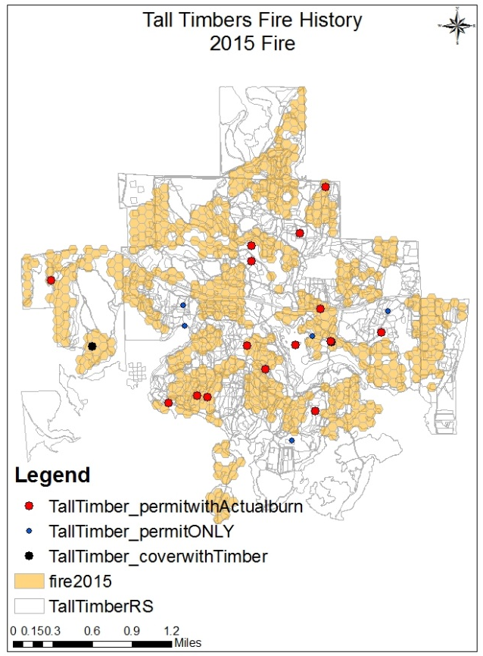
How trustable are the permit records?
Permit: 26 Days
Actual Burn: 16 Days
Tall Timbers Research Station, Tallahassee, FL
Actual
Permit (Points)
Ask permit, but not burn: 264 (11%)
They typically ask for a few more acres than they end up burning. Weather is the reason they would have pulled a permit and not burned.
Permit Asked: 2330
Ask permit and burn: 2066 (89%)
Actual burn: 1354
2015 PB records from Tall Timbers
58%
Unit: Acres
Notes:
Then we also did a case study in Tall Timbers Research Station.
It located in the middle of panhandle area of FL and has very complete burned area records.. The left figure shows the actual burned area of TT in 2015 from their records. The middle on shows the permits they ask. They asked permit for 26 day but only burned on 16 days. The actual burned acres is about 58% of the permit they have asked.

Slide 9
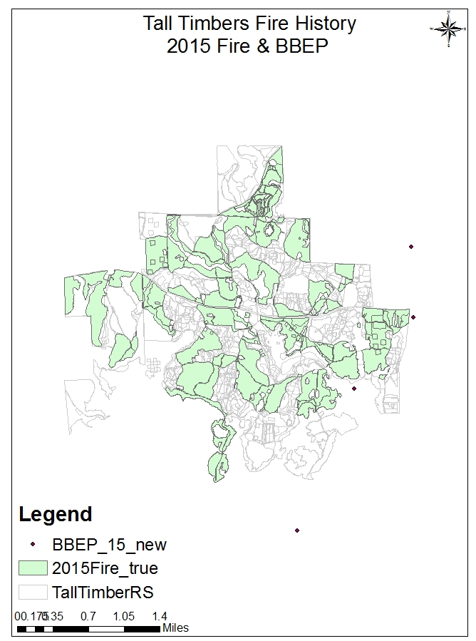
2015 Tall Timbers Satellite results
Actual burned: 1354 acres
Red polygons (BAECV): 84 acres
Points in red circle (BBEP): 70 acres
Only 5~6% of burned acres has been captured by the Satellite-derived products.
Notes:
Then we also compared the satellite derived products with the actual burns.

Slide 10
State total burned acres from all datasets
In GA, GFED4s only accounts for 8% and 11% of the burned areas in permit records while BBEP accounts for 15% and 44% in the first four months of 2015 and 2016,
In FL, GFED4s’ state total burned areas are 19% and 16% of those in permit records in 2015 and 2016, respectively. BBEP’s are 15% and 75% of burned areas in permit records.
Notes:
Let’s take a look at the overall situation of Georgia and Florida pb. This is the first four months state total burned acres,

Slide 11
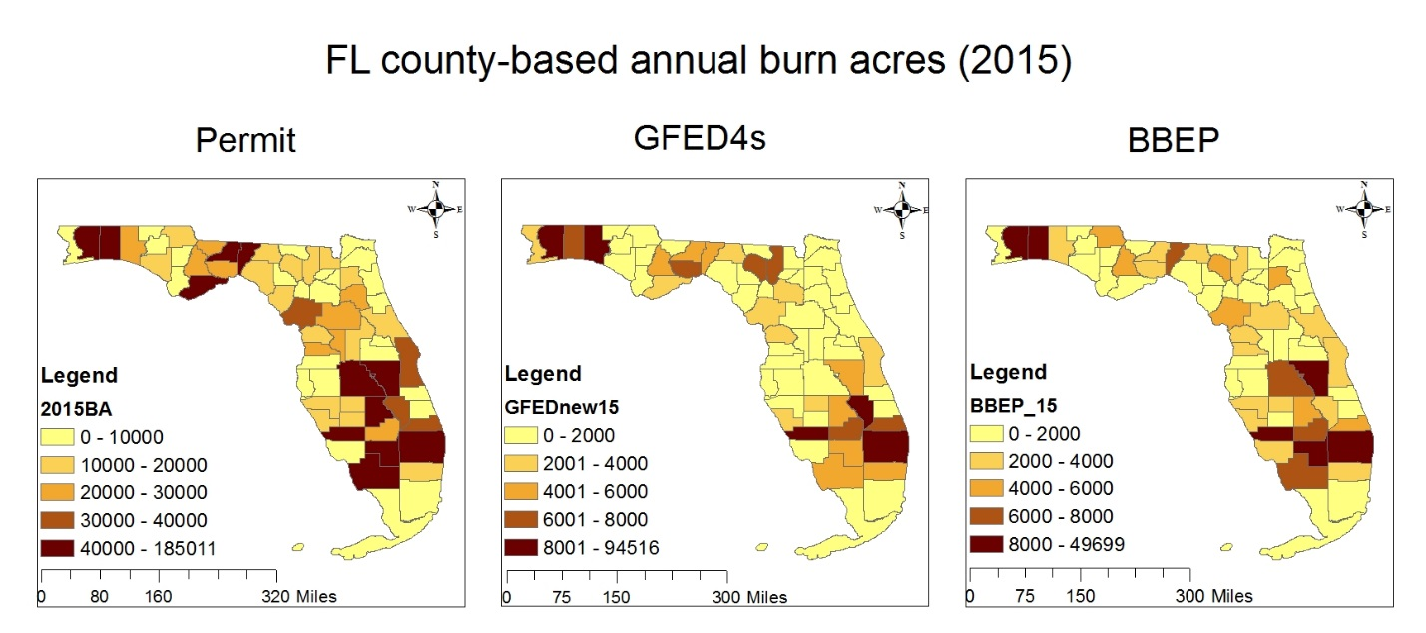
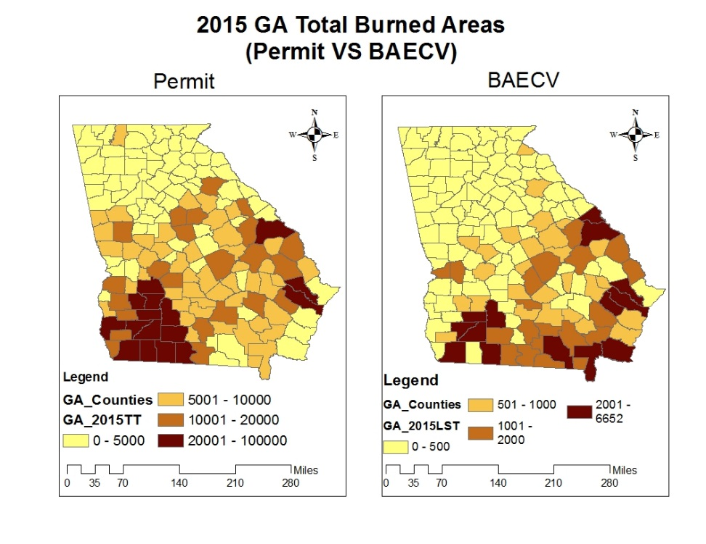
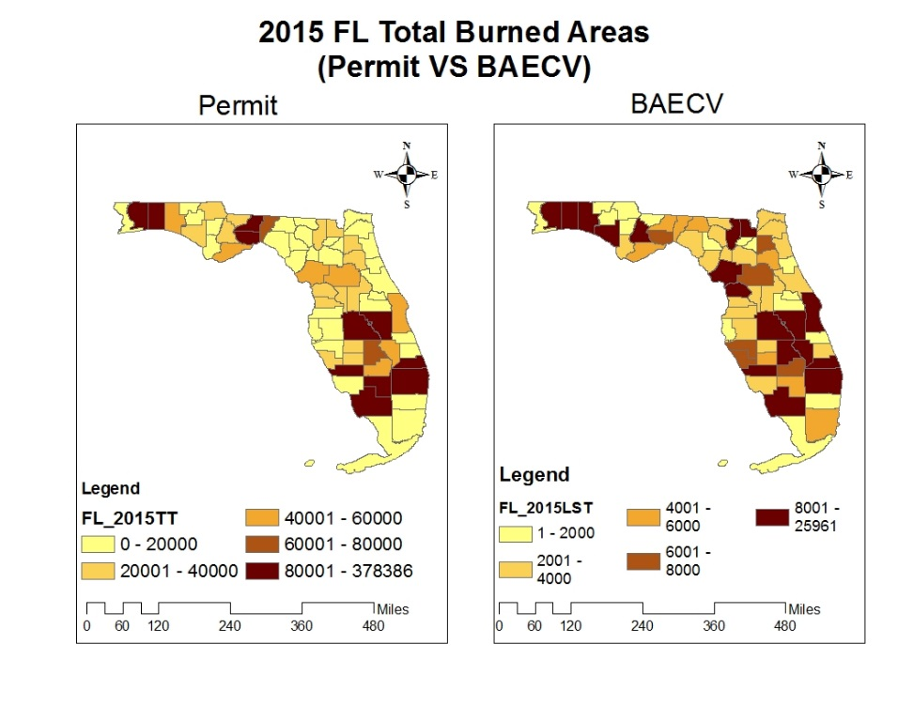
Total burned acres by county in GA and FL
Notes:
Here’s the spatial figure of total burned acres by county in GA and FL.
For GA, most of the burn activity is in the southwest of Georgia. In Florida, the largest burn areas are in the panhandle and the southcentral counties
The legend range here of all three satellite-related figures are 10 times smaller than the permit. GFED4s, BBEP and BAECV can't capture the level of burned area in permit records

Slide 12
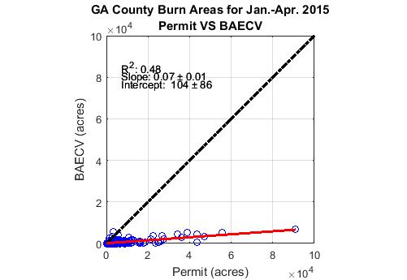
Comparison of county-level total burned areas of 2015 in Georgia : Permit vs. BAECV, GFED4s, BBEP
R² = 0.29
R² = 0.40
R² = 0.48
*Annual results
Notes:
Here’s the comparison of county-level total burned areas. It showed that permit are correlated with all satellite-derived products
BBEP and BAECV are in better agreement than GFED4s with permits. The R2 are 0.4 and 0.48 respectively. But all the slopes are less than 0.1.

Slide 13
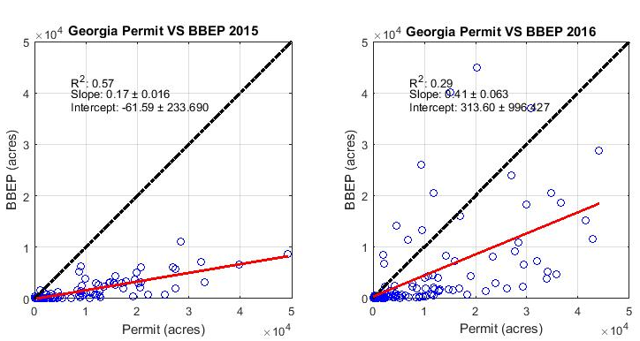
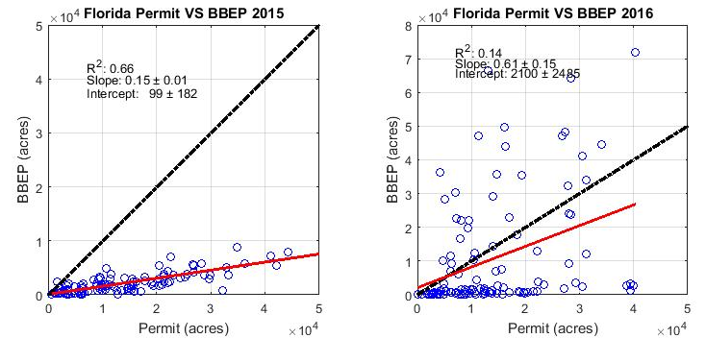
Comparison of daily state total burned areas of 2015 and 2016 in Georgia (top row) and Florida (bottom row): Permit vs. BBEP
Notes:
Here’s the daily analysis in GA and FL. In 2015, r² equals to 0.57 and 0.48, respectively. However, they are not correlated as strongly in 2016 (r² = 0.29 and 0.14)
Note that permit records only account for prescribed burns while satellites cannot differentiate prescribed burns from wildfires. However, our investigations showed no records of wildfire incidences on those days.

Slide 14
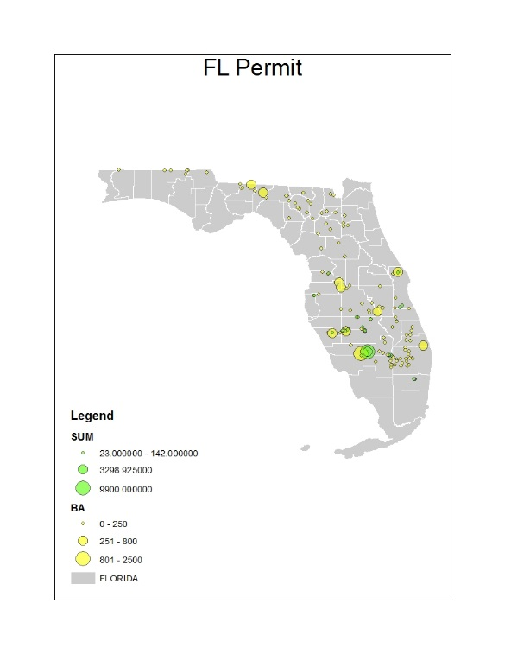
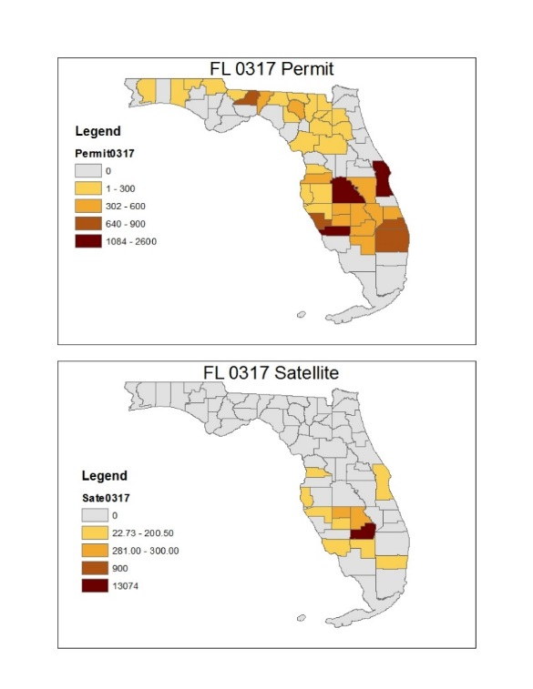
Daily Analysis: 03/17/2016
BBEP and permit record burned areas are almost the same statewide in Florida (~1.40×10⁴ acres).
Notes:
We also did day-by-day analysis between permit and BBEP. Here’s an example.
For 17 March 2016, although BBEP and permit record burn areas are almost the same statewide in Florida (~1.40×10⁴ acres), the locations of the fires are quite different.
In particular, BBEP fires do not capture the permitted burns in the panhandle area of FL. And BBEP are not agree with the small burns permitted in South Florida there are only a few small fires detected by the satellite and their locations are different from those of the permitted burns. In addition, larger fires seen by the satellite in North Central Florida are in different locations, even different counties.

Slide 15
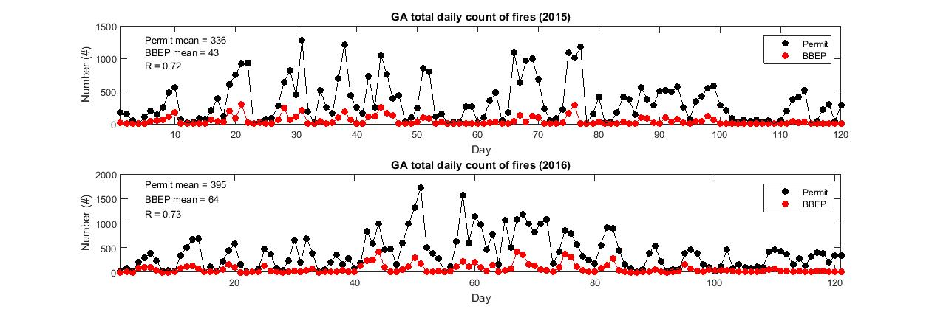
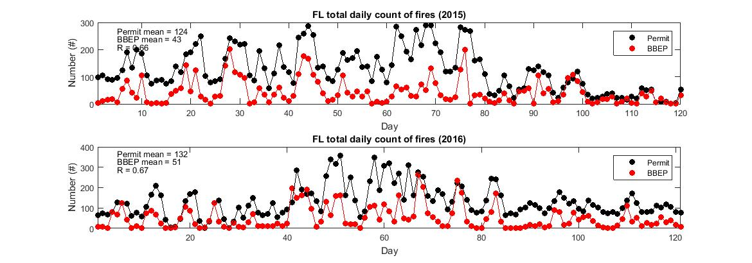
1/8
2015
GA
R = 0.72
2016
1/7
Daily count of fires: Permit vs BBEP
R = 0.73
2015
1/3
R = 0.66
FL
2016
1/3
R = 0.67
Notes:
In Georgia, although the correlations between the daily counts are good (0.72 for 2015 and 0.73 for 2016), BBEP fire counts are only about one-eighth (2015) and one-seventh of permit record burn counts
In Florida, the average daily number of burns from permit record,124, is three times larger than the average daily number of fires from BBEP in 2015. In 2016, the average daily count from permit records,132, is three times larger than that from BBEP

Slide 16
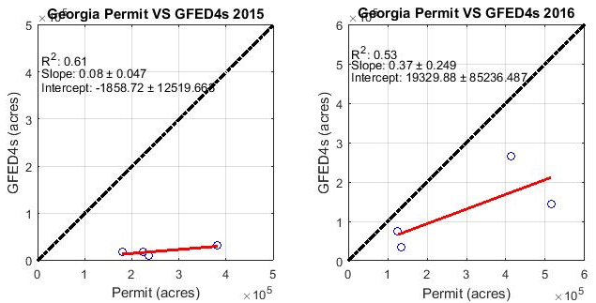
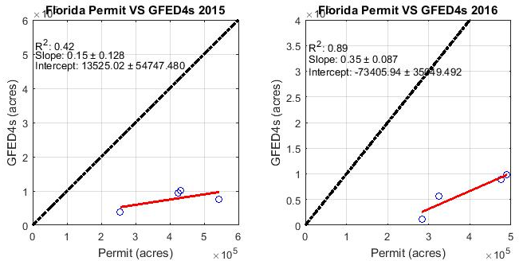
Comparison of monthly state total burned areas of 2015 and 2016 in Georgia (top row) and Florida (bottom row): Permit vs. GFED4s
Notes:
Considering GFED4s only has the monthly total burn areas, there are only four points in the comparisons between permit records and GFED4s. There is strong correlation. However, considering there’re only four points in the comparison, this strong correlation result is not that reliable.

Slide 17
Sugarcane burn
Glades(yellow), Hendry(orange) and Palm Beach(brown)
Notes:
Glades(yellow), Hendry(orange) and Palm Beach(brown)
Considering the openness, burn area and high frequency of sugarcane burns, and that they are conducted in open fields, satellites should be efficient in detecting this type of burns.

Slide 18
Sugarcane burn: Permit VS BBEP
The red dot in the comparisons of county-wise total burn areas on figure that represent Palm Beach County.
Notes:
BBEP comparison show only a slight improvement compared to other types of burn.
Here the sugarcane burn comparison inform that it’s really important to have post-burn situation collecting system. We believe that people burn that much of sugarcane burn, but they may not burn on the day they had a permit.

Slide 19
Conclusions
Current satellite-derived products have limitations in estimating the burned areas of small fires. Three satellite-derived products all underestimate the burned areas compared to permit recorded data about 7% ~ 75% according to different years, states and products.
BAECV is more accurate than the other two but it cannot give the daily or even monthly burned areas.
Satellite-derived products can capture a cluster of fires better than isolated fires, but may misinterpret those small fires together as one big fire, as shown in our specific days’ analysis in Florida.
Considering the openness, wide area and high frequency the sugarcane burn, it should be detected more efficiency. However, BBEP comparison show only a slight improvement compared to other types of burn.

Slide 20
Questions?
Ran Huang
Georgia Institute of Technology
ranhuang2014@gatech.edu

Slide 21
GA and FL county-level burned area comparison

Slide 22
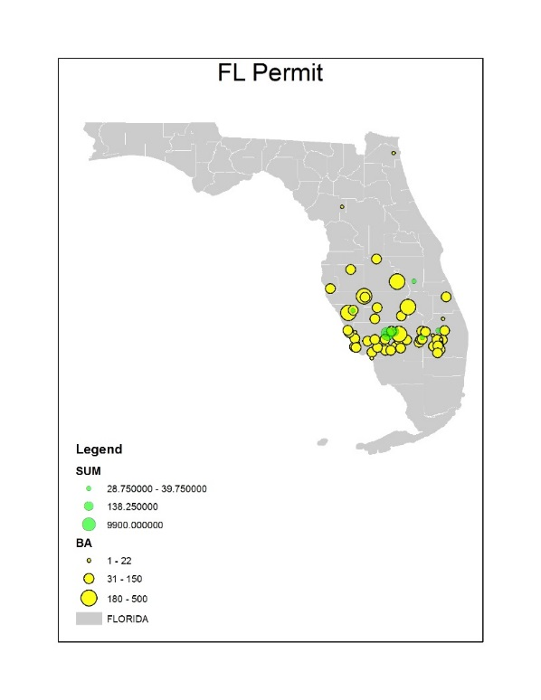
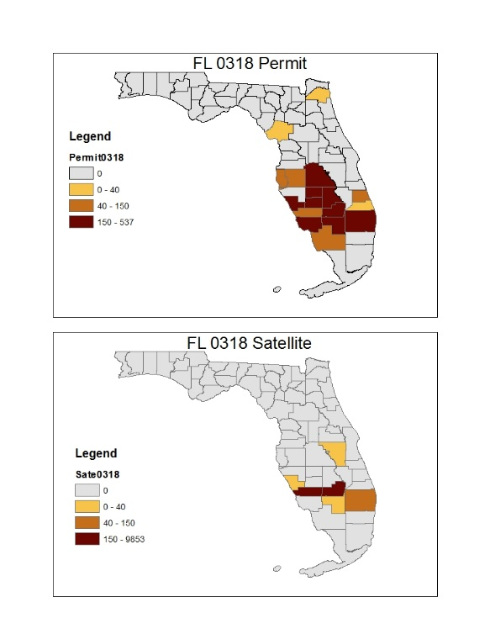
Special days-03/18/2016
Notes:
For 18 March 2016, there is an overlap of permitted burns and BBEP-detected fire locations; however, BBEP detects one very large fire (~10,000 acres) while the permit database implies many small fires in that area.
The county total burn area for the satellite-detected fires is much larger than the one for permitted burns in cHARLOTTE County.
BBEP may be interpreting several small fires as one big fire

