Slide 1




Top-down estimate of methane emissions in California using a mesoscale inverse modeling technique
Yuyan Cui^{1,2}
Jerome Brioude^{1,2}, Stuart McKeen^{1,2}, Wayne Angevine^{1,2}, Si-Wan Kim^{1,2}, Gregory J. Frost^{1,2}, Ravan Ahmadov^{1,2}, Jeff Peischl^{1,2}, Thomas Ryerson¹, Steve C. Wofsy³, Gregory W. Santoni³, Michael Trainer^{1,*}
1. Chemical Sciences Division, Earth System Research Laboratory, NOAA, Boulder.
2. Cooperative Institute for Research in Environmental Sciences, University of Colorado, Boulder.
3. Department of Earth and Planetary Sciences, Harvard University, Cambridge.
The 13th CMAS Conference
October 27-29, 2014
UNC-Chapel Hill
Notes:
Hello, everyone, during this talk, I’m going to present a top-down estimate in methane emissions in California based on mesoscale inverse modeling. First of all, I want to thank all of my coauthors, especially Jerome who was a great help to me in setting up the inverse system.

Slide 2
Outline
Backgrounds, observations and the inversion method
Estimates of methane emissions from the posterior and prior inventories (NEI), over the South Coast Air Basin (SoCAB), CA
Preliminary results for methane emissions over Central Valley, CA
Notes:
This talk is organized into 3 parts. I will briefly introduce methane observations and the inverse modeling first, then show results focusing on the South Coast Air Basin (LA basin), and some preliminary results in the Central Valley.

Slide 3
Background
CH₄ has increased by factor of 2.5 at least since pre-industrial times (IPCC AR5).
The atmospheric lifetime of CH₄ of ~12 years, shorter than CO₂ but with much higher global warming potential than CO₂ (~72 times higher over 20 years, and ~25 times higher over 100 years).
The change in CH₄ mixing ratio also likely altered the concentrations of OH and ozone in the troposphere and water vapor in the stratosphere.
In California, CH₄ emissions are regulated by Assembly Bill 32, enacted into law as the California Global Warming Solutions Act of 2006, requiring the state’s greenhouse gas emissions in the year 2020 not to exceed 1990 emission levels.

Slide 4
CalNex 2010 Airborne measurements
NEI 2005
μg m⁻² s⁻¹
NOAA P-3 research aircrafts
Wavelength- scanned cavity ring-down spectroscopy (Picarro 1301 m)
Central Valley
Sacramento
Valley
Six flights
San Joaquin
Valley
The South Coast Air Basin
(SoCAB)
Six flights
Notes:
In 2010, the CALNEX campaign took place in California including the south coast air basin (SoCAB) and the Central Valley. The SoCAB area includes a densely populated urban area (larger Los Angeles metropolitan area) and has several known anthropogenic sources of methane, including oil/gas wells, natural gas pipelines and urban distribution systems, landfills, and dairies. The Central Valley comprises San Joaquin Valley and Sacramento Valley, with methane sources that include agriculture, livestock, and oil and gas development.
We used six research aircraft flights to estimate methane surface fluxes in the SoCAB area, and six aircraft flights in the Central Valley area. We made uncertainty estimates of each single flight, the posterior inventory, and the transport model.

Slide 5
Lagrangian inverse system in Mesoscale
y=Hx +ε
y: mixing ratio (obs)
x: surface fluxes
Notes:
In order to assess and improve surface fluxes of bottom-up inventory, we develop a mesoscale Lagrangian inverse system.
Here we use an off-line 3D Lagrangian transport model, FLEXPART, and the advanced mesoscale weather forecasting model (WRF) or the WRF model with on-line coupling chemistry (WRF-Chem) are used to provide the MET fields to drive the off-line FLEXPART in the backward-mode. FLEXPART-WRF model is used linearize the transport between emissions at the surface and the airborne measurements. Outputs from FLEXPART-WRF with Bayesian inversion, and with prior information, we calculate out posterior inventory. Three spatial dimensions plus one time dimension are considered in our inverse system, corresponding to the 3D- and 4D-VAR least-square optimizations we are using.

Slide 6
Bayesian formulation with lognormal distribution
Cost
function
J obs
J prior
R and B are covariance matrices
May 08 flight
For each flight we give a background value
For each flight, we give a regularization α (Henze et al. 2009) to reach a good compromise in R and B
Brioude et al. 2011
Notes:
Here is our cost function in Bayesian formulation. In our inverse system, we use the lognormal distribution in the cost function to avoid calculating unphysical negative fluxes. The lognormal distribution also better matches the histogram of enhancements of the airborne measurements of methane above the background values than a Gaussian distribution. Therefore, the error in posterior estimates using this assumption made with a Bayesian least square method is reduced.

Slide 7
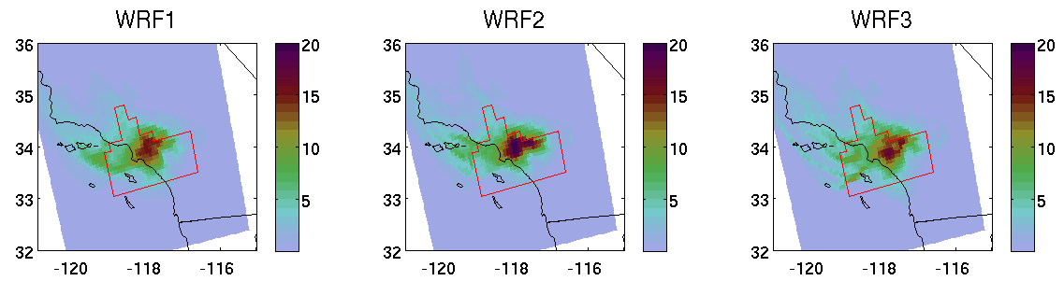
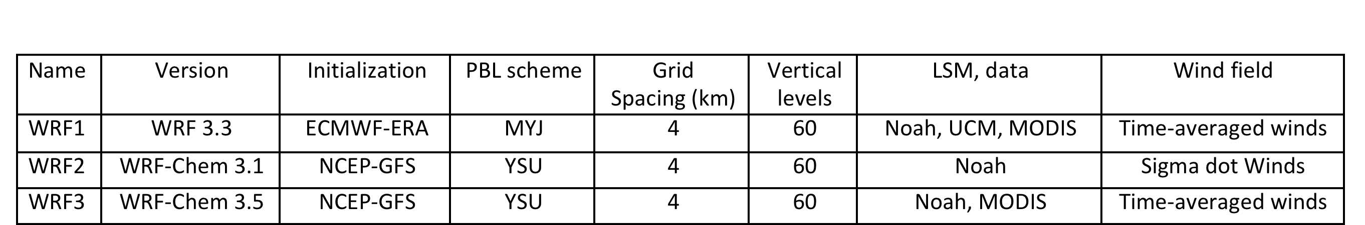
Three off-line transport models (FLEXPART-WRF)
s m³ kg⁻¹
s m³ kg⁻¹
s m³ kg⁻¹
Correlation R
 | CH4 obs | WRF1 | WRF2 | WRF3
CH4 Obs | 1
WRF1 | 0.67 | 1
WRF2 | 0.74 | 0.74 | 1
WRF3 | 0.69 | 0.78 | 0.80 | 1
FLEXPART driven by 3 MET fields
Releasing 10,000 particles every 30 s and every 100 m along flight tracks, backward 24 hrs
Notes:
As mentioned before, three configurations of the WRF or WRF-Chem model provided 3 different off-line meteorological fields to drive FLEXPART at mesoscale. For each MET field, FLEXPART is run by releasing 10000 particles every 30 s and every 100 m along the flight tracks, and following each particle backward for 24 hours. These 3 FLEXPART-WRF model combinations serve as our transport models in the inverse system. The inner domains of MET fields at 4 km resolution are shown here. We checked the correlations among the different transport models, and also correlations between the observations and each of model. The three transport models are not substantially more correlated with each other compared with the correlations between observations and each of them. Therefore, they are considered to be independent off-line transport models, and can therefore be used to construct the ensemble estimates.

Slide 8
Clustering spatially grid cells
Based on Fisher information matrix, a criterion map is used to present the significance of each grid cell in constraining the CH₄ emissions.
J=Tr (BW^{T}R⁻¹W)
Central Valley
Log10
The SoCAB
Log10
Bocquet el al. (2011)
Notes:
Based on the Fisher information matrix, a criterion is used to map the significance of each grid cell to constrain the CH₄ emissions in the inverse system. Those plots show maps of this criterion using a log scale. A higher value of the criterion means there is higher confidence in the emissions constraint provided by that grid cell. The grid cells are aggregated into several clusters when values are below a threshold (we used a threshold of log(criterion) = -5). Each cell with a values equal to or higher than -5 is not aggregated, while grid cells with lower significance are clustered with their neighbors with similar criterion value. Using this clustering method, the number of total grid cells is reduced by 75% and the cross correlation between clusters is reduced.

Slide 9
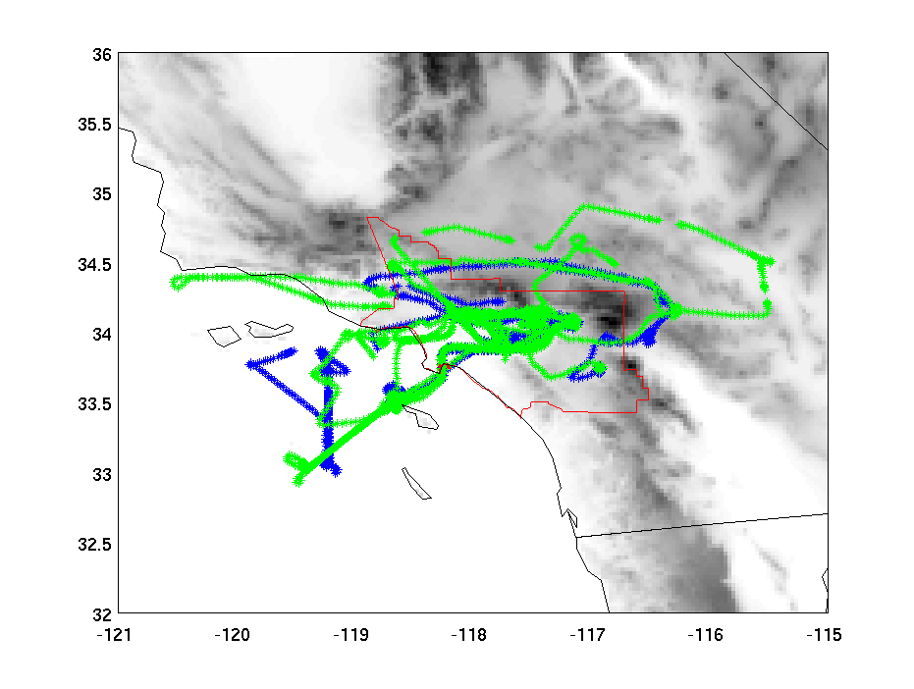
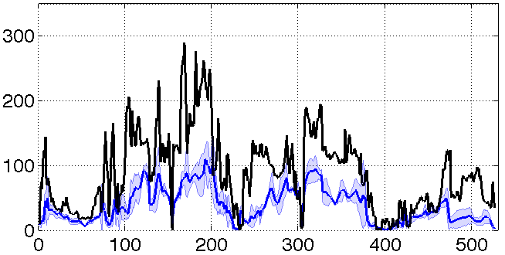
SoCAB Results
CH₄ flux in NEI 2005
μg m⁻² s⁻¹
230 Gg /yr.
CH₄ above bkg (ppb)
0508 flight
Observation
Prior Inventory:
CH₄ emissions were processed following EPA recommendations in EPA SPECIATE 4.1 database (Simon et al. 2010).
Underestimates
Flexpart+prior
# of Obs
Notes:
After the brief introduction on our method, here are some results. First let’s look at CH₄ emissions over the SoCAB area.
In this study, our “bottom-up” prior inventory is EPA NEI 2005. It provides the CH₄ prior information on surface fluxes and their spatial distributions at a resolution of 4x4km which is important to drive our inversion at mesoscale. The figure at the bottom shows time series of CH₄ mixing ratio in the observations and from our simulations along a flight track, using the May 8 flight here as a example. The solid blue line is the average of the 3 transport models, while the range of the 3 models is shown by the lighter blue shaded region. The time series of CH₄ mixing ratio is underestimated using the prior.

Slide 10
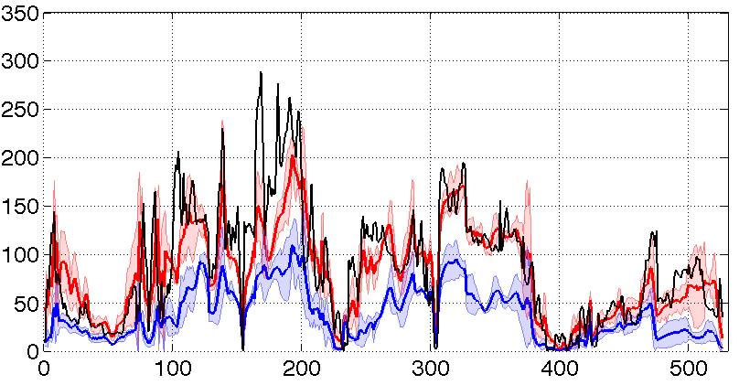
Optimization of CH₄ mixing ratios
CH₄ above bkg (ppbv)
Mean bias: prior: 50ppbv post: 8ppbv
R²: prior: 0.55 post: 0.7
0508 flight
Observation
model above bkg (ppbv)
0508 flight
Flexpart+prior
Flexpart+post
Obs above bkg (ppbv)
Flight | Mean bias (ppbv) |  | R² (WRF1) |  | R² (WRF2) |  | R² (WRF3)
 | Prior | Post | Prior | post | Prior | post | Prior | post
0504 | 44.3 | 7.7 | 0.4 | 0.7 | 0.4 | 0.7 | 0.5 | 0.8
0508 | 49.9 | 7.9 | 0.5 | 0.6 | 0.6 | 0.7 | 0.5 | 0.6
0514 | 10.3 | 4.0 | 0.7 | 0.8 | 0.4 | 0.7 | 0.3 | 0.7
0516 | 35.9 | 7.8 | 0.5 | 0.6 | 0.5 | 0.5 | 0.3 | 0.4
0519 | 28.0 | 8.1 | 0.6 | 0.7 | 0.7 | 0.8 | 0.5 | 0.7
0620 | 24.5 | 3.2 | 0.6 | 0.7 | 0.4 | 0.7 | 0.4 | 0.7
Bias and correlation are improved using the posterior
Notes:
I now show the results of the inversions for the May 08 flight using the 3 different transport models. The posterior inventory performs much better in reproducing the time series of CH₄ mixing ratios, decreasing the mean model-observations bias from 55 to 8 ppb. The correlations between observations and simulated methane mixing ratios are also improved.
For each of the 6 CalNex flights in the SoCAB, the bias and correlation are improved between observed and simulated methane mixing ratios using the posterior estimates compared to the prior.

Slide 11
Results in CH₄ total emission
It is consistent with previous studies
First time using mesoscle inverse system to estimate CH₄ emissions with three transport models in this region
Assuming constant CH₄ emissions in the urban region
427± 92 Gg CH₄/yr
Flights | 0504 | 0508 | 0514 | 0516 | 0519 | 0620
Emissions (Gg CH₄/yr) | 437±85 | 389±58 | 481±86 | 379±72 | 469±80 | 407±65
Surface emission estimates vary by 10% using single flights.
Notes:
Using the 3 FLEXPART-WRF models and 6 flights over the SoCAB, we estimate an annual methane emission from the basin of 427 Gg per year (by assuming our results from a 6-week period are representative of an entire year). Our estimate is consistent with previous top-down estimates, however, it is the first estimate of methane emissions based on a mesoscale inverse model applied to aircraft measurements. Furthermore, our estimate of the uncertainty in the emissions estimate, 22%, includes uncertainties from the transport models. Because we applied the inversion on each flight, we can also estimate the variability of emission estimates based on a single flight. The emission estimate based on any single flight varies from the mean by no more than 10%.

Slide 12
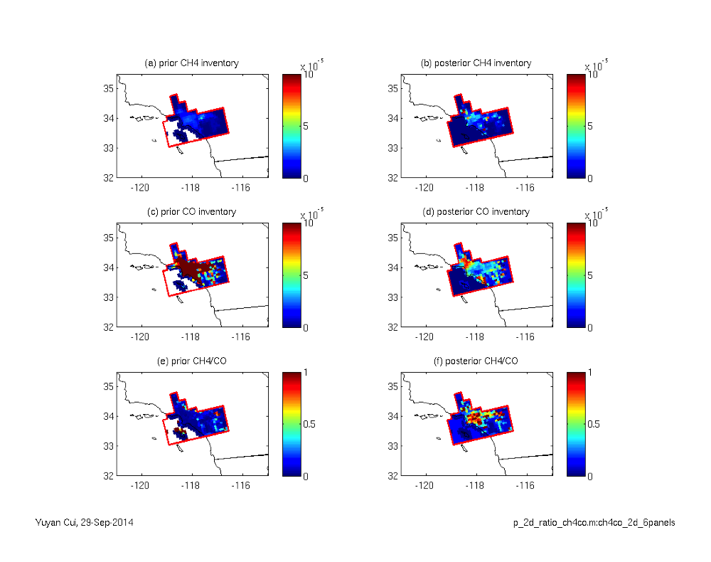
Robust results in CH₄ spatial distributions
Prior
Posterior
Obs Prior Posterior
CH₄
This study
CO
Brioude et al. ACP (2013)
The values and spatial distributions of the ratios of CH₄ and CO are changed in posterior inventory
CH₄ / CO
Notes:
We also study the spatial distribution of CH₄ emissions in the SoCAB. Brioude et al. (2013) used the same mesoscale inversion method and improved the CO emission inventory over the NEI 2005. Using the posterior inventories of CH₄ and CO, we obtain a slope between CH₄ and CO mixing ratios that compares better with observations.
Spatial distributions of CH₄, CO , and the ratio between them are shown in the right figure, both in prior inventories and posterior inventories. In the posterior inventory, the CH₄-CO ratio is heterogeneously distributed, with large ratios where landfills and oil wells are located in the western part of the basin, and lower ratios in the northern part where CO emissions are the highest.

Slide 13
CH₄ source sectors
CARB 08 & 09.
The contribution of the dairy sector is higher by factor of ~1.9 and ~1.6 than bottom-up estimates (NEI05 and CARB09). →Peischl et al. (2013)
The contribution of oil and gas wells, landfills, and point sources (297± 61 Gg/yr) is higher by factor of ~1.6 than the bottom-up estimates (NEI05).
52± 8 Gg /yr (upper bound)
Gg / yr
Gg / yr
#
Gg / yr
Notes:
We now bring in information about the spatial distribution of the predominant sources of methane in the SoCAB from the bottom-up inventory. Along with our posterior emissions estimates for the basin, four important sources of methane emissions in the SoCAB can be estimated, including dairies, landfills, oil wells, and CH₄ point sources. We compare our estimates for these sources to those derived by Jeff Peischl et al. (2013).
You can see that the spatial distribution of dairies is different from the other sources, allowing us to estimate the emissions contributed by this sector. We calculate that the dairy sector contributes 52± 8 Gg CH₄/yr, which is twice than the prior value. Our estimate from dairies is consistent with the Peischl et al. (2013) top-down estimates derived using a mass balanced approach.
Because of the spatial overlap between them, we cannot distinguish oil wells, landfills and point sources. Therefore we estimate that these sources together contributed 297± 61 Gg CH₄/yr in the SoCAB, higher by factor of 1.6 than the prior emissions.
----- Meeting Notes (10/24/14 13:05) -----
CARB

Slide 14
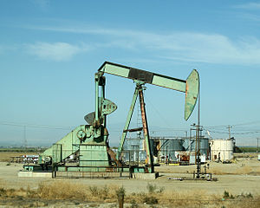
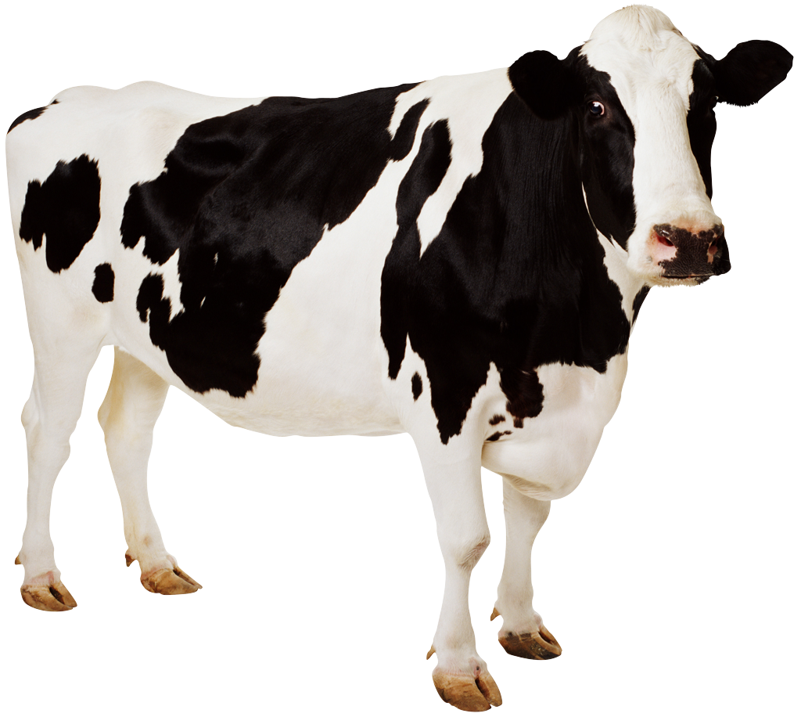
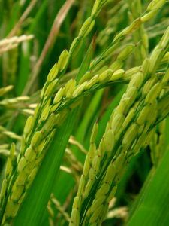
Central Valley Results
South San Joaquin Valley (SSJV)
North San Joaquin Valley (NSJV)
0507
0512
Sacramento river Valley (SV)
Rice cultivation
0511
0614
Each of portion’s CH₄ emissions are dominated by a different source sectors.
Notes:
I will conclude by showing some work in progress using the same method in California’s Central Valley where is more difficult for the MET simulations than the performances in the SoCAB. We consider three portions of the Central Valley: South SJV, North SJV and SV. Each of portion’s CH₄ emissions are dominated by a different source sectors. For each of the three regions, we make a “top-down” estimate of CH₄ surface fluxes using airborne measurements from CalNex flights during the daytime.

Slide 15
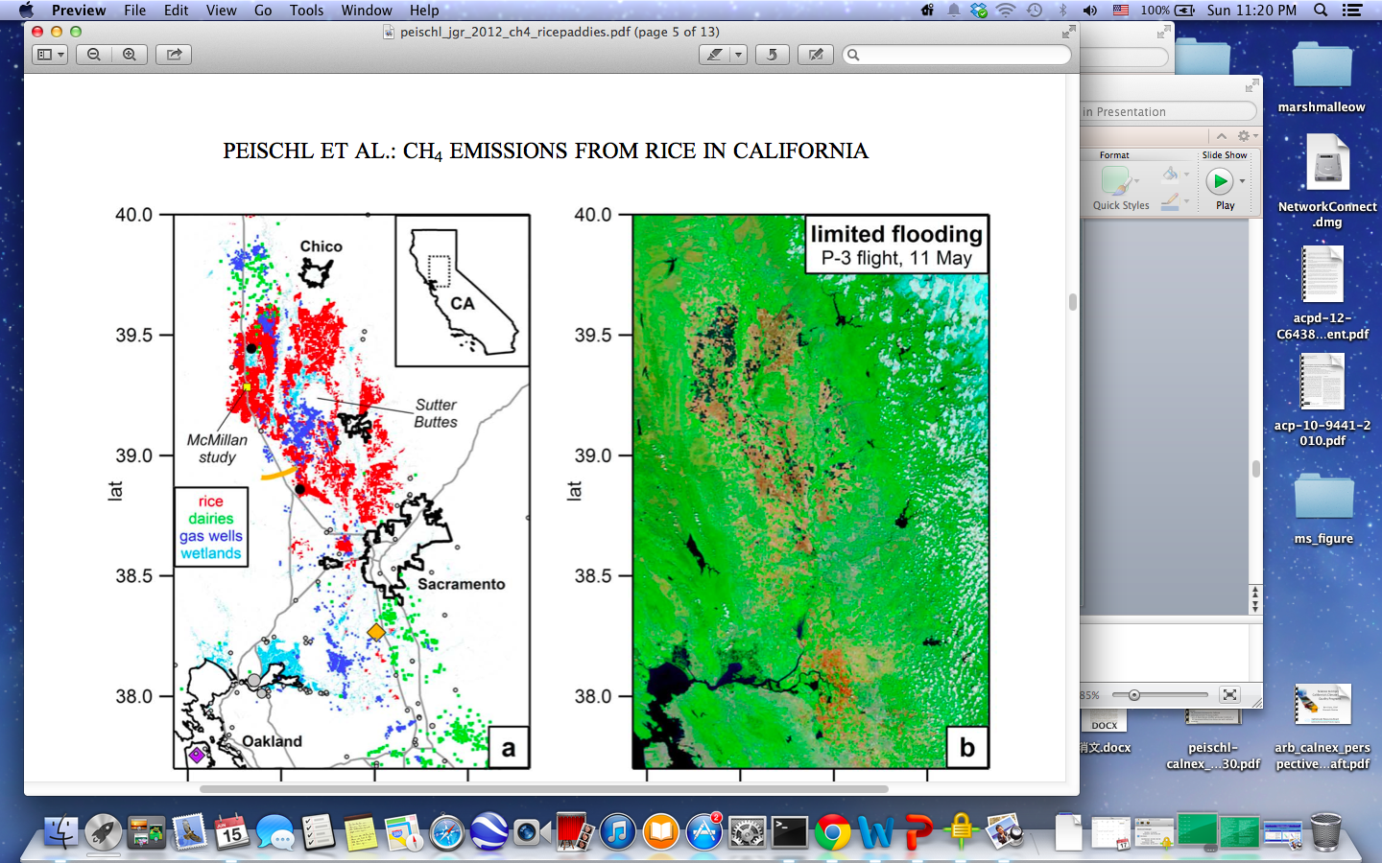
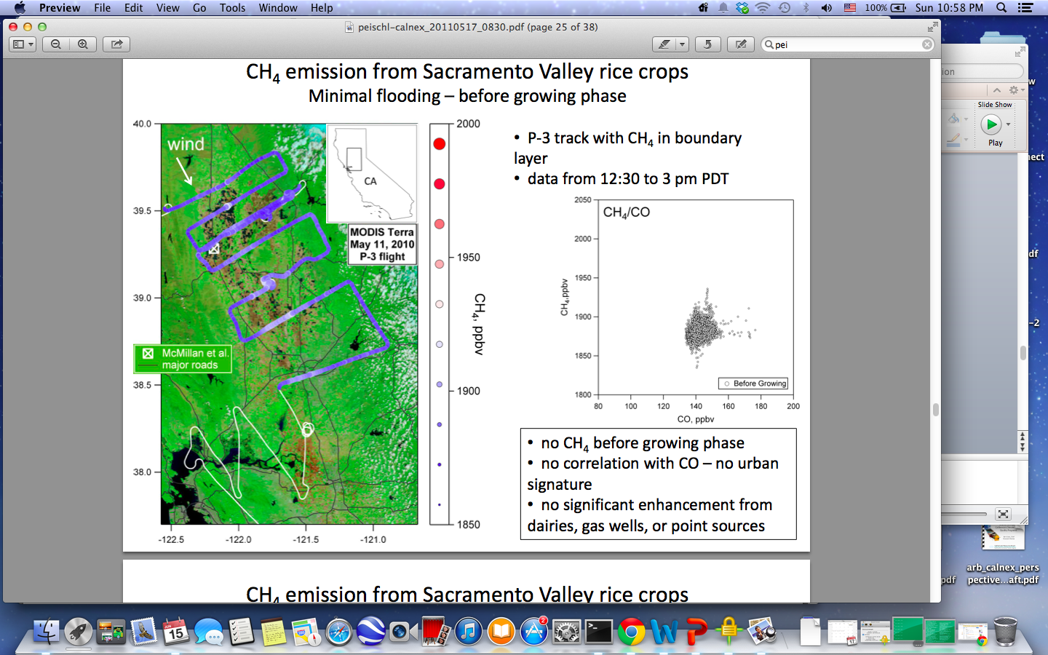
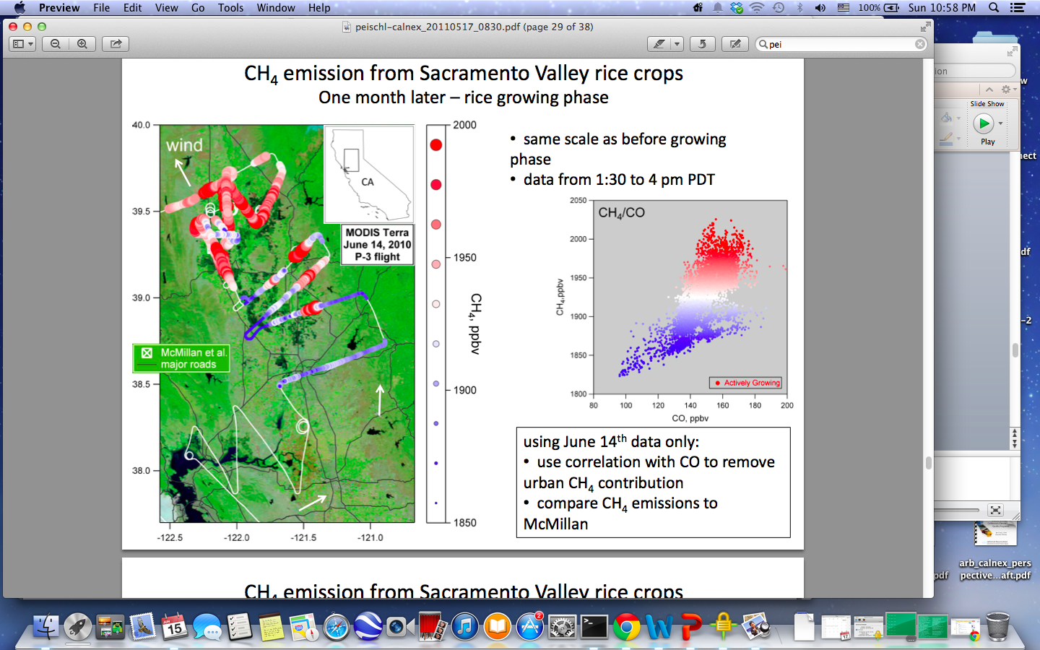
Preliminary Results in CH₄ total emission, and three sectors
Prior
Posterior
0507
0616
Gg CH₄ / yr
0512
0618
0614
(after)
0511
(before)
Peischl et al. (2012)
40-
39-
38-
Dairies
Oil wells
Rice
May 11
June 14
We used measurements from the two flights to constrain CH4 emisisions for the organge box region:0511: 70±4 Gg CH4/yr, 0614: 215±13Gg CH4/yr, and NEI05:18 Gg CH4/yr.
Notes:
In this studies, we estimated total annual emissions of CH₄ for the three portions of the Central Valley. The differences of CH₄ emissions before and after rice growth are identified in this study, which are consistent with Peischl et al. (2012).
In general, estimates in this study based on four aircrafts over San Joaquin Valley all estimated higher emissions of CH₄ than the prior ones, especially for the SSJV, although, there are some discrepancies in inversions between the two aircrafts over SSJV region due to the complex terrain.
For San Joaquin Valley, the dairy sector is a significant contributor and the oil wells sector dominates in the South part. These preliminary results indicated the underestimation of dairy and oil wells sectors in the NEI in Central Valley.

Slide 16
Conclusions
The mesoscale inverse method improve simulations of CH₄ mixing ratios and the slopes of correlations between CH₄ and CO.
The total CH₄ emissions in SoCAB estimated by the inverse system are consistent with previous top-down studies, and by factor of two higher than the prior inventory. This is the first estimate based on a mesoscale inversion method in this region.
Our uncertainty estimates include the uncertainty of the inversion method and also the uncertainty from the transport models.
The dairy and oil well sectors in the San Joaquin Valley seem to be underestimated by the prior inventory (NEI05).
Cui et al. 2014, in prep

