Slide 1

Comprehensive model evaluation of
PM_{2.5} species over Japan:
－Comparison among AERO5,
AERO6, and AERO6-VBS models
Yu Morino, Tatsuya Nagashima, Seiji Sugata, Kei Sato, Kiyoshi Tanabe,
Akinori Takami, Hiroshi Tanimoto, and Toshimasa Ohara
National Institute for Environmental Studies, Japan
ーContentsー
１．Introduction － PM_{2.5} in Japan / PM_{2.5} modelling
２．Methodology － Chemical transport models / Observations
３．Results － Model evaluations
４．Summary
ーAcknowledgementー
Funds： Environment Research and Technology Development Fund (5-1408, S12-1, 5B-1101)
Technical support: K. Suto and T. Noguchi (NIES)
The 13th Annual CMAS Conference, October 28, 2014

Slide 2
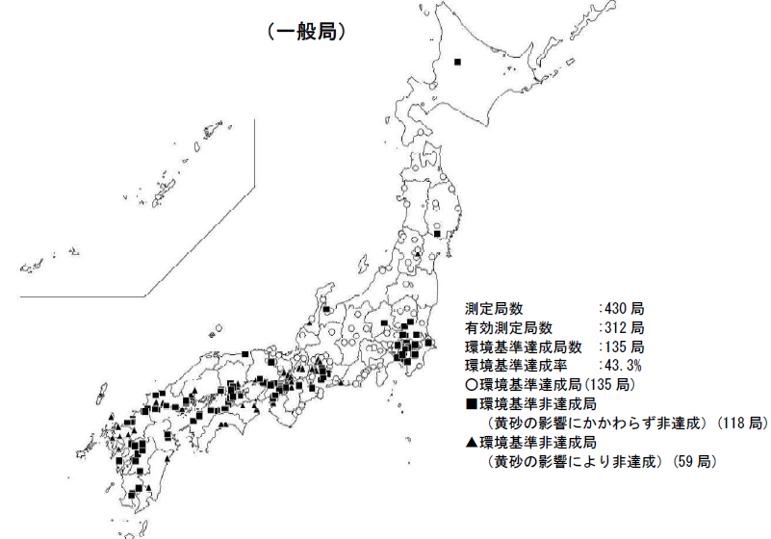
PM_{2.5} in Japan
1. Introduction
Temporal variations during 2001-2010
Spatial variations in 2012
Urban (N=12)
Rural (N=5)
Roadside (N=16)
Attained
PM_{2.5} concentrations
Unattained
2001 2002 2003 2004 2005 2006 2007 2008 2009 2010
PM_{2.5} env. standard
○：Attained
■▲：Not-attained
PM_{2.5} environmental standard
in Japan (Sept. 2009 ‒)
Annual mean: 15 μg m⁻³
Daily mean: 35 μg m⁻³
PM_{2.5} standard was not attained in western Japan and Tokyo Metropolitan Area.
Ministry of Environment (2012)
Ministry of Environment (2013)

Slide 3
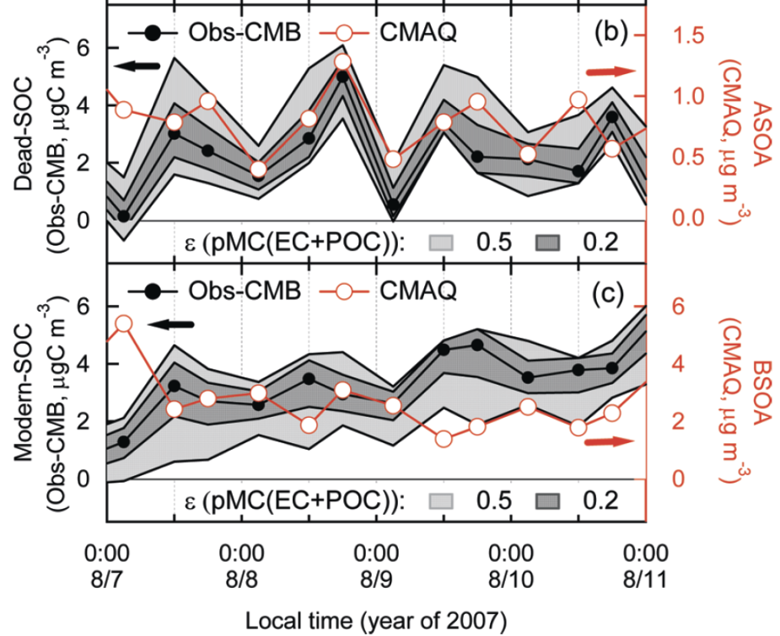
PM_{2.5} modelling in Tokyo Metropolitan Area (in summer 2007)
1. Introduction
Model intercomparison of PM_{2.5} species (Morino et al., JSAE, 2010)
(CMAQ v4.7.1 and CMAQ 4.6 were used.)
Model evaluation of fossil- and biogenic SOA (Morino et al., ES&T, 2010)
(CMAQ–MADRID was used.)
Fossil-SOA: Underestimation by a factor of 6-8
Organic aerosol
S1: Komae, S2: Kisai, S3: Maebashi, S4: Tsukuba
All models significantly underestimated OA.
Biogenic-SOA: Underestimation by a factor of 1.5 - 2

Slide 4
1. Introduction
Intercomparison of SOA models in TMA (in summer 2004)
MCM, CACM-MADRID: Explicitly simulate multi-generation oxidation
AERO4, AERO5: Yield models
Volatility Basis Set (VBS): Grouping of SVOC and IVOC based on volatility
Obs
S=0.193 μgm⁻³/ppbv
CACM
S=0.016
 | #Gas | # Reaction | Aerosol models
MCM v3.2 | 5731 | 16933 | Pankow
CACM -MADRID2 | 366 | 366 | MADRID2
SAPRC99 -AERO4 | 79 | 214 | AERO4
SAPRC99 -AERO5 | 88 | 224 | AERO5
SAPRC99 -VBS | 92 | 214^{#1} | VBS
#1: exclude aging reactions
VBS
S=0.130
from
CMAQ-MADRID
CMAQ v4.6
Others
S=0.003-0.011
CMAQ v4.7.1
(Morino et al., JGR, in revisions)

Slide 5
Background of PM_{2.5} modelling in Japan
1. Introduction
SOA models:
  OA concentrations were largely underestimated by yield and mechanical models in TMA, Japan.
  VBS model better reproduced SOA in TMA.
Limitation of observational data:
  Simultaneous measurement of PM_{2.5} chemical composition were limited in Japan.
  → Model evaluation of PM_{2.5} species were spatially and temporally limited.
  Simultaneous measurements of PM_{2.5} species over Japan were conducted in 2012.
Objectives of this study
Model performance of PM_{2.5} chemical composition were evaluated using the observational data over Japan in 2012.
Results of three simulation models, including the VBS model, were compared.

Slide 6
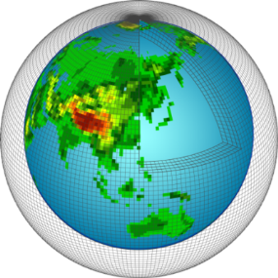
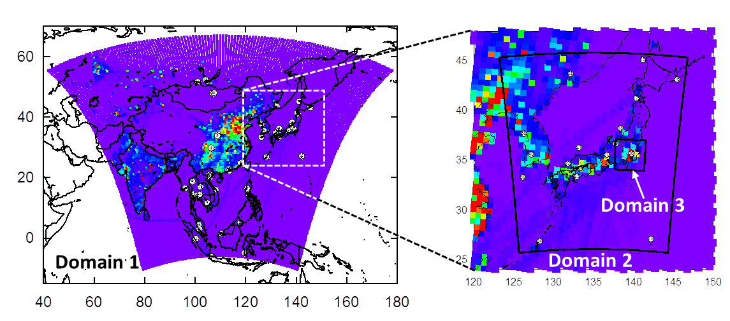
2. Methodology
Chemical transport models
Three versions of CMAQ
 | Models | Chemical Modules | Aerosol modules
① | CMAQ v4.7.1 | SAPRC99 | AERO5
② | CMAQ v5.0.2 | CB05 | AERO6
③ | CMAQ v5.0.2 | CB05 | AERO6VBS
Global-scale CTM
MIROC-ESM-CHEM
Setups of emission data
Δx = 300 km
Target | Emission data | Spatial resol.
Anthropogenic (Japan) | JATOP | ~1km (vehicles) ~10km (others)
Anthropogenic (Easi Asia) | REAS v2.1 | 0.25°
Biomass burning | GFED v3.1 | 0.5°
Volcano | AEROCOM/JMA | Points
Biogenic VOC | MEGAN v2.10 | ~0.04°
Regional-scale CTM
WRF/CMAQ
Δx = 60km
Δx = 15km

Slide 7
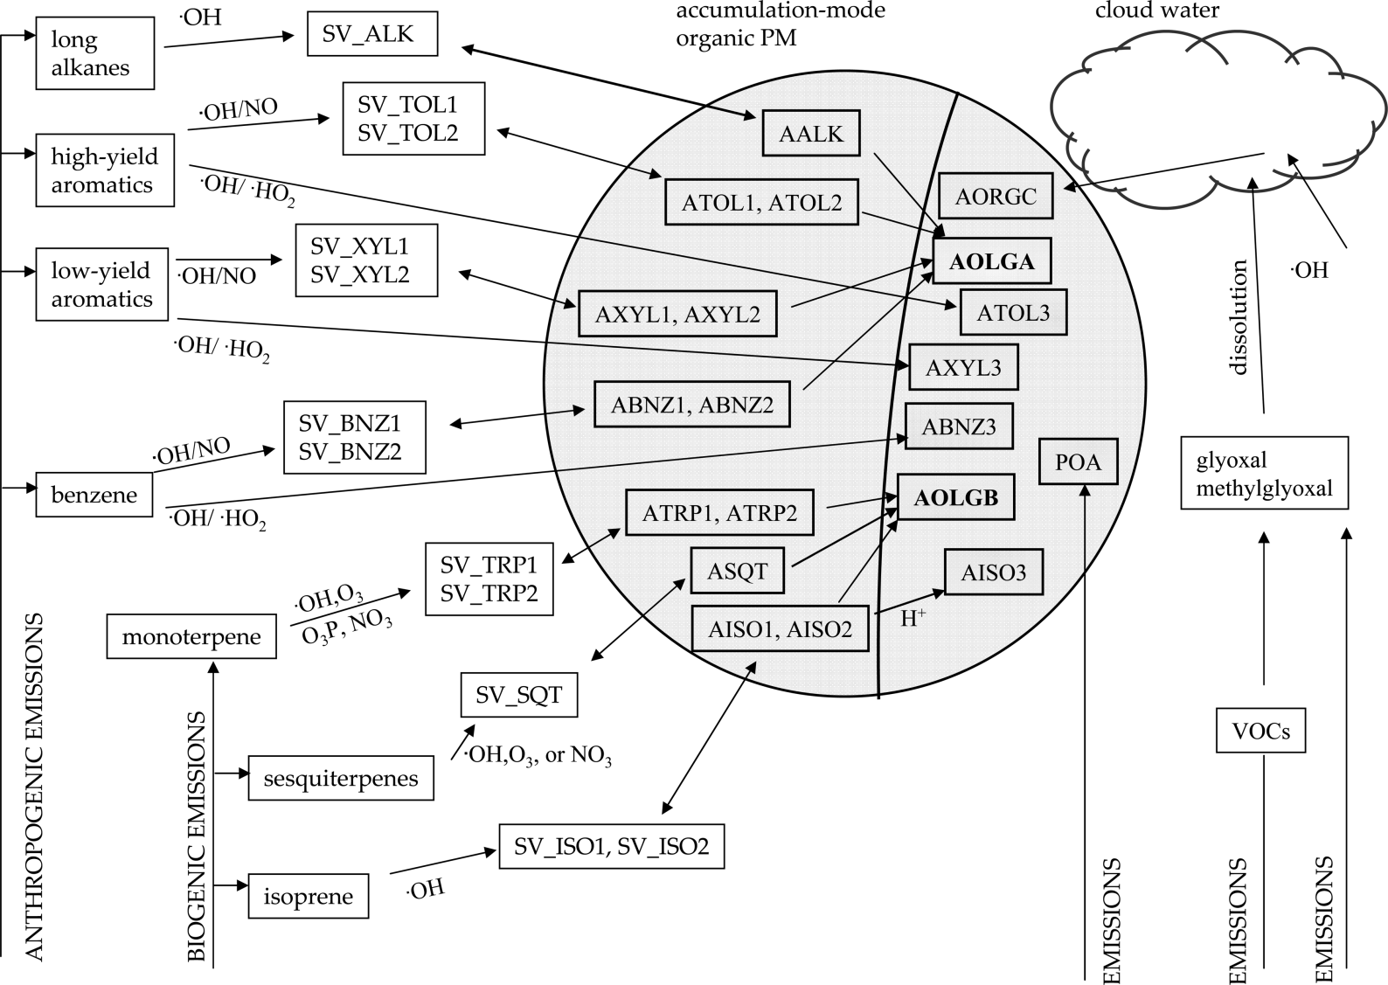
2. Methodology
SOA models ー yield models
AERO5
PNCOM
aging
POC
AERO6
AERO6
Carlton et al., 2010
Notes:
Carlton_10EST_CMAQ.pdf

Slide 8

2. Methodology
SOA models ー Volatility basis-set (VBS) model
VBS model
SOA (I/S)
Yield model
POA
cond./
evapo.
cond./
evapo.
Merit 1
emis.
SVOC3
SVOC1
aging
Emission sources
SVOC2
aging
emis.
SVOC3
SVOC2
emis.
oxidation
aging
aging
Merit 2
SVOC1
cond./
evapo.
VOC
cond./
evapo.
SOA (V)
Merit 1：
Merit 2：
Simulate primary emissions and oxidation (aging) of SVOC/IVOC (semi-/intermediate- VOC)
Simulate aging processes of oxidation products from VOCs

Slide 9
2. Methodology
Observations of PM_{2.5} species in 2012
■Periods:
－Winter: Jan 9 – 20
－Spring: May 6 – 12
－Summer: Jul 24 – Aug 1
■Points
■Sampling duration: 6 h or 12 h
■Target species
－Ion (SO₄^{2–}, NO₃–, NH₄⁺): IC
－Carbon (EC and OC) : TOT (IMPROVE protocol)
 | Remote | Urban/rural
Kyusyu | #1:Tsushima | #2:Dazaifu
Chugoku | #3:Oki | #4:Matsue
Kinki | #5:Kyotango | #6: Osaka #7:Otsu
Chubu | #8:Tateyama #11:Sadoseki | #9:Toyama #10:Niigata
Hokkaido | #13:Rishiri | #12:Sapporo

Slide 10
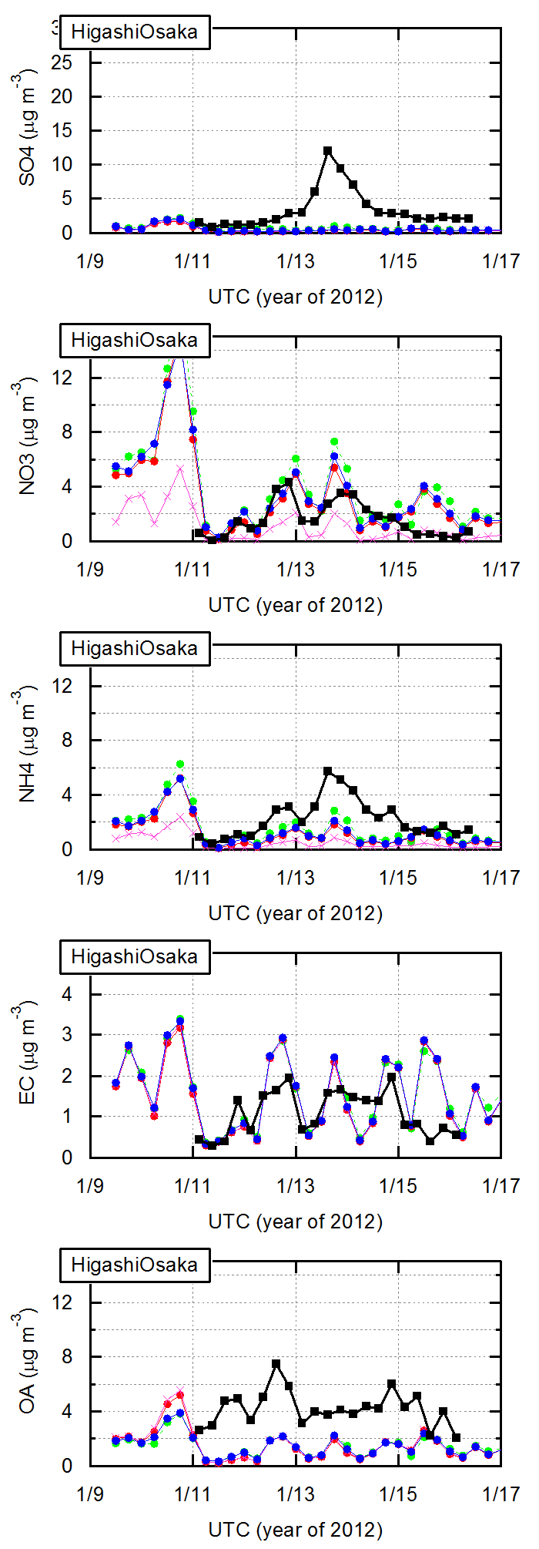
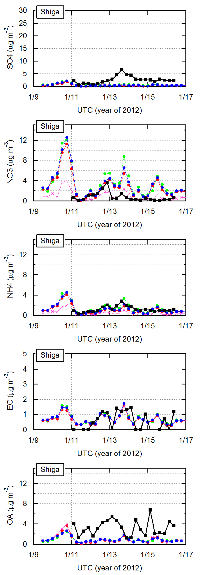
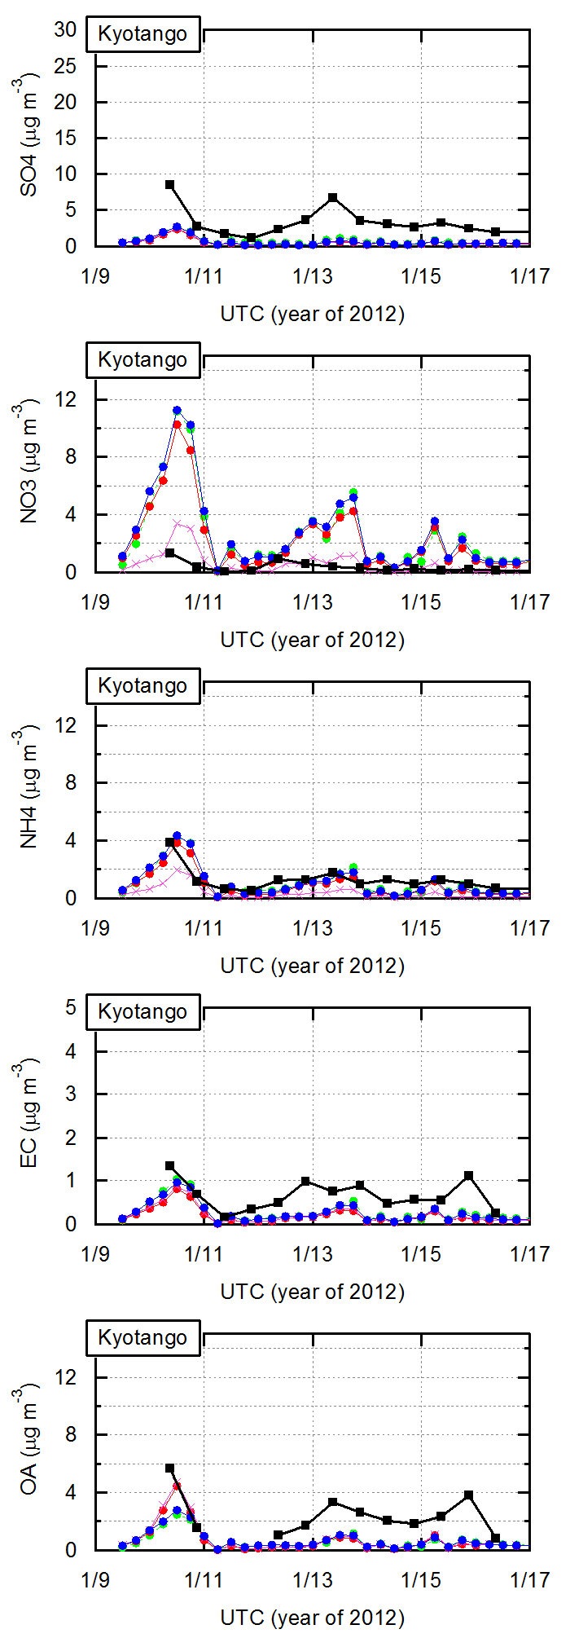
Temporal variations of PM_{2.5} species (winter)
3. Results
#6 Urban ( Osaka)
#7 Urban (Shiga)
#5 Rural (Kyotango)
SO₄^{2–}
NO₃–
NH₄⁺
EC
OA
#5: Kyotango
#7: Shiga
#6: Osaka

Slide 11
Temporal variations of PM_{2.5} species (winter)
3. Results
#6 Urban ( Osaka)
#7 Urban (Shiga)
#5 Rural (Kyotango)
SO₄^{2–} | ・Largely underestimated both in urban and remote areas.
NO₃– | ・Overestimated at all sites. ・Better reproduced when V_{d} of HNO₃&NH₃ were enhanced (×5). (Neuman et al., 2004; Shimadera et al., 2014)
NH₄⁺ | ・Combined trends of SO₄^{2–} and NO₃–.
EC | ・Well reproduced at the urban site and underestimated at the rural site.
OA | ・Large underestimation ・Similar results by the all three models.

Slide 12
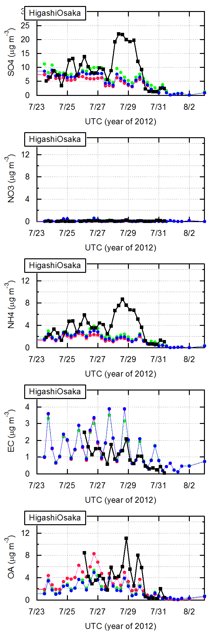
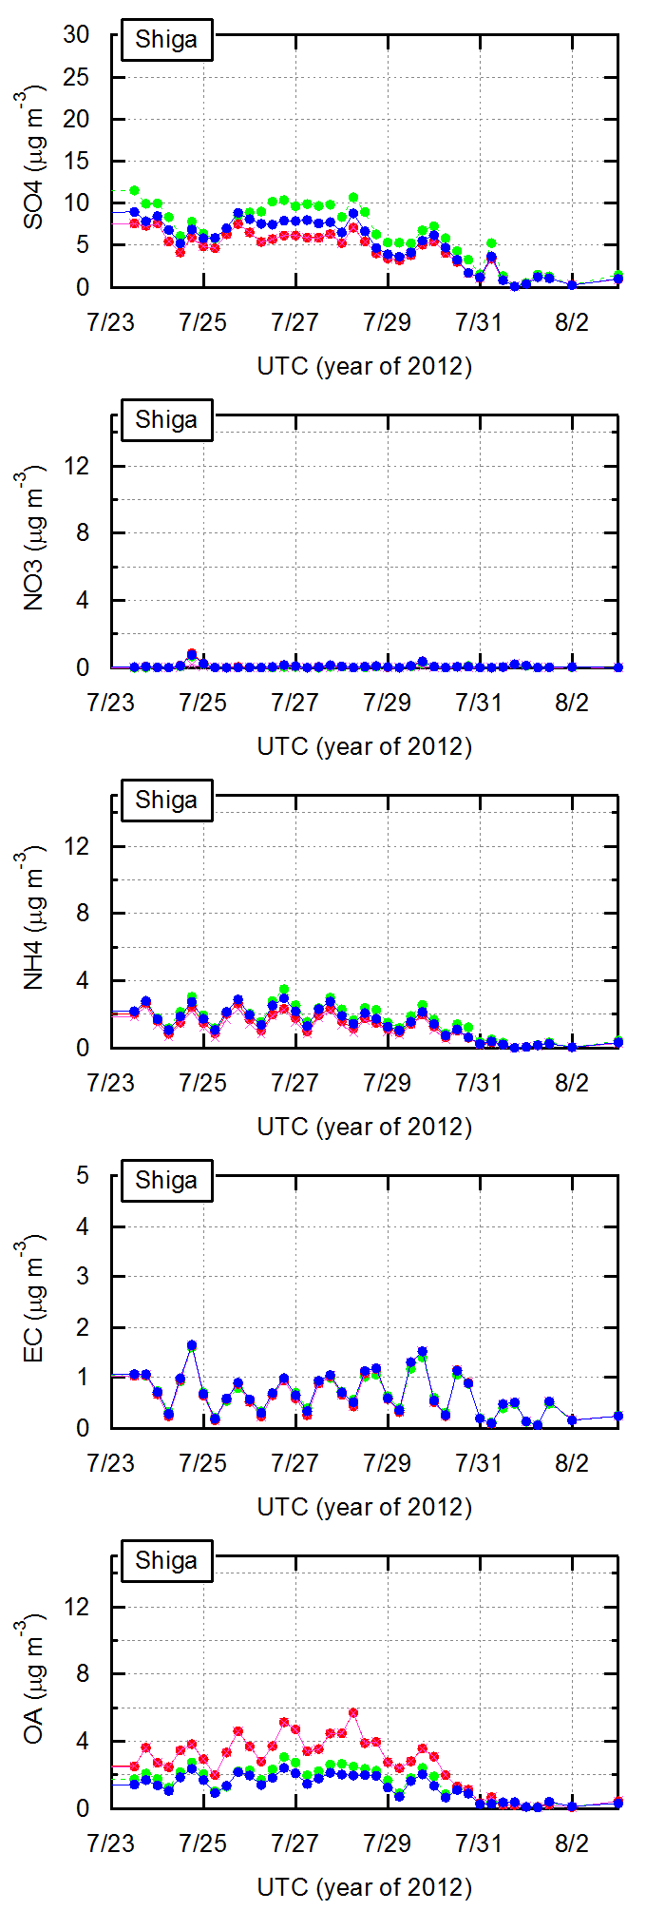
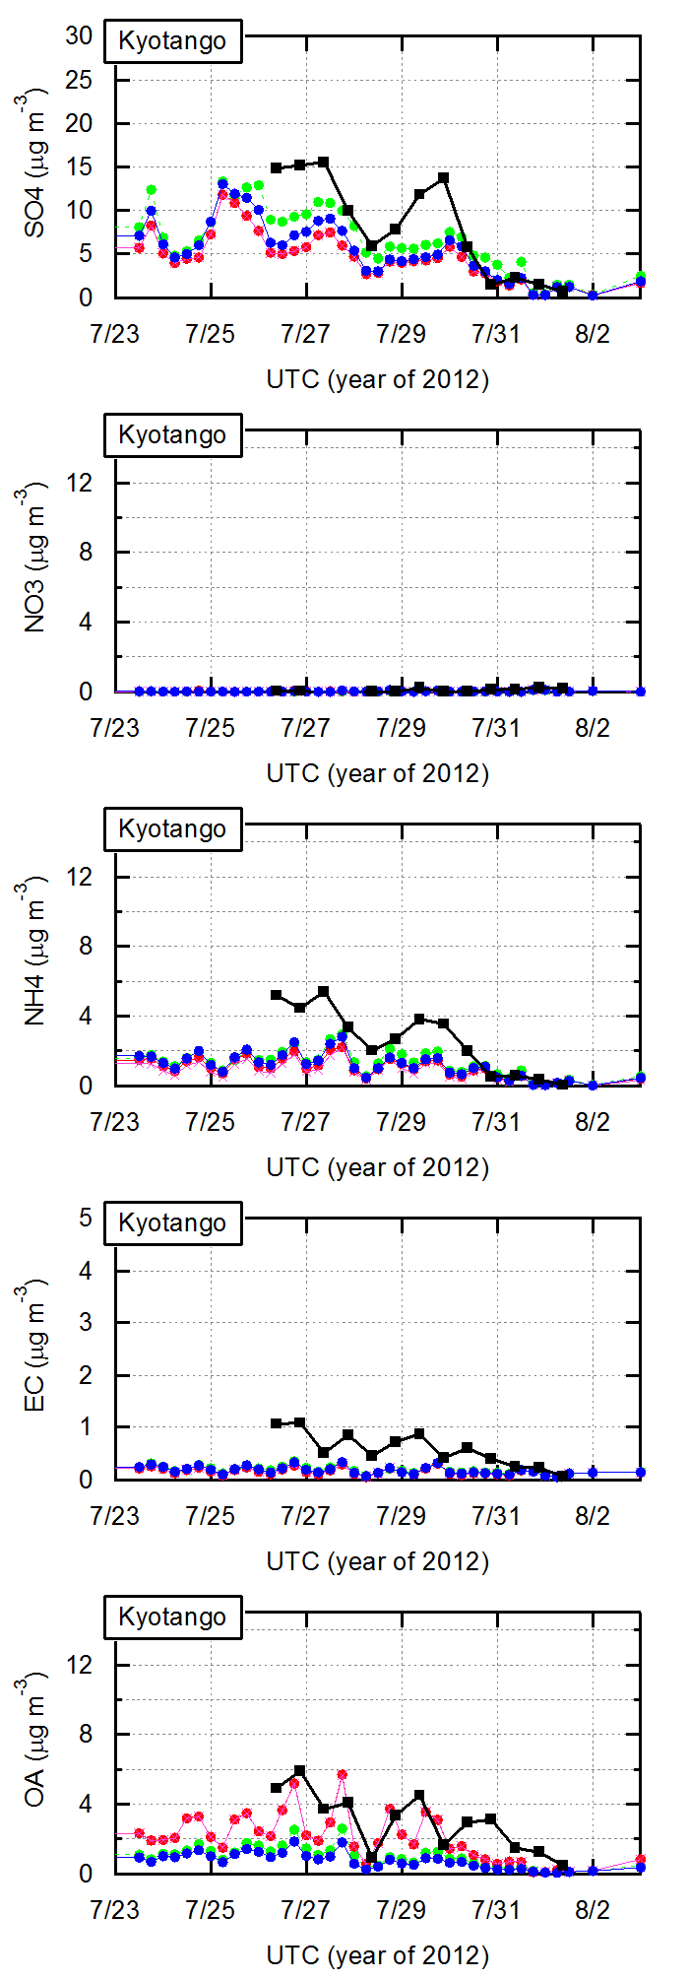
Temporal variations of PM_{2.5} species (summer)
3. Results
#6 Urban ( Osaka)
#7 Urban (Shiga)
#5 Rural (Kyotango)
SO₄^{2–} | ・Generally reproduced, though some peaks were underestimated.
NO₃– | ・Low NO₃– was reproduced.
NH₄⁺ | ・Combined trends of SO₄^{2–} and NO₃–.
EC | ・Reproduced at the urban site and underestimated at the rural site.
OA | ・Underestimated by the yield models. ・VBS better reproduced the observation.
VBS Obs
AERO5
AERO6

Slide 13
Comparison of observed and simulated PM_{2.5} species
3. Results
Winter
Spring
Summer
SO₄^{2–}
NO₃–
NH₄⁺
EC
OA
V_{d}×5
Urban/rural
Remote
Model
VBS
AERO5
AERO6
Observed

Slide 14
Comparison of observed and simulated PM_{2.5} species
3. Results
Winter
Spring
Summer
SO₄^{2–} | ・Underestimated in winter and spring. ・Well reproduced in summer.
NO₃– | ・Overestimated in winter and spring. ・Better reproduced when we enhance V_{d} (×5) of HNO₃&NH₃.
NH₄⁺ | ・Combined characteristics of SO₄^{2–} and NO₃–.
EC | ・Well reproduced (with some variability).
OA | ・Underestimated over the three seasons ・Better reproduced by the VBS.
Model
VBS
AERO5
AERO6
Observed

Slide 15
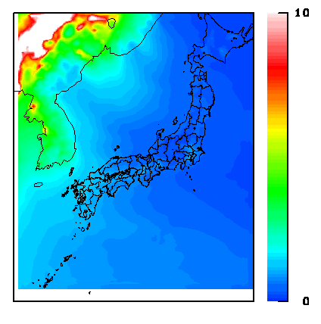
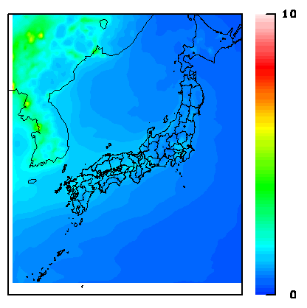
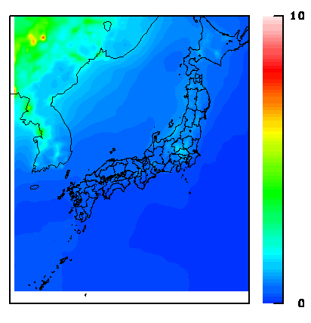
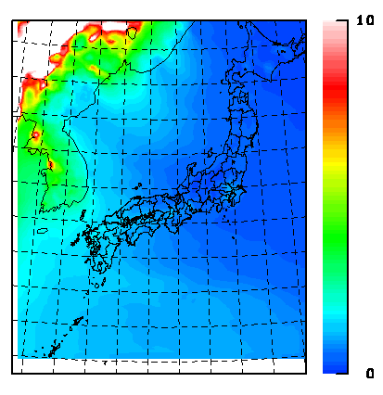
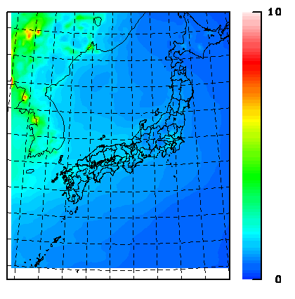
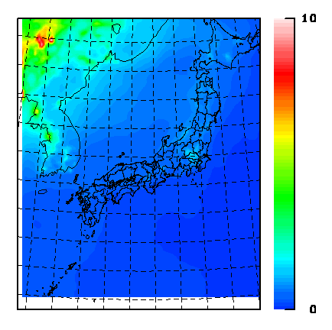
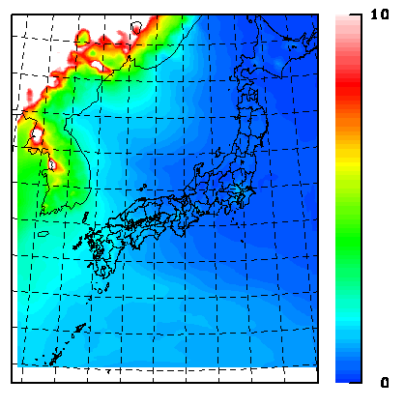
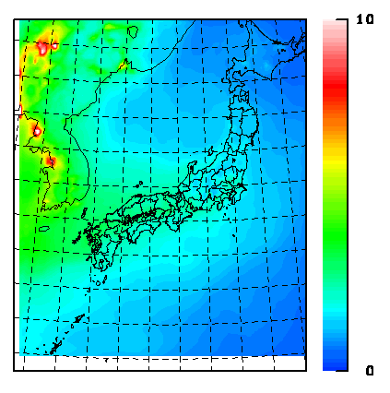
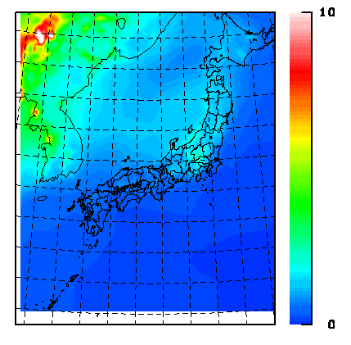
Simulated spatial distributions of organic aerosol
3. Results
Winter (Jan.)
Spring (May)
Summer (Jul.)
CMAQ v4.7.1
SAPRC99-AERO5
OA (μg m⁻³)
CMAQ v5.0.2
CB05-AERO6
OA (μg m⁻³)
CMAQ v5.0.2
CB05-AERO6VBS
OA (μg m⁻³)
In spring and summer, AERO6VBS simulated the highest OA over Japan.

Slide 16
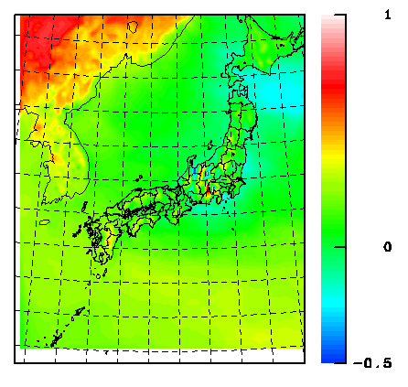
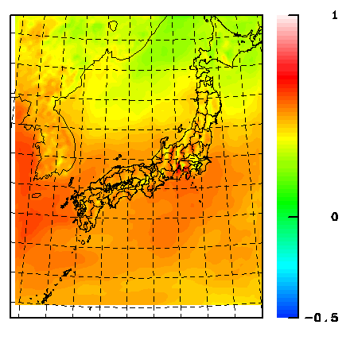
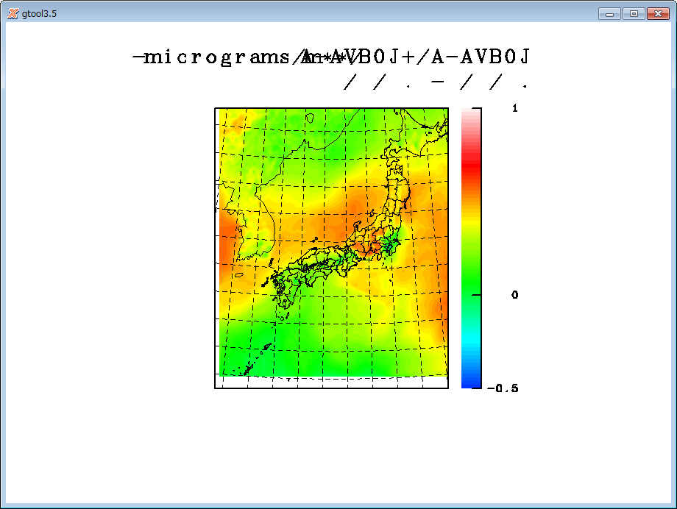
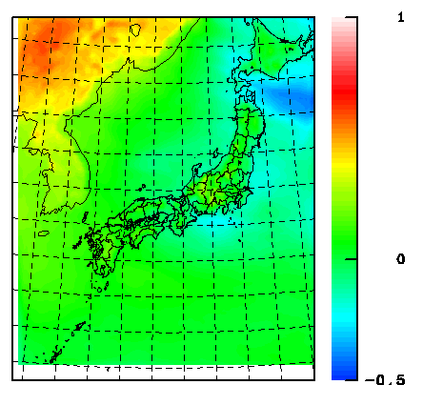
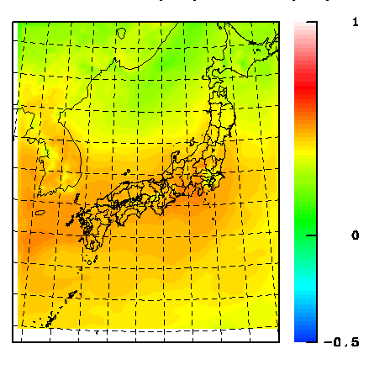
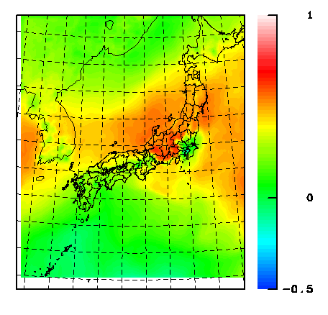
Simulated spatial distributions of organic aerosol
3. Results
Winter (Jan.)
Spring (May)
Summer (Jul.)
AERO6VBS–AERO5
AERO6VBS
AERO6VBS–AERO6
AERO6VBS
Ratio
CMAQ v5.0.2
CB05-AERO6VBS
OA (μg m⁻³)
In spring and summer, AERO6VBS simulated the highest OA over Japan.

Slide 17
Simulated average OA over Japan
3. Results
OA concentrations (μg m^{–3})
Winter (Jan.)
Spring (May)
Summer (Jul.)
High OA concentrations by the AERO6VBS model are due to high ASOA concentrations.

Slide 18
Summary
Performance of three simulation models on PM_{2.5} species were evaluated over Japan in 2012.
Concentrations of SO₄^{2–} , NO₃–, and NH₄⁺ were well reproduced by the all models in summer, while SO₄^{2–} was underestimated NO₃– was overestimated in winter and spring.
OA concentrations were underestimated by all the models in winter and spring.
OA concentrations were largely underestimated by AERO5 and AERO6 summer, and better reproduced by AERO6-VBS because higher ASOA was simulated by AERO6-VBS.

Slide 20
Uncertainty analysis of VBS
SVOC emission profiles
SOA yields
 | AERO6VBS |  | Tsimpidi
 | Anthro. | BB | Anthro.
Nonvolatile | 0.4 | 0.27
C*=10^(-2) |  |  | 0.03
C*=10^(-1) |  |  | 0.06
C*=10^(0) | 0.26 | 0.27 | 0.09
C*=10^(1) | 0.40 | 0.42 | 0.14
C*=10^(2) | 0.51 | 0.54 | 0.18
C*=10^(3) | 1.43 | 1.50 | 0.30
C*=10^(4) |  |  | 0.40
C*=10^(5) |  |  | 0.50
C*=10^(6) |  |  | 0.80
SVOC aging reaction rates (cm₃/molec/sec)
 | AERO6VBS | Tsimpidi
k(AVOC +OH) | 2×10^(-11) | 1×10^(-11)
k(BVOC +OH) | 0 | 0
k(S/IVOC +OH) | 4×10^(-11) | 4×10^(-11)

Slide 21
Uncertainty analysis of VBS
Simulation | [SOA]/[O_{x}] | [V-SOA]/[O_{x}] | [SI-SOA]/ [O_{x}] | POA
 | (μg m⁻³/ppmv) | (μg m⁻³/ppmv) | (μg m⁻³/ppmv) | (μg m⁻³)
Standard | 151.3 | 93.7 | 57.6 | 0.27
No aging | 1.3 | 1.3 | – | 0.19
Aging of BVOC | 152.6 | 95.0 | 57.6 | 0.27
Aging rate × 10 | 503.4 | 343.9 | 159.5 | 0.29
Aging rate ÷ 10 | 6.4 | 4.3 | 2.1 | 0.20
SVOC of Shrivastava et al. [2011] | 290.4 | 117.7 | 172.8 | 1.45
SVOC of Tsimpidi et al. [2010] (low volatility case) | 115.8 | 86.0 | 29.7 | 0.60
SVOC of Tsimpidi et al. [2010] (high volatility case) | 188.3 | 101.0 | 87.3 | 0.28
Nonvolatile POA | 89.1 | 89.1 | – | 2.36
Nonvolatile POA/no aging | 15.5 | 15.5 | – | 2.36
AERO6VBS | 178.0 | 94.6 | 83.4
Obs | 192.6 |  |  | 2.36

