Slide 1
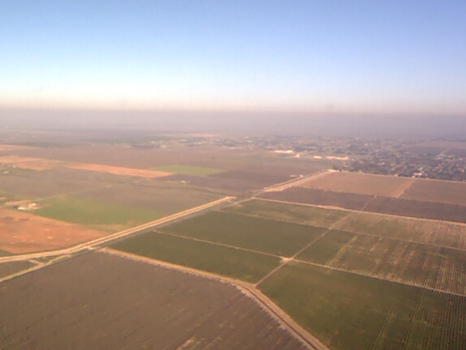
DISCOVER-AQ SJV surface measurements and initial comparisons with photochemical model simulations
Melinda Beaver¹, Russell Long¹, Jim Szykman¹, Rachelle Duvall¹, Kirk Baker¹, James Kelly¹, Andy Weinheimer², David Knapp², Denise Montzka², Sally Pusede³, and Ron Cohen³
1- US EPA; RTP, NC
2 – National Center for Atmospheric Research; Boulder, CO
3- University of California; Berkeley, CA
CMAS Conference
October 29, 2014

Slide 2
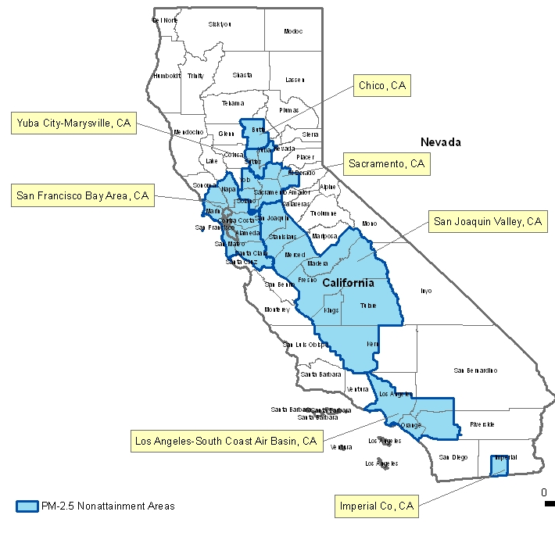
Motivation to study the San Joaquin Valley, CA
California currently has many counties violating the PM_{2.5} NAAQS
Many counties still projected to be nonattainment in the future
Challenges in California: complex terrain, large and diverse emissions sources

Slide 3
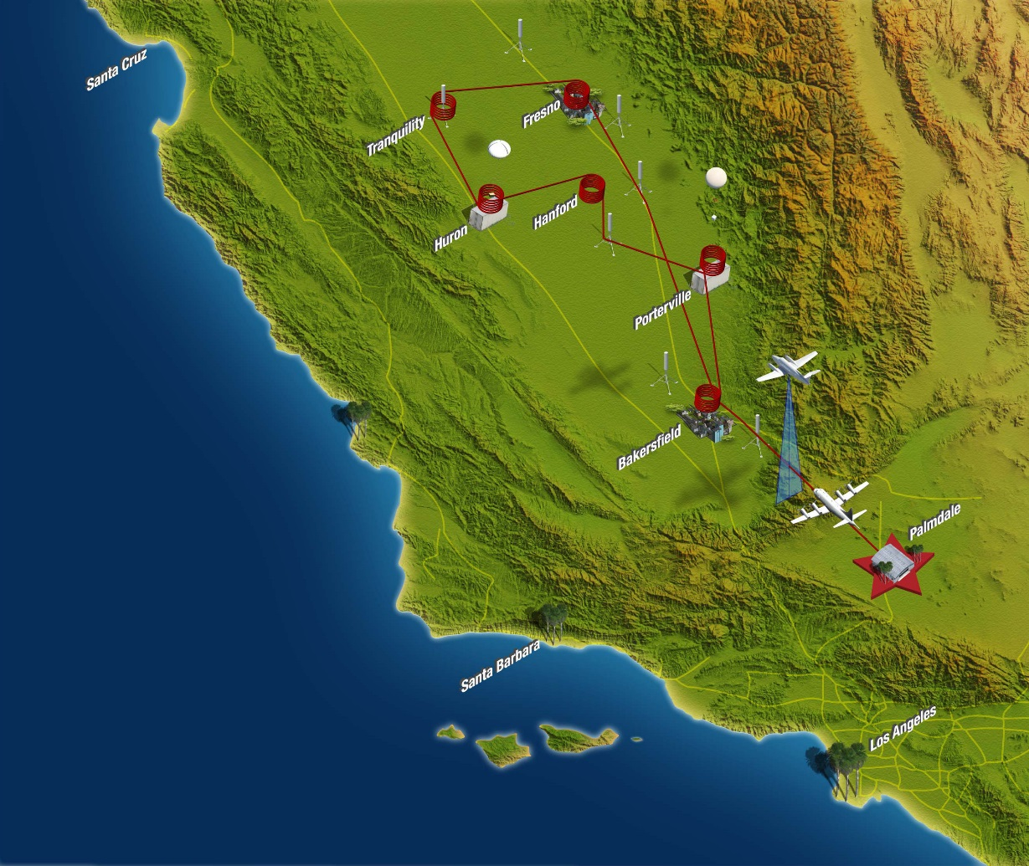
DISCOVER-AQ 2013 – San Joaquin Valley, CA
Deriving Information on Surface Conditions from Column and Vertically Resolved Observations Relevant to Air Quality
Success of study relies on quality measurements of gas and particle species (and properties) aloft and at the surface
San Joaquin Valley study from 16 Jan – 06 Feb 2013
10 flight days/~170 spirals/~150 missed approaches = Huge database!
All data publically available at: http://www-air.larc.nasa.gov/cgi-bin/ArcView/discover-aq.ca-2013

Slide 4
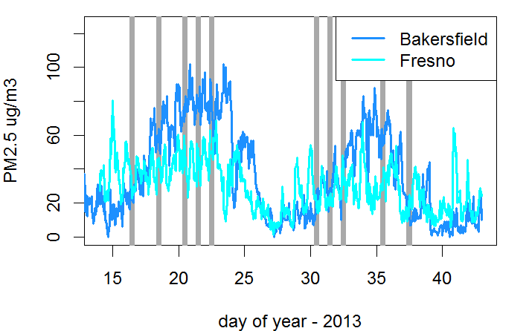
A brief look at PM_{2.5} episodes during the DISCOVER-AQ San Joaquin Valley, CA study
High PM_{2.5} concentrations valley-wide:
NH₄NO₃ was observed to account for ~half the PM_{2.5} mass in Fresno:
organics
NH₄NO₃
*Grey lines indicate flight days
*(data from CARB and SJVAPCD sites)
*(data from Zhang group, UC Davis)

Slide 5

EPA’s efforts in DISCOVER-AQ SJV:
Supplemented surface monitoring sites in Visalia and Bakersfield with direct and more specific NO₂ measurements
  How do direct and indirect NO₂ measurement methods compare in near-roadway setting?
  How do the surface site measurements compare with the P3B missed approaches conducted at the airport?
An Evaluation of CMAQ’s ability to predict PM_{2.5} concentrations and precursor species.
  Objective is to combine routine observation data with non-routine measurements from field campaigns like DISCOVER-AQ to evaluate meteorological and photochemical model performance for periods of elevated PM2.5 in California.
Visalia

Slide 6
EPA’s NO₂ Methods Development
EPA’s current Federal Reference Method (FRM) determines NO₂ indirectly by catalytically (thermally) converting NO₂ to NO, and determining NO by chemiluminescence.
Heated bed -chemiluminescence
NO_{x} channel
NO + O₃ rxn chamber
thermal
converter
PMT
Ambient air
NO channel
“NO₂” = NO_{x} - NO
O₃ generator
Advantages: long term data record exists; provides an NO measurement
Disadvantages: Interferences from higher oxides of nitrogen (more on next slide); indirect method

Slide 7
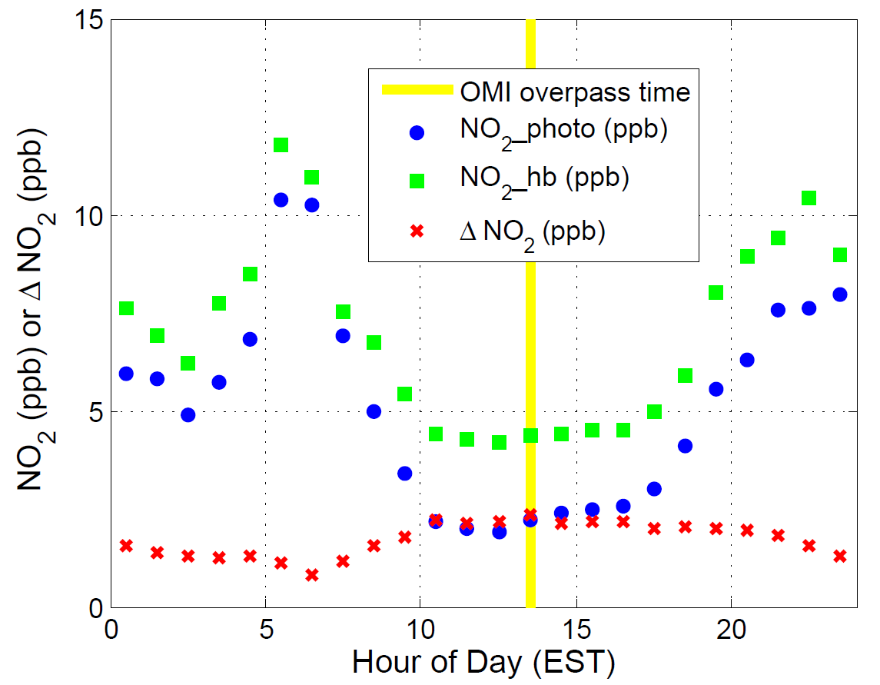
Why evaluate EPA’s Method for NO₂?
Baltimore, MD (July 2011)
FRM is subject to interferences from higher oxides of nitrogen (PANs or ANs).
During summer of 2011, in Baltimore, we observed the interference in the FRM monitor overpredicts by ~50% during the hours surrounding noon.
Difference is correlated with ozone → implies interference is related to photochemical activity.
FRM (ppb)
ΔNO₂ = FRM_NO₂ – photo_NO₂

Slide 8
EPA’s NO₂ Methods Development
A recently designated Federal Equivalent Method (FEM) replaces the headed bed conversion cell with a photolysis cell. (NO₂ + hv → NO + O; hv = 350-420 nm)
photolytic-
chemiluminescence
NO_{x} channel
NO + O₃ rxn chamber
Photolysis cell
λ~ 400 nm
PMT
Ambient air
NO channel
O₃ generator
Advantages: more specific to NO₂; provides an NO measurement
Disadvantages: non-unity conversion efficiency; still an indirect technique

Slide 9
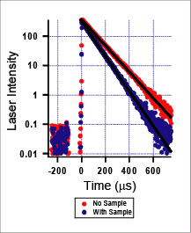
EPA’s NO₂ Methods Development
Commercial, direct, optical methods have recently become available and are being investigated.
Measurement based on light absorption at 405 or 450 nm.
Two methods based on a cavity-enhanced method have been designated as FEMs.
Cavity Ring-Down Spectroscopy:
Gas Sample
Laser or LED
PMT
τ₀
τ
Advantages: direct method, fast (10 seconds)
Disadvantages: measures light absorption at 405 or 450 nm as NO₂; no NO measurement

Slide 10
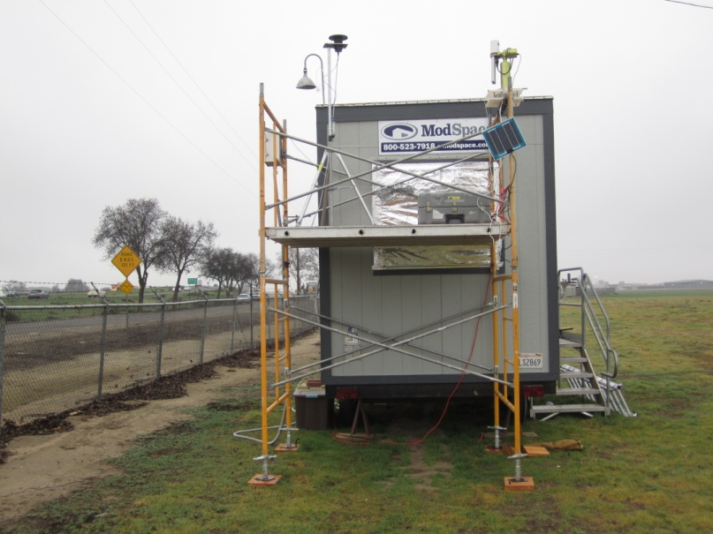
EPA’s NO₂ Methods Development
Visalia, CA
Visalia Municipal Airport (SJVAPCD site)
inlets ~35m from CA-99 (60,000 AADT); 17% heavy duty truck traffic
Thermal conversion, Photolytic conversion, and CRDS analyzers compared

Slide 11
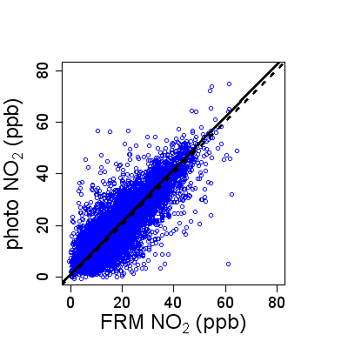
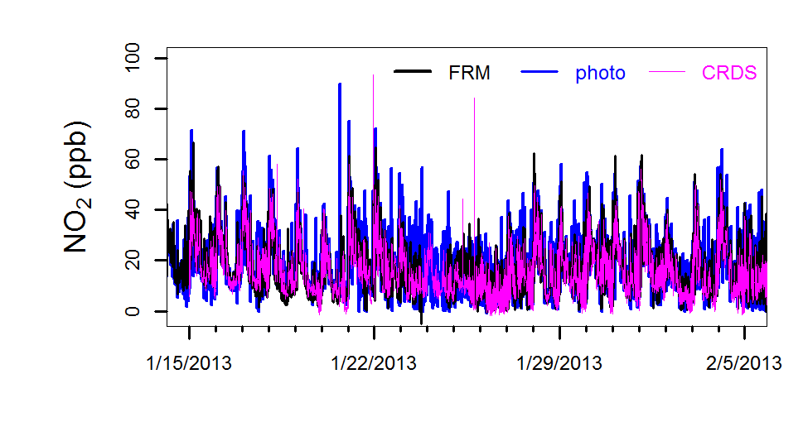
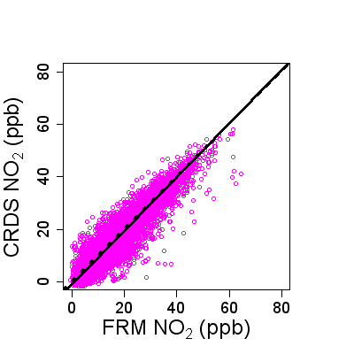
Visalia Municipal Airport Results
y = 1.02x+0.95
R² = 0.79
21 days, 1 minute data
Overall, good agreement
More scatter between indirect methods than between direct and indirect. Why?
y = 1.03x-1.22
R² = 0.88

Slide 12
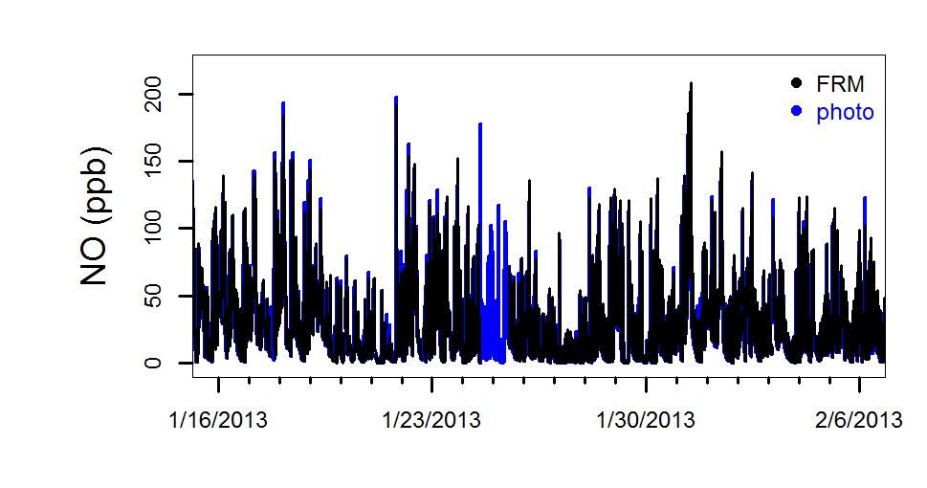
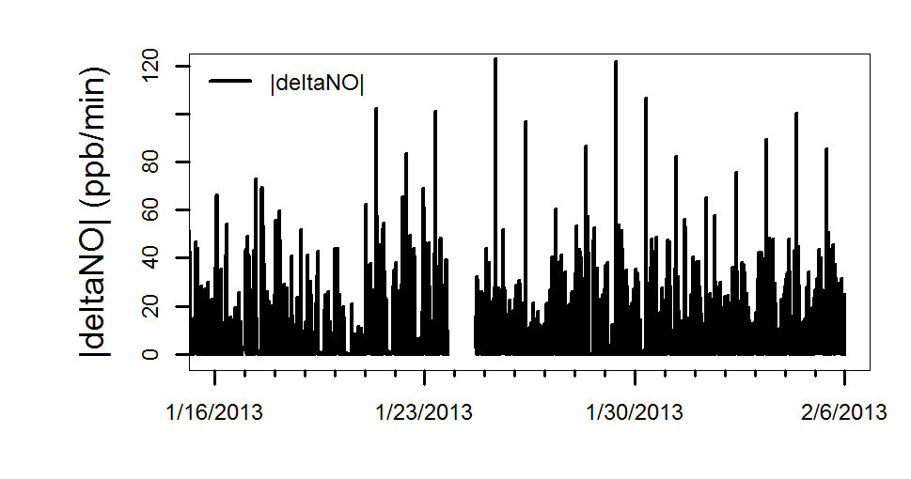
Visalia Municipal Airport Results
Could the scatter be related to the NO mixing ratios?
|deltaNO|= absolute value of the difference between adjacent NO data points.

Slide 13
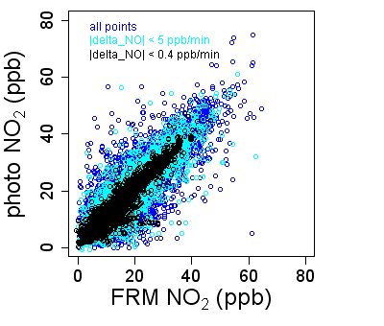
Visalia Municipal Airport Results
 | fit | R² | n
All points | y=1.0x+1.0 | 0.79 | 24,468
|ΔNO| < 5ppb/min | y=1.0x+1.3 | 0.85 | 15,954
|ΔNO| < 0.4ppb/min | y=0.99x+1.4 | 0.90 | 7,900
Under conditions with slowly changing NO, less scatter between the two indirect methods.
The comparison between the direct and FRM analyzers doesn’t depend on the NO concentrations.
Hypothesis: the NO₂ concentrations are affected by the switching between the NO and NOx channels during quickly changing NO distributions.

Slide 14
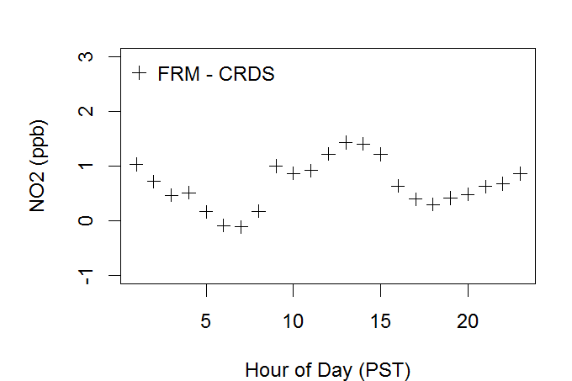
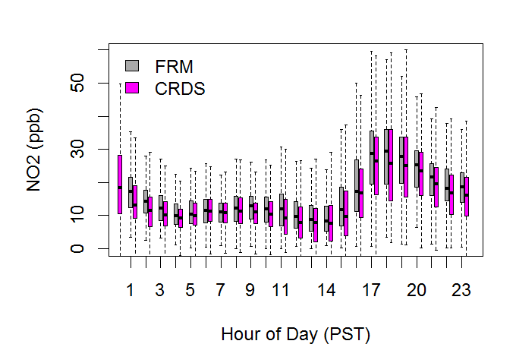
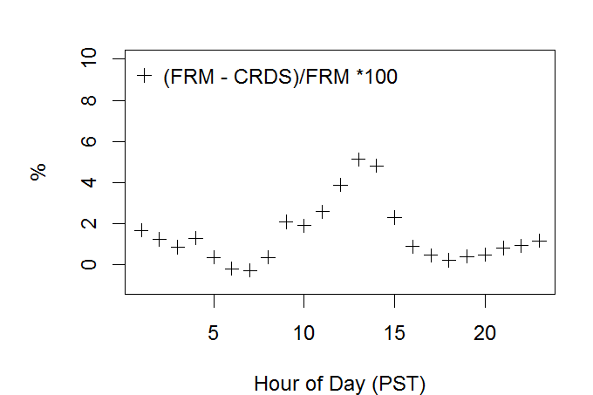
Visalia Municipal Airport Results
Did we see any interference in the FRM NO₂ measurement from higher oxides of nitrogen during the SJV deployment?
~ 5% during midday hours

Slide 15
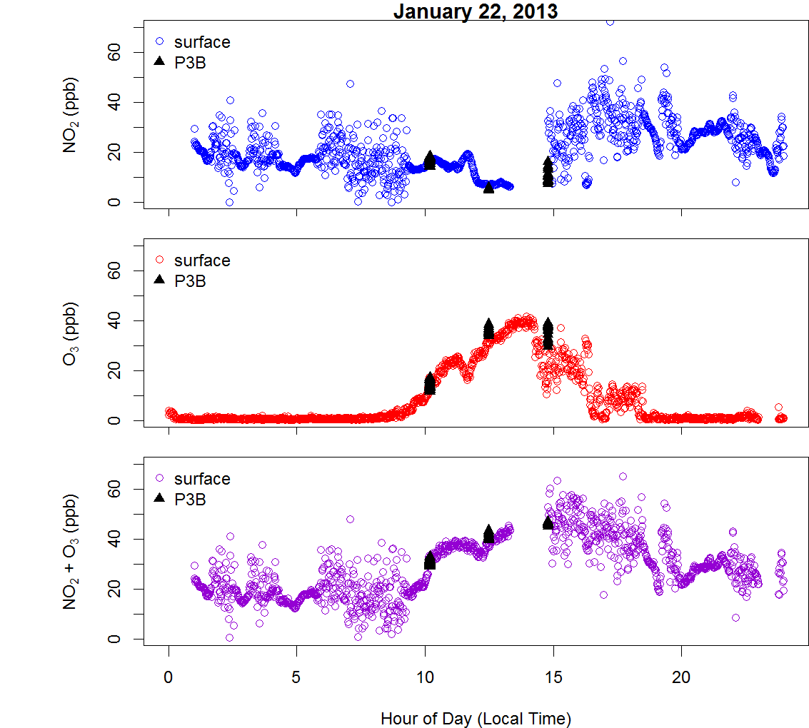
Ground site data compared with P3B Missed Approaches
Radar altitude during missed approaches between 30-40 m AGL.
On January 22, 2013, surface and P3B NO₂ and O₃ were in good agreement.

Slide 16
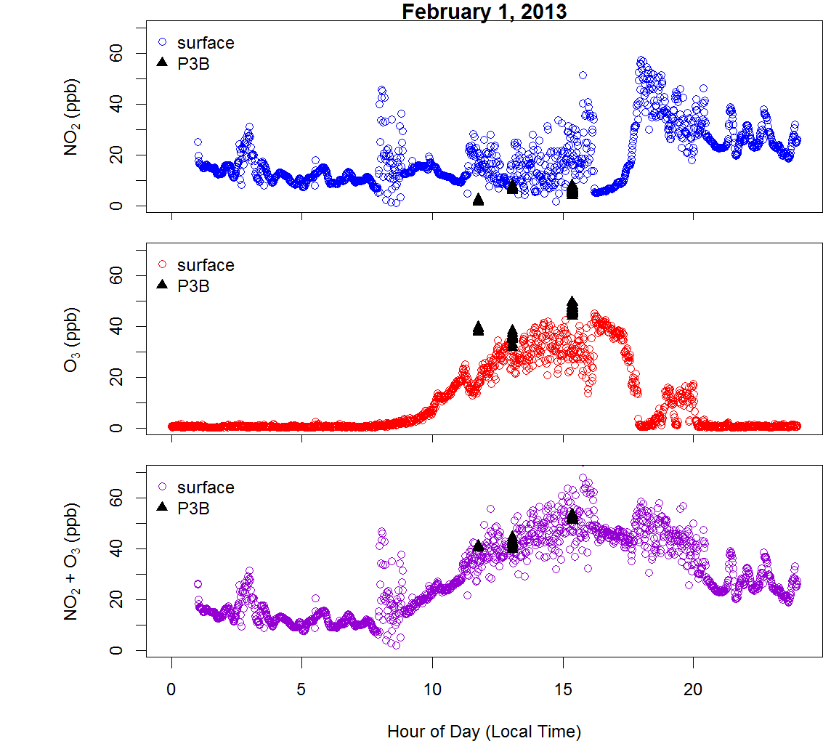
Ground site data compared with P3B Missed Approaches
Radar altitude during missed approaches ~35 m AGL.
On February 1, 2013, surface and P3B NO₂ and O₃ were in good agreement during 2 of 3 missed approaches.
Elevated surface NO₂ was observed on the first missed approach of the day (~10:00 local time)
The sum of NO₂ and O₃ were in good agreement during all 3 missed approaches.

Slide 17
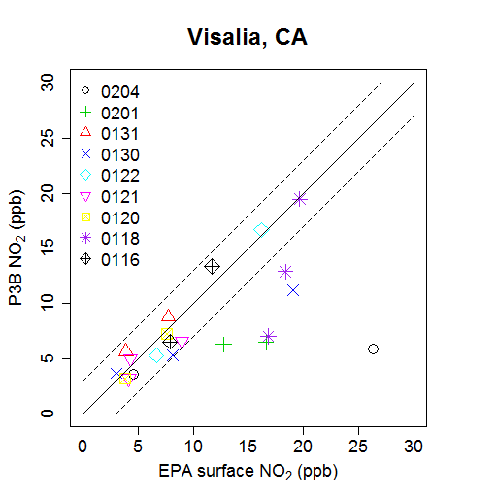
Ground site data compared with P3B Missed Approaches
21 Missed Approaches with concurrent surface and P3 data
Median altitude of missed approaches = 35 m
Surface monitors observed higher NO₂ than P3 on Feb04, Feb01, Jan30, and Jan18

Slide 18
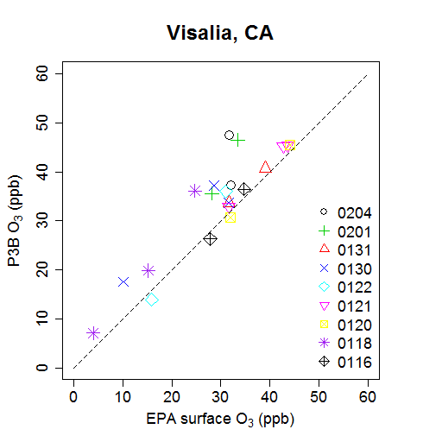
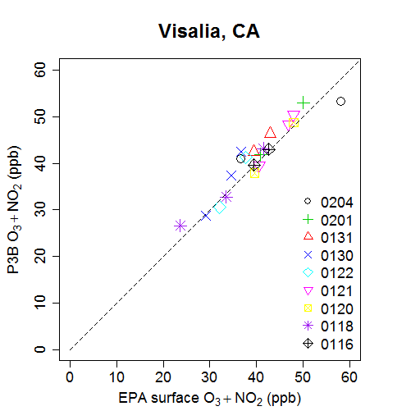
Ground site data compared with P3B Missed Approaches

Slide 19
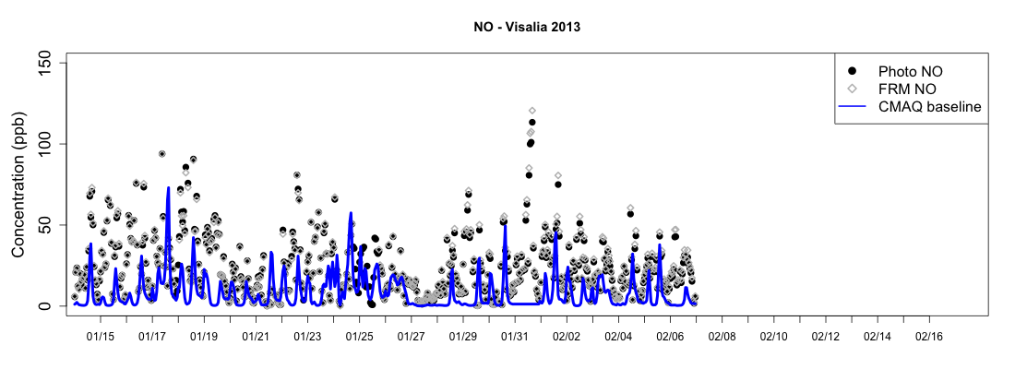
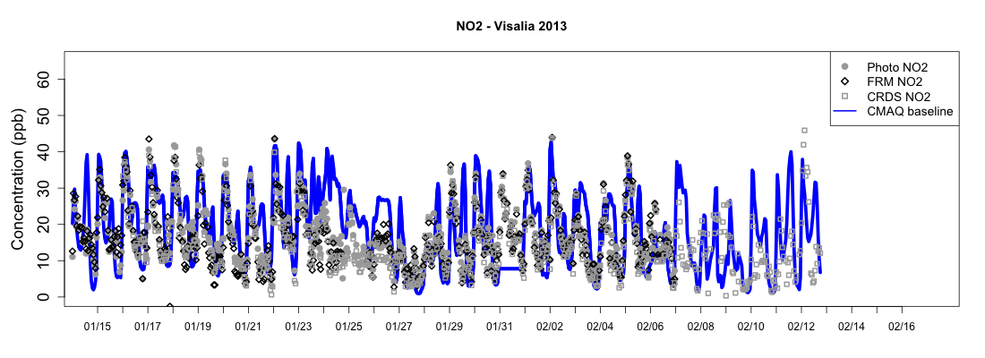
Model/Observation Comparison at Visalia: NOx

Slide 20
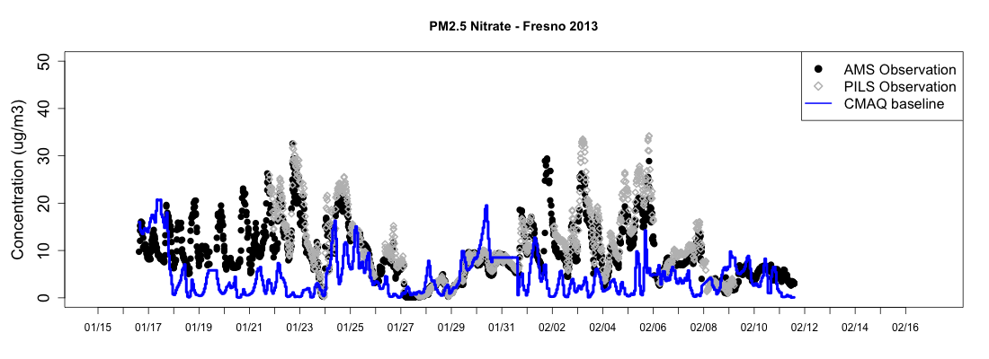
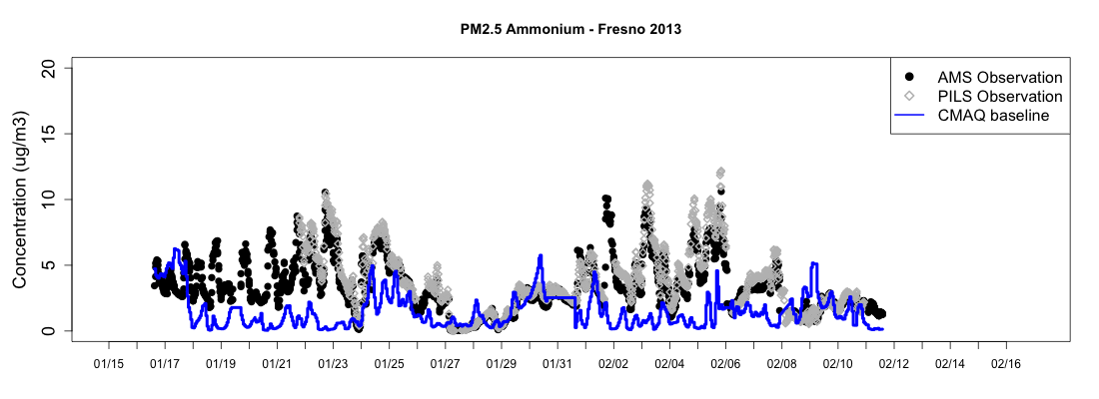
Model/Observation Comparison at Fresno: PM components

Slide 21
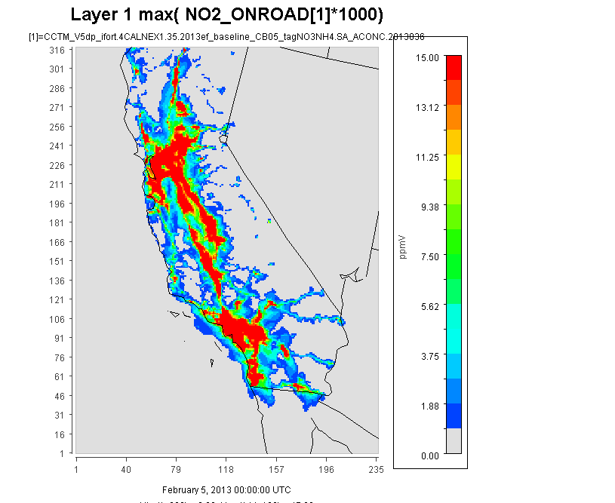
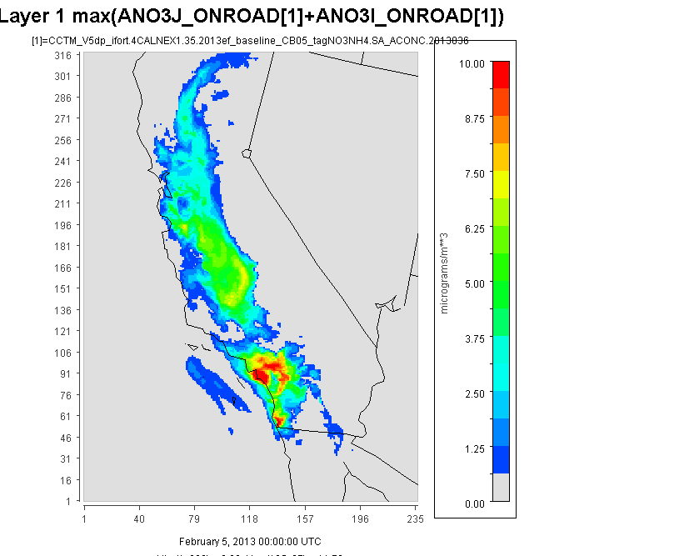
Source Apportionment of PM_{2.5} Ammonium Nitrate using CMAQ
Contribution of onroad NOX emissions to modeled NOX mixing ratios
Contribution of onroad NOX emissions to modeled PM_{2.5} nitrate ion conc.

Slide 22
Conclusions
Differences amongst NO₂ monitoring methods were observed at the near-roadway, and these differences are the most pronounced under conditions with rapidly changing NO_{x} distributions.
Direct optical methods are preferable to the indirect methods in these locations.
NOz Interferences in the FRM were <10% at the Visalia site.
Good agreement between (NO₂+O₃)_{surface} and (NO₂+O₃)_{P3B} at all missed approaches over the Visalia Airport.
Despite the low altitudes of these missed approaches (~35m), ozone titration events were observed during ~20% of the missed approaches.
We are conducting model evaluations using the DISCOVER-AQ dataset along with CMAQ source apportionment tools to better understand PM formation and improve emissions in California’s San Joaquin Valley.

Slide 23
Acknowledgements
NASA (Jim Crawford, Ken Pickering, Mary Kleb, Luci Crittenden)
SJVAPCD (Nathan Trevino)
City of Visalia (Mark Bettencourt)
MDE (Jennifer Hains, Ryan Auvil)
DISCLAIMER – Although this work was reviewed by EPA and approved for presentation, it may not necessarily reflect official Agency policy.

Slide 25
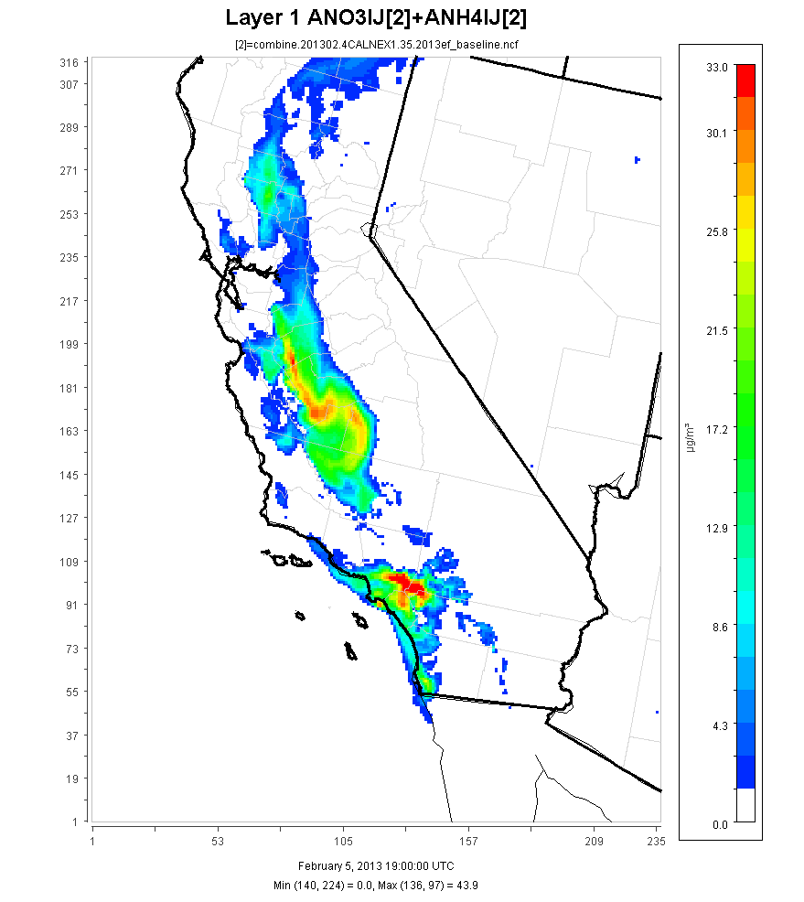
Modeled Jan and Feb 2013 to match DISCOVER-AQ field intensive in San Joaquin Valley
CMAQ v5.0.2
SAPRC07 gas-phase chemistry
ISORROPIA2 inorganic chemistry
4 km resolution domain (right)
35 vertical layers
2013 EGU (and fires)
2011 NEI v1 based emissions for all other sectors
BEIS v3.14 biogenic emissions
WRF v3.5.1 meteorology

Slide 26
Ground site data compared with P3B Missed Approaches

Slide 27
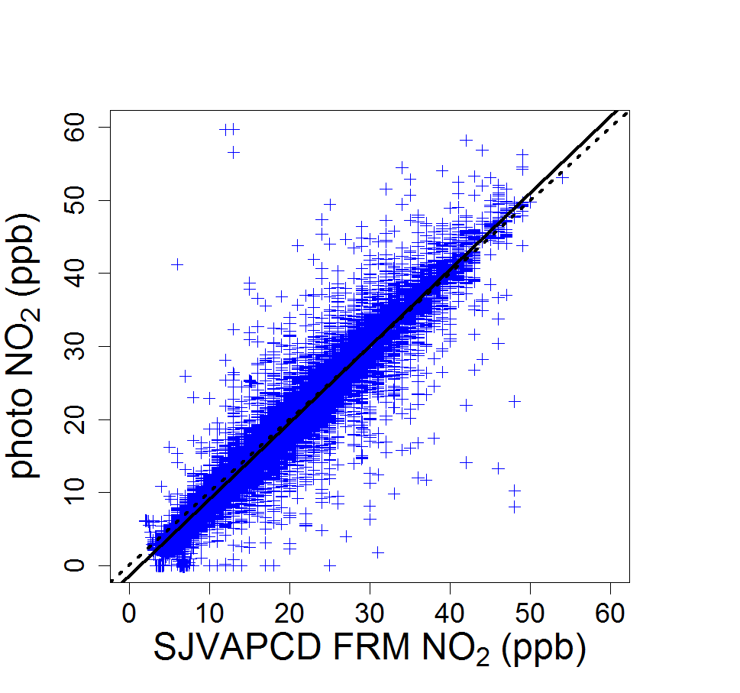
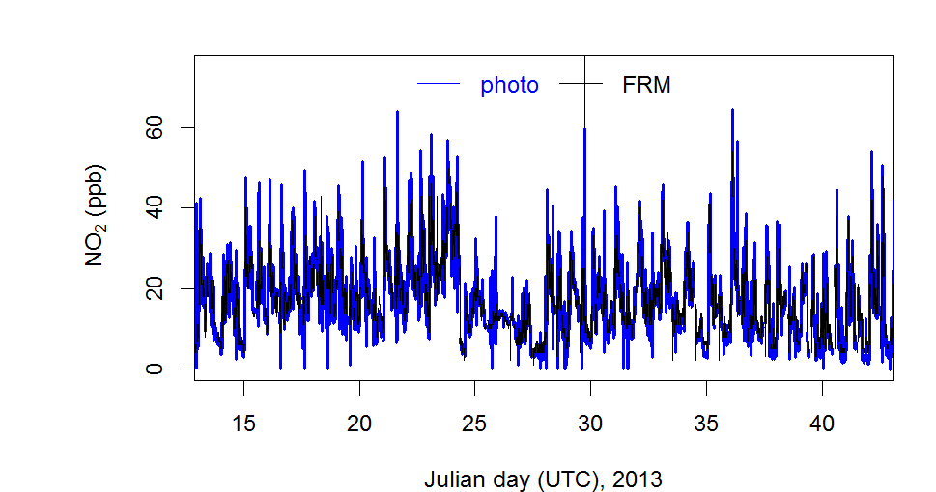
Bakersfield Municipal Airport Results
y = 1.05x-1.4
R² = 0.86

Slide 28
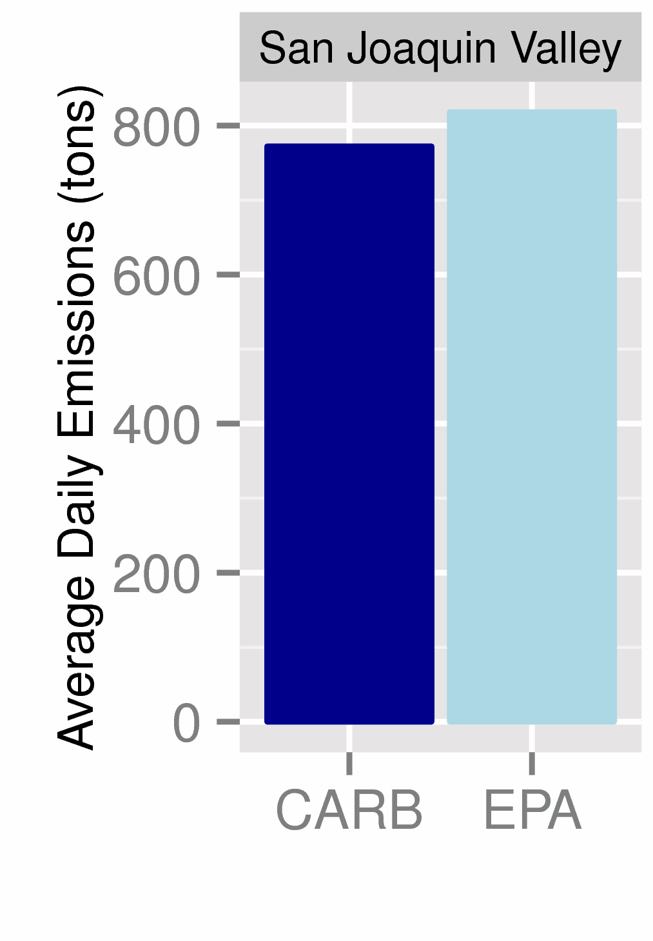
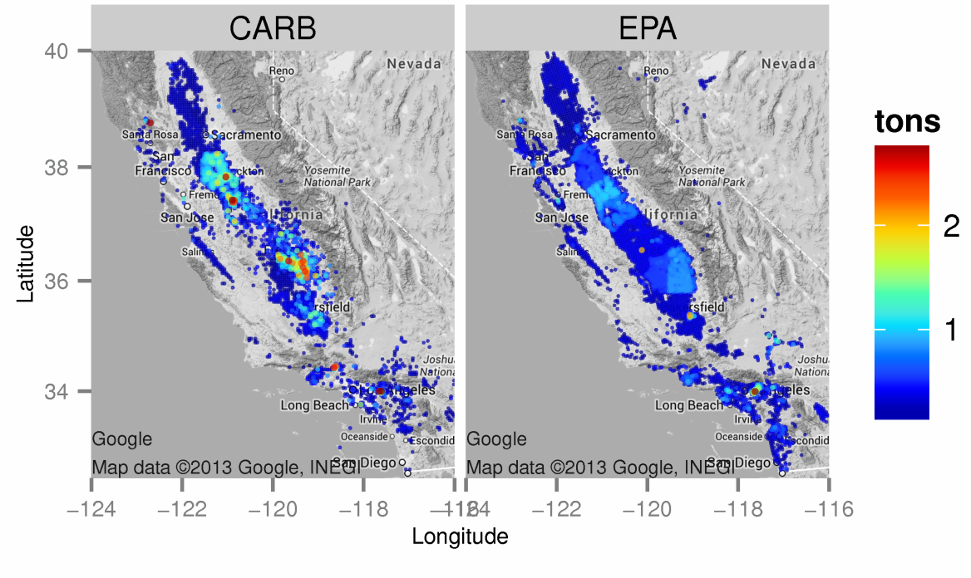
Working towards improved NH₃ emissions
Average daily total NH₃ emissions in SJV are similar for CARB and EPA inventories (left)
Spatial allocation of NH₃ emissions differs in SJV: CARB’s emissions are more concentrated in major source regions than EPA’s (right)

Slide 29
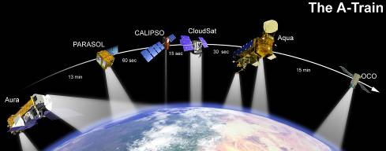

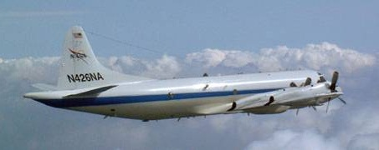
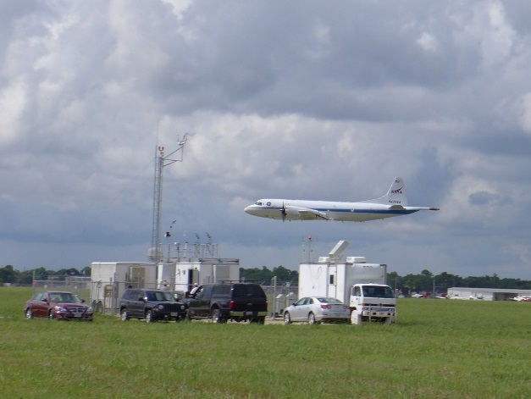
DISCOVER-AQ 2013 – San Joaquin Valley, CA
Deriving Information on Surface Conditions from Column and Vertically Resolved Observations Relevant to Air Quality
Success of study relies on quality measurements of gas and particle species (and properties) aloft and at the surface
NASA King Air
NASA P-3B
EPA, State, Local, and Temporary Ground sites

Slide 30
EPA’s NO₂ Methods Development
Visalia, CA
Bakersfield, CA
Visalia Municipal Airport (SJVAPCD site)
inlets ~35m from I-99 (60,000 AADT); 17% heavy duty truck traffic
Thermal conversion, Photolytic conversion, and CRDS analyzers compared
Bakersfield Municipal Airport (SJVAPCD site)
SE of downtown Bakersfield
Thermal conversion and Photolytic conversion analyzers compared

Slide 31
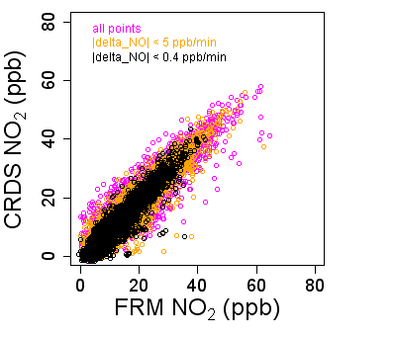
Visalia Municipal Airport Results
 | fit | R² | n
All points | y=1.0x+1.0 | 0.79 | 24,468
|ΔNO| < 5ppb/min | y=1.0x+1.3 | 0.85 | 15,954
|ΔNO| < 0.4ppb/min | y=0.99x+1.4 | 0.90 | 7,900
 | fit | R² | n
All points | y=1.0x-1.2 | 0.88 | 19,000
|ΔNO| < 5ppb/min | y=1.0x-1.5 | 0.88 | 13,821
|ΔNO| < 0.4ppb/min | y=1.05x-1.7 | 0.88 | 6,851

Slide 32
Evaluation of EPA’s NO₂ Method
 | FRM | Photo | CRDS
Measurement approach | Thermal conversion-chemiluminescence | Photolytic conversion-chemiluminescence | Direct, optical technique (cavity ring down spectroscopy)
Designation | FRM | FEM | FEM*
Advantages | Long term record; provides an NO measurement | More specific; provides an NO measurement | Direct; fast response
Disadvantages | Interference from higher oxides of nitrogen (NOz species); indirect method | Non-unity conversion efficiency; indirect method | Other absorbers at 405 or 450 nm (rare!); no NO measurement
FRM = Federal Reference Method; FEM = Federal Equivalent Method

Slide 33
Evaluation of EPA’s NO₂ Method
 | FRM | Photo | CRDS
Measurement approach | Thermal conversion-chemiluminescence | Photolytic conversion-chemiluminescence | Direct, optical technique (cavity ring down spectroscopy)
Designation | FRM | FEM | FEM*
Advantages | Long term record; provides an NO measurement | More specific; provides an NO measurement | Direct; fast response
Disadvantages | Interference from higher oxides of nitrogen (NOz species); indirect method | Non-unity conversion efficiency; indirect method | Other absorbers at 405 or 450 nm (rare!); no NO measurement
FRM = Federal Reference Method; FEM = Federal Equivalent Method

