Slide 1
Toward the integration of air quality and climate strategies at the state level
Daniel Cohan
CMAS Conference
October 29, 2014

Slide 2
Air quality and greenhouse gas challenges at the state level
Ozone attainment
Possible tighter NAAQS in December
PM attainment
Clean Power Plan would require states to meet power plant CO₂ targets for first time
Opportunities to integrate across these challenges?

Slide 3
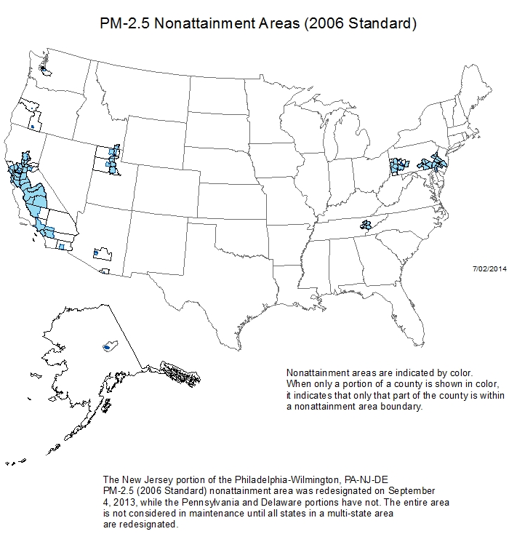
Ozone and PM Non-attainment

Slide 4
Lessons learned from ozone and PM SIPs (Pegues et al., 2012; Cohan and Chen, 2014)
Modeled attainment test performed well
Lack of integration across ozone and PM SIPs
Different regional boundaries and deadlines
Most ozone plans did not consider impact of their NO_{x} and VOC controls on PM
Health benefits not quantified
Costs and emissions reductions not always quantified on measure-by-measure basis

Slide 5
Performance of Ozone SIP Model Predictions
Pegues et al., JA&WMA 2012

Slide 6
Performance of PM_{2.5} SIP model predictions
Cohan and Chen, JA&WMA 2014

Slide 7
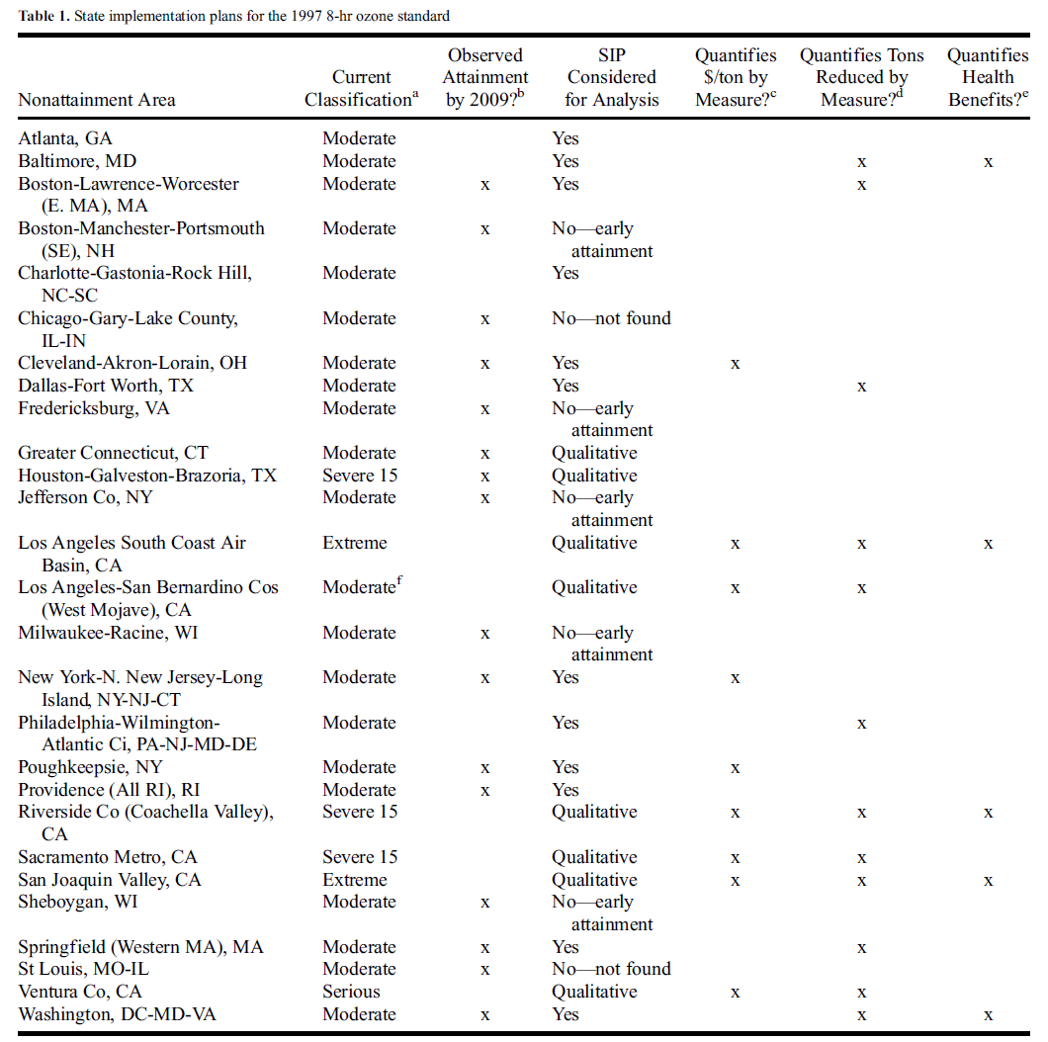
Cost and benefit quantification in ozone SIPs
Pegues et al., 2012

Slide 8
US EPA Proposed Clean Power Plan
30% reduction in power plant CO₂ nationally by 2030 from 2005 levels
Interim standard for 2020-2029
Target for each state, or share across states
Flexibility for efficiency, demand reduction, renewables, fuel switching, carbon capture
State plans would be due June 30, 2016
Can add 1-2 years to finalize commitments
Ozone SIPs due in 2015; later if new NAAQS

Slide 9
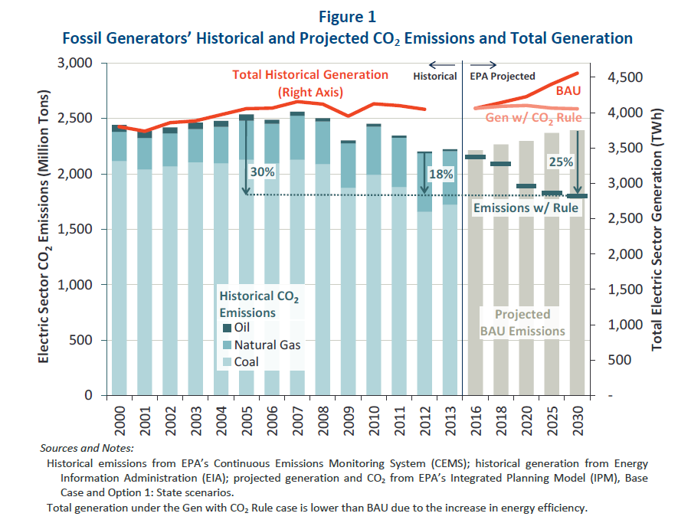
Projected impact of Clean Power Plan on CO₂ and Electricity Generation
Brattle Group based on EPA RIA and EIA data

Slide 10
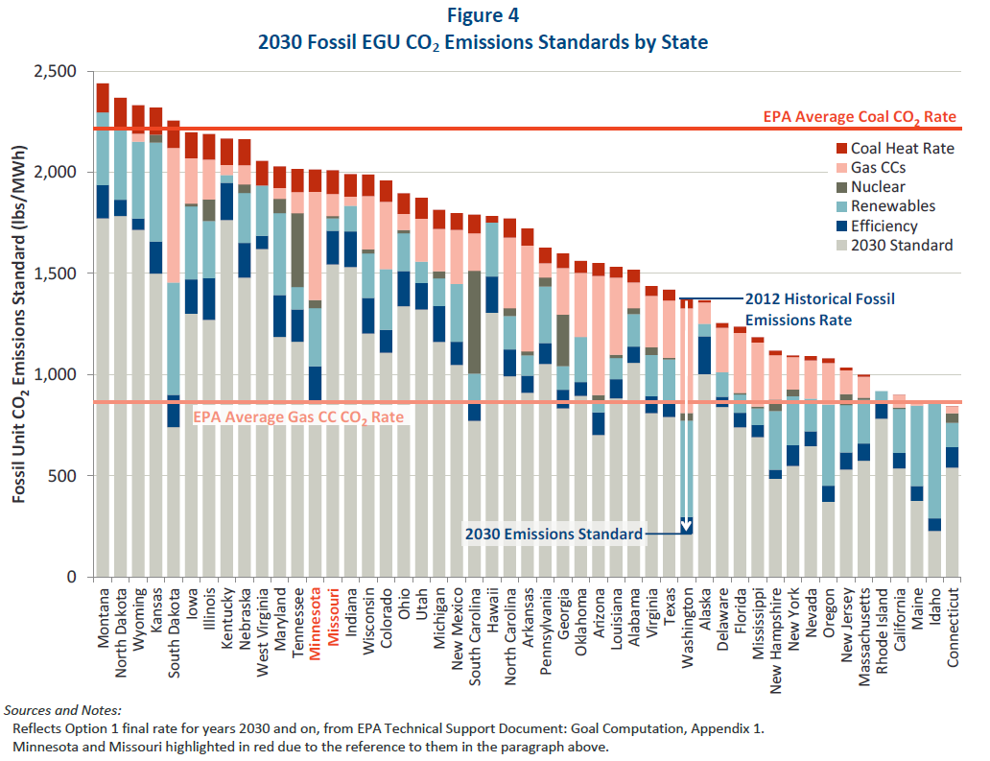
EPA projections of how states might meet Clean Power Plan standards
Brattle Group

Slide 11
Implications of state Clean Power Plan choices for air quality and health
EPA projects 2700-6600 premature deaths, 140-150k asthma attacks averted annually
Actual impacts depend on how targets are met
Nuclear, renewables, and reduced demand would nearly eliminate offset coal emissions
Natural gas would avert SO₂, reduce NO_{x}
Heat rate improvements or carbon capture at coal plants might yield little air quality benefit
Location of the averted coal emissions matters for attainment and health

Slide 12
Challenges to integrating Clean Power Plan with ozone and PM SIPs
More than a dozen states have sued
Additional agencies involved: public utility commissions, energy agencies, grid operators
Different timelines and geographic scope
CO₂ controls likely to occur after NAAQS deadlines
Separate policy structures for control
Ambient standards for criteria pollutants
Emissions reduction targets for CO₂
Lack of experience integrating AQ and ghg control

Slide 13
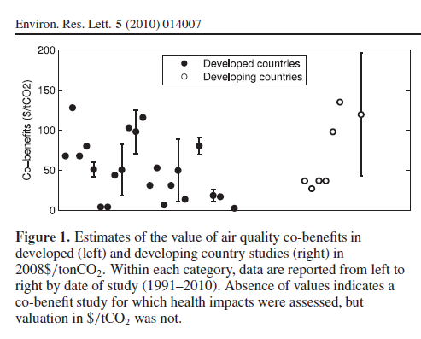
Air quality co-benefits uncertain, can be comparable to climate benefits
Air quality co-benefits*: $49/tCO₂ ($2-$196 depending on study)
Climate impact of CO₂ reductions**: $43/tCO₂ ($12-64 depending on discount rate)
**From US Interagency Working Group, for 2020 with 3% discount rate
*Nemet et al., 2010

Slide 14
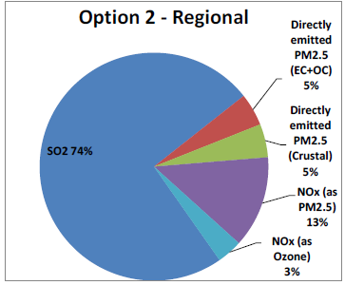
SO₂ (PM) is expected to dominate health impact of Clean Power Plan
US EPA Regulatory Impact Analysis of Clean Power Plan, 2014

Slide 15
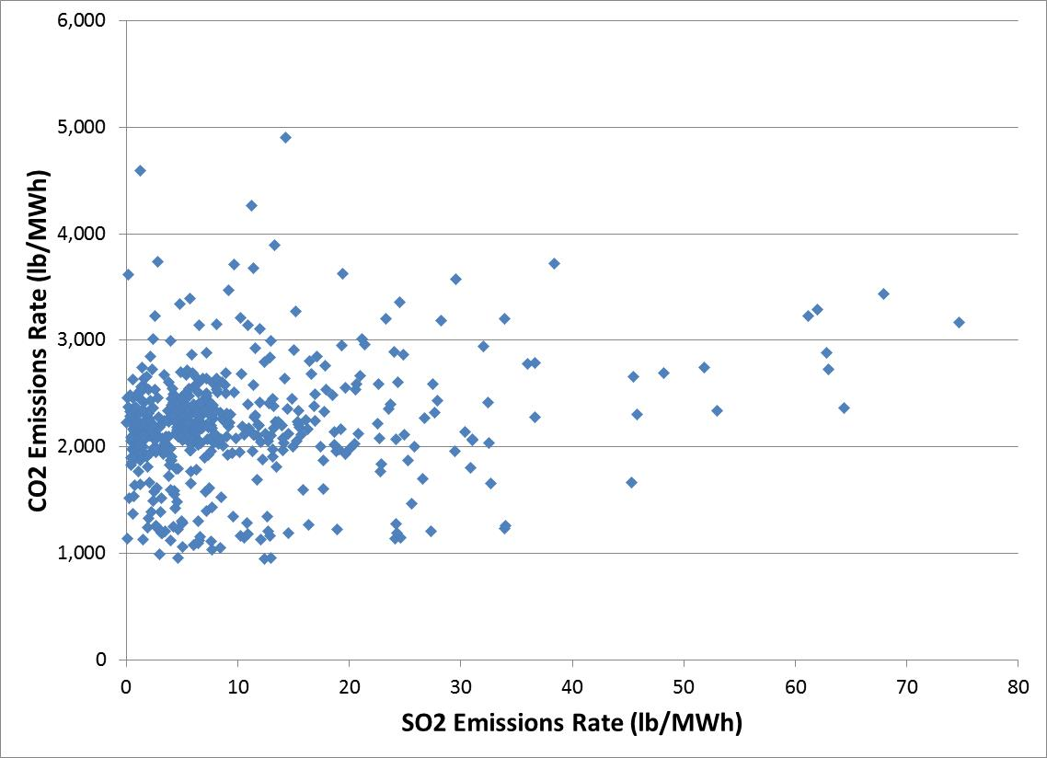
CO₂ and SO₂ emission rates of coal-fired power plants not well correlated
Based on EGRID data for 2010

Slide 16
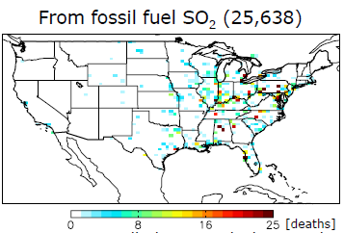
Health impacts of SO₂ control depend on location (adjoint modeling by D. Henze)
Daven Henze presentation to AQAST4

Slide 17
Separate approaches to attainment
Ozone NAAQS
PM NAAQS
Clean Power Plan
NO_{x} and VOC control options
NO_{x}, VOC, SO₂, NH₃, and PM control options
Power sector CO₂ control options
Ozone Attainment Modeling
PM
Attainment Modeling
Power
Sector
modeling
Health Benefits Assessment
Health Benefits Assessment
Co-Benefits Assessment

Slide 18
Joint Attainment of NAAQS & Clean Power Plan
Jointly consider ozone, PM, and CO₂ control options
AQ modeling of ozone and PM attainment
Power sector modeling to inform strategy
Location-specific impacts influence strategies
Impacts inform strategy selection (Wesson et al 2010; Fann et al 2011)
Co-benefits inform strategy selection
Health Benefits Assessment
Co-Benefits Assessment

Slide 19
Integrating Clean Power Plan with NAAQS Attainment
Problem Definition
Goals and Objectives
Constraints
Policy options to consider
Atmospheric Modeling
Simulate impacts on ozone and PM via:
Scenario analyses
Decoupled direct method
Adjoint method
Energy Modeling
Heat rate, new source, and control options
Capacity investments
Dispatch modeling
Energy supply, demand, and prices

Slide 20
Defining the challenge
Objectives and constraints
Attain Clean Power Plan at minimal cost?
Quantify AQ and health co-benefits of chosen strategy
Attain CO₂, O₃, and PM rules at minimal cost?
Attain CO₂, O₃, and PM rules at optimal net benefits?
Requires valuation of health benefits and CO₂
Consider upstream emissions?
Clean Power Plan policy scenarios
Renewable portfolio standards?
Efficiency programs?
Cap-and-trade or emissions fees?
Facility-by-facility approaches?
State-by-state or multi-state?
Informed by location-specific impacts??

Slide 21
Photochemical modeling approaches for simulating benefits of controls
Scenario modeling: Impact of set of scenarios
Decoupled direct method: Simulate impact of defined sources on all pollutants
Adjoint modeling: Simulate response of aggregate impact metric to all sources
Health benefits model: Link BenMAP or other tool to each of above to quantify impacts

Slide 22
Energy modeling options: Integrated Planning Model
Used by EPA for RIA of Clean Power Plan
Identified expected approach to compliance, with co-benefits quantified later
Multi-region, dynamic linear programming electric sector model
Proprietary model not readily available to states and others
Efforts to develop alternative model

Slide 24
NESCAUM approach to integrating GHG and air quality co-benefits (Applied with NYSERDA to New York)

Slide 25
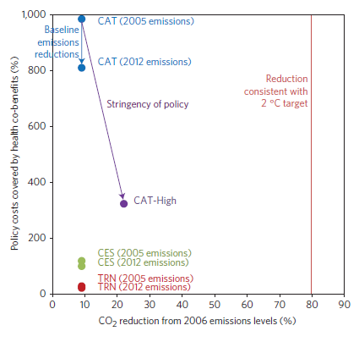
Integration of energy, photochemical, and health models to compute co-benefits (Thompson et al., Nature Climate Change 2014)
MIT US Regional Energy Policy Model
SMOKE
CAMx
BenMAP
Economy-wide cap and trade (CAT) achieved lower costs (and thus higher co-benefits per cost) than electricity (CES) or transportation (TRN) sector policies

Slide 26
Linking ReEDS and RWGTM to simulate electricity sector scenarios
Regional Energy Development System
Capacity expansion model developed by NREL
Detailed representation of electricity generation, transmission, and renewable resources
Projects cost-optimized electricity technologies to meet constraints every two years through 2050
Rice World Gas Trade Model
Dynamic spatial general equilibrium model
Optimizes resource extraction and capacity expansion
Adapting to provide natural gas price supply curves to ReEDS for each region of United States

Slide 27
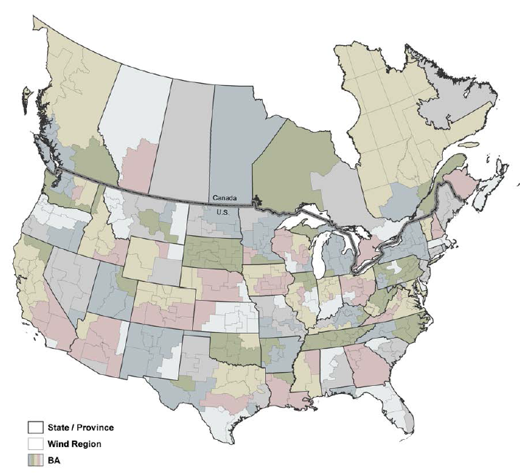
Electricity modeling regions in ReEDS
NREL

Slide 28
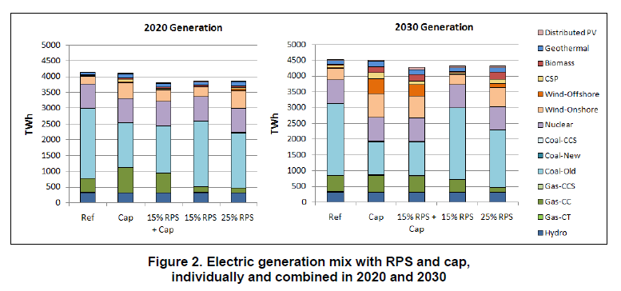
Previous applications of ReEDS to analyze impacts of RPS and CO₂ cap
NREL, 2010

Slide 29
Plan for ReEDS-RWGTM modeling
Simulate state-by-state and regional options under Clean Power Plan
Cap-and-trade
Renewable portfolio standard
Demand-side measures
Simulate interactions between natural gas supply, prices, and exports and electric sector capacity expansions and deployment
Subsequent work to consider dispatch

Slide 30
Conclusions
Clean Power Plan provides opportunities and challenges for achieving air quality co-benefits from CO₂ reductions
Atmospheric models and energy systems models can inform strategy development
Choices for how to consider AQ co-benefits in state plans for Clean Power Plan
Quantify impacts of Clean Power Plan approach?
Inform selection of Clean Power Plan approach?
Influence design of options?

