Slide 1
Connecting Fine-scale Air Quality Modeling of Traffic-Related Pollutants with EPA’s EnviroAtlas
Shih Ying Chang^{1,2} (Changsy, Presenter)
Sarav Arunachalam¹, Brian Naess¹, Kevin Talgo¹, Alejandro Valencia¹,
Vlad Isakov³, Ted Palma⁴, Laura Jackson³, Michael Breen³
Institute for the Environment, University of North Carolina
Department of Environmental Sciences and Engineering, University of North Carolina
Office of Research and Development, U.S. Environmental Protection Agency
Office of Air Quality Planning & Standards, U.S. Environmental Protection Agency
Notes:
Good afternoon everybody. Thanks for coming. I am Changsy, a PhD student here in UNC. Today I’d like to talk about a method we developed that allows rapidly modeling traffic-related air pollutant at census block level and it’s possible application with EPA’s EnviroAtlas

Slide 2
Outline
Introduction
Objective
Methodology
Results
Application with EnviroAtlas
Summary
Future work
Notes:
Difference between LAST YEAR’s talk.

Slide 3
Introduction
The importance of on-road emission source
11%
22%
15%
PM_{2.5} from road transportation causes 53,000 premature death per year
(Caiazzo et al. Atmos. Environ. 2013)
Source: EPA National Air Toxics Assessments (NATA) 2005
Source: Rowangould, Transport Research Part D, 2013
Source: EPA National Emission Inventory
Notes:
Why do we care about near-road air quality? On average, 19% of the population in US lives close to the roads. However, if we look at the distribution map, some counties have up to 79% of population living close to the roads. But why is that important? It turns out that onroad traffic is a big pollution source. For example, onroad traffic accounts for more than 50% of NOx emission and ~39% of Benzene emission nationwide. As for PM2.5, although onroad source accounts for only 5% of emission, it is currently the most harmful pollutant that can affect human health. That is to say, the population living close to the roads is living close to a major pollution source. And from NATA 2005, we see that onroad emission is responsible for 15% of cancer risk, 22% of respiratory risk, and 11% of neurological risk. Benzene is an example for MSATs

Slide 4
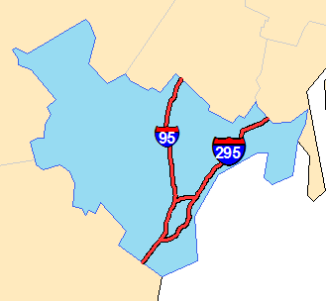
Previous approaches treating sources
National Air Toxics Assessments (NATA)
allocate
Lose the ability to capture gradients from roadways
“Bottom up” (Explicit) approach (Cook et al. J A&WMA 2008)
Time consuming when applied to a large domain
Notes:
NATA: top down

Slide 5
Objective
Provide traffic-related air quality fields in fine resolution to support exposure assessment study nationwide
  8.2 million census blocks to avoid exposure misclassification (Batterman et al. Atmos. Environ. 2014)
Develop approach to speed up the modeling process without sacrificing too much accuracy
Evaluate the approach at Cumberland County, Maine and Detroit, Michigan
Examples in North Carolina Piedmont region; Tacoma, Washington; Portland, Oregon
Possible application connecting EPA’s EnviroAtlas
Notes:
To support ongoing Health Studies in these domains.

Slide 6
Methodology
on-road
Step 1: RLINE (Snyder et al. Atmos. Environ. 2013) METeorologically weighted Averaging for Risk and Exposure (METARE)
Step 2: Spatio-Temporal Ordinary Kriging (STOK Arunachalam et al. Int. J. Environ. Res. Public Health, 2014)
Step 3: Hybrid for total concentration
background
Notes:
Here comes the methodology. We have a three-step approach in this study. The first step is to use RLINE with Annual Average Daily traffic combining with stability array method to provide on-road concentration. The second step is to use the Spatio-Temporal Kriging to provide a background concentration. And the last step is to simply combine these two to provide a total concentration.

Slide 7
Develop emission inputs
Step 1: METARE Step 2: STOK Step 3: Hybrid
MOVES emission factor
Speed
  MOVES input data
Vehicle Type
  8 types:
    LDGV, LDGT 1, LDGT 2, HDGV, LDDV, LDDT, HDDV, MC
    Table VM-4 from the FHWA Statistics Series convert with EPA Emission Inventory Improvement Program
*Road Type
  12 national function class (NFC) types:
    Rural Interstate, Rural Principal Arterial, Rural Minor Arterial, Rural Major Collector, Rural Minor Collector, Rural Local, Urban Interstate, Urban Freeway, Urban Principal Arterial, Urban Minor Arterial, Urban Collector, Urban Local
*Traffic Count
  Annual Average Daily Traffic (AADT)
Temperature
  Temperature bins in Summer and Winter
  Map with AERMET output from 824 National Weather Service (NWS) sites in the U.S.
Vehicle type
Speed
Temperature
NFC
  * from Freight Analysis Framework (FAF3), Federal HighWay Administration (FHWA)
Notes:
To run RLINE, one important thing is to get the emission right. Luckily, EPA provides emission factors from MOVES. MOVES categorizes the emission factor based on Vehicle type, Speed, Temperature, and road type at county level. It does not provide the emission for a specific road. Instead, it tells you that at a specific county, if you have a vehicle, for example, a heavy duty diesel truck, running at 70 m/h on an interstate freeway when the temperature is 100 degree, the emission factor of that vehicle would be a specific value. So, to use this MOVES output, we need to have the information about the actual roads. So here I show the data source in this study, for vehicle speed, I took the MOVES input data, and for vehicle type, I use Table VM-4 from the federal highway administration statistics series and convert that with EPA Emission inventory improvement program. For road type and traffic count, we gather the information from Freight Analysis framework provided by federal highway administration and we get the temperature from AERMET output from 824 NWS sites in the U.S.

Slide 8
Explicit VS. METARE
Step 1: METARE Step 2: STOK Step 3: Hybrid
Explicit
METARE

Slide 9
METeorologically weighted Averaging for Risk and Exposure (METARE)
Step 1: METARE Step 2: STOK Step 3: Hybrid
Use representative hours instead of actual hourly meteorological data
Scale model output to annual average concentration using weights
1 year: 8760 hours
Monin-Obukhov length: 5 categories
Unstable, Slightly Unstable, Neutral, Slightly Stable, Stable
Wind Direction: 4 categories
North, East, South, West
Wind Speed: 5 categories
0~1, 1~2, 2~4, 4~7, >7
1 year: 100 hours
Notes:
That is where the stability array comes into play. In an explicit model run, we have to run the model with 8760 hours of meteorological data to obtain hourly concentration for a whole year. With the STAR approach, we use representative hours instead of actual hourly meteorological data. So how does this work. Basically we group the met data based on 3 parameters, Monin-Obukhov length 5 categories, wind direction 4 categories, and wind speed 5 categories so that’s a total of 100 groups. Within each group, we use one hour of met data to present all the others that fall in that group. Also, we calculate the hour count for each group. For example, how many hours fall in the first group, and so on. Then we calculate the weight, which is the hour count in each group divided by 8760.

Slide 10
Steps 2 & 3
Step 1: RLINE-AADT-STAR Step 2: STOK Step 3: Hybrid
Step 2: Estimate Background concentrations from other sources
  Spatio-Temporal Ordinary Kriging (STOK)
  Use AQS observations as inputs to estimate field of background concentrations at census block resolution
  If AQS observations available, use STOK
    Hourly: PM_{2.5}, NOx, CO
    Daily: Acetaldehyde, Benzene, Formaldehyde, PM_{2.5} OC, PM_{2.5} EC, PM_{2.5} SO4
  Else, use estimates from NATA-2008
    Annual: 1,3-Butadiene, Acrolein
Step 3: Estimate total concentrations (Hybrid)
  Add onroad estimates to background concentrations at each census block centroid
  Spatio-Temporal variability provided in background concentration
  Spatial variability provided in onroad estimates
Notes:
That is where the STOK comes into play. Basically we use the kriging to interpolate the concentration at census block level with AQS observational data. In this study, if AQS observations are available, we use STOK. And that will give us Hourly variation for PM2.5, Nox, and CO and Daily variation for Acetaldehyde, Benzene, Formaldehyde, PM2.5 OC, EC, and SO4. if observational data are not available, we use the estimates from NATA-2008 which gives the annual background concentration at county level. And in the last step, we combine the output from step 1 and step 2 to obtain total concentration. Note that with this approach, we obtian spatio-Temporal variability in background concentration but the spatial variability specific to on-road emission comes from RLINE.

Slide 11
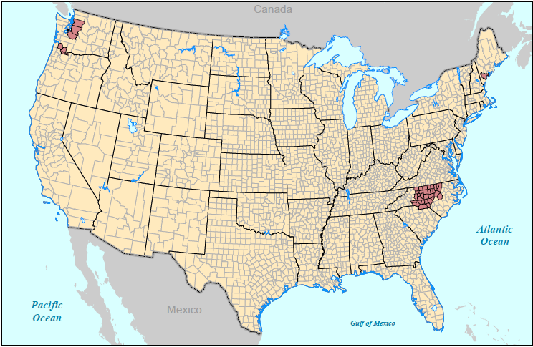
Portland, ME
Tacoma, WA
Portland, OR
NC Piedmont

Slide 12
METARE evaluation (Explicit VS. METARE)
Unit emission
CO
Benzene
R²=0.99
R²=0.95
R²=0.85
NO_{x}
PM_{2.5}
R²=0.97
R²=0.92
METARE demonstrates high R² when comparing to explicit approach

Slide 13
R-LINE evaluation (observation VS. model)
CO
NO_{x}
Base fleet
Sensitive fleet
Using proper fleet data can improve the results for NO_{x}

Slide 14
NO_{x}
PM_{2.5}
BENZENE
Portland, ME
NC Piedmont
Portland, OR
Tacoma, WA
The framework can capture the gradients from the roads

Slide 15

What is EnviroAtlas?
An online decision support tool giving users ability to view, analyze, and download geospatial data related to ecosystem services (nature’s benefits)
Geospatial indicators and indices of the supply, demand, and benefits of ecosystem services
Indicators of drivers of change
Reference data (e.g., boundaries, land cover, soils, hydrography, impaired water bodies, wetlands, demographics)
Analytic and interpretive tools
Developed through cooperative effort among multiple federal agencies and other organizations
Notes:
Blue box is key to mention…. Enviroatlas is developing metrics of the natural resources providing the services, the benefits derived, and the drivers of change.

Slide 16
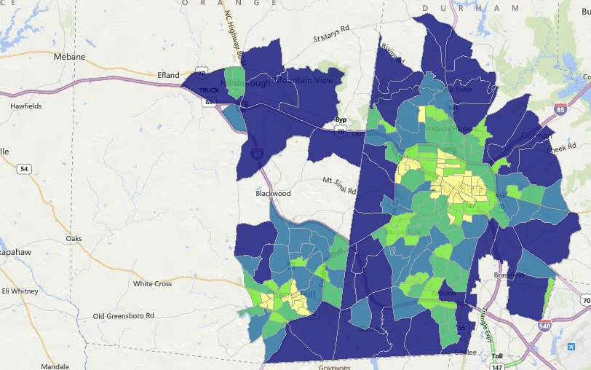
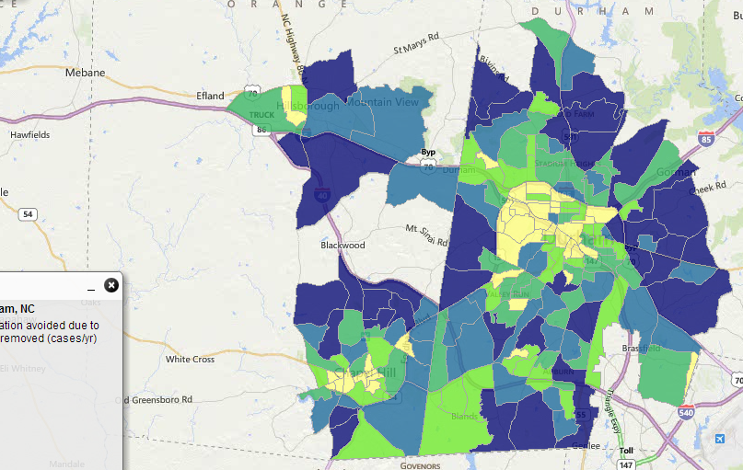
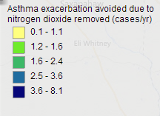
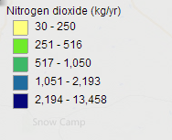
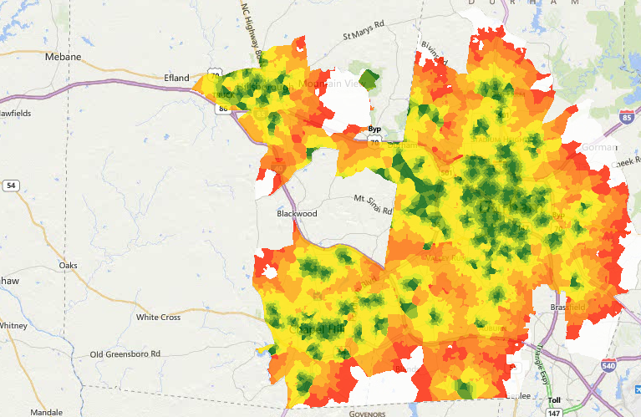
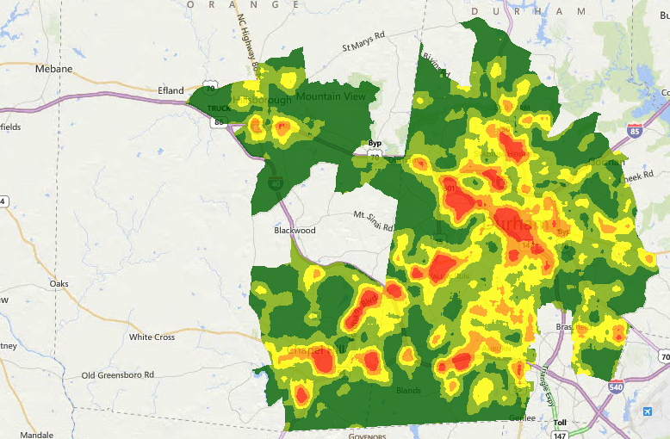
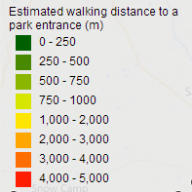
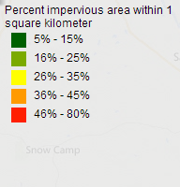
EnviroAtlas includes ~100 fine-scaled maps for featured communities,
including demographic overlays
removed
Notes:
Explaining some differences in the i-Tree vs. BenMAP maps: Even if there’s some tree cover downtown, there may not be a high residential population to benefit from the local air pollutant removal effects.

Slide 17
Connecting with EnviroAtlas (Durham County, NC)
PM_{2.5} removal (μg/m³)
(μg/m³)
iTree tool (Nowak et al. UFUG 2006)
PM_{2..5} reduction (%)
PM_{2.5} reduction: 0.19%

Slide 18
Connecting with EnviroAtlas (Cumberland County, ME)
PM_{2.5} removal (μg/m³)
(μg/m³)
PM_{2.5} reduction: 0.14%
PM_{2..5} reduction (%)

Slide 19
Summary
Developed a framework that can rapidly estimate annual average concentration at census block level due to traffic emissions in near-road environment
Comparing with Explicit method, METARE performs well (R² > 0.85)
Comparing with observational data, using proper fleet distribution can improve the performance
Fine resolution modeling with EnviroAtlas can provide useful information for communities or city planning authorities

Slide 20
Future work
Continue QA’ing the result
  Evaluate model predictions against near-road measurements
Extend methodology to apply to the whole nation
Evaluating the ability of the framework as an exposure metric
Perform health-based risk assessment using these fine-scale outputs

Slide 21
Acknowledge
Funding
EPA Contract EPD 12044 WA 2-08
EPA
David Heist
Alexis Zubrow
Alison Eyth
UNC-IE
B. H. Baek
Michelle Snyder
Lab mates
Matt Woody
Pradeepa Vennam
Scott Boone

Slide 22
references
2005 National-Scale Air Toxics Assessment (http://www.epa.gov/airtoxics/nata2005/tables.html)
Batterman S, Chambliss S, Isakov V. Spatial Resolution Requirements for Traffic-Related Air Pollutant Exposure Evaluations. Atmos Environ. 2014;94:518–28.
Caiazzo F, Ashok A, Waitz IA, Yim SHL, Barrett SRH. Air pollution and early deaths in the United States. Part I: Quantifying the impact of major sectors in 2005. Atmos Environ. 2013;79:198–208.
Cook R, Isakov V, Touma J. Resolving local-scale emissions for modeling air quality near roadways. J Air Waste Manage Assoc. 2008;58(3):451–61.
Karner AA, Eisinger DS, Niemeier DA. Near-roadway air quality: synthesizing the findings from real-world data. Environ Sci Technol. 2010;44(14):5334–44.
Rowangould GM. A census of the US near-roadway population: Public health and environmental justice considerations. Transp Res Part D Transp Environ. 2013;25:59–67.
Snyder MG, Venkatram A, Heist DK, Perry SG, Petersen WB, Isakov V. RLINE: A line source dispersion model for near-surface releases. Atmos Environ. 2013;77:748–56.
Nowak DJ, Crane DE, Stevens, JC. Air pollution removal by urban trees and shrubs in the United States. Urban forestry and urban greening. 2006;4:115-23

Slide 23
Thank you

Slide 24
Near-road analysis: by Distance
NO_{x}
PM_{2.5}
BENZENE
NC Piedmont
Karner et al, 2010
The concentrations drop pattern matches the observational study
Notes:
I try to quantify the concentration change with respect to distance from the road. In this figure, the x-axis represents the distance from the road with interval of 20 meters. For example, 200 represents the distance between 180 to 200 meters to the road. The y-axis represents the percentage to the maximum annual concentration. You can see that the concentrations drop dramatically after 100 meters from the road. In Portland, the concentration drops by 40 to 60% after 100 meters from the road. And in NC Piedmont, the concentration drop is 20 to 40%. This tells us that it is dangerous to live close to the roads.

Slide 25
NO_{x}
PM_{2.5}
BENZENE
Portland, ME
Tacoma, WA
Portland, OR
On-road contribution becomes more important when looking at smaller regions with dense traffic

Slide 26
Summary
Developed a framework that can rapidly estimate annual average concentration at census block level
Comparing with Explicit method, METARE performs well (R² > 0.85)
Comparing with observational data, using proper fleet distribution can improve the performance
Concentration reduction as a function of distance from the road in NC agrees with the pattern observed in Karner et al
Near road impact in urban areas show sharper decreases with distance from the road than rural areas
Fine resolution modeling with EnviroAtlas can provide useful information for communities or city planning authorities

