Slide 1
A Computationally Efficient Model For Estimating Background Concentrations of NO_{x}, NO₂, and O₃
Sam Pournazeri, Si Tan, Nico Schulte, Qiguo Jing, Akula Venkatram
Department of Mechanical Engineering
University of California, Riverside
12th Annual CMAS Conference
Oct 28th – 30th, 2013, Chapel Hill, NC

Slide 2

Acknowledgements
CEC 500-08-055
Vlad Isakov (US EPA)
Marla Mueller (CEC)
CMAS Conference Committee

Slide 3
Motivation
(Stein et al, 2007)
Hybrid Modeling:
Combine regional long-range transport model with short-range transport model
(Isakov et al, 2007) (Stein et al, 2007) (Isakov et al, 2009) and etc.
Notes:
Part of Hybrid Model Project-impact of DG
Human exposure need concentration at small scale—total concentration are affected by multiple scales
Pioneered by Isakov

Slide 4
Introduction
Exposure Studies: (1) need high resolution concentration map
(2) long averaging periods
Comprehensive Models:
computationally cumbersome
Land Use Regression (LUR) Model:
cannot be used to estimate the impact of changes in emissions on concentrations
performance is highly dependent on the measured data
(Jensen et al., 2009)

Slide 5
Introduction
We need a model that:
Connects concentrations explicitly to emissions and meteorology
(2) Computationally convenient for long-term exposure studies
Urban Background Model (UBM)
(Berkowicz, 2000)
straight-line steady dispersion model
Photo-stationary ozone chemistry
Notes:
(1) UBM does not account for the effect of VOCs

Slide 6
Lagrangian Background Model (LBM)
Transport and Chemistry are separated to reduce computational time using average species age
Area of Interest
C
z_{i}
q
5 km
5 km
(Venkatram et al, 1994)
(Venkatram et al, 1998)
Start
Notes:
Comprehensive model solve transport and chemistry separately-computationally expensive
We separate transport and chemistry through species age
Dimension of Box
Uniform concentration
Chemistry calculated after Transport
The concept is not new

Slide 7
Model Formulation
(1) Transport Calculation
Back Trajectory
Concentration calculation
(2) Average Species Age
(3) Chemistry Simulation
Notes:
the 3 major step involved in the LBM model

Slide 8
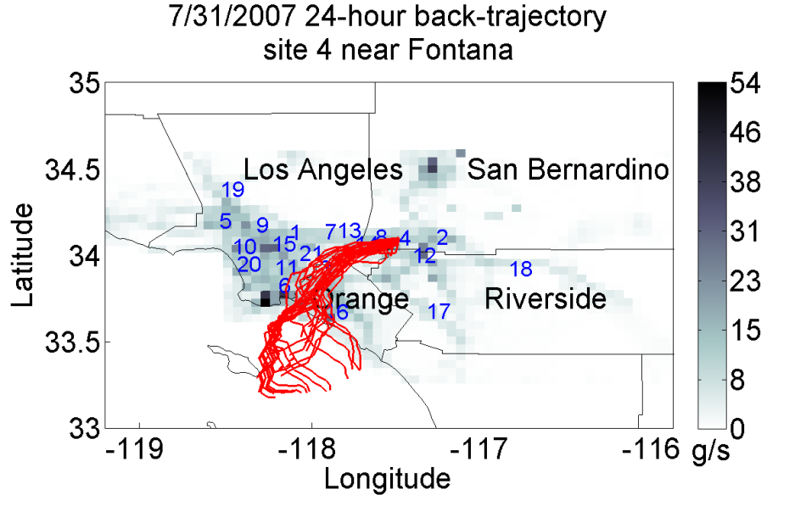
Transport-Back Trajectory calculated using surface wind speed and direction
Notes:
(1) The trajectory is calculated for the past 24 hours in1-hr time steps.

Slide 9

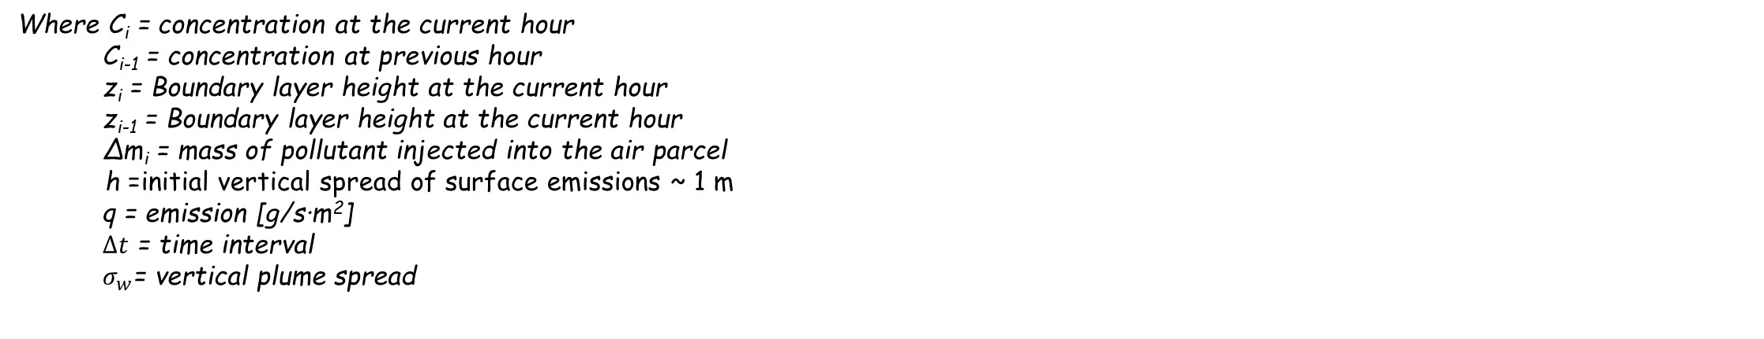
Transport-Concentration Calculation
Concentration:
Hour 1-23:
$C_{i}=C_{i−1}\min\left(\frac{z_{i−1}}{z_{i}} ,1\right)+\frac{Δm_{i}}{z_{i}}$ (1)
Last Hour:
$ΔC_{i}=\sqrt{\frac{2}{π}}\frac{q}{σ_{w}}\ln\left(1+\frac{σ_{w}Δt}{h}\right)$ (2)
(Venkatram and Cimorelli, 2007)
C_{i}
z_{i}
C_{i-1}
q_{i}
q_{i-1}
z_{i-1}
5 km
5 km
5 km
5 km
Where C_{i} = concentration at the current hour
C_{i-1} = concentration at previous hour
z_{i} = Boundary layer height at the current hour
z_{i-1} = Boundary layer height at the current hour
∆m_{i} = mass of pollutant injected into the air parcel
h =initial vertical spread of surface emissions ~ 1 m
q = emission [g/s∙m²]
$Δt$ = time interval
${ σ}_{w}$= vertical plume spread
Notes:
(1) Last Hour-account for incomplete vertical mixing

Slide 10
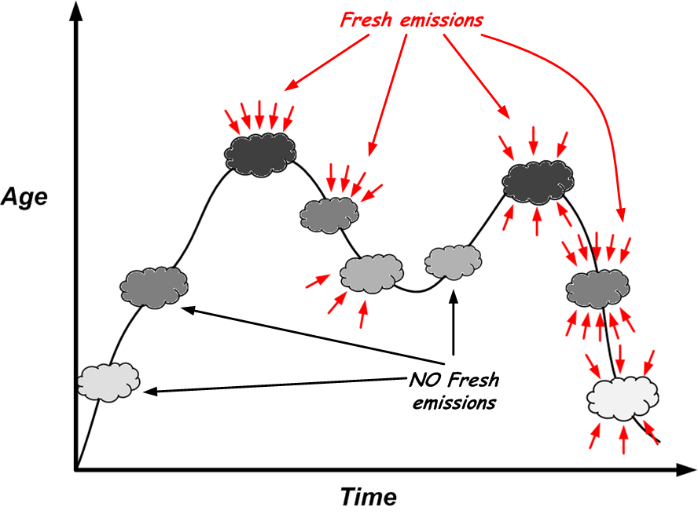
Average Species Age:
The average time that the species undergo chemical reactions
$A_{i}=A_{i−1}\left(1−\frac{Δm_{i}}{m_{i}}\right)+Δt\left(1−\frac{1}{2}\frac{Δm_{i}}{m_{i}}\right)$ (3)
Where A_{i} = average species age at the current hour
A_{i-1} = average species age at previous hour
∆m_{i} = mass of pollutant injected into the air parcel
m_{i} = total mass of pollutant in the air parcel
(Venkatram, 1988)
Notes:
(1)No fresh emission-A increases by dt
(2) Fresh emission tend too decrease A

Slide 11
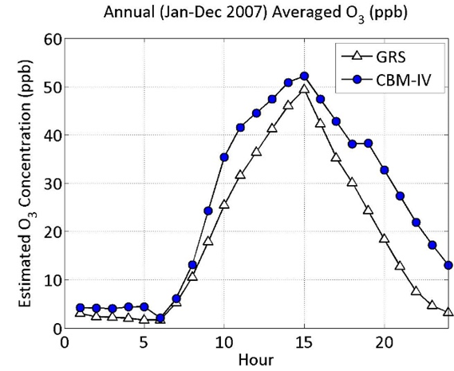
Chemistry Scheme
Carbon Bond IV (CB-IV)
Generic Reaction Set (GRS)
(Azzi, 1992)
Comparison of GRS and CB-IV
Annual Averaged Hourly O₃ Concentration
Notes:
(1) GRS-7 empirically determined equation to approximate O3 formation-include VOC
(2) LBM not tied to GRS-can use chemistry scheme of preference

Slide 12
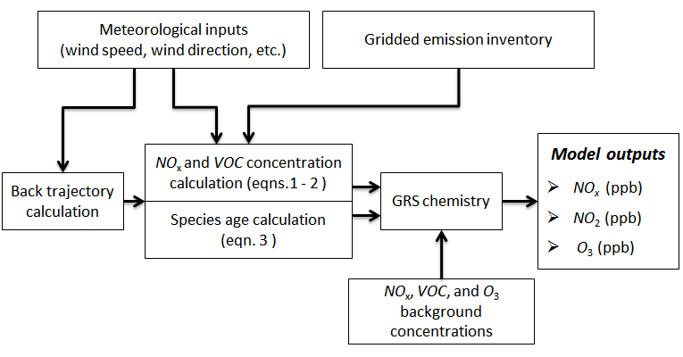
Model Overview
Notes:
input: hourly NOx emission, wind speed, wind direction, and mix layer height
Output: hourly NOx, NO2, and O3 concentration

Slide 13
Evaluations of LBM

Slide 14
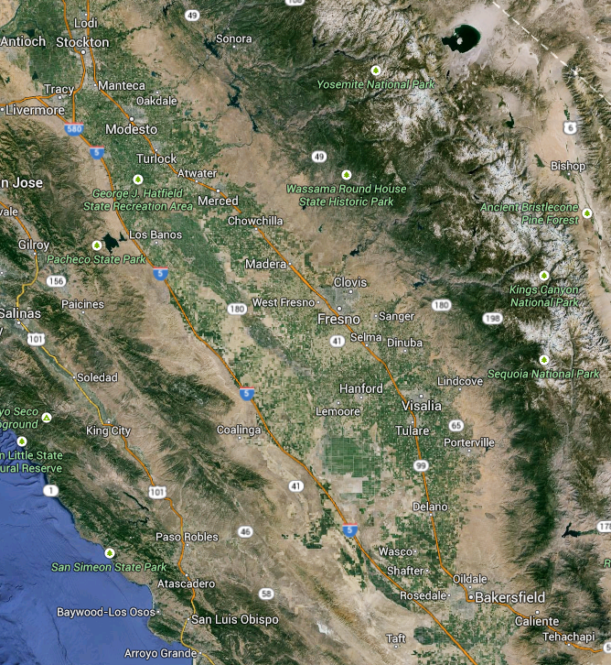
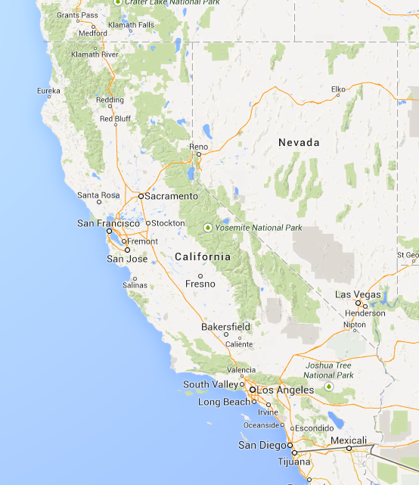
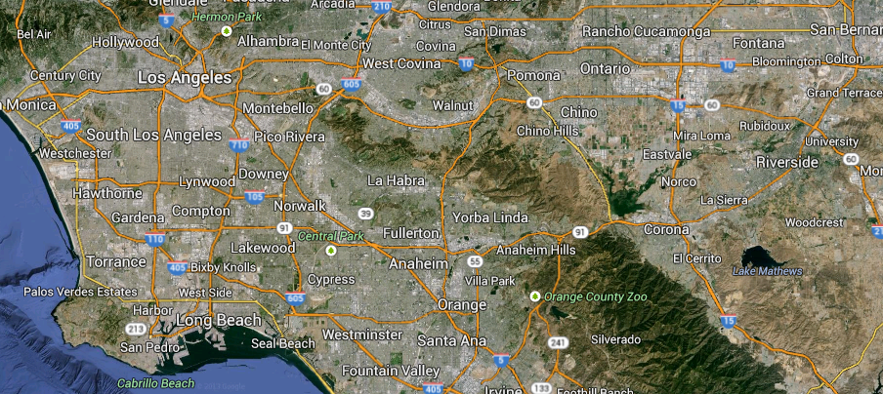
Observation Database
San Joaquin Valley
Contains 21 monitoring stations
The San Joaquin Valley Air Basin
South Coast
The South Coast Air Basin
Contains 21 monitoring stations

Slide 15
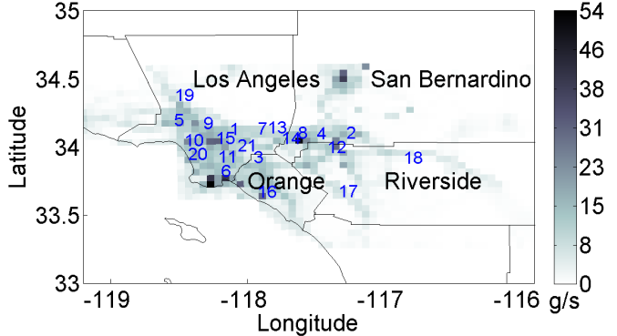
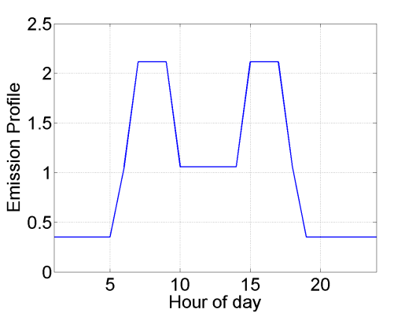
The South Coast Air Basin (SoCAB)
Gridded Daily Average NOx Emission
Emission Temporal Profile
Notes:
(1) No hourly NOx emission available
(1) two peaks corresponding to the rush hours.

Slide 16
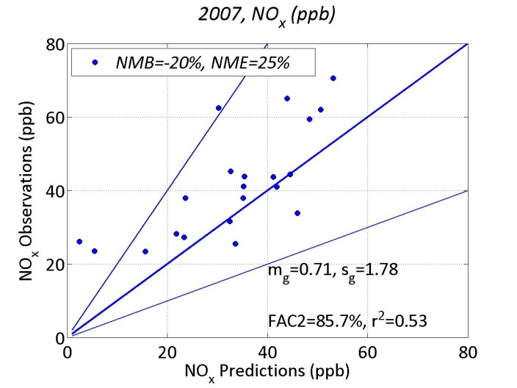
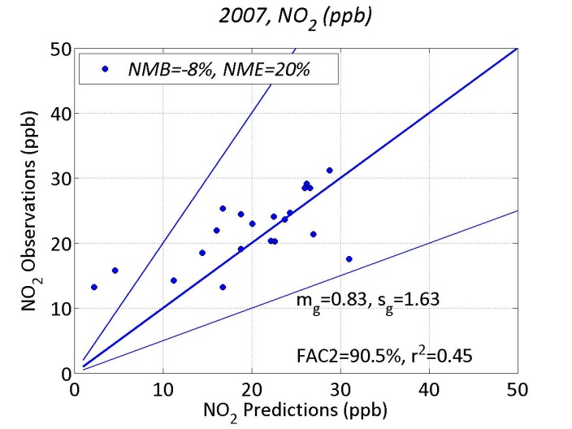
Annual Average Concentration
NO_{x}
NO₂
Notes:
(1) Hourly Data ran for a whole year at 21 sites
(2) LBM implemented in MatLab—took 2 ½ hours to run
(3) Model performs adequately—most data within factor of 2

Slide 17
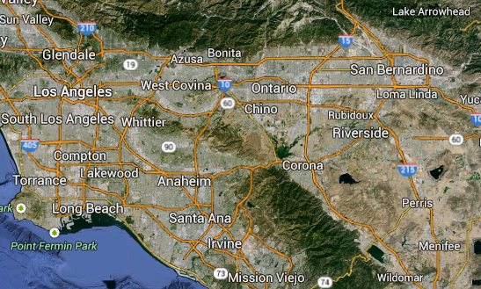
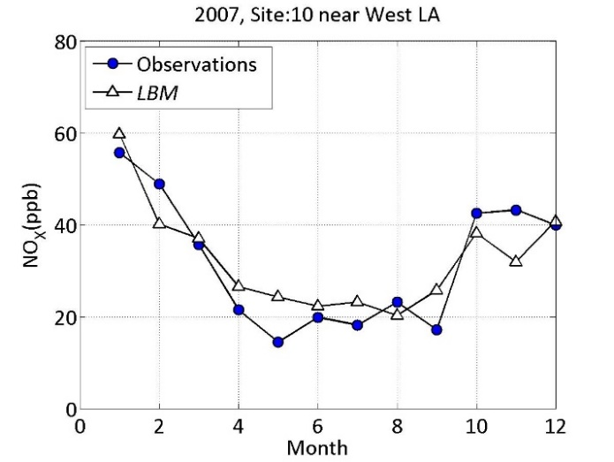
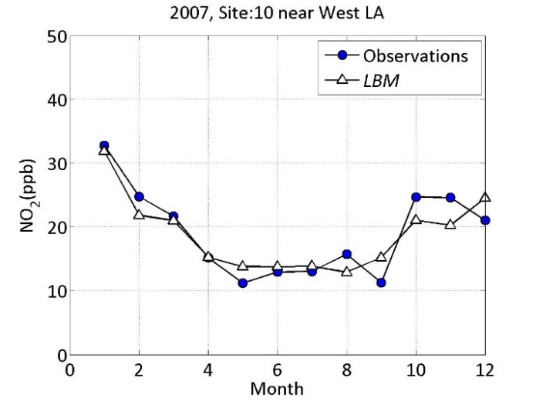
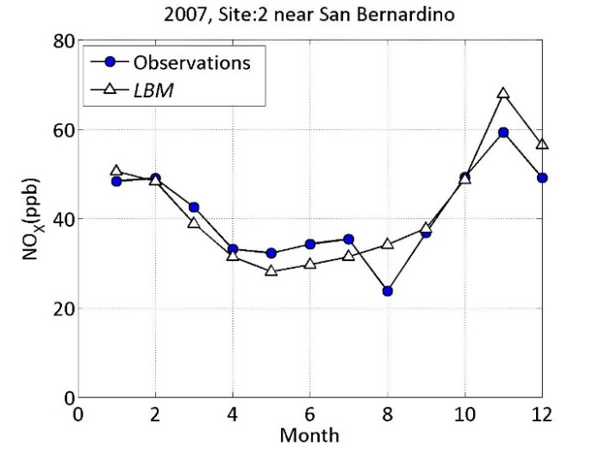
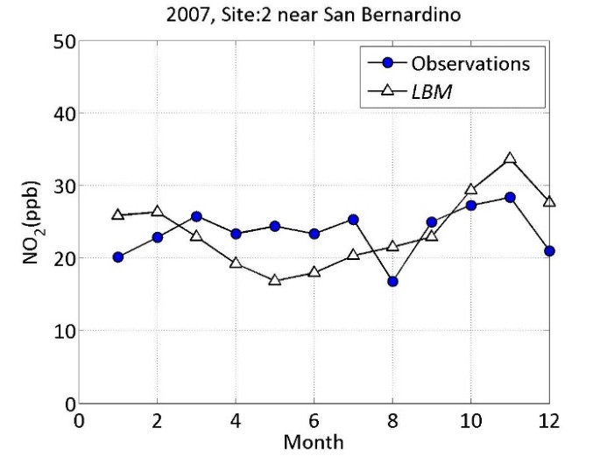
Seasonal Variation
West LA
San Bernardino
West LA
NO_{x}
NO₂
San Bernardino
NO_{x}
NO₂
Notes:
(1) West LA and San Bernardino has different trajectory
(2) LBM is able to capture seasonal variation

Slide 18
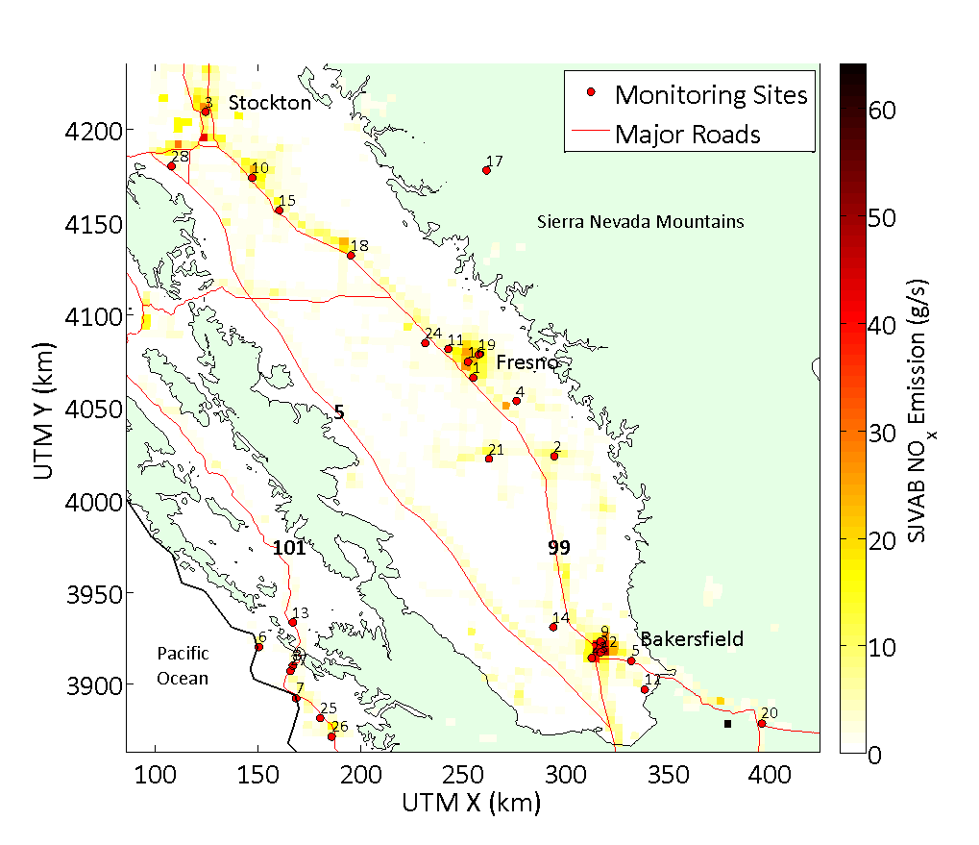
The San Joaquin Valley Air Basin
Gridded Daily Average NOx Emission
Notes:
Long narrow bowl shape-trap pollution
Majority of Emission from large cities and roads

Slide 19
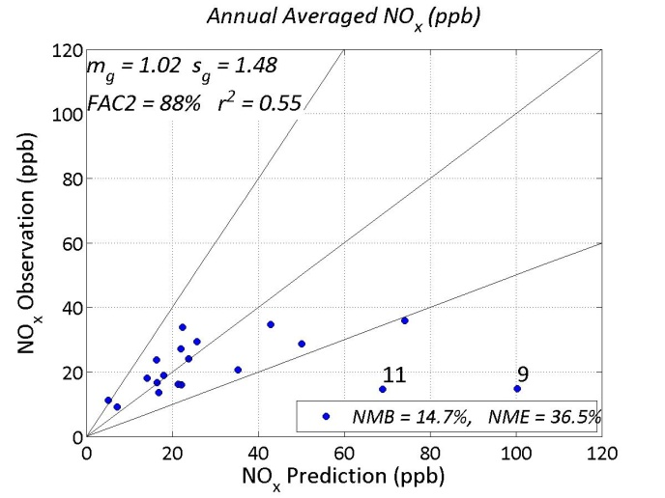
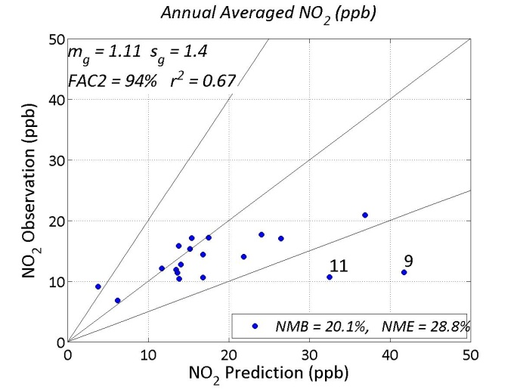
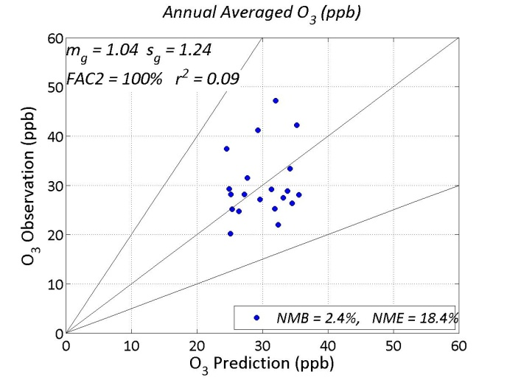
Annual Average Concentration
NO_{x}
NO₂
O₃

Slide 20
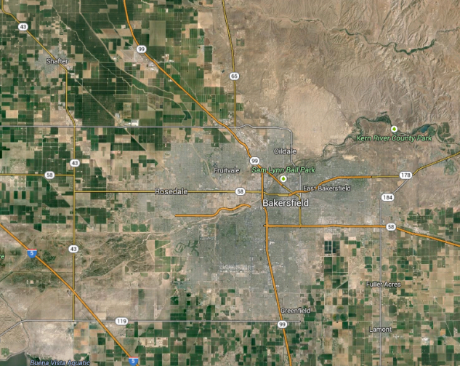
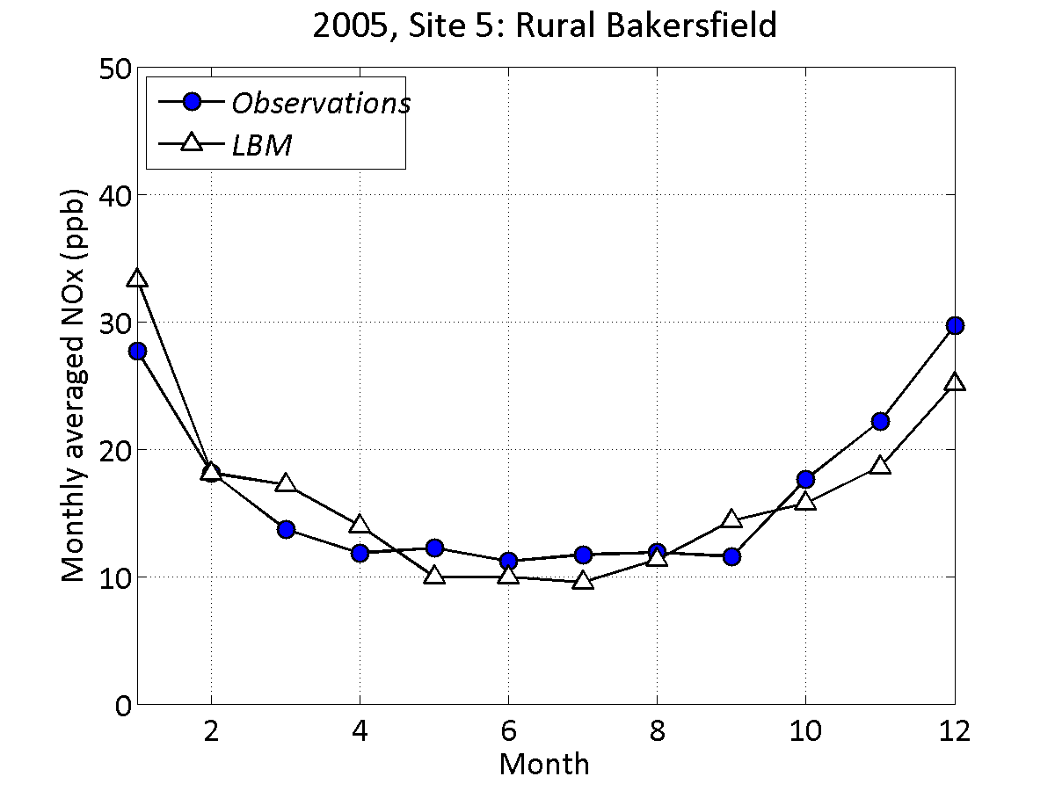
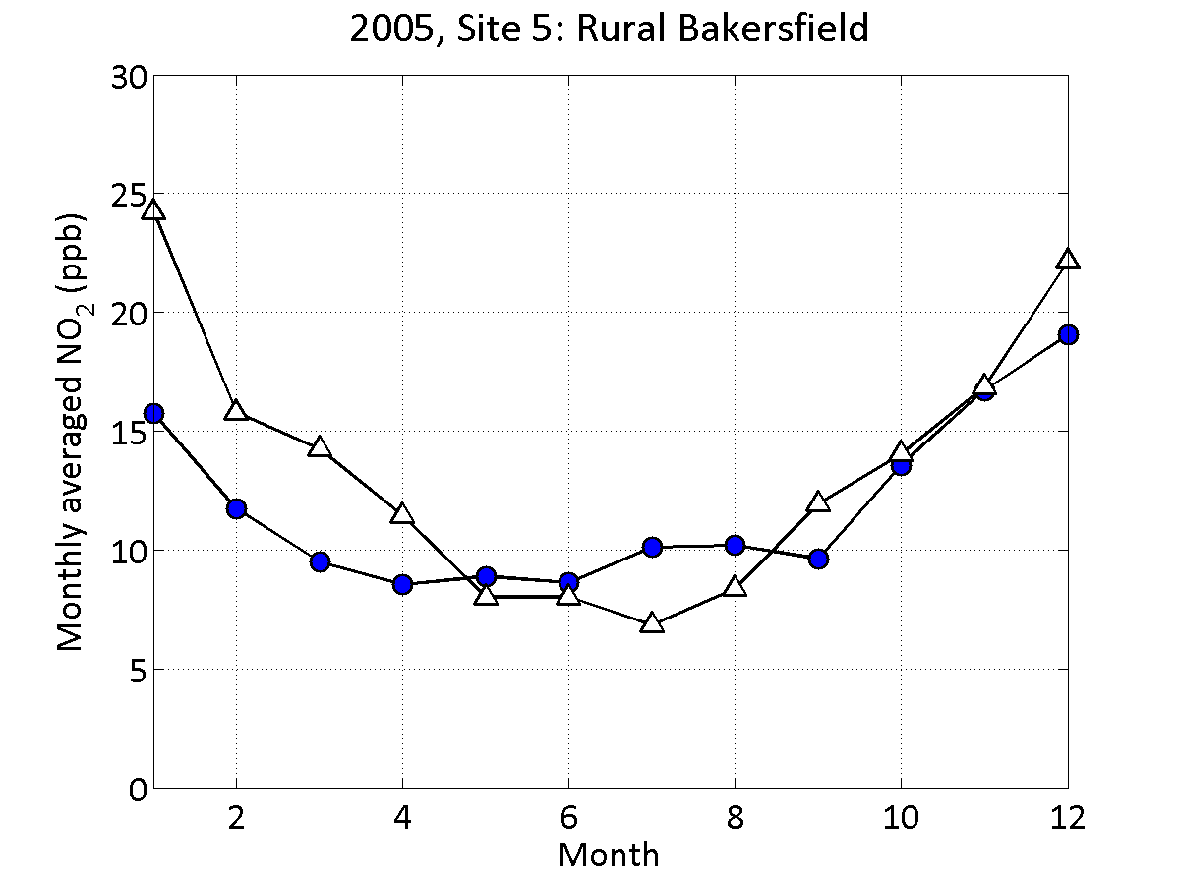
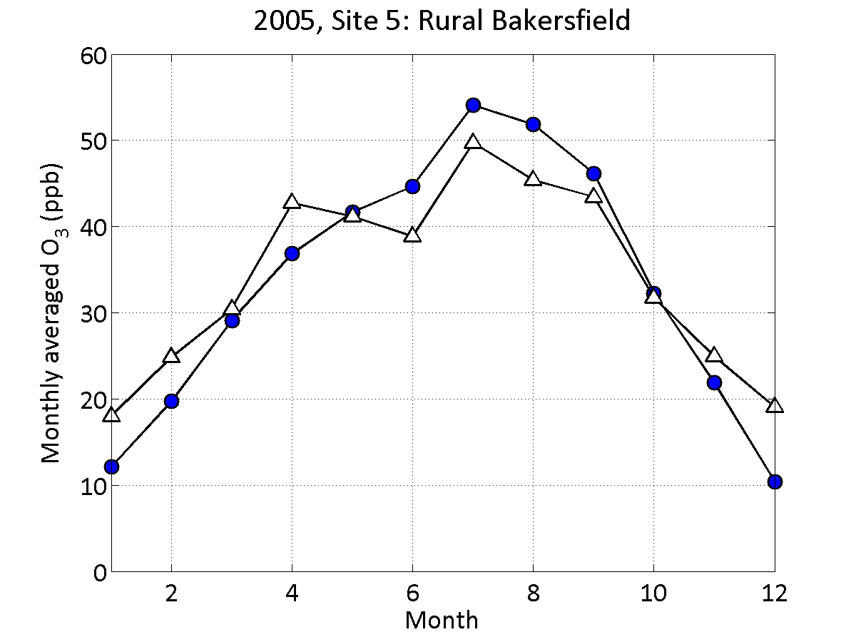
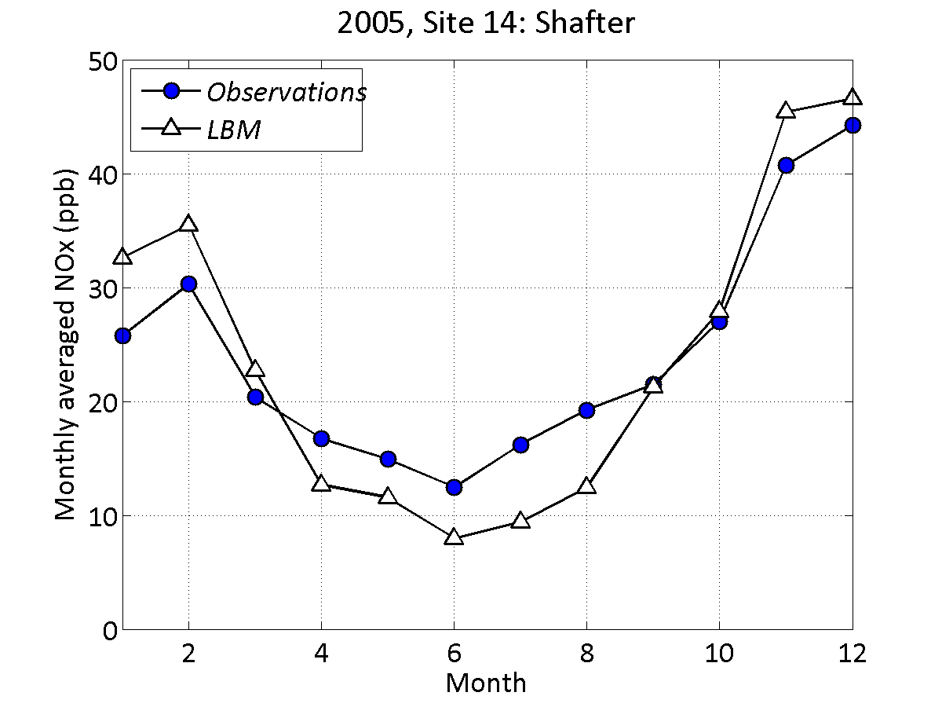
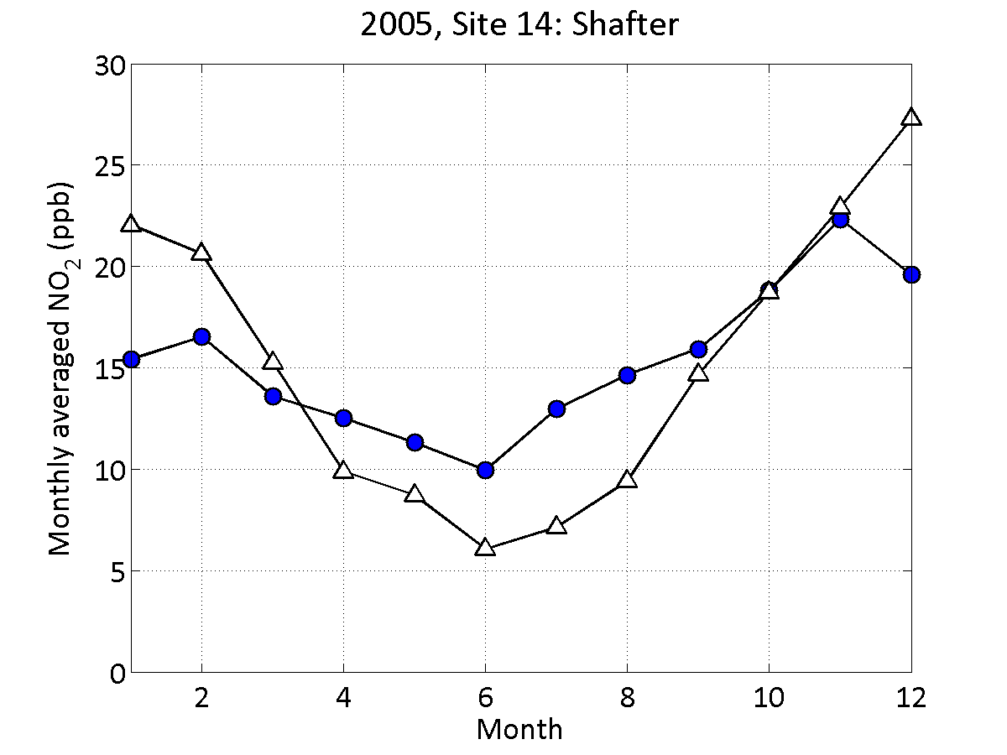
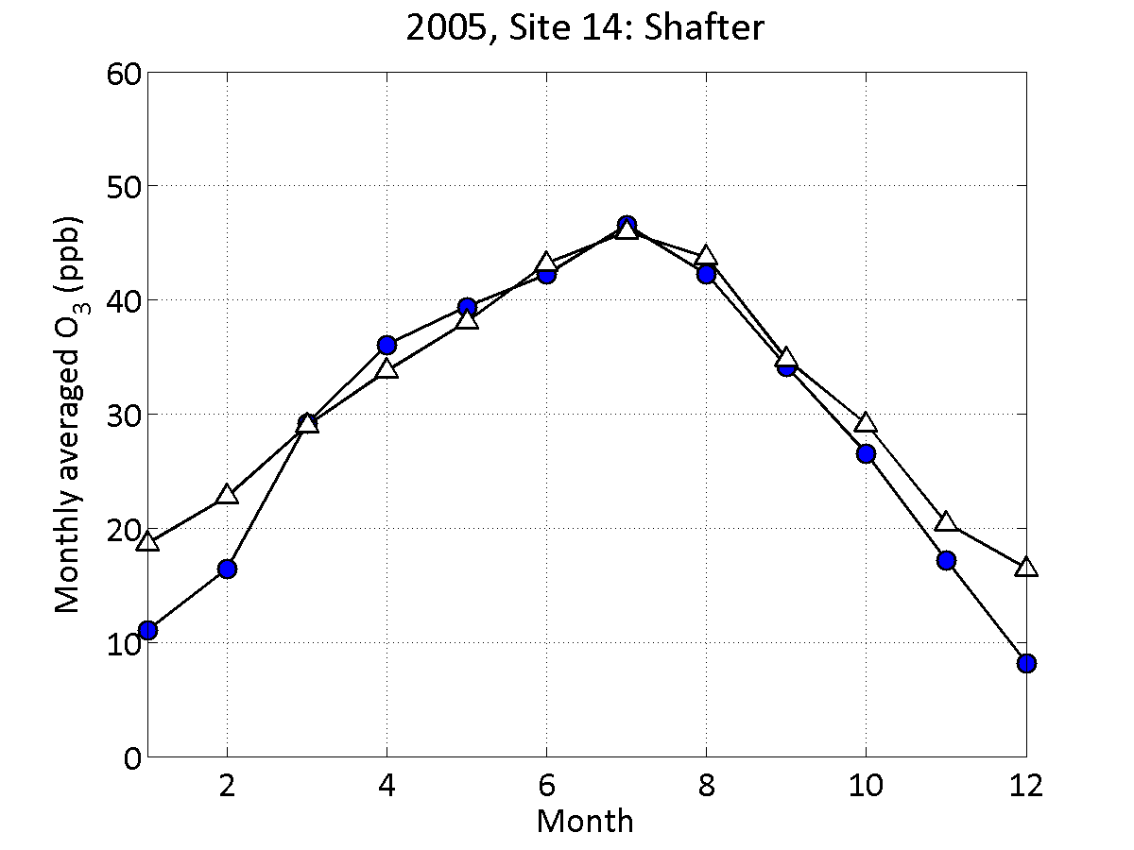
Seasonal Variation
Shafter
Bakersfield
Bakersfield
NO_{x}
NO₂
O₃
Shafter
NO_{x}
NO₂
O₃
Notes:
Shafter - 16miles (26 kilometers) northwest of Bakersfield, and is surrounded by rural areas
LBM is able to capture the seasonal variation of NOx, NO2, and O3 at both locations.

Slide 21
Applications of LBM
Notes:
Through the evaluation of LBM model performance in the two air basin, we can conclude that LBM indeed produces good result.
Now lets look at some of the applications of LBM

Slide 22
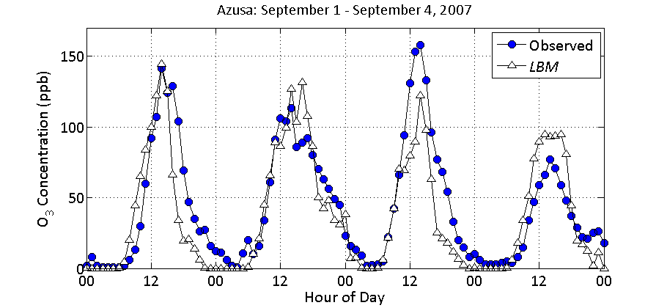
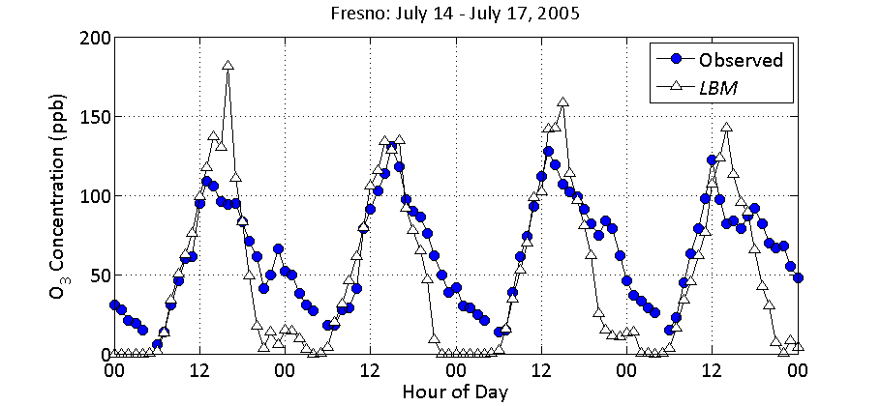
Estimate O₃ Episode
SoCAB-Azusa
SJVAB-Fresno
Notes:
O₃ episodes during September 1 - 4, 2007 in Azusa in the SoCAB (upper panel) and July 14 - 17, 2005 in Fresno in the SJVAB (lower panel)
Figure shows that for the O₃ episode in the SoCAB, the modeled concentrations are in good agreement with the observed concentrations. In Fresno, the model overestimated the maximum O3 concentration on July 14, and the model predicted a faster O3 destruction rate at nighttime, which could be related to the uncertainties in estimating the nighttime boundary height and the emission.

Slide 23
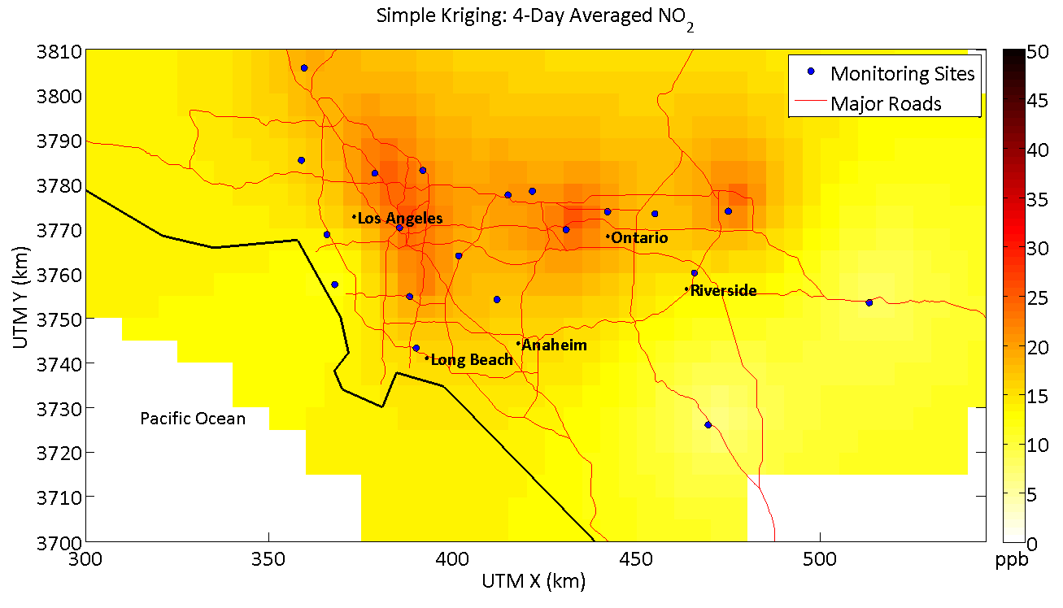
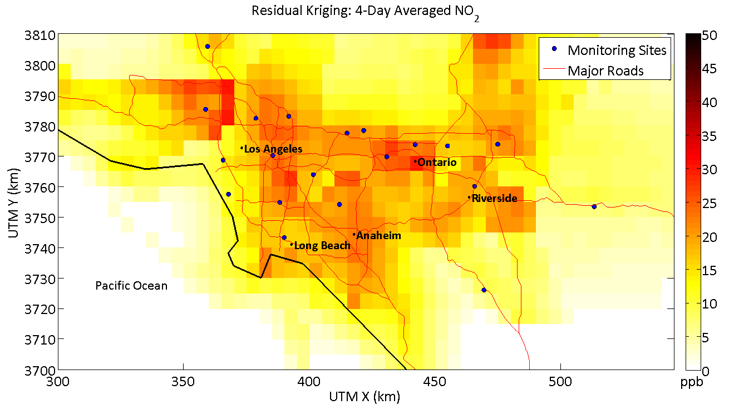
  Improving Kriging Interpolation Using LBM for Exposure Studies
Simple Kriging
Residual Kriging
Residual Kriging: residuals between model estimate and observation are interpolated using residuals at the observation sites
Notes:
Kriging is commonly used
LBM improves the concentration map

Slide 24
Conclusions
Computational time is greatly reduced
The model can reasonably estimate maximum O₃ concentrations.
Model provides adequate descriptions of the spatial and temporal behaviour of NO_{x} and NO₂ measurements made in SoCAB during 2007, and in SJVAB during 2005
Model is good for exposure studies

Slide 25
Thank You!
Questions?
References:
Azzi, M., Johnson, G.M., Cope, M., 1992. An introduction to the generic reaction set photochemical smog mechanism. Proceedings of the 11th International Conference of Clean Air Soc. of Aust. and N.Z., Brisbane. 451-462.
Berkowicz, R., 2000. A Simple Model for Urban Background Pollution. Environmental Monitoring and Assessment. 65, 259-267.
Isakov, V., Touma, J.S., Burke, J., Lobdell, D.T., Palma, T., Rosenbaum, A., kÖzkaynak, H., 2009. Combining Regional- and Local-Scale Air Quality Models with Exposure Models for Use in Environmental Health Studies. Journal of the Air & Waste Management Association 59, 461-472.
Isakov, V., Irwin, J.S., Ching, J., 2007. Using CMAQ for Exposure Modeling and Characterizing the Subgrid Variability for Exposure Estimates. Journal of Applied Meteorology and Climatology 46, 1354-1371.
Jensen, S. S., Larson, T., Deepti, K. C., Kaufman, J. D., 2009. Modeling traffic air pollution in street canyons in New York City for intra-urban exposure assessment in the US Multi-Ethnic Study of atherosclerosis and air pollution. Atmospheric Environment. 43(30), 4544-4556.
Stein, A.F., Isakov, V., Godowitch, J., Draxler, R.R., 2007. A hybrid modeling approach to resolve pollutant concentrations in an urban area. Atmospheric Environment 41, 9410-9426.
Venkatram, A., Du, S., Hariharan, R., Carter, W., Goldstein, R., 1998. The concept of species age in photochemical modeling. Atmospheric Environment. 32, 3403-3413.
Venkatram, A., Karamchandani, P., Pai, P., Goldstein, R., 1994. The development and application of a simplified ozone modeling system (SOMS). Atmospheric Environment 28, 3665-3678.
Venkatram, A., Du, S., Hariharan, R., Carter, W., Goldstein, R., 1998. The concept of species age in photochemical modeling. Atmospheric Environment 32, 3403-3413.

