Slide 1
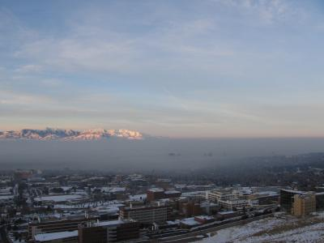
Fine-scale Meteorological Simulation of Cold Pools in Salt Lake City
Chris Misenis, Kirk Baker, Pat Dolwick
Image courtesy of Erik Crosman, University of Utah

Slide 2
Overview & Air Quality Implications
Cold-air pool (CAP) formation occurs due to strong inversions within topographical deformations.
Persistent CAPs are due to restricted ventilation (deeply stable) and lack of horizontal displacement (orographic forcing).
CAPs in dense urban locations can lead to significant stagnation and a build-up of local emissions (vehicles, industrial, home heating).
Current meteorological models tend to be too diffusive, leading to chemical models failing to capture pollution (PM2.5 in SLV, O3 in Upper Green River Basin) buildup.

Slide 3
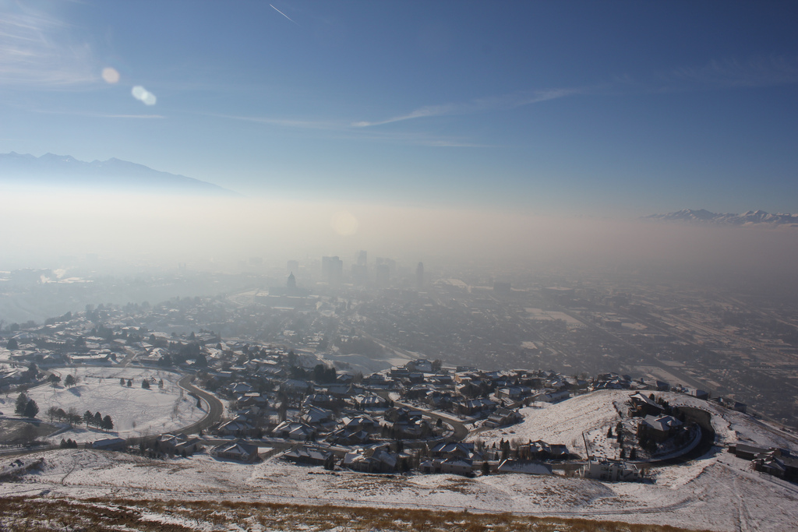
Salt Lake City, 1/6/2011 – Image by Tim Brown

Slide 4
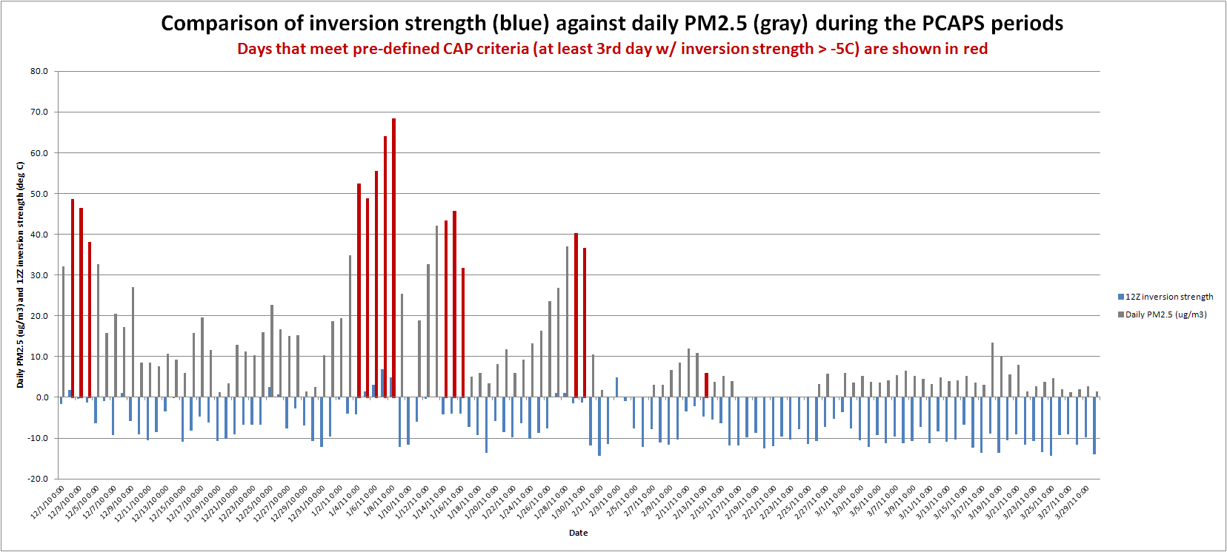
PCAPS
Persistent Cold-Air Pool Study
Intensive field campaign ran from December 2010 through early February 2011, centered over the Salt Lake Valley
Will focus on early January 2011 period.
Strongest, most polluted period during PCAPS (1/1-1/9)

Slide 5
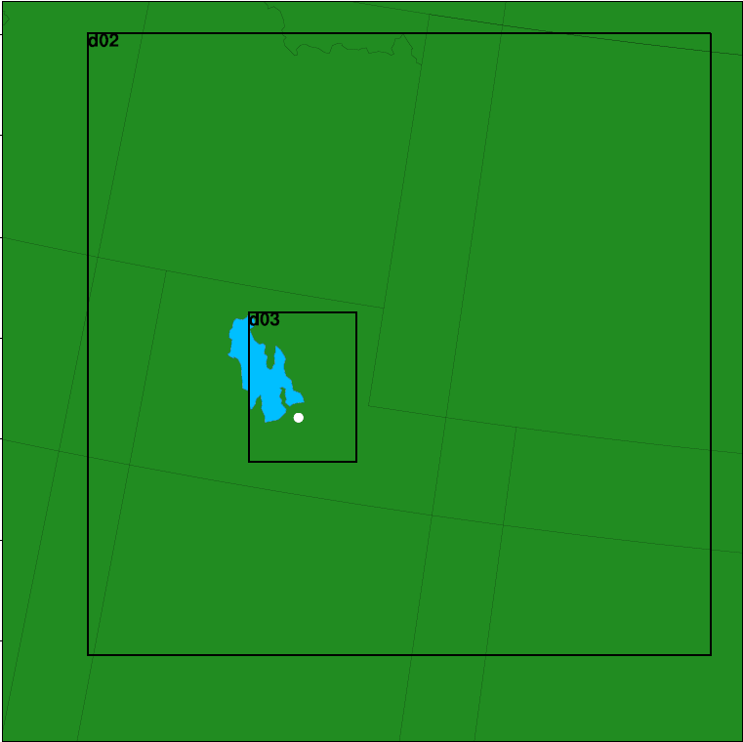
Modeling Setup
WRF v3.3
12/4/1km (only 4 & 1km shown)
12/6/2010 – 3/15/2011
NAM-12 Initialization
USGS landuse
Noah land-surface
Mellor-Yamada-Janjic PBL
Goddard SW, RRTM LW
Thompson microphysics
35 layers up to 50 mb, 20-m lowest layer
Nudging of T, Q and winds above PBL
Sensitivity | Initialization | PBL | LSM
Base (NAM) (1 & 4km) | NAM | MYJ | Noah
NARR (4km) | NARR | MYJ | Noah
PX (1 & 4km) | NAM | ACM2 | PX

Slide 6
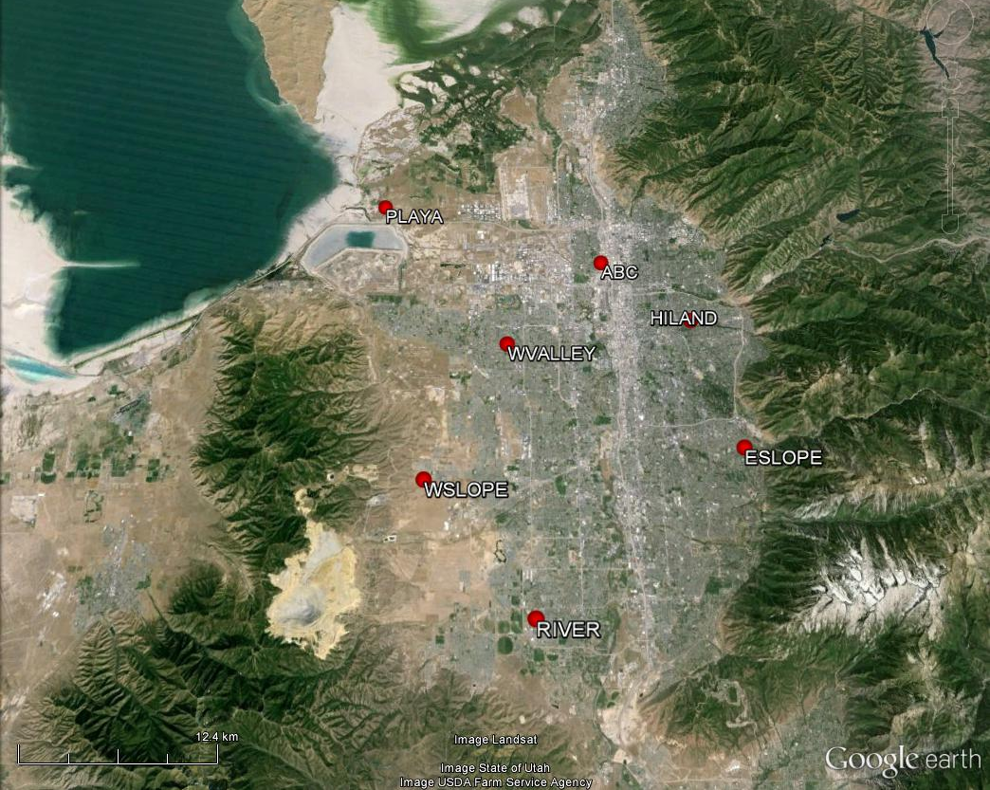
Runs to be evaluated against 7 ISFS stations (temperature, winds, shortwave radiation)

Slide 7
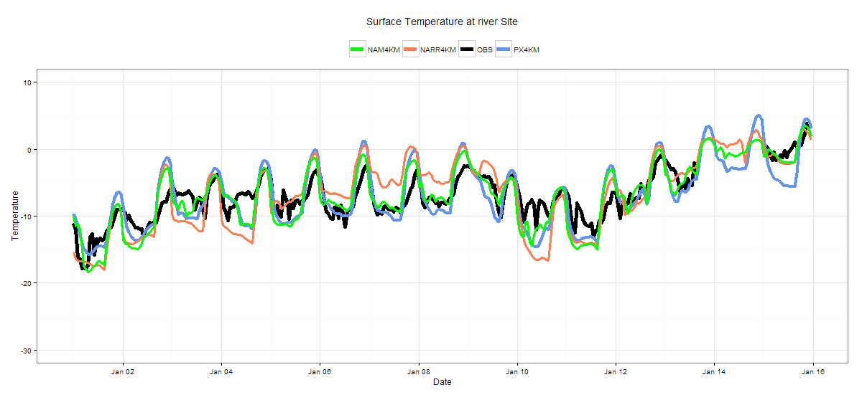
Temperature – 4km
Playa
CAP ends
River

Slide 8
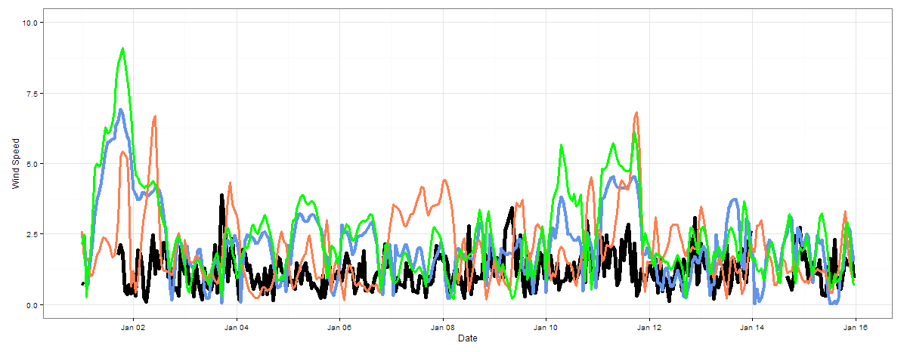
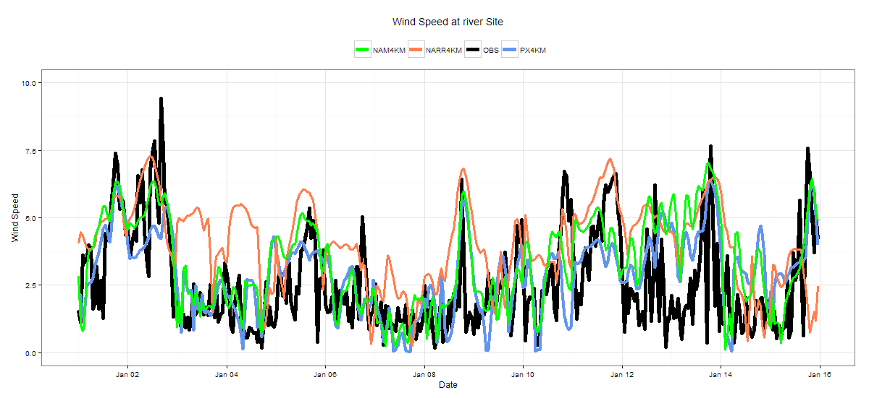
Wind Speed – 4km
Playa
River

Slide 9
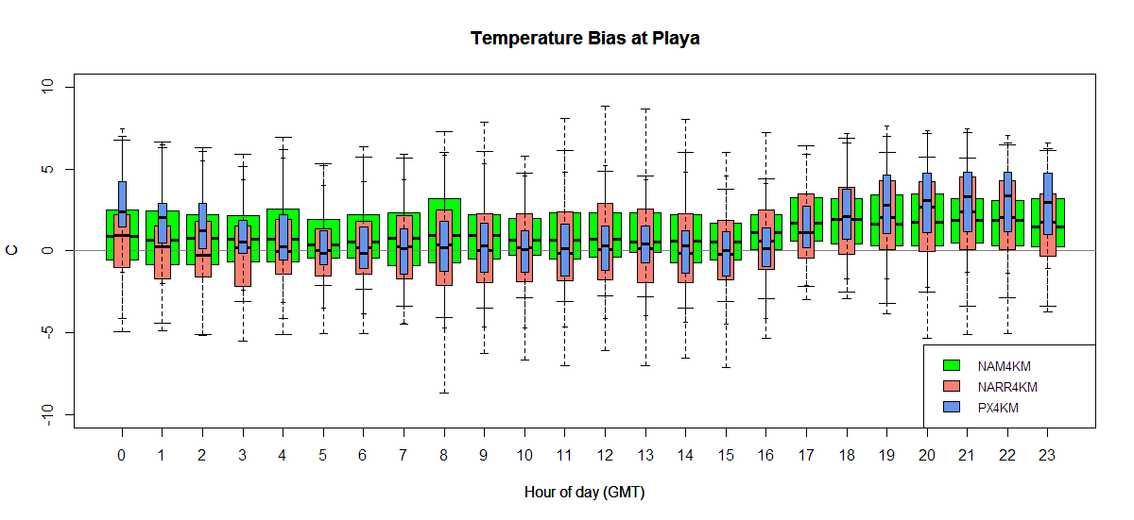
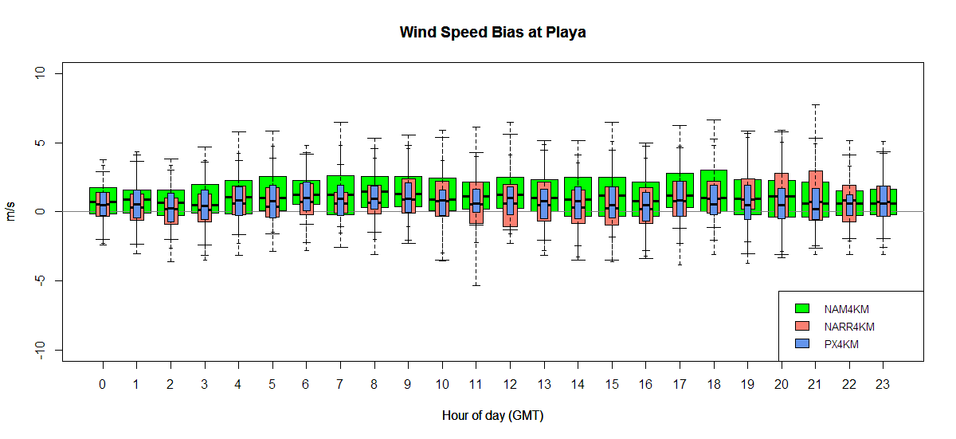
Biases – 4km

Slide 10
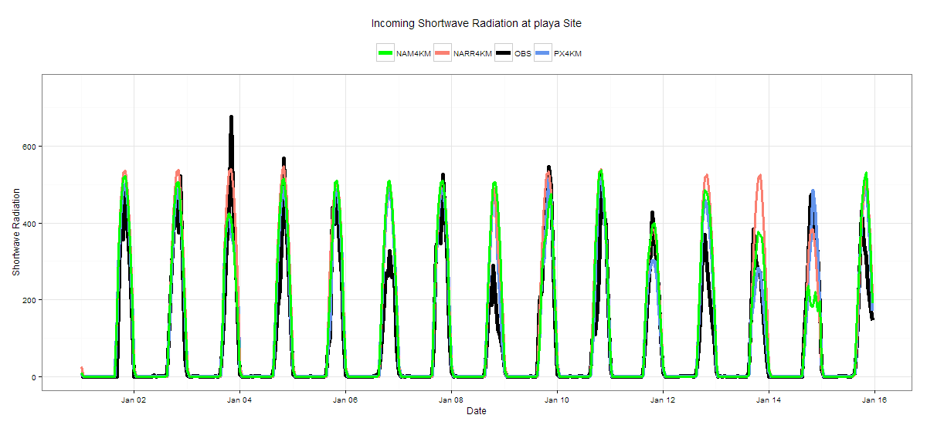
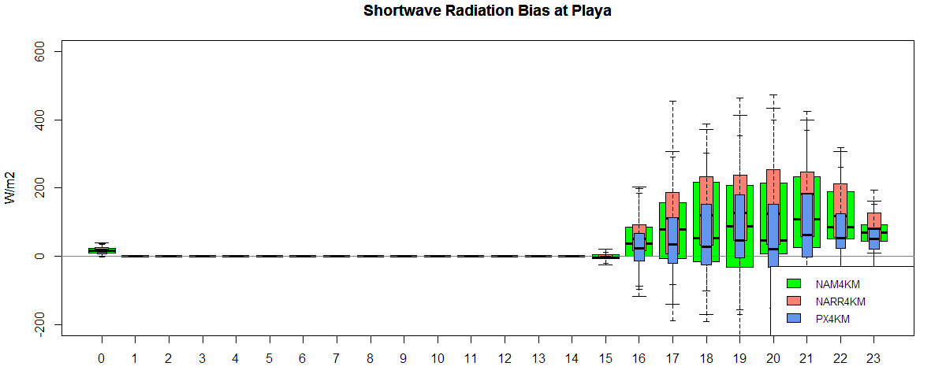
Shortwave Radiation – 4km
Playa

Slide 11
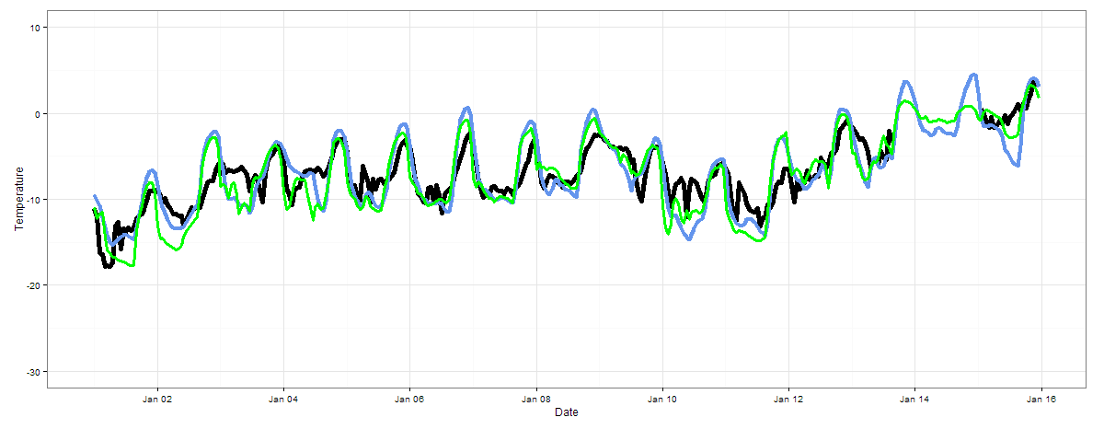
Temperature – 1km
Playa
River

Slide 12
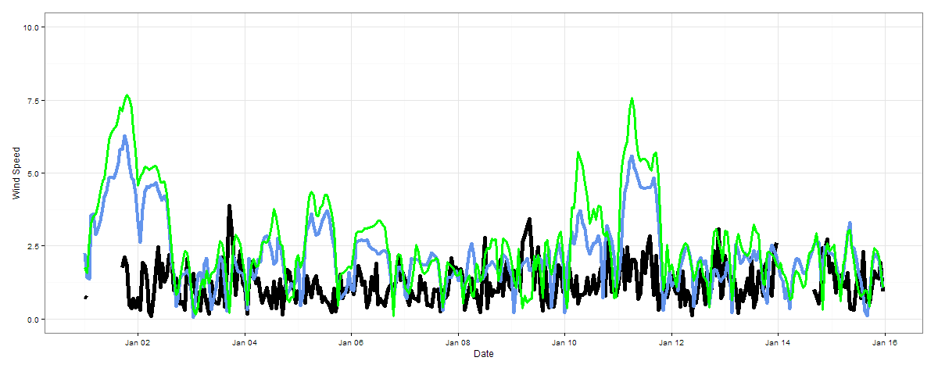
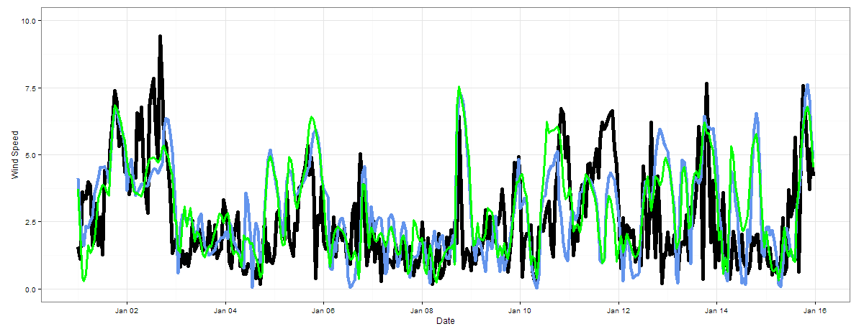
Wind Speed – 1km
Playa
River

Slide 13
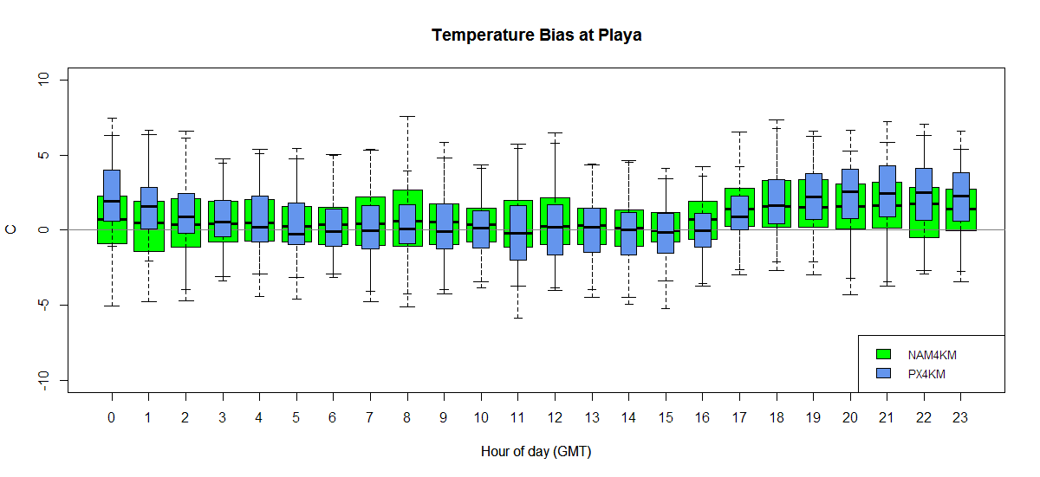
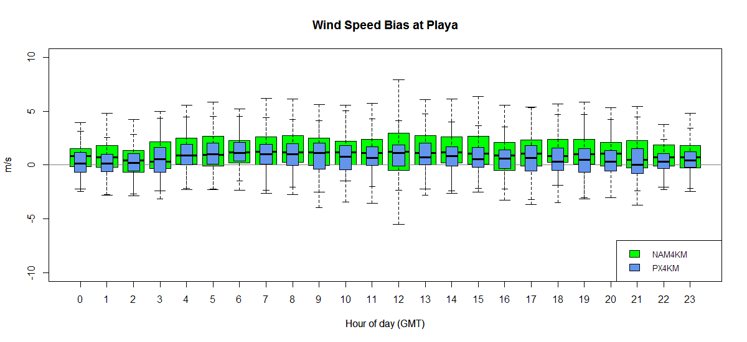
Biases – 1km

Slide 14
Summary Statistics
 | T2 |  | WS10 |  | RH
 | BIAS | RMSE | BIAS | RMSE | BIAS | RMSE
NAM4 | .74 | 4.28 | .98 | 1.80 | -2.72 | 13.08
NARR4 | .90 | 4.75 | 1.41 | 2.32 | -12.84 | 22.60
PX4 | .34 | 4.25 | .70 | 1.53 | -3.23 | 10.85
NAM1 | .13 | 2.69 | .85 | 1.51 | 1.38 | 11.78
PX1 | .22 | 2.89 | .43 | 1.36 | -.55 | 10.77
While having overall low biases, simulations using NARR initialization had worse model performance per RMSE.
In terms of model error, performance improves when increasing resolution from 1 to 4-km.
Initialization dataset has greater impact than model physics.

Slide 15
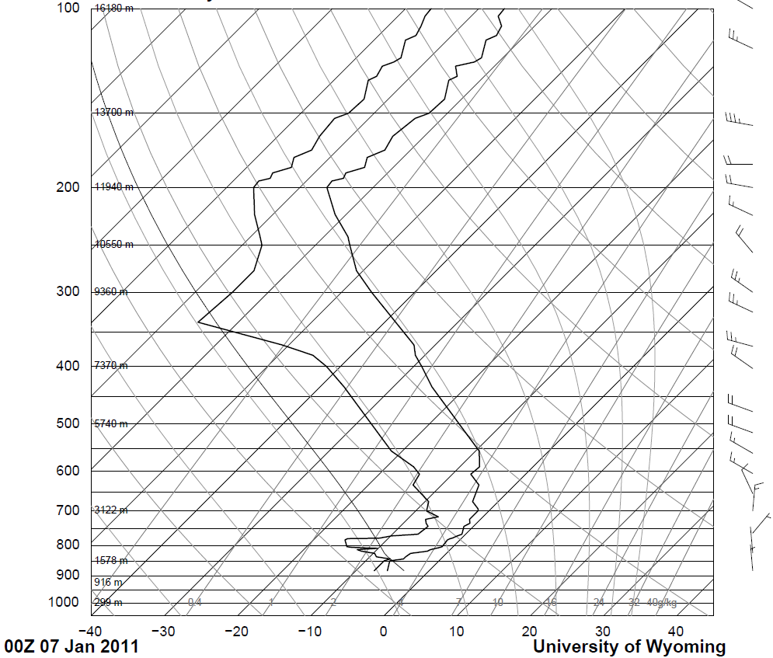
Vertical Profile
NAM1KM
PX1KM

Slide 16
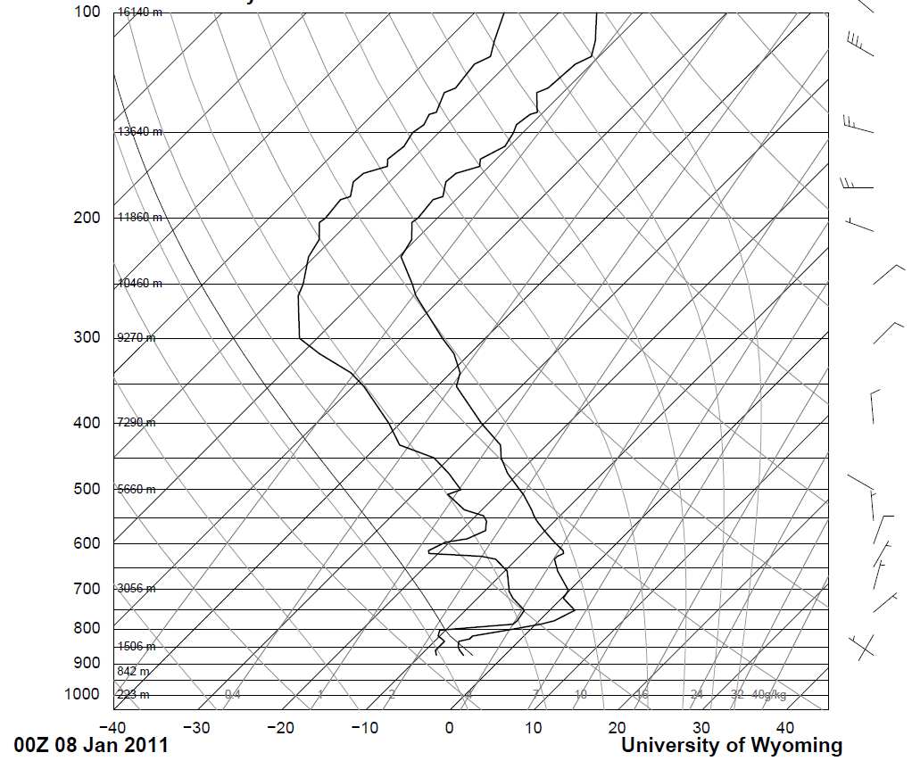
Vertical Profile
NAM1KM
PX1KM

Slide 17
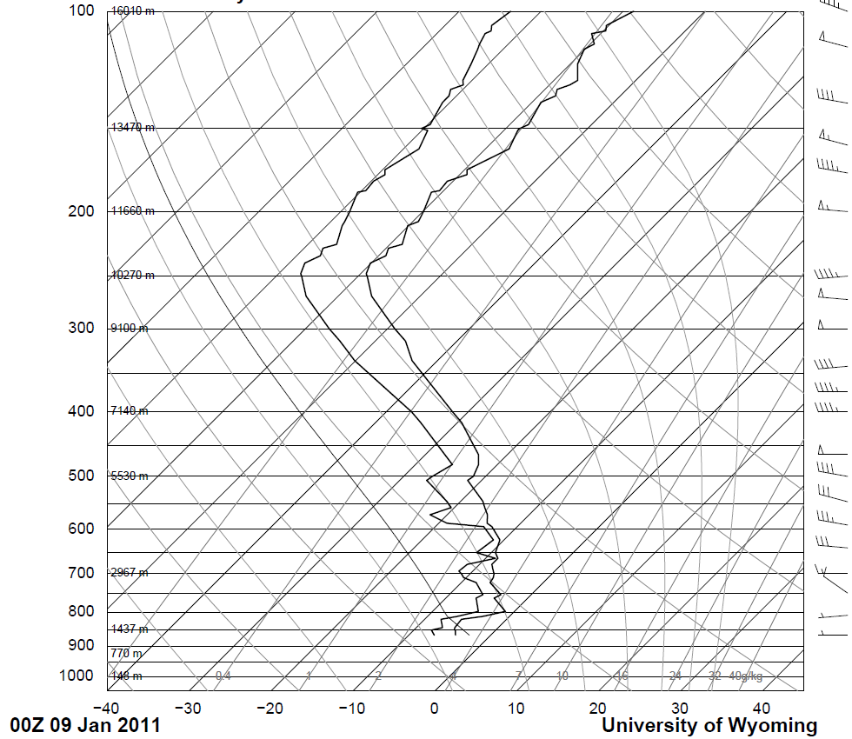
Vertical Profile
NAM1KM
PX1KM

Slide 18
Thoughts and Future Work
During periods of cold pool formation, WRF:
tends to overestimate surface temperature and wind speeds, with slight improvements as resolution is increased.
overestimates incoming shortwave radiation
typically erodes the deeply stable layers too soon, per vertical profiles.
Further analysis of initialization datasets required to better understand biases and possible corrections
Broad community working to better understand current issues
Lareau et al., 2013
Silcox et al., 2012

