Slide 1
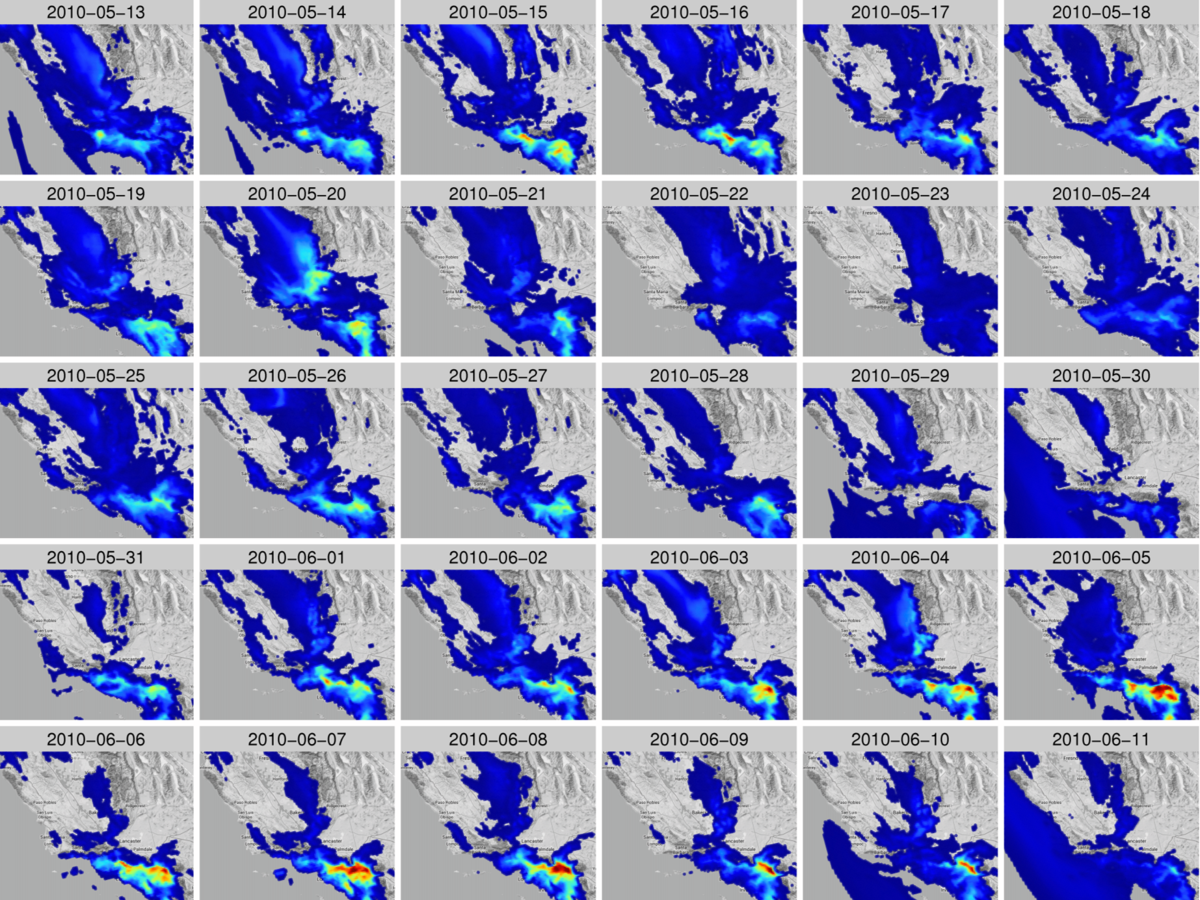
Fine-Scale Simulation of Ammonium and Nitrate over the South Coast Air Basin and San Joaquin Valley of California during CalNex-2010
James Kelly, Kirk Baker, and Chris Misenis
EPA Office of Air Quality Planning & Standards
Observations
John Nowak, Andy Neuman, James Roberts,
Patrick Veres, and Joost de Gouw
National Oceanic & Atmospheric Administration
Jennifer Murphy, Milos Markovic, and
Trevor VandenBoer
University of Toronto
Rodney Weber
Georgia Institute of Technology
Barry Lefer
University of Houston
Emissions Development
Alison Eyth, Rich Mason, and Alexis Zubrow
EPA Office of Air Quality Planning & Standards
CMAQ Model Developers
Rob Gilliam, Jon Pleim, Golam Sarwar,
and Donna Schwede
EPA Office of Research & Development
12th Annual Community Modeling and Analysis System (CMAS) Conference
28-30 October 2013, Chapel Hill, NC

Slide 2
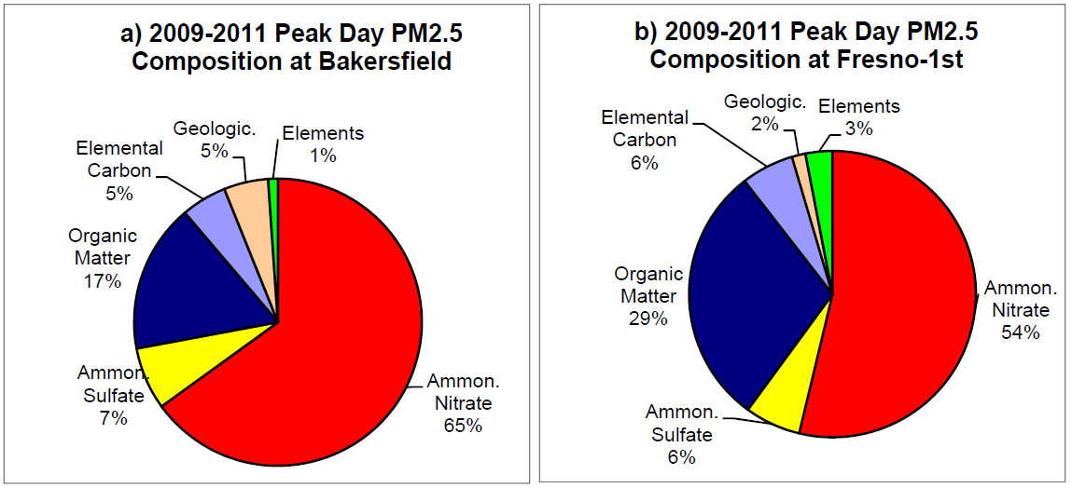
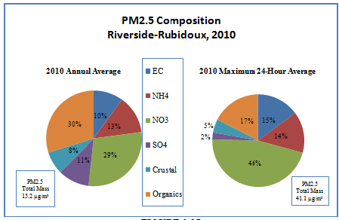
PM_{2.5} in South Coast and SJV
Primary PM_{2.5} NAAQS levels are set to protect human health
Annual NAAQS Level: 12 μg m⁻³
24-h NAAQS Level: 35 μg m⁻³
2010-2012 PM_{2.5} Design Values exceed NAAQS levels in SC & SJV
NH₄⁺ and NO₃⁻ make up >50% of PM_{2.5} mass on polluted days
Area | Highest Annual | Highest 24-h
South Coast | 15.6 | 37
San Joaquin Valley | 19 | 59
Sources:
http://www.epa.gov/airtrends/values.html
http://www.aqmd.gov/aqmp/2012aqmp/Final-February2013/AppII.pdf
http://www.valleyair.org/Air_Quality_Plans/PM25Plans2012.htm

Slide 3
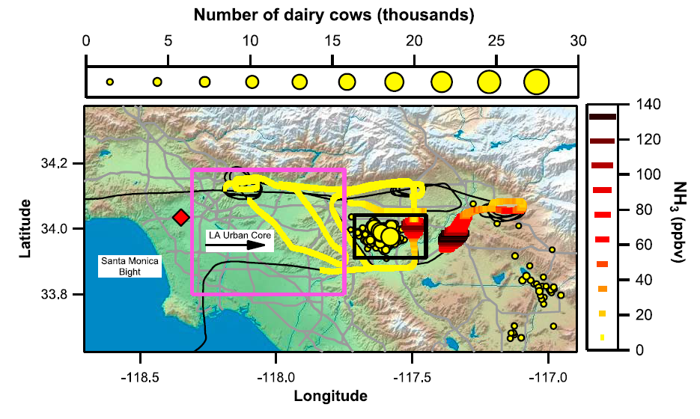
Motivation
Accurate NH₄⁺ and NO₃⁻ modeling is useful for developing control plans, health and exposure studies, and single-source applications
Modeling NH₄⁺ and NO₃⁻ is challenging in California due to complex emissions, terrain, meteorology, and chemistry, e.g.,
CalNex-2010 provides a rich dataset for model evaluation
Emissions: ports, LA, dairy facilities
Terrain: San Gabriel, San Bernardino, and San Jacinto Mtns.
Meteorology: land-sea breeze, upslope-downslope flow, Temp. inversions, Bight recirculation
Chemistry: aging of LA and port emissions and mixing w/ dairy emiss.
Nowak et al. (2012)
Figure: Nowak et al. (2012) Ammonia sources in the California South Coast Air Basin and their impact on ammonium nitrate formation, Geophys. Res. Letters

Slide 4
Model Configuration
Category | Description
Simulation period | 4 May – 30 June 2010
AQ model | CMAQv5.0.1
Resolution | 4-km horizontal, 34 vertical layers
Gas-Phase chemistry | CB05TU
Aerosol chemistry | AERO6
Meteorology | WRFv3.4 with ACM2 PBL and PX LSM
Boundary conditions | GEOS-Chem v8-03-02
Onroad/nonroad emissions | Interpolated from CARB’s 2007 and 2011 totals
Point source emissions | 2010 data
Other US anthro. emissions | 2008 NEIv2
Biogenic emissions | BEISv3.14, offline, w/ BELD3 land-use data (USGS)

Slide 5
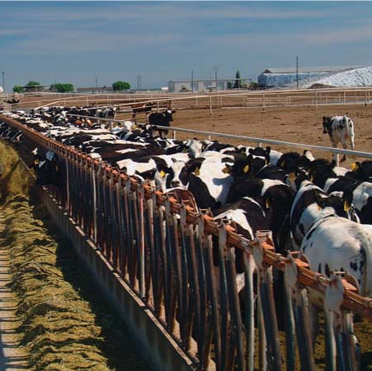
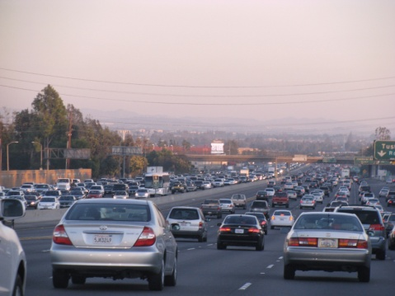
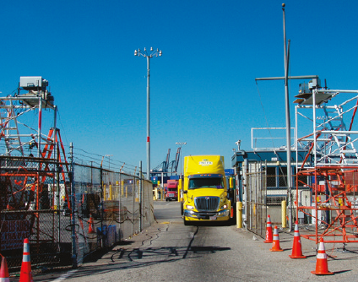
Precursor Gases: NH₃ and HNO₃
NH₃ is directly emitted
Livestock and agriculture
Automobiles
Waste disposal
HNO₃ forms via NOx oxidation in atmosphere
Daytime:
NO + O₃ → NO₂
NO₂ + OH → HNO₃
Nighttime:
NO + O₃ → NO₂
NO₂ + O₃ → NO₃(g)
NO₂ + NO₃(g) ↔ N₂O₅
N₂O₅+ H₂O(p) → 2HNO₃
Photos:
Castillo (2009) California Agriculture 63(3):149-151.
Bishop et al. (2012) Environ. Sci & Technol. 46(1):551-558

Slide 6
Gas-Particle Partitioning
Total NHx (NH₃+NH₄⁺) and total nitrate (HNO₃+NO₃⁻) partition between the gas phase and fine particles according to equilibrium
Inorganic Fine Aerosol Equilibrium
H₂O
HNO₃(g) ↔ H⁺(p) + NO₃⁻(p)
HNO₃
K⁺
H⁺
NO₃⁻
Ca²⁺
CO₃²⁻
Mg²⁺
OH⁻
NH₄⁺
NH₃
Na⁺
NH₃(g) + H⁺(p) ↔ NH₄⁺(p)
Cl⁻
H⁺
H⁺
SO₄²⁻
HCl
H₂SO₄

Slide 7
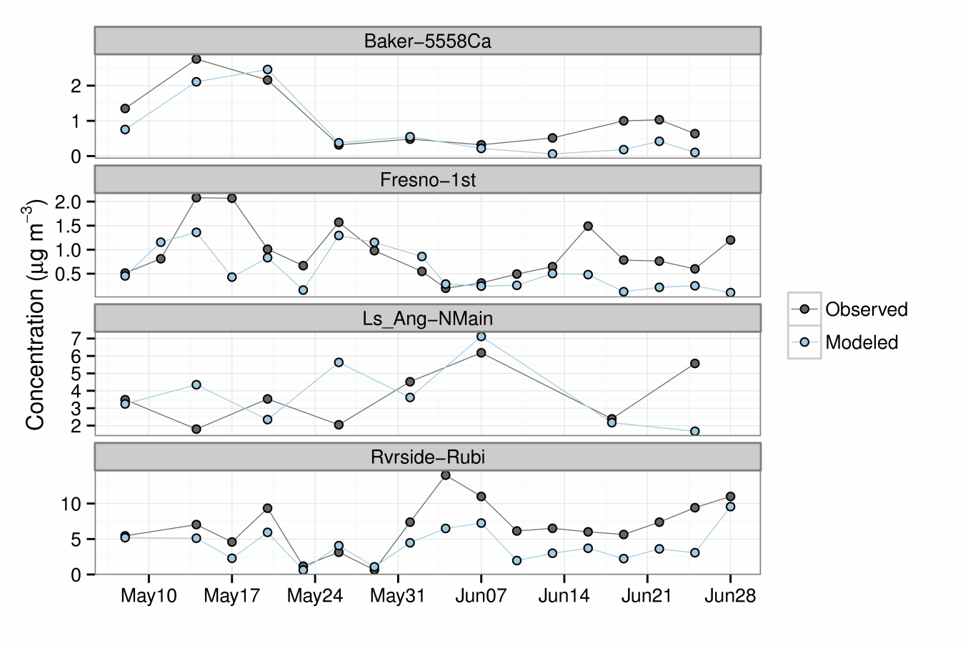
Nitrate Evaluation with CSN Data
4-km domain and CSN Sites
Ls_Ang-NMain (Los Angeles)
Rvrside-Rubi (Riverside-Rubidoux)
Baker-5558Ca (Bakersfield)
Fresno-1st (Fresno)
Good correlation in Bakersfield and Riverside
Under-prediction of high values in Riverside
Over-prediction on May 26th in Los Angeles

Slide 8
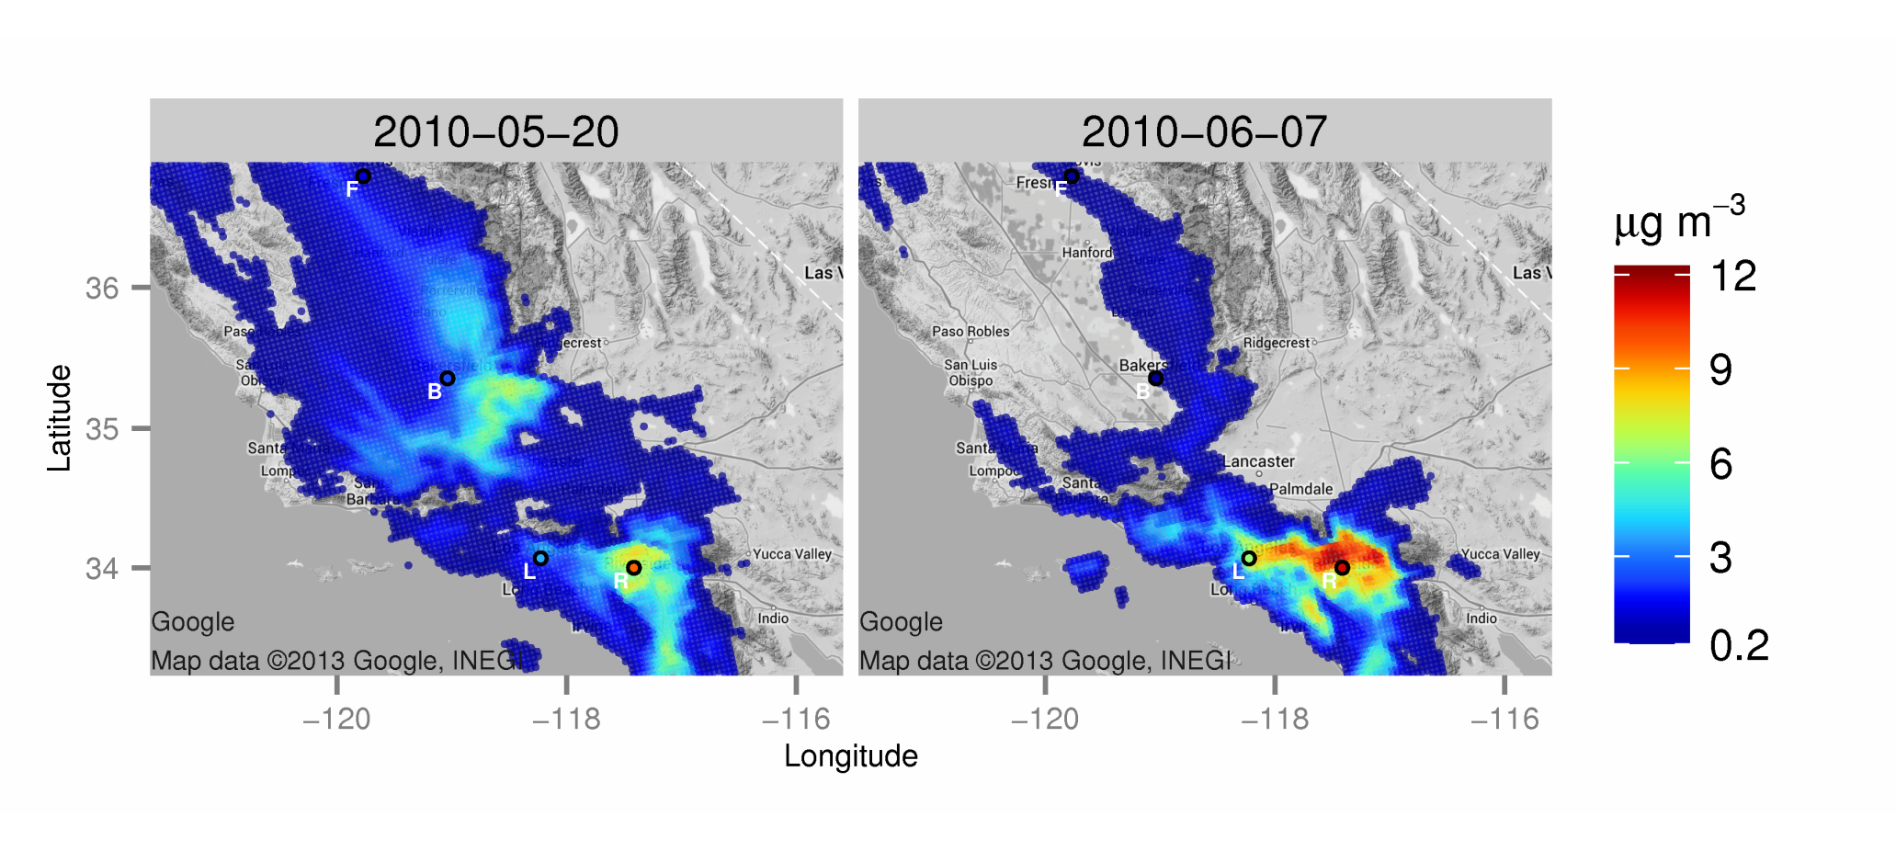
Daily Average Nitrate w/ CSN Data
CSN Sites
L: Ls_Ang-Nmain
R: Rvrside-Rubi
B: Baker-5558Ca
F: Fresno-1st

Slide 9
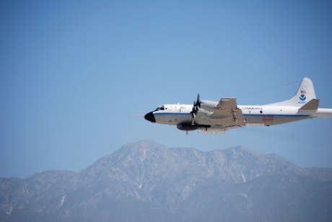
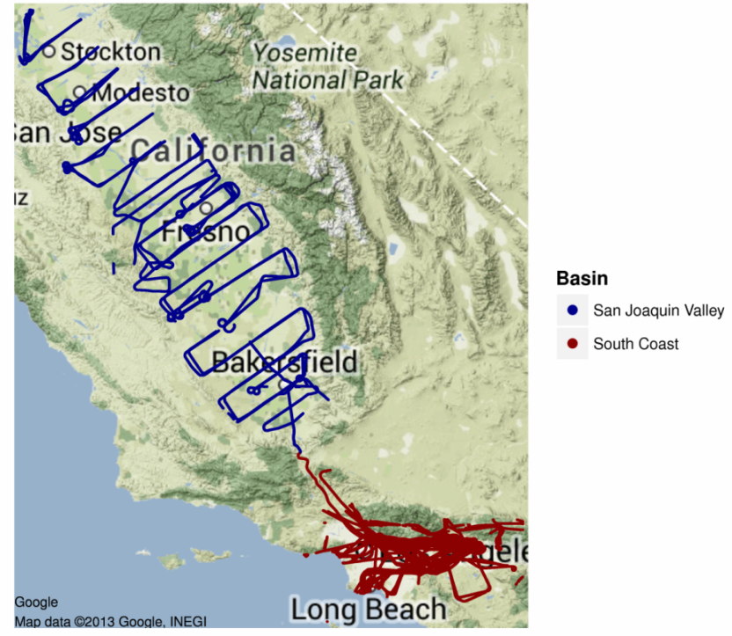
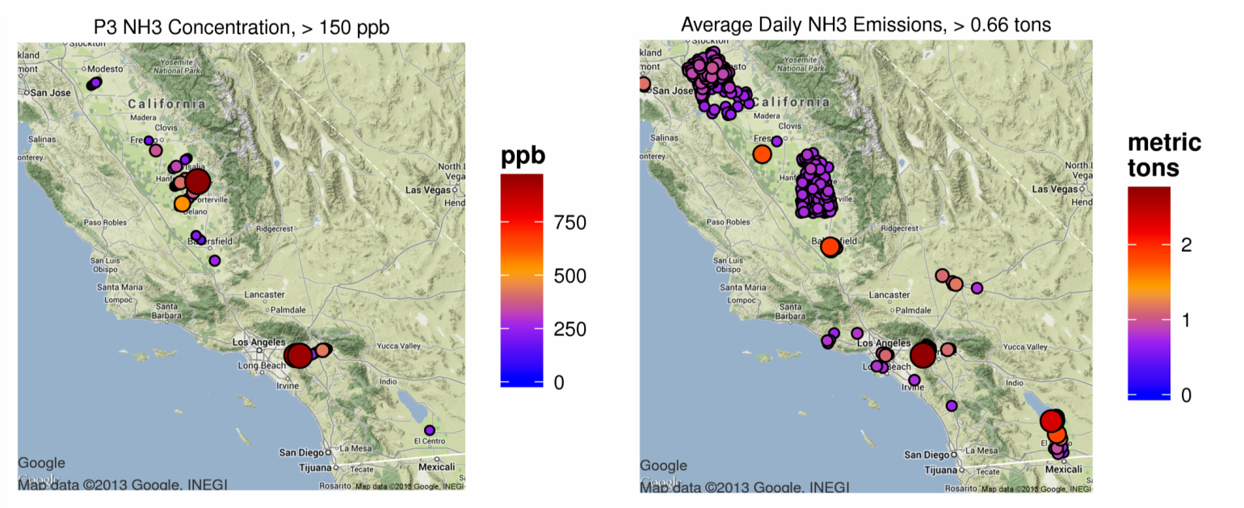
NH₃ from NOAA WP-3
Peak* NH₃ Concentration
Peak§ NH₃ Emissions
*NH₃ Concentration > 150 ppb
§NH₃ Emissions > 0.66 tons day⁻¹
In South Coast, the location of peak concentrations and emissions agrees reasonably well
In SJV, spatial allocation of emissions warrants further investigation
Photo: J. Nowak, NOAA/CIRES

Slide 10
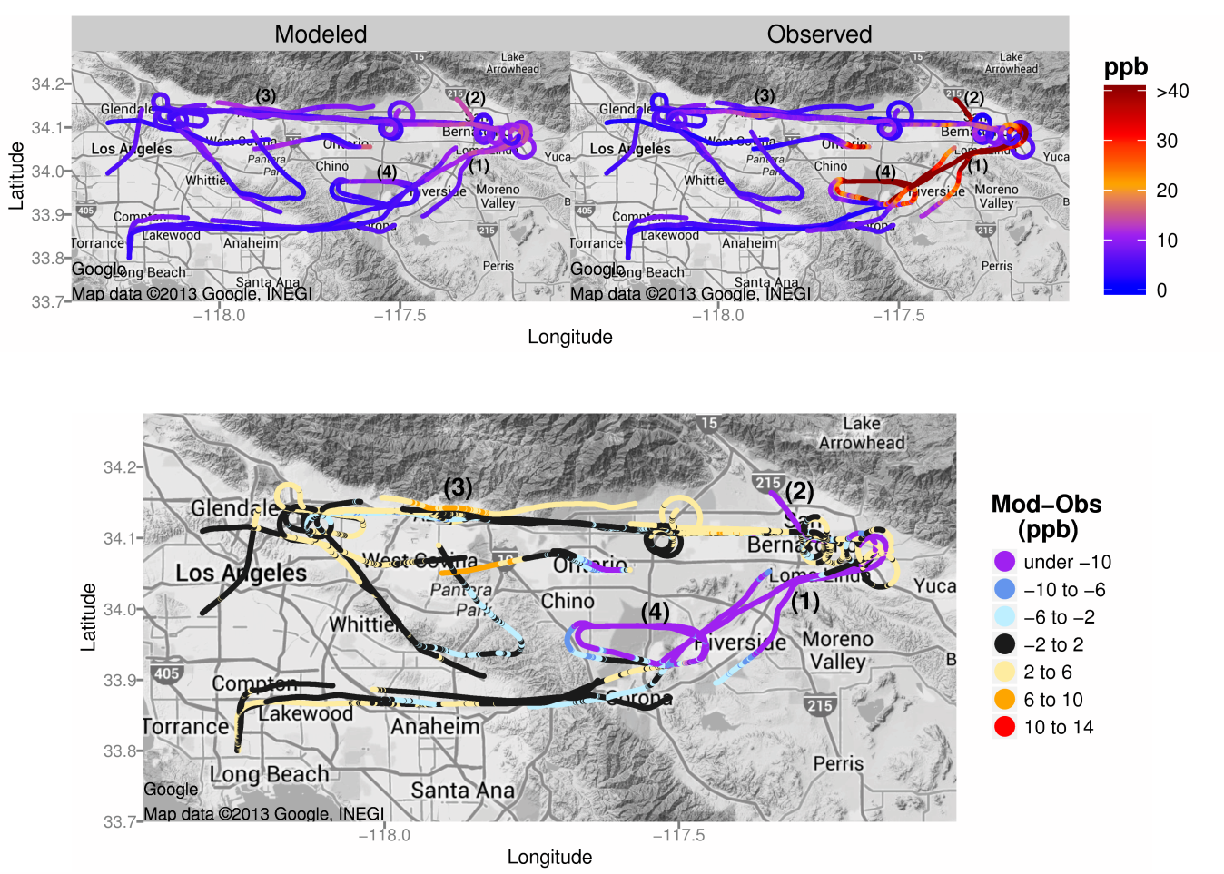
NH₃ on 8 and 19 May 2010
Under-predictions downwind of Chino dairy facilities, e.g., (1) and (4)
Over-predictions along San Gabriel Mountains near Pasadena, e.g., (3)
Note: NH₃ emissions are quite variable from dairy facilities and aircraft transects provide only short snapshots of concentration

Slide 11
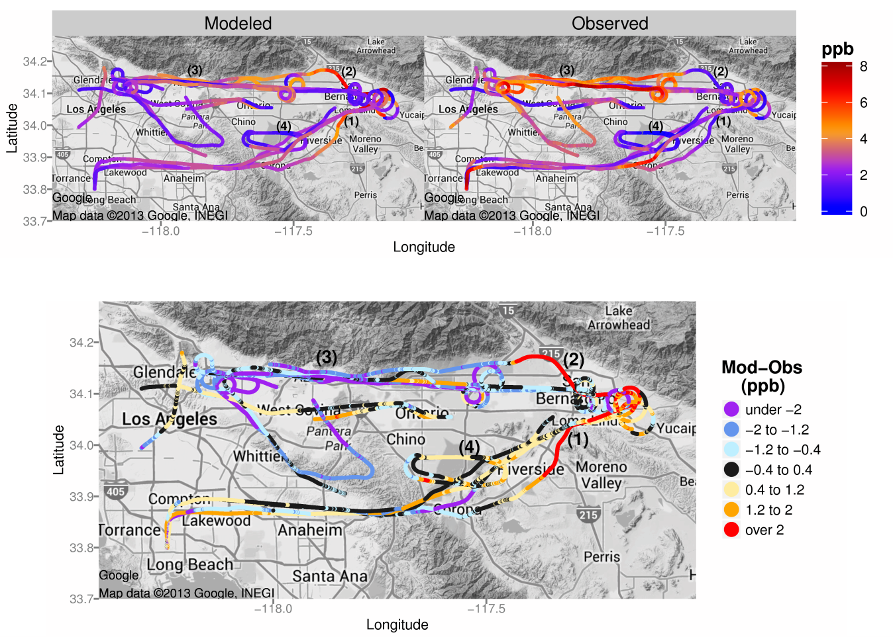
HNO₃ on 8 and 19 May 2010
Over-predictions downwind of Chino dairy facilities, e.g., (1) and (4)
Under-predictions along San Gabriel Mountains near Pasadena, e.g., (3)
Note: aircraft transects provide only short snapshots of concentration

Slide 12
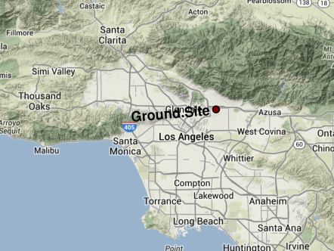
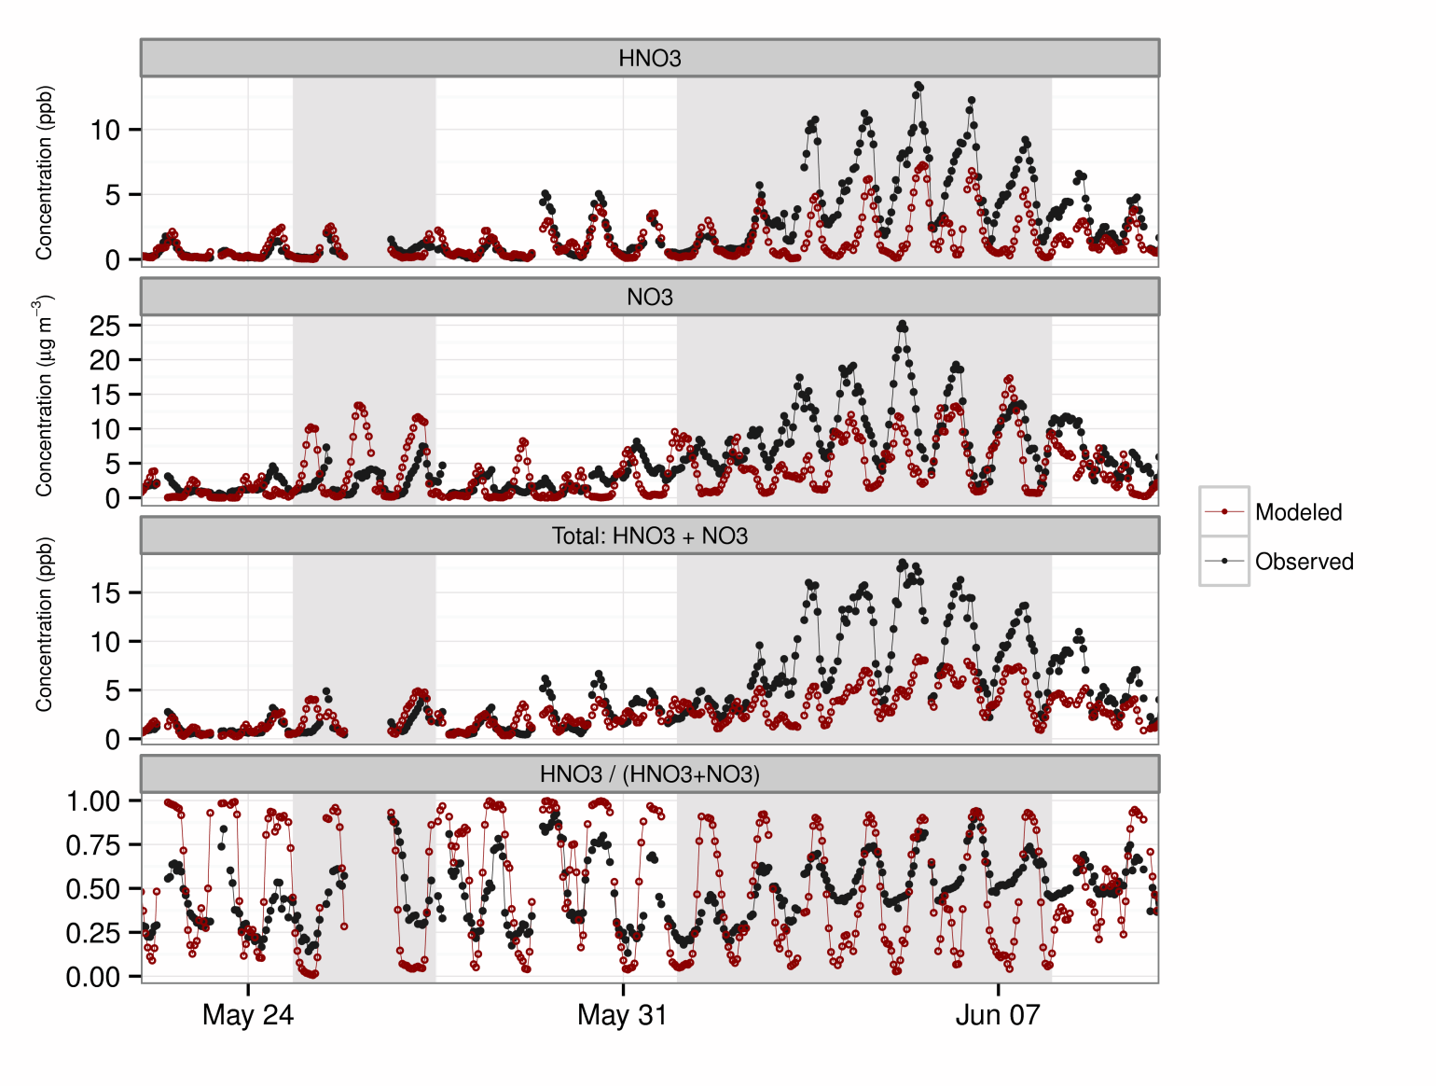
Nitrate System at Pasadena
Google
NO₃⁻ peaks are out of phase
Gas-phase fraction
Too high during day
Too low during night

Slide 13
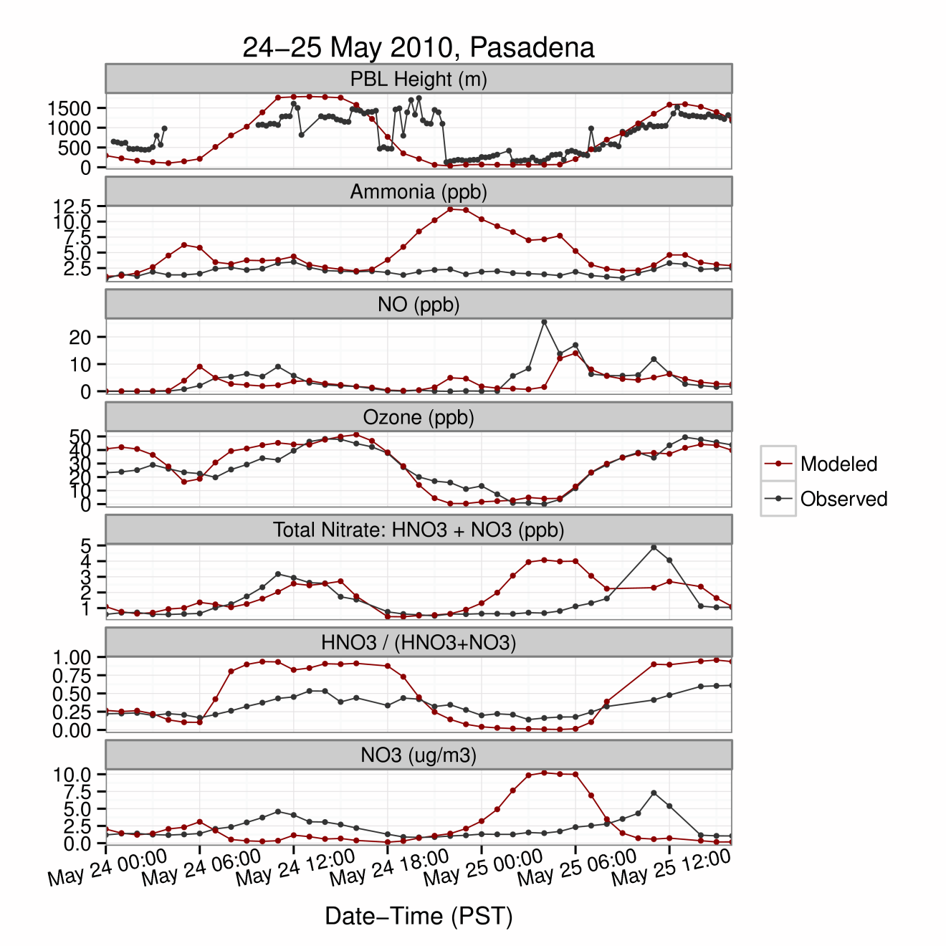
Timing of NO₃⁻ Peak on 24-25 May
PBL collapses too early in the evening on 24 May 2010 and leads to NH₃ and NO over-prediction
NO over-prediction leads to excessive titration of O₃ and production of HNO₃ via N₂O₅
Total nitrate partitions too much to the particle phase during night causing nighttime NO₃⁻ peak

Slide 14
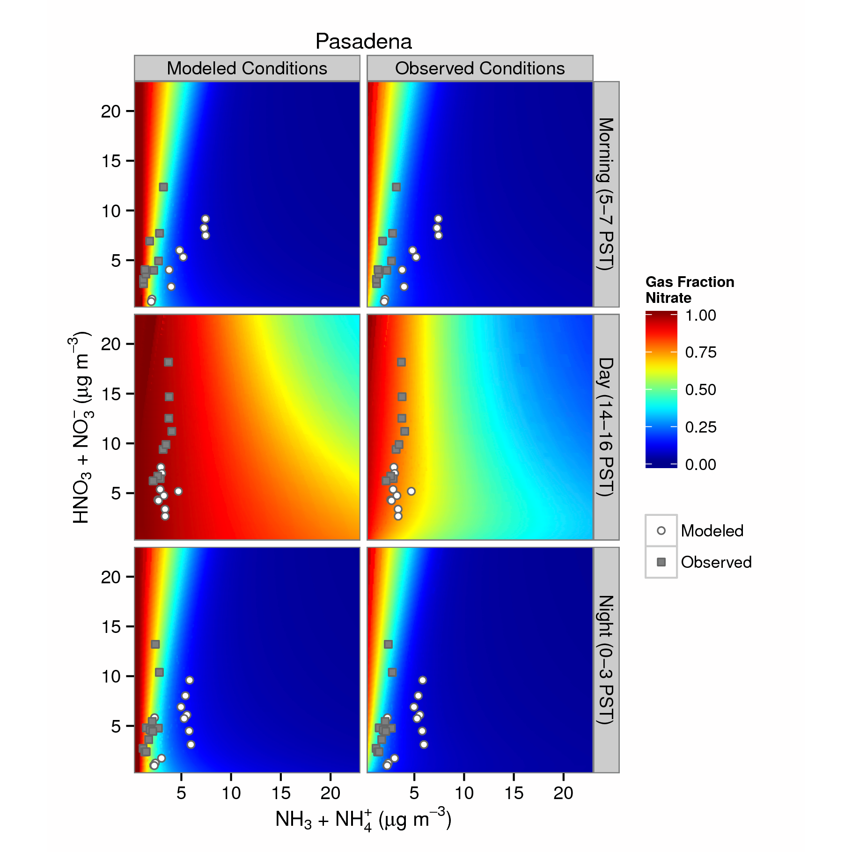
Gas Fraction of Nitrate (GFN) at Pasadena
ISORROPIA II calculations of GFN constrained by average modeled values (left) and observed values (right)
During morning and night, GFN gradients based on modeled and observed conditions are similar but total ammonia is over-predicted (top and bottom)
During the day, ISORROPIA II predicts higher GFN for average modeled conditions than for average observed conditions (middle)
Gas Fraction of Nitrate (GFN): HNO₃ / (HNO₃ + NO₃⁻)

Slide 15
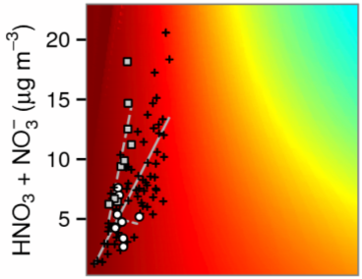
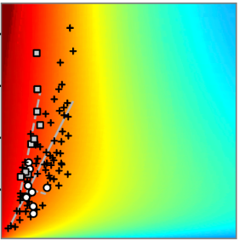
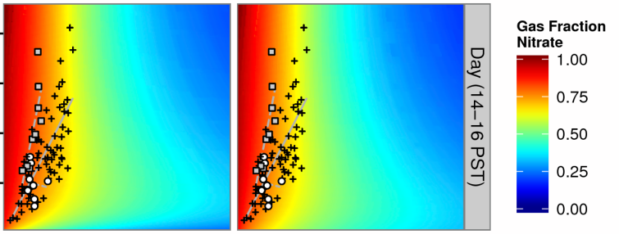
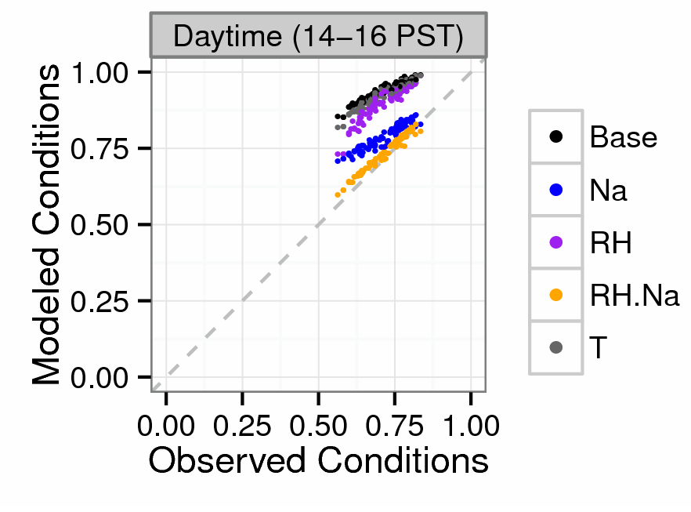
Daytime GFN Sensitivity at Pasadena
Model w/
Observed Na⁺
Model w/
Observed Na⁺ & RH
Modeled Conditions
Observed Conditions
Daytime gas fraction of nitrate is sensitive to Na⁺ and RH
Under-predictions of Na⁺ and, to a lesser degree, RH could explain daytime over-predictions of GFN

Slide 16
Conclusion
Good correlation for predictions and observations of 24-h NO₃⁻ at key CSN sites suggests basic processes are captured
Over-predictions of NH₃ in Pasadena and under-predictions near Riverside appear to influence gas-particle partitioning of total nitrate
Meteorology also influences gas-particle partitioning, and early PBL collapse can lead to NO₃⁻ over-predictions at night
During the daytime, under-predictions of Na⁺ concentration may cause too much partitioning of total nitrate to gas phase
Future work will focus on model development for meteorology, emissions, and chemistry to improve simulations of NH₄⁺ and NO₃⁻

