Slide 1
Development of a regional-scale pollen emission and transport modeling framework for investigating the impact of climate change on allergenic airway disease (AAD)
Rui Zhang, Serena H. Chung, Timothy M. VanReken and Brian K. Lamb
Laboratory for Atmospheric Research, Washington State University
Tiffany Duhl and Alex Guenther
National Center for Atmospheric Research
Muhammad T. Salam, Edward L. Avol and Frank D. Gilliland
University of Southern California
James M. House and Richard C. Flagan
Department of Chemical Engineering, California Institute of Technology
Jeremy Avise
California Air Resource Board

Slide 2
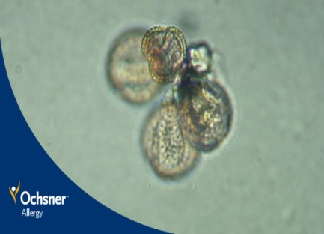
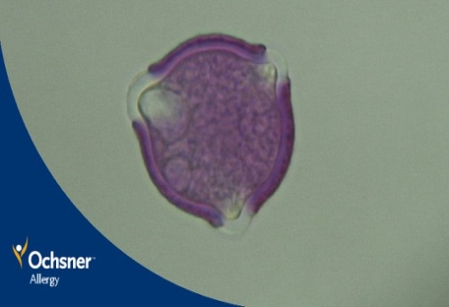
Background & Motivation
Allergenic Pollen and AAD: impact 10%~15% total population in US and Europe
Pollen Emission during Flowering Season: driven by meteorological conditions
Pollen Transport: wind, deposition, long distance dispersion (LDD)
Pollen Observation Network: count and species identification
Human allergenic repose to pollen exposure: FeNO level, dose response function
Adjuvant effect of pollen allergenicity and air pollutants
Olive pollen grain
Oak pollen grain
Ultimate Goal:
Develop quantitative model for pollen observation, concentration and health impact with climate change

Slide 3
Modeling Framework
Pollen Emission Potential Modeling
STAMPS
(NCAR)
Daily Pollen Pool
Pollen Transport Modeling (WSU)
Climate
Projection
ECHAM5,
A1B
Current
Decade
(1995-2004)
Future
Decade
(2045-2054)
Temperature
Precipitation
Regional Meteorological Model:
WRF V3.2.1
Emission
Potential
wind
Pollen Release Module:
Hourly pollen emission flux
Dry deposition velocity
Pollen-Health Linkages (USC)
Dose Response Function
Pollen
Conc.
Regional Transport Model: CMAQ V4.7.1
Pollen Observation
(Caltech)
Daily Mean Pollen Count
Evaluation
Added pollen as non-reactive tracers
(DIFF+ADV+EMIS+DDEP)

Slide 4
Pollen Emission Potential Modeling
Simulator of the Timing And Magnitude of Pollen Season
(STAMPS) Model
Daily Pollen Emission Potential
Meteorological Coefficient
T: temperature, P: precipitation
P_{a}= ε_{sp}*λ_{T,TP}*γ
Pollen Production Pool
(sp: species spefic)
Area Coverage Fraction
(USDA/FIA; USDA/CLD
USGS/NLCD)
Thermal time approach (GDD – Growing Degree Day) to predict the onset and duration of pollen season.
Chilling module for species require vernalization base on De Melo-Abreu et al. 2004).

Slide 5
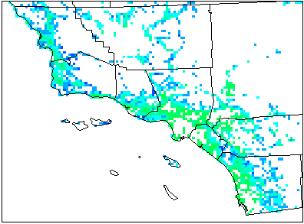
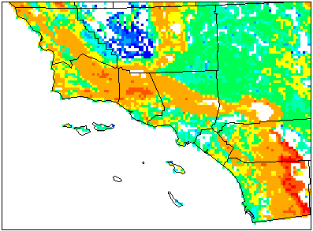
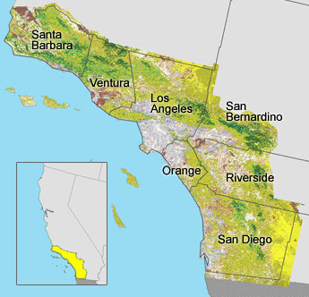
Spatial Distribution of Pollen Emission Potential
Olive tree pollen
Oak tree pollen
grains/m2
Vertical label is the exponent with base 10
30m Landsat satellite imagery

Slide 6
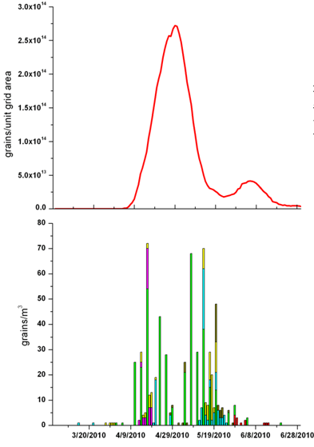
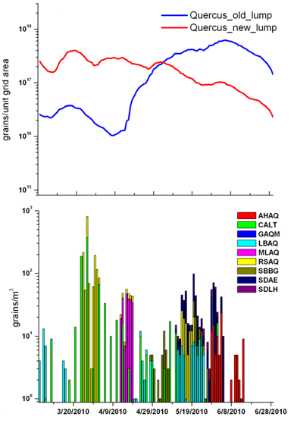
Temporal Variation of Pollen Emission Potential
Olive tree pollen
Oak tree pollen
Modeled Pollen Potential P_{a}
(grains m⁻²)
Observed Pollen Count (grains m⁻³)
After regrouping oak into earlier and later-blooming category, the synchronization was improved

Slide 7
Pollen Emission Flux E_{p}
Pollen emission potential
(grain/m²)
Hourly Pollen emission
(grains/m²/hr)
Friction velocity
(m/s)
canopy height
(m)
Wind effect scale factor [0 1]
Time
conversion
factor

Slide 8
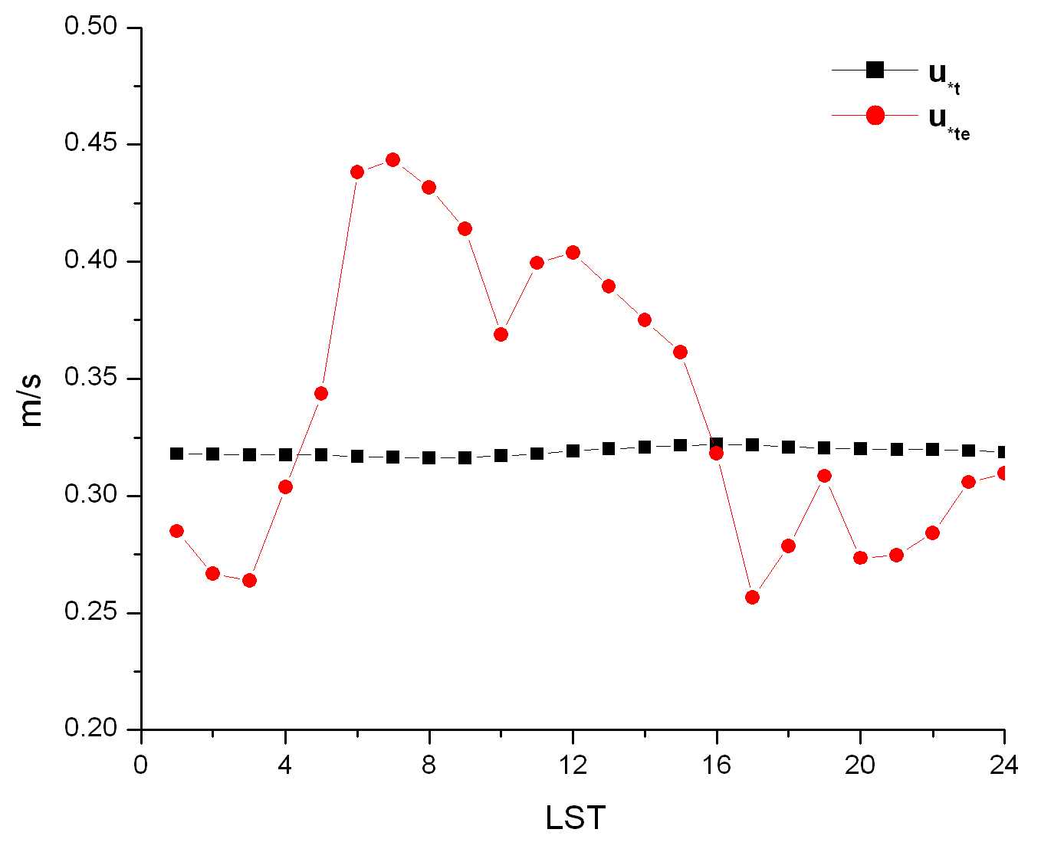
Pollen Emission Flux Wind Factor
(Helbig et al., 2004)
wind tunnel studies for sand erosion
empirical threshold wind speed

Slide 9
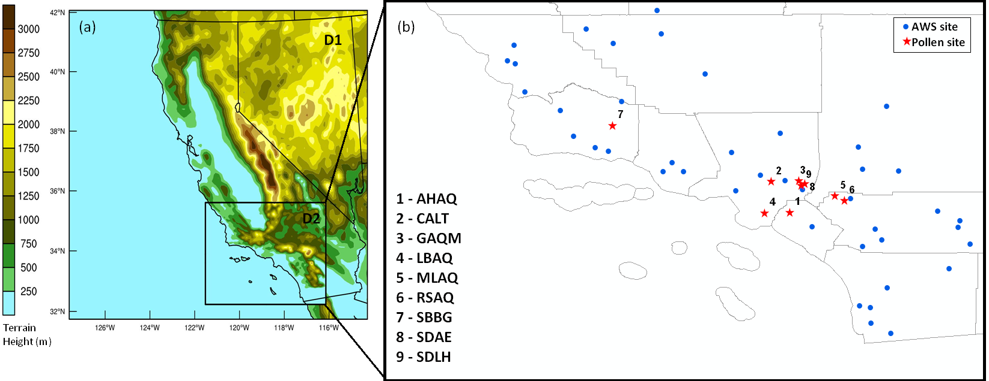
Case study in Southern California
Time: Mar – Jun 2010 (USC Children Health Study)
Pollen Genera: Bromus, Birch, Walnut, Mulberry, Olive, Oak

Slide 10
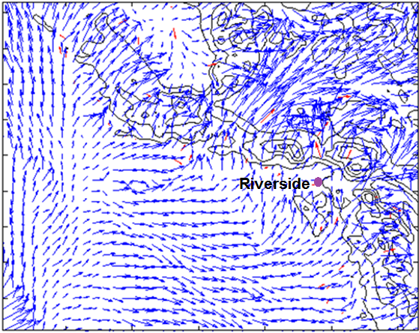
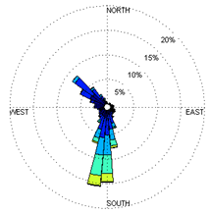
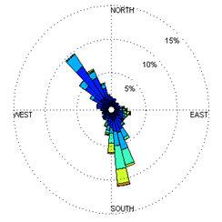
Wind Fields by WRF
Observation
Simulation
Analysis nudging @ D1 on top of PBL with NARR
Observational nudging @ D2 T2 and U10 on the surface with CARB data

Slide 11
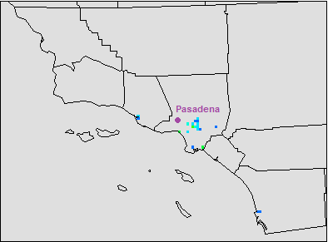
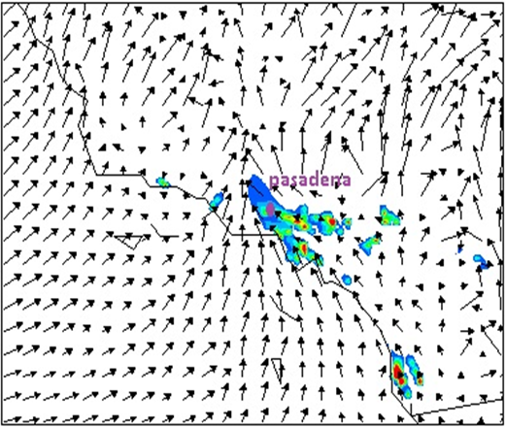
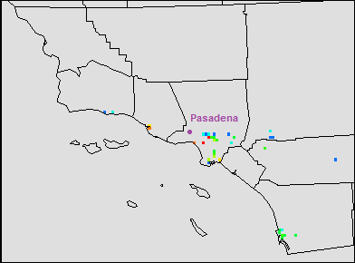
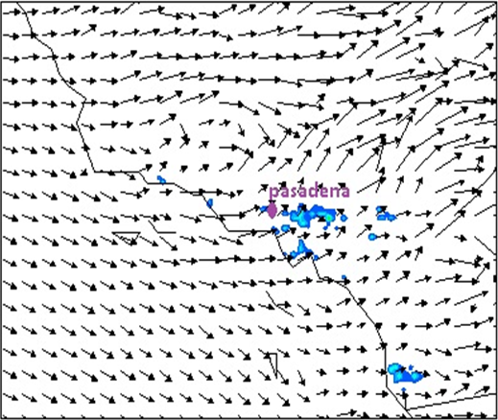
Simulated Pollen Emission & Concentration
Simulated pollen emission
Simulated pollen concentration
12 am local time
3pm local time

Slide 12
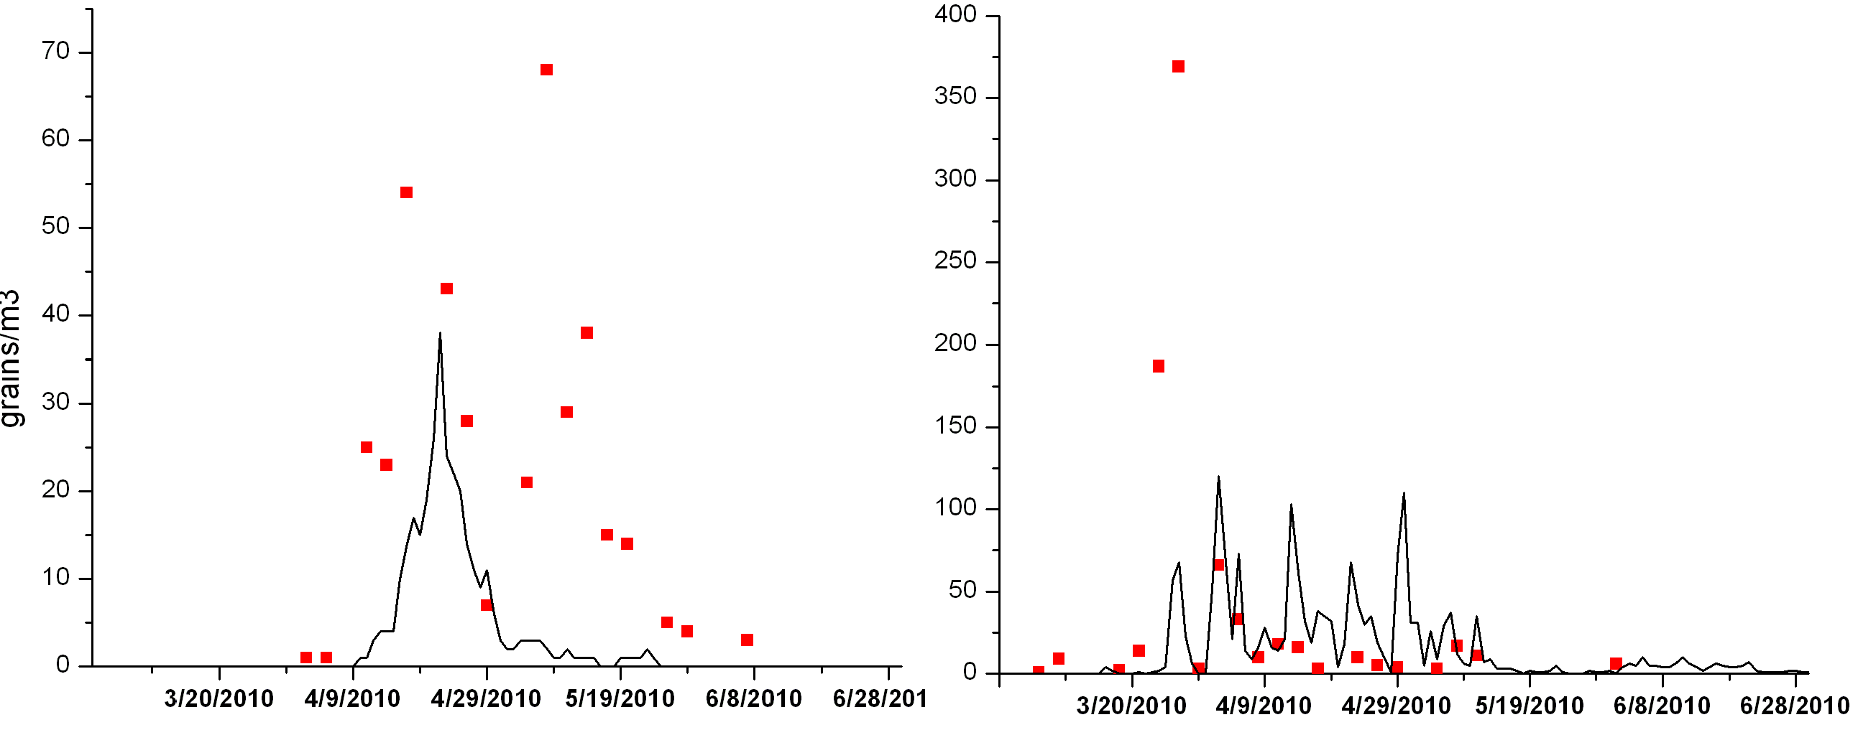
Evaluation of Simulated Pollen Concentration
Olive tree pollen
Oak tree pollen
grains/m³
Measured @ Caltech Campus, Pasadena, CA

Slide 13
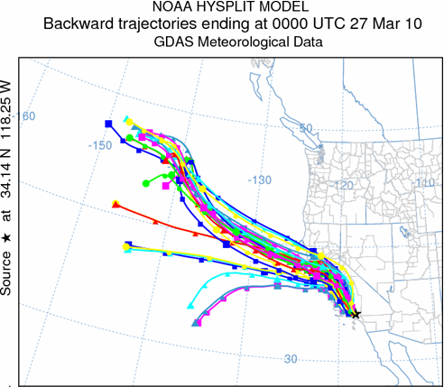
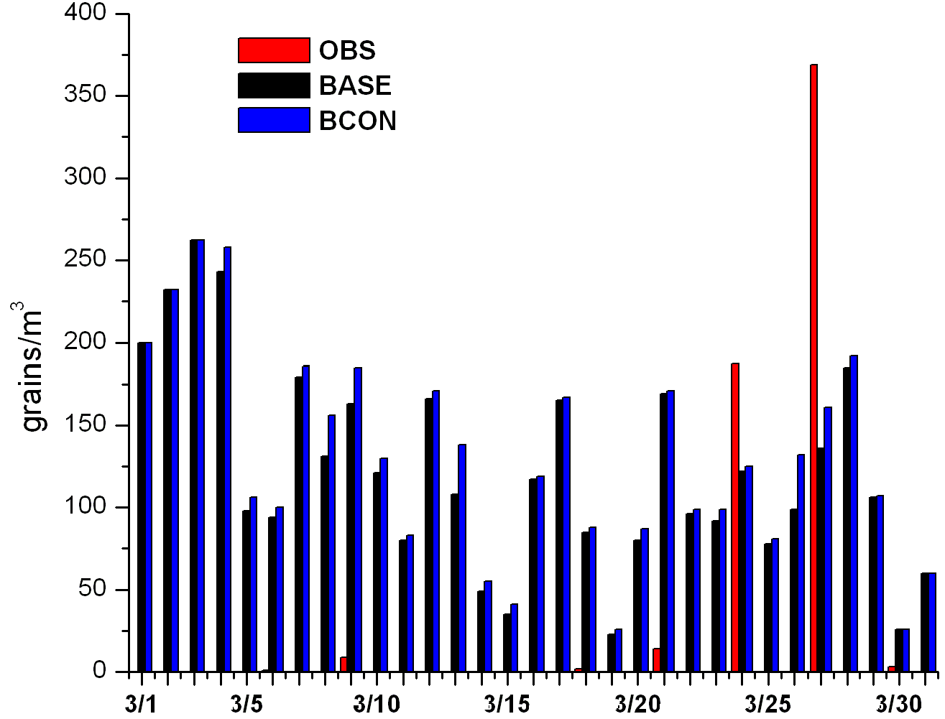
Sensitivity study: influence from outside modeling domain
OBS: 381 #/m3
BASE: 131 #/m3
BCON: 164 #/m3
D2
Including the outer domain (BCON) improve the model performance during peak time, the underestimation indicating that the impact is mainly from nearby sources.

Slide 14
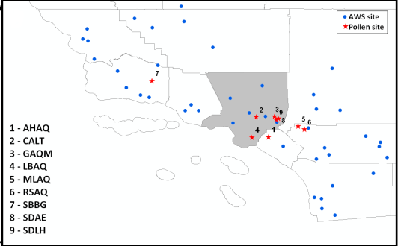
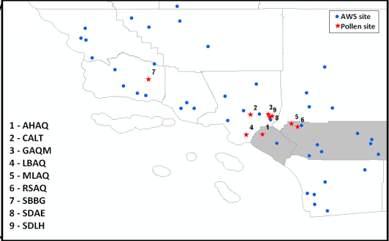
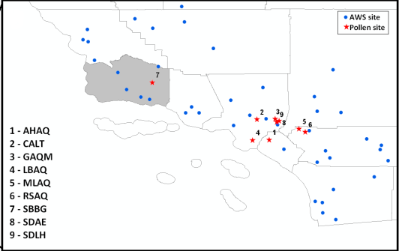
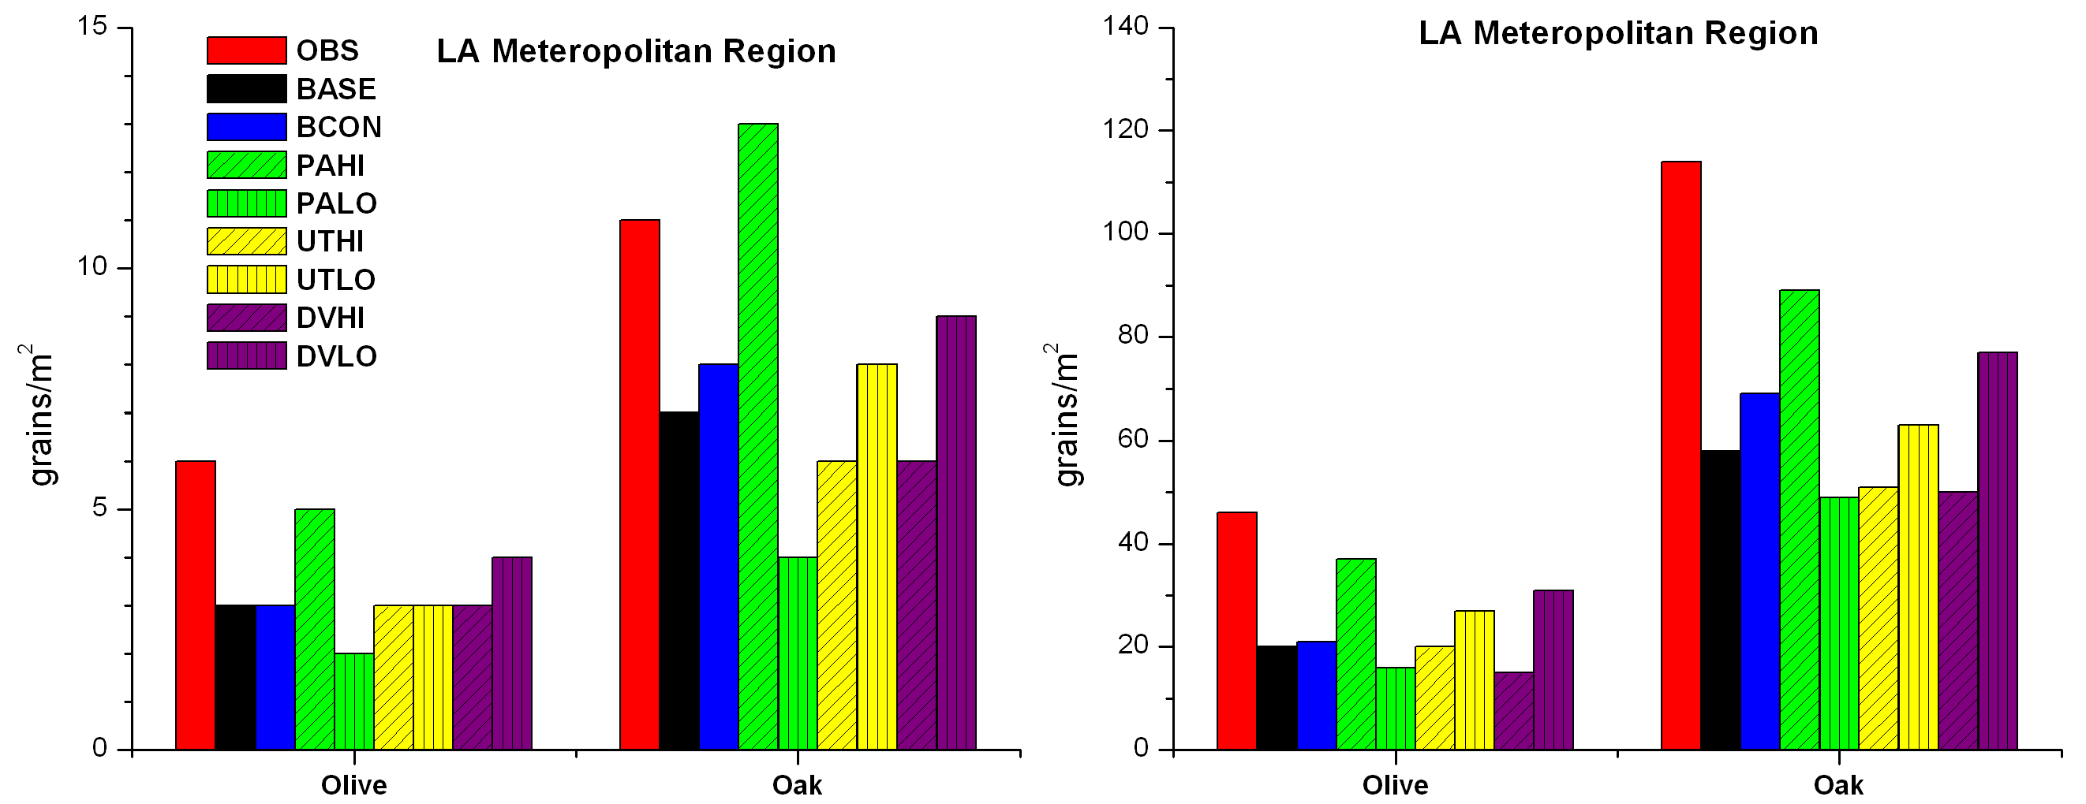
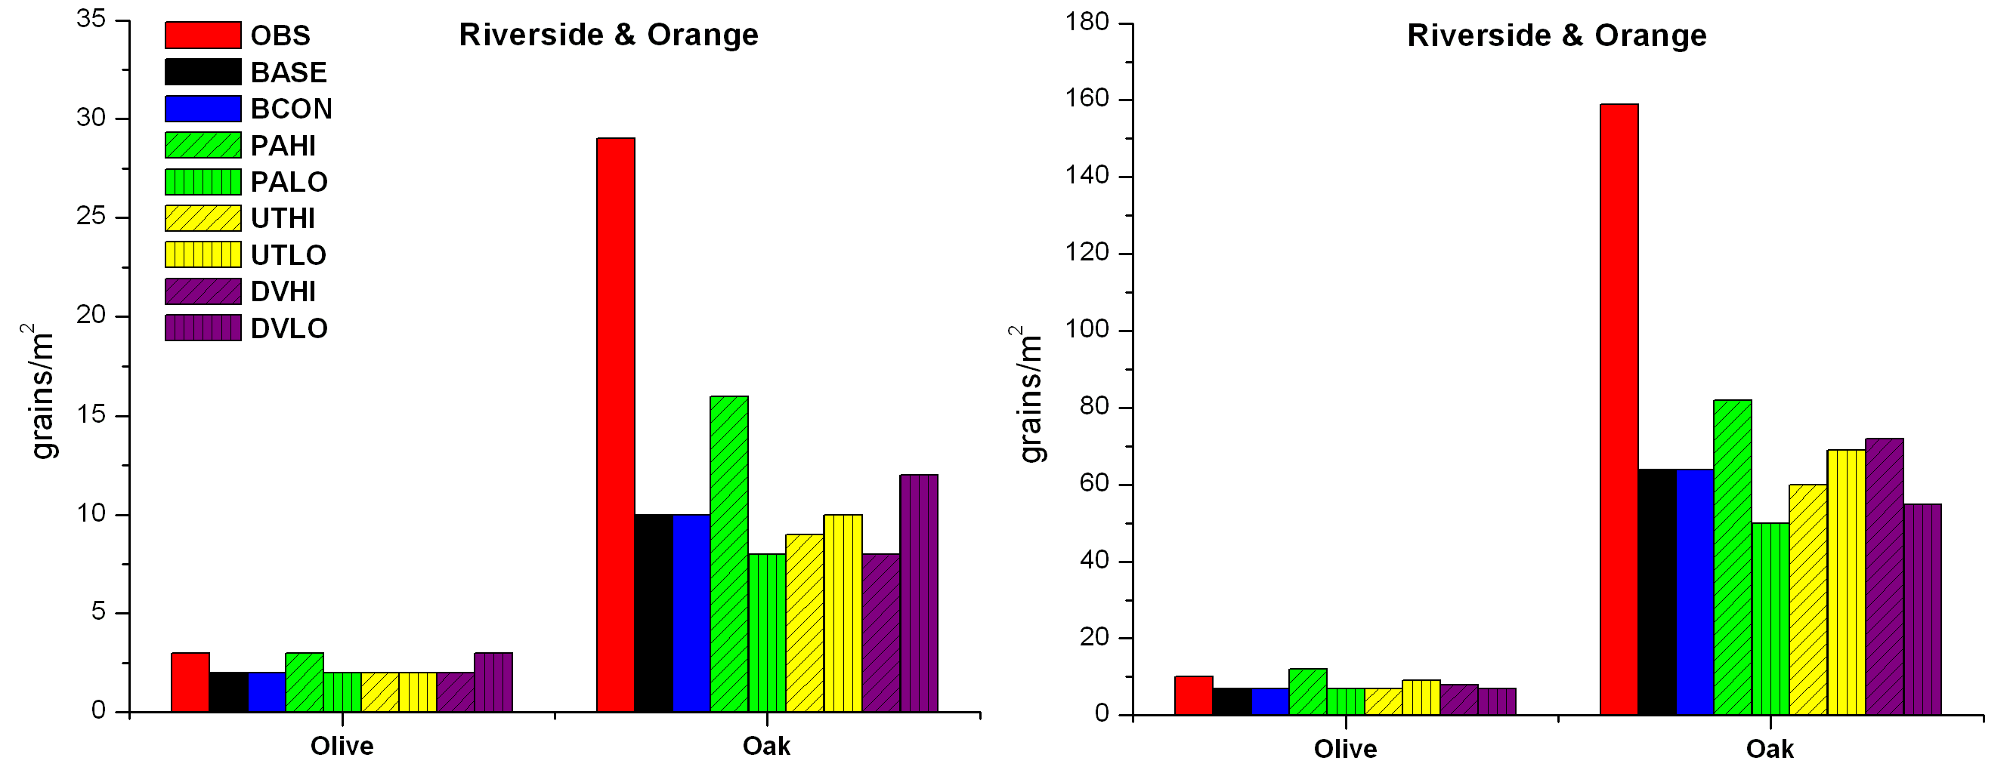
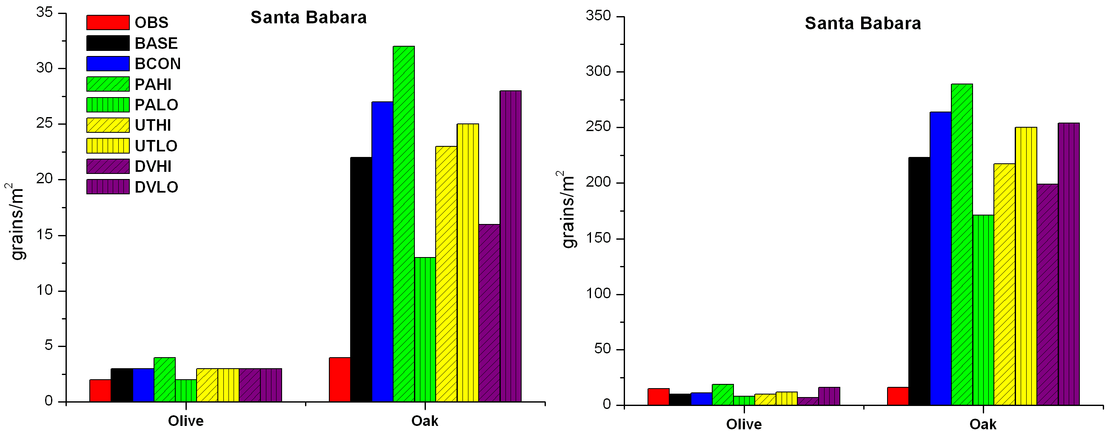
Sensitivity Study
BASE : Base case
BCON : Sensitivity of boundary Condition
PAHI & PALO : Sensitivity of poll production pool
UTHI & UTLO: Sensitivity of empirical friction velocity setting
DVHI & DVLO: Sensitivity of settling velocity
Mean
Max
Emission pool > deposition rate > empirical friction velocity

Slide 15
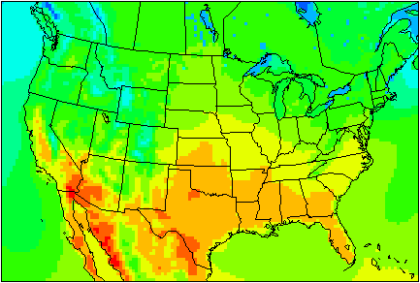
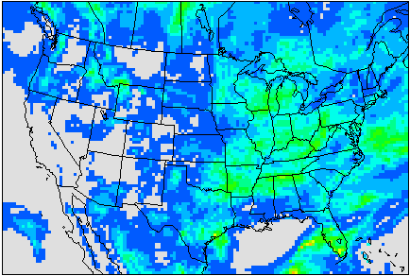
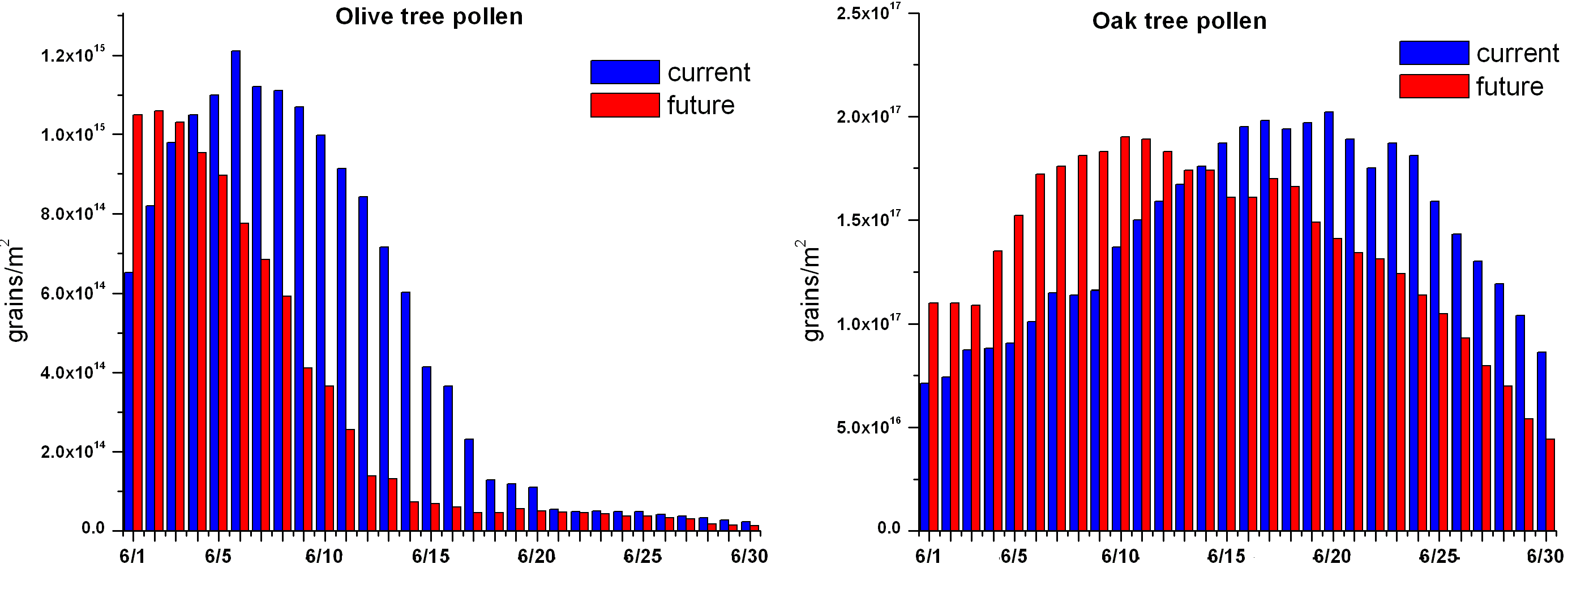
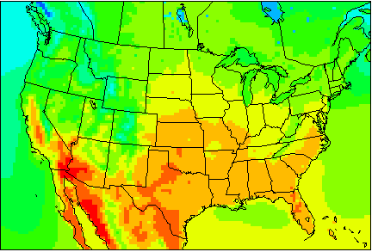
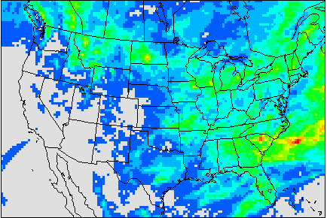
Pollen Emission Potential with Climate Change
Current Decades
1995-2004
Current Decades
1995-2004
Future Decades
2045-2054
Future Decades
2045-2054

Slide 16
Summary
STAMPS model was developed to predict daily pollen emission potential.
The hourly pollen emission flux was parameterized by applying wind factor to the pollen emission potential.
Consistency of temporal pattern between emission potential and the observed count is the key for successful pollen concentration simulations.
Current model tends to underestimate peaks in oak pollen concentrations, but showed reasonable agreement with observed olive tree pollen concentrations.
Pollen emission potential estimation is crucial to model performance.

Slide 17
Acknowledgement
We would like to thank the funding of US EPA STAR Grant R834358 (“Projecting Pollen Allergens and Their Health Implications in a Changing World”) for this project.

Slide 18
Support Slides

Slide 19
Model configuration
WRF configuration: V3.2.1
BCON: NARR(32 km)
PBL Simulation: YSU scheme
Microphysics: Thompson scheme
Land-surface Model: Thermal diffusion
Data Assimilation: U10, T2 observation nudging @ D2; NARR analysis nudging @ D1
Emission configuration:
Standard: ARCTAS2008+ NEI2002+ MEGAN(8-day LAI)
Pollen: Hourly emission flux of different pollen are released into the first model layer.
CMAQ configuration: V4.7.1
BCON: MOZART-4
Chemistry: SAPRC99
Aerosol: AE5
Advection: Yamartino scheme
Diffusion: ACM2
Dry deposition: Add off-line calculated pollen settling velocity in MCIP METCRO2D

Slide 20
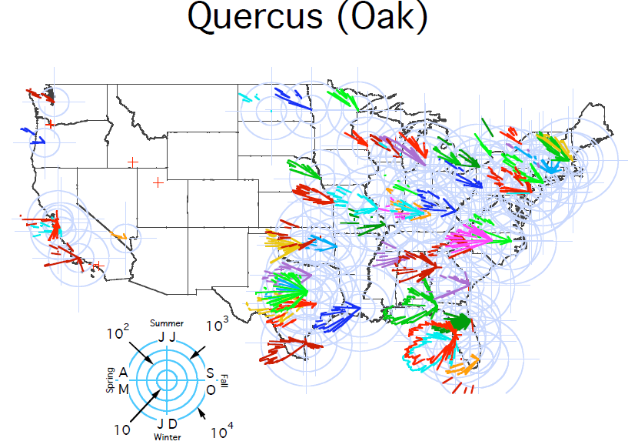
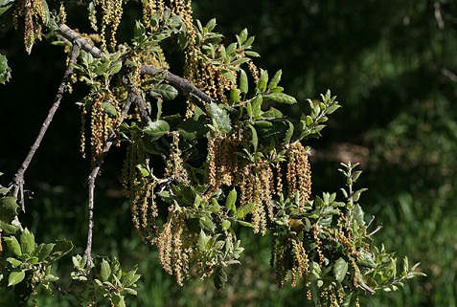
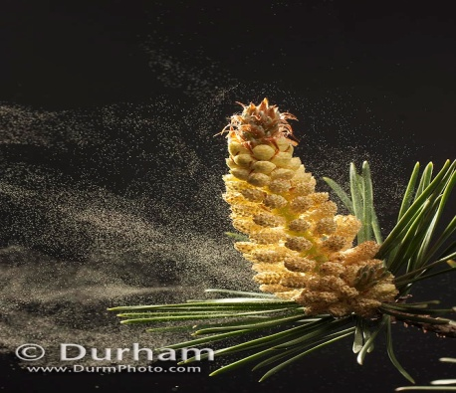
Pollen observation network
Different color represents different pollen species
Notes:
Mention the talk will focus on the oak and olive. Busy slide. Too much information. Consider delete this slide. As a backup slide. Allergenic, different size. Focus on the campaign have the detail pollen. Zoom in the California.

Slide 21
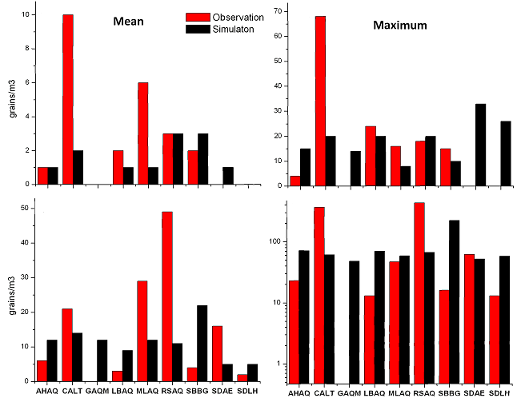
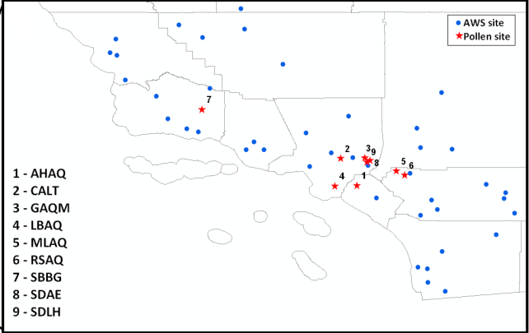
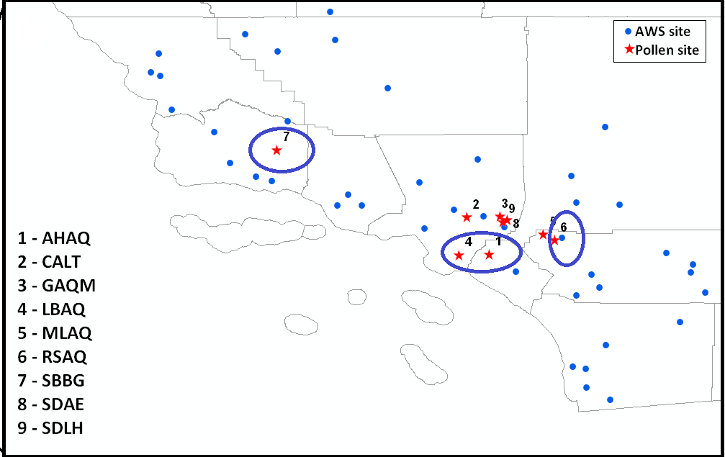
BASE case evaluation
Olive tree pollen
Oak tree pollen
The pollen transport model tends to underestimate oak but performs relatively fair for olive.
Notes:
]

Slide 22
Model limitation & future work
Limitation:
High uncertainties for modeling emission potential , e.g. pollen pool size, choice of species composition and fractional vegetation cover database
Immature pollen release parameterization scheme, e.g., u_{*te} tuning parameter, empirical relationship between meteorological condition and pollen flux
Sparseness of pollen count data and measurement uncertainties (location, time resolution, automatic identification tool )
Future work:
Assess the impact of emission uncertainty on predicted concentrations and health impacts
Conduct CMAQ run to assess the impact of climate change on pollen levels in the future
Add more important physical processes for pollen dispersion, i.e., pollen rupture parameterization, re-suspension, viability change during transport into the modeling scheme

Slide 23
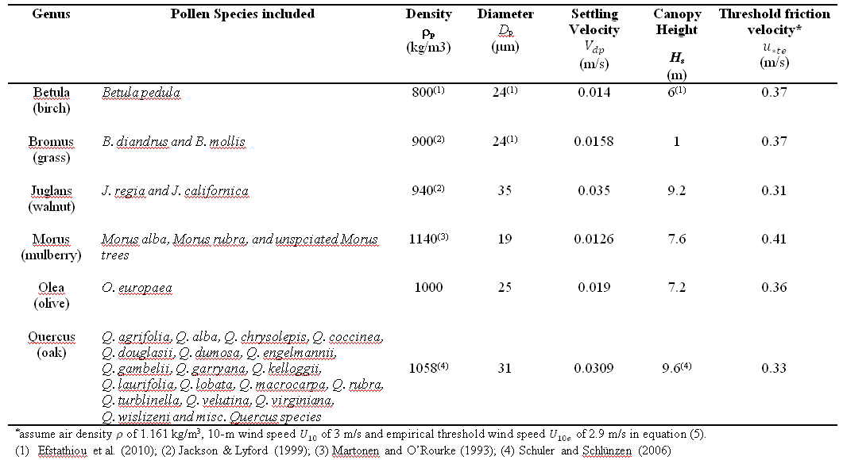
Pollen genera considered in case study
Notes:
Why choose oak and olive as the simulation species. High allergic. Too much information. Cut off the right side, canopy height, settling velocity, friction velocity.

