Slide 1
Development of Methodology to Downscale Global Climate Fields to 12km Resolution
Russ Bullock
11th Annual CMAS Conference
October 17, 2012

Slide 2
Acknowledgements
Kiran Alapaty, Jerry Herwehe, Megan Mallard, and Tanya Otte

Slide 3
Background
AMAD/AMB has previously demonstrated successful dynamical downscaling from 2.5-degree (~250 km) to 108- and 36-km resolution in a nested WRF configuration with feedback (i.e., two-way nesting).
Watershed ecology managers and urban air quality planners require meteorology/climate information on even finer scales.
In the interest of time and efficiency, could we work from existing 36-km results and just add another nest to 12-km?
4) The real questions: Would it really be practical on our computing systems? How would the results be tested? Would the results be more accurate?

Slide 4
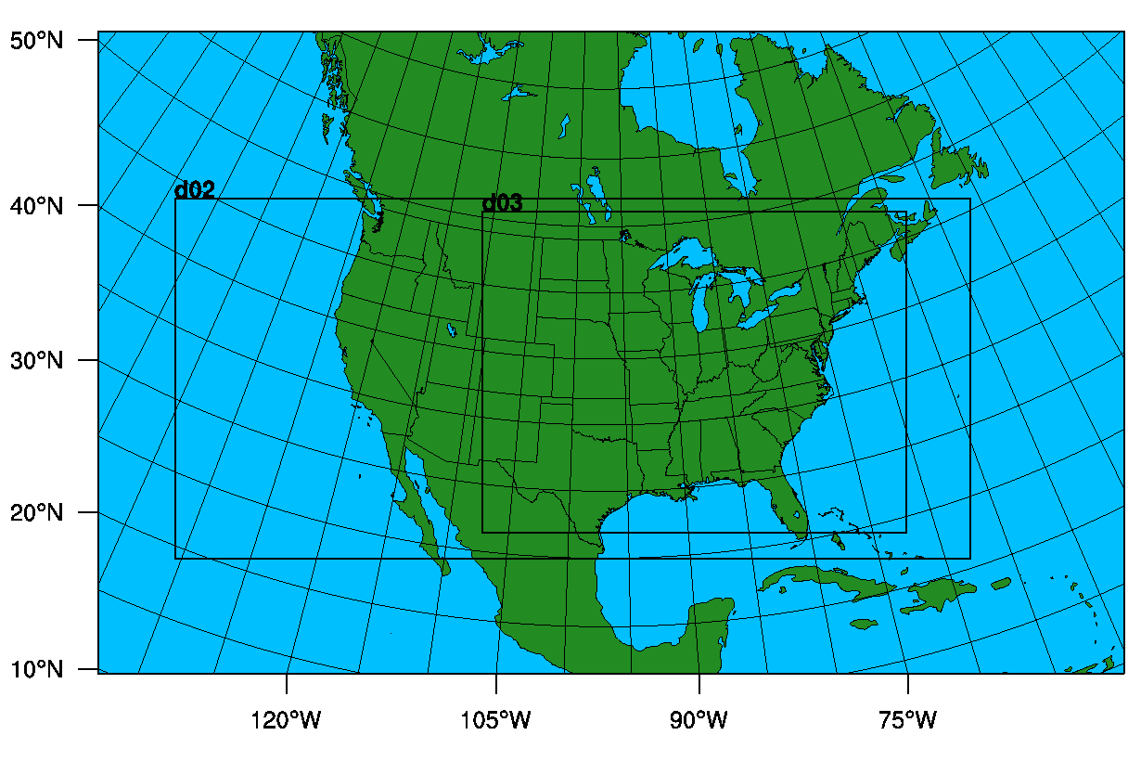
108-36-12 Nesting Configuration

Slide 5
12-km Simulation Requirements
192 processors – 60 hours CPU time per year
20-year climate run will take 50 days
20-year climate run will write 33 TB of output

Slide 6
To nudge, or not to nudge?
Nudging, a.k.a. Four-Dimensional Data Assimilation or FDDA, applies an artificial term to the governing equations to force the value of a variable towards its corresponding value in a target field (climate model).
WRF can be run with no nudging, analysis nudging, or spectral nudging.
Do we really want to nudge our 12-km WRF simulation towards the relatively smooth fields of the global data?
Can spectral nudging keep the larger scales of the WRF simulation in check while allowing the model to simulate fine-scale phenomena?

Slide 7
What the heck?
Let’s just run WRF all three ways.

Slide 8
What the heck?
Let’s just run WRF all three ways.
What could go wrong?

Slide 9
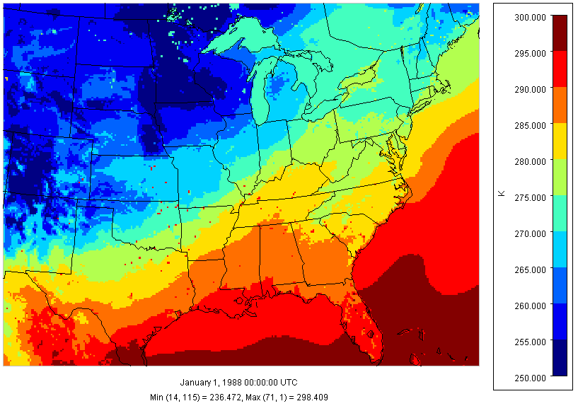
Inland lake temperatures
at 12-km resolution

Slide 10
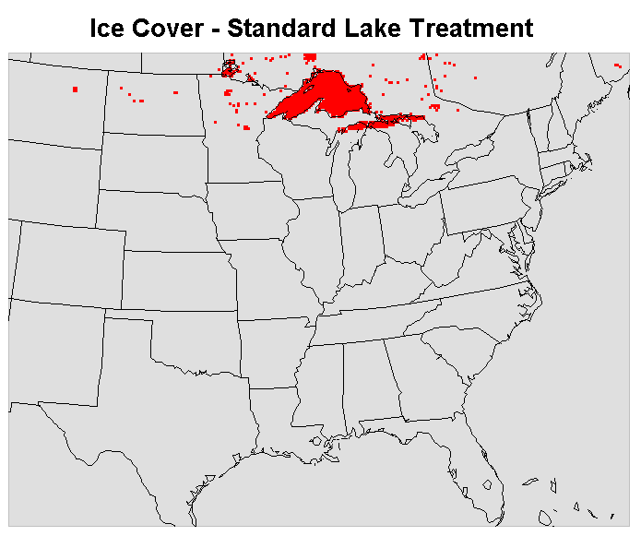
Unrealistic winter freeze-up

Slide 11
Solution for lake temperatures?
Megan Mallard is incorporating an internal lake temperature model into WRF, the FLake model.
One-dimensional analytical thermal energy model using the WRF simulation of wind, temperature, humidity and radiation.
Preliminary results look very good.

Slide 12
How can we evaluate these
12-km WRF downscaling results?
Previous work at 36-km resolution compared WRF results to North American Regional Reanalysis (NARR) which provides 32-km resolution.
No similar product is available for 12-km resolution, so let’s throw caution to the wind and compare WRF simulations to REAL OBSERVATIONS!
Simulation period is calendar year 2006.
11,000,000+ observations from the Meteorological Assimilation Data Ingest System (MADIS) are used for evaluation.

Slide 13
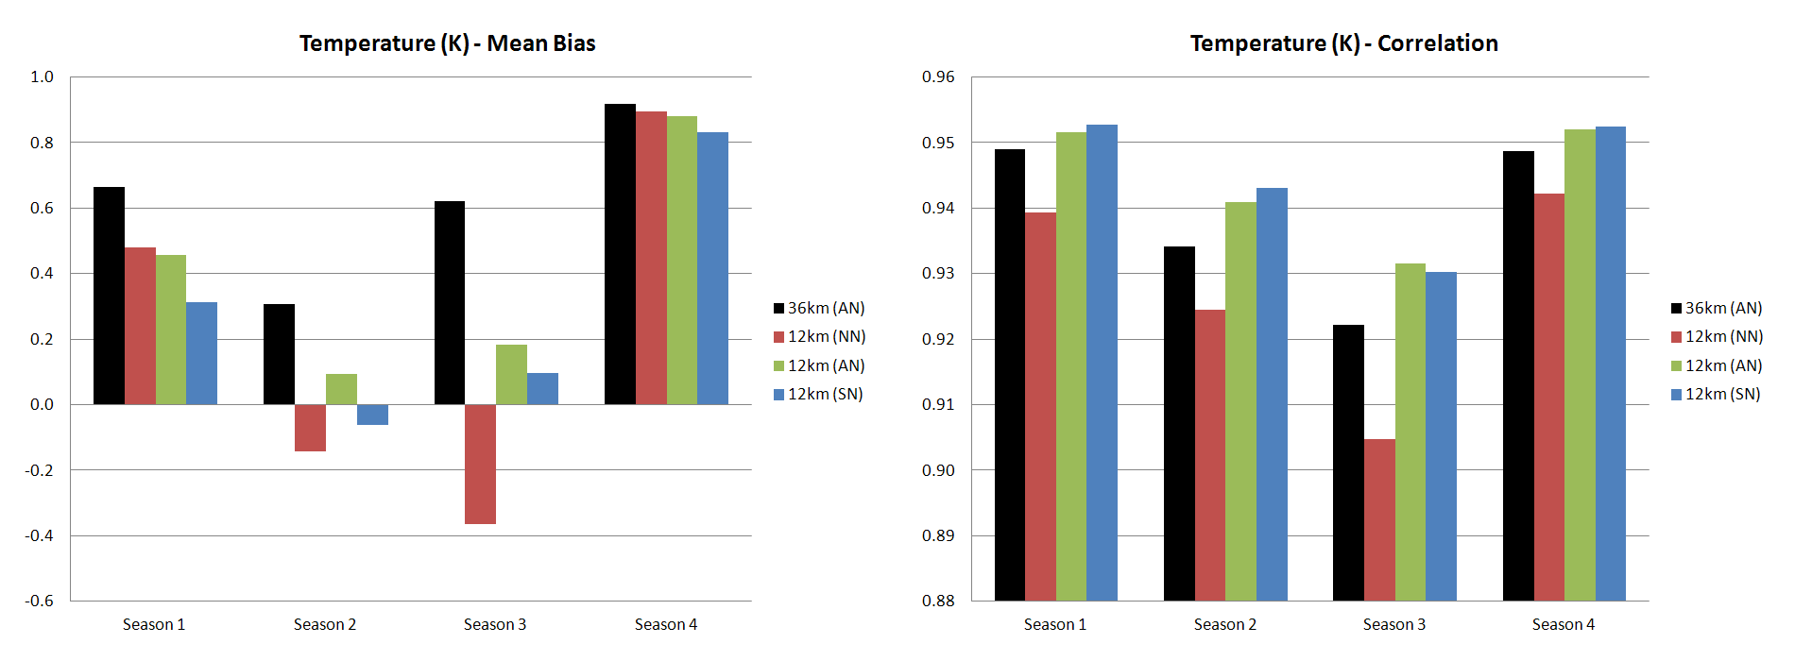
Seasonal analysis of temperature
36-km parent vs. 12-km downscale (all 3 options)

Slide 14
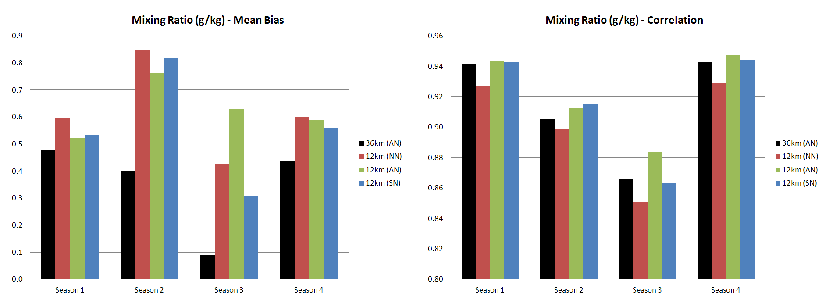
Seasonal water vapor mixing ratio
36-km parent vs. 12-km downscale (all 3 options)

Slide 15
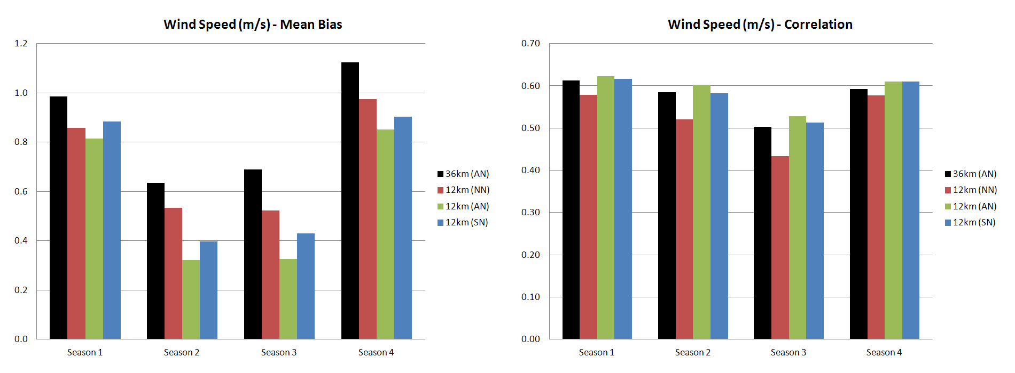
Seasonal analysis of wind speed
36-km parent vs. 12-km downscale (all 3 options)

Slide 16
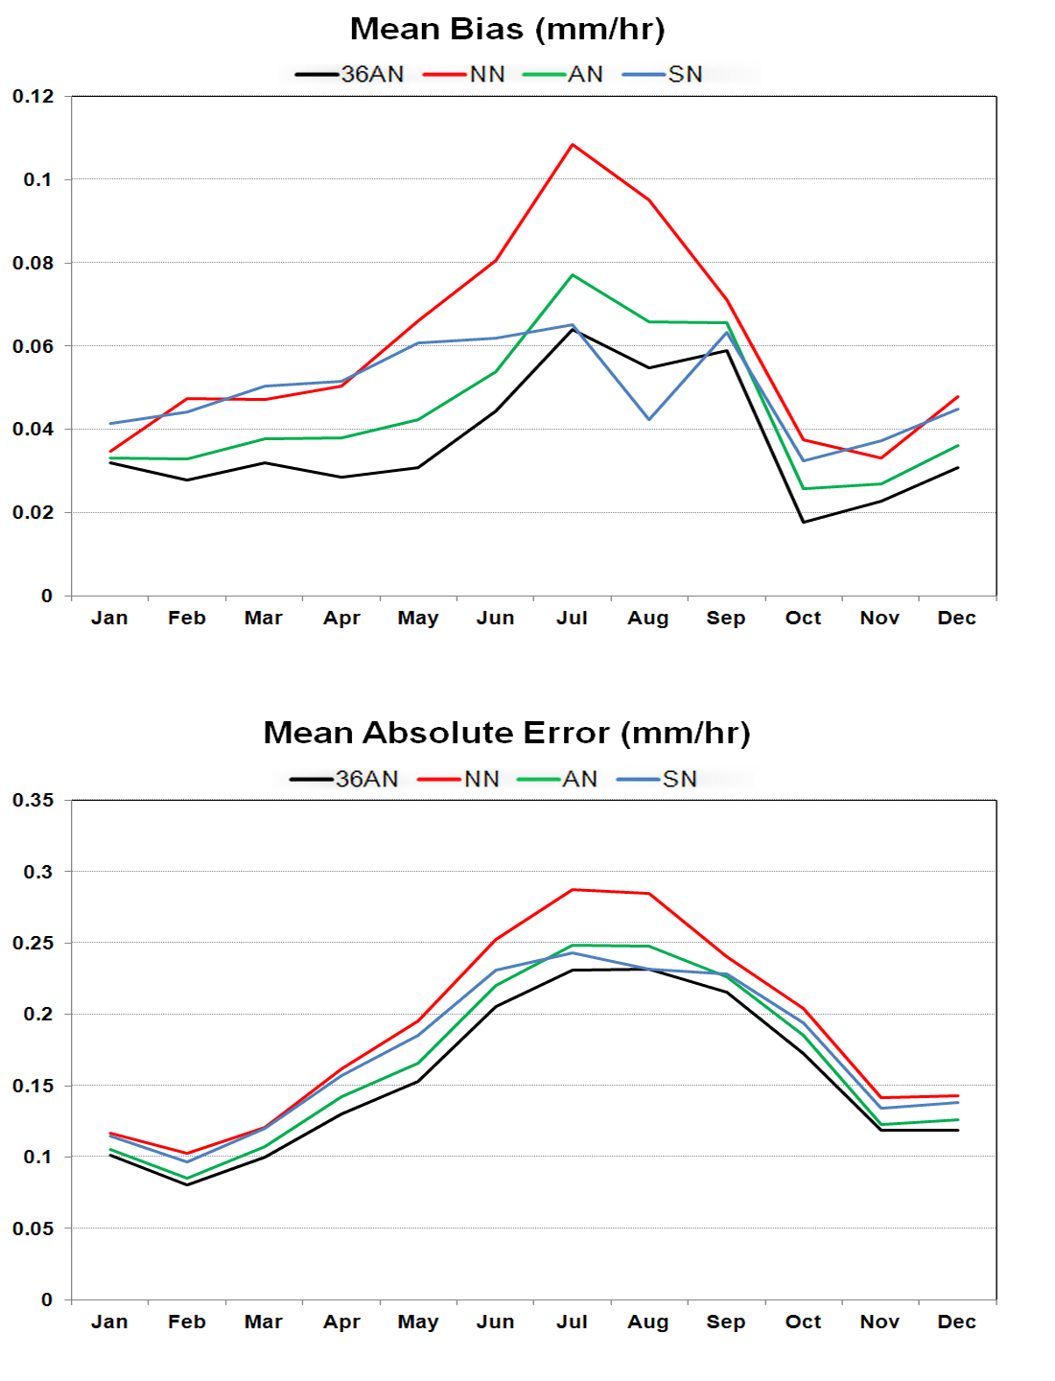
Monthly Precipitation Statistics

Slide 17
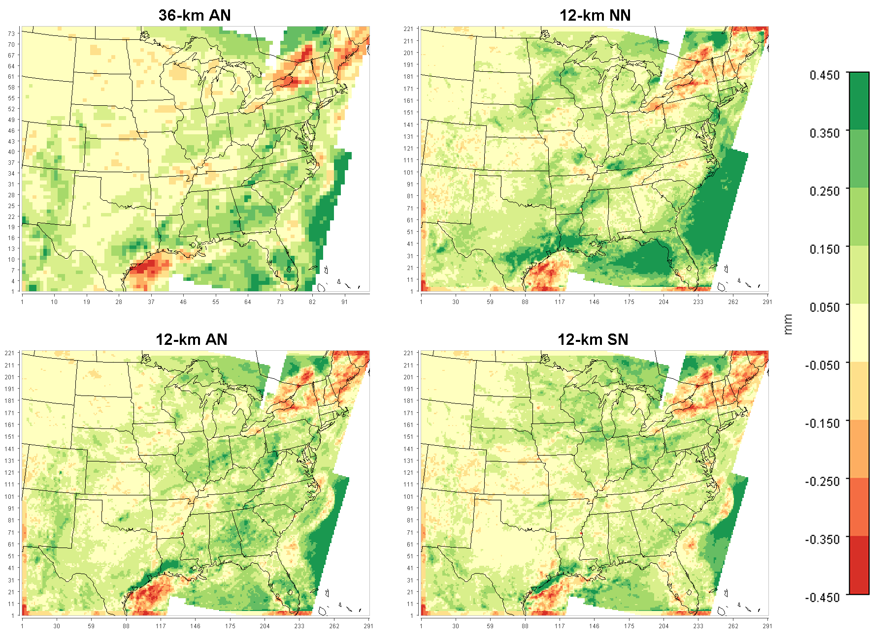
July Precipitation Bias

Slide 18
How might changes to the nudging strength affect accuracy?
The inventors of analysis nudging (Stauffer and Seaman, PSU) warned that nudging a fine-scale model simulation towards coarse-scale data is destructive to the simulation details and recommended weaker nudging in these cases.
Spectral nudging was designed to avoid this destruction of simulation details by spectral decomposition of the difference field and only nudging towards the longer-wave spectra.
The nudging for this 12-km modeling was weakened compared to the previous 36-km work, but is it optimal?
Nudging strength was increased and decreased by a factor of 2 for both analysis and spectral nudging to test model sensitivity.

Slide 19
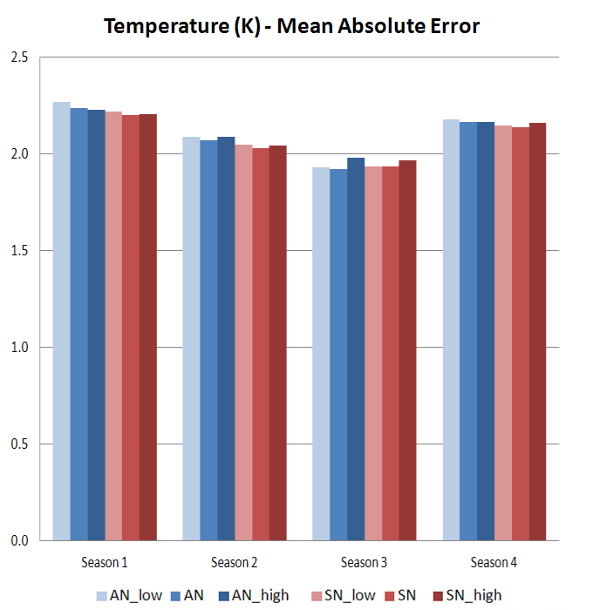
No significant effect

Slide 20
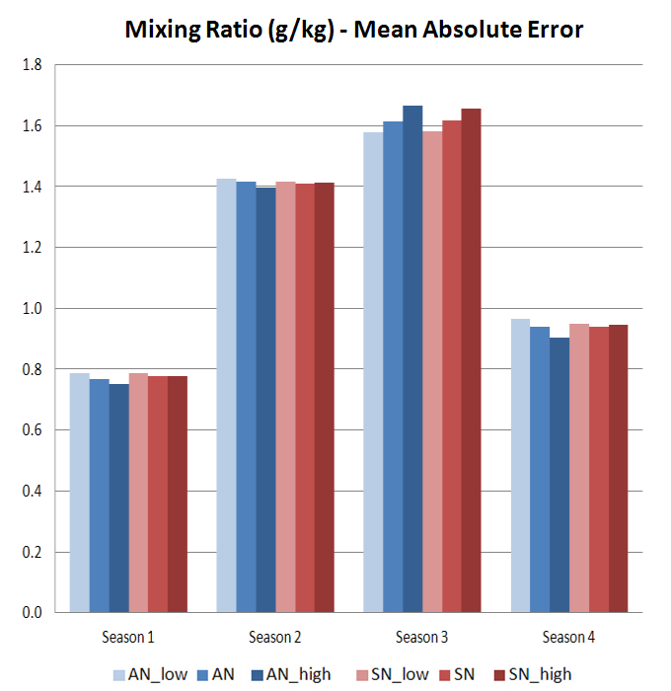
No significant effect

Slide 21
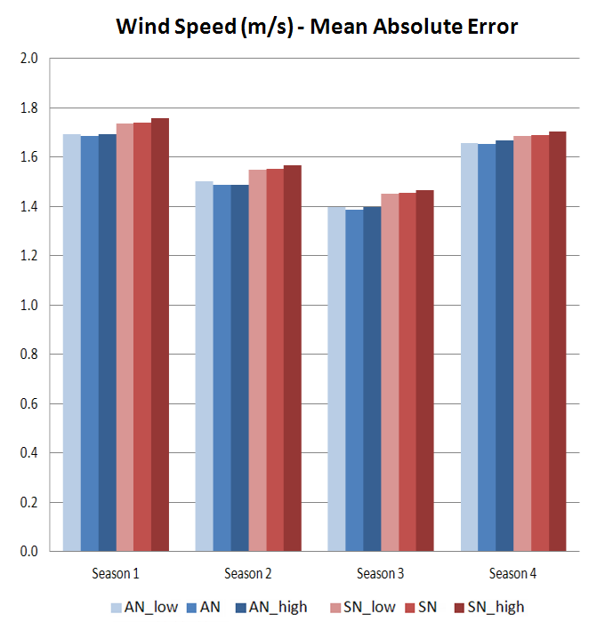
No significant effect

Slide 22
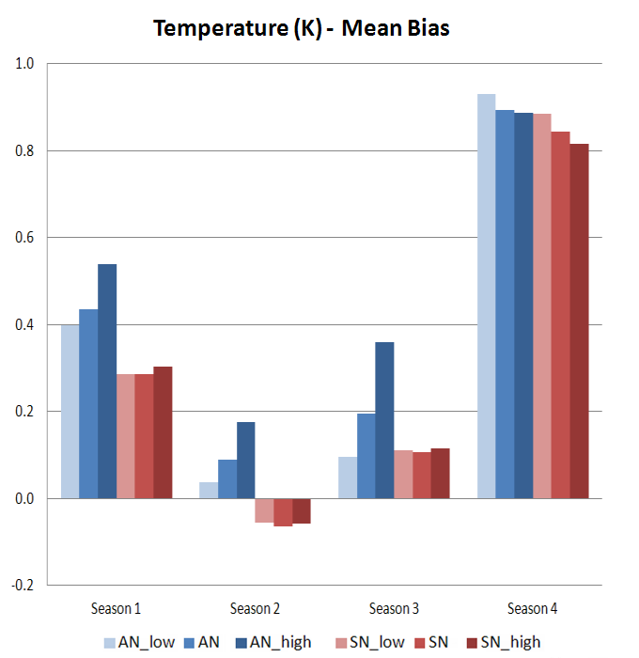

Slide 23
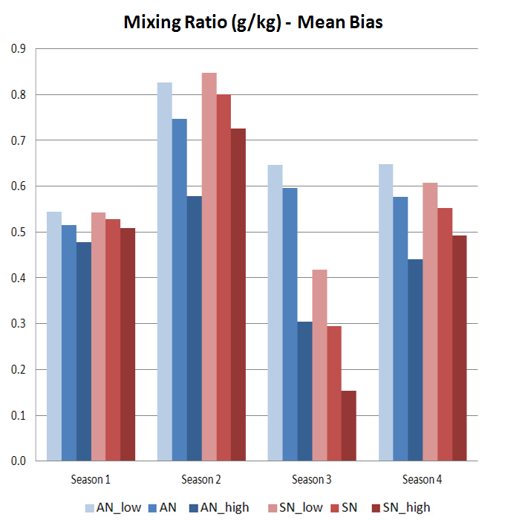

Slide 24
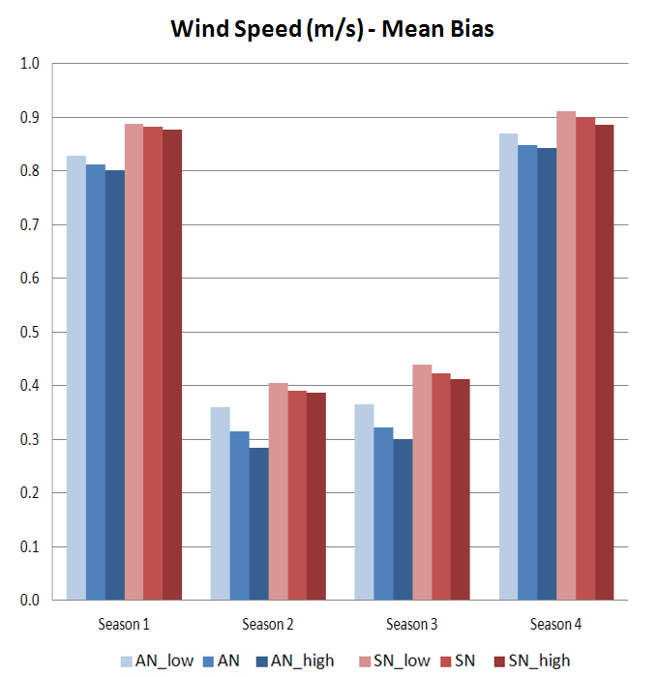

Slide 25
Effect of Nudging Strength: Conclusions
The effect on mean absolute error is quite small.
There is generally too much water vapor and stronger nudging reduces the high bias, even with spectral nudging where water vapor is not nudged.
The link between stronger spectral nudging (of temperature, wind and geopotential height only) and reduced bias in water vapor is not direct and suggests complex interactions of model physics.

Slide 26
Investigating the high moisture bias
Sub-grid convective parameterization: The Grell-3 cumulus parameterization was replaced with the Modified Kain-Fritsch scheme.
Cloud microphysics: The WRF Single-Moment 6-Class microphysics scheme was replaced with the Morrison Double-Moment scheme.
Both of these tests were conducted without any interior nudging to better show their effects on the basic WRF model behavior.

Slide 27
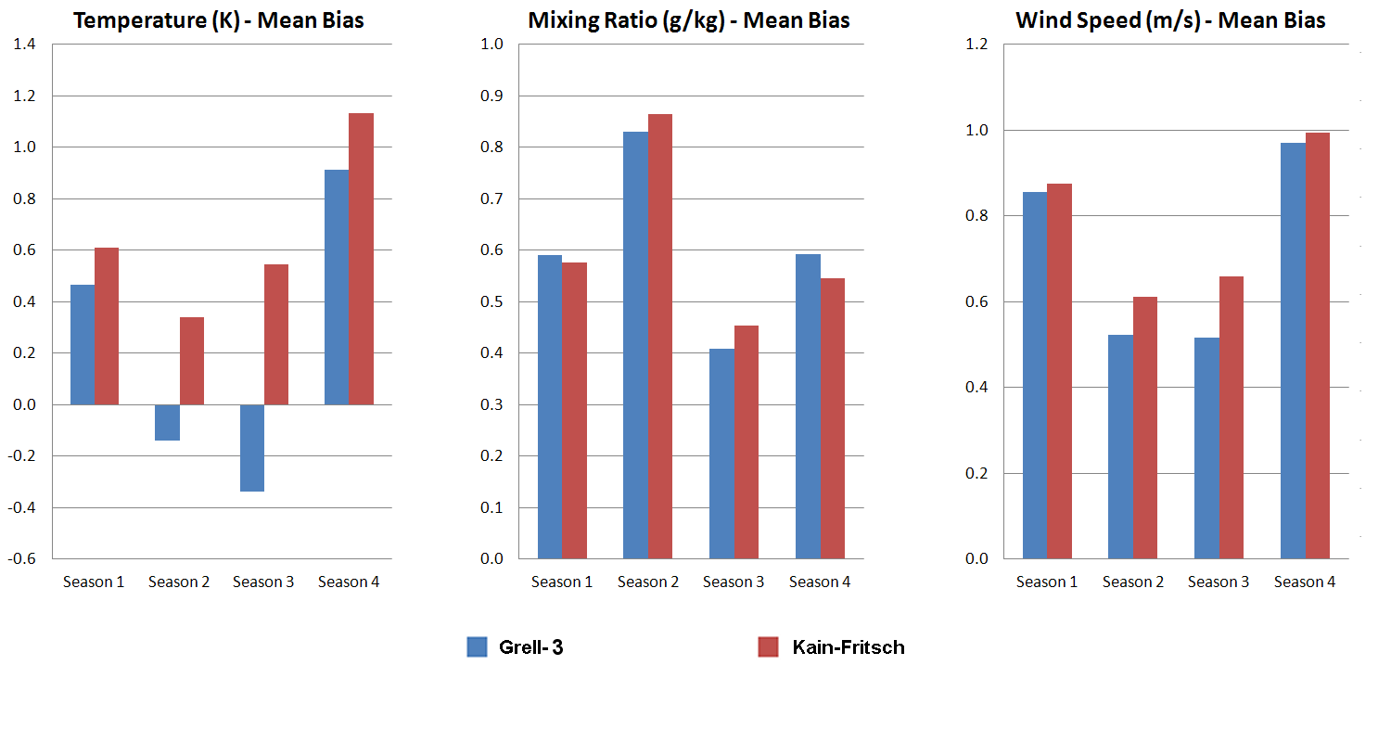
Bias from Convective Parameterization

Slide 28
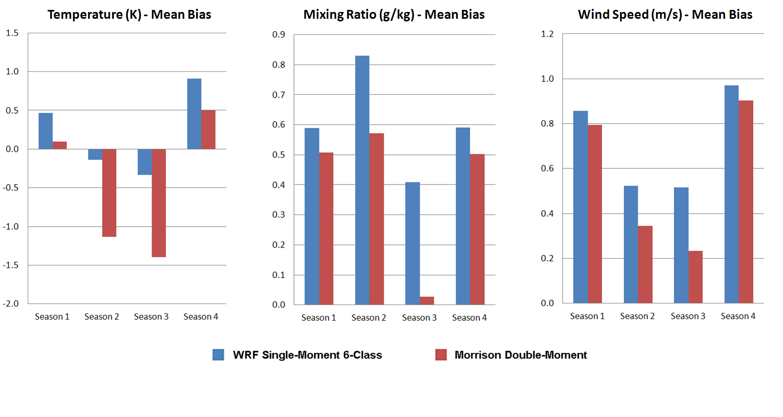
Bias from Microphysics Scheme

Slide 29
General Findings for Microphysics
Morrison Double-Moment scheme reduces the high bias for water vapor mixing ratio
It also has a very strong effect on temperature by turning a weak positive bias (annual mean) into a rather strong negative one, with the effect especially strong in the warm seasons.
Small effect on reducing positive wind speed bias also.
Could be that the primary effect is more opaque cloud cover leading to lower temperatures and lower evaporation at the surface. Also lower wind speeds.

Slide 30
Overall Conclusions
Dynamical downscaling to 12-km should be practical on our computing and data storage systems, but will demand a significant fraction of available resources.
The finer horizontal resolution does appear to provide better accuracy overall, but only when nudging is applied.
Whether analysis nudging or spectral nudging is best depends on the meteorological variable of most interest. Precipitation needs to be investigated further.
The base nudging strength for analysis nudging was reduced to ½ of that used at 36-km resolution. This seems to be generally appropriate.
The base nudging strength for spectral nudging was also reduced from the 36-km value. This may not be necessary. Separate work to include nudging of moisture in the spectral method may help to reduce the high biases seen here.

