Slide 1
UK Air Quality Forecasting of Particulate Matter Spring 2011
Andrea Fraser, Geoff Dollard, Paul Willis,
Trevor Davies, Justin Lingard

Slide 2
Presentation outline
Brief outline of the UK air quality forecast
Air Quality Forecast Spring 2011
PM episodes
PM Speciation during the episodes
Summary

Slide 3
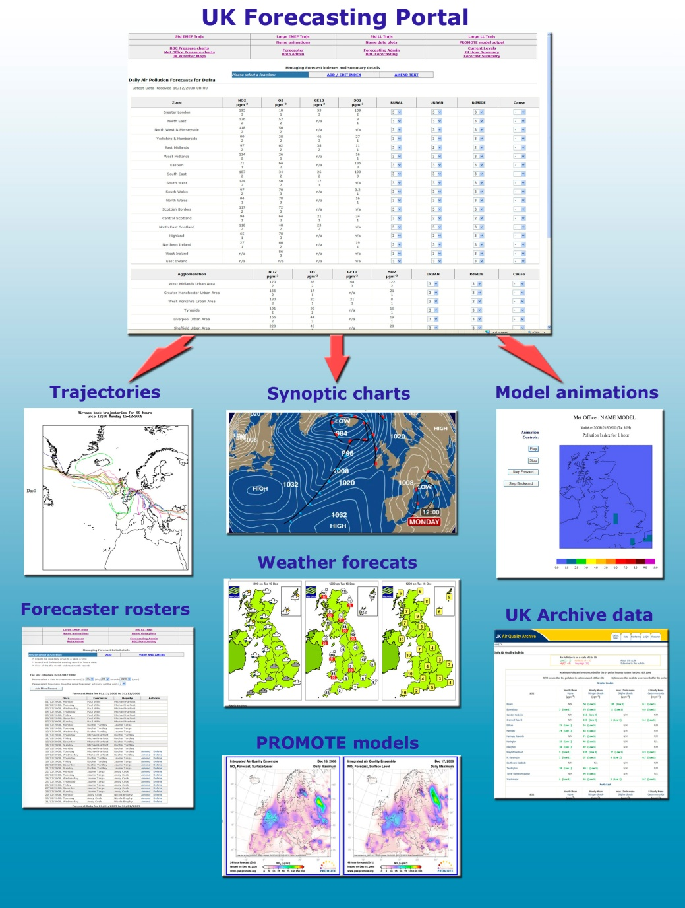
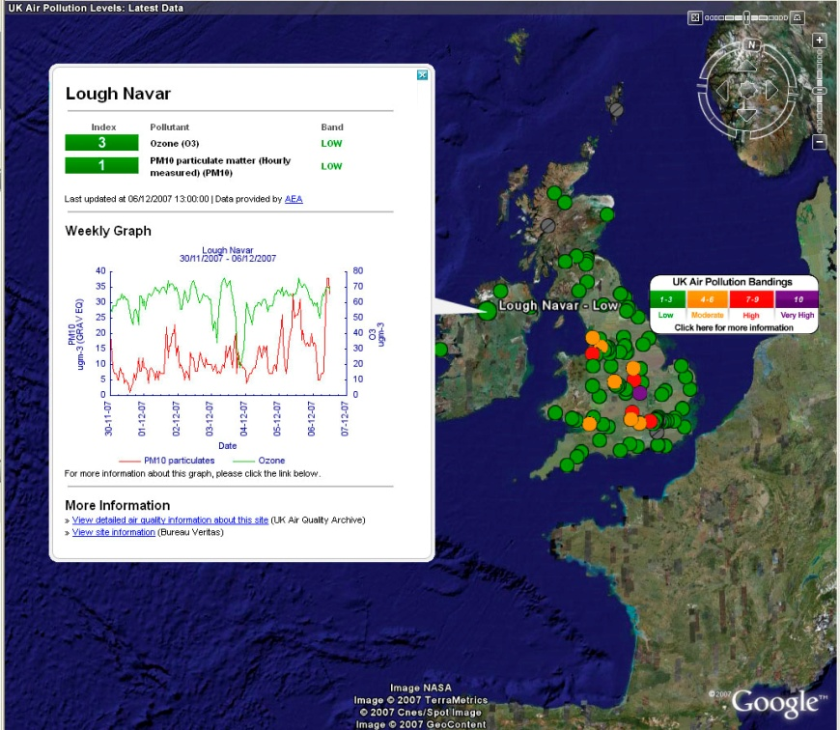
AEA – UK Air Quality Forecast
AEA have been providing daily forecasts to protect public health and to meet specific EC Directive Requirements since 1990.
AEA’s approach is to use a team of air quality experts to compile the forecasts based on a portfolio of inputs.
Inputs Include:
  WRF-CMAQ AQ forecasting models.
  Back Trajectories
  Pan-European model results.
  Latest UK & European monitoring data.
  Weather forecasts.
  Satellite imagery.
  Expert judgement based on analyses of historical air pollution episodes.

Slide 4
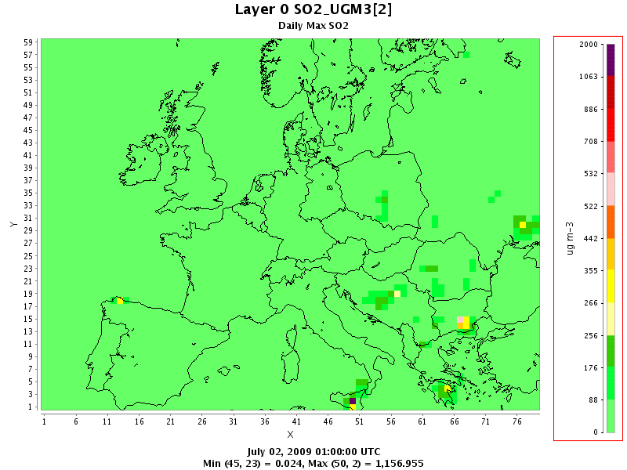
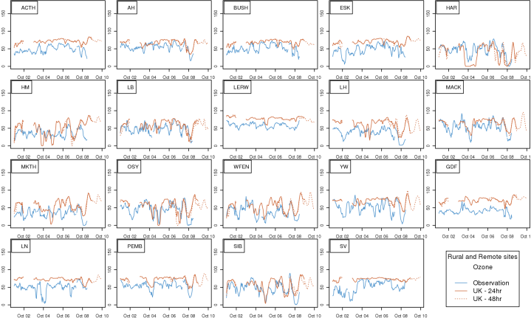
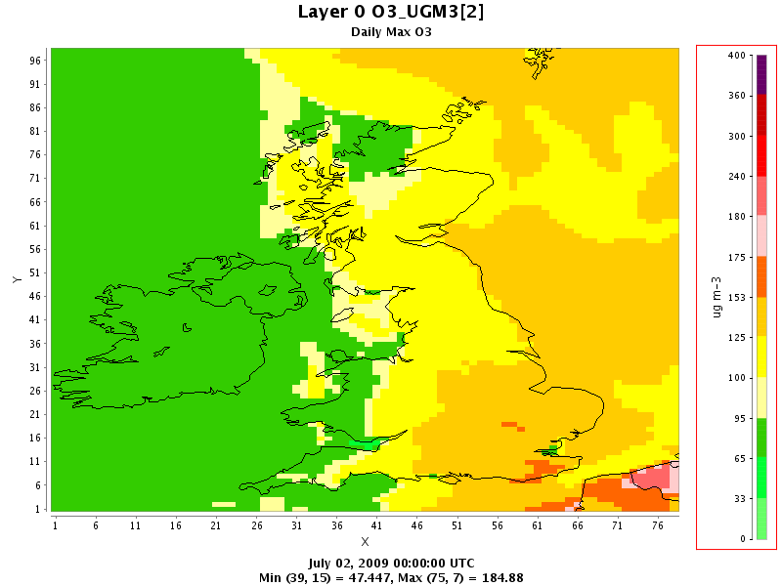
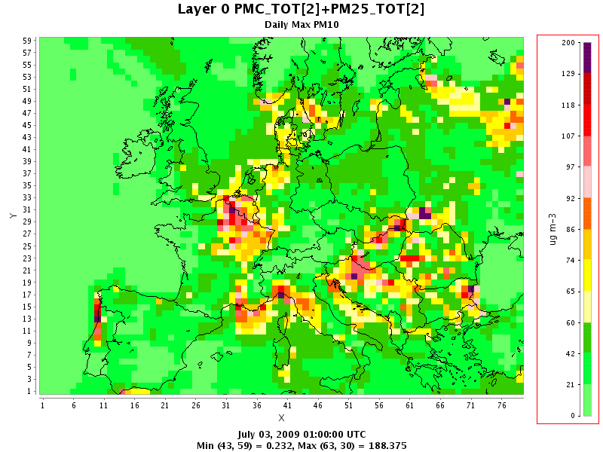
WRF-CMAQ for UK Air Quality Forecast
Meteorology Data produced using WRF
(Weather Research and Forecasting) Model
50km and 10km resolution for Europe and the UK.
48 vertical layers.
Using GFS initial and boundary conditions
Emissions data
Europe – EMEP - 50km
UK - NAEI - 1km
Biogenic Potential Inventory - 50km
CMAQ (Community Multiscalar Air Quality) Model
  Version 4.7.1
  CB05 Chemistry with aerosol and aqueous extensions (AE5)
  Boundary conditions are from the STOCHEM global model
  CMAQ uses the same resolution as WRF, with a slightly smaller grid
  and 25 vertical layers, with 12 layer below 800M
Create Images
Animations and plots of daily maximum
– O₃ NO₂ SO₂ CO PM₁₀ PM_{2.5}
Extract values at monitoring stations
Daily and Monthly evaluation with monitoring data
Ozone Daily max
PM₁₀ Daily Max
SO₂ Daily Max
Notes:
GFS – global forecast system – a US model available through NCAR

Slide 5
Air Quality Forecast
AQ forecasting has a few more challenges than a retrospective modelling study.
Retrospective model
  Weather is modelled using boundary conditions from models that have assimilated measurements.
  Emissions from the inventory for the year being simulated.
  Boundary conditions may be taken from a variety of sources including models that have assimilated measurement and satellite data.
Forecast model
  The weather is modelled using boundary conditions from a weather model projecting into the future.
  The emission are based on the last available year – 2009.
  Generic modelled boundary conditions.

Slide 6
Air Quality Forecast
When making an air quality forecast you need to use your experience of model performance to decide how reliable the forecast is.
Retrospective model
  Evaluate over long time periods - often months, years.
  Detailed studies of specific time periods often associated with intensive measurement campaigns.
  Uses ratified measurements from automated and specialised networks and campaigns.
Forecast model
  Everyday for a over a 24 and 48 hour period.
  Need to know how well the model will perform over the next few days.
  Evaluated with provisional data from the Automated Urban and Rural Network (AURN).
  We can learn about the seasonal performance from evaluation of the forecast over longer time scale.
  Use more specialised measurements for evaluation and model development

Slide 7
WRF-CMAQ Performance – 2010
Ozone 2010
PM₁₀ 2010
In 2010 Ozone had a positive bias and PM₁₀ negative. Particularly at the Urban and Urban Background sites

Slide 8
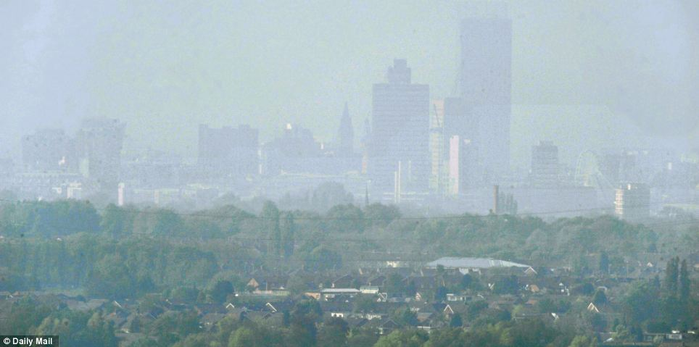
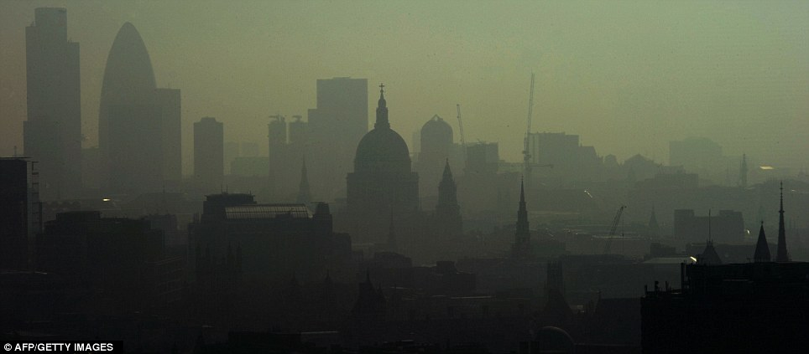
“Summer-Smog” April 2011
High pollution episode warning: First “summer-smog” of 2011
The high pressure system persisting over the UK is forecast to bring warm and still conditions to the UK over the Easter weekend. These conditions mean it is likely that the UK will experience a high pollution episode this weekend.
Elevated levels of PM₁₀ and ozone reaching high or moderate are expected from now until at least Sunday.
This was the first ‘smog warning’ for two years. The unusual weather caused by a high pressure system above the UK, and pollution drifting over from Europe, combined to breach European safety limits.

Slide 9

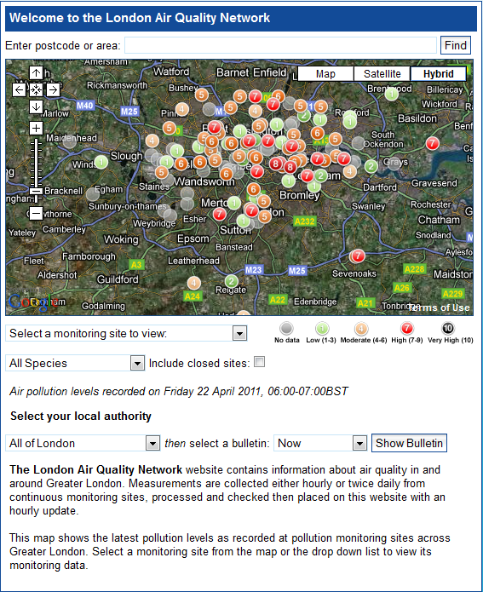
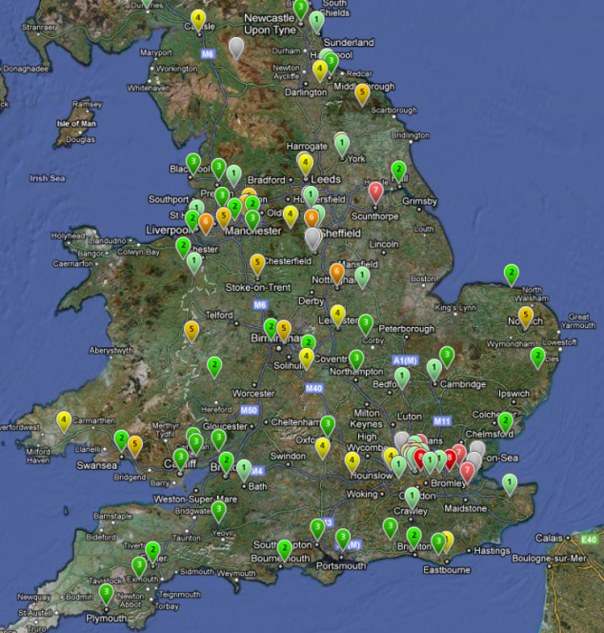
Friday 22nd April 2011
http://uk-air.defra.gov.uk/ http://www.londonair.org.uk/

Slide 10
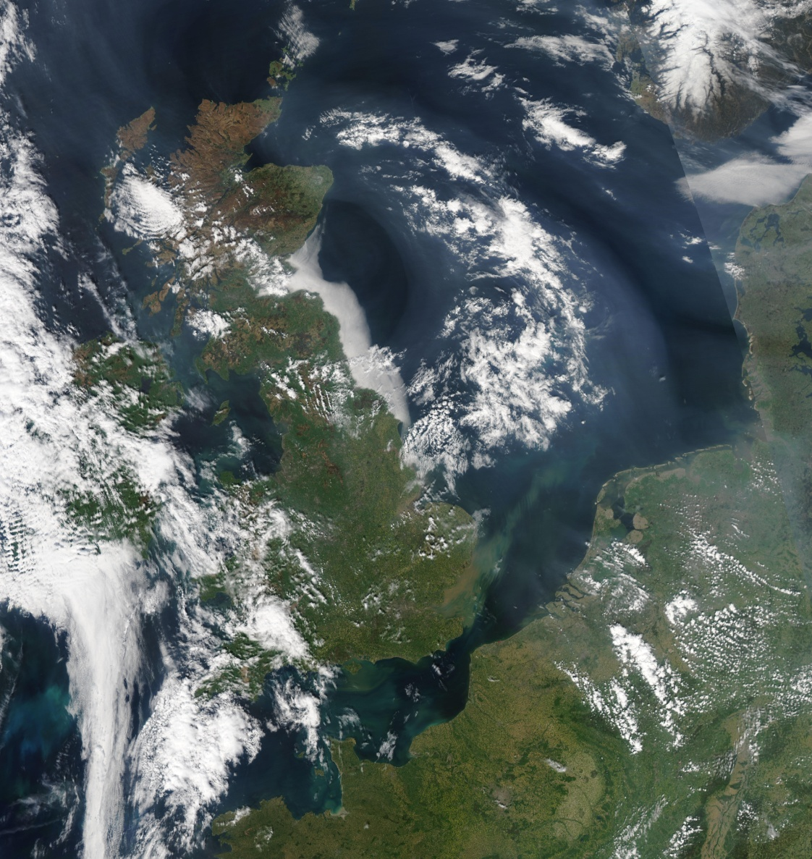
Earth Observatory NASA
Looking more like summer than spring, the United Kingdom was wreathed in smog on April 22, 2011, when the Moderate Resolution Imaging Spectroradiometer (MODIS) on NASA’s Aqua satellite acquired this image.
According to UK Air, much of the pollution is coming from continental Europe, and some of that transport is evident in the image.
http://earthobservatory.nasa.gov/NaturalHazards/view.php?id=50214&src=nha

Slide 11
March 2011 – PM₁₀ (24hr running mean)
Moderate
Index 4 – 65 μgm⁻³
Index 5 – 75 μgm⁻³
Index 6 – 87 μgm⁻³
High
Index 7 – 97 μgm⁻³

Slide 12
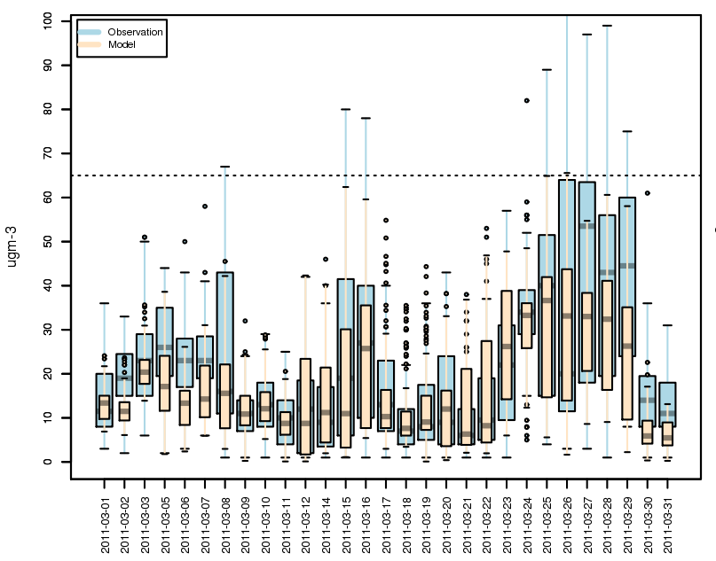
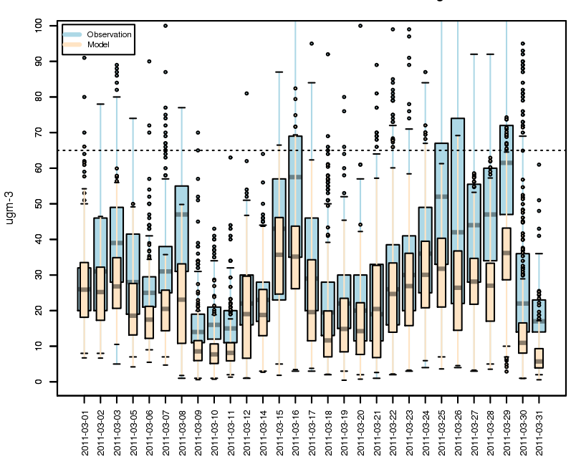
March 2011
Rural sites (4)
Urban Background (16)

Slide 13
April 2011 – PM₁₀ (24hr running mean)
Moderate
Index 4 – 65 μgm⁻³
Index 5 – 75 μgm⁻³
Index 6 – 87 μgm⁻³
High
Index 7 – 97 μgm⁻³

Slide 14
UK Met. Office UK overview April 2011
With areas of high pressure over or near to the UK for much of the month, there was plenty of fine, warm weather.
Temperature
The UK mean temperature was 3.7 °C above the 1971–2000 average and it was the warmest April in the series from 1910.
The daily maximum temperatures in particular were well above average, by as much as 6 °C in south-east England.
A maximum temperature of 27.8 °C was recorded at Wisley, Surrey on 23rd.
In central England, it was the warmest April for over 350 years.
Sun
It was a sunny month across all of the UK, with amounts generally close to 150% of normal, making it the sunniest April in the series from 1929.
Rainfall
Rainfall was close to or above normal over much of western Scotland, but elsewhere it was dry — exceptionally so over much of southern, central and eastern England where less than 10% of normal rainfall was recorded
http://www.metoffice.gov.uk/climate/uk/2011/april.html

Slide 15
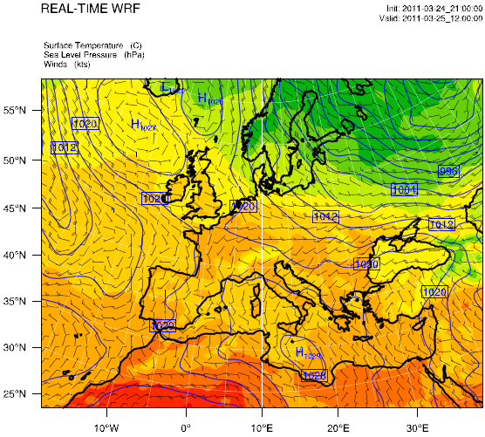
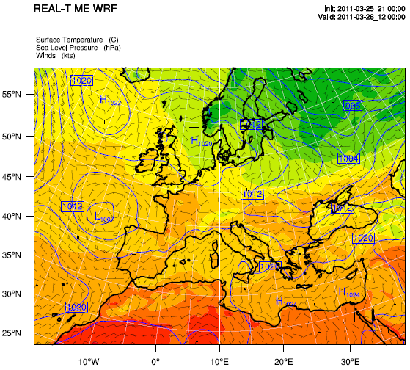
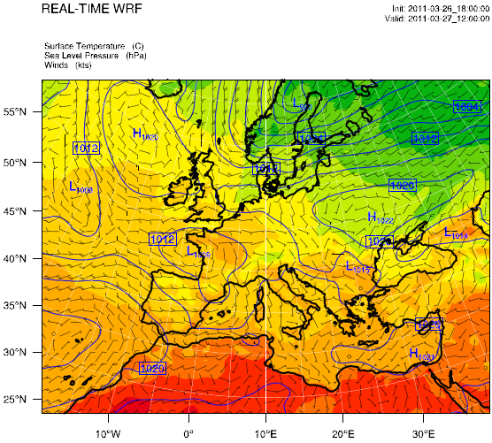
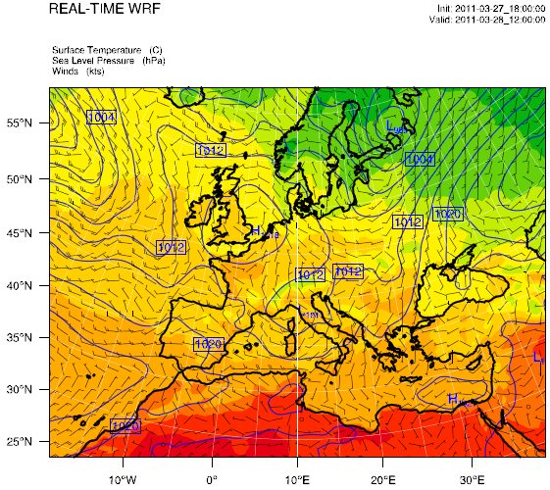
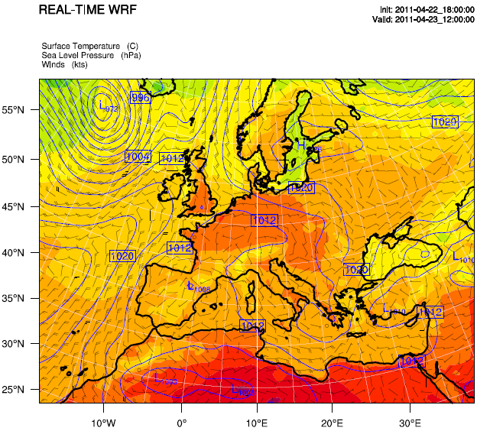
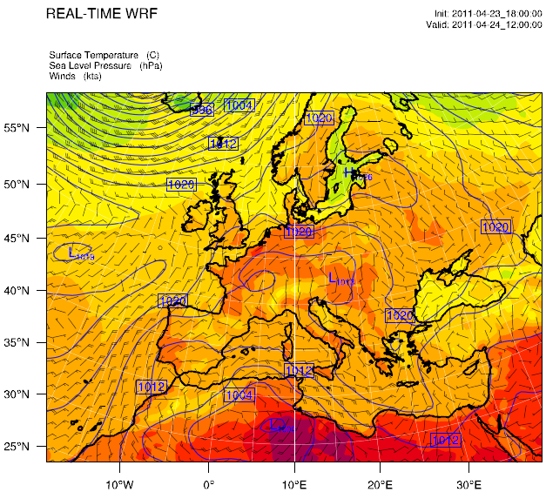
WRF Forecast
Surface Conditions 19th to 24th April at 12:00
23rd April

Slide 16
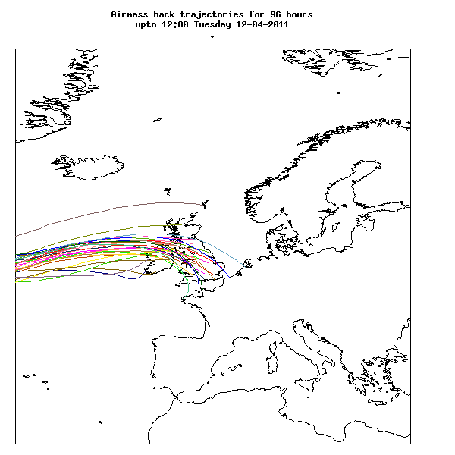
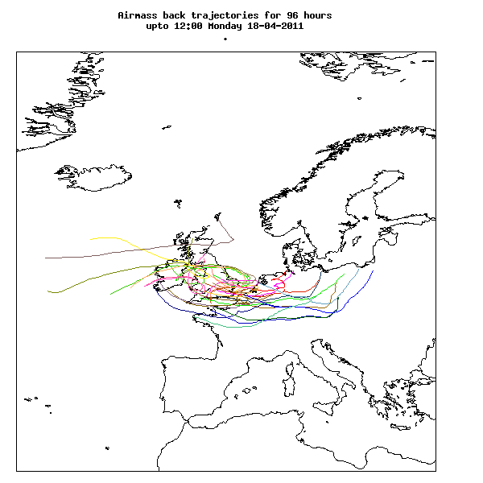
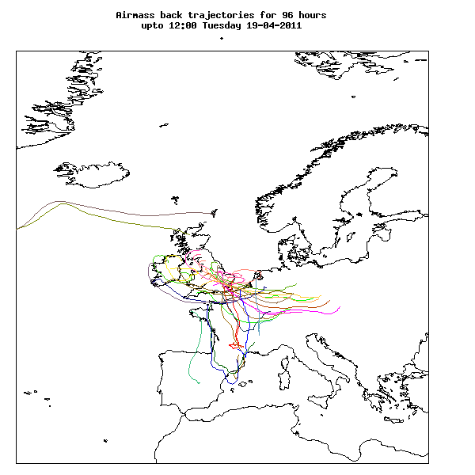
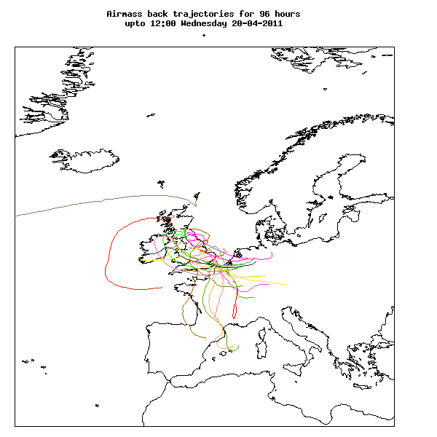
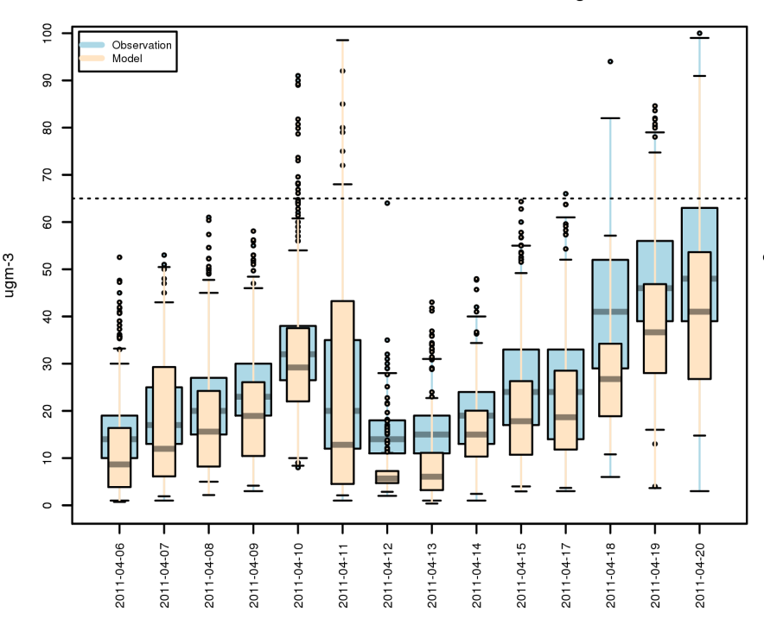
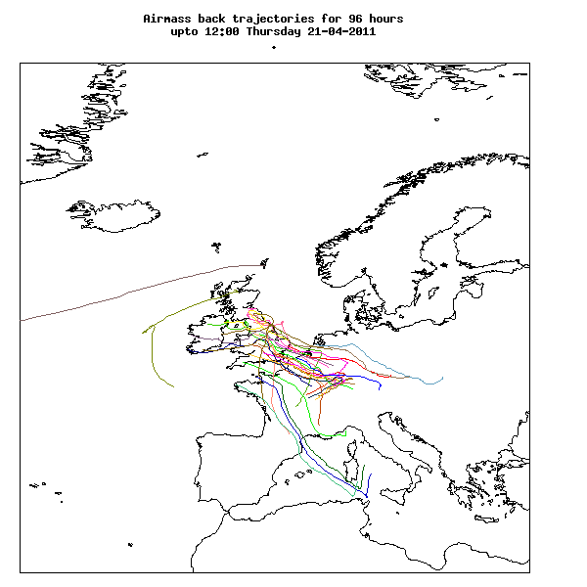
Back Trajectories
Urban Background

Slide 17
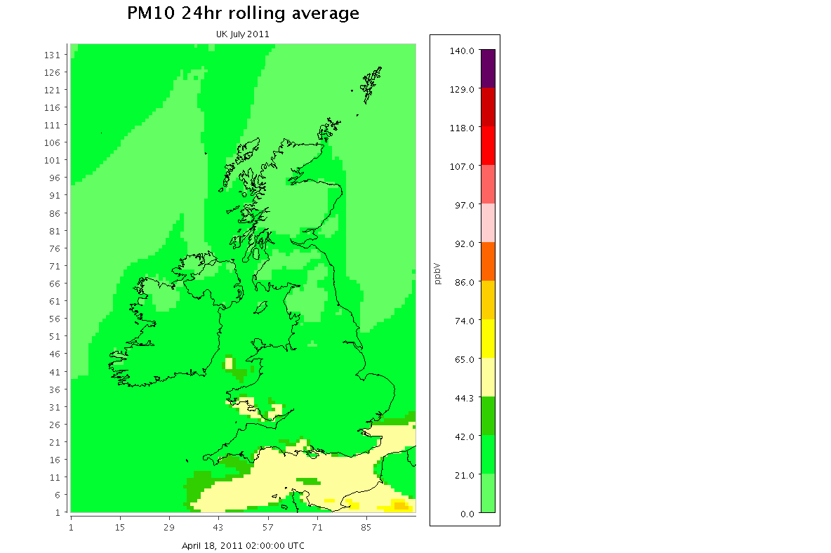
19th – 26th April 2011

Slide 18
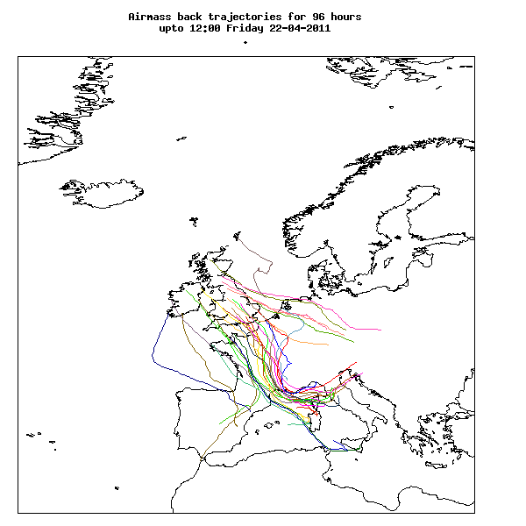
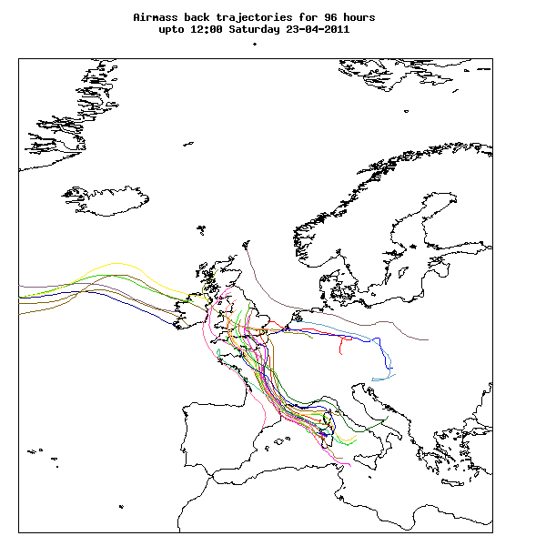
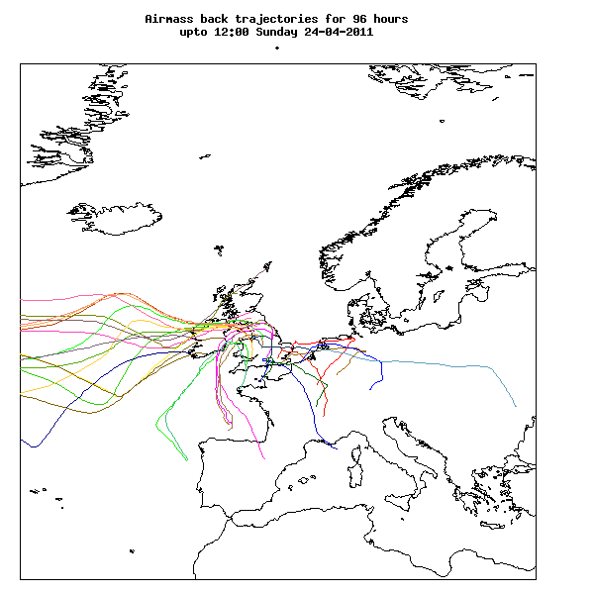
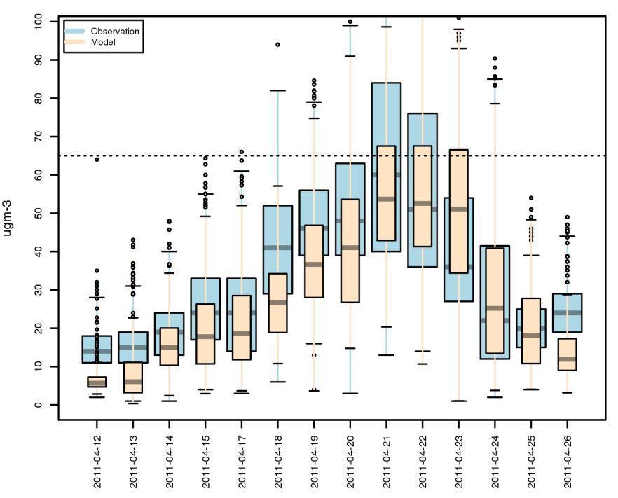
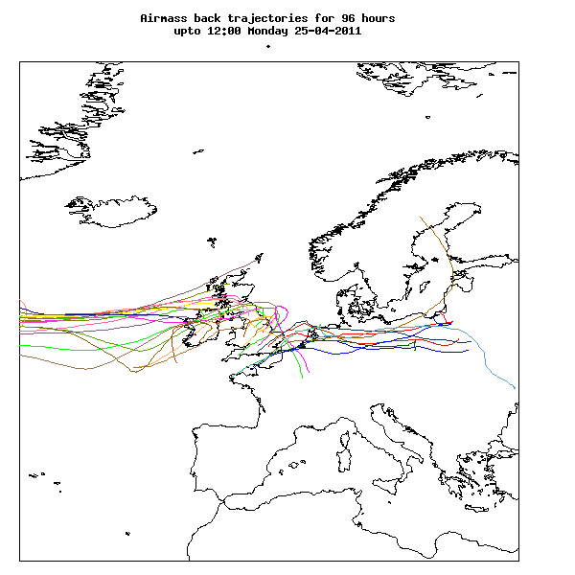
Back Trajectories
Urban Background

Slide 19
Elevated PM April 2011
Evaluation of CMAQ forecast with hourly PM₁₀ provisional data from 16 AURN Urban Background sites 12-26th April 2011
 | Rural and Remote | Urban Background | Urban
No. of Sites | 4 | 16 | 12
Normal Mean Bias (%) | 8 | -14 | -24
Normal Mean Error (%) | 44 | 37 | 41
% of pairs within a factor of 2 | 68 | 73 | 68
Forecast the hourly PM₁₀ exceeding 65 μgm⁻³
Proportion Correct | 0.96 | 0.91 | 0.97
Odds Ratio Skill Score | 0.98 | 0.90 | 0.64

Slide 20
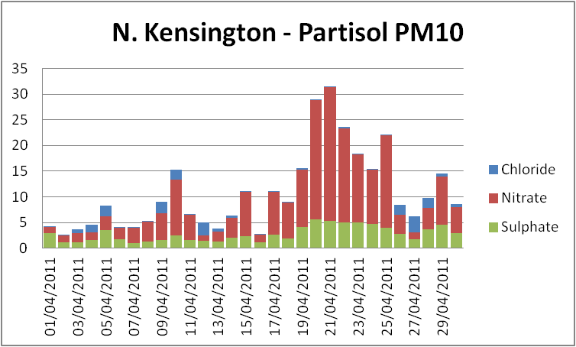
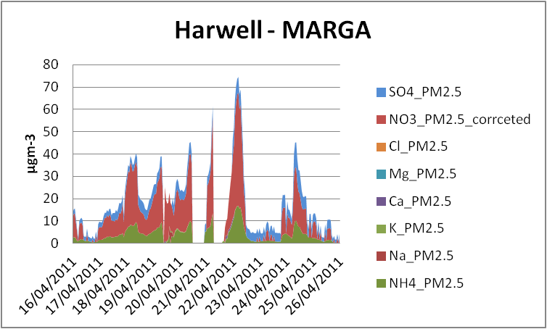
Typical Episodes result in higher nitrate
Daily average (μg m⁻³)
Provisional anion measurement from NPL
Dharsheni Muhunthan (NPL)
Sonya Beccaceci (NPL)
David Green (Kings College London)

Slide 21
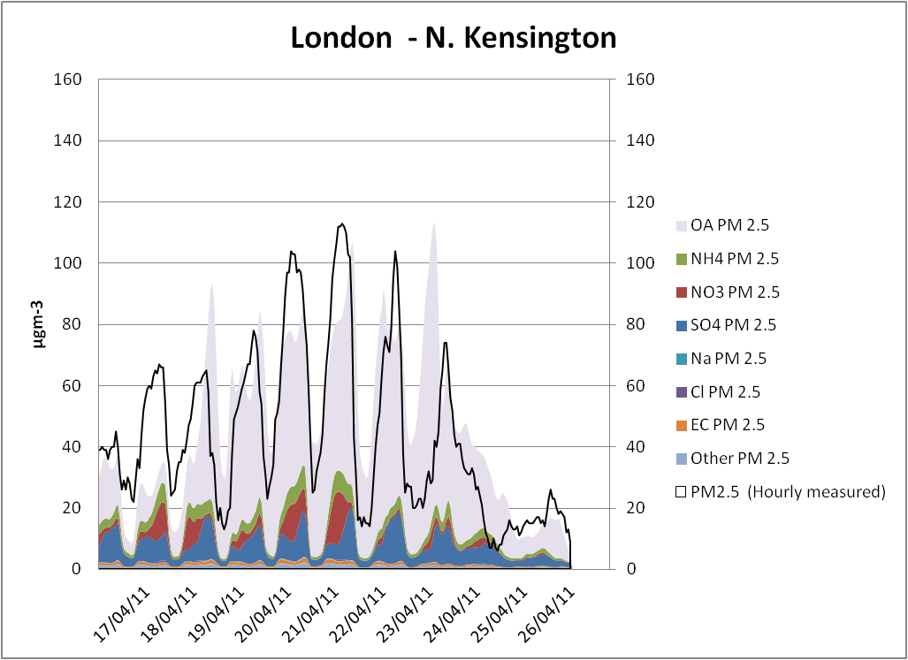
PM_{2.5} Species
Provisional AURN measurement

Slide 22
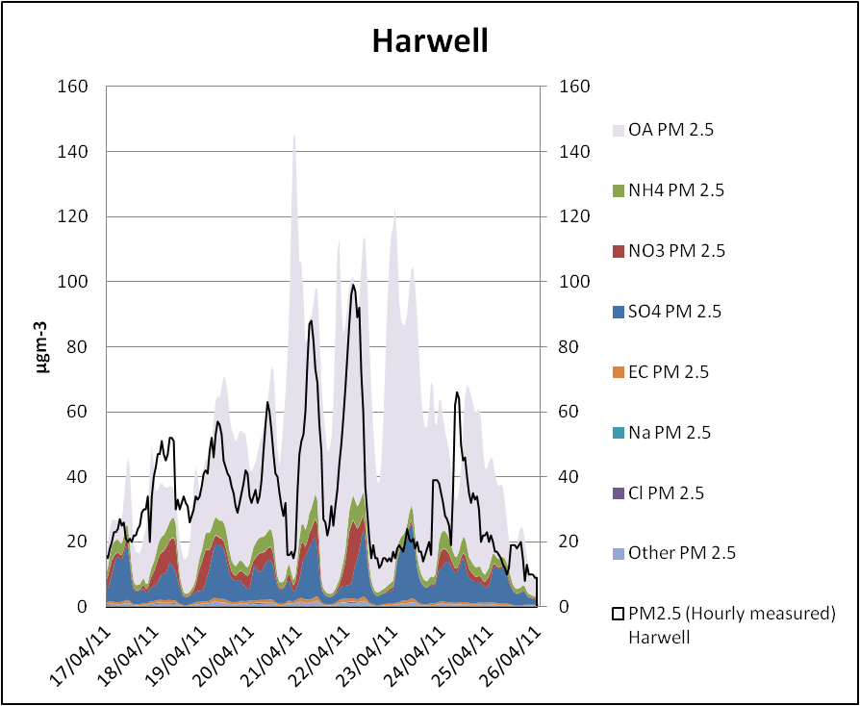
PM_{2.5} Species
Provisional AURN measurement

Slide 23
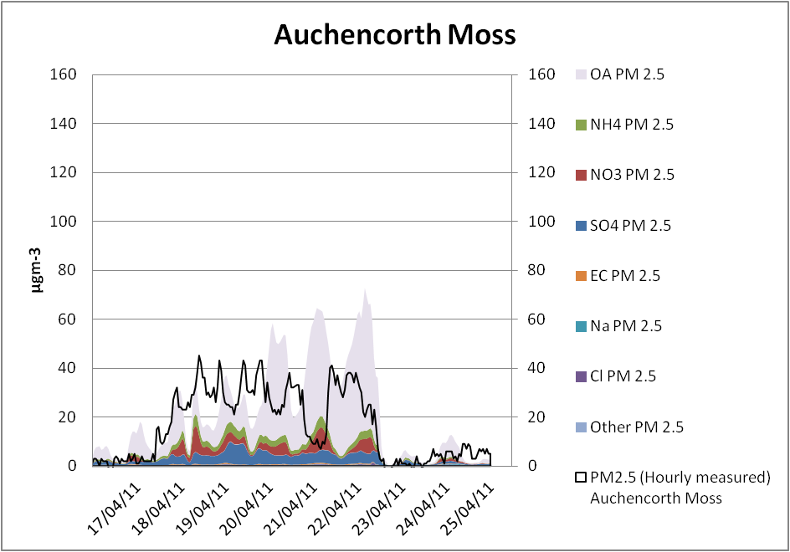
PM_{2.5} Species
Provisional AURN measurement

Slide 24
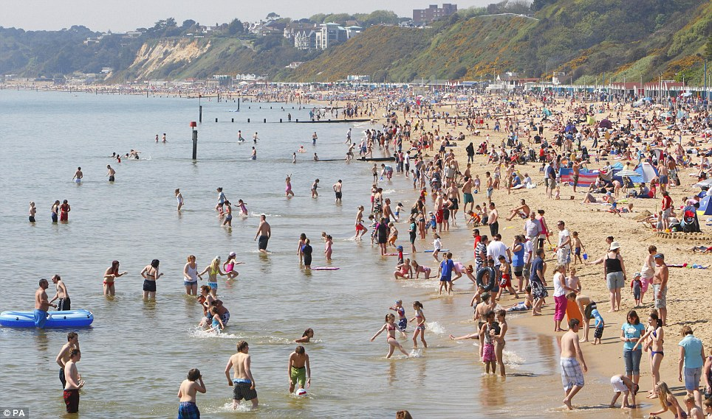
Summary
The UK CMAQ air quality forecast generally underestimates PM₁₀ pollution.
During the period of moderate to high pollution in April 2011 model performance was better than in previous years.
Can we identify why model performance was better during the ‘summer smog’ of April 2011?
  It was an unusual period and was challenging for the air quality forecast.
  Weather – hot, dry and sunny.
  Emissions:
  Two four day holiday weekends with only 3 ‘normal’ working days
  Holidays and daytrips
  Biogenic emissions

Slide 25

Thank you
The air quality forecast is produce on behalf of the Department for the Environment, Food and Rural Affairs and the Devolved Authorities.

