Slide 1
Recent Enhancements to the
Community Multiscale Air Quality Modeling System (CMAQ)
The CMAQ Team
Computational Exposure Division
National Exposure Research Laboratory
Office of Research and Development
U.S. Environmental Protection Agency
March 30, 2017

Slide 2
Presentation Overview
Purpose: Provide Regions, States, and Tribes with summary of scientific updates included in new release of EPA’s Community Multiscale Air Quality (CMAQ) modeling system (v5.2)
Outline:
  Background on CMAQ (Rohit Mathur)
  Relevance of scale interactions
  Process updates
    Meteorology–chemistry linkages (Jon Pleim)
      PBL/LSM, clouds & precipitation, stratosphere-troposphere exchange
    Chemistry (Ben Murphy)
    Aerosols
  Evaluation (Wyat Appel)
  Summary

Slide 3
Evolution of Air Quality Models
To address increasingly complex applications and assessments
Background air pollution
Met-AQ Interactions
Exposure & Health
Multimedia
Application Needs
O3, PM attainment demonstrations
Regional Haze
Meteorology- Air Quality Interactions
Exposure
NATA
&
Air Quality
Forecasting
-PSD
-New Source
Permitting
NAAQS
8-hr O₃
PM 2.5
- Hg
Toxics
-Standards
-Assessments
NAPAP
1-hr O3
SIP
Neighbor Scale CMAQ
CFD
NAM-CMAQ
CMAQ NextGen
Coupled
WRF-CMAQ
CMAQv5.2
AQDM
UNAMAP
RADM-ROM
Eulerian Grid Models
- Acid Deposition
- Ozone
MODELS3
CMAQ
For PM
Multi-pollutant CMAQ
Single Pollutant
Non-reactive
Gaussian Dispersion
Local/urban Scales
Single Pollutant
Reactive
Eulerian Grid
Regional/urban Scales
Multi-pollutant
Multi-scale
Reactive
Eulerian Grid
Regional/urban Scales
Multi-pollutant
Multi-scale (local to hemispheric)
Interactions with Climate forcing and Air Quality changes
Eulerian Grid
Multi-pollutant
Near-source to Global
Reactive
Multimedia:
Atmospheric-
Hydrologic
Model Development

Slide 4
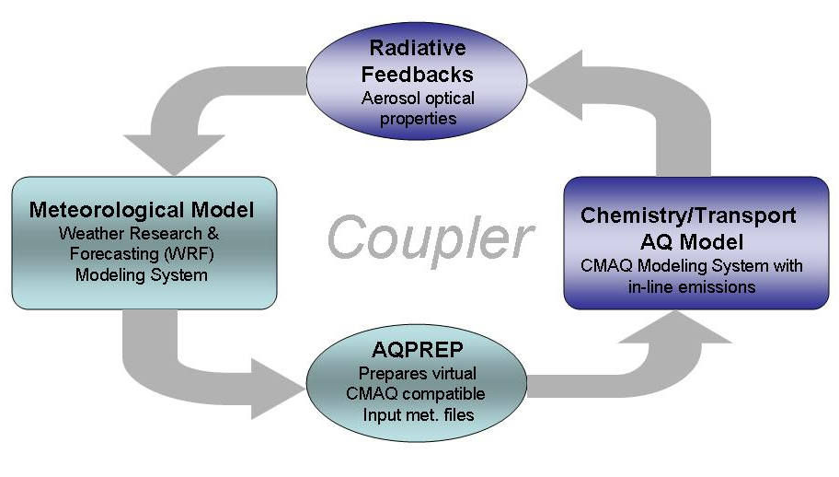
The Community Multiscale Air Quality (CMAQ) Modeling System
Comprehensive Eulerian Chemical Transport Model
  Emission, advection, diffusion, chemistry, deposition
Multi-scale: Hemispheric → Continental → Regional → Local
Multi-pollutant & multi-phase:
  Ozone Photochemistry
    NO_{x} + VOC (biogenic & anthropogenic) → O₃
  Particulate Material (PM)
    Inorganic chemistry & thermodynamics → Sulfate, Nitrate, Ammonium
    Organic aerosol → primary, secondary
    Geogenic aerosol → wind-blown and fugitive dust, sea salt
  Acid deposition
    Aqueous chemistry, Wet deposition
  Air Toxics
    Benzene, Formaldehyde, Hg, etc
Coupled to the Weather Research & Forecast
(WRF) Model
  “Off-line” – sequential operation
  “On-line” – 2-way coupled

Slide 5
Recent CMAQ Versions
Periodic public release of improved versions of the modeling system
CMAQv4.7 (Fall 2008) and CMAQv4.7.1 (June 2010)
  Supporting evaluation: Foley et al, Geoscientific Model Development, 2010
CMAQv5.0 (Feb. 2012)
  Updates to gas-aqueous-aerosol chemistry and photolysis
  Improved advective and turbulent transport
  Major structural upgrades that improve flexibility and maintainability
  2-way coupling between WRF-CMAQ
  Bi-directional exchange: NH₃ and Hg
CMAQv5.0.2 (May 2014)
  Instrumented Models (Direct Decoupled Method (DDM), Source Apportionment, Sulfur Tracking)
  Community Contributions (Volatility Basis Set (VBS))
CMAQv5.1 (October 2015)
  Revised gas chem and Photolysis
  Aerosol updates: New pathways for SOA production
  Improve computational performance
  Supporting Evaluation: Appel et al., GMDD, 2016
CMAQv5.2 (β-version in November 2016; final version in June 2017)
  New Organic aerosol treatment
  New wind-blown dust model
  CB6 chemical mechanism
  Lightning – NOx and assimilation
  Instrumented models compatible with process updates
  Process options for hemispheric configuration

Slide 6
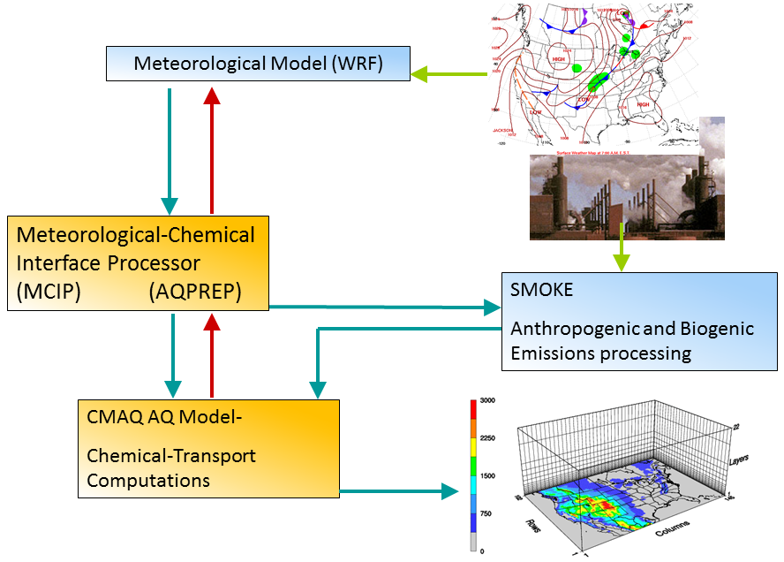
CMAQ Modeling System
“Numerical Laboratory” to synthesize our evolving understanding of processes (& interactions) regulating air pollution

Slide 7
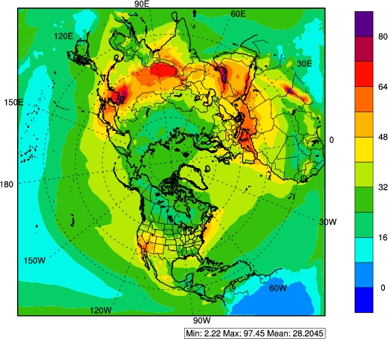
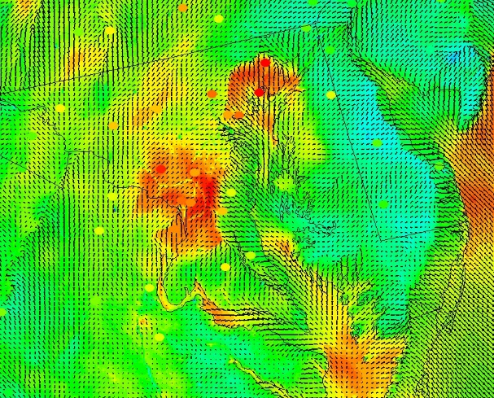
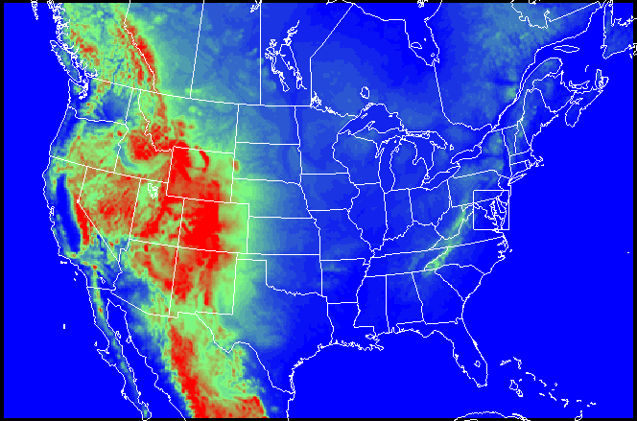
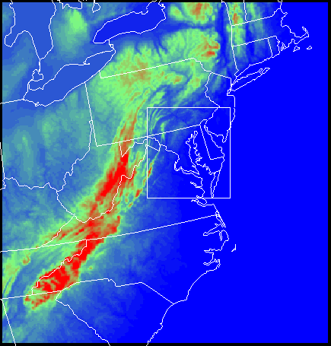
Current Multi-scale Modeling
Hemispheric model needed to provide lateral boundary conditions (LBCs) for US Domain
  Increasing importance of long range transport (LRT) contributions as NAAQS are reduced
Fine scales:
  Urban Environments
  Linkage with human exposure & health studies
  Residual non-attainment
Hemispheric model at 108 km provides LBCs for 12 km CONUS with nests to 4 km and 1 km

Slide 8
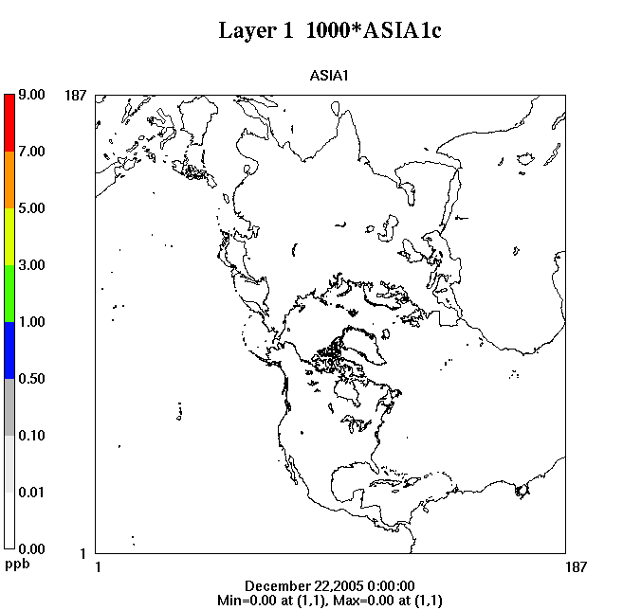
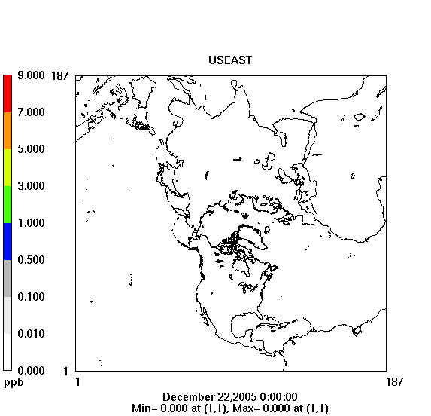
Long-Range Pollutant Transport
Example: Tracer transport at 850 mb
Tightening NAAQS and greater emphasis on characterizing “background” air pollution requires improved representation of scale interactions

Slide 9
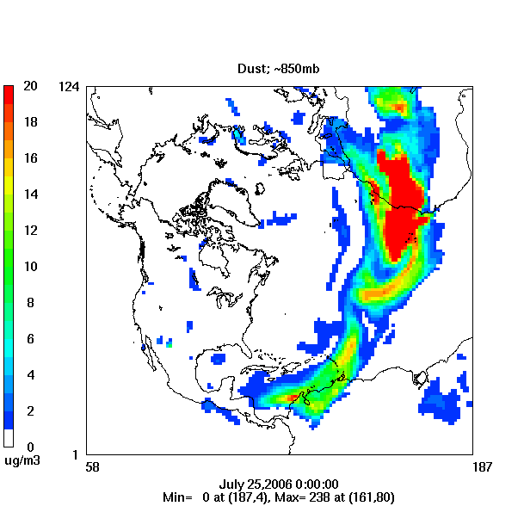
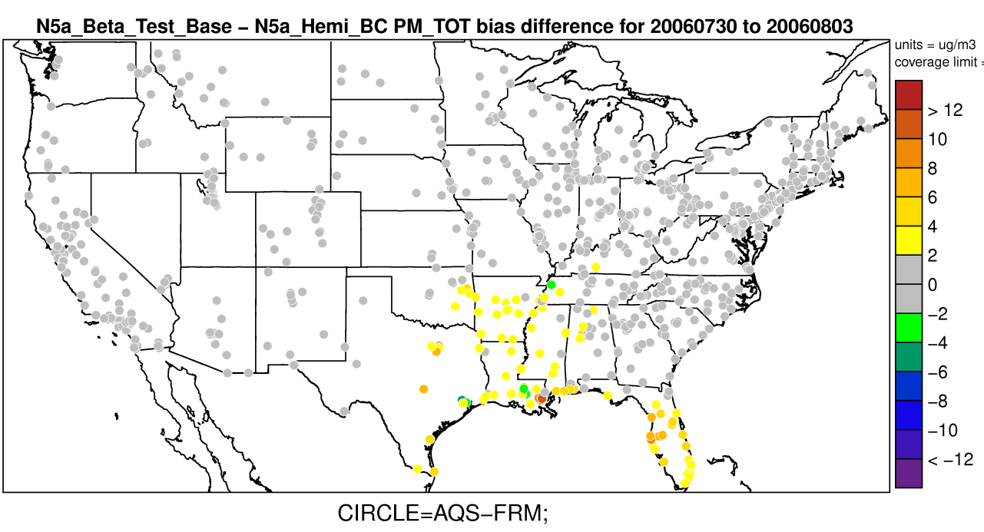
Trans-Atlantic Transport of Saharan Dust
Impact on surface-level PM_{2.5} in the Gulf States
Reduction in bias in simulated surface PM_{2.5}
Lower bias
Higher bias
Space and time varying LBCs from hemispheric CMAQ helped capture impacts of long-range transport on episodic Saharan dust intrusion events

Slide 10
Recent updates to Planetary Boundary Layer (PBL) and Land Surface Model (LSM)
The Asymmetric Convective Model version 2 (ACM2) in WRF-CMAQ
  Designed especially for AQ applications
  Consistent PBL transport of meteorology and chemistry
  Combined local and non-local closure scheme for convective conditions
  Combines local scaling and boundary layer scaling for eddy diffusivities
  Updates to ACM2 in WRFv3.7 and WRF v3.8
    Different K_{m} and K_{h} (Pr = K_{m}/K_{h} ≠ 1)
    New eddy diffusivities for stable conditions
PX Land Surface Model in WRF-CMAQ
  Designed for consistent treatment of heat, moisture, and momentum fluxes in WRF and chemical fluxes (dry dep, bi-directional) in CMAQ
  Updates to PX LSM:
    Modified stomatal conductance function for PAR (F1) (WRFv3.8)
    Reduced heat capacity of vegetation (WRFv3.7)
  Together updates to PBL and LSM reduce biases in meteorology (particularly T and Q) mostly at night
  Updates also reduce over-prediction of ground level emitted species (e.g. NOx, CO, EC)

Slide 11
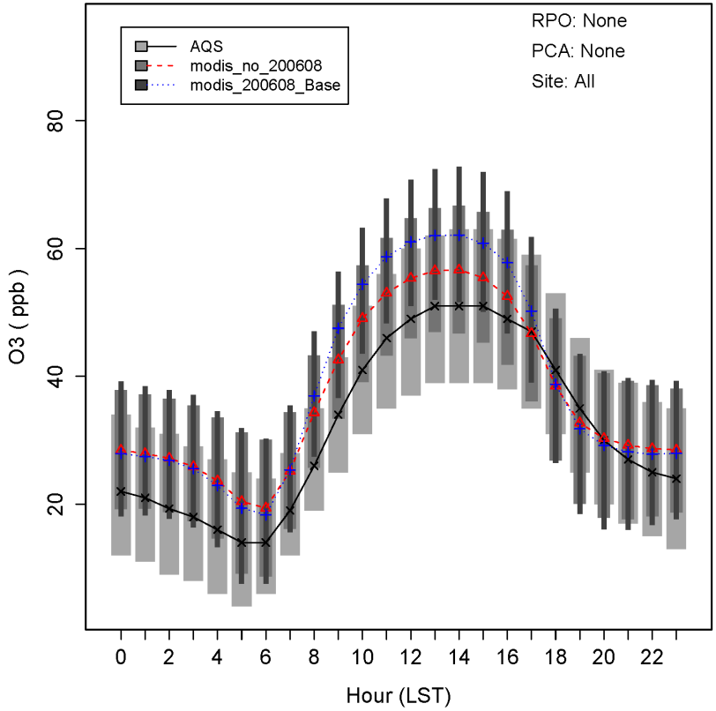
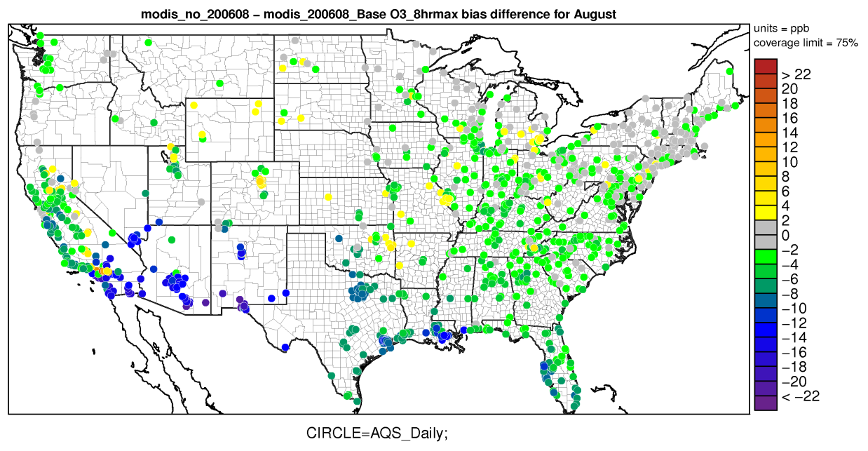
Effects of PBL and LSM Updates on O₃
Max 8-h bias difference → New - Base
AQS
New model
Base model
Higher bias
Lower bias
Δx = 12 km : Aug. 10 to Aug. 30, 2006
Changes to PBL and LSM tend to reduce ozone during mid-day hours, resulting in reductions in the MD8hr O₃ bias

Slide 12
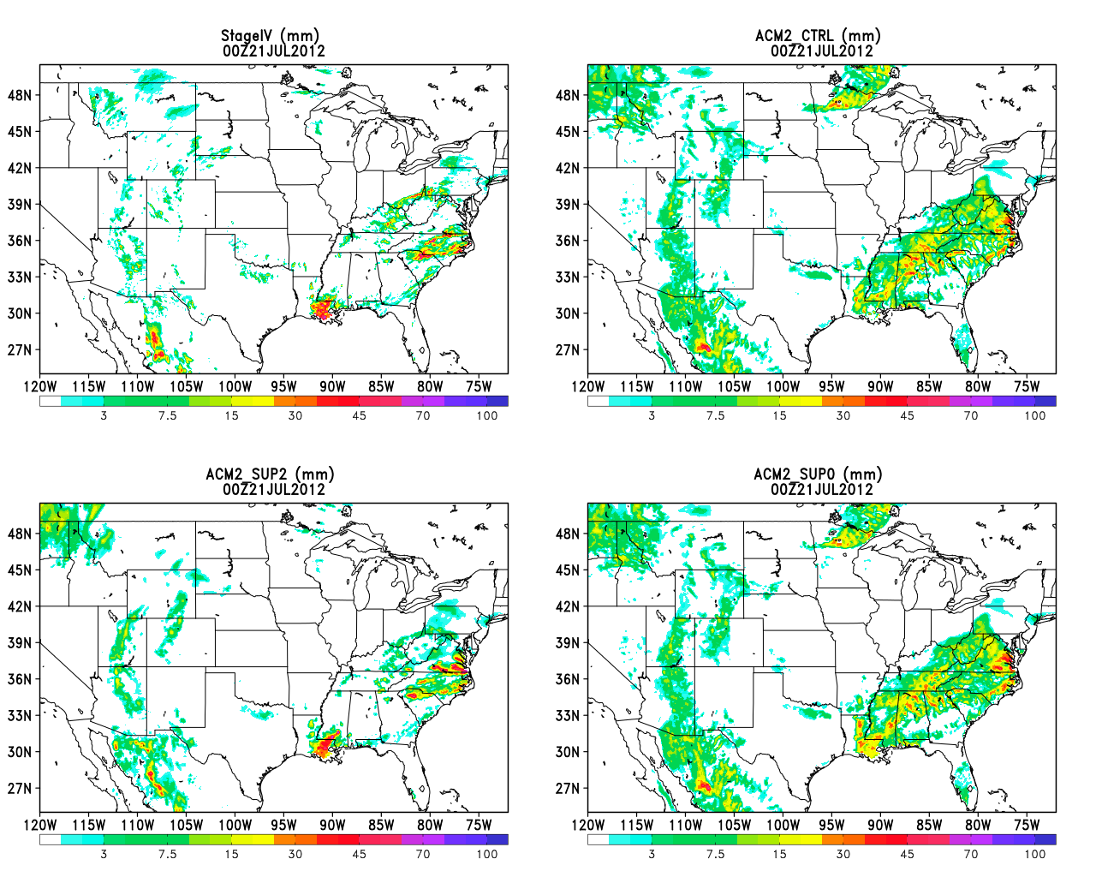
Improvements in Clouds, Radiation, and Precipitation
Observations
Base Case
Predicting clouds and precipitation is challenging.
Example on the left shows both over- and underestimation of precipitation.
WRF Lightning Assimilation in Kain-Fritsch
Use lightning data from the National Lightning Detection Network (NLDN)
Simple, computationally efficient approach: (builds off of Mansell et al. 2007)
  Force deep convection where lightning is observed
  Only allow shallow clouds where it is not
Is lightning present?
YES
Force thunderstorm
NO
Only allow shallow clouds
Heath et al., JAMES, DOI: 10.1002/2016MS000735, 2016

Slide 13
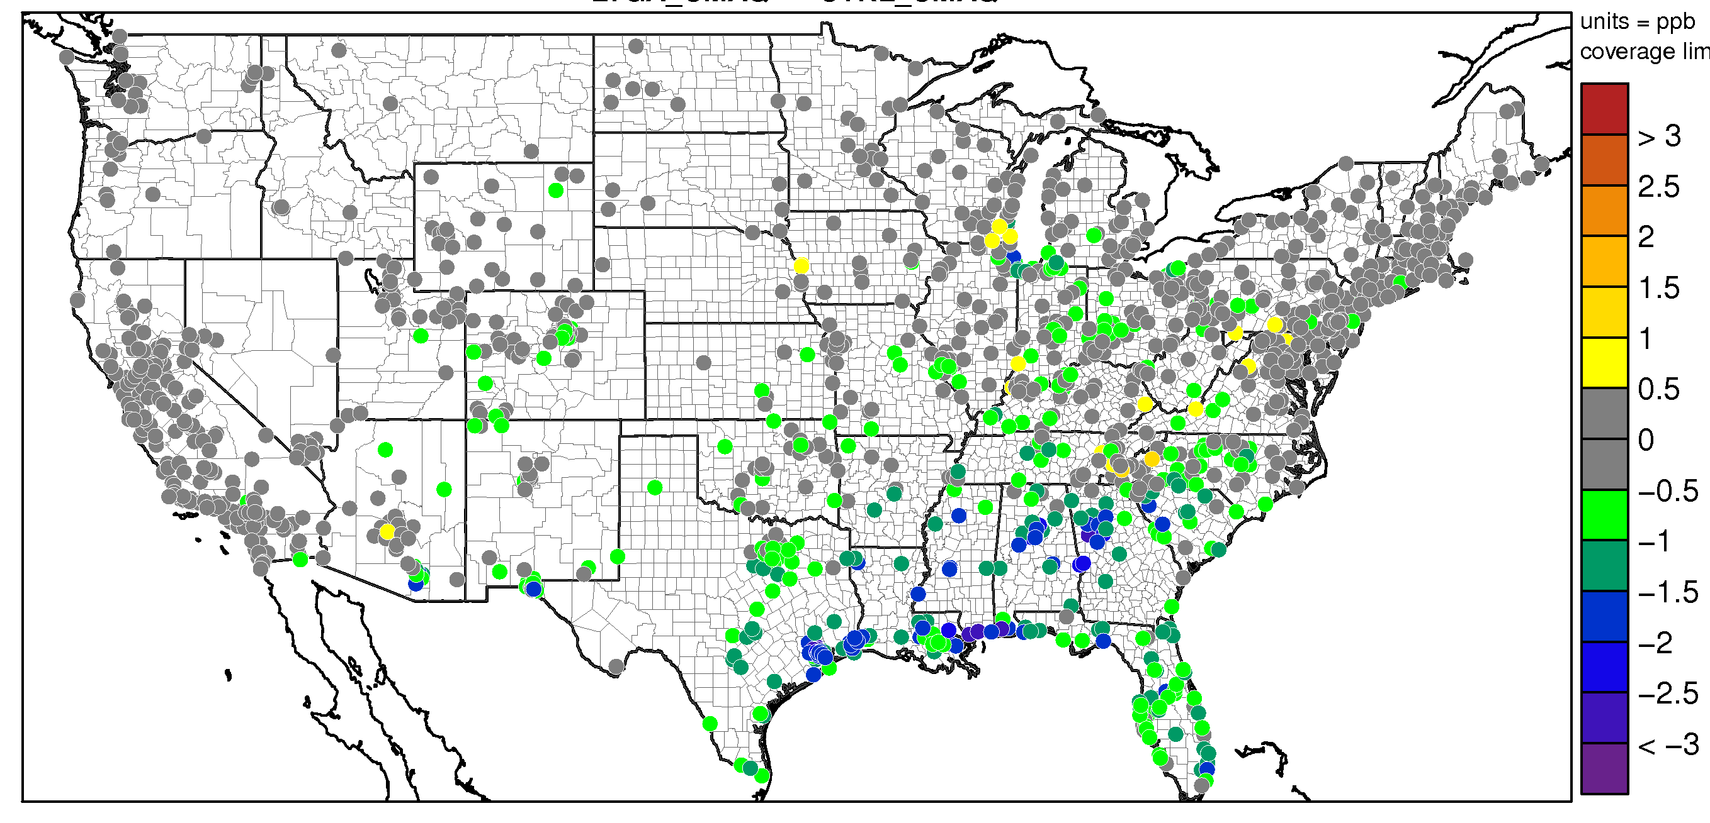
Improving Precipitation in WRF-CMAQ through Lightning Assimilation
Observations
Base Case
Lightning Assimilation
Reduced O₃ Bias at 71% of AQS sites (July 2011)
Lightning assimilation methodology improves clouds, precipitation, and O₃.
Courtesy: Nicholas Heath

Slide 14
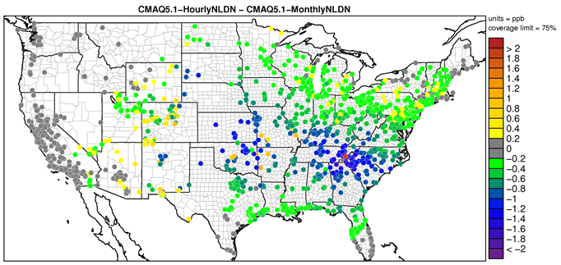
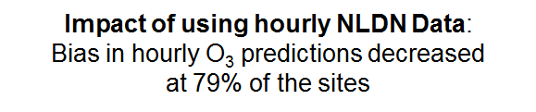
Improving Estimates of Lightning NO Generation
CMAQv5.1: monthly climatological data from the National Lightning Detection Network (NLDN) were associated with WRF’s gridded convective rainfall rate to distribute lightning strikes per grid cell.
CMAQv5.2: hourly raw NLDN data are now used to generate gridded hourly LNO, resulting overall in ~30% decrease in LNO.
Monthly NLDN
Monthly Domain Total NO (moles x 10⁶ )
Hourly NLDN
Courtesy: Daiwen Kang

Slide 15
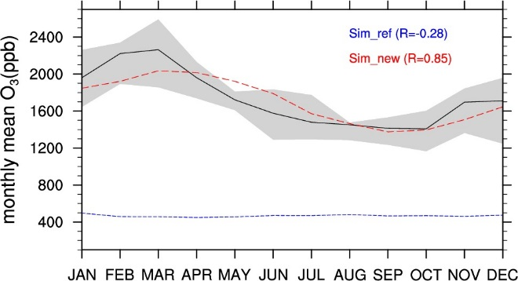
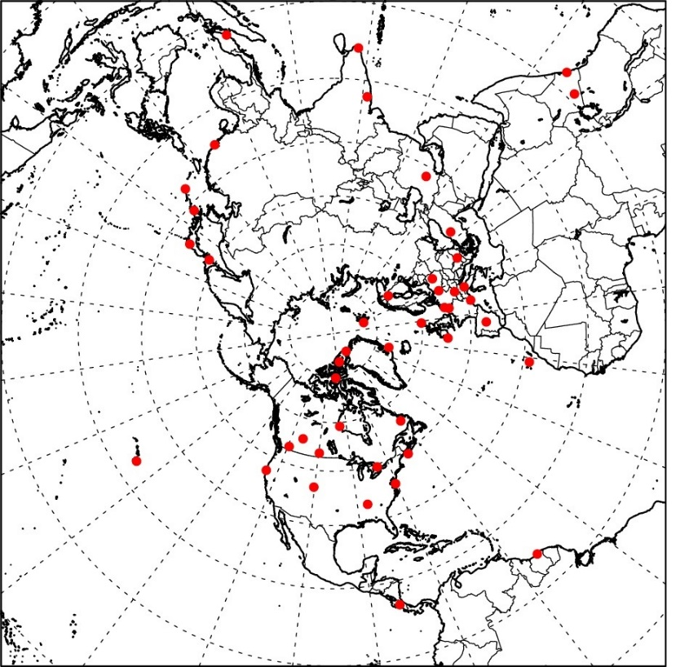
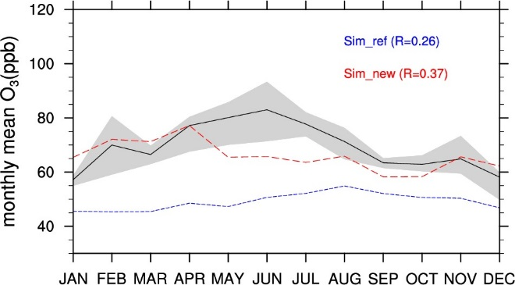
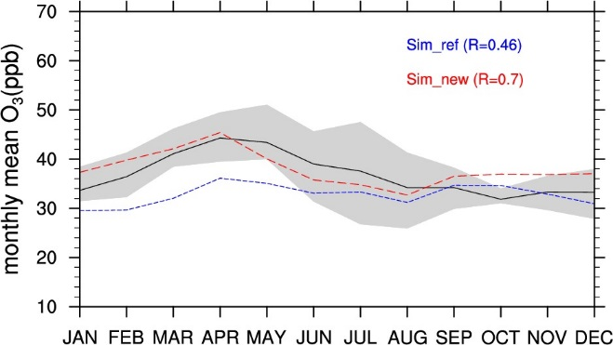
CMAQv5.2 Updates:
Impact of stratosphere-troposphere exchange on tropospheric O₃
Modeled O₃ specified by enforcing the condition of proportionality to Potential Vorticity: [O₃] = c•PV
Used recent CMAQ multi-decadal simulations to develop a robust relationship that varies spatially and temporally: O₃/PV = F(spatial) X G(temporal)
Used observed O₃ data from 1990-2010 from 44 WOUDC sites
UTLS
P<100mb
Comparison of Observed O₃ with Reference simulation and New PV scaling
Mid-Troposphere
300mb<P<500mb
PBL
P>800mb
Xing et al, ACP, 2016

Slide 16
CMAQv5.2 Updates:
Gas-phase chemistry
CMAQ includes different mechanisms so that mechanism can be matched to application
New in CMAQ v5.2 is CB6 (r3) mechanism:
  Updated reaction rates and yields (matches current science recommendations)
  Updated nitrate yields in low temperatures (winter simulations); 3 nitrates instead of 1 in CB05tucl
  More high-emitted, longer-lived species, including acetone, benzene, propane, carbonyls (slower reacting, more transport)
  CMAQ extensions to CB6r3:
    Customized to interface with SOA improvements
    Can modify for emerging issues/pollutants (respond faster to science updates and new research findings)
Mechanism family | Specific mechanisms in CMAQ
Carbon Bond | CB05tucl, CB05e51 (expanded nitrates), CB05e51h (with halogens), CB6r3
SAPRC | SAPRC07T (explicit toxics), SAPRC07tic (expanded isoprene)
RACM | RACM2

Slide 17
CMAQv5.2 Updates:
Improving representation of marine environments
Issue: Halogen chemistry and deposition to water are key sinks for O₃ in marine environments; their accurate representation impacts predictions of both long-range transport and ambient levels in coastal areas.
Mean O₃ without halogen chemistry
Impact of enhanced deposition on ozone
Impact of halogen chemistry on ozone
Sarwar et al., ES&T, 2015

Slide 18
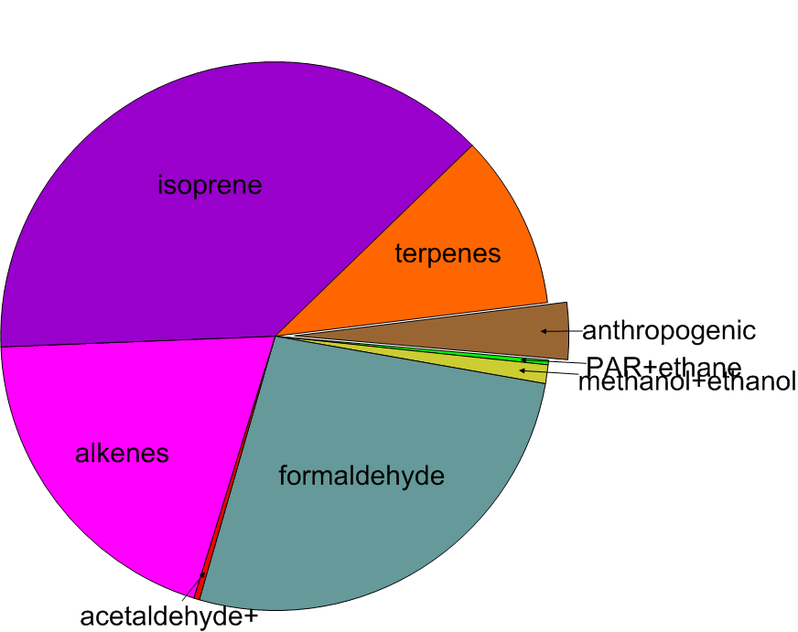
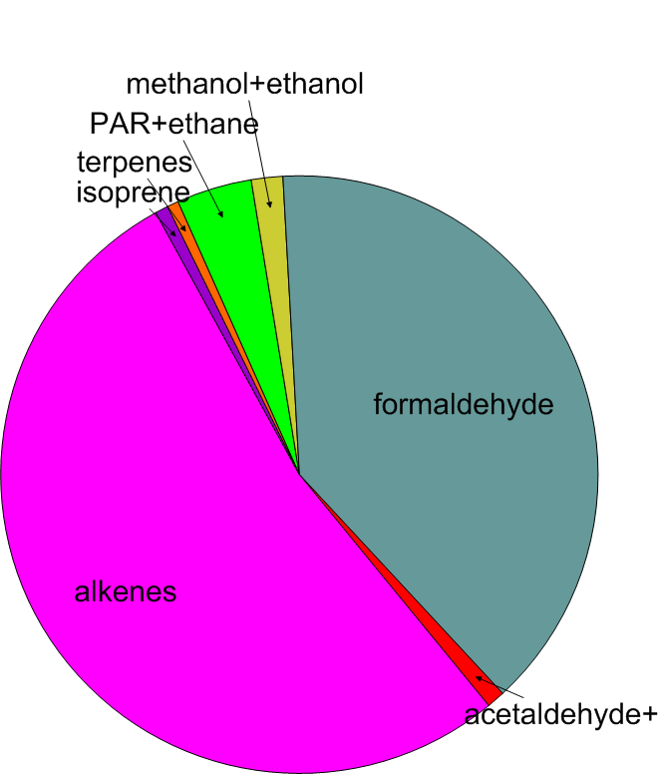
CMAQv5.2 Updates:
Gas-phase chemistry for HAPs
CB6r3 extended to predict concentrations of 41* Hazardous Air Pollutants (HAPs), used in 2014 National Air Toxics Assessment, to identify those air toxics which are of greatest potential concern in terms of contribution to population risk
Example: Use of CMAQ to quantify the VOCs that contribute the most to ambient formaldehyde in the Southeast from all VOCs (left) and breakdown from anthropogenic sources (right)
Example: Some of the important HAPs predicted by CMAQv5.2, including those which have been identified as national and regional cancer and noncancer hazard drivers.
All VOCs
Anthropogenic portion
* users can now easily change model output to subset the 41 HAPs for their own applications

Slide 19
+ OH/NO
SV_PAH1 SV_PAH2
Secondary Organic Aerosols in CMAQv5.2
PAHs
+ OH/HO₂
APAH1 APAH2
long
alkanes
+ OH
SV_ALK1 SV_ALK2
AALK1 AALK2
high-yield aromatics
+ OH/NO
SV_TOL1 SV_TOL2
APAH3
VOC Precursors
+ OH/HO₂
ATOL1 ATOL2
low-yield aromatics
+ OH/NO
Condensable Organic Vapors
SV_XYL1 SV_XYL2
Secondary Organic Aerosol Particles
Oxidants
AXYL1 AXYL2
AOLGA
+ OH/HO₂
benzene
+ OH/NO
SV_BNZ1 SV_BNZ2
ABNZ1 ABNZ2
AXYL3
ATOL3
+ OH/HO₂
ABNZ3
sesquiterpenes
SV_SQT
AORGC
cloud
water
+OH, +O₃, +NO₃, +O³P
ASQT
APIN monoterpenes
+OH, +O₃, +O³P
ATRP1 ATRP2
AOLGB
SV_TRP1 SV_TRP2
AGLY
TERP monoterpenes
GLY MGLY
+OH, +O₃, +O³P
ANTHROPOGENIC EMISSIONS
VOCs
isoprene
SV_ISO1 SV_ISO2
BIOGENIC EMISSIONS
+OH
AISO1 AISO2
EMISSIONS
EMISSIONS
aqueous aerosol

Slide 20
20
CMAQv5.2 Updates:
Biogenic Secondary Organic Aerosol
Isoprene Epoxide (IEPOX) SOA
Particulate Organic Nitrate Aerosols
(Percentage of total OA mass in green)
(Percentage of total OA mass in cyan)
Hu et al., 2015 ACP
Ng et al., accepted ACP

Slide 21
+ OH/NO
SV_PAH1 SV_PAH2
Secondary Organic Aerosols in CMAQv5.2
PAHs
+ OH/HO₂
APAH1 APAH2
long
alkanes
+ OH
SV_ALK1 SV_ALK2
AALK1 AALK2
high-yield aromatics
+ OH/NO
SV_TOL1 SV_TOL2
APAH3
VOC Precursors
Condensable Organic Vapors
ATOL1 ATOL2
+ OH/HO₂
Secondary Organic Aerosol Particles
Oxidants
low-yield aromatics
+ OH/NO
SV_XYL1 SV_XYL2
AXYL1 AXYL2
AOLGA
+ OH/HO₂
benzene
+ OH/NO
SV_BNZ1 SV_BNZ2
ABNZ1 ABNZ2
AXYL3
ATOL3
+ OH/HO₂
ABNZ3
sesquiterpenes
SV_SQT
AORGC
cloud
water
+OH, +O₃, +NO₃, +O³P
ASQT
APIN monoterpenes
+OH, +O₃, +O³P
ATRP1 ATRP2
AOLGB
SV_TRP1 SV_TRP2
AGLY
TERP monoterpenes
GLY MGLY
+OH, +O₃, +O³P
AIETET, AIEOS, ADIM, AIMGA, AIMOS
AMTNO₃
+OH/NO, +NO₃
MTNO₃
AMTHYD
ANTHROPOGENIC EMISSIONS
+NO₃
AISOPNN
ISOPNN
VOCs
isoprene
SV_ISO1 SV_ISO2
BIOGENIC EMISSIONS
+OH
AISO1 AISO2
EMISSIONS
+ OH/HO₂
IEPOX
EMISSIONS
+ OH/NO/NO₂
MAE+HMML
aqueous aerosol

Slide 22
22
CMAQv5.2 Updates:
Organic aerosol co-benefits from SO_{x} and NO_{x} reductions
Better capture of Isoprene SOA dependence on aerosol sulfate
NO_{x} reductions lead to substantial OA reductions via NO_{x} participation in organic nitrate formation
Model
(Pye et al., 2017 ACP, Mao et al., in review ACPD)
Organic Nitrates!
(Pye et al., 2015 ES&T)

Slide 23
23
CMAQv5.2 Updates:
Anthropogenic Organic Aerosol
Primary Secondary
OA OA
Organic aerosol in the atmosphere:
is a significant contribution to mass throughout the world
is becoming relatively more important for PM_{2.5} predictions as PM sulfate and nitrate concentrations fall
has been shown to evaporate with dilution from near-source to ambient conditions
(Lipsky et al., Environ Sci Technol, 2006, Huffman et al., 2009, Grieshop et al., ACP, 2009, May et al., Atmos. Environ, 2013)
is primarily comprised of oxygenated compounds
(Ng et al., ACP, 2010; Zhang et al., Anal Bioanal Chem, 2011)
Organic aerosol in CMAQv5.1:
is dominated by primary, nonvolatile organic mass
underestimates the response of OA to photooxidation in urban areas
(Woody et al., ACP, 2016)
overestimates OA observations in winter (due to high POA concentrations)
underestimates OA observations in summer (due to low SOA concentrations)

Slide 24
CMAQv5.2 Updates:
Anthropogenic Organic Aerosol
Semi-volatile POA
  The research community and our own models tell us a significant fraction of POA should be volatilized.
  Distributed POA from inventory into separate species based on Volatility:
New Anthropogenic SOA model species
  Lump The uncertain processes into one NEW model surrogate: Potential SOA from Combustion Emissions (pcSOA)
Nonvolatile POA is still available in CMAQv5.2 for backwards compatibility
Class C* (µg m⁻³)
ELVOC C* < 10⁻³
LVOC 10⁻³ ≤ C* < 10⁰
SVOC 10⁰ ≤ C* < 10³
IVOC 10³ ≤ C* < 10⁶
POC
+
PNCOM
LVPOA
SVPOA-1
SVPOA-2
SVPOA-3
IVPOA
Nonvolatile
Configuration
Semivolatile Configuration
+ OH
pcVOC
pcSOG
(C* = 10⁻³ µg m⁻³)
EF =
6.5gVOC /gPOA
k_{OH} =
1.25 x 10⁻¹¹
cm³ molec⁻¹ s⁻¹
emissions
pcSOA
(Hayes et al., ACP, 2013; Woody et al, ACP, 2016)

Slide 25
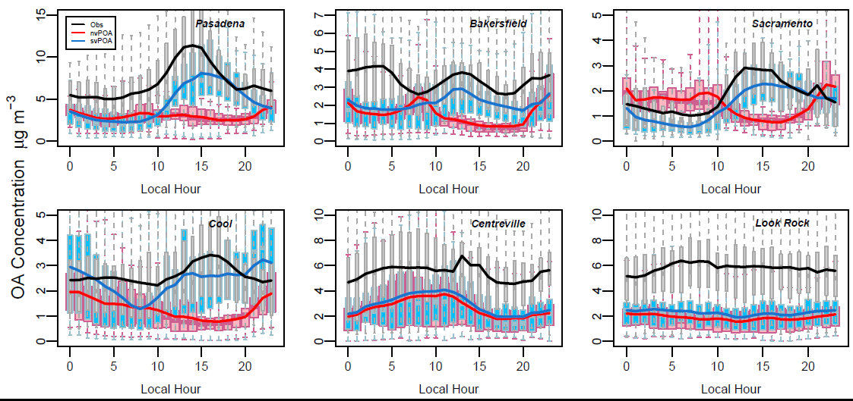
CMAQv5.2 Updates:
Anthropogenic Organic Aerosol
OA Diurnal profiles for California 4-km simulation. May-June 2010.
Seasonal performance indicators for CONUS 2011 simulation
Notes:
Schematic of the mechanism of dust emission by saltation. The forces acting on a stationary sand particle include drag (F_{D}), lift (F_{L}), gravitational (F_{g}), and cohesive (F_{c}) forces. The particle starts to move when the aerodynamic drag and lift exceed gravitational and inter-particle cohesive forces. The strike of the particle back to the surface results in the vertical emission of dust

Slide 26
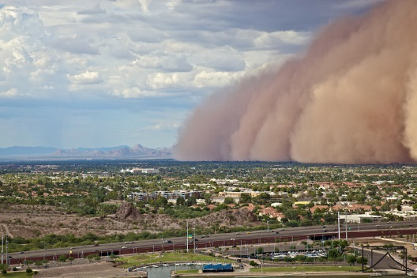
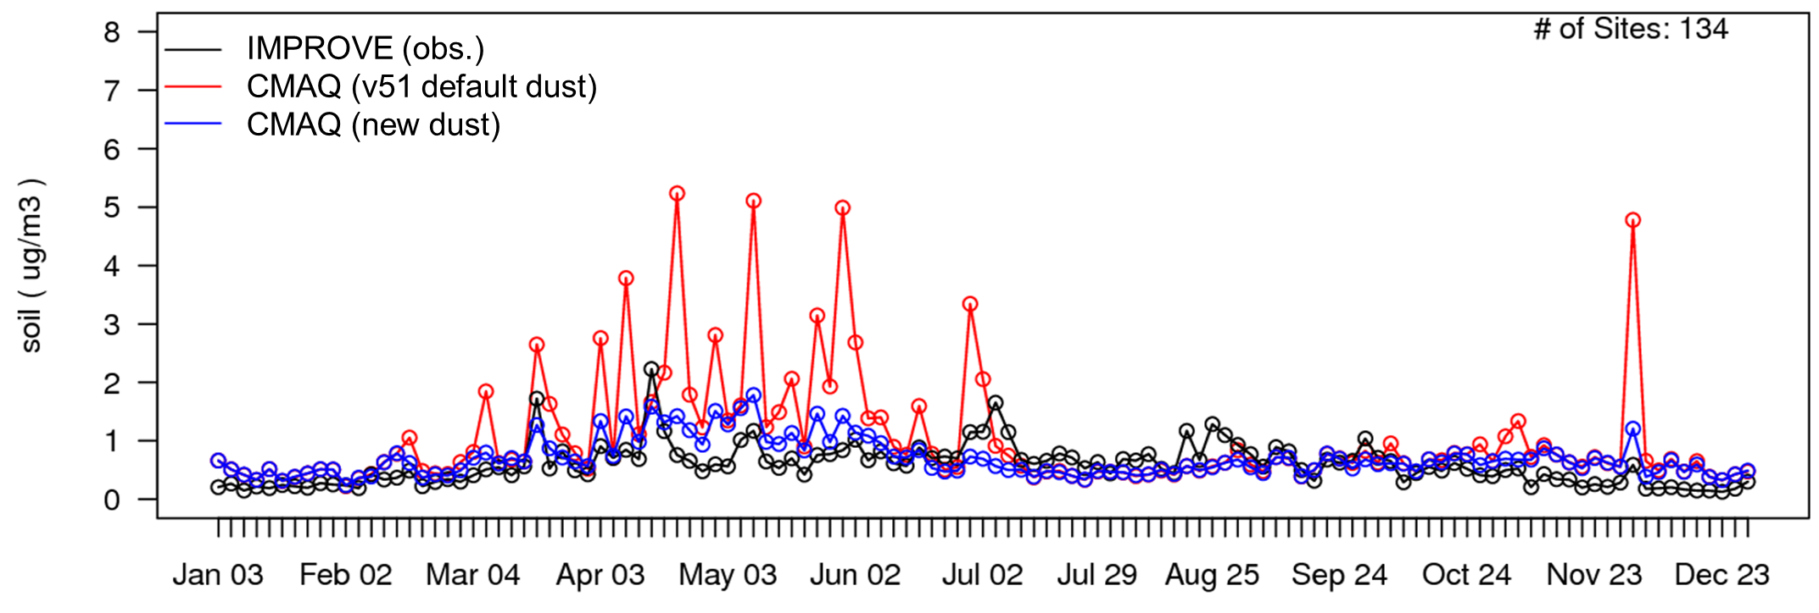
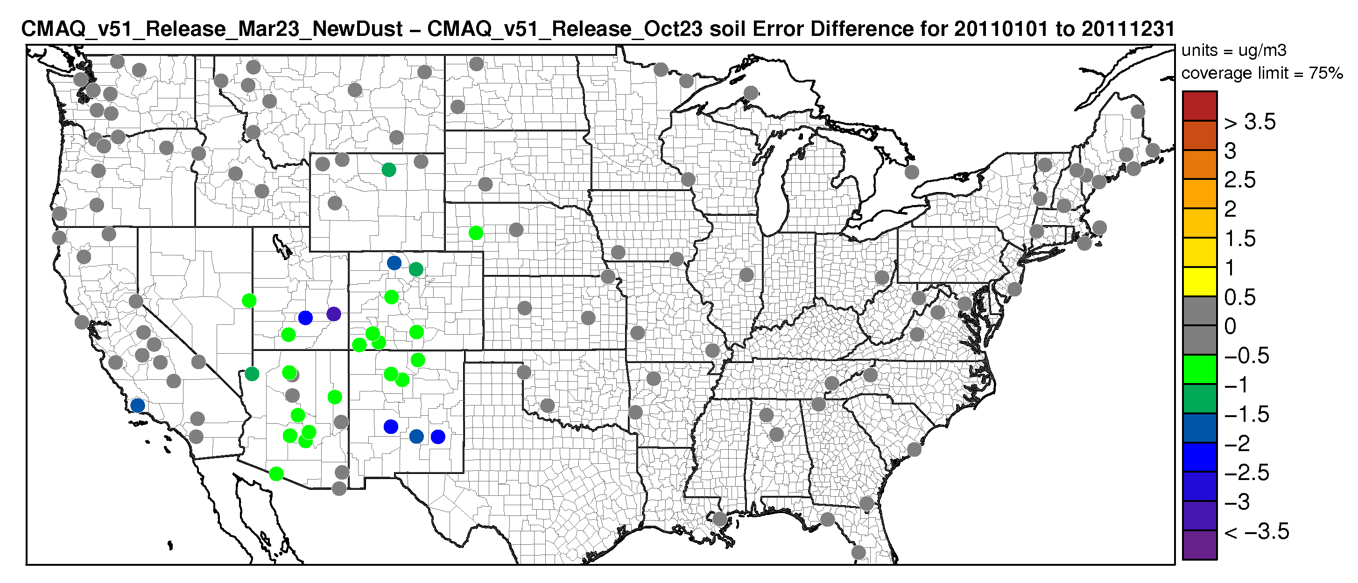
CMAQv5.2 Updates:
Evaluation of New physics-based windblown dust module
Massive dust storm in Phoenix, AZ
Time series of fine particulate soil for all IMPROVE sites (CONUS, 2011)
CMAQv5.1 windblown dust model Issue
Tendency to occasionally produce unrealistically high emissions
Extensive updates to the windblown dust module for CMAQv5.2 release
Difference in the soil error for entire year 2011 (CMAQv5.2 – CMAQv5.1)
Update | Implications
Threshold friction velocity | More realistic values of the threshold velocity smoothly distributed
Roughness factor | Include the effect of roughness elements (both solid and vegetation)
Surface roughness | Develop a new relation for surface roughness based on data from several different studies
Vegetation cover fraction | Spatially and temporally variable vegetation fraction based on satellite observations
Increase in Error
Decrease in Error
(98% of sites)
Individual contributions of several emission sources to PM concentrations at a receptor for a hypothetical scenario.

Slide 27
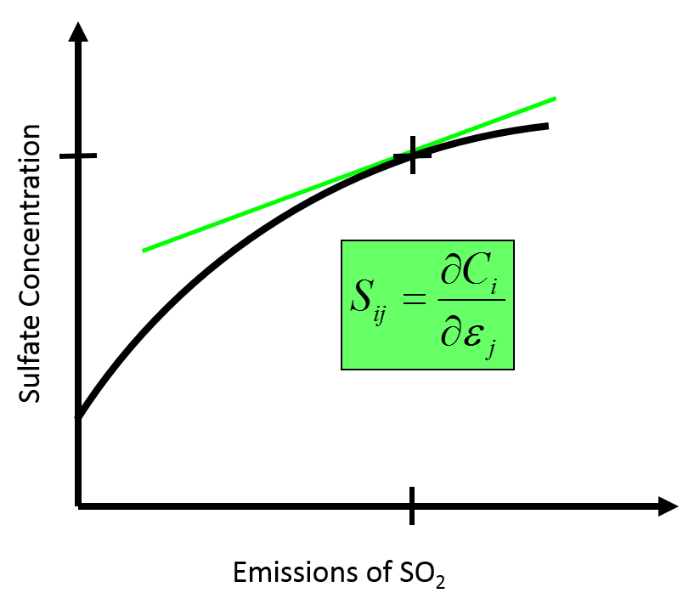
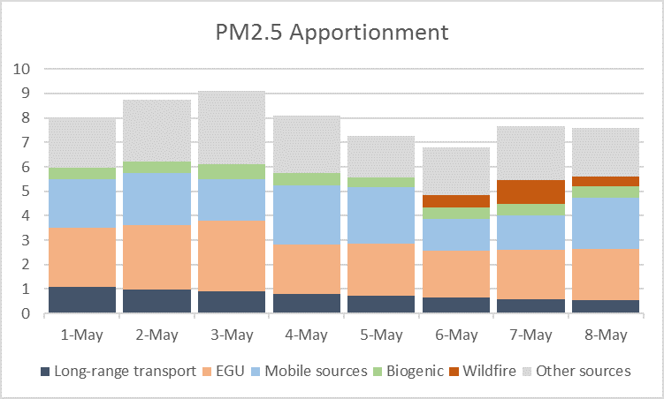
CMAQv5.2 Instrumented Models
Decoupled Direct Method in Three Dimensions (DDM-3D)
A hypothetical relationship between emissions of SO2 and sulfate concentrations. The green tangent line illustrates the sensitivity of sulfate concentration to emissions of SO₂.
CMAQ-DDM-3D enables sensitivity calculations simultaneously with the standard concentrations and deposition calculations using the existing core model algorithms. Sensitivities are with respect to:
  Emissions (gridded, point, biogenic, lightning, etc)
  Boundary and/or Initial conditions
  Reaction rates
  Potential Vorticity
  Region or Time of emission
Second order sensitivity calculation (sensitivity of sensitivity) is also available.
Integrated Source Apportionment Method (ISAM)
An example of source-resolved particulate concentrations. This scenario demonstrates the effect of a wildfire plume impacting the receptor on May 6.
CMAQ-ISAM allows for source attribution calculations for both gaseous (O₃, VOC, and NO_{x}) and particulate species (SO₄, NO₃, EC, OC, etc.) in a single model run.
O₃ attribution is classified into VOC/NO_{x} limited regimes.
All reactive VOCs are explicitly tracked.
Source attribution for user-defined combinations of emissions sectors and regions.
Each simulation tracks IC/BC contributions as well as an other category to reconstruct the full bulk concentration.
Courtesy: Sergey Napelenok
Individual contributions of several emission sources to PM concentrations at a receptor for a hypothetical scenario.

Slide 28
Incremental Testing of the CMAQv5.2
Modeling System
V5.1 Base
Updates in CMAQv5.2 reduce high bias in summer O₃ and low bias in summer PM_{2.5} across much of the US. Changes in high bias in winter PM_{2.5} are more spatially heterogeneous.
WRF3.7
2011NEI v2
CB05e51
Geos-Chem BCs
WRF3.8 with lightning assimilation
V5.2 with CB05e51 chemical mechanism
V5.2 with CB6r3 chemical mechanism
Update to Calculation of NO from Lightning
Hemispheric CMAQ BCs
Lightning assimilation:
Decreases summer O₃
Improves bias
Mostly increases sulfate in eastern US in summer
Increases nitrate in eastern US in winter
Other changes in WRF3.8 have much smaller impact
Increases PM_{2.5} in summer due to SOA updates
Decreases PM_{2.5} in winter due to addition of semivolatile POA
→ Improves bias in both seasons
Impact on summer O₃ is mixed
Decreases summertime O₃ and NO₂
Improves bias
Small decrease in summer SOA in the southeast
Decrease in summertime O₃
Decreases summertime O₃ across much of the domain. Exception is over the Pacific.
Improves bias
Increases PM_{2.5} in summer
Decreases nitrate in winter
Notes:
V5.1 emissions: 2011 NEI v2 eh
V5.2 CB05e51 increment switched to 2011 NEI v2 ek platform:
~ Updated from MOVES2014 to MOVES2014a for mobile emissions (updates for TX, OH, NJ, CA, AZ)
~ Revised spatial surrogates for underway emissions from commercial marine

Slide 29
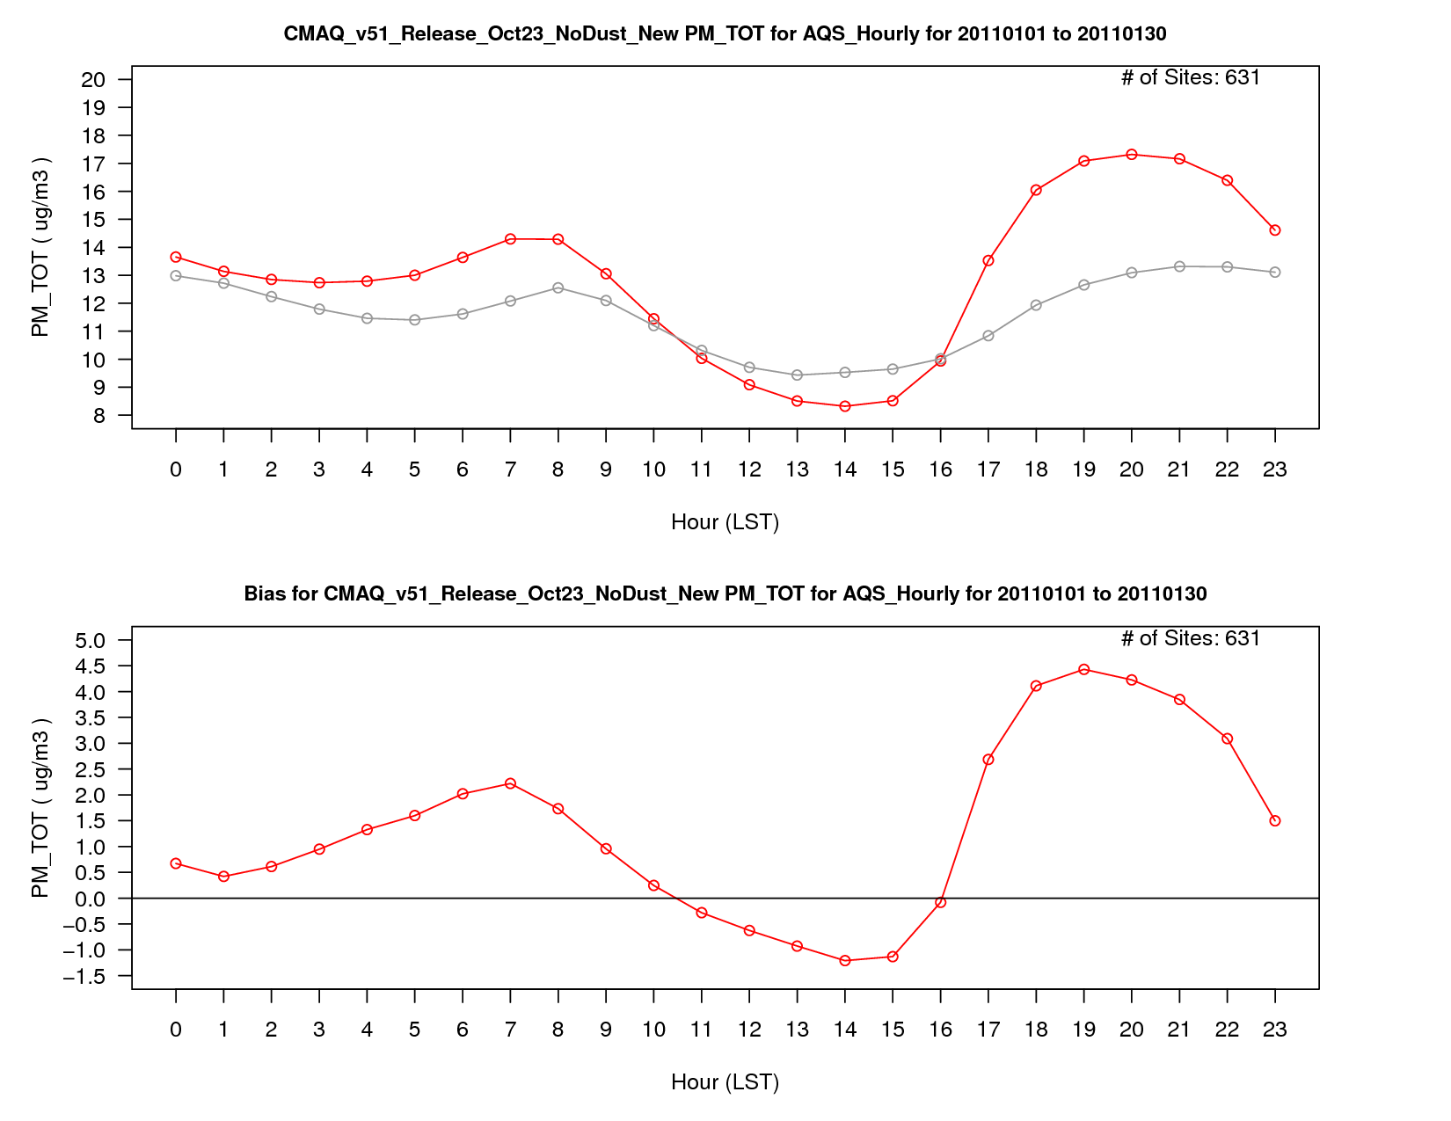
PM_{2.5} Concentration – January 2011
PM_{2.5} Concentration – January 2011
January 2011
Incremental Testing for PM_{2.5}
AQS Observations
v5.1 Base
PM_{2.5} Bias
PM_{2.5} Bias

Slide 30
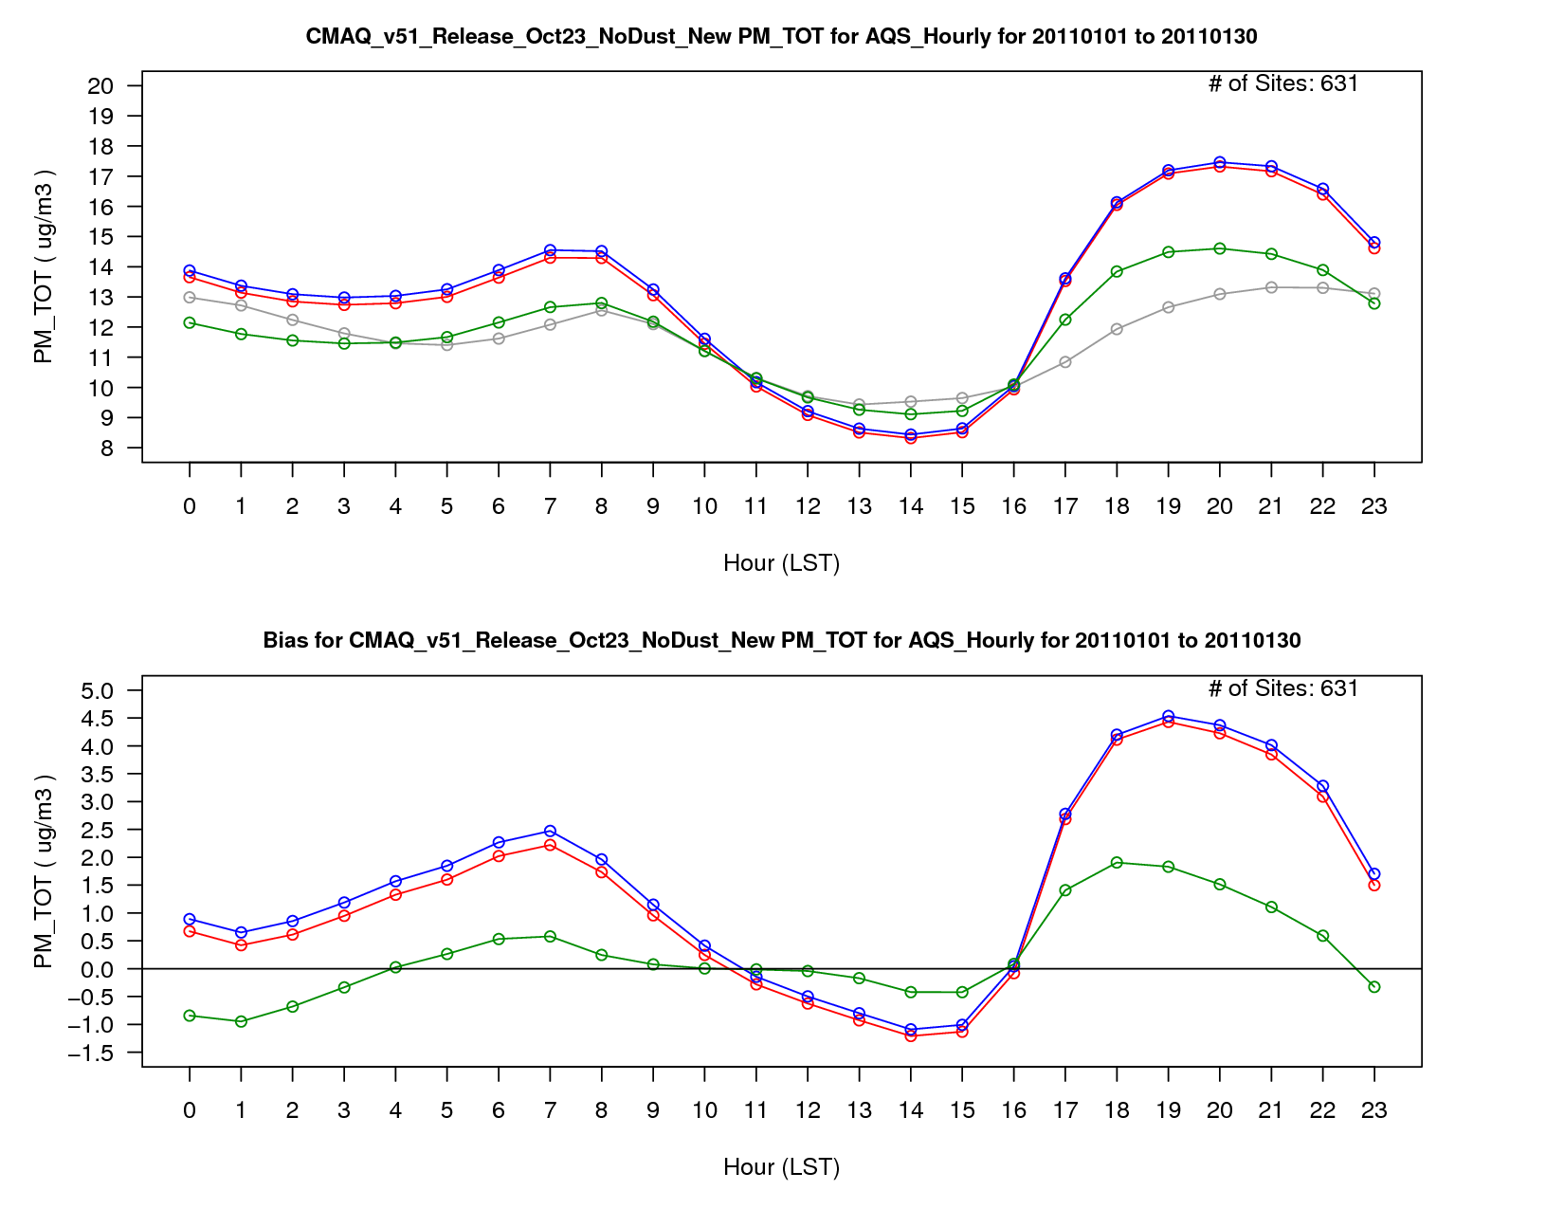
PM_{2.5} Concentration – January 2011
January 2011
Incremental Testing for PM_{2.5}
AQS Observations
v5.1 Base
v5.1 w/ WRF Updates
v5.2 CB05e51
PM_{2.5} Bias
Improvements in bias due primarily to organic aerosol updates in v5.2 CB05e51.

Slide 31
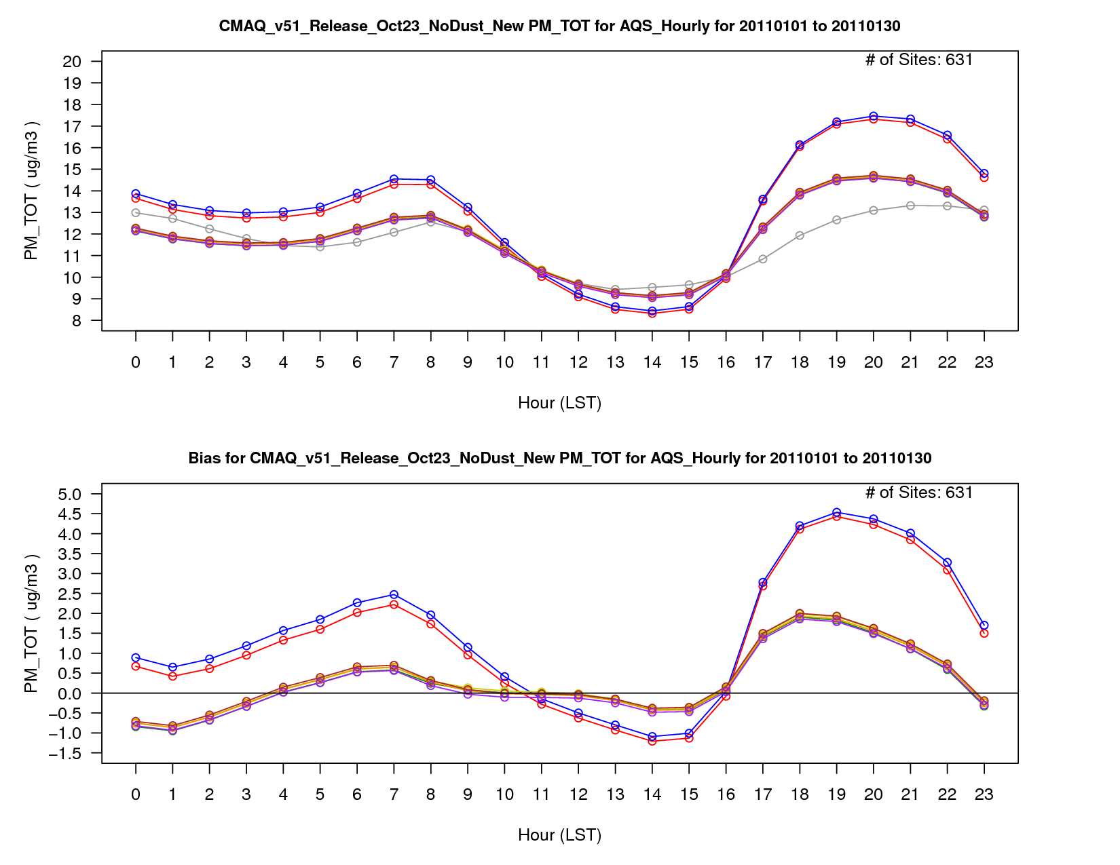
PM_{2.5} Concentration – January 2011
January 2011
Incremental Testing for PM_{2.5}
AQS Observations
v5.1 Base
v5.1 w/ WRF Updates
v5.2 CB05e51
v5.2 CB05e51 (ek emis)
v5.2 CB6r3
Lightning NO Update
Hemispheric CMAQ BCs
PM_{2.5} Bias
Other model updates have less impact on mean bias.

Slide 32
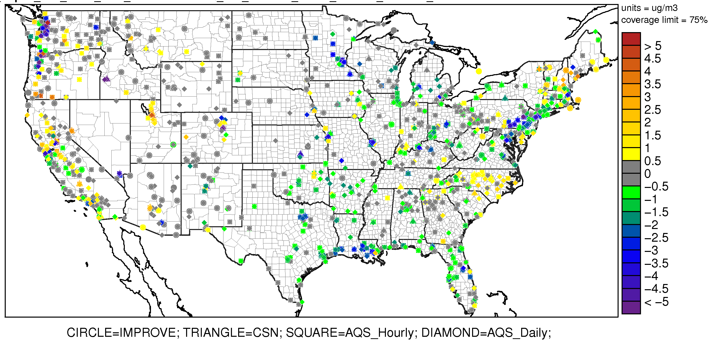
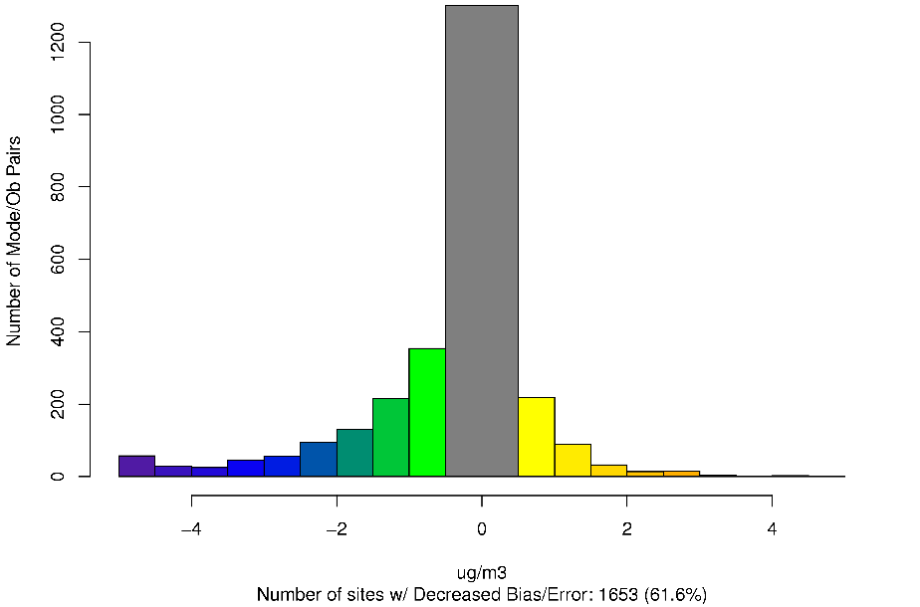
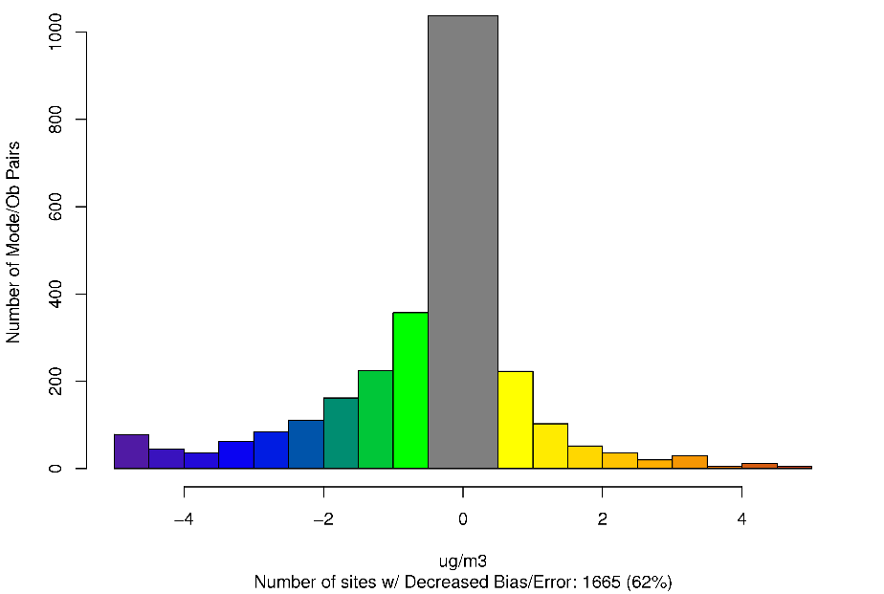
CMAQv5.2 (Hemi) – CMAQv5.1 – Difference in PM_{2.5} Absolute Bias January 2011
January 2011
Improvement in PM_{2.5} diurnal profile leads to decrease in bias at most locations
Worse Bias
Improved Bias
Worse Error
Worse Bias
Improved Error
Improved Bias

Slide 33
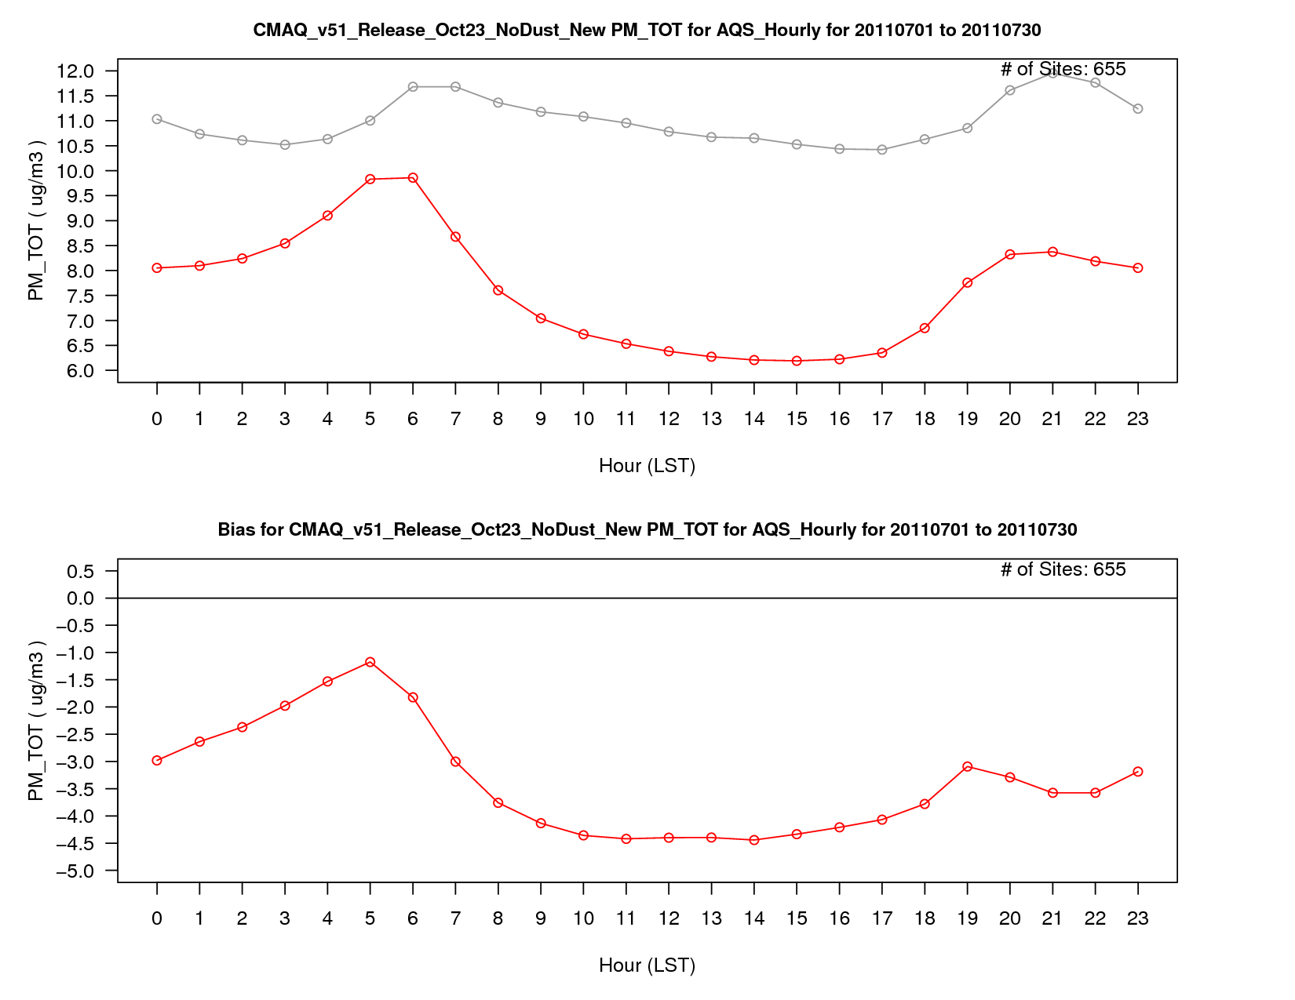
PM_{2.5} Concentration
PM_{2.5} Concentration – July 2011
July 2011
Incremental Testing for PM_{2.5}
AQS Observations
v5.1 Base
AQS Observations
v5.1 Base
PM_{2.5} Bias
PM_{2.5} Bias
PM_{2.5} Bias
33

Slide 34
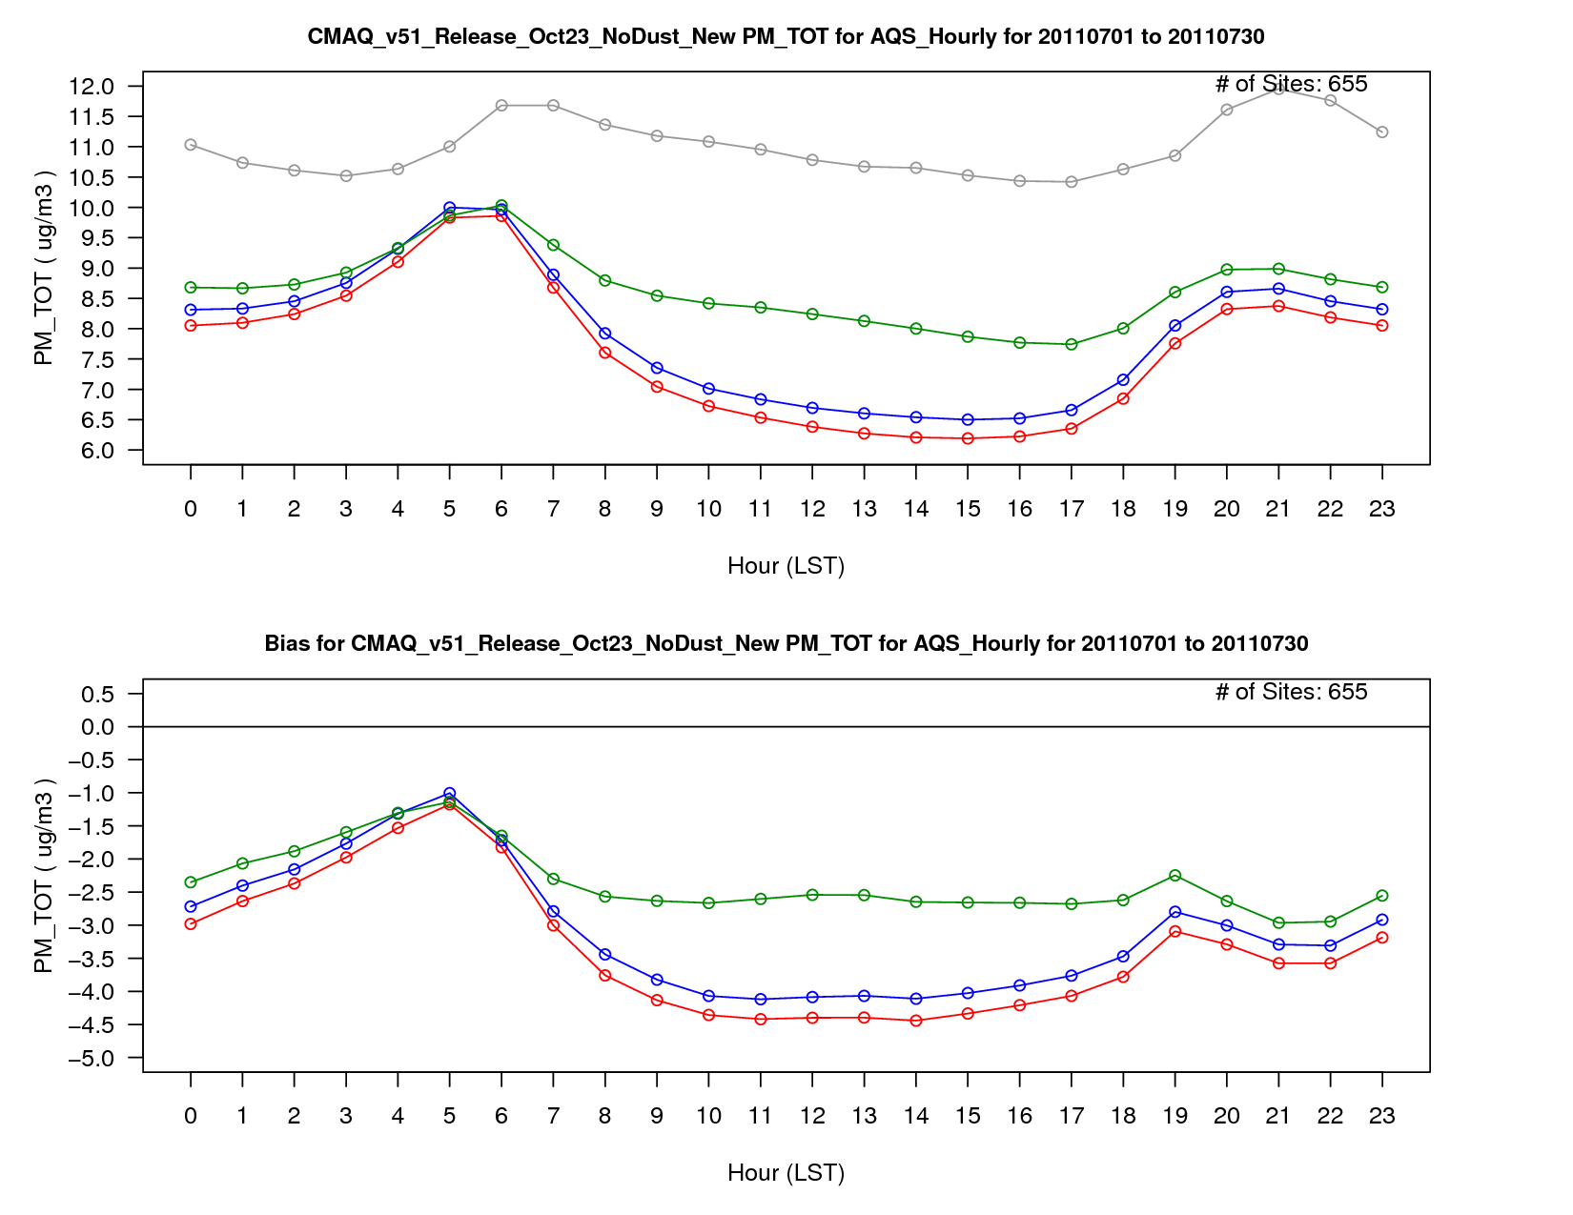
PM_{2.5} Concentration – July 2011
July 2011
Incremental Testing for PM_{2.5}
AQS Obs
v5.1 Base
v5.1 w/ WRF Updates
v5.2 CB05e51
Improvements in bias due primarily to organic aerosol updates in v5.2 CB05e51.
PM_{2.5} Bias

Slide 35
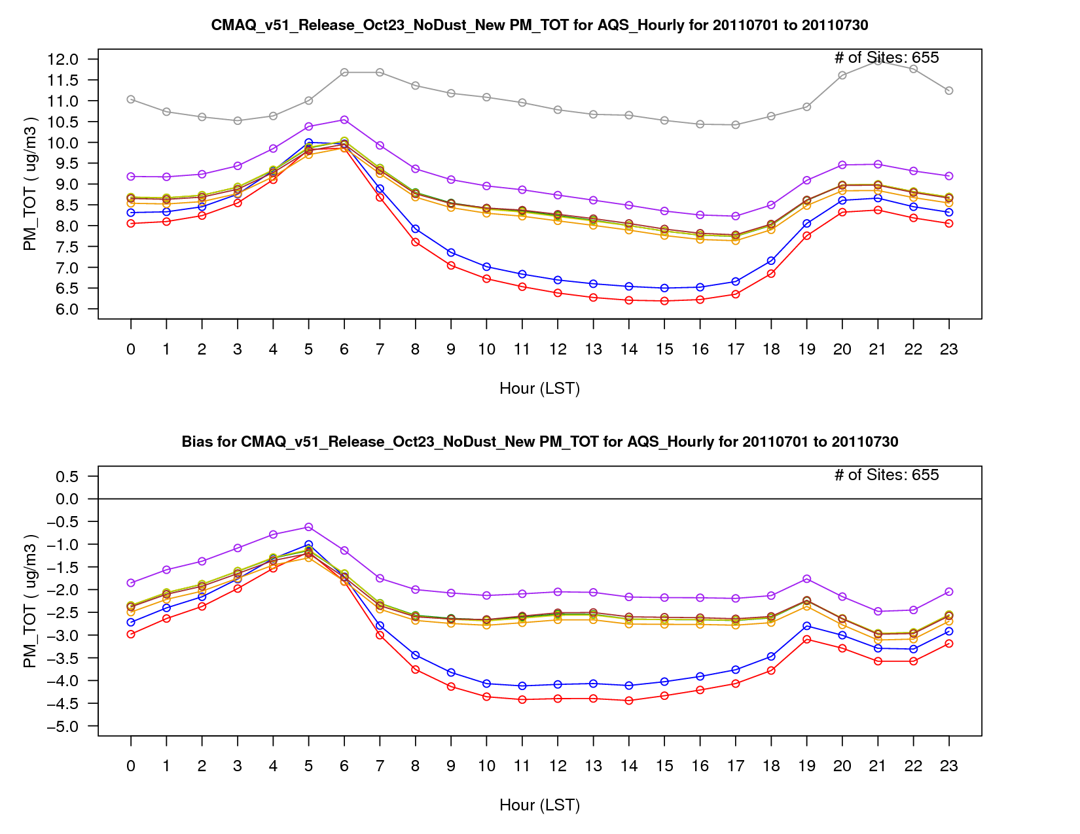
PM_{2.5} Concentration – July 2011
July 2011
Incremental Testing for PM_{2.5}
AQS Obs
v5.1 Base
v5.1 w/ WRF Updates v5.2 CB6r3
v5.2 CB05e51 Lightning NO Update
v5.2 CB05e51 (ek emis) Hemispheric CMAQ BCs
Switch to boundary conditions from Hemispheric CMAQ also decreases bias.
PM_{2.5} Bias

Slide 36
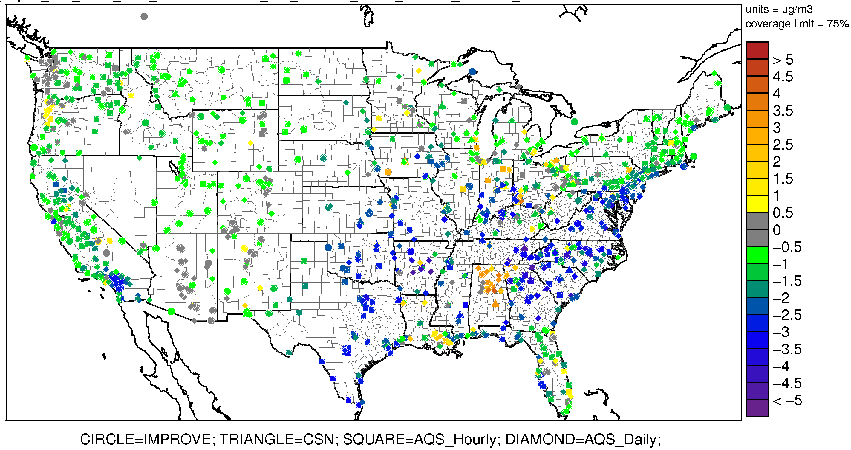
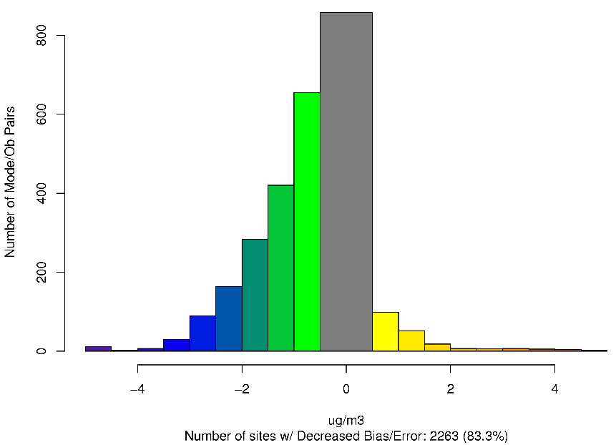
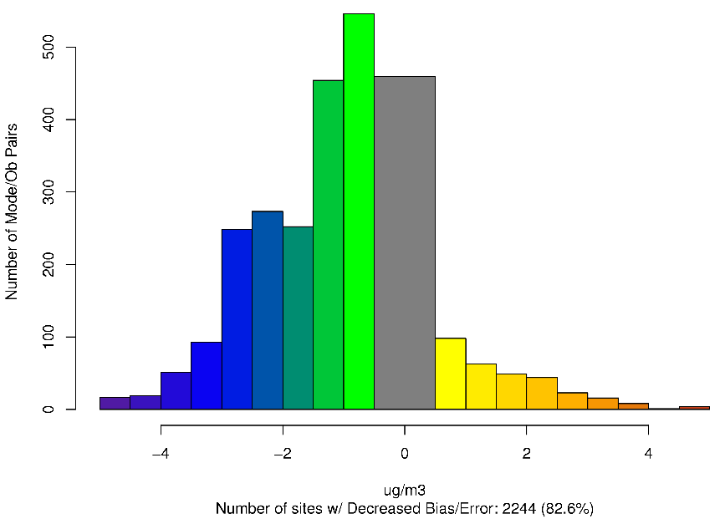
CMAQv5.2 (Hemi) – CMAQv5.1 – Difference in PM_{2.5} Absolute Bias July 2011
July 2011
Bias in modeled PM_{2.5} decreases at most locations from v5.1 to v5.2
Worse Bias
Improved Bias
Worse Error
Worse Bias
Improved Error
Improved Bias

Slide 37
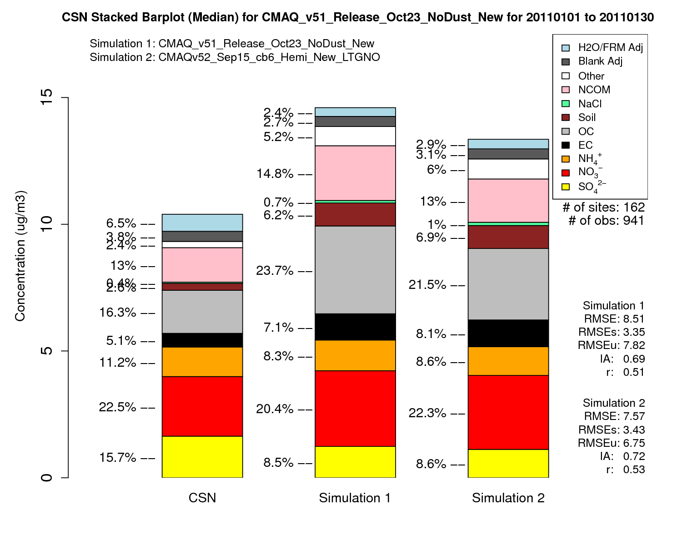
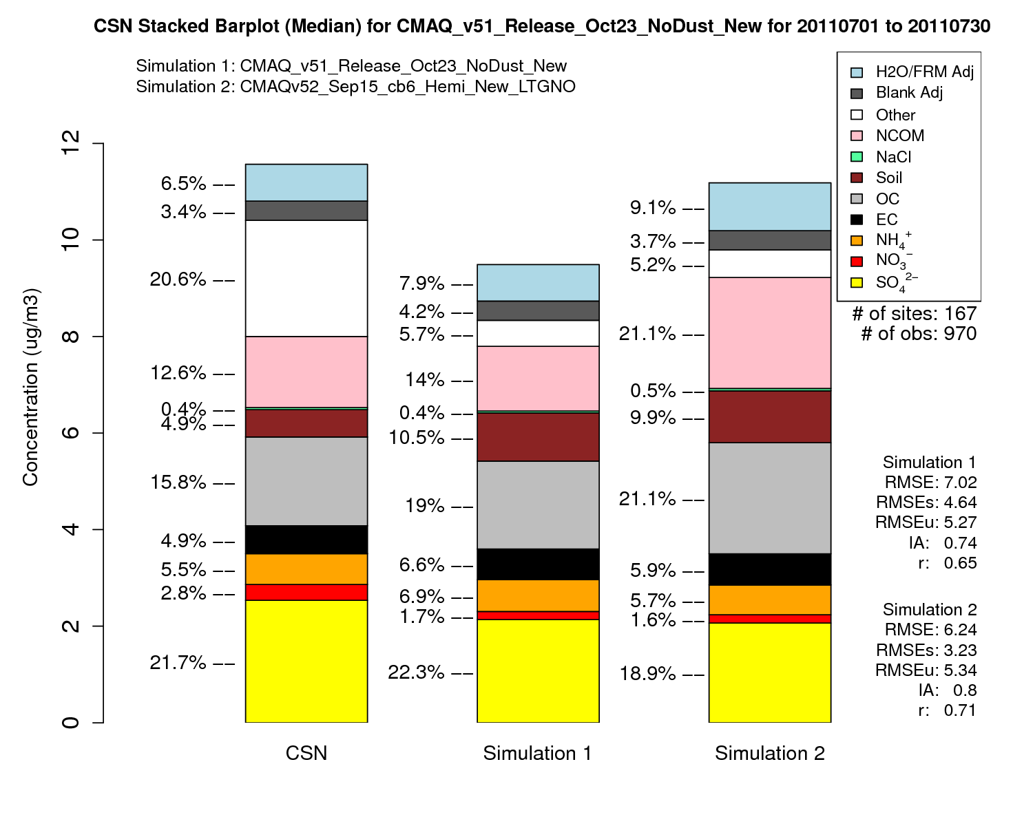
PM_{2.5} Speciated Stacked Bar Plot
January 2011
July 2011
CSN
CMAQv5.1
CMAQv5.2
CSN
CMAQv5.1
CMAQv5.2

Slide 38
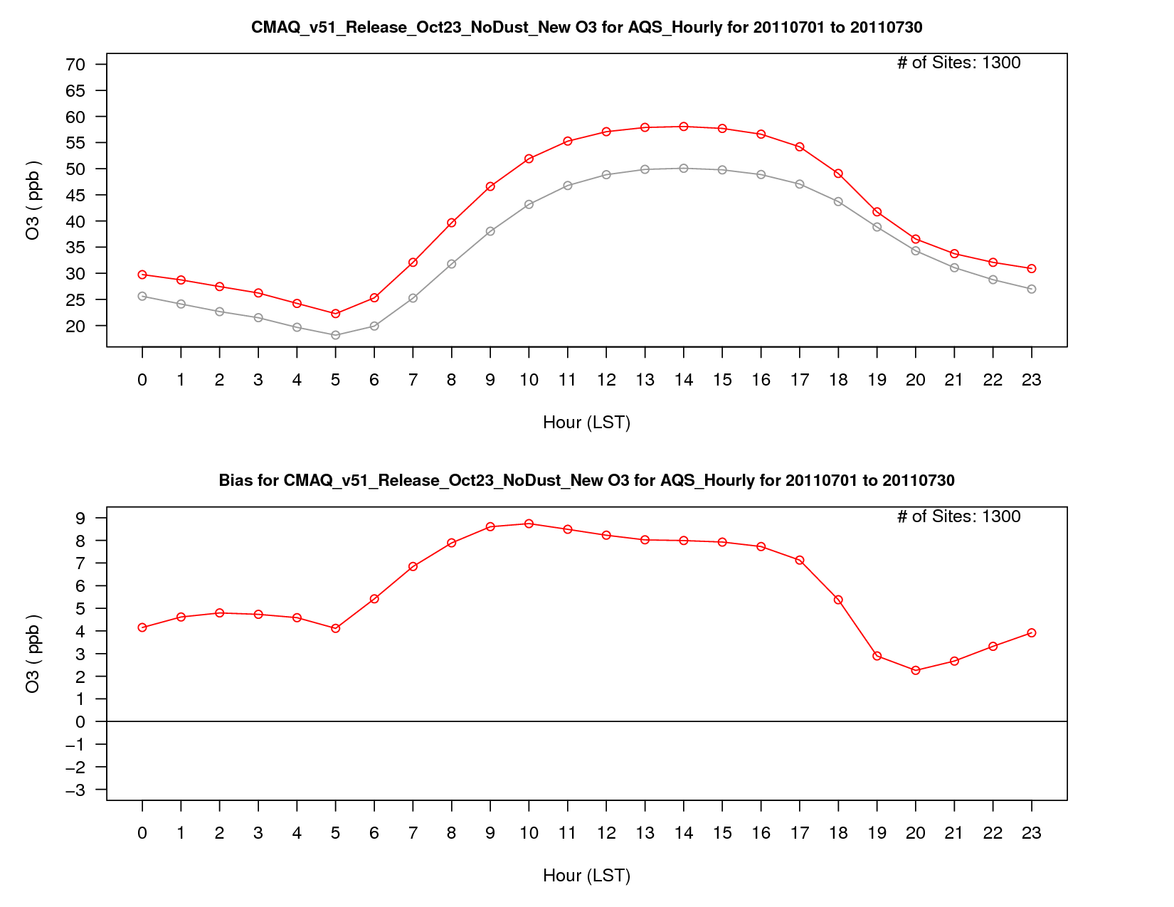
O₃ Mixing Ratio – July 2011
July 2011
Incremental Testing for O₃
AQS Observations
v5.1 Base
O₃ Bias

Slide 39
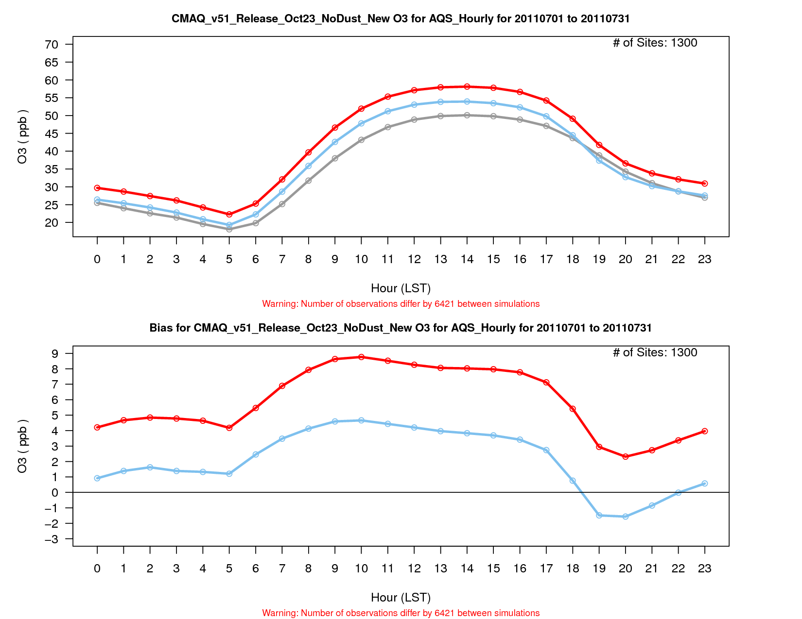
O₃ Mixing Ratio – July 2011
July 2011
Incremental Testing for O₃
AQS Observations
v5.1 Base
v5.2 Beta
Consistent decrease in O₃ bias across all hours in v5.2 compared to v5.1.
O₃ Bias

Slide 40
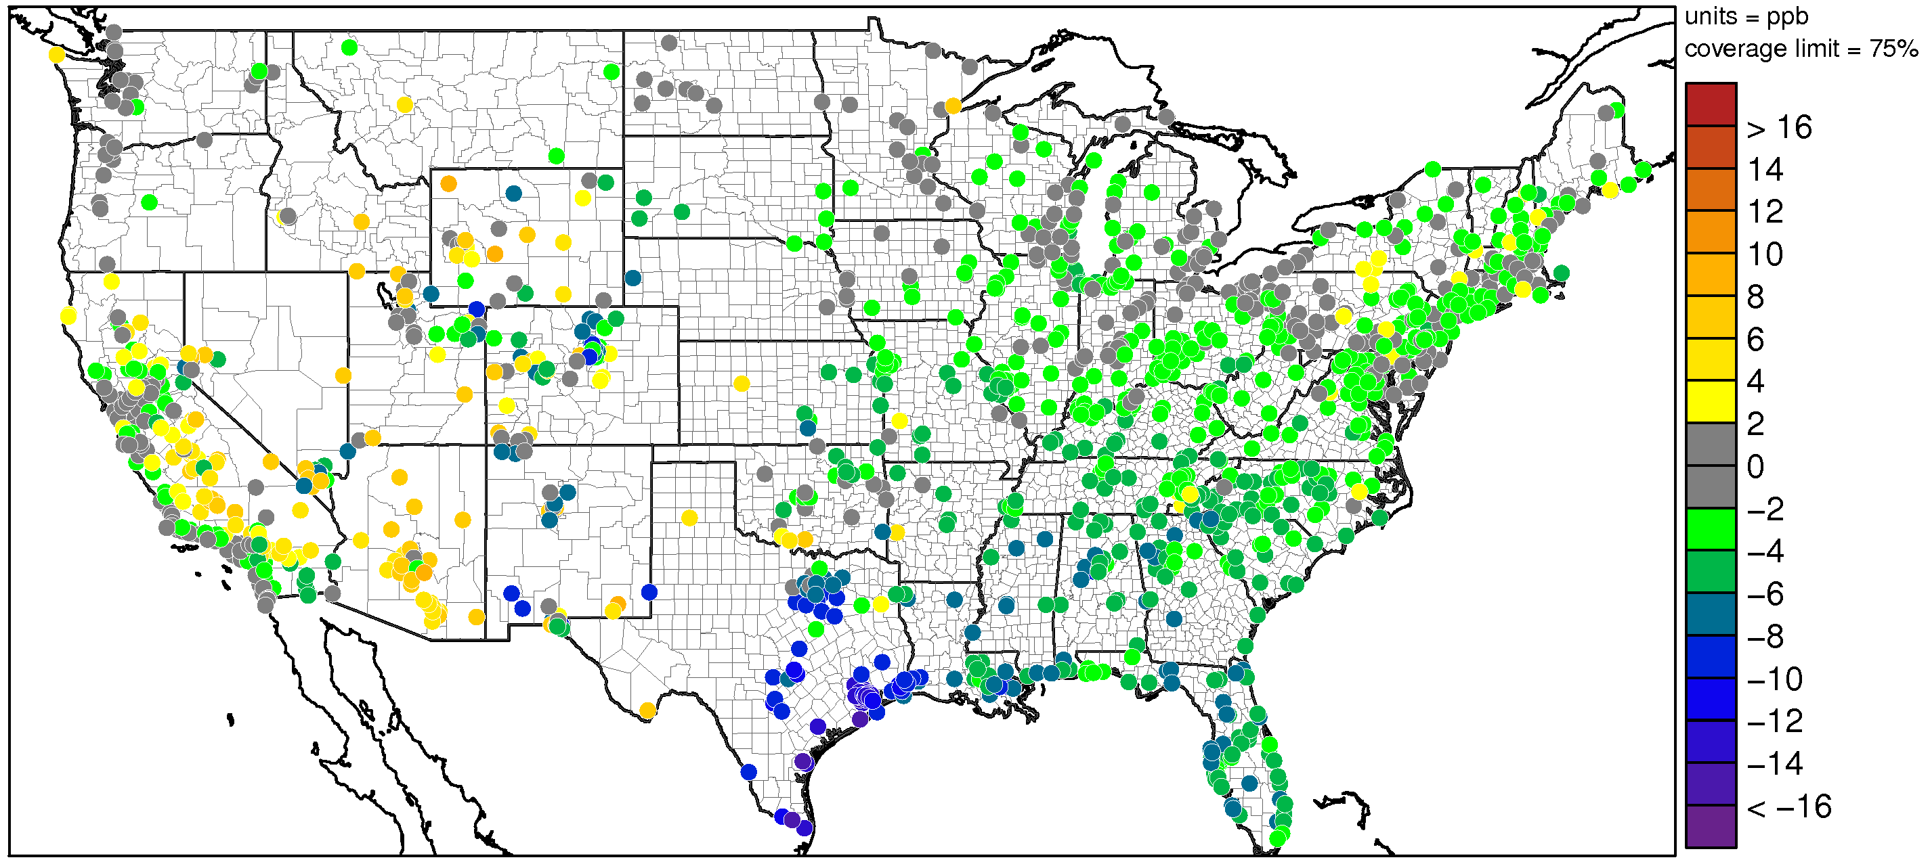
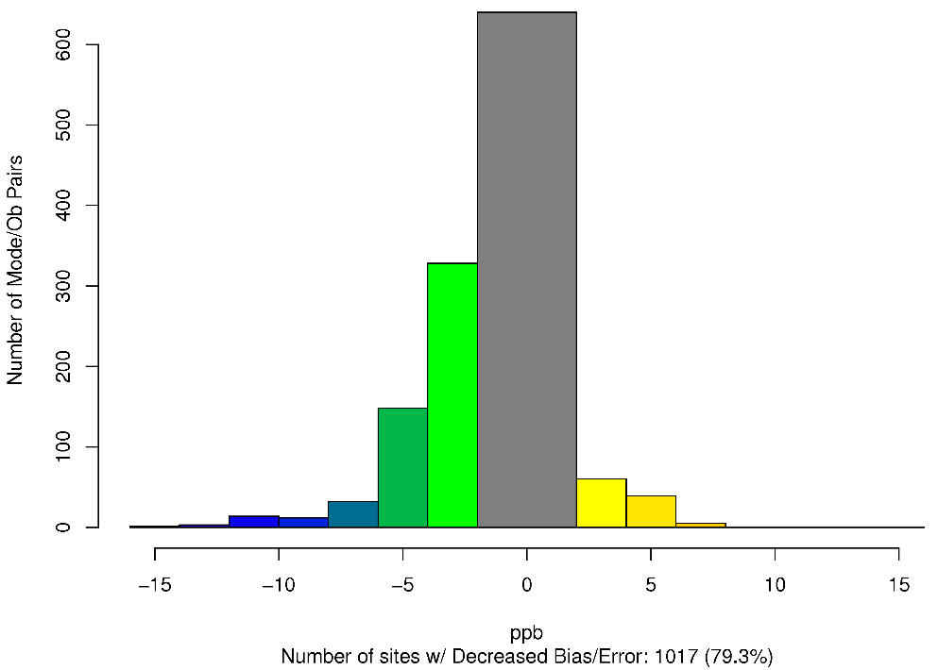
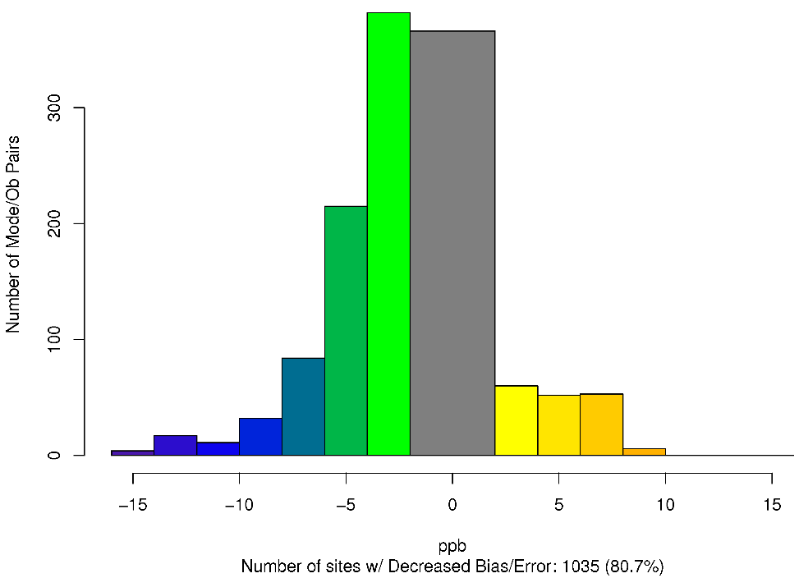
CMAQv5.2 (LTGNO) – CMAQv5.1 – Difference in MDA8 O₃ Absolute Bias July 2011
CMAQv5.2
July 2011
Bias in modeled O₃ decreases at most location from v5.1 to v5.2
Worse Bias
Improved Bias
Worse Error
Worse Bias
Improved Error
Improved Bias

Slide 41
CMAQ Evaluation Documentation and Tools
Model performance for v5.1 documented online:
  Appel et al. (2017). Overview and evaluation of the Community Multiscale Air Quality (CMAQ) model version 5.1. Geosci. Model Dev. Disc., 1-41.
The release of v5.2 in June will correspond to updates in several evaluation tools:
  New version of AMET (easier installation)
  Updates to programs and scripts for post-processing CMAQ output to prepare for evaluation
  New resources for users on CMAQ’s new website: www.epa.gov/cmaq
                (available June 2017)

Slide 42
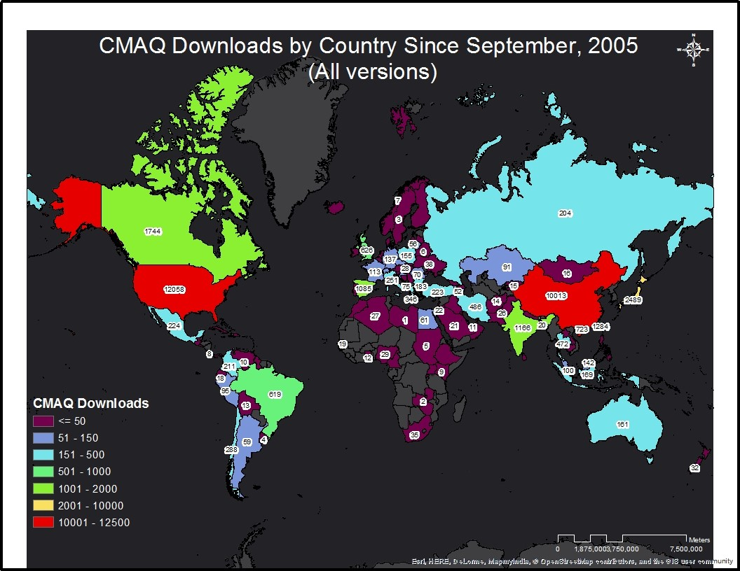
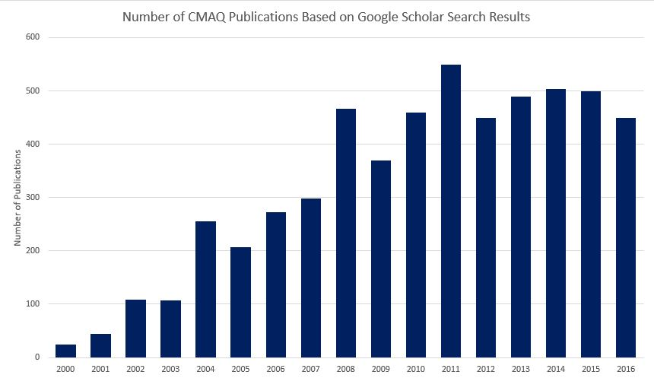
Outreach & Dissemination
Periodic scientific updates to the CMAQ model have led to the creation of :
Dynamic and diverse user community
More robust modeling system
Diverse applications supporting
  Regulatory analysis by EPA & States (State implementation plans and rulemaking, Clean Air Interstate Rule, Clean Air Mercury Rule, Renewable Fuels Standard Act-2)
  Air quality forecasting & public health advisories (NOAA, internationally)

Slide 43
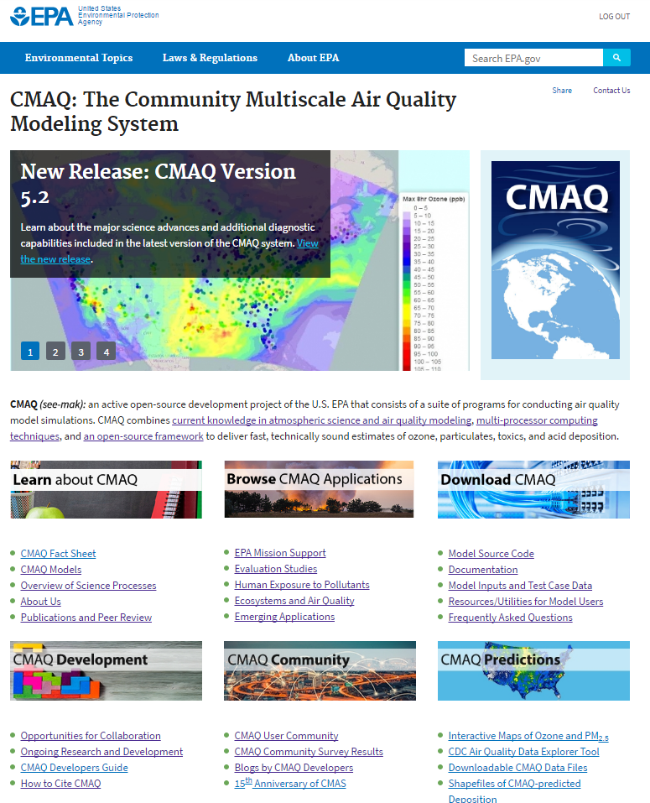

www.epa.gov/cmaq [June 2017]

Slide 44



www.epa.gov/cmaq [June 2017]

Slide 45

CMAQ git Repository Now Available on GitHub
A prerelease of CMAQv5.2 is now available via git repository at github.com/usepa/cmaq
  Previous CMAQ model versions are also available on dedicated branches
  CMAQv5.2 will be released officially June 2017
CMAQ development collaboration via GitHub is encouraged:
  Issue tracking will allow users to raise and document specific model issues that need to be addressed, although we encourage users to first reach out to m3user listserve for support.
  Pull Requests will be considered, reviewed and incorporated depending on the robustness, documentation and potential impact of the submission.

Slide 46
Vision for Next Generation Model
The Next Generation model will be a 1-D AQ component coupled to meteorology models
  Chemical tracers to be transported in meteorology model
  Can couple to multiple Meteorology models
Three configurations of flexible systems:
  On-line global variable grid (e.g. MPAS, OLAM)
  Online regional (WRF-AQ)
  Offline regional (WRF-AQ with offline chem transport)
One dimensional AQ component
  Gas, aerosol, aqueous in modular box
  Modules for biogenic emissions, dry dep/bidi, wind-blown dust, photolysis, etc
Transport in met models for online systems (adv, diffusion)
  Ensure mass conservation
  Consistency with met parameters
  Minimize numerical diffusion and dispersion
MPAS

Slide 47
Additional Information
Download CMAQv5.2Gamma: https://github.com/USEPA/CMAQ/tree/5.2Gamma

