Slide 1
CMAQv5.3: Enhanced Capabilities to Analyze Emissions Scenarios
The CMAQ Team
US EPA Office of Research and Development
CMAS Webinar
October 8, 2019
US EPA Office of Research and Development
Center for Environmental Measurement & Modeling

Slide 2
Outline for Today’s Webinar
Improvements to model process representation - Rohit Mathur
Taking advantage of CMAQ’s improved log file output - Ben Murphy
The Detailed Emissions Scaling, Isolation and Diagnostic (DESID) module - Ben Murphy
The Integrated Source Apportionment Method (ISAM) - Sergey Napelenok
The Sulfur Tracking Method (STM) - Sergey Napelenok
New documentation and modeling datasets - Kristen Foley
Additional information on the science updates in CMAQv5.3 may be found at www.epa.gov/cmaq

Slide 3
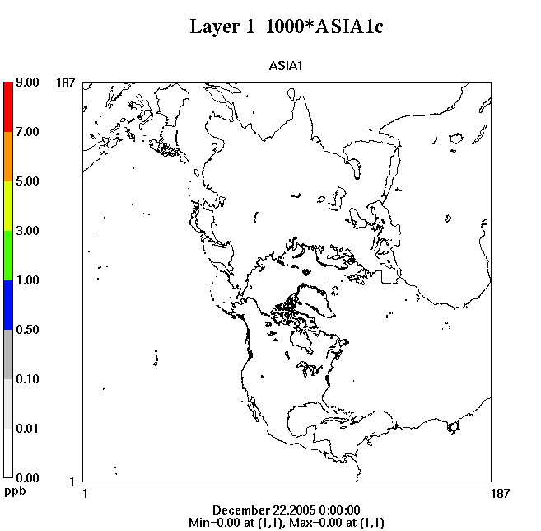
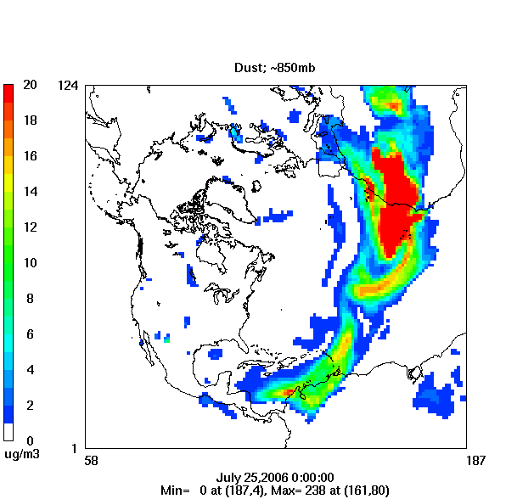
CMAQ Evolution Drivers: Air pollution must be examined in the context of changing global emissions
Simulated transport @ ~2km of an inert tracer emitted at the surface
Dust Transport: 850 mb
Increasing importance of long range transport (LRT) contributions as National Ambient Air Quality Standards (NAAQS) are updated
There is a need for accurate representation of key atmospheric processes across global to local scales

Slide 4
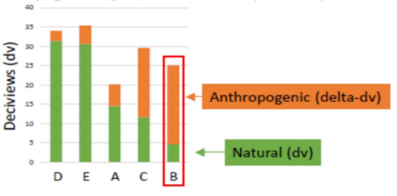
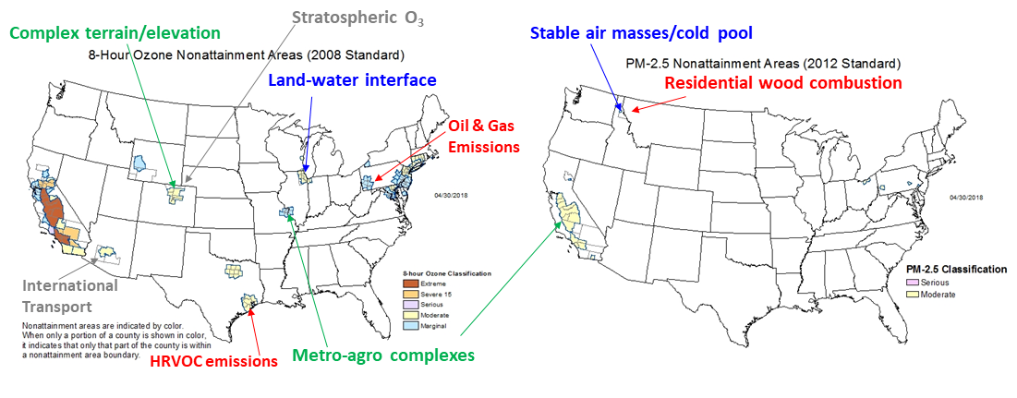
CMAQ Evolution Drivers
Local nonattainment present unique process challenges: emission sources, meteorological conditions, geographical features, non-controllable sources
Regional Haze
Nonattainment Classification: O₃
Nonattainment Classification: PM_{2.5}
Updated standards place greater/renewed emphasis on the ability of models to
Simulate the entire spectrum of concentrations
Accurately represent (smaller) contributions from numerous sources
Distinguish “Anthropogenic impairment” vs. natural contributions
Represent aerosol optical properties (composition & size)
Fine-scale air quality modeling capabilities developed for a particular nonattainment area may not necessarily be transferable to another area

Slide 5
CMAQv5.3: Available on GitHub
Science Application Goals
Improve capabilities for addressing local nonattainment issue
Added new features to the Weather Research and Forecasting (WRF) model to support better meteorological prediction
Updated the underlying chemistry mechanisms based on the latest science
Enable examination of US air pollution in context of changing
global emissions
Updated marine chemistry to better represent long-range Ozone transport
Quantifying natural contributions vs anthropogenic enhancements,
especially with lower NAAQS threshold
Better representation of secondary pollutant formation in Clouds
Updated model of secondary organic aerosol formation from
Biogenic VOCs
Harmonized the treatment of water uptake to aerosol organic
phase – applications to chemistry, mixing state, optics, etc.
Improve cross-media application capability
Incorporated latest science on deposition
Two deposition modules now available –
M3dry (consolidated) and STAGE (tiled)
User-Oriented Development Goals
Greater transparency
of emissions source options
and online scaling
Improved diagnostic tools for
probing and understanding model
results
Increased numerical efficiency with expanded
use of modern high performance computing
techniques
Improved user-oriented design features like better-
organized output logs with consistent and expanded meta-data
https://github.com/USEPA/CMAQ

Slide 6
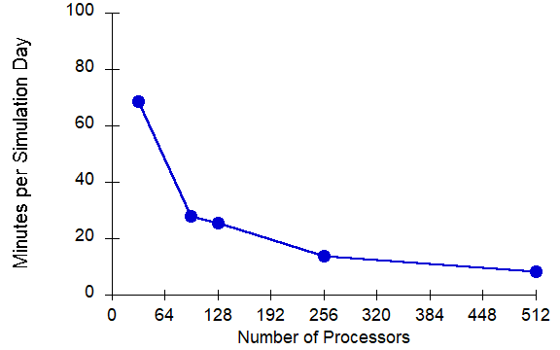
Improved Computational Performance
Conducted extensive profiling to identify bottlenecks and guide restructuring/rewrite
CMAQ scalability: CONUS Domain; ∆x = 12km
8.4 min/simulation-day
~ 2.2 days for an annual run

Slide 7
CMAQ Log Files Improved for Clarity and Transparency
Goals for improving CMAQ Logs include:
Readability! Reduced redundancy and stepped towards consistent formatting.
User-options. Report values so that
a complete list of options is readily accessible and
selections are transparent
Enable tracking of configuration options with model output (via “Execution ID”).
Report timing information for full model and sub-processes at the time step level → help users/developers diagnose potential runtime bottlenecks.
Revise a number of error messages to improve clarity of descriptions and recommendations.

Slide 8
CMAQ Log Files Improved for Clarity and Transparency
Screen Output – high level information common to all processors. Contains “content you’ll want to know when things are going well”:
model configuration options
domain decomposition record
timing of individual model processes
Processor Logs – numbered from [0] to [Nproc – 1]. Contains “content you’ll want to know when things may be going wrong”
deeper information relevant for each model process
I/O-API output
Emissions control diagnostic output
NaN detects from each sub-process.

Slide 9
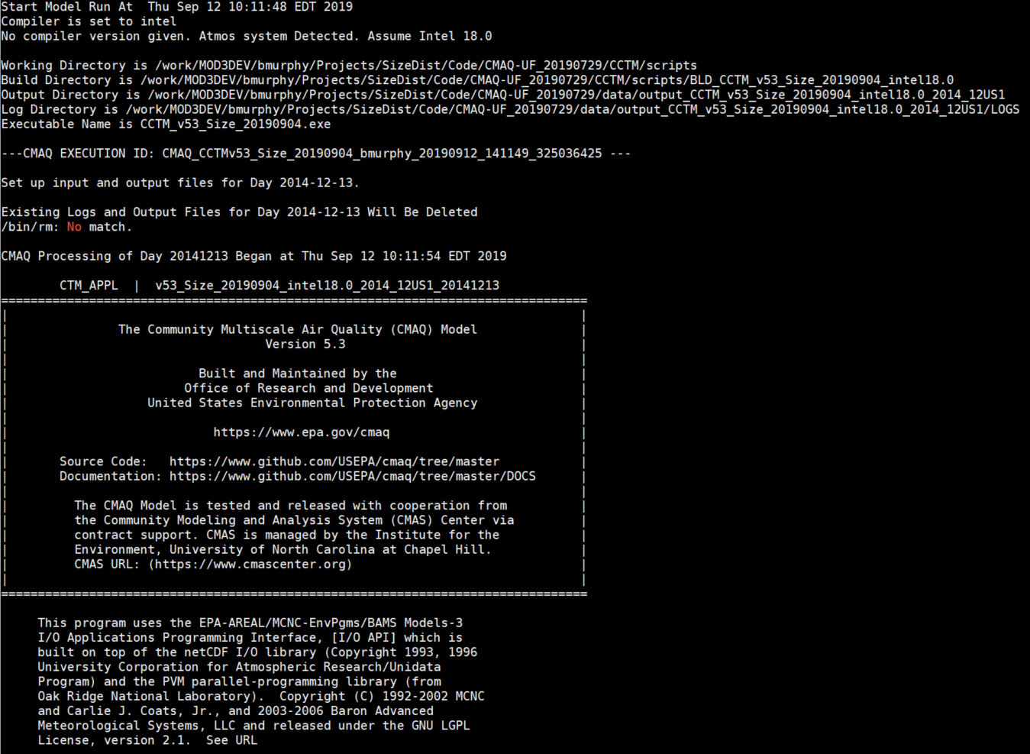
CMAQ Log Files: Screen Output
File Paths
Execution ID
Headers
User Options
Domain Config
Process Timing
Scenario Timing

Slide 10
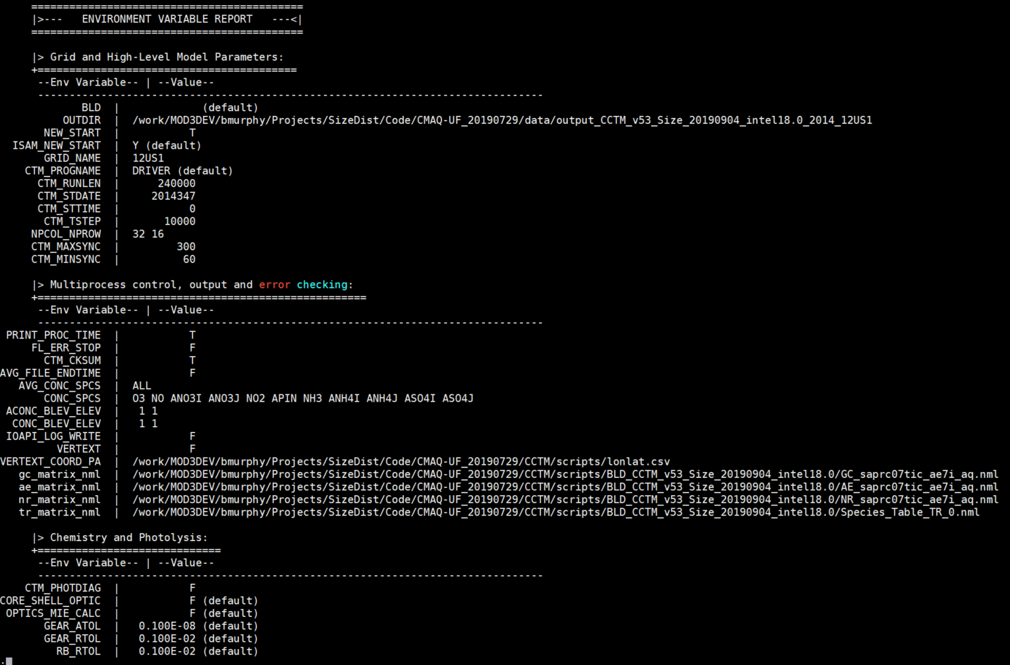
CMAQ Log Files: Screen Output
File Paths
Execution ID
Headers
User Options
Domain Config
Process Timing
Scenario Timing

Slide 11
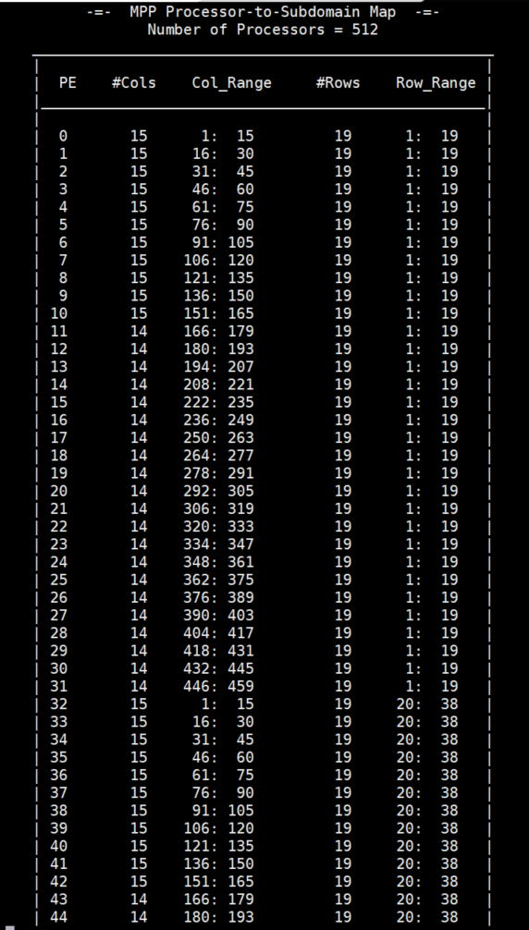
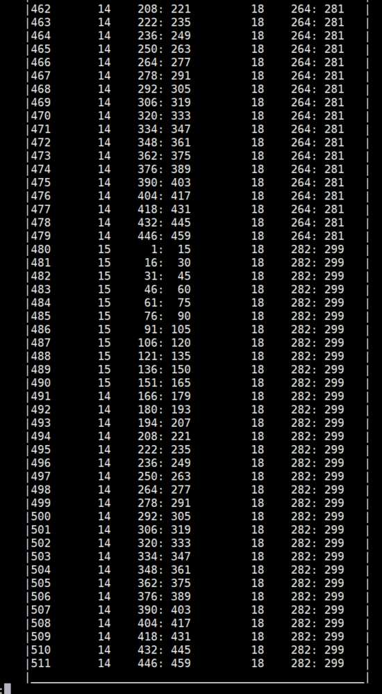
CMAQ Log Files: Screen Output
File Paths
Execution ID
Headers
User Options
Domain Config
Process Timing
Scenario Timing

Slide 12
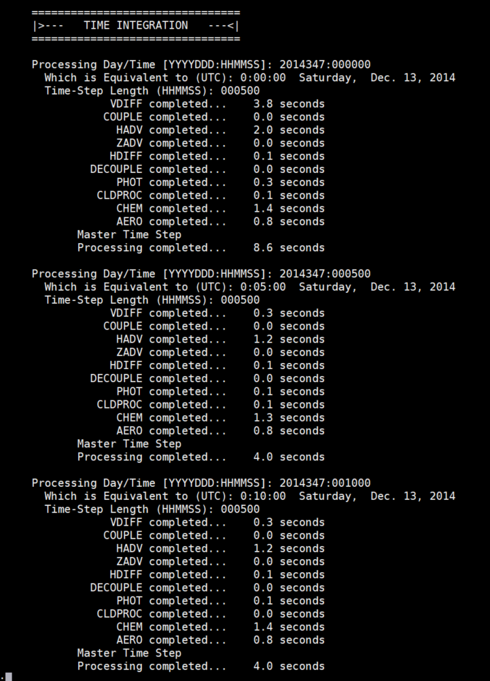
CMAQ Log Files: Screen Output
File Paths
Execution ID
Headers
User Options
Domain Config
Process Timing
Scenario Timing

Slide 13
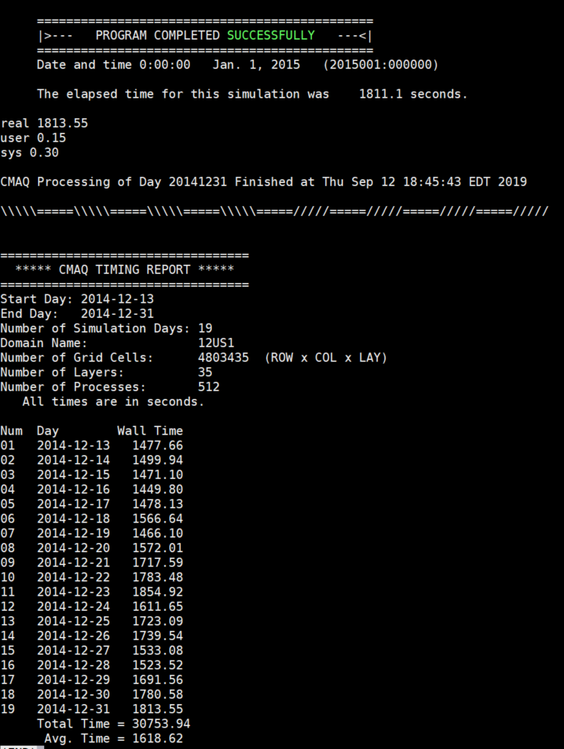
CMAQ Log Files: Screen Output
File Paths
Execution ID
Headers
User Options
Domain Config
Process Timing
Scenario Timing

Slide 14
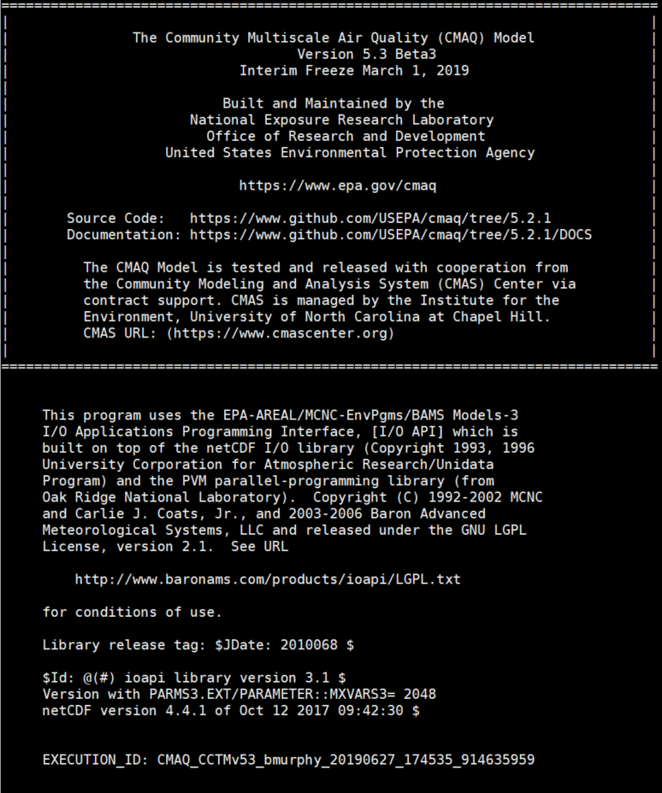
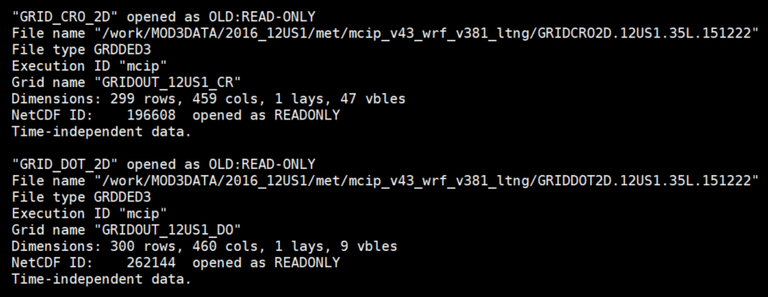
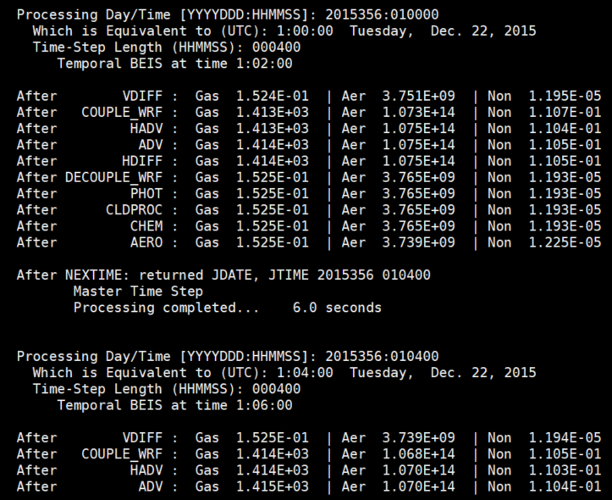
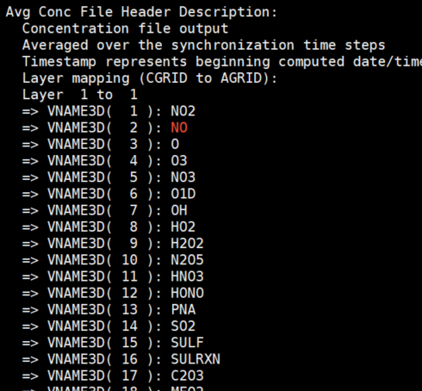
CMAQ Log Files: Processor Logs
Headers
File Input/Output
Mapping
Warnings
Emissions Diagnostic
Information (discussed next)
NaN-checks

Slide 15
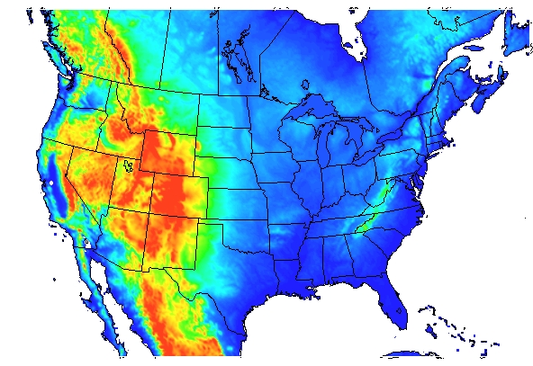
DESID: Detailed Emission Scaling, Isolation, and Diagnostic Module
BlueSky Wildfire Emissions
National Emission Inventory
MOVES
(Mobile Emissions Processor)
Many tasks can now be completed with one line of instruction:
How do I scale only emissions for one chemical species from one emissions source by a constant factor like 25% or 50%?
How do I scale all surrogates from a given emission source?
How can I introduce emissions of some new pollutant using emissions of something I have related it to, like CO or total VOCs?
How do I scale an emissions source computed inside CMAQ like wind-blown dust, biogenic VOCs, etc
How do I scale emissions from a particular source only over a specific region of the domain, like over one county, state or a group of states?
We are learning more about the size of particles when they are emitted – how can I experiment with this parameter for different sources?
And more…
SMOKE
(Emissions Processing Software)
Agriculture
Offroad Vehicles
Construction
Wildfires
Consumer Products
Passenger Vehicles
Onroad Shipping
EGUs
Resid. Fuel
Trains
CMAQ
NonEGU Point Sources
Wind-Blown Dust
Biogenic VOCs
Output Concentrations
Lightning NO
Sea Spray Aero
Marine Gas
14
Diagnostic Files and Logs

Slide 16
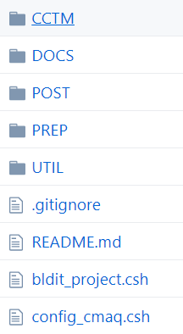
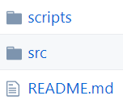
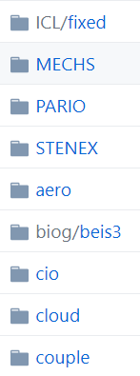
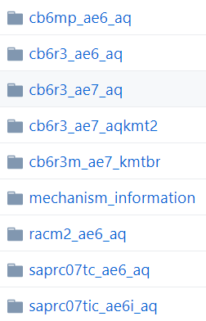
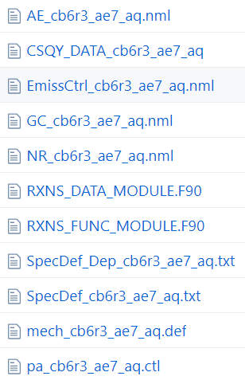
Where is DESID’s interface?
All commands are issued through the “Emission Control File”, which is provided for every chemical mechanism.

Slide 17
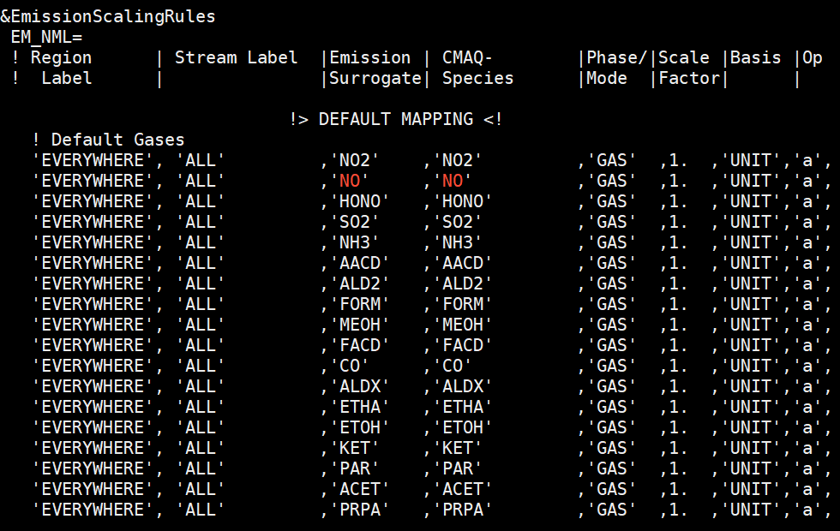
What is the structure of a basic DESID rule?
Example of default Emission Control File for CB6r3 mechanism
Note: without any default entries, there will be no emissions used in CMAQ

Slide 18
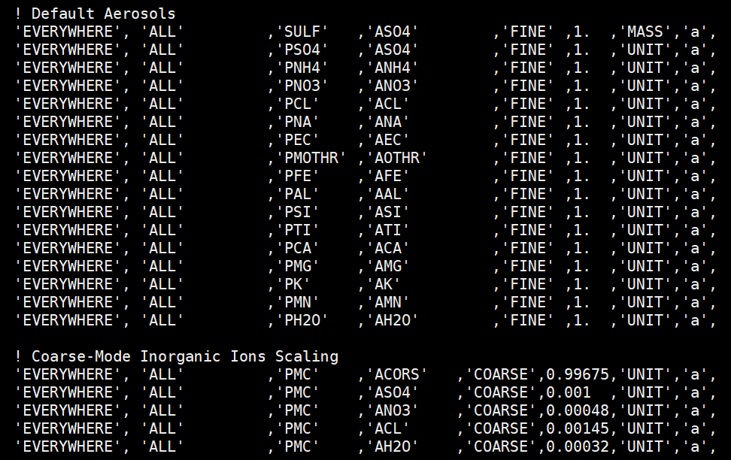
What is the structure of a basic DESID rule?
Example of default Emission Control File for CB6r3 mechanism
Note: without any default entries, there will be no emissions used in CMAQ

Slide 19
What is the structure of a basic DESID rule?
Add or multiply emissions across all streams and locations
Examples:
50% NOx cut for all emissions
Multiply all NH3 emissions by a factor of 2
Scale all aerosol emissions to 90%

Slide 20
Specifying and Using Stream Labels in DESID
Modifying or introducing emissions for a single stream
Examples:
50% NOx cut for a stream
90% cut in all emissions from a single stream
New tracer variable from a specific stream

Slide 21
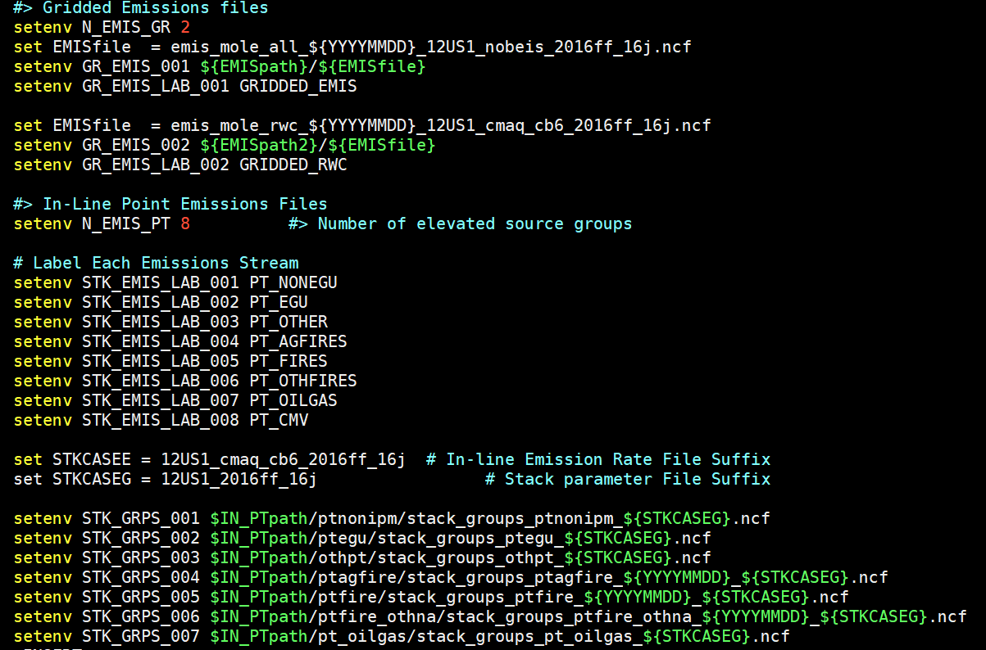
Specifying and Using Stream Labels in DESID
Modifying or introducing emissions for a single stream

Slide 22
Specifying and Using Region Labels in DESID
Modifying or introducing emissions for a specific region
Emissions Control File
CMAQ Run Script
Examples:
50% NOx cut for all streams in a region
16% cut in all emissions from a single stream in a single region

Slide 23
Specifying and Using Region Labels in DESID
Modifying or introducing emissions for a specific region
Emissions Control File
CMAQ Run Script
Examples:
20% cut in US, 30% in IL, then 10% in Chicago

Slide 24
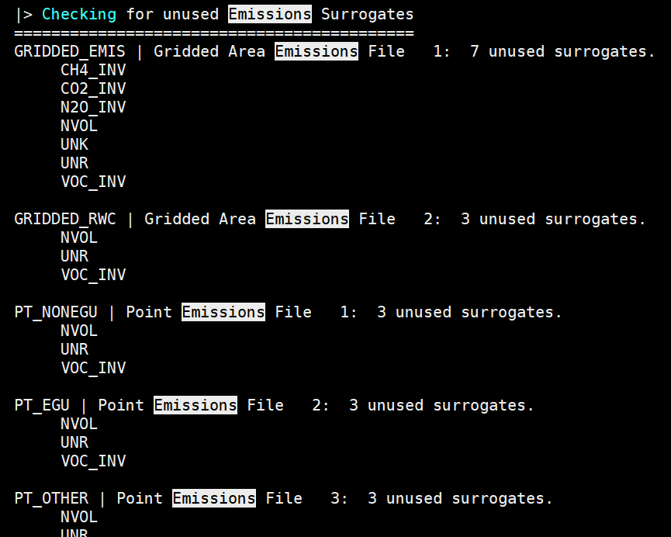
Diagnostic Capabilities for DESID
Processor Logfiles give useful multi-level information on how emissions were mapped:

Slide 25
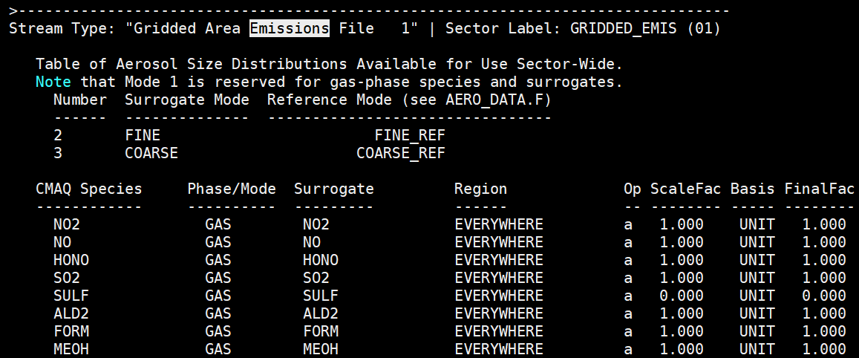
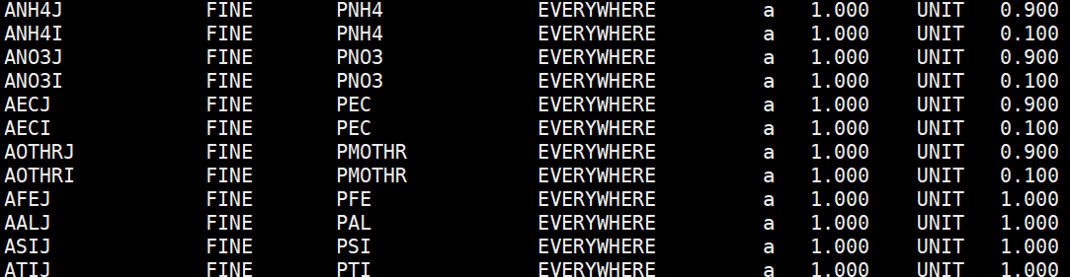
Diagnostic Capabilities for DESID
Processor Logfiles give useful multi-level information on how emissions were mapped:

Slide 26
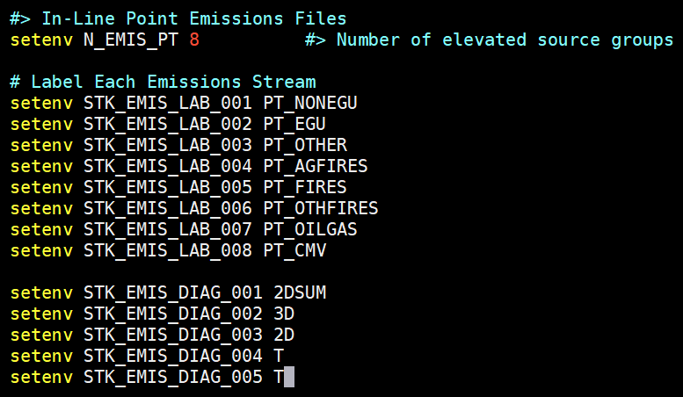
Diagnostic Capabilities for DESID
Run Script example of turning diagnostics on and off. These options create gridded output files that report the emissions CMAQ used on a per-source basis.
Stream by Stream →
Set Default Behavior

Slide 27
Summary and Future Plans for DESID
The Detailed Emission Scaling, Isolation, and Diagnostic Module:
Allows multiple gridded, point, and online sources to be input to one model run.
Provides one framework for perturbing emissions from a user-defined (i.e. limitless) number of emissions.
Standardizes the approach to emissions processing inside CMAQ, making it easier for external and internal developers to make informed modifications.
Features coming soon:
Add support for defining ‘families’ of species, streams, and regions to reduce the burden of listing out a large number of rules for a defined, but broad task (i.e. scaling 20 VOCs from 3 streams).
Add one optional gridded emission diagnostic output that represents all emissions summed together and input to the CMAQ field.

Slide 28
Integrated Source Apportionment Method CMAQ-ISAM
CMAQ-ISAM provides source tracking information simultaneously with the concentrations/depositions outputs.
CMAQ-ISAM has been released previously in parallel to the base CMAQ release since version 5.0.2.
For the current version (5.3), the source apportionment model is built into the base CMAQ.
The current release ISAM implementation also addresses the main issue of the previous releases – slow run times.
New ISAM gas chemistry module, new ISAM cloud treatment, new ISAM aerosol wrapper

Slide 29
Current ISAM Capability
CMAQ-ISAM is based around tracking species classes from user-specified sources.
Currently available Tag Classes are:
SULFATE: ASO4I/J, SO2, SULF
NITRATE: ANO3I/J, HNO3, HNO3, NO, NO2, NO3, HONO, N2O5, other mechanism-dependent species
AMMONIUM: ANH4I/J, NH3
EC: AECI/J
OC: APOCI, APOCJ, APNCOMI/J
VOC: mechanism-dependent species participating in ozone chemistry
PM25_IONS*: ACLI/J, ANAI/J, AMGJ, AKJ, ACAJ, AFEJ, AALJ, ASIJ, ATIJ, AMNJ, AOTHRI/J
CO
OZONE*: O3, all NITRATE species + all VOC species
The goal is complete, mechanism-specific species coverage
*Expect a patch in the near future to improve the PM25_IONS and the OZONE Tag Classes

Slide 30
Current ISAM Capability (2)
Each CMAQ-ISAM simulation can track any number and any combination of Tag Classes.
The user must also specify which Emissions Streams and geographical regions (if any) are of interest .
Every simulation will also automatically track initial conditions (ICON) and boundary conditions (BCON) for the Tag Class species.
Emissions Streams that are not specified by the user for tracking will be aggregated and tracked as OTHR.
It is possible to track any combination of Emissions Streams including the ones calculated inline (BIOG, LTNG, SEASPRAY, WBDUST).
Finally, it is possible to track the impact of stratospheric ozone through the potential vorticity calculations (PVO3).

Slide 31
Building CMAQ-ISAM
Step 1 – Follow the directions to download the CMAQ model.
Step 2 – When you are ready to build the executable, edit the bldit_cctm.csh script to enable the ISAM:
Step 3 – Follow the rest of the procedure as normal to build the CMAQ model.

Slide 32
Running CMAQ-ISAM – Planning
Once the model is built, it’s a good idea to setup up the run script and simulate a couple of days without the ISAM option to debug any issues with scripts or input data.
Decide which Tag Classes, Emissions Streams, and geographical regions to track.
Warning! This model generates a lot of output data, so careful consideration of what exactly you want to track and why is strongly advised.

Slide 33
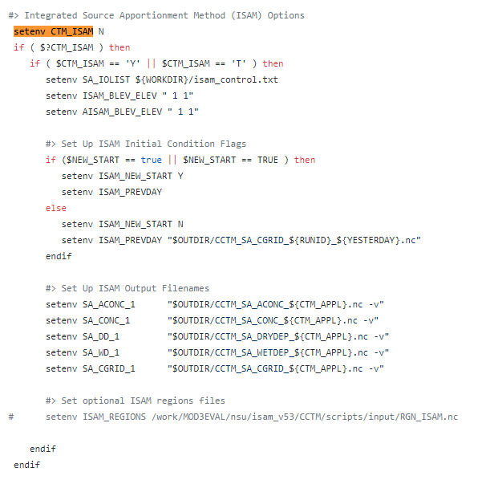
Running CMAQ-ISAM – Run Script
Set the CTM_ISAM flag to Y
Specify the location of the isam_control.txt file.
Select the layers for output.
Select the restart option (analogous to base CMAQ).
Optionally, specify the location of the regions file to enable regional emissions apportionment.

Slide 34
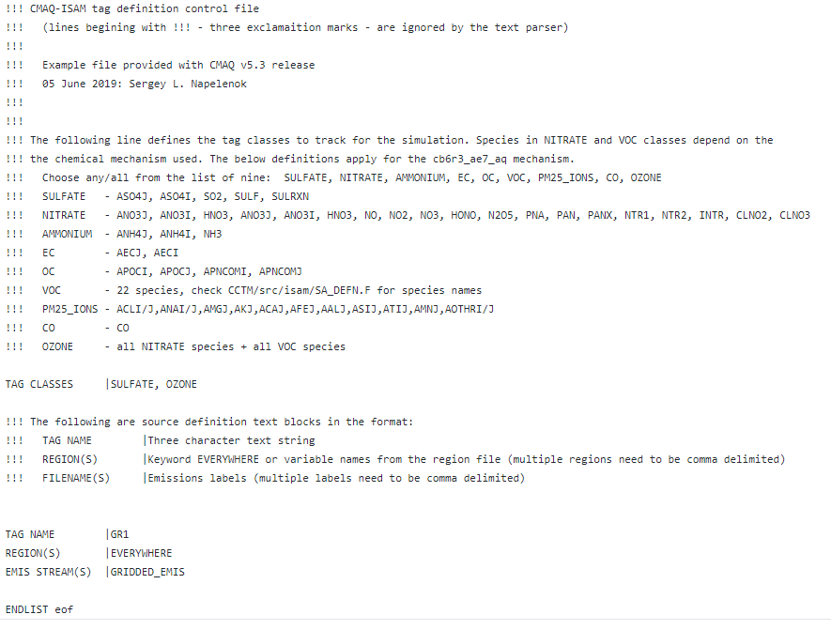
Running CMAQ-ISAM – Control File
Select the Tag Classes based on which species you want to see in the output.
Create a 3-line entry for each source (or combination of sources)
L1: Character String Tag Name
L2: REGION(S) of interest or the keyword EVERYWHERE
L2: List of Emissions Stream Labels.

Slide 35
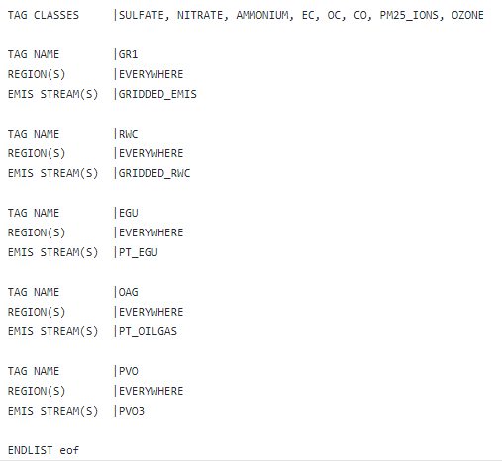
CMAQ-ISAM Run Times
Possibly a typical simulation:
All the Tag Classes
4 Emissions Streams
1 Potential Vorticity Source
3 other sources (ICON, BCON, OTHR)
Run time example:
30 days in July 2016 over continental US (12km horizontal resolution, 36 vertical layers)
256 processors on the EPA supercomputer
Total Simulation Time (hours)

Slide 36
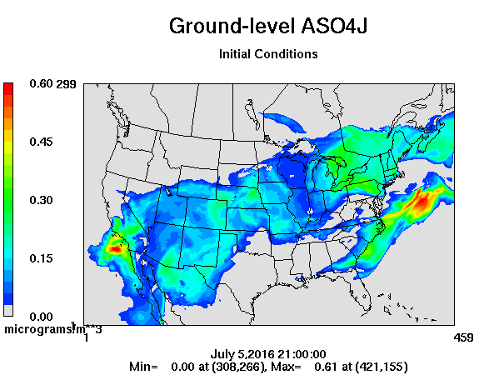
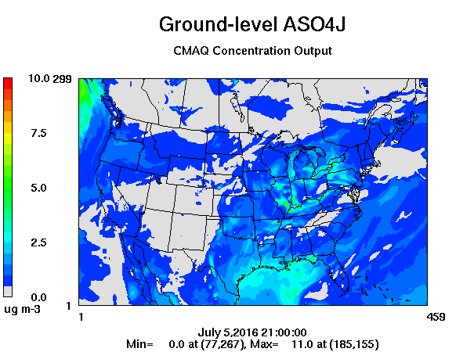
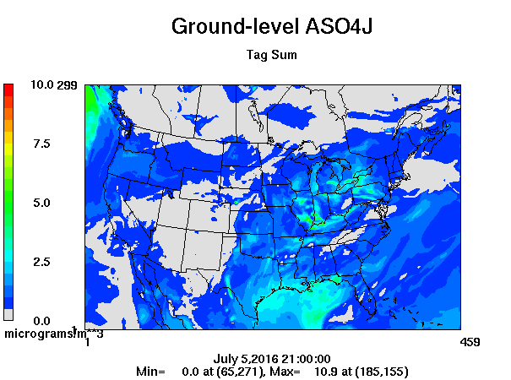
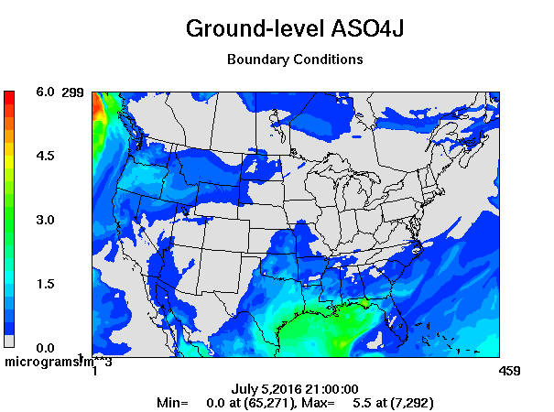
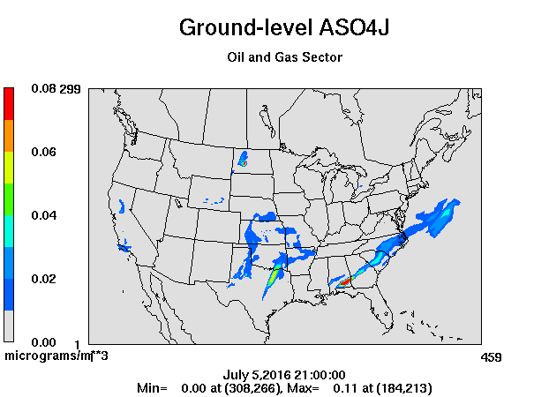
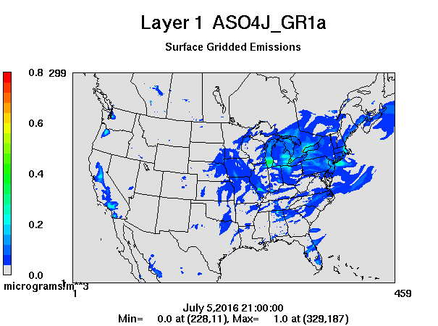
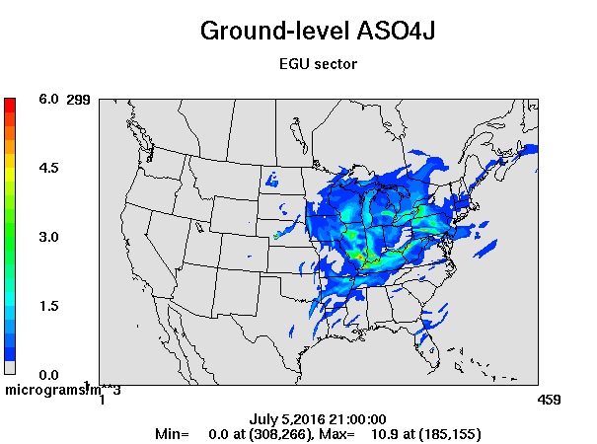
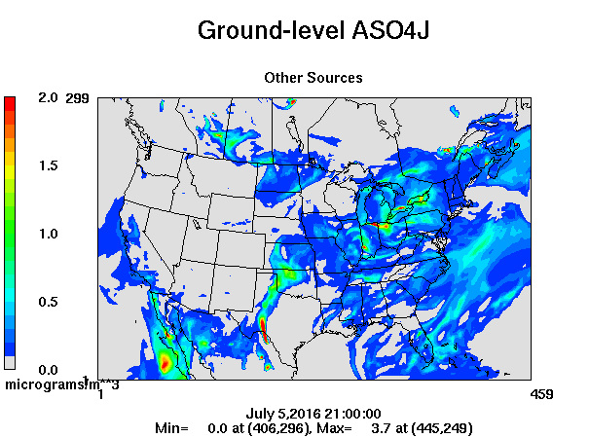
Sample CMAQ-ISAM Result Sulfate Production
~

Slide 37
CMAQ-ISAM Current Development
Patches in the near future.
Correct errors in tracking particulate chlorine (ACLI/ACLJ).
Ozone apportionment methodology will be expanded to include more intermediate radical species to better attribute production to sources.
Longer term improvements.
Expand PM apportionment to secondary organics
Ultimately obtain full (mechanism-specific) species coverage.

Slide 38
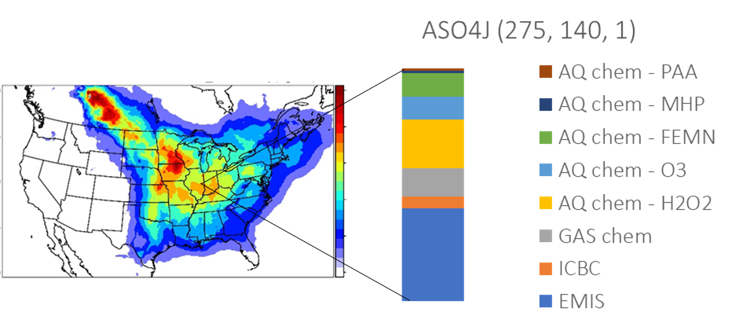
CMAQ Sulfur Tracking Method (STM) How is STM different from ISAM and when might it be useful?
STM is a diagnostic option for tracking sulfate production from individual gas- and aqueous-phase chemical reactions, as well as emissions and initial/boundary conditions.
STM can be used to better understand controlling mechanisms behind sulfate concentrations by providing detailed process-level information on modeled sulfur budgets.
Updates in STMv5.3:
Now a runtime option.
Includes 9 additional species to track the loss of inorganic sulfate to organosulfate for chemical mechanisms that include this loss pathway.

Slide 39
CMAQ Documentation: Finding what you need
CMAQ documentation is included throughout the repository as Markdown (.md) files
CMAQv5.3 documentation has a new organization and new content compared to past versions
Goal of new organization:
Intuitive for users
Easier for model developers to keep up-to-date

Slide 40
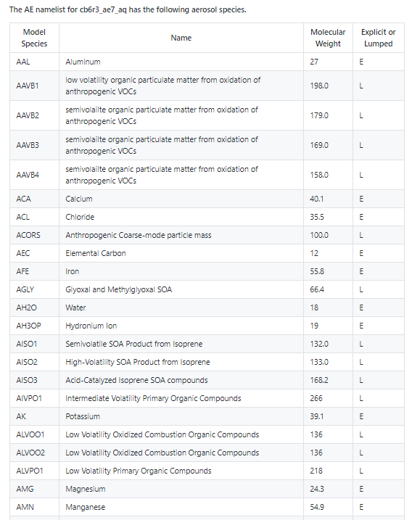
CMAQ Documentation: Chemical Mechanisms
CCTM/src/MECHS/README.md
Documentation on Chemical Mechanisms
Mechanism name, e.g. cb6r3_ae7_aq
Model species tables for gas phase and aerosol species
Species available with the STM
Reactions and rate constants for photochemistry
How to modify a mechanism’s photochemistry
How to use species namelist files

Slide 41
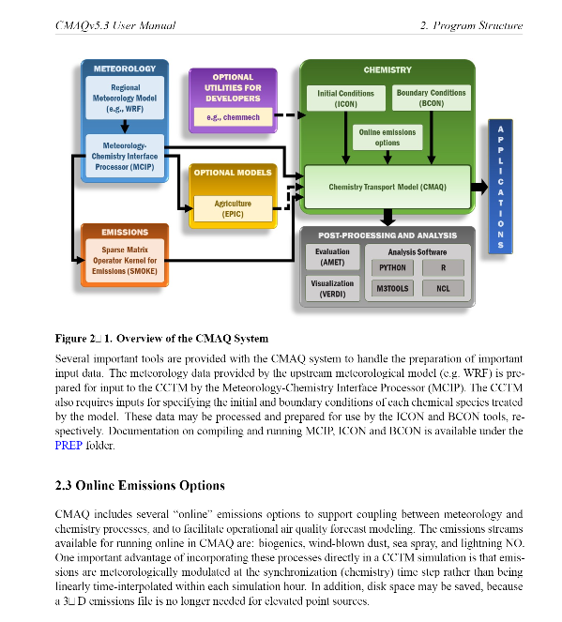
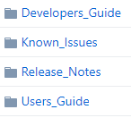
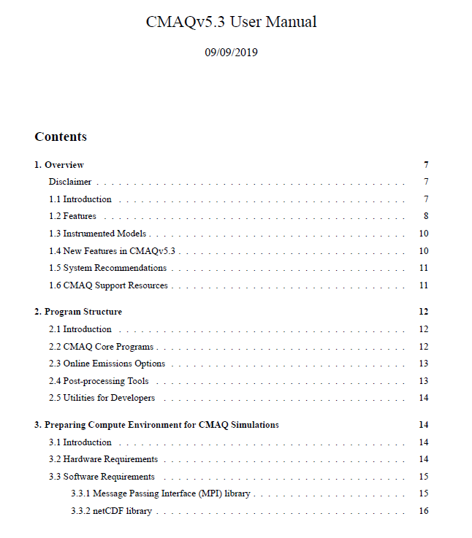
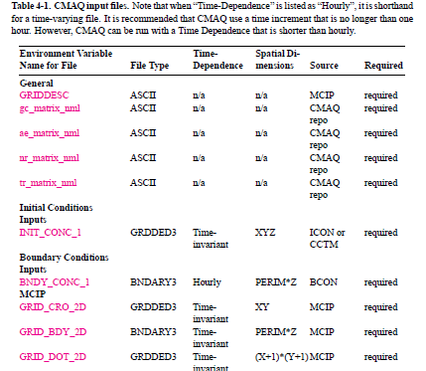
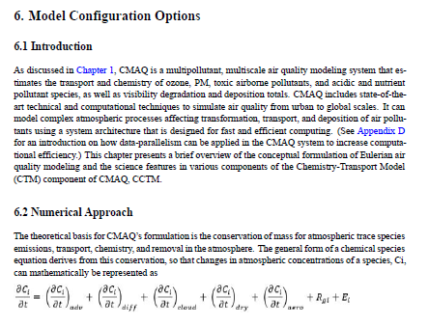
CMAQ Documentation: User’s Guide

Slide 42
CMAQ Documentation: User’s Guide
DOCS/Users_Guide/README.md
CMAQv5.3 User’s Guide
Streamlined with a focus on specific steps needed to run CCTM (software/hardware needs, required vs optional inputs, install/compile/run instructions, output data, analysis tools)
New content:
Model configuration options for different science modules
Chapters on CMAQ Instrumented Models: Process Analysis, HDDM-3D, ISAM, STM
New tutorials and appendices
Documentation for support utilities moved to POST, PREP, UTIL folders.

Slide 43
CMAQ Documentation: UTIL/PREP/POST
UTIL/PREP/POST
UTIL: optional utilities for model developers and advanced users, e.g. chemmech
PREP: programs to prepare meteorology (MCIP), initial conditions (ICON) and boundary conditions (BCON) inputs
POST: set of programs to prepare model output for evaluation against observations

Slide 44
CMAQ Documentation: UTIL/PREP/POST
Documentation on UTIL/PREP/POST
CMAQv5.3 User’s Guide provides information on how these programs fit in the overall CMAQ system
README.md files provide background information and instructions on compiling/running each program
User’s Guide Chapters 2, 4, 8
POST/README.md
PREP/README.md
UTIL/README.md

Slide 45
CMAQ Documentation: Finding what you need
Documentation is viewed as a ‘living document’. Feedback is welcome!
Please share feedback via email or through the CMAS User Forum:
https://forum.cmascenter.org

Slide 46
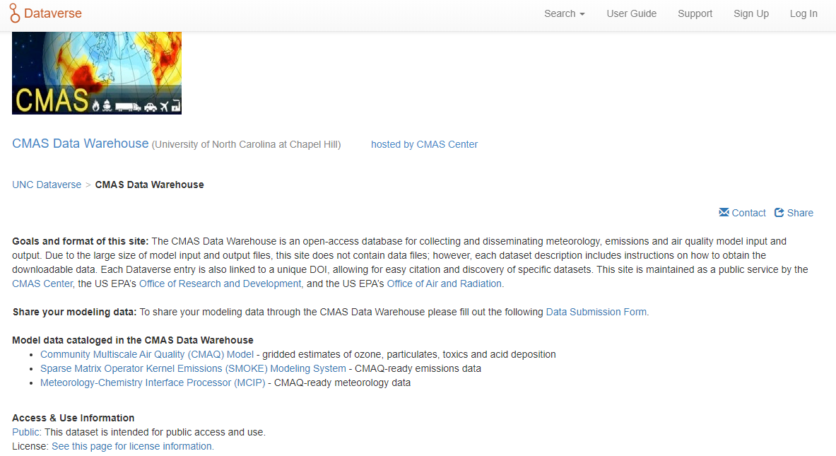
CMAS Data Warehouse
New CMAQ input and output datasets available to download!
Hosted on CMAS Google Drive
Download instructions, metadata and DOIs for each dataset available on Dataverse

Slide 47
Input/Output Available on CMAS Data Warehouse
Hourly and daily outputs for a subset of pollutants for 12km CONUS:
CMAQv5.0.2: 2002-2012
CMAQv5.1: 2013
CMAQv5.2: 2014
Complete set of model inputs for 2016 benchmark cases including:
July 1-14 2016 Southeast benchmark domain for testing installation
Annual(!) 2016 CONUS simulation used to evaluate v5.3
Seasonally averaged Hemispheric CMAQ output data
2016 HCMAQ CMAQv5.3beta CB6R3m_AE7_KMTBR
See CMAQ tutorial on how to use this file for creating initial and boundary conditions:
https://www.epa.gov/cmaq/cmaq-documentation#tutorials

Slide 48
Additional Resources
CMAQ website: www.epa.gov/cmaq
CMAQ GitHub repository: https://github.com/USEPA/CMAQ
CMAS Data Warehouse: https://dataverse.unc.edu/dataverse/cmascenter
CMAS User Forum: https://forum.cmascenter.org

Slide 49
Contact Information
Rohit Mathur
Senior Scientist
919-541-1483
mathur.rohit@epa.gov
Sergey Napelenok
Research Physical Scientist
919-541-1135
napelenok.sergey@epa.gov
Ben Murphy
Physical Scientist
919-541-2291
Murphy.benjamin@epa.gov
Kristen Foley
Research Statistician
919-541-5367
foley.kristen@epa.gov
Disclaimer: The views expressed in this presentation are those of the authors and do not necessarily reflect the views or policies of the US EPA

Slide 50
Extra Slides

Slide 51
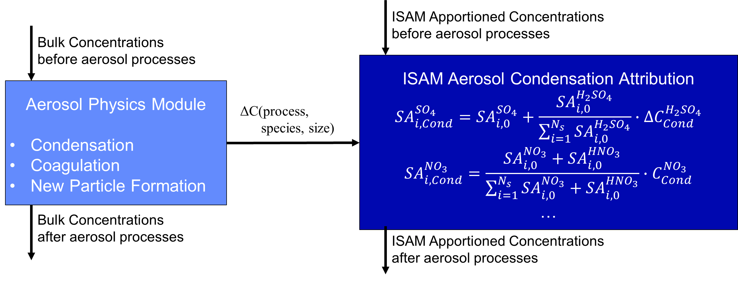
CMAQ-ISAM Extra Slides Aerosol Algorithms
The apportionment across the aerosol science routines for sulfate, nitrate, and ammonium takes into processes, e.g., condensation and coagulation.
The algorithms are explicit for sulfate (nonvolatile) and equilibrium based for semivolatile compounds like nitrate and ammonium. Calculations depend on total sum of gases and particles at the beginning of the timestep and the bulk partitioning at the end.

Slide 52
CMAQ-ISAM Extra Slides Clouds
Previously, cloud process apportionment was proportioned to changes to the bulk.
This works well for most CMAQ species with the exception of sulfate since it is both produced (oxidation of SO₂) and removed (deposition).
Source specificity is often lost with the bulk proportion approach.
Instead, we now separate sulfate production from sulfate loss in the cloud science routines:
${SA}_{i,t+1}^{{SO}_{4}}$=${SA}_{i,t}^{{SO}_{4}}+P\left({SA}_{i}^{{SO}_{4}}\right)−L\left({SA}_{i}^{{SO}_{4}}\right)$
This allows for apportioning the production based on precursor abundance and the loss based on the sulfate availability at time of removal:
${SA}_{i,t+1}^{{SO}_{4}}$=${SA}_{i,t}^{{SO}_{4}}+P\left(C^{{SO}_{4}}\right)\frac{{SA}_{i,t}^{{SO}_{2}}}{\sum_{i}{{SA}_{i,t}^{{SO}_{2}}}}$ - $L\left(C^{{SO}_{4}}\right)\frac{{SA}_{i,t}^{{SO}_{4}}}{\sum_{i}{{SA}_{i,t}^{{SO}_{4}}}}$

Slide 53
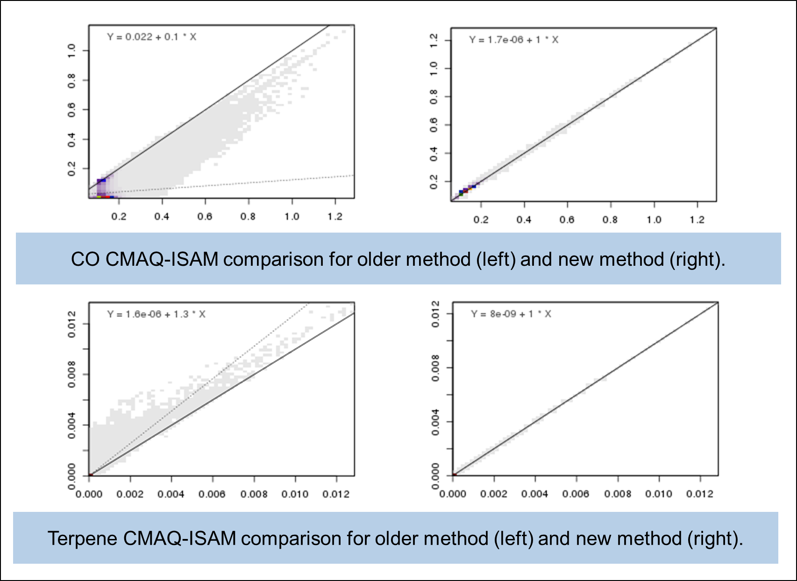
CMAQ-ISAM Extra Slides Chemistry
The previous version estimating source attributions in photochemistry has been replaced - it solved a system of differential equations.
The new method is based on Integrated Reaction Rates (IRR).
Total species changes and how reactions contributed to their change are known after each photochemistry sub-timestep.
Source contributions are then estimated using fractions of a reaction's reactants from each source.
The new method improves both accuracy of the results and computational efficiency.

