Slide 1
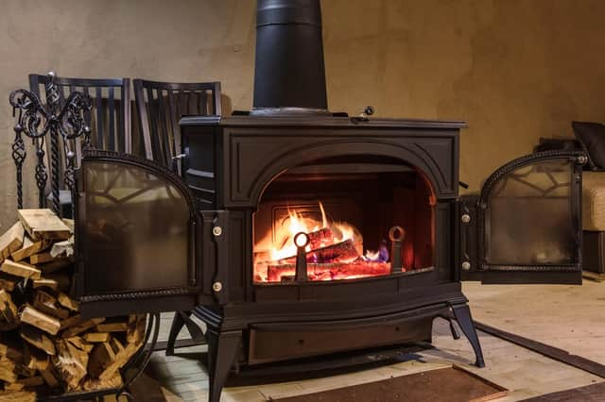
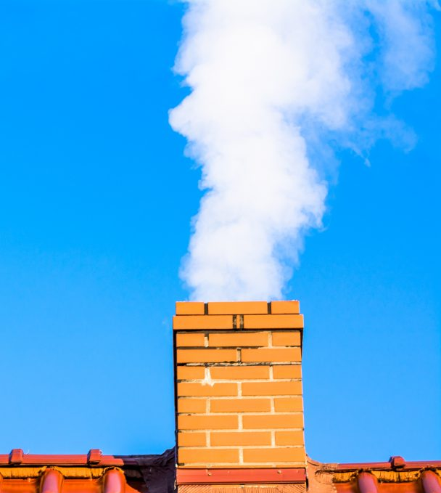
Updating Residential Wood Combustion Emissions with the Reactive Organic Carbon Approach
BEN MURPHY
Center for Environmental Measurement and Modeling (CEMM)
Office of Research and Development (ORD)
U.S. EPA
Co-Authors: Karl Seltzer¹, Havala O. T. Pye², Amara Holder², Gabriel Isaacman-Van Wertz³
¹Office of Air Quality Planning and Standards, U.S. EPA
²Office of Research and Development, U.S. EPA
³Virginia Polytechnic Institute and State University
Disclaimer: The views expressed in this presentation are those of the author and do not necessarily reflect the views or policies of the U.S. EPA.
CMAS Annual Conference | October 16-18, 2023

Slide 2
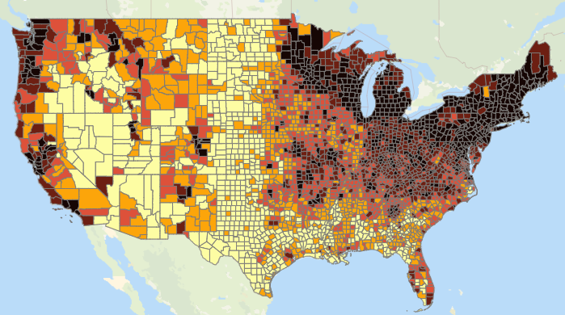
Residential Wood Combustion (RWC) Emissions
Residential wood combustion is a significant source of multiple pollutants including PM, CO, and VOCs (both toxics and precursors to PM and O₃)
Measuring wood smoke emissions and translating to models is challenging:
Fuel (wood species) vary
Fuel moisture and condition vary
Real-world operations vary
Standard test method procedures may introduce biases
Emissions chemical composition is complex
Residential Wood Sources PM_{2.5} Emissions (tons/mi²). EPA 2020 NEI Exploration Tool.
Pollutant | Annual 2020 Emissions [kt yr⁻¹] | Fraction of NEI 2020*
PM_{2.5} | 484 | 20.0%
VOC | 460 | 4.6%
*Excludes dust, biogenic, and fire (wild, prescribed and agriculture) sources

Slide 3
Standard methods for measuring RWC emission factors
PM_{2.5} Measurement
Glass filters collect PM mass
Quartz Filters (not shown) measure OC and EC
IVOCs and SVOCs may condense to the filter or break through
PM emission factor depends on the temperature and concentration of the sample (Robinson et al., 2011)
Stack Sample
Glass Filters
Method 5H
Impinger
< 120 C
< 20 C
Dilution Tunnel
Glass Filters
Method 5G
< 32 C

Slide 4
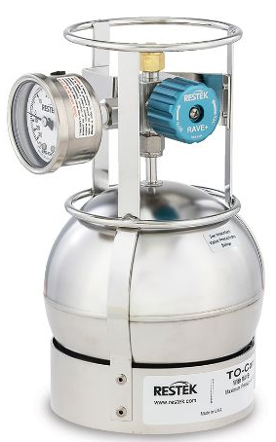
Standard methods for measuring RWC emission factors
PM_{2.5} Measurement
Glass filters collect PM mass
Quartz Filters (not shown) measure OC and EC
IVOCs and SVOCs may condense to the filter or break through
PM emission factor depends on the temperature and concentration of the sample (Robinson et al., 2011)
Stack Sample
Glass Filters
Method 5H
These Methods are useful but may not capture the full extent of emissions.
Applying speciation profiles to these bulk metrics adds further uncertainties.
Impinger
< 120 C
< 20 C
Dilution Tunnel
Glass Filters
Method 5G
< 32 C
VOC Measurement
Particles removed by the glass fiber filter before entering the Flame-Ionization Detector (FID).
Uncertain losses to filters, canisters, and bags
FID undercounts oxygenated carbons and doesn’t count non-carbon atoms.
The total NMOG reported depends on definition and losses.
> 110 C
Flame Ionization Detector
Method 25a
Method TO-15
Offline
Summa Canister or Tedlar Bag
GC-FID

Slide 5
Standard methods for measuring RWC emission factors
PM_{2.5} Measurement
Research Questions:
Do these Methods account for the mass and character of all reactive organic carbon (ROC) emitted by wood-burning sources?
How can we translate these operational definitions of PM and VOC to standard definitions for use in the NEI and air quality modeling?
What is the impact on RWC carbon emissions and ambient organic aerosol?
Glass filters collect PM mass
Quartz Filters (not shown) measure OC and EC
IVOCs and SVOCs may condense to the filter or break through
PM emission factor depends on the temperature and concentration of the sample (Robinson et al., 2011)
Stack Sample
Glass Filters
Method 5H
Impinger
< 120 C
< 20 C
Dilution Tunnel
Glass Filters
Method 5G
< 32 C
VOC Measurement
Particles removed by the glass fiber filter before entering the Flame-Ionization Detector (FID).
Uncertain losses to filters, canisters, and bags
FID undercounts oxygenated carbons and doesn’t count non-carbon atoms.
The total NMOG reported depends on definition and losses.
> 110 C
Flame Ionization Detector
Method 25a
Method TO-15
Offline
Summa Canister or Tedlar Bag
GC-FID

Slide 6
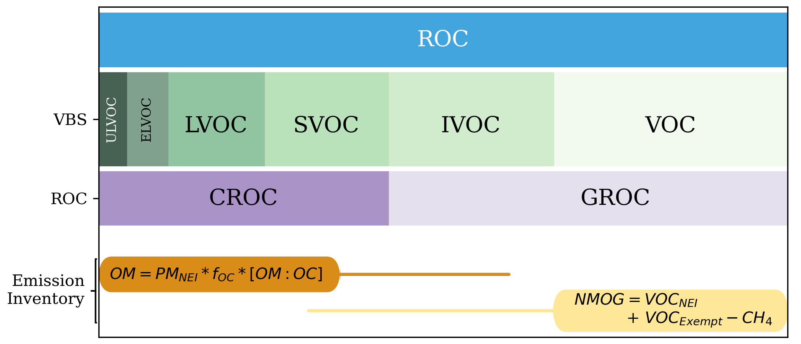
Reactive Organic Carbon (ROC) Framework
Volatility
Gas
Particle
CROC (Condensable Reactive Organic Carbon) – compounds with volatility less than C20 (n-Eicosane).
CROC = [SVOC + LVOC + ELVOC + ULVOC]
GROC (Gaseous Reactive Organic Carbon) – compounds with volatility greater than C20.
GROC = [IVOC + VOC]
f_{OC} = organic carbon fraction from speciation profile
OM:OC = ratio of non-carbon to carbon
VOC_{Exempt} = gas-phase compounds exempted from the regulatory definition of VOC

Slide 7
Reactive Organic Carbon (ROC) Framework
Volatility
Gas
Particle
CROC (Condensable Reactive Organic Carbon) – compounds with volatility less than C20 (n-Eicosane).
CROC = [SVOC + LVOC + ELVOC + ULVOC]
GROC (Gaseous Reactive Organic Carbon) – compounds with volatility greater than C20.
GROC = [IVOC + VOC]
?
?
f_{OC} = organic carbon fraction from speciation profile
OM:OC = ratio of non-carbon to carbon
VOC_{Exempt} = gas-phase compounds exempted from the regulatory definition of VOC

Slide 8
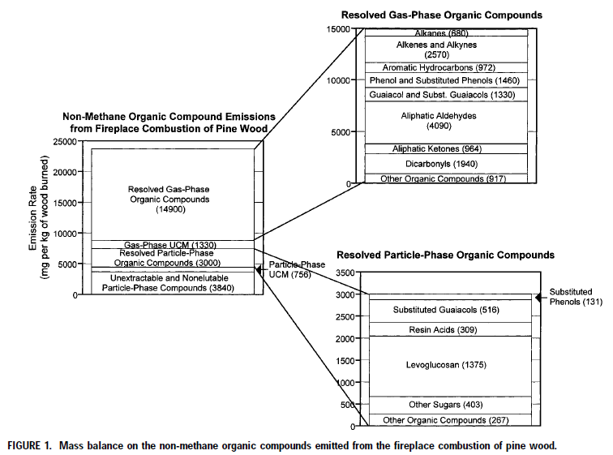
Use a detailed speciation profile to simulate Test Method measurements
Fireplace pine smoke reported by Schauer et al. (2001) and Nolte et al. (2001)
226 explicit species measured
Semivolatile components quantified in both gas and particle phases.
EC fraction = 1.4%
NMOG/OM = 2.1
Unresolved non-methane organic gas = 8.1%
Unresolved particle = 61%
Schauer et al. (2001): https://pubs.acs.org/doi/full/10.1021/es001331e
Nolte et al. (2001): https://pubs.acs.org/doi/full/10.1021/es001420r

Slide 9
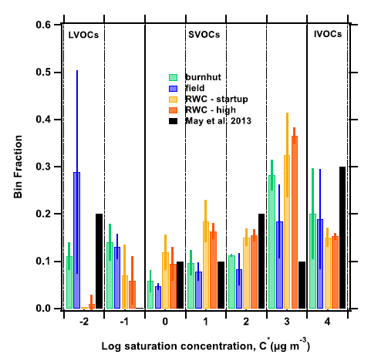
Assign unspeciated mass to reproduce observed volatility trends
Particle
Volatility
Gas
$$c^{∗}=\frac{p_{vap}MW}{RT}$$
Woodsmoke volatility distribution
(Sinha et al., 2022)
https://pubs.rsc.org/en/content/articlehtml/2023/ea/d2ea00080f

Slide 10
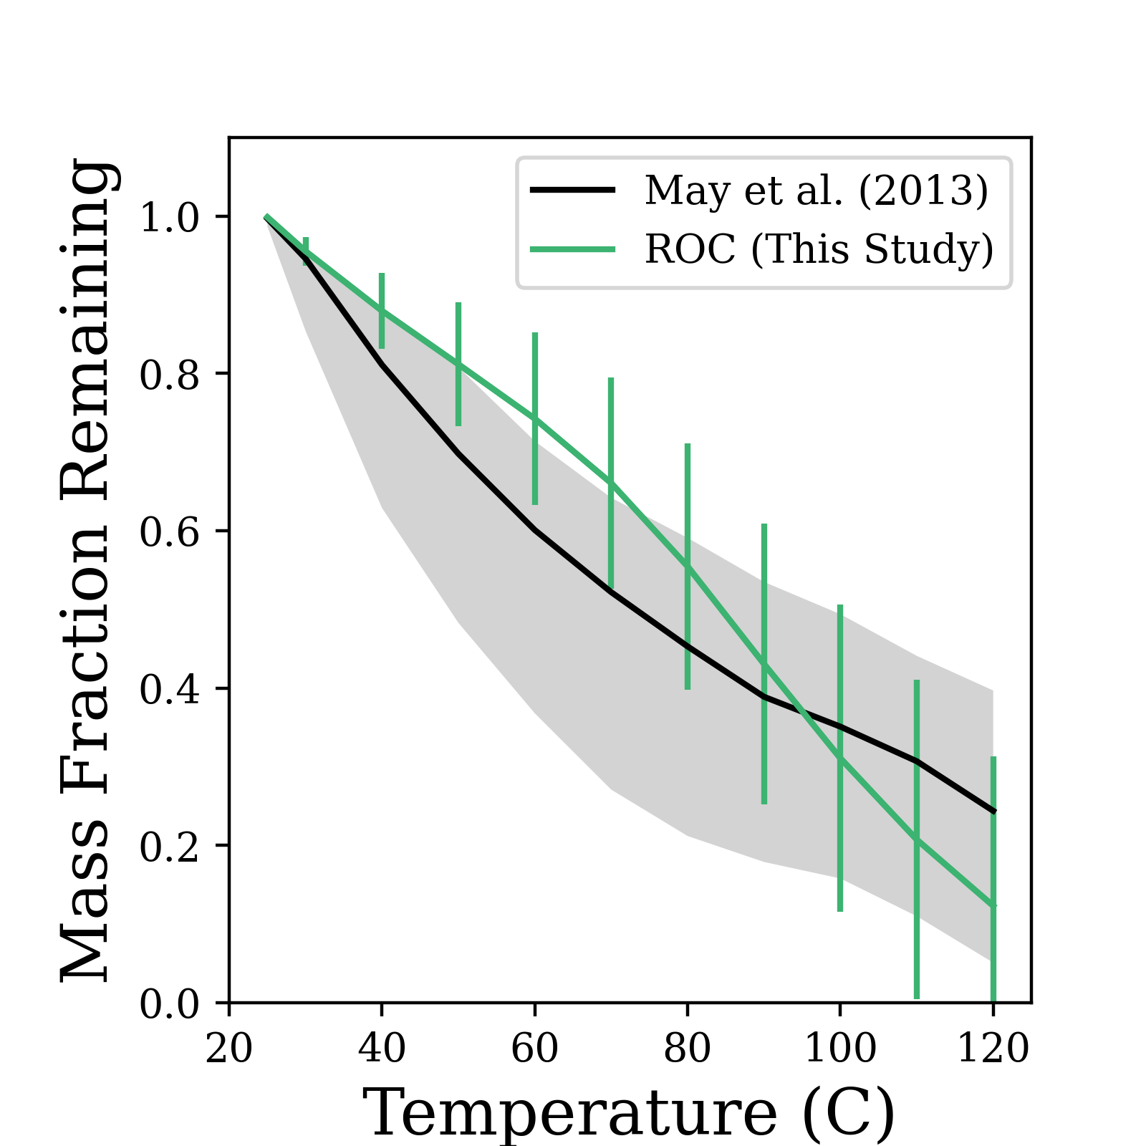
Assign unspeciated mass to reproduce observed volatility trends
Particle
Volatility
Gas
PM temperature sensitivity is similar to that observed in previous biomass burning studies
$$c^{∗}=\frac{p_{vap}MW}{RT}$$

Slide 11
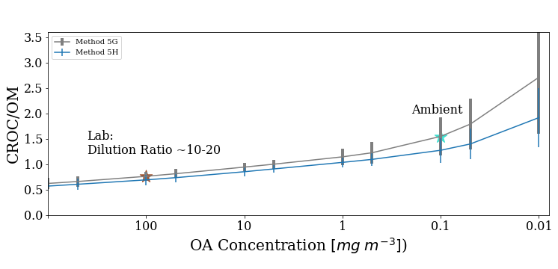
Impact of partitioning on Method 5G and 5H measurements
Sum EFs for CROC compounds from Schauer profile
PM_{2.5} Measurement
Glass Filters
CROC/OM =
Stack Sample
Calculate particle-phase EF given filter temperature and OA conc.
Method 5H
Impinger
< 120 C
< 20 C
Dilution Tunnel
Glass Filters
Method 5G
< 32 C
Laboratory conditions –need to discount absorption of IVOCs. Multiply by 0.77 for 5G and 0.72 for 5H.
Ambient conditions –need to add SVOCs broken through the filter. Multiply by 1.55 for 5G and 1.27 for 5H.

Slide 12
Impact of partitioning and functionality on FID detection
Method TO-15
Canisters and bags:
VOCs
IVOCs
→ Temperature independent correction
Lu et al., Atmos, Chem and Phys. 2018.
https://acp.copernicus.org/articles/18/17637/2018/
VOC Measurement
> 110 C
Flame Ionization Detector
Method 25a
Method TO-15
Offline
Summa Canister or Tedlar Bag
GC-FID

Slide 13
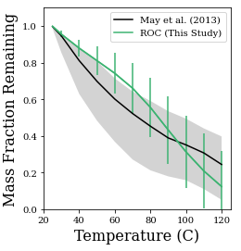
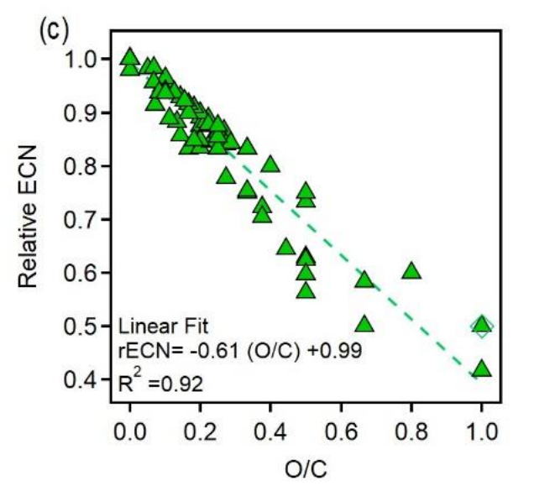
Impact of partitioning and functionality on FID detection
Method TO-15
Canisters and bags:
VOCs
IVOCs
→ Temperature independent correction
Method 25a
Inline FID with glass filter (110 C)
Lu et al., Atmos, Chem and Phys. 2018.
https://acp.copernicus.org/articles/18/17637/2018/
VOC Measurement
> 110 C
May et al., Journal of Geophys. Res. (2013)
https://agupubs.onlinelibrary.wiley.com/doi/full/10.1002/jgrd.50828
Hurley et al. Atmos. Meas. Tech. (2020)
https://amt.copernicus.org/preprints/amt-2020-44/amt-2020-44.pdf
Flame Ionization Detector
Method 25a
Method TO-15
Offline
Summa Canister or Tedlar Bag
GC-FID

Slide 14
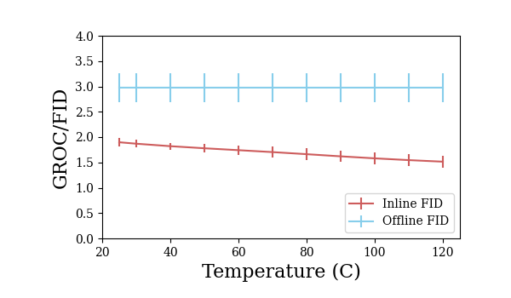
Impact of partitioning and functionality on FID detection
Method TO-15
Canisters and bags:
VOCs
IVOCs
→ Temperature independent correction
Method 25a
Inline FID with glass filter (110 C)
Lu et al., Atmos, Chem and Phys. 2018.
https://acp.copernicus.org/articles/18/17637/2018/
Method TO-15
Method 25a
VOC Measurement
> 110 C
Flame Ionization Detector
Method 25a
Method TO-15
Offline
GROC/FID: Method TO-15 → Multiply by 3.0
Method 25a → Multiply by 1.6 (assuming 110 C)
Summa Canister or Tedlar Bag
GC-FID

Slide 15
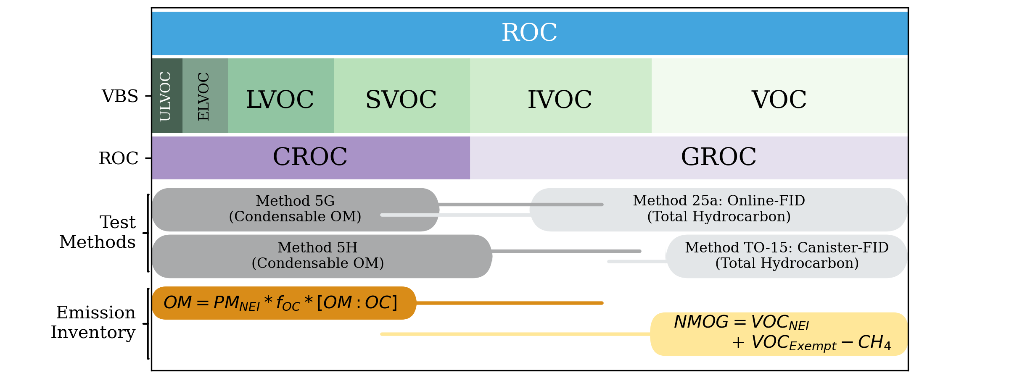
Relationship between ROC and Test Methods
At high concentration (low dilution rate), Methods 5H and TO-15 together approximately account for total ROC. → Add OM and NMOG and then speciate with detailed profile.
If Method 5G or Method 25a are used instead, conversion to CROC and GROC should be calculated separately.

Slide 16
Determine Method basis for each RWC source
Reference 2020 NEI Technical Support Document, AP-42 and supporting studies.
SCC Description | Particulate | VOC | Approach
Conventional Woodstoves | Method 5H | Tedlar Bag (TO-15) | A
Certified Woodstoves | Method 5H | Tedlar Bag (TO-15) | A
Indoor Furnaces | Method 5G | Method 25a | B
Fireplaces | Method 5H | Canister (TO-15) | A
Outdoor Wood Burning Devices | Method 5H | Tedlar Bag (TO-15) | A
Synthetic Firelogs | Method 5G | Method 25a | B
Approach A Approach B
Speciate
Speciate further
Speciate further
VOC
Add
ROC
GROC
VOC
Convert
GROC
OM
Schauer et al. (2001)
CROC
Schauer et al. (2001)
OM
CROC
Schauer et al. (2001)

Slide 17
Impact of update on RWC emission factors and OA potential
Left:
NEI
Right:
ROC
Account for activity, POA partitioning and 1st-generation SOA yields

Slide 18
Impact of update on hazardous air pollutants
NEI
ROC
Total TOG emissions increase by 50% but HAP emissions stay roughly the same.

Slide 19
Summary
Proposed revised emission factors for conventional wood stoves and similar combustion sources.
Total ROC increases by 11.3%. This mass is missing in the NEI.
OA potential decreases by -39%.
Larger role for SOA (30% of OA in ROC case)
HAPs are essentially unchanged.
More work to do on cleaner technologies:
Pellet Stoves
Catalytic Stoves
Hydronic Heaters
Contact: murphy.ben@epa.gov

