Slide 1
Construction of the Advanced Air Quality Modeling System (AAQMS) and the MPAS-CMAQ Coupled Model
David C. Wong¹, Jeff Willison¹, Jonathan E. Pleim¹, Russell Bullock Jr.¹, Robert C. Gilliam¹, Jerold A. Herwehe¹, George A. Pouliot¹, Christian Hogrefe¹, Daiwen Kang¹, and Hosein Foroutan²
¹ Office of Research and Development, U.S. Environmental Protection Agency
² Department of Civil & Environmental Engineering, Virginia Tech
The views expressed in this presentation are those of the authors and do not necessarily reflect the views or policies of the U.S. EPA.
Office of Research and Development
Center for Environmental Measurement and Modeling • Atmospheric and Environmental Systems Modeling Division
22nd Annual CMAS Conference
16–18 October 2023
Notes:
Purpose: science talk

Slide 2
CMAQ Release History
* Created by Sarah Simm

Slide 3
Development Progression
CMAQ (offline mode)
Relies on Models-3 I/O API (aka IOAPI) for I/O
Utilizes MCIP to prepare meteorological inputs
Requires external model/data to produce IC/BC
Limitations
Regional simulation rely on LBCs from large scale models or other data sources
Lack of influence from outside the domain (long range transport, development/usage of Hemispheric CMAQ alleviate this)
Low frequency of meteorological information
Lack of interaction with meteorological model

Slide 4
Development Progression (cont’d)
WRF-CMAQ coupled model
Relies on Model-3 I/O API for I/O and BUFFERED file for coupling
User controls incoming meteorological information frequency
Aerosol information from CMAQ can feedback to WRF and affects SW radiation calculation (radiative aerosol direct effect *)
Requires external model/data to produce IC/BC
Limitations
Regional simulation rely on LBCs from large scale models or other data sources
Lack of influence from outside the domain (long range transport, development/usage of Hemispheric CMAQ alleviate this)
*D.C.Wong, J.Pleim, R.Mathur, F.Binkowski, T.Otte, R.Gilliam, G.Pouliot, A.Xiu, J.O.Young, and D.Kang.: WRF-CMAQ two-way coupled system with aerosol feedback: software development and preliminary results, Geosci.Model Dev., 5, 299–312, 2012 www.geosci-model-dev.net/5/299/2012/ doi:10.5194/

Slide 5
Development Progression (cont’d)
MPAS-CMAQ coupled model
Relies on an ad hoc coupler
Utilizes an internal I/O system
User controls incoming meteorological information frequency
Aerosol information from CMAQ can feedback to MPAS and affects SW radiation calculation (will be implemented soon)
Transport of chemical species is handled by MPAS for numerical consistency and mass conservation

Slide 6
Various Model Configurations

Slide 7
Advanced Air Quality Modeling System

Slide 8
Advanced Air Quality Modeling System (cont’d)

Slide 9
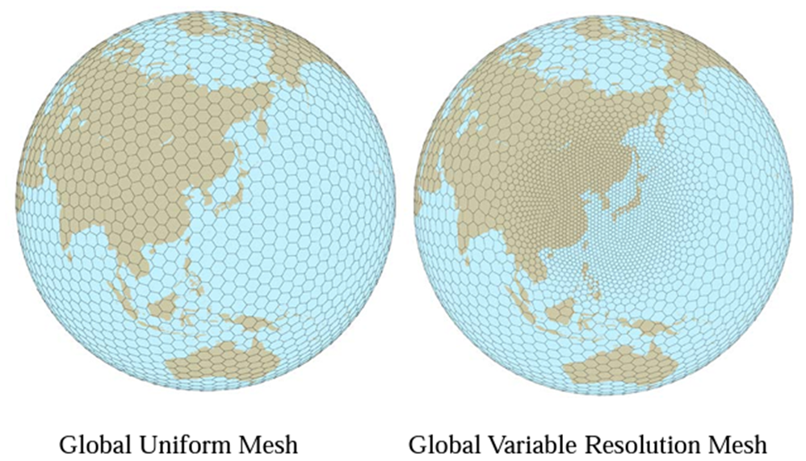
What is MPAS
Model for Prediction Across Scales (MPAS)
Fully-compressible, non-hydrostatic dynamics
Finite volume discretization on centroidal Voronoi (nominally hexagonal) grids
Single global mesh with seamless refinement to local scales
Regional capability
source: https://www.ecmwf.int/sites/default/files/elibrary/2012/14043-global-nonhydrostatic-
atmospheric-model-mpas-preliminary-results-uniform-and-variable.pdf

Slide 10
MPAS Updates by EPA
Added US EPA physics routines to MPAS
ACM2 boundary layer model
Pleim-Xiu Land Surface Model (PX LSM)
Updated Kain-Fritsch convective cloud scheme
including radiation feedback and dynamic lifetime
All modified EPA physics is consistent between WRFv4.3 and MPAS7.1
Data Assimilation
Implemented analysis FDDA as in WRF (Bullock et al. 2018)
Implemented indirect soil moisture data assimilation in PX LSM
Meteorological Evaluation
Gilliam et al. (2021) showed that the EPA configuration of MPAS performs comparably well with the EPA configuration of WRF for air quality applications

Slide 11
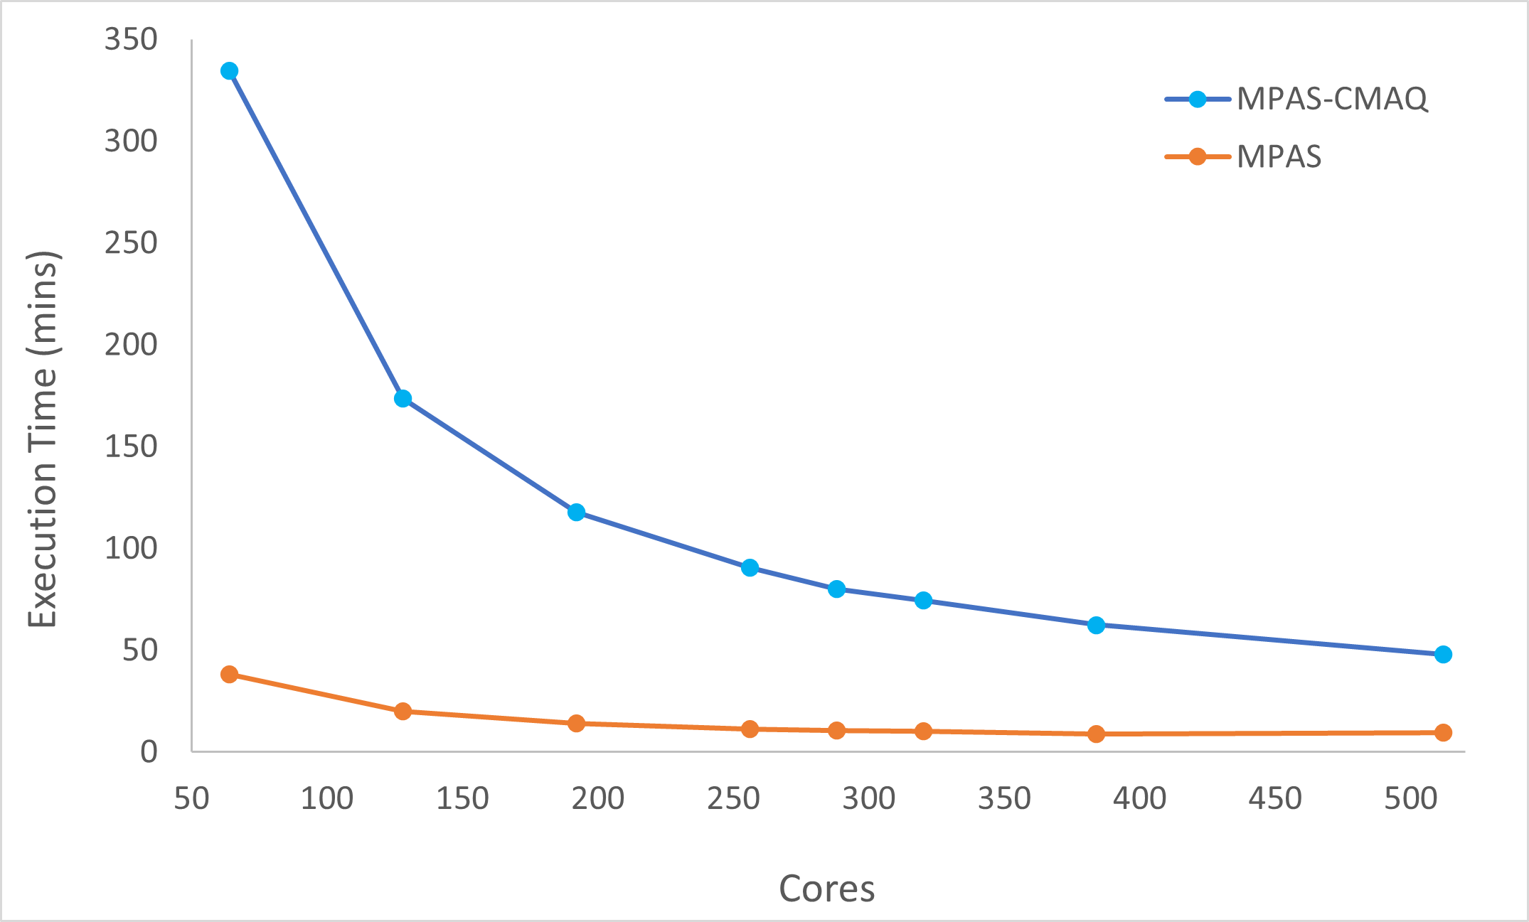
MPAS and MPAS-CMAQ Computational Performance
120km uniform mesh
92-25km variable mesh

Slide 12
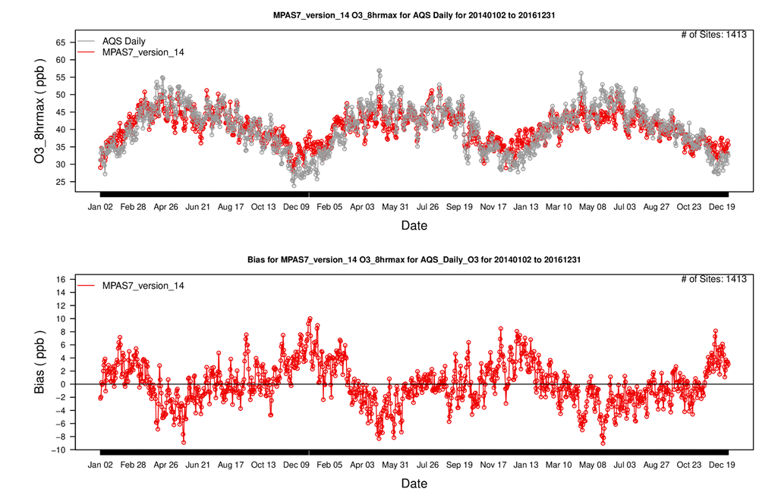
Surface O₃ Over US (120km uniform mesh)
Comparison with AQS sites indicates a seasonally-varying bias for surface 8-hr max ozone concentration over the United States.
Average low bias in spring, average high bias in winter.
No noticeable drift in first three years.

Slide 13
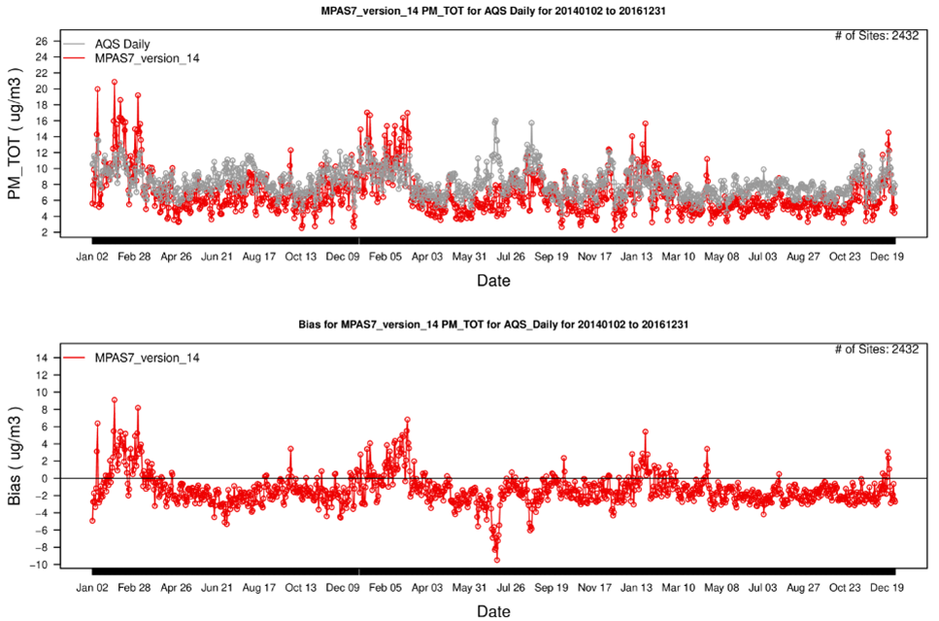
Surface PM_{2.5} Over US (120km uniform mesh)
Comparison with AQS sites indicates general low bias but brief high bias in winter
Again, no noticeable drift in three years.

Slide 14
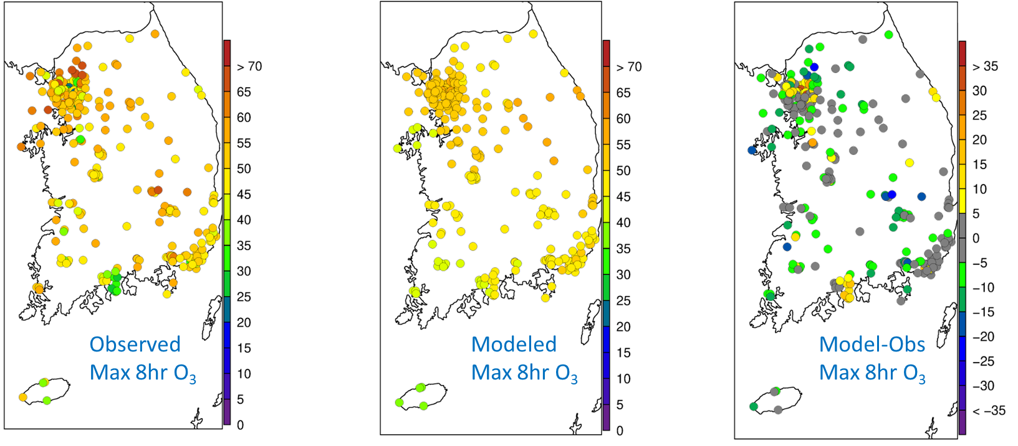
South Korea O₃ Performance (120km uniform mesh)
Overall, max 8hr O₃ concentrations (ppb) have little bias for summer (JJA) in South Korea
The coarse mesh is insufficient to resolve high O₃ on the outskirts of Seoul or the titration in the Port of Gwangyang

Slide 15
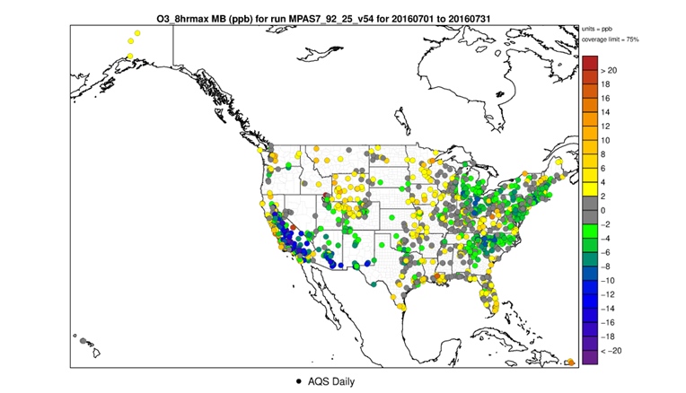
O₃ Performance (92-25km variable mesh)

Slide 16
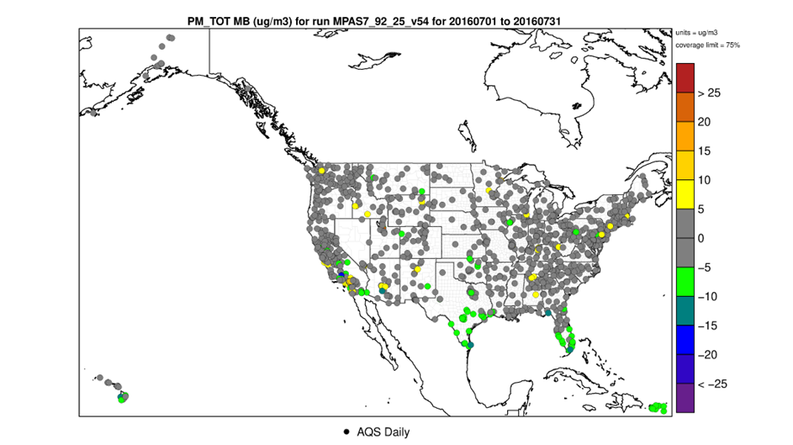
PM₂₅ Performance (92-25km variable mesh)

Slide 17
Global O₃ Performance (92-25km variable mesh)

Slide 18
Global PM₂₅ Performance (92-25km variable mesh)

Slide 19
Take Away Points
With AAQMS, configurating/constructing CMAQ offline mode, WRF-CMAQ coupled model, and MPAS-CMAQ coupled model can be done seamlessly.
Preliminary results show MPAS-CMAQ coupled model performs reasonably well.
Code is “available” on request.

