Slide 1
Intercomparison of different ground-level ozone datasets for health-relevant metrics
Hantao Wang, Kazuyuki Miyazaki, Jason Sun, Xiang Liu, Antje Inness, Zhen Qu, Marc Serre, J. Jason West
Gillings School of Global Public Health

Slide 2
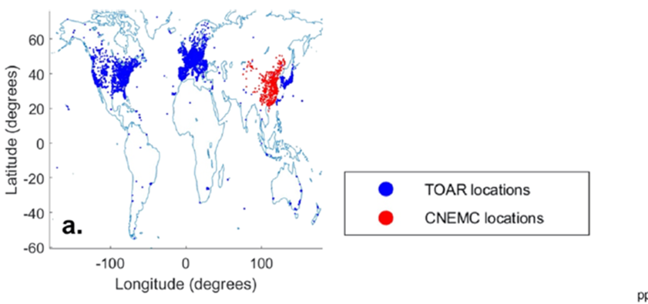
Estimating global ground-level ozone
Observations are limited in many world regions
Computer models as a supplement to the monitoring network
Satellite data can be processed as a supplement to the monitoring network

Slide 3
Previous work in our group
Multi-model Composite M³Fusion to create a composite of multiple models by weighting based on their performance.
RAMP Regionalized Air Quality Model Performance (RAMP) framework to correct model bias.
BME data fusion Bayesian Maximum Entropy (BME) to fuse the multi-model composite with observations in space and time.
Addition of fine resolution obtain BME estimates at 0.1° * 0.1° from 0.5 °*0.5 °.
DeLang et al,2021
BME dataset annual fine-resolution estimates of global surface ozone from 1990 to 2017 by fusing data from observations and 9 global models.

Slide 4
Motivation
Understand global ground-level ozone concentration to inform global health burden studies
Objective
Compare recent estimates of global ground-level ozone from different products: 3 chemical reanalyzes, 1 geostatistical, 2 machine learning
Identify inconsistencies and biases in the ozone mapping products.

Slide 5
Global ozone dataset in comparison and evaluation
Global ozone dataset | Resolution | period | scheme | metric
Bayesian Maximum Entropy Data Fusion (M.Delang) (BME) | 0.1°*0.1° | 1990-2017 | Geostatistics(BME) | OSMDA8 (Ozone Season MDA8)
Cluster-Enhanced Ensemble Learning (X.Liu) (NJML) | 0.5°*0.5° | 2003-2019 | Machine Learning | monthly mean MDA8
Space−Time Bayesian Neural Network Downscaler (H.Sun) (UKML) | 0.125°*0.125° | 1990-2019 | Machine Learning | monthly mean MDA8
CAMS (A.Inness) (CAMS) | 0.75°*0.75° | 2003-2020 | Chemistry reanalysis | 3-hourly data
GEOS-Chem (Q.Zhen) (GEOS) | 0.25°*0.3125° | 2006-2016 | Chemistry reanalysis | Daily MDA8
TCR2 (K.Miyazaki) (TCR2) | 1.1°*1.1° | 2005-2020 | Chemistry reanalysis | 2-hourly data

Slide 6
Comparison
Evaluation
Variations in surface ozone
Re-grid all datasets to 0.1°*0.1°
Change all metric into OSMDA8
Cover year from 2006 to 2016
Index for comparison
Population weighted mean
Average standard deviation over spatial
Difference to mean of six datasets
Pairwise correlation
Root mean square difference (RMSD)
Mean difference (MD)
Average silhouette for grouping
Population density exposure to ozone by regions
Evaluation with latest TOAR-II database
Keep original resolution
Change all metric into OSMDA8
Evaluation observations in 2010 & 2016
Use the nearest datapoint to represent miss match from TOAR-II stations
Index for evaluation
Pearson R-squared
Root mean square error (RMSE)
Standard deviation of estimates ozone (SD)
Kernel density

Slide 7
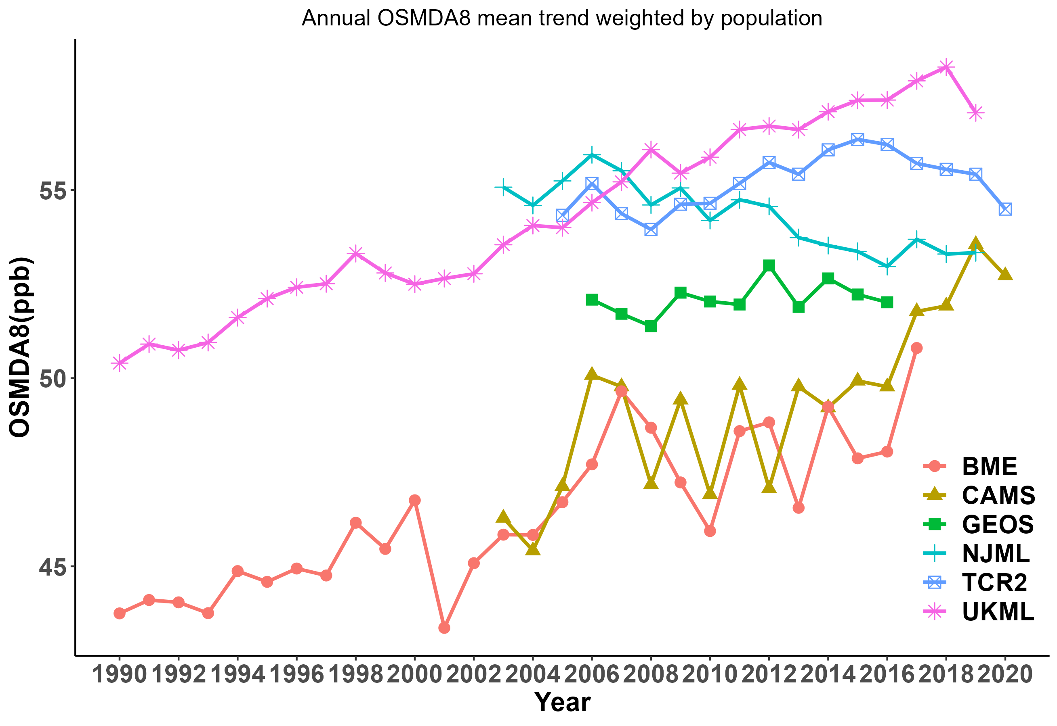
Mean trend

Slide 8
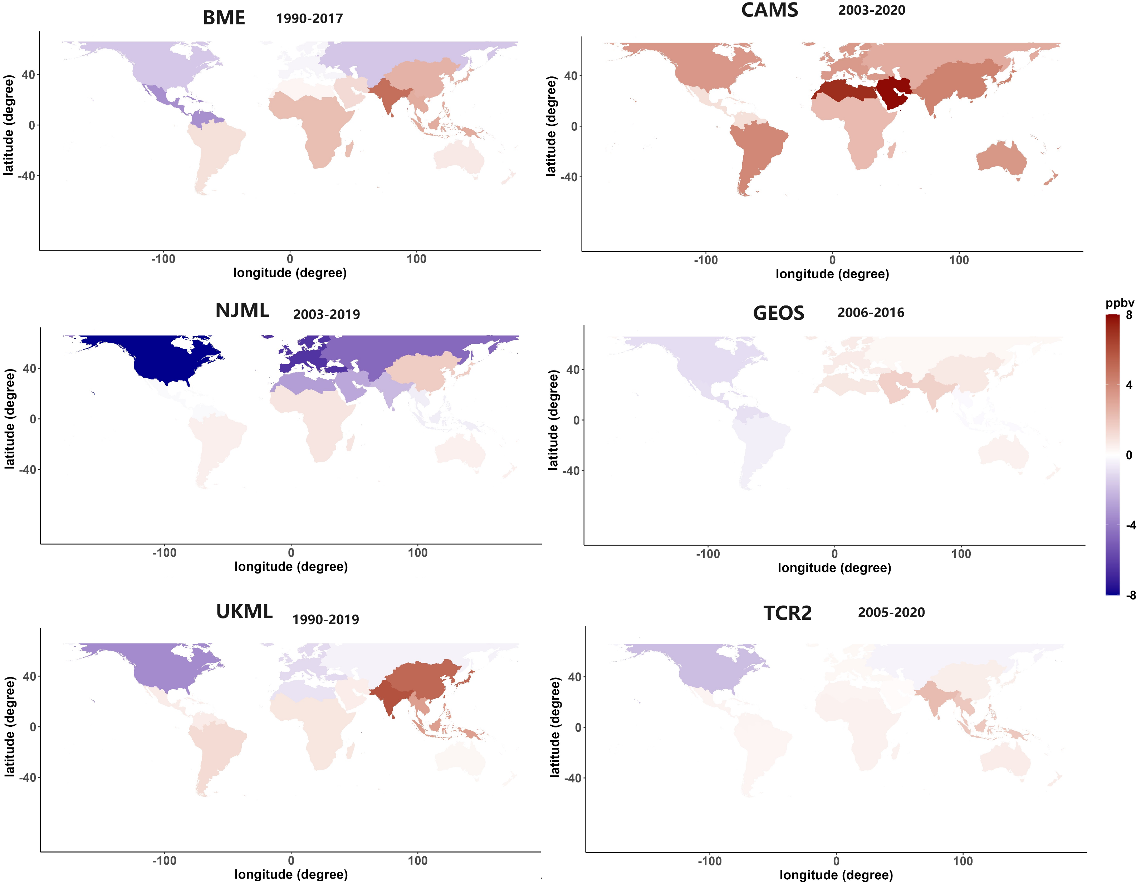
Ozone trend by regions (ppb/decade)

Slide 9
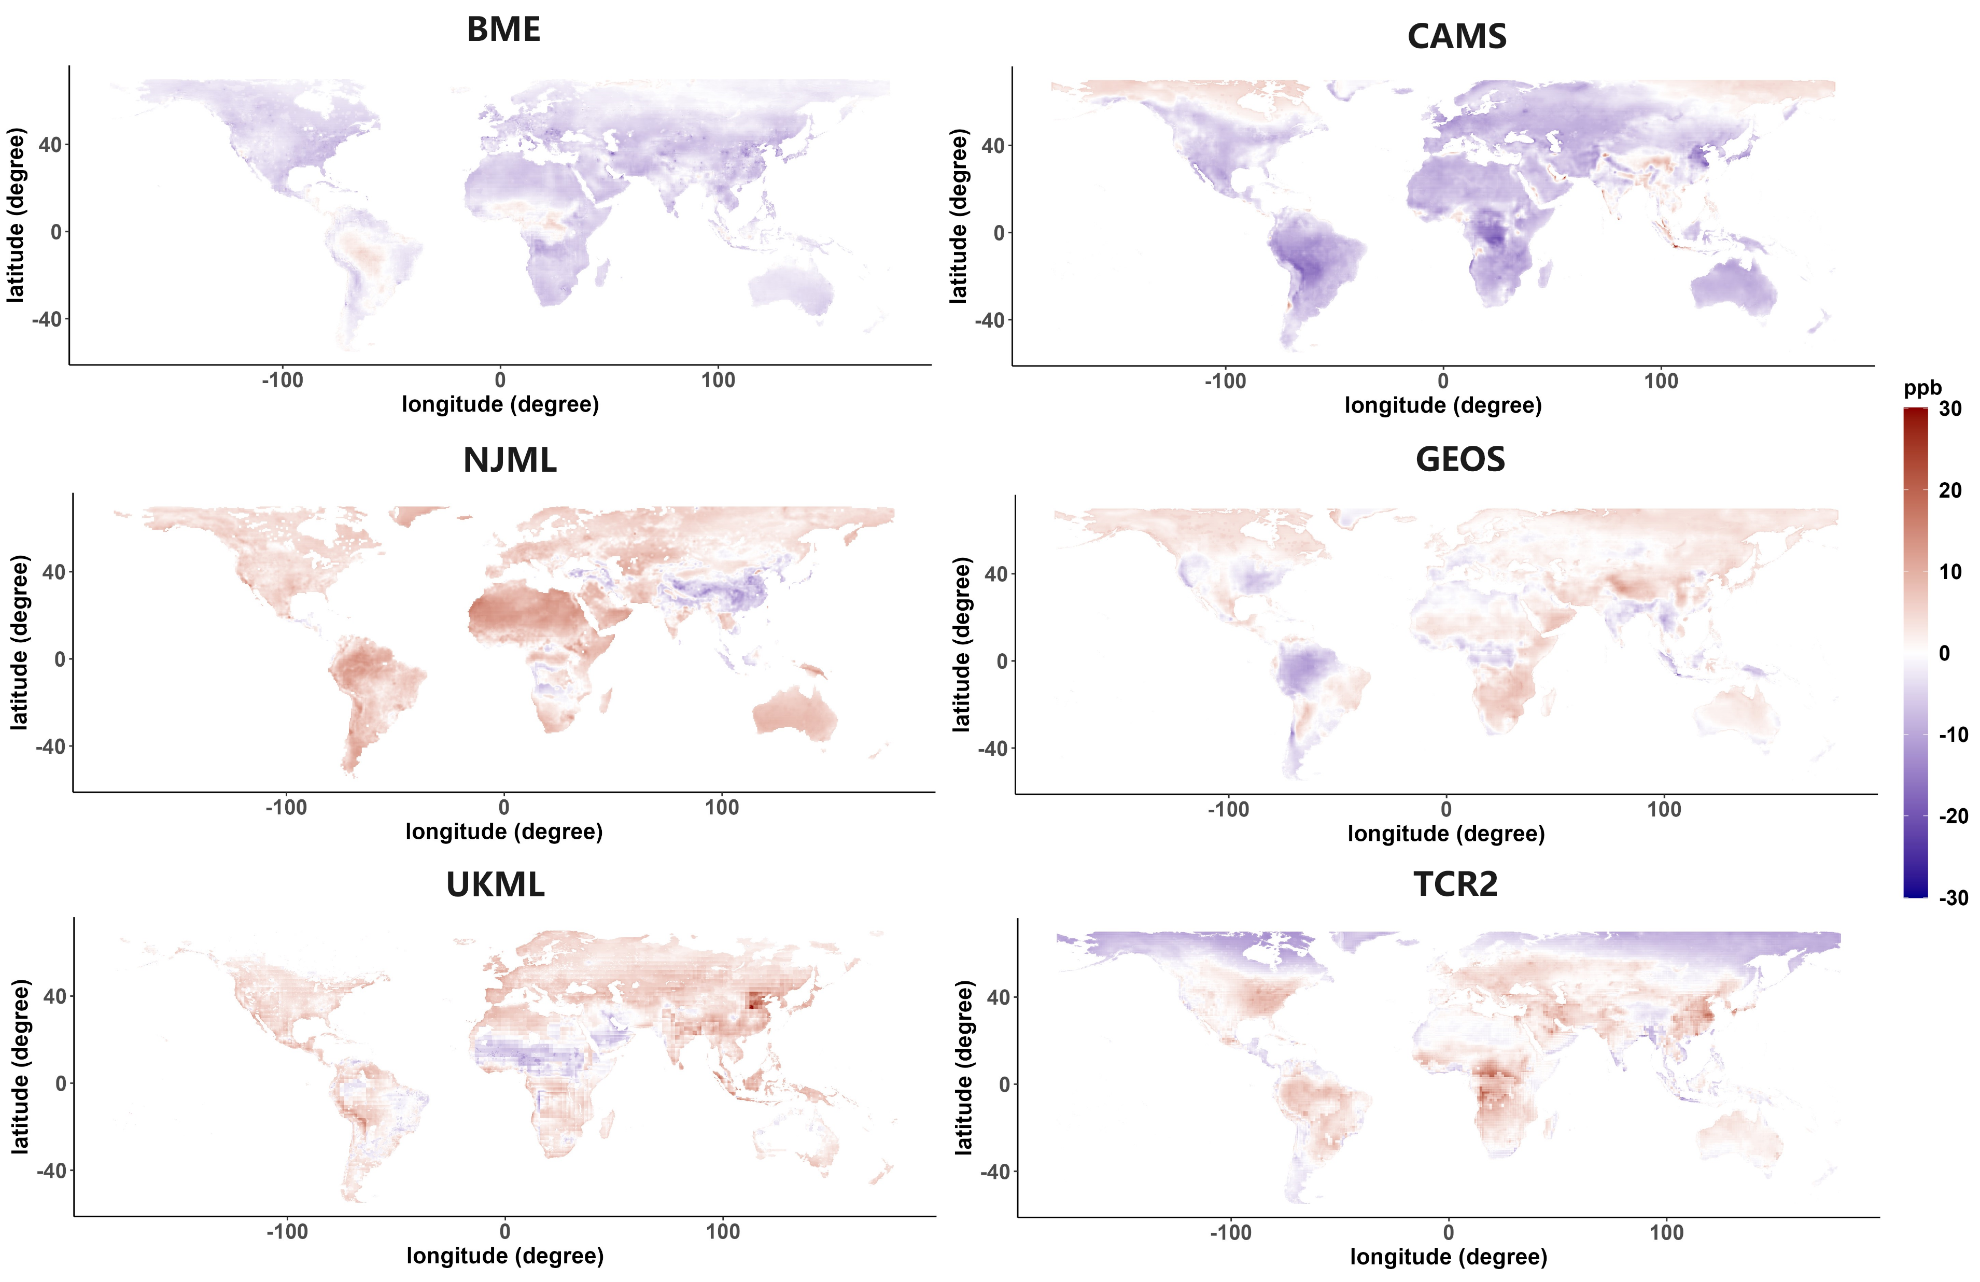
Mean of differences from the six datasets mean 2006-2016

Slide 10
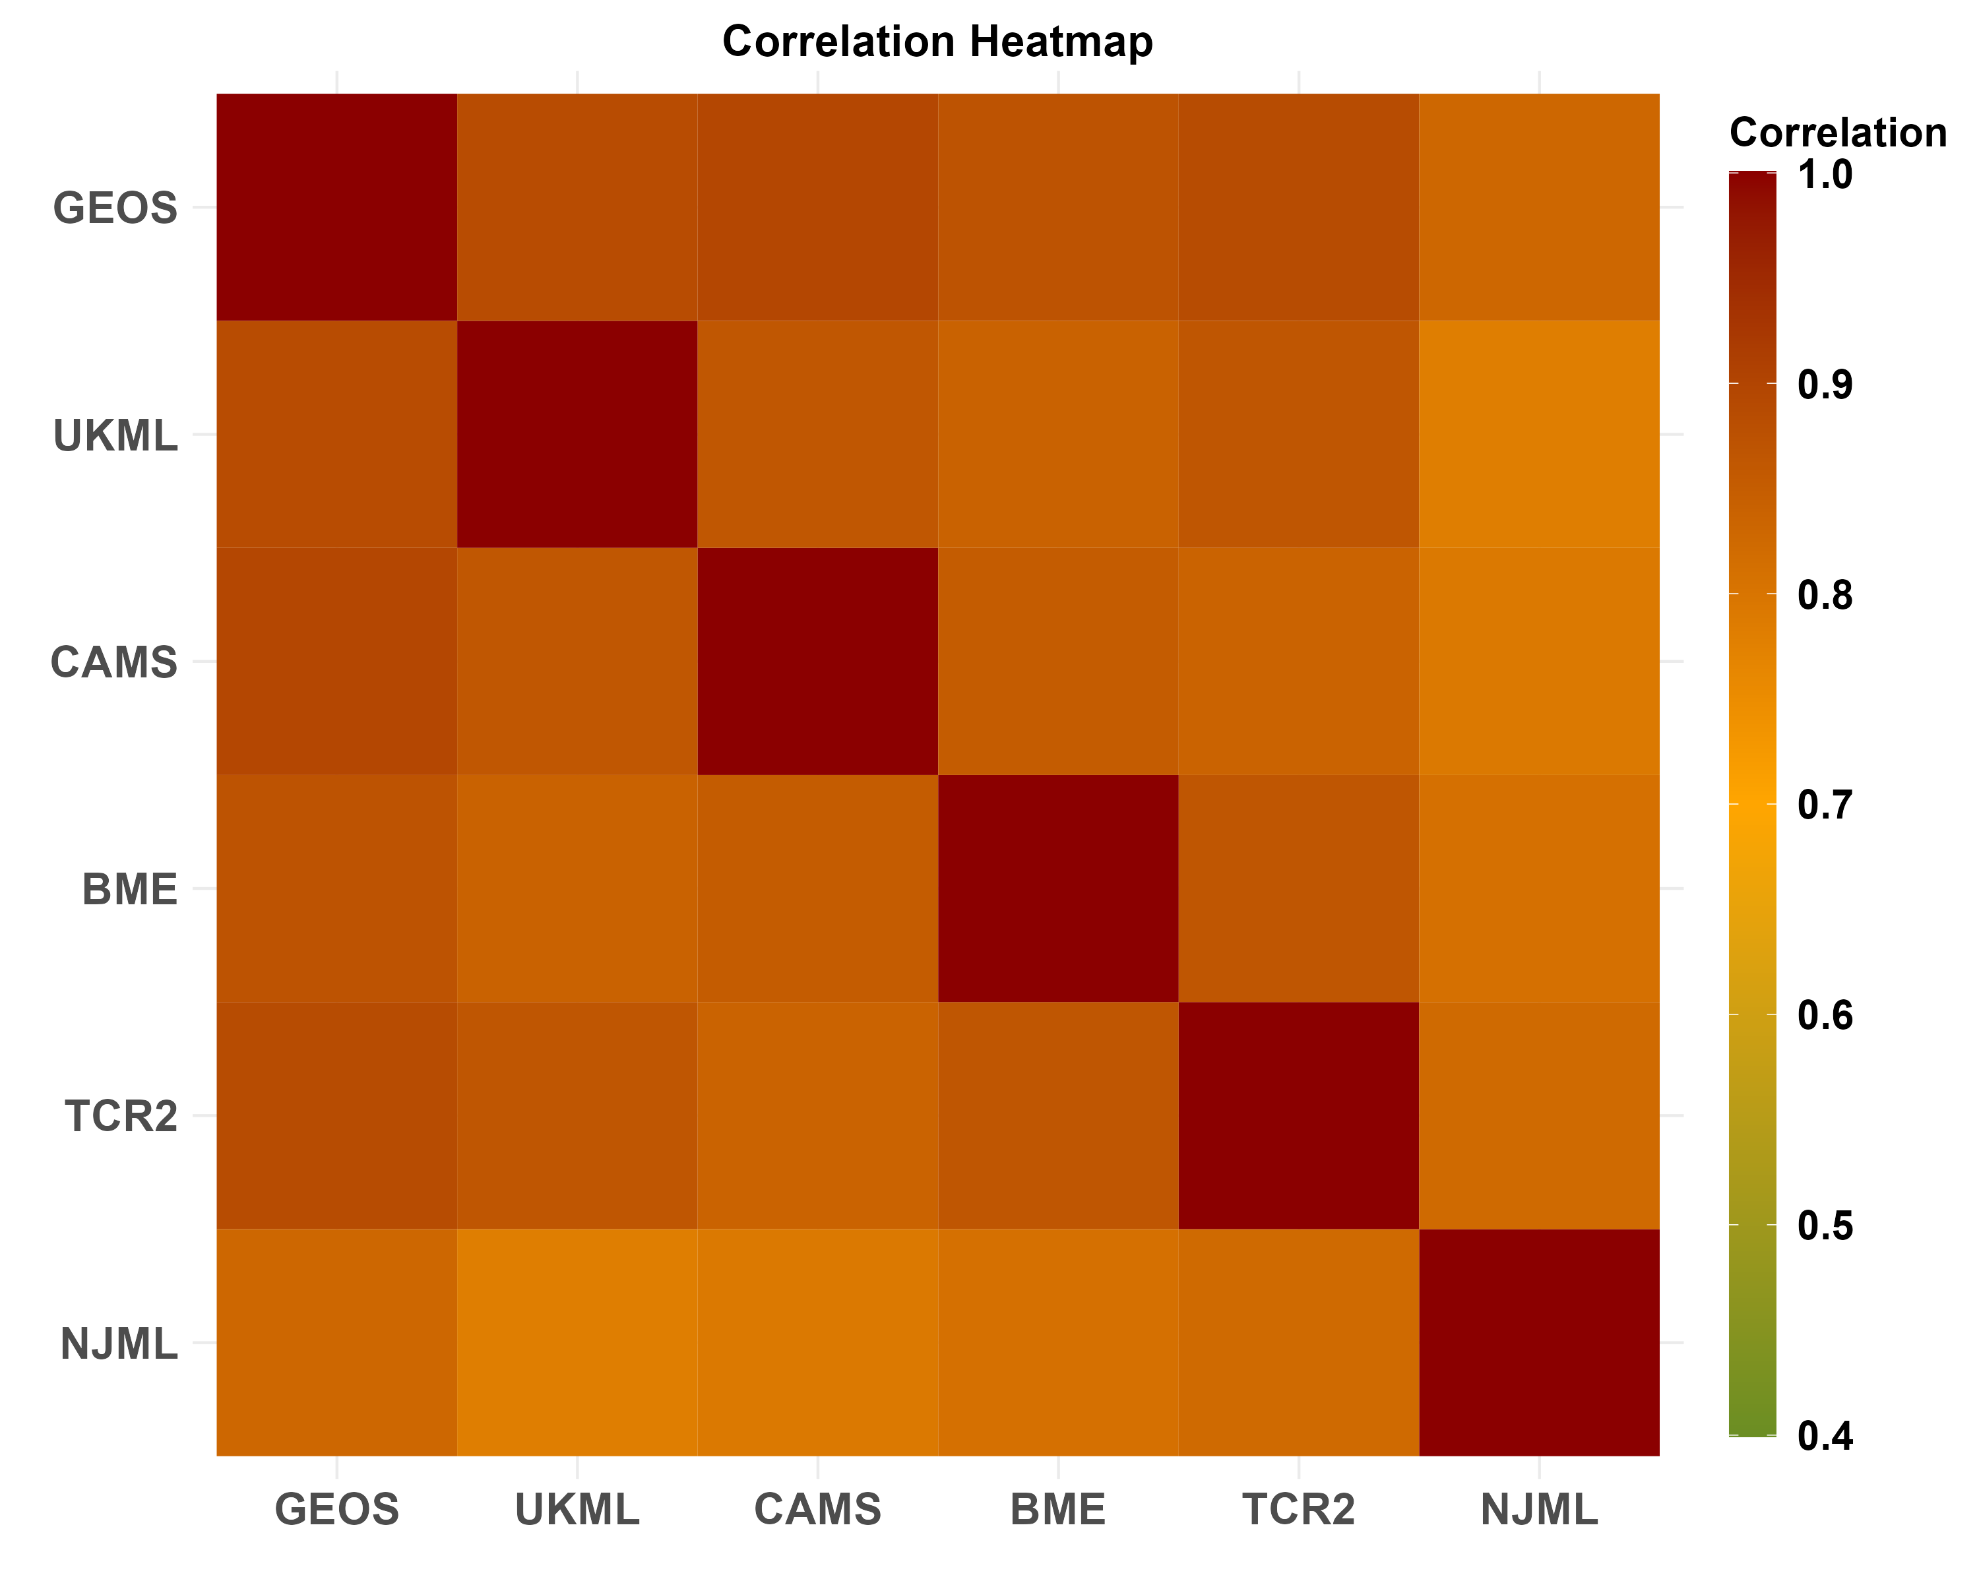
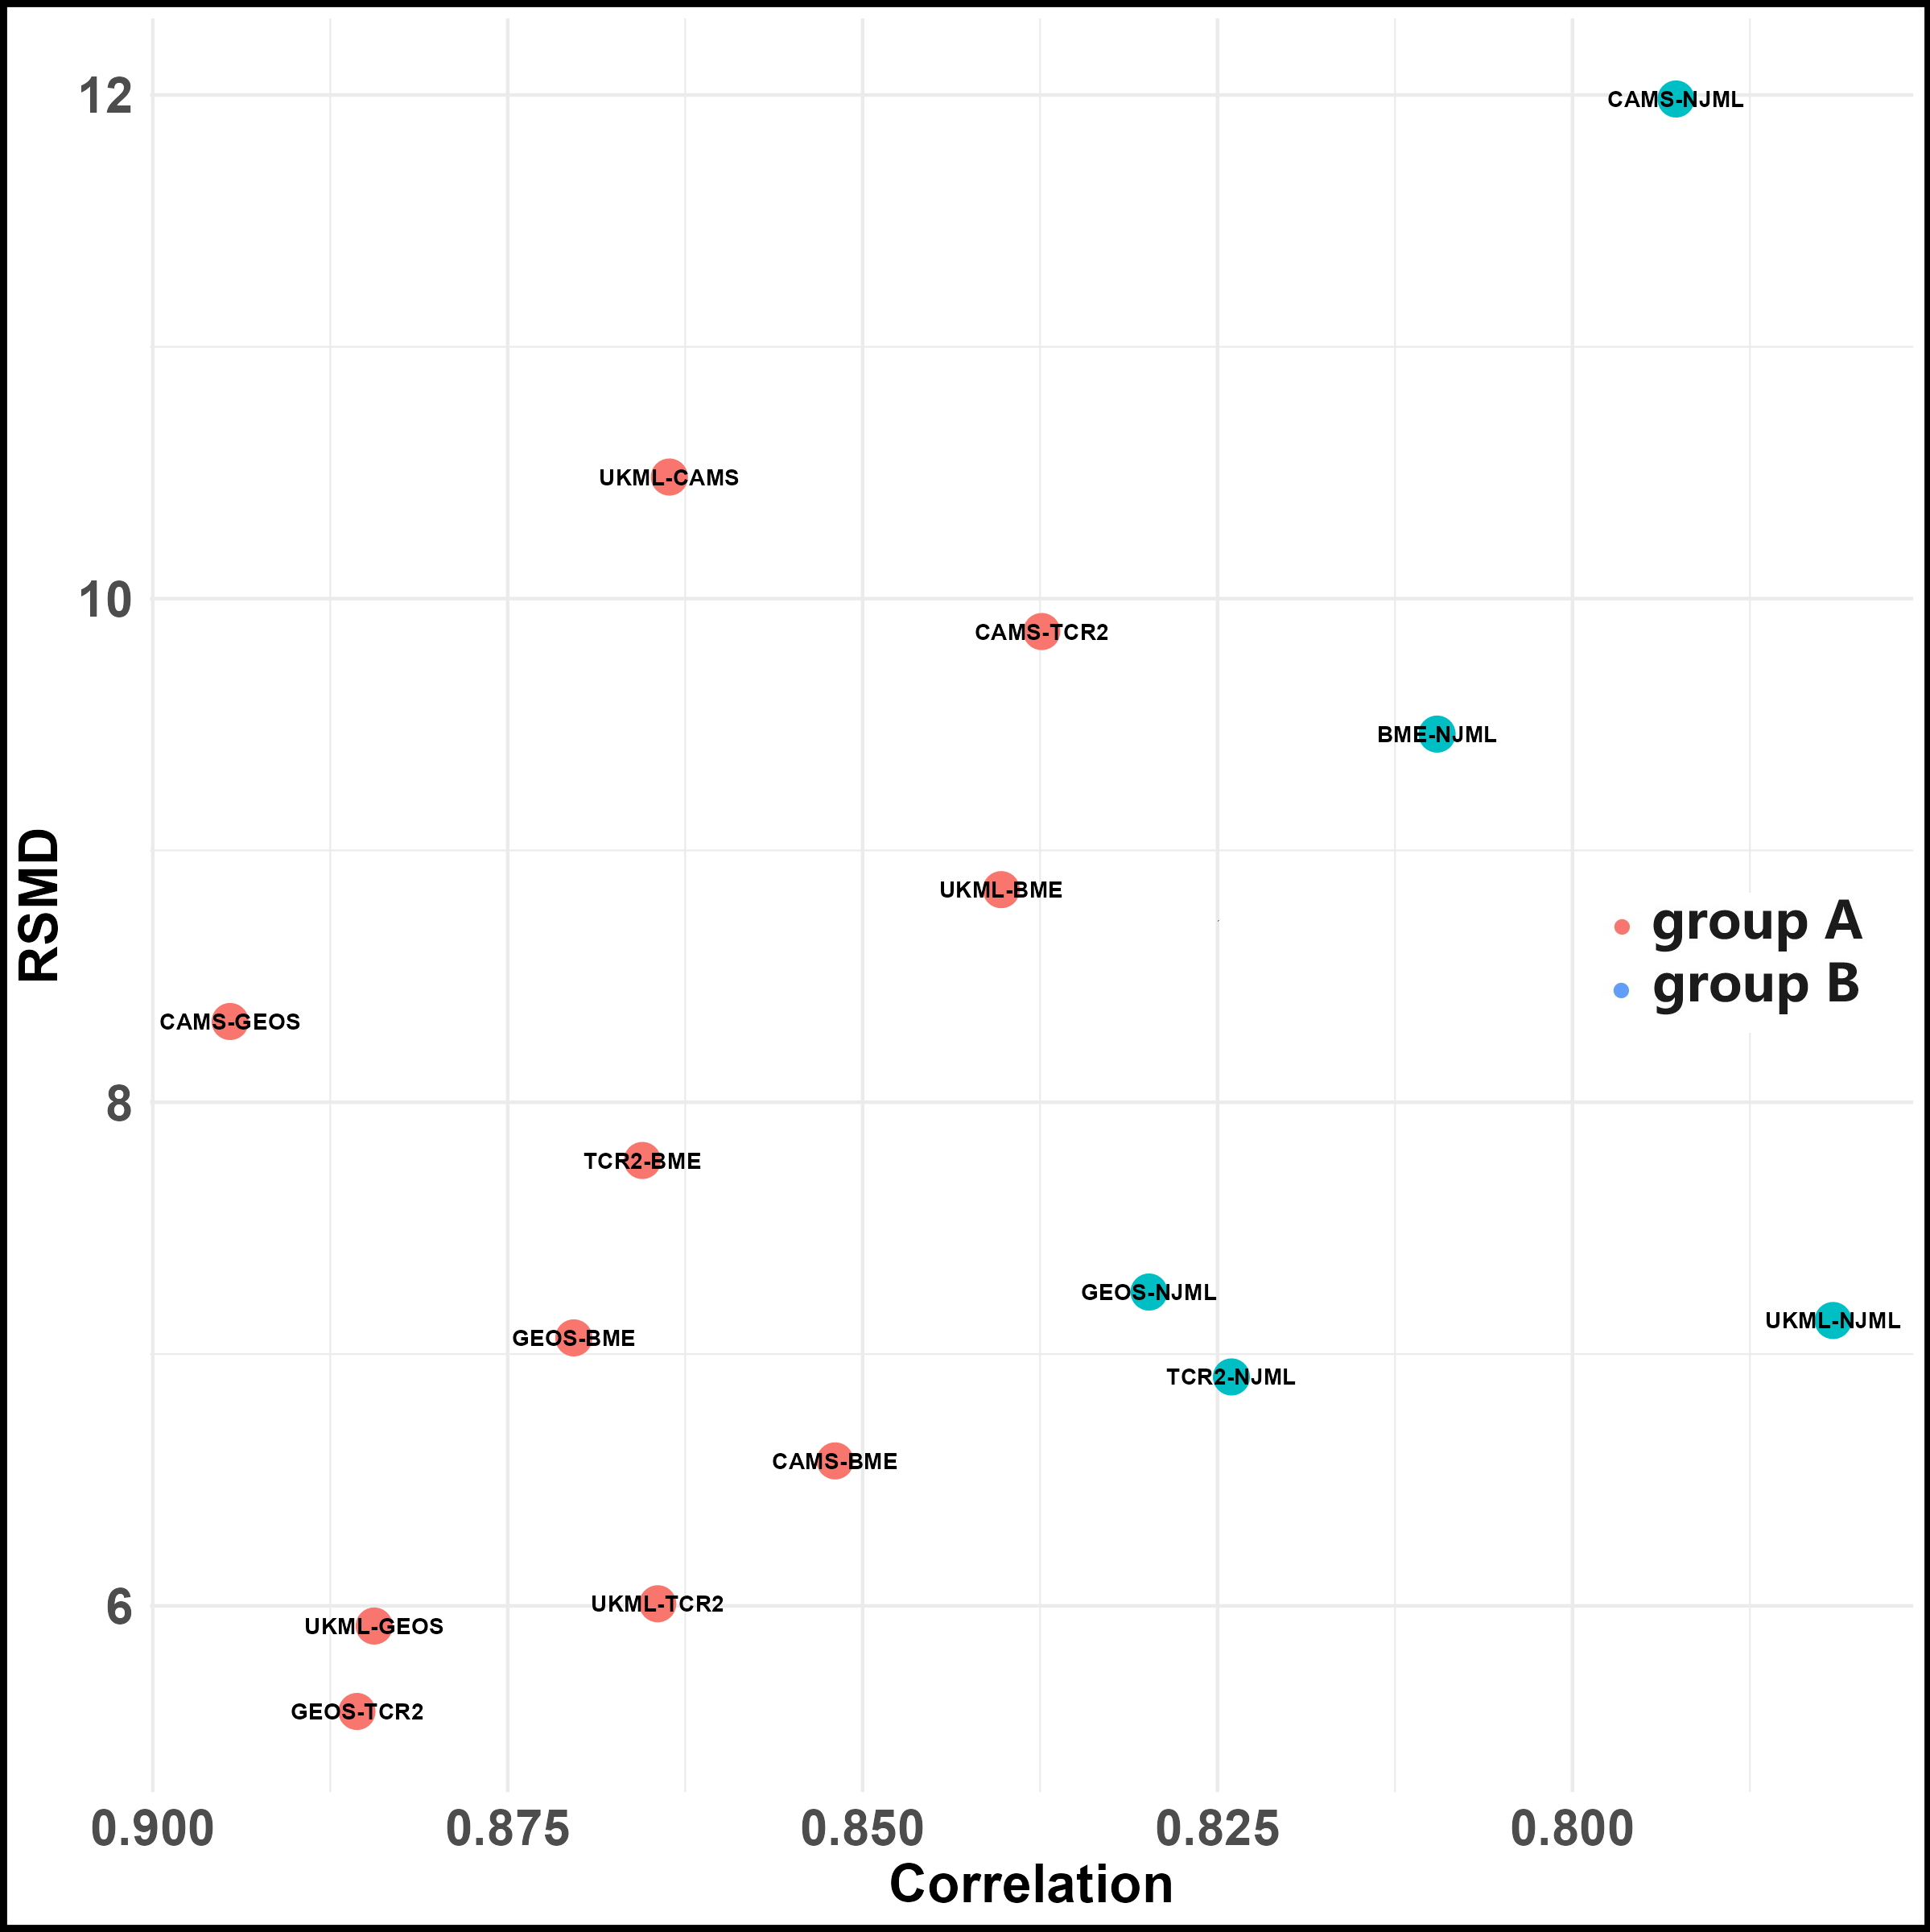
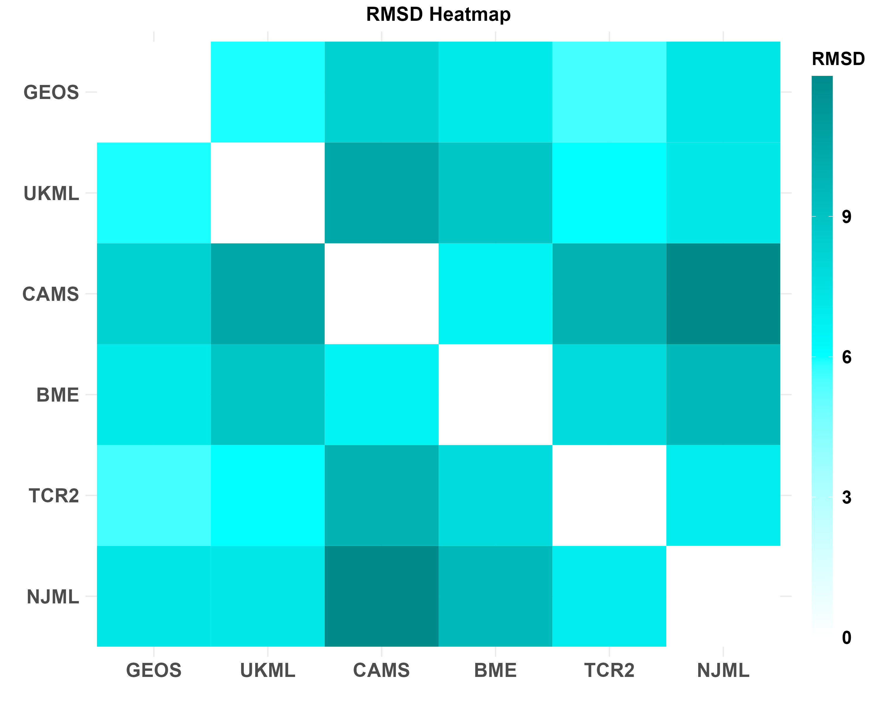
Heat map averages from 2006 to 2016
A
B
A
B

Slide 11
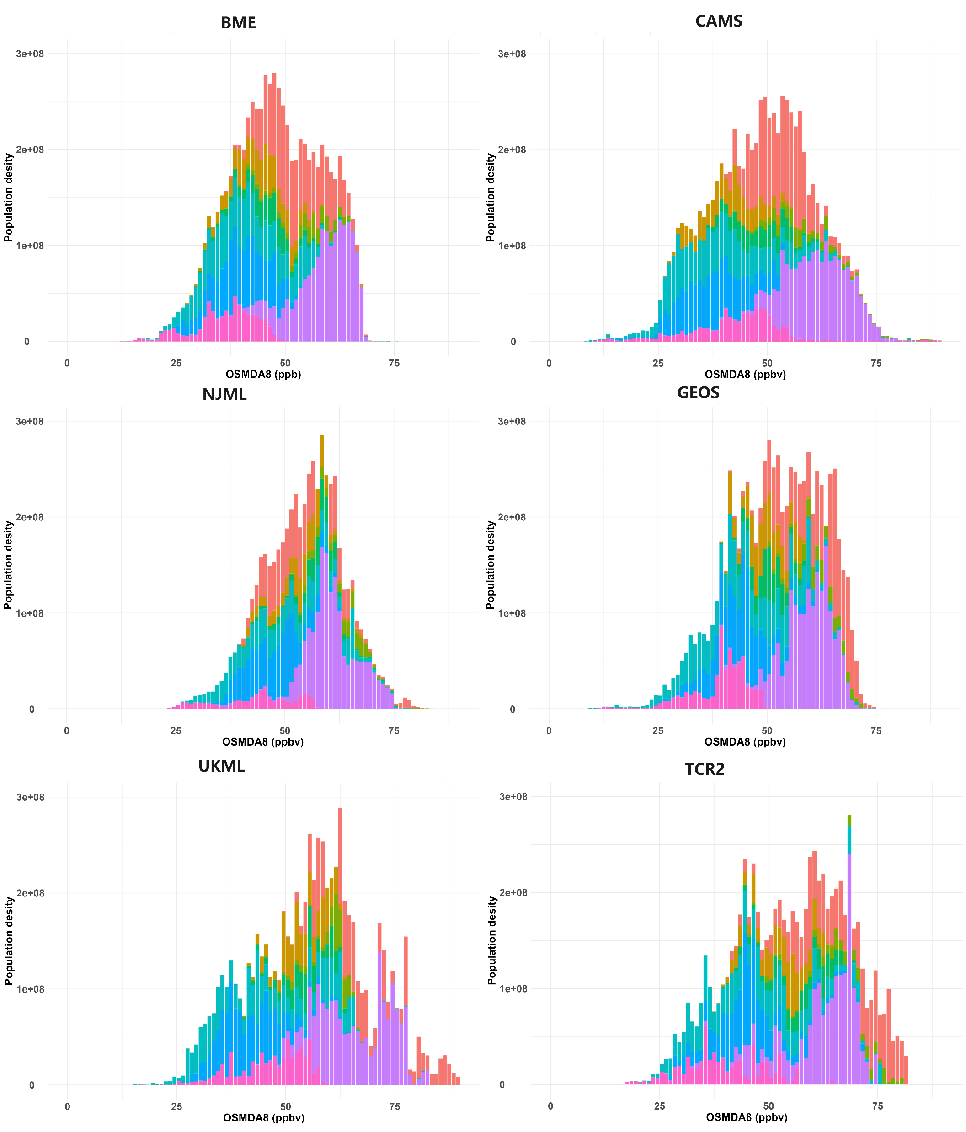
Population Density Ozone Exposure average 2006-2016
50ppb
Region | Tier 1 (Source)
EAS | E Asia: China, Korea, Japan
MDE | Middle East; S. Arabia etc, Iran, Iraq
SAS | South Asia: India, Pakistan, Nepal, Bangadesh, Sri Lanka
EUR | Western + Eastern EU+Turkey (upto 66 N polar circle)
NAM | US+Canada (upto 66 N; polar circle)
SAF | Sub Saharan Africa
SEA | South East Asia
Other | Other regions except above

Slide 12
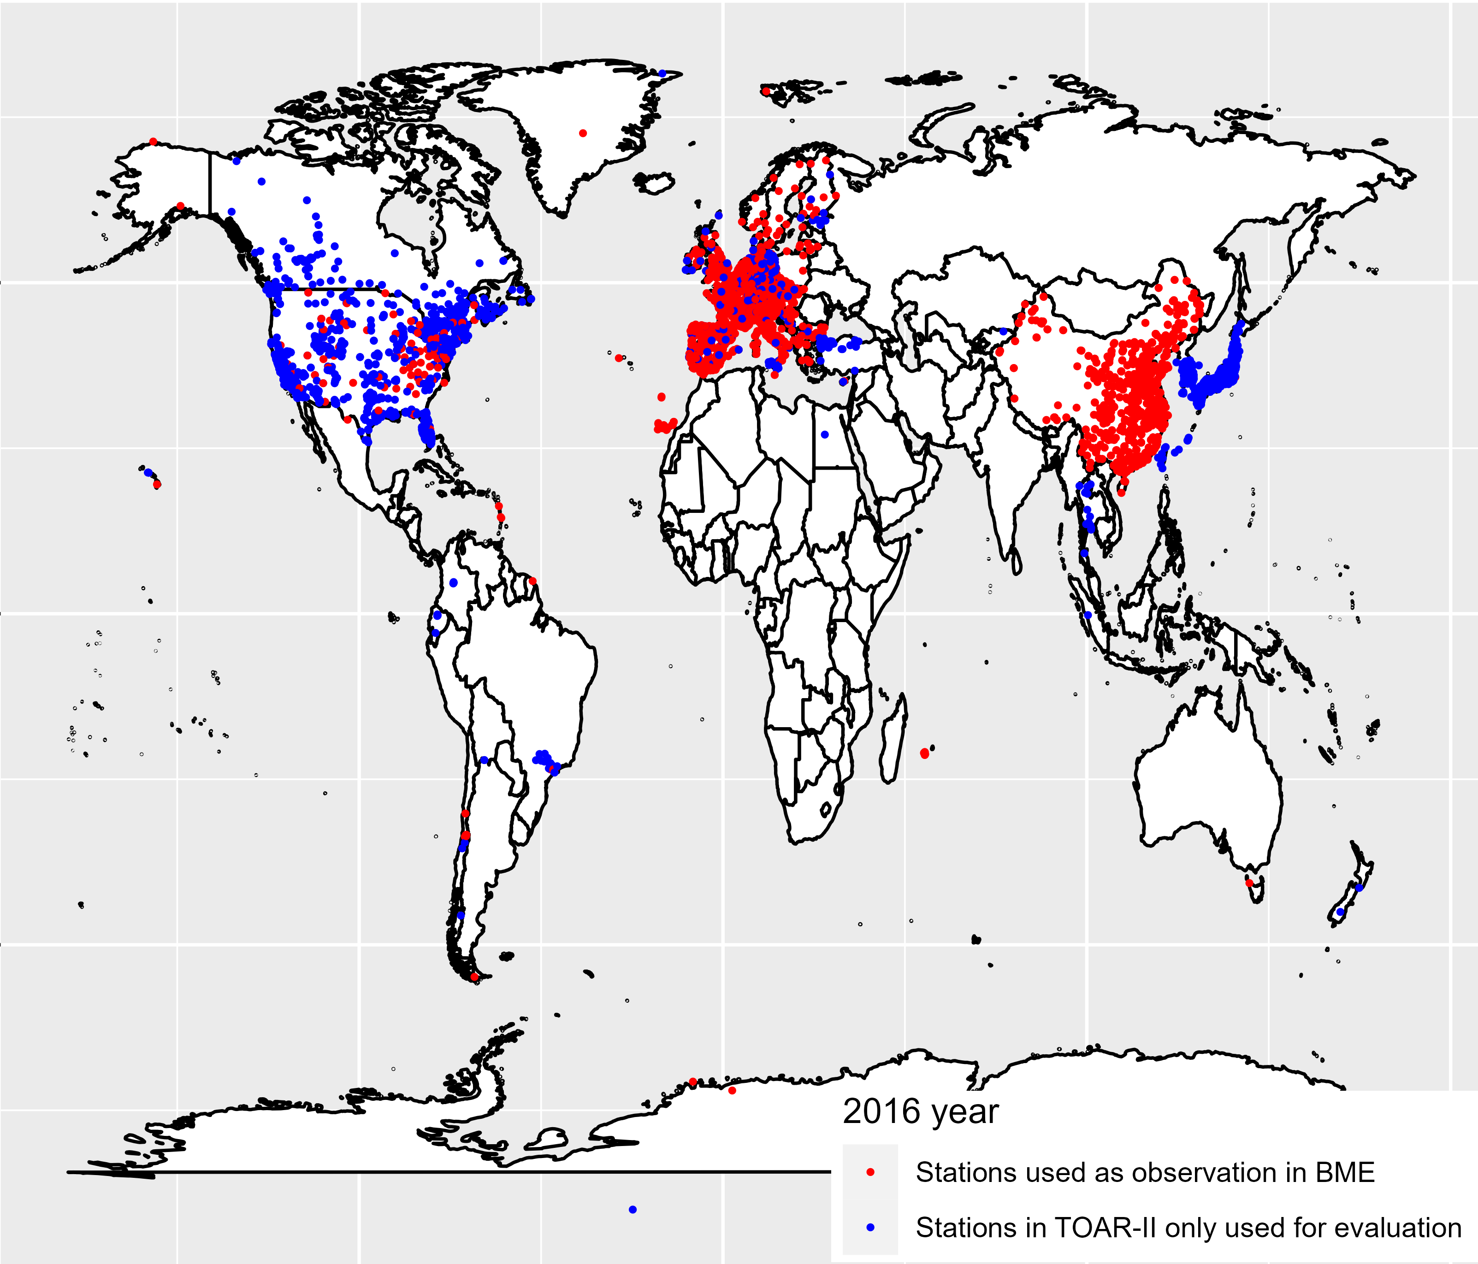
Ground-level ozone observations in 2016 Tropospheric Ozone Assessment Report (TOAR)

Slide 13
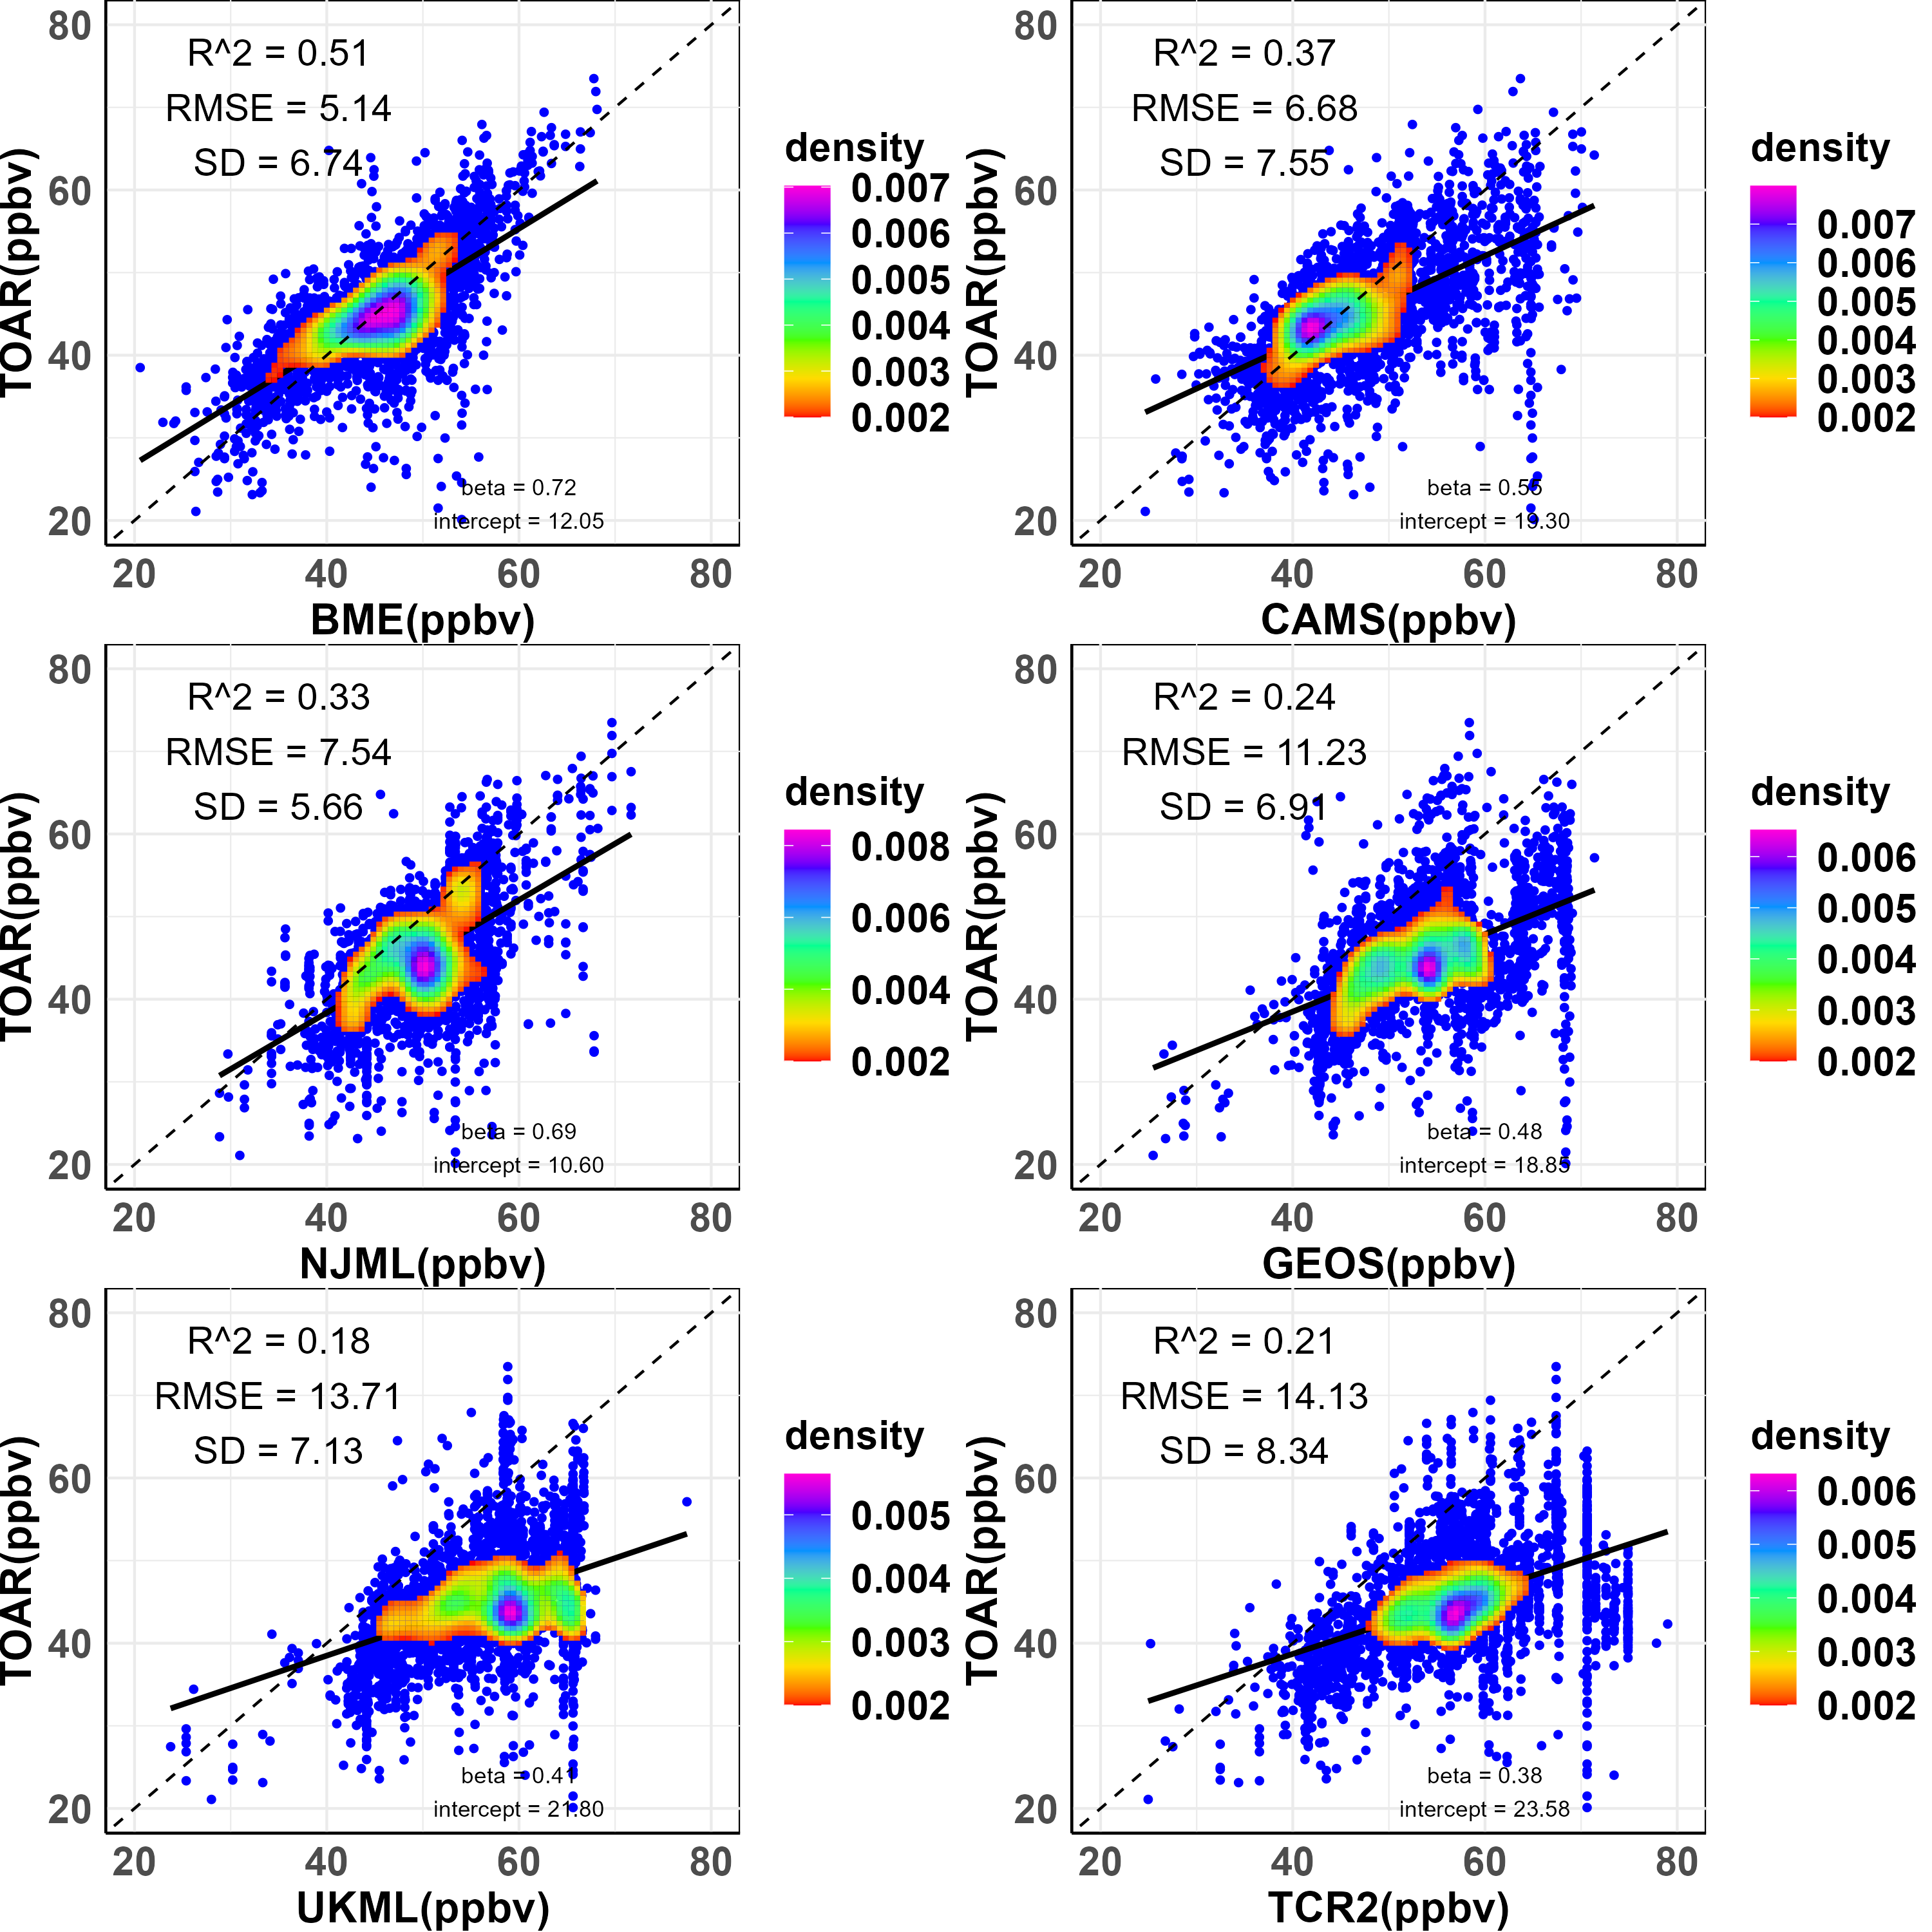
Only stations in TOAR-II not as input in 2016

Slide 14
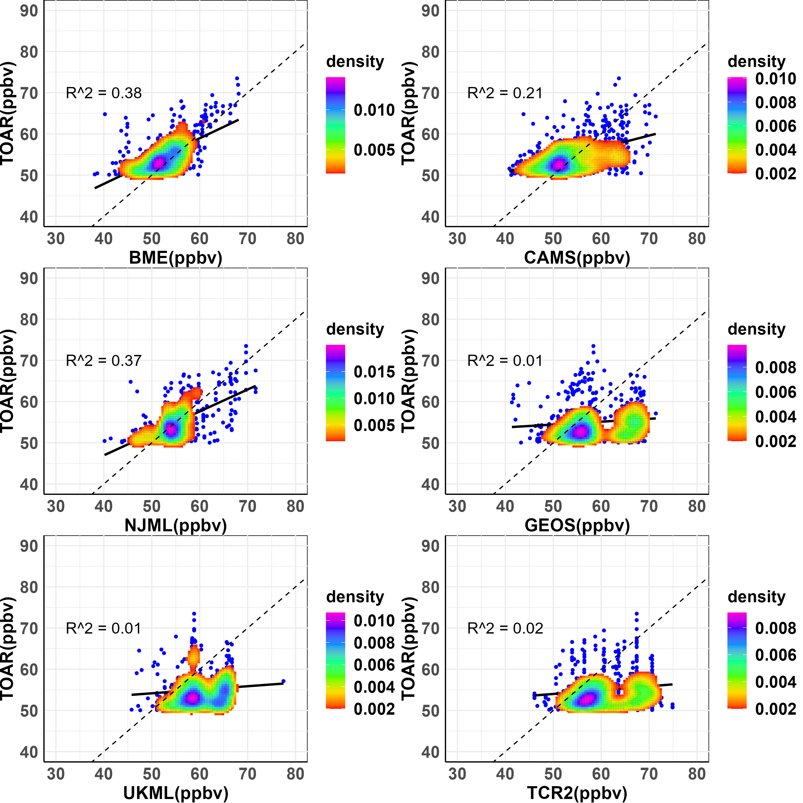
Only stations in TOAR-II not as input Above 50ppb in 2016

Slide 15
Results
The global population-weighted means exhibit substantial disparities (>5ppb). UKML and TCR2 estimate relatively high, while BME and CAMS estimate relatively low.
NJML diverges from the upward trend of other datasets.
Pairwise correlation reveals that datasets display similar spatial distribution patterns.
East Asia has the highest population exposed to ozone above 70 ppb in GEOS and TCR2, while South Asia leads in BME, CAMS, NJML and UKML for 2006-2016.
Evaluation with TOAR-II data in 2016, TCR2, CAMS, and GEOS demonstrate robust R² values, with BME exhibiting the best fit. UKML performs relatively worse.
TCR2, GEOS perform worse for observations above 50 ppb.
Reanalysis generally do not perform worse than machine learning or geostatistical methods, and there are no clear patterns of biases or performance by dataset type.

Slide 16
Conclusions
The analysis uncovered significant disparities in ozone magnitude and trends, emphasizing the need for further investigation in observation limited areas.
Ozone population-weighted concentrations exhibit regional variations between datasets, suggesting that health impact assessments may give significantly different results depending on the dataset used.

Slide 17
Thank you! and any questions?

