Slide 1
Applying satellite data assimilation to infer lightning-NO_{x} emissions in CMAQ
James D. East^{1,2}, Barron H. Henderson³, Sergey Napelenok⁴, Shannon Koplitz³, J. Mike Madden¹, Daiwen Kang⁴, Fernando Garcia Menendez²
1. ORISE Research Fellow at US EPA
2. North Carolina State University, Department of Civil, Construction, and Environmental Engineering
3. US EPA Office of Air Quality Planning and Standards
4. US EPA Atmospheric & Environmental Systems Modeling Division
Office of Research and Development
AESMD
CMAS 2022

Slide 2
Why estimate emissions by assimilating satellite data?
Secondary products of NO_{x} emitted elsewhere can impact US air quality
Accurate global emissions inventories are critical but are challenging to develop and update
Satellites, providing data in real time, offer an opportunity to bridge this data gap
Short lifetime of NO₂ along with rich dataset of NO₂ observed from space provides opportunities to estimate NO_{x} emissions using NO₂ satellite data alongside chemical transport models
Video: Nitrogen Dioxide from Aura/OMI 2013-2014,
NASA/Goddard Space Flight Center
O₃
Figure: Itahashi et al. 2020, ACP. (Figure 6),
Notes:
https://svs.gsfc.nasa.gov/30014

Slide 3
Data assimilation in CMAQ
Satellite assimilation in CMAQ provides capability to:
Constrain international emissions
Improve boundary conditions for US air quality simulations
Create fast, first-pass estimates of NOx emissions in response to unexpected changes (e.g. COVID-19)
Estimate NOx emissions from some sources with uncertainty, such as soil NOx
This presentation will:
Describe the data assimilation system and anthropogenic emissions inversion
Share new results of a targeted lightning-NOx emissions inversion
This project originated as a HAQAST Tiger Team led by Brad Pierce and Daniel Tong
Notes:
Main point: system is an advancement that utilizes latest satellite technology to fill a need and advance research

Slide 4
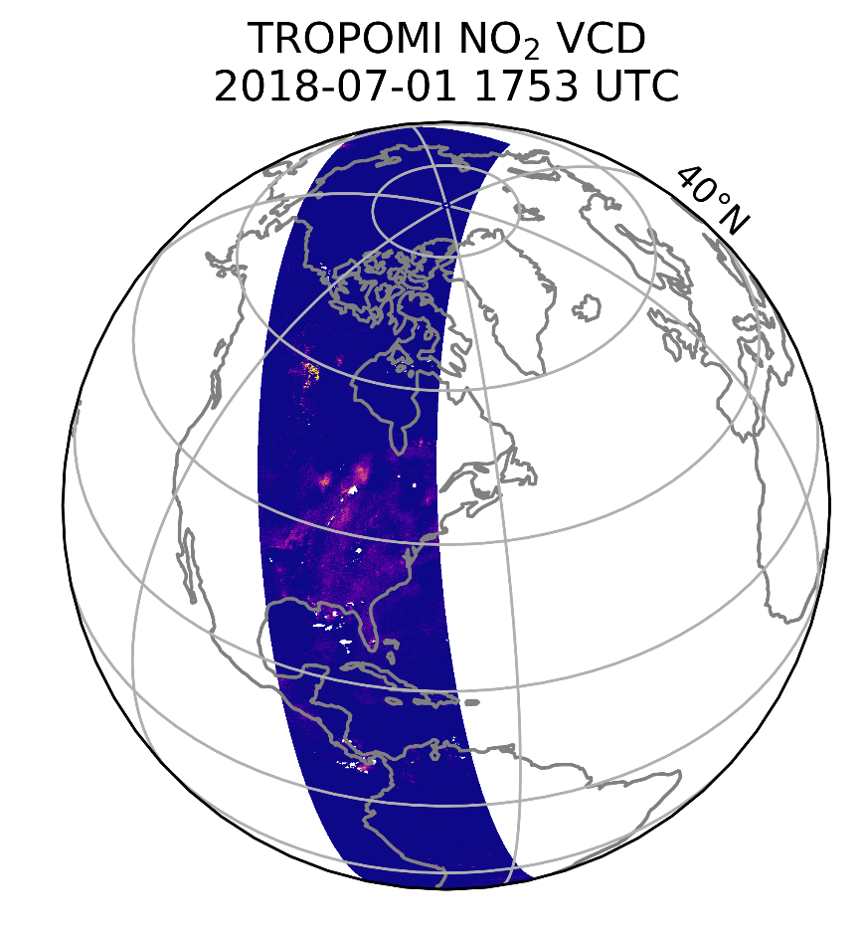
NO₂ Satellite data
TROPOMI satellite instrument
2018 launch aboard the Sentinel-5P satellite
1:30pm equatorial overpass time
Daily global coverage
3.5km x 5.5km data resolution
A low bias, particularly in urban areas, was noted in previous TROPOMI NO₂ versions
Recent updates have improved the bias
Notes:
…also provides opportunity to compare emissions inferred with OMI & TropOMI

Slide 5
NOx emissions inversion
To estimate emissions, we iterate the finite-difference mass-balance (FDMB) method
Typically, $ΔΩ$ is calculated as the difference between the model and satellite VCD
In our approach, $ΔΩ$ is the difference between the model VCD with 3D-var assimilation and the model VCD without 3D-var assimilation
$$\frac{ΔE}{E}=β\frac{ΔΩ}{Ω}$$
$E$ is NO_{x} emissions
$Ω$ is the NO₂ vertical column density (VCD)
$β$ is the sensitivity of the modeled NO₂ vertical column density to a change in emissions, created by finite differencing in the model
FDMB introduced in Lamsal et al. 2011

Slide 6
Data assimilation in CMAQ
3D-variational data assimilation produces a statistically optimal combination of modeled and satellite-observed NO₂
It accounts for uncertainties in the model and satellite retrieval
In effect, 3D-var “nudges” modeled concentrations closer to the satellite retrieval
In this framework, 3D-var is coupled to CMAQ online, updating model NO₂ concentrations at each timestep that coincides with a satellite retrieval
CMAQ
Prior NO_{x} Emissions
FDMB NO_{x} Inversion
Posterior NO_{x} Emissions
CMAQ+3D-var
Satellite retrievals
background errors

Slide 7
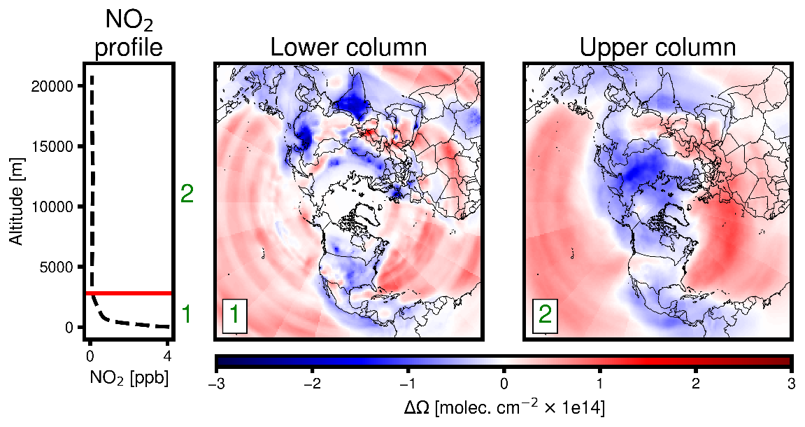
Emissions updates
Change due to satellite assimilation,
separated by vertical level
Upper troposphere $ΔΩ$ ≠ near-surface $ΔΩ$
Greater sensitivity of satellite to upper troposphere
Upper troposphere lengthscales > near-surface lengthscales
In typical FDMB, this can lead to misallocations for surface emissions
How to address this?
Refine lighting NO_{x} emissions to reduce model bias in the upper troposphere
Data assimilation allows us to split the modeled column into upper and lower
In our framework for updating anthropogenic inversion, emissions are updated in 2 steps:
Update lightning NO_{x} emissions in a single iteration
Update anthropogenic NO_{x} emissions iteratively
Framework and emissions inversion:
East et al. 2022. Inferring and evaluating satellite-based constraints on NO_{x} emissions estimates in air quality simulations. ACPD [preprint], https://doi.org/10.5194/acp-2022-435
Notes:
𝚫𝛀 is shown for one iteration of assimilating July 2019 TROPOMI NO2 with background errors for the boundary layer and LNOx emissions updates applied.

Slide 8
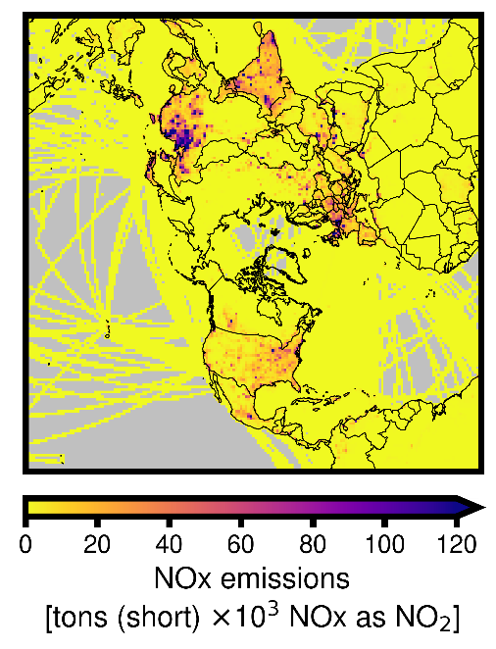
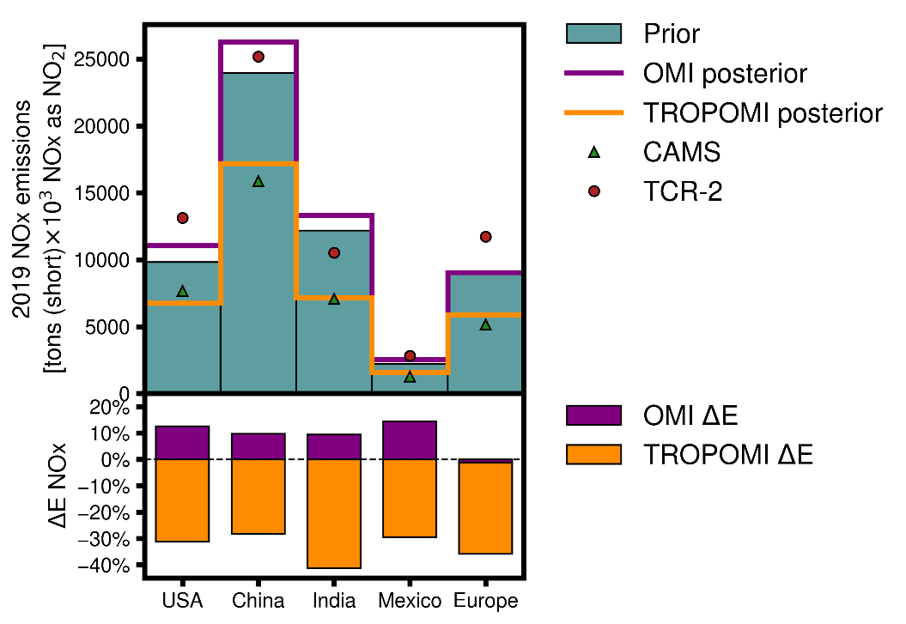
Anthropogenic emissions inference
Inversion system was applied to infer 2019 NO_{x} emissions using OMI and TROPOMI
Results showed diverging estimates for OMI and TROPOMI
Large decreases inferred by TROPOMI were attributed to low bias in previous version
Prior NO_{x} emissions
Inverse estimates
CAMS = 2019 inventory from the Community Atmosphere Monitoring Service
TCR-2 = 2019 inventory from the Tropospheric Community Reanalysis 2
Framework and emissions inversion:
East et al. 2022. Inferring and evaluating satellite-based constraints on NOx emissions estimates in air quality simulations. ACPD [preprint], https://doi.org/10.5194/acp-2022-435

Slide 9
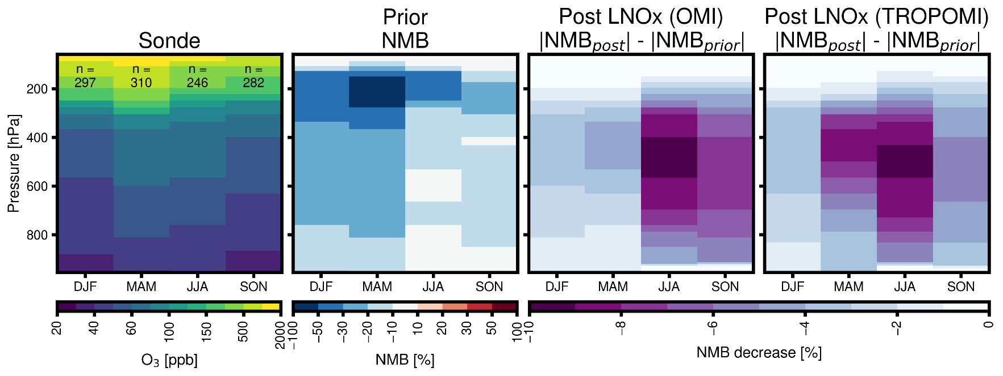
Impact of lightning updates
Before updating anthropogenic emissions, lightning NO_{x} (LNO_{x}) emissions were inferred
Initial LNO_{x} updates, based on climatological emissions, showed impact on upper troposphere ozone
Recent development of a LNO_{x} observation-based inventory for CMAQ and the large impact of LNO_{x} on ozone bias in previous work motivate a more refined, targeted approach to infer lightning NO_{x} emissions

Slide 10
Study design
Lightning NOx inversions
LNOx Emissions | Satellite NO₂ retrievals
GEIA climatological | TROPOMI v2.3.1 (cloud screened)
WWLLNs | TROPOMI v2.3.1 (cloud screened)
WWLLNs | TROPOMI v2.3.1 (not cloud screened)
Here, 2019 lightning-NOx emissions in CMAQ for the northern hemisphere are inferred using v2.3.1 TROPOMI retrievals
Two prior emissions inventories are used:
GEIA climatological
Worldwide Lightning Location Network (WWLLNs) derived emissions for hemispheric CMAQ
For WWLLNs, a separate inversion using NO₂ satellite retrievals with clouds is performed
CMAQ Simulation inputs
Anthropogenic NOx emissions | 2019 OMI-inferred
Non-NOx Emissions (North America & rest of hemisphere) | 2017 EPA platform
Non-NOx Emissions (China) | 2015 Tsinghua University
Meteorology | 2019 WRF
CMAQ WWLLNs lightning NOx emissions:
Kang, D. et al. Assessing the Impact of Lightning NO_{x} Emissions in CMAQ Using Lightning Flash Data from WWLLN over the Contiguous United States. Atmosphere 2022, 13, 1248. https://doi.org/10.3390/atmos13081248

Slide 11
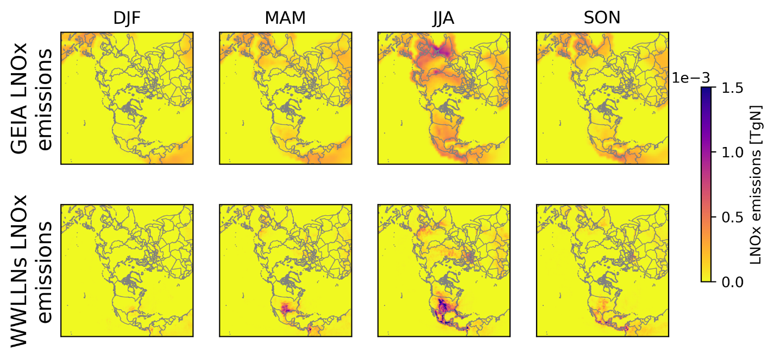
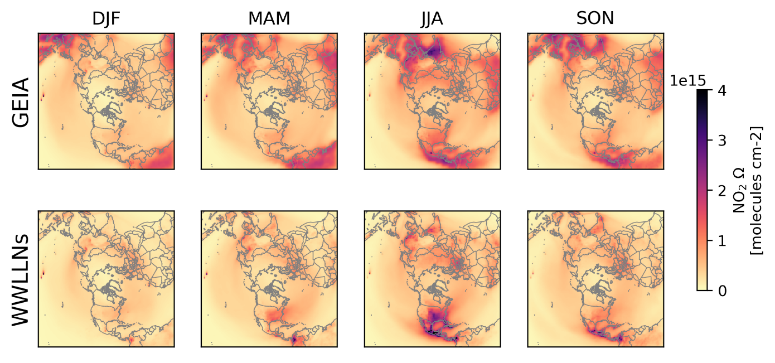
Lightning NO_{x} emissions
LNO_{x} emissions
Upper troposphere NO₂ VCD
Outside North America, GEIA > WWLLNs
Upper troposphere column is largely controlled by LNOx emissions
See presentations by Mike Madden and Daiwen Kang for more WWLLNs details and model impacts!
Notes:
Column cutoff roughly ~720 hPa
GEIA = climatological
WWLLNs = year-specific

Slide 12
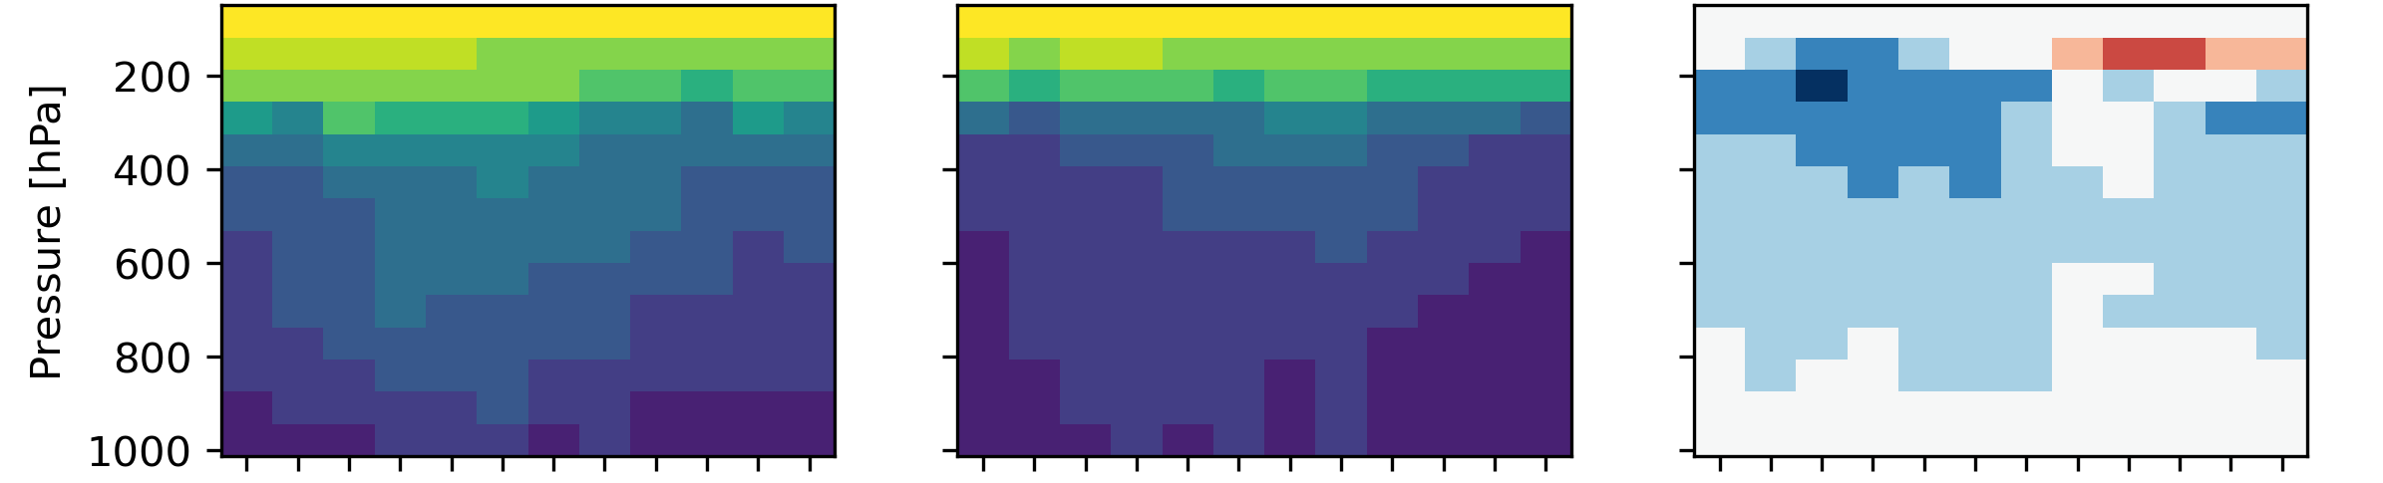
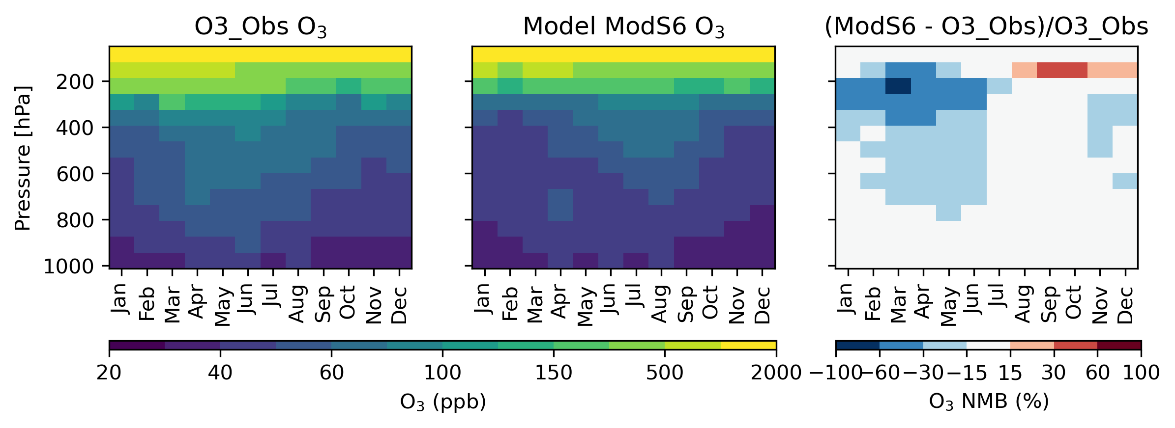
Simulated ozone using prior emissions
WOUDC ozonesonde
CMAQ ozone
NMB
Each case initialized with 1-year spinup
All cases are low-biased for ozone
Bias is at its worst in the winter and spring
WWLLNs
GEIA
Notes:
~1100 releases

Slide 13
Assimilation results
Upper troposphere NO₂ $Δ$VCD due to assimilating satellite NO₂
Assimilating TROPOMI NO₂:
Leads to increases in model NO₂ in all cases
Leads to indirect impacts on ozone, decreasing but not erasing model springtime bias
VCD using GEIA a priori increases more than VCD using WWLLNs a priori, but at different latitudes
Splitting the column reduces the anthropogenic emissions signal in $Δ$VCD
GEIA
WWLLNs
Bias against
ozonesonde

Slide 14
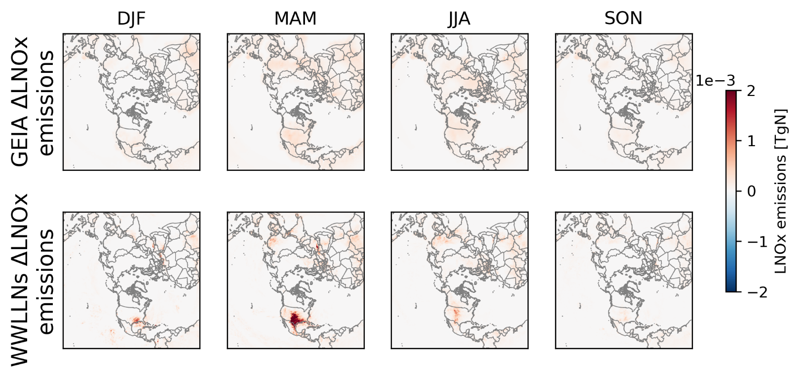
Inferred emissions
The FDMB inversion leads to:
Widespread increases for GEIA
Increases with hotspots in North America, elsewhere for WWLLNs
Larger relative springtime increases for WWLLNs
The background error covariance and $β$ play major roles in determining emissions changes
Changes are restricted to areas where model emissions already exists, highlighting importance of prior inventory

Slide 15
Impact of cloud filtering
GEIA and WWLLNs assimilation includes only “cloud free” scenes
<30% clouds in the satellite pixel
Including all scenes, regardless of clouds:
Increased NO₂ in mid-latitudes
Did not have a large overall emissions impact
Note: scales are much smaller!
∆NO₂ VCD
Inferred
emissions

Slide 16
Conclusions and next steps
Assimilating TROPOMI NO₂ increases model NO₂ in all emissions cases
Assimilating NO₂ leads to indirect impacts on ozone, improving model bias against ozonesondes
Emissions inversion indicates LNOx is underestimated by both GEIA and WWLLNs
In both cases, geographic distributions largely reflect the prior inventories
Using cloudy scenes did not lead to significant emissions impact, on average, but may have more localized impacts
Future work may include:
Evaluate the updated emissions comparing model predictions against different types of observations (airborne, sonde, satellite, surface)
Iterating FDMB inversion
Exploring impact of cloud filtering on finer scales

Slide 17
Thank you!
east.james@epa.gov
Disclaimer: The views expressed in this presentation are those of the authors and do not necessarily represent the views or policies of the U.S. Environmental Protection Agency.
Acknowledgement: James East is supported in part by an appointment to the ORISE participant research program supported by an interagency agreement between the U.S. Environmental Protection Agency (EPA) and the U.S. Department of Energy (DOE).

