Slide 1
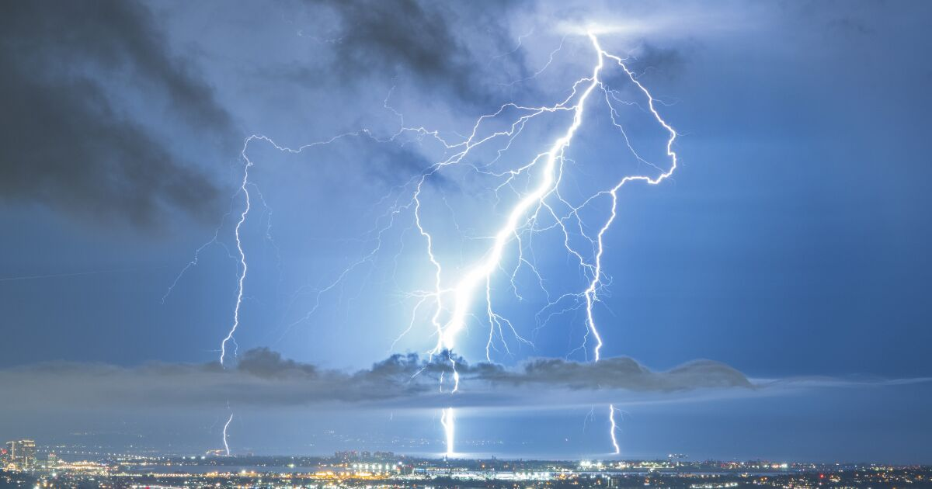
Introducing Geostationary Lightning Mapper Nitrogen Oxides (GLM-NOx) Emissions Processor and its Application in 2019 Air Quality Simulations
Arastoo Pour Biazar¹, Yuling Wu¹, Peiyang Cheng², William Koshak³, Andrew White⁴, Maudood Khan⁵, Richard T. McNider²
Earth System Science Center, University of Alabama in Huntsville, Huntsville, Alabama
Atmospheric Science Dept., University of Alabama in Huntsville, Huntsville, Alabama
NASA-Marshall Space Flight Center, Huntsville, Alabama
NASA SPoRT Center, Huntsville, Alabama
Booz Allen Hamilton DC, Washington, DC, United States
Presented at:
21st Annual Community Modeling and Analysis System (CMAS) Conference October 17-19, 2022 Friday Center, University of North Carolina, Chapel Hill, NC
Notes:
Hello everyone. Thank you for listening to this presentation. I’ll be presenting some preliminary results from air quality simulations using satellite-derived lightning NO emission estimates for 2019. First I would like to acknowledge the people who have contributed to this work. YuLing Wu who has done most of the work in creating the software tool for producing the emission estimates, Peiyang Chang who performed the air quality simulations, Bill Koshak who has been instrumental in moving this project forward, Maudood Khan for his contribution to the emissions processing, Andrew White and Dick McNider for his contributions to different aspects of this work.

Slide 2
Background & Motivation
Lightning-generated NO (LNO) is an important source of NO_{x} (NO_{x}=NO+NO2) in the troposphere and a major contributor to the free tropospheric ozone.
It is estimated that lightning-generated NOx (LNOx) accounts for about 10-15% of global NOx emissions, and about 80% of upper tropospheric NOx (Kang et al., 2019).
Studies show that over the U.S. LNOx can account for 14% of total July NOx emissions (Zhang et al., 2003) and up to 73% of upper tropospheric NOx (Allen et al., 2010).
As anthropogenic NOx emissions are decreasing over the United States, it is important for the regional air quality models to account for LNOx in their simulations.
In this study, Geostationary Lightning Mapper (GLM) observations are used to estimate LNO for use in an air quality simulation over the summer of 2019.

Slide 3
Issues With Estimating LNOx for Input in Air Quality Simulations
Large uncertainty in per flash production rate. Latest studies and review papers suggest consensus around 250-500 mole/flash
The uncertainty is partly due to applying regional/local limited results for attaining global budget:
$G=γ\overline{P}F$ where $γ$ is conversion factor (e.g. to TgN/yr), $\overline{P}$ is the average production rate (350-500 mole/flash for CMAQ), and $F$ is the total number of flashes.
Model uncertainties due to lightning detection: count, location, classification
Geographical differences affecting classification for both space-borne and ground-based detection(Ni et al., 2021; Rudlosky 2014; Bandholnopparat et al., 2020)
Vertical distribution of estimated LNO, model environment: based on the observed location or where the storms are in the model

Slide 4
The Approach Used in the Current Study
Based on Koshak (2018) LNOx calculated directly from flash optical energy observed by GLM:
LNOx production for the k^{th} flash
$P_{k}=\frac{Y}{N_{A}}Q_{k}$
$Q_{k}$: actual energy of the k^{th} flash
$Y$: thermo-chemical yield of NOx ($\sim {10}^{17}$ molecules/joule)
$N_{A}$: Avogadro’s number ($=6.022×{10}^{23}$ molecules/mole)
Assuming that $\overline{P}=\frac{Y}{N_{A}}\overline{Q}$ and $\overline{E}=β\overline{Q}$ , where $\overline{E}$ is the average optical energy from all the flashes detected by GOES-16/17 GLM for multiple years and over the entire domain, and $β$is an average scale factor representing the fraction of actual lightning optical energy reaching the satellite, then
$$β=\frac{Y}{N_{A}}\frac{\overline{E}}{\overline{P}}$$
By allowing $\overline{P}=250$ mol/flash, Using GLM16/17 optical energy for 2019-2021 we obtained $β$= 1.5336x10⁻²²
$P_{k}=\frac{Y}{{β N}_{A}}$ $E_{k}$
Variations in LNOx produced is realized through variations in optical energy, E_{k}.

Slide 5
GLM Detection Characteristics & Definition of a Lightning Flash
8-14 km spatial resolution
2 ms integration window (500 frames/s)
A narrow spectral band (~1 nm) centered on 777.4 nm (near IR)
Detector array: 1,372 by 1,300 pixels
Flash is defined as a set of groups separated in time by no more than 330 ms and in space by no more than 16.5 km
EVENT: An optical pulse above the background threshold for a single pixel during a single frame. (RED DOTS)
GROUP: Two or more adjacent events within the same integration time frame (2 ms). A group may consist of only one event or include many events.
FLASH: One to multiple optical pulses within a specified time and distance. A flash is a set of groups sequentially separated in time by 330 ms or less, and in space by no more than 16.5 km (no more than 3 s).
Goodman et al., 2010; Zhang et al., 2020

Slide 6
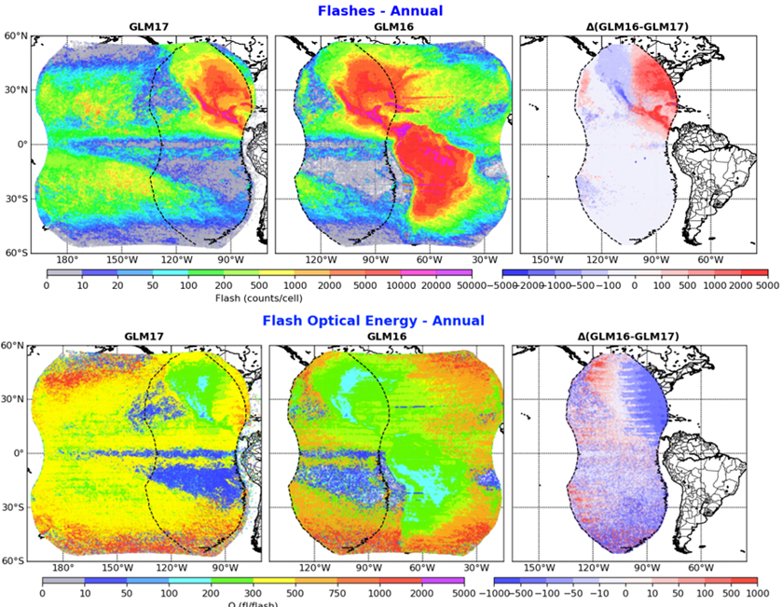
GLM-16 and GLM-17 Coverage – Feb. 2019 to Feb. 2021
More flashes over land
Detection efficiency decreases as viewing angle increases; thus the difference between GLM16 and 17 (over CONUS and ocean)
Ratio of GLM16 flashes to GLM17 flashes. The vertical dashed line indicates 106.2⁰W that is right in the middle between GLM16’s center longitude at -75.2⁰W and GLM17’s at -137.2⁰W. The numbers in the individual plot title are the ratios: the 1st number is the ratio for the entire CONUS and the two numbers in the brackets are ratios for West and East of 106.2⁰W, respectively.
Wu et al., 2022

Slide 7
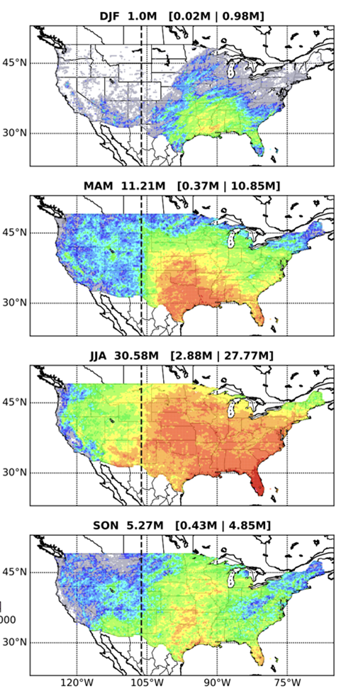
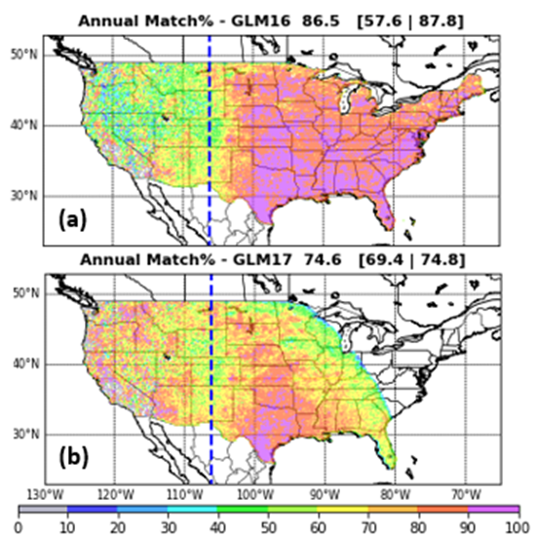
Merged GLM-16/17 Over CONUS
Geographical variation of annual mean (a) overall, (b)-(c) diurnal, (d)-(g) seasonal lightning flashes over CONUS from GLM observation compiled for the period of March 2019 through December 2021. GLM16/17 data are used east/west of 106.20W
 | GLM16 |  |  | GLM16* |  |  | GLM17
 | All | West | East | All | West | East | All | West | East
Flashes (10⁶) | 42.09 | 1.74 | 40.41 | 36.78 | 1.74 | 35.04 | 26.17 | 2.52 | 23.71
Annual (%) | 86.5 | 57.6 | 87.7 | 86.3 | 57.6 | 87.7 | 74.6 | 69.4 | 74.8
Day (%) | 83.0 | 53.2 | 84.7 | 82.5 | 53.2 | 84.4 | 67.0 | 65.1 | 67.1
Night (%) | 90.4 | 67.3 | 91.0 | 90.4 | 67.3 | 91.1 | 82.6 | 79.2 | 82.7
Matching NLDN-CG flashes to GLM flashes, percentage of NLDN-CG flashes matched to flashes detected by (a) GLM16 and (b) GLM17; The vertical dashed line indicates the 106.2 0W longitude. The three numbers in the title bars of (a) and (b) are the matching percentage for the overall, west, and east of the longitude divide, respectively.

Slide 8
Flow Chart of GLM LNOx model
download_glm.csh
1. download
<yyyymmdd>/OR_GLM-L2-LCFA_G*.nc
3. β, IC/CG and correction
(2 years, CONUS only)
2. Pre-processing
getGLMflash.csh
get_GLMflashesGroups.py
β
GLMems_beta.py
Alternative
route
Total LNOx
GLM<##>_Flash_<yyyymmddhh>.nc
GLMems_betaCorr.py
Correction for β
Corrector
run_GLMems.csh
proc_glmEms.py
GLM input
Re-gridding
Output 2D
IC/CG ratio
LNOx vert distribution
Output 3D
5. Emission estim. Re-gridding Vertical distribution
IC_TO_CG_<CF/GF>.nc
eval_GLM_NLDNcg.py
Get IC/CG
IC/CG_NOx_profiles
<prefix>2D_<date_time_string>.nc
<prefix>_<date_time_string>.csv
NLDN – CG
Model elevation + terrain
4. GLM detection against NLDN
Dashed line – input
Solid line – output
Long dash – output + input
<prefix>3D_<date_time_string>.nc

Slide 9
2019 WRF/CMAQ Simulations
Animation shows hourly and daily total LNOx estimates for Aug. 9-14, 2020
LNOx accounted for 10-20% of total daily NOx emissions (average for the month of August 2019 was 13%)

Slide 10
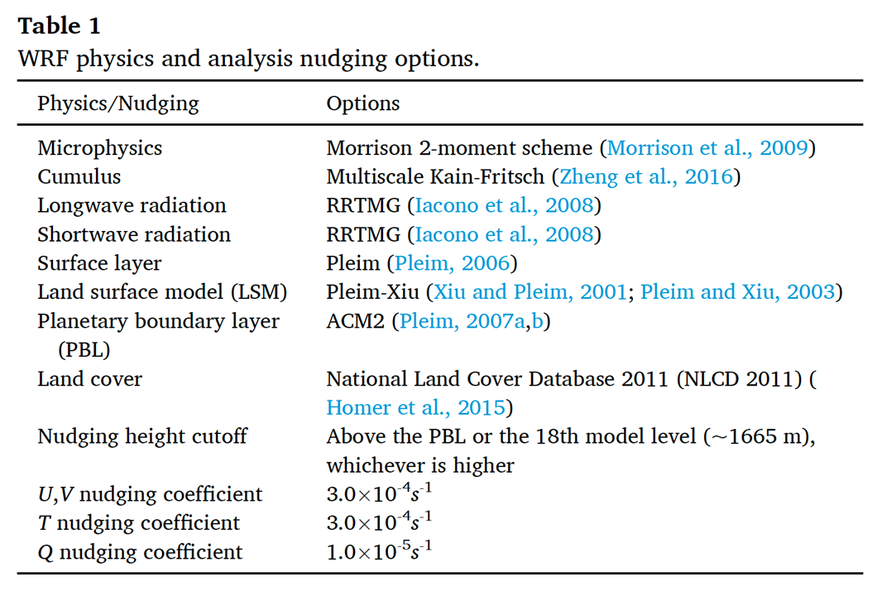
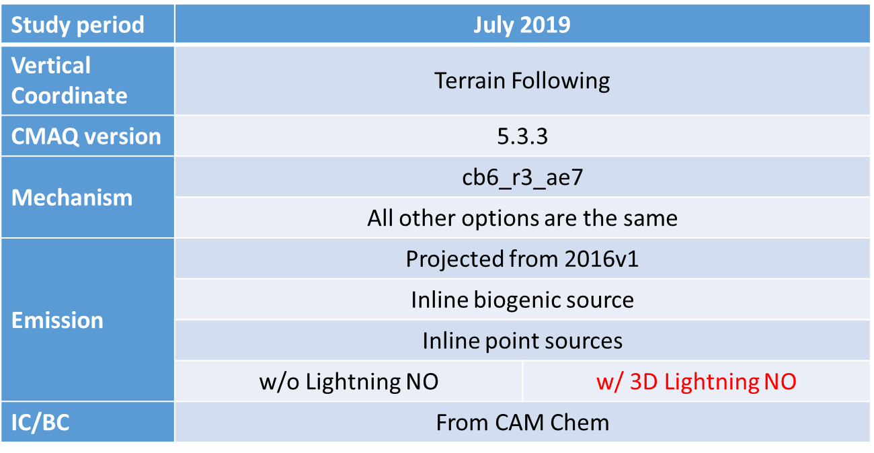
WRF/CMAQ Simulations – June-September, 2019
WRF v4.1.4 Configuration
CMAQ 5.3.3 Configuration
50 vertical layers, with more layers at the tropopause
Performed a control simulation (CNTRL) and another simulation with the addition of LNOx.
Lateral BC was obtained from CAM-Chem

Slide 11
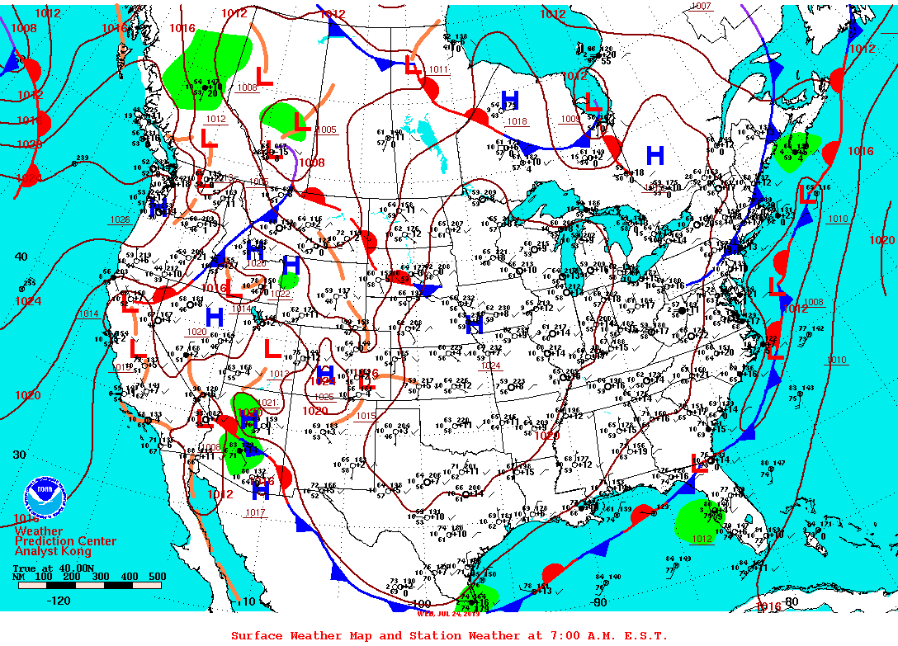
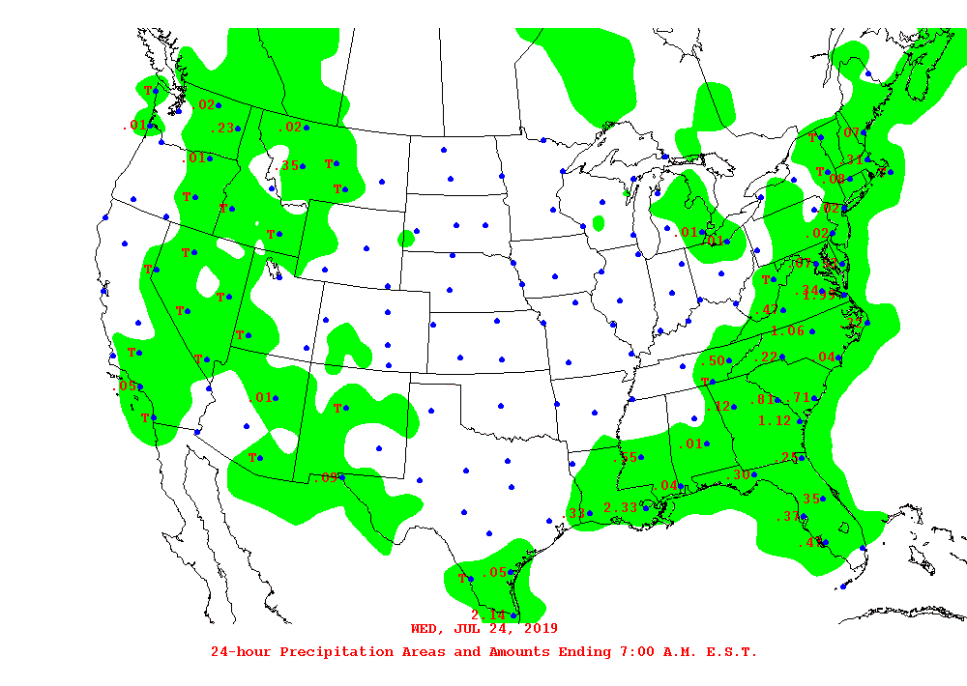
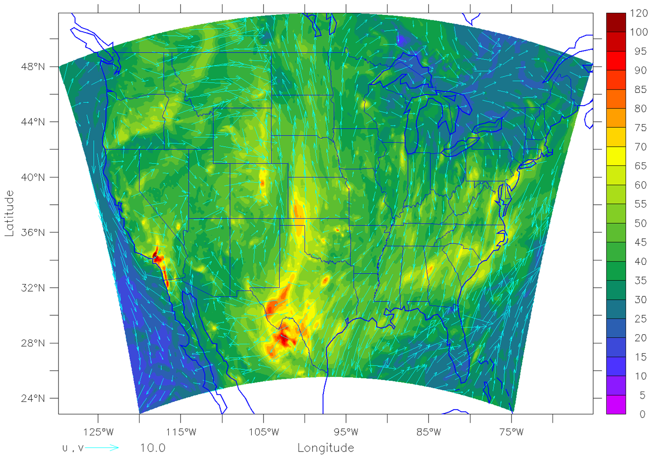
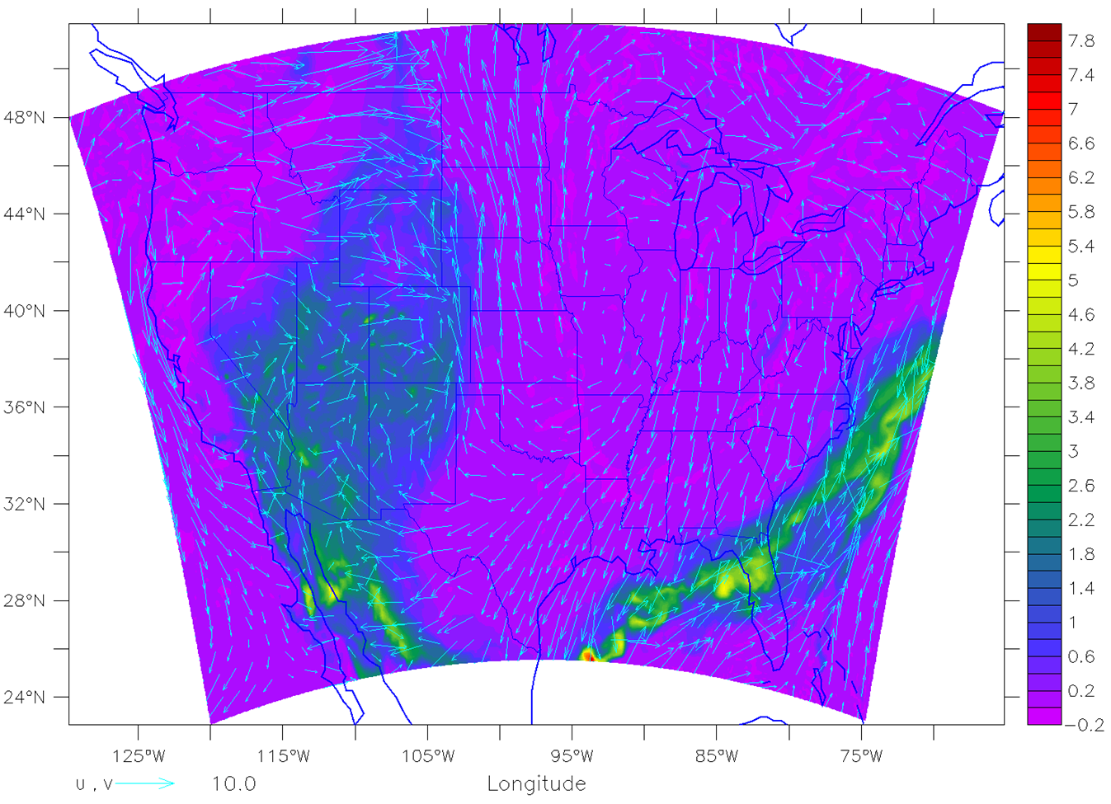
Surface Ozone for July 24, 2019, 20:00 GMT
Surface Weather Map for 7:00 A.M. EST, July 24, 2019
24 hr. Precipitation for July 24, 2019
Surface Ozone Concentratio, July 24, 2019 @20:00 GMT
Difference in Surface Ozone between Lightning and Control Simulation for July 24, 2019 @20:00 GMT
(LNOx-CNTRL)

Slide 12
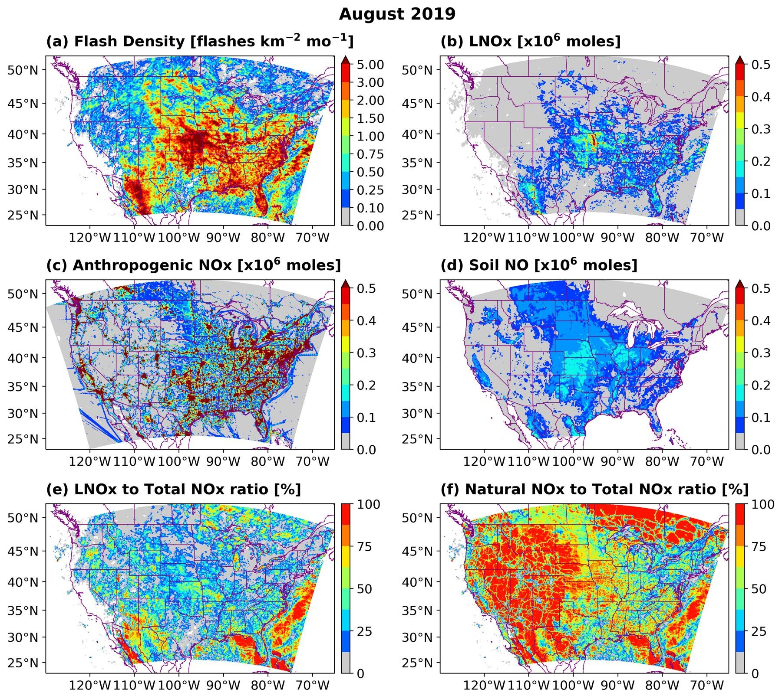
Lightning NOx Produced During the Summer of 2019
Monthly domain total NO_{x} emissions from lightning, anthropogenic, and soil sources. Round brackets present the contribution percentages of different sources to the total NO_{x} budget.
Spatial distribution of monthly flash density, NO_{x} emissions from different sources, and contributions of lightning/natural sources to total NO_{x} emissions for August 2019. (a) Flash density, (b) LNO_{x} emission, (c) anthropogenic NO_{x} emission, (d) soil NO emission, (e) the percentage of LNO_{x} to total NO_{x} emissions, and (f) the percentage of natural to total NO_{x} emissions.

Slide 13
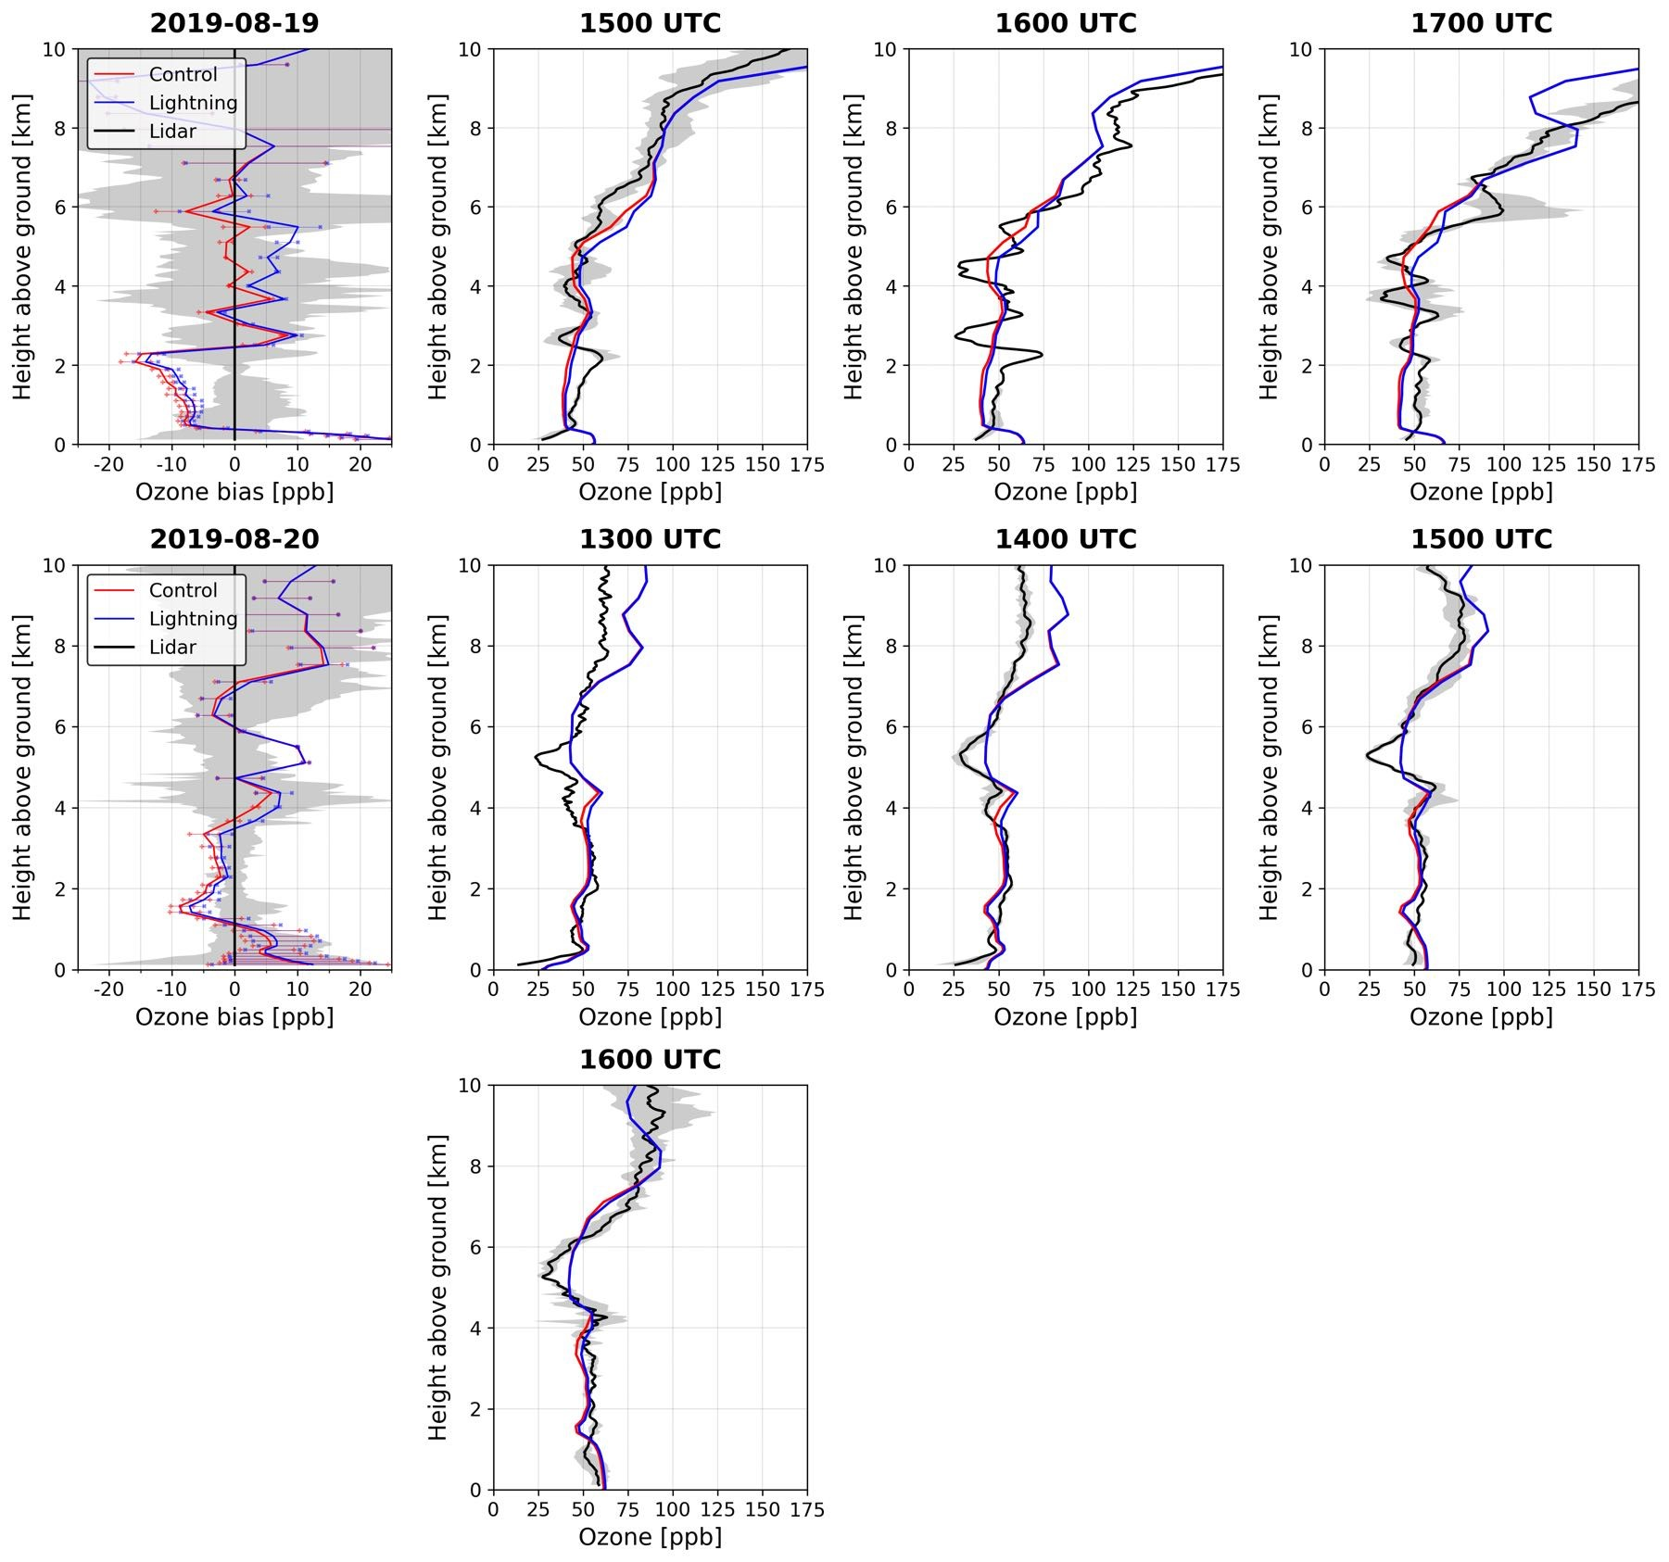
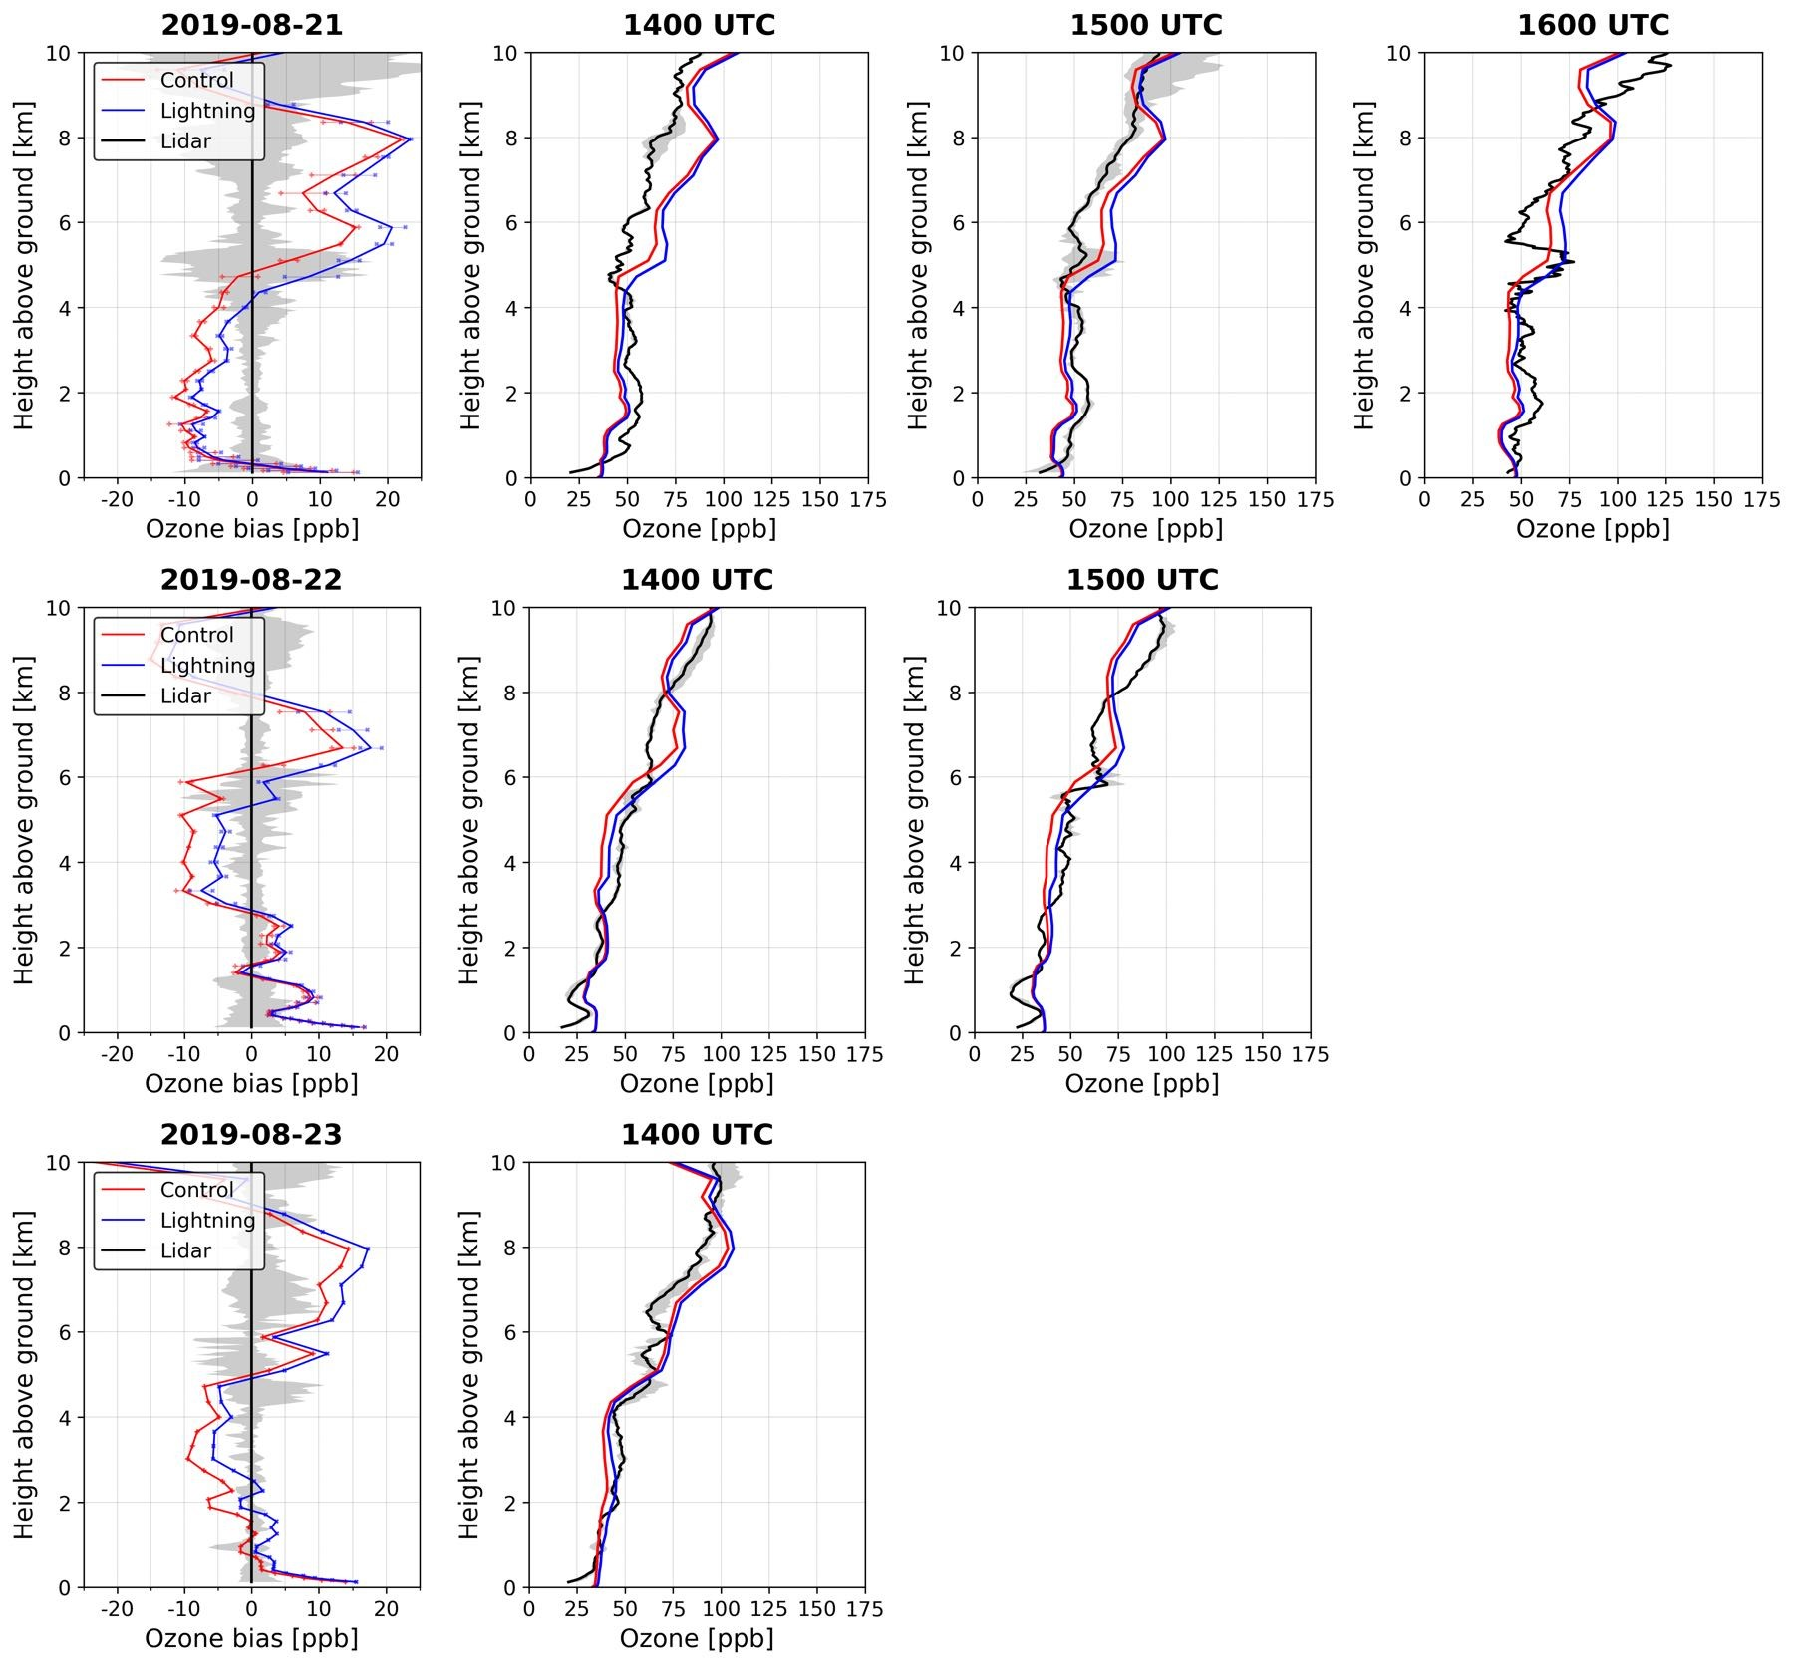
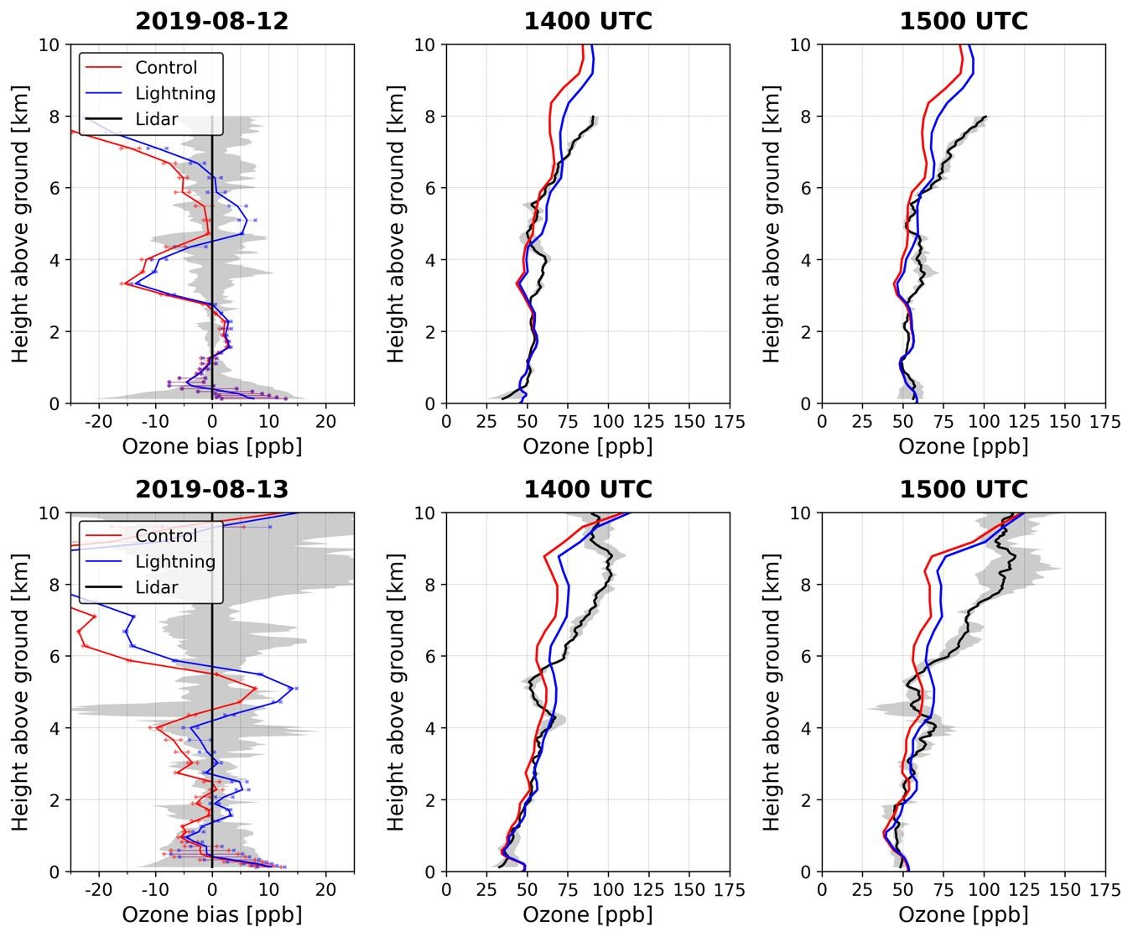
Ozone Evaluated Against Lidar Measurements at Huntsville, AL
Time-height cross-sections of differences in ozone mixing ratios between the LGTNO and the CNTRL simulations at Huntsville, AL, during August 2019.
Ozone profiles at Huntsville, AL, on August 12, 13, 19, 20, 21, 22, and 23 2019. The top-left panel presents daily averages, while the rest show hourly values. Black lines represent lidar retrievals. Shaded regions indicate value ranges of lidar measurements. Red and blue lines represent predicted ozone profiles of the CNTRL and the LGTNO simulations, respectively. Red and blue horizontal bars in the top-left panel indicate ranges of corresponding daily mean model biases.

Slide 14
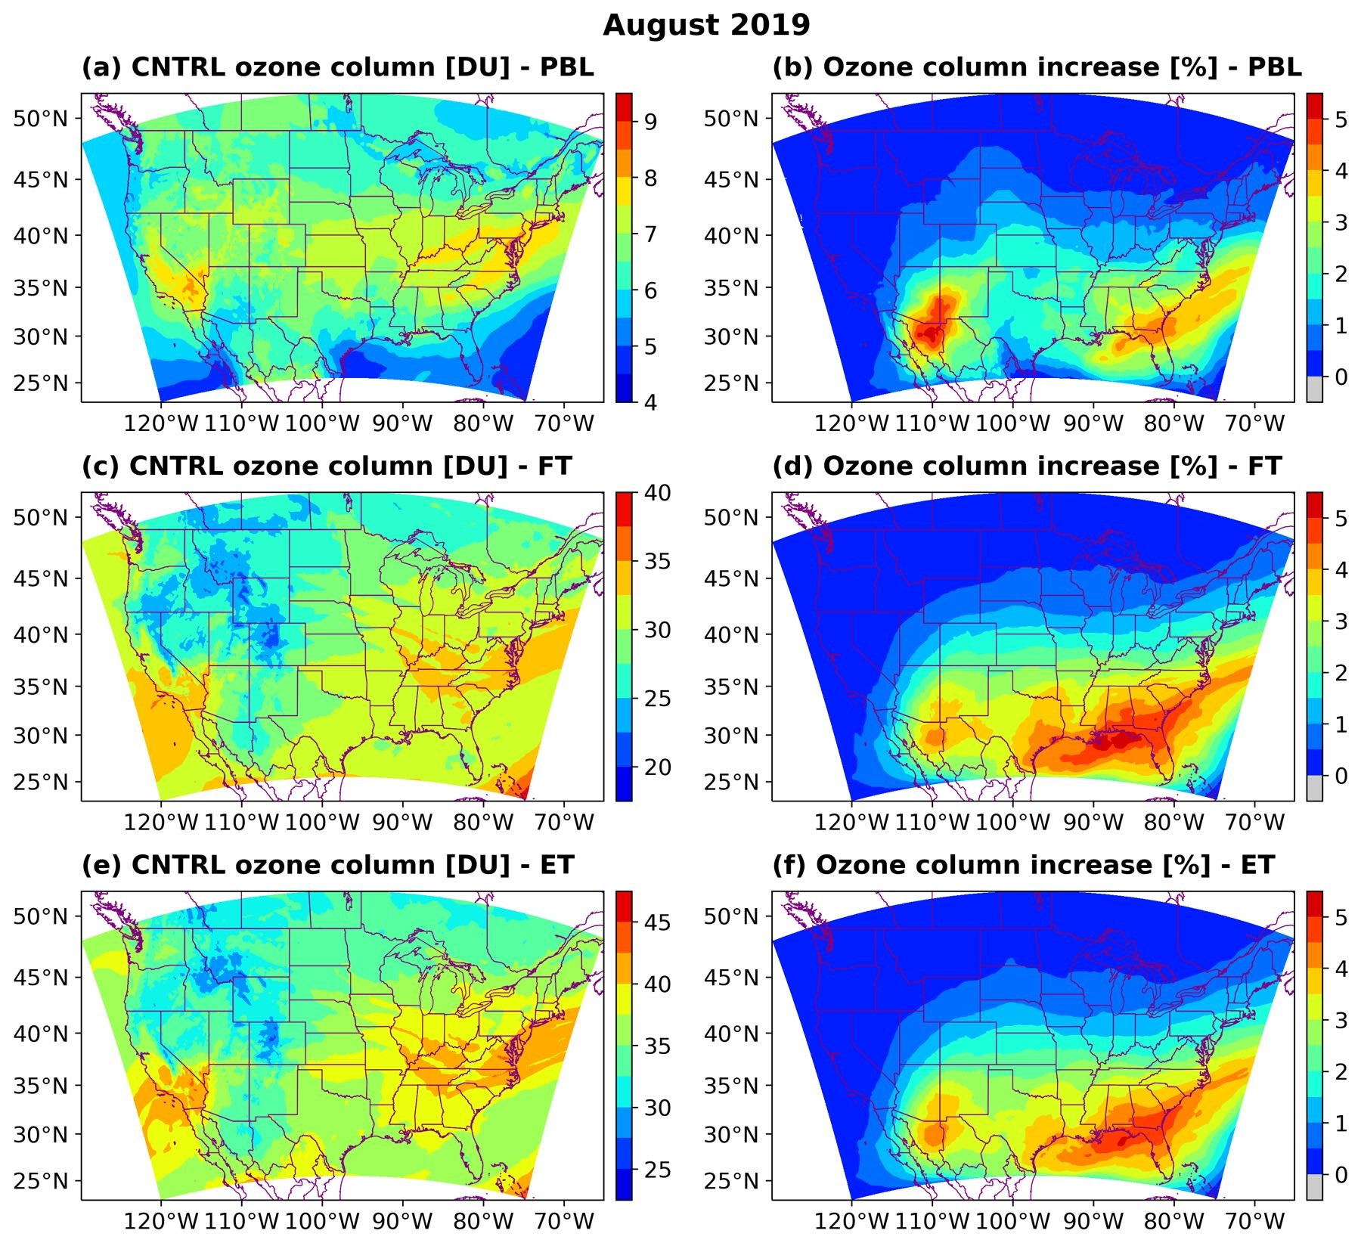
LNO Impact on Column Ozone (PBL, FT, and the Entire Column) For August 2019
Spatial distribution of monthly mean ozone columnar density (in Dobson units) and percentage difference for August 2019. (a) CNTRL ozone column in the PBL, (b) ozone column percentage increase in the PBL, (c) CNTRL ozone column in the free troposphere (FT), (d) ozone column percentage increase in the FT, (e) CNTRL ozone column in the entire troposphere (ET), and (f) ozone column percentage increase in the ET.

Slide 15
Recap and Concluding Remarks
A new technique was used to estimate lightning-generated NO (LNO) from GLM observed optical energy.
Evaluation of GLM observations indicated that the GLM-16 observations are more reliable to the east of 106 W longitude and GLM-17 should be used for areas to the west of 106 W
A software tool was developed to merge GLM-16/17 observations and to estimate LNO for use in air quality modeling systems.
GLM-derived LNOx estimates for the summer of 2019 was used in air quality simulations.
The preliminary results show that LNOx contributes 10-20% of total NOx emissions for this period.
Free tropospheric ozone was increased up to 30 ppb due to the addition of LNOx.
Preliminary evaluation against ozone lidar measurements show a reasonable agreement between the model and observations.

Slide 16
Acknowledgment
The findings presented here were accomplished under partial support from NASA Science Mission Directorate Applied Sciences Program.
Note the results in this study do not necessarily reflect policy or science positions by the funding agencies.

Slide 17
Extra Slides

Slide 18
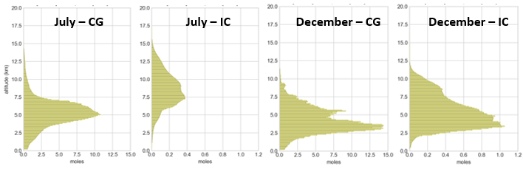
Vertical LNOx profiles derived from the LNOM (Koshak, 2014) for the month of July and December. Vertical increment is 100m.
In general, the LNOM derived mean IC/CG LNOx profiles have accounted for the pressure-dependence of LNOx production, the seasonal vertical extents, the IC/CG differences, etc. However, the use of LNOM derived profiles does not factor in the geographical variation that may exist in the IG/CG profiles as the LMA observation used in generating the LNOx profiles came solely from one single LMA network in the SE US (North Alabama). For instance, the lower tropopause in higher latitude regions will lead to a more limited vertical extent of the LNOx in these regions. Fortunately, relatively small amounts of LNOx will be misplaced above the tropopause in that case as LNOx production is pressure-dependent (less in lower pressure, Wang et al., 1998). Furthermore, the majority of the LNOx below the tropopause will quickly undergo vertical exchanges in the storm.

Slide 19
Contribution of LNOx to NOx for July 2019 over Huntsville
Huntsville Lidar Station:
Lat: 35.28 N, Lon: 86.59 W
Curtain Plot (date/height) for Difference in NOx Concentration Between LNOx and CNTRL Simulations for July 2019 over Huntsville Lidar Station
Curtain Plot (date/height) for NOx Concentration from Lightning Simulation for July 2019 over Huntsville Lidar Station

Slide 20
Contribution of LNOx to Ozone for July 2019 over Huntsville
Huntsville Lidar Station:
Lat: 35.28 N, Lon: 86.59 W
Curtain Plot (date/height) for Difference in O3 Concentration Between LNOx and CNTRL Simulations for July 2019 over Huntsville Lidar Station
Curtain Plot (date/height) for O3 Concentration from Lightning Simulation for July 2019 over Huntsville Lidar Station

Slide 22
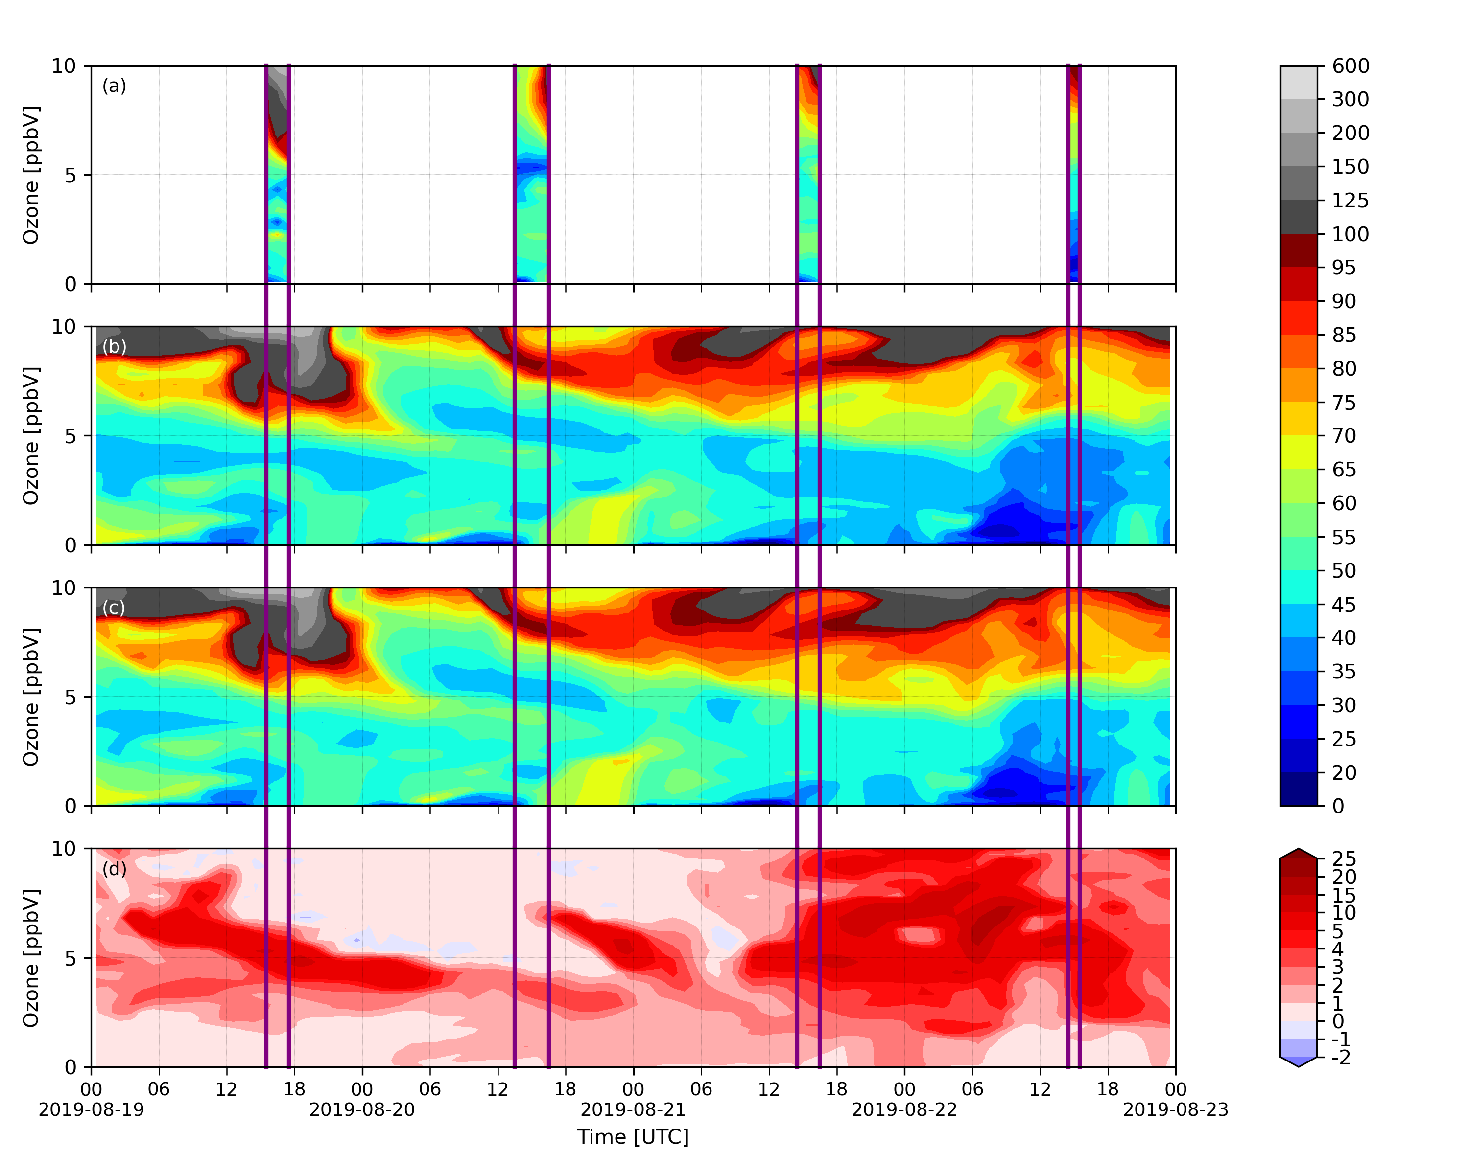
Vertical Ozone Profiles Over Huntsville as Compared to Lidar Observations
August 19-23, 2019
Lidar/CNTRL/LNOx and the Difference Between CNTRL and LNOx (LNOx – CNTRL)
Huntsville Lidar Station:
Lat: 35.28 N, Lon: 86.59 W
Lidar
Control
Lightning
Difference

Slide 23
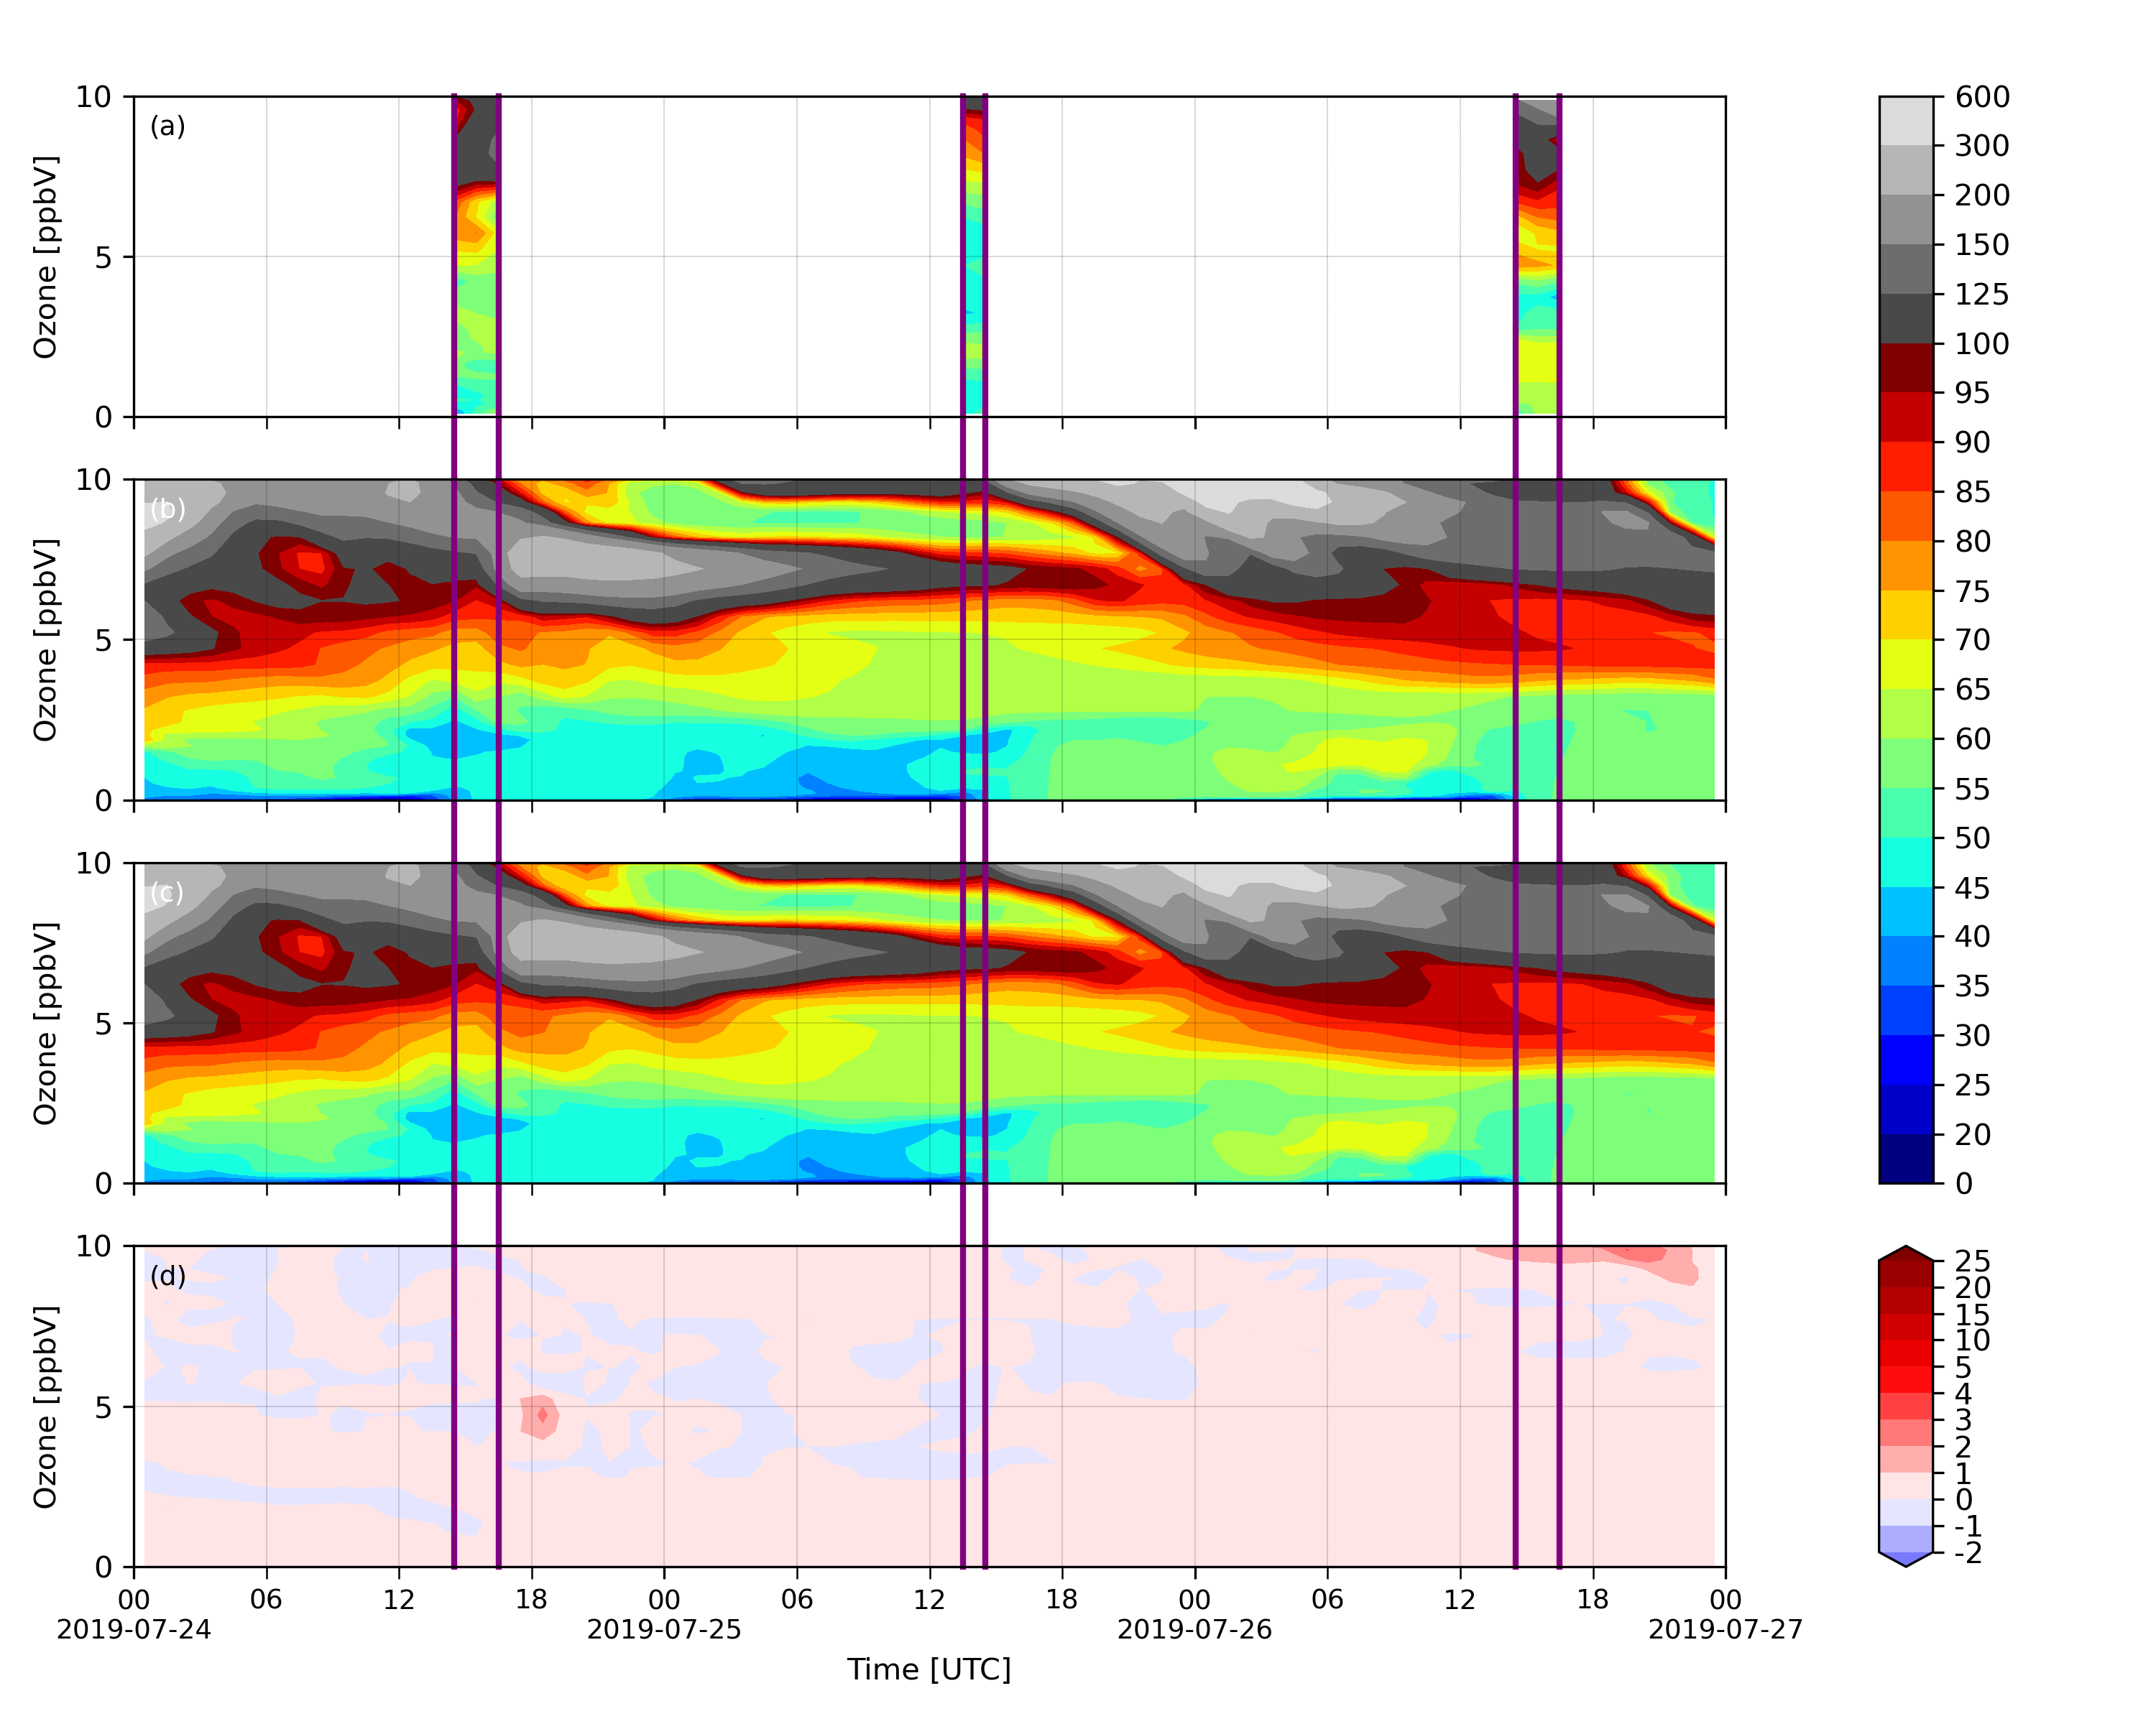
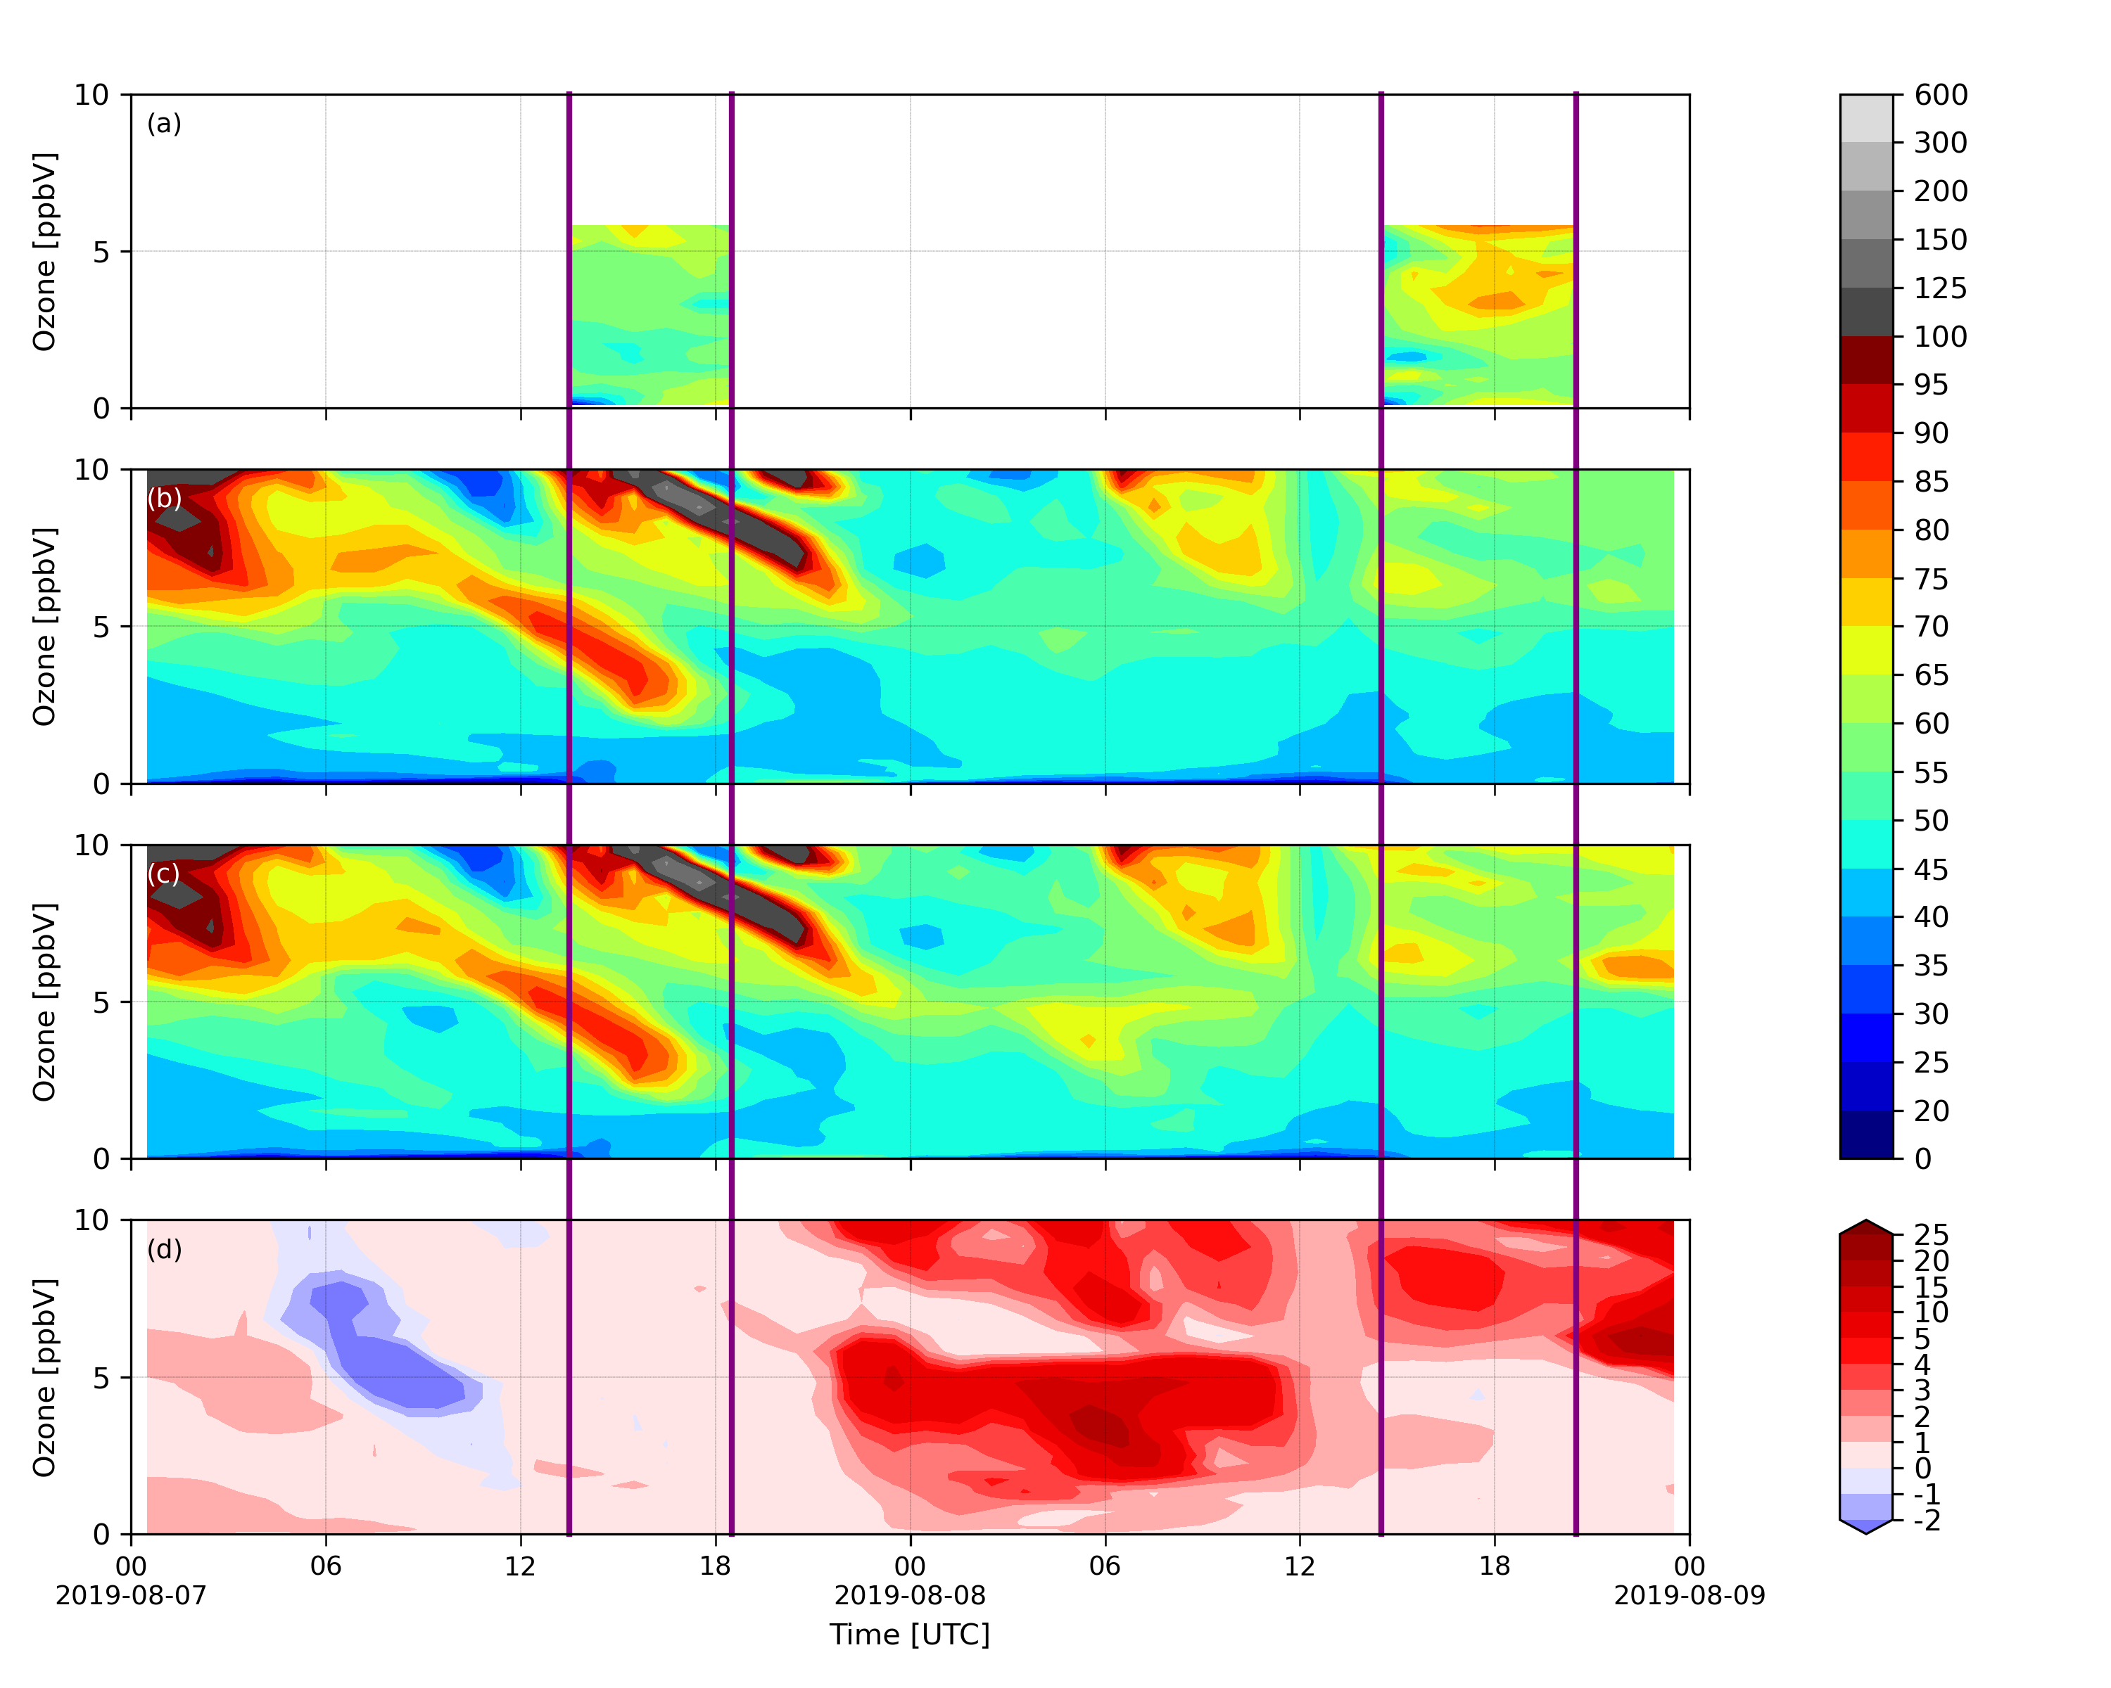
Model/Lidar Comparison for Selected Days
Model shows higher stratospheric/tropospheric exchange (STE) and deeper intrusion into the free troposphere

Slide 24
