Slide 1
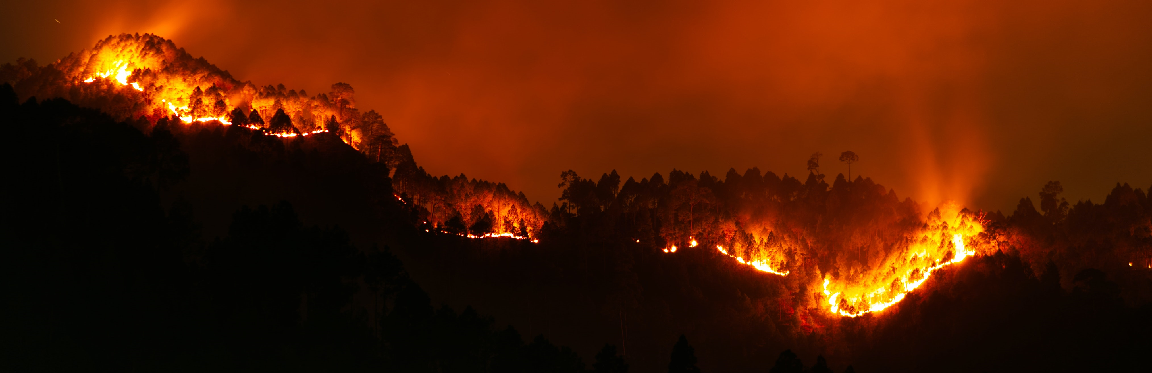
Fire Emissions Inventory Comparison and Processor Development
Jeremiah Johnson¹, Pradeepa Vennam¹, Xiao Yu², Cara Scalpone²
¹Ramboll
²Texas Commission on Environmental Quality

Slide 2
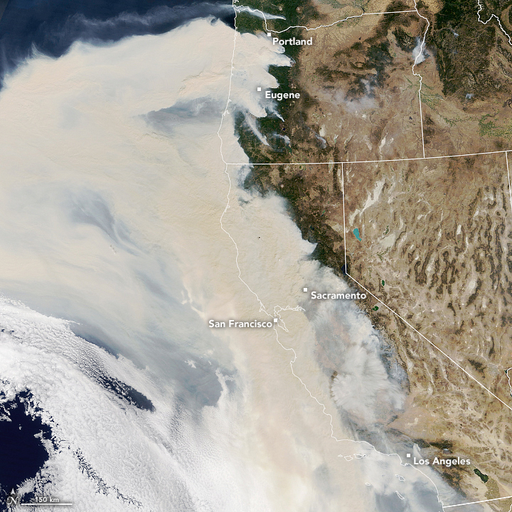
Motivation
Fires are large emission sources and Fire Emission Inventories (FEIs) are uncertain
Accurate FEIs needed for Exceptional Event (EE) analyses and State Implementation Plan (SIP) modeling for ozone/PM_{2.5}/regional haze
Processing tools can limit choice of FEI and different processing methods can introduce uncertainties
Source: ABC News, October 3, 2020

Slide 3
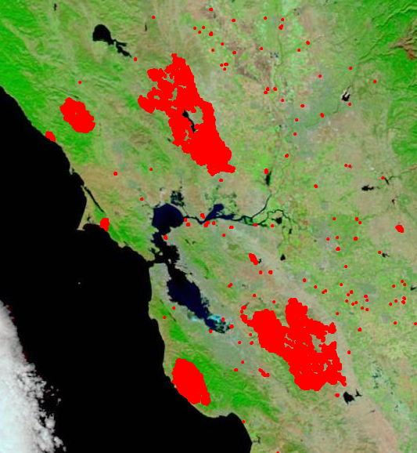
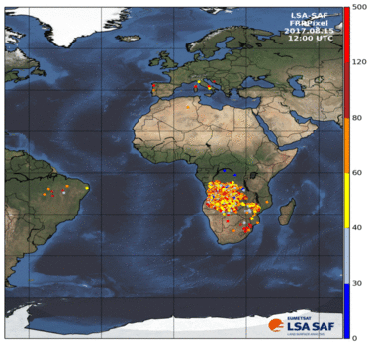
Available Fire Inventories
Burned areas
Fire Radiative Power
Source: NASA Disasters Mapping Portal
Source: https://wildfire.geog.kcl.ac.uk/products-and-data/
Area burned
LC-specific biomass loading and EFs
Thermal anomalies
LC-specific dry matter
combustion rates and EFs
FINN, GFED, BlueSky
GFAS, QFED, FEER, FLAMBE, GBBEPx, IS4FIRES

Slide 4
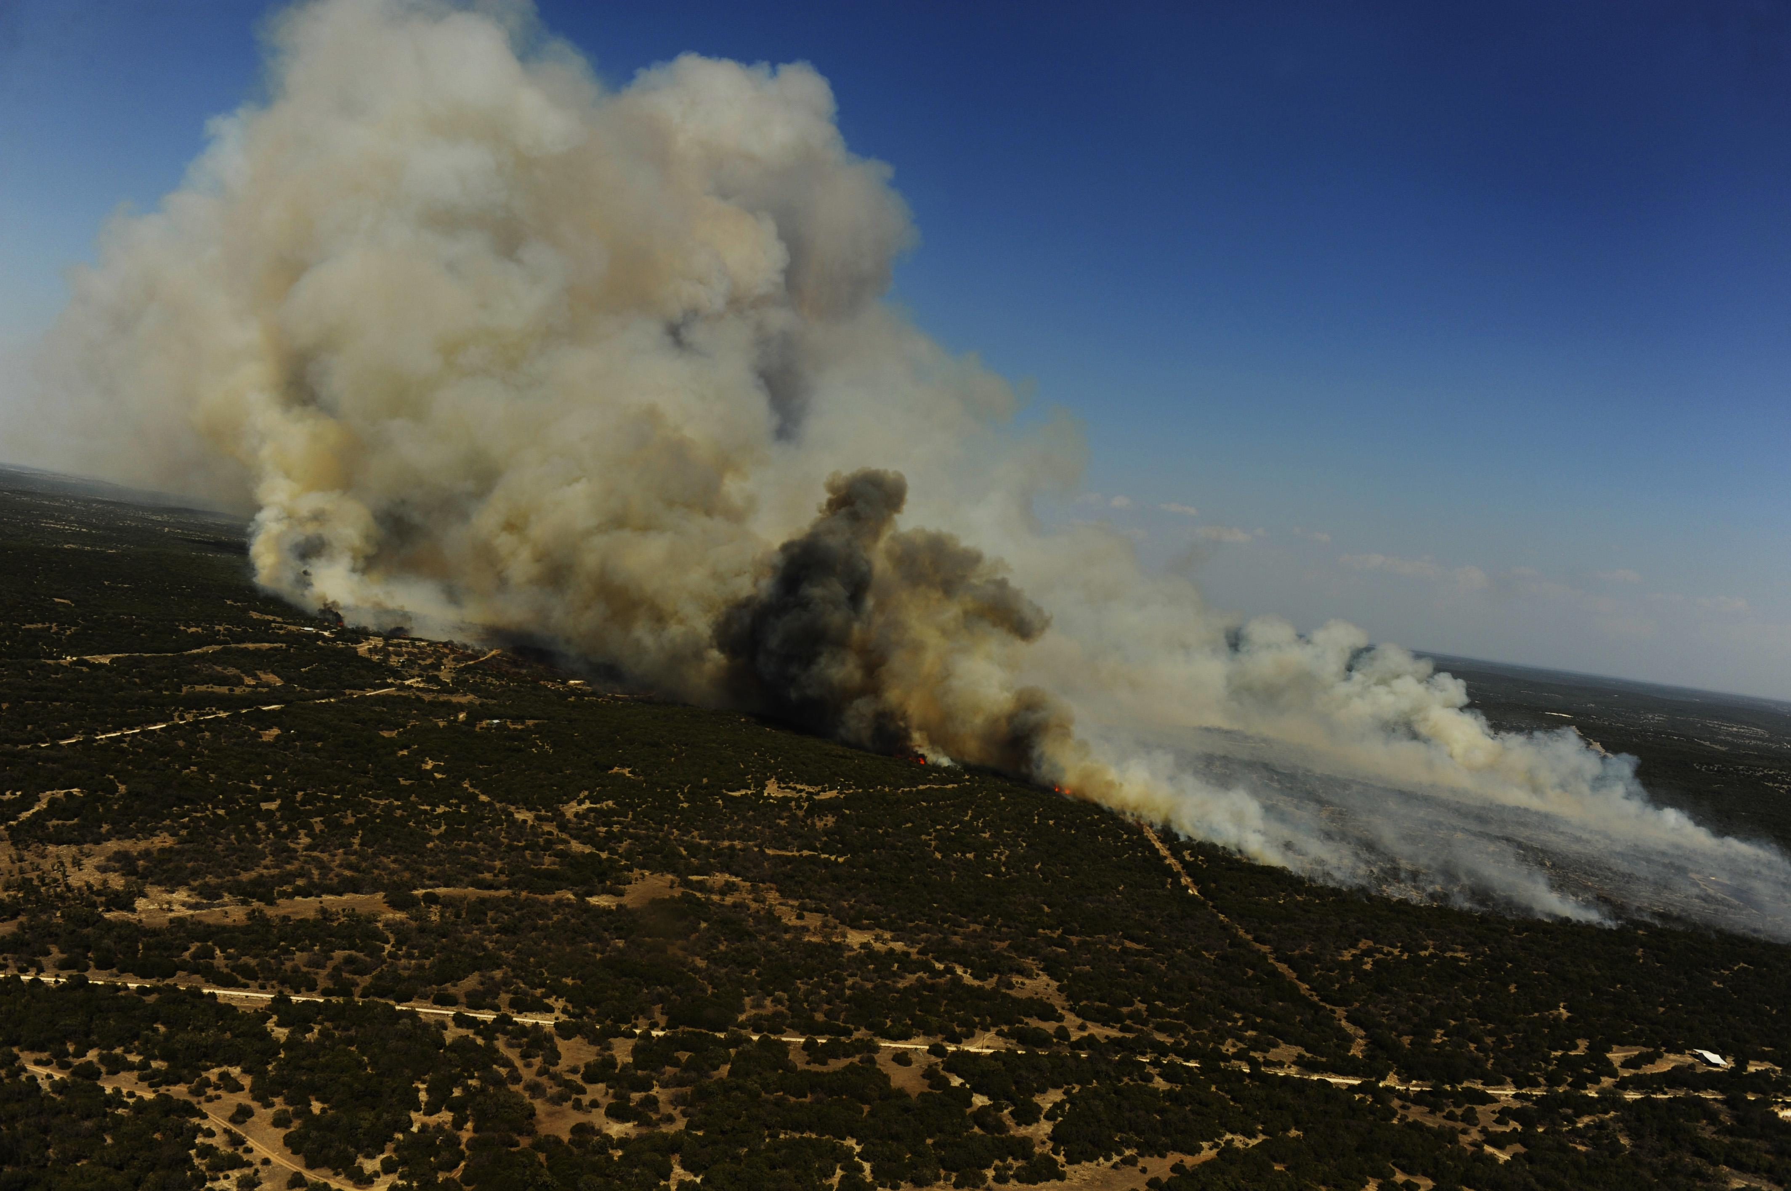
Ramboll’s FEI Processor
A Python-based tool that:
Re-grids emissions to target modeling domain projection/extent
Speciates using CB6 or CB7 mechanisms
Temporally and vertically allocates emissions
Implemented for FINN1.0/2.5, GFAS1.2 and QFED2.5 (FEER1.0-G1.2 coming in 2023)
Other global FEIs can be added in the future
Output formatted as netCDF-4 w/ compression to use space efficiently
By U.S. Department of Defense Current Photos - 110426-F-RM405-451,
Public Domain, https://commons.wikimedia.org/w/index.php?curid=51091038

Slide 5
FEI Processing Diagram

Slide 6
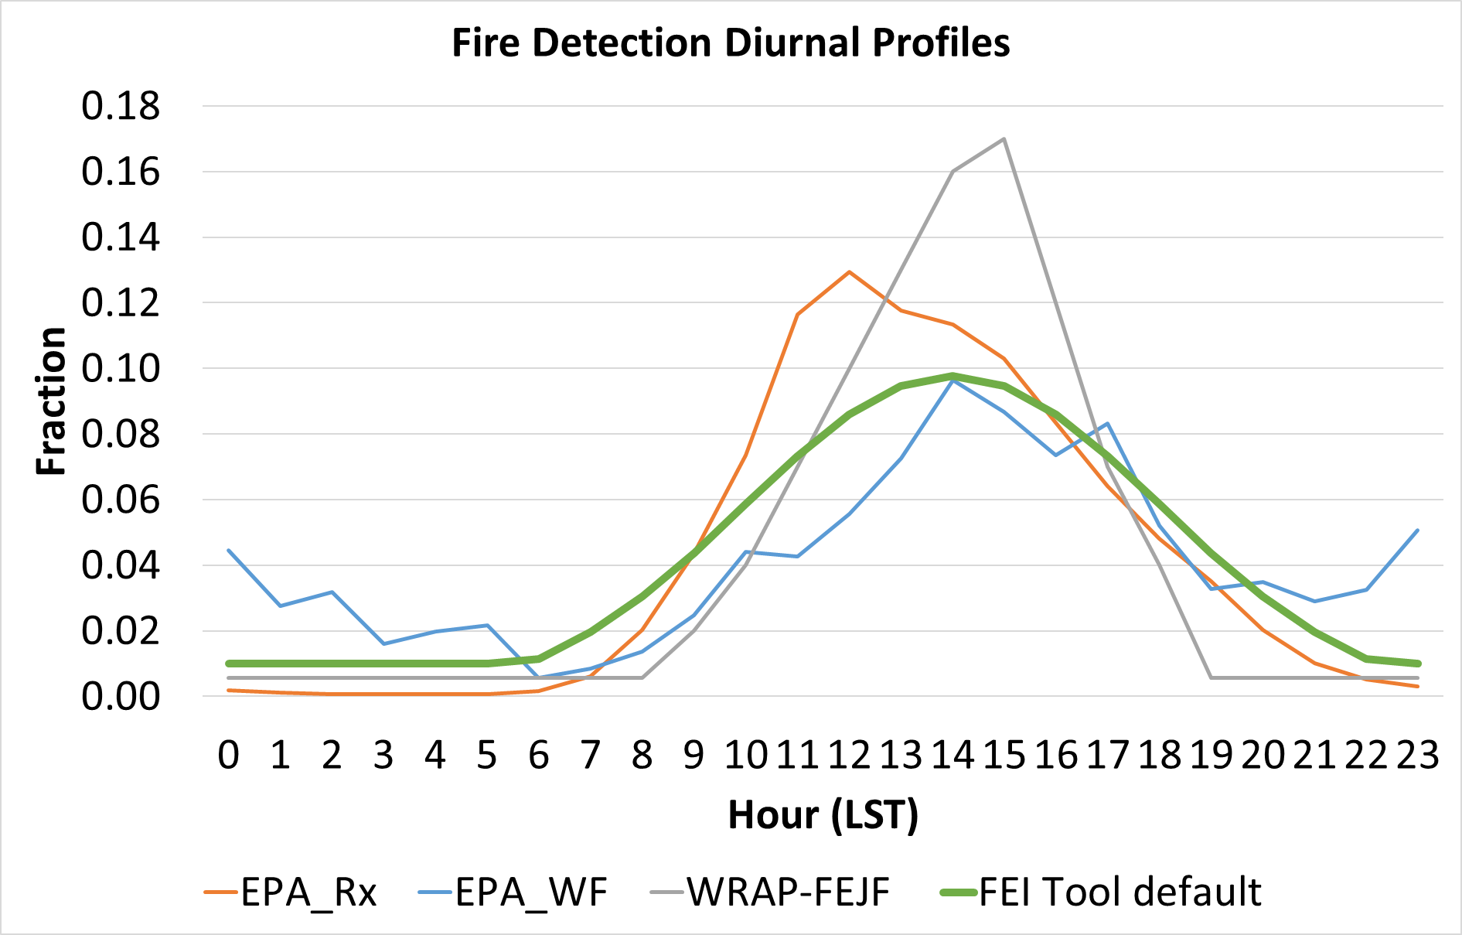
Temporal Allocation
Diurnal behavior specific to fire type and environment
Gridded FEIs do not discern fire type
Chose a smoothly varying profile to apply to all fires
More improved profiles are needed and are easily implemented
Notes:
Higher injection height will typically reduce near‐field downwind concentrations
Reference: Lareau, N.P. and Clements, C.B., 2017. The mean and turbulent properties of a wildfire convective plume. Journal of Applied Meteorology and Climatology, 56(8), pp.2289-2299.

Slide 7
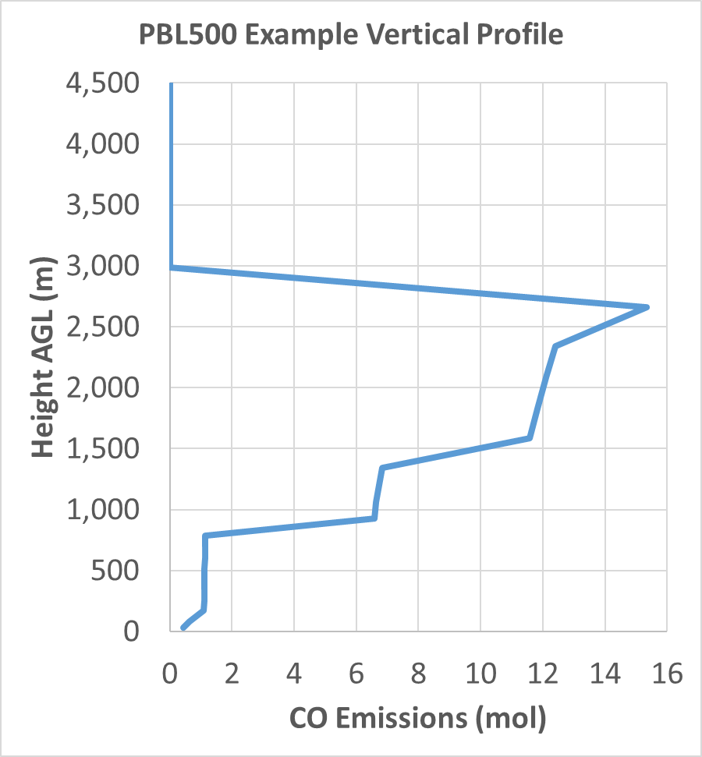
Vertical Allocation
Smoke injection height and vertical allocation play a vital role in downwind pollutant dispersion
Wilkins et al. (2022) found PBL+500m injection height comparable to Sofiev for 2013 Rim Fire in CA and 2017 Rx burns in KS
PBL500 and Sofiev prescribe injection height only
FEI tool applies PBL500 with SMOKE/Briggs-like vertical allocation
Notes:
Wilkins, J. L., Pouliot, G., Pierce, T., Soja, A., Choi, H., Gargulinski, E., Gilliam, R., Vukovich, J., Landis, M. S. 2022. An evaluation of empirical and statistically based smoke plume injection height parametrisations used within air quality models. International Journal of Wildland Fire 31, 193-211. https://doi.org/10.1071/WF20140

Slide 8
Case Study: April 9, 2019
NOAA HMS Smoke and Fire
GOES-16 Aerosol Optical Depth

Slide 9
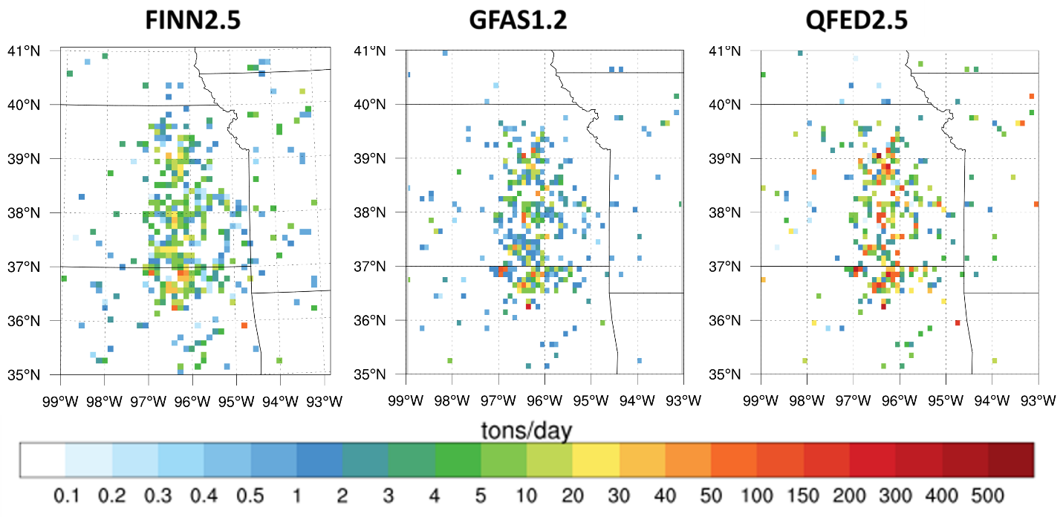
PM_{2.5} Emissions Comparison
2,098 tpd
2,354 tpd
6,756 tpd
Substantial variation in fire detects and range of PM_{2.5} emissions

Slide 10
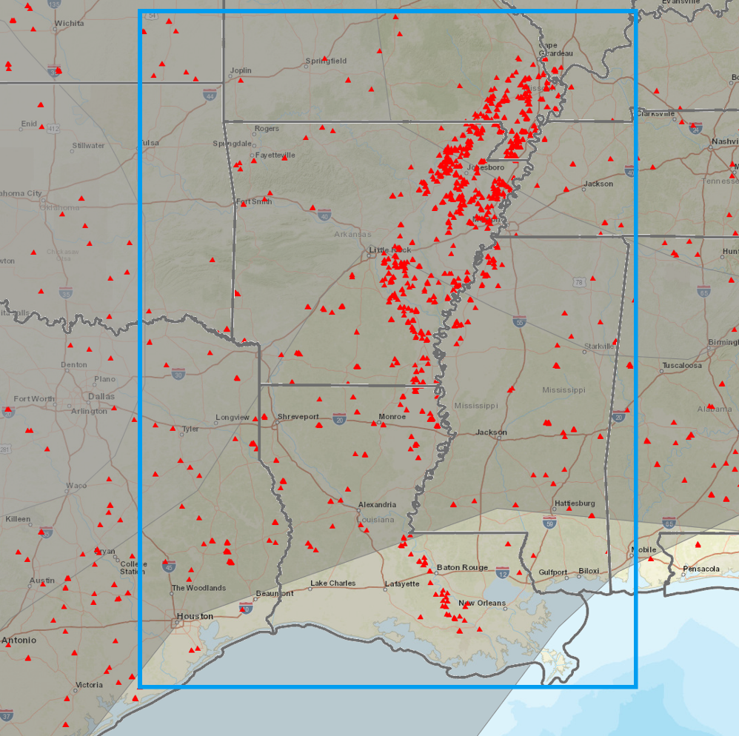
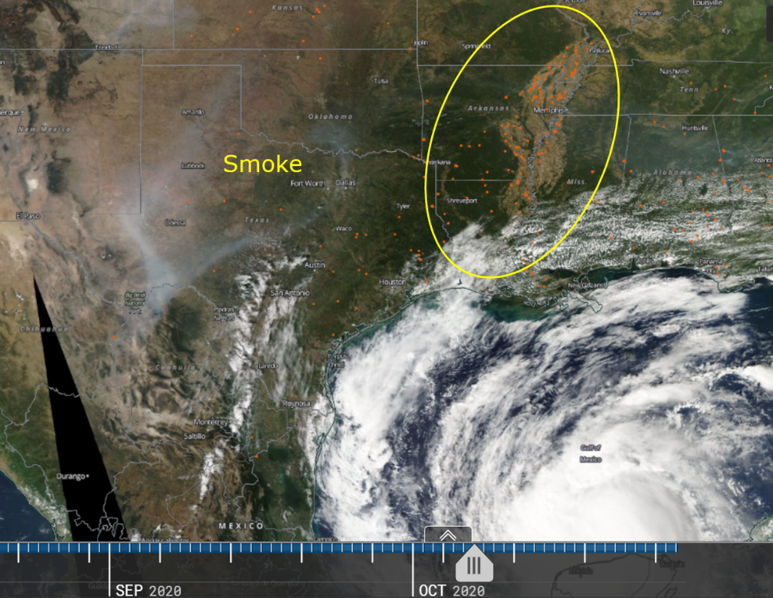
Case Study: October 8, 2020
NOAA HMS Smoke and Fire
MODIS visible with fire detects
Fire detects

Slide 11
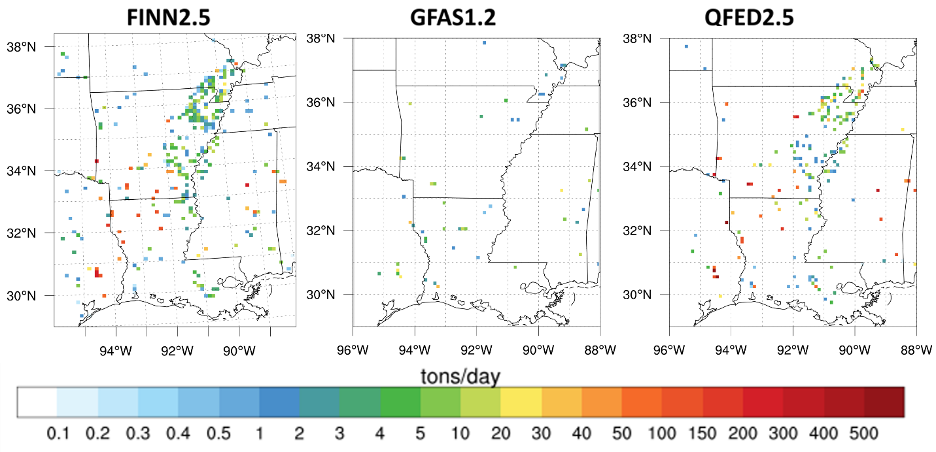
PM_{2.5} Emissions Comparison
4,578 tpd
319 tpd
6,603 tpd
Considerably more disagreement between FEIs on this day

Slide 12
FEI Comparison – 2019 Ozone Season
QFED PM_{2.5} ~3x higher than FINN
QFED NOx ~60% higher than FINN

Slide 13
FEI Comparison – 2019 Ozone Season
FINN VOC ~6-7x higher than QFED
Better agreement for CO

Slide 14
Next Steps
Implement alternative temporal allocation and Sofiev plume injection height
Use modeling to evaluate ozone and PM_{2.5} model performance of different FEIs
Add NASA’s FEER1.0-G1.2 product

Slide 15
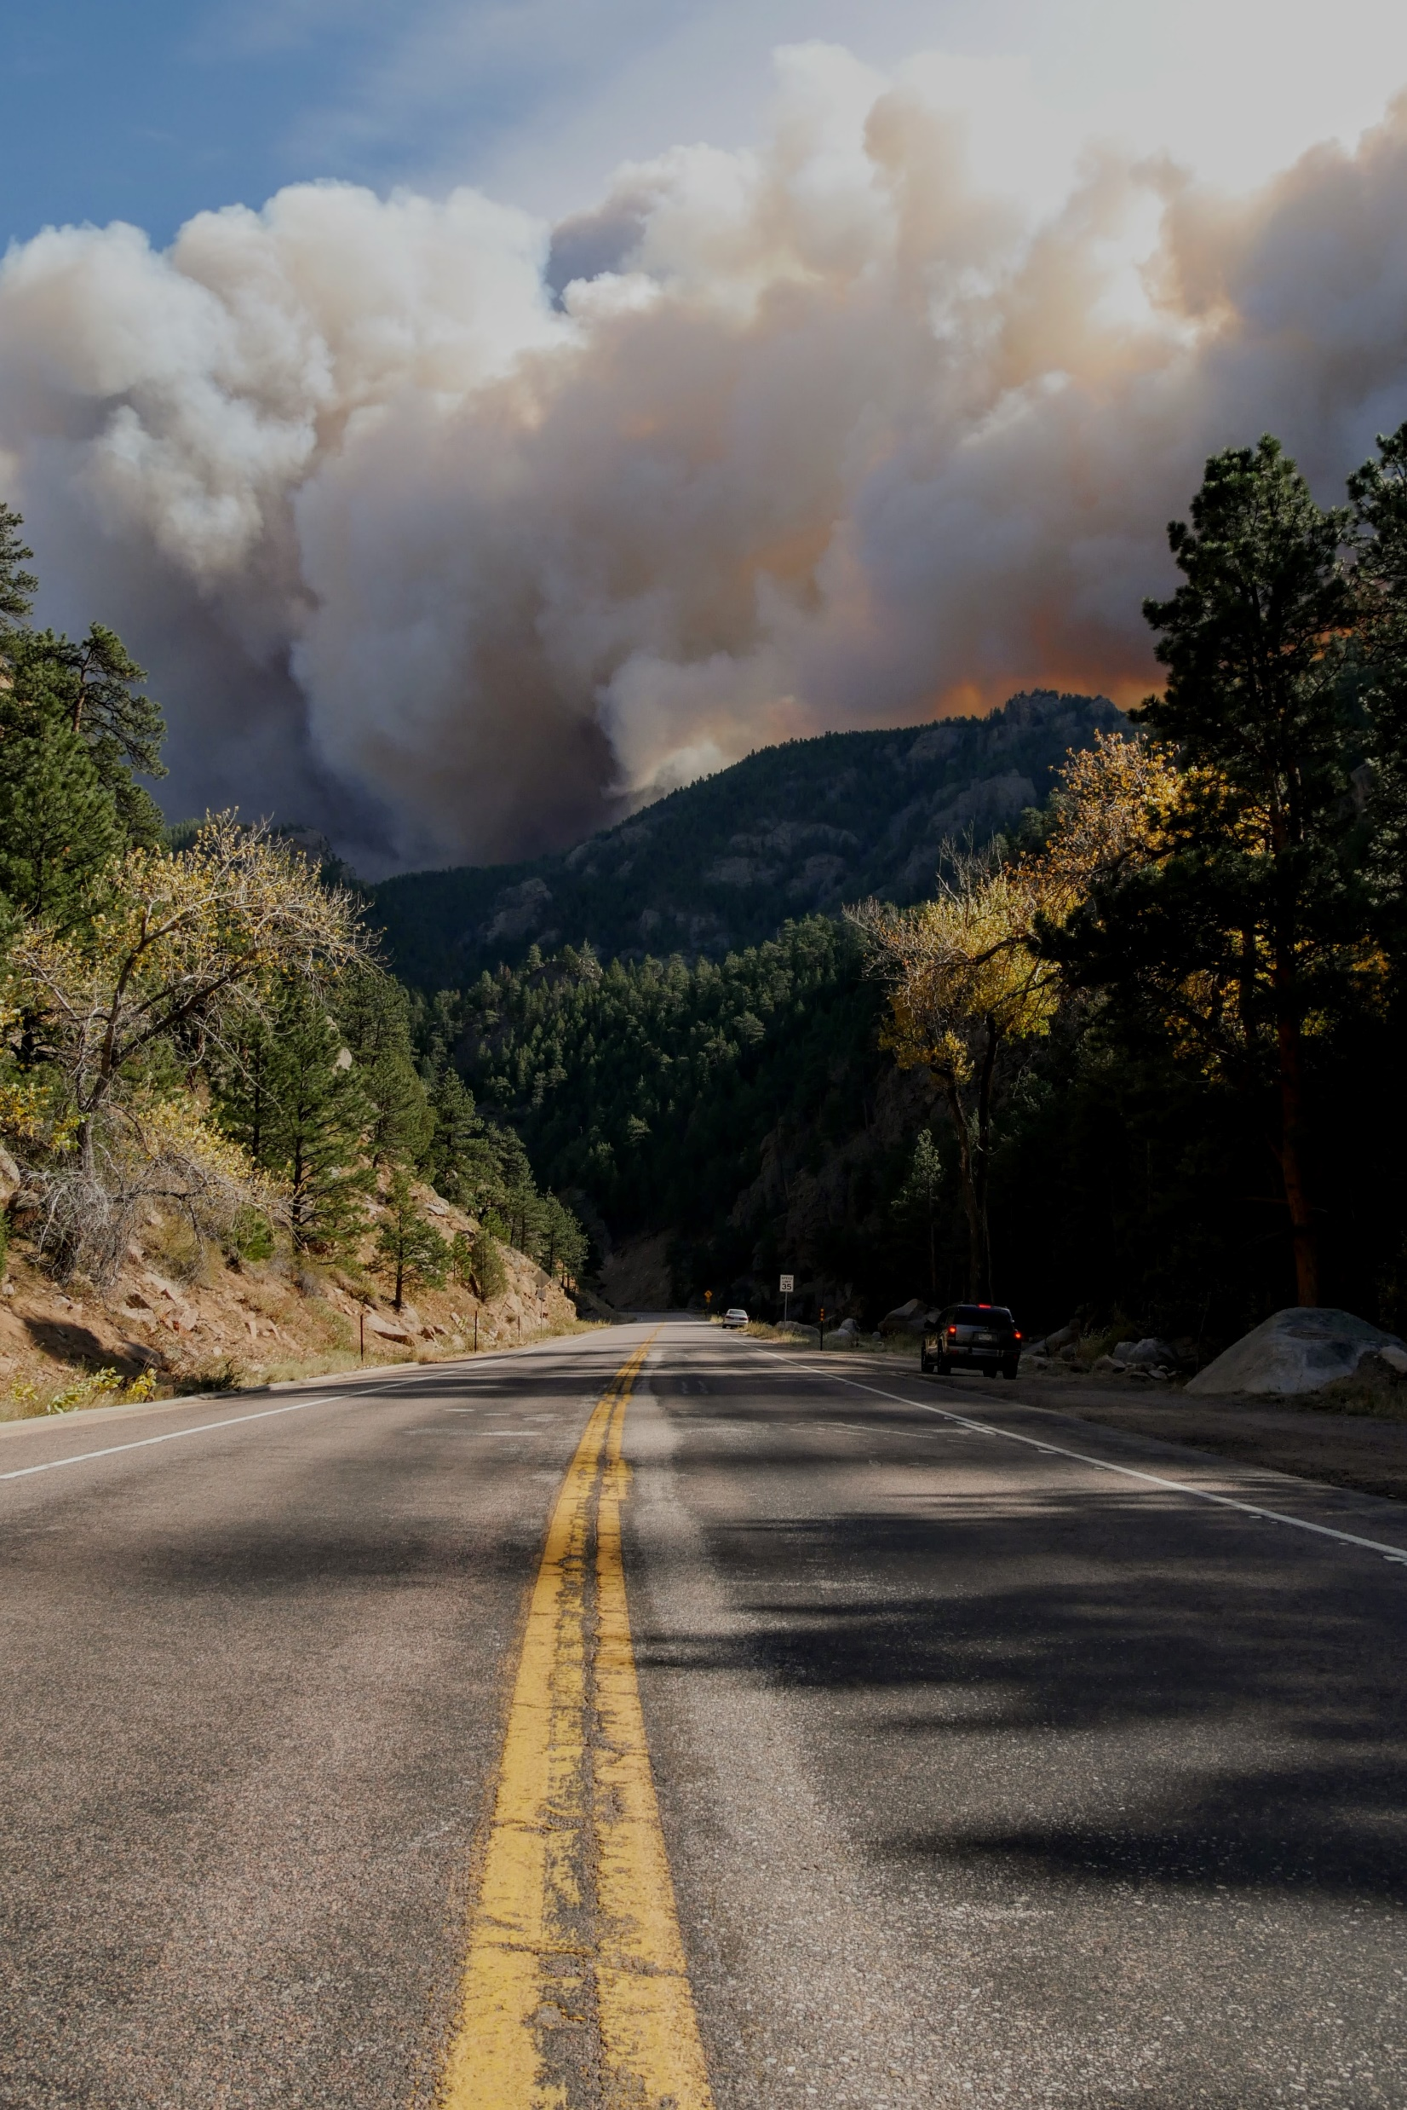
Questions?
Contacts:
Jeremiah Johnson JJohnson@ramboll.com
Cara Scalpone Cara.Scalpone@tceq.texas.gov
Notes:
Photo by Malachi Brooks on Unsplash

