Slide 1


Ramboll Shair:
Integrating realtime sensor measurements and regional/local-scale models in Richmond, California
Justin Bandoro, Julia Luongo, Mike Dvorak, Drew Hill, Tasko Olevski, Kurt Richman, Chris Emery, Greg Yarwood, Shari Libicki
18th CMAS Conference
October 22nd, 2019

Slide 2
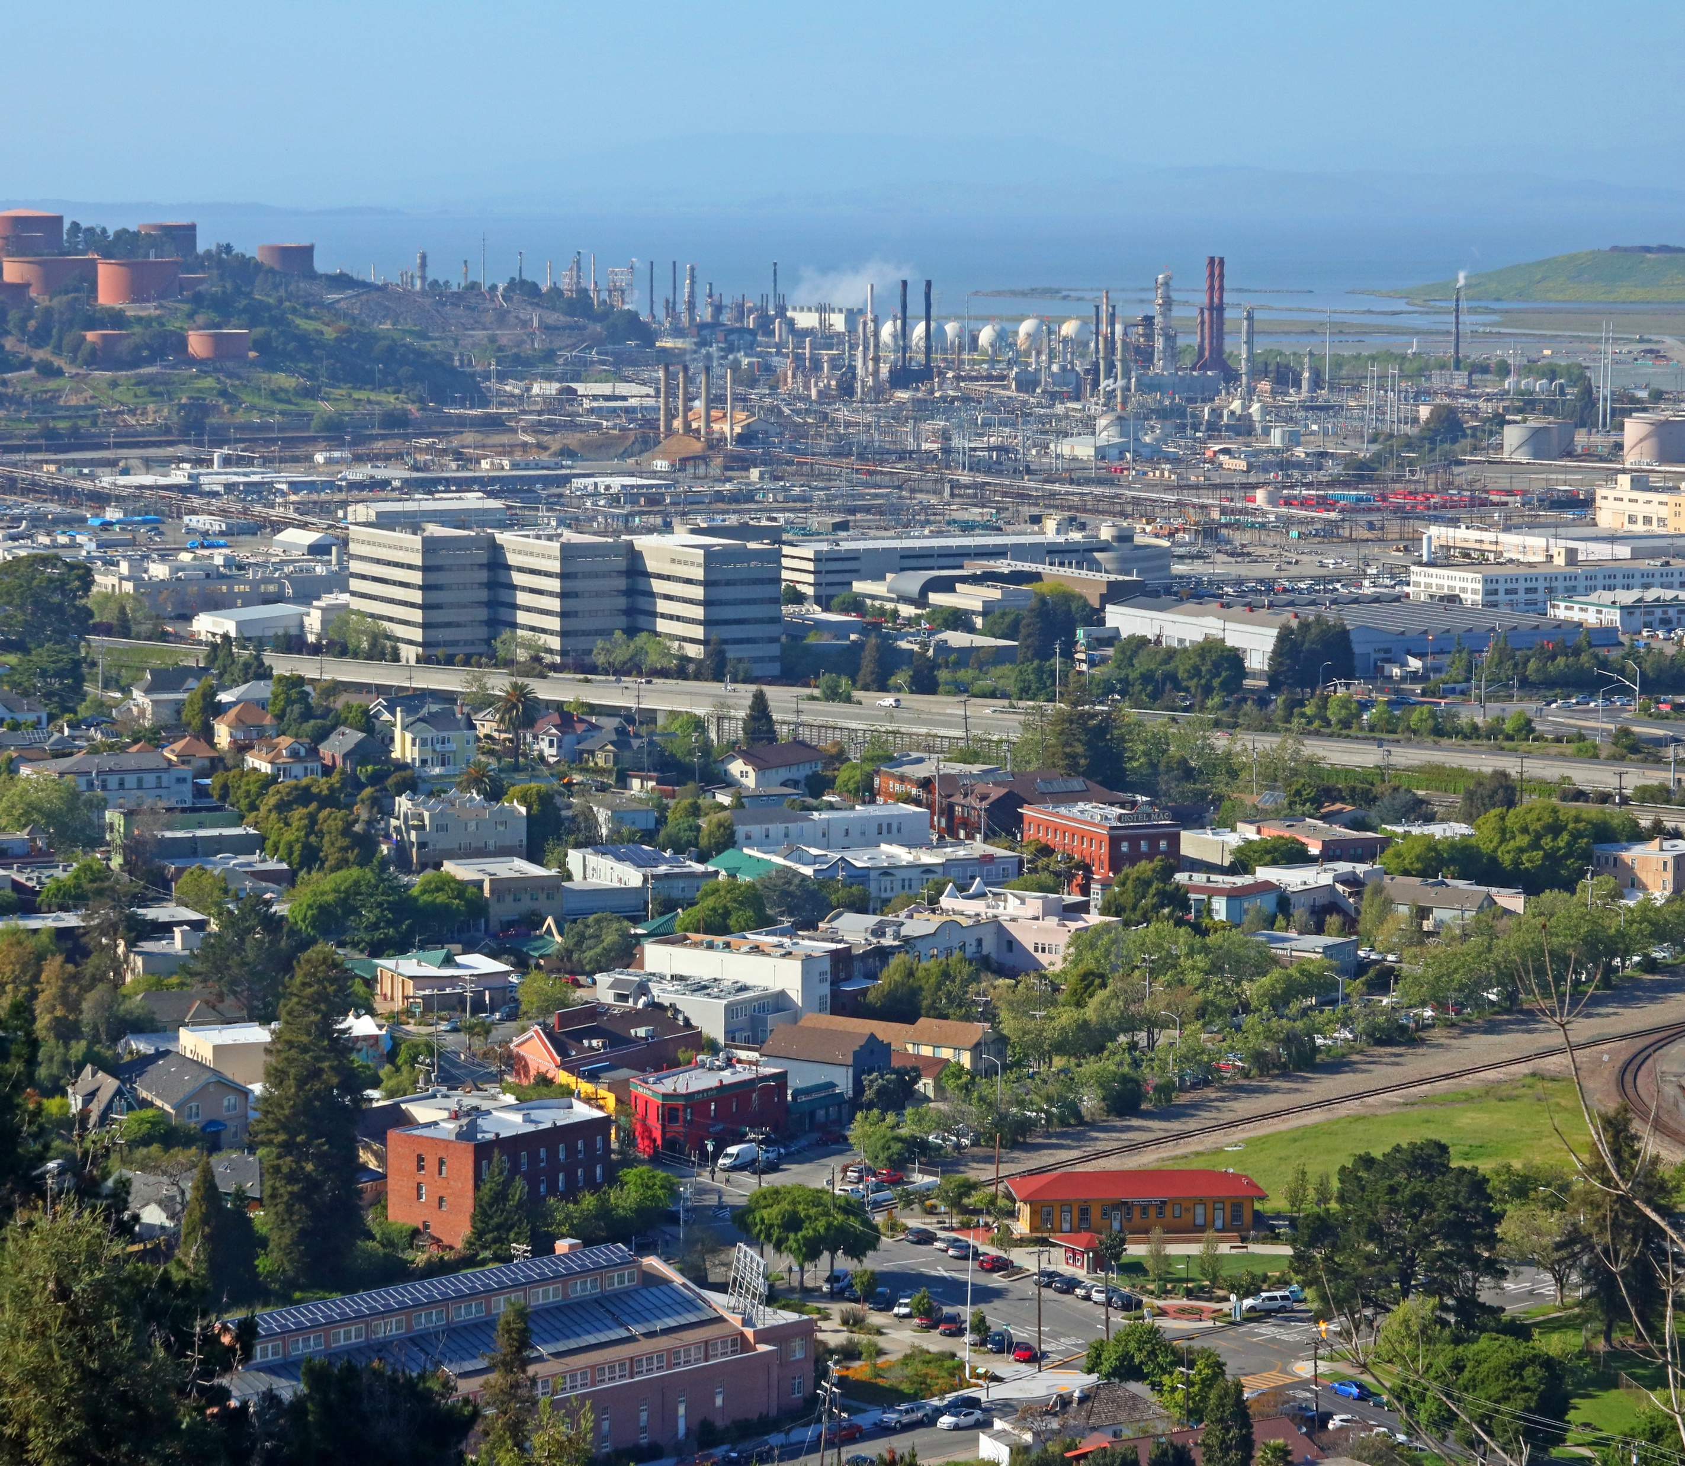
Outline
Background
  AB617 overview
  Air Rangers Community Air Protection
Ramboll Shair Model
  Emission estimates with near-realtime traffic emissions
  CAMx regional and Shairstreet roadway models
  Sensor integration
Feedback and Next Steps
  Communicating results to the Richmond community
Source: Wikipedia (Audiohifi)

Slide 3
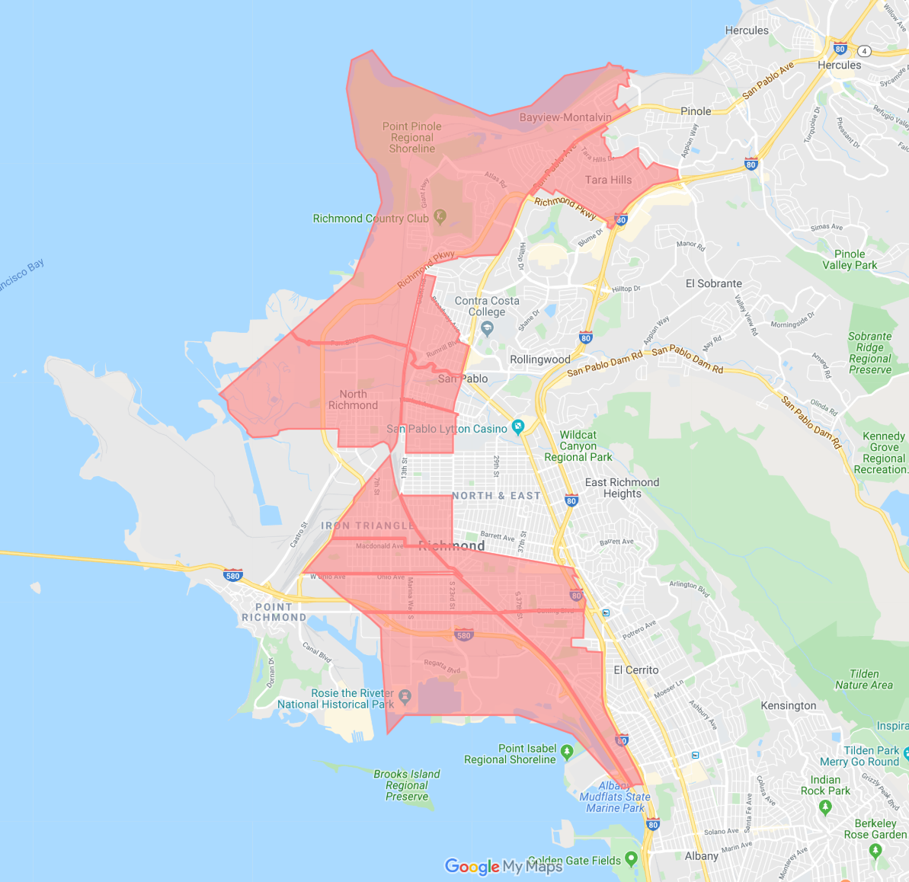
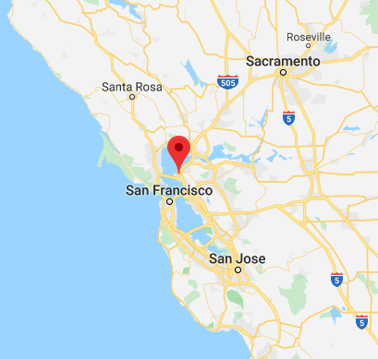
Background
AB617
California Assembly bill
Funds community level air measurement, education, and emissions reductions
Targets disadvantaged communities
AB617 Funded Project in Richmond, CA (“Air Rangers”)
Fill PM and NO₂ monitoring gaps
Attribute hotspots to sources
Communicate actionable data to the public in near-realtime
Facilitate healthy outdoor recreation
Local work force development for disadvantaged youth
SB 535 Disadvantaged Communities

Slide 4



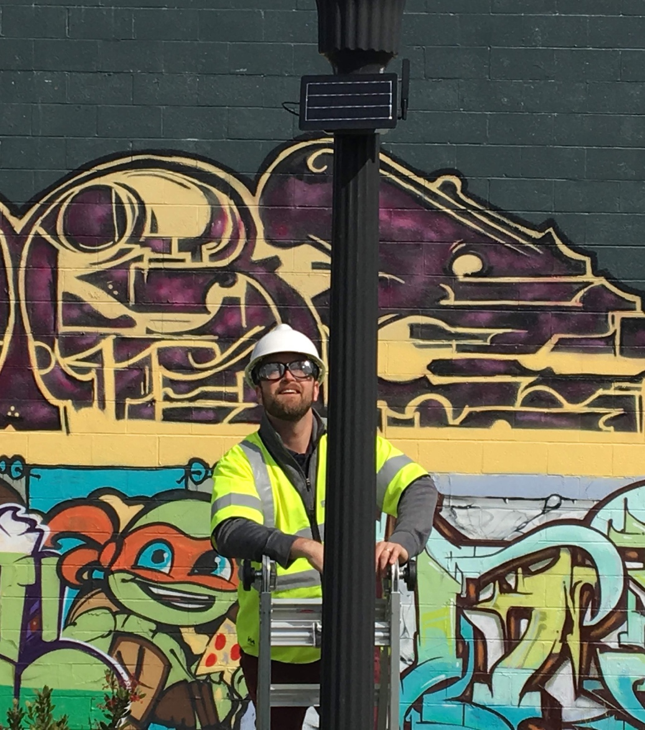
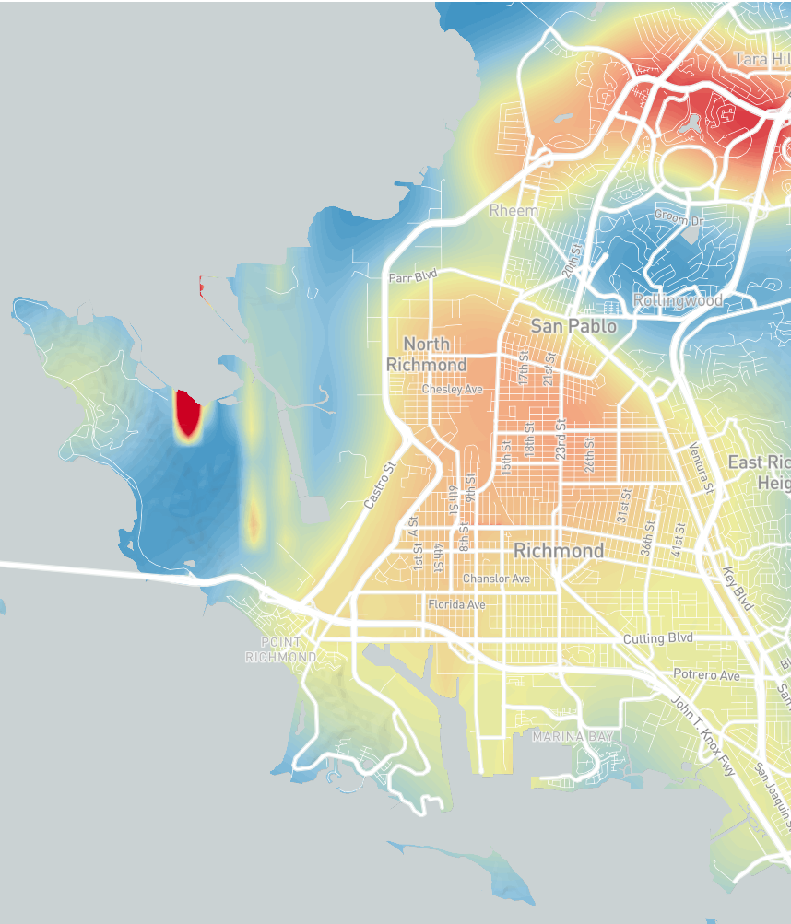
Air Rangers Community Air Protection Grant
Action Plan
Converge strategic partners
Site 50 PM & NO₂ sensors; take 70 toxic metals samples
Communicate hyper-local air quality to the public, hourly
Hourly hotspot identification and source attribution

Slide 5
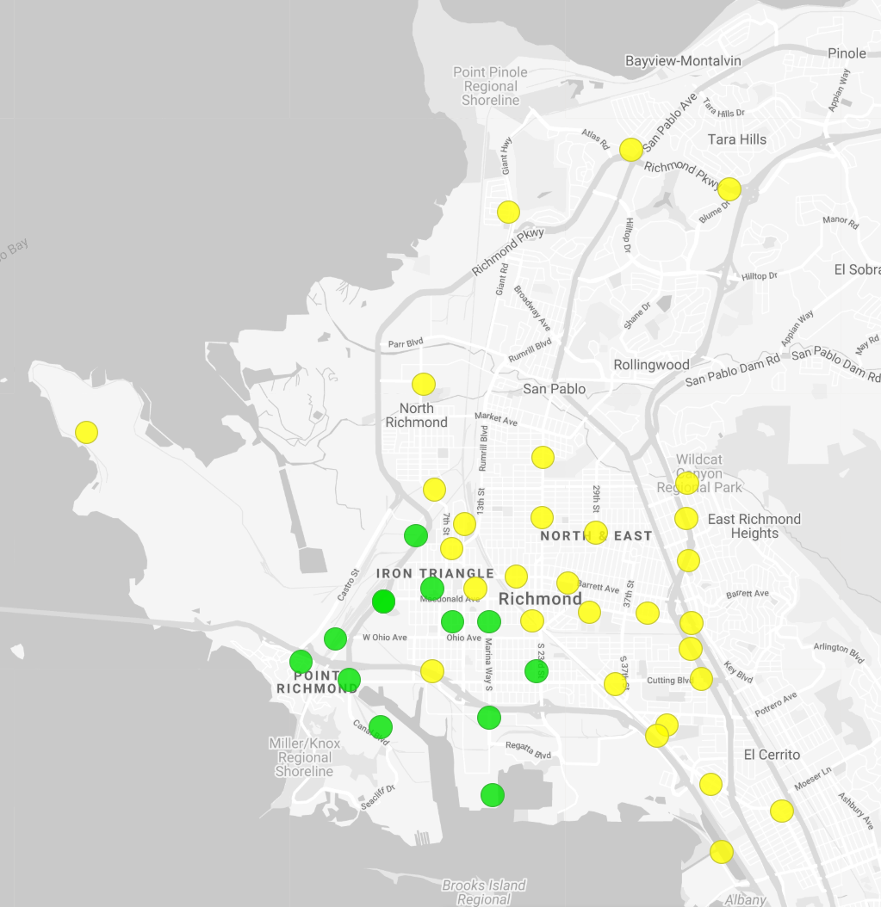
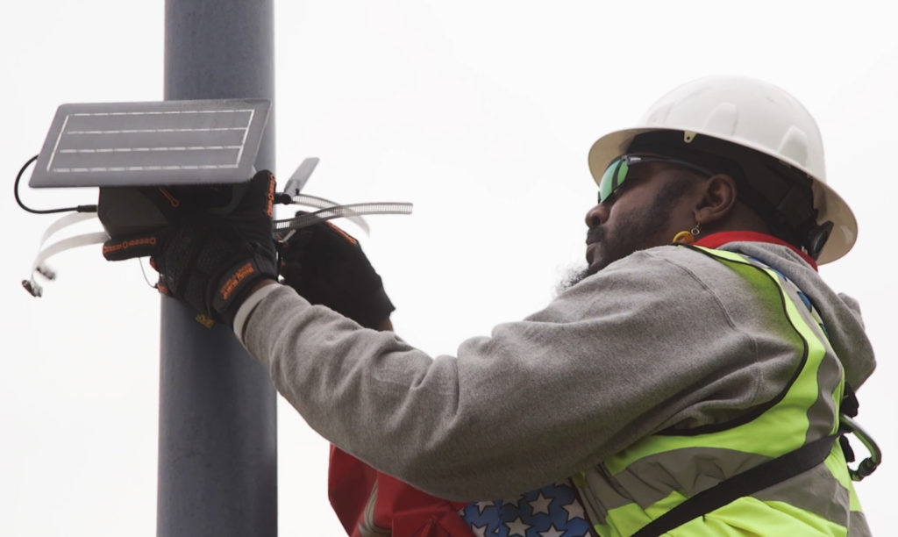
Sensor network in Richmond
Network of 50 low-cost Clarity sensors
Pollutants: PM_{2.5}, PM₁₀, and NO₂
Sited in greenways, parks, and near high traffic roadways, and industrial centers
Groundwork Richmond Air Rangers

Slide 6

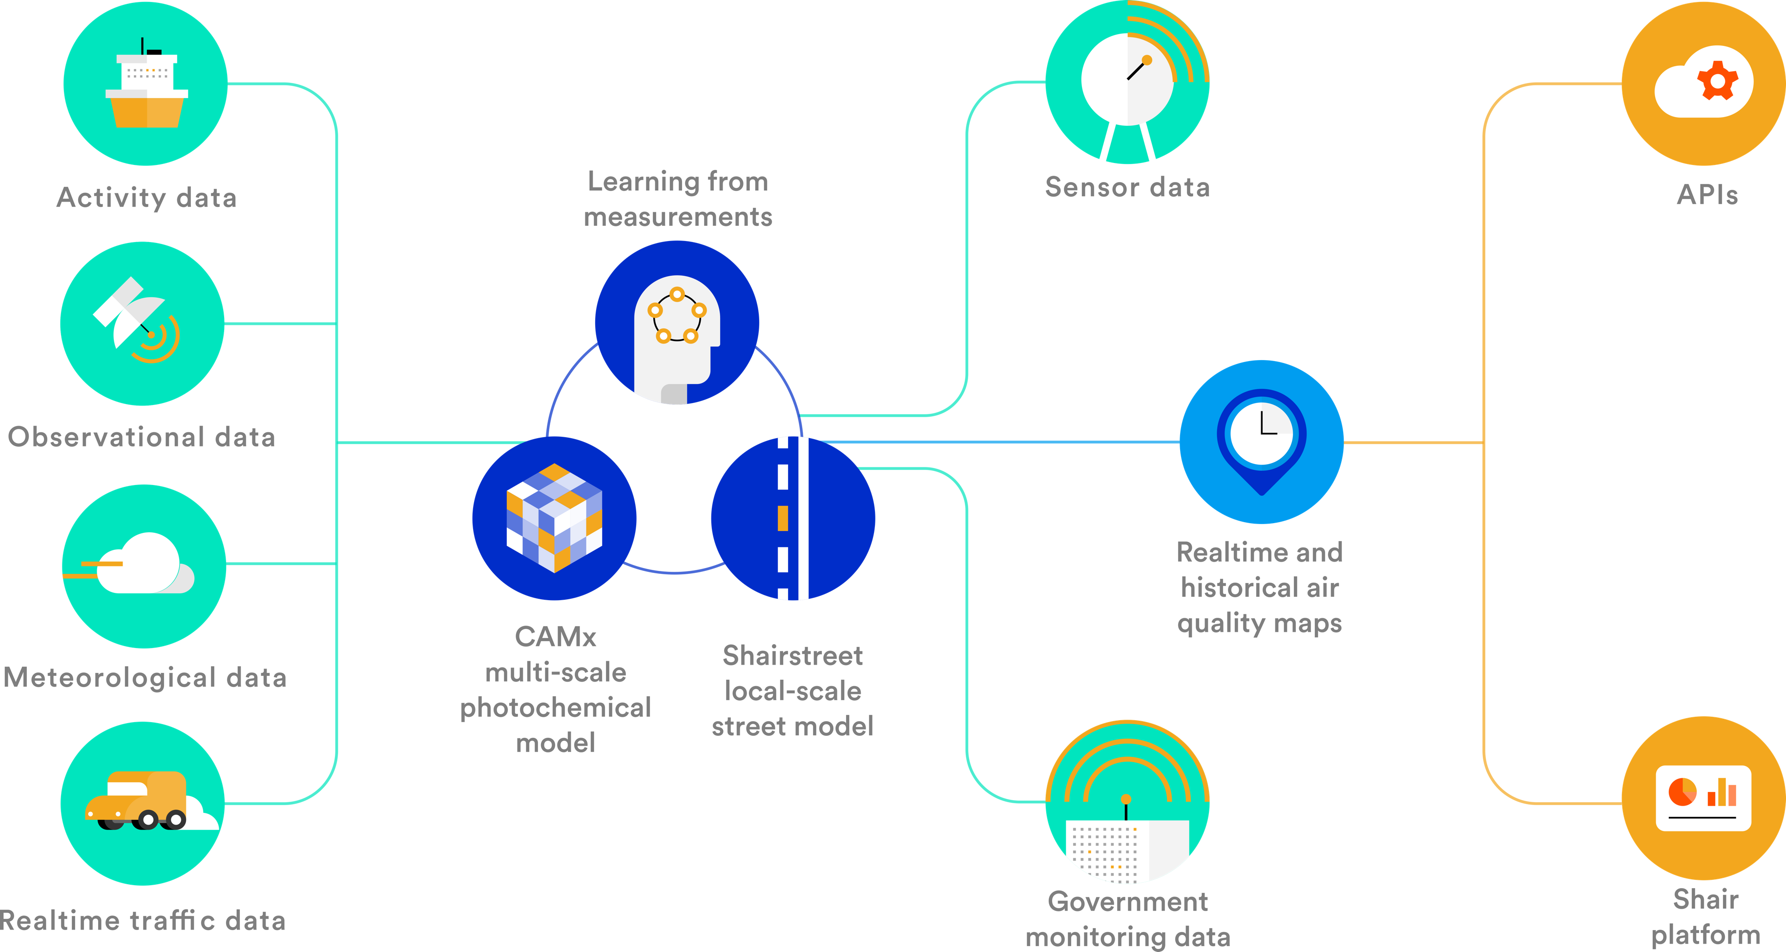
Ramboll Shair

Slide 7
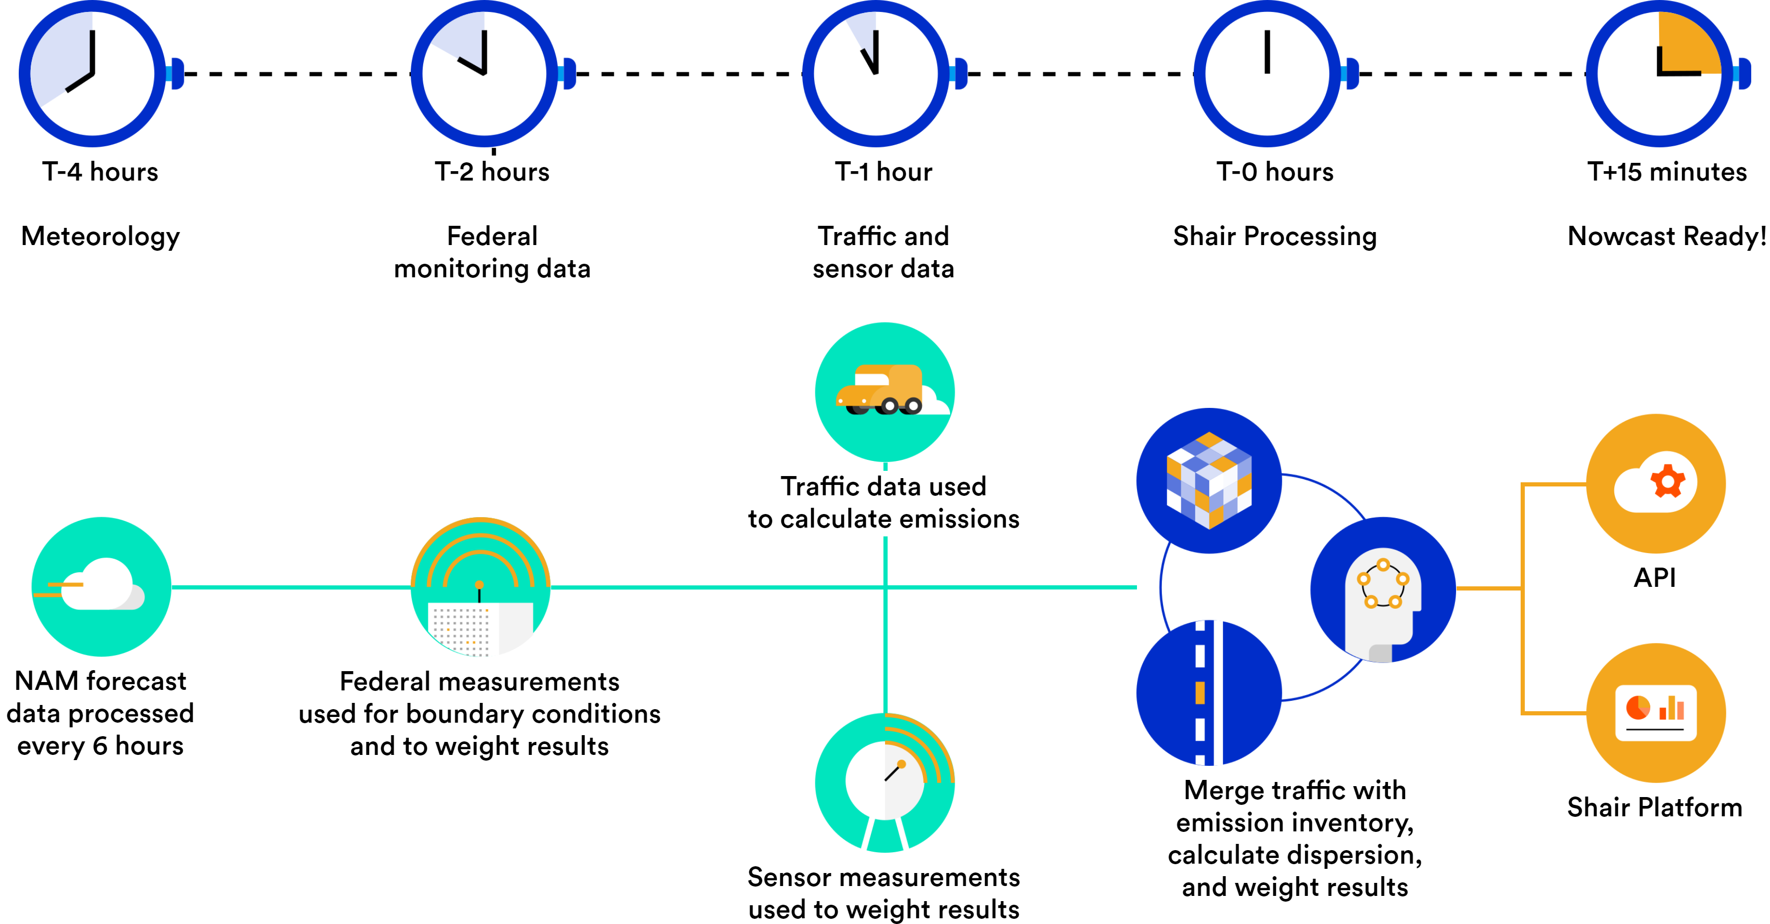
Ramboll Shair Nowcast Data Timing

Slide 8
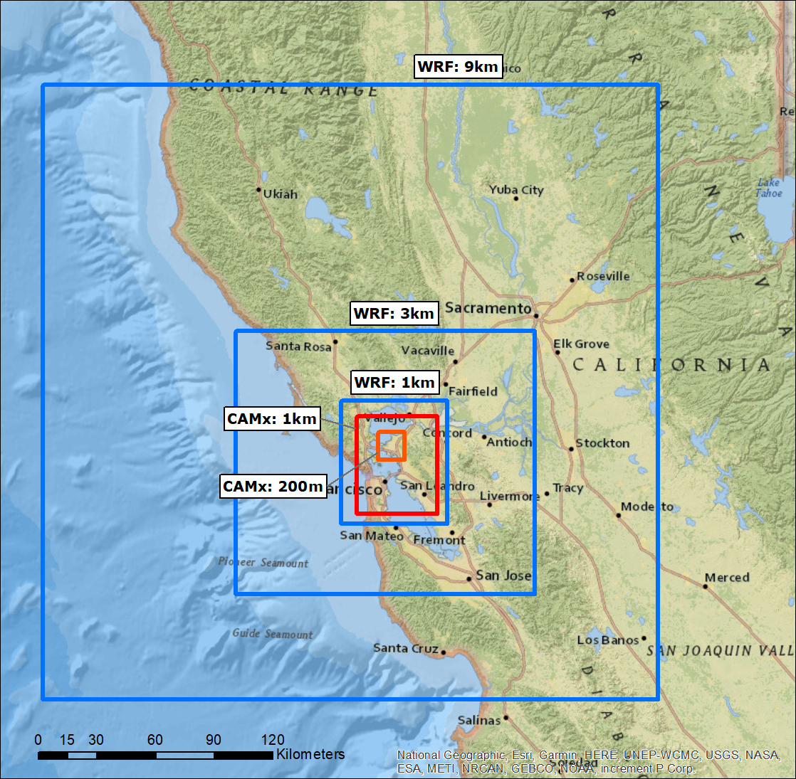
CAMx Modeling
Meteorology
  WRF NAM forecast refreshed every 6 hours
  Nested grids: 9km, 3km, and 1km resolution
CAMx Grids
  1km and 200m resolution
  Captures region’s most influential sources
Chemistry and Deposition
  Fast chemical scheme for O3-NO-NO2
  Wet and dry deposition with ZHANG03 model
Source Attribution
  Tag emissions by source category for source apportionment
Modeled every hour
  Latest emissions combined with previous hour dispersion results
Source: Wikipedia (Audiohifi)

Slide 9


Realtime Traffic Emissions
Mobile emission inventories (EMFAC, MOVES, COPERT)
Merge data
Retrieve all streets in an area
Open Street Map data
Traffic emissions
Realtime speed data from an API
Calculate real-time traffic flow
Travel demand model
358,269 Modeled Road Links in the Bay Area

Slide 10
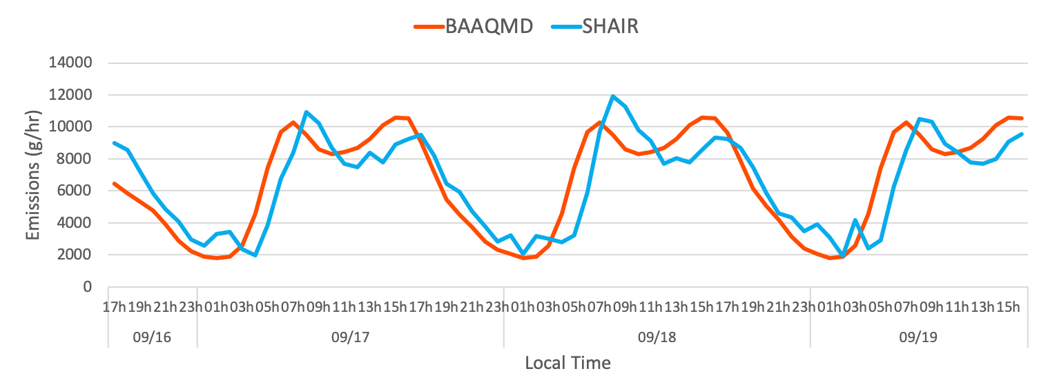
Realtime Traffic Emissions
Total on-road mobile emissions over modeled Richmond domain.
PM_{2.5}

Slide 11
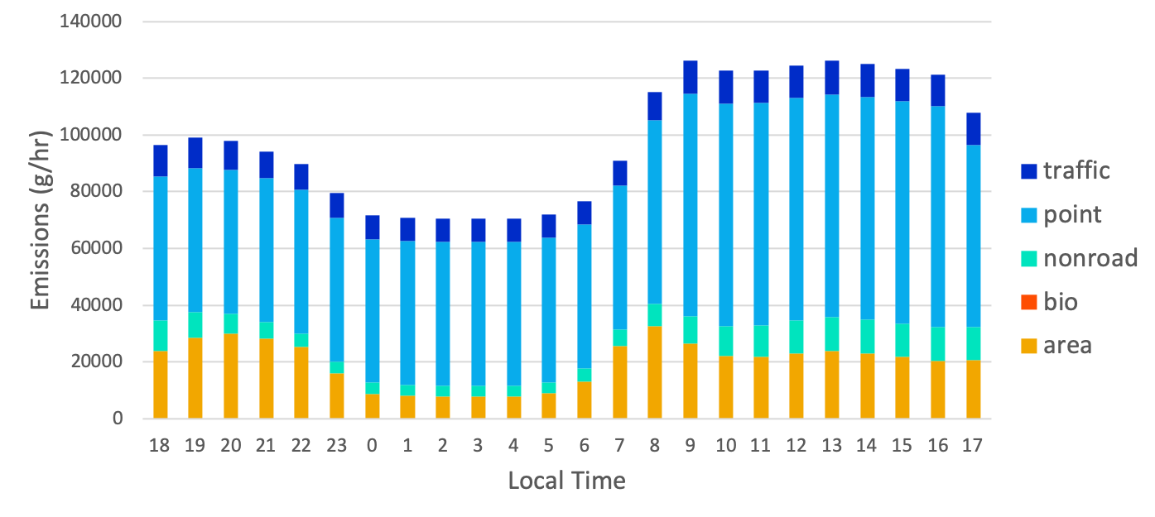
Additional Source Emissions
2016 BAAQMD 1km emissions inventory used for non-mobile sources.
Total emissions over modeled Richmond domain.
PM_{2.5}

Slide 12
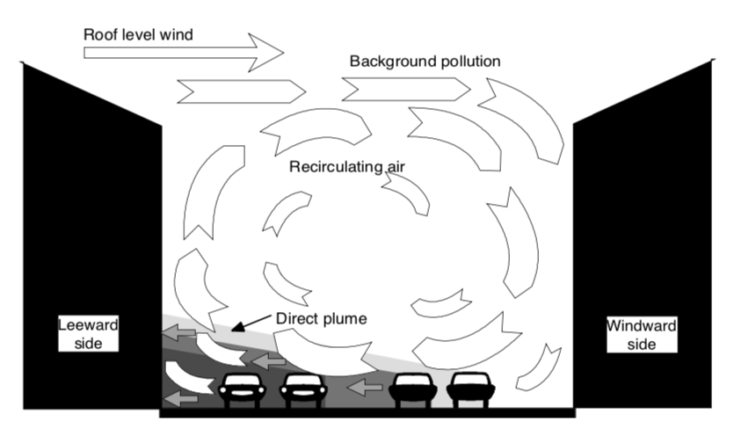

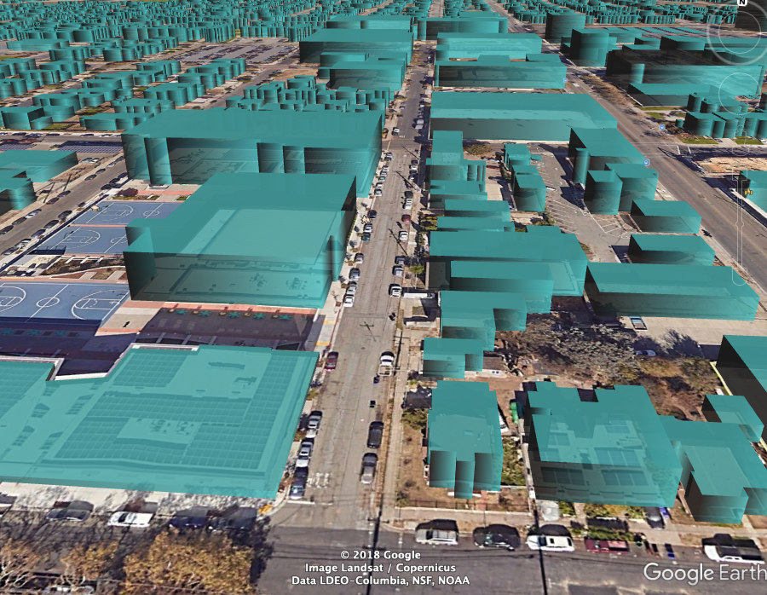
Shairstreet Modeling
Fine scale resolution of road emissions
1. Street canyon model
  Calculates additional recirculation contribution for road links that have street canyon-like geometry, using wind speed and direction at top of the canyons. Takes into account vehicle generated mechanical turbulence.
Source: Berkowicz 1997.
Modeled buildings in Richmond
(view from Chanslor Ave and 9th St)

Slide 13

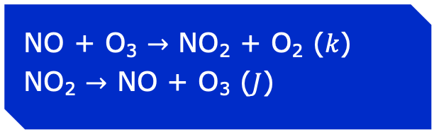

Shairstreet Modeling
Fine scale resolution of road emissions
1. Street canyon model
  Calculates additional recirculation contribution for road links that have street canyon-like geometry, using wind speed and direction at top of the canyons. Takes into account vehicle generated mechanical turbulence.
2. Line source dispersion model
  Road links are modeled as line sources based on Venkatram and Horst 2006 approximate Gaussian dispersion solution at 10x10m resolution.
3. NOx chemistry model
  Simplified NO-NO₂-O₃ model based on During et al. 2011, with parameterized mixing times based on street-canyon geometry.
$$C\left(x,y,z\right)=\frac{Q∗L}{2\sqrt{2π}u_{t}\cos{θ}σ_{z}\left(d_{eff}\right)}\exp\left(\frac{−{\left(z−h_{0}\right)}^{2}}{2σ_{z}^{2}\left(d_{eff}\right)}\right)$$
$×\left[erf\left(\frac{\left(y−y_{1}\right)\cos{θ}−x\sin{θ}}{\sqrt{2}σ_{y}\left(d_{1}\right)}\right)−erf\left(\frac{\left(y−y_{2}\right)\cos{θ}−x\sin{θ}}{\sqrt{2}σ_{y}\left(d_{2}\right)}\right)\right]$
NO + O₃ $→$ NO₂ + O₂ ($k$)
NO₂ $→$ NO + O₃ ($J$)
  Reaction and photolysis rates, $k$ and $J,$ taken from CAMx 200m grid along with background NO_{x} and O₃

Slide 14
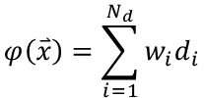
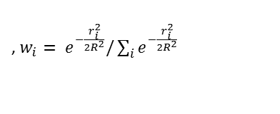
Sensor Integration
October 12th 2019, 7:00pm PDT
Raw model + sensors
Latest Clarity sensor and BAAQMD monitor data pulled
Measurement data undergoes internal quality control checks and adjustment
Objective analysis via Barnes interpolation is used to assimilate sensor measurements
Interpolated model error
$$φ\left(\overset{⃑}{x}\right)=\sum_{i=1}^{N_{d}}{w_{i}d_{i}}$$
, $w_{i}= e^{−\frac{r_{i}^{2}}{2R^{2}}}/\sum_{i}{e^{−\frac{r_{i}^{2}}{2R^{2}}}}$

Slide 15
Sensor Integration
October 12th 2019, 7:00pm PDT
Latest Clarity sensor and BAAQMD monitor data pulled
Measurement data undergoes internal quality control checks and adjustment
Error between model and observations are calculated
Objective analysis via Barnes interpolation is used to assimilate sensor measurements
Assimilated map
$$φ\left(\overset{⃑}{x}\right)=\sum_{i=1}^{N_{d}}{w_{i}d_{i}}$$
, $w_{i}= e^{−\frac{r_{i}^{2}}{2R^{2}}}/\sum_{i}{e^{−\frac{r_{i}^{2}}{2R^{2}}}}$

Slide 16
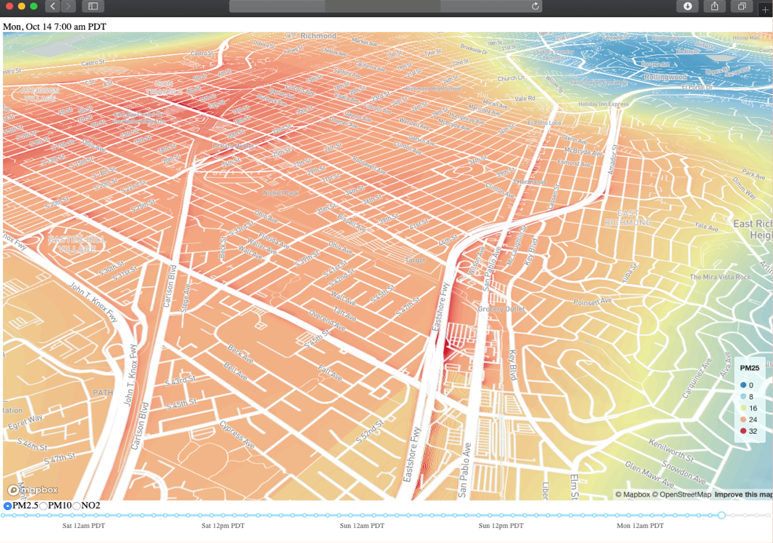
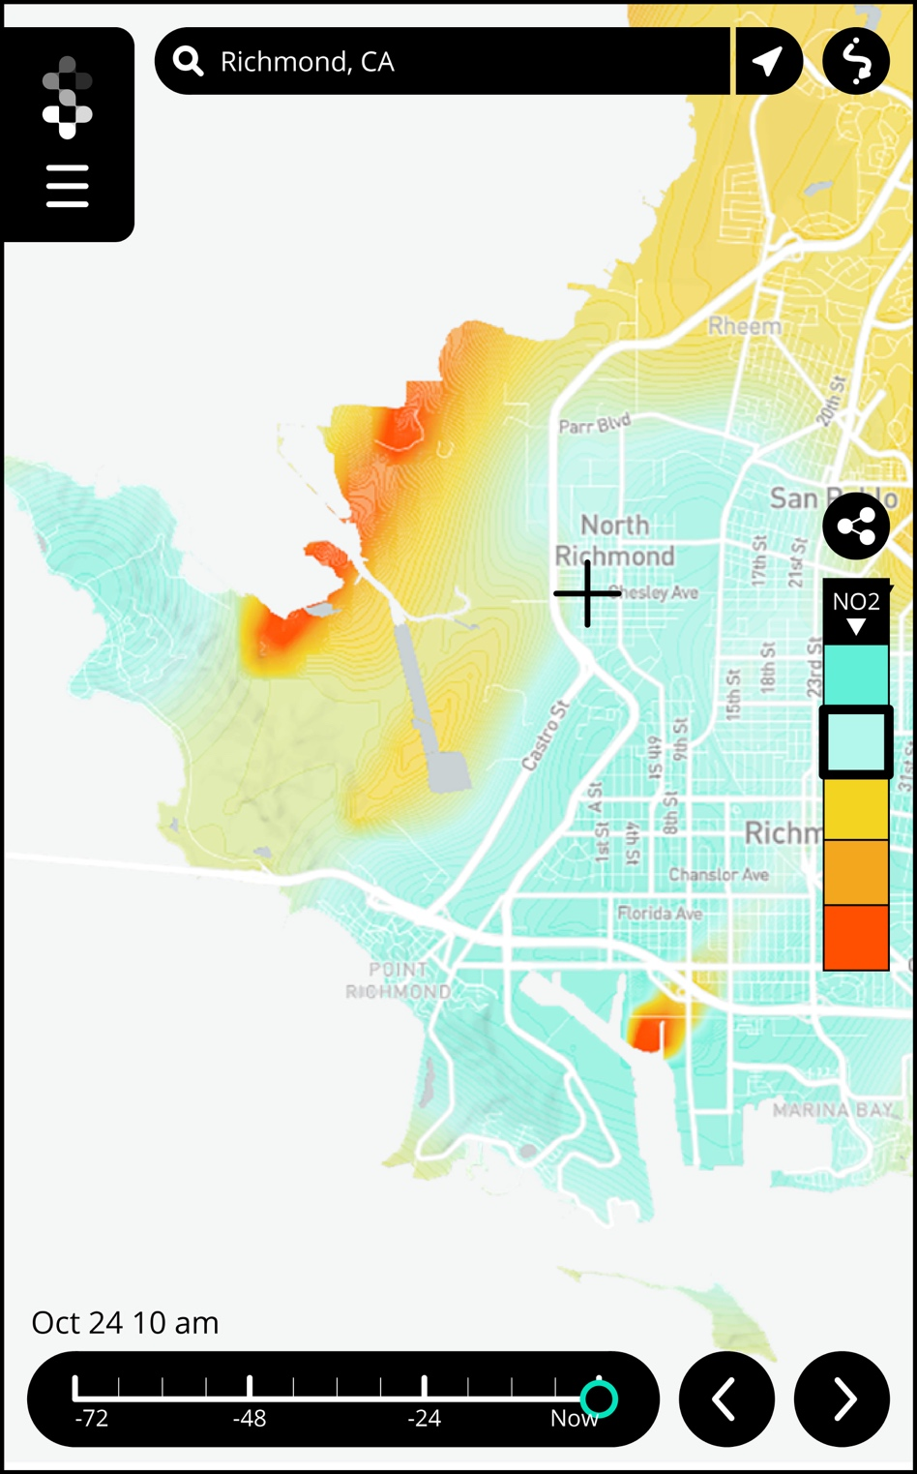
Communicating Results
Web/phone app for Richmond is being developed

Slide 17

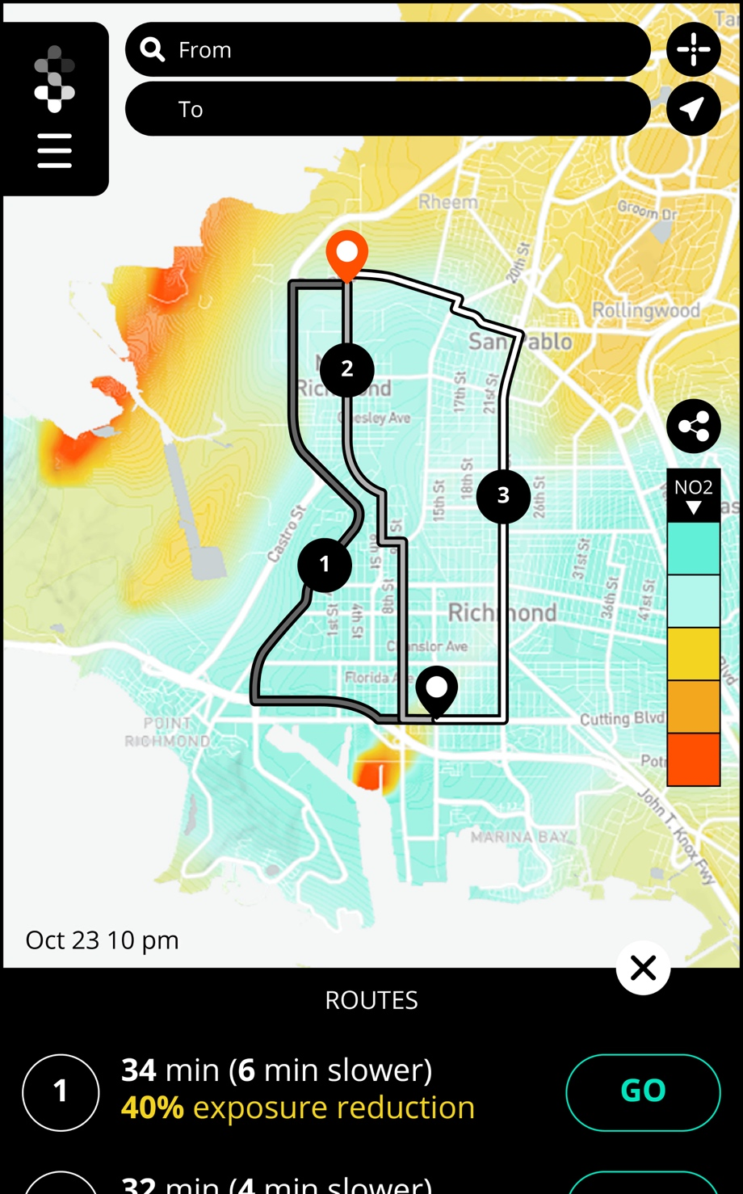
Next Steps
In the coming months, Shair output will be put to use by stakeholders
Groundwork Richmond
  Targeted tree planting as an air pollution intervention
City of Richmond
  Integrate hourly Shair output into the City’s web data dashboard
  Investigate air quality data-driven land use planning activities
  Communicate information to the public
Richmond citizens
  Engage with their environment
  Plan healthier outdoor activities
  Take precautionary actions during localized pollution events
Richmond-San Pablo Community Air Monitoring Steering Committee
  Identify major emissions sources
  Inform their official Community Emissions Reduction Plan (December 2020)

Slide 18
We’re excited to partner with Ramboll Shair to better understand air quality on a community scale. We need more information to better direct our resources and achieve our climate action goals.
- Adam Lenz, Environmental Services Manager, City of Richmond

Slide 19

Thank you
Justin Bandoro
jbandoro@ramboll.com
Get a copy of our whitepaper:
https://ramboll-shair.com

