Slide 1
Impact of anthropogenic emissions on urban air quality over the East African big conurbations of Addis Ababa, Kampala and Nairobi.
Mazzeo Andrea^{(1, 3)}, Quinn Andrew⁽¹⁾, Burrow Michael⁽¹⁾, Marais Eloise⁽²⁾, Singh Ajit⁽³⁾, and Pope Francis ⁽³⁾
1. School of Civil Engineering, University of Birmingham, UK
2. Department of Physics, Earth Observations and Astronomy, University of Leicester, UK
3. School of Geography Earth and Environment Sciences, University of Birmingham, UK

Slide 2
Summary:
Air Pollution in East Africa: Level of exposure, population growth, lack of laws, few academic works on the topic. Absence of modelling work on the topic.
ASAP-East Africa : Description of the project, main aims, division in WPs and main duties
ASAP-East Africa WP4: Description of the WP, main aims: modelling and training capabilities
Modelling of Meteorology and Chemistry for East Africa:
Validation of the Modelling System (with this extent of data is possible to reproduce the main patterns of aerosols in EA?)
Results (can the Modelling System a tool feasible to analyse the daily value of aerosols against world limits from WHO?)
Sector Analysis
Main achievements from HDM4 training calibration in East Africa
Conclusions and Forthcoming step of the work

Slide 3
Summary:
Air Pollution in East Africa: Level of exposure, population growth, lack of laws, few academic works on the topic. Absence of modelling work on the topic.
ASAP-East Africa : Description of the project, main aims, division in WPs and main duties
ASAP-East Africa WP4: Description of the WP, main aims: modelling and training capabilities
Modelling of Meteorology and Chemistry for East Africa:
Validation of the Modelling System (with this extent of data is possible to reproduce the main patterns of aerosols in EA?)
Results (can the Modelling System a tool feasible to analyse the daily value of aerosols against world limits from WHO?)
Sector Analysis
Main achievements from HDM4 training calibration in East Africa
Conclusions and Forthcoming step of the work

Slide 4
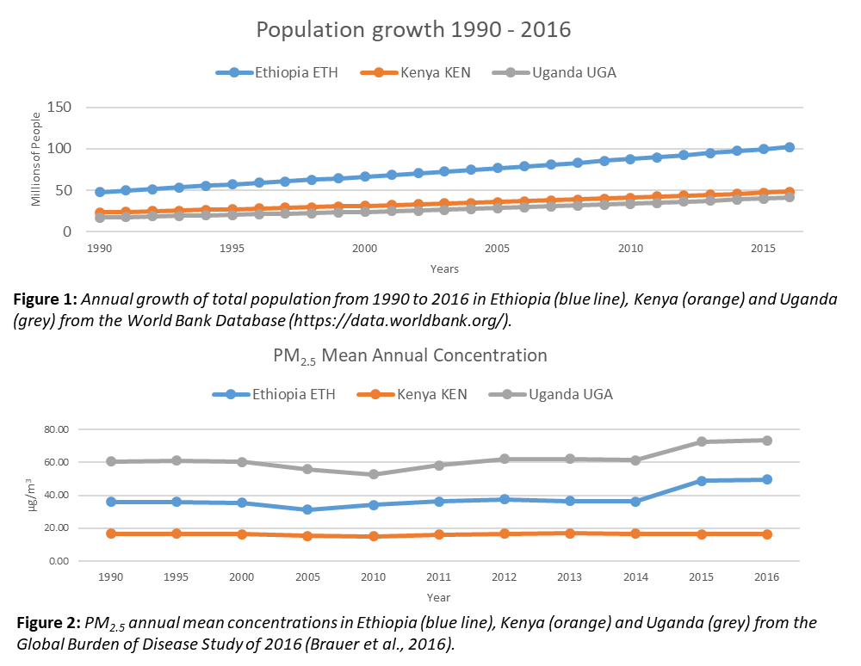
Air Pollution and population growth in East Africa
The atmospheric contamination of the urban areas of Sub Saharan Africa (SSA) is historically influenced by the large presence of seasonal burning biomass emissions. ⁽¹⁾
In addition, several countries in this area are experiencing a consistent growth in terms of population from 4.5 billion in 1980 to 7 billion in 2010. According to projections, population could grow up to 8.5 billion of people in 2030. ⁽²⁾
A similar growth has been observed also in terms of industrial activities, on–road transport (considering the increase of private vehicles owners) and in the use of solid fuels (e.g. woods, charcoal and agricultural residues) for cooking and heating. ⁽²⁾
All these factors can contribute to the worsening of air quality in urban areas, increasing the exposure of citizens to air pollution and in particular to Particulate Matter (PM) with aerodynamic diameter smaller than 10 and 2.5 µm (PM₁₀ and PM_{2.5}). ⁽³⁾
(Liousse et al, 2010).
(WPP,2015)
(Brauer et al., 2016; New Urban Agenda, 2017)
Notes:
.: For the purpose of the Work Package 4 of the ASAP-East Africa project two numerical models will be implemented over the domain of Sub-Saharan Africa, centred on the cities of Addis Ababa (Ethiopia), Kampala (Uganda) and Nairobi (Kenya).
1. The first model, HDM-4 is designed to simulate road network management, investment alternatives and to quantify the related emissions generated by the entire road network. HDM-4 will be used to create road networks associated with the three cities in question. The road networks will be described in terms of both vehicle fleet traveling on them and in terms of describing the conditions associated with the roads of the road network under examination.
2. The second is a modelling system conceived to make simulations at different resolution of regional and local meteorology and of the main chemistry-transport processes acting in the low troposphere and affecting the air quality.
.: The objective of the first system is to reproduce the ground state conditions of each road network, overall in terms of road-transport emissions released in the atmosphere simulating also different possible interventions and investment alternatives and quantifying the emissions reduction generated by these projections.
.: The output will be used by the second modelling system to extend the simulation of these scenarios over the entire domains of Addis Ababa, Nairobi and Kampala urban areas evaluating each scenario in terms of, costs, effective reduction in PM concentrations, and consequently improvements to air quality.

Slide 5
Air Pollution and population growth in East Africa
Previous Studies Focus:
PM_{2.5} concentrations have been quantified in the order of 100 µg/m³ as annual average in few urban areas of SSA (Brauer et al, 2012) - about ten times higher than the Air Quality guidelines levels defined by the World Health Organization for PM_{2.5} (WHO, 2016; Avis & Khaemba, 2018).
Air pollution in Nairobi indicate that air quality regularly exceeds the WHO guideline daily amounts, 25 and 50 µg/m³ annual concentrations of PM_{2.5} and PM₁₀, respectively (WHO, 2006; Gaita et al., 2016).
Analysis of the measured PM data highlights that Nairobi’s air pollution levels exceed WHO guideline values on a significant number of sampled days. At the urban roadside location, on 85% and 90% of the days, PM_{2.5} and PM₁₀ concentrations exceeded WHO guidelines, with 13% and 40%, respectively, in exceedance by at least double. (Pope et al., 2018)
Environmental Legislation in the East Africa:
Each country has its own environmental legislation (Law 300/2002, (2002) for Ethiopia, NEA, (2005) and NEAsB, (2017) for Uganda and EMCA, (2014) for Kenya) but in none of them an air quality monitoring network is present or is working.
Only in the Kenyan legislation emission threshold limits for gaseous pollutants and aerosols are quantified on daily and annual average (EMCA, 2014).
The daily threshold limits for PM₁₀ are 150, 100 and 75 µg/m³ respectively for industrial, residential and controlled areas while PM_{2.5} daily limit is 75 µg/m³ but only for industrial areas.
Notes:
.: For the purpose of the Work Package 4 of the ASAP-East Africa project two numerical models will be implemented over the domain of Sub-Saharan Africa, centred on the cities of Addis Ababa (Ethiopia), Kampala (Uganda) and Nairobi (Kenya).
1. The first model, HDM-4 is designed to simulate road network management, investment alternatives and to quantify the related emissions generated by the entire road network. HDM-4 will be used to create road networks associated with the three cities in question. The road networks will be described in terms of both vehicle fleet traveling on them and in terms of describing the conditions associated with the roads of the road network under examination.
2. The second is a modelling system conceived to make simulations at different resolution of regional and local meteorology and of the main chemistry-transport processes acting in the low troposphere and affecting the air quality.
.: The objective of the first system is to reproduce the ground state conditions of each road network, overall in terms of road-transport emissions released in the atmosphere simulating also different possible interventions and investment alternatives and quantifying the emissions reduction generated by these projections.
.: The output will be used by the second modelling system to extend the simulation of these scenarios over the entire domains of Addis Ababa, Nairobi and Kampala urban areas evaluating each scenario in terms of, costs, effective reduction in PM concentrations, and consequently improvements to air quality.

Slide 6
ASAP: A Systems Approach to air Pollution for East Africa
The ASAP-East Africa project is designed to support and facilitate innovative and interdisciplinary research. It leverages existing expertise and partnerships and encourages the uptake and application of knowledge in new ways.
WPs 1-6 have been designed to support knowledge development in specific disciplinary areas and collectively feed into WP 7 i.e. the ‘co-creation and production of innovative solutions to air pollution’
WP-4 aims and focus :
Training on Road Transport Emissions modelling (HDM-4):
Modelling of different road sections
Extrapolation of the complete road network
Simulation of the entire road network and generation of annual emissions from road transport
Calibration of annual emissions against different emission inventories field observations and yearly extracted emissions.
Simulation of different investment plans according to the projections made by HDM-4
Meteorological and chemistry-transport process simulations over East Africa (WRF-CHIMERE):
Implementation of WRF and CHIMERE models over East Africa domain.
Simulation of the general patterns of dispersion over each regional and local domain with different emission inventories.
Transfer of the results from HDM-4 projections in scenarios for chemistry-transport simulations by WRF CHIMERE.
Notes:
.: For the purpose of the Work Package 4 of the ASAP-East Africa project two numerical models will be implemented over the domain of Sub-Saharan Africa, centred on the cities of Addis Ababa (Ethiopia), Kampala (Uganda) and Nairobi (Kenya).
1. The first model, HDM-4 is designed to simulate road network management, investment alternatives and to quantify the related emissions generated by the entire road network. HDM-4 will be used to create road networks associated with the three cities in question. The road networks will be described in terms of both vehicle fleet traveling on them and in terms of describing the conditions associated with the roads of the road network under examination.
2. The second is a modelling system conceived to make simulations at different resolution of regional and local meteorology and of the main chemistry-transport processes acting in the low troposphere and affecting the air quality.
.: The objective of the first system is to reproduce the ground state conditions of each road network, overall in terms of road-transport emissions released in the atmosphere simulating also different possible interventions and investment alternatives and quantifying the emissions reduction generated by these projections.
.: The output will be used by the second modelling system to extend the simulation of these scenarios over the entire domains of Addis Ababa, Nairobi and Kampala urban areas evaluating each scenario in terms of, costs, effective reduction in PM concentrations, and consequently improvements to air quality.

Slide 7
Summary:
Air Pollution in East Africa: Level of exposure, population growth, lack of laws, few academic works on the topic. Absence of modelling work on the topic.
ASAP-East Africa : Description of the project, main aims, division in WPs and main duties
ASAP-East Africa WP4: Description of the WP, main aims: modelling and training capabilities
Modelling of Meteorology and Chemistry for East Africa:
Validation of the Modelling System (with this extent of data is possible to reproduce the main patterns of aerosols in EA?)
Results (can the Modelling System a tool feasible to analyse the daily value of aerosols against world limits from WHO?)
Sector Analysis
Main achievements from HDM4 training calibration in East Africa
Conclusions and Forthcoming step of the work

Slide 8
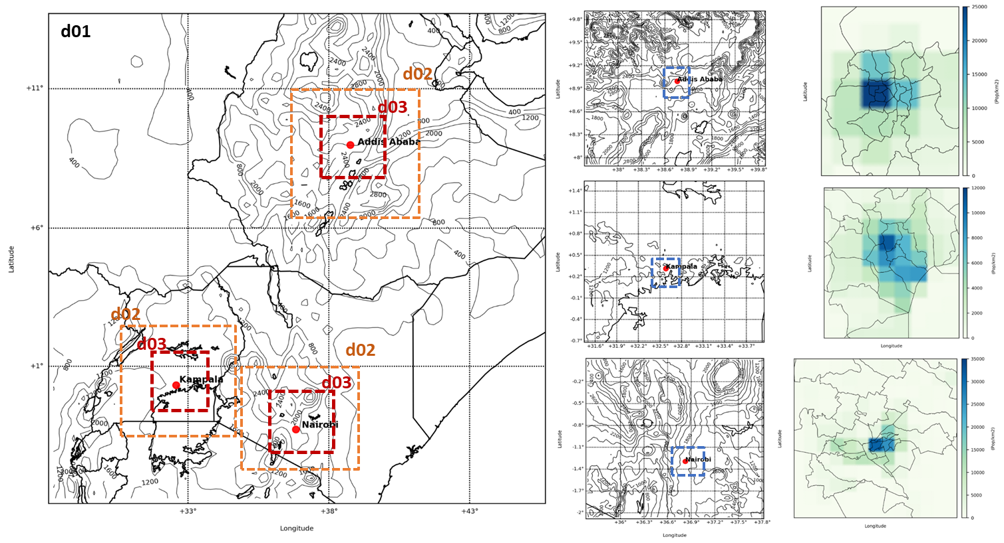
Domains for East Africa:
: analysed area for population density
D01: 18x18km
D02: 6x6km
D03: 2x2km

Slide 9
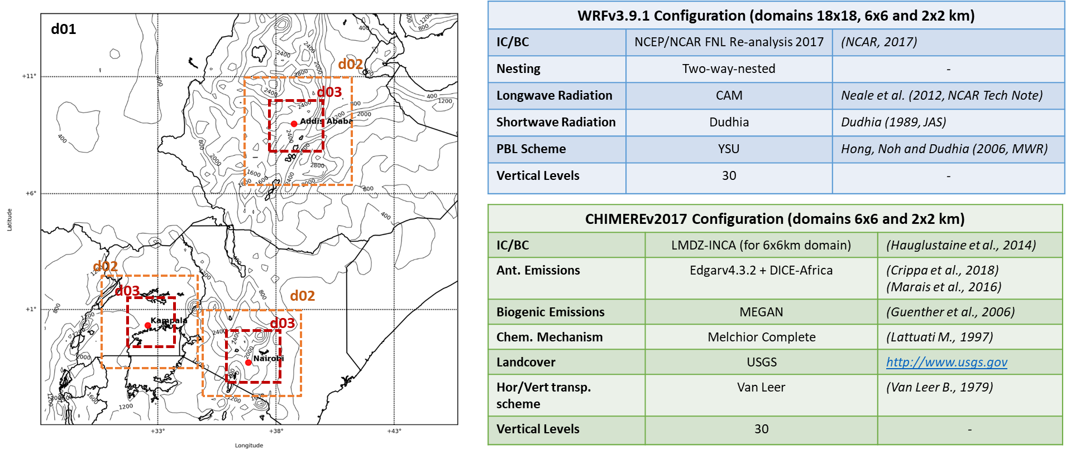
Domains for East Africa:

Slide 10
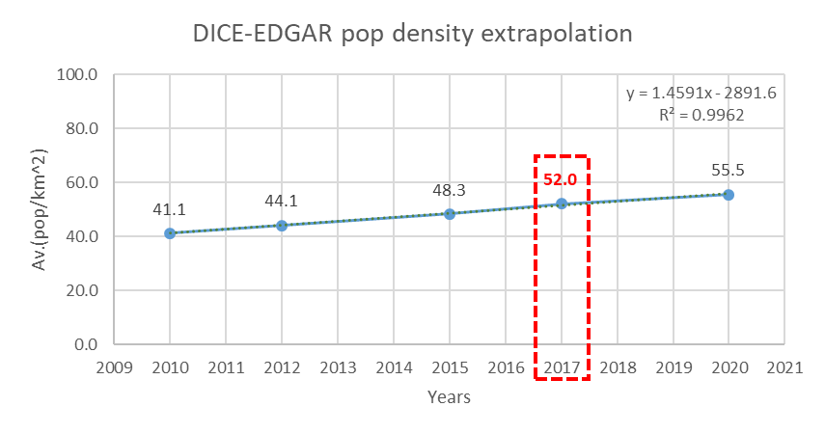
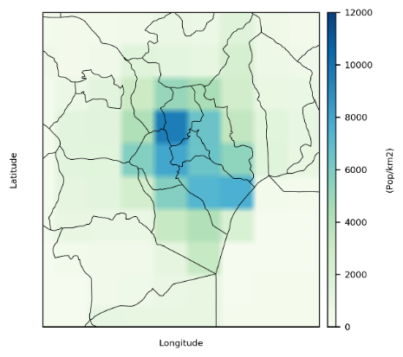
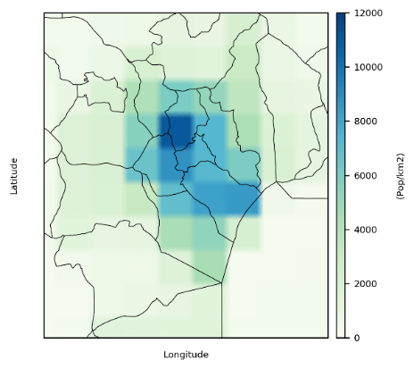
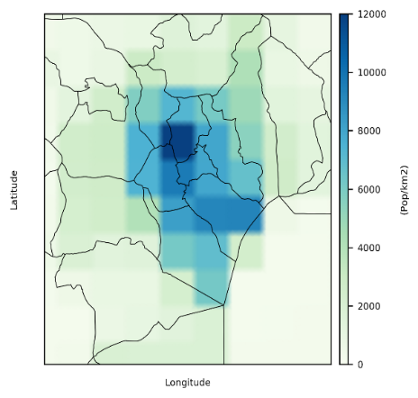
Emission Analysis
The global emission inventory EDGARv4.3.2 (Crippa et al., 2018) has been merged with Diffuse and Inefficient Combustion Emissions in Africa inventory (DICE-Africa, Marais et al., 2016), both created originally for the year 2012.
The final inventory (DICE-EDGAR) has been projected for the year 2017 by linear extrapolation of population density data from the Socioeconomic Data and Application Centre of the Columbia University and NASA (SEDAC, 2019).
Emissions sectors provided by DICE-Africa:
Gas-flares
Fuelwood use for charcoal production
Fuelwood use for other comm. Enterprises
Generator Use
Land-based transport emissions
Residential heating emissions
(+ HTAP04_INDUSTRY)
(+ HTAP04_INDUSTRY)
(+ HTAP04_INDUSTRY)
(+ HTAP03_ENERGY)
(+ HTAP05_TRANSPORT)
(+ HTAP06_RESIDENTIAL)
added
replaced
2010
2015
2020

Slide 11
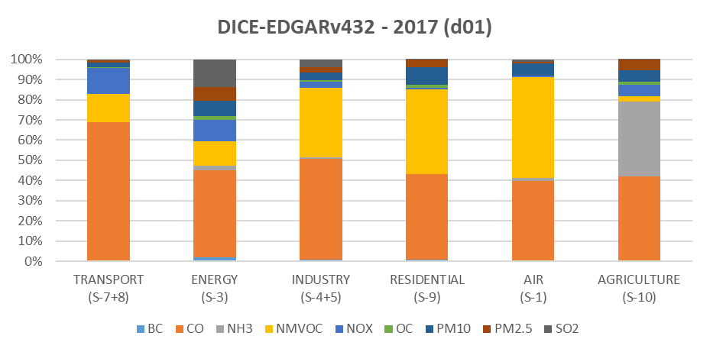
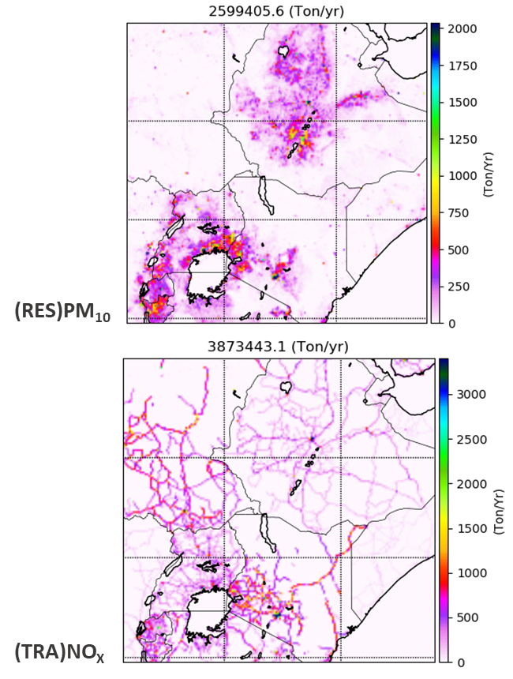
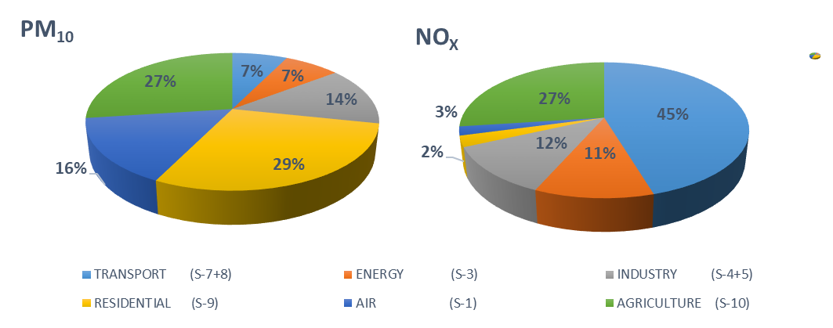
Emission Analysis

Slide 12
Summary:
Air Pollution in East Africa: Level of exposure, population growth, lack of laws, few academic works on the topic. Absence of modelling work on the topic.
ASAP-East Africa : Description of the project, main aims, division in WPs and main duties
ASAP-East Africa WP4: Description of the WP, main aims: modelling and training capabilities
Modelling of Meteorology and Chemistry for East Africa:
Validation of the Modelling System (with this extent of data is possible to reproduce the main patterns of aerosols in EA?)
Results (can the Modelling System a tool feasible to analyse the daily value of aerosols against world limits from WHO?)
Sector Analysis
Main achievements from HDM4 training calibration in East Africa
Conclusions and Forthcoming step of the work

Slide 13
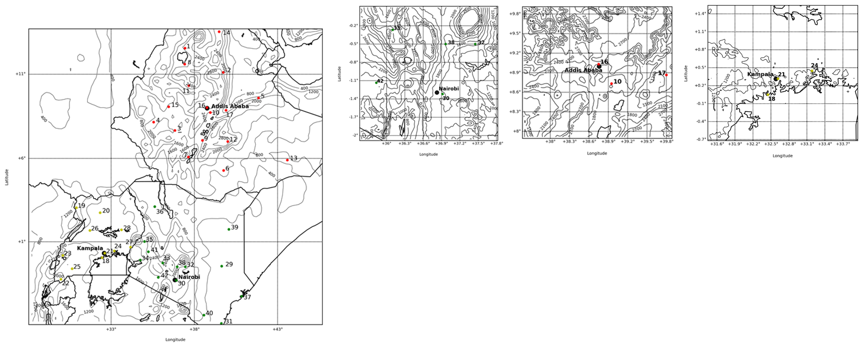
Modelling System Validation: Observations sites and sources
Statistical Evaluation done on all the available Stations for East Africa (42):
Statistics calculated over the 6x6km and 2x2km domains
Stations at different altitude have been taken in account ( up to ~ 2400m a.g.l.)
CEDAS-MIDAS Database for 2017 (T , RH, WD, WS)
ASAP-WP2 Weather Observations (From city Airports)
Statistic Analysis of PM₁₀ and PM_{2.5} concentrations at hourly/daily level :
WP2 observations for Kenya (PM₁₀ and PM_{2.5}) (Pope et al., 2018)
US Embassy observations for Ethiopia and Uganda (PM_{2.5})
Statistical Parameters:
Mean Observations values
Mean Model values
Mean Normalized Bias (MNB)
Normalized Root Mean Square Error (NRMSE)
Parson Coefficient (R)

Slide 14
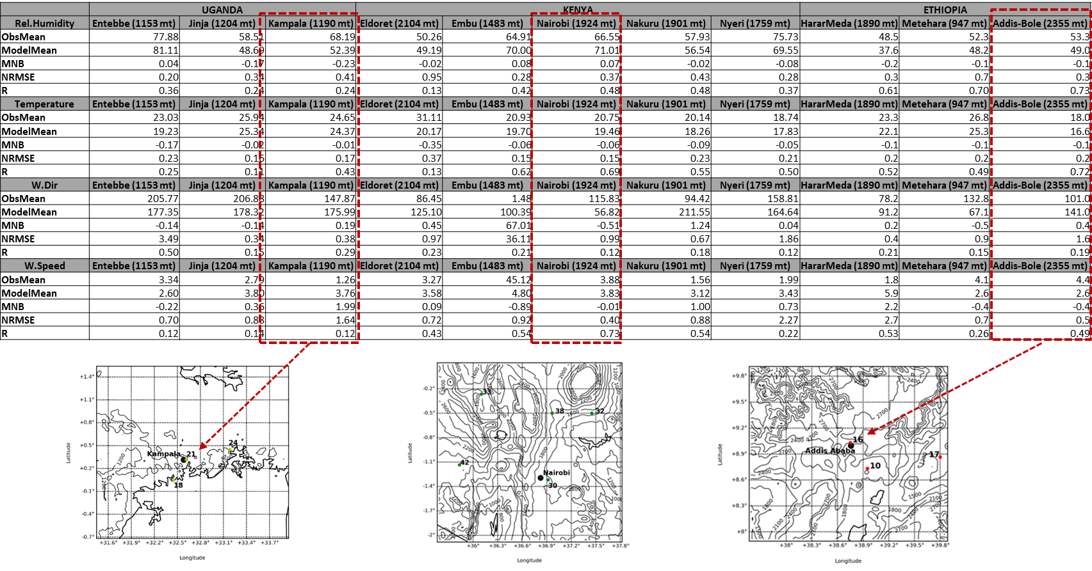
Statistical Evaluation of WRF performance for East Africa (2x2km Domains)

Slide 15
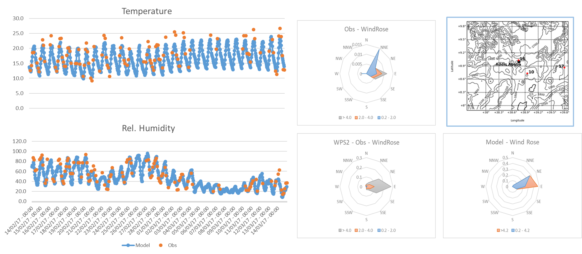
Weather Evaluation for Addis Ababa Station (16)

Slide 16
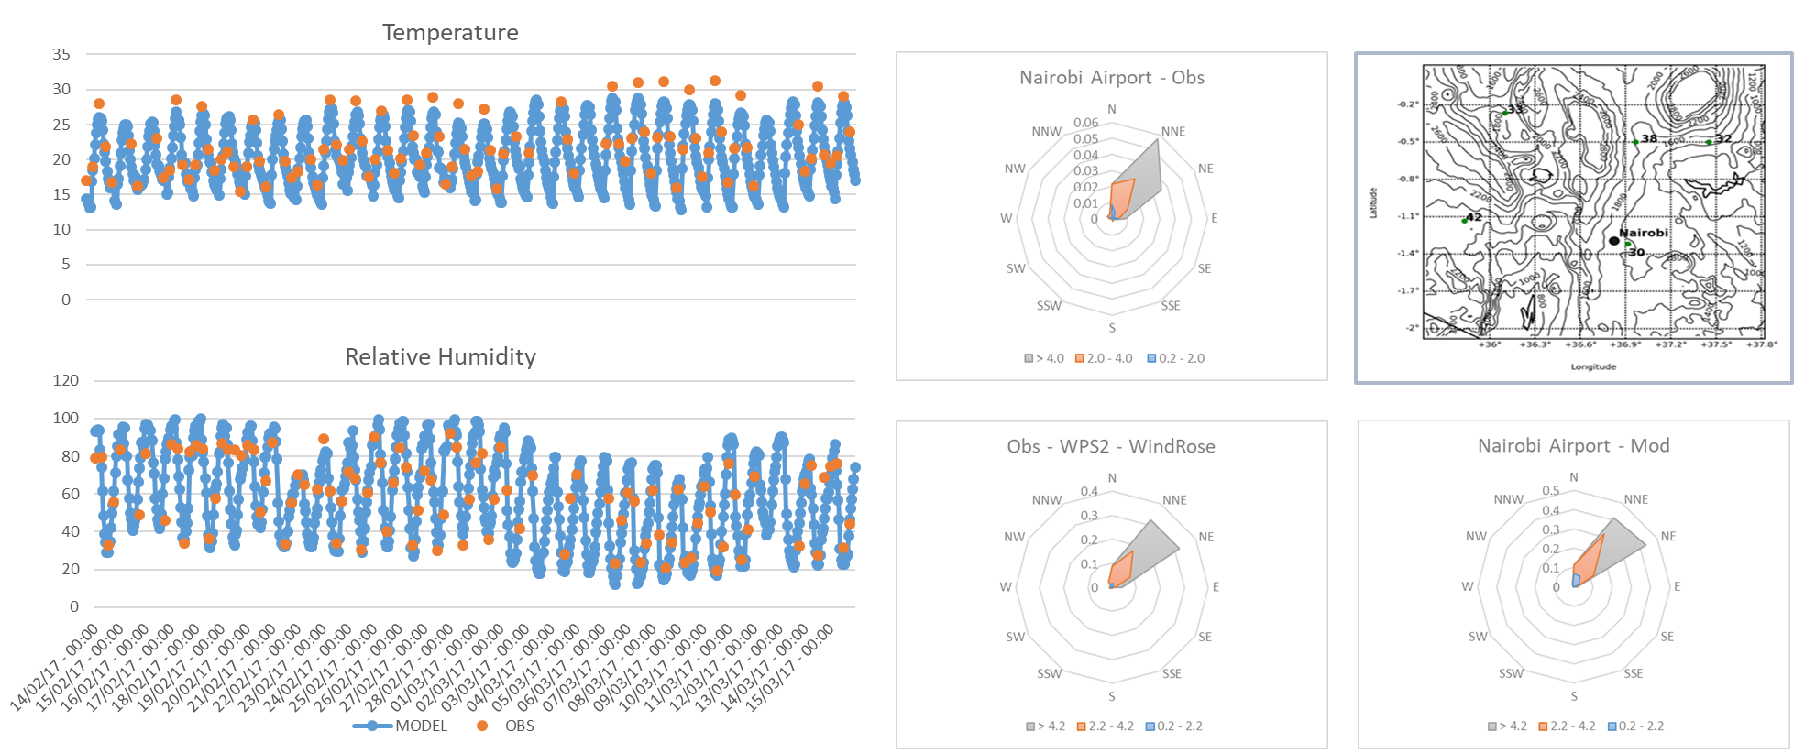
Weather Evaluation for Nairobi Station (30)

Slide 17
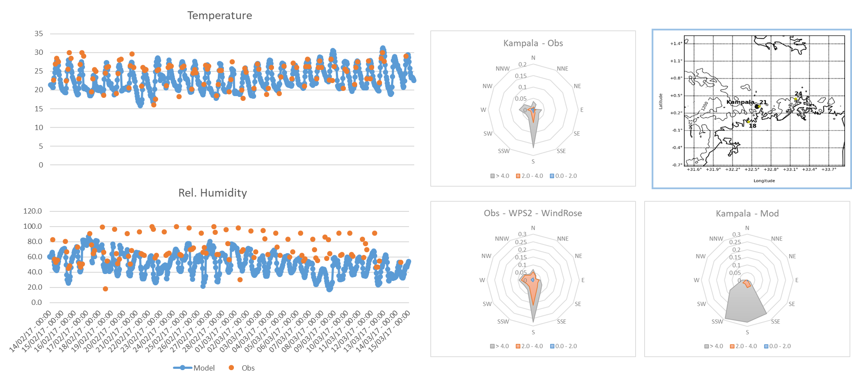
Weather Evaluation for Kampala Station (21)

Slide 18
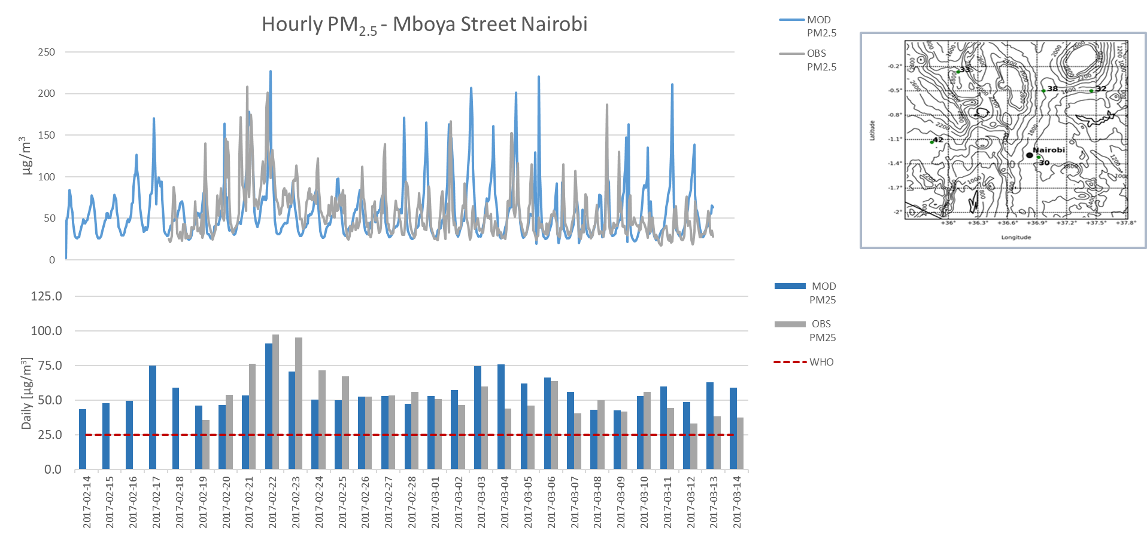
CHIMERE Validation for East Africa

Slide 19
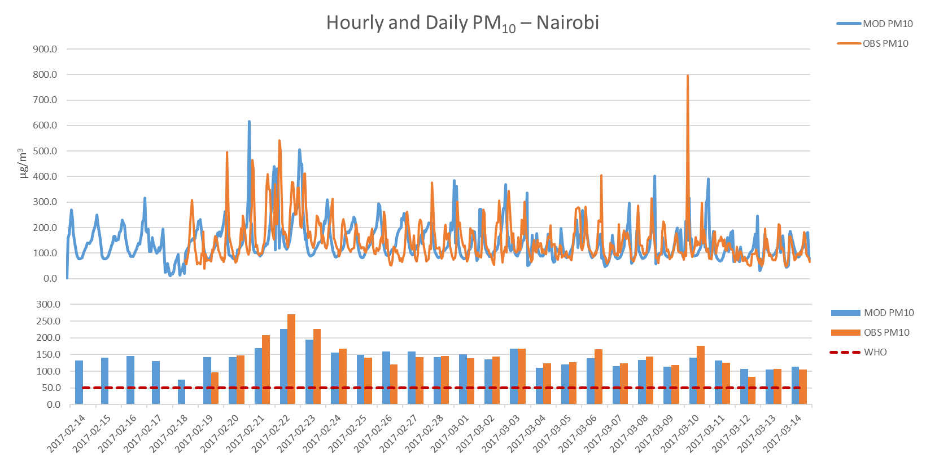
CHIMERE Validation for East Africa

Slide 20
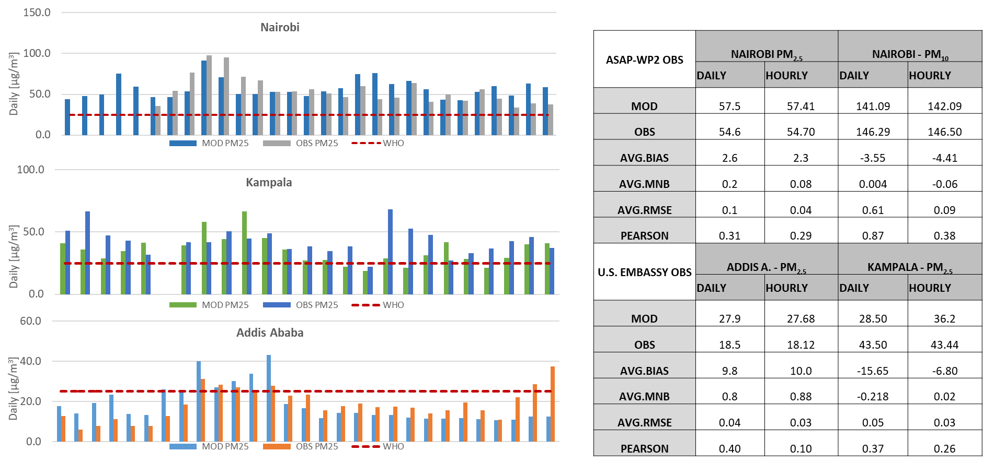
PM_{2.5} DAILY value MODEL vs US. Embassy Data

Slide 21
Summary:
Air Pollution in East Africa: Level of exposure, population growth, lack of laws, few academic works on the topic. Absence of modelling work on the topic.
ASAP-East Africa : Description of the project, main aims, division in WPs and main duties
ASAP-East Africa WP4: Description of the WP, main aims: modelling and training capabilities
Modelling of Meteorology and Chemistry for East Africa:
Validation of the Modelling System (with this extent of data is possible to reproduce the main patterns of aerosols in EA?)
Results (can the Modelling System a tool feasible to analyse the daily value of aerosols against world limits from WHO?)
Sector Analysis
Main achievements from HDM4 training calibration in East Africa
Conclusions and Forthcoming step of the work

Slide 22
WRF-CHIMERE evaluation vs WHO daily limits for PM_{2.5}
Can WRF-CHIMERE be used for analysis and forecast of air quality in East Africa despite the low quantity, quality and updating of input data?
WHO Exceeding Limits (Obs vs Mod): comparison of the number of days in which the concentration levels exceeded the limits set by the WHO between observations and model
Ratio: Ratio between the number of exceedances reproduced by the model and those actually observed
Model Overestimations: Number of days exceeding the limits reproduced by the model but not corresponding to the observations

Slide 23
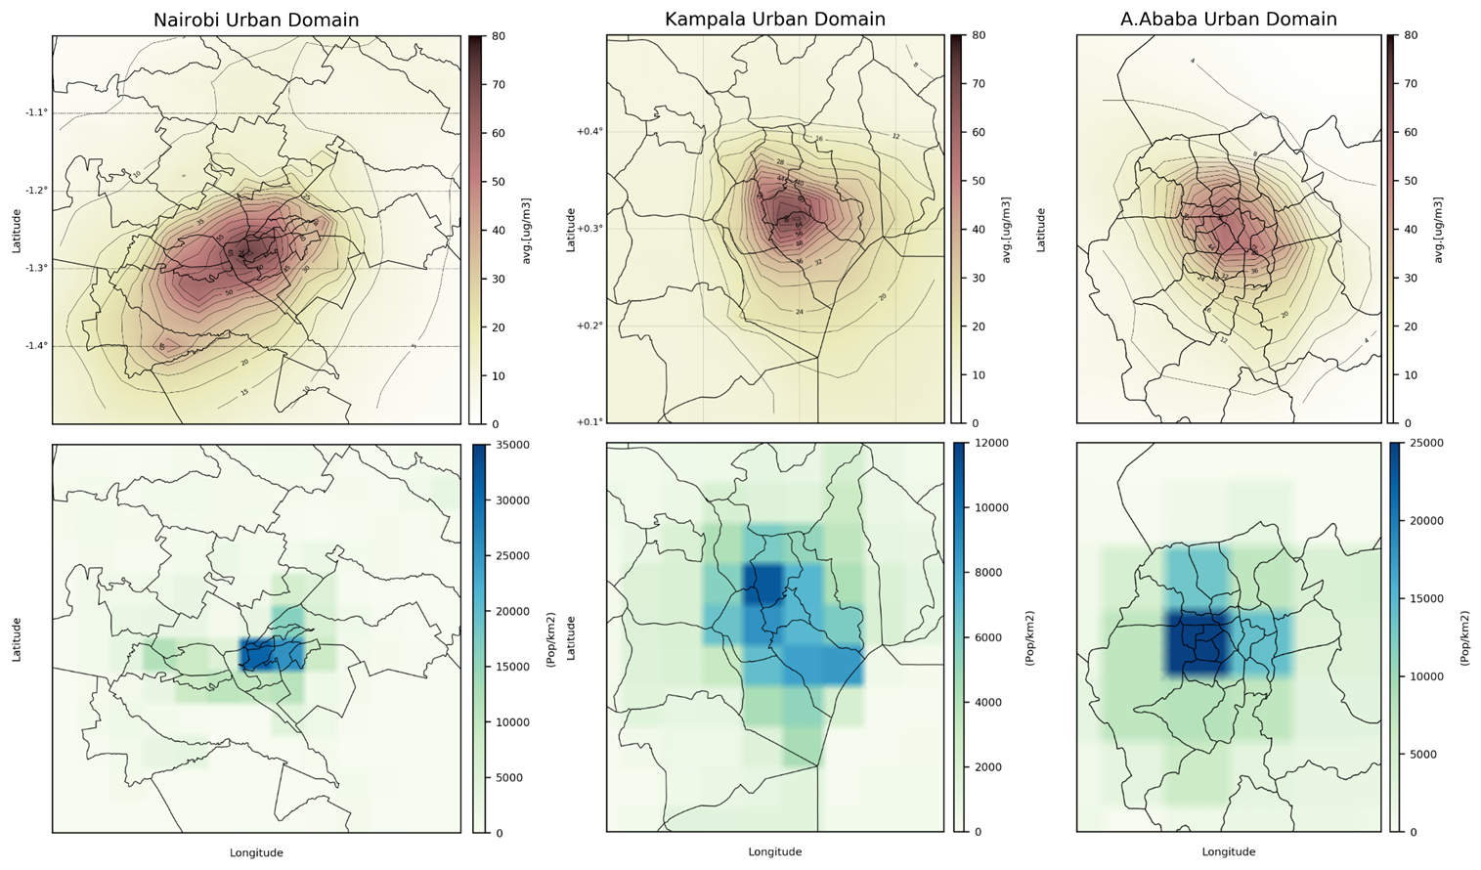
PM_{2.5} average concentrations 14th 02 – 15th 03 2017 vs Pop Dens

Slide 24
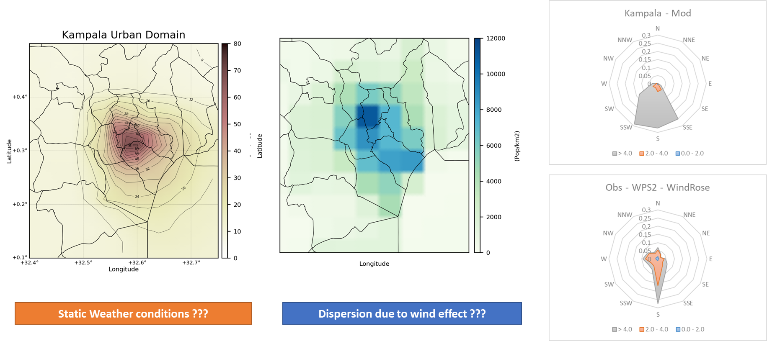
PM_{2.5} average concentrations 14th 02 – 15th 03 2017 vs Pop Dens

Slide 25
Summary:
Air Pollution in East Africa: Level of exposure, population growth, lack of laws, few academic works on the topic. Absence of modelling work on the topic.
ASAP-East Africa : Description of the project, main aims, division in WPs and main duties
ASAP-East Africa WP4: Description of the WP, main aims: modelling and training capabilities
Modelling of Meteorology and Chemistry for East Africa:
Validation of the Modelling System (with this extent of data is possible to reproduce the main patterns of aerosols in EA?)
Results (can the Modelling System a tool feasible to analyse the daily value of aerosols against world limits from WHO?)
Sector Analysis
Main achievements from HDM4 training calibration in East Africa
Conclusions and Forthcoming step of the work

Slide 26
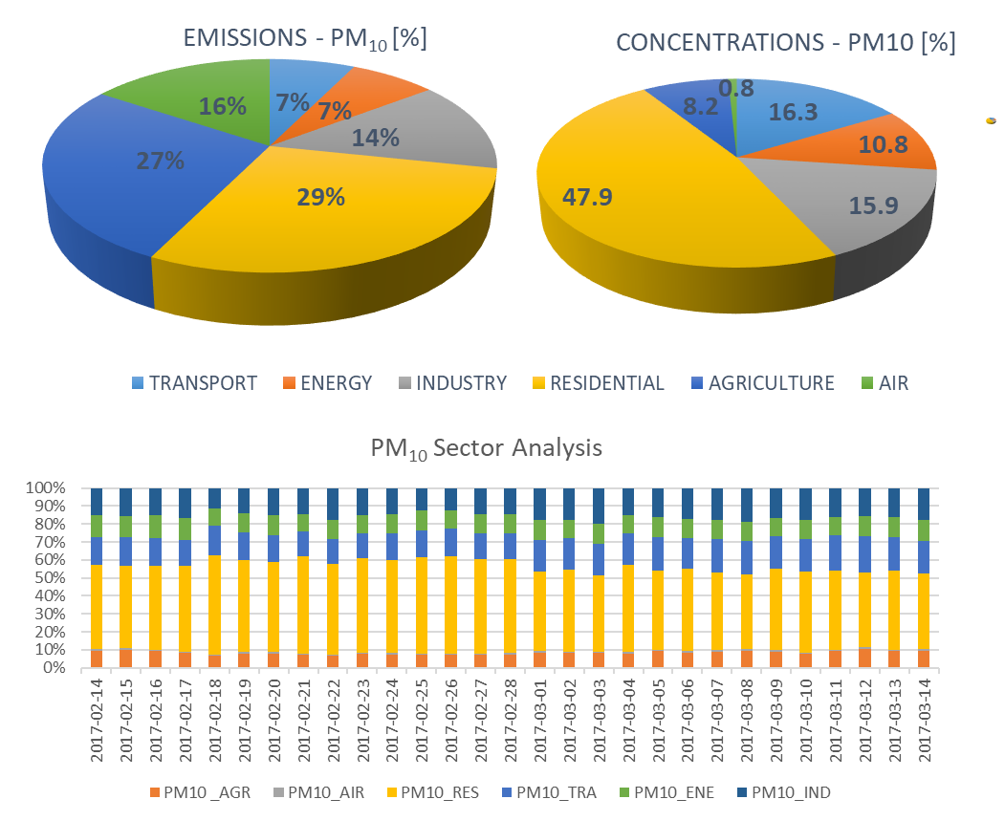
CHIMERE Single Sector Analysis
The RES and TRA emissions compared with the relative concentrations have a high impact compared to other sources. RES emissions account for 29% of the annual total but in the analysis period they impact for ~ 48% of the total concentrations.
The ENE and IND emissions are the next to show the greatest impact on concentrations although with more similar percentages between emissions and concentrations.

Slide 27
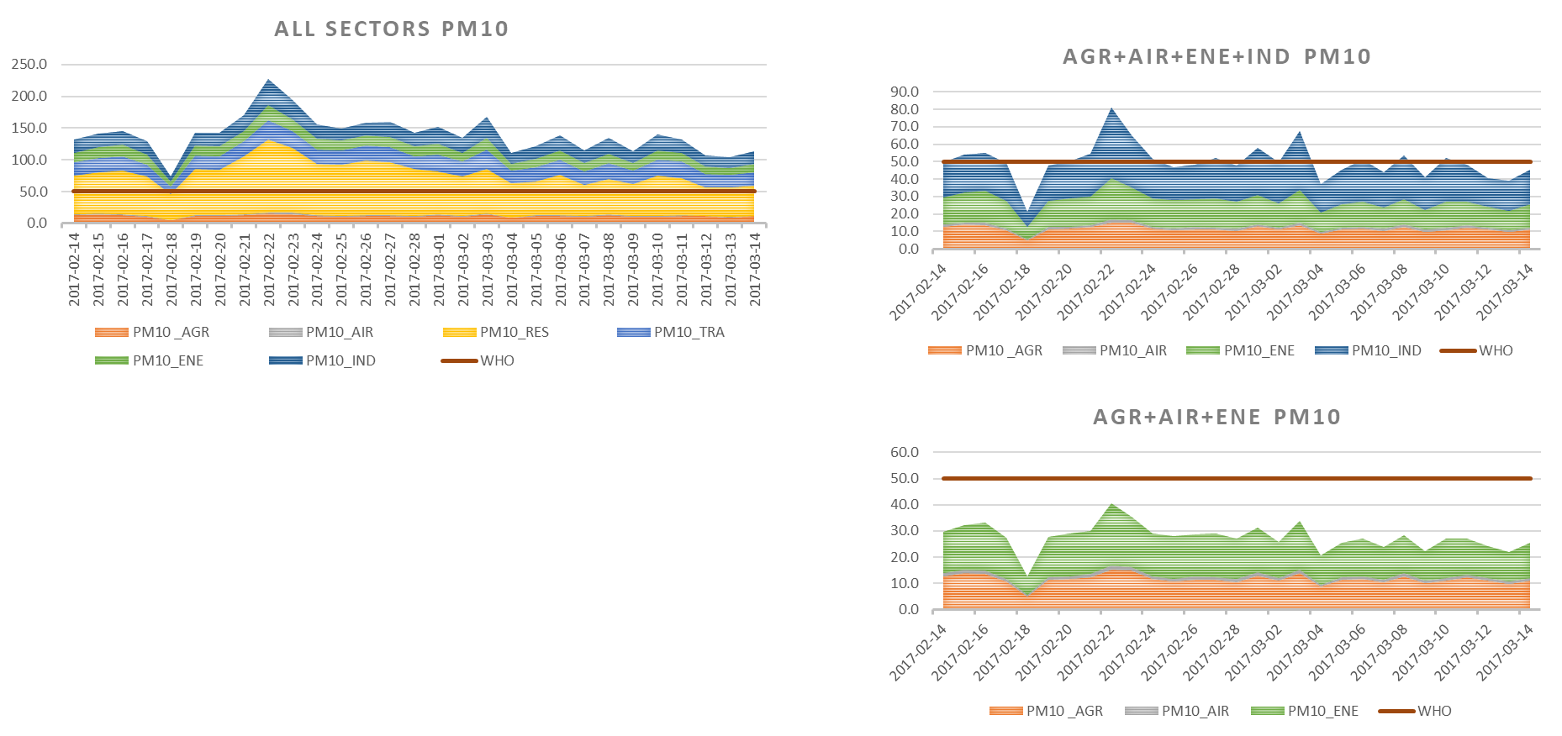
CHIMERE Single Sector Analysis
Single-sector simulations suggest that even by intervening exclusively on the total reduction of emission levels relating to RES and TRA, many exceedances of WHO levels persist.
Only a drastic (and not-properly realistic) reduction of the main RES emission sources, TRA and IND would allow a lowering of the daily PM₁₀ levels below the threshold set by the WHO.

Slide 28
Summary:
Air Pollution in East Africa: Level of exposure, population growth, lack of laws, few academic works on the topic. Absence of modelling work on the topic.
ASAP-East Africa : Description of the project, main aims, division in WPs and main duties
ASAP-East Africa WP4: Description of the WP, main aims: modelling and training capabilities
Modelling of Meteorology and Chemistry for East Africa:
Validation of the Modelling System (with this extent of data is possible to reproduce the main patterns of aerosols in EA?)
Results (can the Modelling System a tool feasible to analyse the daily value of aerosols against world limits from WHO?)
Sector Analysis
Main achievements from HDM4 training calibration in East Africa
Conclusions and Forthcoming step of the work

Slide 29
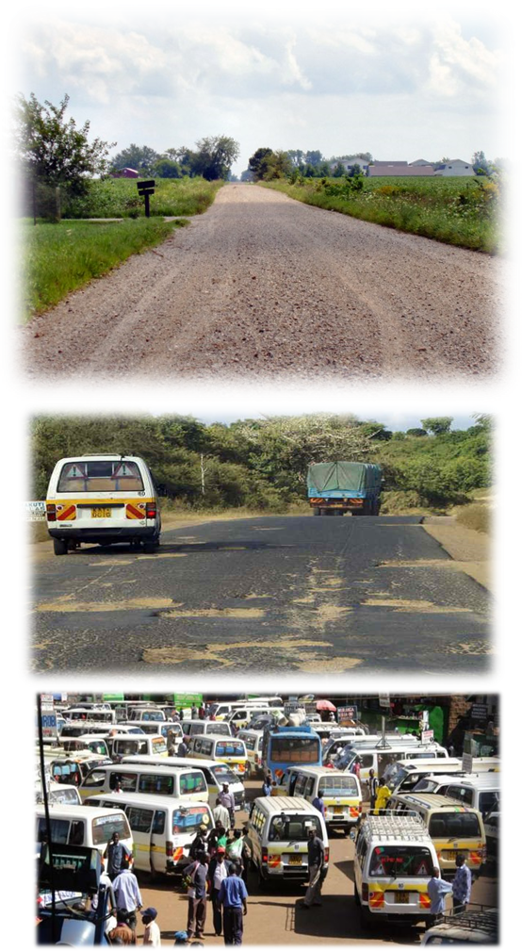
ASAP-East Africa Work Package 4: HDM-4 Training and Calibration
HDM-4 Model: The Highway Development and Management (HDM-4) model is a road management, investment and appraisal tool, originally developed by The World Bank. The tool has been widely used to investigate economic viability of road programmes as well as optimize the benefits accrued to road users under various climatic, budget and road conditions (Kerali, Odoki & Stannard, 2000). Watanatada et al. (1987) further explains that HDM-4 can be used to determine various public policies such as those affecting vehicle characteristics.
Focus of the Training:
Modelling of different road sections
Extrapolation of the complete road network
Simulation of the entire road network and generation of annual emissions from road transport
Calibration of annual emissions against different emission inventories field observations and yearly extracted emissions.
Simulation of different investment plans according to the projections made by HDM-4

Slide 30
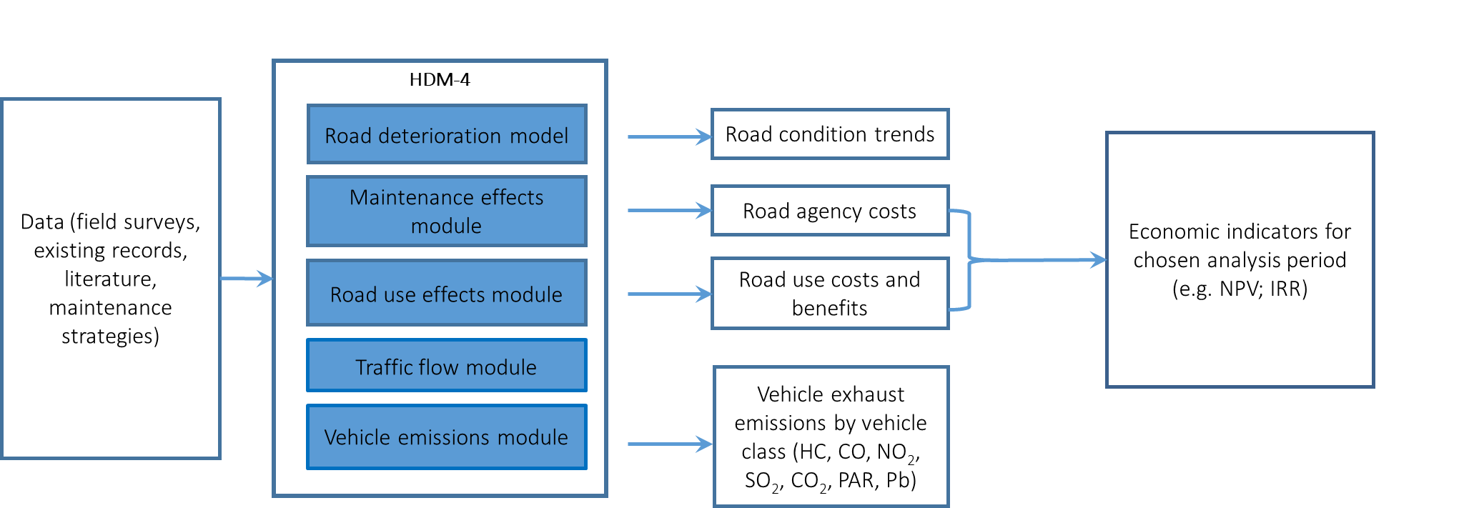
ASAP-East Africa Work Package 4: HDM-4 Model
Notes:
.: HDM-4 has been developed by World Bank with the purpose to plan and program an expendable tool for the highway maintenance and investment planning activities in many countries of the world. HDM-4 simulates physical and economic conditions of a defined road network accounting for alternatives and scenarios specified in the inputs for a certain time period.
.: The model is made up of two main modules: the Road Deterioration & Works Effects and Road User Effects modules. The former consist of pavement distress models while the latter works on vehicle operation, travel time and accidents generating also the related emission in the atmosphere connected with road transport effects. A third additional mandatory module is represented by the Maintenance Effect Module, necessary to test different maintenance alternative applied over a defined road section/ road network
.: HDM-4 incorporates also seven modules for the modelling of exhaust emissions predicted using information about traffic volume and its composition, type and geometry of the road section, vehicle operating speed, fuel type and vehicle life . The pollutants that, in particular, can be simulated by HDM-4 are: Carbon Dioxide (CO₂), Carbon Monoxide (CO), Hydrocarbon (HC), Lead (Pb), Nitrogen Oxide (NO_{X}), Particulates (PAR) and Sulphur Dioxide (SO₂).

Slide 31
ASAP-East Africa Work Package 4: HDM-4 Calibration
Each Research group from WP4 worked on the calibration of the model HDM-4 for the respective cities of Addis A., Nairobi and Kampala.
The quantity and the quality of the input data differ between the groups. This reflect on the determination of the resulting scenarios.
Steps of the work performed by the three groups:
Learning how to use HDM-4
Analysis of the input data and transfer into the model environment
Calibration of the model against reference data
Analysis of outputs and generation of scenarios with reduced emissions

Slide 32
ASAP-East Africa Work Package 4: HDM-4 Calibration (Nairobi, Kenya)
Extrapolation of the Road Network from the Road Sections

Slide 33
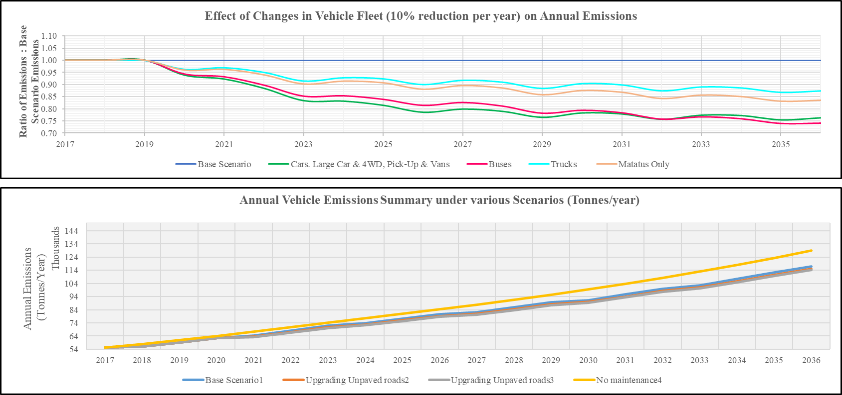
ASAP-East Africa Work Package 4: HDM-4 Scenarios (Nairobi, Kenya)

Slide 34
Summary:
Air Pollution in East Africa: Level of exposure, population growth, lack of laws, few academic works on the topic. Absence of modelling work on the topic.
ASAP-East Africa : Description of the project, main aims, division in WPs and main duties
ASAP-East Africa WP4: Description of the WP, main aims: modelling and training capabilities
Modelling of Meteorology and Chemistry for East Africa:
Validation of the Modelling System (with this extent of data is possible to reproduce the main patterns of aerosols in EA?)
Results (can the Modelling System a tool feasible to analyse the daily value of aerosols against world limits from WHO?)
Sector Analysis
Main achievements from HDM4 training calibration in East Africa
Conclusions and Forthcoming step of the work

Slide 35
Conclusions and Forthcoming steps:
Modelling of Meteorology and Chemistry for East Africa:
Modelling System WRF-CHIMERE was implemented for the first time on the domain of Eastern Sub-Saharan Africa using currently available input and validation data.
In order to obtain updated anthropogenic emissions in the year under review (2017) the global Edgar inventory and the DICE inventory for Africa have been merged and extrapolated up to 2017 using population density data.
Validation of the Modelling System (with this extent of data is possible to reproduce the main patterns of aerosols in EA?)
WRF has proved capable of reproducing the main meteorological patterns for all domains.
A lower agreement between observations and model was observed in Kampala for relative humidity and wind speed.
CHIMERE reproduces the daily levels of PM₁₀ and PM_{2.5} according to the observations, the latter is drastically reduced in the analysis of PM_{2.5} hourly concentrations
Results (can the Modelling System a tool feasible to analyse the daily value of aerosols against world limits from WHO in East Africa?)
Despite the low resolution of anthropogenic emissions CHIMERE manages to reproduce most of the exceedances of the limits set by the WHO for PM_{2.5} for all three cities.
The analysis of individual emission sectors for Nairobi has shown that the emissions relating to the residential sector are those with the greatest impact in the urban domain together with the Transport and Industry sector.
The contribution of the RES and TRA sectors in particular, respectively of 29 and 7% of the total emissions, contributes respectively to 47.9 and 16.3% of the modelled PM₁₀ concentrations.
Forthcoming Step of the Work:
Extension of the sector analysis to the Ethiopia and Uganda domains
Use of scenarios created by ASAP-East Africa partners with HDM-4 for simulations in CHIMERE.
Definition of scenarios with reduced emissions from residential and transport online with National Mitigation Policies.

Slide 36
Thanks for
your attention.
a.mazzeo@bham.ac.uk

Slide 37
Bibliography:
ASAP, 2018 “A System Approach to Air Pollution for East Africa” – www.asap-eastafrica.com
Avis W. and Khaemba W., “Vulnerability and air pollution”. ASAP-East Africa Rapid Literature Review. Birmingham, UK: University of Birmingham, 2018
EEA, 2018 “European Environmental Agency Common Air Quality Index (CAQI)” - https://www.eea.europa.eu/themes/air/air-quality-index/index
Brauer M et al “Exposure assessment for estimation of the global burden of disease attributable to outdoor air pollution” Environ. Sci. Technol., vol. 46 (2), pp. 652 – 660, 2012
Crippa M., Guizzardi D., Muntean M., Shaaf E., Dentener F., van Aardenne J.A., Monni S., Doering U., Olivier J.G.J., Pagliari V. and Janssens-Maenhout G. – “Gridded emissions of air pollutants for the period 1970-2012 within EDGAR v4.3.2” – Earth. Sci.Data, Vol. 10, pp. 1987 – 2013, 2018
Gaita, S. et al. (2016). Characterization of Size-Fractionated Particulate Matter and Deposition Fractions in Human Respiratory System in a Typical African City: Nairobi, Kenya. Aerosol and Air Quality Research, 16: 2378–2385. http://www.aaqr.org/files/article/6/6_AAQR-16-01-OA-0019_2378-2385.pdf
Guenther, A., Karl, T., Harley, P., Wiedinmyer, C., Palmer, P., and Geron, C. (2006). Estimates of global terrestrial isoprene emissions using MEGAN (Model of Emissions of Gases and Aerosols from Nature). Atmos. Chem. Phys., 6:3181–3210.
Hauglustaine, D. A., Hourdin, F., Jourdain, L., Filiberti, M.-A.,Walters, S., Lamarque, J.-F., and Holland, E. A. (2004). Interactive chemistry in the Laboratoire de Meteorologie Dynamique general circulation model: Description and background tropospheric chemistry evaluation. Journal of Geophysical Research, 109(D04314). doi:10.1029/2003JD003,957, 2014
Lattuati, M. (1997). Contribution à l’étude du bilan de l’ozone troposphérique à l’interface de l’Europe et de l’Atlantique Nord: modélisation lagrangienne et mesures en altitude. Phd thesis, Université P.M.Curie, Paris, France.
Marais E.A., Wiedinmyer C., “Air Quality impact of Diffusive and inefficient Combustion Emissions in Africa (DICE-Africa)” - Environ Sci. Technol., vol. 50, pp. 10739 - 10745, 2016
Met Office, 2012: “Met Office Integrated Data Archive System (MIDAS) Land and Marine Surface Stations Data (1853-current)”. NCAS British Atmospheric Data Centre, date of citation. http://catalogue.ceda.ac.uk/uuid/220a65615218d5c9cc9e4785a3234bd0
National Centers for Environmental Prediction/National Weather Service/NOAA/U.S. Department of Commerce (2000): NCEP FNL Operational Model Global Tropospheric Analyses, continuing from July 1999. Research Data Archive at the National Center for Atmospheric Research, Computational and Information Systems Laboratory. https://doi.org/10.5065/D6M043C6. Accessed 15 March 2018.
New Urban Agenda (2017). New Urban Agenda. UN-Habitat. http://habitat3.org/wp-content/uploads/NUA-English.pdf
NUA, 2017 “New Urban Agenda. UN-Habitat” - http://habitat3.org/wp-content/uploads/NUA-English.pdf
Odoki, J.B., Anyala, M. and Bunting, E. (2012). HDM-4 adaptation for strategic analysis of UK local roads [online]. Available at: https://canvas.bham.ac.uk/courses/31667/files/5534446?module_item_id=946476
Pope F., Gatari M., Ng’ang’a D., Poynter A. and Blake R. “Airborne particulate matter monitoring in Kenya using calibrated low-cost sensors” – Atmos. Chem. Phys., vol. 18, pp. 15403 – 15418, 2018
Van Leer, B. (1979). Towards the ultimate conservative difference scheme. A second order sequel to Godunov’s method. J. Computational Phys., 32:101–136.
Watanatada, T. et al. (1987). The Highway Design and Maintenance Standards Model – Volume 1: Description of the HDM-III Model. World Bank Publications, Washington, D.C., USA.
World Bank and Institute for Health Metrics and Evaluation (2016). The Cost of Air Pollution Strengthening the Economic Case for Action. Washington DC: World Bank. https://openknowledge.worldbank.org/bitstream/handle/10986/25013/108141.pdf?sequence=4&isAllowed=y
World Health Organisation (2004). Health Aspects of Air Pollution. World Health Organisation. http://www.euro.who.int/__data/assets/pdf_file/0003/74730/E83080.pdf?ua=1
World Health Organisation (2016). Household air pollution and health: Fact Sheet No 292. World Health Organisation. http://www.who.int/en/news-room/fact-sheets/detail/household-air-pollution-and-health
World Health Organisation (2005). Effects of air pollution on children’s health and development: a review of the evidence. WHO Regional Office for Europe. http://apps.who.int/iris/bitstream/handle/10665/107652/E86575.pdf?sequence=1&isAllowed=y
WHO (2006). Air Quality Air Quality Guidelines Global Update 2005. World Health Organisation. http://www.euro.who.int/__data/assets/pdf_file/0005/78638/E90038.pdf?ua=1%201/23/17
WPP, 2015 “World Population Prospect: “The 2015 Revision, Key Findings and Advance Tables” – United Nation Department of Economic and Social Affairs/Population Division” – http://esa.un.org/unpd/wpp/DVD

Slide 38
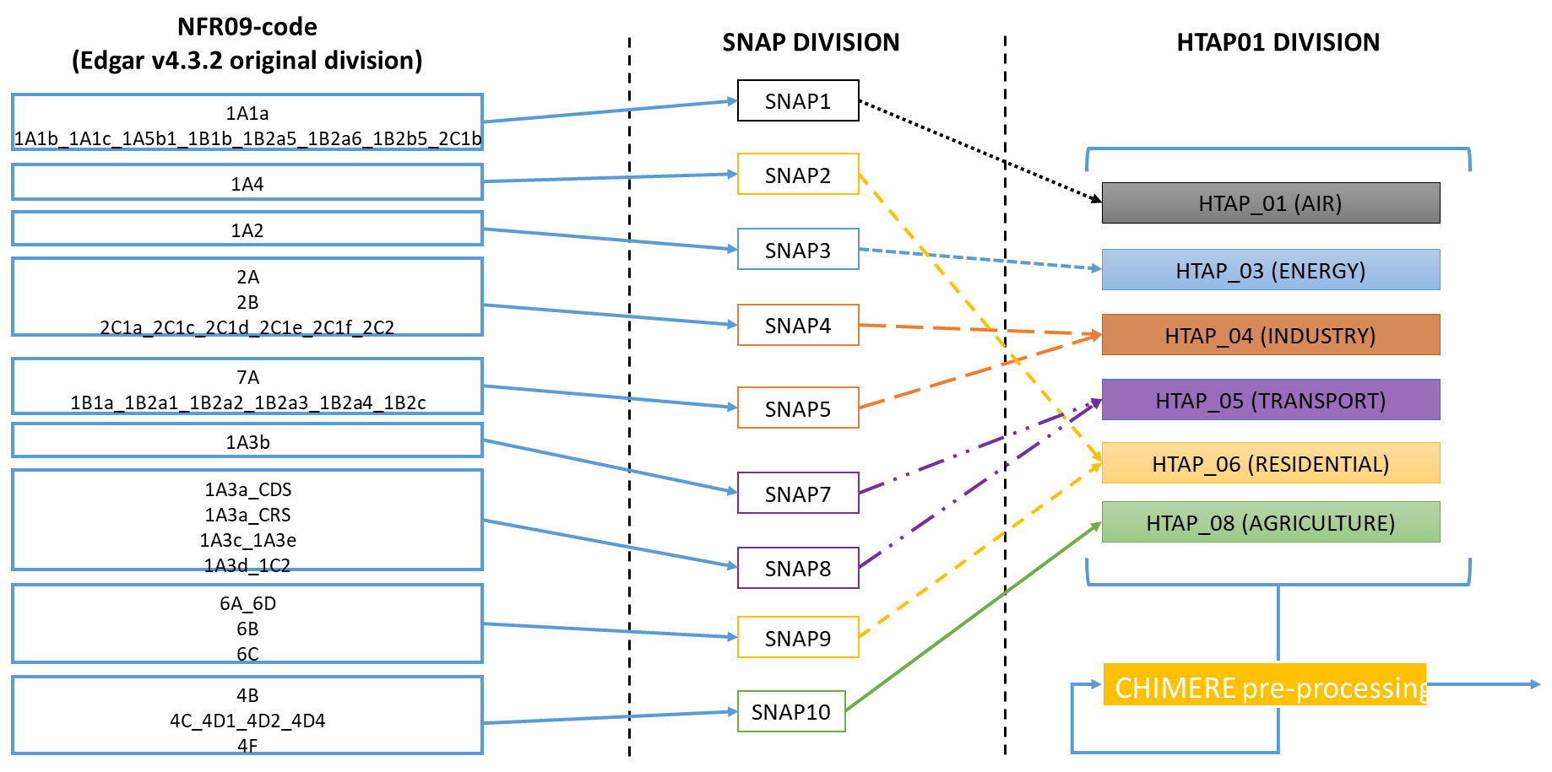
Emission Analysis

Slide 39
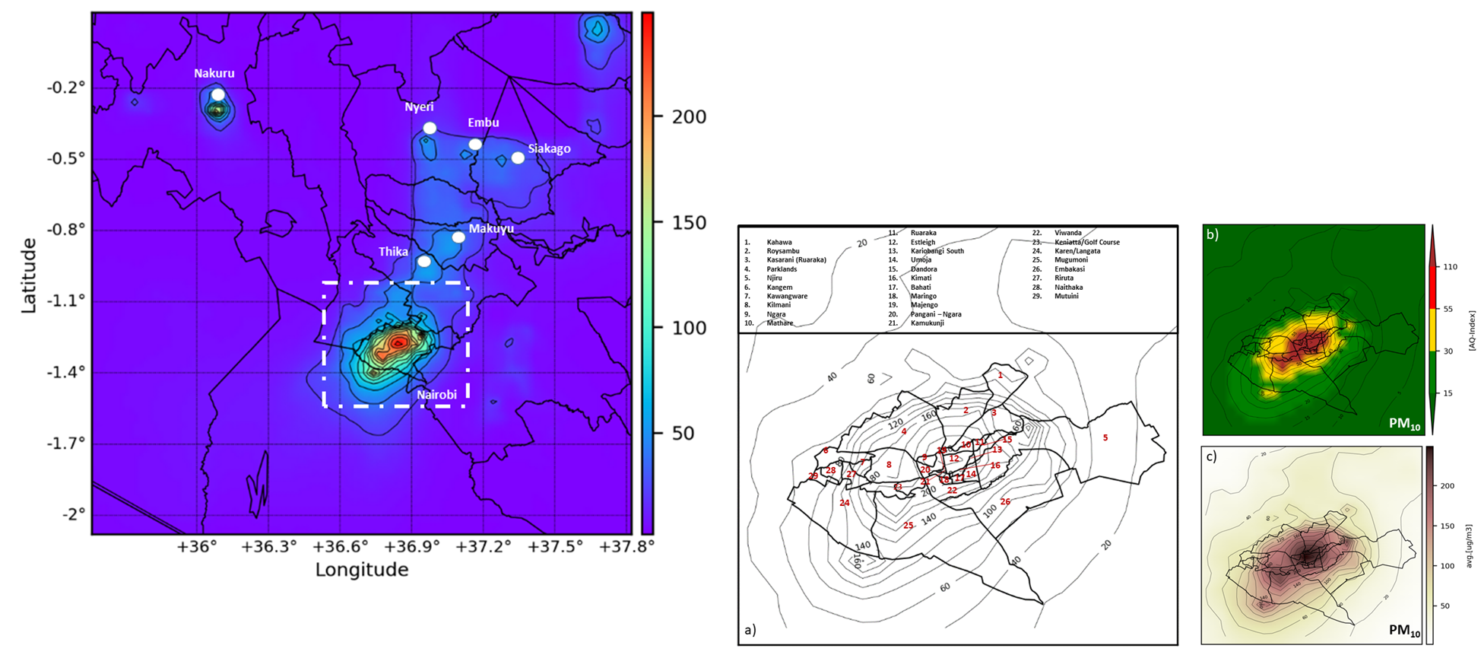
CHIMERE Validation for East Africa
The internal domain at 2x2km centred on the city of Nairobi (1.29°S, 36.81°E):
(a) Maps showing Air Quality levels of Particulate Matter PM₁₀ for all counties
(b) Air Quality Index levels relative to the average concentrations of PM10 in Nairobi for the period 14/02 - 15/03 2017;
(c) Average concentrations of PM₁₀ for the period 14/02 - 15/03 2017
Domain at 2x2km centred on the city of Nairobi (1.29°S, 36.81°E)

Slide 40
Summary:
Air Pollution in East Africa: Level of exposure, population growth, lack of laws, few academic works on the topic. Absence of modelling work on the topic.
ASAP-East Africa : Description of the project, main aims, division in WPs and main duties
ASAP-East Africa WP4: Description of the WP, main aims: modelling and training capabilities
Modelling of Meteorology and Chemistry for East Africa:
Description of the modelling chain and geographical domains
Description of the Emission inventory and procedure of merging
Description of the observations from MIDAS used for the WRF validation
Description of the observations from FPope2018 for CHIMERE validation
Validation of the Modelling System (with this extent of data is possible to reproduce the main patterns of aerosols in EA?)
WRF Validation
CHIMERE Validation (hourly PM10 vs PM2.5)
Results (can the Modelling System a tool feasible to analyse the daily value of aerosols against world limits from WHO?)
Time Series Daily
Maps AVG vs POP DENS
Focus KAMPALA possible wind removal of PM
Sector Analysis
Daily T-series for Nairobi → impact of reduction of TRA+IND+RES
Comparison between Emission % and relative concentrations
Main achievements from HDM4 training calibration in East Africa
Training on the use of HDM4 and calibration for the three cities
Scenarios created by each groups
Conclusions and Forthcoming step of the work
with this extent of data is possible to reproduce the main patterns of aerosols in EA?
can the Modelling System a tool feasible to analyse the daily value of aerosols against world limits from WHO?

