Slide 1
Improve EMISSION Inventory for Mexico using Satellite Data
Tejas Shah Novato, CA

Slide 2
OVERVIEW
Background
Purpose
Review of satellite datasets
Global catalogue of large SO₂ sources available from NASA
Measurements of tropospheric NO₂ columns by OMI
Global gas flaring observed from space
Notes:
A1 - consultancy
We provide technical consultancy services and experience as a basis for enabling the execution and planning of projects.
We perform holistic analyses of the challenges at hand, and provide the multi-disciplinary solutions needed to solve these in the most beneficiary way.
We provide consultancy on almost every aspect of a large range of projects – from the highly technical details to the processes for successful results.
We have a powerful tool in combining our technical consultancy with socio-economic analyses and process knowledge.
We are the leading experts within a number of technical areas. Here, we are the engineer that other engineers consult.
We perform professional project management on multi-billion projects as well as smaller, local projects.
This is complemented with our process management experience and our stakeholder management expertise – enabling the successful completion of a broad range of projects.

Slide 3
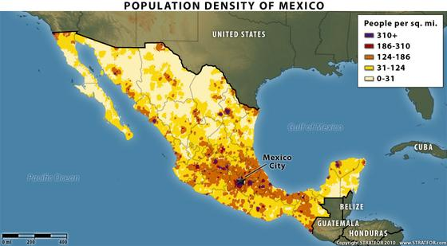
Background
International transport contributes to ozone and PM nonattainment issues in the US; example, Mexico air pollution
New generation of Earth-observing satellites has been able to detect tropospheric air pollution at increasingly high spatial and temporal resolution
Satellite data are becoming more widely used in the decision-making and environmental management activities
Satellite data are employed for estimating emissions, tracking pollutant plumes, forecasting activities and evaluating air quality model output

Slide 4
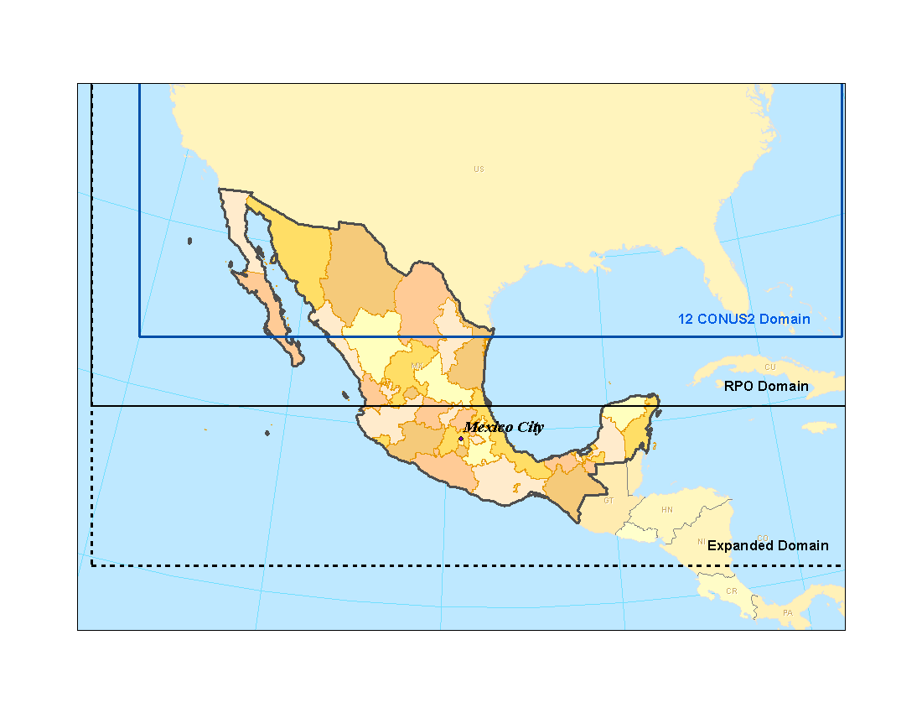
purpose
The purpose of this project is to improve emission inventory for Mexico using satellite data
We compared three satellite datasets to the Mexico emission inventory:
Global catalogue of large SO₂ sources available from NASA https://so2.gsfc.nasa.gov/measures.html#aq
Measurements of tropospheric NO₂ columns by Ozone Monitoring Instrument (OMI)
Global gas flaring observed from space https://www.ngdc.noaa.gov/eog/viirs/download_global_flare.html

Slide 5
REVIEW OF Satellite data
01
Global catalogue of large SO₂ Sources available from NASA
02
Measurements of tropospheric NO₂ columns by OMI
03
Global gas flaring observed from space
Notes:
Agenda, Process, 6, boxes, steps

Slide 6
Global Catalogue of Large SO₂ Sources
SO₂ is currently being measured over the entire earth using the ozone monitoring instrument (OMI) on the Aura satellite
NASA provides a global catalogue of large SO₂ point sources
Sources are classified as: volcanoes, power plant, smelters and oil and gas
Globally, a total of 519 continuously emitting sources have been identified
Provides annual SO₂ emission estimates from 2005 to 2018
10 Power Plants
8 Oil and Gas
1 Smelter
1 Volcano

Slide 7
Comparing Magnitudes of Inventory & Satellite SO₂ Sources
Scatter plot shows satellite-derived SO₂ emission estimates versus EPA inventory data for 2011
Satellite-derived SO₂ emission estimates are generally higher than EPA inventory data
Inventory misses 2 major sources
Good agreement in source location except for Cadereyta (O&G), Sonora (smelter), and Popcatepetl (volcano)

Slide 8
REVIEW OF Satellite data
01
Global catalogue of large SO₂ sources available from NASA
02
Measurements of tropospheric NO₂ columns by OMI
03
Global gas flaring observed from space
Notes:
Agenda, Process, 6, boxes, steps

Slide 9
Satellite Tropospheric NO₂ Column Data
Measurements taken by the OMI instrument aboard the Aura satellite and converted into tropospheric NO₂ columns through a process known as a “retrieval”
NASA has a tool “Giovanni” that displays the tropospheric NO₂ columns and provides a means to download NO₂ column data in an accessible format https://giovanni.gsfc.nasa.gov/giovanni/
The Giovanni tool can perform spatial extraction for a user-defined region and temporal averaging
We extracted annual average tropospheric NO₂ columns data for Mexico from 2008 to 2017

Slide 10
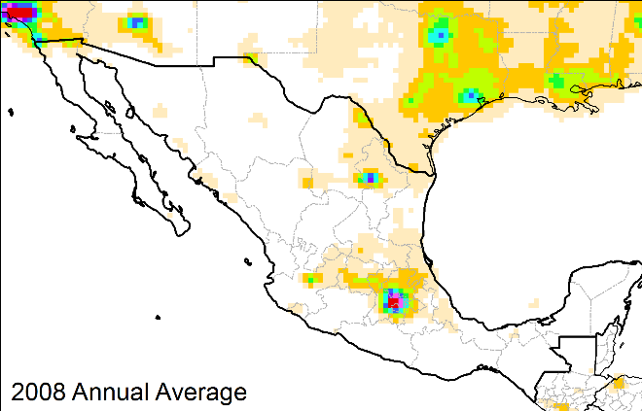
Satellite NO₂ Column Data for 2008
Highly populous areas (ie Mexico City, Guadalajara and Monterrey) are “hotspots” of NO₂ columns ≥ 3 x10¹⁵ molec.cm⁻²
Much of Mexico has NO₂ columns < 1 x10¹⁵ molec.cm⁻²
Level of uncertainty ~ 1x10¹⁵ molec.cm⁻²

Slide 11
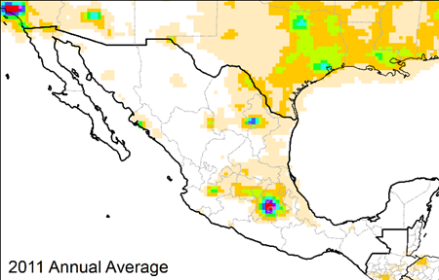
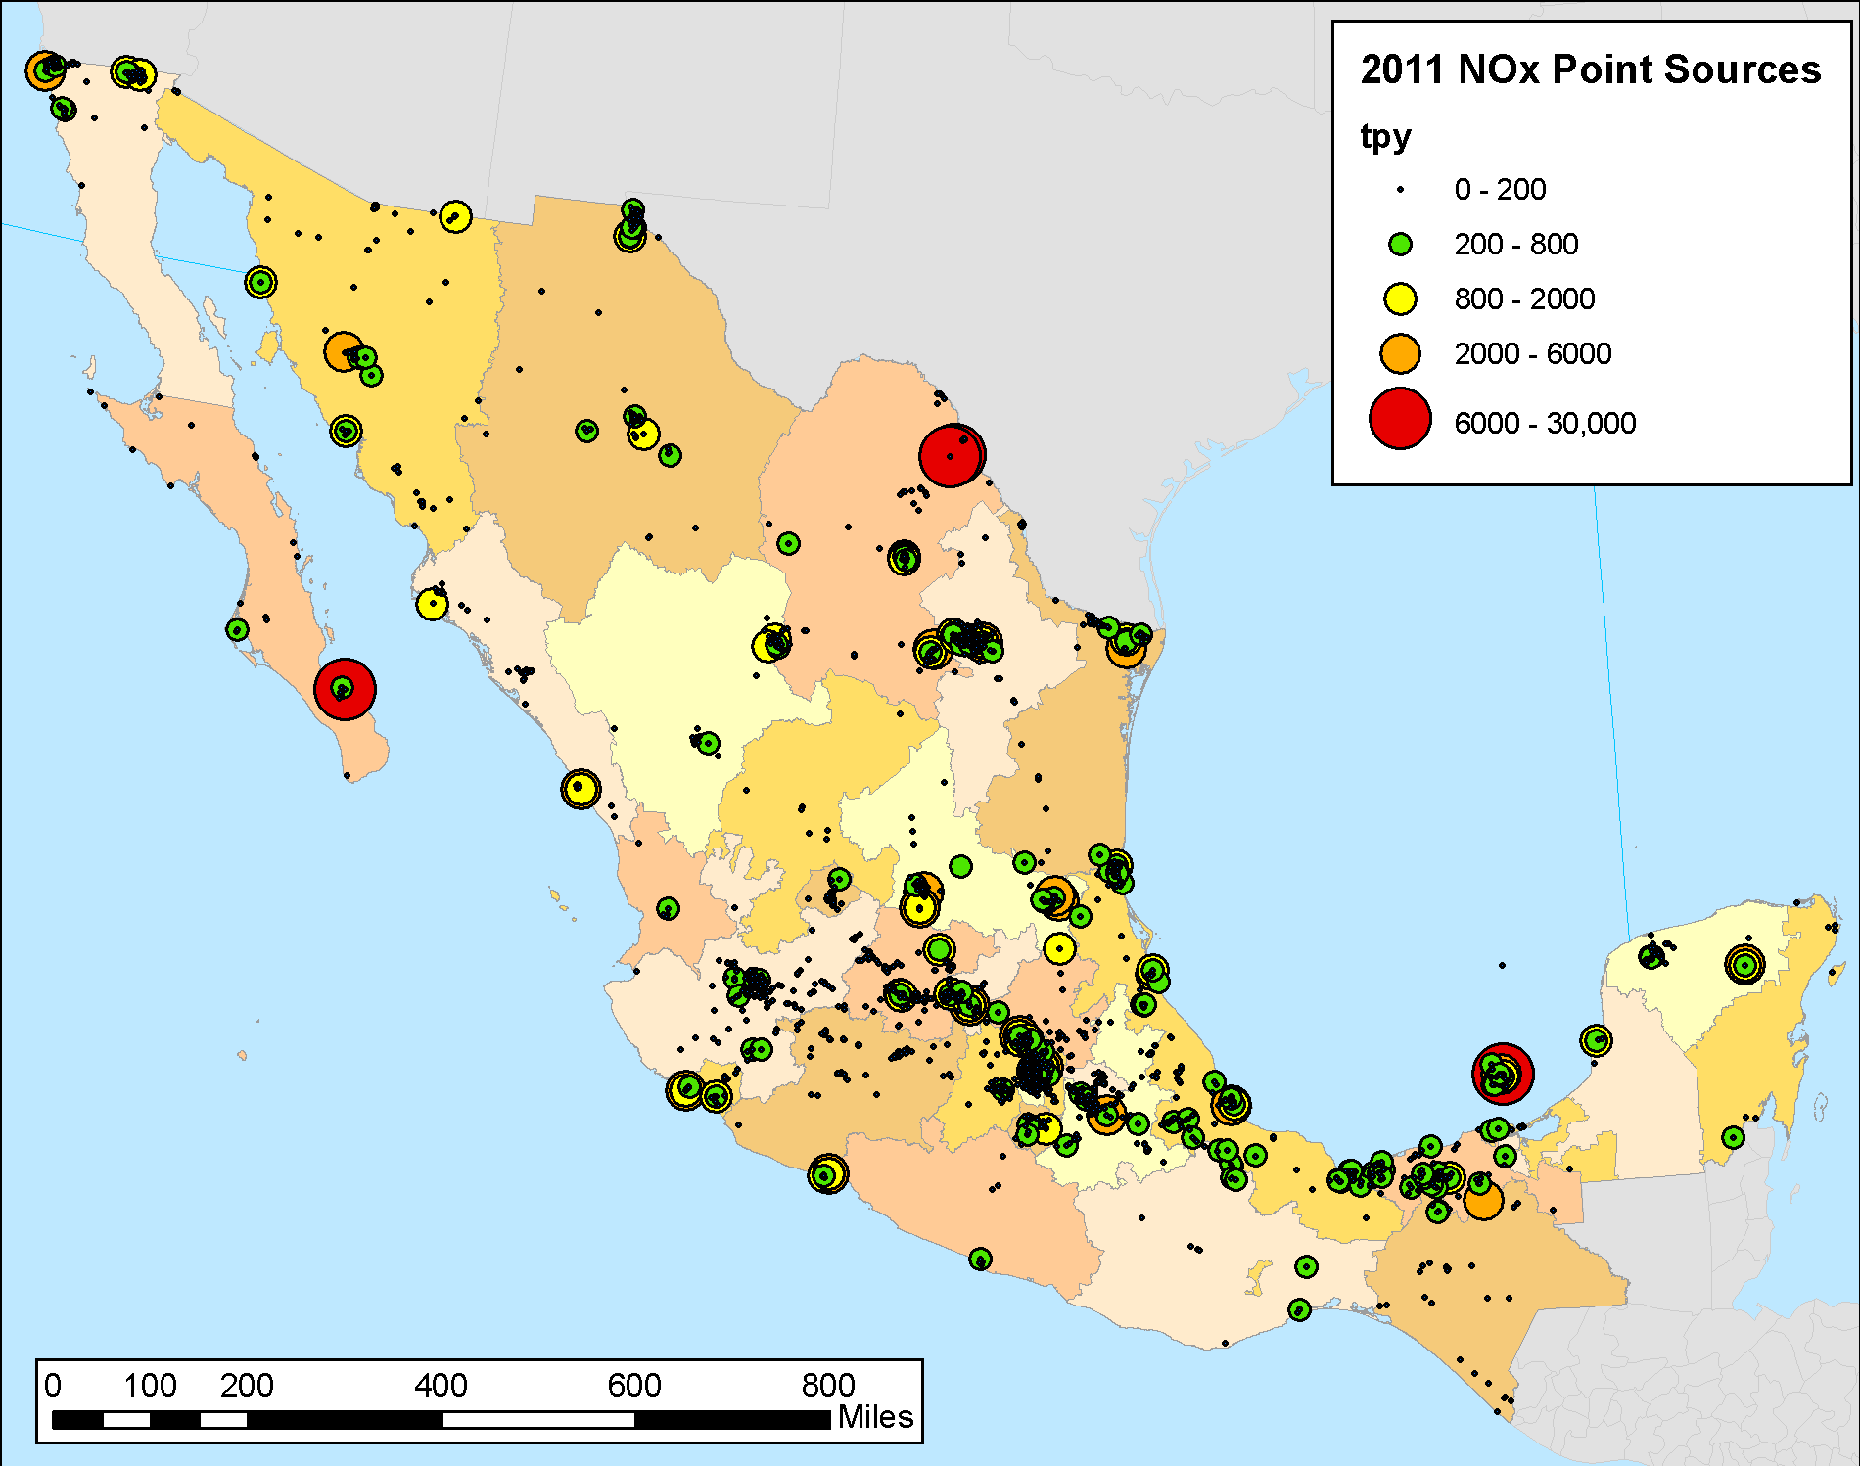
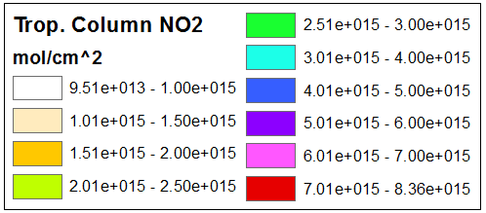
Compare 2011 Point Source NOx Emissions and Satellite NO₂ Columns
Generally good agreement
Some isolated large points are not observed in columns

Slide 12
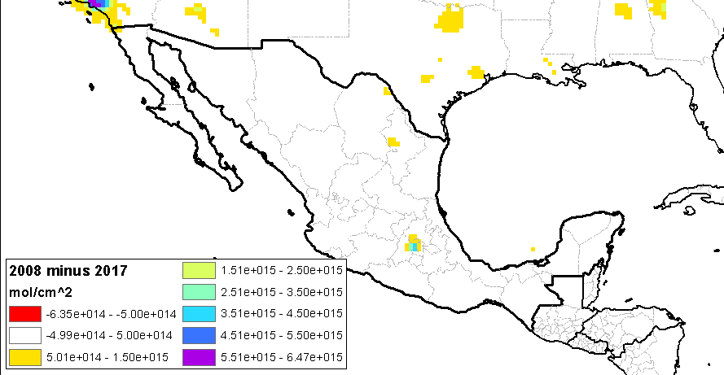
2008 minus 2017 Satellite NO₂ Column Difference Plot
There are no increases in the NO₂ columns that are >0.5 x 10 ¹⁵ molec.cm⁻² (~uncertainty limit)
There are 4 “hotspots” in Mexico showing a decrease in NO₂ columns over the period:
Mexico City area
Monterrey
Carbon Power Plant
Cantarell field in the Bay of Campeche
These decreases in NO₂ columns may indicate reductions in on-road, power plant and offshore O&G emissions

Slide 13
REVIEW OF Satellite data
01
Global catalogue of large SO₂ sources available from NASA
02
Measurements of tropospheric NO₂ columns by OMI
03
Global gas flaring observed from space
Notes:
Agenda, Process, 6, boxes, steps

Slide 14
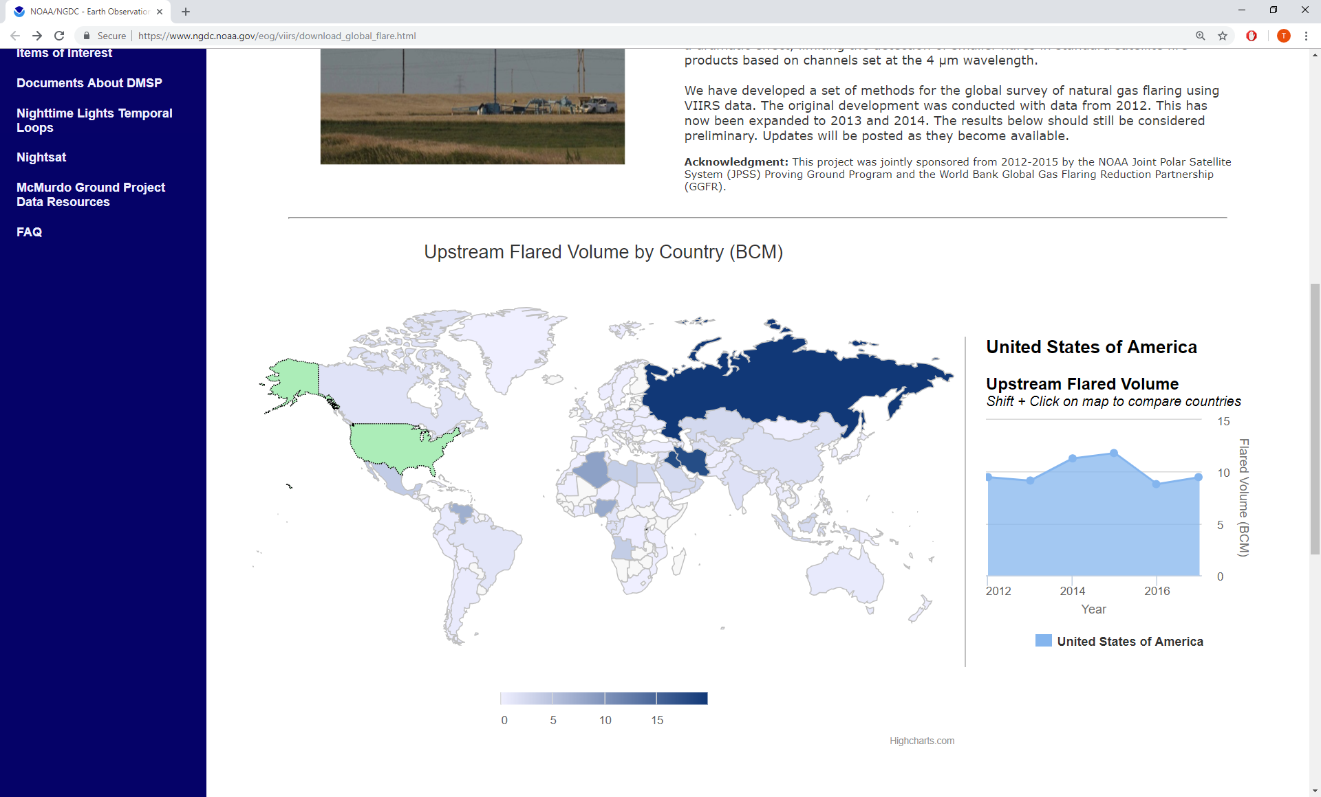
Global Gas Flaring Observed from Space
Elvidge et al (NOAA) provide satellite-derived gas flaring estimates using nighttime data collected by the Visible Infrared Imaging Radiometer Suite (VIIRS) data https://www.ngdc.noaa.gov/eog/viirs/download_global_flare.html
The global flare data are divided into three categories: upstream in oil and gas production areas, downstream at refineries and transport facilities, and industrial (eg coal mines, landfills, water treatment plants, etc)
Figure. Volume of gas flared for Mexico in 2014 derived from VIIRS (https://www.ngdc.noaa.gov/eog/viirs/download_global_flare.html)

Slide 15
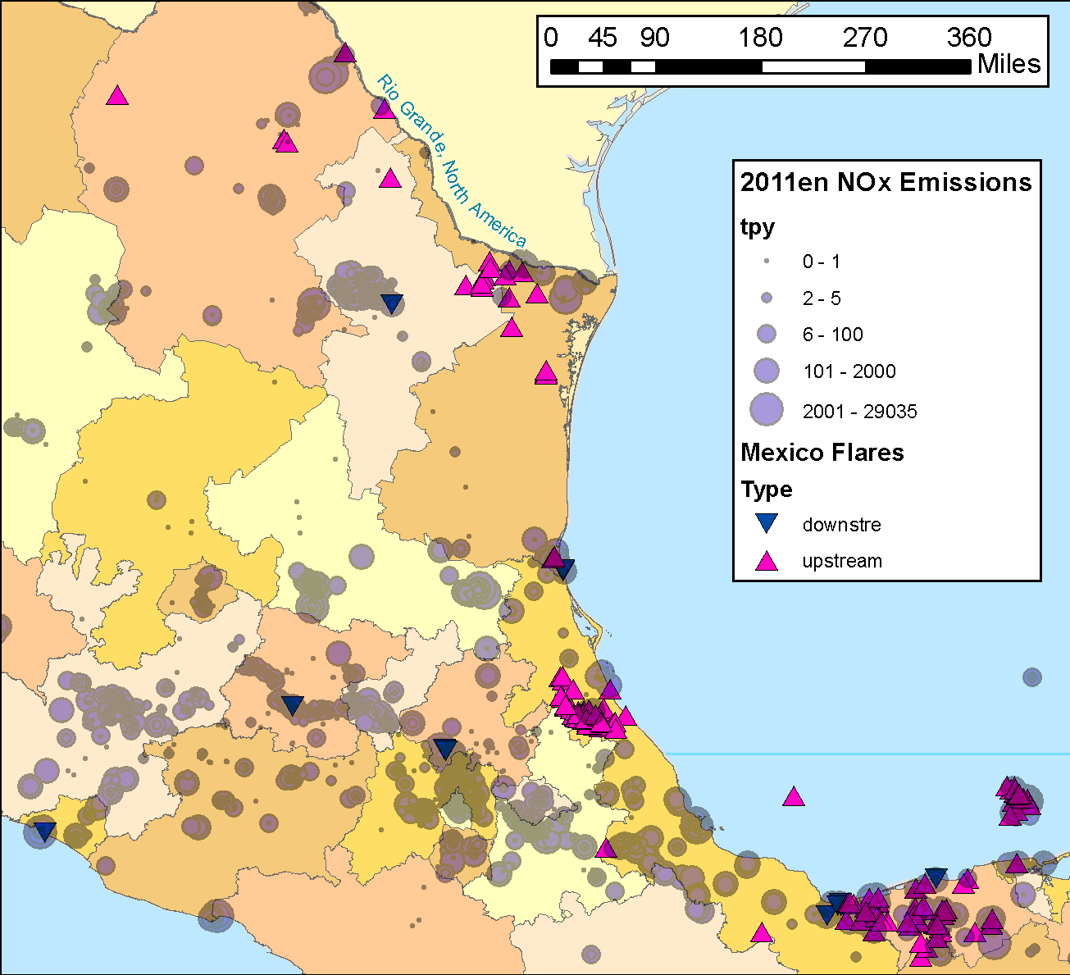
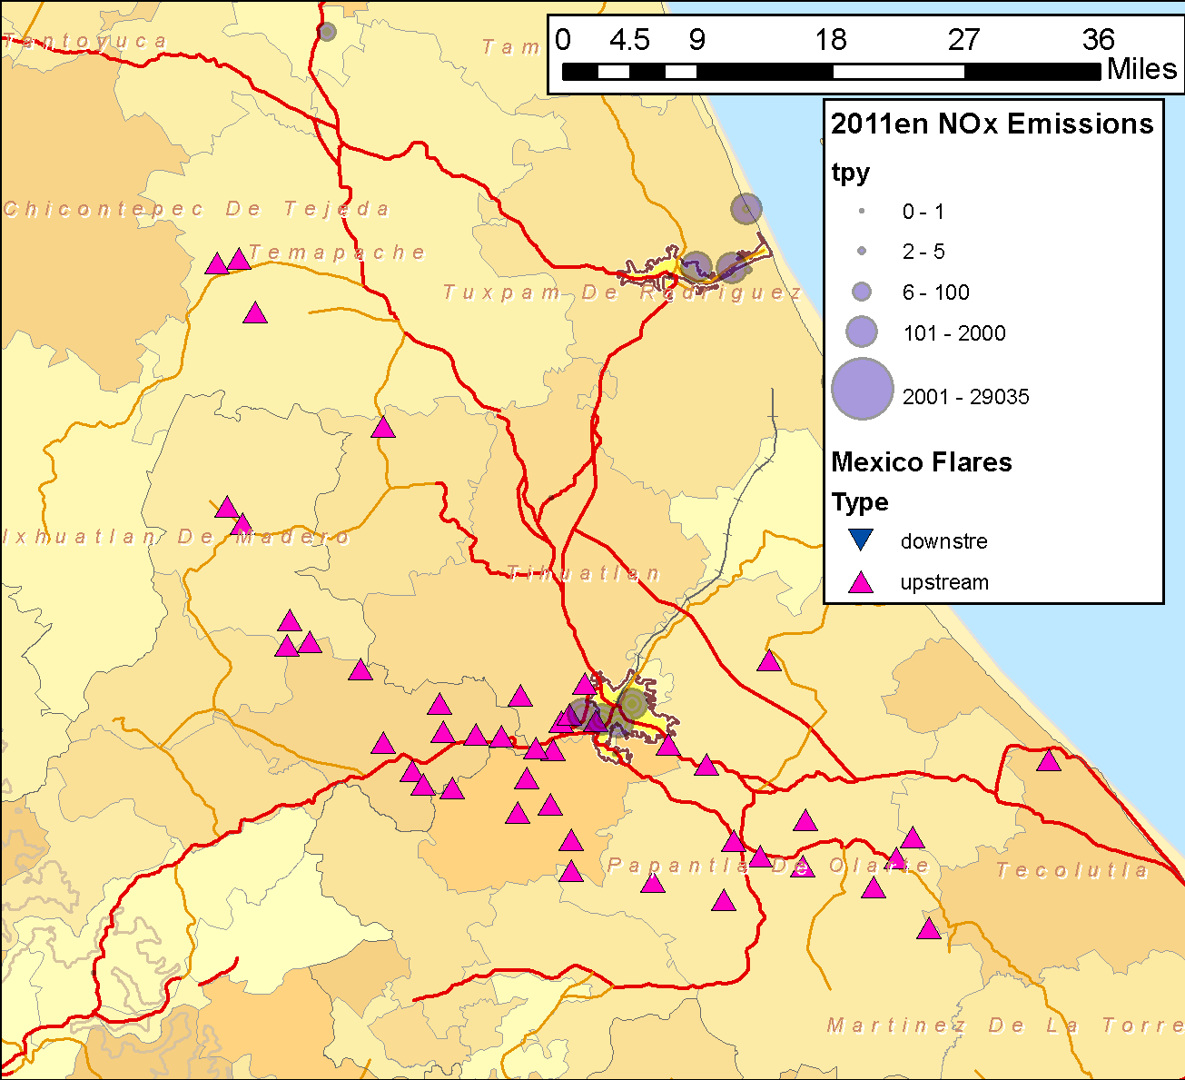
Comparing Inventory Sources with Global Flare Data
Plotted flare data for Mexico and overlaid with the EPA inventory data to determine any missing sources
Downstream flares (blue down arrows) are included in the EPA inventory
Most upstream flares (pink up arrows) are missing from the EPA inventory

Slide 16
Summary
Satellite data can be used to determine whether major sources are either missing or not well represented in the current inventories
Generally good spatial agreement between inventory and satellite data
Sonora smelter source identified by SO₂ satellite data missing from the EPA inventory
Popocatepetl volcano near Mexico City missing from the EPA inventory
Reductions in regions with the some of the highest 2008 columns - Mexico City area, Carbon Power plant, Monterrey and Cantarell oil field
Many upstream O&G flares missing from the EPA inventory
Content slide
Notes:
Content slide

