Slide 1
Improving SCICHEM Pre- and Post-Processing
Setup Speed Using Cloud Computing
CMAS: Model Development
Chapel Hill, NC October 2019
By Amy McVey, Jarrod Lewis, and Matthew J. Alvarado - Atmospheric and Environmental Research (AER)
Prakash Karamchandani – Ramboll
Douglas Henn – Xator Corp.
Eladio Knipping - EPRI

Slide 2
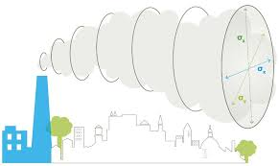
What is SCICHEM?
A Second Order Closure Integrated Puff Model with Chemistry
A reactive non-steady-state plume dispersion model that can be used to calculate
  Single source impacts of emissions at downwind locations
  Multi-source impacts of emissions at downwind locations
  Short-range calculations (for example, 1-hour SO₂, 1-hour NO₂, 24-hour secondary PM_{2.5}, or 8-hour ozone concentrations at fence line receptors)
  Long-range calculations for primary and secondary pollutant impacts
*https://www.epri.com

Slide 3


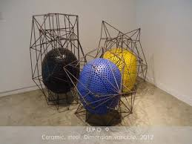
Dispersion Modeling Challenges
All models have pre-processors, which can take days to weeks to setup and process by hand.
Some pre-processors can take hours to run given they use a single CPU.
Model input data such as elevation files or meteorology can be cumbersome to find.
There are various file types and formats, but the model requires something different:
  ArcGrid, GeoTIFF, GIS shapefiles for Building Downwash
A client’s definition of a “rush job” and the modeler’s are never them same.
Modeling compute environments can be specific and tricky.
Background data is important when modeling regional ozone with SCICHEM and can come from CMAQ or CAMx, which are large files.

Slide 4
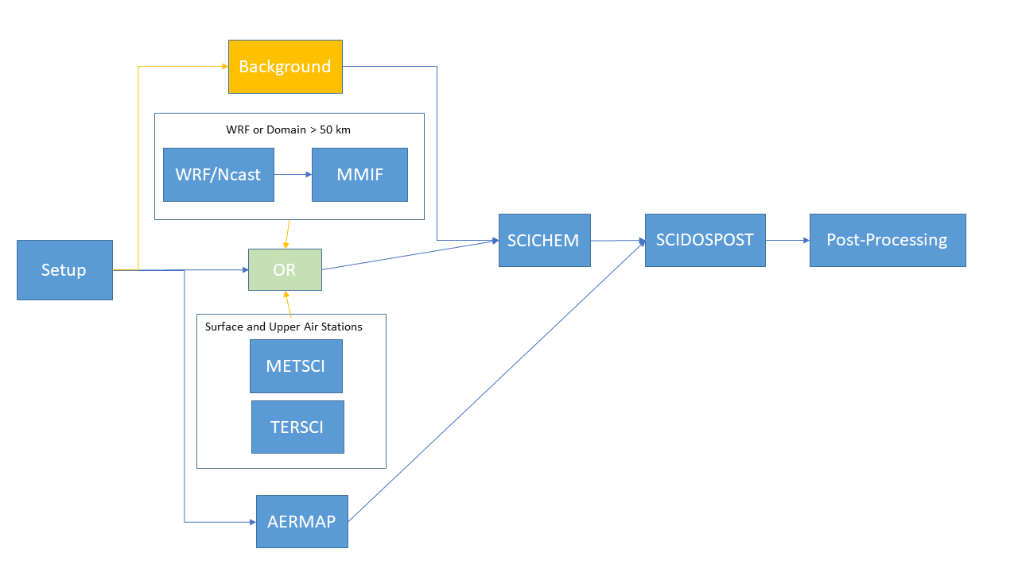
SCICHEM Modeling Components
TERSCI – terrain processor
METSCI – meteorological processor
MMIF – WRF data processor
CTM2SCICHEM – extracts background data from CAMx or CMAQ output
SCICHEM – dispersion model
SCIDOSPOST – dispersion model post-processor

Slide 5

Amazon Web Services (AWS) Components
Docker Containers – standalone, executable package of software that includes everything needed to run an application
EC2 Instances – a virtual computing environment
AWS Batch – plans, schedules, and executes your computing workloads
Lambda Functions – provides a way to add logic to the EC2 Instances and Batch environments
S3 Bucket – AWS cloud data storage service
User Interface (UI) – Allows the user to interact with the input options for the model workflow

Slide 6

Docker Containers
Allows developers to create a specific modeling environment that can be shared and repeated anywhere
Can run the same container ‘N’ number of times simultaneously
Can easily update model versions for all users at once.
*https://www.docker.com/

Slide 7
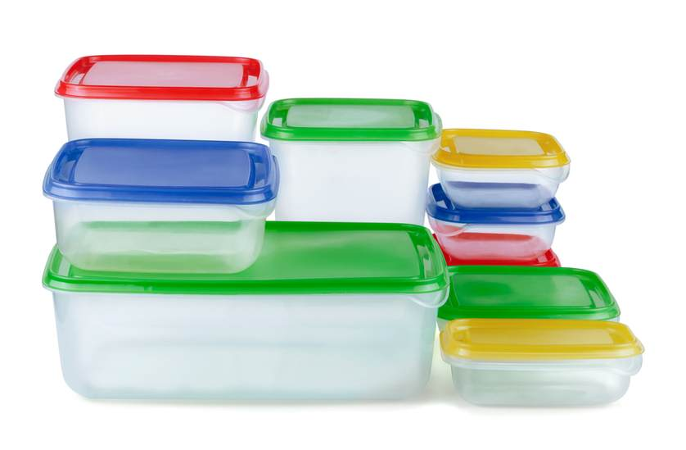
Docker Example Code
FROM centos:latest
RUN yum install -y -q tcsh
RUN yum install -y wget curl unzip bzip2
RUN yum install -y gcc-gfortran
#Install Python
RUN wget –quiet https://repo.anaconda.com/miniconda/Miniconda3...
…
ENTRYPOINT ["python", “main.py"]

Slide 8

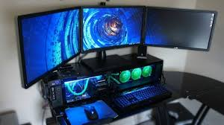
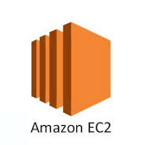
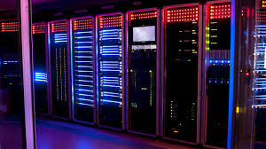
AWS EC2 Instances
Elastic Compute Cloud (EC2)
EC2 Instance = a machine of various sizes.
  r5.12xlarge instance has 48 processors and 384 GB RAM
  c5.large instance has 2 processors and 4 GB RAM
Use of these machines is not free, but cheap depending on the resources needed and the duration used.
Each container runs with specified processors and RAM.

Slide 9
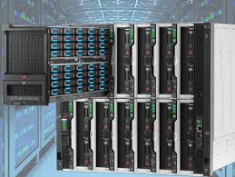
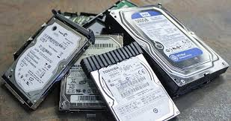
S3 Data Storage
WRF
  North America at 12km. Daily wrfout files 1.6 GB each.
  5 years of data ~3 TB
CMAQ
  12US2 daily concentration files ~10 GB each.
  5 years of data ~ 18 TB
AWS Open Registries
  https://registry.opendata.aws/
  Terrain Tiles
  Open Street Map
  Various Radar/Lidar/satellite datasets

Slide 10
How does this is Apply to SCICHEM?
TERSCI – terrain processor
CTM2SCICHEM – extracts background data from CAMx or CMAQ output
METSCI – meteorological processor
MMIF – WRF data processor
SCICHEM – dispersion model
SCIDOSPOST – dispersion model post-processor

Slide 11








AWS Cloud Computing - Lambda Functions and Batch Processing
Users
Private Subnet
Batch
AQcast UI
Submit Request
Lambda Functions
Job Queue
Retrieve results
Submit batch jobs
Query batch job status
Cancel batch jobs
Etc…
SETUP
TERSCI
METSCI
SCICHEM
SCIDOSPOST
Bootstrap Init Data
Archive Results
S3 Bucket
EFS Volume

Slide 12

MMIF/ CTM2SCICHEM
MMIF
  Multiple large wrfout files takes time to cycle through
  MMIF is a single processor program
  MMIF container
    Runs with 36 processors & 90 GB RAM
    Using this setup, the complete modeling period can be split into 36 sections.
    EXAMPLE: run 1 year. Each processor would run MMIF for a different 10-day period.
CTM2SCICHEM
  Similar to MMIF there many large CMAQ out files to loop through with a single processor program.
AERMAP
  Again similar to the above. Using AERMAP, 26,000 receptors completed in 7 min. On a local laptop using a single CPU, this can take on the order of days.

Slide 13
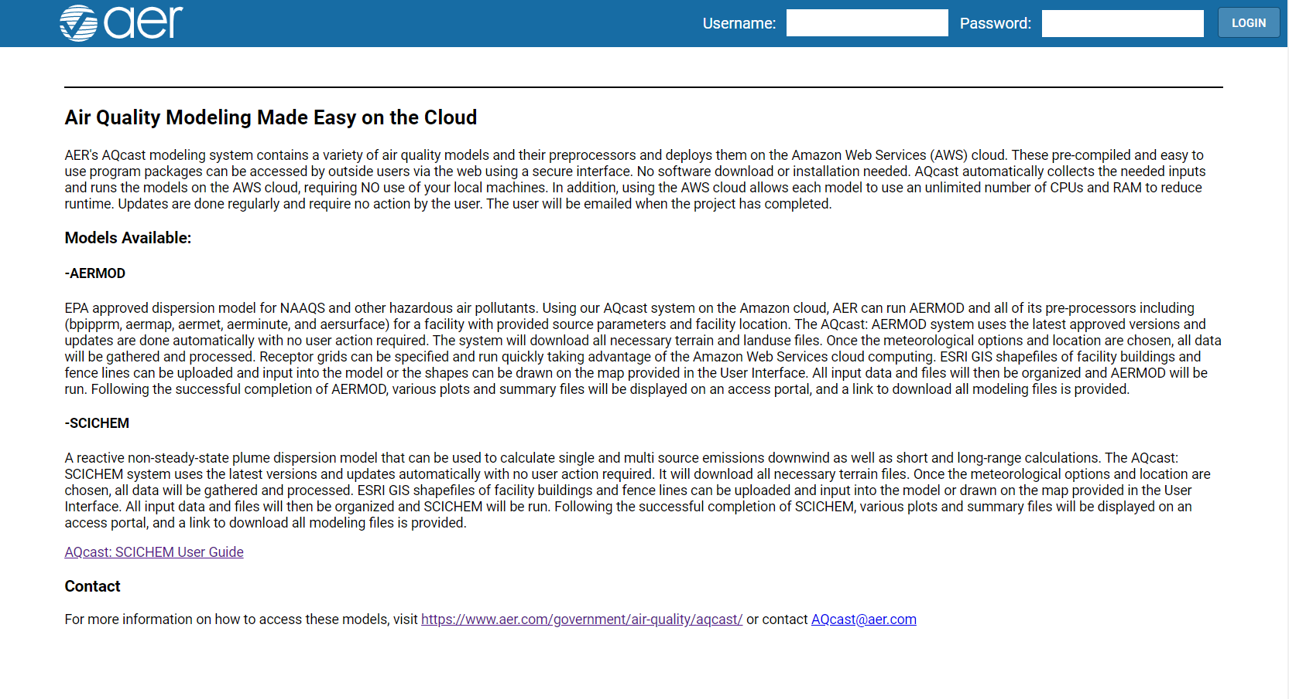
Demo aqcast.aer.com

Slide 14
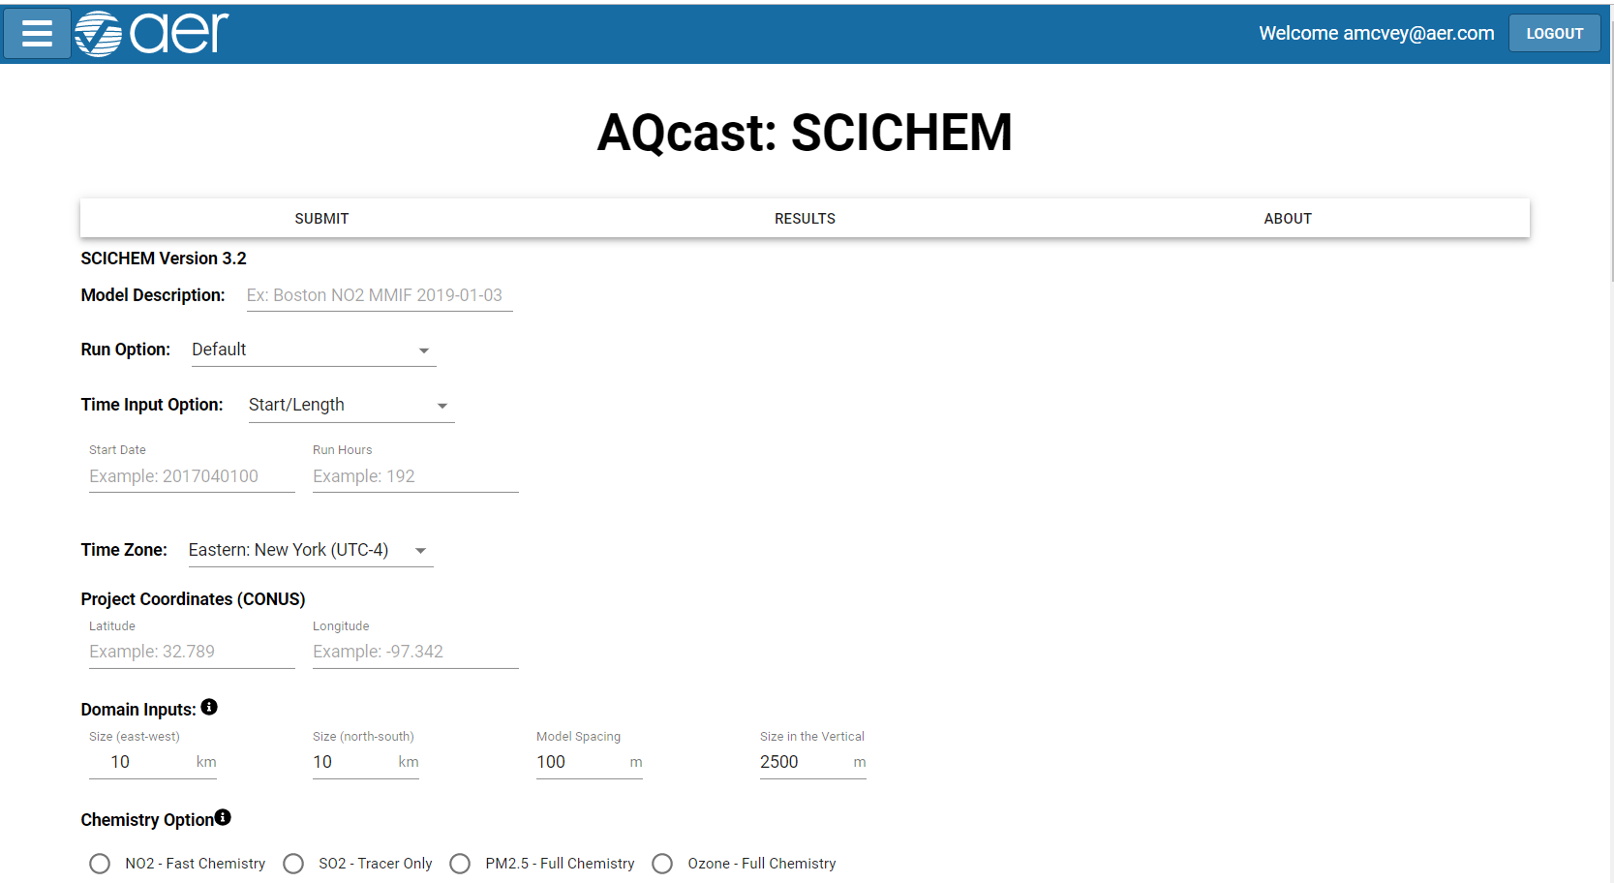
Demo aqcast.aer.com

Slide 15
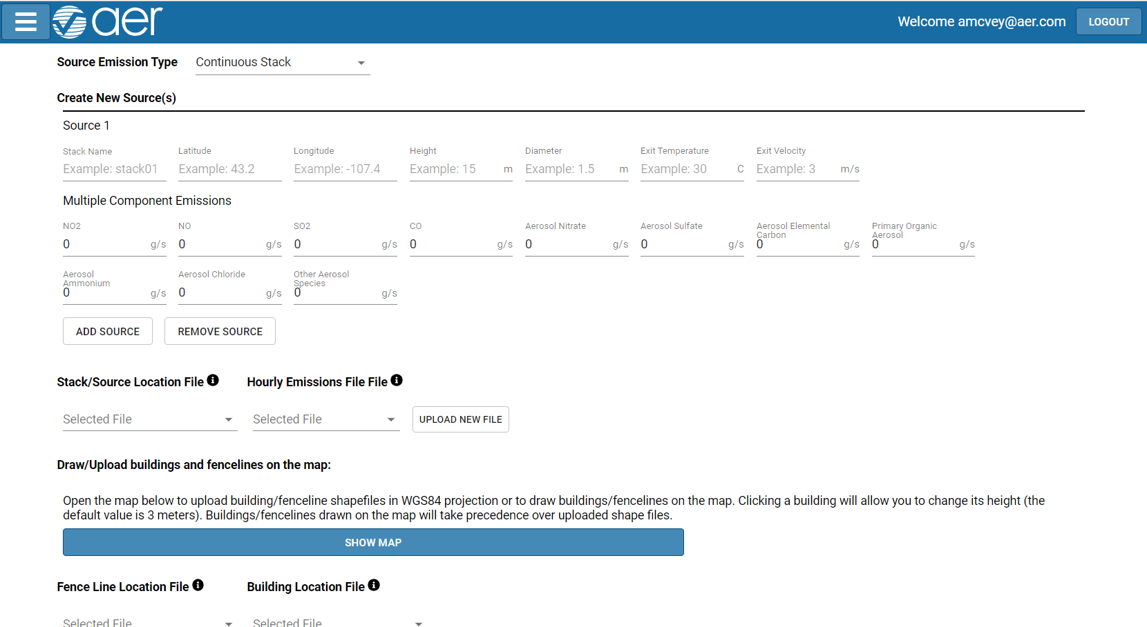
Demo aqcast.aer.com

Slide 16
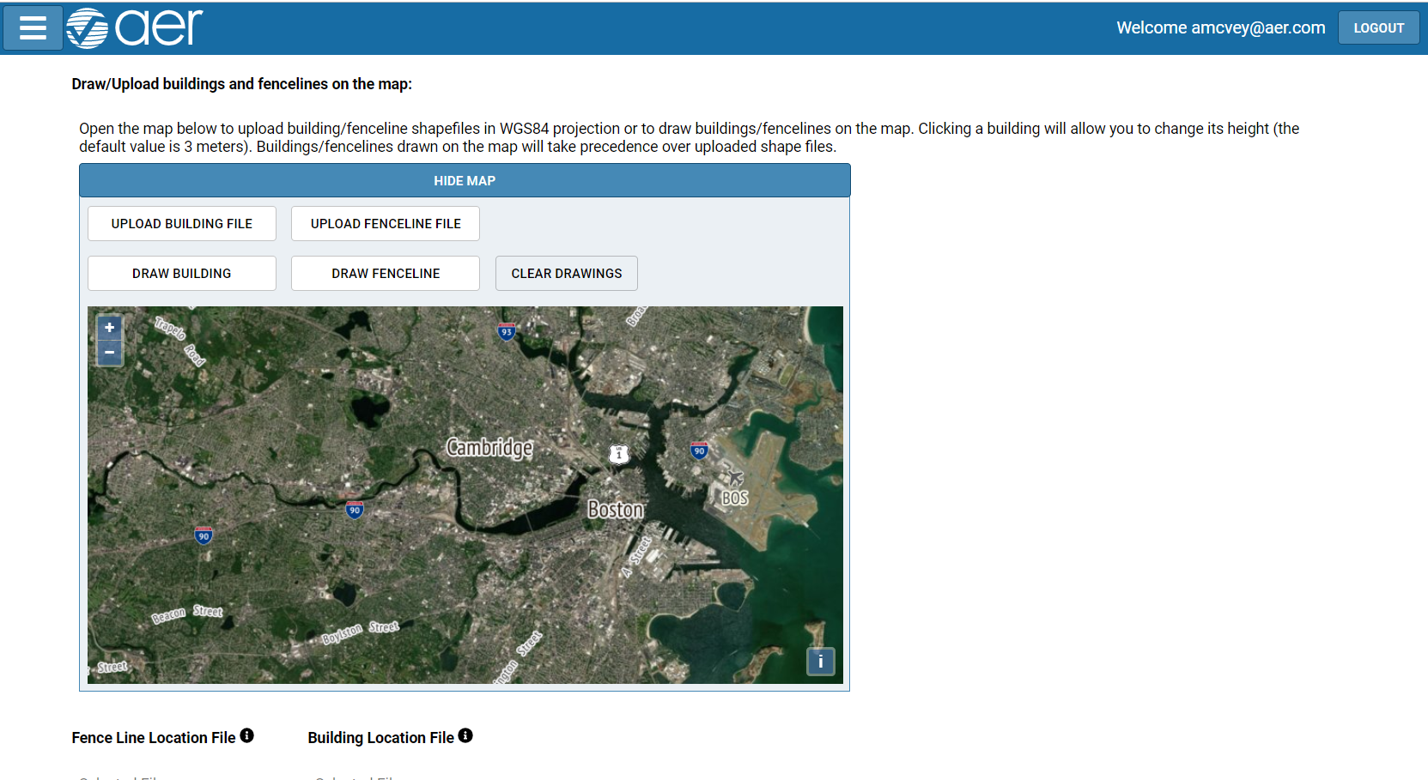
Demo aqcast.aer.com

Slide 17
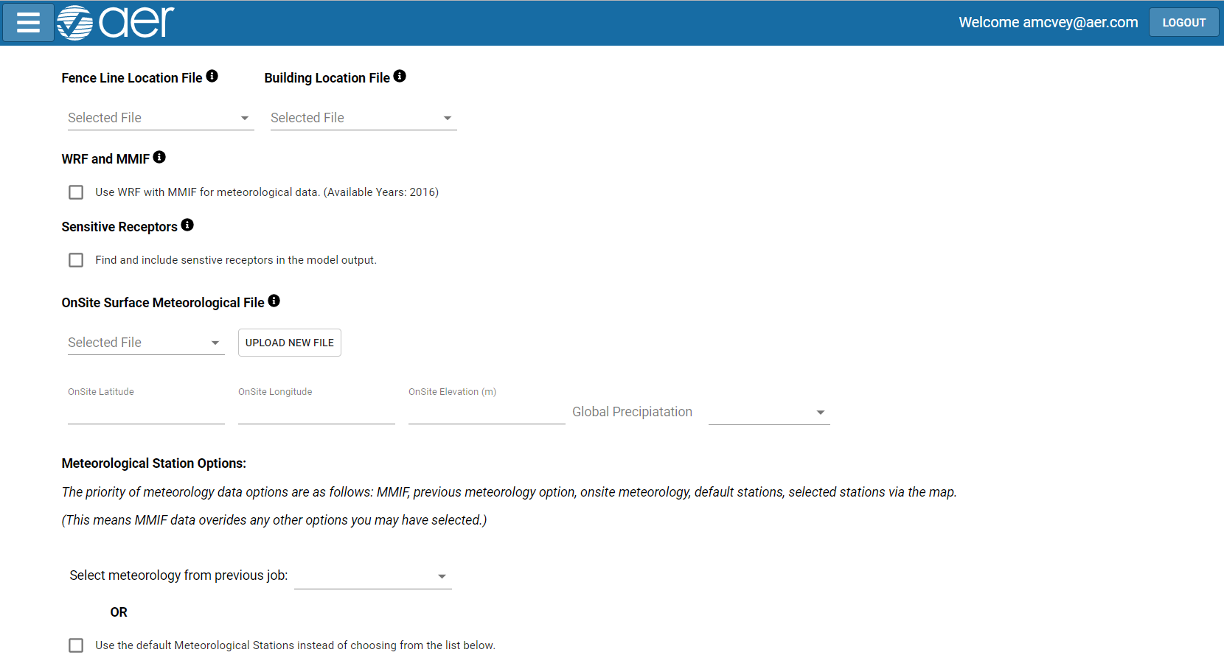
Demo aqcast.aer.com

Slide 18
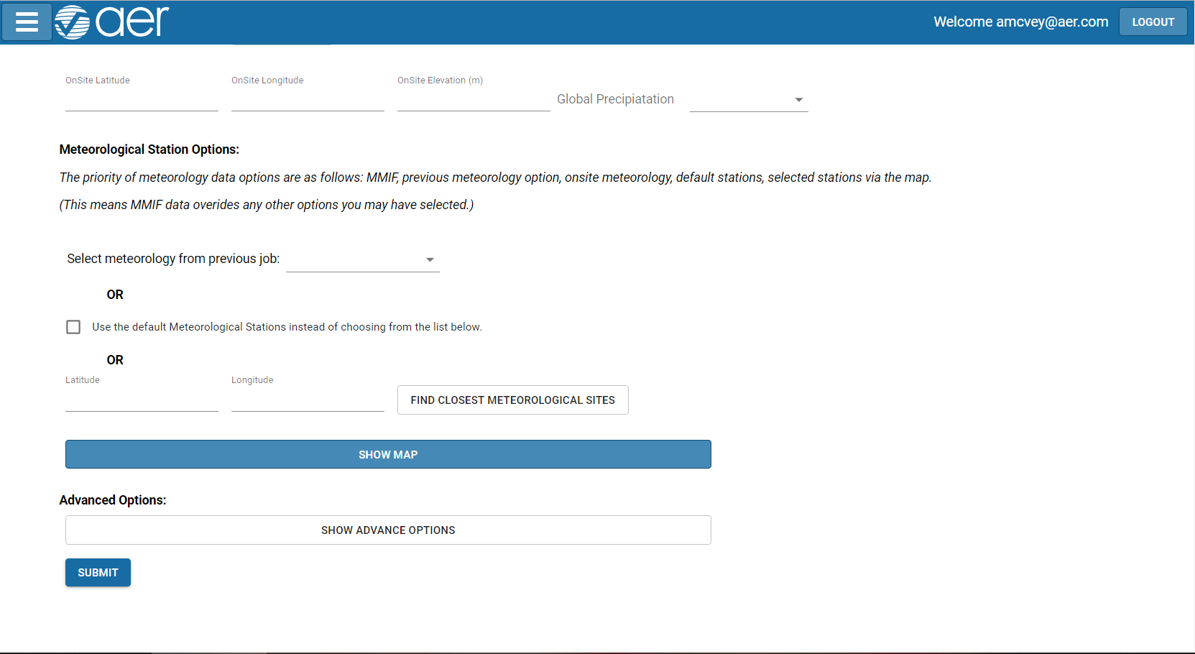
Demo aqcast.aer.com

Slide 19
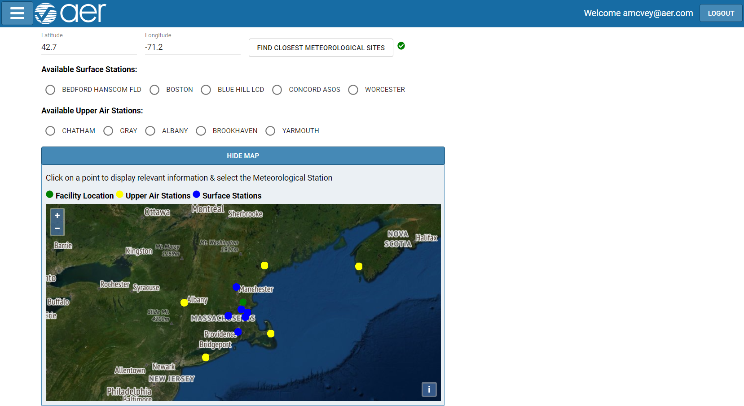
Demo aqcast.aer.com

Slide 20
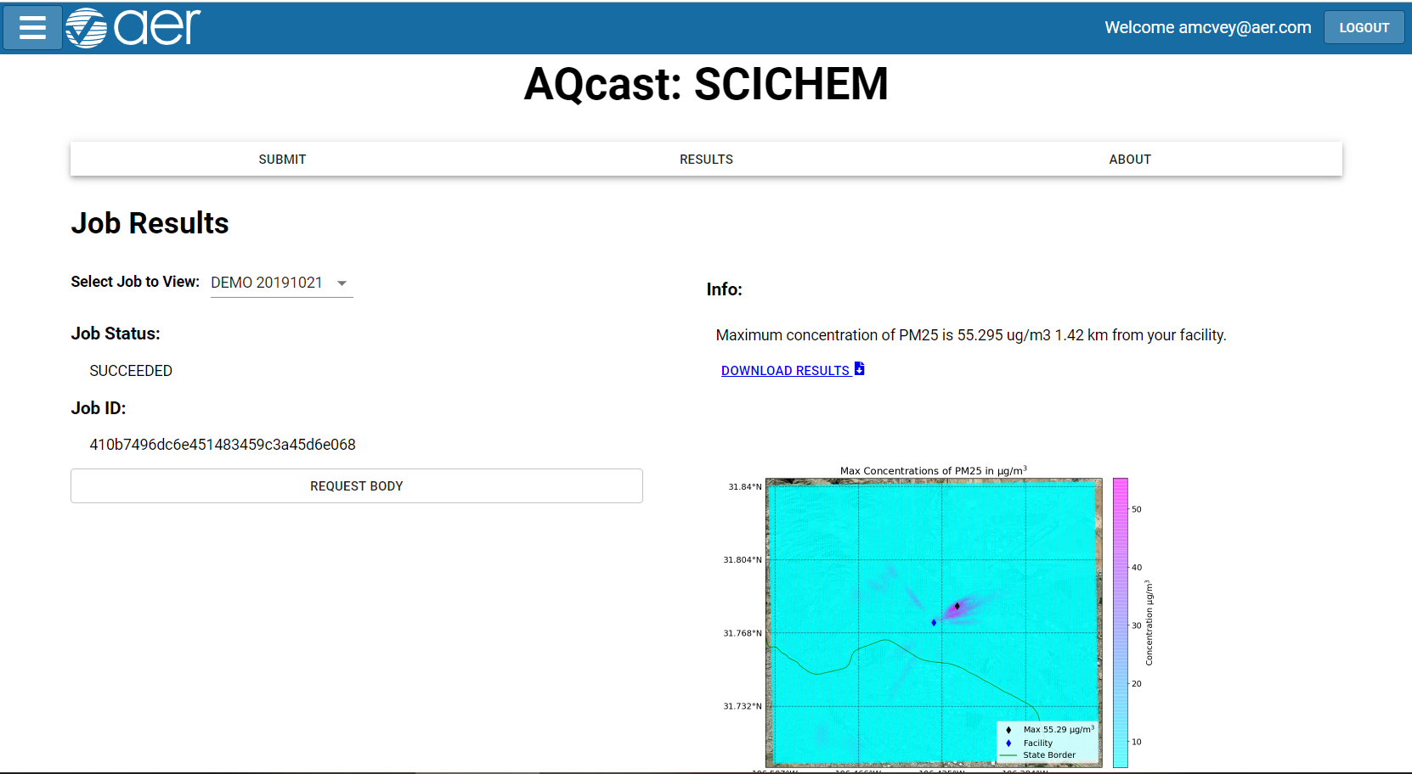
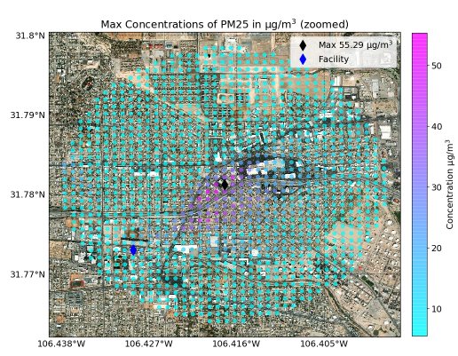
Demo aqcast.aer.com
Additional Figure Example

Slide 21
AWS Cloud Computing
Users
Private Subnet
Batch
AQcast UI
Submit Request
Lambda Functions
Job Queue
Retrieve results
Submit batch jobs
Query batch job status
Cancel batch jobs
Etc…
SETUP
TERSCI
METSCI
SCICHEM
SCIDOSPOST
Bootstrap Init Data
Archive Results
S3 Bucket
EFS Volume

Slide 22
Questions?
Thank you
Amy McVey
amcvey@aer.com

